Slide 1

New Electrical Safety support – James Devine
Joining EP-DI-SO team 100% from 1st February 2020 as Electrical Safety Officer.
Background in low voltage electrical design, lighting and cable calculations, life safety power systems, radiation hard electronics and electrical standards (IEC, EN, NF, BS).
Prior work at CERN on projects in TDC2, CCC, Atlas, PSB and PS accelerators.

Slide 2
What can I help you with? Advice on electricity
More specifically:
Electrical safety questions
Electrical aspects of HSE periodic inspection reports, understanding and prioritising non-conformities, taking appropriate action.
Electrical accident analysis, study and improvement actions.
Electrical questions on new equipment or installations.
Questions about electrical equipment
Choosing the appropriate electrical safety training courses

Slide 3
What can I help you with? Advice on electricity
Other electrical subjects that I can help you with:
Periodic testing of AUL (Local Emergency Stop) systems in EP buildings
Decisions on installing AUL systems in your buildings
Earthing and grounding schemes
Electrical/Electronic Noise and EMC issues
High reliability electrical distribution design
Radiation resistant electronics design

Slide 4
What can I help you with? AUL Testing
All AUL (Local Emergency Stop) buttons must be tested annually (IS5)
This is the responsibility of the TSO
When you perform the test please let me know (jdevine@cern.ch)
If you need assistance with the test, get in touch with me.
If you need an AUL system to be installed or modified, get in touch with me.
We have a register of EP buildings and record logs of AUL tests

Slide 5
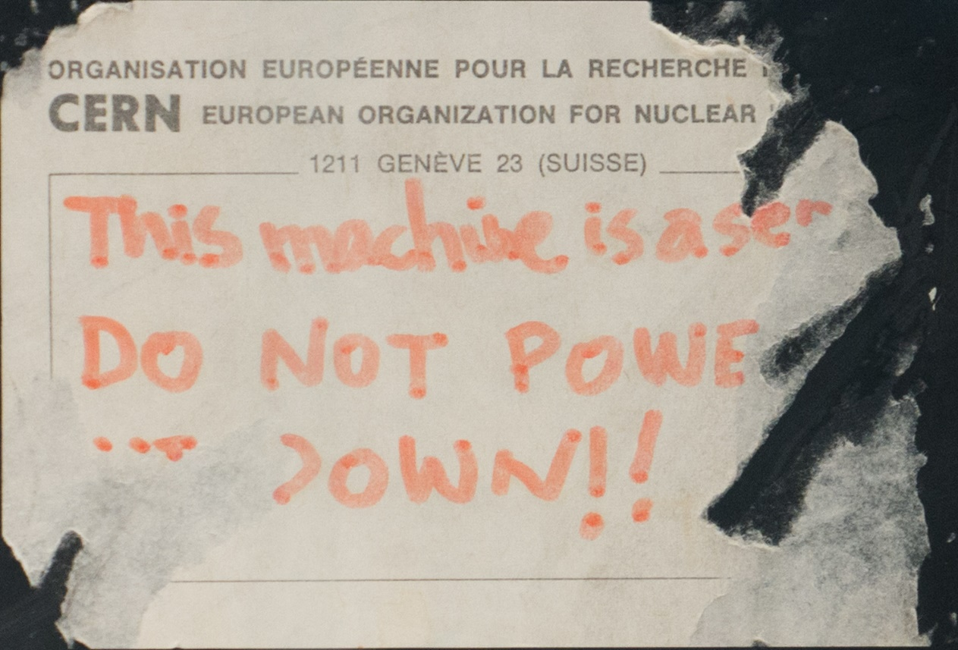
Periodic inspections – new HSE position on 30mA differential (RCD) protection
All 30mA differential protection devices installed within a building to be tested during the (annual) periodic inspection.
These are typically found on socket outlets, inc. within equipment racks!
The test causes a short power cut, for the time it takes to reset the circuit breaker – a few seconds but…
This will interfere with the operation of your equipment in the rack.

Slide 6
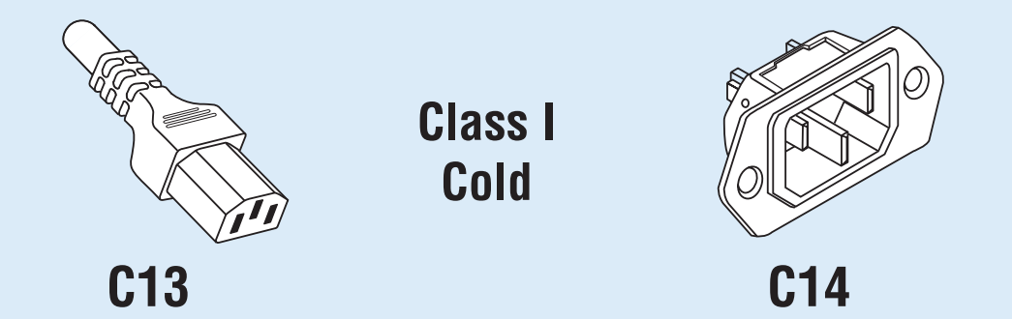
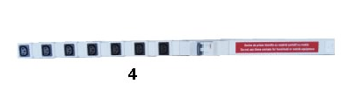
Periodic inspections – new HSE position on 30mA differential (RCD) protection
The simplest solution is to change the installation to avoid T-13 or T-23 sockets within racks/feeding critical equipment.
Available from CERN stores via SCEM 06.61.81.714.3 instead of regular socket outlet strips; 30mA protection is not required on IEC plugs. 120 CHF per strip.
This is 35 CHF cheaper than a T-13 socket outlet strip, but cables/plugs will need to be changed.
Speak to me about potential alternatives
IEC C13/C14 Couplings
Rated to 10A
Don’t forget - Plugs also need to be changed!

