Slide 1


Flammable gas in experimental areas or laboratories
EP Department

Slide 2

Flammable gas hazard
Flammable gas used in experiment for various reasons
At CERN, Safety Rules define how to use these gases:
  GSI-C-2 “Explosive Atmosphere”
  SG-C-2-0-1 (guideline) “Explosion protection measures”
  SG-C-2-0-2 (guideline) “Identification and prevention of explosion hazards”
  SG-C-2-0-3 (guideline) “Practical guide for classification of hazardous areas”
You can use them… In a declared and safe way!

Slide 3
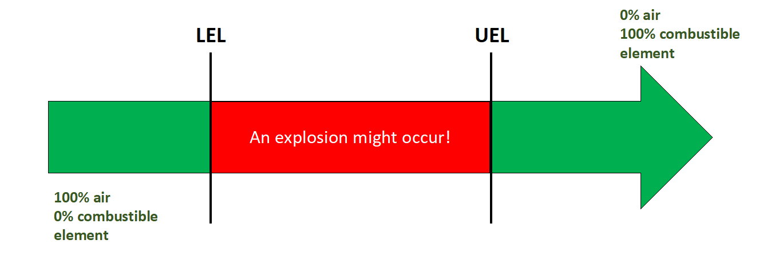
Flammable gas hazard
Main flammable gas hazards are:
  Fire
  Explosion Flammable gases mixed with air, can create an EXplosive ATmosphere
Mixtures of flammable substances with air will burn only if the fuel concentration lies within:
  Lower Explosive Limit (LEL) - lower % in air capable of creating an explosive atmosphere
  Upper Explosive Limit (UEL) - upper % in air capable of creating an explosive atmosphere

Slide 4

ATEX Areas
Avoid creation of explosive atmosphere
If not possible
Objectives of ATEX Directive
Areas where flammable gases/liquids are present can be classified as ATEX.
0 – if an explosive atmosphere is permanently present
1 – if an explosive atmosphere is likely to occur in normal operation
2 – if an explosive atmosphere is not likely to occur in normal operation
Avoid the presence of ignition sources
If not possible
Decrease the effects of an explosion

Slide 5
EP Safety Office
EP Flammable Gas Safety Officer (FGSO) Letizia DI Giulio (myself!)
My role:
Provide information and expertise on the use of flammable gas, complying with CERN Safety Rules (seen before)
Carry on the Explosion Risk Assessment (Safety Form C-2-0-1) and (if required) the Classification of Hazardous (ATEX) Area (Safety Form C-2-0-2)
Support in the implementation of safety measures
Authorize EP users to purchase flammable gases

Slide 6
Procedure to use flammable gas
Contact EP FGSO about your need

Slide 7
Procedure to use flammable gas
Contact EP FGSO about your need
Provide descriptive document of flammable gas system

Slide 8
Procedure to use flammable gas
Contact EP FGSO about your need
Provide descriptive document of flammable gas system
Based on the information provided, FGSO starts Explosion Risk Assessment and, if necessary, Classification of Hazardous Area

Slide 9
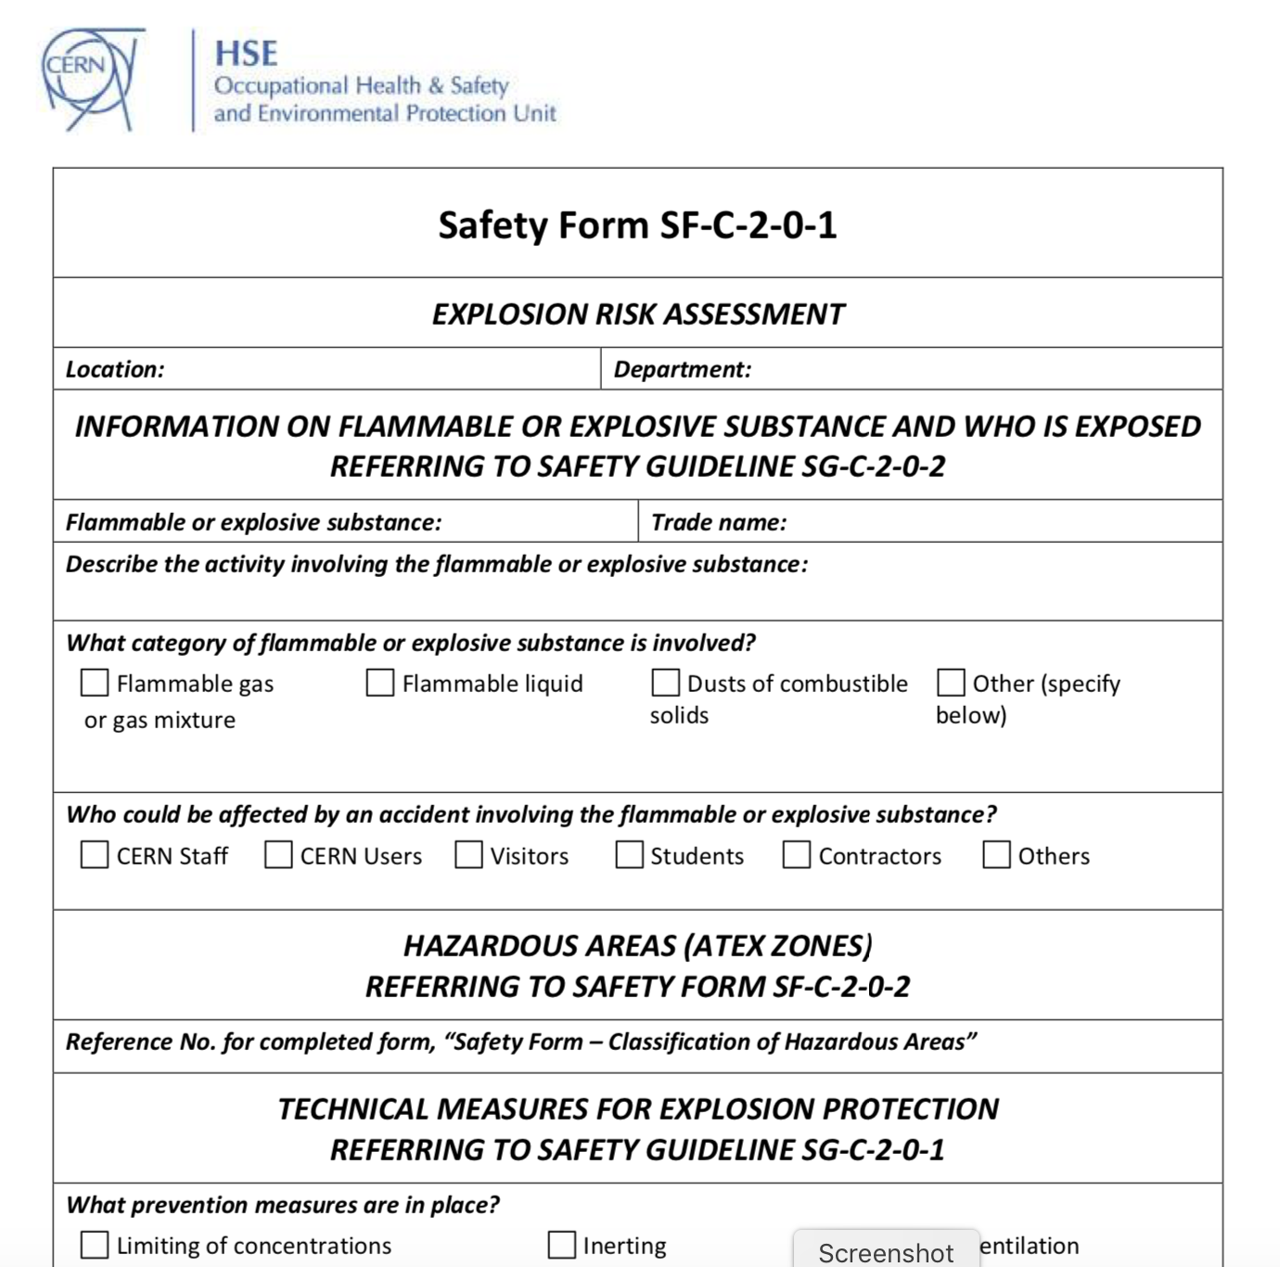

Slide 10
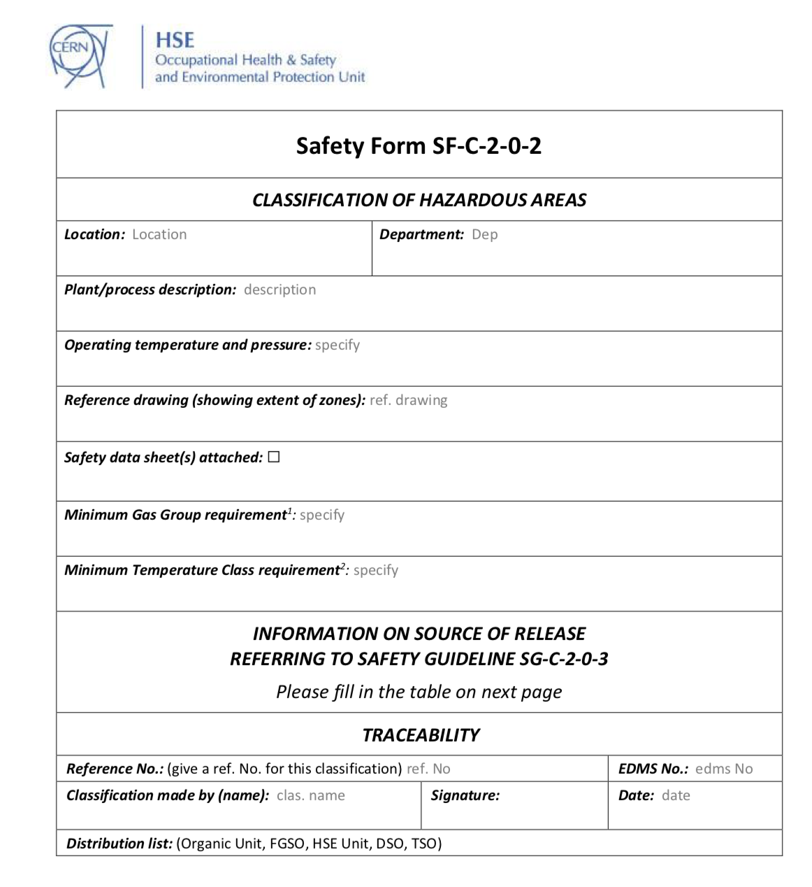

Slide 11
Procedure to use flammable gas
Contact EP FGSO about your need
Provide descriptive document of flammable gas system
Based on the information provided, FGSO starts Explosion Risk Assessment and, if necessary, Classification of Hazardous Area
If fixed gas detection system is needed, you should contact BE-ICS-AS. All detection installations must pass an acceptance test before usage!
Preliminary steps

Slide 12
Procedure to use flammable gas
Contact EP FGSO about your need
Provide descriptive document of flammable gas system
Based on the information provided, FGSO starts Explosion Risk Assessment and, if necessary, Classification of Hazardous Area
If fixed gas detection system is needed, you should contact BE-ICS-AS. All detection installations must pass an acceptance test before usage!
Preliminary steps
Buy the considered gas (EDH form to be signed by EP FGSO) and install the gas system

Slide 13
Procedure to use flammable gas
A visit on site is performed by the EP FGSO and the HSE Unit FG expert

Slide 14
Procedure to use flammable gas
A visit on site is performed by the EP FGSO and the HSE Unit FG expert
The FGSO completes the Explosion Risk Assessment and, if needed, the classification of Hazardous area – both validated by HSE Unit

Slide 15
Procedure to use flammable gas
A visit on site is performed by the EP FGSO and the HSE Unit FG expert
The FGSO completes the Explosion Risk Assessment and, if needed, the classification of Hazardous area – both validated by HSE Unit
Specific safety checks are organized, such as electrical safety inspection

Slide 16
Procedure to use flammable gas
A visit on site is performed by the EP FGSO and the HSE Unit FG expert
The FGSO completes the Explosion Risk Assessment and, if needed, the classification of Hazardous area – both validated by HSE Unit
Specific safety checks are organized, such as electrical safety inspection
Complete the Declaration of the use of Flammable Gas (Safety Form C-2-0-3), just before using the flammable gas, and send it to distribution list

Slide 17
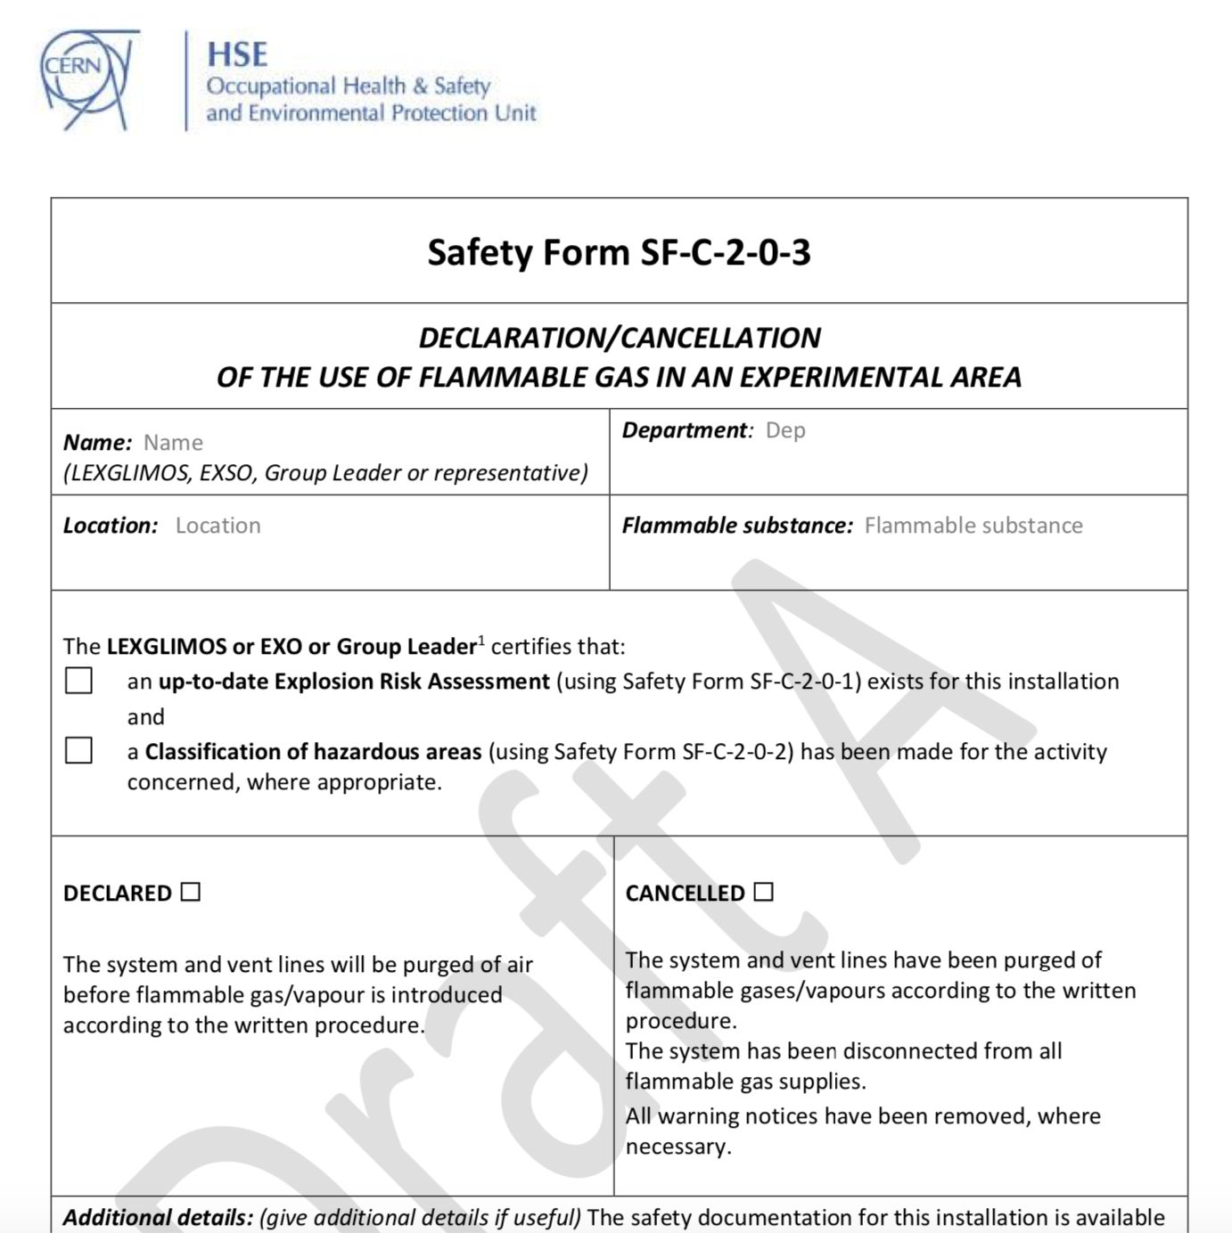

Slide 18
Procedure to use flammable gas
A visit on site is performed by the EP FGSO and the HSE Unit FG expert
The FGSO completes the Explosion Risk Assessment and, if needed, the classification of Hazardous area – both validated by HSE Unit
Specific safety checks are organized, such as electrical safety inspection
Complete the Declaration of the use of Flammable Gas (Safety Form C-2-0-3), just before using the flammable gas, and send it to distribution list
Once the test is over, complete the Cancellation of the use of Flammable Gas (same form) and send it to distribution list

Slide 19
Procedure to use flammable gas
A visit on site is performed by the EP FGSO and the HSE Unit FG expert
The FGSO completes the Explosion Risk Assessment and, if needed, the classification of Hazardous area – both validated by HSE Unit
Specific safety checks are organized, such as electrical safety inspection
Complete the Declaration of the use of Flammable Gas (Safety Form C-2-0-3), just before using the flammable gas, and send it to distribution list
Once the test is over, complete the Cancellation of the use of Flammable Gas (same form) and send it to distribution list
All documents will be kept in the EDMS Safety Folder!

Slide 20
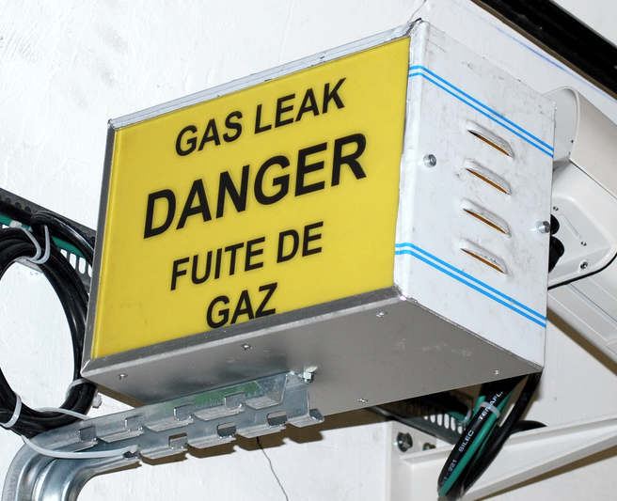
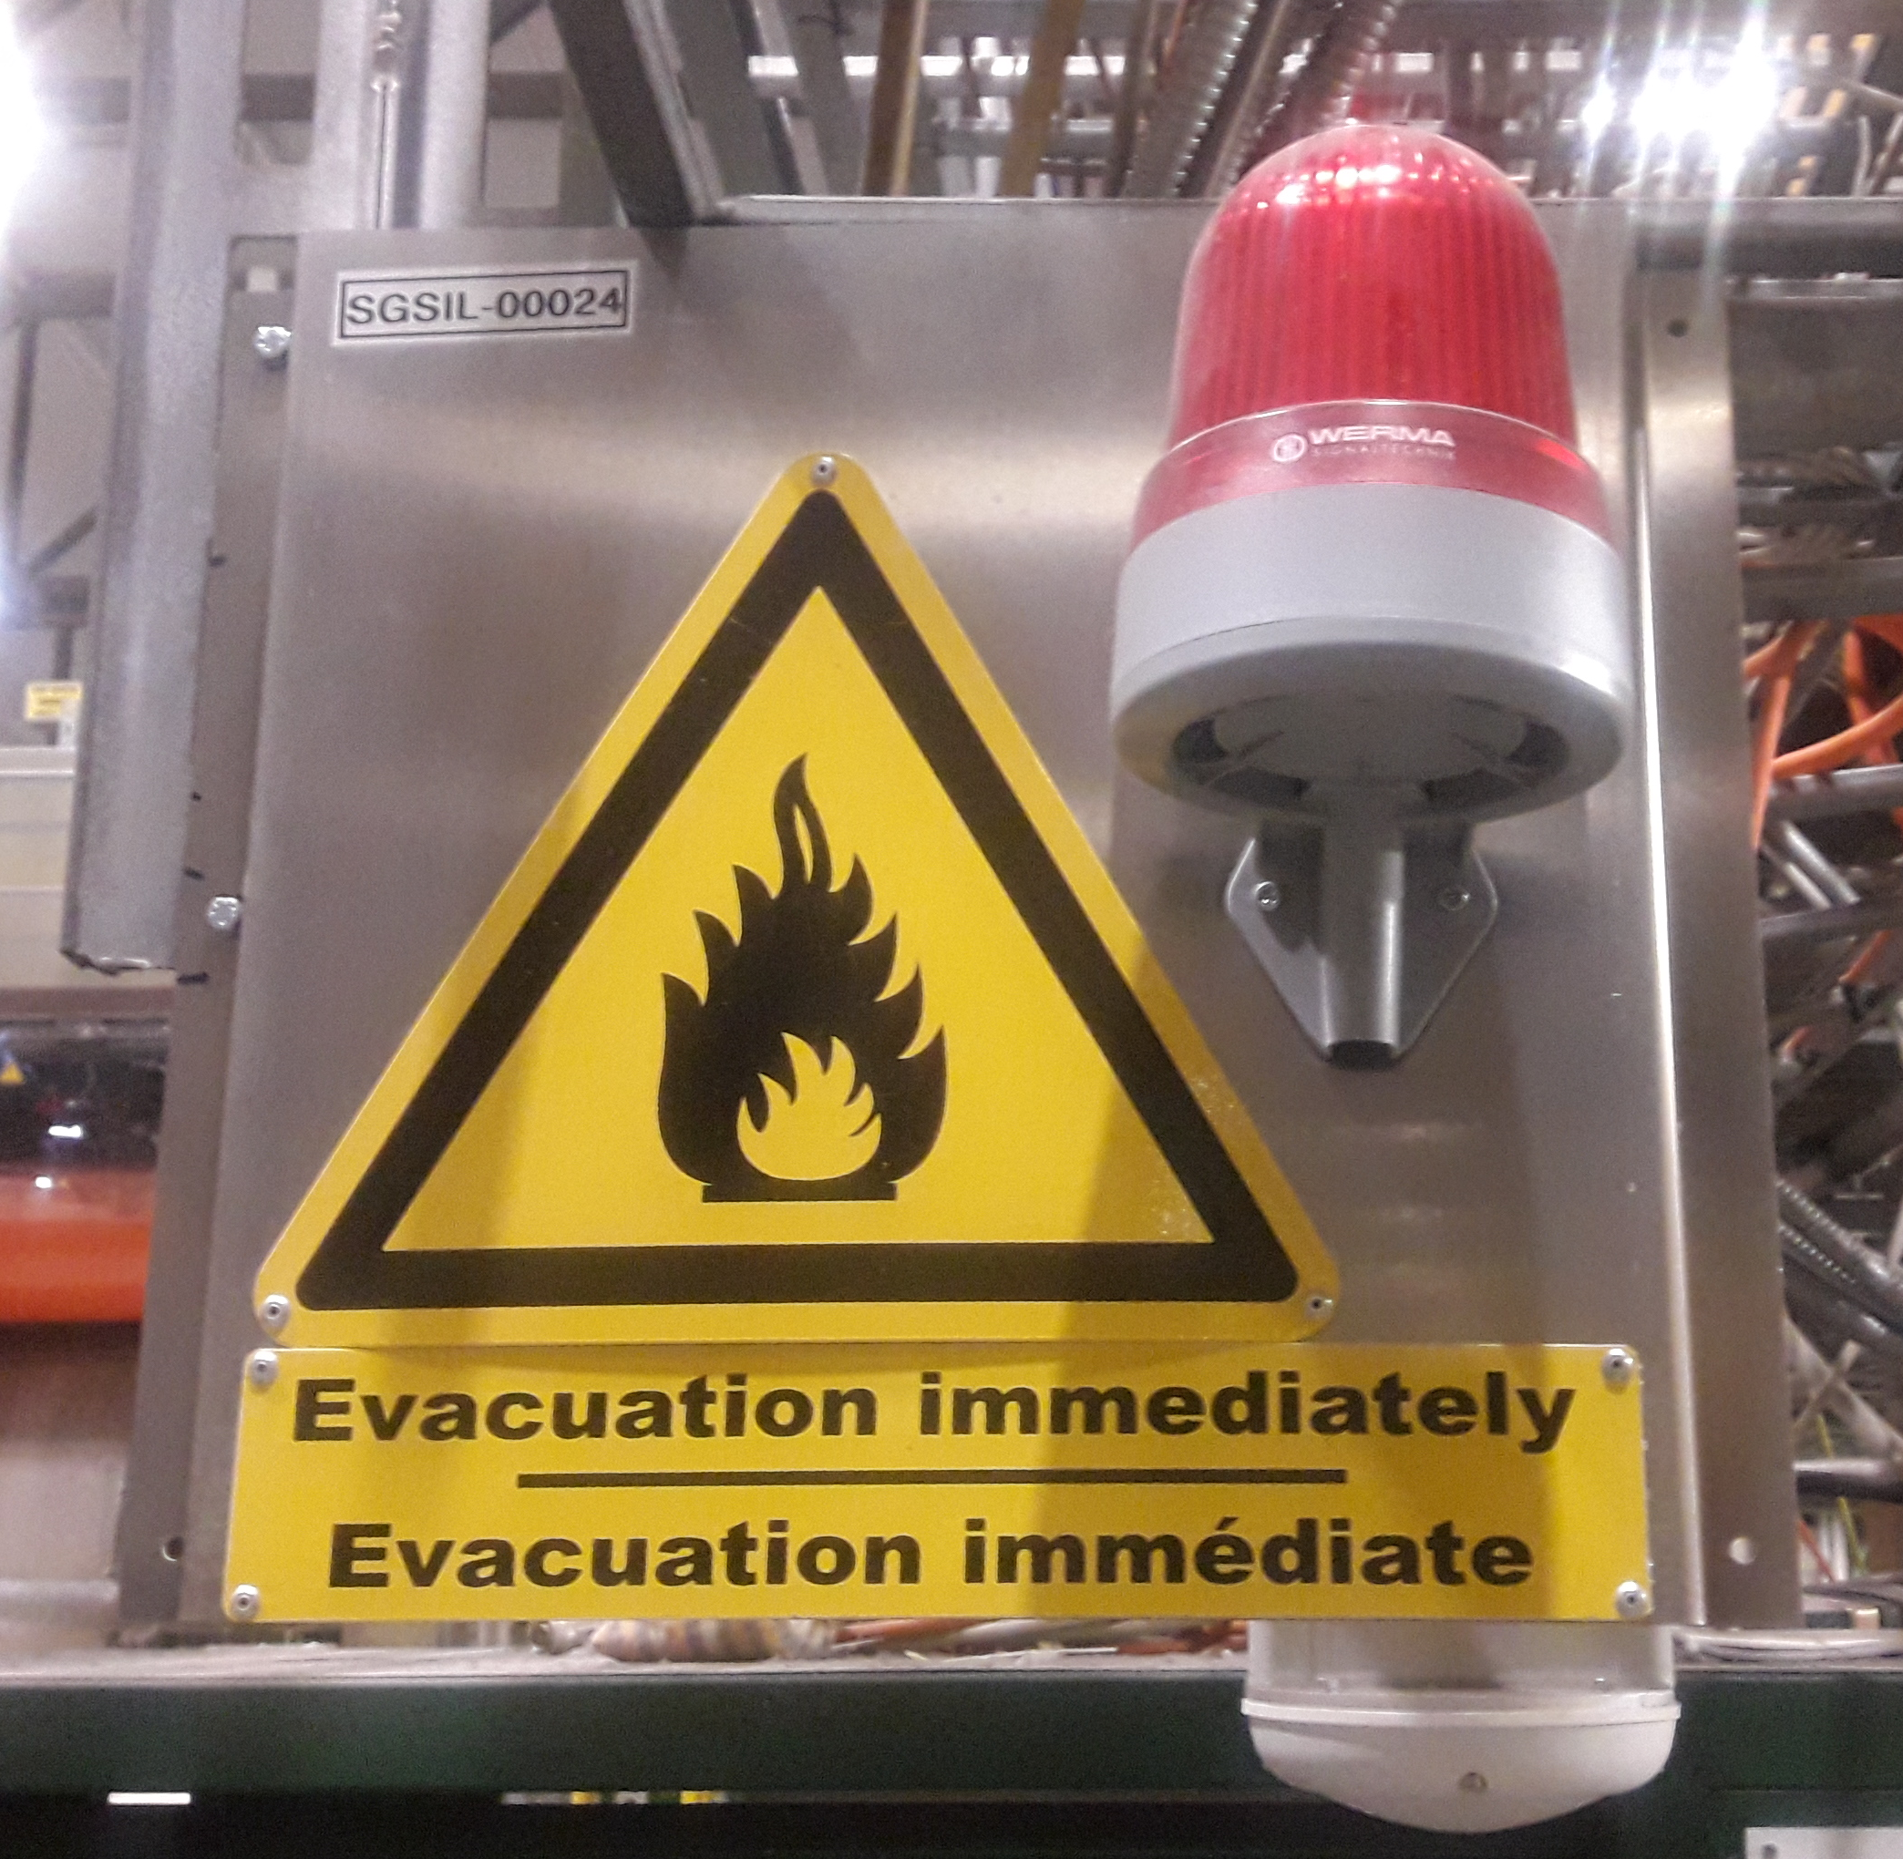
Gas detectors – Alarm level 2
Alarm Level 2 (10% LEL):
  Only the visual warning flashing light is triggered
  The alarm arrives automatically to the CCC and the gas detection piquet (will intervene remotely or on site in max 2h time)
  The users, if possible, should check if their equipment (connections, detector, human error, etc.) is causing a gas leak and wait for the gas piquet to intervene and reset the alarm.
In case of questions, please contact the TI operators at 72201 (+41 227672201).

Slide 21
Gas detectors – Alarm level 3
Alarm Level 3 (20% LEL):
  Audible siren and visual warning flashing light
  The alarm arrives automatically to the Fire Brigade
  The distribution supply valve of the gas is automatically closed
  The users should calmly evacuate the area (experimental area, gas cage or laboratory) and no other actions should be taken.
In case of emergency, please contact the Fire Brigade at 74444 (+41 227674444).

Slide 22
Contacts – Flammable Gas Safety
For further information about flammable gas hazards and risks, please contact:
EP FGSO – Letizia Di Giulio
Deputy EP FGSO – Henric Wilkens
HSE Unit Expert – Jonathan Gulley
Large Experiments: ask your LEXGLIMOS who is your FGSO
Thank you! Questions?

