Slide 1


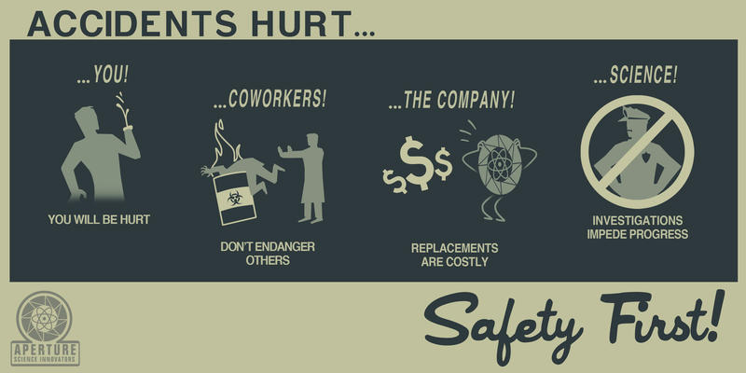
Incidents and accidents
Lessons learned
https://indico.cern.ch/event/866752
cern.ch/ep-th-safety
ep-safety-office@cern.ch

Slide 2
Agenda
CERN 2018 accidents statistics
Faintness and first-aid
Fire
Evacuation

Slide 3
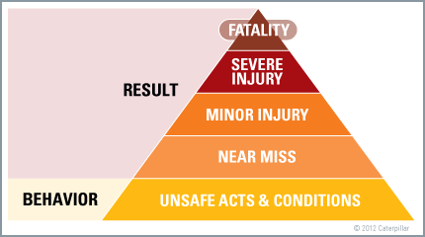
What do we want to avoid?

Slide 4
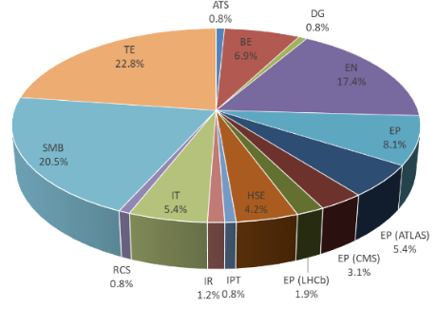
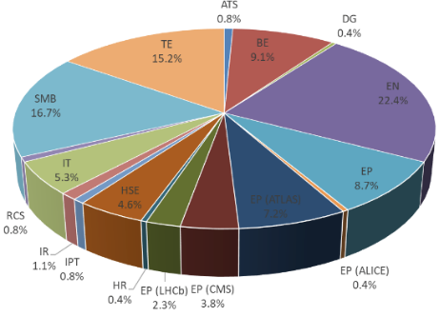
Accidents: 2018 CERN’s statistics
259 accidents: 100 on MPE, 56 on MPA (resp. 237, 86 and 46 in 2017) – 103 on contractors
Home dep.
Territorial resp.

Slide 5
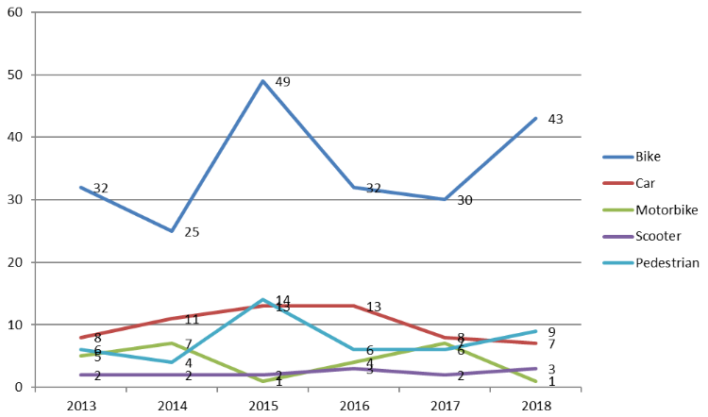
Accidents: 2018 CERN’s statistics
MPE and MPA

Slide 6
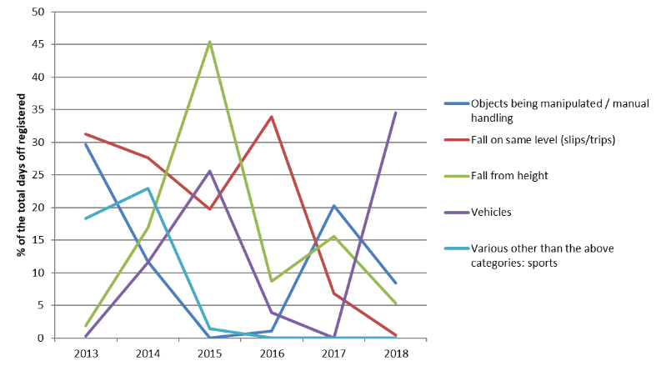
Accidents: 2018 CERN’s statistics
MPE

Slide 7
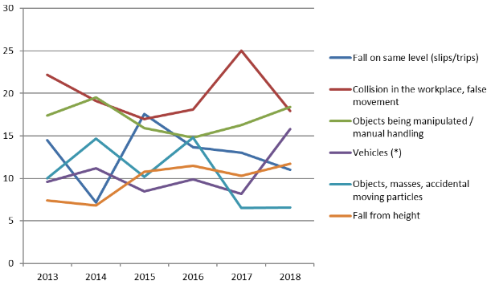
Accidents: 2018 CERN’s statistics
MPA

Slide 8
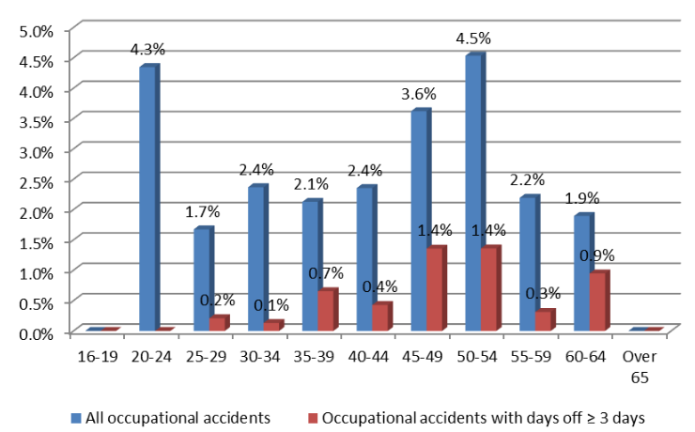
Accidents: 2018 CERN’s statistics
MPE

Slide 9
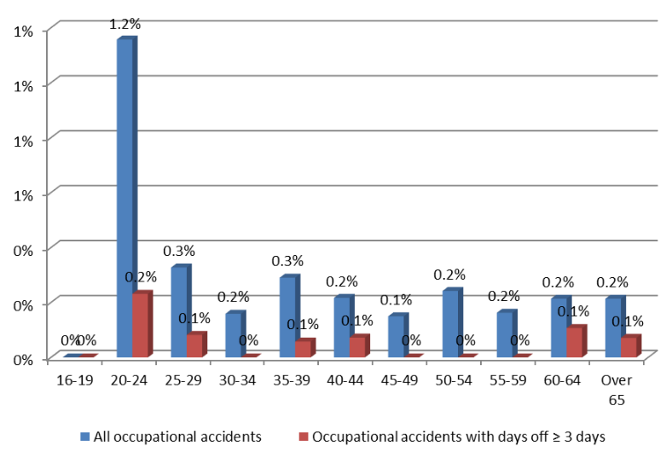
Accidents: 2018 CERN’s statistics
MPA

Slide 10
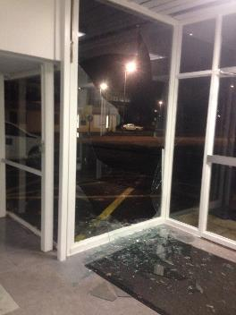
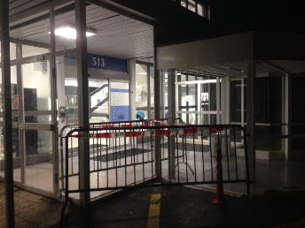
2018 - Accident
B.513, glass wall
Severe injuries on the face
Glass wall not conform
Ongoing campaign at CERN (EDMS 2110342)
  Please report any glass wall which is
    Not marked
    Not “Securit”
  If in doubt please contact us
https://www.bfu.ch/api/publications/bfu_2.006.02_Le%20verre%20dans%20l'architecture.pdf

Slide 11
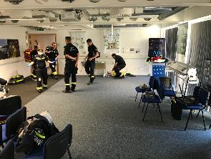
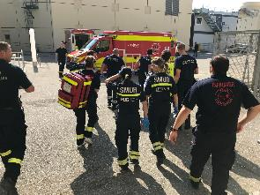
2019 - Faintness
25 May 2019
Stroke of a visitor at Point 5 on a Saturday
Guide called CERN FB, placed casualty in recovery position and inform the CMS XCR
“Piquet catastrophe Genève” training ongoing at Point 5, emergency medical doctor and 3 nurses intervened immediately
Operational material available (not only the training one), plus the O2 bottle of Point 5 infirmary
The visitor survived and left the hospital few weeks later

Slide 12
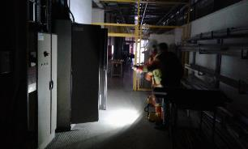
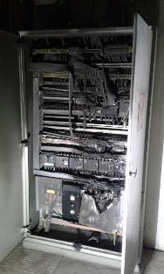
2019 - Accident
Fire in an old (40 yo) electrical cabinet on Wed. 6 Feb. 2019 in b.904
Was spotted by personnel around after the noise of a detonation
Personnel reacted very well, triggered the evacuation sirens, patrolled the building and joined the assembly point
Smoke detection triggered alarm level 3
Several improvements needed:
  Lack of preventive maintenance on all electrical cabinets
  Fire doors blocked open in the building
  Assembly point lack or wrong signaling
  No emergency guides trained and equipped

Slide 13
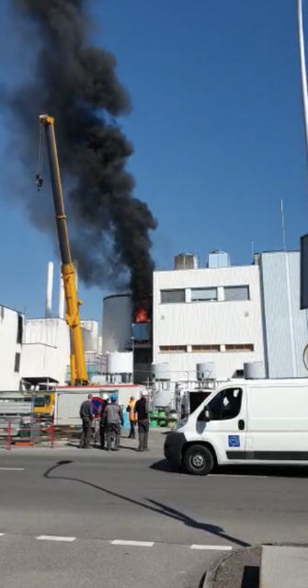
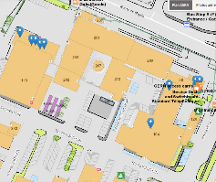
2019 - Accident
Fire on a ventilation unit dismantling worksite close to b.242 on Thu. 21 March
When cutting with oxy-acetylene, the plastic part caught fire
The acetylene bottle caught fire
All Meyrin site entrances closed
Crisis cell activated
No injury
Fire Brigade cooled down the acetylene bottle for several hours, and then extinguished the fire, and cooled down the bottle in water during 24 h.
Potential serious consequences in case of an explosion

Slide 14
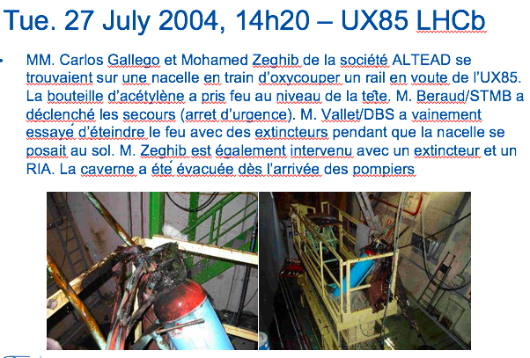
2019 - Accident
Similar accident in 2004 in LHCb experimental cavern
Several incidents in France:
https://www.aria.developpement-durable.gouv.fr/wp-content/uploads/2018/07/Flash_bouteilles_acetylene-V4.pdf

Slide 15
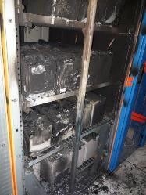
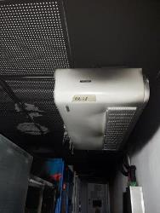
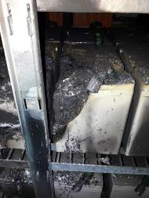
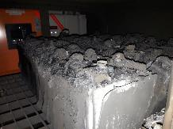
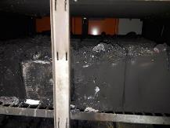
2019 - Accident
Lead-acid battery fire in SCX5 on Sat. 25 May around 22h40
Level 3 smoke alarm, Fire brigade intervened and extinguished the fire
Short-circuit on the battery created by a leak of acid
SCX5 control room relocated temporarily
200 kCHF

Slide 16
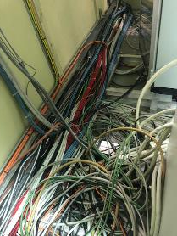
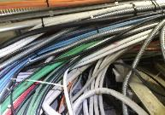
2019 - Accident
Summer 2019
16

Slide 17
2019 - Accident
Summer 2019
Causes:
Material:
Floor non uniform
Use of transpalette not appropriate
Center of gravity height and out of axis (not identified, not communicated)
Procedure and work/safety management:
Activity and environmental risks were not assessed
The victim was working alone

Slide 18
2019 - Accident
Summer 2019
Causes :
Material :
Rail was damaged for long time
Manpower:
People were used to place by hand the gate in the rail
Procedure and work/safety management:
This non-conformity was not identified in the general safety inspection of the building
05.08.2019 – Build. 573
EDH: 787916
18

Slide 19
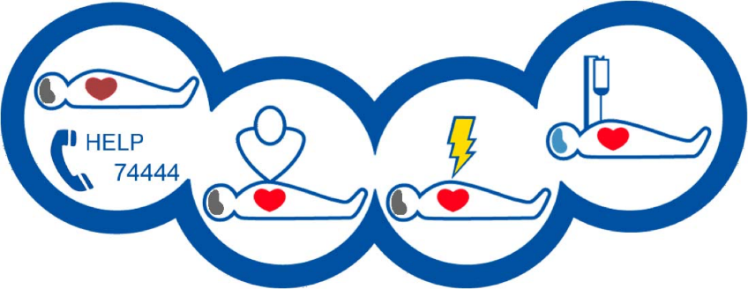
First-aid
First-aid training course:
    Initial courses (8h)
    Refresher courses (4h)
    Short version (1h) – Defibrillator and chest compressions
  Lms.cern.ch
REGISTRATION BLOCKED SINCE 6th JANUARY

Slide 20
Fire – what made the difference
Quick detection and alert
  Smoke detection (automatic or human)
  AL3 or 74444 (0041 22 767 4444)
Quick reaction
  Fire extinguisher
  AUL
Personnel trained and vigilant
  Fire extinguisher
  Reduced amount of combustible material
  Type of combustible (IS23 and IS41)

Slide 21
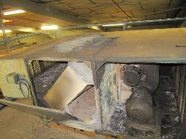
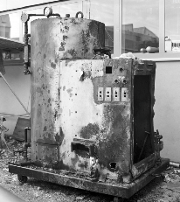
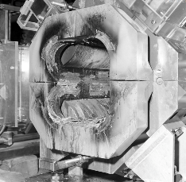
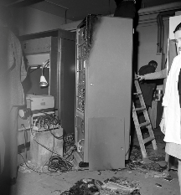
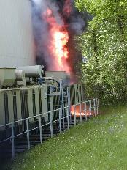
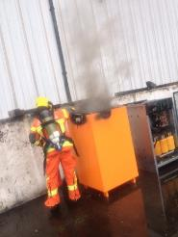
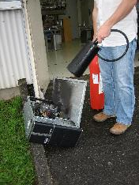
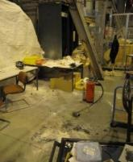
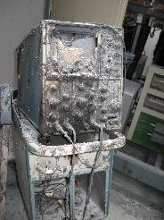
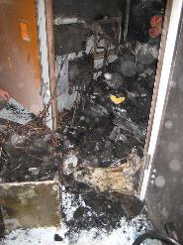
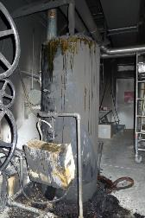
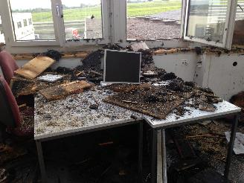
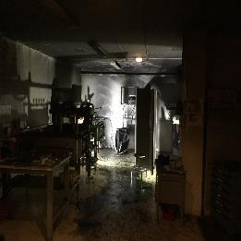
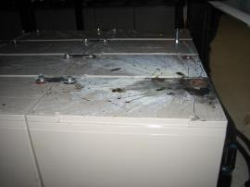
Fire-extinguisher training course is highly recommended to all personnel!
EP-TH SO Plenary - 23 Jan. 2020 - N. DUPONT - EDMS 2311454
21

Slide 22
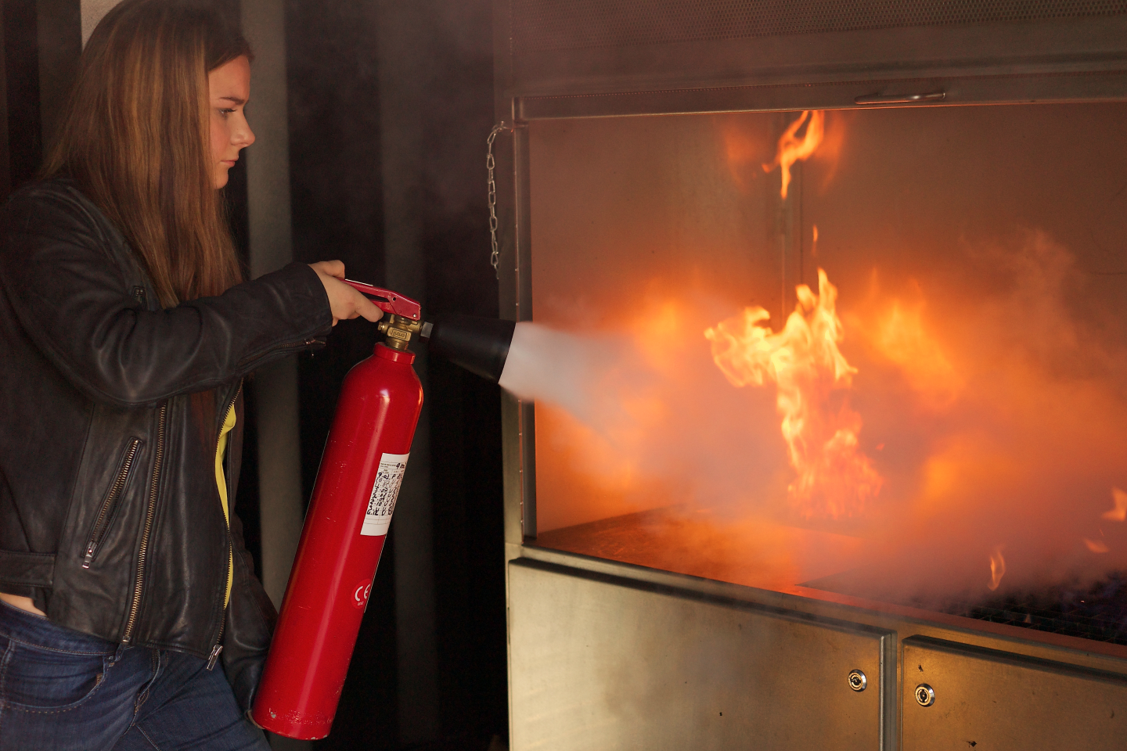
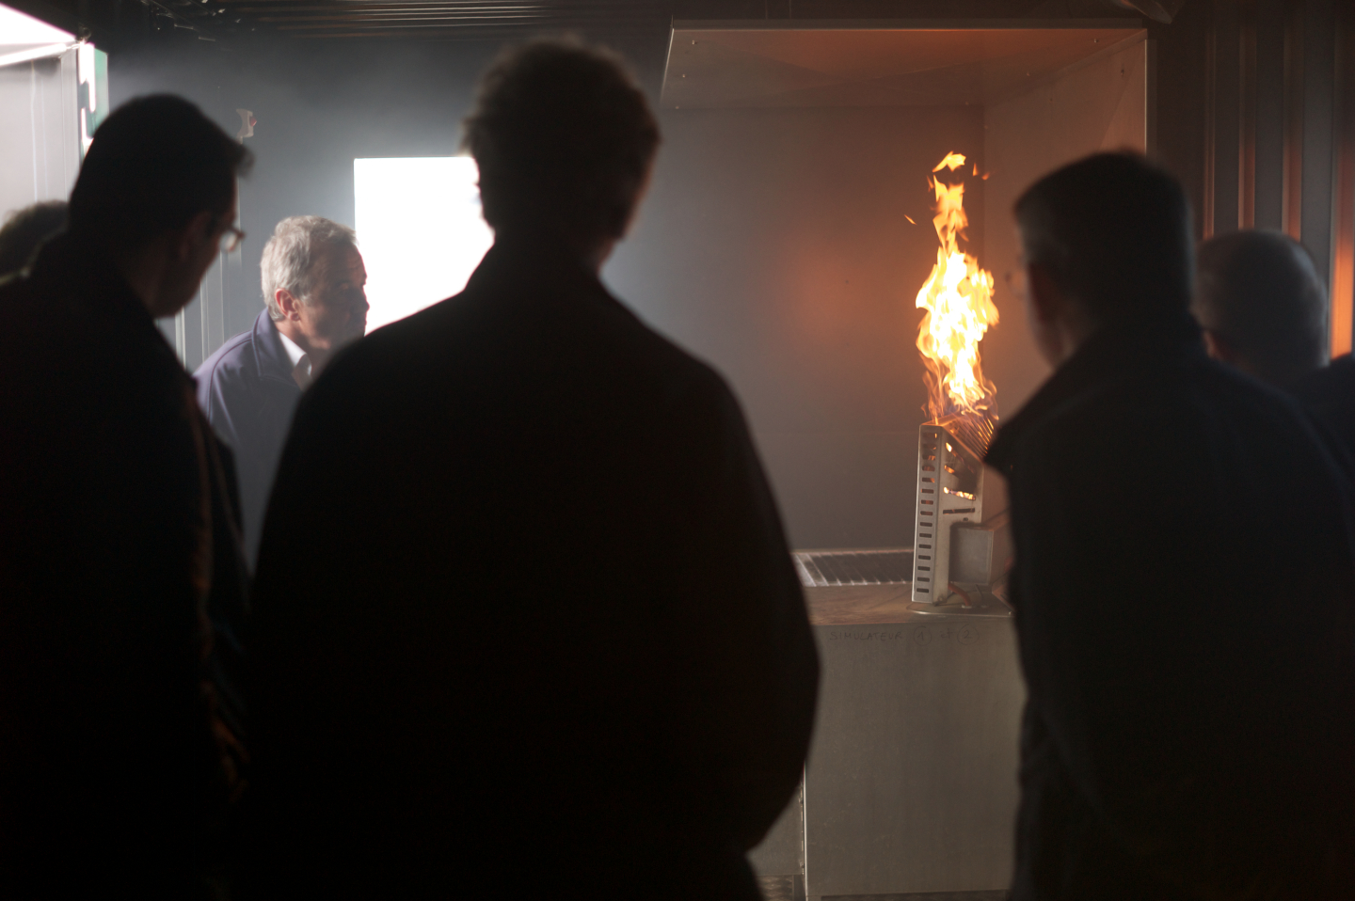
Fire extinguisher
Get trained: short (2h), free, fun, interesting for your work and your private life, and you meet fire-fighters!
  Lms.cern.ch

Slide 23
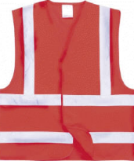
Evacuations in 2019
Several evacuation drills organized with the help of HSE Unit – reports available in EDMS
40 evacuations planned in 2020
  List validated by the DSOC
  If you identify a need for your building, please contact us
  Get equipped and equip your emergency guides

Slide 24
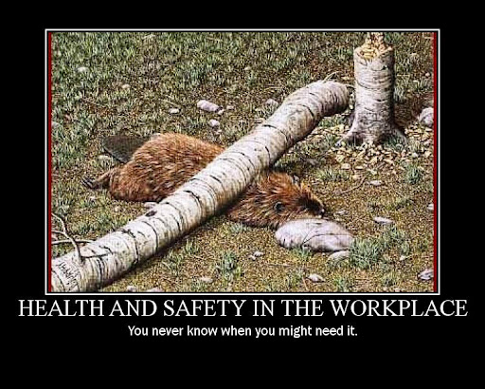
Questions

Slide 25
Spare slides

Slide 26
The 9 general principles of prevention
The 9 general principles of prevention
1
2
3
Avoid
the risks
Evaluate
the risks
Fight the risks at their source
Replace dangerous items by safer or less dangerous items
Adapt the workplace to technical progress
6
4
5
Adapt the work
to the individual
Include
prevention in the work planning
Take collective prevention
measures
7
8
9
Give appropriate instructions

Slide 27
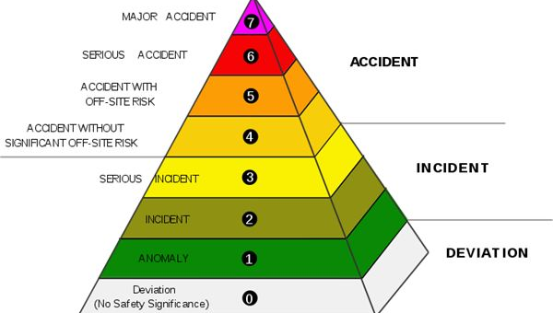
What do we want to avoid?

Slide 28
