Slide 1



The equation of state of compact stars in the gravitational wave era
David E. Álvarez Castillo
Joint Institute for Nuclear Research
Dubna, Russia
Zimányi School 2019
Budapest, Hungary
December 5, 2019

Slide 2
Outline
A brief introduction to the neutron star matter equation of state and its location within the QCD phase diagram.
The compact star mass twins hypothesis.
Astrophysics measurements of compact stars: multi-messenger astronomy & the GW170817 event.
Astrophysical implications and perspectives.

Slide 3
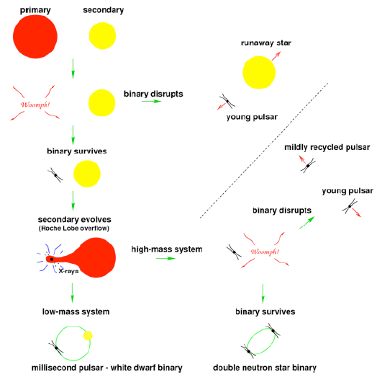
Double Neutron Stars and Millisecond Pulsars

Slide 4
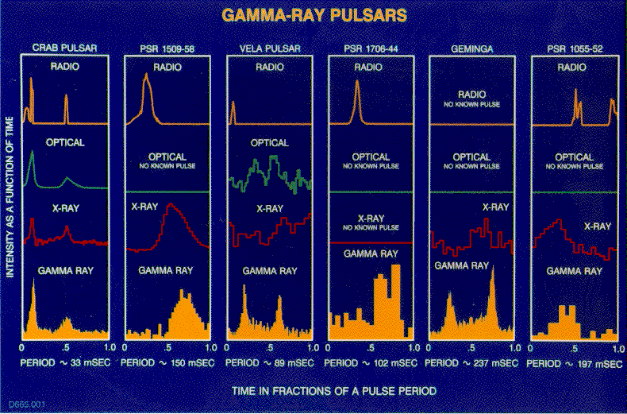
Pulse shapes and el.-magn. spectrum

Slide 5
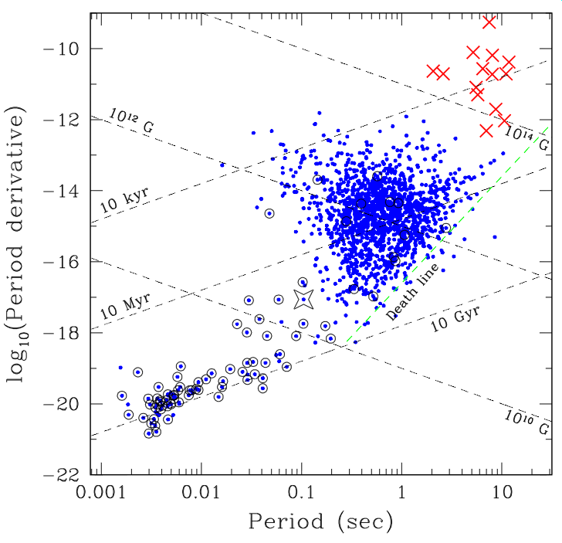
Statistics of Pulsars
Magnetars:
B > 10¹⁵ Gauss
Young pulsars:
P < 1 sec
B ~ 10¹² Gauss
Recycled (old) Pulsars:
P ~ few milliseconds
B ~ 10⁸ Gauss

Slide 6
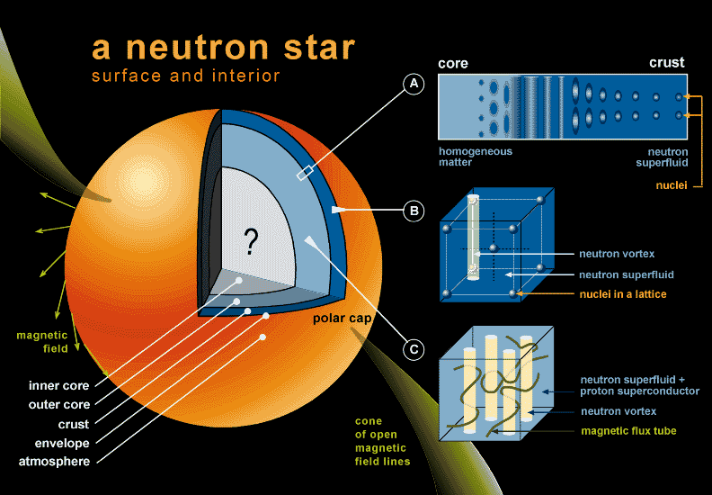
Superdense objects – what is inside?

Slide 7
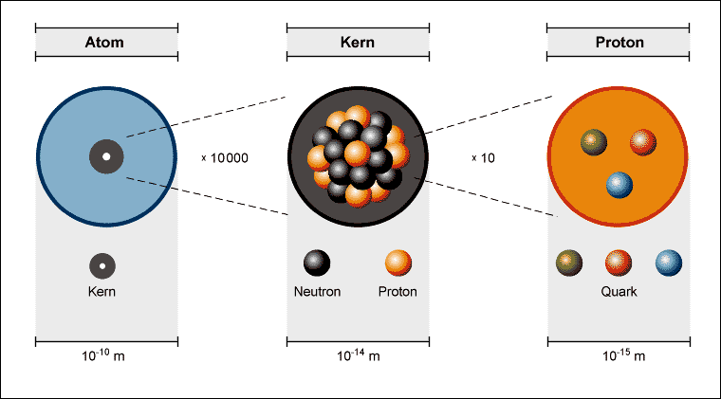
Superdense objects – what is inside?
Nucleus, A nucleons: R_{A}=1.2 10⁻¹³ cm A^{1/3}; ρ₀=A1.67 10⁻²⁴ g/(4π/3 R_{A}³)= 2.3 10¹⁴ g/cm³
Neutron star: R= 10 km; ρ= 2 Mo/(4π/3 R³) = 4 10³³ g/(4 10¹⁸ cm³)= 10¹⁵ g/cm³ = 4 ρ₀

Slide 8
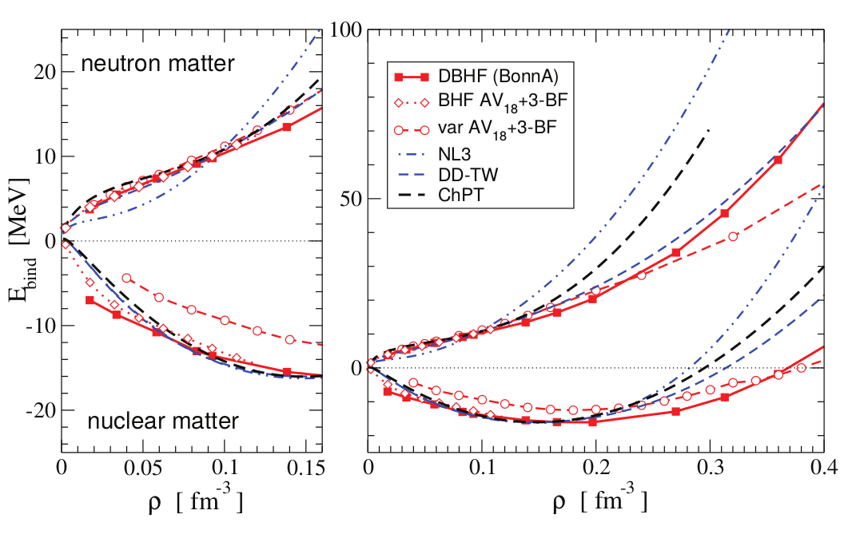
Nuclear Matter
C. Fuchs, H.H. Wolter, EPJA 30(2006)5

Slide 9
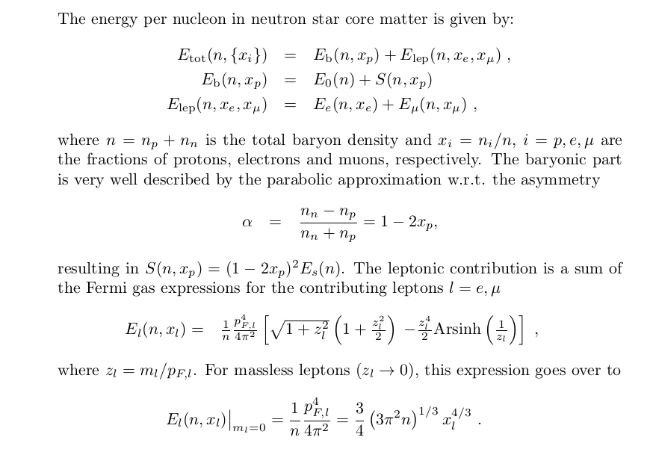
Neutron Star Equation of State

Slide 10
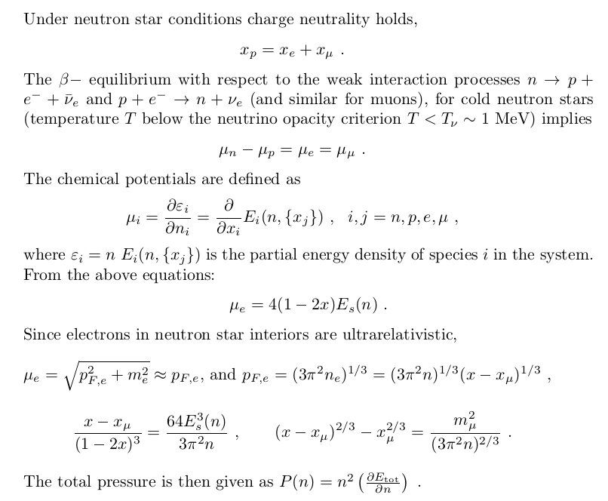
Charge neutrality and β-equillibrium

Slide 11
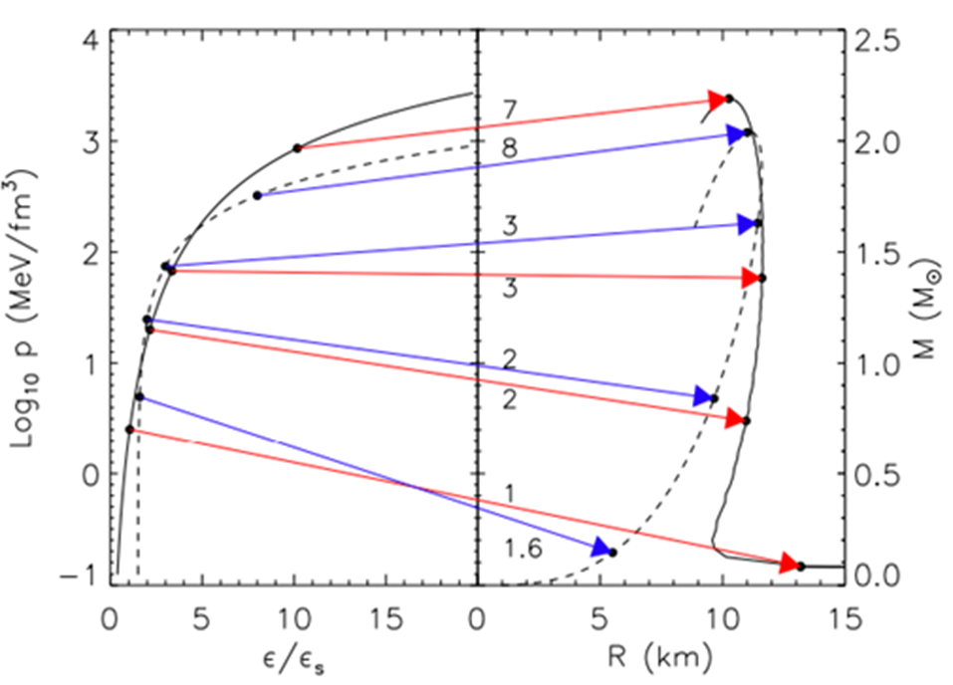
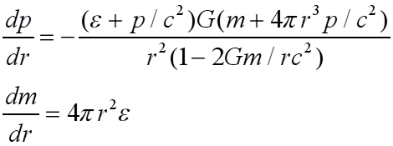

Compact Star Sequences
(M-R ⇔ EoS)
Lattimer,
Annu. Rev. Nucl. Part. Sci. 62, 485 (2012)
arXiv: 1305.3510
TOV Equations
Equation of State (EoS)

Slide 12
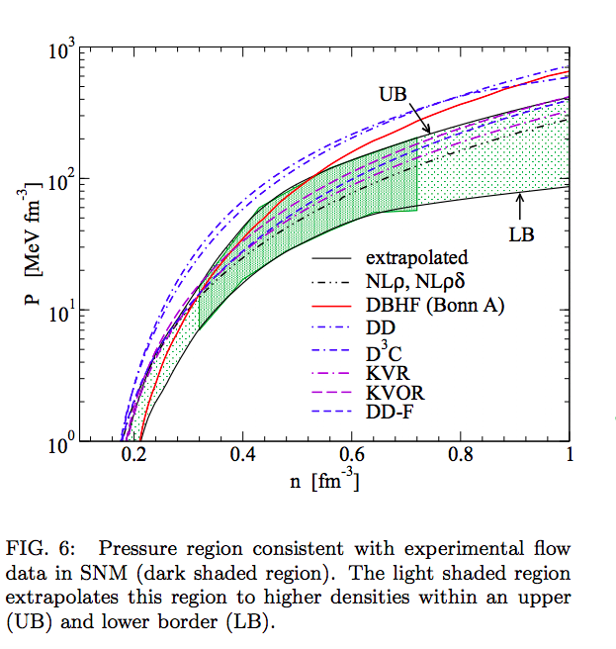
Flow Constraint
Klaehn et al. PhysRev C74 (2006)
P. Danielewicz, R. Lacey and W.G. Lynch, Science 298, 1592 (2002)

Slide 13
EoS Stiffness

Slide 14
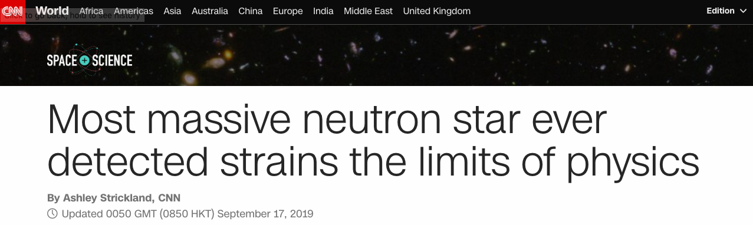
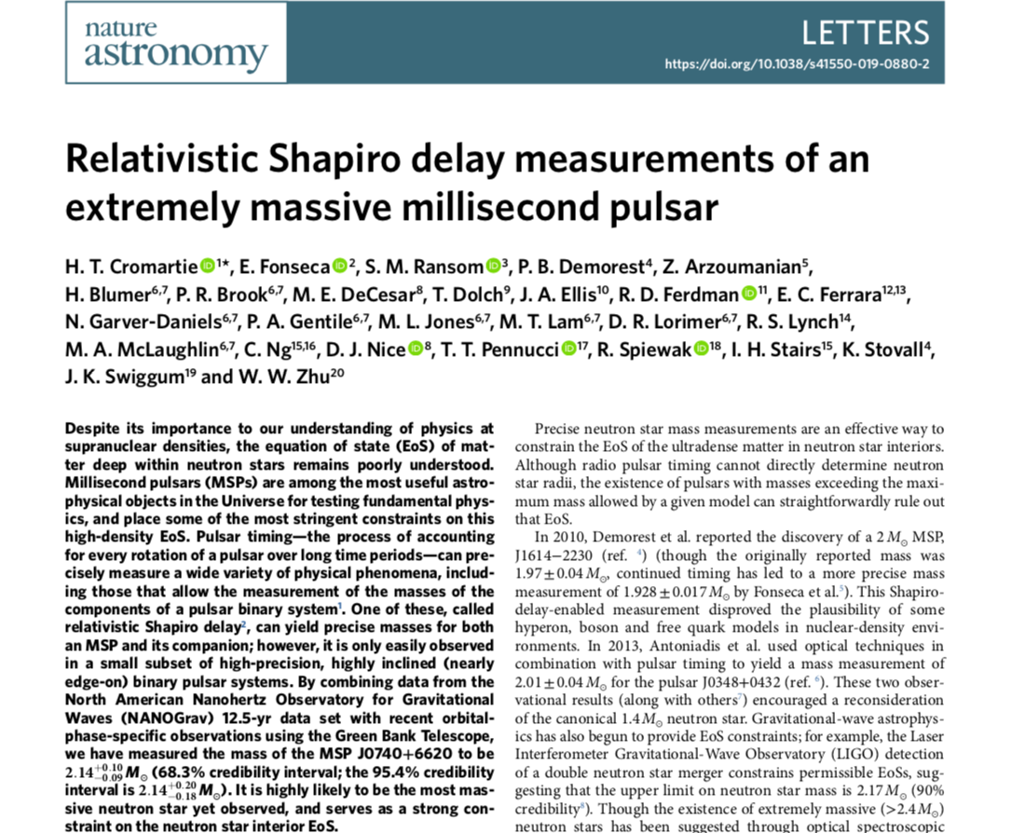

Slide 15
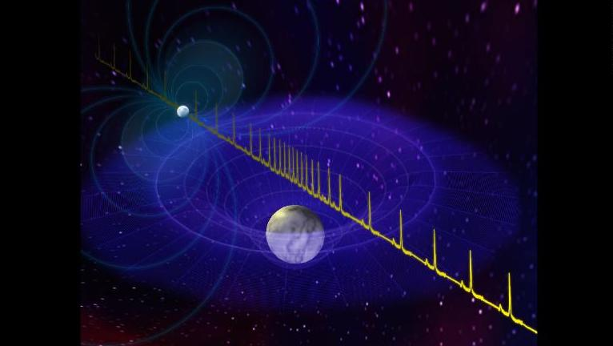
Massive Neutron Stars

Slide 16
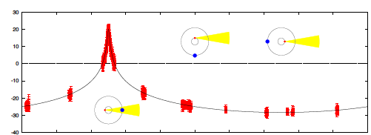
PSR J1614-2230
A precise AND large mass measurement
Shapiro delay:

Slide 17
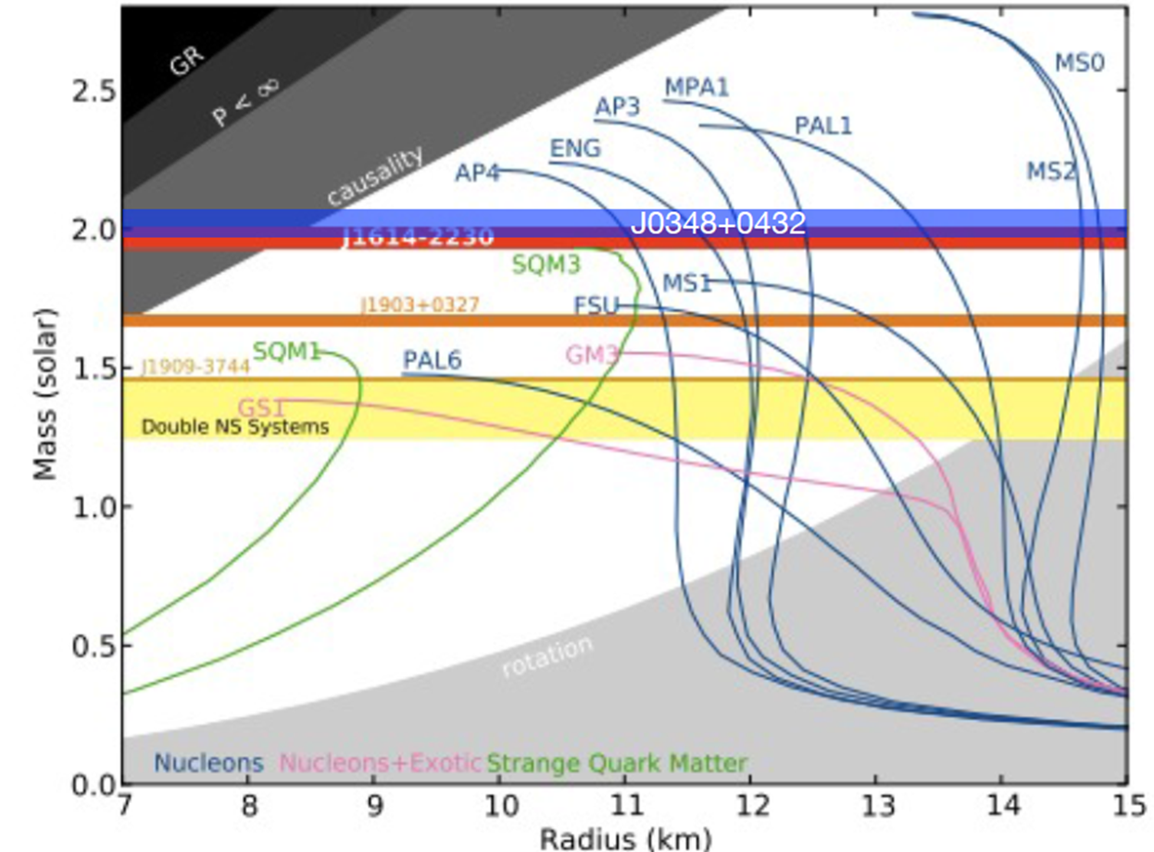
Massive Neutron Stars
PSR J0740+6620: M=2.17(+0.11, -0.10) Msun, at 68.3% credibility

Slide 18
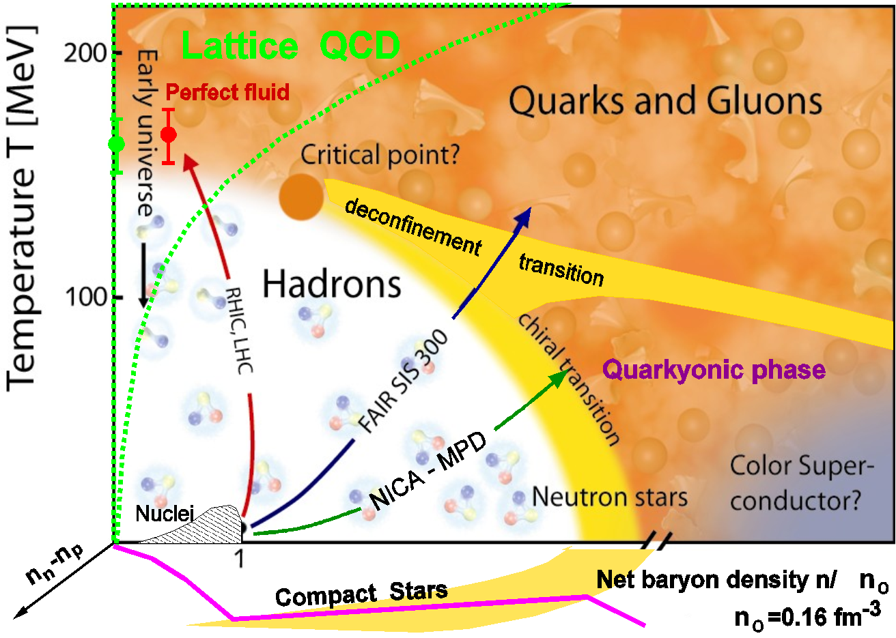
Critical Endpoint in QCD

Slide 19
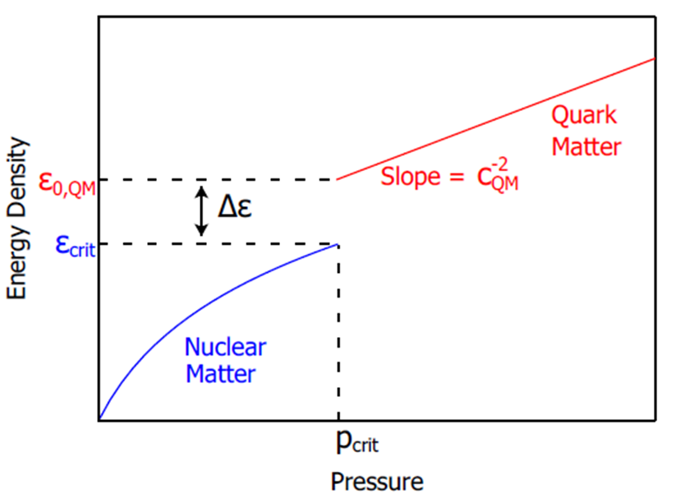
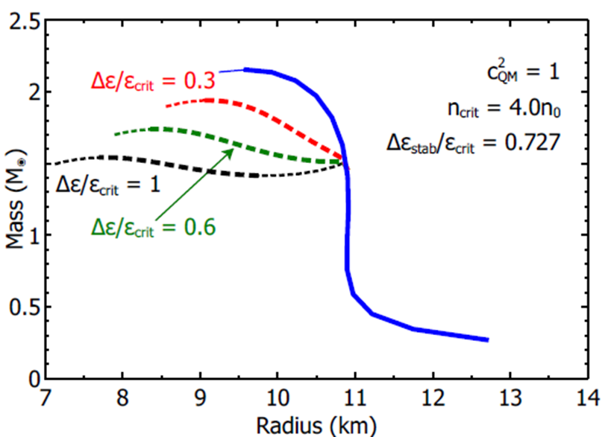
Compact Star Mass Twins and the AHP scheme
First order PT can lead to a stable branch of hybrid stars with quark matter cores which, depending on the size of the “latent heat” (jump in energy density), can even be disconnected from the hadronic one by an unstable branch → “third family of CS”.
Measuring two disconnected populations of compact stars in the M-R diagram would represent the detection of a first order phase transition in compact star matter and thus the indirect proof for the existence of a critical endpoint (CEP) in the QCD phase diagram!
Alford, Han, Prakash,
Phys. Rev. D 88, 083013 (2013)
arxiv:1302.4732

Slide 20
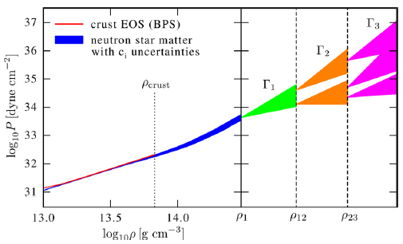

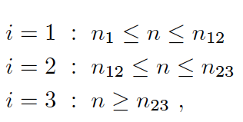

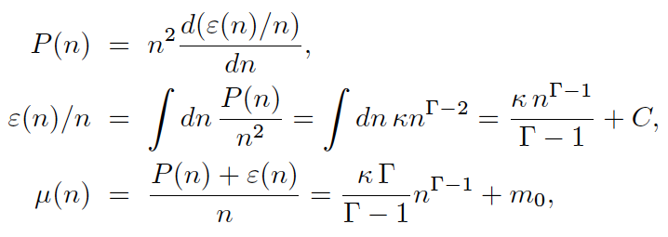
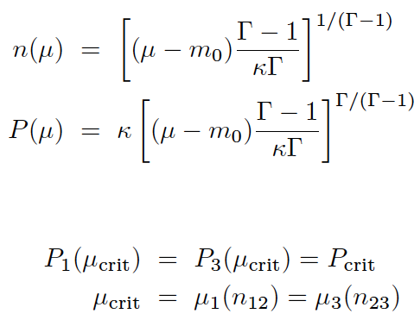

Piecewise polytrope EoS
Hebeler et al., ApJ 773, 11 (2013)
Here, 1st order PT in region 2:
Maxwell construction:
Seidov criterion for instability:

Slide 21
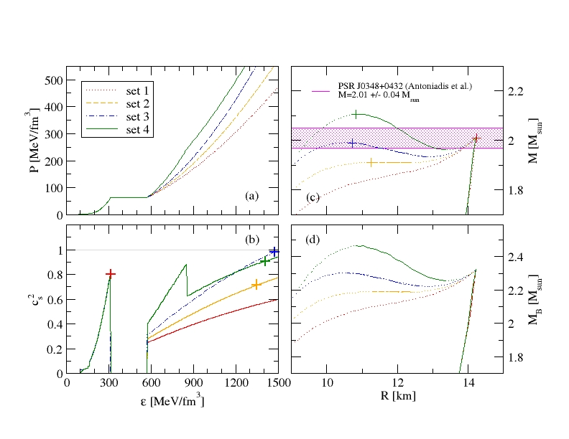
Compact Star Twins
Alvarez-Castillo, Blaschke (2017)
High mass twins from multi-polytrope equations of state
arXiv: 1703.02681v2, Phys. Rev. C 96, 045809 (2017)

Slide 22
Multi-messenger Astronomy

Slide 23
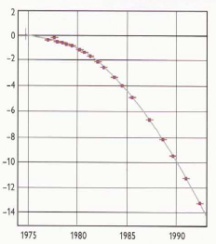
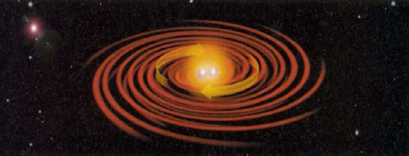
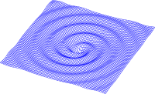
Hulse-Taylor pulsar – binary system
PSR B1913+16 (now J1915+1606)
Nobel Prize for
Hulse and Taylor
(1993)
Excellent confirmation of Einstein theory of GW emission by observation of period decay

Slide 24
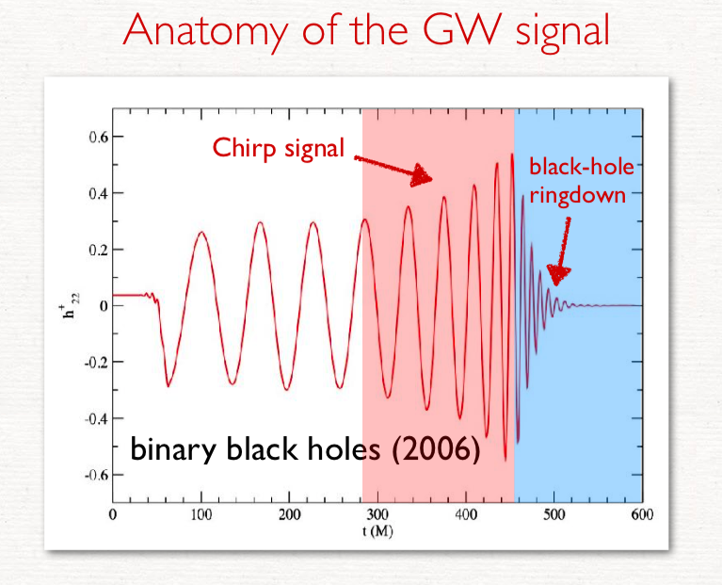

Slide 25
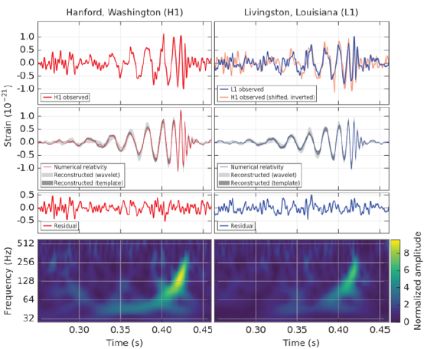
Direct measurement of gravitational waves – merging of two massive black holes (2015)
First detection of gravitational waves
September 14, 2015 at 5:51 a.m. EDT
(LIGO Collaboration)
Source at 410(18) Mpc [z=0.09(4)]
Initial black hole masses:
36(5) Mo and 29(4) Mo
Final black hole mass:
62(4) Mo
Energy release in gravitational waves
3.0(5) Mo c²
Phys. Rev. Lett. 116, 061102 (2016)
Nobel Prize Physics 2017 !! Rainer Weiss, Barry C. Barish, Kip Thorne

Slide 26
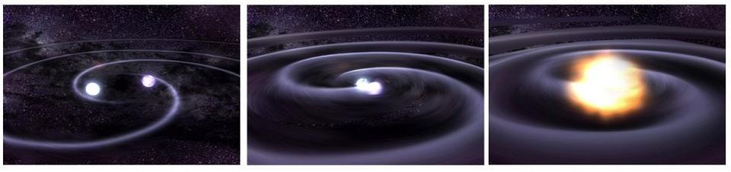
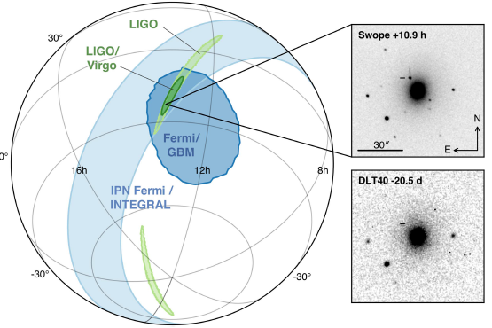
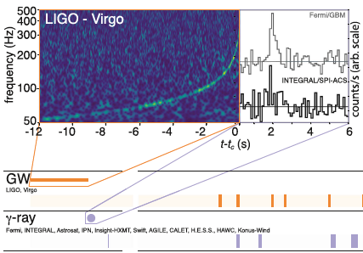
GW170817: Neutron Star Merger
GW170817A , announced 16.10.2017 *)
*) B.P. Abbott et al. [LIGO/Virgo Collab.], PRL 119, 161101 (2017); ApJLett 848, L12 (2017)

Slide 27
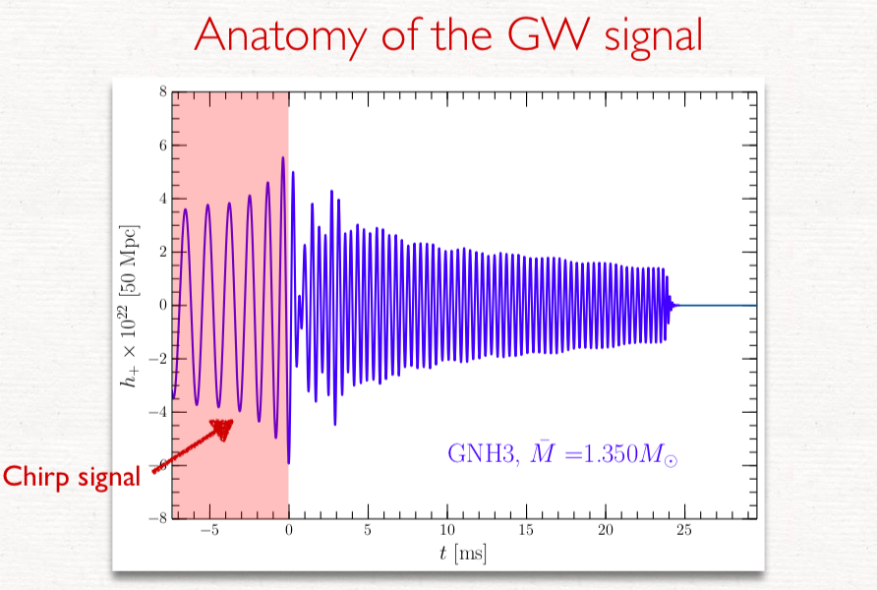

Slide 28
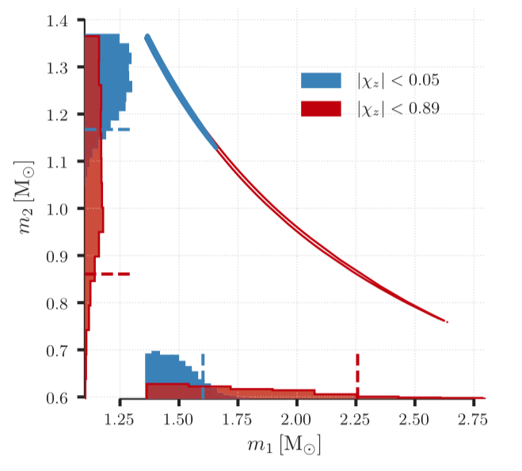
Implications from GW170817
GW170817: Observation of Gravitational Waves from a Binary Neutron Star Inspiral
B. P. Abbott et al. arXiv:1712.00451

Slide 29
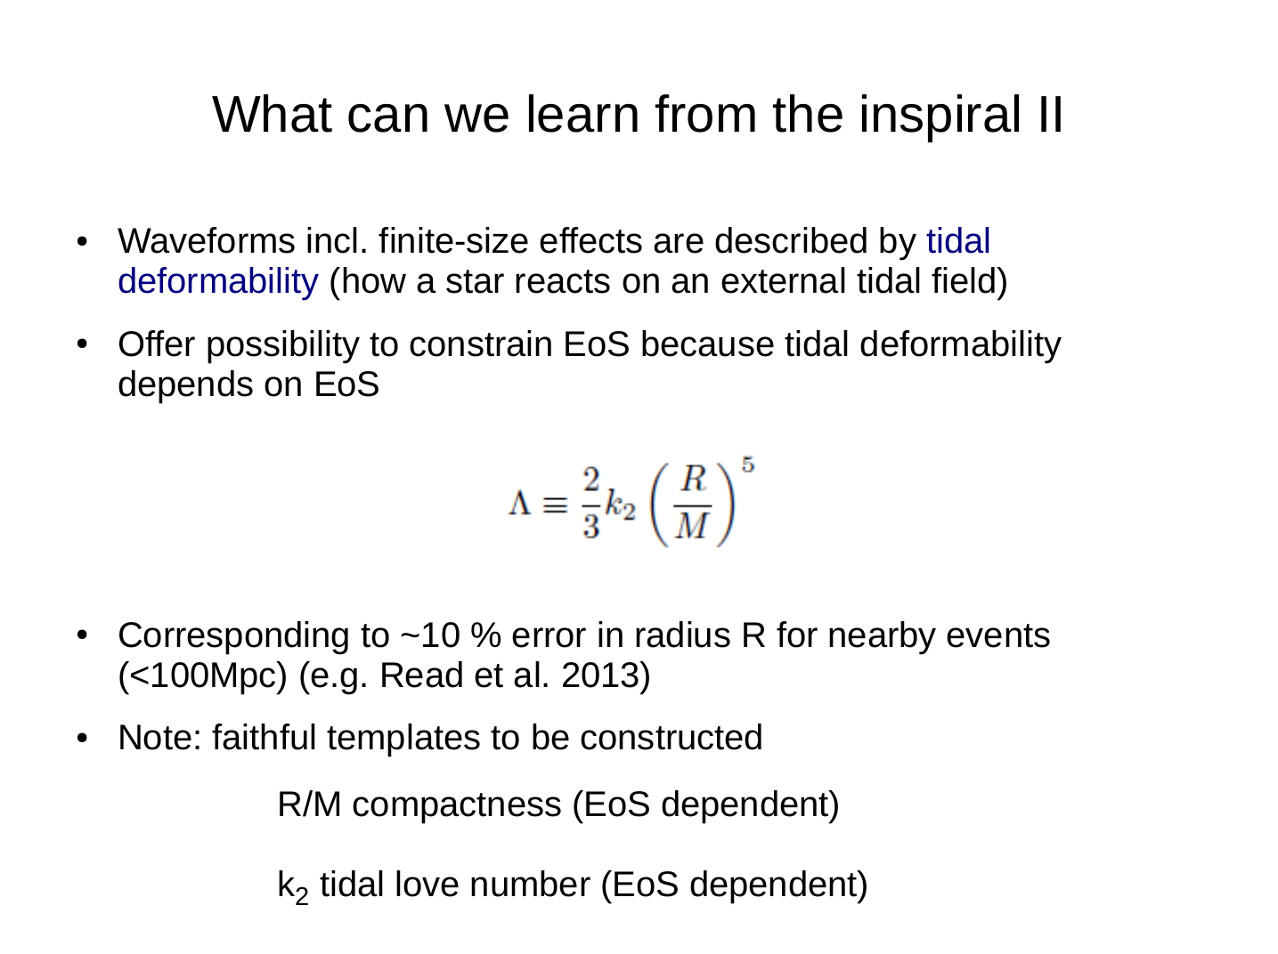

Slide 30
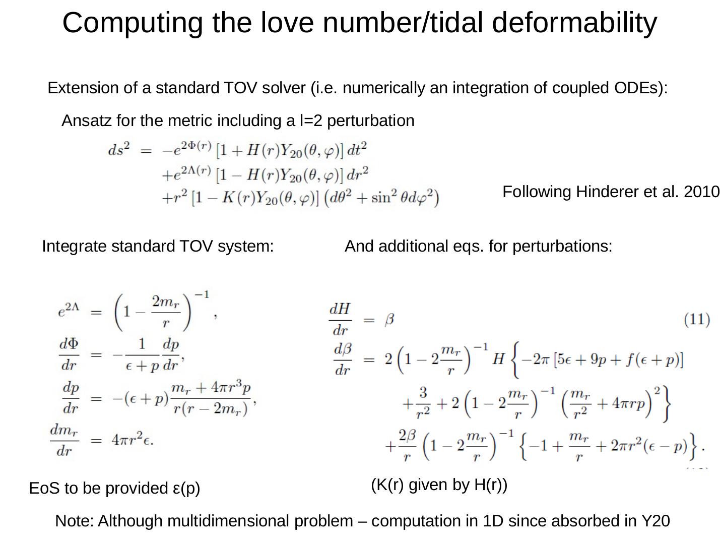

Slide 31

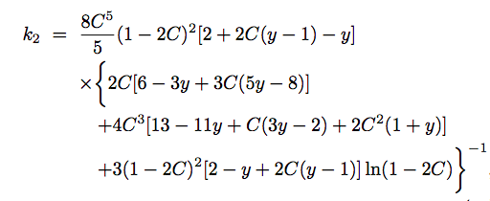
Love number

Slide 32
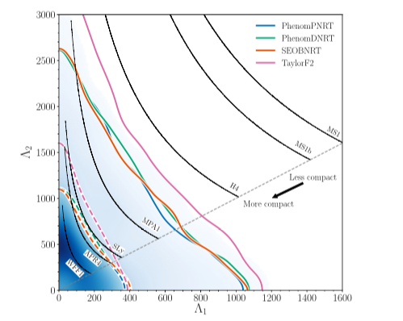
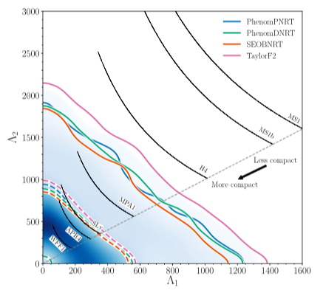
Implications from GW170817
Properties of the Binary Star Merger GW170817
B. P. Abbott et al., Phys. Rev. X 9, 011001 (2019)

Slide 33
Implications from GW170817
Vasileios Paschalidis, Kent Yagi, David Alvarez-Castillo,
David B. Blaschke, Armen Sedrakian
Phys. Rev. D 97, 084038 (2018), arXiv:1712.00451

Slide 34
Implications from GW170817
Vasileios Paschalidis, Kent Yagi, David Alvarez-Castillo,
David B. Blaschke, Armen Sedrakian
Phys. Rev. D 97, 084038 (2018), arXiv:1712.00451

Slide 35
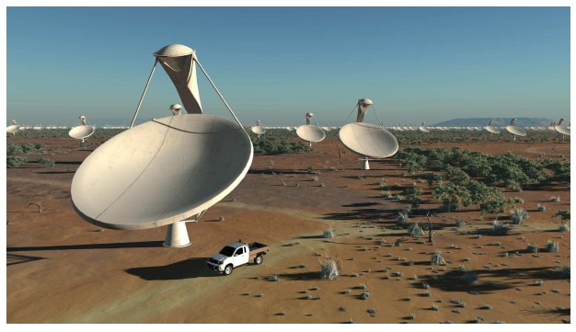
Perspectives for new Instruments?

Slide 36
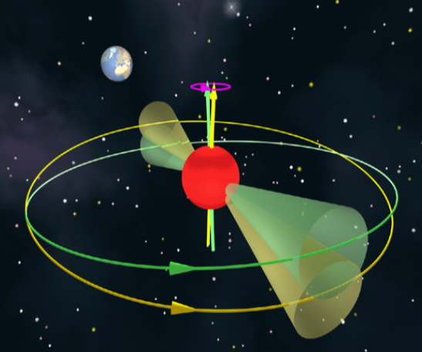
Measurement of Spin Precession of a Pulsar

Slide 37
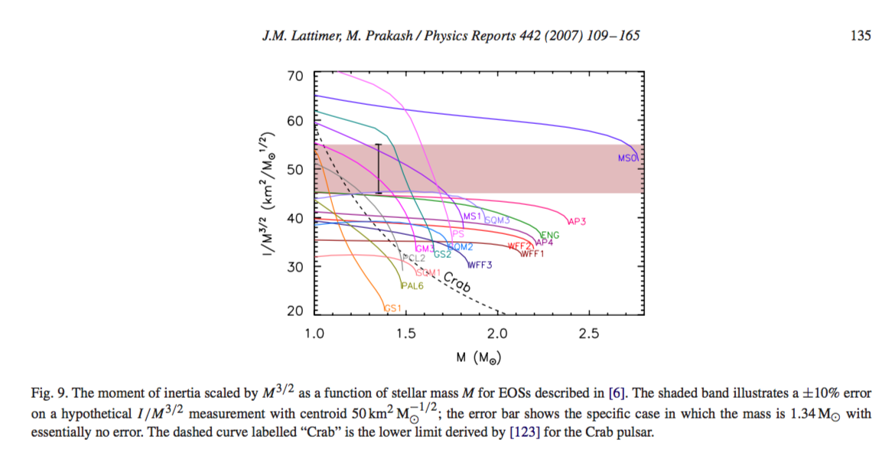
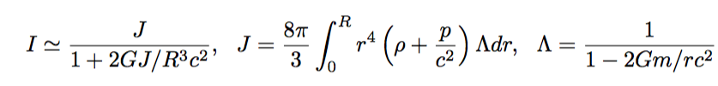
Moments of Inertia

Slide 38

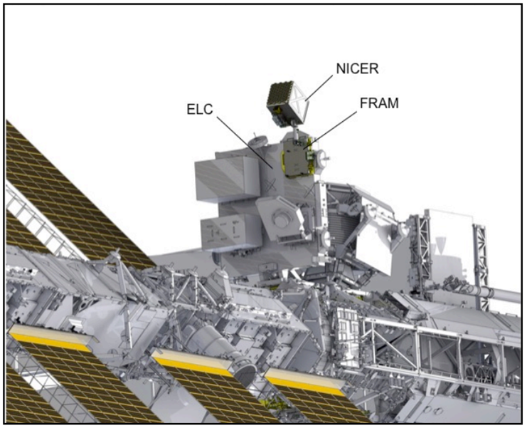
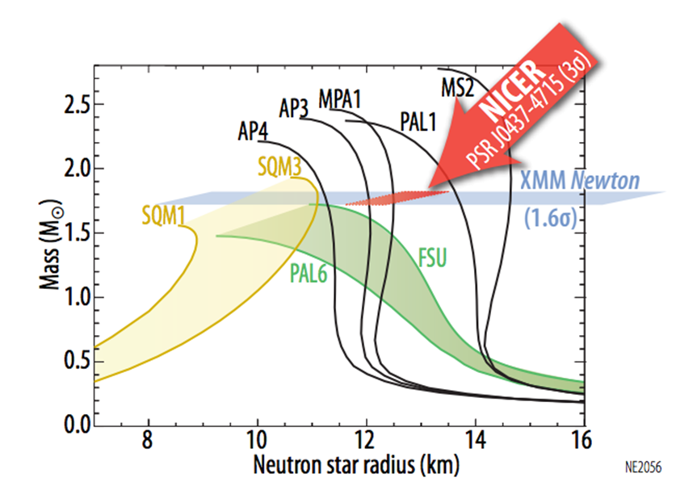
NICER 2017
Gendreau, K. C., Arzoumanian, Z., & Okajima, T. 2012, Proc. SPIE, 8443, 844313

Slide 39
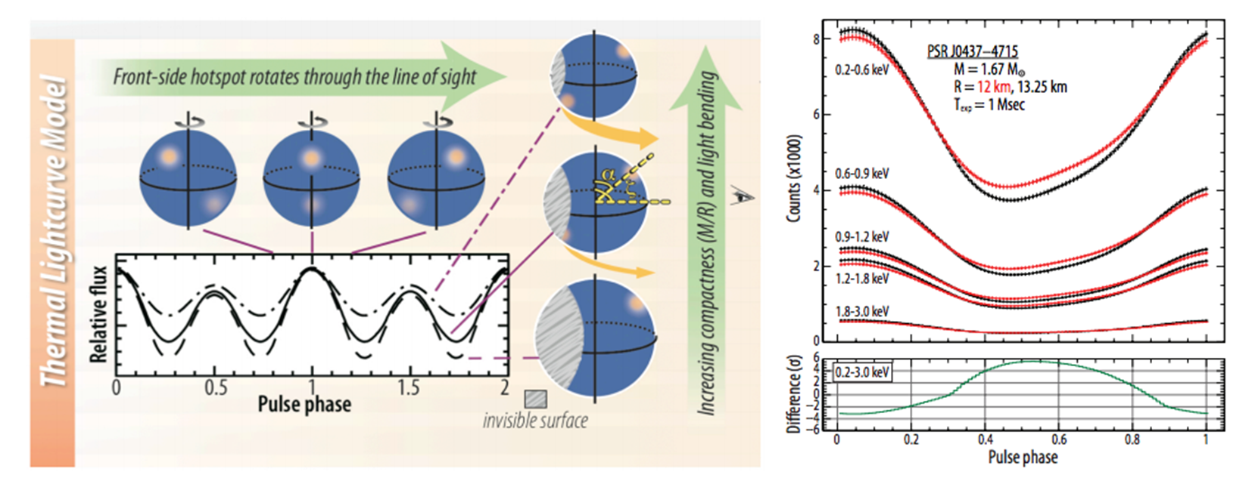
Hot Spots

Slide 40
Implications from GW170817
Nonlocal NJL
D. Alvarez-Castillo, D. Blaschke, G. Grunfeld, V. Pagura
Phys. Rev. D 99, 063010 (2019) - arXiv: 1805.04105

Slide 41
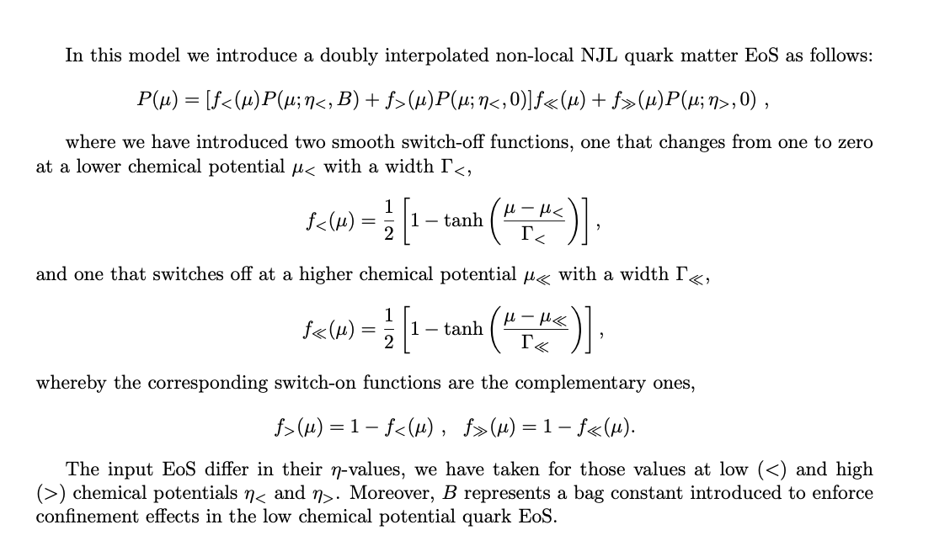
Nonlocal NJL
D. Alvarez-Castillo, D. Blaschke, G. Grunfeld, V. Pagura
Phys. Rev. D 99, 063010 (2019) - arXiv: 1805.04105

Slide 42
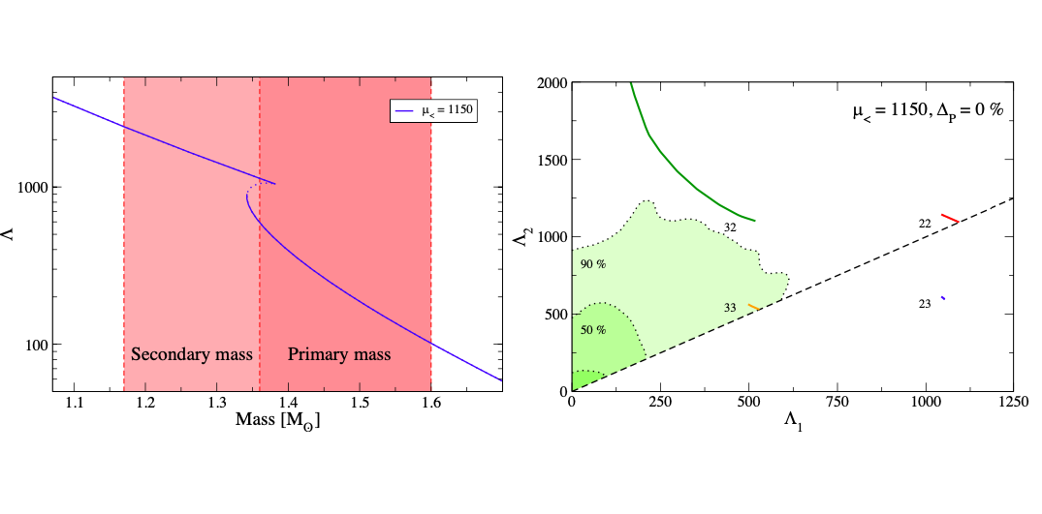
GW170817 - Nonlocal NJL
A. Ayriyan, D.Alvarez-Castillo, D. Blaschke and H. Grigorian,
in preparation
D. Alvarez-Castillo, D. Blaschke, G. Grunfeld, V. Pagura
Phys. Rev. D 99, 063010 (2019) - arXiv: 1805.04105

Slide 43
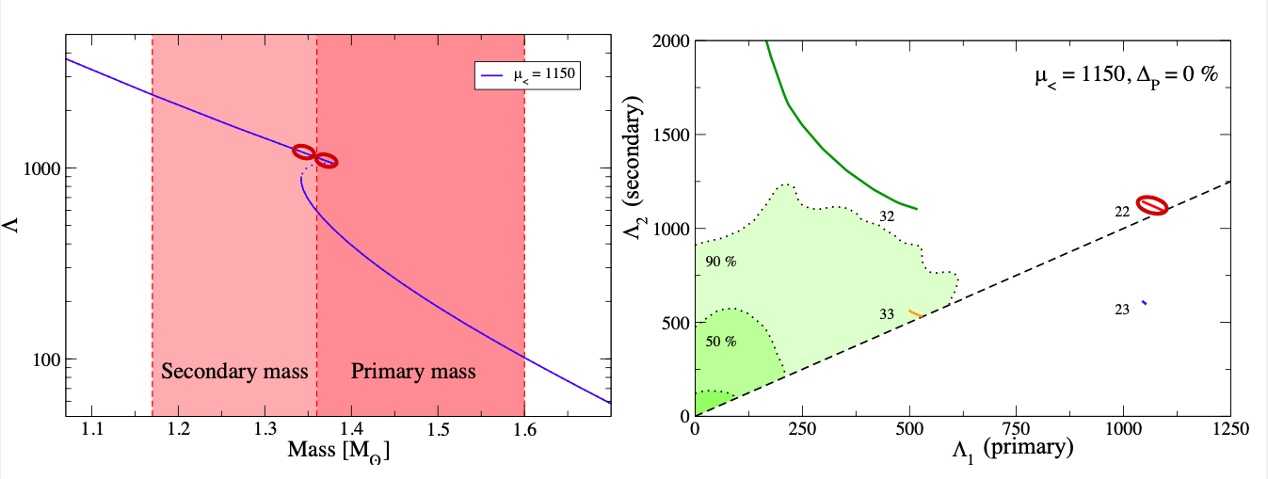
GW170817 - Nonlocal NJL
A. Ayriyan, D.Alvarez-Castillo, D. Blaschke and H. Grigorian,
in preparation
D. Alvarez-Castillo, D. Blaschke, G. Grunfeld, V. Pagura
Phys. Rev. D 99, 063010 (2019) - arXiv: 1805.04105

Slide 44
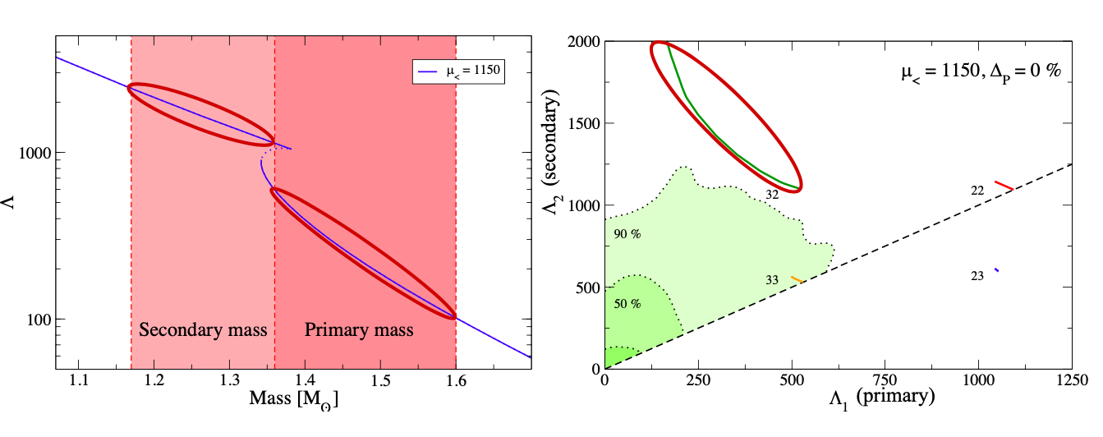
GW170817 - Nonlocal NJL
A. Ayriyan, D.Alvarez-Castillo, D. Blaschke and H. Grigorian,
in preparation
D. Alvarez-Castillo, D. Blaschke, G. Grunfeld, V. Pagura
Phys. Rev. D 99, 063010 (2019) - arXiv: 1805.04105

Slide 45

GW170817 - Nonlocal NJL
A. Ayriyan, D.Alvarez-Castillo, D. Blaschke and H. Grigorian,
in preparation
D. Alvarez-Castillo, D. Blaschke, G. Grunfeld, V. Pagura
Phys. Rev. D 99, 063010 (2019) - arXiv: 1805.04105

Slide 46

GW170817 - Nonlocal NJL
A. Ayriyan, D.Alvarez-Castillo, D. Blaschke and H. Grigorian,
in preparation
D. Alvarez-Castillo, D. Blaschke, G. Grunfeld, V. Pagura
Phys. Rev. D 99, 063010 (2019) - arXiv: 1805.04105

Slide 47
GW170817 - Nonlocal NJL
D. Alvarez-Castillo, D. Blaschke, G. Grunfeld, V. Pagura
Phys. Rev. D 99, 063010 (2019) - arXiv: 1805.04105

Slide 48


Gravitational Wave Signals
First Order Phase Transitions
A. Bauswein et al. - arXiv: 1904.01306, PRL 122 (2019) 061102

Slide 49
Conclusions
The equation of state at high densities must be effectively soft, either as a relatively soft hadronic one or a hybrid one with a strong phase transition.
Future GW observations, NICER and SKA will soon result into stronger NS EoS constraints probing the mass twins hypothesis.
Many possible astrophysical scenarios for mass twins could be confirmed implying a CEP in QCD.
Gracias

