Slide 1
ATS MD programs in Run 3
S. Fartoukh, S. Kostoglou & M. Solfaroli for the ATS MD team
Reminders (basic ATS principles and past MDs)
ATS optics development for Run 3
ATS optics development for LHC-2024 & HL-LHC

Slide 2
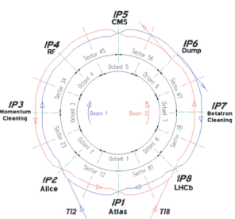

The basic principles of the ATS
A squeeze in 2 steps
1) An “almost” standard squeeze, the Pre-squeeze:
→ acting on the matching quads of IR1 and IR5,
→ with new matching constraints on the left/right IR phase
→ till reaching some limits (sextupoles, matching section).
2) A further reduction of β*, the Squeeze:
acting on IR2/8 for squeezing IR1 and IR4/6 for IR5,
inducing β-beating bumps in sectors 81/12/45/56 to boost
the sextupole (& octupole) efficiency at constant strength.
$$≝ {1/r}_{tele}:Telescopic index$$

Slide 3
Key achievements in Run 1 & Run 2
Run 1 : Demonstration of the key principles with probe beams (telescope, achromaticity, ..)
Run 2 (2017/2018):
High intensity tests (a few trains or more) with
  Round telescopic optics deployed in the squeeze (r_{tele}=3-4)
  Round telescopic optics deployed in the ramp (r_{tele}=3-4)
  Flat telescopic optics: β*=15/60 cm, r_{tele}=1 and r_{tele}=4 in the crossing and parallel separation planes, respectively
2) “Light” implementation of the ATS for LHC-OP (2017)
→ new inj. optics, telescopic squeeze from 40 cm down to 25 cm (r_{tele}=1.6)

Slide 4
ATS MD (in 2021) for Run 3 operation
→ LHC hypercycle for Run 3 (as of 2022) for high intensity operation (up to 1.8e11 p/bunch) including brand new features
Anti-telescopic optics deployed in the ramp for Landau damping efficiency (r_{tele}=1/2.5 with β*=1.5 EoR) and preparing the telescopic β* levelling
β* levelling in purely telescopic mode for AFP & PPS over a wide range (β*=1.5 m @ r_{tele}=1/2.5 down to β*=20 cm @ r_{tele}=3).
Crossing angle gymnastic for LHCb (optional, i.e. if not commissioned in 2021).
.. With all relevant studies needed: OP mechanics & optics correct-ability (2 shifts), collimation & machine protection (2 shifts), intensity ramp up & collective effects & beam-beam (2 shifts), contingency (1 shift)
→ 6-7 shifts needed

Slide 5
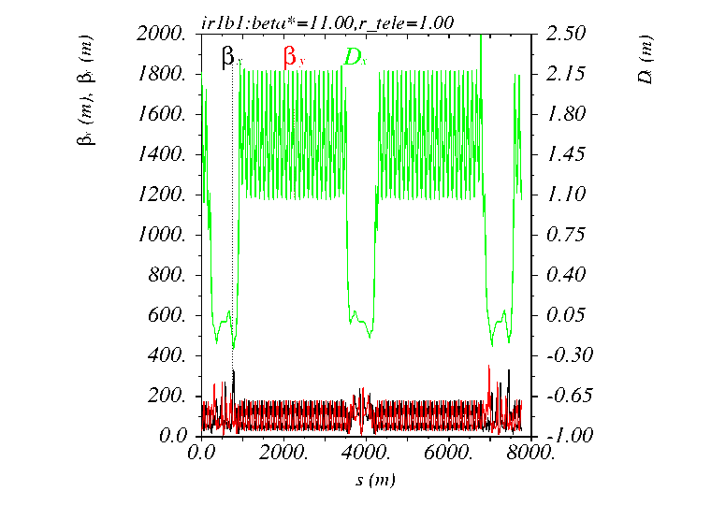
Ramp (2022):
  Pre-squeeze down to β*=1.5/10/1.5/1.5 m at IP1/2/5/8
  Combined Pre-squeeze and anti-tele squeeze at constant β* =1.5 m down to a tele-index of 0.40, i.e β*_{pre-squeeze} = 0.4×1.5=0.6 m
β∗ levelling in Tele mode from 1.5 m to 20 cm (28 cm @ 7 TeV from aperture constraint), i.e. r_{tele} = 0.4 → 3.0
IR8
IR1
IR2

Slide 6
First Ramp Prototype (compatible with 6.5 TeV)
Matched Point | Time [s] | Parab. fraction | Optics | Tele- Index | β* [m] at IP1 & 5 | β* [m] at IP2 | β* [m] at IP8 | Energy [GeV]
1 | 0 | 0.1 | R2022a_A11mC11mA10mL10m_test | 1.00 | 11.00 | 10.00 | 10.00 | 450.0
1 | 15 | 0.05 | R2022a_A11mC11mA10mL10m_test | 1.00 | 11.00 | 10.00 | 10.00 | 452.2
1 | 30 | 0.05 | R2022a_A11mC11mA10mL10m_test | 1.00 | 11.00 | 10.00 | 10.00 | 459.0
1 | 45 | 0.05 | R2022a_A11mC11mA10mL10m_test | 1.00 | 11.00 | 10.00 | 10.00 | 470.2
1 | 60 | 0.05 | R2022a_A11mC11mA10mL10m_test | 1.00 | 11.00 | 10.00 | 10.00 | 486.0
1 | 90 | 0.05 | R2022a_A11mC11mA10mL10m_test | 1.00 | 11.00 | 10.00 | 10.00 | 530.9
1 | 120 | 0.05 | R2022a_A11mC11mA10mL10m_test | 1.00 | 11.00 | 10.00 | 10.00 | 593.9
1 | 160 | 0.05 | R2022a_A11mC11mA10mL10m_test | 1.00 | 11.00 | 10.00 | 10.00 | 705.6
1 | 241 | 0.05 | R2022a_A11mC11mA11mL10m_test | 1.00 | 11.00 | 10.00 | 10.00 | 1012.8
2 | 267 | 0.16 | R2022a_A10mC10mA10mL10m_test | 1.00 | 10.00 | 10.00 | 10.00 | 1137.4
3 | 303 | 0.13 | R2022a_A960cmC960cmA10mL960cm_test | 1.00 | 9.60 | 10.00 | 9.60 | 1335.0
4 | 319 | 0.16 | R2022a_A910cmC910cmA10mL910cm_test | 1.00 | 9.10 | 10.00 | 9.10 | 1427.6
5 | 343 | 0.18 | R2022a_A830cmC830cmA10mL830cm_test | 1.00 | 8.30 | 10.00 | 8.30 | 1566.6
6 | 367 | 0.18 | R2022a_A710cmC710cmA10mL710cm_test | 1.00 | 7.10 | 10.00 | 7.10 | 1705.6
7 | 387 | 0.16 | R2022a_A590cmC590cmA10mL590cm_test | 1.00 | 5.90 | 10.00 | 5.90 | 1821.4
8 | 407 | 0.16 | R2022a_A490cmC490cmA10mL490cm_test | 1.00 | 4.90 | 10.00 | 4.90 | 1937.2
9 | 427 | 0.18 | R2022a_A410cmC410cmA10mL410cm_test | 1.00 | 4.10 | 10.00 | 4.10 | 2053.0
10 | 449 | 0.18 | R2022a_A330cmC330cmA10mL330cm_test | 1.00 | 3.30 | 10.00 | 3.30 | 2180.4
11 | 469 | 0.20 | R2022a_A260cmC260cmA10mL260cm_test | 1.00 | 2.60 | 10.00 | 2.60 | 2296.2
12 | 490 | 0.20 | R2022a_A210cmC210cmA10mL210cm_test | 1.00 | 2.10 | 10.00 | 2.10 | 2417.8
13 | 530 | 0.20 | R2022a_A170cmC170cmA10mL170cm_test | 1.00 | 1.70 | 10.00 | 1.70 | 2649.5
14 | 595 | 0.20 | R2022a_A150cmC150cmA10mL150cm_ind-1_test | 1.00 | 1.50 | 10.00 | 1.50 | 3025.9
15 | 697 | 0.20 | R2022a_A150cmC150cmA10mL150cm_ind-1-17_test | 1.17 | 1.50 | 10.00 | 1.50 | 3616.5
16 | 756 | 0.21 | R2022a_A150cmC150cmA10mL150cm_ind-1-33_test | 1.33 | 1.50 | 10.00 | 1.50 | 3958.2
17 | 845 | 0.20 | R2022a_A150cmC150cmA10mL150cm_ind-1-53_test | 1.53 | 1.50 | 10.00 | 1.50 | 4473.6
18 | 942 | 0.22 | R2022a_A150cmC150cmA10mL150cm_ind-1-86_test | 1.86 | 1.50 | 10.00 | 1.50 | 5035.3
19 | 1067 | 0.21 | R2022a_A150cmC150cmA10mL150cm_ind-2-24_test | 2.24 | 1.50 | 10.00 | 1.50 | 5759.1
20 | 1181 | 0.21 | R2022a_A150cmC150cmA10mL150cm_ind-2-50_test | 2.50 | 1.50 | 10.00 | 1.50 | 6419.3
20 | 1210 | 0.05 | R2022a_A150cmC150cmA10mL150cm_ind-2-50_test | 2.50 | 1.50 | 10.00 | 1.50 | 6500.0
Constant optics
Pre-squeeze
Anti-Tele-squeeze

Slide 7
Timing table for the squeeze (β*-levelling):
7.0 TeV version
10 optics from 1.5 m down to 30 cm (~ aperture limit at 160 μrad half crossing angle) in a purely telescopic mode
Which optics will deserve state of the art optics correction and MP validation is not yet decided: all, or a subset ??
All IPQ settings compatible with present limits except RQ7.L8B1 @ 5391 A vs. IPNO=5390A (+50 A margin ..)
Matched Point | Time [s] | Parab. fraction | Optics | Tele- Index | β* [m] at IP1 & 5 | β* [m] at IP2 | β* [m] at IP8 | Energy [GeV]
1 | 0 | 0.00 | R2022a_A150cmC150cmA10mL150cm_ind-2-50_test | 2.50 | 1.50 | 10.00 | 1.50 | 7000.0
2 | 98 | 0.39 | R2022a_A133cmC133cmA10mL150cm_ind-2-22_test | 2.22 | 1.33 | 10.00 | 1.50 | 7000.0
3 | 189 | 0.38 | R2022a_A116cmC116cmA10mL150cm_ind-1-93_test | 1.93 | 1.16 | 10.00 | 1.50 | 7000.0
4 | 273 | 0.38 | R2022a_A100cmC100cmA10mL150cm_ind-1-67_test | 1.67 | 1.00 | 10.00 | 1.50 | 7000.0
5 | 357 | 0.38 | R2022a_A84cmC84cmA10mL150cm_ind-1-40_test | 1.40 | 0.84 | 10.00 | 1.50 | 7000.0
6 | 431 | 0.39 | R2022a_A71cmC71cmA10mL150cm_ind-1-18_test | 1.18 | 0.71 | 10.00 | 1.50 | 7000.0
7 | 533 | 0.41 | R2022a_A60cmC60cmA10mL150cm_ind-1-00_test | 1.00 | 0.60 | 10.00 | 1.50 | 7000.0
8 | 633 | 0.32 | R2022a_A51cmC51cmA10mL150cm_ind-0-85_test | 0.85 | 0.51 | 10.00 | 1.50 | 7000.0
9 | 721 | 0.32 | R2022a_A43cmC43cmA10mL150cm_ind-0-72_test | 0.72 | 0.43 | 10.00 | 1.50 | 7000.0
10 | 801 | 0.33 | R2022a_A36cmC36cmA10mL150cm_ind-0-60_test | 0.60 | 0.36 | 10.00 | 1.50 | 7000.0
11 | 878 | 0.36 | R2022a_A30cmC30cmA10mL150cm_ind-0-50_test | 0.50 | 0.30 | 10.00 | 1.50 | 7000.0
12 | 954 | 0.38 | R2022a_A25cmC25cmA10mL150cm_ind-0-42_test | 0.42 | 0.25 | 10.00 | 1.50 | 7000.0
13 | 1028 | 0.43 | R2022a_A22cmC22cmA10mL150cm_ind-0-37_test | 0.37 | 0.22 | 10.00 | 1.50 | 7000.0
14 | 1115 | 0.43 | R2022a_A20cmC20cmA10mL150cm_ind-0-33_test | 0.33 | 0.20 | 10.00 | 1.50 | 7000.0

Slide 8
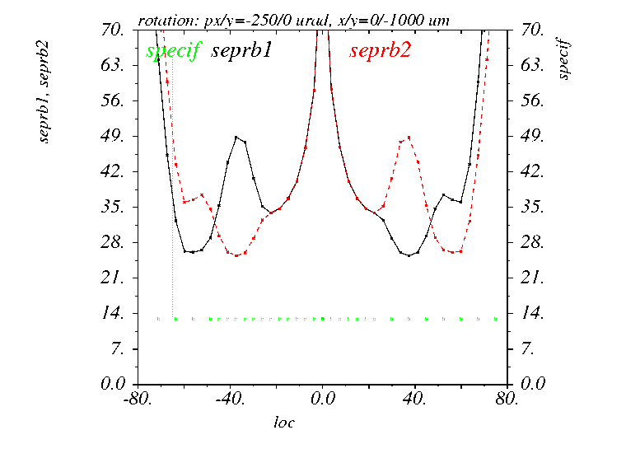
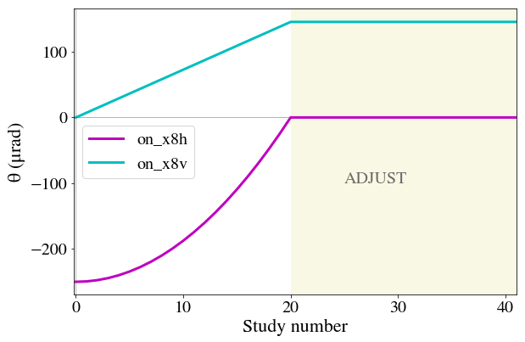
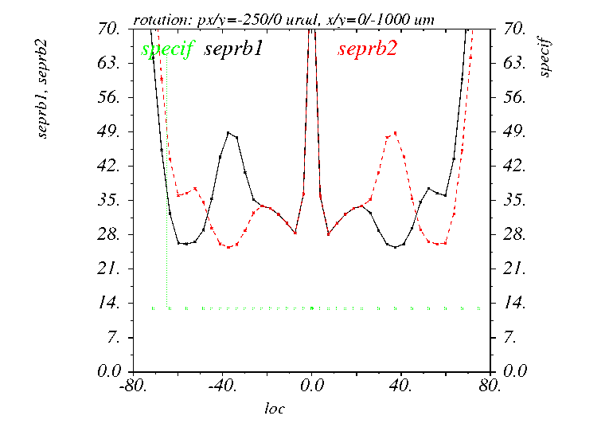
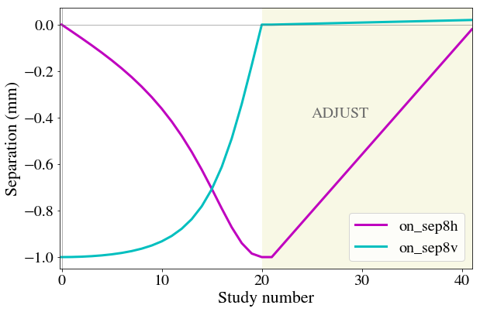
Ad-hoc: crossing angle rotation in LHCb (EoR)
IR8 crossing bump gymnastic at flat top:
one single beam process (suitable for both LHCb polarity) to rotate the external crossing angle from H to V
For negative LHCb polarity
13 σ
For positive LHCb polarity
13 σ

Slide 9
ATS MD (in 2022-2023) for LHC24
& HL-LHC
→ Further gain experience with flat optics as an eventual optics candidate for 2024 [IT life time] with β∗= 60/15 cm, i.e.
r_{tele}=1 & r_{tele}=4 in the X and || planes for 60 cm pre-squeezed β*.
Via a continuous extension of the above, mimic the HL-LHC back up plan with telescopic flat optics [β∗= 30/7.5 cm] with
r_{tele}=1.7 & r_{tele}=6.7 in the X and || planes, respectively
[e.g. realized with β∗= 60/15 cm but a pre-squeezed β* relaxed to1 m]
Typically 8 shifts

