Slide 1
Feasibility study on Measurements of the
Multi-charmed hadron production in Pb+Pb collisions at the LHC fixed target energy
Speaker: Jungeol Kim (from Yonsei University)

Slide 2
[Contents]
  Physical Goals
  Experimental characteristics for Multi-charmed hadrons
  Detector Geometry
  Resolution (First Shots)
  Acceptance
  Pattern recognition in the High-multiplicity events
  Tracking Efficiency
  Summary and Plans

Slide 3
1. Physical Goals
Charm production predicted by the Perturbative QCD.
Limited measurements reported for Multi-charmed hadrons.
Enhanced production in the heavy ion collisions when compared with p+p reactions. → No measurements done so far due to the large backgrounds.
Possible enhancement mechanisms behind will be of utmost interests.

Slide 4
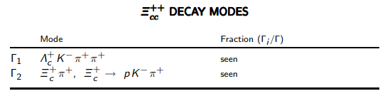
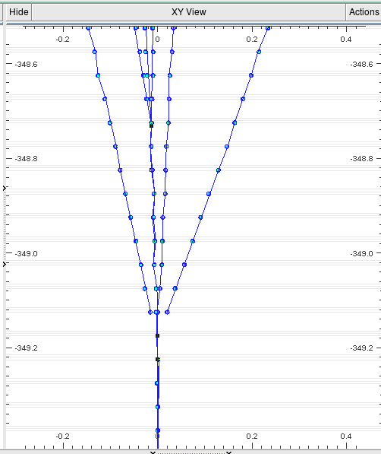
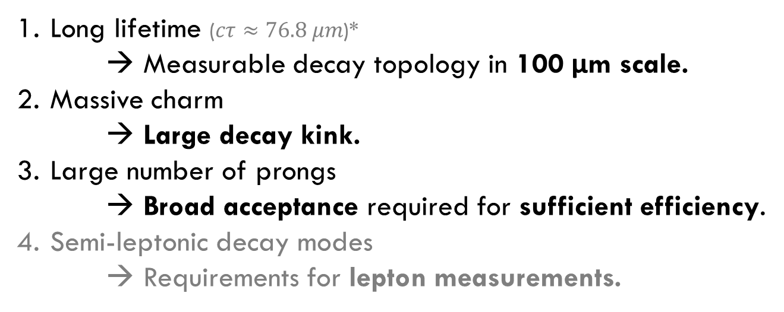



2. Experimental characteristics for Multi-charmed hadrons
Decay vertex demo using PYTHIA
from PDG 2019
Long lifetime ($cτ≈76.8 μm$)*
→ Measurable decay topology in 100 μm scale.
Massive charm
→ Large decay kink.
Large number of prongs
→ Broad acceptance required for sufficient efficiency.
Semi-leptonic decay modes
→ Requirements for lepton measurements.
$$pπ^{+}K^{−}$$
$$Λ_{c}^{+}$$
$$Ξ_{cc}^{++}$$
XY Plane x20
* from LHCb Measurement in 2018, https://arxiv.org/abs/1806.02744

Slide 5
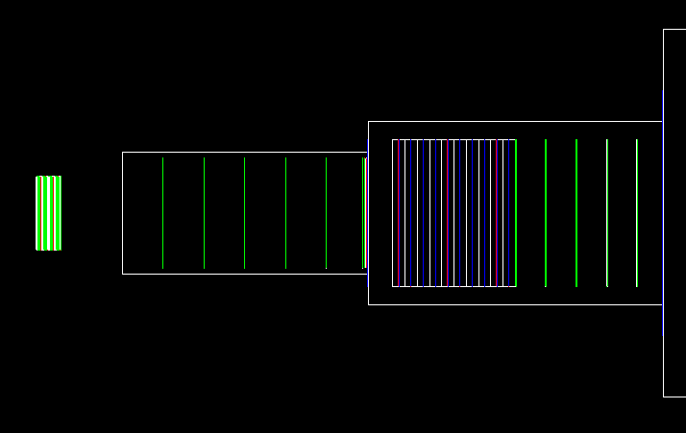
3. Detector Geometry
MUID
TRID
TACT
TRAC
Beam Axis
Momentum Spectrometer
with B field (3 Tesla)
Vertexing
Lepton Identification
All measurement layers are the Silicon MAPS.
TRAC: Total 1 meter, 18 Layers (~ 1/100 Radiation length) for decent momentum resolution.

Slide 6
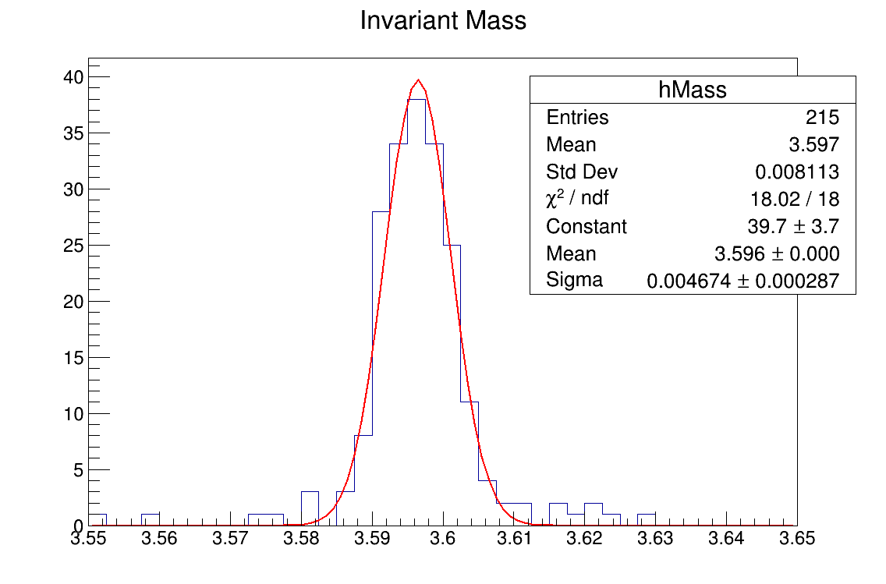

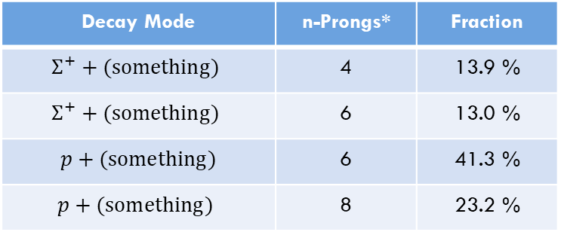
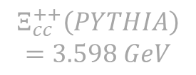
4. Resolution: Invariant Mass for $Ξ_{cc}^{++}$ (Fully Charged Modes)
$$Ξ_{cc}^{++}\left(PYTHIA\right)$$
$$=3.598 GeV$$
Fully Charged & Hadronic Mode at TRAC
Decay Mode | n-Prongs* | Fraction
$$Σ^{+}+(something)$$ | 4 | 13.9 %
$$Σ^{+}+(something)$$ | 6 | 13.0 %
$p+(something)$ | 6 | 41.3 %
$$p+(something)$$ | 8 | 23.2 %
$$σ_{mass}=4.674 MeV$$
* : # of Charged Tracks at TRAC
Mass (GeV)
Mass reconstruction (First Shot) from 4 dominant decay modes: (Some baryon) + ($πK$ tracks)
for successfully reconstructed events only

Slide 7
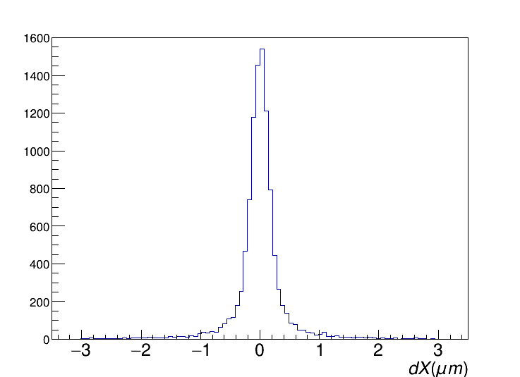
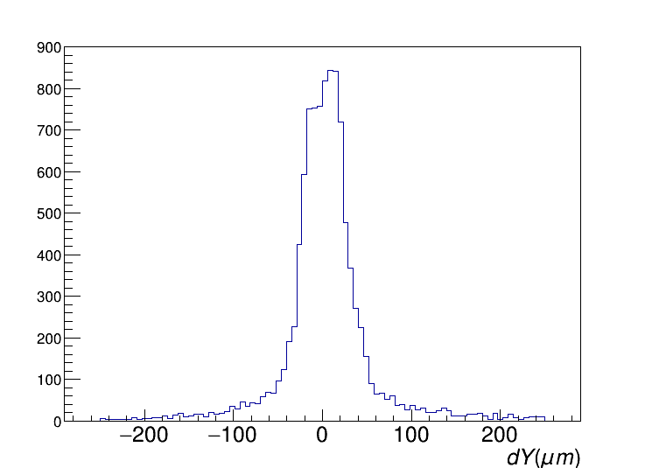
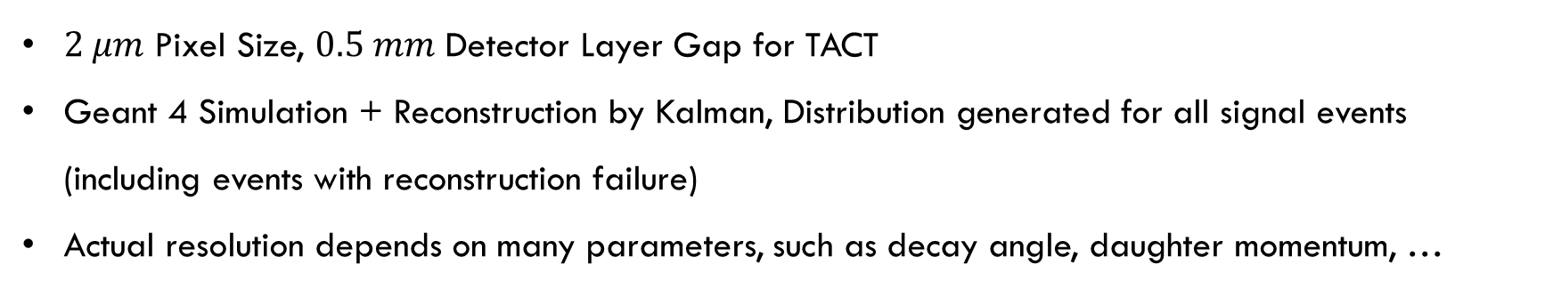
4. Resolution: Vertex Reconstruction at TACT (First Shot)
Lateral
Longitudinal
$2 μm$ Pixel Size, $0.5 mm$ Detector Layer Gap for TACT
Geant 4 Simulation + Reconstruction by Kalman, Distribution generated for all signal events
(including events with reconstruction failure)
Actual resolution depends on many parameters, such as decay angle, daughter momentum, …

Slide 8
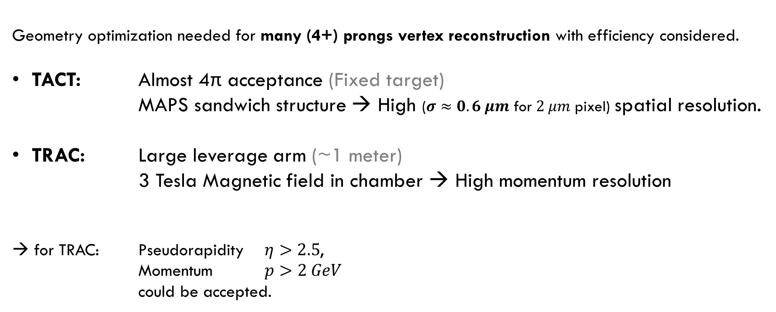
5. Acceptance
Geometry optimization needed for many (4+) prongs vertex reconstruction with efficiency considered.
TACT: Almost 4π acceptance (Fixed target)
MAPS sandwich structure → High ($σ≈0.6 μm$ for $2 μm$ pixel) spatial resolution.
TRAC: Large leverage arm (~1 meter)
3 Tesla Magnetic field in chamber → High momentum resolution
→ for TRAC: Pseudorapidity $η>2.5$,
Momentum $p>2 GeV$
could be accepted.
45 cm
135 cm

Slide 9
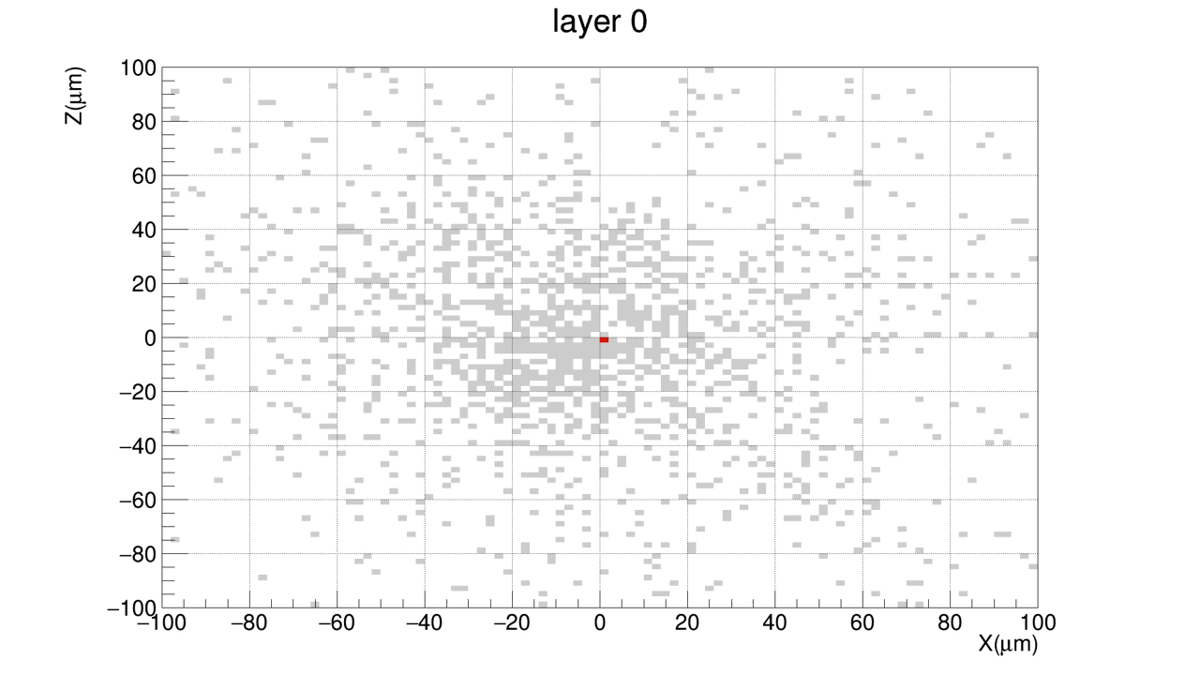
Special condition formed in heavy-ion reactions
Pixel Classification Occupied by hit (background) $\text{Occupied} \text{by} \text{hit}\text{ (}\text{signal}\text{)}$
High Occupancy around the Beam axis + Huge background prongs

Slide 10
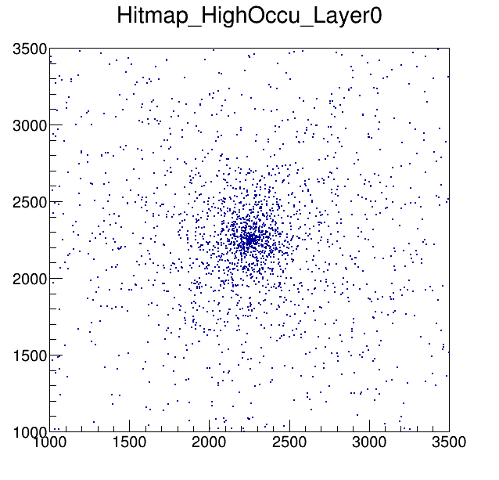
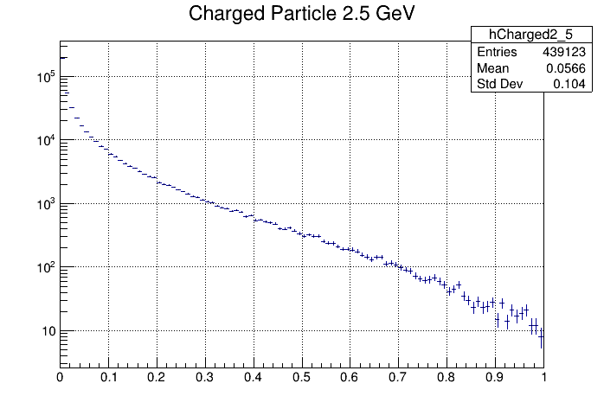

6. Pattern recognition in the High-multiplicity events
using 2.5 TeV, PYTHIA6 MSEL2, non-elastic, 400 overlapping p+p events
Fired hits on the first plane of TRAC
$$dN/dθ$$
Angle (radian)
2500 px = 5 mm

Slide 11




6. Pattern recognition in the High-multiplicity events
TACT
TRAC
$$1 m$$
3 Tesla
Gap
$$25 cm$$
#0
#1
#2
#3
#4
#5
#6
Nominal Interaction Position
= Center of TACT
$$6×\left(2 Layers Station\right)+1×\left(6 Layers Station\right)$$
TRAC Segment
Station
Overall detector is divided into few conceptual parts.
→ Step-by-step tracking: from #6 to #0 and TACT.
Gap between TRAC and TACT for suppressing lateral track density.
Each sensor gaps at TRAC Segment determined to optimize:
Tracking efficiency/time and Track bending measurement.
$$0.8 cm$$
Sensor Gap
$$500μm$$

Slide 12
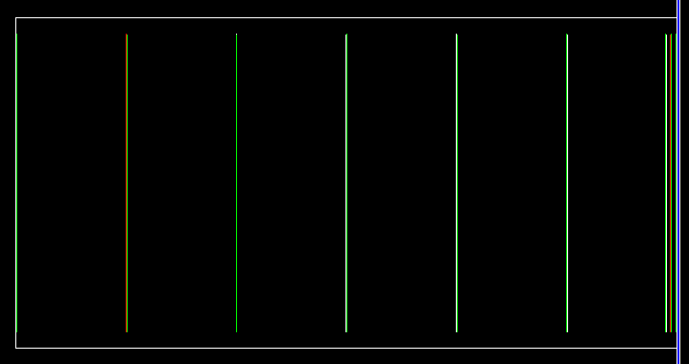
6. Pattern recognition in the High-multiplicity events
Tracking strategy (at TRAC)
Starting from last 6 planes of TRAC,
Find "Track segment" (composed of 6 hits).
Using Track segment, Find "Helix seed"
(Helix Candidates)
Project to upstream plane and associate rest hits,
Form complete helix for TRAC.
(using Kalman filter)
For high occupancy region, Load hitmap on memory for fast calculation.
① Divide into sub-detector (hitmap) for TRAC plane
② Find
Track Segment
④ Associate hits on rest planes,
form Helix
③ Find
Helix seed
TRAC

Slide 13
7. Tracking Efficiency
"Track Segment" reconstruction
99.9% reconstruction efficiency, with 10% background (ghost) segments for A+A event.
Total run-time within 80 seconds.
"Helix seed" reconstruction
For individual p+p events, high reconstruction efficiency with 0.5% background.
Now in progression for optimizing ghost rejection criteria and reconstruction efficiency.

Slide 14
8. Summary and Plans
We've decided tracking strategy, and currently on the track segment finding and helix-seed finding step with the optimized detector geometry.
Overall tracking seems to be feasible even in the high-multiplicity events.
Now in working for full helix reconstruction in TRAC (including cut optimization).
Planned to complete TACT vertex reconstruction and feasibility study for hadronic decay modes of multi-charmed hadron in following 6 months.

