Slide 1

Properties of new type MRPC with $C_{2}F_{4}H_{2}$ 100%
2020 KoALICE WorkShop
GWNU
Kyounghyoun Kwon

Slide 2
Contents
Chamber Building
(double stack total 8 gaps with PCB)
How to measure without NINO
(perform with Oscilloscope)
Result
(Gas shielding, Efficiency)

Slide 3
Material
Glass(400um)
PCB(1.6mm, 0.8mm)
Mylar(175um) for insulation
Fishing line(250um) with screw
Kepton tape for insulation
Gas Tube to make flush gas evenly into the chamber

Slide 4
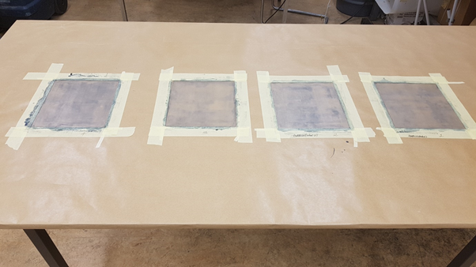
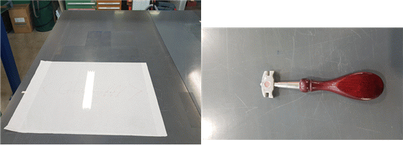
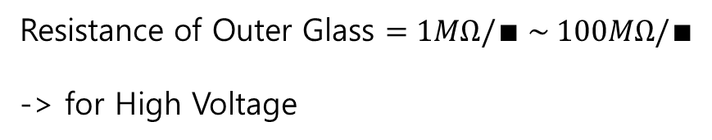
Glass(Resistive Plate)
400um Glass and Glass knife
Resistance of Outer Glass $=1MΩ/∎ \sim 100MΩ/∎$
-> for High Voltage

Slide 5
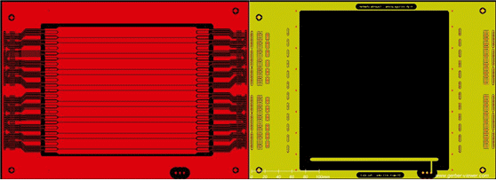
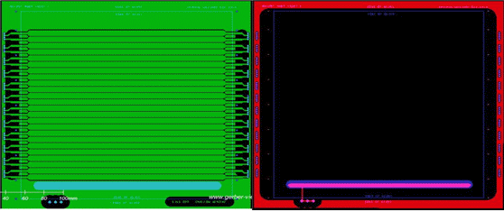
Strip type Readout PCB
Three kinds of PCB
ANODE(contain NINO connector part)
CATHODE(different strip line)
EMPTY(same as CATHODE but not-printed only drill)
Open masked area↑

Slide 6
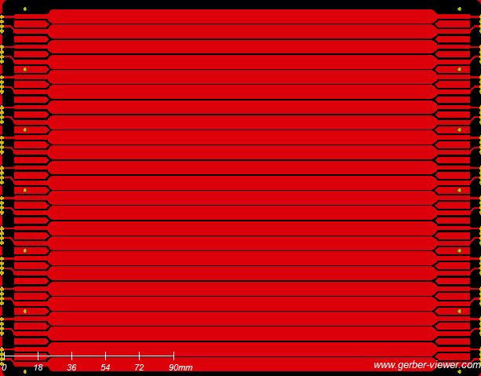
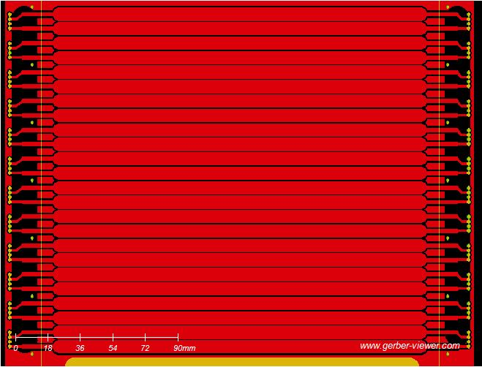
Strip line
ANODE
CATHODE
Strip line of Cathode is shifted
Notes:
1번이 ANODE 2번이 CATHODE strip line

Slide 7
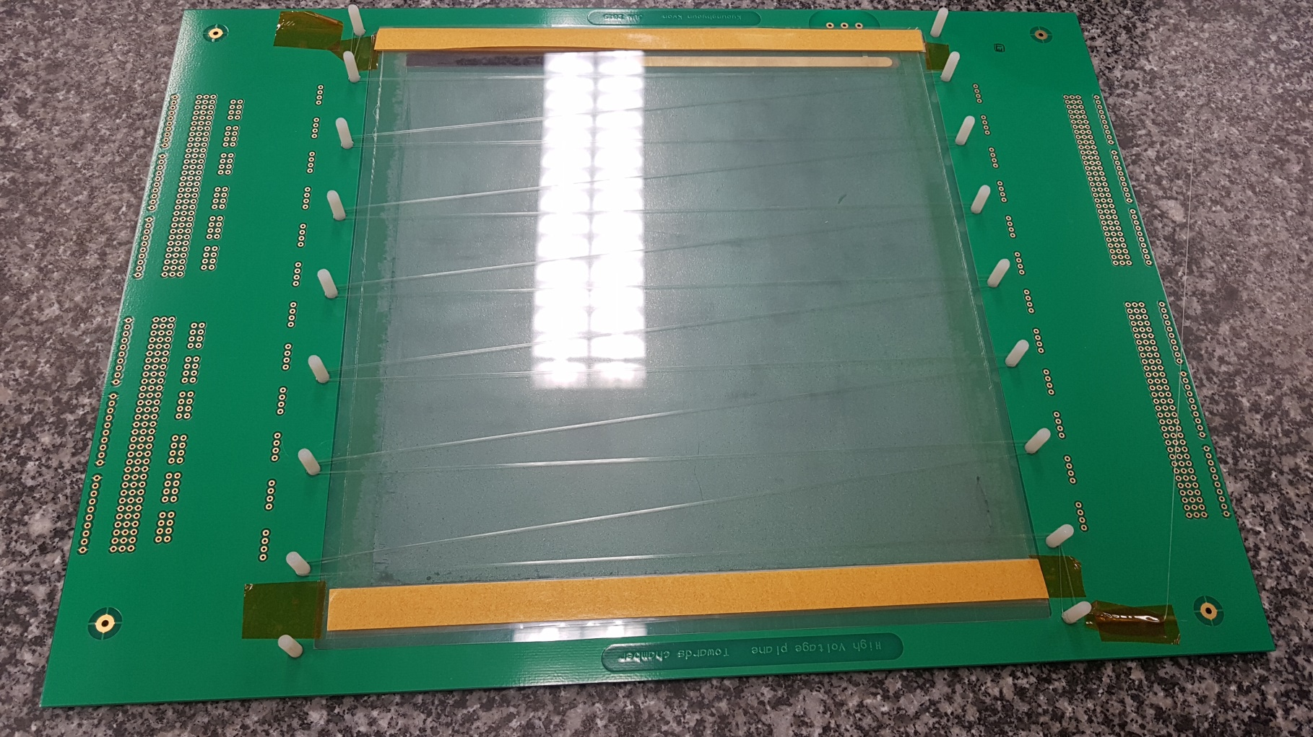
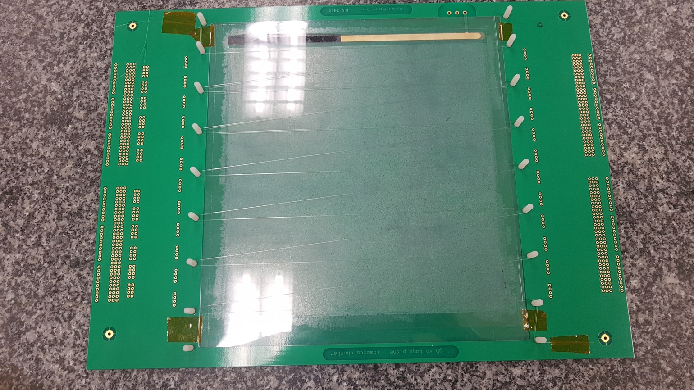
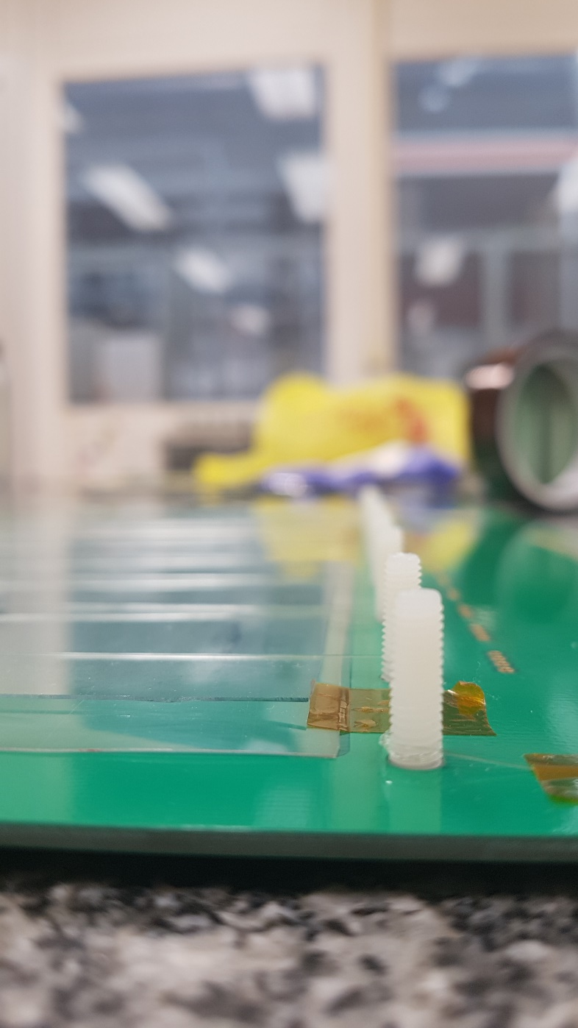
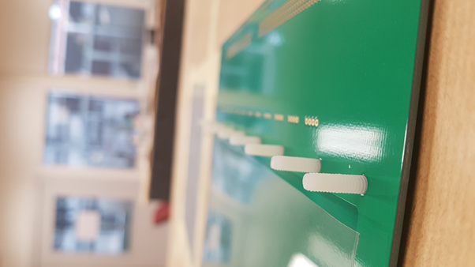
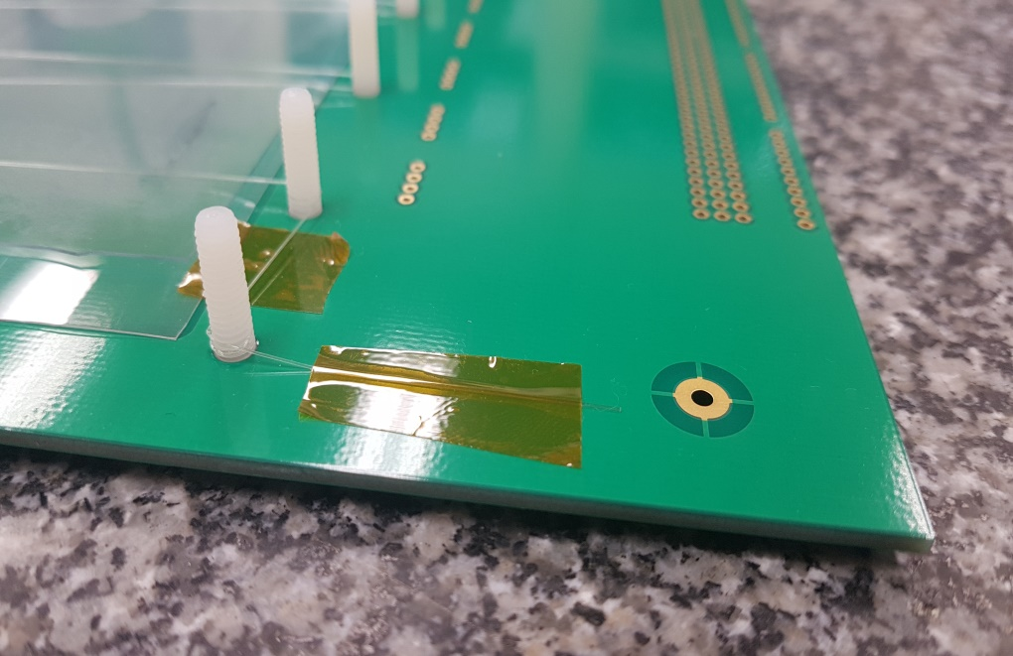
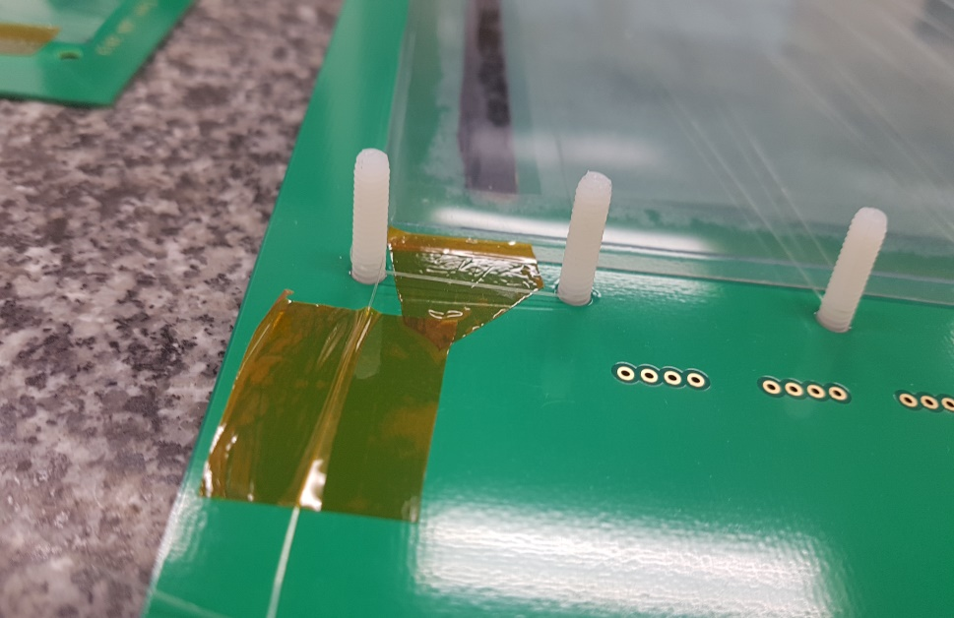
Building
Hang the fishing line on the screw
Tape the Starting and End point of the fishing line keep tension
Put the Outer Glass and to Connect painted surface with the HV line
Attach the Mylar to both ends of the glass with a yellow tape
Put mylar on the PCB and insert the screw

Slide 8
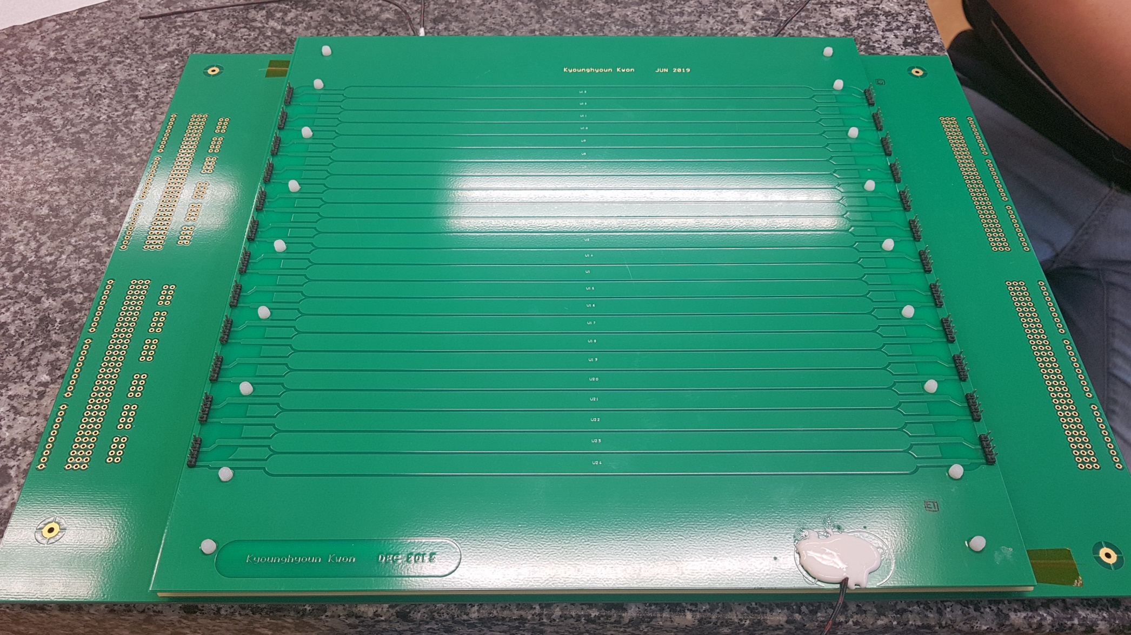
Completed Gap

Slide 9
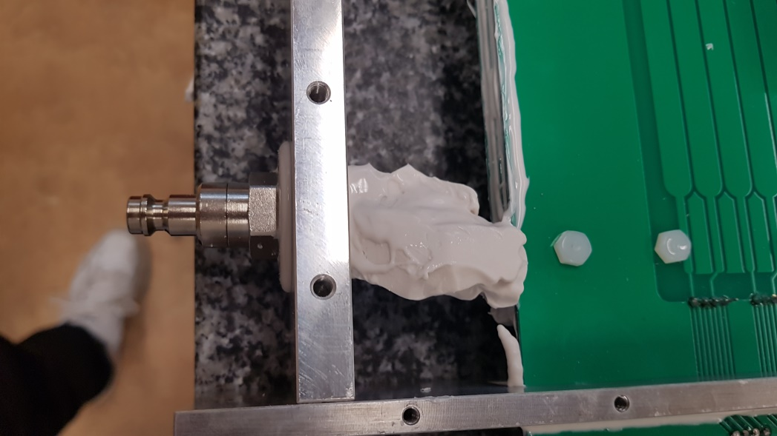
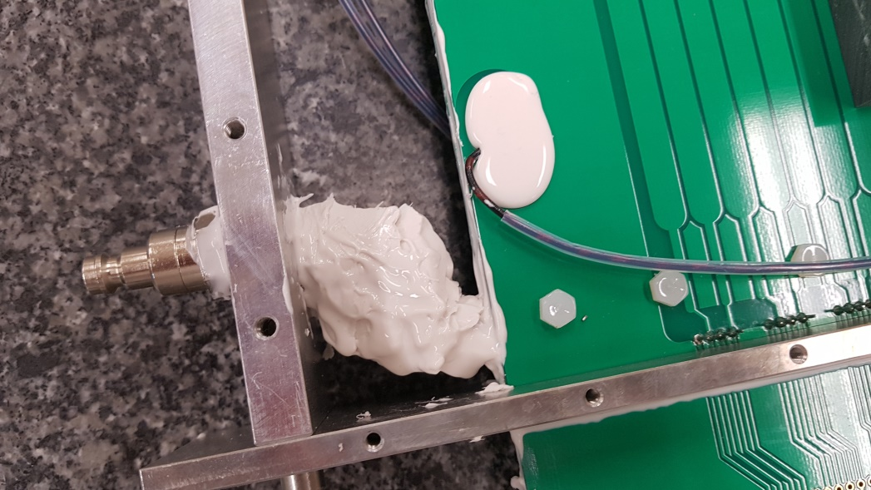
Gas tube connected with Gas connector

Slide 10
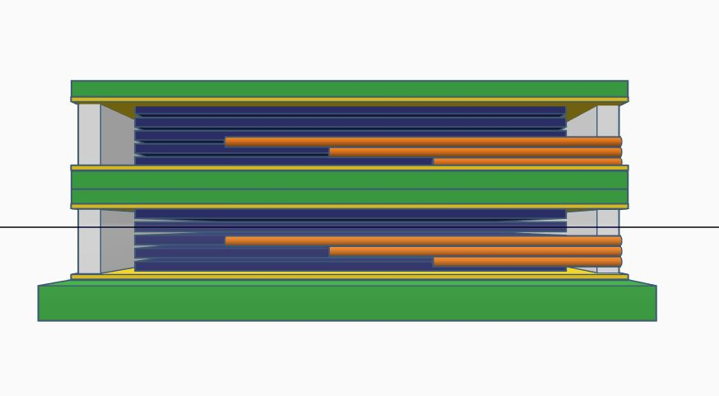
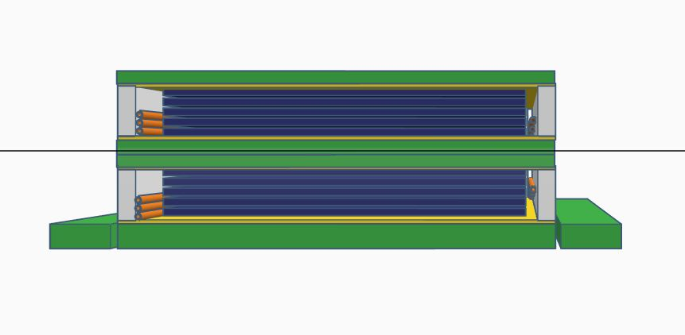
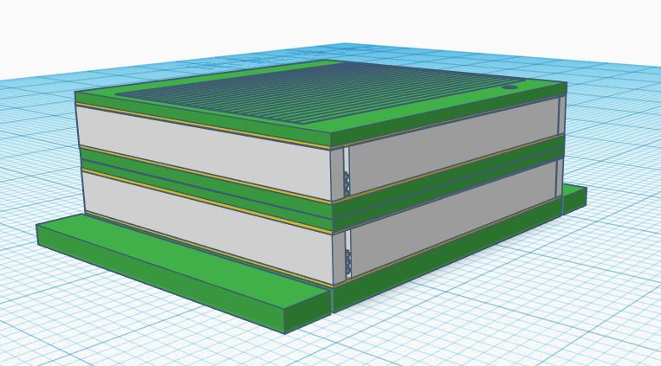
3D model
Orange color = gas tube inside of the chamber
-> flush the gas into the chamber
The length of the gas tube was varied
-> gas flush into the chamber evenly

Slide 11
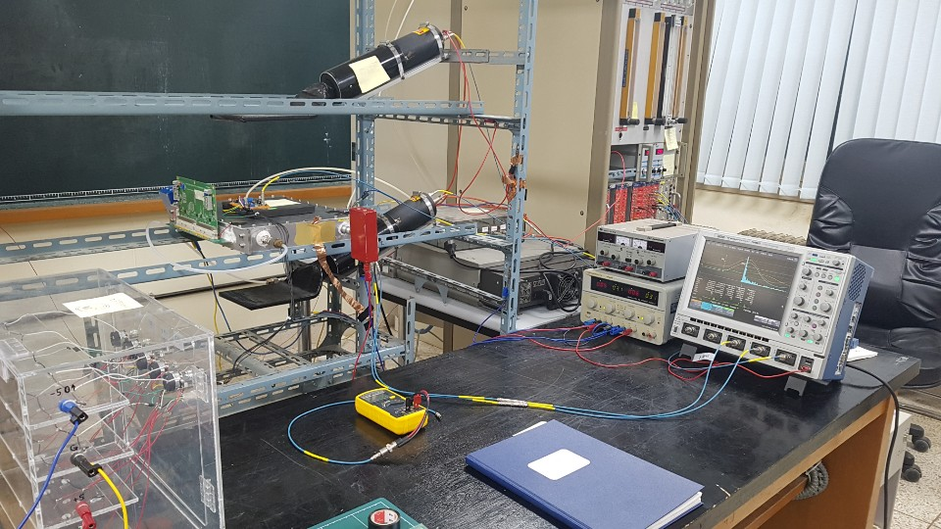
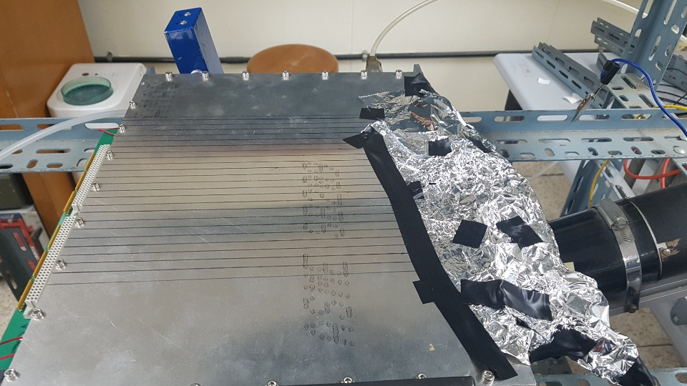
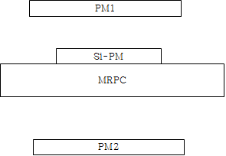
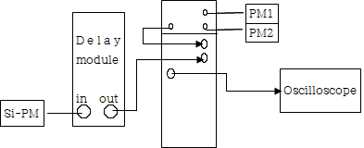
Trigger Setting
a figure of meausrement perform
Noise shielding with Al foil
Trigger signal = (PM1 & PM2) & (Si-PM + 40ns) -> Oscilloscope

Slide 12
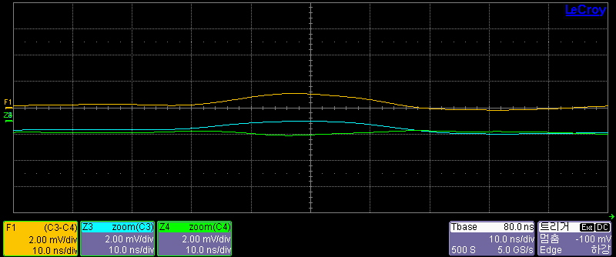
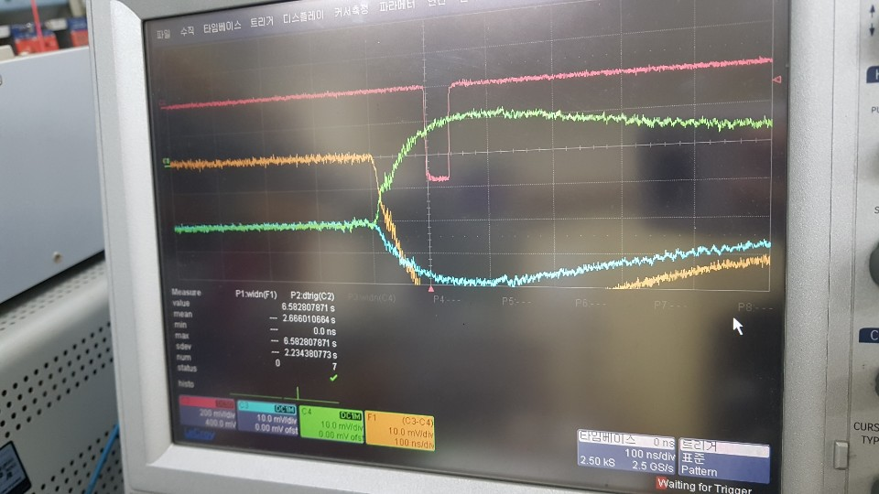
Differential signal(sample)
F1 = C3 – C4 : (+ signal) – (- signal)
50Ω Coupling in 10ns scale
1MΩ Coupling in 100ns scale

Slide 13
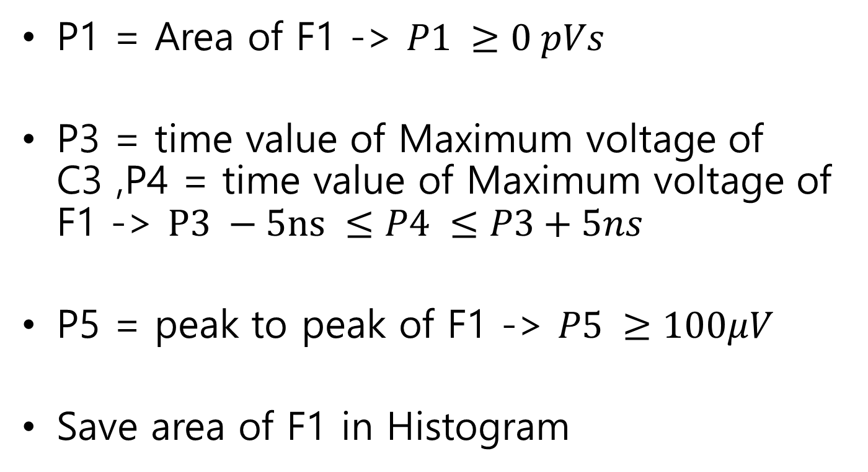
Parameter Setting
P1 = Area of F1 -> $P1 ≥0 pVs$
P3 = time value of Maximum voltage of C3 ,P4 = time value of Maximum voltage of F1 -> $P3 −5ns ≤P4 ≤P3+5ns$
P5 = peak to peak of F1 -> $P5 ≥100μV$
Save area of F1 in Histogram

Slide 14
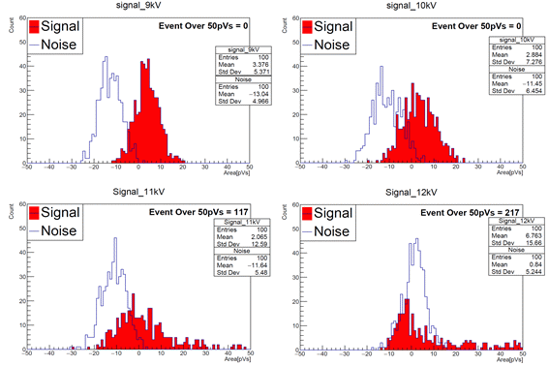

Slide 15
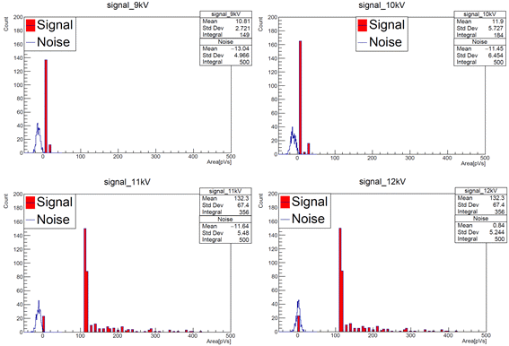

Slide 16
Result
Gas shielding
Dark Current compare
Efficiency
With Dark Current

Slide 17
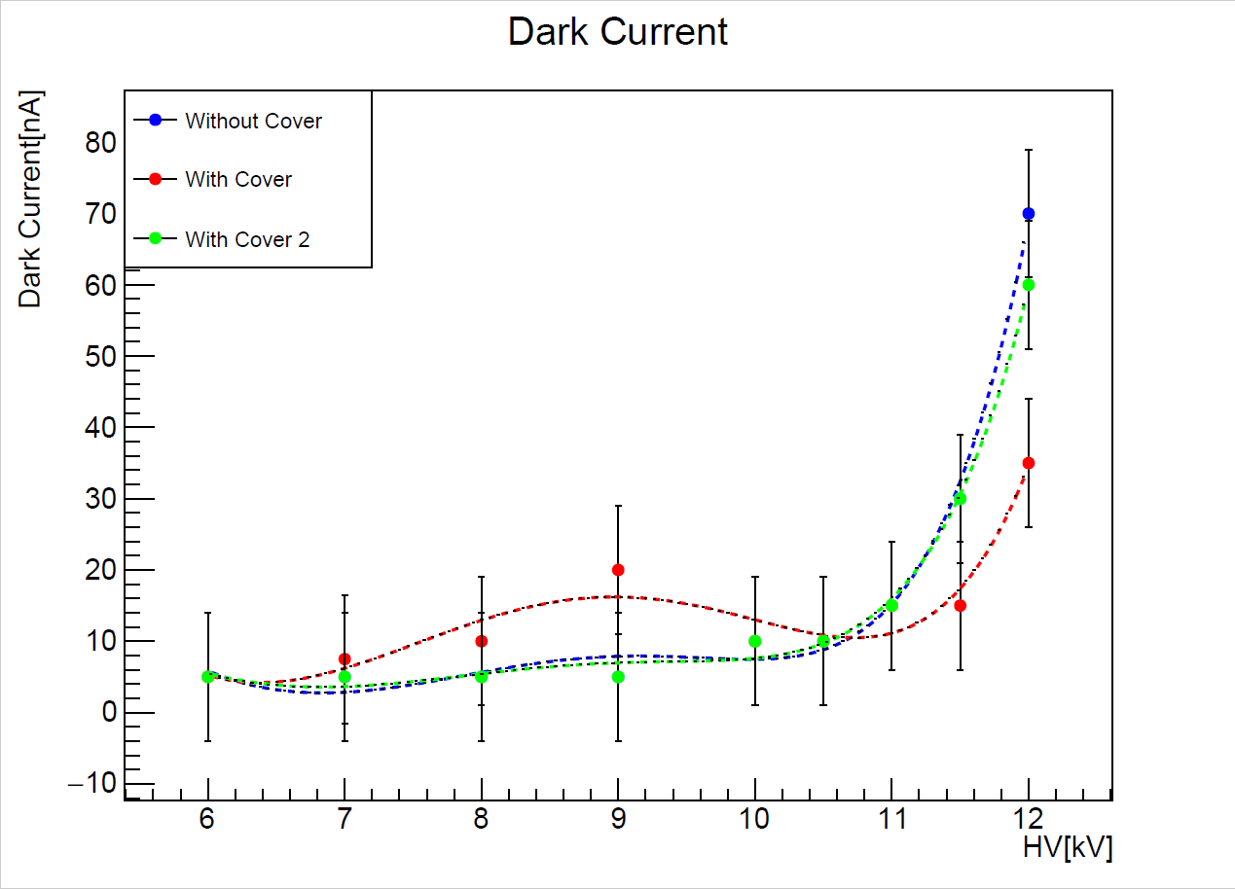
Gas shielding
Blue and Green plots are performed as same condition

Slide 18
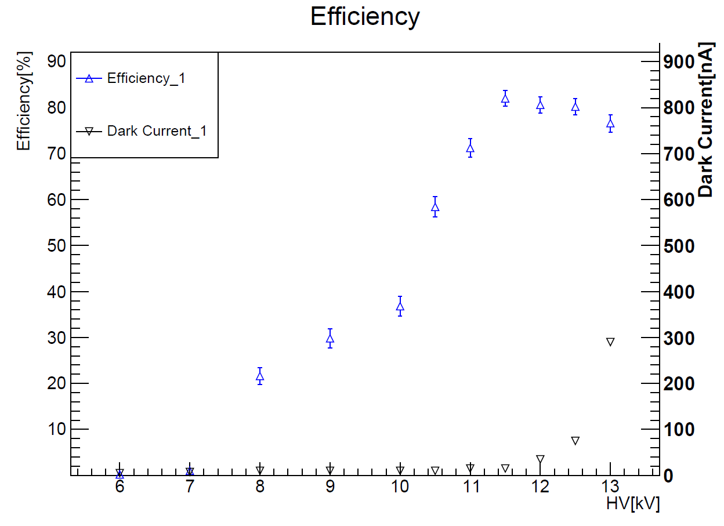

No Plateau?
-> No $SF_{6}$

Slide 19
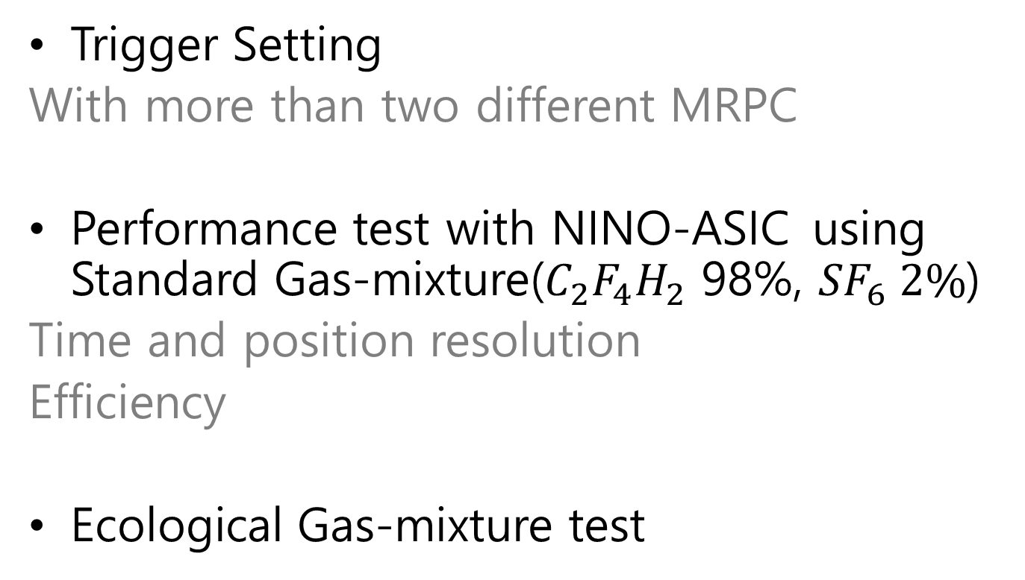
Future Plans
Trigger Setting
With more than two different MRPC
Performance test with NINO-ASIC using Standard Gas-mixture($C_{2}F_{4}H_{2}$ 98%, ${SF}_{6} 2\%$)
Time and position resolution
Efficiency
Ecological Gas-mixture test

Slide 20
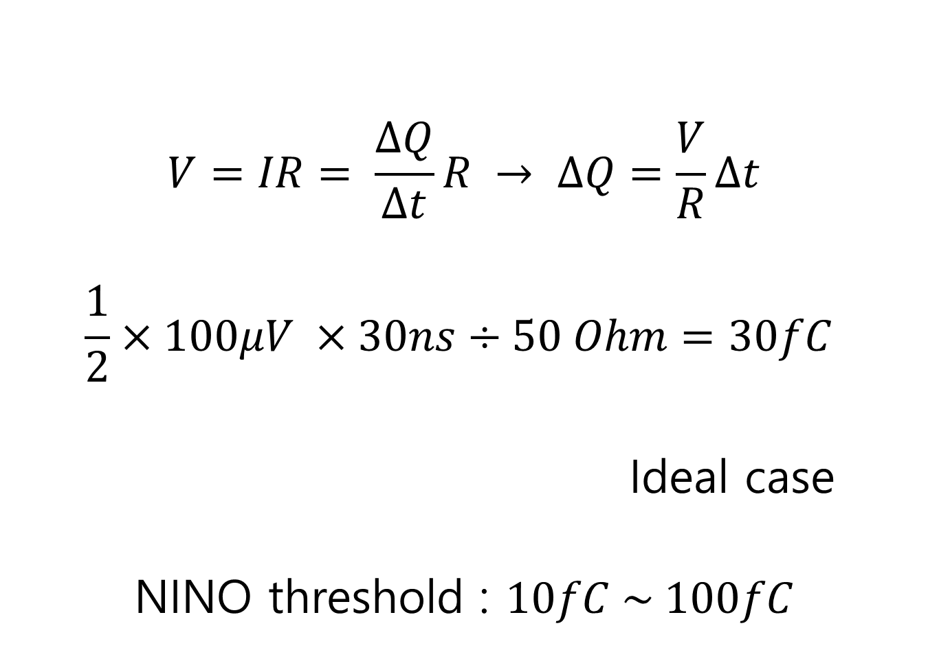
$$V=IR= \frac{∆Q}{∆t}R → ∆Q=\frac{V}{R}∆t$$
$$\frac{1}{2}×100μV ×30ns÷50 Ohm=30fC$$
Ideal case
NINO threshold : $10fC \sim 100fC$

