Slide 1
CO3 - ICALEPCS 19 CO3 meeting 2019-OCTOBER E. Blanco
Post-conference initial feedback

Slide 2
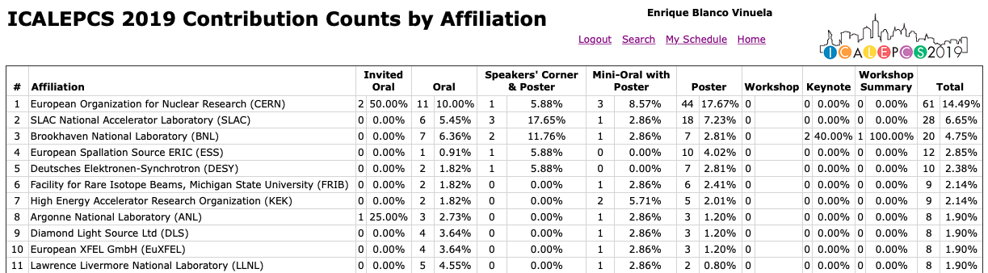
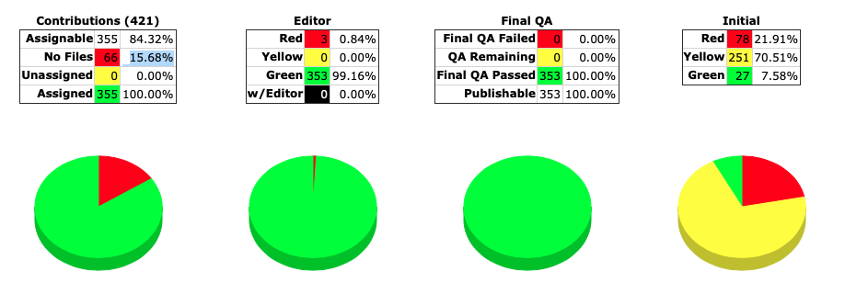
Some stats vs. CERN
Initially ~453 contributions
114 Orals (14 CERN)
37 Mini-orals + Poster (4 CERN)
267 Posters (50 CERN)
17 Speakers’ Corner (1 CERN)
421 Final contributions
355 valid contributions
Large dependency on CERN

Slide 3
Submissions
Main tracks: - Device Control and Integrating…
- Software Technology Evolution
- Control Systems Upgrades
- User Interfaces, UX
Reasonable number of oral requests

Slide 4
Orals assignments
Total of 114 orals
There are tracks which “auto-assign” orals.
There are tracks which contributes not evenly to the total orals

Slide 5
Some stats on orals / region

Slide 6
CERN
61 contributions: 13 orals (2 invited)

Slide 7
CERN

Slide 8
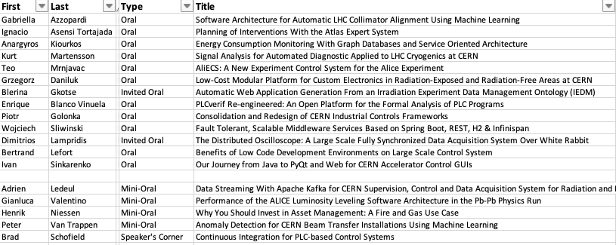
CERN orals, mini-orals, speakers’ corner

Slide 9
Post-conference general feedback
Products/Technologies
Excitement on Machine learning (mixing feedback control systems and machine learning)
Increase use of DEVICE models and generators for PLC development (see EuXFEL)
Spare/asset handling for PLCs
Architectures
Safety systems: FPGAs developments for safety systems (interlocks). e.g. SLAC, ATLAS Itk…
Collaborations contacts
Formal verification and PLCverif: ESO, ESA, CEA Sacley, Bordeaux, ELI…

Slide 10
Post-conference general feedback
It went well
Workshops are really appreciated. Foster communication and discussion further in the conference
Good timing among parallel tracks. Allowed switching
It went not so well..
Bi-theme: EPICS, TANGO
Parallel tracks are always difficult to handle: e.g. data analytics & Functional safety
Speaker’s corner isolation to avoid
Centralized place to have all workshops info

Slide 11
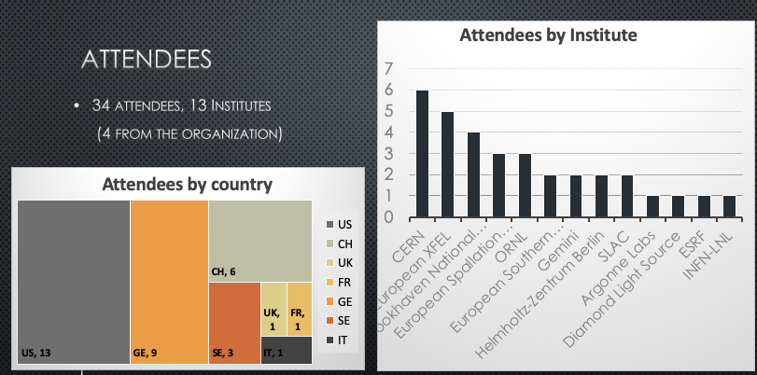
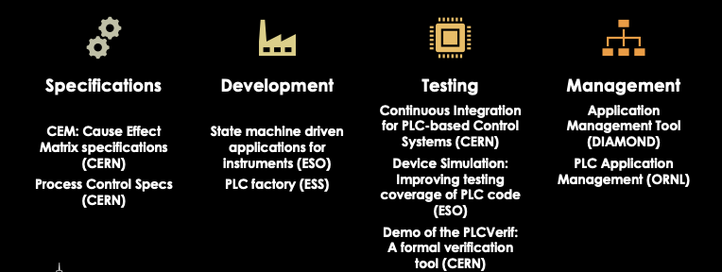
Workshop: PLC based control sytems
Stronger convergence of IT and OT
Increasing use of device model frameworks (code generation)
Importance of:
Testing and verification
Management of the deployed applications
Obsolescence management
Facilitated collaboration possibilities
Formal verification, Twincat-based frameworks, obsolescence…

