Slide 1
Silicon crystals for steering of high-intensity particle beams at ultra-high energy accelerators
A. Mazzolari, M. Romagnoni
10/03/2020

Slide 2





Crystals technology at INFN
Collimation
Beam steering
Innovative radiation sources
Pair production studies
Innovative detectors
Beam steering
Innovative radiation sources
Pair production studies
Beam steering
Innovative radiation sources
Pair production studies
CRYSBEAM
SELDOM

Slide 3
INFN Competencies
INFN has competencies related to
  Development of innovative ideas and research activities
  (connected to channeling and related effects)
  Crystals manufacturing and characterization
  Holders manufacturing and characterization
  Goniometry
  Trackers and detectors
  Data analysis
  Design of setups for channeling experiments
INFN is a scientific agency encompassing a full set of competencies related to studies of coherent effects between charged particle beams and crystals.

Slide 4
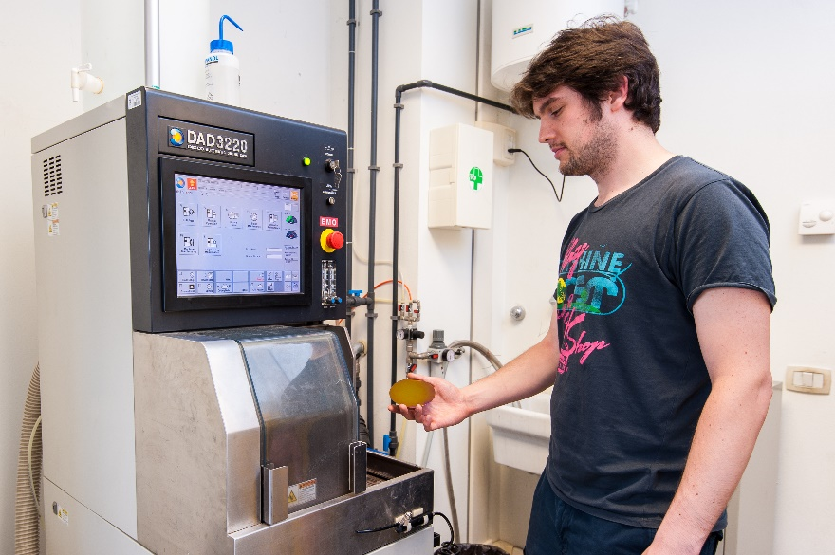
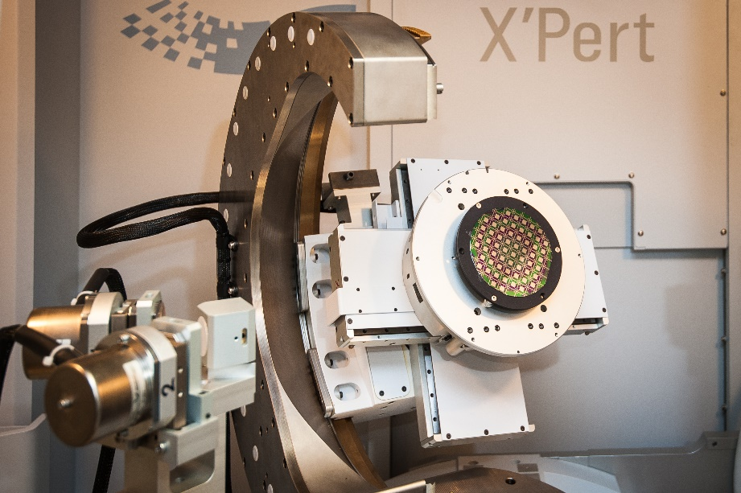
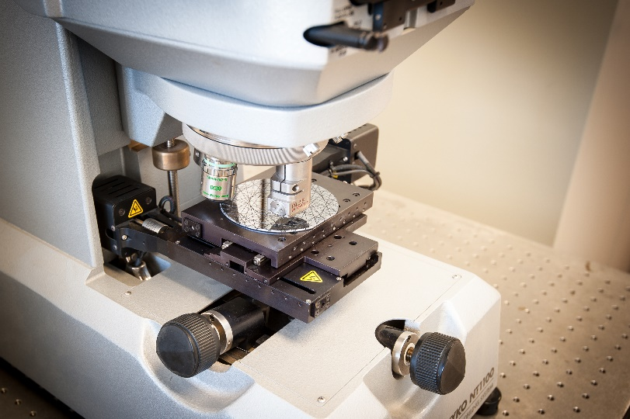
INFN infrastructure
Laboratory fully equipped for silicon micro and nanomachining
ISO4 certified clean room (130 m²)
High-resolution x-ray diffraction
Dicing and polishing equipment
White light and Fizeau inteferferometers

Slide 5
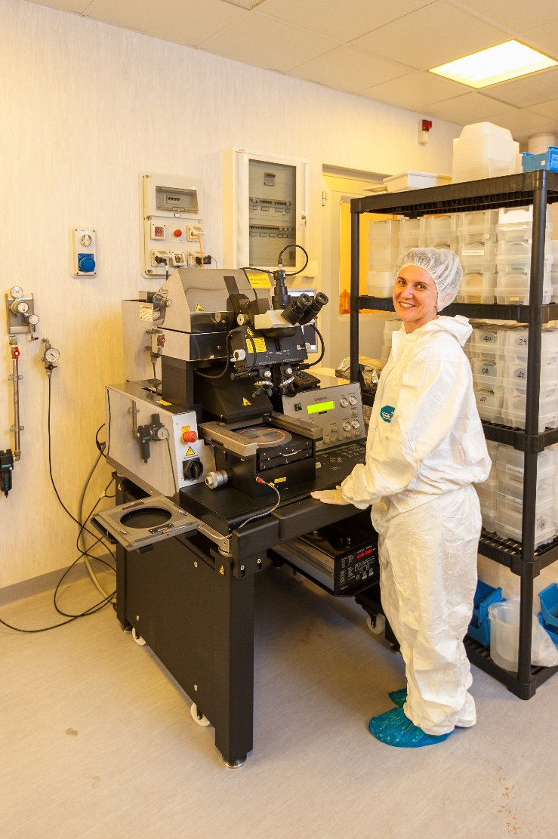
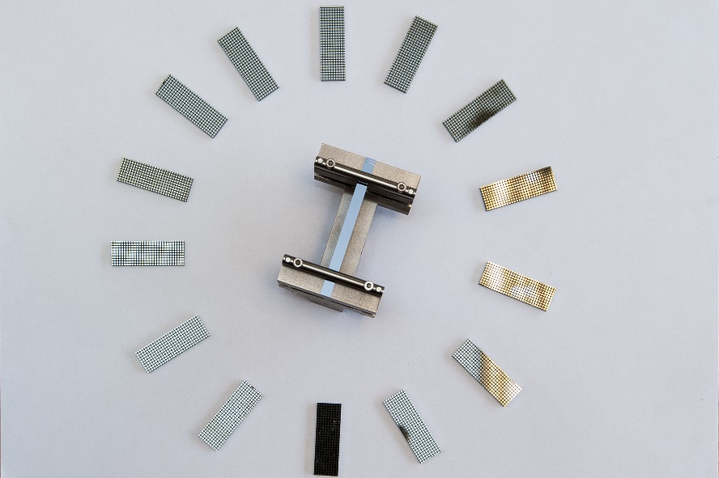

INFN infrastructure
Laboratory fully equipped for silicon micro and nanomachining
Fotolitography
Equipment for silicon chemical etching
Nanoimpringing

Slide 6
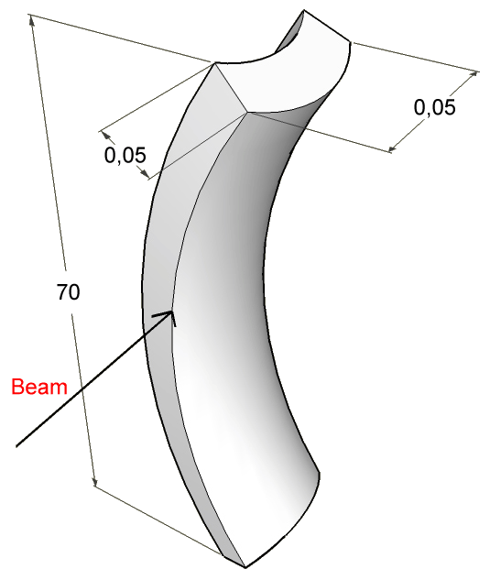
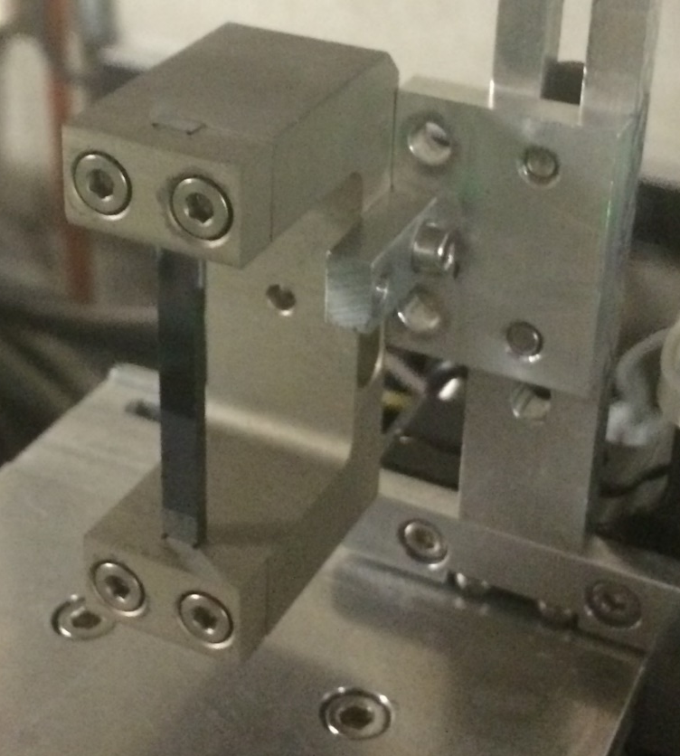
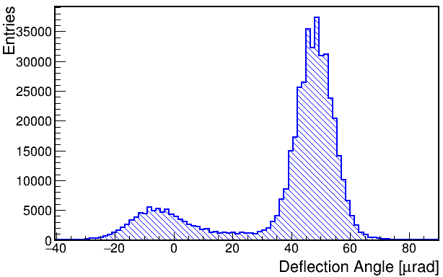
Strip crystals for the LHC
4 mm
2
50
A primary bending is mechanically imposed along the 50 mm size.
As a result, «anticlastic bending» manifests along the 4 mm size.

Slide 7
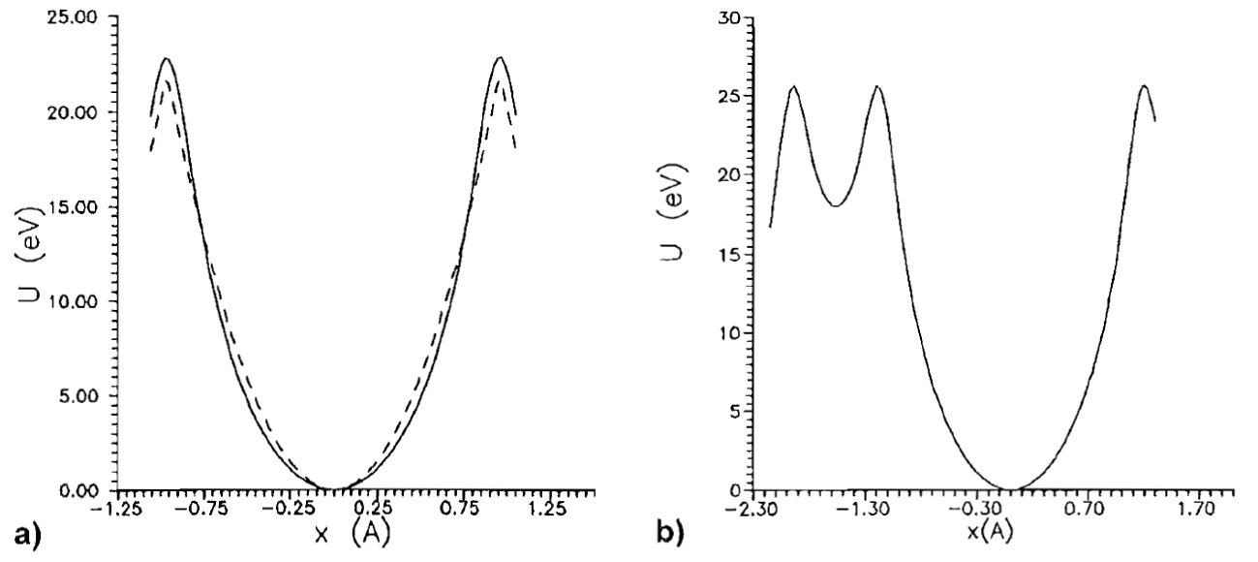
Choice of crystalline planes
(110)
(111)
Comparable depth of potential well
(110) Planes offers lower nuclear interaction rate
See also W. Scandale et al., Eur. Phys. J. C (2018) 78:505

Slide 8
Brief recap about crystals manufacturing
2006 Manufacturing based on mechanical dicing followed by chemical etching
2007 Manufacturing based on purely chemical methods
2014 Manufacturing of low-miscut crystals (<10 urad)
2018 Manufacturing based on mechanical dicing followed by chemical etching and polishing of surface entry face
Manufacturing of ultra low-miscut crystals (<1 urad)

Slide 9
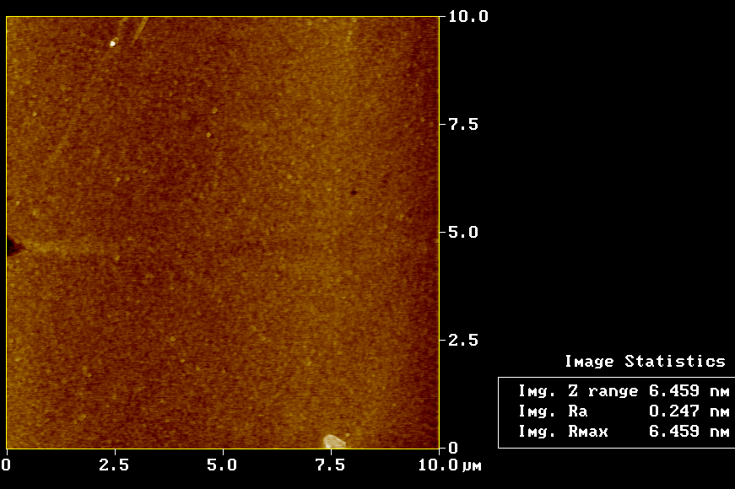
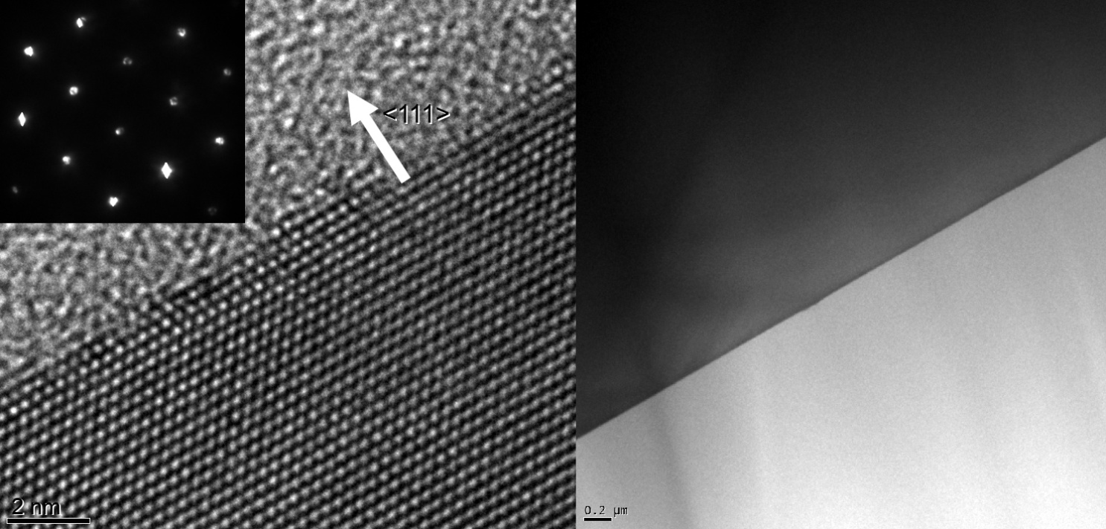
Crystal manufacturing – AFM and HRTEM –
High-quality surfaces achieved via anisotropic chemical etching
Lateral surface (AFM)
Entry surface (High Resolution transmission electron microscopy).
Zero nm amorphous layer
Sub-nm roughness achieved (0.2 nm)
Sub-nm roughness was achieved

Slide 10
Brief recap about holders manufacturing
2006 First holders version (in collaboration with IHEP), made of Al7075
2007 FEM-assisted optimization of holder geometry
2008 First prototypes of pre-shaped holders (aluminum)
2013 Request for holders with the following specs:
weight<90 g
UHV compatible (bakeable)
electron cloud compatible
2014 First generation of titanium grade 5 holders→not compatible with bake-out
2018 Pre-shaped titanium grade 5 holders now fits LHC requirements
About 90 commercial alloys, most common is «titanium grade 5» (90% Ti 6% Al 4% V )
Titanium.

Slide 11
Crystals for the LHC
Thickness along the beam: 4.0±0.1 mm
Height < 55 mm.
Weight < 150 g
Channeling plane: (110)
Channeling axis: <111> or <110>
Miscut for axial channeling: 0±18 mrad
Miscut for planar channeling: < 10 μrad.
Torsion: < 1 μrad/mm
Bending angle: 47.5-52.5 μrad
Dislocation density < 1 cm²
Bake out
• Bake out temperature= 250°C
• heating ramp= 50°C/h
• Bake out time =48h00
• Number of thermal cycles: 3 at least
• Maximum allowed total outgassing after each bake out: 1*10⁻⁷ mbar·l·s⁻¹
The compliance of the mechanical properties of the crystal assemblies to the specifications of Table 1, in particular the bending angle, must be assessed after at least 3 thermal cycles.

Slide 12
Challenging aspects
Planar miscut: < 10 μrad→ MRF finishing
Torsion: < 1 μrad/mm → ultra precise machining and assembly.
Bending angle: 47.5-52.5 μrad → ultra precise machining and assembly.
Dislocation density < 1 cm² → standard for microelectronics is 1 order of magnitude higher→ purchase of large quantity of silicon wafers and selection of the best ones.

Slide 13
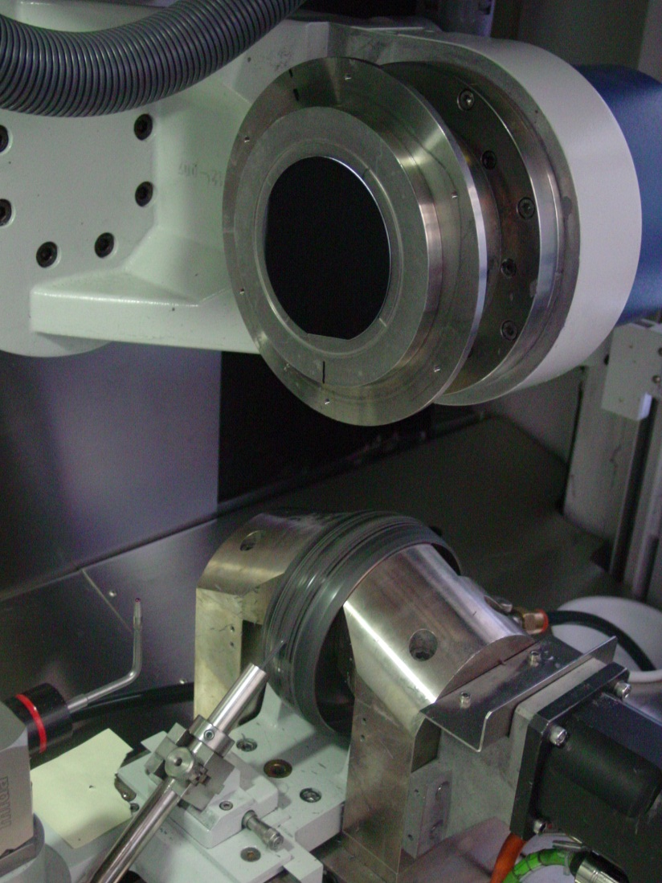
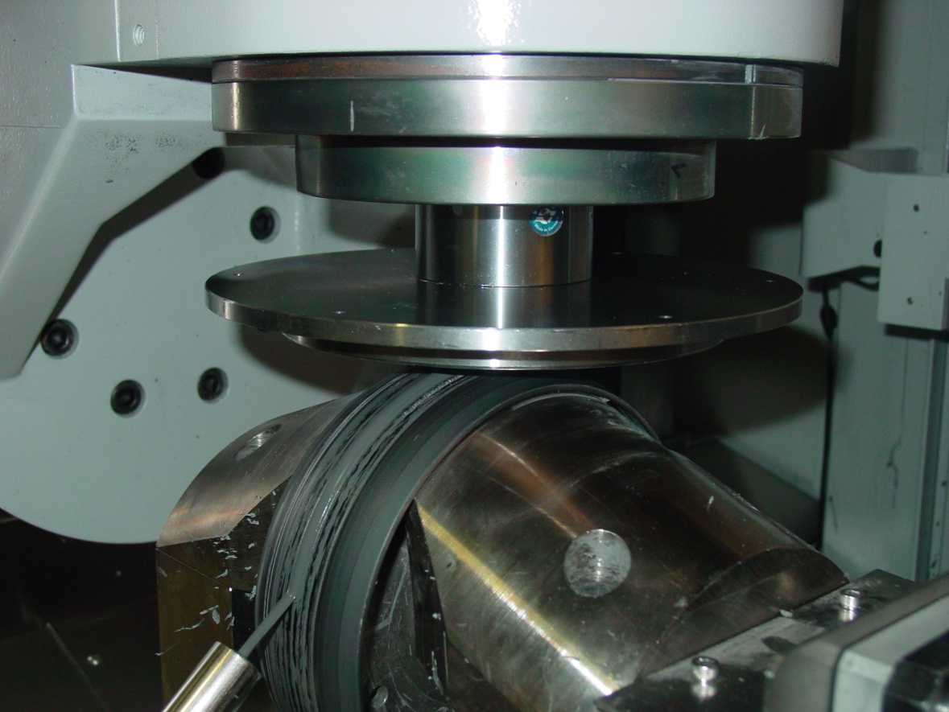
MRF finishing
Technique developed for astronomy applications (glasses and ceramics, i.e. amorphous materials)
After a 2 years R&D the tecnique was adapted to operate on crystalline materials.
6” vacuum wafer chuck
5-axis CNC machine moves wafer
4” Si Wafer
150mm MRF Wheel w/ ribbon of MR fluid

Slide 14
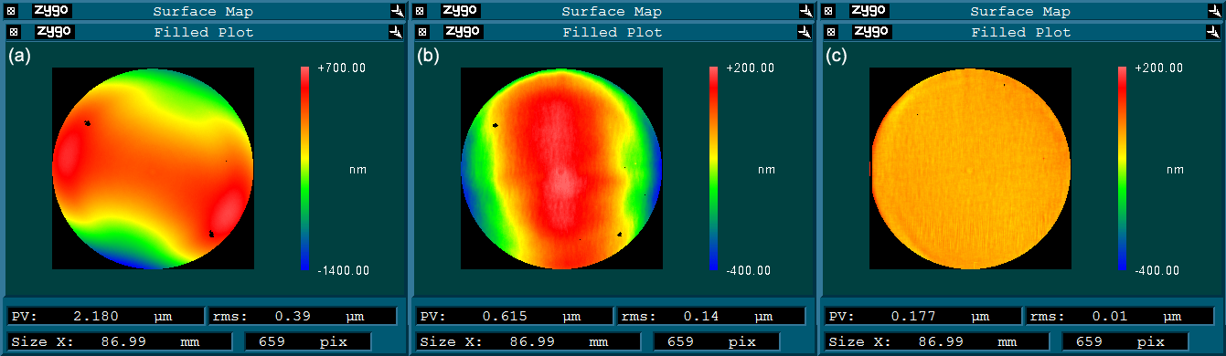
MRF finishing
Starting surface
PV 2.18 um
RMS 0.39 um
Surface after first treatment
PV 0.615 um
RMS 0.14 um
Final surface
PV 0.177 um
RMS 0.01 um
MRF is a deterministic polishing process
Does not induce any lattice damage
Miscut < 1 urad

Slide 15
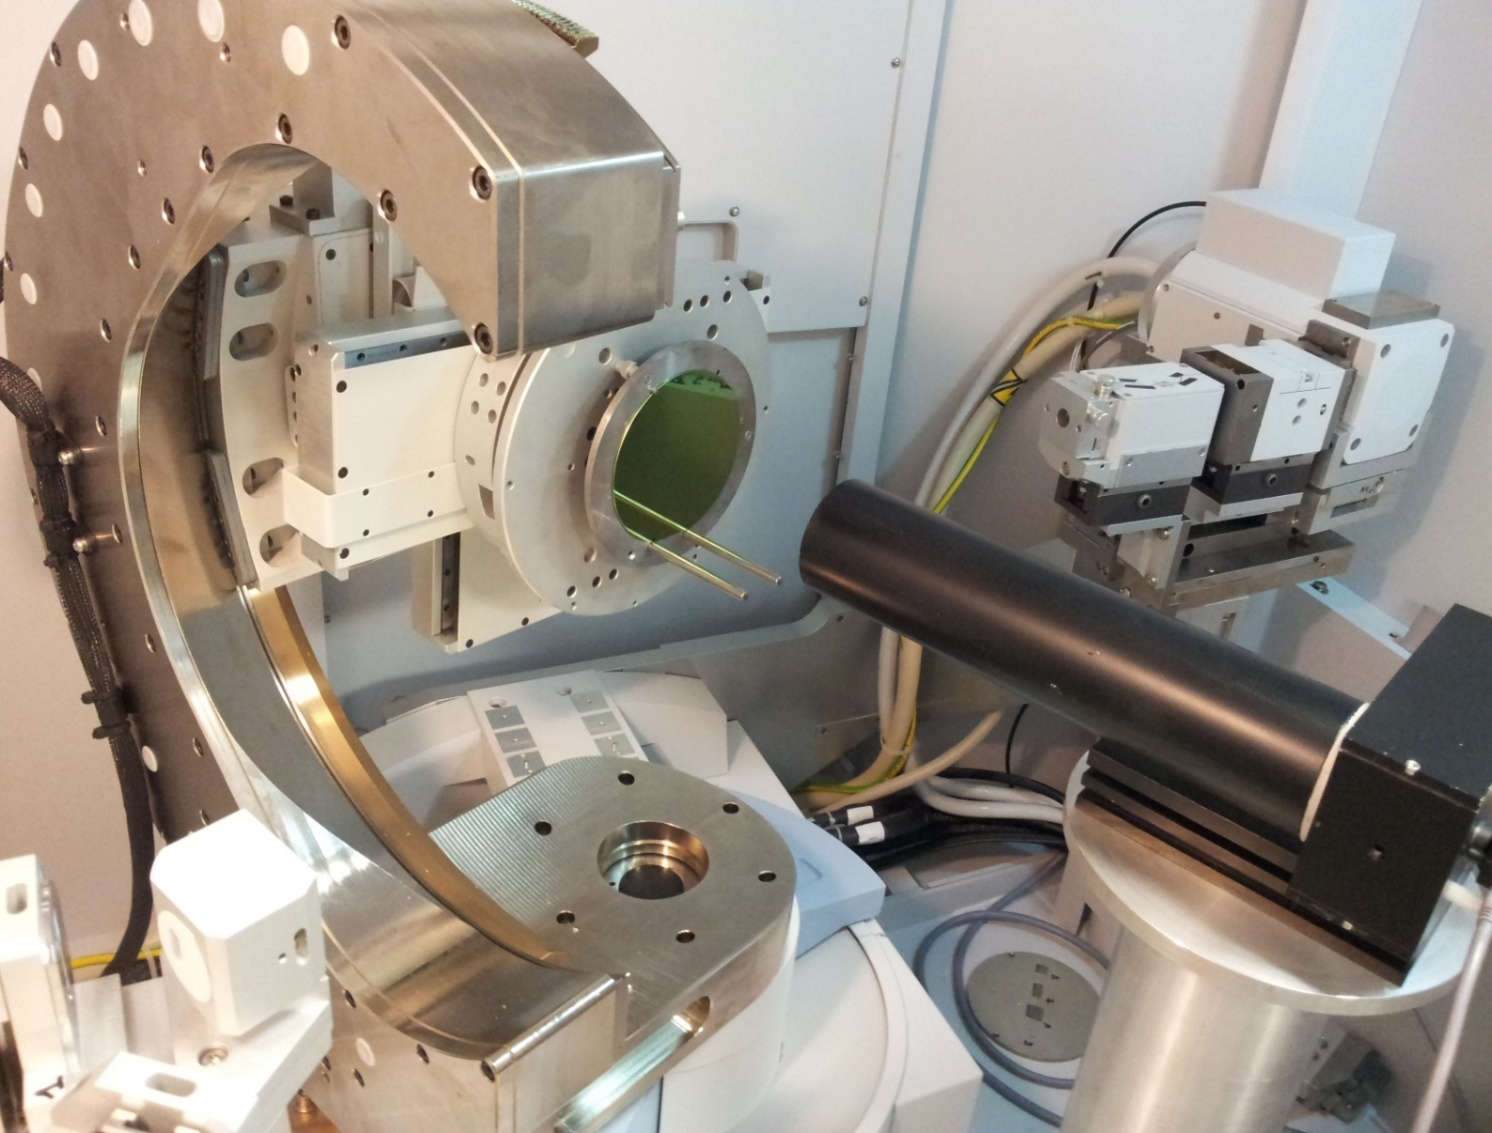
MISCUT REDUCTION
Autocollimator
X-ray source
High resolution x-ray diffractometer (PANALYTICAL)
Miscut: angle between optical surface and atomic planes
Requested miscut < 10 μad.
Monochromator
Sample
Mirror
Detector

Slide 16
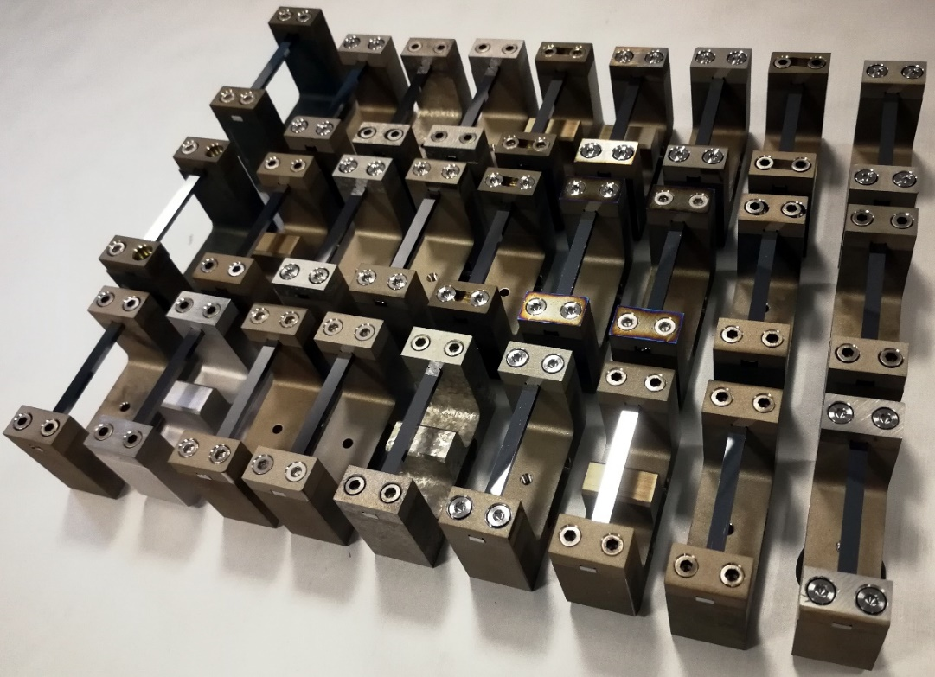
Recently developed crystals
Developed «pre-shaped» holders made of titanium grade 2 and grade 5.
High-resolution x-ray diffraction characterizations: analysis of correlation
Investigated thermal stability of holders+crystal
assembly.
Crystals for the LHC

Slide 17
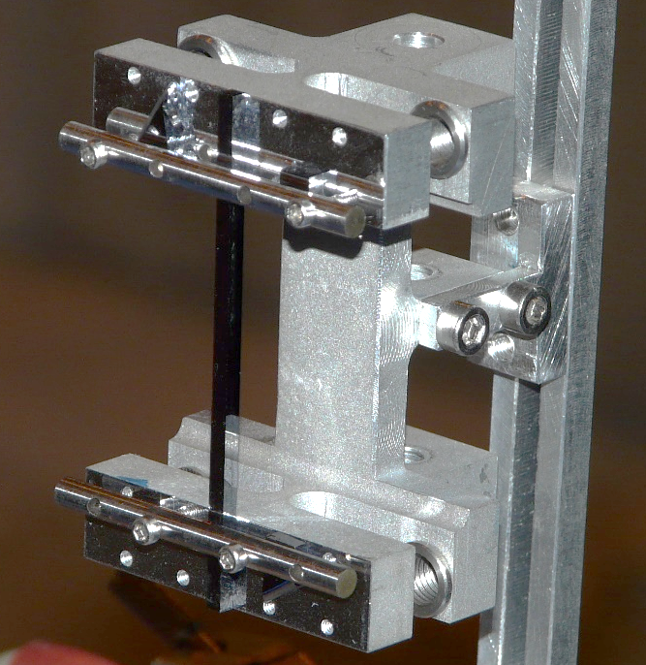
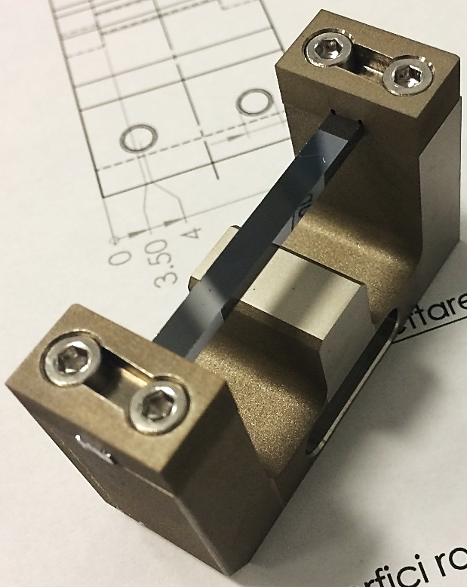
Pre-shaped holders
Ultra-high precision machining provides holders with crystal-supporting surfaces inclined at a proper angle to impart to the crystal the desired deformation.
  At first step, the holders are manufactured with approaches typical of conventional precision mechanics.
  selected holders are treated with super-finishing techniques to adjust surface inclinations.
Approach already developed for crystals installed in the SPS
and for studies of multiple-volume reflections (∼2010÷2015)
Design is now revisited:
  holders made of titanium grade 2 and grade 5
  (previous version was made of aluminium).
  removed torsion-adjustment mechanism.
A pre-shaped holder manufactured in 2011 for UA9. Holder was made from aluminium and torsion correction mechanism still used.
Base for development of current holders.
A pre-shaped holder for LHC. Holder is made of titanium.
Flexure for torsion adjustment have been removed.

Slide 18
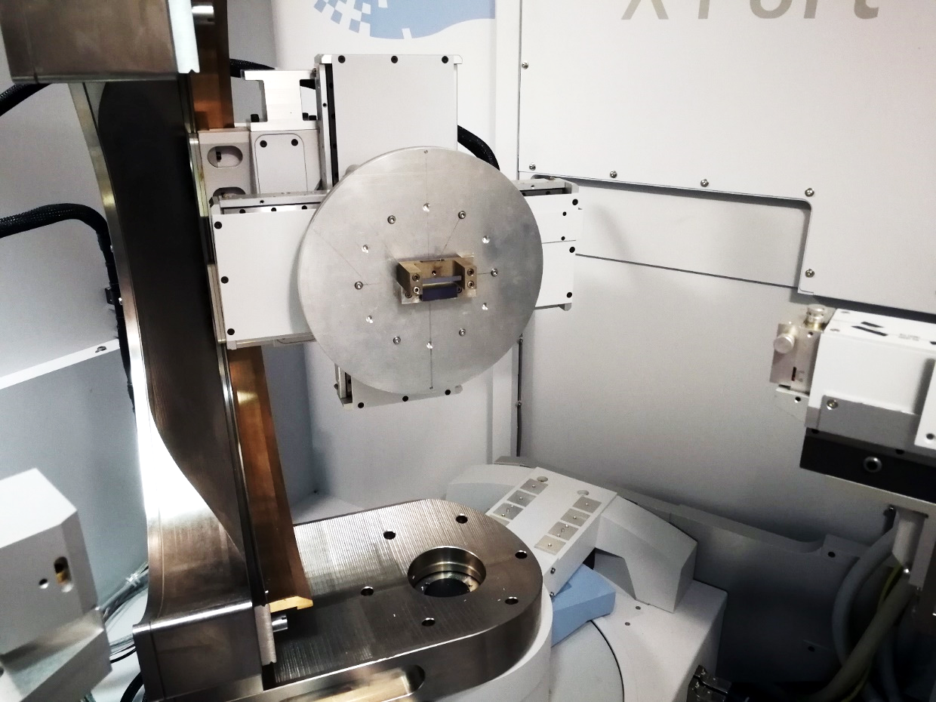
Crystal | Deflection angle (µrad)
 | High resolution x-ray diffraction | Channeling | Consistency
STF47 | 33±2 | 35±2 | YES
STF48 | 144±2 | 142±2 | YES
STF49 | 247±3 | 246±2 | YES
STF50 | 142±5 | 143±2 | YES
STF51 | 33±2 | 33±2 | YES
STF70 | 56±2 | 55±2 | YES
STF71 | 60±5 | 62±2 | YES
STF99 | 119±3 | 120±2 | YES
STF100 | 67±6 | 63±2 | YES
STF101 | 170±6 | 165±2 | YES
STF102 | 45±3 | 42±2 | YES
STF103 | 52±5 | 54±2 | YES
STF104 | 95±5 | 91±3 | YES
STF105 | 49±3 | 50±2 | YES
STF106 | 42±2 | 42±2 | YES
STF107 | 56±2 | 56±2 | YES
STF110 | 52±3 | 54±2 | YES
STF110 | 56±10 | 62±2 | YES
STF112 | 64±3 | 63±2 | YES
STF113 | 46±3 | 45±1 | YES
STF114 | 52±3 | 52±1 | YES
STF117 | 53±3 | 50±1 | YES
STF118 | 52±3 | 53±1 | YES
STF119 | 54±3 | 52±1 | YES
STF120 | 54±3 | 52±1 | YES
STF121 | 48±3 | 48±1 | YES
STF122 | 50±3 | 46±1 | YES
SFT123 | 52±3 | 52±1 | YES
PL08 | 715±30 | 706 ± 2 | YES
PL09 | 1040±50 | 1067 ± 2 | YES
Determinantion of crystal bending angle with high-resolution x-ray diffraction and channeling of high-energy particles are in good agreement.

Slide 19
Holders Thermal stability
Crystal bending angle is measured through high-resolution x-ray diffraction before and after thermal cycles for 41 holder+crystals assemblies.

Slide 21
Holder stability vs bake-out: conclusions
Manufactured 41 holders (31 titanium grade 2+10 titanium grade 5).
41 holders subjected to bake-out thermal cycles. Performed a total of 243 thermal cycles.
For all the cases crystal bending angle is stable.
Newly developed holders (both titanium grade 5 and titanium grade 2) are thermally stable with respect to bake-out cycles.

Slide 22
CRYSTALS FOR THE LHC

Slide 23
CRYSTALS FOR THE LHC

Slide 24
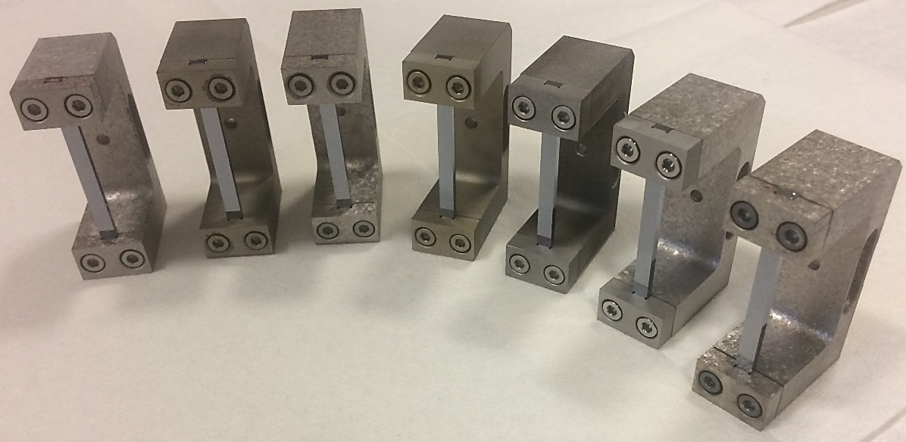
CRYSTALS FOR THE LHC
Crystal code | Bending angle | Miscut | Bakeable
STF117 | 51±1 | 6±1 | YES
STF118 | 53±1 | 6±1 | YES
STF119 | 53±1 | 6±1 | YES
STF120 | 52±1 | 6±1 | YES
STF121 | 47±1 | 6±1 | YES
STF122 | 46±1 | 6±1 | YES
STF123 | 51±1 | 6±1 | YES
STF124 | 49±1 | 6±1 | YES
STF125 | 50±1 | 6±1 | YES
STF126 | 50±1 | 6±1 | YES

Slide 25
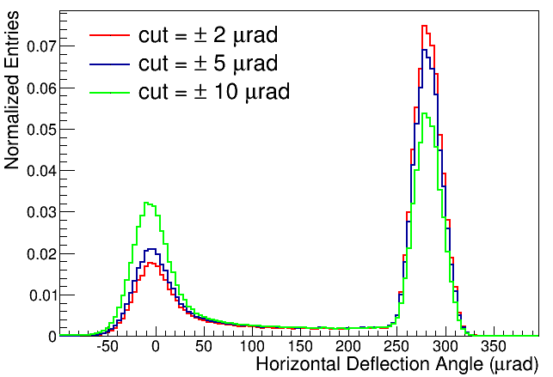
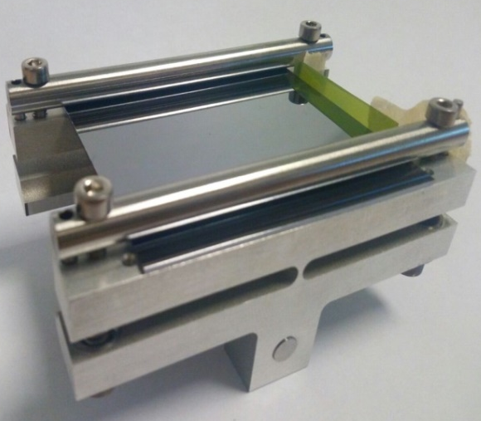
CRYSBEAM EU project
Motivation: extraction of the LHC circulating beam, delivering extracted particle beams to users
Need of a crystal bent at ~1 mrad, bending radius ~80 m
Deflection ~0.3 mrad

Slide 26
SELDOM EU project
P.I. Nicola Neri

Slide 27
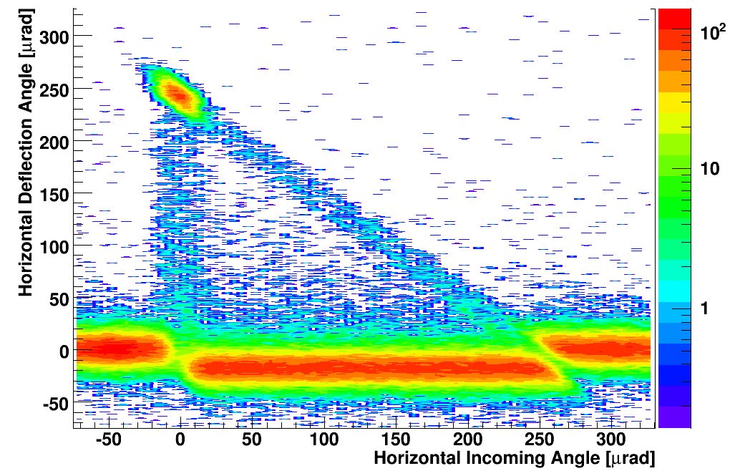
Germanium crystals
We own the technology to machine also germanium crystals
Mechanical machining
Chemical etching for lattice damage removal

Slide 28
Most recent developmentS
Crystals with miscut less than 1 urad
Assessed a correlation between x-ray and particle measurements
Thanks to the experience already gained in development of holders for the SPS, pre-shaped holders made of titanium (grade 2/grade 5) are now available
Holders/crystals assembly are now bakeable to 250 °C
Tight requirement on bending angle can be routinely satisfied
Recent progresses on torsion reduction

Slide 29
COnclusions
INFN owns the expertise, technical resourses, manpower to perform channeling experiments at any wordwide facility.
Established a protocol for manufacturing of crystals free from crystalline defects.
Possibility to deliver crystals with miscut lower than 1 urad.
Developed a protocol to manufacture crystals matching requirements for installation in the LHC.
Possibility to realize germanium crystals
Possibility to realize cm-thick uniformly bent crystals

