Slide 1
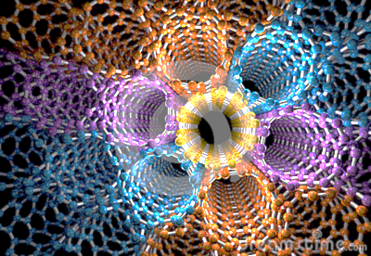
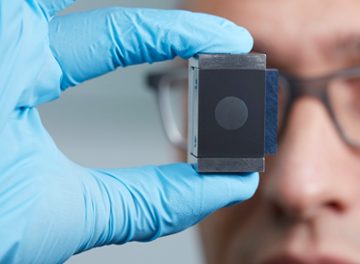
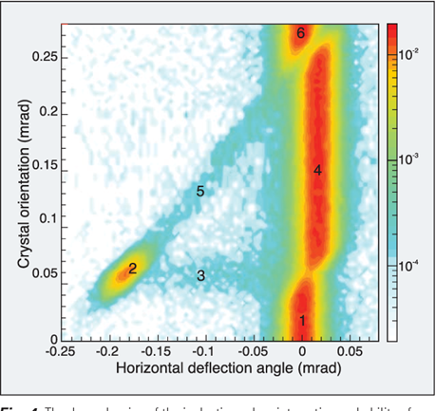
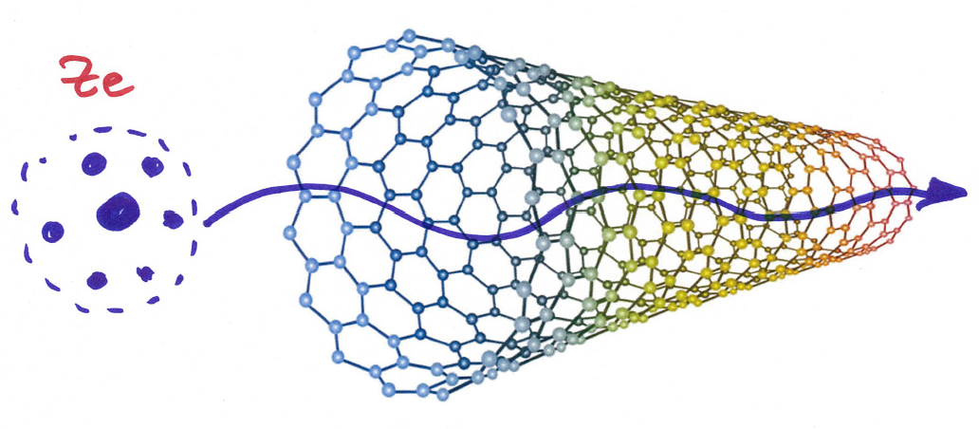




ACN2020 - Applications of Crystals and Nanotubes
- CLOSING WORDS
ARIES WP6 Workshop
EPFL, Lausanne, 10-11 March 2020
Tatiana Pieloni, Marco Zanetti,
Frank Zimmermann
https://indico.cern.ch/event/867535

Slide 2
thank you for participating –
either in person or remotely!
thanks to EPFL & UNIL for their hospitality

Slide 3
workshop statistics
10 Live attendees: Tatiana Pieloni (EPFL), Andrey Solov’yov (MBN), Rasmus Ischebeck (PSI), Frank Zimmermann (CERN), Francesco Velotti (CERN), Aakash Sahai (UC Denver), Youngmin Shin (formerly FNAL/NIU), Fred Blanc (EPFL), Mike Seidel (EPFL & PSI), Aravinda Perera (U Liverpool)
17 Remote attendees: Walter Scandale (IN2P3, INFN, CERN), Laura Bandiera (INFN Ferrara), Stefano Redaelli (CERN), Qing Qin (IHEP), Roberto Rossi (CERN), Marco Zanetti (INFN Padova), Nadia Pastrone (INFN Torino), Sultan Dabagov (INFN Frascati), Alexandre Bonatto (U Manchester), Alex Fomin (KIPT & CERN), Andrea Mazzolari (INFN Ferrara), Marilena Tomut (U Siegen), Iryna Chaikovska (IJCLab), Emilio Nanni (SLAC & MIT), Javier Resta Lopez (U. Liverpool), Daniele Mirarchi (CERN), Lenny Rivkin (EPFL & PSI)
1 posters: Aravinda Perera

Slide 4
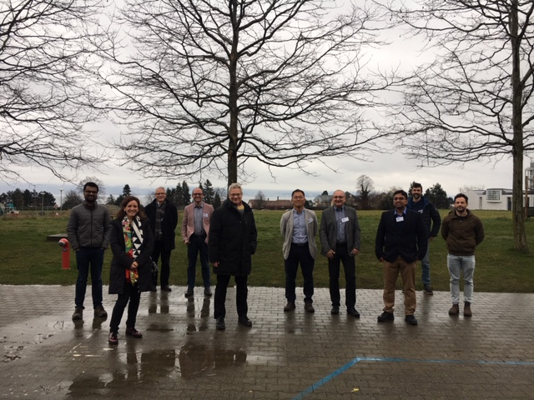
in addition
hand disinfectant
in the meeting rom
(thanks Rasmus!)
plus 1 or 2 empty
seats between
participants
remote
participants:
please send us
your photo !
safety distances

Slide 5
all speakers:
please upload or send your presentations !

Slide 6
ARIES workshop summary report
invitation of individual contributions from speakers (and others) containing e.g.
1. Key result(s) achieved
2. Next steps and outlook
3. One or two highlight pictures
4. Any particular take-home messages
5. List of relevant references
deadline for contributions: Sunday 22 March

Slide 7
ACN(C)2020
a pioneering workshop:
  hybrid live & remote
  safest workshop ever

Slide 8
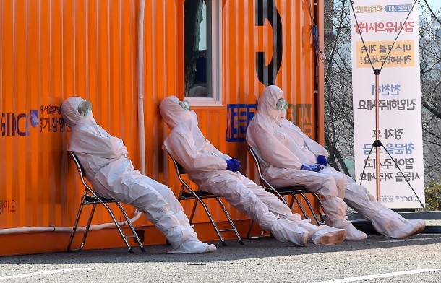
we are starting planning for ACN(C)2022

Slide 9
safe travel, or stay at, home
and remain healthy !

