Slide 1
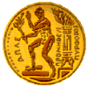




Athens Meeting 21-24 January 2020
Welcome to Greece!, Welcome to Athens!!
a) Institute of Accelerating Systems & Applications
b) National Technical University of Athens
c) Athens University of Economics & Business
d) European Spallation Source
EN Gazis/IASA-NTUA
1

Slide 2

National Technical University of Athens
1837, foundation year, NTUA is the oldest Technical University
9 Faculties, 512 faculty members, 4.100 external collaborators, 24.000 students, 300,000 sq.m. of installations.
Over time, the baccalaureate grades required for admission in all of NTUA schools remain constantly the highest rank between all Greek academic institutions by specialty.
EN Gazis/IASA-NTUA
https://www.ntua.gr/en
2

Slide 3
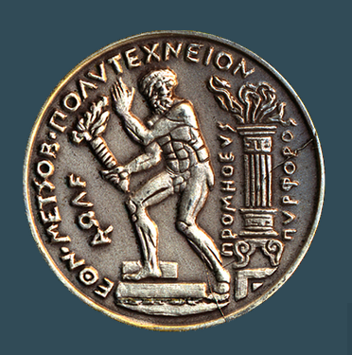
NTUA has chosen its emblem the “PROMETHEUS PYRFOROS”, who brought the fire from the gods to the mankind
NTUA never loses sight of the real human needs and dimensions
NTUA develops the broader personal and social qualities of its academic and research staff and its students
EN Gazis/IASA-NTUA
3

Slide 4
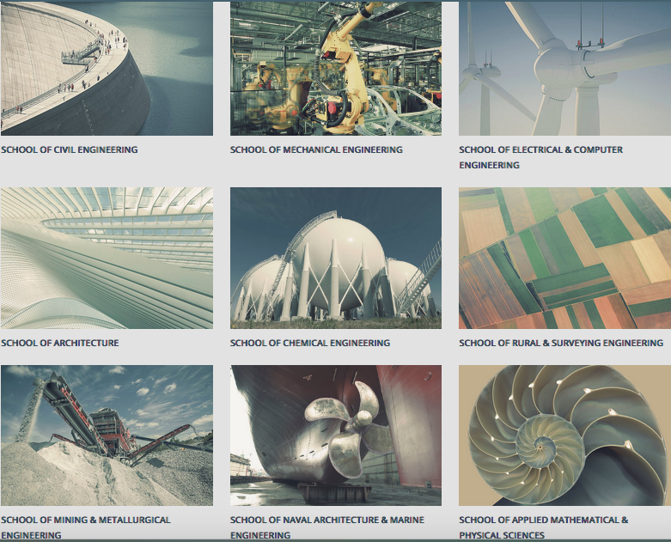
EN Gazis/IASA
3

Slide 5
According to QS World Universities Ranking 2016, NTUA is the leading academic institution in Greece and the only one in the top 400 institutions worldwide.
The School of Civil Engineering is in the 33rd position of the world’s best schools by specialty.
NTUA is in 67th place worldwide among technological universities.
At NTUA operate 194 laboratories, 140 of which are certified. In 2015, they were ongoing 1423 national and European research projects.
NTUA Faculty members publish annually more than 3.000 scientific papers (in journals, conference proceedings, chapters in volumes etc.) which earn more than 20.000 citations.
EN Gazis/IASA-NTUA
3

Slide 6
NTUA supports two Institutes:
The Institute of Communication and Computer Systems (ICCS) of the School of Electrical and Computer Engineering (ECE) of the National Technical University of Athens (NTUA) founded in 1992
https://www.iccs.gr/en/?noredirect=en_US
The Institute of Accelerating Systems & Applications (IASA) of the National Technical University of Athens (NTUA) and National & University of Athens (NKUA), affiliated by the schools and departments:
  Electrical and Computer Engineering, Chemical Engineering and Applied Mathematical & Physical Sciences
  Medicine, Physics, Informatics
  https:/www.iasa.gr/
IASA is currently engaged in Research projects in the following areas:
          Nuclear and Particle physics
          Nuclear medicine and imaging
          Accelerator Science & Engineering
          Automated Control
          Scientific Computing
          Environmental Physics
          Microwave Engineering
          Telecommunications
EN Gazis/IASA-NTUA
3

Slide 7
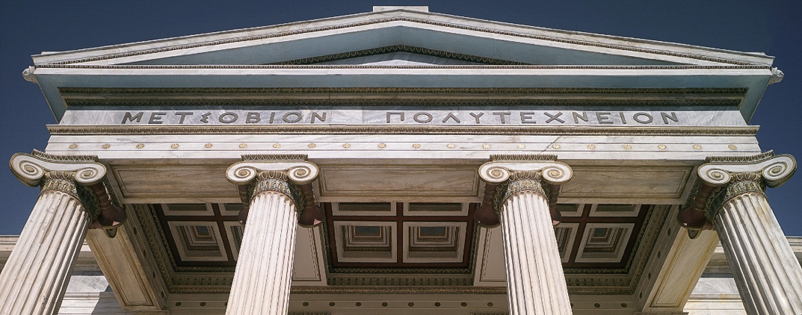
Thank you and enjoy your stay in Athens!!
EN Gazis/IASA-NTUA
3

