Slide 1
WP4 C-band injector rf system design
Second CompactLight Annual Meeting,
Athens 21-24/01/2020
M. Diomede (INFN-LNF)
on behalf of the WP3 C-band injector working team*
* D. Alesini, A. Vannozzi, G. Muti, F. Cardelli, E. Gazis, E. Trachanas, M. Croia, A. Gallo, M. Diomede, M. Ferrario, C. Vaccarezza, A. Giribono, L. Ficcadenti, J. Scifo, L. Pellegrino, B. Spataro.

Slide 2
A C-BAND INJECTOR LAYOUT
Considered layout (not in scale)
3 C-band TW structures, 2 with solenoids around, operating at 40 MV/m average accelerating gradient (as example, PSI-like structures)
TW structures solenoids
Gun solenoid
2 m
X-band accelerating module
1.6 cell RF gun operating at 200-240 MV/m cathode peak field
Linearizer (X,Ka?)

Slide 3
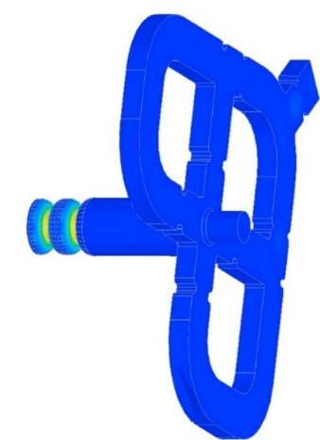
DESIGN CRITERA FOR THE C-BAND GUN
The design and fabrication of the new gun has been driven by the same criteria used in the design of room temperature high gradient X-band structures developed in the last 20 years in the framework of linear collider projects (NLC, JLC and CLIC). There are four main quantities that play a crucial role in the BDR control: the peak electric field, the modified Poynting vector (S_{c}), the RF pulse length (t_{p}) and the pulsed heating (ΔT). The gun has been designed keeping under control these quantities.
Standard couplers on the full cell cannot be adopted because of the high pulsed heating due to the high magnetic field on the coupling holes and, therefore, a mode launcher type coupler has been considered. To reduce the dipole and quadrupole field components induced in the mode launcher a modified design of the mode launcher itself will be necessary. Holes on the mode launcher coupler to allow the laser injection will be also implemented.
Mode launcher
(with comp. of quad. component)

Slide 4
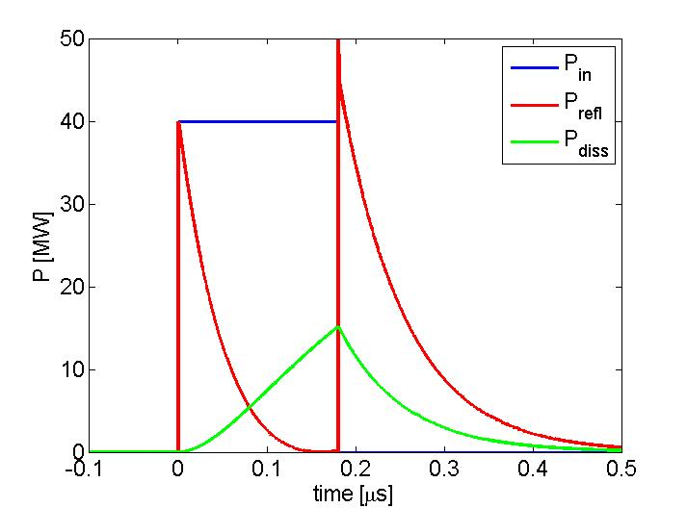
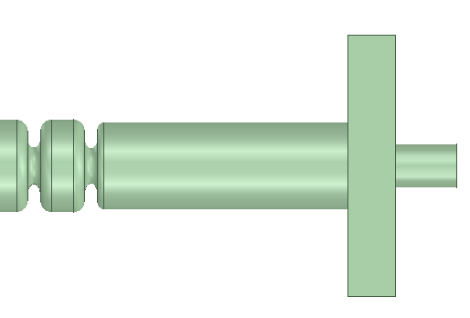
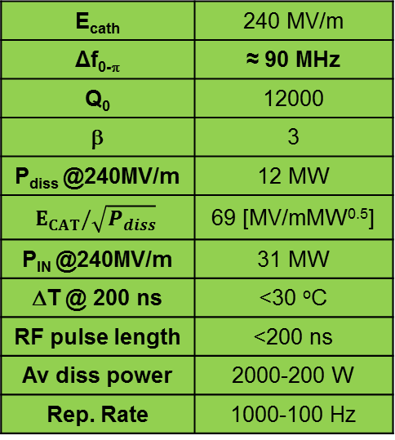
C-BAND GUN POWERING SCHEME
RF pulses of few tens of MW at 200 ns allow reaching E_{cath}>200 MV/m.
Because of its higher efficiency, a C-band RF Gun is also suitable for application requiring repetition rates in the 500 Hz ÷ 1 kHz range
Moreover, to feed the SW gun a C-band circulator is necessary to protect the klystron from the power reflections during transients (a commercially available C-band circulator exists and will be purchased from CML to allow the high-power tests).
E_{cath} | 240 MV/m
Δf_{0-π} | ≈ 90 MHz
Q₀ | 12000
β | 3
P_{diss} @240MV/m | 12 MW
$$E_{CAT}/\sqrt{P_{diss}}$$ | 69 [MV/mMW^{0.5}]
P_{IN} @240MV/m | 31 MW
ΔT @ 200 ns | <30 ºC
RF pulse length | <200 ns
Av diss power | 2000-200 W
Rep. Rate | 1000-100 Hz
<0.200 μs 40 MW
KLY
circ
[1] D. Alesini et al., TUPTS024, IPAC 19

Slide 5
FULL C-Band gun 2D DESIGN

Slide 6
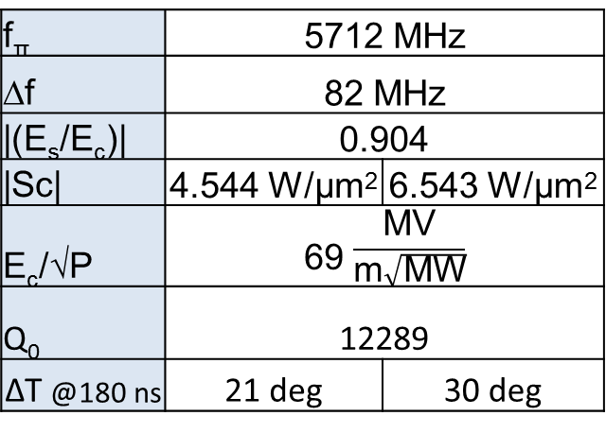
FULL C-Band gun 2D DESIGN: RESULTS
(@200 MV/m)
(@240 MV/m)
f_{π} | 5712 MHz
∆f | 82 MHz
|(E_{s}/E_{c})| | 0.904
|Sc| | 4.544 W/µm² | 6.543 W/µm²
E_{c}/√P | 69 $\frac{\text{MV}}{\text{m}\sqrt{\text{MW}}}$
Q₀ | 12289
∆T @180 ns | 21 deg | 30 deg

Slide 7
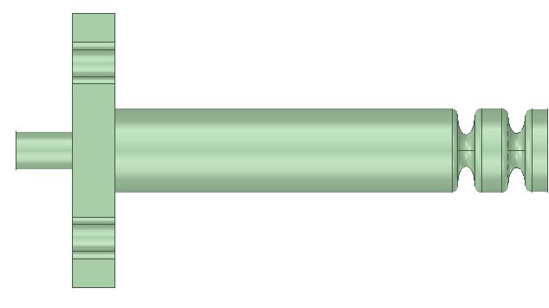
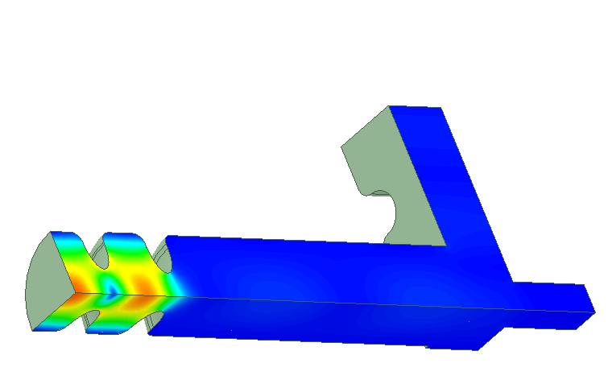
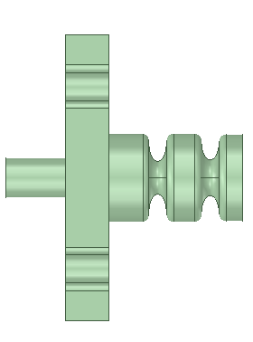
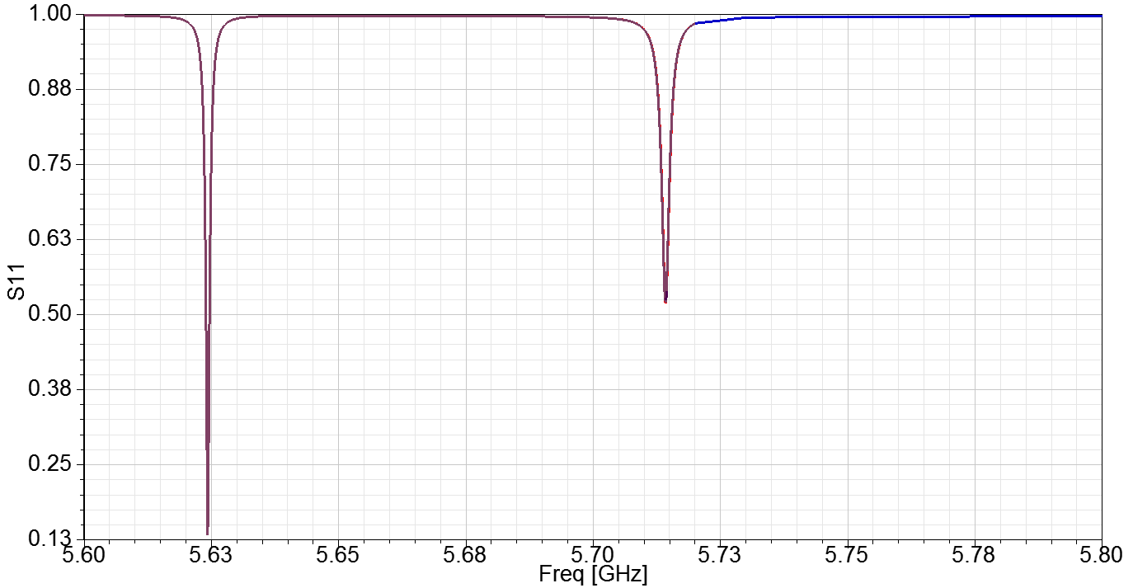
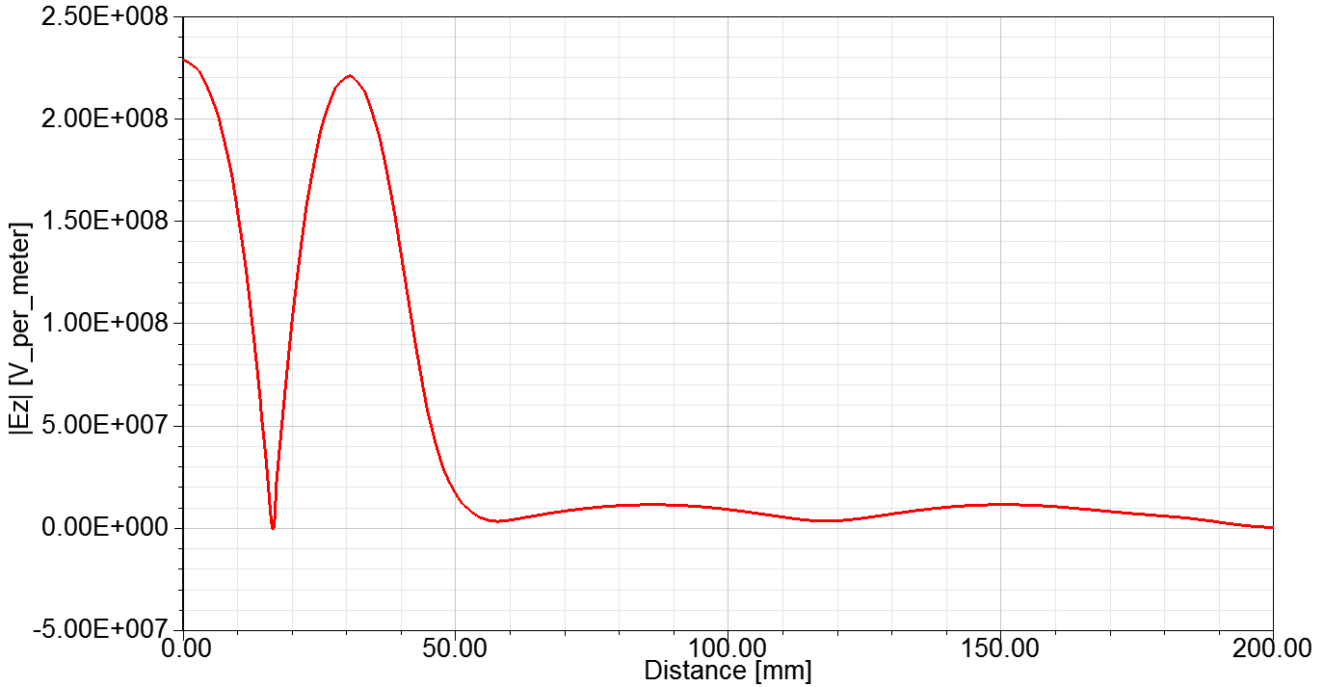
3D ELECTROMAGNETIC DESIGN
laser
A first version of the mode launcher coupler (w/o quadrupole compensation) has been designed.
The S11 put in evidence the presence of the only two modes.
The position of the coupler can be varied according to the BD/solenoid design.
On axis injection with external mirrors is possible.
BD calculations considering the tail of the electric field into the circular waveguide need to be done
(@200 MV/m)
(@240 MV/m)
laser

Slide 8
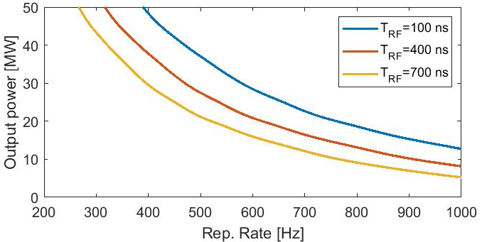
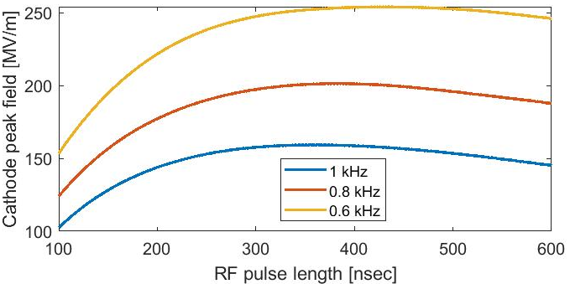
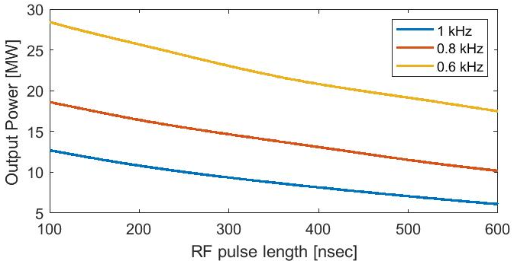
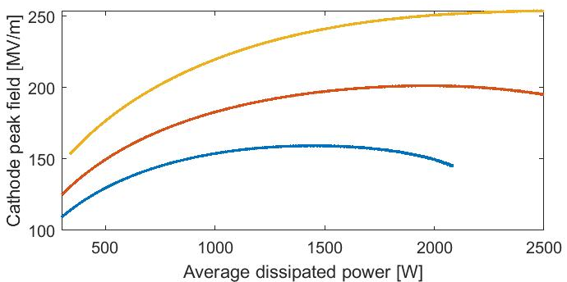
1 KHz OPERATION
(@200 MV/m)
(@240 MV/m)
In this case we reduce the RF pulse but we are dominated by the modulator transients. Looking at the values of the high power C-band klystron Canon (Toshiba) E37212 that are specified for 100 Hz, 50 MW, t_{RF_MAX}=2.5 μs, t_{trans}=2.5 μs, we obtain P_{coll_MAX}≅58kW.
Assuming equivalent transients given by solid state modulators similar to that measured on SPARC C-band klystrons (t_{trans}∼1.2 μs) we obtain:
Mode launcher case
9 MW

Slide 9
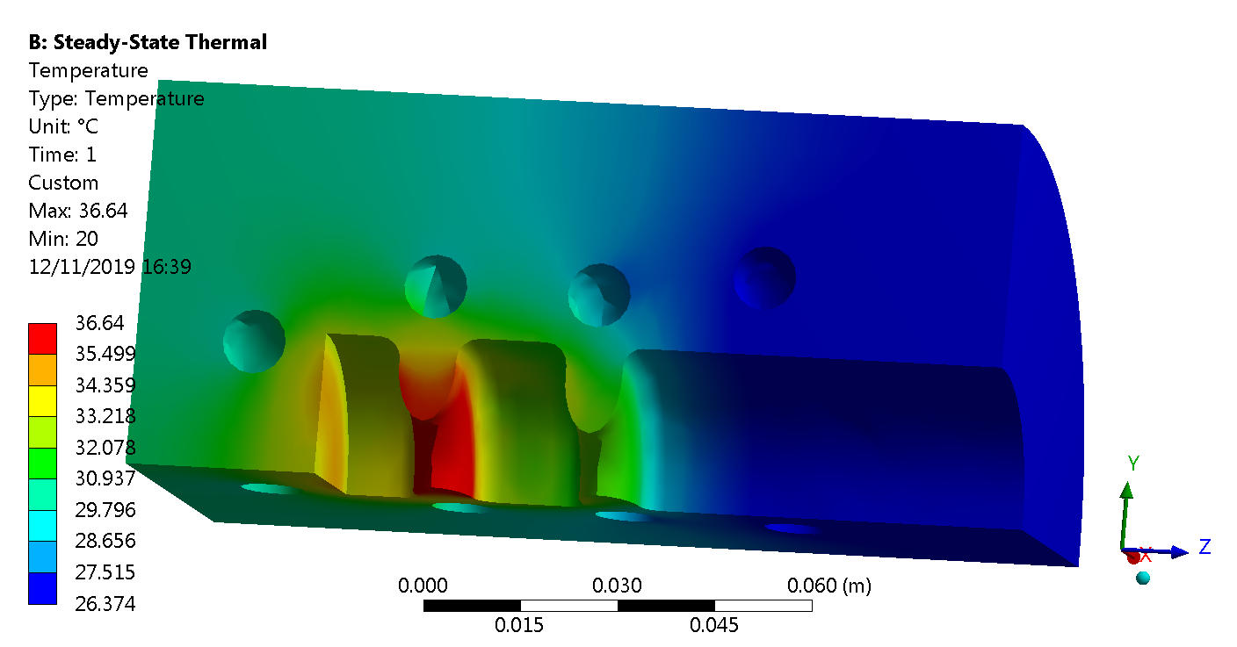
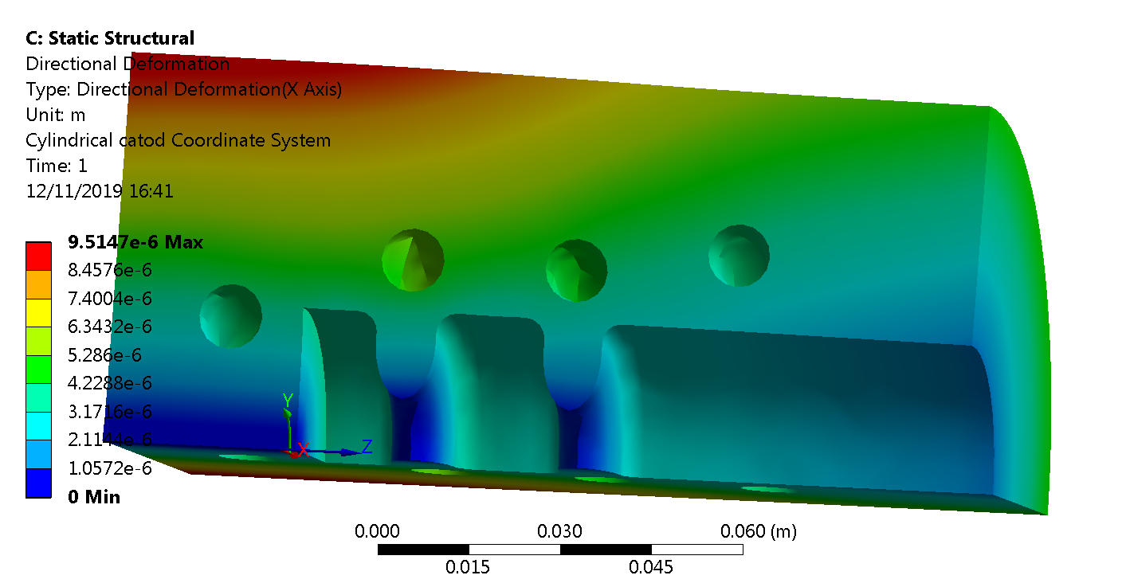
THERMAL ANALISYS (1 KHz REGIME)
We started a thermo-mechanical analysis to investigate the feasibility of the 1 KHz operation.
We use the ansys code. In the figure a preliminary calculation in the case of a 1 KW dissipated power is shown.
Courtesy
L. Pellegrino

Slide 10
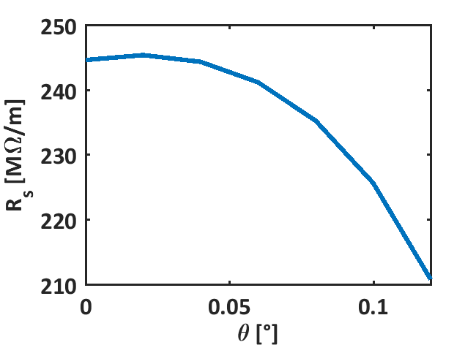
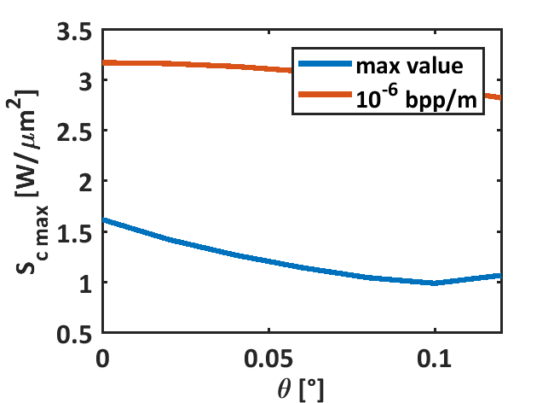
2 m long sections (PSI-LIKE)
Canon E37212
(@240 MV/m)
Acc. Structure
Phase advance | 2pi/3
Cell length [mm] | 17.495
Number of cells | 114
Total length [m] | 1.9945
Average iris radius [mm] | 6.6
Tapering angle [deg] | 0.02
Iris radius (first - last) [mm] | 6.945 – 6.255
Shunt imp. [MOhm/m] | 78.5-85
Q | 10209-10170
Group velocity/c [%] | 2-1.4
Filling time [ns] | 403
Repetition rate [Hz] | 100 | 1000
BOC | ON | Bypassed
Kly. Pow./struct. [MW] | 13 | 8
Avg. acc. gradient [MV/m] | 40 | 15.6
RF system
Operating frequency [GHz] | 5.712
Klystron pulse length [us] | 3
Klystron peak power (Net) [MW] | 50 (40)
Pulse rate [pps] | 100
Q0 of BOC | 216000
Qe of BOC (optimized) | 24700
(@200 MV/m)
100 Hz: 40 MV/m w/ 1 klystron for 3 structures (considered 20 MW per structure).
1 kHz: <20 MV/m w/ 1 klystron for 1 structure (BD check is required).
PRELIMINARY BETTER RESULTS W/ SHORTER STRUCTURES.

Slide 11
WP4 Task 1: Layout and optimization of the linac rf system
Second CompactLight Annual Meeting,
Athens 21-24/01/2020
M. Diomede (INFN-LNF)
On behalf of the XLS WP4 Study group @ LNF

Slide 12
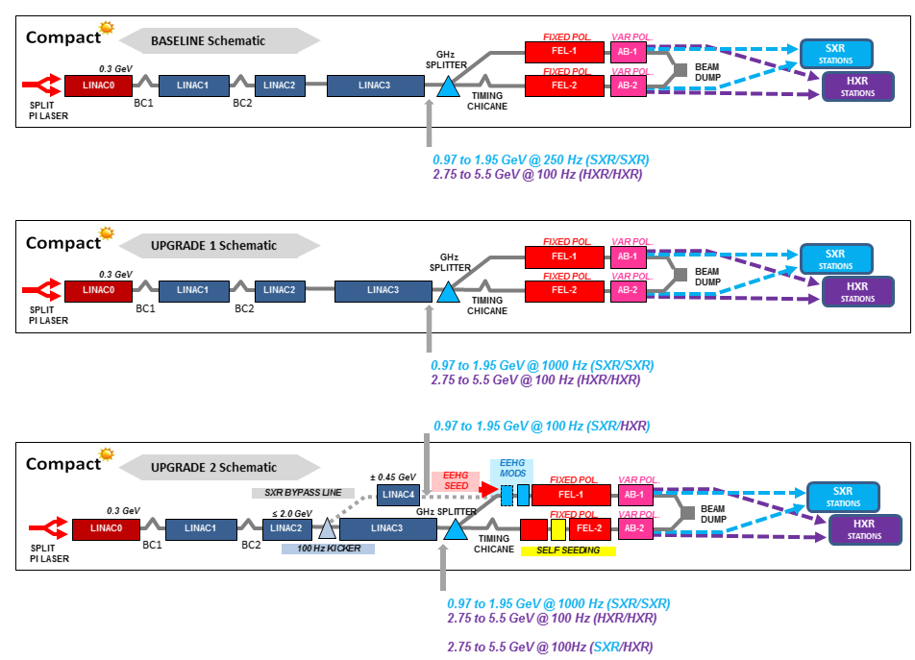
Layouts
Baseline (1 RF source):
Twin bunches (2-colors)
RF in dual mode
  SXR @250Hz
  HXR @100Hz
Variable pol.
Upgrade-1 (2 RF sources):
RF in dual source (combined)
  SXR @1kHz
  SXR & HXR NOT in parallel
Upgrade-2 (2 RF sources):
RF in dual linac
100 Hz kicker
  SXR & HXR @100Hz
Seeding (self-, external)

Slide 13
ACCELERATING STRUCTURE AND MODULE: PARAMETERS
Parameter | Value
Frequency [GHz] | 11.9942
Phase advance per cell [rad] | 2π/3
Shunt impedance R [MΩ/m] | 90-131
Effective shunt Imp. R_{s} [MΩ/m] | 387
Group velocity v_{g} [%] | 4.7-1.0
P_{out}/P_{in} | 0.215
Filling time [ns] | 144
Number of cells per structure | 108
Unloaded SLED Q-factor Q₀ | 180000
External SLED Q-factor Q_{E} | 23000
# structures per module N_{m} | 4
Module active length L_{mod} [m] | 3.6
Average iris radius <a> | 3.5
Iris radius input-output [mm] | 4.3-2.7
Structure length L_{s} [m] | 0.9
Accelerating cell length [mm] | 8.332
 | Rep. rate [Hz]
 | 100 | 250 | 1000
Average gradient <G> [MV/m] | 65 | 32 | 30.4
Max klystron available output power [MW] | 50 | 50 | 10
Required input power per module P_{K} [MW] | 39 | 42.5 | 8.5
RF pulse [µs] | 1.5 | 0.15 | 1.5
SLED | ON | OFF | ON
Av. diss. power per structure [kW] | 1 | 0.31 | 2.2
Peak input power per structure [MW] | 68 | 10.6 | 14.8
Av. Input power per structure [MW] | 44 | 10.6 | 9.6
Module energy gain [MeV] | 234 | 115 | 109

Slide 14
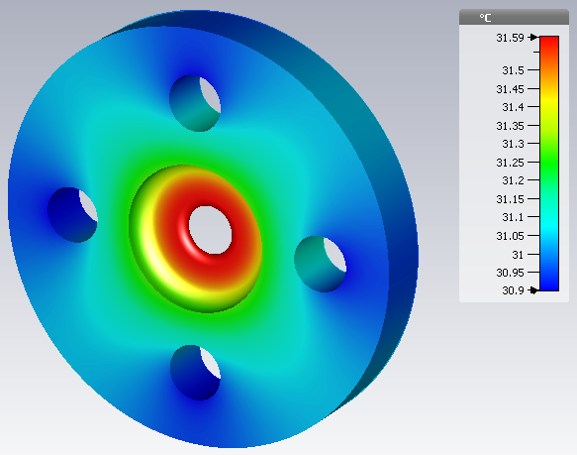
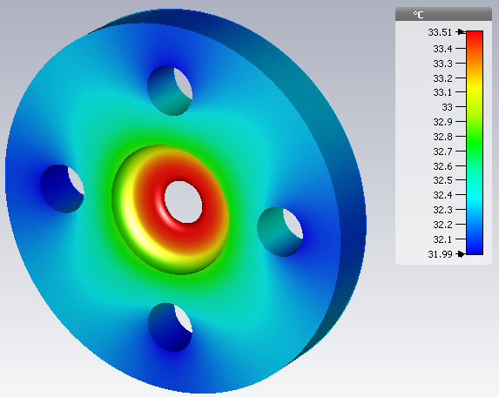
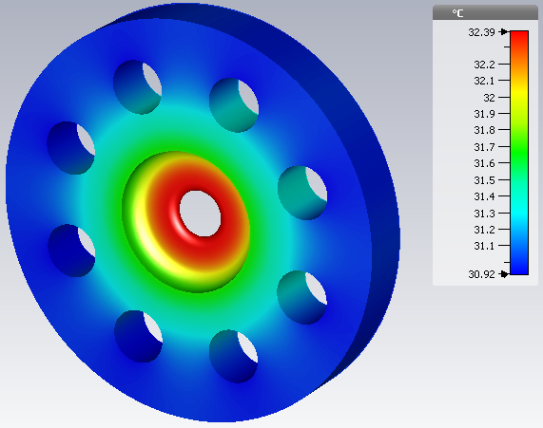
Thermal analysis with CST of the average cell
Pdiss=9 W
Pdiss=19 W
Pdiss=19 W
100 Hz
4 channels
1 kHz
4 channels
1 kHz
8 channels
Water temperature: 30°C
Collaboration with L. Faillace (INFN)

Slide 15
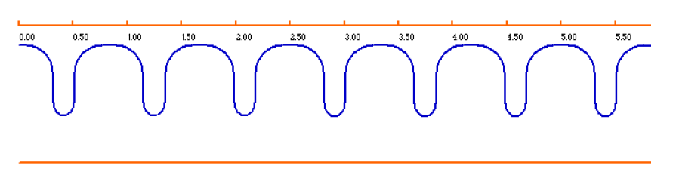
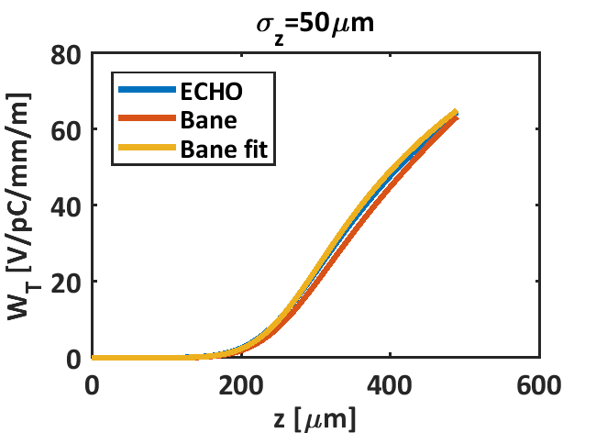
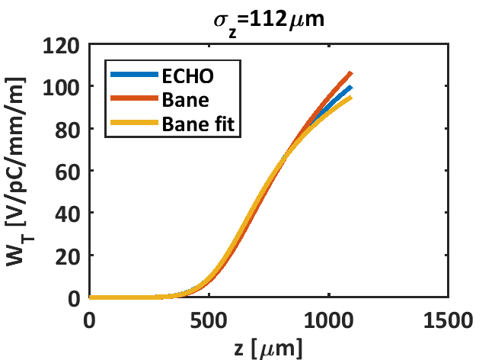
Short range wakefield with ECHO (EuPRAXIA case)
Wake potential

Slide 16
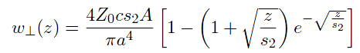
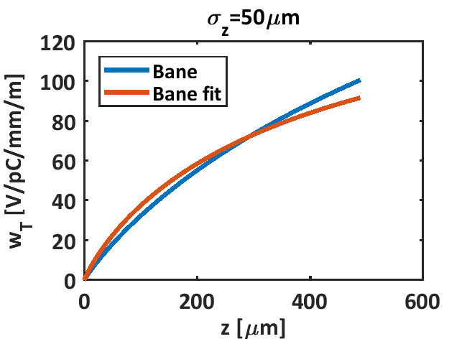
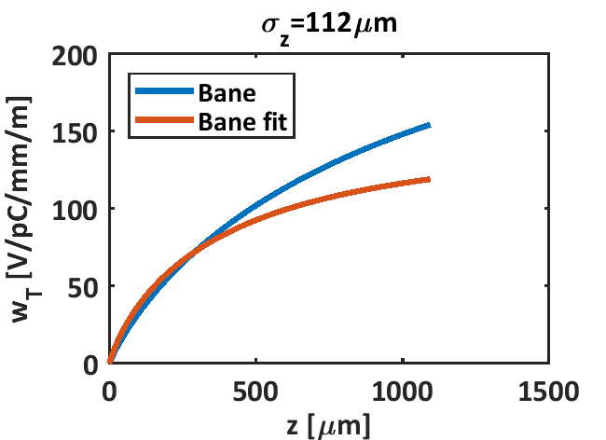
Short range wakefield with ECHO (EuPRAXIA case)
Fitted formula
a=3.5mm
A=1.48
s₂ =9.948 × 10⁻⁵
Wake function

Slide 18

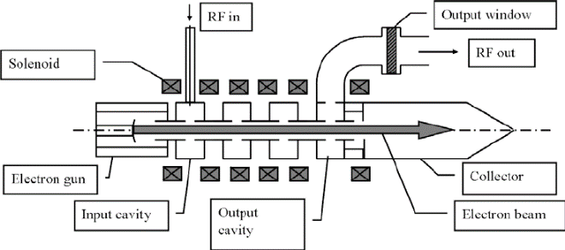
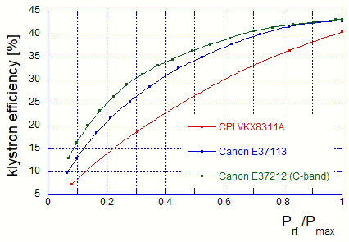
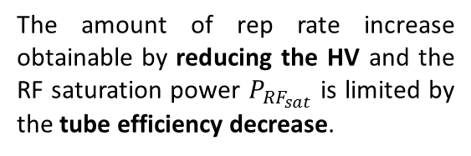
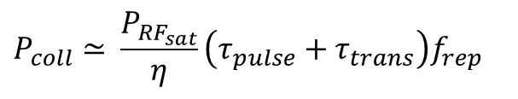
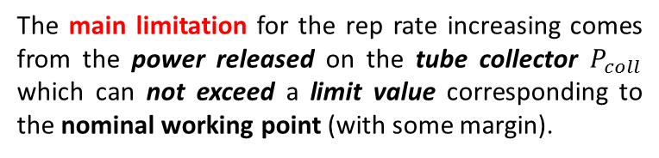
HIGH REPETITION RATE OPERATION
The high repetition rate operation is limited by two effects:
The average dissipate power in the structure: is someting manageable.
The main limitation for the rep rate increasing comes from the power released on the tube collector $P_{coll}$ which can not exceed a limit value corresponding to the nominal working point (with some margin).
The amount of rep rate increase obtained by reducing the pulse duration depends very much on the actual value of the dead time τ_{trans}, which is a characteristics of the modulator.
Klystron efficiency vs. power derating
$$P_{coll}≃​​\frac{P_{RF_{sat}}}{η}\left(τ_{pulse}+τ_{trans}\right)f_{rep}$$
The klystron operational rep rate can be increased at expenses of the saturated RF power (by decreasing the tube HV) and/or the pulse duration
The amount of rep rate increase obtainable by reducing the HV and the RF saturation power $P_{{RF}_{sat}}$ is limited by the tube efficiency decrease.

Slide 19

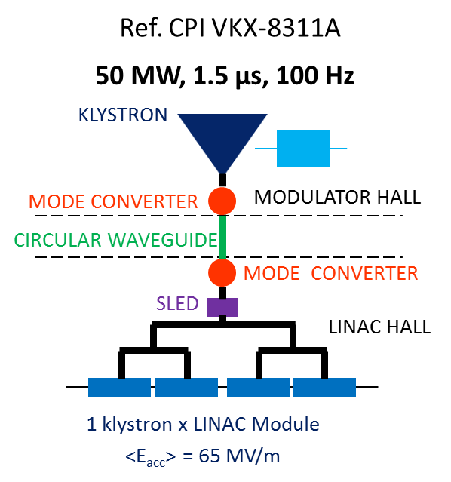
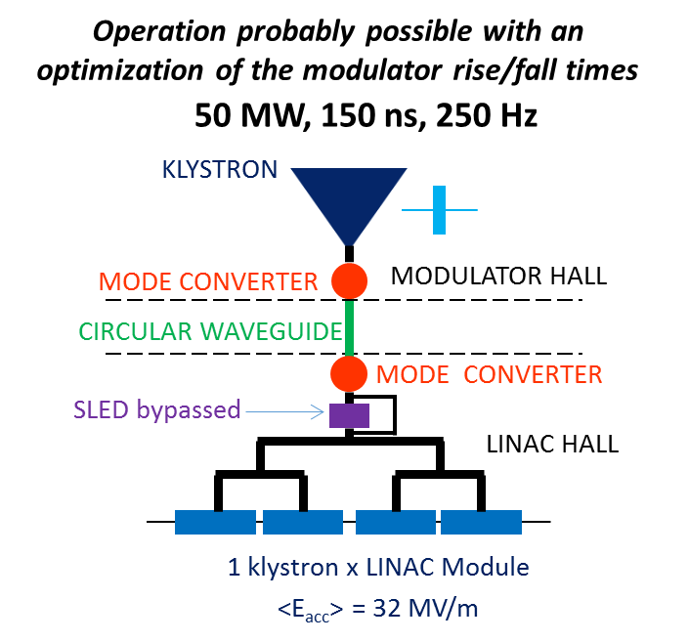
HIGH REP. RATE 1st SCENARIO: pulse shortening with high peak power klystrons
Accelerating gradient and Linac energy reduced by a factor ∼2 @ 250 Hz rep rate;
The SLED has to be bypassed;
Klystron operated always at its nominal working point (good!);
Max rep rate very much dependent on modulator rise/fall times τ_{trans}

Slide 20
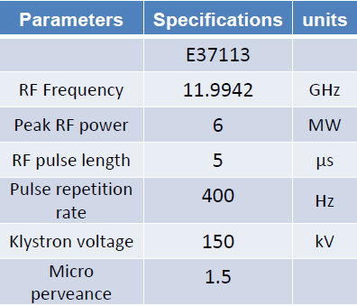
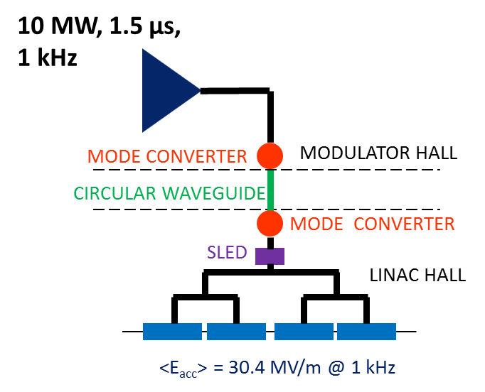
HIGH REP. RATE 2nd SCENARIO:
LOW POWER HIGH REP. RATE KLYSTRONS
Reference RF source CANON Commercially available
10 MW, 1.5 µs, 1 kHz, operation probably possible in the near future
1 kHz rep rate capability, with linac energy up to ≈ 47% of the max value;
R&D activity in progress @CANON and CPI on high rep. rate klystrons towards 10 MW, 1.5 µs, 1 kHz

Slide 21
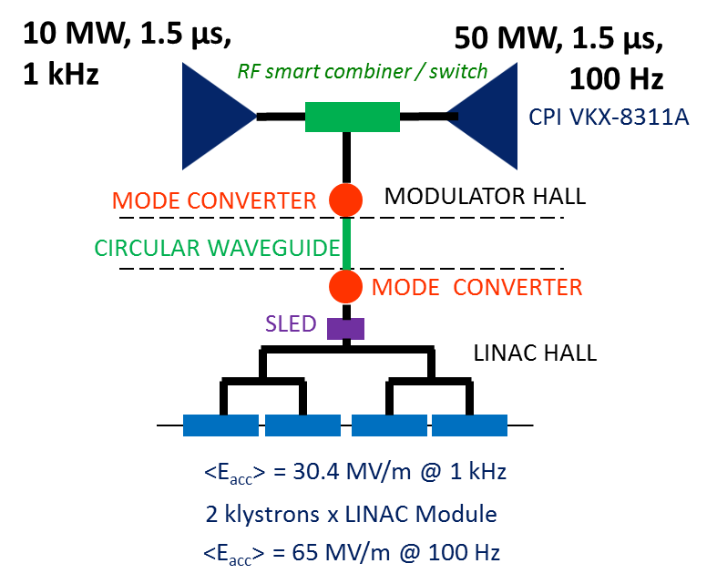
HIGH REP. RATE 3rd SCENARIO:
COMBINATION OF HIGH REP. RATE AND LOW REP. RATE KLYSTRONS
Reference RF source CANON
10 MW, 1.5 µs, 1 kHz, operation probably possible in the near future
Switching or combining 2 sources would preserve high gradient at low rep rate;
If source combination is possible, gradients > 30 MV/m available at rep rates ≤ 250 Hz;

Slide 22
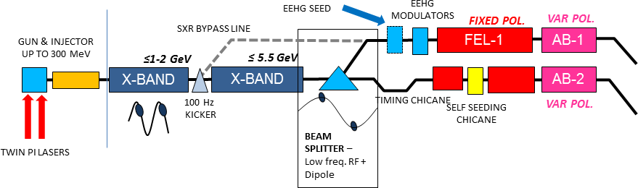
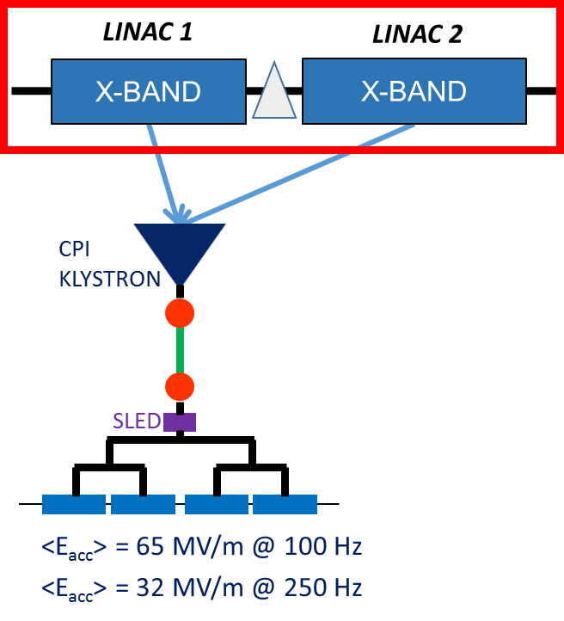
1st OPTION: DUAL MODE
Single rf source
single linac run in two operating modes
Cheapest
Limited increase in repetition rate (SLED by-passed)
Linac optics needs to operate at two gradient
Parameter | LINAC 1 | LINAC 2 | TOTAL
Number of structures | 32 | 60 | 92
Number of modules | 8 | 15 | 23
Number of klystrons | 8 (CPI) | 15 (CPI) | 23
Linac active length [m] | 29 | 54 | 83
Rep. rate [Hz] | 100 (250)
<E_{acc}> per struct. [MV/m] | 65 (32)
Energy gain per module [MeV] | 234 (115)
Max. Energy gain [MeV] | 1872 (921) | 3510 (1728) | 5382 (2649)

Slide 23
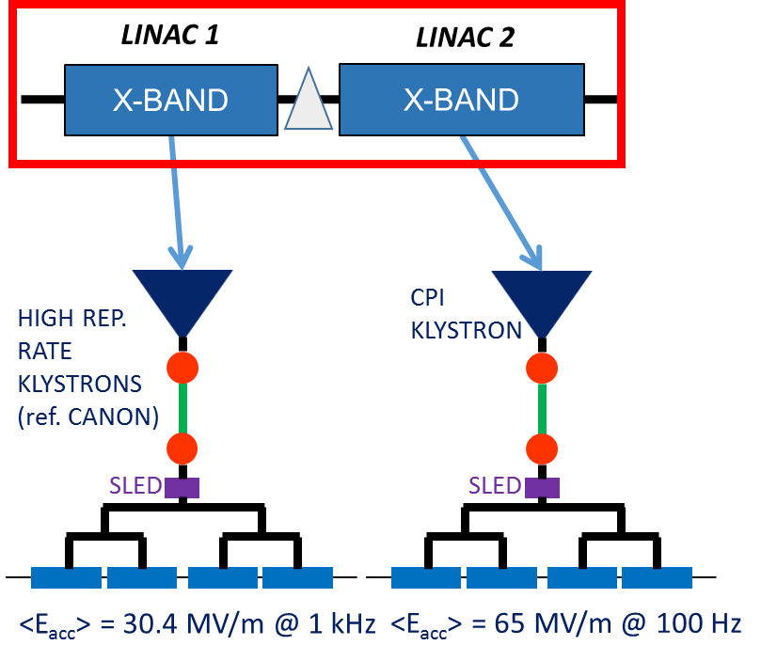
2nd OPTION: DUAL LINAC
two distinct linacs with different rf sources
SXR@ 1 kHz
HXR@ 100 Hz
SXR@ 900 Hz and HXR@ 100 Hz running in parallel
Parameter | LINAC 1 | LINAC 2 | TOTAL
Number of structures | 68 | 60 | 128
Number of modules | 17 | 15 | 32
Number of klystrons | 17 (HRR) | 15 (CPI) | 32
Linac active length [m] | 61 | 54 | 137
<E_{acc}> per struct. [MV/m] | 30.4 | 65 | -
Rep. rate [Hz] | 1000 | 100 | -
Energy gain per module [MeV] | 109 | 234 | -
Max. Energy gain [MeV] | 1853 | 3510 | 5363

Slide 24
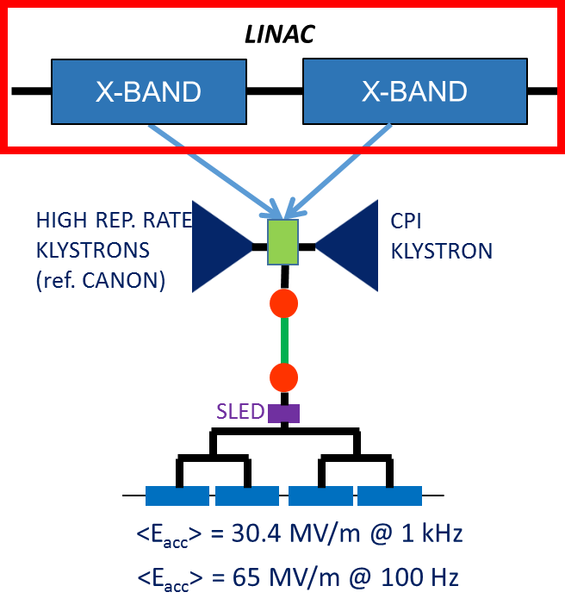
3rd OPTION: DUAL SOURCE
Single linac with two sources
SXR@ 1 kHz
HXR@ 100 Hz
SXR and HXR CANNOT run in parallel
Parameter | LINAC
Number of structures | 92
Number of modules | 23
Number of klystrons | 23 (HRR) + 23 (CPI)
Linac active length [m] | 83
<E_{acc}> per struct. [MV/m] | 30.4 (@1 kHz), 65 (@ 100 Hz)
Rep. rate [Hz] | 100-1000
Energy gain per module [MeV] | 109 (@1 kHz), 234 (@ 100 Hz)
Max. Energy gain [MeV] | 2507 (@1 kHz), 5382 (@ 100 Hz)

Slide 25
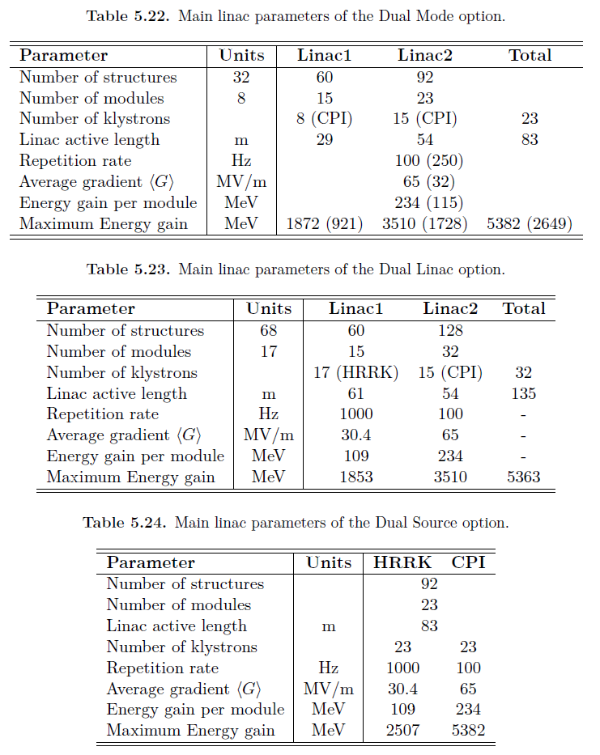
ACCELERATING STRUCTURE AND MODULE: PARAMETERS

Slide 26
Short range wakefield with ECHO (EuPRAXIA case)
Wake potential
Wake function

Slide 27
Short range wakefield with ECHO (EuPRAXIA case)
Fitted formula
a=3.5mm
A=1.48
s₂ =9.948 × 10⁻⁵

