Slide 1
Wakefield Effects in Undulators
Zafer Nergiz
Niğde Ömer Halisdemir University, Physics Department
(Ankara University Institute of Accelerator Technologies )

Slide 2
Outline
Effects of wakefield
Model for resistive wakefield
Parameters
GENESIS Simulation results
Conclusion

Slide 3
Effect of the wakefield
Wakefields such as the resistive wall and the surface roughness wakefields inside an undulator can cause significant electron beam energy loss and energy spread growth.
Such energy loss inside an undulator can induce energy variation along the bunch length
That will limit the performance of the undulator and the quality of the final FEL radiation.
For FEL sources, like LCLS II and SwissFEL, Resistive wall wakefield is much more dominant.
In this presentation the effect of the resistive wall wakefield to the FEL performance is investigated for Hard x-ray parameters.

Slide 4



Model for resistive wake potantial
In GENESIS, the energy loss due to the wake potential along the bunch should be entered from a data file.
Therefore, the wake potential is calculated from Bane’s paper formula (Resistive wall wakefield in the LCLS undulator beam pipe, SLAC-PUB-10707,LCLS-TN-04-11, Revised, October 2004).
The wakefield is
τ is relaxation time and s₀ is characteristic distance. The characteristic distance is
where a is beam pipe radius and σ is conductivity.

Slide 5
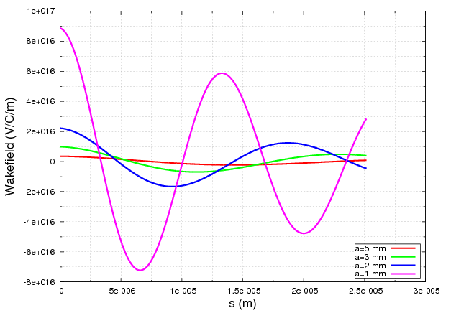
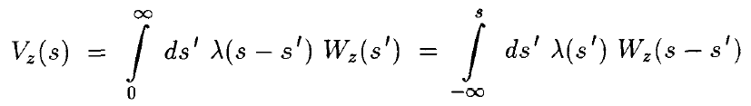
Calculation of wake function
Single particle wake function inside the normal conducting undulator (Cu) for different aperture
The wakefield within a bunch can be calculated by

Slide 6
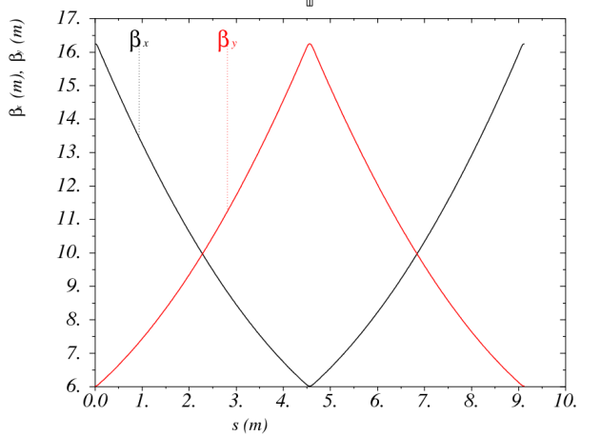
The Parameters for HXR
The undulator parameters and electron beam energies are chosen to cover the photon energy between 0.8 Å and 6 Å for hard x-ray beam line.
The electron beam parameters are from Jim Clark’s presentation at Helsinki meeting.
Undulator period and strengths are choosen to make the FEL wavelengths 0.76 Å , 1 Å and 6 Å.
The Lattice is FODO and average beta values are 11 m
Electron Beam Parameters
Electron beam energy (GeV) | 5.5 |  | 2.8
Bunch Charge (pC) | 75
RMS Bunch length (micro m) | 1.31
Peak Current (A) | 5000
Energy Spread (%) | 0.01
N. Emit x (mm mrad) | 0.2
N. Emit y (mm mrad) | 0.2
Betax Average (m) | 11
Betay Average (m) | 11
Undulator Parameters
Undulator period (cm) | 1.5 |  |  | 1.5
Undulator strength (K_{rms}) | 0.431 | 0.707 |  | 1.181
Number of period | 280 |  |  | 280
Distance between undulators (cm) | 36 |  |  | 36
Radiation Parameters
Wavelength (Å) | 0.767 | 0.97 |  | 5.98
Peak Power (GW) | 4.5 | 7 |  | 11
Saturation length (m) | 37 | 25 |  | 12

Slide 7
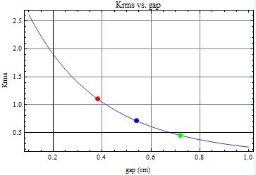

Undulator
The parameters investigated for the hybrid planar undulator given in Neil’s Helsinki presentation.
c₁=3.67, c₂=-5.08, c₃=1.54
The RMS K Value for the hybrid undulator with undulator period 1.5 cm versus gap graphic is given in Figure.
For 5.5 GeV (0.767 Å ) the required K_{rms} value can be produced at 7.42 mm gap. For 1 Å required gap is 5.4 mm.
For 2.8 GeV (5.98 Å) the required K_{rms} value can be produced at 3.6 mm gap.
Krms=1.18
Krms=0.70
Krms=0.43

Slide 8
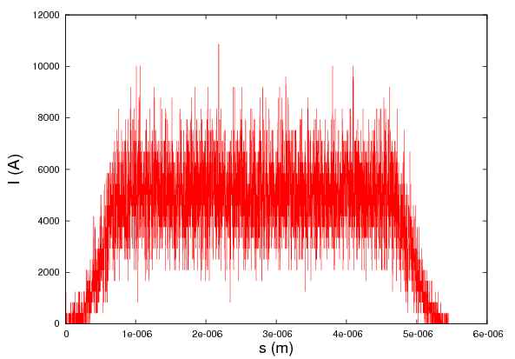
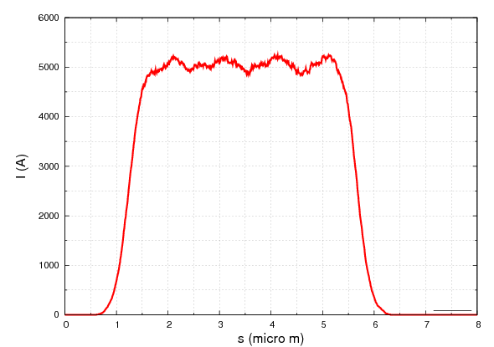
GENESIS Simulation
In simulations the resistive wall wake field with parallel plat configuration (for in-vacuum undulator) is taken in account .
In the calculation the resistivity and relaxation time for Copper (Cu) are used (ρ=1.68x10⁻⁸ Ωm, τ=2.4x10⁻¹⁴ s).
The beam distribution generated according the values in the table which is given before is used in the simulation.
Generated distribution
Ploted distribution from Genesis Output

Slide 9
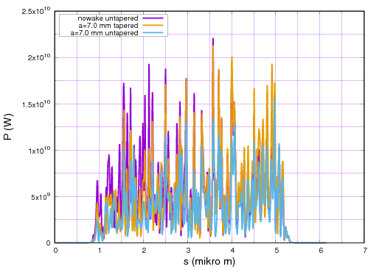
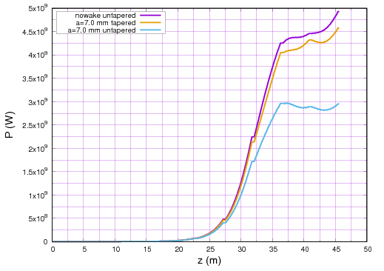
Simulation results for 5.5 GeV (0.76 Å)
Simulation results for 5.5 GeV (0.76 Å) for different aperture values: Left is laser temporal profile at saturation (37 m) and right is power evolution in undulators.
The tapering is solution partially negative effect of wake.

Slide 10
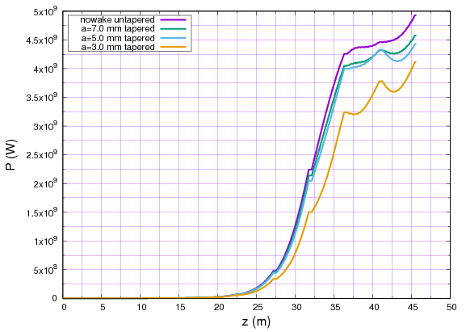
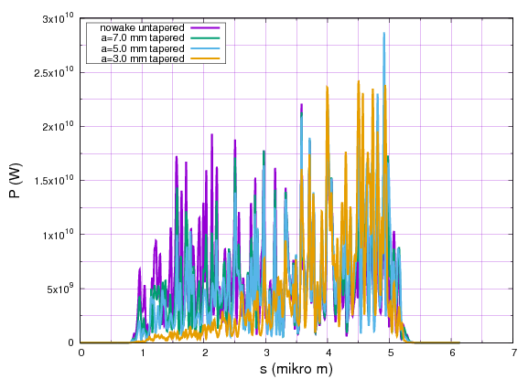
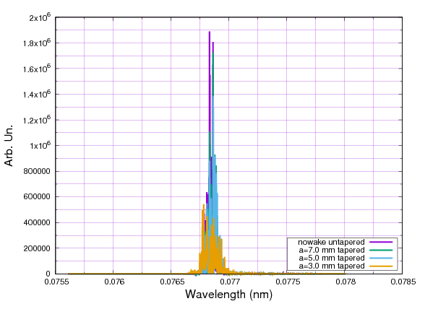
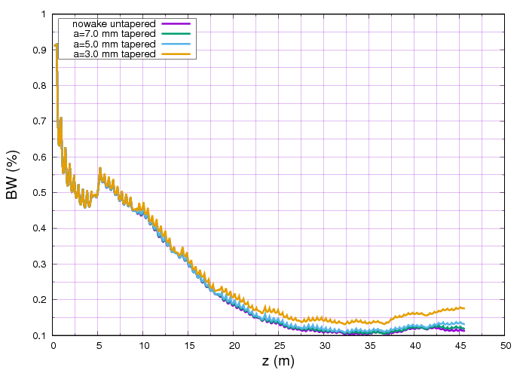
Simulation results for 5.5 GeV (0.76 Å)
Laser profile at saturation (37 m)
The evolution of FEL power along the undulator section.
FEL wavelength spectra
The evolution of FEL badwidth along the undulator section.
Resistive wakefield has strong impact to the FEL peak power and laser temporal profile. By using tapered undulator (∼0.5%) the negative effect of wake can be compensated. The profile start to distort for the apertures below 5 mm.

Slide 11
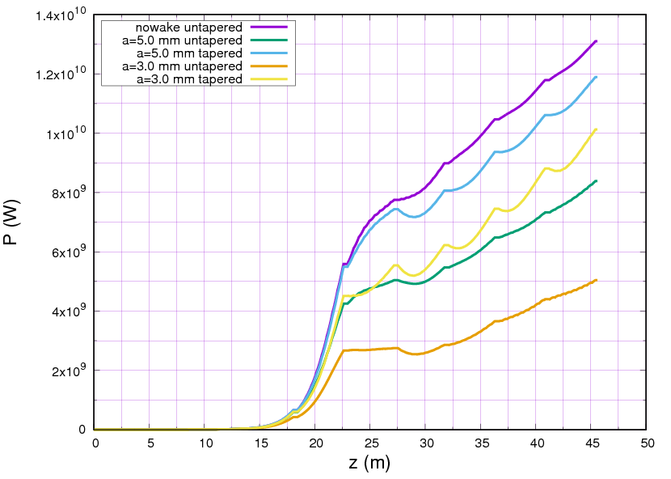
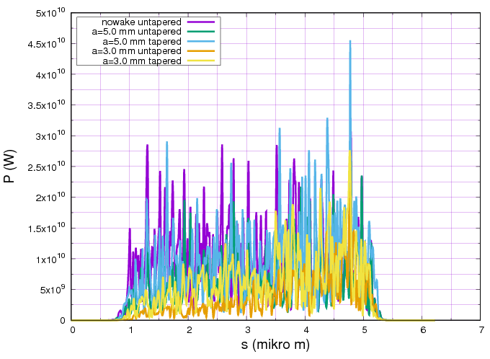
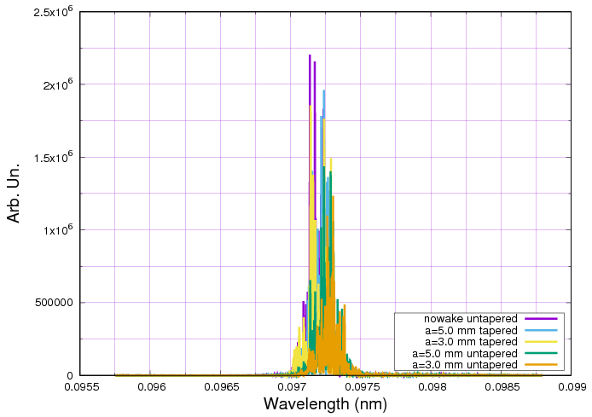
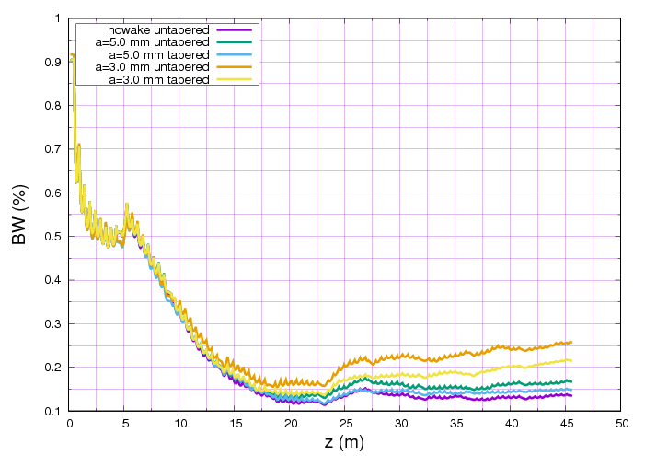
Simulation results for 5.5 GeV (0.97 Å)
Laser profile at saturation (25 m)
The evolution of FEL power along the undulator section.
The evolution of FEL badwidth along the undulator section.
FEL wavelength spectra
By using tapered undulator (∼ 0.2%) the negative effect of wake can be effectively compensated for 5 mm aperture.

Slide 12
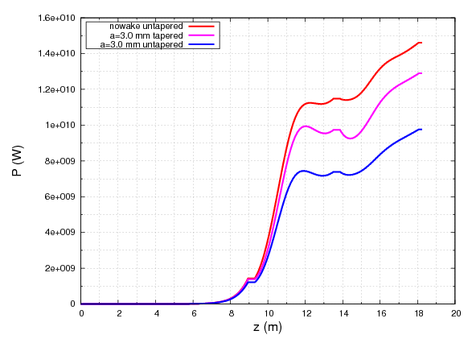
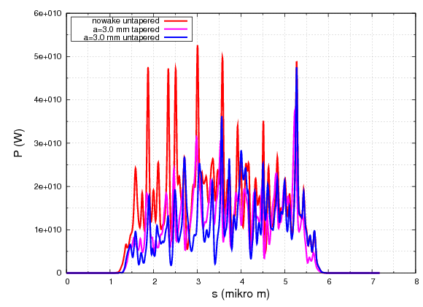
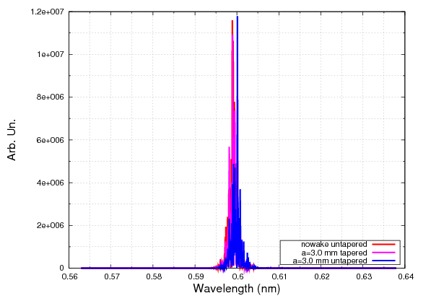
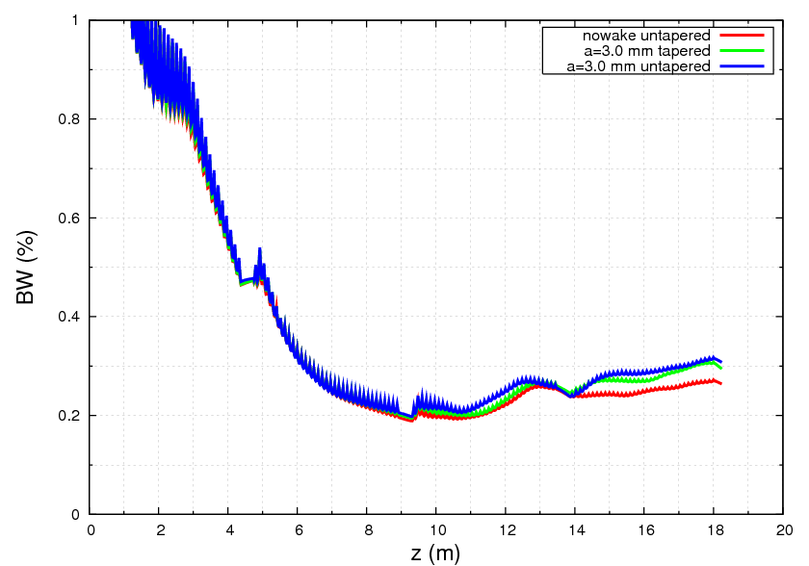
Simulation results for 2.8 GeV (5.96 Å)
The evolution of FEL power along the undulator section.
Laser profile at saturation (12 m)
FEL wavelength spectra
The evolution of FEL bandwidth along the undulator section.
The distortion starts around 3 mm for 2.8 GeV 5.96 Å . In case of the use of tapering (∼ 0.2) the 3 mm gap can be acceptable.

Slide 13
Conclusion
For the chosen parameters at 5.5 GeV, resistive wakefield has strong impact to the FEL peak power and laser temporal profile.
The profile start to distort for the apertures below 7 mm for 0.76 Å. By using tapered undulator the negative effect of wake can be compensated.
The distortion start around 3 mm for 2.8 GeV case.
In case of the use of tapering the 3 mm gap can be acceptable.
Therefore the hybrid undulator can be used (1.5 cm undulator period) to produce FEL between 0.76-6 Å with chosen energies.

