Slide 1
Two-mode Linac Design for the C-band Injector Option
Xingguang Liu*(CERN), Michele Croia(INFN), Xiaowei Wu(CERN) and Andrea Latina(CERN)
Second CompactLight Annual Meeting
21-24 January 2020
Athens, Greece
xingguang.liu@cern.ch

Slide 2
OUTLINE
Baseline layout and two modes
C-band injector distributions
Linac Design Settings
Design Results
Conclusion and coming work

Slide 3
Baseline Layout and Two modes
Baseline Layout* for CompactLight
*https://espace.cern.ch/compactlight/_layouts/15/start.aspx#/XLS%20wiki/XLS%20with%20upgrade%201%20applied.aspx
2 klystrons x LINAC Module*
Module Design
(M. Aicheler, Aug 2019, WP4)
<E_{acc}> = 65 MV/m @ 100 Hz
(HX mode)
<E_{acc}> = 22.7 MV/m @ 1 kHz
(SX mode)
for E < 2GeV, 5.10 m, RF-fill factor: 71%
Quad contains BPM&Corrector
Sector valve
Conn.
Quad
Quad
Quad
Quad
6 MW 1.5 µs
1 kHz
RF smart combiner / switch
50 MW
1.5 µs
100 Hz
Acc-Structure
Acc-Structure
Acc-Structure
Acc-Structure
Two WFM per AS with pumping
10cm
103cm
5cm
12cm
MODE CONVERTER
MODULATOR HALL
For E<5.5GeV, 4.76 m; RF-fill factor: 76%
Quad contains BPM&Corrector
CIRCULAR WAVEGUIDE
Sector valve
Conn
Quad
Quad
MODE CONVERTER
Acc-Structure
Acc-Structure
Acc-Structure
Acc-Structure
SLED
Two WFM per AS with pumping
LINAC HALL
10cm
103cm
5cm
103cm
5cm
12cm
*https://espace.cern.ch/compactlight/_layouts/15/start.aspx#/XLS%20wiki/Accelerating%20Structure.aspx
Notes:
https://espace.cern.ch/compactlight/_layouts/15/start.aspx#/XLS%20wiki/XLS%20with%20upgrade%201%20applied.aspx

Slide 4
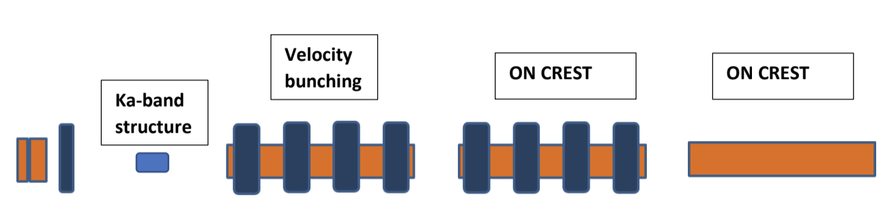
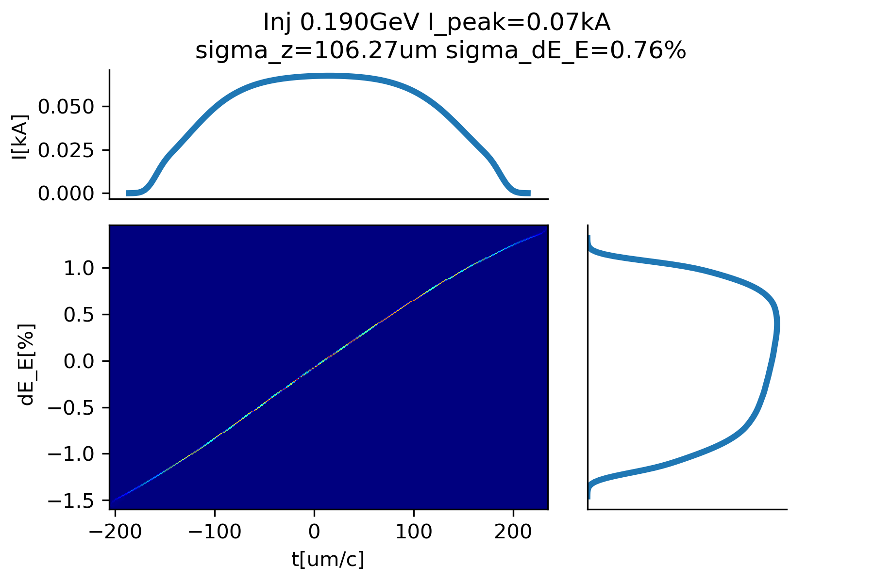
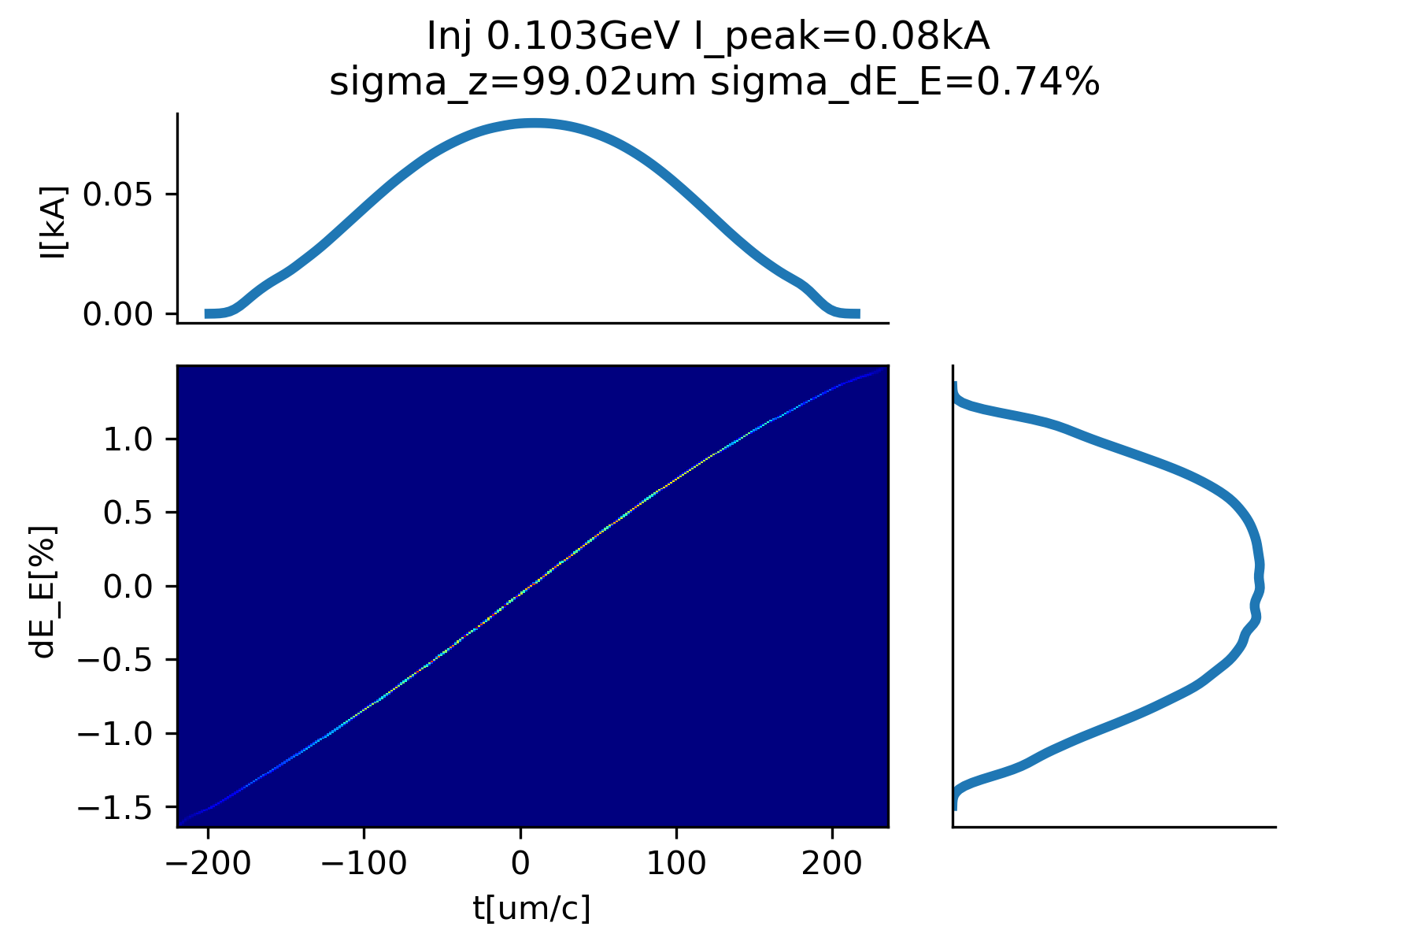


C-band injector in two modes
* See M. Croia’s presentation
C-band injector Layout*
Linac
HX mode: Gun @ 240 MV/m
160 MV/m
Three C-band @ 40 MV/m
20 MV/m
7.4m
Injector output
SX mode:
190 MeV
106 $μm$
103 MeV
99 $μm$
Inj-HX
Inj-SX

Slide 5
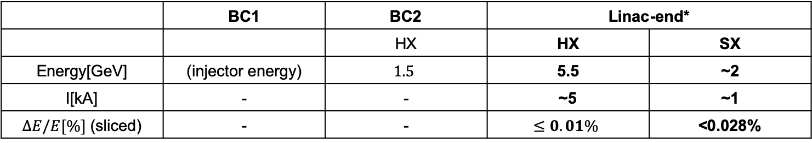


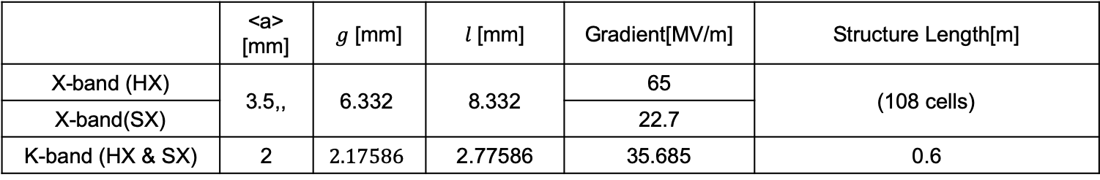


Linac Design Settings
C-band
injector
$$K$$
BC1
Linac-1
Linac-1
BC2
Linac-2
FEL
Linac RF Structure
 | <a> [mm] | $g$ [mm] | $l$ [mm] | Gradient[MV/m] | Structure Length[m]
X-band (HX) | 3.5,, | $$\text{6.332}$$ | 8.332 | 65 | (108 cells)
X-band(SX) |  |  |  | 22.7
K-band (HX & SX) | 2 | $$2.17586$$ | 2.77586 | 35.685 | 0.6
Bunch Compressor: $R_{56}, T_{566}=−\frac{3}{2}{ R}_{56}$
Design Objectives*
 | BC1 | BC2 | Linac-end*
 |  | HX | HX | SX
Energy[GeV] | (injector energy) | $$1.5$$ | 5.5 | ~2
I[kA] | - | - | ~5 | ~1
$ΔE/E[\%]$ (sliced) | - | - | $$≤0.01\%$$ | <0.028%
Design/Simulation Tools: Track1D (by A. Latina) and Octave
* “Electron Beam Parameter”: https://espace.cern.ch/compactlight/_layouts/15/start.aspx#/XLS%20wiki/Parameters%20and%20user%20requirements.aspx

Slide 6
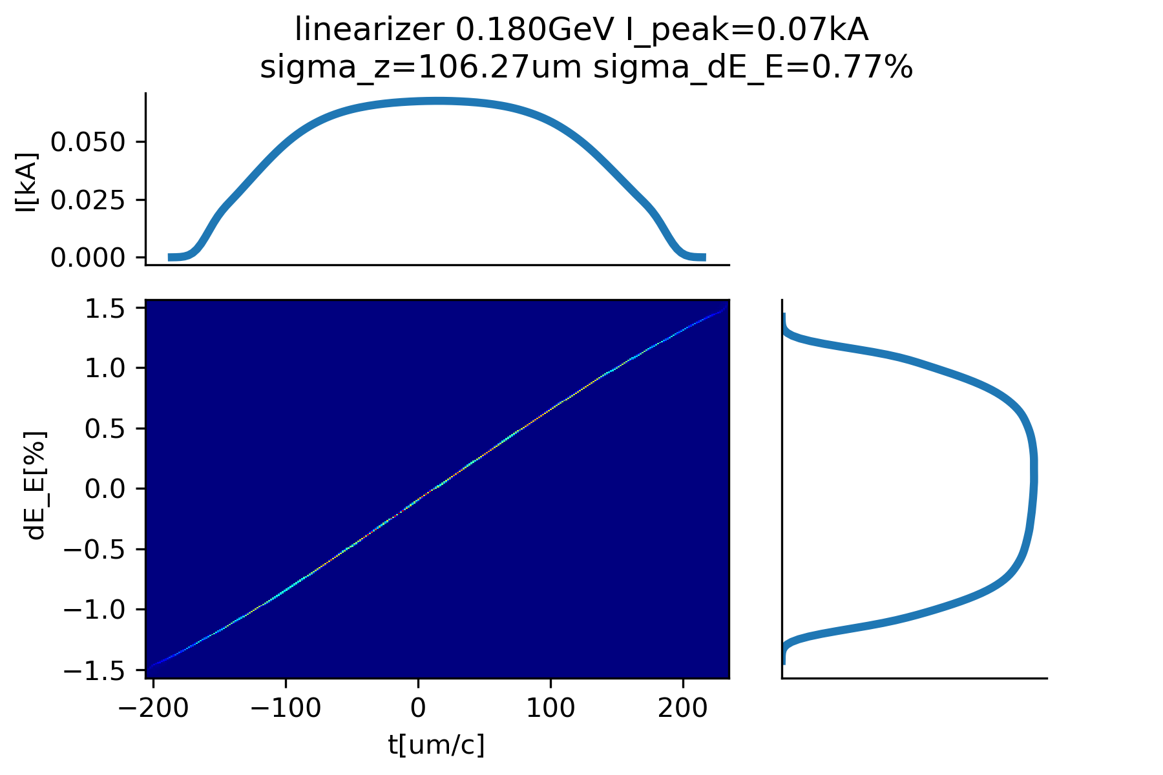
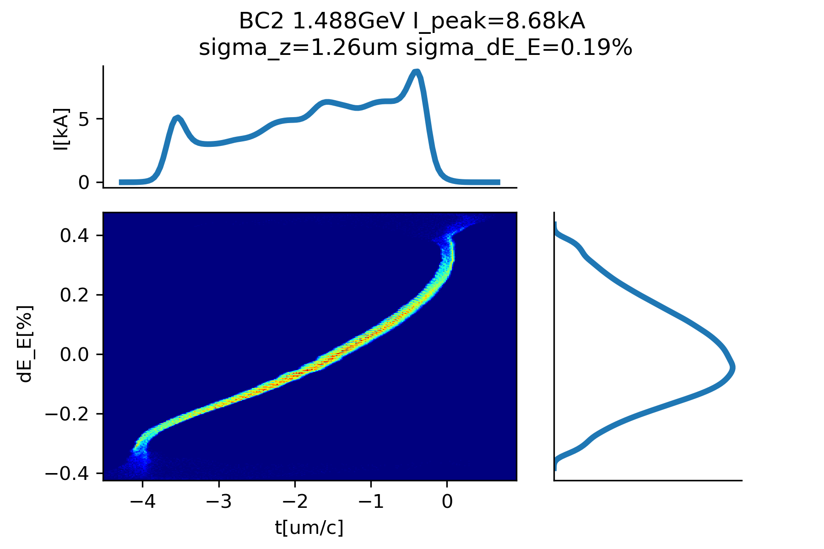
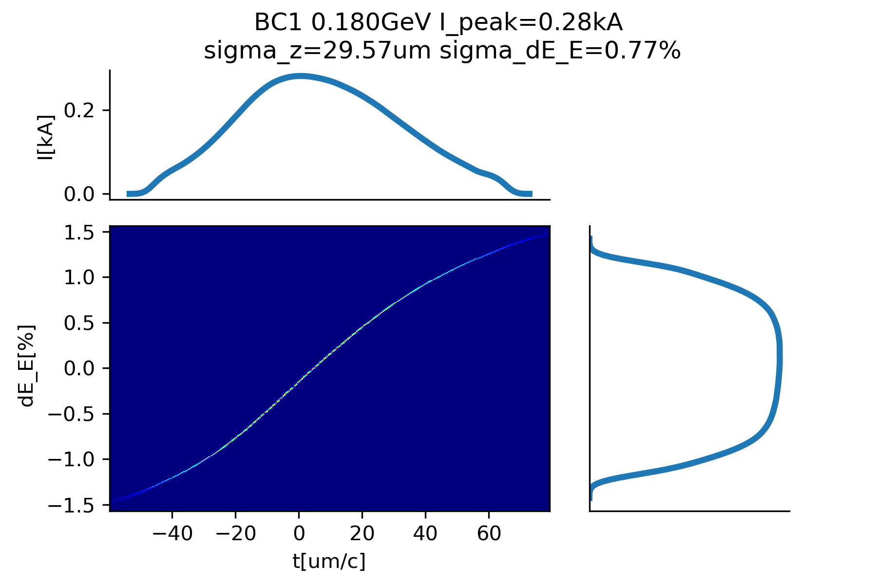
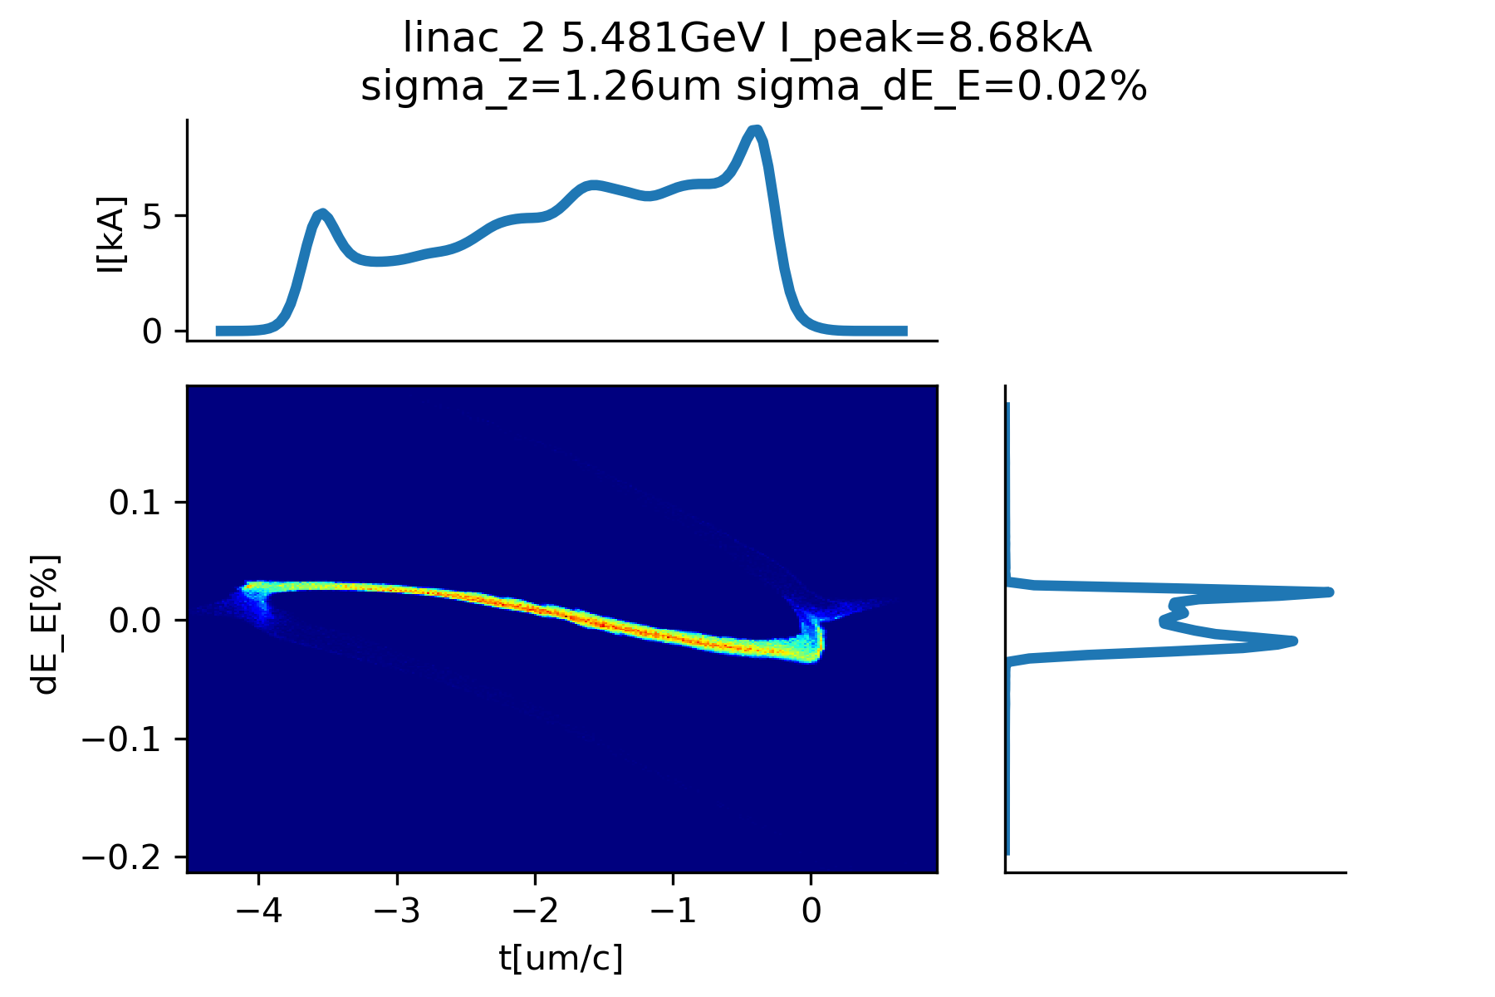







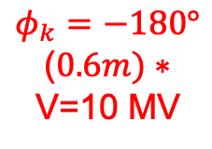



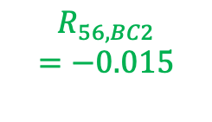
Phase Space: HX mode
$$φ_{k}=−180°$$
($0.6m)∗$
V=10 MV
180 MeV
106 $μm$
1.5 GeV
1.3 $μm$
(1)Linearizer
$$R_{56, BC1}$$
$$=−0.01$$
$$R_{56, BC2}$$
$$=−0.015$$
(3)BC2
C-band
injector
$$K$$
BC1
Linac-1
Linac-1
BC2
Linac-2
$$φ_{1}=14°$$
$$n=6$$
$$φ_{2}=10°∗$$
$$n=18$$
(4)
(1)
(2)
(3)
(module number)
5kA
180 MeV
30 $μm$
5.5 GeV
1.3 $μm$
(2)BC1
(4)Linac-end
(* this is only the RF structure length)

Slide 7
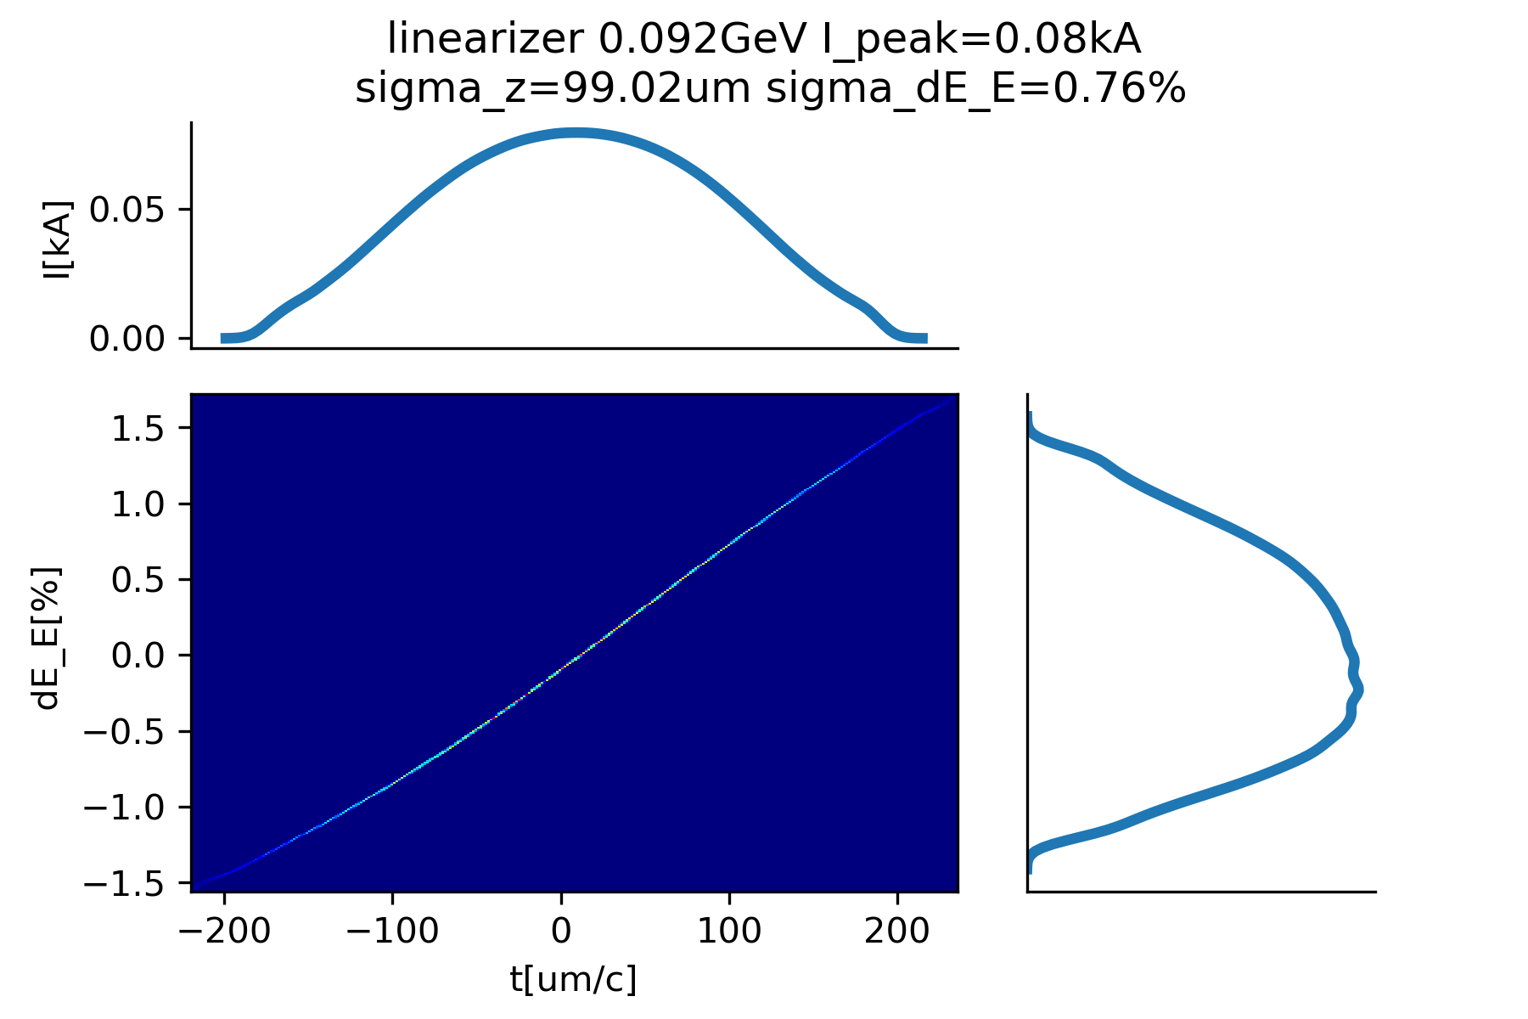
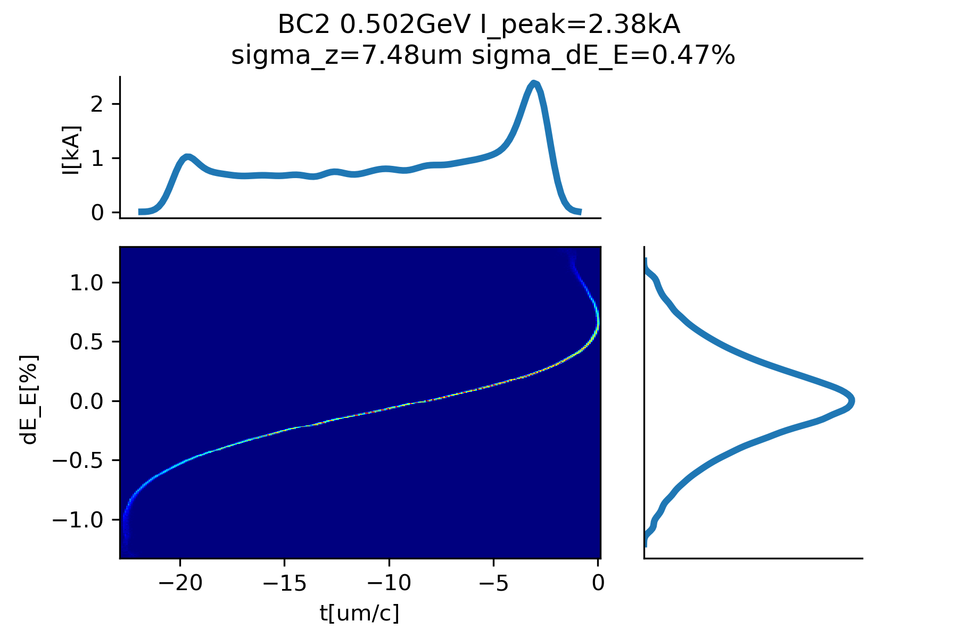
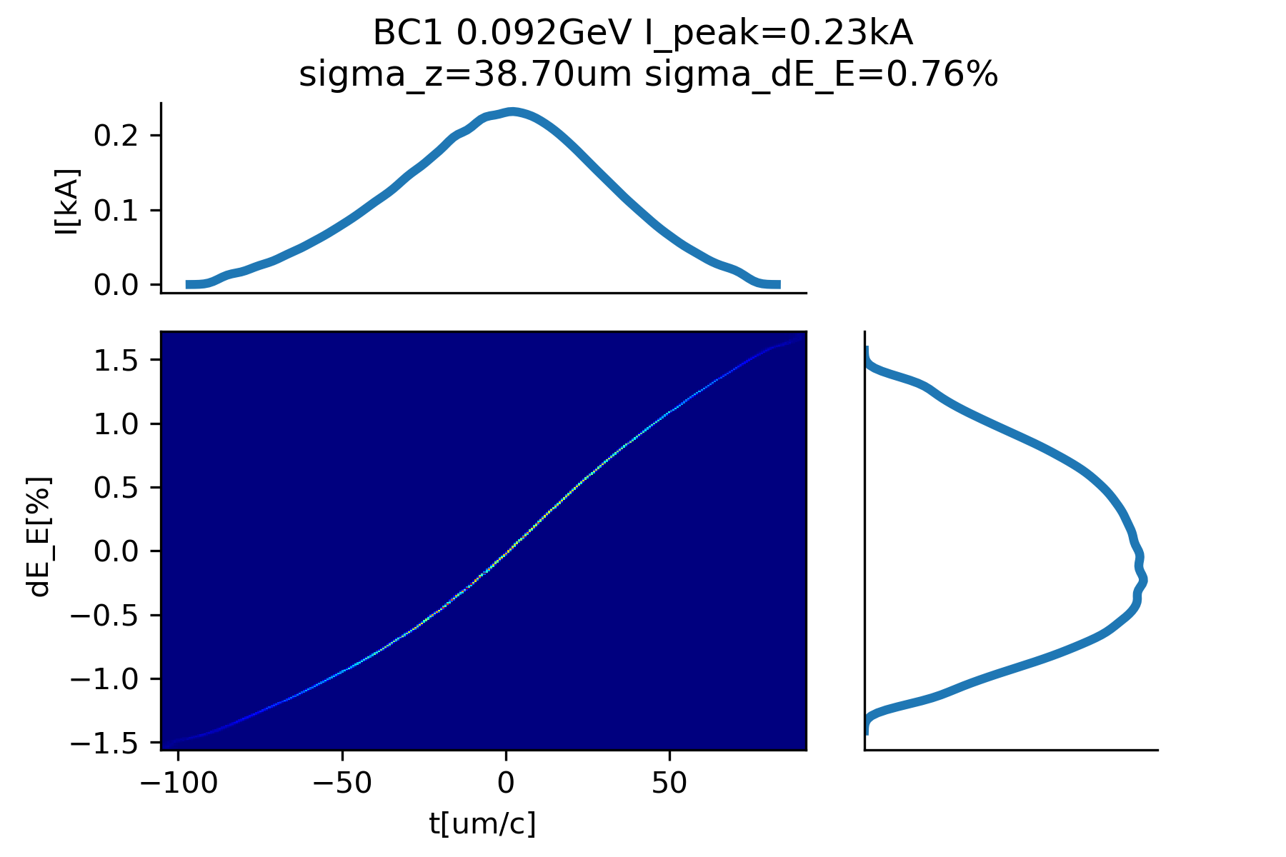
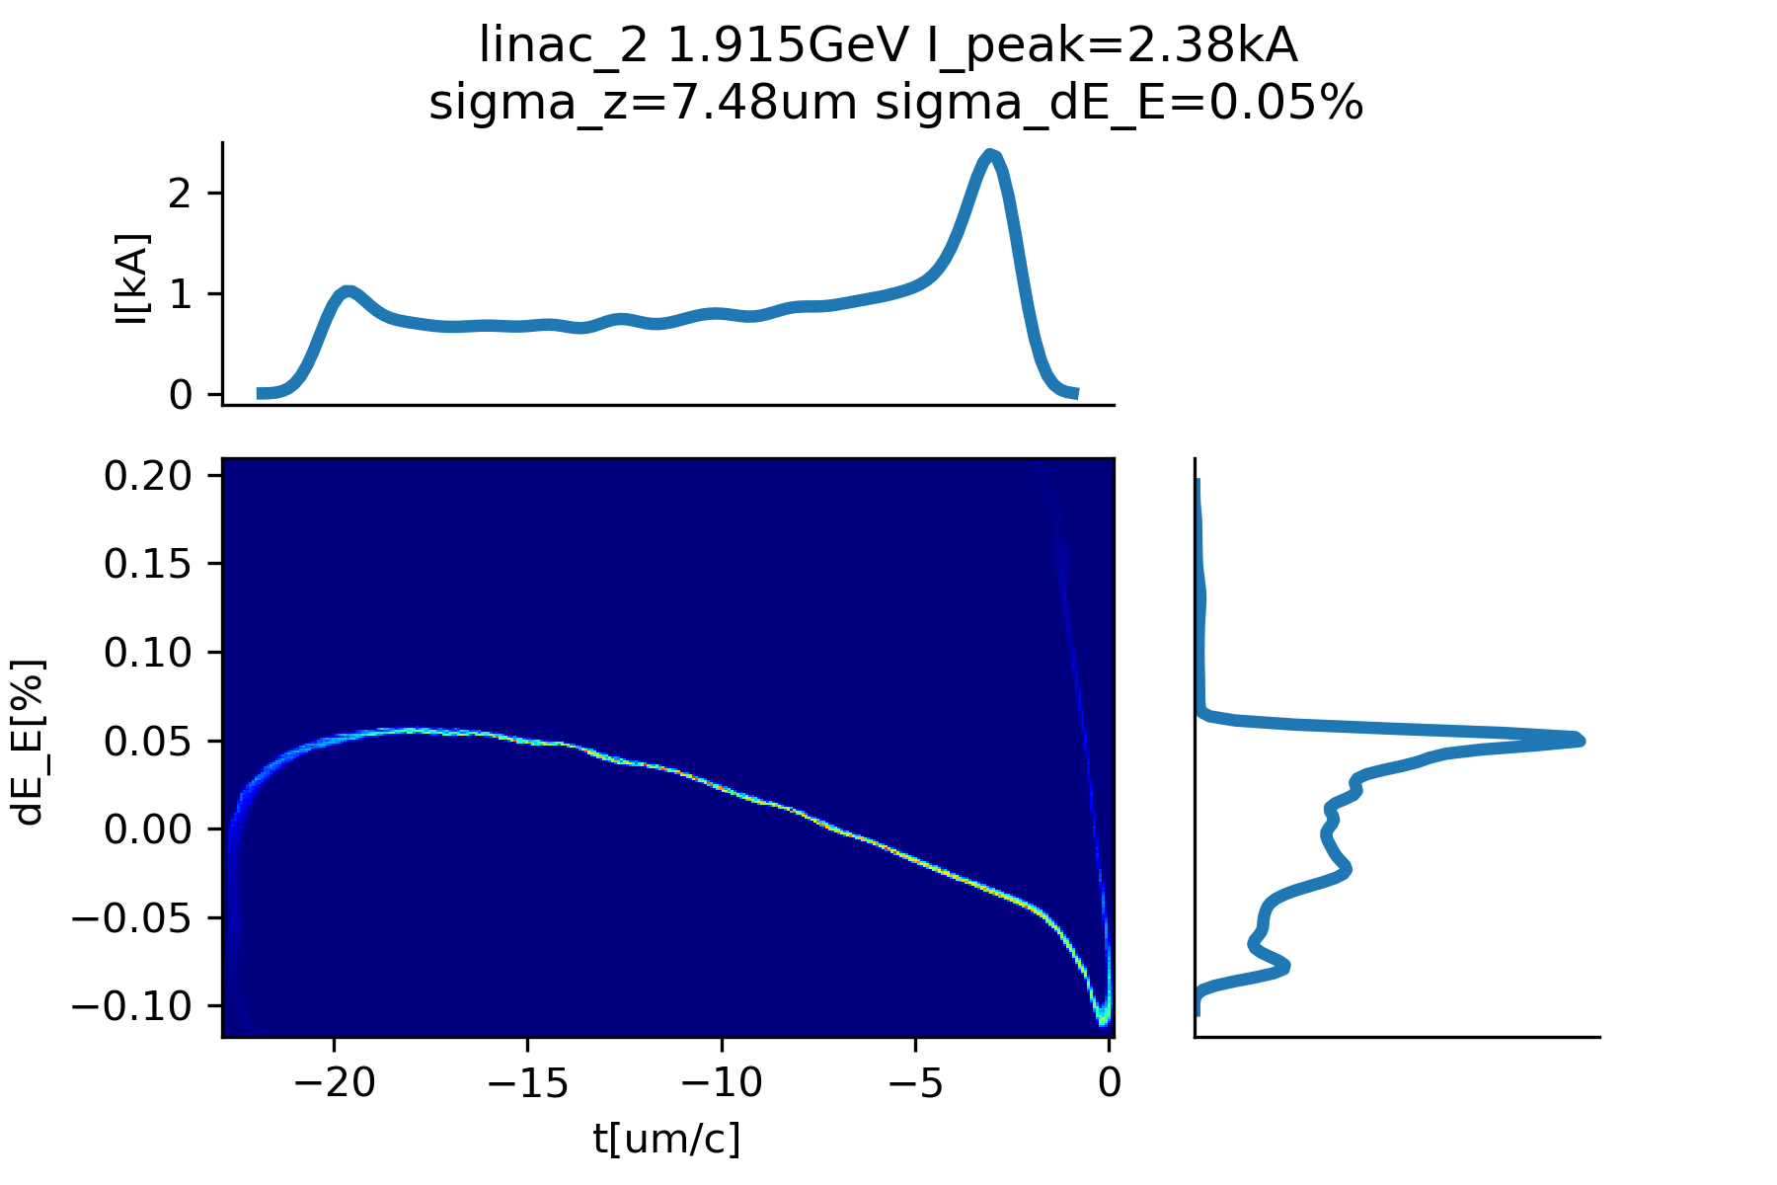





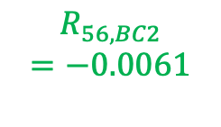



Phase Space: SX mode
$$φ_{k}=−180°$$
($0.6m)∗$
$$n=1$$
92 MeV
99 $μm$
502 MeV
7.5 $μm$
(1)Linearizer
$$R_{56, BC1}$$
$$=−0.008$$
$$R_{56, BC2}$$
$$=−0.0061$$
(3)BC2
C-band
injector
$$K$$
BC1
Linac-1
Linac-1
BC2
Linac-2
$$φ_{1}=33°$$
$$n=6$$
$$φ_{2}=15°∗$$
$$n=18$$
(4)
(1)
(2)
(3)
1kA
92 MeV
38 $μm$
1.9 GeV
7.5 $μm$
(2)BC1
(4)Linac-end
(* this is only the RF structure length)

Slide 8
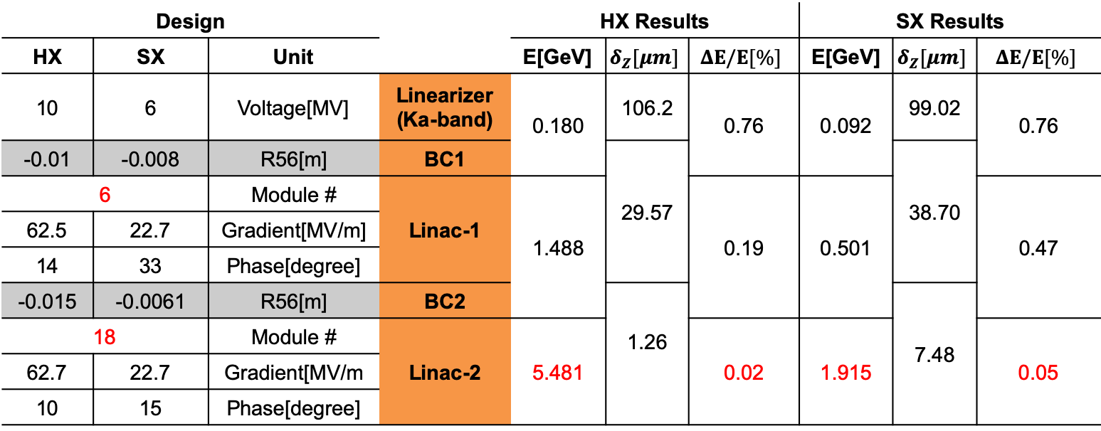
Design & Results Table
Design |  |  |  | HX Results |  |  | SX Results
HX | SX | Unit |  | E[GeV] | $$δ_{Z}[μm]$$ | $$ΔE/E[\%]$$ | E[GeV] | $$δ_{Z}[μm]$$ | $$ΔE/E[\%]$$
10 | 6 | Voltage[MV] | Linearizer (Ka-band) | 0.180 | 106.2 | 0.76 | 0.092 | 99.02 | 0.76
-0.01 | -0.008 | R56[m] | BC1 |  | 29.57 |  |  | 38.70
6 |  | Module # | Linac-1 | 1.488 |  | 0.19 | 0.501 |  | 0.47
62.5 | 22.7 | Gradient[MV/m]
14 | 33 | Phase[degree]
-0.015 | -0.0061 | R56[m] | BC2 |  | 1.26 |  |  | 7.48
18 |  | Module # | Linac-2 | 5.481 |  | 0.02 | 1.915 |  | 0.05
62.7 | 22.7 | Gradient[MV/m
10 | 15 | Phase[degree]
*overall energy spread
Linac structure overview:
24 x-band modules(94 structures)
two chicanes
1 k-band linearizer

Slide 9
Conclusion and Coming Work
Linac design based on C-band injector for the baselines scheme:
  Two chicanes, simple layout
  K-band as linearizer, low voltage (<20 MV), one structure (0.6m)
  [X-band (like acc. structure) can be used as linearizer (TBC)]
S2E simulation: Two-mode simulation from the injector to Linac end
Coming work: Migrating to 3D simulation for baseline scheme
  3D beam dynamics simulation
  CSR effects
  Start to end (S2E) simulation integration
 | C Injector 3D | Linac 1D | Linac 3D |  |  |  | FEL
 | Design | Design | Design | CSR | Stability /Tolerance | Beam Based Alignment
HX | O | O | -> |  |  | Tested by Andrea* for Avni’s C-band input
SX | O | O | ->
*see Andrea’s presentation

