Slide 1


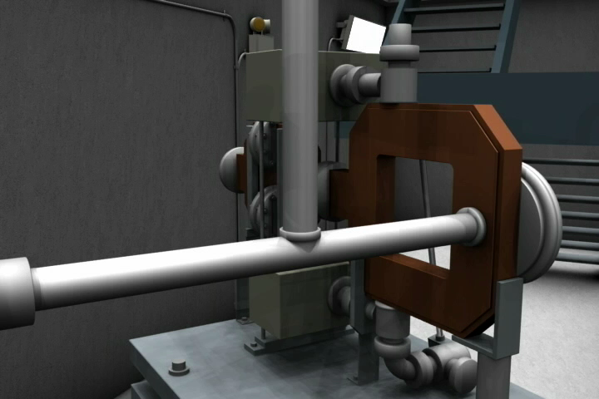
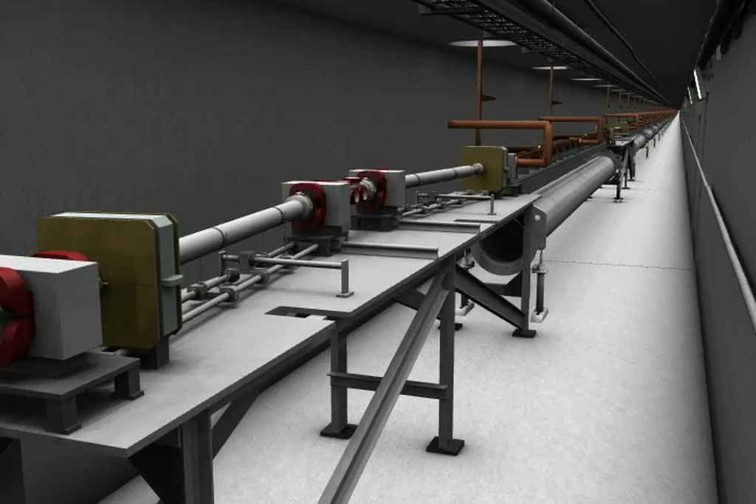
WP3 – Gun and Injector
Massimo.Ferrario@LNF.INFN.IT
Laser/Photocathode
RF/DC Gun
Solenoid
RF Velocity Bunching
RF Linearizer and L. Heater
Magnetic Chicane
Transv. RF Deflector
Beam Diagnostics
To design the Compact High Brightness Injector
To design the proper matching with the X-band Linac

Slide 2
WP3 Deliverables
D3.1 - Preliminary assessments and evaluations of the optimum e-gun and injector solution for the CompactLight design, (=>M18).
D3.2 – A review report on the bunch compression techniques and phase space linearization, (=>M18).
D3.3 – Design of the injector diagnostics/beam manipulations based on a X-band cavities, (=>M36).
D3.4 - Design of the CompactLight e-gun and injector, with phase space linearizer (=>M36).
WP3 CDR Contribution

Slide 3
Tasks and sub-Tasks
(task leaders institutes in bold)
Task 3.1 - Gun Design (RF, Solenoid, Cathode, Laser, Diagnostics) => D3.1 M18 => D3.4 M36
  S-Band Gun RF Design (CNRS + IASA+UAIAT-INFN+ALBA )
  C-Band Gun RF Design (INFN +IASA+Sapienza)
  X-Band Gun RF Design (CSIC-IFIC + UAIAT+ Sapienza)
  DC Gun Design (TU/e )
  Laser/Photocathode (IASA+CNRS+INFN )
Task 3.2 - Compressor Design (Velocity Bunching, Magnetic Chicane) ) => D3.2 M18 => D3.4 M36
  S-Band Velocity Bunching (TU/e + IASA+ALBA)
  C-Band Velocity Bunching (INFN +IASA+TU/e )
  X-Band Velocity Bunching ( Sapienza+CERN+IASA+INFN )
  Magnetic Compressor (ST + CERN+INFN+CNRS) ➔ WP6
  Task 3.3 – X-Band Transverse RF Deflector and Injector Diagnostics (Sapienza+ IASA+ ) => D3.3 M36
Task 3.4 - : RF Linearizer Design => D3.2 M18 => D3.4 M36
  X-Band RF Linearizer Design (Sapienza )
  K-Band RF Linearizer Design (ULANC +Sapienza )
  Passive linearizer (CNRS )

Slide 4
Parameter List and Requirements
Twin bunches operation,
Variable Repetition Rate (100 – 1000 Hz) with the same layout

Slide 5
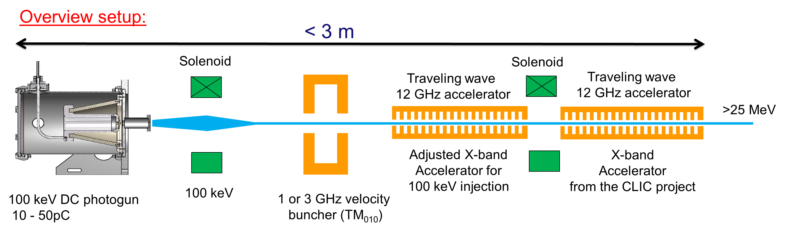
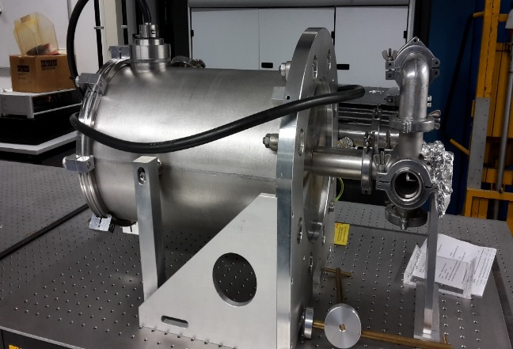
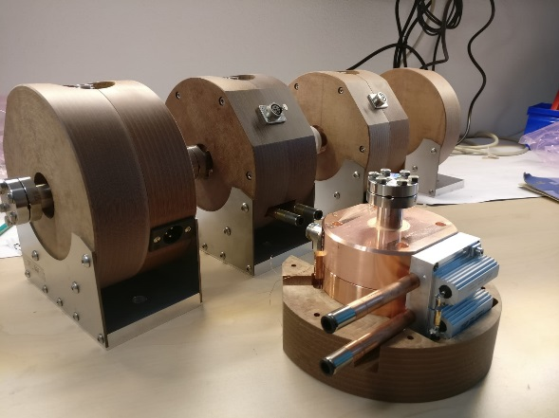
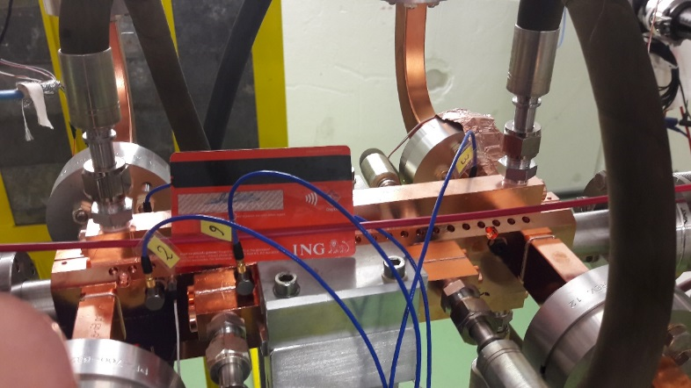

DC gun
Made by ACCTEC
Made by ACCTEC
CLIC accelerator

Slide 6
Configurations with Velocity Bunching
S-band , C-band , X-band , K-band
Linear.
TD
Gun
Vel. Bunching
Booster
X-Linac
K-Linear.

Slide 7
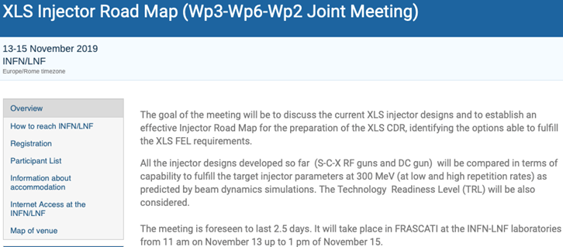

Slide 8
Agenda
11:00 G. D’Auria, “Status of the CompactLight project” (20+10)
11:30 M. Ferrario, “Introduction and goals of the meeting” (20+10)
12:00 S. Di Mitri, “Toward a comprehensive parameter list of CompactLight FEL” (20+10)
12:30 Discussion
13:00 Lunch Break
14:30 P. Craievich (PSI), “Overview of the SwissFEL injector design and performances" (40'+20') (Invited)
15:30 R. Pompili, “Experience with the SPARC_LAB photoinjector” (20+10)
16:00 Coffee Break
16:30 C. Vaccarezza, “Status of the S-band injector simulations, VB versus MC options” (20+10)
17:00 S. Doebert, “S-band gun direct injection in the X-band booster” (20+10)
17:30 E. Marin “Integrated start-2-end simulation results for the XLS S+X-band option” (20+10)
18:00 End of the Session
20:00 Restaurant Zaraza’
10:00 SPARC_LAB Tour
11:00 Coffee Break
11:30 T.G. Lucas, “Updates on the DC gun injection option for compact light” (20+10)
12:00 M. Croia “Status of the C-band injector simulations, VB versus MC options” (20+10)
12:30 D. Alesini/A. Vannozzi, “Status of the C-band injector design” (20+10)
13:00 Lunch Break
14:30 D. Gonzalez-Inglesias “Updates on the X gun injection option for compact light” (20+10)
15:00 Xingguang Lu, "1D linac design based on C-band and X-band injector options" (20+10)
15:30 E. Gazis “Laser-Photocathode Studies and Solenoid 3D design” (20+10)
16:00 Coffee Break
16:30 J. Scifo, “Spatial autocorrelation study for laser beam quality estimation” (20+10)
17:00 Discussion: Evaluation of the proposed schemes and preparation of the inputs for WP2 and WP6
18:00 End of the Session
20:00 Restaurant Cacciani
10:00 Xiaowei Wu, “Ka-band lineariser and rf system updates” (20+10)
10:30 F. Nguyen, "Undulator technologies for the XLS FEL schemes" (20+10)
11:00 Coffee Break
11:30 Final Discussion and Conclusions
13:00 End of the Meeting

Slide 9
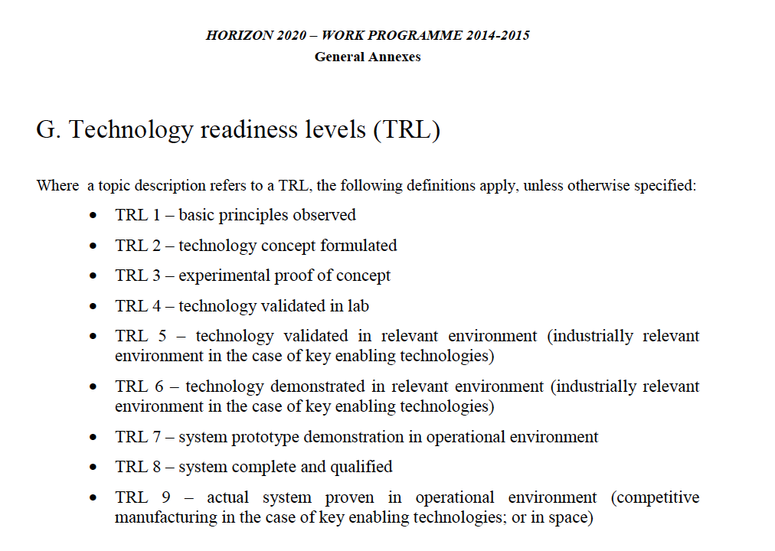

Slide 10
 |  | Goals | DC | S vb | S mc | C vb | S/X | X mc
Charge (Q) | pC | 75 | 10 | 75 | 75 | 75 | 75 | 75
Beam energy | MeV | 300 | 270 | 313 | 280 | 346/341 | 300 | 300
rms bunch length (σt) | fs | 350 | 700 | 367 | 300 | 323/350 | 133-350 | 353.5 (83.7 after BC1)
Peak current (Q12σt) | A | 60 | 4 | 57 | 60 | 67/62 | 65-162 | 61.23
rms Energy Spread | % | 0.5 | 0.2 | 0.2 | 0.3 | 0.3/0.4 | 0.3 | 0.48%( BC1)
Projected rms norm. emittance | μm | 0.2 | 0.25 | 0.2 | 0.2 | 0.23/0.15 | 0.13 | 0.17
Peak Field at Cathode | Mv/m | / | 10 | 120 | 120 | 240/160 | 120 | 200 - 250
Repetition rate |  Hz |   | 750-1000 | 100-400 | 100-400 | 100 Hz-1 KhZ | 1kHz x-band 400 Hz s-band | 100 - 400
Total Length | m | / | 11.3 | <15 | <15+8 | 10 | 8.6 m | 7 m + Ka-band + chicane
TRL |  | / |  | 8 | 8 | 2 | 8/5 | 4
Priority |  |  | ? | Medium | Medium | High | Medium | Low

Slide 11


C-band Gun FUNDING PROGRAMS
FUNDED BY CSN V INFN: 190 KEuro
Realization and test of one gun+circulator
RF Test
3 years program (2020-2022)
ACCEPTED

Slide 12
A C-BAND INJECTOR IS THE BASELINE
Considered layout (not in scale)
3 C-band TW structures, 2 with solenoids around, operating at 40 MV/m average accelerating gradient (as example, PSI-like structures)
TW structures solenoids
Gun solenoid
2 m
C or X-band accelerating module ??
1.6 cell RF gun operating at 200-240 MV/m cathode peak field
Linearizer (X,Ka?)

Slide 13
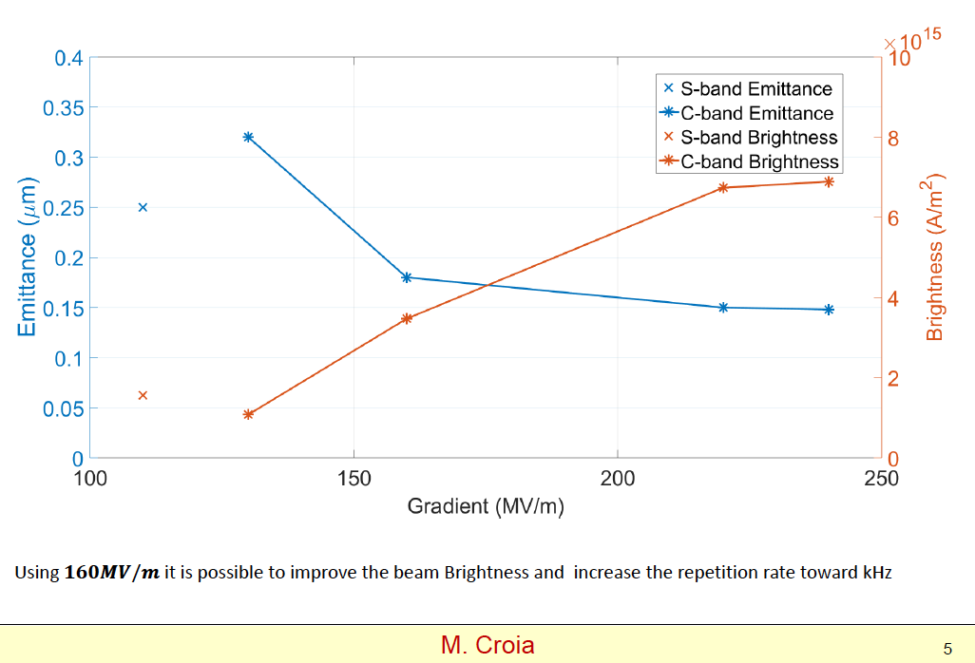
Gradient Choice

Slide 14
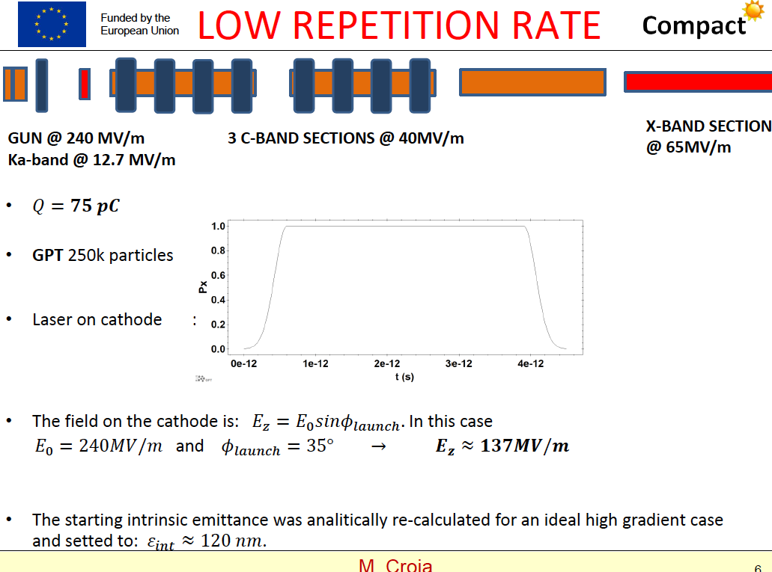

Slide 15
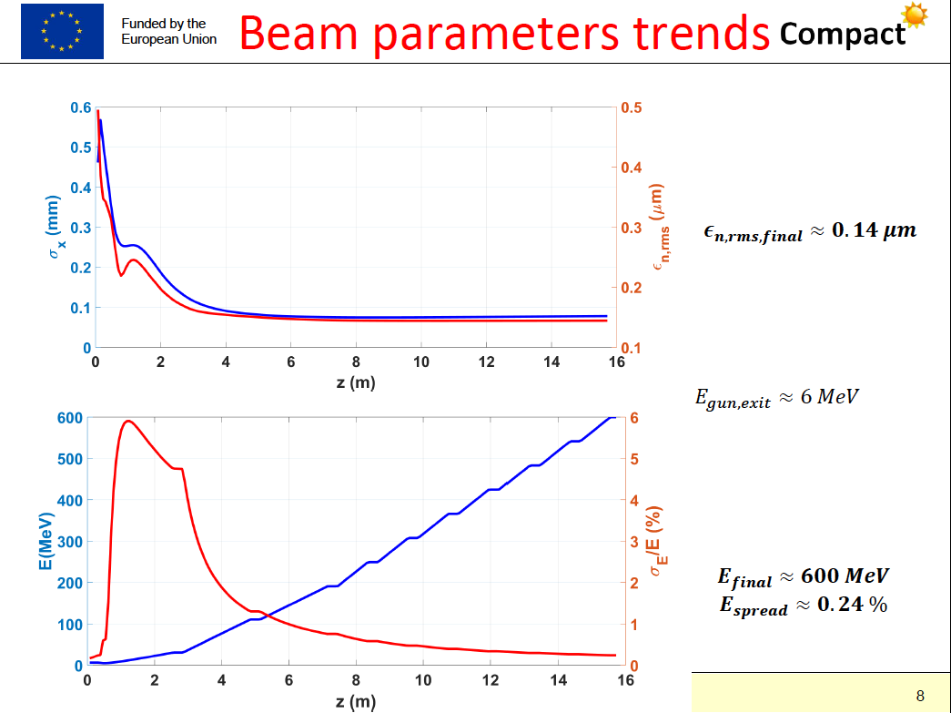

Slide 16
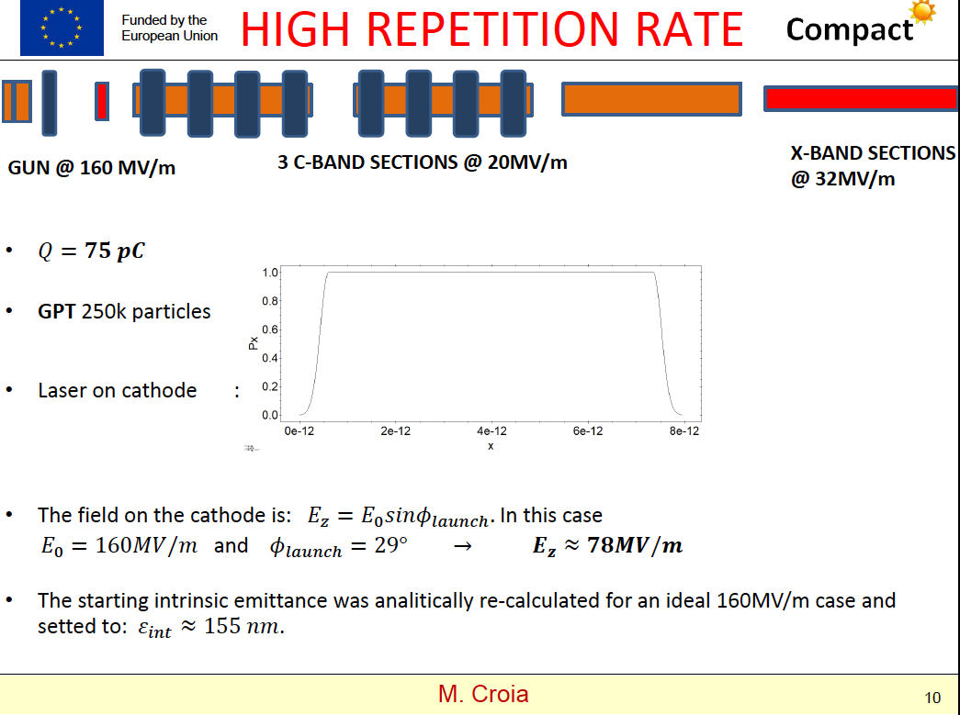

Slide 17
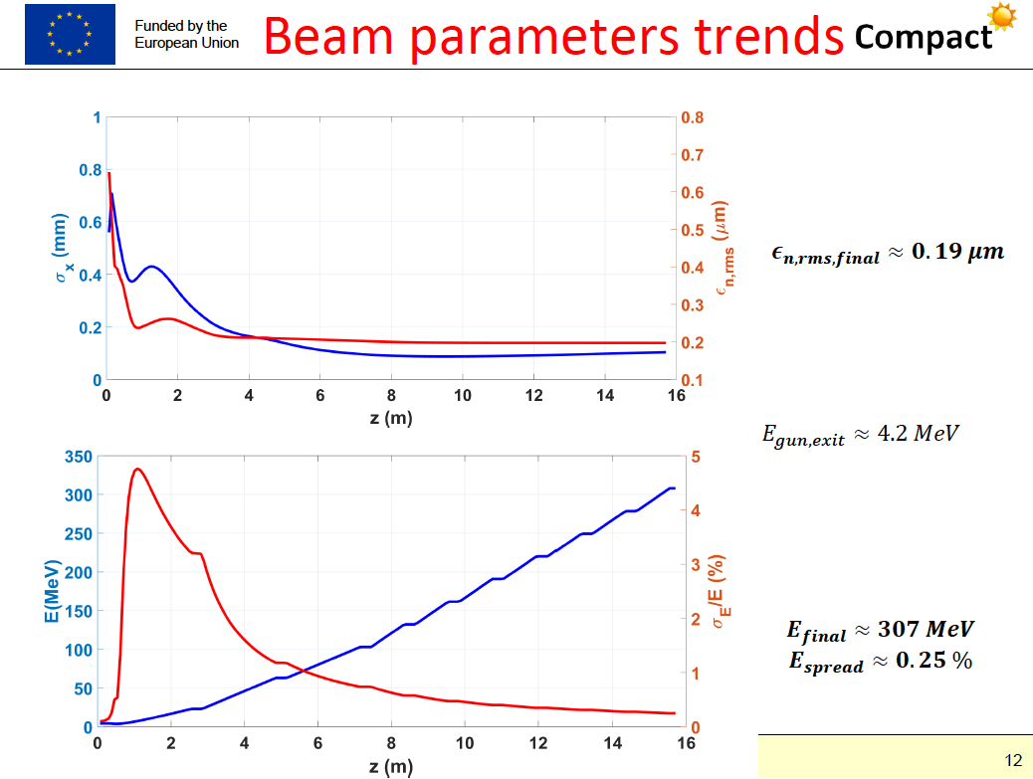

Slide 18
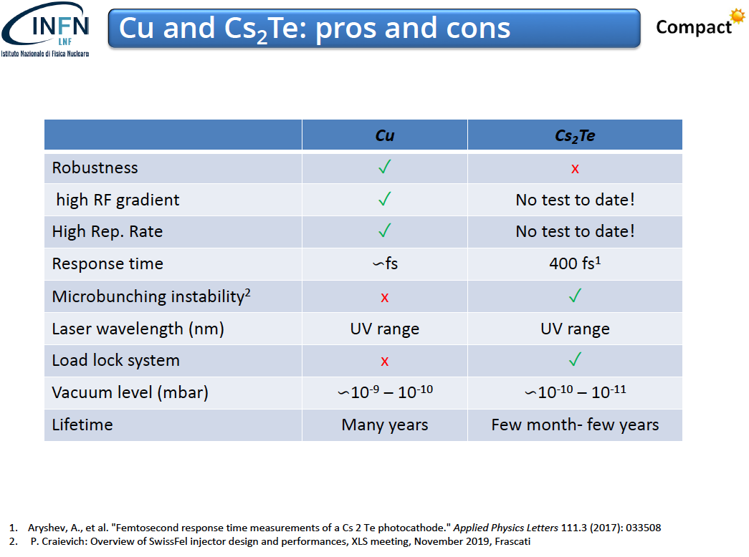
Courtesy J. Scifo

Slide 19
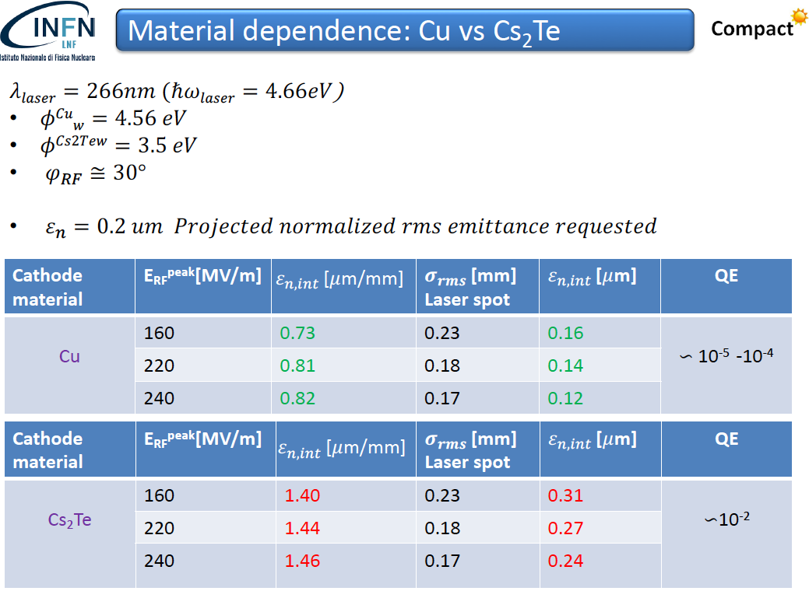

Slide 20
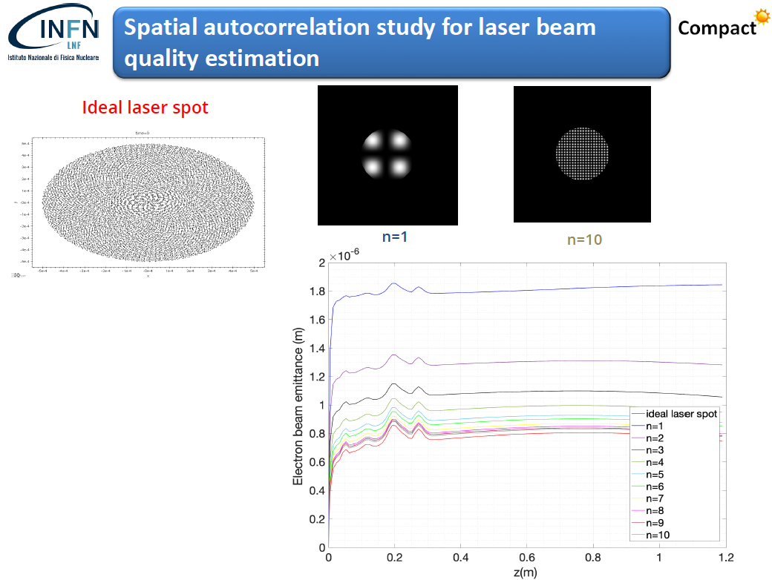

Slide 21
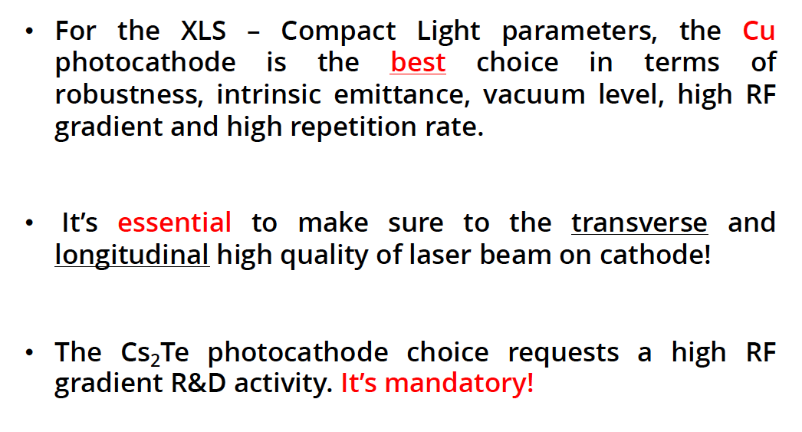
Courtesy J. Scifo

Slide 22
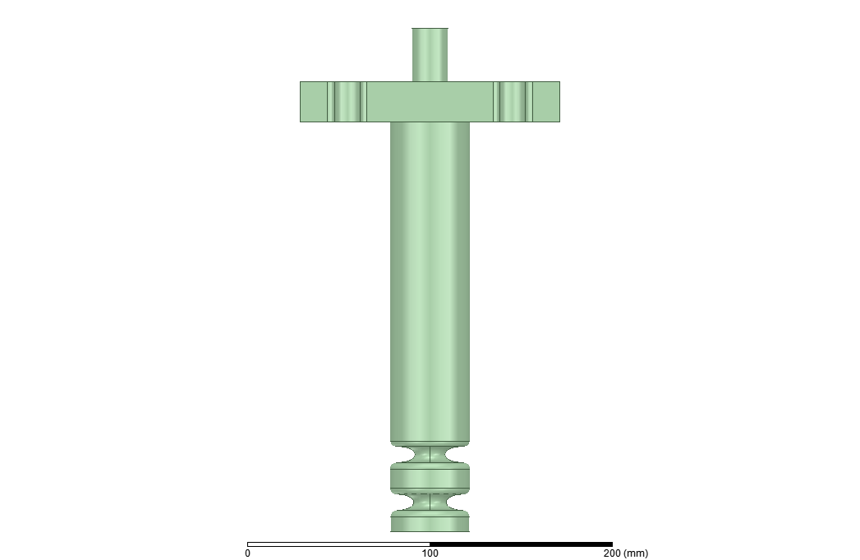
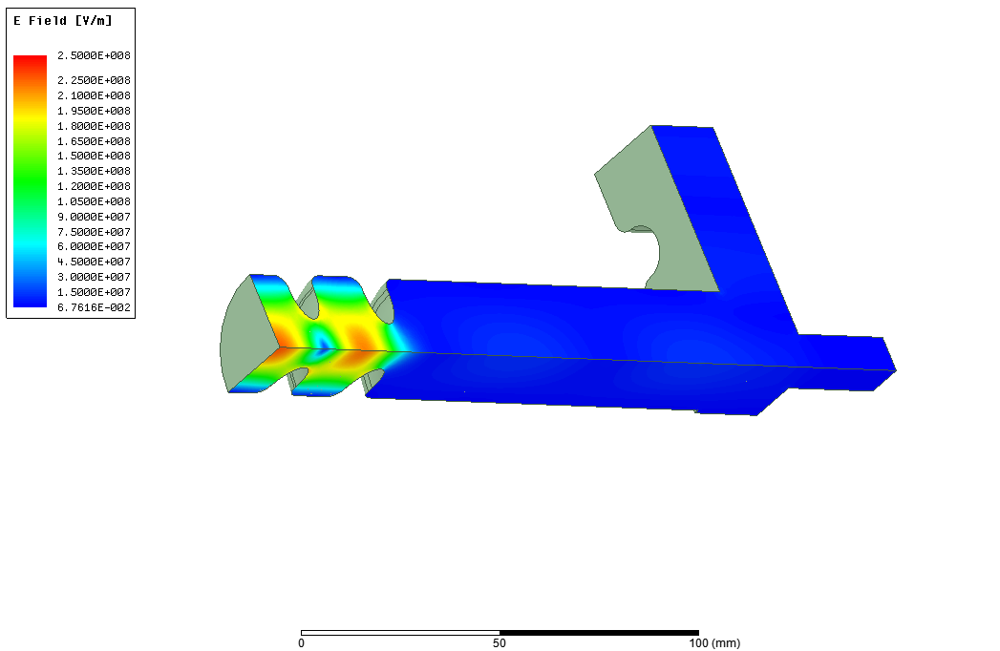
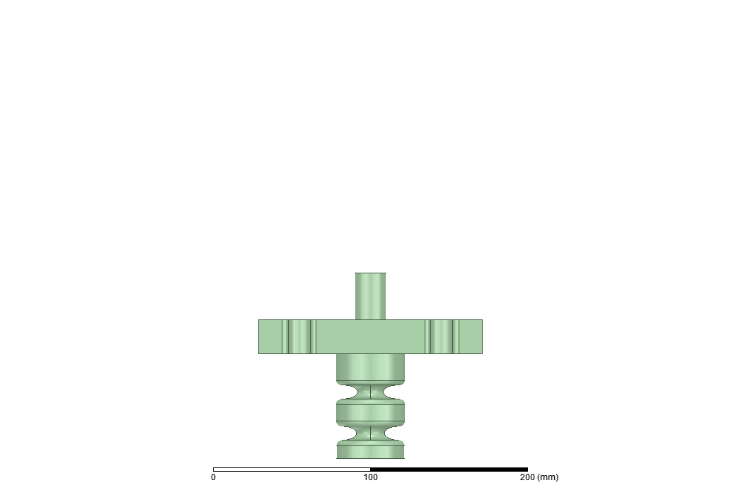
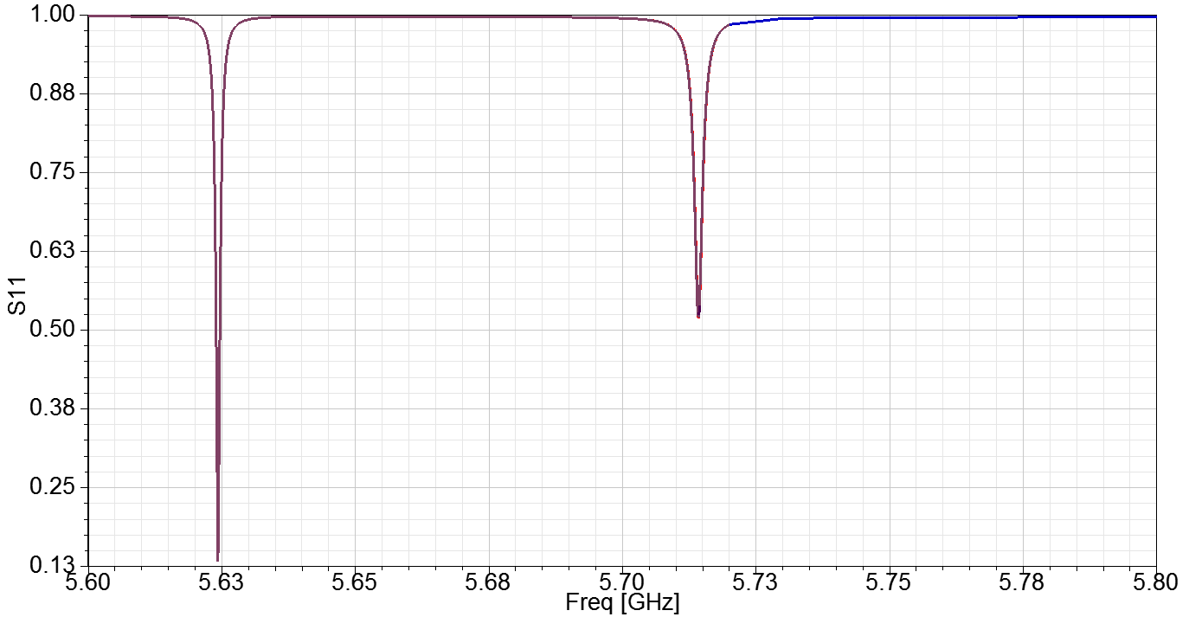
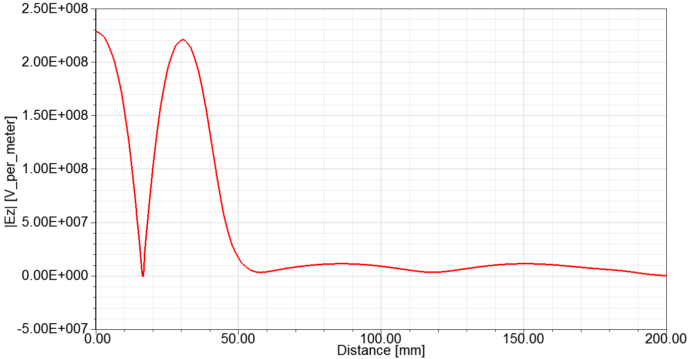
3D ELECTROMAGNETIC DESIGN
laser
A first version of the mode launcher coupler (w/o quadrupole compensation) has been designed.
The S11 put in evidence the presence of the only two modes.
The position of the coupler can be varied according to the BD/solenoid design.
On axis injection with external mirrors is possible.
BD calculations considering the tail of the electric field into the circular waveguide have to be done
laser
Courtesy M. Diomede

Slide 23
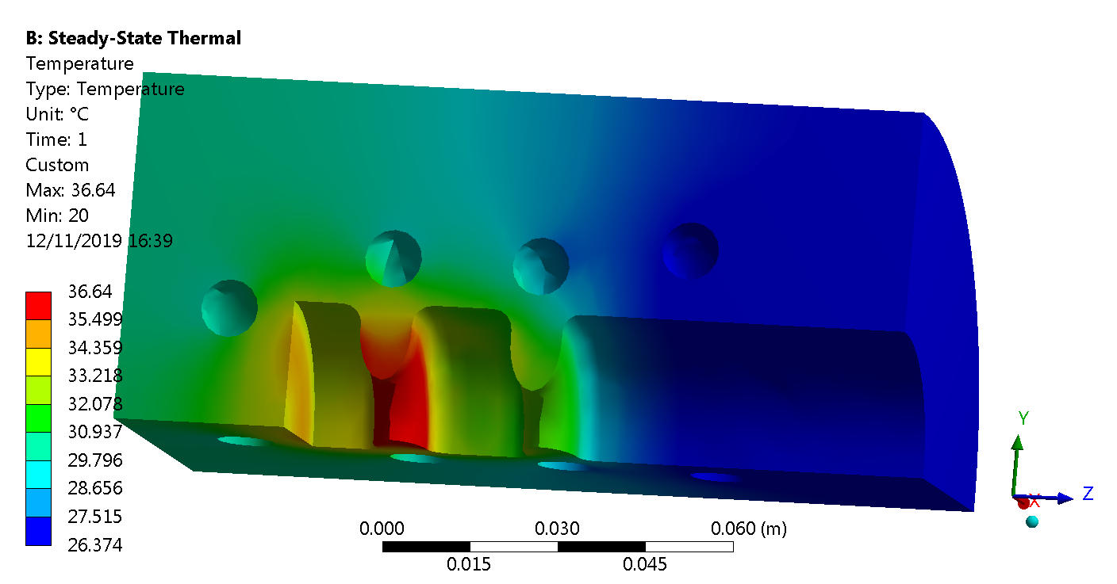
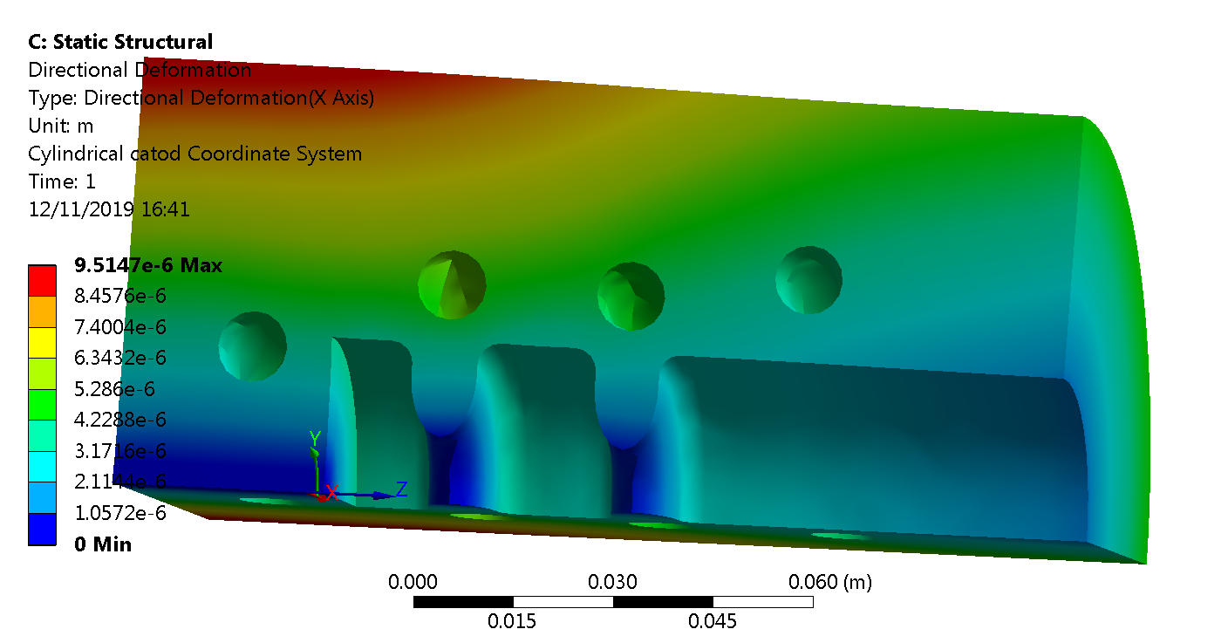
THERMAL ANALISYS (1 KHz REGIME)
We started a thermo-mechanical analysis to investigate the feasibility of the 1 KHz operation.
We use the ansys code. In the figure a preliminary calculation in the case of a 1 KW dissipated power is shown.
Courtesy
L. Pellegrino

Slide 24
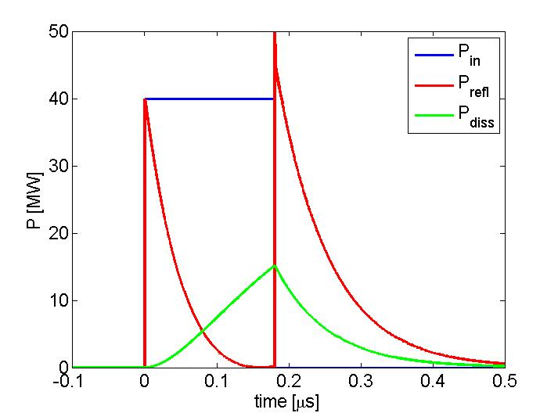
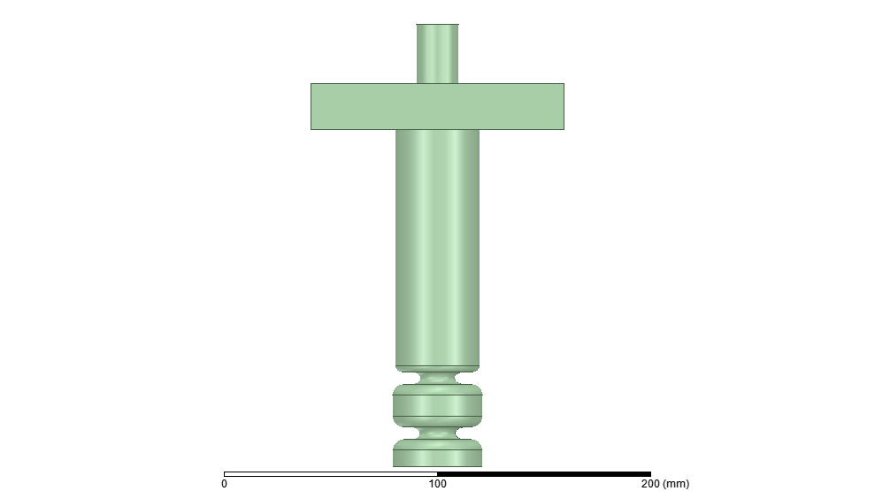
C-BAND GUN POWERING SCHEME
RF pulses of few tens of MW at 200 ns allow reaching E_{cath}>200 MV/m.
Because of its higher efficiency, a C-band RF Gun is also suitable for application requiring repetition rates in the 500 Hz ÷ 1 kHz range
Moreover, to feed the SW gun a C-band circulator is necessary to protect the klystron from the power reflections during transients (a commercial available C band circulator exists and will be purchased to allow the high power tests).
E_{cath} | 240 MV/m
Δf_{0-π} | ≈ 90 MHz
Q₀ | 12000
β | 3
P_{diss} @240MV/m | 12 MW
 | 69 [MV/mMW^{0.5}]
P_{IN} @240MV/m | 31 MW
ΔT @ 200 ns | <30 ºC
RF pulse length | <200 ns
Av diss power | 2000-200 W
Rep. Rate | 1000-100 Hz
<0.200 μs 40 MW
KLY
circ
[1] D. Alesini et al., TUPTS024, IPAC 19

Slide 25
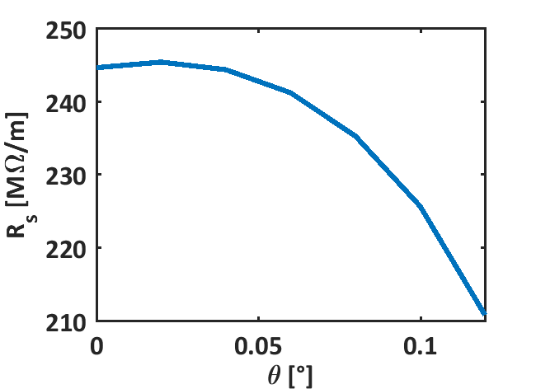
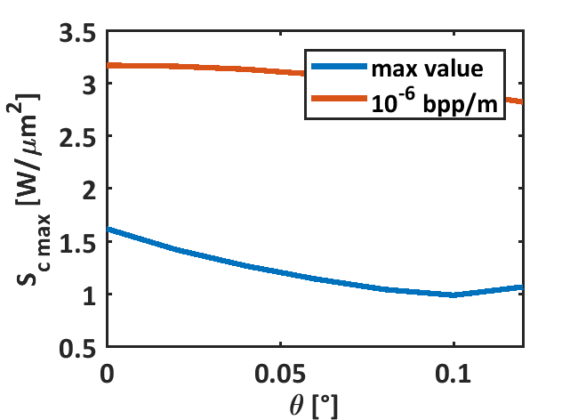
C-band accelerating structures, 2 m long (PSI-LIKE)
Canon E37212
(@240 MV/m)
Acc. Structure
Phase advance | 2pi/3
Cell length [mm] | 17.495
Number of cells | 114
Total length [m] | 1.9945
Average iris radius [mm] | 6.6
Tapering angle [deg] | 0.02
Iris radius (first - last) [mm] | 6.945 – 6.255
Shunt imp. [MOhm/m] | 78.5-85
Q | 10209-10170
Group velocity/c [%] | 2-1.4
Filling time [ns] | 403
Repetition rate [Hz] | 100 | 1000
BOC | ON | Bypassed
Kly. Pow./struct. [MW] | 13 | 8
Avg. acc. gradient [MV/m] | 40 | 15.6
RF system
Operating frequency [GHz] | 5.712
Klystron pulse length [us] | 3
Klystron peak power (Net) [MW] | 50 (40)
Pulse rate [pps] | 100
Q0 of BOC | 216000
Qe of BOC (optimized) | 24700
(@200 MV/m)
100 Hz: 40 MV/m w/ 1 klystron for 3 structures (considered 20 MW per structure).
1 kHz: <20 MV/m w/ 1 klystron for 1 structure (BD check is required).
PRELIMINARY BETTER RESULTS W/ SHORTER STRUCTURES.

Slide 26
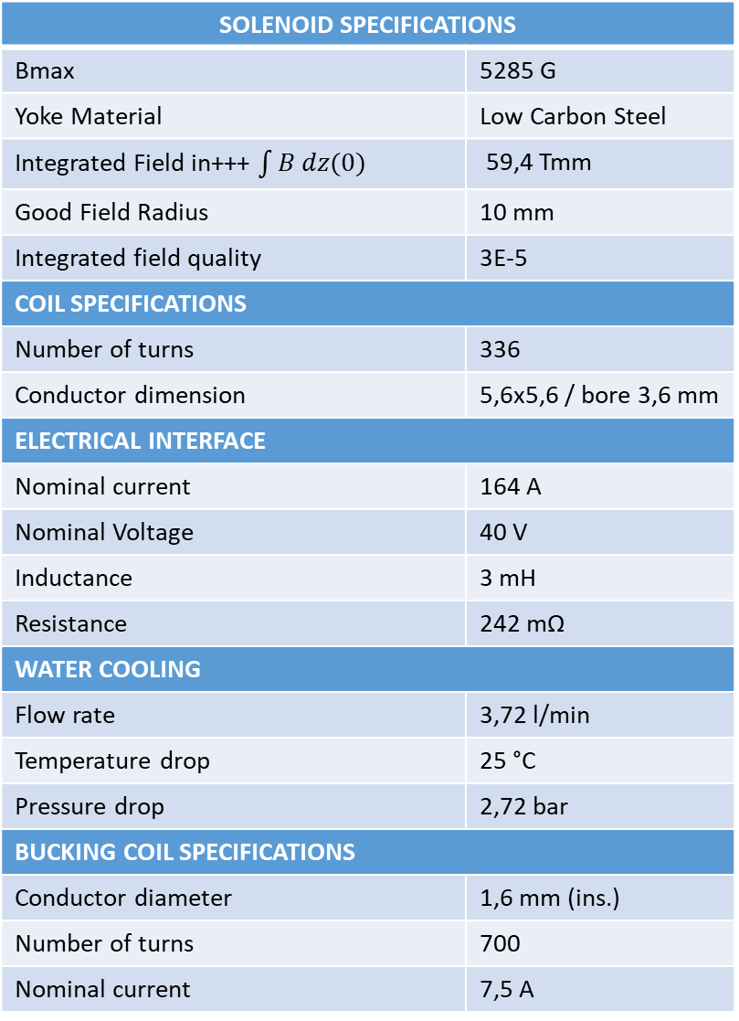
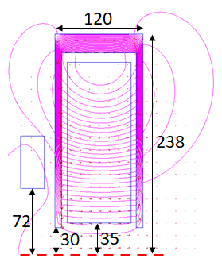
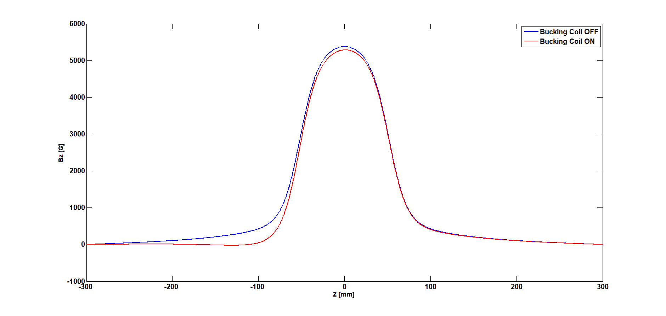
SOLENOID FOR THE C-BAND GUN
Work done in collaboration with Emmanouil Trachanas
Bucking Coil
Axial symmetric 2D simulations have been performed with Poisson Superfish.
Integrated field the same of the SPARC_LAB S-band gun solenoid.
Bucking coil for the cancellation of the field on cathode (from almost 360 G to ≈1 G).
Cathode position
(110.5mm from the
solenoid center)

Slide 27
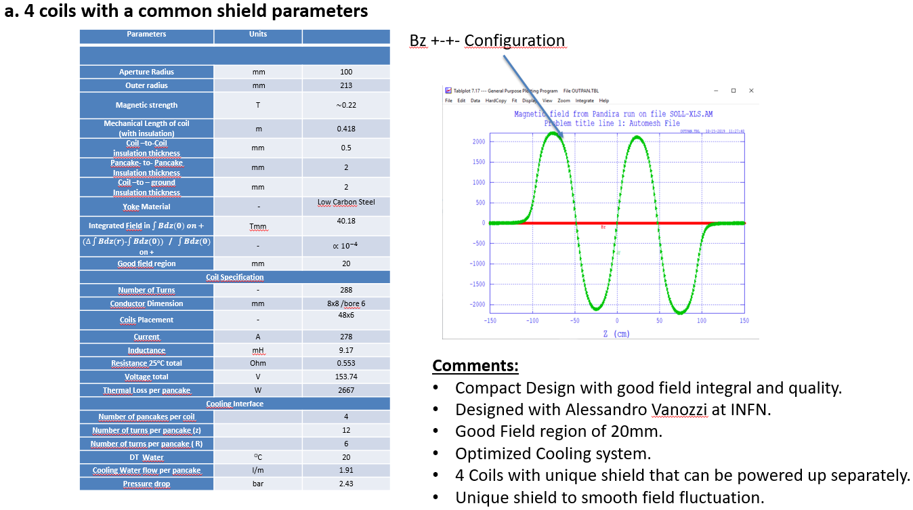
SOLENOID on THE C-BAND accelerating structure
Work done in collaboration with Emmanouil Trachanas
Unique Shield configuration

Slide 28
Concluding Remarks
Deliverables 1 and 2 successfully delivered => Many thanks to all the WP3 participants
C-band Injection selected as a baseline with cu Cathode
C-band EM design advanced (gun, solenoid and booster)
Detailed study of the final layout is underway
Define the reference injector codes (TSTEP, Astra, GPT)
Define the Injector/BC1 interface (SC and CSR effects) with WP6 => Laser Heater?
Define the Linearizer Parameters (how many, X or Ka, Voltage, Length and Aperture) with WP6
Investigate Laser and Diagnostics Requirements
Investigate the impact on Injector of Twin Bunch Operation
  Task 3.3 – X-Band Transverse RF Deflector and Injector Diagnostics (Sapienza+ IASA+ ) => D3.3 M36
Task 3.4 - : RF Linearizer Design => D3.4 M36
  X-Band RF Linearizer Design (Sapienza )
  K-Band RF Linearizer Design (ULANC +Sapienza )

Slide 29


