Slide 1
LHCb RICH2 CF4 02/12/2019

Slide 2
DONE
27th Wednesday : Restarted
Recuperated:
25.2 bar → 1260 litres
2.5 bar in 51 hours

Slide 3
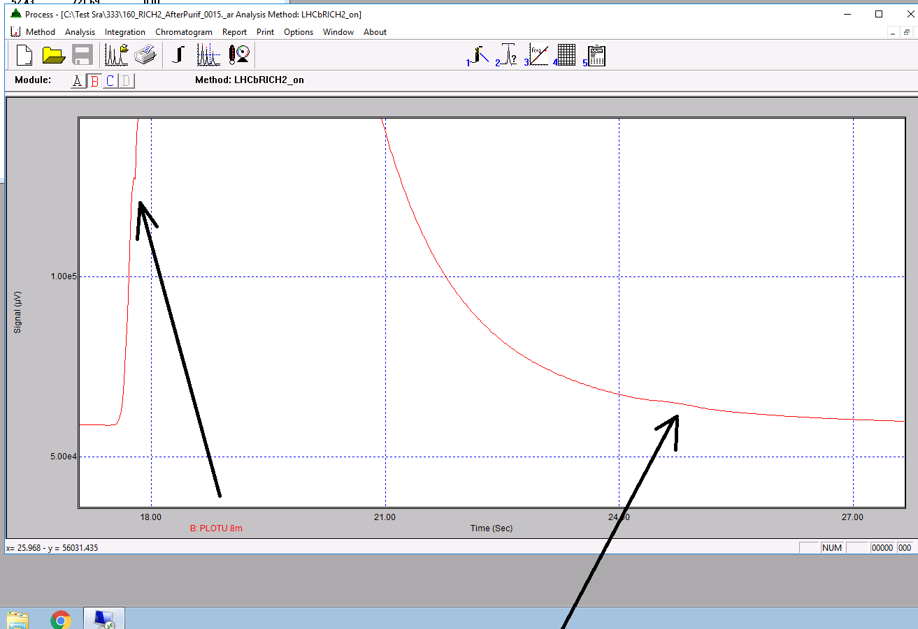
ANALYSIS
Input membrane (valve 3515)
Ar : 0,2%
CF4 : 2,7%
CO2 : 97,1%
After Purifier:
~ 100% CF4

