Slide 1


Investigation of Nb thin films deposited on QPR sample B2
Stewart Leith, Michael Vogel
Authors would like to acknowledge the support provided by European Union’s ARIES collaboration H2020 Research and Innovation Programme under Grant Agreement no. 730871.

Slide 2
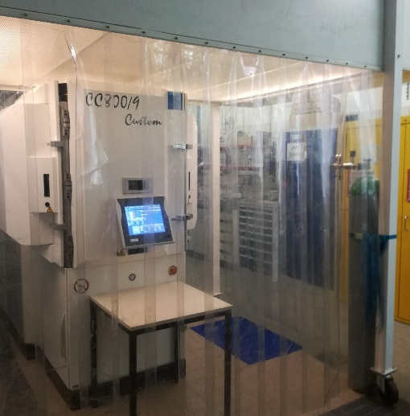
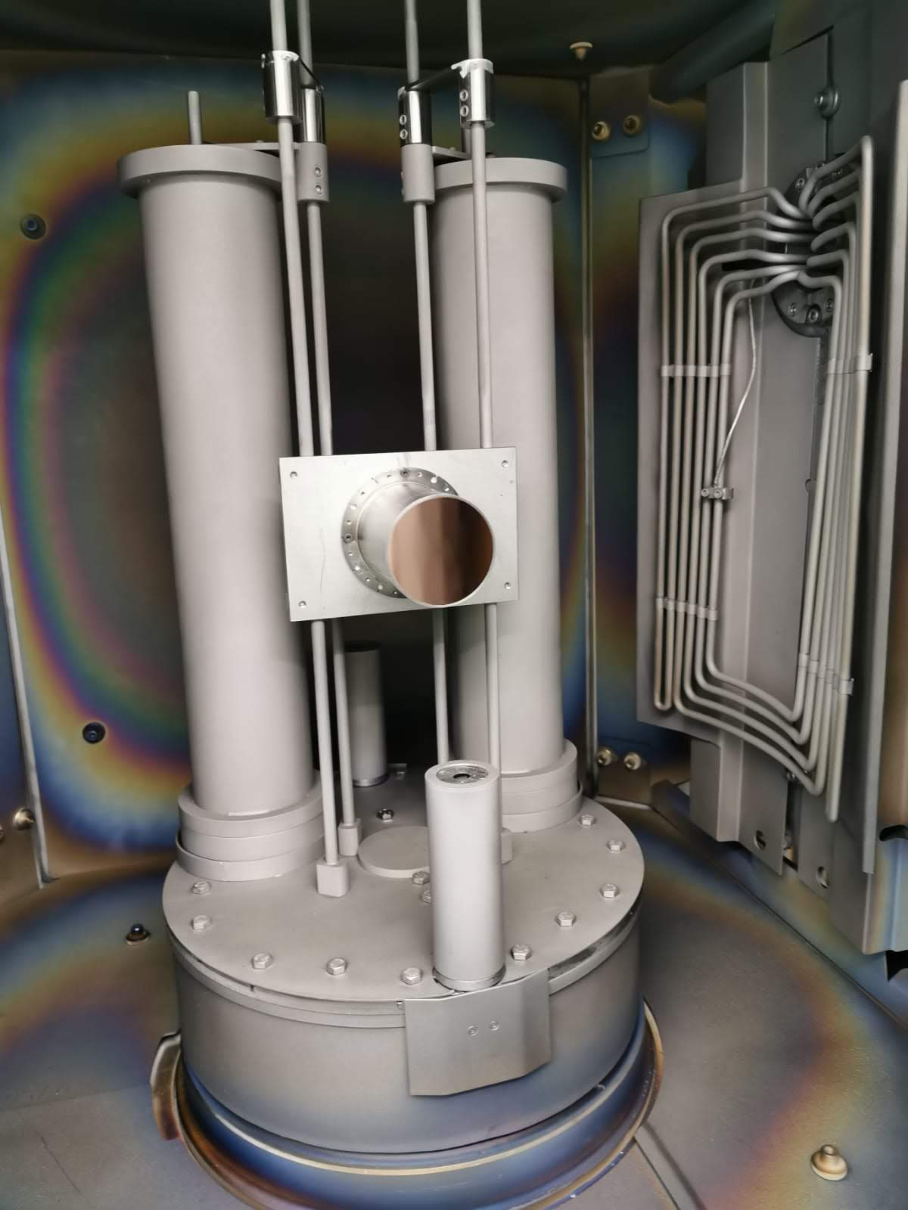
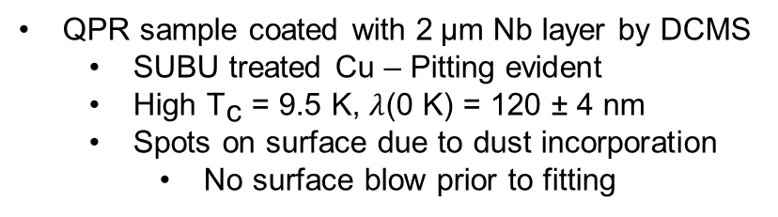
  Initial QPR results
QPR sample coated with 2$\text{μm}$ Nb layer by DCMS
  SUBU treated Cu – Pitting evident
  High ${\text{T}}_{\text{c}}\text{ = 9.5 }\text{K}$, $λ$(0 K) = 120 ± 4 nm
  Spots on surface due to dust incorporation
    No surface blow prior to fitting

Slide 3
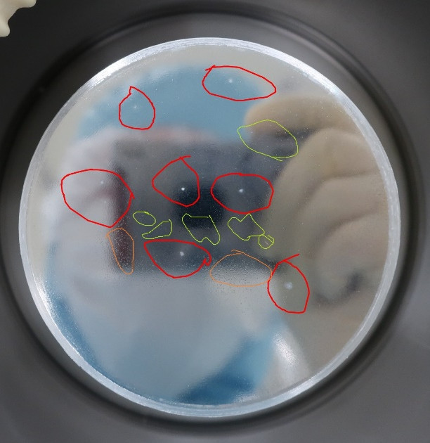
  Initial QPR results
Homogeneous film thickness across QPR sample
Poor performance due to dust?
  Ionising gun and gas line filters purchased
415MHz:
R_{res} ~ 125 nOhm
B_{quench} > 70 mT
848MHz:
R_{res} ~ 295 nOhm

Slide 4
  Initial QPR results
Homogeneous film thickness across QPR sample
Poor performance due to dust?
  Ionising gun and gas line filters purchased
415MHz:
R_{res} ~ 125 nOhm
B_{quench} > 70 mT
848MHz:
R_{res} ~ 295 nOhm
XRF measurement of QPR sample surface.
Measurement courtesy of G. Rosaz

Slide 5
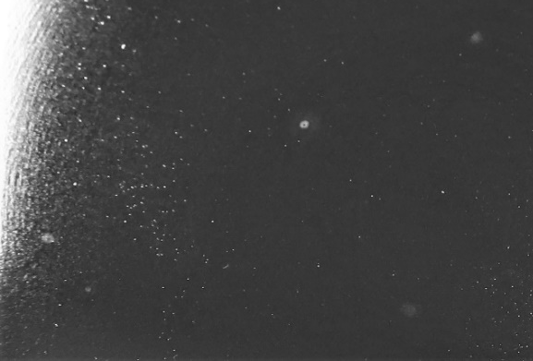
  Initial QPR results
Homogeneous film thickness across QPR sample
Poor performance due to dust?
  Ionising gun and gas line filters purchased
415MHz:
R_{res} ~ 125 nOhm
B_{quench} > 70 mT
848MHz:
R_{res} ~ 295 nOhm
XRF measurement of QPR sample surface.
Measurement courtesy of G. Rosaz
Images courtesy of A. Perez Fontenla

Slide 6
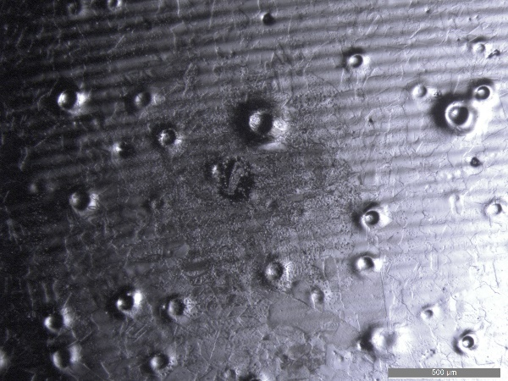
  Initial QPR results
Homogeneous film thickness across QPR sample
Poor performance due to dust?
  Ionising gun and gas line filters purchased
415MHz:
R_{res} ~ 125 nOhm
B_{quench} > 70 mT
848MHz:
R_{res} ~ 295 nOhm
XRF measurement of QPR sample surface.
Measurement courtesy of G. Rosaz
Images courtesy of A. Perez Fontenla

Slide 7
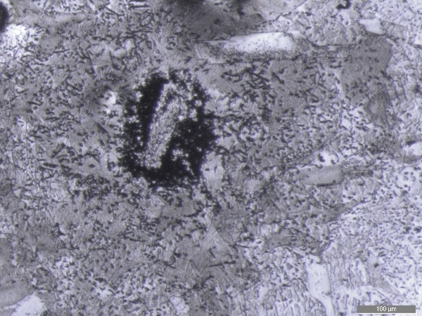
  Initial QPR results
Homogeneous film thickness across QPR sample
Poor performance due to dust?
  Ionising gun and gas line filters purchased
415MHz:
R_{res} ~ 125 nOhm
B_{quench} > 70 mT
848MHz:
R_{res} ~ 295 nOhm
XRF measurement of QPR sample surface.
Measurement courtesy of G. Rosaz
Images courtesy of A. Perez Fontenla

Slide 8
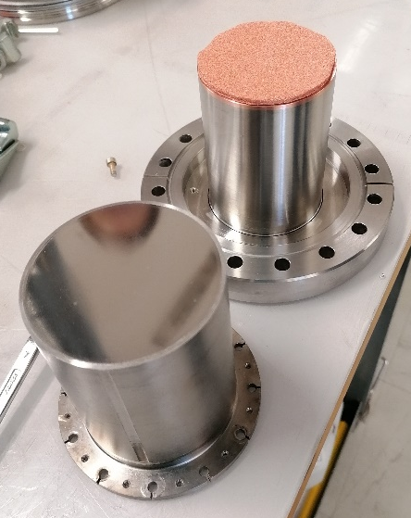
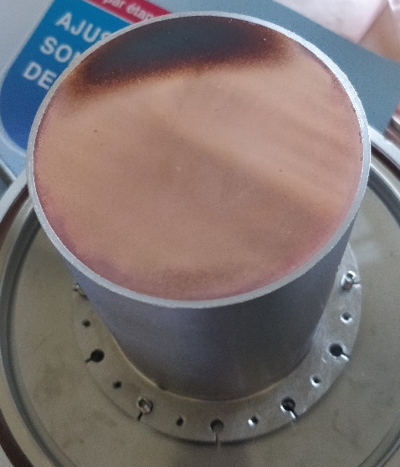
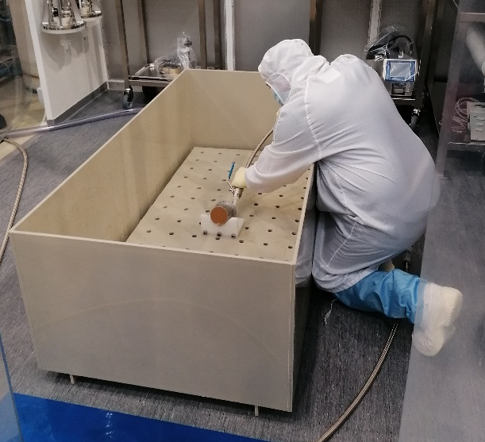
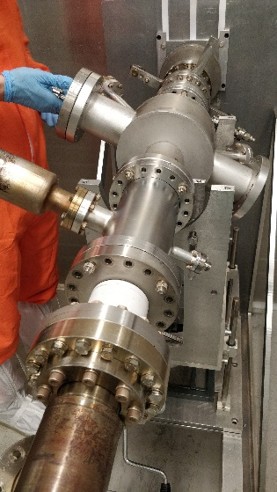
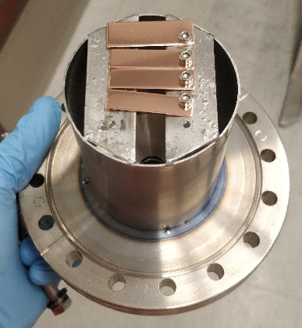
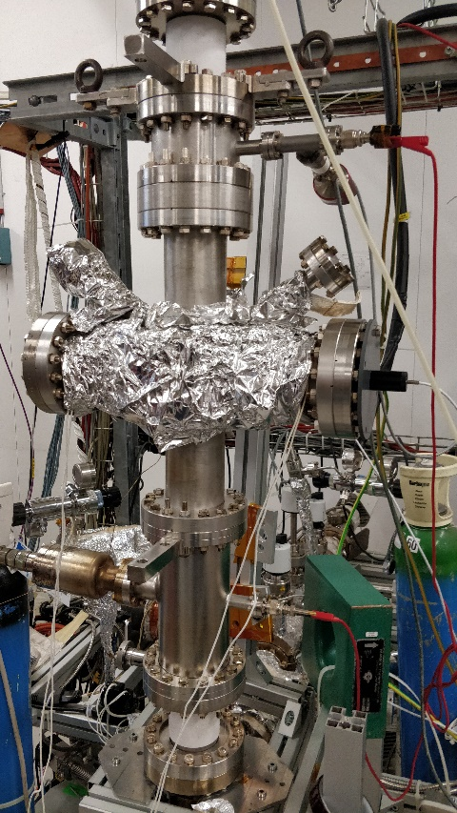
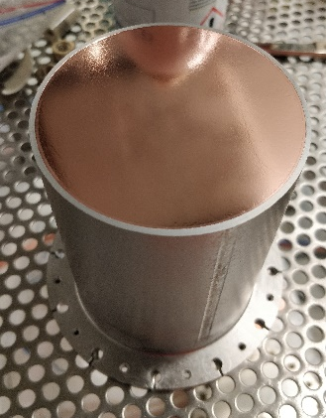
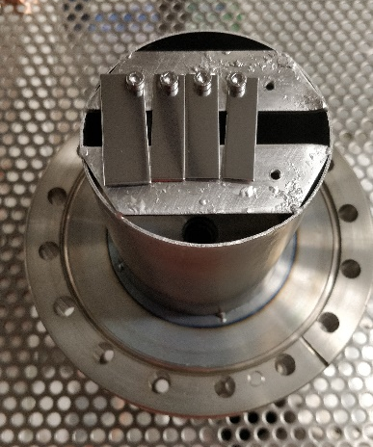
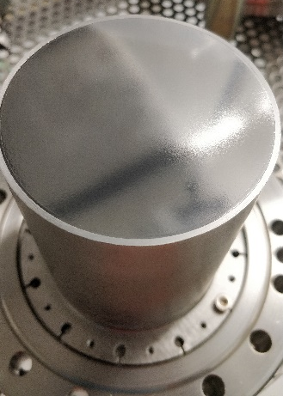

Slide 9
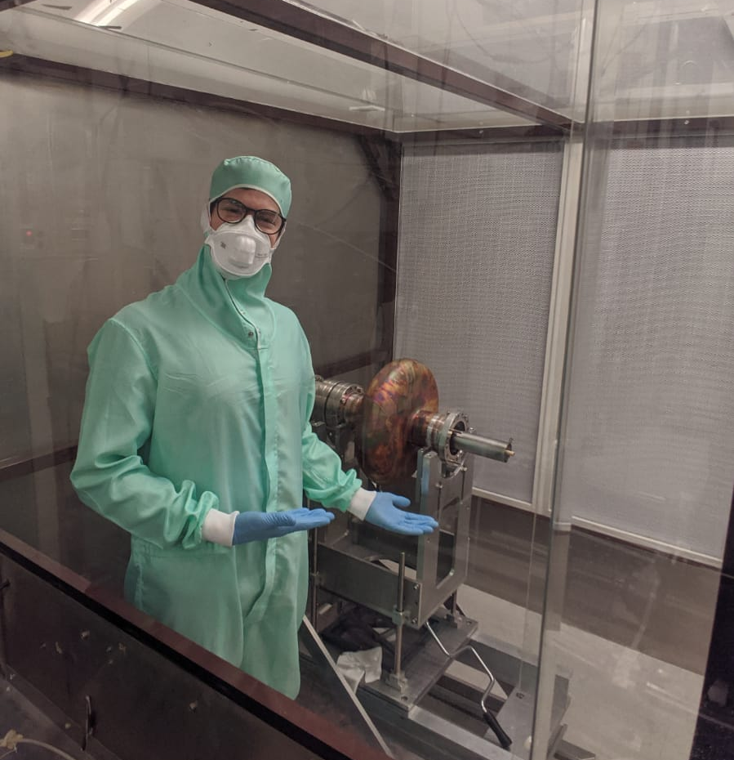


Thanks for your attention!
Authors would like to acknowledge the support provided by European Union’s ARIES collaboration H2020 Research and Innovation Programme under Grant Agreement no. 730871.
https://i2.wp.com/www.ruggaworld.com/wp-content/uploads/2019/11/A05I7285.jpg?fit=600%2C380&ssl=1

