Slide 1
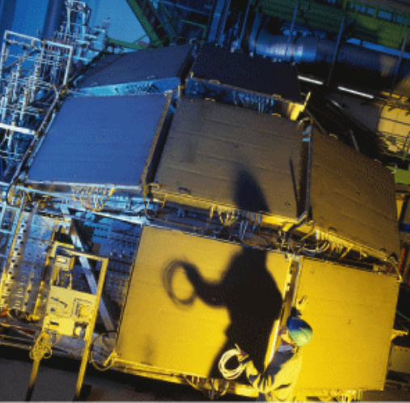
New Pedestal maps and Status of the FEE/RO electronics
A. Franco, GdC, J. L. Gauci, R. Arteche Diaz and G. Volpe

Slide 2
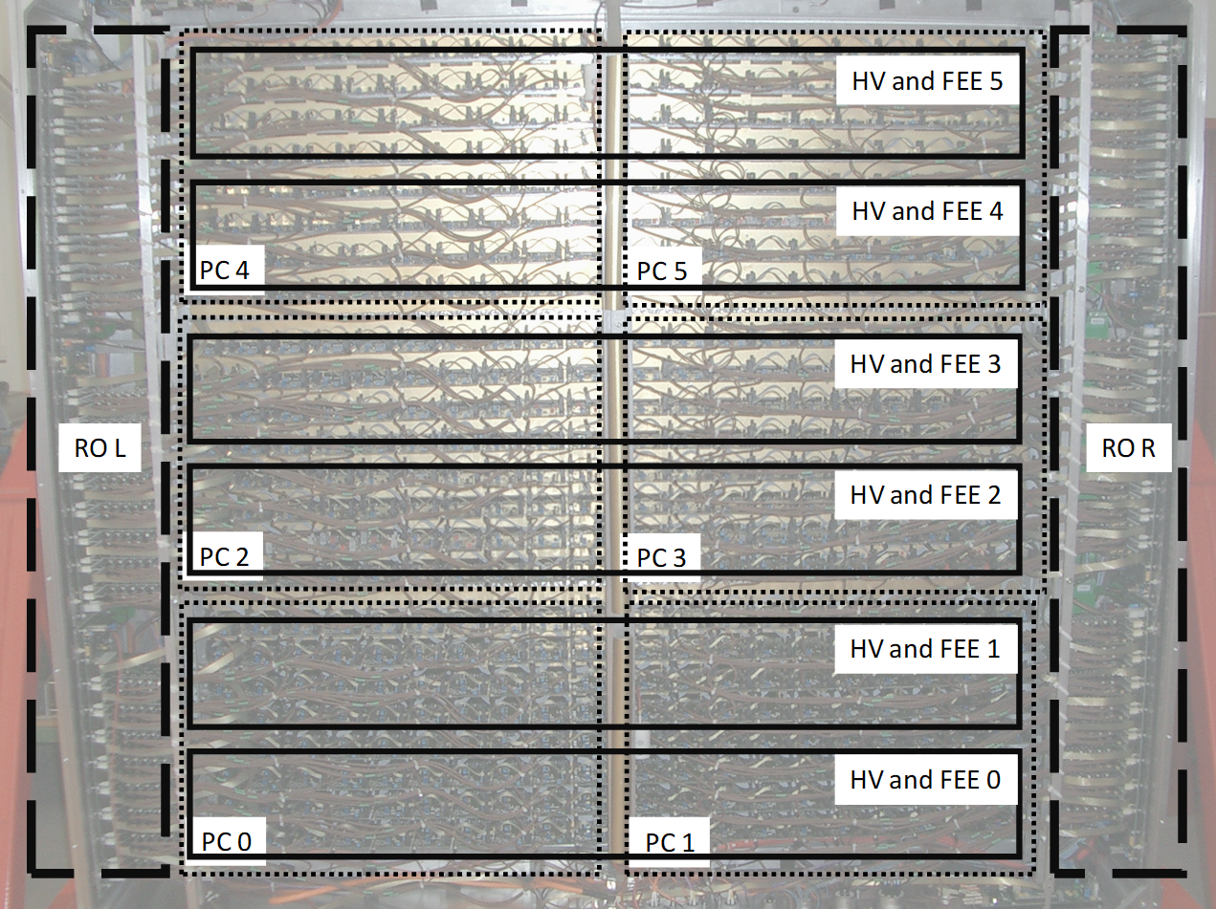
Correspondence DCS-RICH module
To FLP
DDL Left
Pedestal map
Pad 1
Pad 3840
DDL Right
To FLP

Slide 3
HMPID commissioning activities
First read-out tests at P2 (18th-21st Nov.) by auto-triggering FW:
  Successfully read out of all the 14 HMPID equipment ☺
  Produced the first pad-map in O² of the seven HMP RICH modules.
  Useful functional tests of the HMP RO electronics,
  …but not reliable for FEE ADC value!
As from Nov. 27th, Read out tests at P2 with LTU and Fan_IN/OUT modules (from CTP):
  14 Equipment out of 14 are OK, only RICH4_L, Column 23 Missing!
  At RICH power ON FW uploaded from flash memory on board the RICHs modules (few seconds);
  Actual TTCrx FW without HBr and Time Frame trigger handling;
  New TTCrx FW version in preparation at bld 581 (see presentation of Jordan);

Slide 4
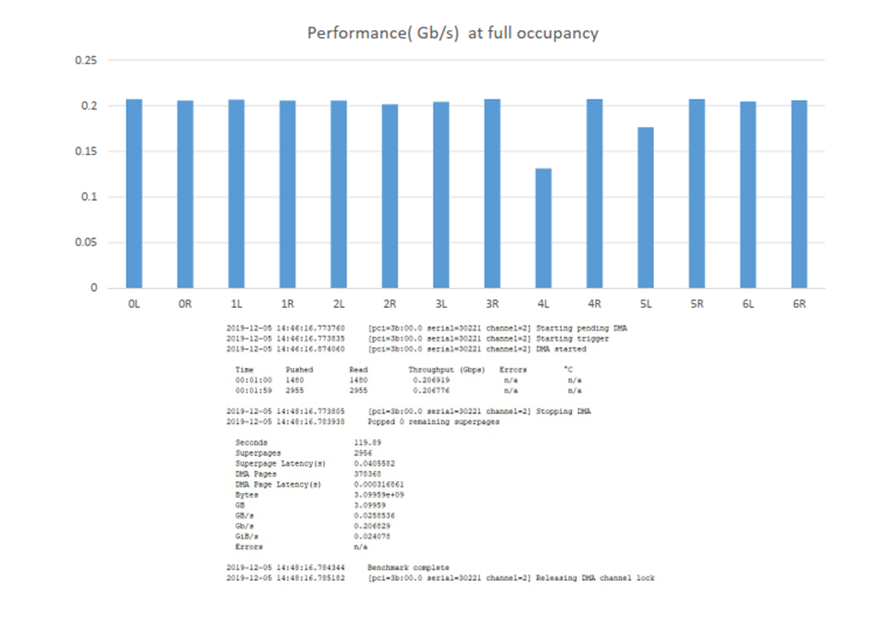
Data Throughputs per equipment
RICH4 with one missing columns (23rd);
RICH5 with 17% of skipped events (see after).

Slide 5
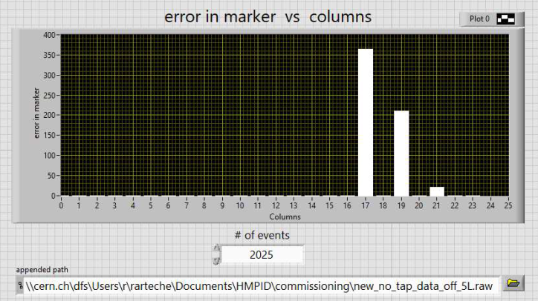
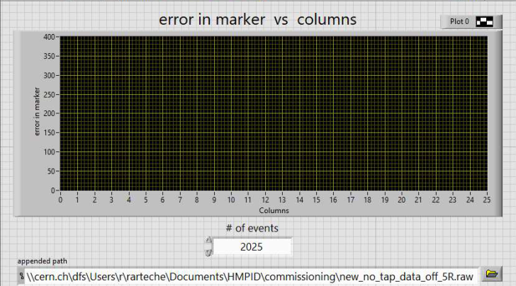
RO errors in columns
On the average, the RO errors in the modules are of the order of ~2 %;
In the RICH5-L errors at 17% of events (~380/2200 tot). Checks under way. In the right equipment no errors;
These events skipped for the calculation of the Pedestal Sigma (see after).

Slide 6
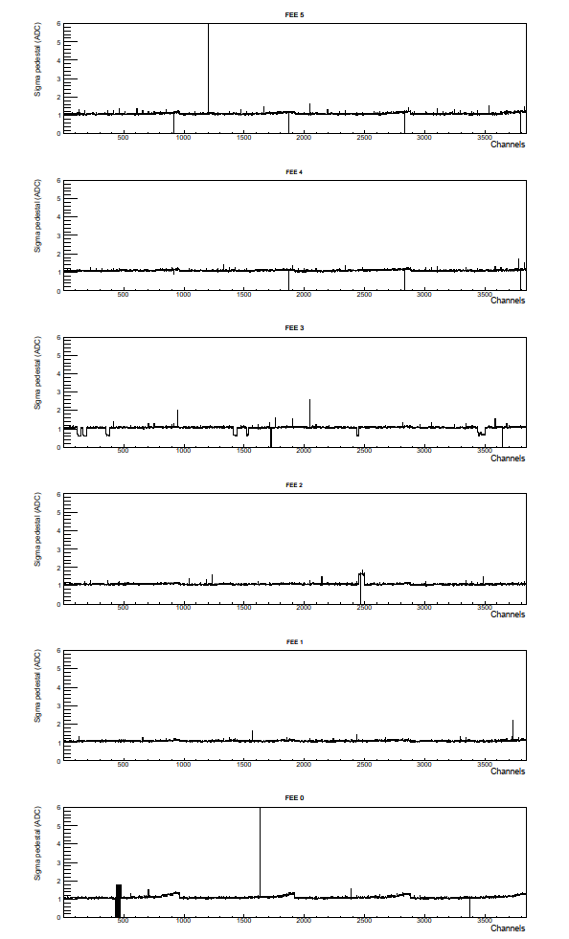
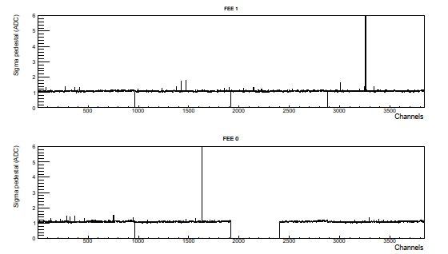
2019: pedestal maps
RICH4-FEE0-1
3840 pds
σ=1 ADC ch!
<σ> =1 ADC ch!
<Speph>~30 ADC chs
Th=ped+ 4 <σ>
ε_{d}=88%
RICH0-FEE4 3840 pds
RICH4-L-C23rd missing

Slide 7
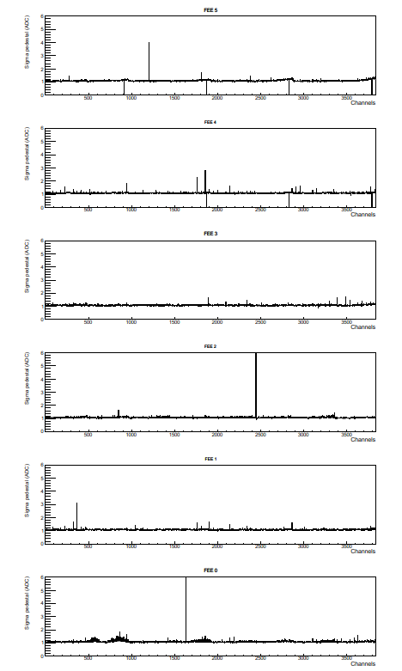
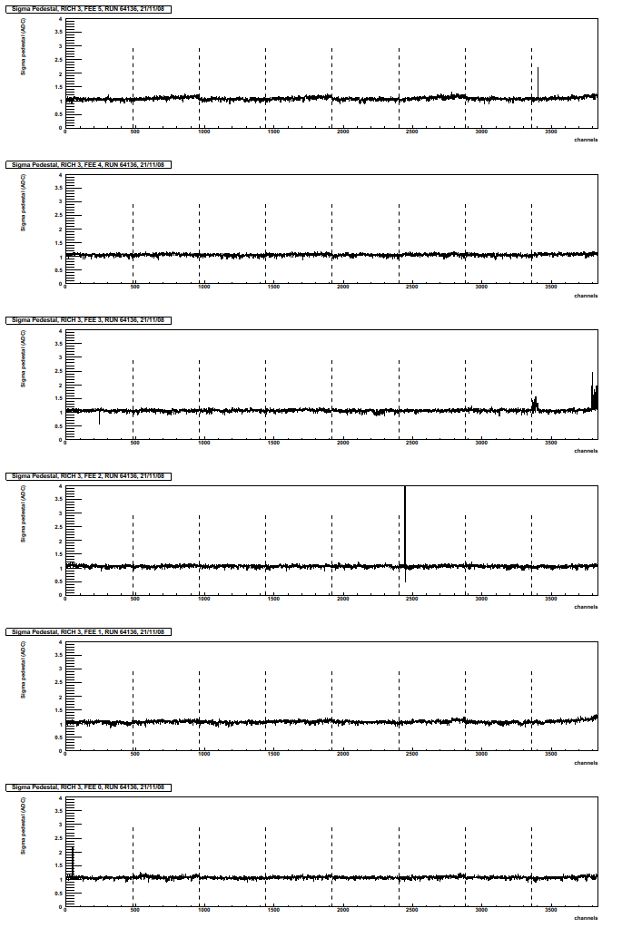
New (and old!) pedestal patterns!
RICH3 10 Dic. 2019
<σ>=1 ADC ch!
RICH3 21 Nov. 2008
<σ>=1 ADC ch!

Slide 8
Future commissioning plans
Use the LTU at P2 to continue RO tests till end of this week 13th Dec. 2019. Continue with the HMP LTU as from February 2020 (delivery date);
On the base of pedestals maps so far, we are going to request the TC the access on the beginning of 2020 the RICH4 to repair RO-L-C23rd. Scaffoldings should be installed;
New TTCrx FW with HBr and Time Frame trigger handling by end of January 2020;
As from summer 2020, HMP-CTP agreement for the usage of the Fan_IN/OUT modules ,VME crate, crate controller and relevant software (Run 2 device). HMP will use and maintain those device and the relevant software during all the Run 3.

Slide 9
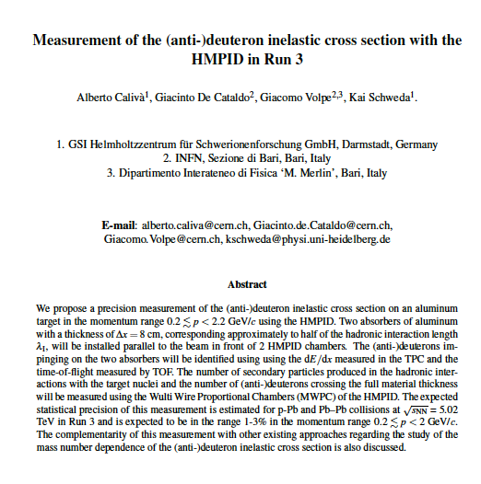
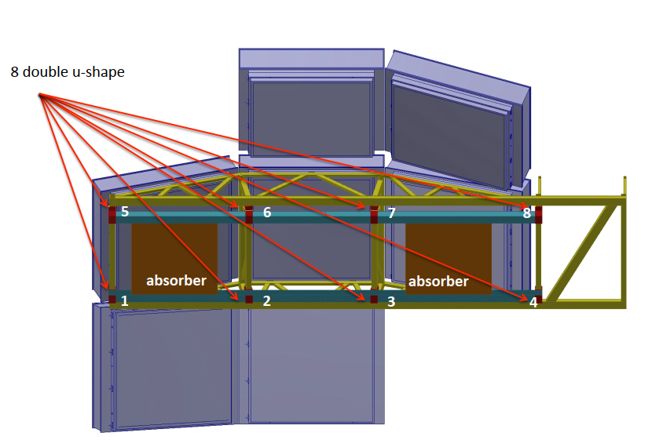
(Anti)deuteron inelastic C.S. measurement
Meeting with TC already planned before the end of 2019 to discuss the installation of two aluminum Absorbers;
Preliminary scheme of installation available.
First comments of reviewers, received;
The new version of the document under preparation (see later the presentation of A. Caliva).

Slide 10
Summary
18th-21st Nov.: successful read out tests with auto-triggering FW at P2 of the 14 HMPID equipment!! ☺
  Pad-map for all the 7 HMP RICH modules produced. Minor problems spotted;
  Useful functional tests of the RO electronics,
  not reliable for FEE ADC value!
As from Nov 27th: Read out tests at P2 with LTU and Fan_IN/OUT modules (from CTP):
  14 Equipment out of 14 are OK, only RICH4_L, Column 23 Missing!
  Actual TTCrx FW without HBr and Time Frame trigger handling;
Future commissioning plans prepared:
  C6F14 LCS: re-installation of the cold trap by end of February 2020;
  RO tests till end 2019 and new tests beginning 2020;
  New TTCrx FW in preparation at bld 581 (see presentation of Jordan). Expected by end of January 2020;
  To be agreed with TC:
    Beginning of 2020: Opening of the RICH4 module to repair the C23rd. A scaffolding should be installed
    After electronics reparation , installation of aluminum absorber for (anti)deuteron inelastic c.s. measurement.
First Comments of reviewers on the Document for the anti-d inelastic c.s. measurement received. Contacts with TC for the installation of the Aluminium absorbers, already under way.

