Slide 1
Εισαγωγή στo Grid,EGEE και το HellasGrid
Introduction to Grid, EGEE and HellasGrid
Athanasia Asiki
aassiki@cslab.ece.ntua.gr
Computing Systems Laboratory,
National Technical University of Athens

Slide 2
Contents
What is the Grid?
Grid paradigms
Enabling Grid for E-sciencE (EGEE)
HellasGrid Taskforce

Slide 3
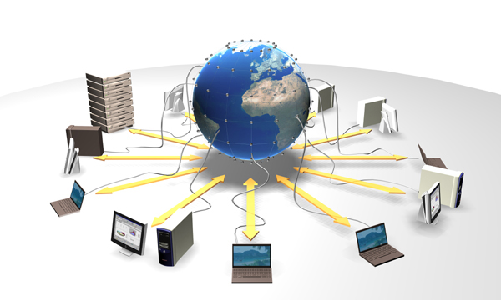
Grid Technologies (Grids)

Slide 4


What is the Grid?
The World Wide Web provides seamless access to information that is stored in many millions of different geographical locations
The Grid is an emerging infrastructure that provides seamless access to computing power and data storage capacity distributed over the globe
Server
Source of Information
Users

Slide 5
The Grid
Collaboration
Grid
Operations, Support and training
Network infrastructure linking resource centres

Slide 6
Definition of Grid systems
Collection of geographically distributed heterogeneous resources
“Most generalized, globalized form of distributed computing”
“An infrastructure that enables flexible, secure, coordinated resource sharing among dynamic collections of individuals, institutions and resources”
Ian Foster and Carl Kesselman
Offers access to a virtual and very powerful computing system
A user does not care, in which resource his / her job / jobs is going to be executed

Slide 7
Defining the Grid
A Grid is the combination
of networked resources and the corresponding middleware, which provides services for the user.
Notes:
7

Slide 8
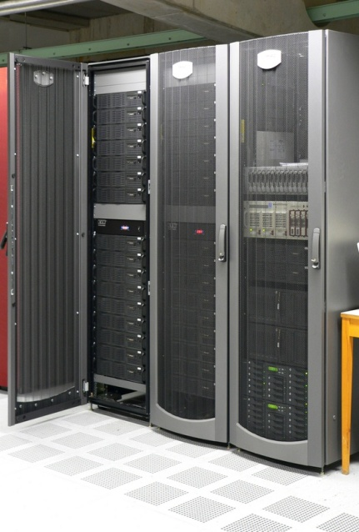
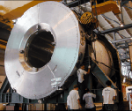
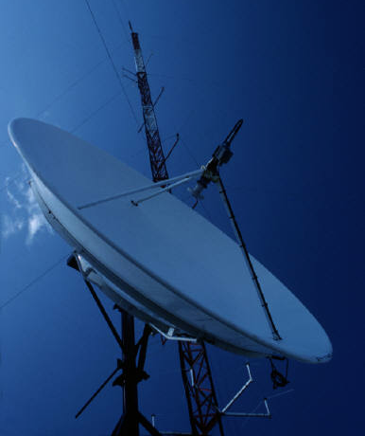
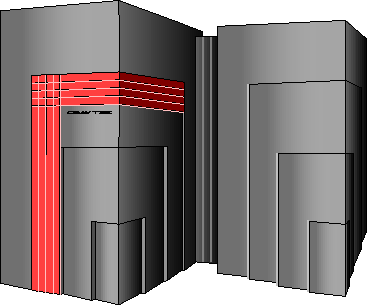
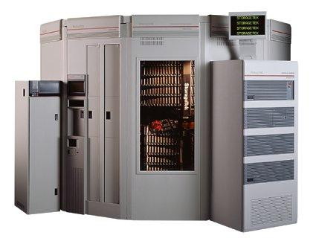
Resources
An entity that is going to be shared
such as:
 computational units
 storage units
 sensors
 visualization tools
 software

Slide 9
Principles of grid
Resource sharing
  Geographically distributed resources offer computational power, storage capacity and bandwidth to the users
Secure and reliable access
  Authentication
  Authorization
  Access policy
Open standards
Co-operation among people belonging to different organizations, institutes, groups

Slide 10
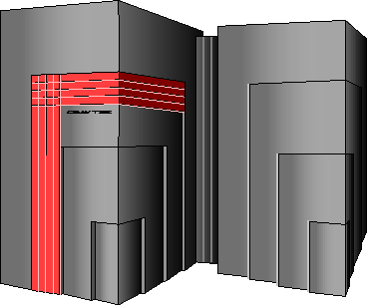
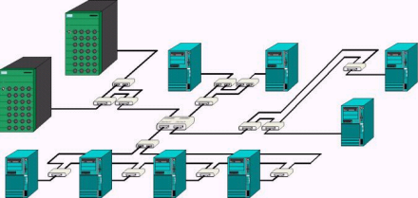
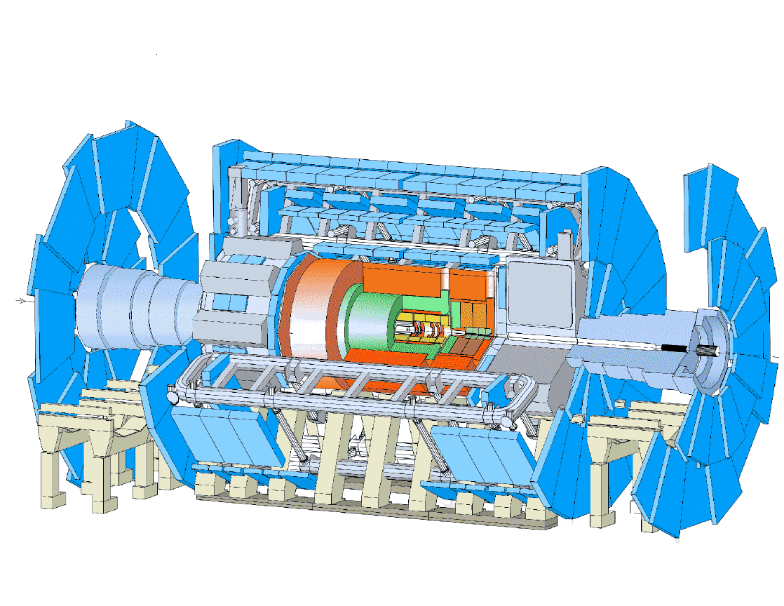
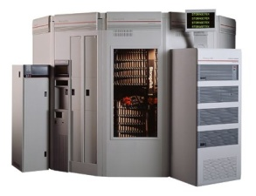
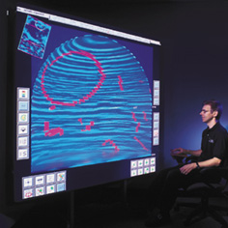
Grid metaphorically …
Mobile Access
G
R
I
D
M
I
D
D
L
E
W
A
R
E
Supercomputer, PC-Cluster
Workstation
Data-storage, Sensors, Experiments
Visualising
Internet, networks

Slide 11
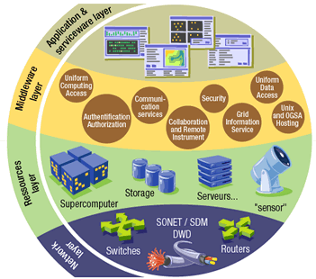
Grid middleware
The Grid relies on advanced software, called middleware, which interfaces between resources and the applications
The Grid middleware:
  Basic services
    Secure and effective access
    to resources
  High level services
    Optimal use of resources
    Authentication to the
    different sites that are used
    Job execution & monitoring
    of progress
    Problem recovery
    Transfer of results back to the user

Slide 12
Grid Middleware
When using a PC or workstation you
  Login with a username and password (“Authentication”)
  Use rights given to you (“Authorisation”)
  Run jobs
  Manage files: create them, read/write, list directories
Components are linked by local hardware
Operating system
One admin. domain
When using a Grid system
  Login with digital credentials – single sign-on (“Authentication”)
  Use rights given you (“Authorisation”)
  Run jobs
  Manage files: create them, read/write, list directories
Services are linked by the Internet
Middleware
Many admin. domains
Notes:
“services” = data storage, CPUs
In effect, restating the idea that “the network becomes the computer”.

Slide 13
Why now?
Development of networking technology (doubling every nine months or so over the last years) and high-speed networks
✓ widespread penetration of optical fibers
✓ wireless connections
✓ new Internet technologies (ADSL, WiMax)
Moore’s law everywhere
✓ Instruments, detectors, sensors, scanners, …
   Organising their effective use is the challenge
Applications require a huge amount of computations to be executed and the collaboration among scientists

Slide 14
E-science
Science that became feasible and promiscuous by resource sharing (sharing of data, scientific instruments, computational resources, colleagues) across the Internet
  ✓ Often very compute intensive
  ✓ Often very data intensive (both creating new data and accessing very large data collections) – data deluges from new technologies
  ✓ Crosses organisational and administrative boundaries

Slide 15
VO concept
gLite middleware runs on each shared resource to provide
  Data services
  Computation services
  Security service
Resources and users form Virtual organisations:
basis for collaboration
Distributed services (both people and middleware) enable the grid
INTERNET
Notes:
Single sign-on – instead of individual usernames and passwords at each resource (many being used by software clients) have a digital credential that can be securely passed to identify user… more later.

Slide 16
Virtual Organizations
Virtual Organization
“A set of individuals and / or institutions defined by highly controlled sharing rules, with resource providers and consumers defining clearly and carefully just what is shared, who is allowed to share and the conditions under which sharing occurs”
Ian Foster
Abstract entities grouping users, institutions and resources in the same administrative domain
What is going to be shared ?
✓ resources ✓ licenses
✓ software ✓ services
✓ special equipment ✓ Internet bandwidth

Slide 17
Virtual Organizations (VOs)
Astrophysics, astro-particle physics
Biomedical and Bioinformatic Applications
Computational chemistry
Earth sciences
Finance
Fusion
Geophysics
High-energy physics
Infrastructure
Other …
Our regional VO: SEE
VO for trainings : hgdemo
List of existing VOs
  http://cic.gridops.org/index.php?section=home&page=volist#1

Slide 18
Contents
What is the Grid?
Grid paradigms
Enabling Grid for E-sciencE (EGEE)
HellasGrid Taskforce

Slide 19
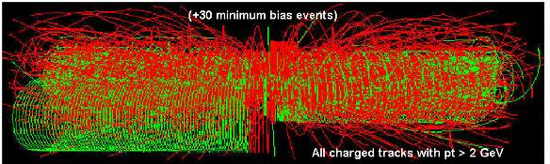
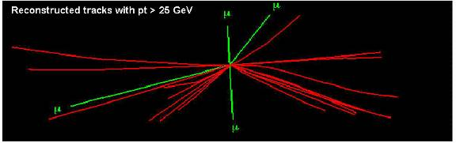
LHC Data Challenge
Starting from this event (particle collision) …
Data Collection
Data Storage
Data Processing
You are looking for this “signature”…
Selectivity: 1 in 1013
 Like looking for 1 person in a thousand world populations!
 Or for a needle in 20 million haystacks!

Slide 20
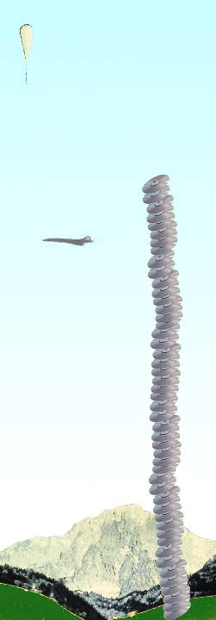
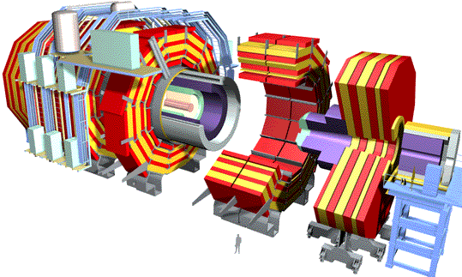
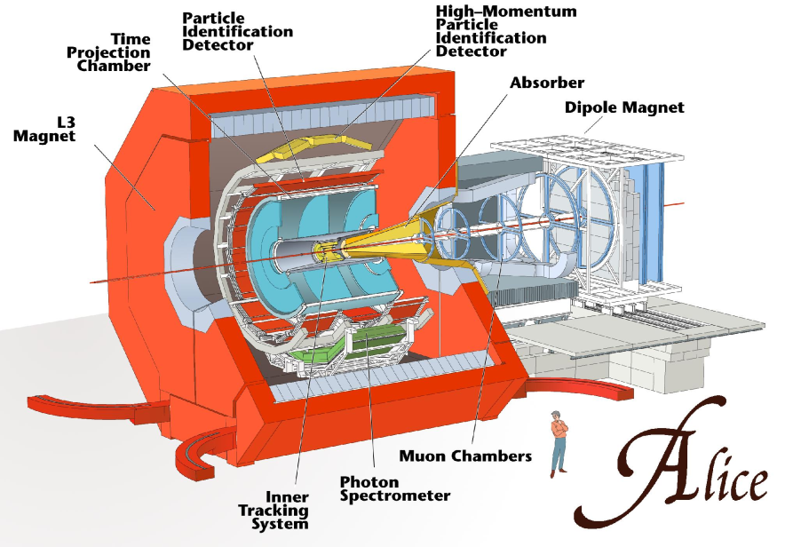
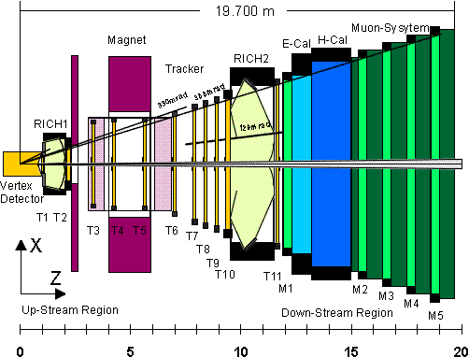
Amount of data from the
LHC detectors
Balloon
(30 Km)
CMS
ATLAS
CD stack with
1 year LHC data!
(~ 20 Km)
~15 PetaBytes / year
~10¹⁰ events / year
~10³ batch and interactive users
~ 20.000.000 CD / year
Concorde
(15 Km)
Mt. Blanc
(4.8 Km)
LHCb

Slide 21

LHC Computing Grid
The LHC Computing Grid Project (LCG) was born to prepare the computing infrastructure for the simulation, processing and analysis of the data of the Large Hadron Collider (LHC) experiments.
The processing of the enormous amount of data, that will be generated, will require large computational and storage resources and the associated human resources for operation and support.
Preparation of a common infrastructure of
✓ libraries
✓ tools
✓ frameworks
required to support the physics application software

Slide 22
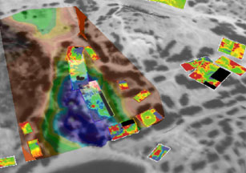
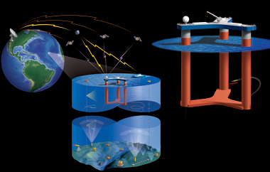
Some examples
ArchaeoGrid
Create a computer model that weaves together data from many sources and predicts feedback interaction
LOOKING
Observe and analyze data streams in real time. A sensor grid with thousand of different sensors providing real time data and measurements from ocean-going researchers enabling an enormous data grid infrastructure.
Notes:
ArchaeoGrid (EUMED GRID)
Data from geographical, geological information, botanical descriptions such as fossilized pollen records, economic data, records of human migration and settlement
For example, ArchaeoGrid can create a palaeoclimate simulation and predict how changes to climate, from the agricultural revolution 8,000 years ago, influenced human settlement patterns
(Computational power + Integration of data archives)
Picture -> fusion of aerial satellite data and geographical maps (Crete )
LOOKING (USA) -> REAL TIME DATA PUBLICALLY AVALIABLE

Slide 23
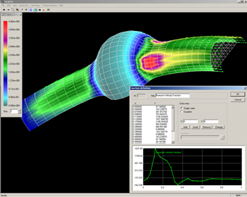
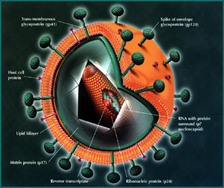
Some examples
Parallel Blood Flow Simulation
Allows surgeons to perform virtual stent surgery until they get it just right. It combines parameters such as blood velocity and pressure with a series of medical images to automatically create a 3D computational model.
ViroLab
Aims to create a collaborative virtual labaratory for grid-based decision support for viral disease treatment. HIV treatment in the increasingly common case of HIV drug resistance is mainly studied. Virolab “vertically” integrates biomedical information relating to viruses, patients and literature resulting in a rule-based decision support system for drug ranking.
Notes:
Parallel Blood Flow Simulation ->SEE-GRID-2

Slide 24
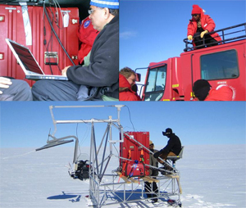
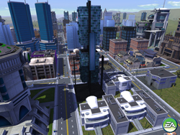
Some examples
Image © Electronic Arts Inc.
All rights reserved.
Polar Grid
A planned project for an advance cyberinfrastructure, empowering smaller universities, and provide scientists with a gateway to teraflops of power: enough to drive new and improved high-performance simulations and enable measurement and prediction of ice sheet response to climate change and effect on ocean levels.
MoSES (Modelling and Simulation for e-Social Science)
Runs predictive models integrating real Census data, survey data, healthcare data of UK population. Determine the impact of different policy decisions and various social aspects like increasing life expectancy, immigration, aging population.

Slide 25
Contents
What is the Grid?
Grid paradigms
Enabling Grid for E-sciencE (EGEE)
HellasGrid Taskforce

Slide 26
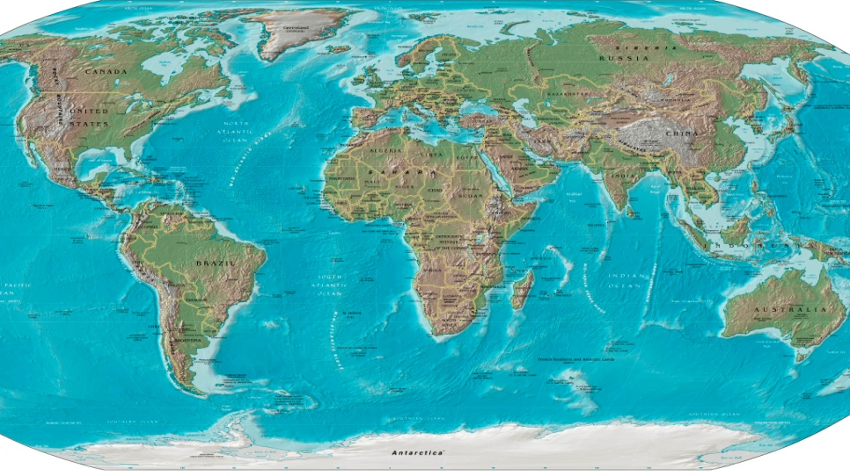
From EGEE to ΕGEE IiI
EGEE objective:
  “to establish a seamless European Grid infrastructure for the support of the European Research Area (ERA)”
EGEE:
  Accomplished all of its objectives
  Scope expanded beyond
  Europe
EGEE-II :
  Full capacity from day one
  Large-scale, production-quality infrastructure
  Supporting a wide range of applications
  Staff with extensive knowledge of Grid technology

Slide 27
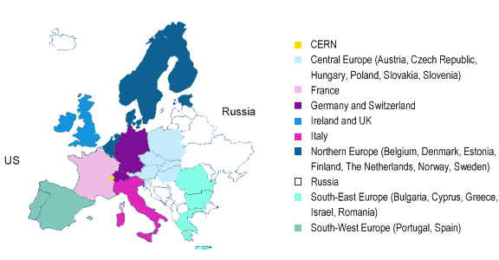
EGEE
Enabling Grids for E-Science
EGEE-II aims to provide a production quality Grid infrastructure across the European Research Area and beyond.
Started on 1 April 2006
Available infrastructure to the
Research and Academic
community 24 hours per day
and 7 days per week
Participants:
✓ 240+ institutions
✓ 45 countries
Consists of:
✓ 202 sites
✓ ≈41.000 CPUs
✓ ≈5 PB
✓ 100,000 concurrent jobs
http://www.eu-egee.org/

Slide 28
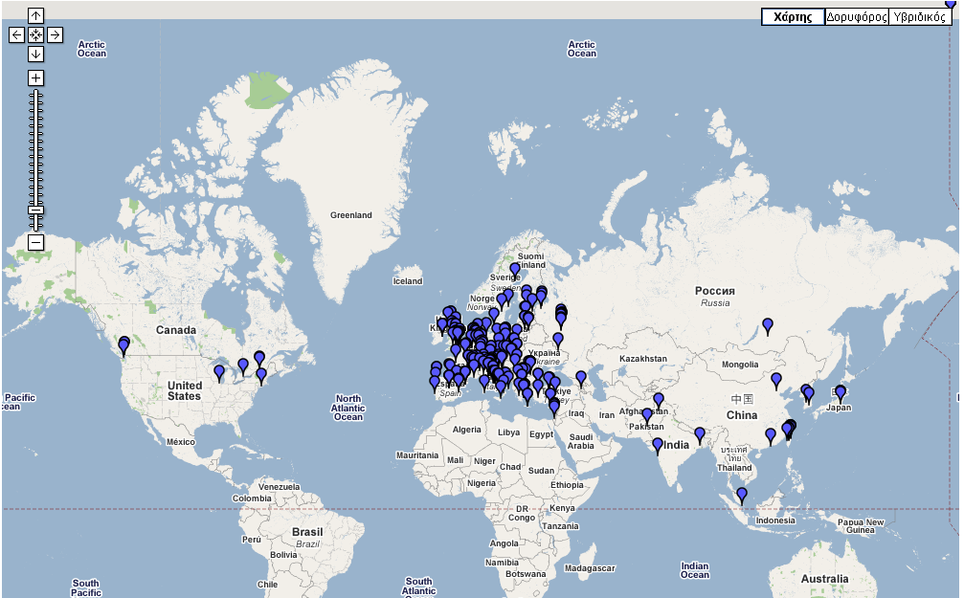
Infrastructure of EGEE
Information about sites: http://goc.grid.sinica.edu.tw/gstat/

Slide 29
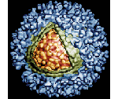

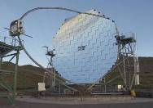

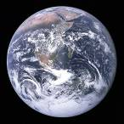
EGEE Mission
Mission:
Manage and operate production Grid infrastructure for the European Research Area
Interoperate with e-Infrastructure projects around the globe (Open Standards-GGF) and Contribute to Grid standardisation efforts
Incorporate new users from the industry and from the research community as well assuring the best possible training and support
Support applications deployed from diverse scientific communities:
  ✓ High Energy Physics ✓ Biomedicine
  ✓ Earth Sciences ✓ Astrophysics
  ✓ Computational Chemistry ✓ Finance, Multimedia
  ✓ Fusion ✓ Geophysics . . .
  …
Prepare for a permanent/sustainable European Grid Infrastructure (in a GÉANT2-like manner)

Slide 30
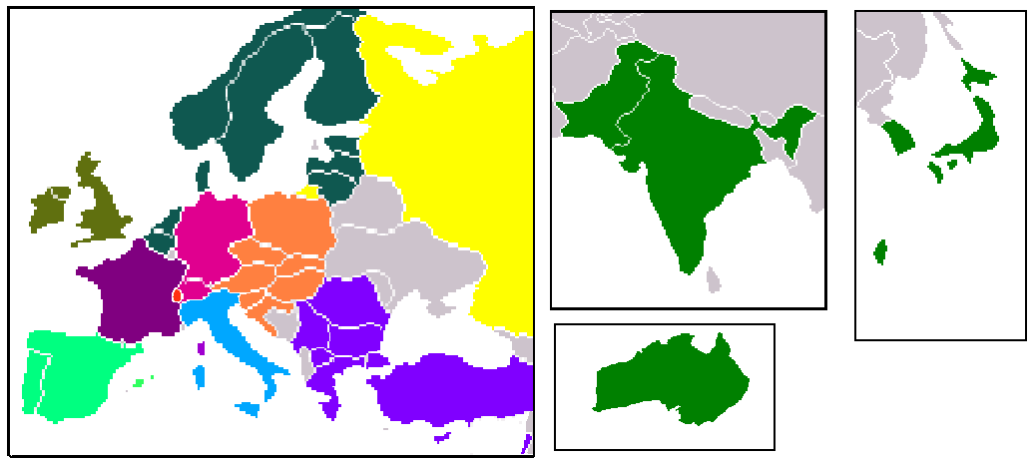
Operations centres in EGEE
Regional Operations Centres (ROC)
  Front-line support for user and operations issues
  Provide local knowledge and adaptations
  One in each region – many distributed
z
User Support Centre (GGUS)
  In FZK: provide single point of contact (service desk), portal
https://gus.fzk.de/pages/home.php

Slide 31
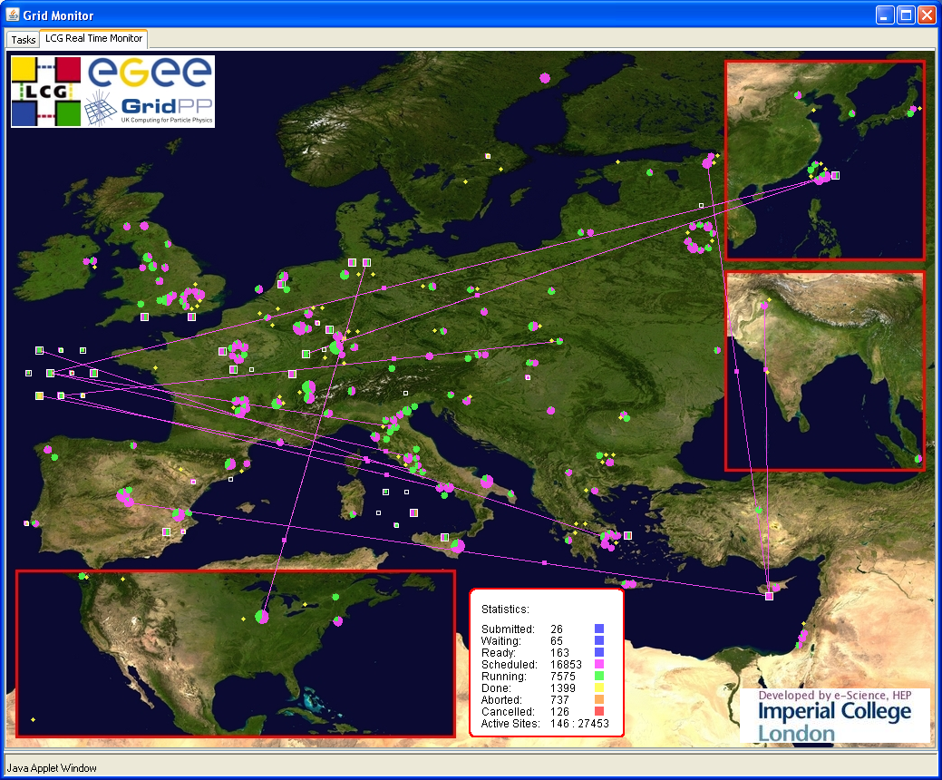
What is happening now?
Real Time Monitor
  Java tool
  Displays jobs running (submitted through RBs)
  Shows jobs moving around world map in real time,
  along with changes
  in status
http://gridportal.hep.ph.ic.ac.uk/rtm/

Slide 32

gLite
Lightweight Middleware for Grid Computing
Part of the EGEE project
Next generation middleware for grid computing
In its development participate from different academic and industrial European centers
Provides services for computing element, data management, accounting, logging and bookeping, information and monitoring, service discovery, security, workload management

Slide 33



The European Network - GÉANT 2
“GÉANT2 is the seventh generation of pan-European research and education network, successor to the pan-European multi-gigabit research network GÉANT”
http://www.geant2.net/
The project officially started on 1 September 2004 and will continue to take place for the next 4 years
The project is supported by the European Committee and by 30 European National Research and Education Networks (NRENs) in 34 countries and is administrated by DANTE (Delivery of Advanced Network Technology to Europe).
It provides services of high quality and readability in the European Education and Research community and connects all the National Research Networks of European Union, Centre and East Europe, Israel and Cyprus

Slide 34
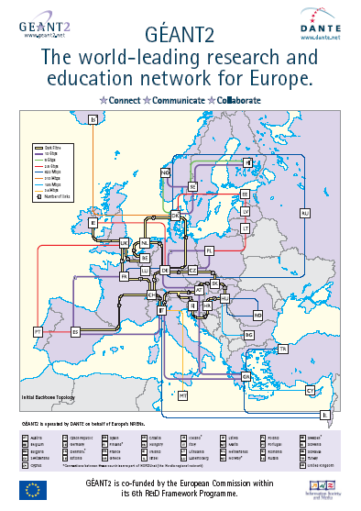

GÉANT 2
It provides:
  Basic IPs services
  Quality of service levels
Two main services:
  Routed (Internet) and switched (L1-L2)
Backbone mixed:
  Part of will be based on dark fiber
  Part of it on leased services
Greece interconnection:
  2 * 10Gbps lambdas
Grid paradigms

Slide 35
Grid systems’ related software
Operating system:
  Linux (+GNU utilities), usually a RHEL3-like,
  for example Scientific Linux, etc
Middleware:
  gLite v3.x
Libraries and Applications
  Defined by the system and VOs administrators’ foresight
  The user can install and execute its own programmes

Slide 36
VOs software
Each VO according to its needs installs experimental software:
ATLAS: atlas software (a big collection, v12.2.0 etc)
CMS: cmkin, cobra, famos, geometry, ignominy, orca, oscar
ALICE: alien, alice, root, proof
LHCb: dirac, boole, DC, decfiles, gauss, paramfiles
BIOMED: gate, cdss, gps@, gromacs, simri3d, gptm3d
ESR: (earth science specific… eg, idl package)
The users can negotiate with their VOs for the installation of needed software

Slide 37
Infrastructure Sites
http://www.grid.auth.gr/pki/seegrid-ca/
http://www.grid.auth.gr/pki/seegrid-ca/
http://wiki.egee-see.org/index.php/SEE-GRID_Wiki
EGEE Helpdesk:
https://helpdesk.egee-see.org/index2.php
http://www.egee-see.org/User_documentation.php
https://voms.irb.hr:8443/edg-voms-admin/seegrid/index.html

Slide 38
Contents
What is the Grid?
Grid paradigms
Enabling Grid for E-sciencE (EGEE)
HellasGrid Taskforce

Slide 39
HellasGrid Infrastructure, Phase Ι & ΙΙ
HellasGrid I
  Located at N.C.S.R. Demokritos (a.k.a. Isabella)
  34 dual Intel P4 Xeon @ 2.8GHz, 1GB RAM, 2x 70GB SCSI HDD, 2x Gbit
  IBM FAStT900 Storage Area Network
    2x Redundant Fiber Channel Controllers with 1Gbyte Cache each
    70x146.8GB= 10,276ΤΒ raw storage capability, over 5 disk shelves
  Tape Library ~30 TBytes, integrated monitoring
  December 2004
HellasGrid II
  5 sites: EKT (>220), ΙΕΣΕ (48), ΑΠΘ (128), ΙΤΕ (128), ΙΤΥ (128)
  ~700 CPUs x86_64, 2 GB RAM, 1x 80GB SATA HDD, 2x Gbit
  ~20 TBytes storage space in SAN (5x 4TBs)
  ~50 TBytes Tape Library in National Documentation Center
http://www.hellasgrid.gr/

Slide 40
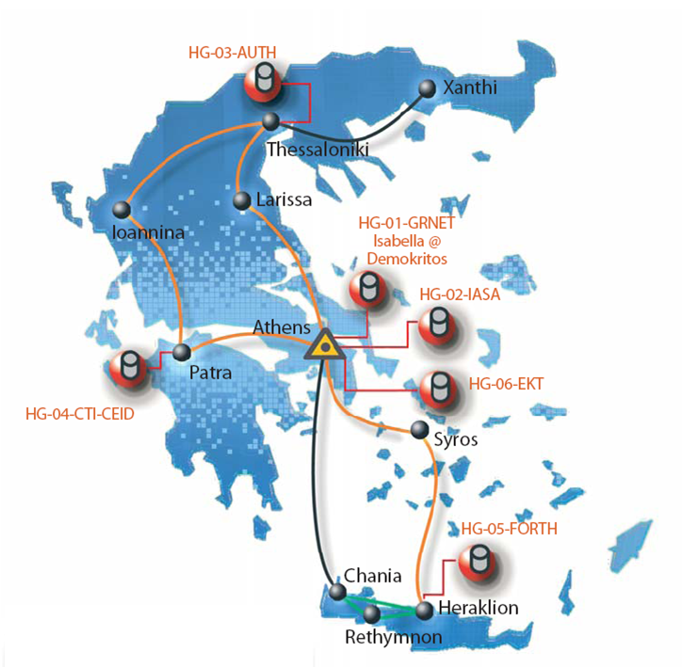
HellasGrid e-Infrastructure

Slide 41








HellasGrid structure
Main site: HG-01-GRNET (Isabella, cslab@ICCS/NTUA)
HG-02…HG-06 sites @ (NDC, IASA, AUTH, FORTH, CTI)
HG CA and VOMS (AUTH):
http://www.grid.auth.gr/pki/seegrid-ca/
Helpdesk (CTI):
      user-support@hellasgrid.gr
Regional monitoring tools (FORTH):
http://hellasgrid-ui.ics.forth.gr/acctROC/
Apps support (IASA):
application-support@hellasgrid.gr

Slide 42
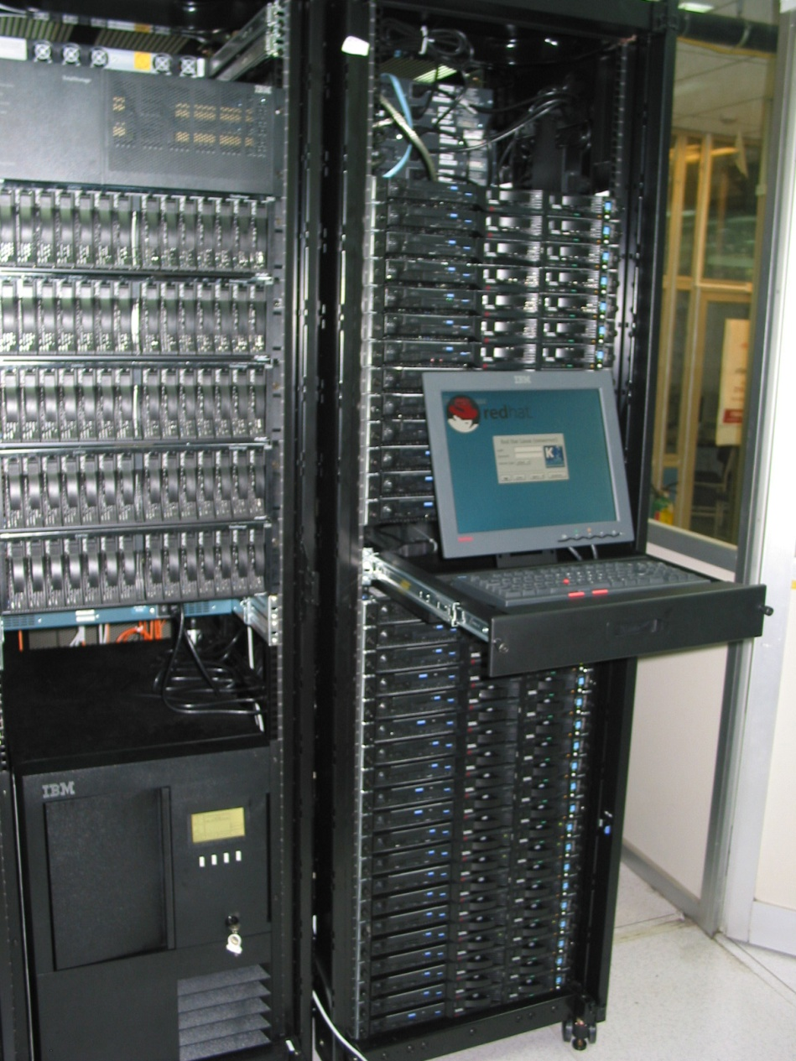
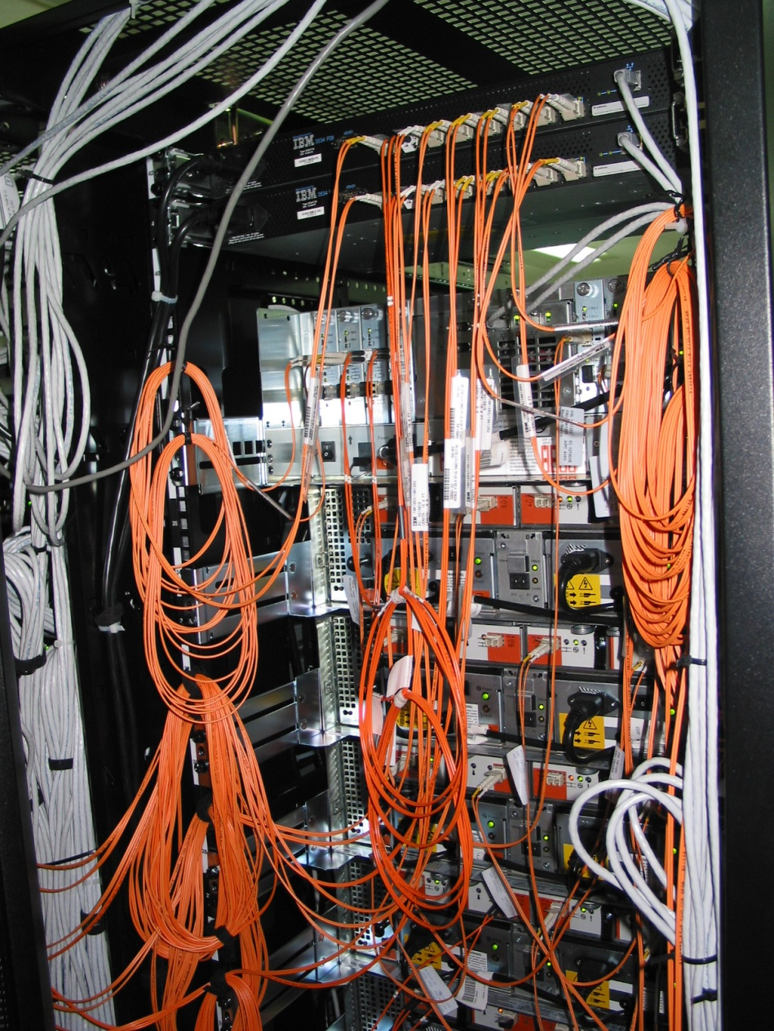
HellasGrid I Infrastructure, Isabella

Slide 43
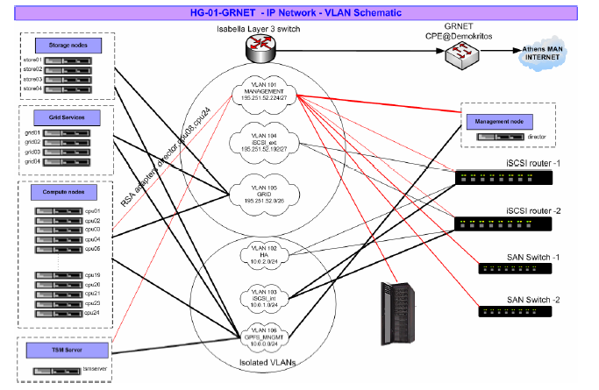
HellasGrid I, Isabella: Network

Slide 44
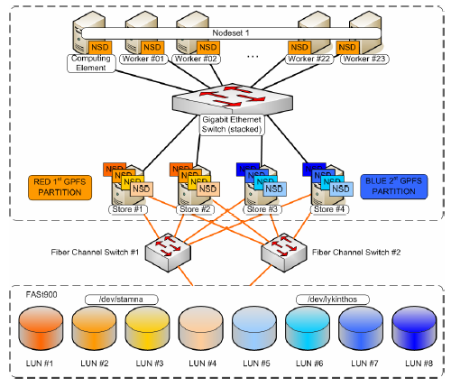
HellasGrid I, Isabella: Storage
The first node of the Greek Grid Infrastructure, consisting a prototype for the next HellasGrid nodes
Remarkable and innovative organization of SAN and filesystems
 Scientific Linux, gLite 3.0._, LCG, MPICH, CODESA3D-1.0, VO-alice, VO-atlas, VO-biomed, VO-dteam, VO-cms, VO-esr, VO-lhcb, VO-see (octave), VO-seegrid ,…

Slide 45
Core Services (HG-01-GRNET)
Core Services
  Central LCG File Catalog (LFC) for the users of the VOs:
    eumed, hgdemo, see
  Resource Broker and Information Index (BDII) which can be accessed by the users of the VOs:
    atlas, alice, lhcb, cms, dteam, sixt, biomed, esr, magic, compchem, see, planck, hgdemo, eumed
  Catch-All User Interface for HellasGrid
    Registration is handled through the Hellasgrid User-Support Team
    UI services are offered by all HG sites
Certification Services for new sites (SFTs)
  https://mon.isabella.grnet.gr/sft/lastreport.cgi (Need a valid HellasGrid Certificate)

Slide 46
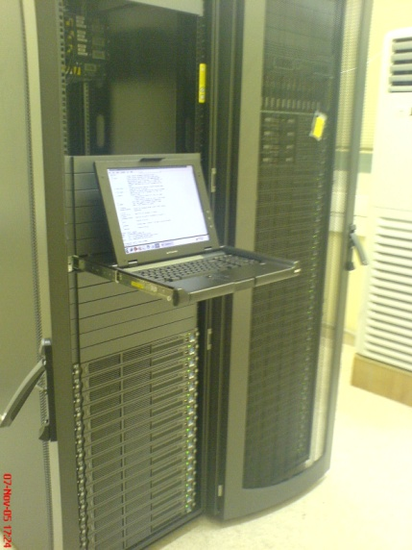
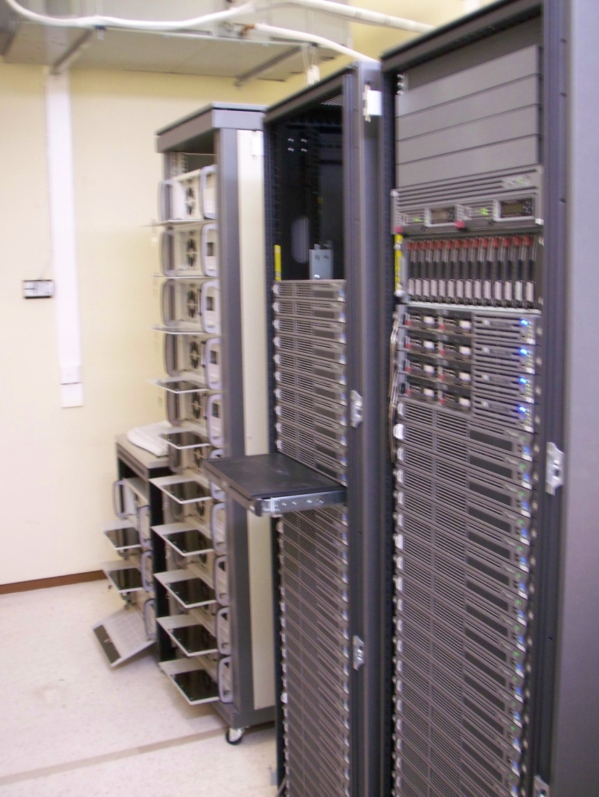
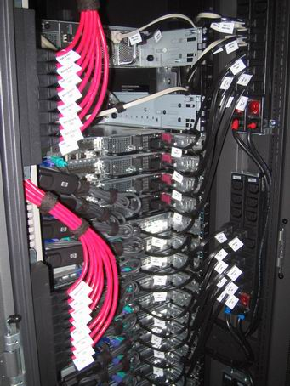
HellasGrid II Infrastructure

Slide 47
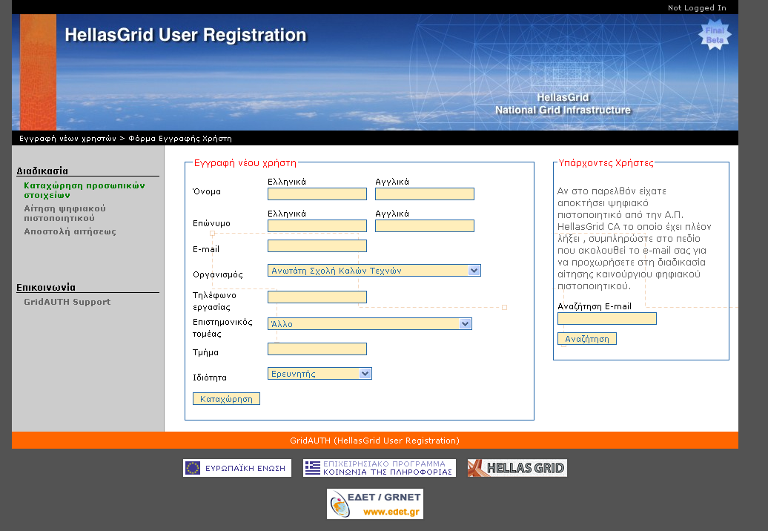
Registration to HellasGrid
https://access.hellasgrid.gr/register/registration_form

Slide 48
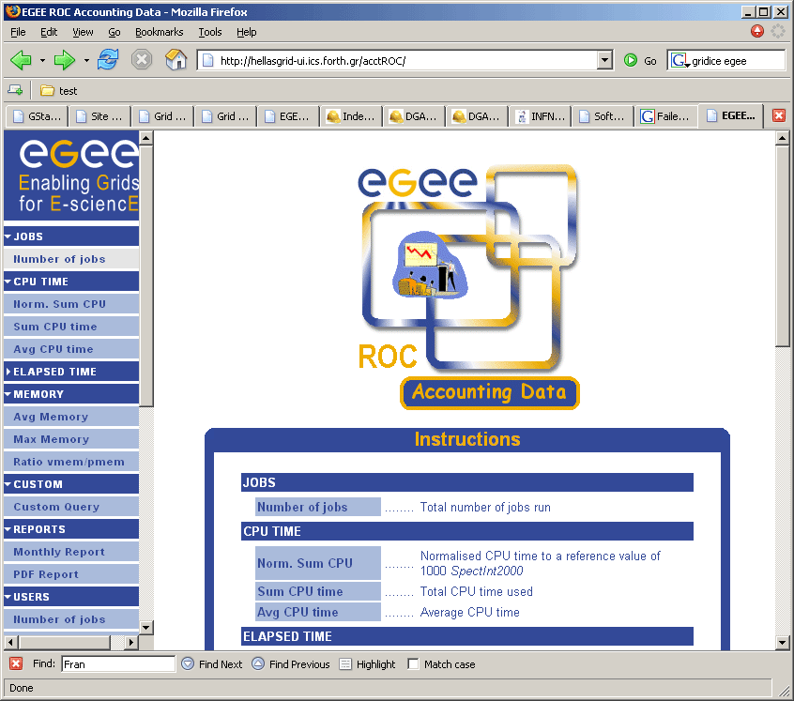
Accounting statistics for the HellasGrid Infrastructure
http://hellasgrid-ui.ics.forth.gr/HG/

Slide 49
Q&A
Thank you!

Slide 50
Αναφορές
Grid café:
http://www.gridcafe.org/
Open Grid Forum:
  http://www.gridforum.org/
HellasGrid Task Force
  http://www.hellasgrid.gr/
EGEE (Enabling Grids for E-science)
  http://www.eu-egee.org/
The Globus Alliance
http://www.globus.org/
Grid Operations Centre
http://goc.grid-support.ac.uk/gridsite/gocmain/
gLite UserGuide
http://glite.web.cern.ch/glite/documentation/

Slide 51
Χρήσιμα web links
EGEE – South East Europe
http://www.egee-see.org/
SEE-GRID
http://www.see-grid.org/
GRNET
http://www.grnet.gr/
gLite
http://glite.web.cern.ch/glite/
SEE-GRID Wiki
http://wiki.egee-see.org/index.php/SEE-GRID_Wiki
GOC Wiki
http://goc.grid.sinica.edu.tw/gocwiki/
SEEREN2
http://www.seeren.org/

