Slide 1
Laboratory: Hands-on using EGEE Grid and gLite middleware‏
Αthanasia Asiki
aassiki@cslab.ece.ntua.gr
Computing Systems Laboratory,
National Technical University of Athens

Slide 2
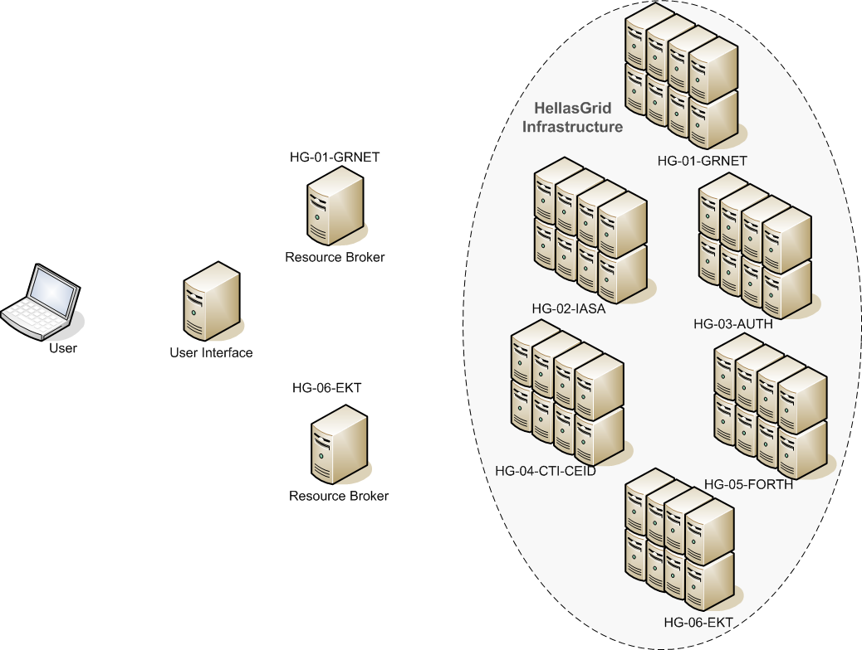
Job execution
WMS
Choose an available site for the job execution
Each site has:
Computing Element
Storage Element
Worker Nodes
The user connects to User Interface using a SSH-client
ui01.isabella.grnet.gr
User’s personal account and its certificate
Command Line Interface for job submission

Slide 3
Catching up!
Creating a proxy certificate
  voms-proxy-init --voms=hgdemo
Listing Computing Elements that match a job description
  glite-wms-job-list-match -a testJob1.jdl
Submitting a job
  glite-wms-job-submit -o jobId -a testJob1.jdl
Retrieving the status of a job
  glite-job-status -i jobId
Retrieving the output of a job
  glite-wms-job-output -i jobId

Slide 4
Filenames(1)‏
Grid Unique Identifier (GUID)‏
  Identifies a file uniquely
  Example: guid:ab993b98-8bc9-4984-901e-91290276090c
Logical File Name (LFN) (User Alias)‏
  Refers to a file instead of a GUID
  lfn:<any_string>
  LFC catalogue: lfn:/grid/<MyVO>/<MyDirs>/<MyFile>
  Example: lfn:/grid/hgdemo/test_hgdemodemo/test_file
Storage URL (SURL) (Physical File Name-PFN)‏
  Identifies a replica in a SE
  <sfn|srm>://<SE_hostname>/<some_string>
  Example: sfn://se01.isabella.grnet.gr/storage/hgdemo/generated/2007-04-20/filec4087974-dbaa-4890-91e2-3c105fa0a3df
Transport URL (TURL)‏
  A valid URI with the necessary information to access a file in a SE
  <protocol>://<some_string>
  Example:gsiftp://se01.isabella.grnet.gr/storage/hgdemo/generated/2007-04-20/file1a08d327-d7dc-4d89-bb01-2c86f59eae37

Slide 5
Filenames(2)‏
User Metadata
Replicas
LFN₁
SURL₁
TURL₁
Grid Unique IDentifier
LFN₂
SURL2
TURL1
GUID
SURL3
TURL2
LFN₃
User Metadata
System Metadata

Slide 6
LFC commands
lfc-ls: List file / directory entries in a directory
lfc-mkdir: Create directory
lfc-chmod: Change access mode of a LFC file / directory
lfc-chown: Change owner and group of a LFC file / directory
lfc-ln: Make a symbolic link to a file / directory
lfc-rename: Rename a file / directory
lfc-rm: Remove a file / directory
lfc-setcomment: Add / replace a comment
lfc-delcomment: Delete the comment associated with a file / directory

Slide 7
More advanced LFC commands
lfc-getacl: Get file / directory access control lists
lfc-setacl: Set file / directory access control lists
lfc-entergrpmap: Defines a new group entry in the Virtual ID table
lfc-enterusrmap: Defines a new user entry in Virtual ID table
lfc-modifygrpmap: Modifies a group entry corresponding to a given virtual gid
lfc-modifyusrmap: Modifies a user entry corresponding to a given virtual uid
lfc-rmgrpmap: Suppresses group entry corresponding to a given virtual gid or group name
lfc-rmusrmap: Suppresses user entry corresponding to a given virtual uid or user name.

Slide 8
LCG Data Management Client Tools
lcg_util tools
  Allow users to copy files between UI, CE, WN and a SE
  Allow users to register entries in the file catalogue and replicate files between SEs
Replica Management
lcg-cp: Copies a Grid file to a local destination (download)‏
lcg-cr: Copies a file to a SE and registers the file in the catalogue
(upload)‏
lcg-del: Deletes one file (either one replica or all replicas)‏
lcg-rep: Copies a file from one SE to another SE and registers it in the
catalogue (replicate)‏
lcg-gt: Gets the TURL for a given SURL and transfer protocol

Slide 9
LCG Data Management Client Tools
File Catalogue Interaction
  lcg-aa: Adds an alias in the catalogue for a given GUID
  lcg-ra: Removes an alias in the catalogue for a given GUID
  lcg-rf: Registers in the catalogue a file residing on an SE
  lcg-uf: Unregisters in the the catalogue a file residing on an SE
  lcg-la: Lists the aliases for a given LFN, GUID or SURL
  lcg-lg: Gets the GUID for a given LFN or SURL
  lcg-lr: Lists the replicas for a given LFN, GUID or SURL

Slide 10
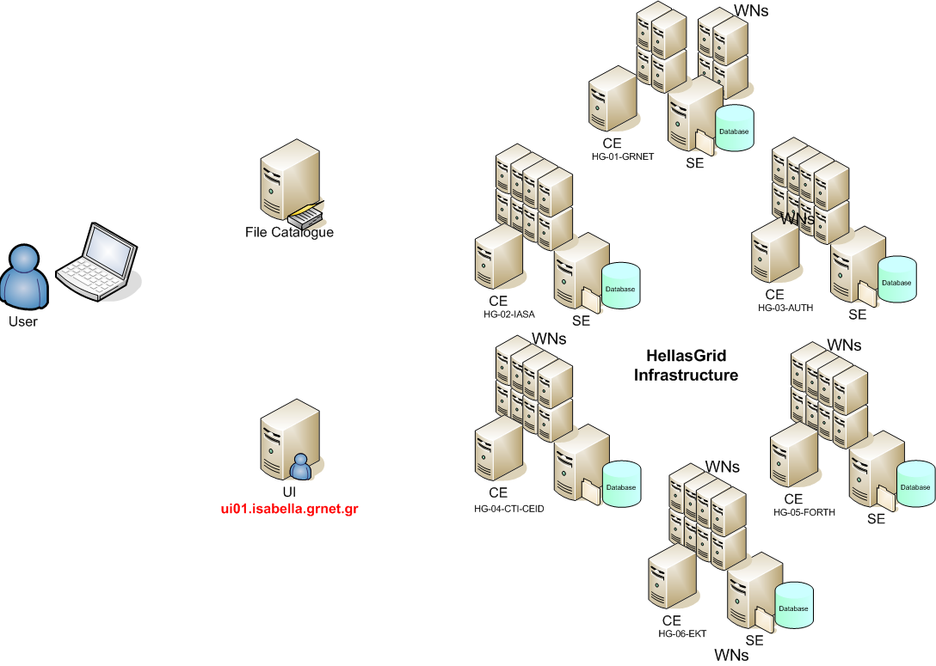
Operations on files
The identifiers of the file are stored under its LFN to the user’s directory
The user creates its own directory in the File Catalogue
The user interacts with the Grid Infrastructure through the UI
The new information is added to the user’s directory
The file is REPLICATED to another site
The user UPLOADS a file to a Grid SE
The user DOWNLOADS a file from the Grid

Slide 11
Configuration to use the LFC
The LFC_HOST variable must contain the hostname of the machine providing the LFC service
 [egee@ui01.isabella.grnet.gr]$ export LFC_HOST=`lcg-infosites --vo hgdemo lfc`
 [egee@ui01.isabella.grnet.gr]$ export LCG_CATALOG_TYPE=lfc
The LCG_GFAL_VO variable must contain the name of the user’s VO
 [egee@ui01.isabella.grnet.gr]$ export LCG_GFAL_VO=hgdemo

Slide 12
Create a directory
Creating a directory in the LFN namespace
 [egee@ui01.isabella.grnet.gr]$ lfc-mkdir /grid/hgdemo/test_($USER)‏
where $USER -> the username of each participant
Listing the entries of a LFC directory
 [egee@ui01.isabella.grnet.gr]$ lfc-ls -l /grid/hgdemo/
drwxrwxr-x 0 26158 32000 0 Apr 20 12:45 test_hgdemodemo
Defining LFC_HOME variable to point to the created directory
 [egee@ui01.isabella.grnet.gr]$ export LFC_HOME=/grid/hgdemo/test_($USER)‏
Removing LFNs from the LFC
 [egee@ui01.isabella.grnet.gr]$ lfc-rm -r lfc:/grid/hgdemo/test_($USER)‏

Slide 13
Upload and replicate a file
Uploading a file to the grid with specific LFN and in a specific
storage element
[egee@ui01.isabella.grnet.gr]$ lcg-cr file:$PWD/satimg.ppm -l lfn:satimg
guid:e20d1fa9-e35f-426d-aa72-cb99b18c2791
 [egee@ui01.isabella.grnet.gr]$ lfc-ls /grid/hgdemo/test_$USER/
image1
Replicating a file
[egee@ui01.isabella.grnet.gr]$ lcg-rep -v lfn:satimg -d se01.athena.hellasgrid.gr
Copying a file out of the Grid
 [egee@ui01.isabella.grnet.gr]$ lcg-cp lfn:satimg file:$PWD/copy_image1

Slide 14
File management operations (1)
Listing replicas
[egee@ui01.isabella.grnet.gr]$ lcg-lr --vo hgdemo lfn:satimg
srm://se01.grid.hgdemo.gr/dpm/grid.hgdemo.gr/home/hgdemo/generated/2009-05-06/fileaaa2af18-8b10-4566-8b96-1f55f3eb2610
Listing guids given the lfn
 [egee@ui01.isabella.grnet.gr]$ lcg-lg lfn:satimg
guid:e20d1fa9-e35f-426d-aa72-cb99b18c2791
Adding metadata information to LFC entries
   [egee@ui01.isabella.grnet.gr]$ lfc-setcomment /grid/hgdemo/test_($USER)‏
  /satimg "Created for the training"
View metadata of a specific file
 [egee@ui01.isabella.grnet.gr]$ lfc-ls --comment /grid/hgdemo/test_($USER)/satimg
  image1 Created for the training
Removing metadata information to LFC entries
 [egee@ui01.isabella.grnet.gr]$ lfc-delcomment /grid/hgdemo/test_$USER/satimg

Slide 15
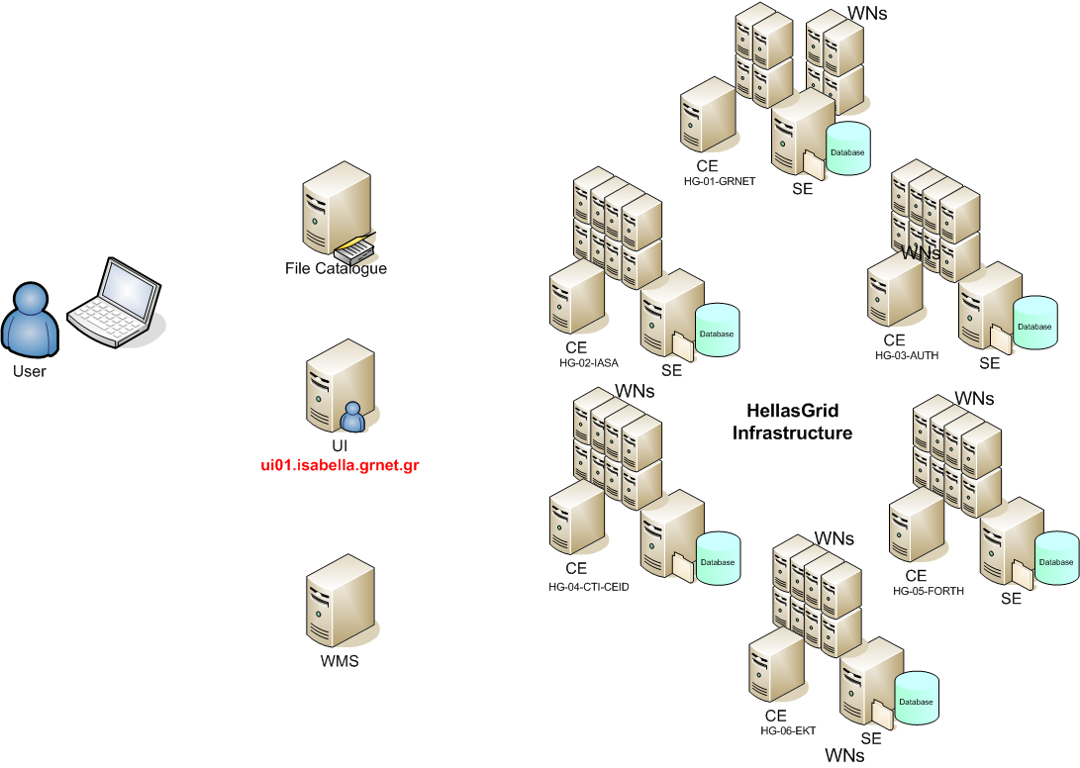
Job interacting with files
Job is being executed here!
The input file is downloaded locally during job execution
The site for the job execution is selected by the WMS
The LFN and the other file identifiers are stored in the user’s directory in the File Catalogue
The output files are uploaded to a SE
The user interacts with the Grid Infrastructure through the UI
The file catalogue is informed about the new LFNs
The user UPLOADS the input file to the Grid with a specific LFN
The result of the job execution is returned to the user
The user submits his/her job

Slide 16
A simple job with data management
 [egee@ui01.isabella.grnet.gr]$ less testJob2.sh
#!/bin/sh
echo Information about the Worker Node
echo Running at `hostname`
echo Date `date`
echo Enabling the executable flag for the application
chmod 755 $PWD/comprjesspeg
echo Fetching data from a Storage Element
lcg-cp --vo hgdemo $1 file:$PWD/local_copy
echo Runnning executable of the user taking as input the transfered file
$PWD/compressjpeg local_copy > local_compressed_copy
echo Convert to jpeg _ Unix command
pnmtojpeg local_copy > local_copy_jpeg
ls -al
echo Registering output to the Storage Elements
lcg-cr --vo hgdemo -l $2 file:$PWD/local_compressed_copy
lcg-cr --vo hgdemo -l $3 file:$PWD/local_copy_jpeg
echo Job is done!

Slide 17
A simple JDL file
[egee@ui01.isabella.grnet.gr]$ less testJob2.jdl
[
Type = "job";
JobType = "normal";
RetryCount = 0;
ShallowRetryCount = 3;
Executable = "testJob2.sh";
Arguments = "lfn:/grid/hgdemo/test_(username)/satimg lfn:/grid/hgdemo/te
st_(username)/satimgjpg lfn:/grid/hgdemo/test_(username)/greysatimg";
InputSandbox = {"file:///home/training/(username)/testJob2.sh", "file:/
//home/training/(username)/compressjpeg"};
StdOutput = "std.out";
StdError = "std.err";
OutputSandbox = {"std.out", "std.err", "local_copy_jpeg"};
DataRequirements = {
[InputData = {"lfn:/grid/hgdemo/test_(username)/satimg"};
DataCatalogType = "DLI";]
};
DataAccessProtocol = {"gsiftp", "https"};
  ]

Slide 18
Upload a file again!
Uploading a file to the grid with specific LFN and in a specific storage element
 [egee@ui01.isabella.grnet.gr]$ lcg-cr file:$PWD/satimg.ppm -l lfn:satimg guid:594cf6b5-e3b7-49b5-a916-0d5e3054af17
 [egee@ui01.isabella.grnet.gr]$ lfc-ls /grid/hgdemo/test_($USER)/
satimg

Slide 19
Job execution and data retrieval (1)‏
Submit job
glite-wms-job-submit -o jobId2 -a testJob2.jdl
Watch the job status
watch "glite-wms-job-status -i jobId2"
Retrieve the job output
glite-wms-job-output -i jobId2
Listing the entries of a LFC directory
[egee@ui01.isabella.grnet.gr]$ lfc-ls -l /grid/hgdemo/test_($USER)‏
-rw-rw-r-- 1 26259 32000 1438745 Nov 04 22:36 greysatimg
-rw-rw-r-- 1 26259 32000 14110553 Nov 04 22:32 satimg
-rw-rw-r-- 1 26259 32000 1521142 Nov 04 22:36 satimgjpg

Slide 20
Job execution and data retrieval (2)‏
Listing the entries of a LFC directory
[egee@ui01.isabella.grnet.gr]$ lcg-lr --vo hgdemo lfn:satimgjpg
[egee@ui01.isabella.grnet.gr]$ lcg-lr --vo hgdemo lfn:greysatimg
Download output files
[egee@ui01.isabella.grnet.gr]$ lcg-cp -t 100 lfn:satimgjpg file:$PWD/local_satimgjpg
[egee@ui01.isabella.grnet.gr]$ lcg-cp -t 100 lfn:greysatimg file:$PWD/local_greysatimg

Slide 21
Delete Grid files and LFC entries
Deleting all replicas with the specific lfn
 [egee@ui01.isabella.grnet.gr]$ lcg-del -a lfn:satimg
 [egee@ui01.isabella.grnet.gr]$ lcg-lr --vo hgdemo lfn:satimg
lcg_lr: No such file or directory
Delete LFC directory
 [egee@ui01.isabella.grnet.gr]$ lfc-ls /grid/hgdemo/test_($USER)‏
[egee@ui01.isabella.grnet.gr]$ lfc-rm -r /grid/hgdemo/test_($USER)‏
 [egee@ui01.isabella.grnet.gr]$ lfc-ls /grid/hgdemo/

Slide 22
References
Commandline Tutorial
  http://wiki.egee-see.org/index.php/Programming_from_the_Command_Line

Slide 23
Q&A
Ευχαριστώ πολύ!!!

