Slide 1
dCache QoS and Storage Events
Dmitry Litvintsev, Fermilab. On behalf of dCache Collaboration.
3rd Rucio Community Workshop.
11 March 2020, Fermilab.
https://indico.cern.ch/event/867913

Slide 2
What is this talk about?
The conflict between anticipated flat budgets and dramatic increase in data volumes of current and future experiments is suggested to be solved by application of several remedies:
  Improvement of data movement efficiency
    Tape I/O optimization
    Smart caching
    Cheap(er) JBODs for cached data.
  Consolidation of distributed resources by proximity
  Removal of redundancies.
We propose language of QoS states and transitions complimented by storage events to implement intelligent storage management interface on a SE that can be taken advantage of by a data management systems like Rucio to improve efficiency.

Slide 3
Data lifecycle
Data lifecycle can be broken down into well defined stages:
  On write:
    Allocate space on SE to accommodate incoming data.
    Direct data to tape, pin to disk and(or) replicate data depending on retention, access latency, redundancy policies.
  On read:
    Stage data from tape and keep it online for the duration of analysis/campaign/conference cycle. If necessary, maintain multiple online replicas.
    Release data from disk when no longer needed
  Archival:
    Keep data on permanent storage for N years.
    Migrate from one media type to the next.
  Disposal:
    Garbage collect volatile data.
    Remove from and recycle permanent media.

Slide 4
Blast from the past: SRM
In the 2003-2006 the technology of Storage Resource Management (SRM) initiated by LBNL was adopted by WLCG as a standard to manage heterogeneous storage elements on the Grid.
SRM specifies many of the functions necessary to implement the data lifecycle described in previous page.
Each WLCG storage element was required to implement SRM interface as a SOAP Web Service.
Non-trivial amount of effort went into ensuring interoperability and protocol clarification.
We have been living with SRMs for ~ 15 years all the while talking about getting rid of it.
Now seems like a good time to do it ;)

Slide 5
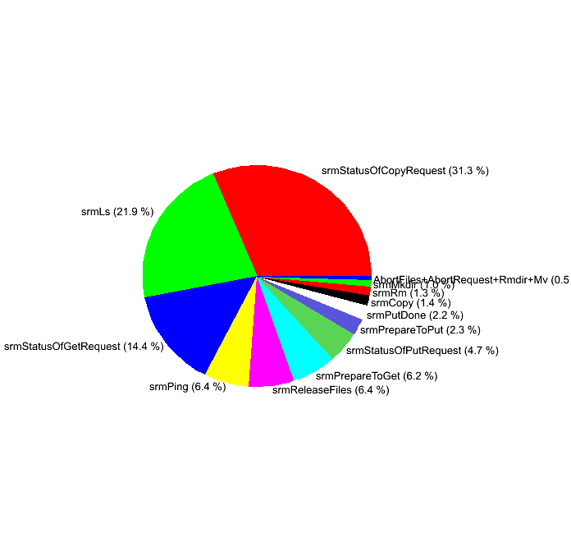



SRM what were the issues?
Top down, academic, design approach resulted in somewhat complex and at times ambiguous functionality.
Stateful service adds complexity and imposes consistency and persistency considerations.
SOAP Web services have become a thing of the past having been replaced by REST+JSON APIs.
Requires dedicated client.
Polling request status is really a performance killer.
BUT, so far, SRM has been the best tool we had. It does get the work done.
bringonline
SRM
scheduled
Are you done?
No
…
Are you done?
No

Slide 6
A possible solution: QoS based data management
Started as part of European H2020 project INDIGO-DataCloud Data Lifecycle based on Storage Quality of Service PaaS in 2015
Continues under XDC http://www.extreme-datacloud.eu/indigo-paas-orchestrator/
Also activity under DOMA umbrella
  https://twiki.cern.ch/twiki/bin/view/LCG/QoS
  white paper

Slide 7
Storage QoS
A Storage QoS represents an agreement between storage providers and the users using that storage on how that storage system should behave.
A QoS class is typically understood in terms of access-latency, bandwidth and likelihood of data loss.
Data may require different QoS classes at different times.

Slide 8
dCache configuration and how it maps to QoS
 | vernacular | Resilience | RP/AL | QoS Class
 | Disk only scratch (volatile pools) | No | REPLICA/NEARLINE | DISK
 | Disk only (regular) | {1 ..N} | REPLICA/ONLINE | DISK
 | Disk Tape backed | {1 ..N} | CUSTODIAL/ONLINE | DISK_AND_TAPE
 | Archive | No | CUSTIODIAL/NEARLINE | TAPE
( )
( )

Slide 9

dCache QoS implementation
dCache provides REST API allowing to control data QoS
  Per file basis.
  Currently supports DISK, TAPE and DISK_AND_TAPE classes.
  Allows the client to introspect available QoS classes and metadata about them.
No special client necessary. Mad curling skills may be required.
  Try it:
    https://dcache.example.org:3880/api/v1
    curl -X POST -H "Accept: application/json" \
    -H "Content-Type: application/json” \ "https://example.org:3880/api/v1/namespace/foo.data" –data \ '{"action" : "qos", "target" : "disk+tape"}'

Slide 10
dCache QoS bulk operations
One benefit of SRM is that single request can target multiple files.
This is currently not possible with dCache REST API.
We are adding bulk operations.
API is documented here:
  google doc
API is subject to change ;)

Slide 11
dCache QoS bulk operations
Creating a request
  Issue POST operation to the endpoint:
curl -X POST --data ‘{...}’ https://dcache.example.org/api/v1/bulk-requests
  The response contains the location of a URL representing this request.
  There will be some authorization: not all users may perform bulk operations.
  Clients may have multiple requests concurrently.
Interacting with bulk operations
  Clients can use the returned URL to interact with the request: once they
    GET request to learn the current status,
    PATCH request to cancel the bulk operation,
    DELETE request to clear the bulk operation (canceling if not already finished).
  Notice that *polling* is creeping in… Subsequent update will add storage events. Stay tuned.
Targets:
  List of files (SRM style)
  Directory(ies) targeting immediate children
  Directory(ies) with full recursion
Activities:
  One bulk operation performs one activity
  Delete, pin/unpin, modify QoS are examples of activities

Slide 12
What about request polling
When user interacts with dCache, dCache generates internal events that are not accessible to the user
One can detect these events by looking for effects of these events :
  File uploaded -> directory mtime changes.
  File staged -> fileLocality changes to ONLINE_AND_NEARLINE
  SRM request queued –> query SRM request status
Repeat the checks periodically and take action when desired change has happened.
Issues:
  Each time dCache is polled it needs to generate a report that is almost always the same, wasting resources
  Does not scale with the number of “things” to query and number of components where the queries need to run

Slide 13
Events – a better alternative
WHAT IF THE SYSTEM PUBLISHED ITS ACTIVITY ?
  When new data is available
  When files are staged from tape
  When files are flushed to tape
  When files are deleted
  When …. anything really
This is more efficient.
Allows integration with standard tools.
Solves SRM polling issue too.

Slide 14
Two approaches : Kafka and SSE
Kafka is industry standard platform to handle data feeds
  Any dCache internal event can be sent to Kafka
  Easy integration
  Currently all consumers can see all messages in Kafka
  Configurable event catch-up storage
  Suitable for site-level, VO-level integration
SSE (Server Sent Events) is industry standard protocol enabling a client to receive automatic updates from a server via HTTP connection.
  Supported by major browsers
  Built-in dCache focused security
  Limited catch-up event storage
  Suitable for user driven integration

Slide 15
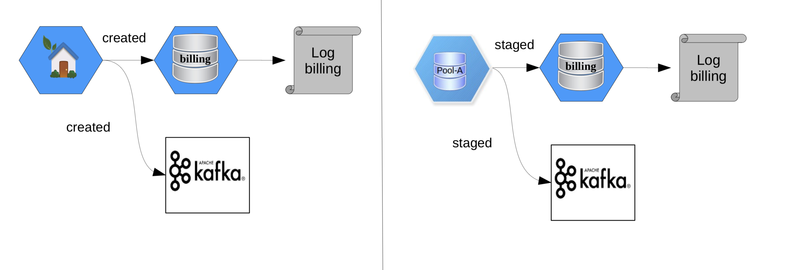
dCache and Kafka

Slide 16
Kafka consumer
import json
from kafka import KafkaConsumer
from datamanagement import DataManager
consumer = KafkaConsumer("ingest.dcache.billing",
bootstrap_servers="lssrv03:9092,lssrv04:9092,lssrv05:9092”,
value_deserializer=lambda m: json.loads(m.decode("utf-8")))
dm = DataManager(’DUNE’) # hypothetical data manager API
for msg in consumer:
message = msg.value
msg_type = message[‘msgType’]
id = message.get(‘pnfsId’)
if msg_type == ‘store’:
dm.mark_file_stored(id)
elif msg_type == ‘restore’:
dm.mark_file_online(id)
elif msg_type == ‘remove’:
dm.clear_catalogue(id)

Slide 17

A more efficient data management
NOW
Rucio
SRM
dCache

Slide 18
A more efficient data management
FUTURE
Rucio
QoS REST API
dCache

Slide 19
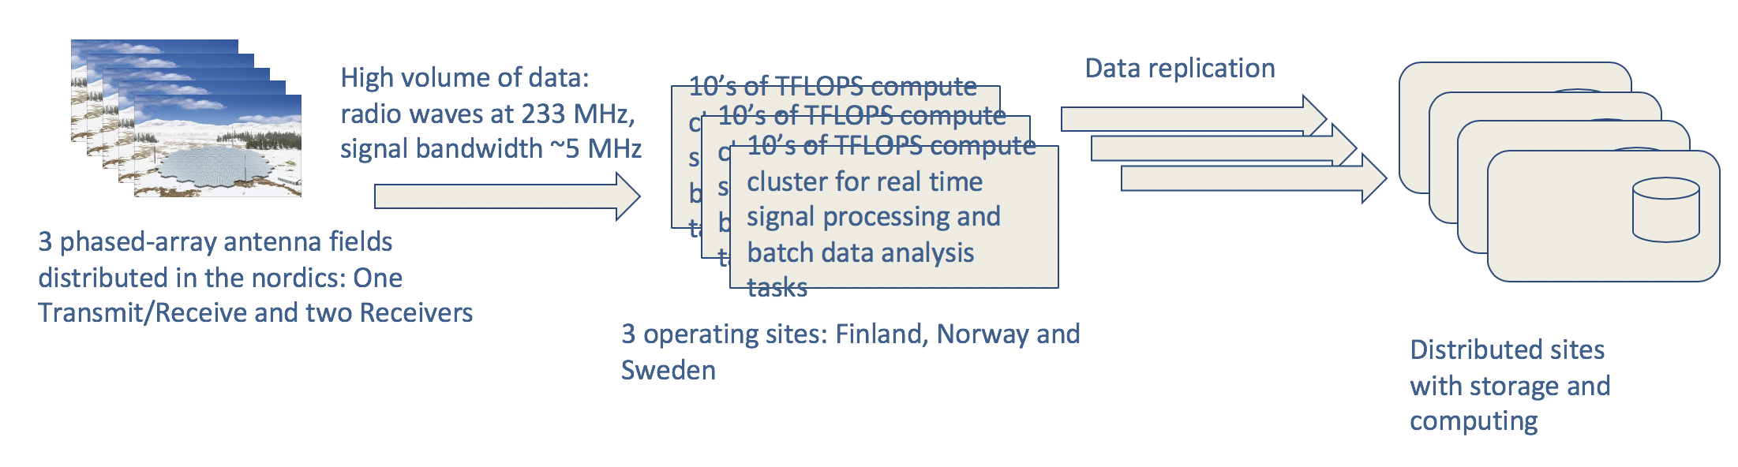
Rucio Integration with SSE
EISCAT_3D Use case: Next generation radar for 3D monitoring of the atmosphere and ionosphere. https://eiscat3d.se
Data-intensive instruments generates a high volume of data
Researchers need to analyse data and share their results
How to automate the data replication ? sync with third party system ,e.g., data management tools and catalogs ?

Slide 20
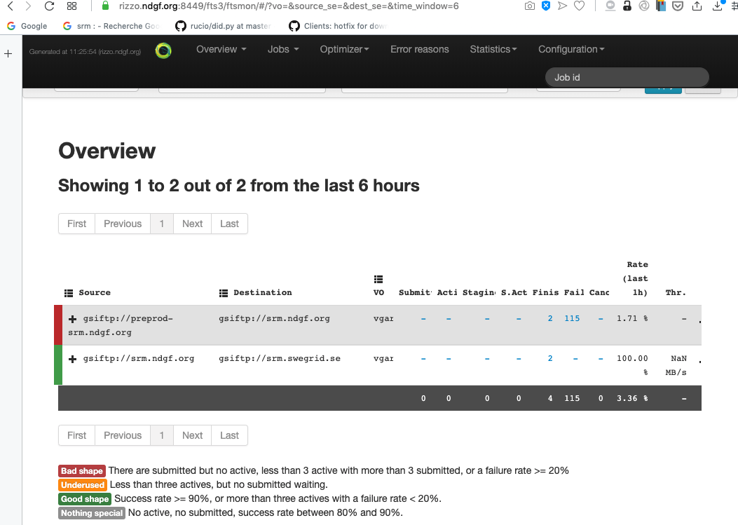
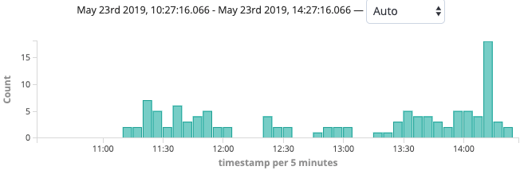
Automatic replication with SSE plugin
Data upload
/eiscat3d/upload/
/eiscat3d/
dCache@NDGF
dCache@NDGF preprod
Data replication
Storage events: New files
Data replication
Panoptes Service
https://pypi.org/project/dcacheclient/
Detect new files and register them into Rucio for replication and data sharing
Rucio, FTS
/eiscat3d/
dCache@SNIC
Data orchestration: automatic transfers, distribution and deletion
https://github.com/neicnordic/dcacheclient/tree/master/dcacheclient/sync

Slide 21
Conclusion: dCache QoS todo list
Add data loss notification (via SSE and Kafka).
  Allow data management service to learn when data is lost
  Reduce the operational cost of using unreliable/opportunistic storage.
Add bulk-request notification.
  Monitor the progress without polling.
Work closely with DOMA-QoS to continue extending QoS vocabulary.
Compared to SRM the QoS based data management is in its infancy but it already starts to looks like a viable solution going forward given amount of interest and effort is is receiving from the community.

