Slide 1
Can Machine Learning Rid us of Systematic Uncertainties ?
ICNFP IX, Kolympari (Crete)
Tommaso Dorigo
INFN, Padova
September 5 2020

Slide 2
Foreword
We will discuss the impact of nuisance parameters on HEP analyses and how to reduce it by focusing on supervised classification, which is by far the most common use case.
The contents match well with those of Chapter 7.2 of a book on ML for HEP, which will be published by World Scientific toward the end of the year.
A preprint of that chapter, titled “Dealing with Nuisance Parameters Using Machine Learning in HEP Analysis – A Review” and authored by Pablo de Castro Manzano and myself is available as arXiv:2007.09121[stat.ML].
- Credits to Pablo de Castro Manzano for part of the material

Slide 3
Contents
Problem statement
Nuisance parameters in statistical inference
Toward fully sufficient statistic summaries
Nuisance-parametrized models
Feature decorrelation, penalized methods, and adversary losses
Semi-supervised approaches
Inference-aware approaches
Summary

Slide 4
1. Problem statement
Supervised classification is used to construct low-dimensional event summaries: we may call them with their name, summary statistics
  Summary statistics can be employed to carry out statistical inference on parameters of interest θ
E.g. we may use a NN to reduce features y into a single-dimensional output x, which according to our model distributes with a PDF f(x|θ)
The implied compression is informed by simulated observations produced by a generative model (MC). The fidelity of the latter is limited by
  Imperfections in the model (e.g. “NLO accuracy”)
  Imprecise simulation of detector (calibration constants, etc.)
  Uncertainty in fundamental parameters (top mass?)
  Finiteness of available data samples
The above are referred to as “nuisance parameters”

Slide 5
Nuisance parameters
To account for the above imperfections, described by nuisance parameters α, we would need to enlarge our model to p(x|θ,α). The latter can then be used in the construction of a likelihood function or a proper surrogate or whatever other estimator we need.
  This allows us to account for the variability of the nuisances in our inference
  The inclusion of nuisances usually enlarges the resulting confidence intervals on θ
  A similar effect occurs if we use the model in hypothesis testing → power reduction
→ The presence of nuisance parameters limits the precision and the discovery reach in HEP analyses

Slide 6
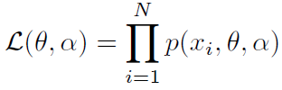
2. Nuisance parameters in statistical inference
It is useful to recall how nuisance parameters are “profiled away” from a likelihood function in the extraction of confidence intervals
  In statistical parlance, our measurements constitute a problem of parameter estimation, whose solution is provided by specifying a statistical model where nuisance parameters are free and unknown.
We solve the measurement problem by constructing estimators using the likelihood function. Let
  x_{i}, i=1…N be our observations: random i.i.d variables
  θ be the parameters of interest
  α be the nuisance parameters
We may write the joint PDF as p(x,θ,α) and with it the likelihood,

Slide 7



Profiling and marginalizing
If there are no nuisance parameters, the estimation problem is solved by constructing estimators as
When nuisances α are present, the profile-likelihood method consists in first obtaining the profile PL(θ) by maximizing over nuisances,
αnd then proceeding as above[5][6]. MIGRAD[7] can do this for you, as other more recent packages. However, this assumes that L be differentiable, and can become an impractical solution for large-dimensionality of parameters.
Similar issues affect the main alternative, a Bayesian solution, which marginalizes by integration in the nuisance space over the nuisance prior p(α):
Of course, knowledge (or assumption) of the PDF p(α) is necessary, and there is the rub – that is not always given. But even in that case, of course the nuisance parameters affect the inference by widening our confidence intervals!

Slide 8
3. Toward fully sufficient statistic summaries
ML applications usually focus on the goal of minimizing the statistical uncertainty on the estimates of parameters of interest θ.
  The summary statistic they provide should enable the extraction of the highest amount of information on θ, conditional to the validity of the underlying model used to generate the samples, as well as of the assumptions made on the value of nuisance parameters α.
The conditionality above is hard to get rid of!, as e.g.
  Problems are complex and high-dimensional
  Nuisance parameters have unknown PDF
  Effect of nuisances on the default model is not easy to parametrize
The above implies that the summary statistic is not sufficient: being oblivious of a part of feature space, it does not retain all the information relevant to the parameter estimation task – it can be outperformed.

Slide 9
Statistical sufficiency
An all-important concept in statistical inference!
Fisher-Neyman factorization criterion: a summary statistic for a set of n i.i.d. observations D={x_{i}, i=1…n} is sufficient WRT a statistical model and a set of parameters θ iff the generating probability density function of the data, p (x|θ), can be factorized as
p (x|θ) = q (x) * r (s(x)|θ)
where q is a non-negative function not depending on θ, and r() is another non-negative function for which dependence on x occurs only through the summary statistic s(x).
s then contains all the information provided by D needed to estimate model parameters θ, and no other statistic may add any information from D.
note: x is a sufficient statistic – but it is not a meaningful summary! (it does not reduce the dimensionality).
If we do not know p(x) analytically, we cannot solve the problem analytically! However, in 2-mixture models where the signal fraction is the only parameter, the density ratio s(x)=p_{s}(x)/p_{b}(x) is a sufficient summary. Hence the advantage of probabilistic classification to approximate density ratios.

Slide 10
Optimize at your own risk
How many of you have never read the word “optimize” declined somehow in a physics article?
To those of you who raised their hand, or thought they probably should but didn’t: you have not done enough reading as of late. The word is used quite liberally, usually in connection with incremental advances of the employed analysis technique
Typically the evidence in support of an optimization task is offered as the integral of the Receiver Output Characteristic (ROC) curve, or on signal acceptance at fixed purity, e.g.
→ Those named above are reasonably good proxies to the measurement precision: their maxima somehow track the minima of the statistical uncertainty on intermediate parameters of interest, such as signal fraction….
Yet they are blind to the more general, ultimate goal of, e.g., extracting the cross section of the signal, once all non-stochastic uncertainties are included

Slide 11
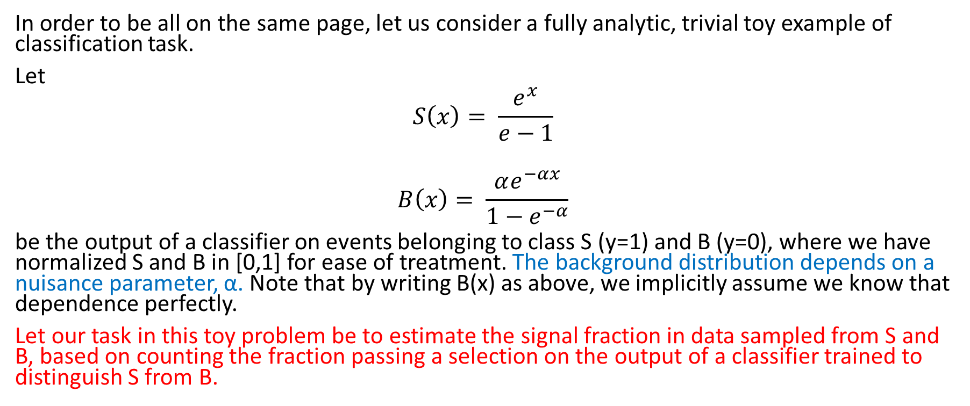
One trivial example
In order to be all on the same page, let us consider a fully analytic, trivial toy example of classification task.
Let
$$S\left(x\right)= \frac{e^{x}}{e−1}$$
$$B\left(x\right)= \frac{αe^{−αx}}{1−e^{−α}}$$
be the output of a classifier on events belonging to class S (y=1) and B (y=0), where we have normalized S and B in [0,1] for ease of treatment. The background distribution depends on a nuisance parameter, α. Note that by writing B(x) as above, we implicitly assume we know that dependence perfectly.
Let our task in this toy problem be to estimate the signal fraction in data sampled from S and B, based on counting the fraction passing a selection on the output of a classifier trained to distinguish S from B.

Slide 12
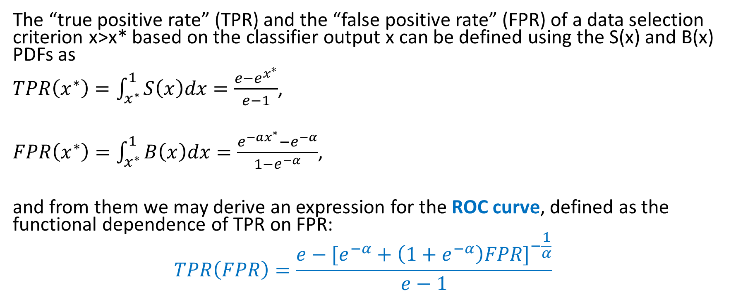
TPR, FPR, ROC
The “true positive rate” (TPR) and the “false positive rate” (FPR) of a data selection criterion x>x* based on the classifier output x can be defined using the S(x) and B(x) PDFs as
$TPR\left(x^{∗}\right)=\int_{x^{∗}}^{1}{S\left(x\right)dx=\frac{e−e^{x^{∗}}}{e−1}}$,
$FPR\left(x^{∗}\right)=\int_{x^{∗}}^{1}{B\left(x\right)dx=\frac{e^{−ax^{∗}}−e^{−α}}{1−e^{−α}}}$,
and from them we may derive an expression for the ROC curve, defined as the functional dependence of TPR on FPR:
$$TPR\left(FPR\right)=\frac{e−{[e^{−α}+\left(1+e^{−α}\right)FPR]}^{−\frac{1}{α}}}{e−1}$$
“What are the odds that data with x>x* are signal?”
“What are the odds that data with x>x* are background?”

Slide 13
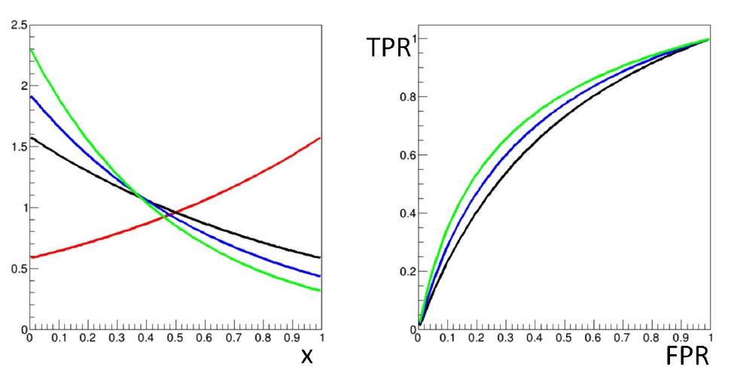
Systematics at work
Our toy model allows a visualization of the effect of a nuisance parameter α on our figures of merit.
Again, we have assumed we know the analytic form of B(x|α)…
α=1.0
α=1.5
α=2.0
B(x)
S(x)

Slide 14
So what?
TPR increases with α for fixed FPR, and so do the ROC and its integral: B(x) becomes steeper at small x, and the signal is more distinguishable.
The first take-away bit is that if we train a classifier with a given value of α (e.g. 1.5 for the blue B(x) curve), the performance is going to be under- or over-estimated if the true value of α is different
  the choice of a critical region x>x* corresponding to a pre-defined FPR will similarly be affected, as will the value of TPR.
Now, recall that the fraction of data selected in the critical region is our summary statistic – our only input to the extraction of the signal fraction.
That number is affected by α, but its value alone does not allow us to extract the full information on the true signal fraction: it is not a sufficient statistic.
  The whole distribution would be one such statistic, but it would not summarize our data well enough (in terms of dimensional reduction).

Slide 15
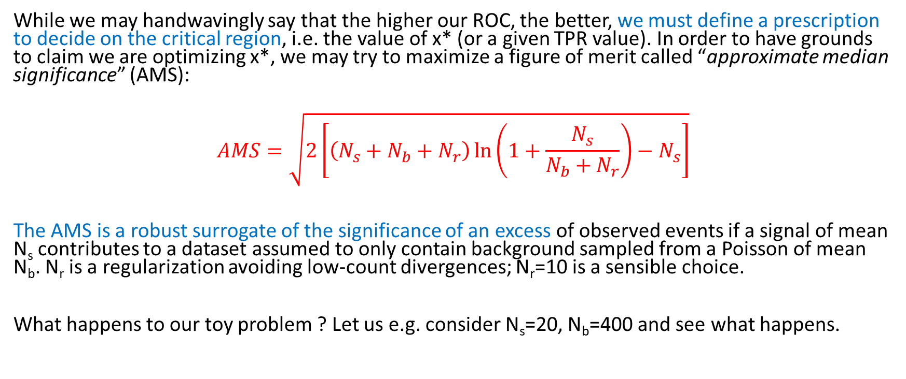
Taking a decision: enter the AMS
While we may handwavingly say that the higher our ROC, the better, we must define a prescription to decide on the critical region, i.e. the value of x* (or a given TPR value). In order to have grounds to claim we are optimizing x*, we may try to maximize a figure of merit called “approximate median significance” (AMS):
$$AMS=\sqrt{2\left[\left(N_{s}+N_{b}+N_{r}\right)\ln\left(1+\frac{N_{s}}{N_{b}+N_{r}}\right)−N_{s}\right]}$$
The AMS is a robust surrogate of the significance of an excess of observed events if a signal of mean N_{s} contributes to a dataset assumed to only contain background sampled from a Poisson of mean N_{b}. N_{r} is a regularization avoiding low-count divergences; N_{r}=10 is a sensible choice.
What happens to our toy problem ? Let us e.g. consider N_{s}=20, N_{b}=400 and see what happens.

Slide 16
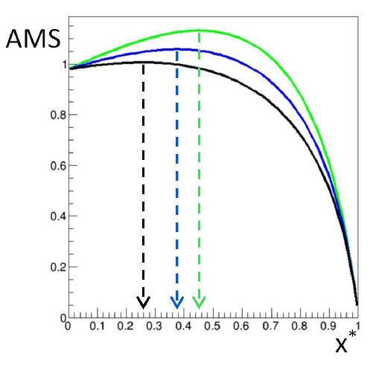
Where is the AMS maximum?
Note: there is often a misalignment between the specification of the classification task and the true objective of an analysis. Maximizing the AMS (even with no nuisances) may not be the correct way to optimize for an upper limit on Ns, e.g.
The AMS computed for the three exemplary values of α is shown on the right. As we fully expected, the values reached when α is larger are higher.
However, if we do not know what α is, we cannot “optimize” our critical region, as the optimal choice of x* strongly depends on the value of α, which we do not know.
Nuisance parameters affect the optimal working point, as well the performance of the classifier and the relative merits of different classifiers (which produce different summaries x)
→ Standard supervised classification techniques may not reach optimality unless they address the conditionality issue discussed supra.

Slide 17
4. Nuisance-Parametrized models
A straightforward attempt at accounting for nuisance parameters is to parametrize their effect on the observable features
→ this requires injecting a priori knowledge of their PDF
In low-dimensional cases, a fully analytical solution may be sought, when the parametrization of the nuisance allows to “decorrelate” its effect on the salient features of the events.
An example was proposed in a study of the n-subjettiness ratio τ₁₂ [9]
→ see next slide

Slide 18
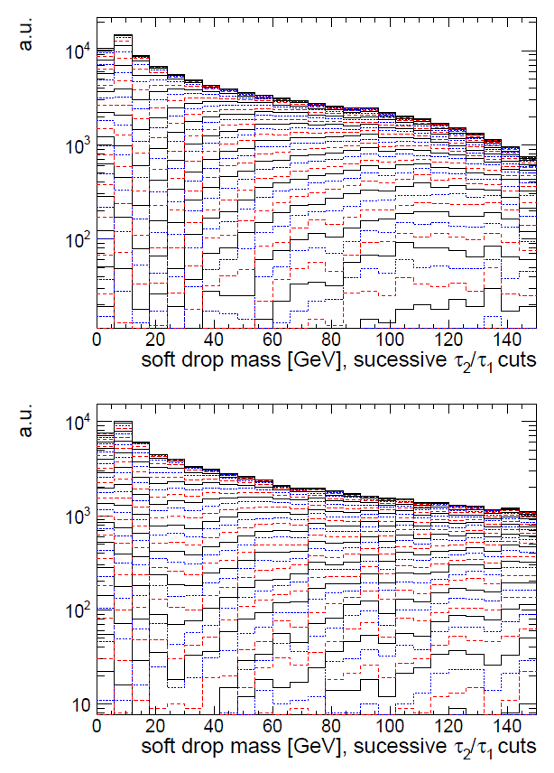
Example: N-subjettiness in boosted decays
A number of observable features of fat energetic jets have been constructed to separate the hadronic 2- and 3-prong decay of heavy objects (W,Z,H,t) from QCD jets.
Useful variable to discriminate two-body decays: τ₂₁=τ₂/τ₁, where taus are functions of the energy distribution within subjets
The “soft-drop” mass M of two subjets is correlated with τ₂₁: a cut on the latter increases S/B but distorts the distribution of M, because of the mutual dependence on jet p_{T}. In statistical parlance we may consider p_{T} a nuisance parameter – it reshapes the variable we want to use for inference.
Dolen et al.[10] use an analytical parametrization of the nuisance to decorrelate its effect in the variable of interest

Slide 19
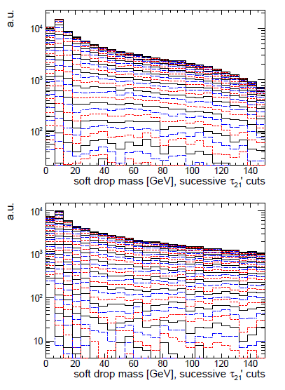
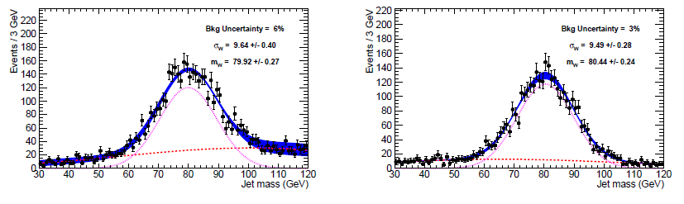
Correcting for the nuisance
Define ρ = log(m²/p_{T}²), an appropriate scaling variable for QCD jets
Compute average of τ₂₁ as f(ρ): it shows linear behaviour
Define ρ’=ρ + log(p_{T}/GeV); then define τ’₂₁=τ₂/τ₁-Mρ’
Observe that new variable has flat behaviour for QCD
→ τ’₂₁ decorrelates the p_{T} dependence on mass, allowing selection that preserves ability to use sidebands, etc.
Same signal efficiency, better behaviour for decorrelated tagger (right)

Slide 20
What if we have no prior ?
The absence of information on a nuisance parameter is more common in HEP. We can still solve the problem by a parametrization of its effect.
Consider a search for a new particle of unknown mass M: usually, M influences in a smooth manner the observable event features x. If a classifier assumes a value M₁=M+α in training, its performance will degrade as α deviates from zero. M is thus in earnest a nuisance parameter.
One may train many classifiers using data simulated at different M values, but the solution is sub-optimal (1/N use of total available data)
Better solution: parametrize the effect of M in the classifier [15]. The training data may be constructed as a mixture of different M hypotheses if M is included among the features.
→ note that one must decide what to do with the background (for which M is undefined).
→ also note: this is not a Bayesian technique – the chosen admixture is not a prior on M, and it only affects the power of the classifier.
The advantage is that the network may meaningfully classify events for M* values not seen during training. An interpolation of the score for different mass hypotheses is also possible.

Slide 21
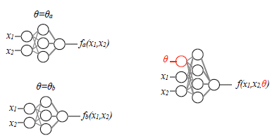
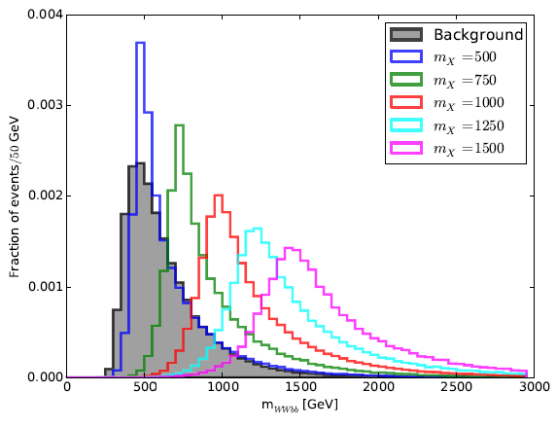
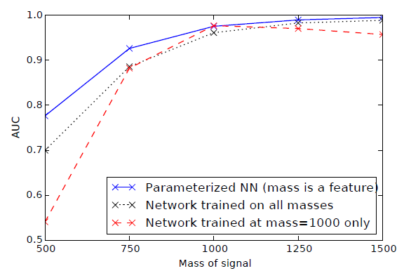
Example: X→tt in ATLAS
The technique proposed by Baldi et al. in[15] was tested with DELPHES[16] simulations, searching for a ttbar resonance within non-resonant ttbar backgrounds.
Random M values were used for the background in the training.
The network provides different scores for same features x, depending on the value of the nuisance M.
The parametrized network was shown to perform as well as individual NN on the mass points at which the latter were trained, but better than a NN trained on a mixture.

Slide 22
5. Decorrelation, penalization, adversaries
When a direct parametrization of nuisances proves impractical to implement, there are several alternatives. We can broadly lump them into three classes:
Techniques that operate a preprocessing of training data to reduce or remove the dependence of classifier score on the nuisance parameters
Construction of a robust optimization objective for the classification task, by penalizing the loss such that it becomes insensitive to α
Use adversarial setups to achieve the above result
There are a number of recent algorithms using each of the above approaches. In what follows we look at one representative example for each these methods

Slide 23
Mass decorrelation
The most important use case of the first technique addresses the issue already discussed – keeping the background mass distribution unbiased.
The simplest way to avoid a reshaping of the mass PDF of background events is called planing[18,19]. One may implement it by pre-selecting training samples for S and B such that they have the same PDF on the variable to be planed, but of course this is sub-optimal.
Better strategy: weight each training event with w(M) as follows:
For signal, w(M_{rec}) = 1/p_{S}(M_{rec}) For background, w(M_{rec}) = 1/p_{B}(M_{rec})
The weights enter the calculation of the loss during training, but are not used in validation or testing.
Planing is more effective than its simplicity would suggest! (some evidence is shown later)
Limitations occur when other event features indirectly inform the classifier on the value of the planed variable, when it carries discriminating power.

Slide 24
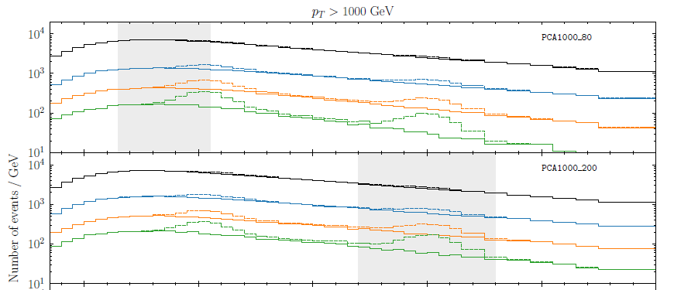
Mass decorrelation in boosting, reprise
Another way to preprocess the data before a NN, to decorrelate the classifier output from the jet mass, is to use PCA on the NN inputs[18].
In the considered case the 17 inputs were a basis set of n-subjettiness variables, and the data was binned in jet mass and p_{T}, PCA acting on each bin separately.
The technique was tested on searches for H→AA→bbbb and H→WW →qq’qq’ with several mass hypotheses.
The discriminants are shown to preserve the mass distribution and are effective also outside of the range of masses where they are trained (grey areas)

Slide 25
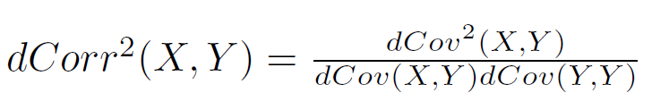
Penalizing the loss: DisCo
Kasieczka and Shih recently published[25] a method to decorrelate a nuisance parameter by incorporating a «distance-correlation»-inspired regularization term in the loss of a NN.
One first defines a distance covariance
where |.| is the Euclidean norm, and (X,Y), (X’,Y’), (X’’,Y’’) are i.i.d. pairs from the joint PDF. The so-named distance correlation, defined as
is then a [0,1] measure, null only if x,y are fully independent. Crucially, it is differentiable and computable with data samples, so it can be included in the loss function (for label y and mass m) with a penalty regularization factor λ
L = L_{class}(y,y_{true}) + λ dCorr²(m,y)

Slide 26
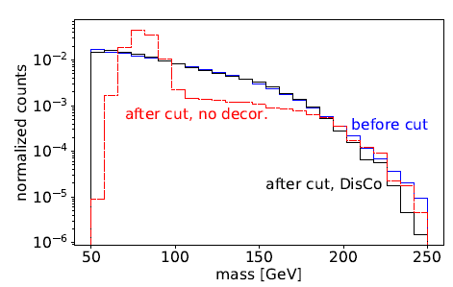
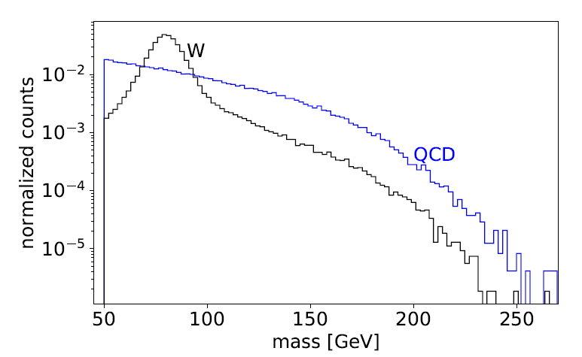
DisCo action
Kasieczka and Shih test DisCo on W-boson tagging in simulated ATLAS data, reweighted to have a flat p_{T} distribution. They show that a NN discrimination of W-like jet images produces a biased mass distribution for QCD backgrounds, while DisCo preserves the QCD mass shape (bottom left).
Signal and background
before selections

Slide 27
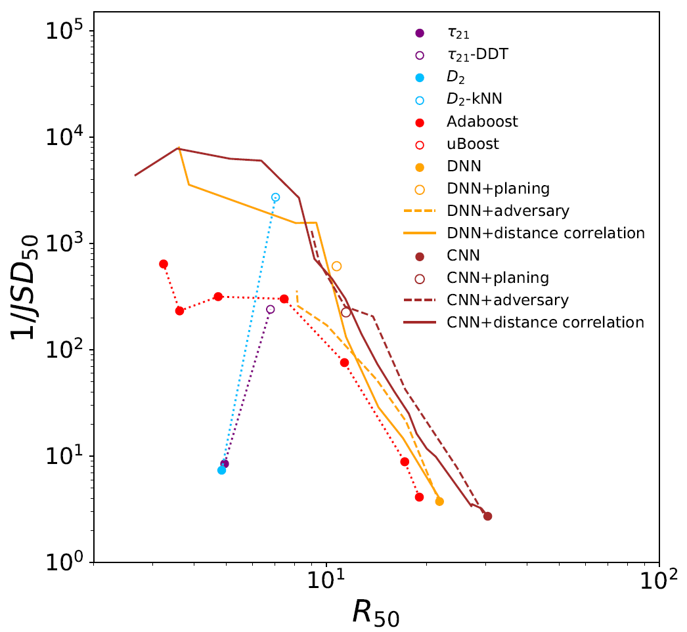
Comparisons
A comparison of the background rejection (x axis) of different W taggers, retrofitted with decorrelation methods (planing, adversarial NN, and DisCo regularization) shows that DisCo performs well. Surprisingly, also planing seems to do a decent job in this particular task.
DisCo regularization works well with complex image-based CNN setups, too.
More studies in other setups are advisable…
Above: a measure of decorrelation (inverse of Jensen-Shannon
Divergence between QCD bgr before and after 50%TPR selection)
as a function of background rejection at 50%TPR.

Slide 28
Adversarial solutions
Adversarial architectures were investigated in computer science to achieve domain adaptation of discriminative classifiers[28][29] much before they were adopted in HEP.
General issue: training and test data are not drawn from same PDF
This may arise when they come from different domains, or if the simulation (used for training) is imperfect model of (real) test data.
  Other common situation in DA is that problem is semi-supervised (labels not available for all test data) → let’s leave this for later
Solutions usually involve finding a data representation that is maximally insensitive to their source
→ task an ANN to learn such representation, while competing with the one that tries to separate labelled classes of training data[30].
Adversarial setups attacking the decorrelation problem should be considered an extension, if not the logical next step, of the penalized loss methods seen above.
The loss is still the combination of two parts – a BCE term and a penalization contributed by the adversary, modulated by a hyperparameter.

Slide 29


Learning to pivot
The first use of ANNs to achieve robustness to systematics in HEP comes from the work of Cranmer, Kagan and Louppe[31] who sought pivotal[32] classification scores f(x;θ_{f}): ones independent on nuisance α (θ_{f} are the classifier parameters).
The adversary, with parameters θ_{r}, tries to guess α from f(x;θ_{f}), and the loss is defined globally as
The minimax solution of this problem is reached for
A convergence of the above constrained problem cannot be guaranteed in general; a hyperparameter λ can be used to tune the adversary term.

Slide 30
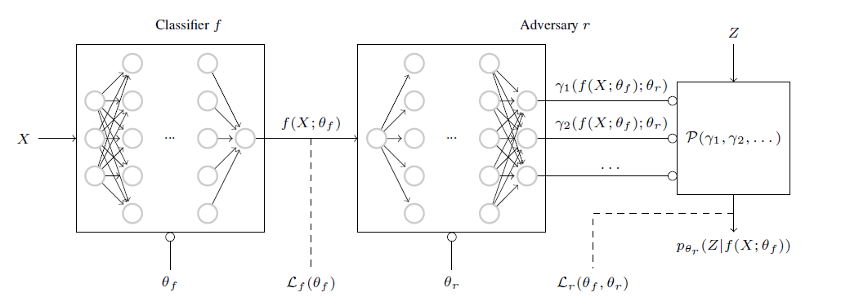
Pivoting ANN architecture
The architecture is a series of two discriminative classifiers: the adversary tries to model p(z|f(x)), and the global loss forces this toward the unconditional prior p(z). When this happens, f is independent on z.

Slide 31
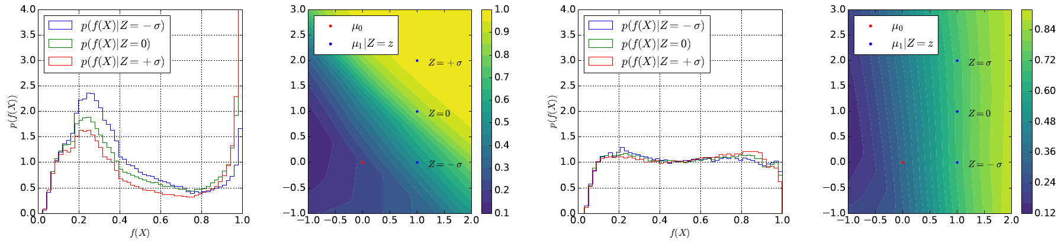
Experiments with the pivot
Left: a standard NN produces f(x) depending on nuisance Z (the vertical location of the signal 2D Gaussian PDF)
Right: the pivoting setup makes f(x) independent on Z.

Slide 32
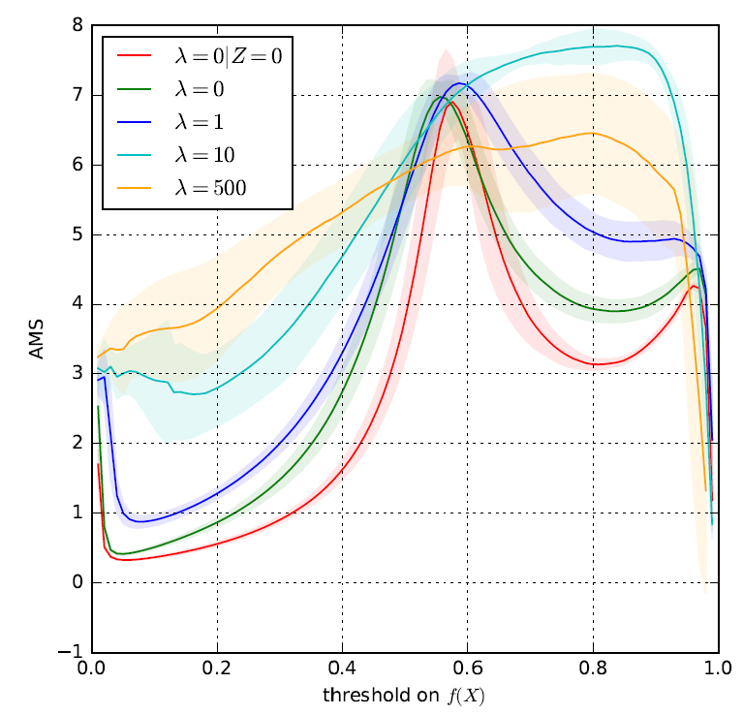
HEP example
The technique is demonstrated on boosted W tagging in ATLAS, with pile-up being the nuisance (Z=0 no pileup, Z=1 PU-50 conditions).
As in this case finding a f that is pivotal while minimizing the loss Lf is probably not possible, one must optimize a suitable objective (AMS) WRT the hyperparameter.
For a suitable choice of λ (10) the AMS reaches a higher maximum

Slide 33
6. Semi-supervised approaches
Weakly-supervised and semi-supervised learning techniques have been proposed to close the gap between learning from simulated and real data:
  Simulated data are fully labeled, but they are often an imperfect model
  Real data are unlabelled or only partly labelled (e.g. control samples, different admixtures)
These approaches strive to learn useful models from partial, non-standard, or noisy label information. They are thus potentially useful for reduction of the impact of certain systematic uncertainties in HEP problems.
The challenge is that these methods typically rely on assumptions (known fractions, independence of PDF of features) that are hardly met in practice. We see a few examples in what follows.

Slide 34


LLP (Learning from Label Proportions)
LLP is a weak-supervision approach that may allow the training on real data (Dery et al.[38]). While in a full supervision setup one tries to find a score fulfilling
(l is a loss, e.g. mean squared error or BCE, and t is the target label), in LLP one only exploits knowledge of the fraction of each label in training data:
The problem is thus very ill-constrained, but a minimization of the loss can still be performed with batches of data of different class proportions, as long as the PDFs of the features do not change in the batches.

Slide 35
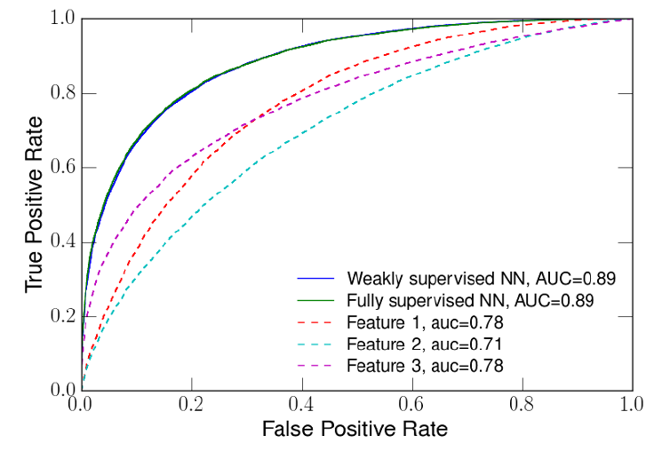
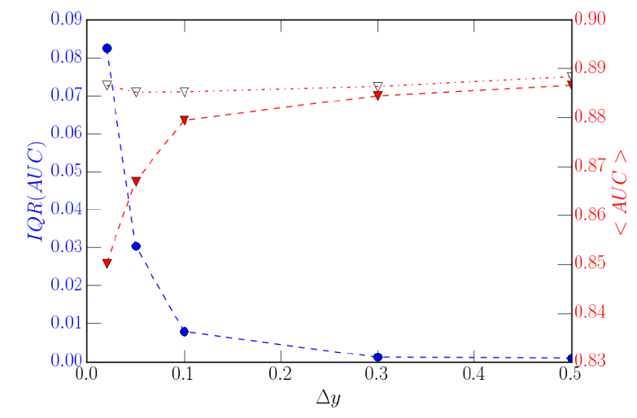
LLP proof of concept
Using a 3-layer NN and synthetic data with class proportions between 0.2 and 0.4, with three features, allows LLP to perform equally as well as a fully supervised method.
The range of performances, due to randomness of the inputs, decreases when training data has wider range of class proportions (Δy on x axis, bottom)

Slide 36
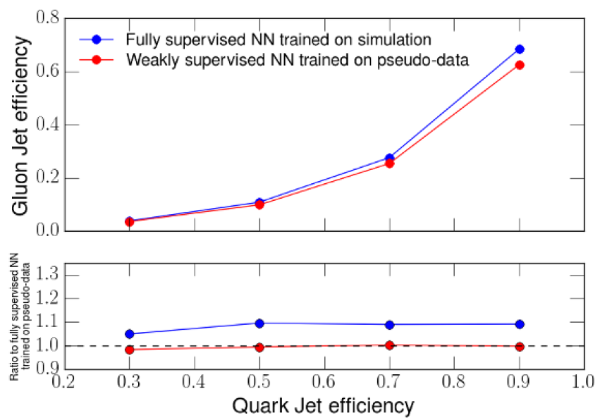
Test of LLP on Q/G discrimination
Authors of [38] argue that quark/gluon jet separation lends well to this method, as a priori fractions in different physical processes are well estimated from QCD+PDF theory.
12 different samples are obtained by binning in dijet pseudorapidity difference (quark fractions vary from 0.21 to 0.32).
In this work, a distortion of real data is mimicked by modeling previous studies; then a comparison with a full supervised classifier shows 10% advantages (lower G efficiency for given Q efficiency)

Slide 37
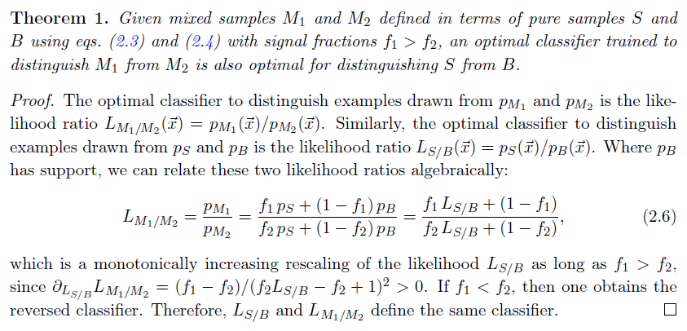
CWoLa – classification without labels
One limitation of LLP is the need to precisely know the class labels of training subsets. A technique by Metodiev et al.[39], CWoLa, overcomes this by using as labels the identifiers of the different mixed samples.
CWoLa is based on the fact that the optimal binary classifier is a function of the density ratio between the components, so the discrimination of the two mixed samples works also for pure classes:

Slide 38
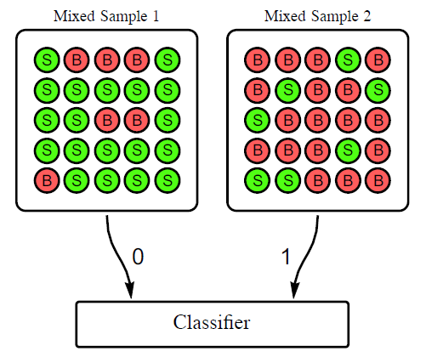
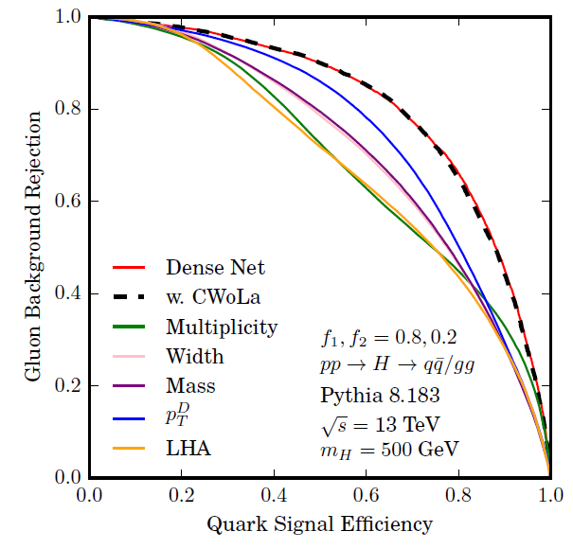
CWoLa at work
Tested on the same problem of Q/G discrimination, and with a NN as classifier, the CWoLa concept was shown to performs as well as a NN working on pure classes if trained on classes with 80%-20% class proportion split.
Of course the algorithm still
requires labelled data for tests of performance and choice of operating point, but the proof of principle is
encouraging.

Slide 39
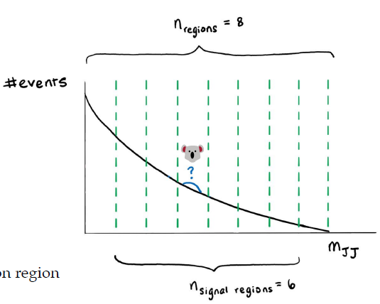
CWoLa applications to LHC data
Two recent applications of CWoLa:
CMS used it in a recent ttbb measurement[56]
ATLAS used in a search for resonances A→BC in dijets [57], where the plane of two fat-jet masses is scanned by weak supervised NN learning where training data are extracted from sidebands in M_{jj} in 8 bins (right, figure from F. de Almeida Dias talk at Anomaly detection mini-workshop[58])

Slide 40
7. Inference-aware approaches
What we have seen so far are ways to cope with the imperfect knowledge of the generative model of our data, which affects the power of our simulation-based classification tasks.
There are now solutions that try to move away from the proxy classification task, and address directly the optimization of simulation-based statistical inference.
→ This realigns task and objective
The area of research[42] is called «Likelihood-free inference»
Here we discuss how some of these inference-aware approaches may be used to tame nuisance parameters in HEP.

Slide 41
Estimates of the likelihood ratio
As discussed earlier, a reparametrization and approximation of the likelihood ratio for all possible pairs of relevant parameters θ₀,θ₁ of a generative model p(x|θ) may allow[17] to efficiently solve the problem of inference in the presence of nuisances.
The method may be too CPU intensive to be practical in high-dim cases, as large datasets are required to approximate the LR.
A number of techniques were published by Brehmer et al.[44-46] to evaluate the LR in a data-effective manner, using information from the simulator to augment the training data.
These techniques may collectively be addressed as «learning efficiently from the simulator».
A meaningful discussion of the wealth of ideas deployed for this would require a couple of lectures by itself

Slide 42
Inference-aware summary statistics
A complementary family of techniques to “likelihood-free inference methods” tries to construct summaries that are better aligned with inference goal, once nuisance parameters are accounted for.
Typical procedure in HEP:
“optimize” a classifier f(x) to best distinguish S(θ) from B (e.g., θ=σ, cross section of signal process), e.g. focusing on maximizing AUC or other figures of merit connected to observability of S (pseudo-significances)
2a. Choose operating point (e.g. cut on f), maybe accounting for variability of S and B PDFs, and perform a counting experiment on data above f cut;
2b. Parametrize shape and fit for signal fraction, accounting for nuisances as shape variations
→ In both cases, the optimization target (discrimination of S/B in absence of nuisances) is different from the true objective of the analysis (minimize uncertainty on parameter of interest)
For a realignment, we must inform the classifier of the effect of nuisances on the final measurement goal

Slide 43
INFERNO (inference-aware neural optimization)
Idea of P. de Castro and TD[49]: make the loss of a NN aware of what we really want to make of the NN output, and simultaneously inject in it a parametrization of nuisances, so that a loss minimization perfectly matches the (stat+syst) variance minimization of the final measurement.
The NN constructs summaries that are differentiable WRT the nuisances, and this property is propagated to the inference step, such that a global minimization can be performed.
NN parameters are optimized by SGD within an AutoDiff framework (in TensorFlow)
Problem 1: need to produce differentiable map of nuisance effect on features → Calls for custom solutions in HEP problems of different complexity
Problem 2: how to estimate the final variance on the parameter of interest? → Use the inverse of the Hessian matrix of a likelihood constructed with the summary statistic provided by the NN

Slide 44
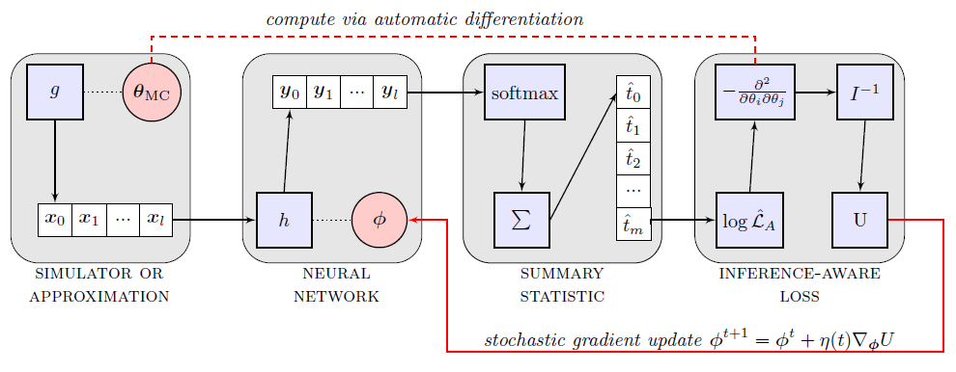
INFERNO structure
Βlock 1: A simulator or an approximation of it is used to sample observations given parameters θ
Block 2: NN with parameters φ produces outputs y
Block 3: A one-dimensional summary statistic, as a smoothed version of y, is produced by softmax
Block 4: An Asimov likelihood is constructed with the summary (e.g. a histogram of Poisson counts), and used to get Hessian matrix, yielding expected variance on parameter of interest
Autodiff allows to update the NN parameters given the value of the variance, to navigate with SGD to
the optimal solution

Slide 45


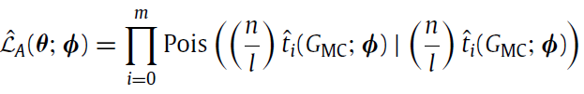
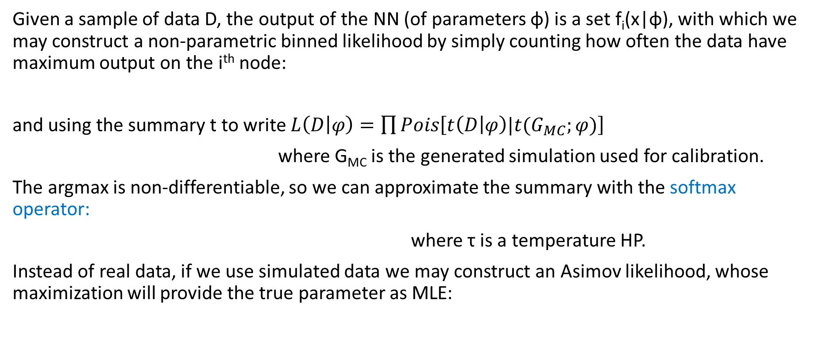
INFERNO details
Given a sample of data D, the output of the NN (of parameters φ) is a set f_{i}(x|φ), with which we may construct a non-parametric binned likelihood by simply counting how often the data have maximum output on the i^{th} node:
and using the summary t to write $L\left(D | φ\right)=\prod{Pois\left[t\left(D | φ\right)|{t(G}_{MC};φ)\right] }$
where G_{MC} is the generated simulation used for calibration.
The argmax is non-differentiable, so we can approximate the summary with the softmax operator:
where τ is a temperature HP.
Instead of real data, if we use simulated data we may construct an Asimov likelihood, whose maximization will provide the true parameter as MLE:
(n/l factors account
for different fractions
of S and B simulation data)

Slide 46


INFERNO details / 2
The Asimov likelihood we have written,
is maximized by the value of simulation parameters θ_{ΜC} used to generate the data G_{MC}.
We may then take the second derivative, expanded in θ around θ_{MC}, of the Asimov likelihood and interpret it as the Fisher information matrix,
whose inverse, by the Cramer-Rao lower bound, is a lower limit of the covariance: we may then use it as an estimator of the variances of our parameters of interest in the loss function, e.g.

Slide 47
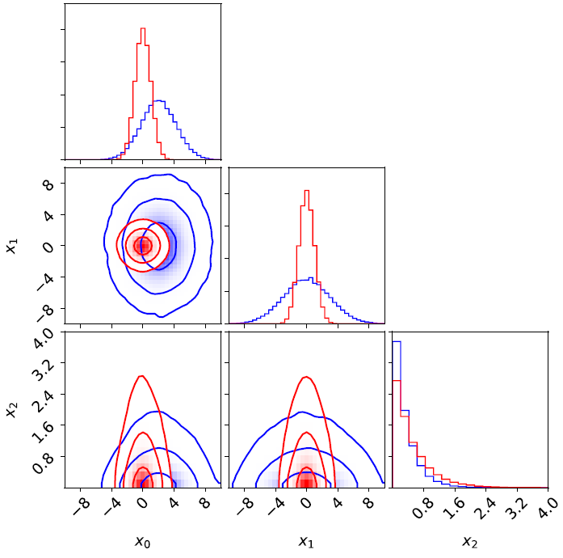
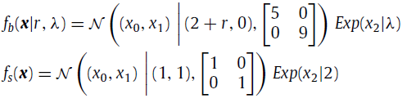

INFERNO synthetic example
In [49] a simple example with 3 nuisances affecting the background of a 2-component mixture problem is considered:
r shifts the background mean, λ changes the slope, and b is background normalization. The model is then
and the optimization of the NN is tested with several benchmarks, releasing nuisances (see below)

Slide 48
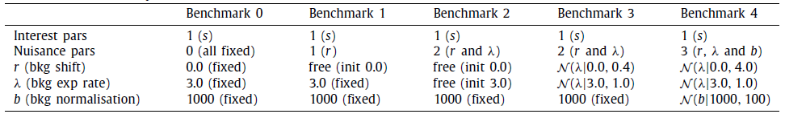
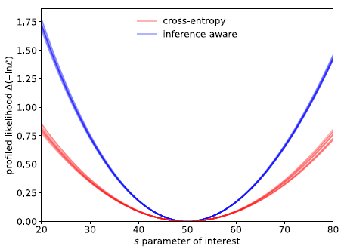
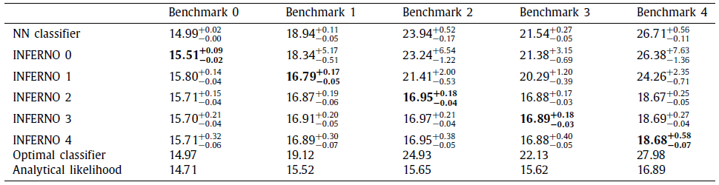
INFERNO results
INFERNO consistently outperforms the NN and has performance which approaches that of the analytical likelihood result.
←Sqrt(variance) values

Slide 49
INFERNO challenges and status
The structure of INFERNO is complex, but the minimization of the loss is relatively straightforward
Main issue: how to model HEP nuisances and effect on observations: must e.g. transform input features, interpolating simulated observation weights, or interpolate histogram counts (last ditch).
An application to a real HEP analysis is underway through the work of Lukas Layer (INFN-PD) on CMS open data (a Run 1 top cross section measurement)

Slide 50
Recent developments
Two recent works have built on the idea of INFERNO for HEP applications.
Wunsch et al.[52] use a single-output NN to construct a Poisson-count likelihood instead of a softmax, and make the histogram differentiable by smoothing it with a Gaussian kernel.
Heinrich and Simpson[53] use “fixed-point differentiation” to compute gradients of a profile likelihood, aiming at directly minimize the expected upper limits on sought processes with CLs. Also in their work (NEOS) the modelling of the nuisances is restricted to histogram interpolation.
In addition there have been
a proposal to use the AMS in a single bin counting experiment including a single systematic in the loss function[54]
A variation of BDT training (QBDT) targets directly signal significance with an approximate model of nuisances[55].
The field is in rapid evolution and new ideas are possible. The bottomline is that if one can realign the MVA target to be the final desired goal, results will be close to optimal, in the sense of maximizing the use of the available information.

Slide 51
8. Summary
A wide arsenal of techniques has been developed for HEP problems in recent years, to try and remove the impact of systematic uncertainties in supervised classification.
The focus in many cases is achieving a decorrelation of salient features (jet mass), to maximize discovery significance
  Several methods successfully achieve the desired goal, with minor performance loss
The real issue is however how to minimize the effect of systematic uncertainties whatever their origin, with tools of more general applicability
  Important steps have been made but the topic is a cutting-edge area of research in ML

Slide 52
References
[1] P. De Castro Manzano. Statistical Learning and Inference at Particle Collider Experiments. PhD thesis (2019). URL https://cds.cern.ch/record/2701341.
[2] K. Cranmer, G. Lewis, L. Moneta, A. Shibata, and W. Verkerke, HistFactory: A tool for creating statistical models for use with RooFit and RooStats (June 2012).
[3] K. Cranmer. Practical Statistics for the LHC. In 2011 European School of High-Energy Physics, pp. 267{308 (2014). doi: 10.5170/CERN-2014-003.267.
[4] L. Lista. Practical Statistics for Particle Physicists. In 2016 European School of High-Energy Physics, pp. 213{258 (2017). doi: 10.23730/CYRSP-2017-005.213.
[5] W. M. Pateeld, On the maximized likelihood function, Sankhya: The Indian Journal of Statistics, Series B (1960-2002). 39(1), 92{96 (1977). URL http://www.jstor.org/stable/25052054.
[6] D. R. Cox and O. E. Barndor-Nielsen, Inference and Asymptotics. CRC Press (Mar., 1994). URL https://play.google.com/store/books/details?id=KxYeBQAAQBAJ.
[7] F. James and M. Roos, Minuit - a system for function minimization and analysis of the parameter errors and correlations, Comput. Phys. Commun. 10 (6), 343{367 (Dec., 1975). URL http://www.sciencedirect.com/science/article/pii/0010465575900399.
[8] G. Cowan, K. Cranmer, E. Gross, and O. Vitells, Asymptotic formulae for likelihood-based tests of new physics, Eur. Phys. J. C. 71, 1554 (2011). doi: 10.1140/epjc/s10052-011-1554-0. [Erratum: Eur. Phys. J. C73, 2501 (2013)].
[9] J. Thaler and K. Van Tilburg, Maximizing Boosted Top Identication by Minimizing N-subjettiness, JHEP. 02, 093 (2012). doi: 10.1007/JHEP02(2012)093.

Slide 53
References / 2
[10] J. Dolen, P. Harris, S. Marzani, S. Rappoccio, and N. Tran, Thinking outside the ROCs: Designing Decorrelated Taggers (DDT) for jet substructure, JHEP. 05, 156 (2016). https://doi.org/10.1007/JHEP05(2016)156.
[11] I. Moult, B. Nachman, and D. Neill, Convolved Substructure: Analytically Decorrelating Jet Substructure Observables, JHEP. 05, 002 (2018). doi: 10.1007/JHEP05(2018)002.
[12] R. M. Neal, Computing likelihood functions for high-energy physics experiments when distributions are defined by simulators with nuisance parameters (2008). URL http://cds.cern.ch/record/1099977.
[13] T. Aaltonen et al., Evidence for a particle produced in association with weak bosons and decaying to a bottom-antibottom quark pair in Higgs boson searches at the Tevatron, Phys. Rev. Lett. 109, 071804 (2012). doi: 10.1103/PhysRevLett.109.071804.
[14] S. Chatrchyan et al., Combined results of searches for the standard model Higgs boson in pp collisions at sqrt(s) = 7 TeV, Phys. Lett. B. 710, 26{48 (2012). doi: 10.1016/j.physletb.2012.02.064.
[15] P. Baldi, K. Cranmer, T. Faucett, P. Sadowski, and D. Whiteson, Parameterized neural networks for high-energy physics, Eur. Phys. J. C. 76(5), 235 (2016). doi: 10.1140/epjc/s10052-016-4099-4.
[16] J. de Favereau, C. Delaere, P. Demin, A. Giammanco, V. Lemaitre,A. Mertens, and M. Selvaggi, DELPHES 3, A modular framework for fast simulation of a generic collider experiment, JHEP. 02, 057 (2014). doi: 10.1007/JHEP02(2014)057.
[17] K. Cranmer, J. Pavez, and G. Louppe, Approximating likelihood ratios with calibrated discriminative classifiers (June, 2015). URL http://arxiv.org/abs/1506.02169.
[18] J. Aguilar-Saavedra, J. H. Collins, and R. K. Mishra, A generic anti-QCD jet tagger, JHEP. 11, 163 (2017). doi: 10.1007/JHEP11(2017)163.

Slide 54
References / 3
[19] S. Chang, T. Cohen, and B. Ostdiek, What is the Machine Learning?, Phys. Rev. D. 97(5), 056009 (2018). doi: 10.1103/PhysRevD.97.056009.
[20] K. Datta and A. Larkoski, How Much Information is in a Jet?, JHEP. 06,073 (2017). doi: 10.1007/JHEP06(2017)073.
[21] R. Dalitz, On the analysis of tau-meson data and the nature of the tau-meson, Phil. Mag. Ser. 7. 44, 1068{1080 (1953). doi: 10.1080/14786441008520365.
[22] J. Stevens and M. Williams, uBoost: A boosting method for producing uniform selection efficiencies from multivariate classifiers, JINST. 8, P12013 (2013). doi: 10.1088/1748-0221/8/12/P12013.
[23] Y. Freund and R. E. Schapire, A decision-theoretic generalization of on-line learning and an application to boosting, Journal of Computer and System Sciences. 55(1), 119{139 (Aug., 1997). doi: 10.1006/jcss.1997.1504.
[24] A. Rogozhnikov, A. Bukva, V. Gligorov, A. Ustyuzhanin, and M. Williams, New approaches for boosting to uniformity, JINST. 10(03), T03002 (2015). doi: 10.1088/1748-0221/10/03/T03002.
[25] G. Kasieczka and D. Shih, DisCo Fever: Robust Networks Through Distance Correlation, arXiv:2001.05310 (Jan 2020).
[26] S. Wunsch, S. Jorger, R. Wolf, and G. Quast, Reducing the dependence of the neural network function to systematic uncertainties in the input space (July, 2019). URL http://arxiv.org/abs/1907.11674.
[27] C. Adam-Bourdarios, G. Cowan, C. Germain-Renaud, I. Guyon, B. Kegl, and D. Rousseau, The Higgs Machine Learning Challenge, J. Phys. Conf. Ser. 664(7), 072015 (2015). doi: 10.1088/1742-6596/664/7/072015.
[28] S. Ben-David, J. Blitzer, K. Crammer, and F. Pereira. Analysis of representations for domain adaptation. In eds. B. Scholkopf, J. C. Platt, and T. Homan, Advances in Neural Information Processing Systems 19, pp. 137-144. MIT Press (2007). URL http://papers.nips.cc/paper/2983-analysis-of-representations-for-domain-adaptation.pdf.

Slide 55
References / 4
[29] S. Ben-David, J. Blitzer, K. Crammer, A. Kulesza, F. Pereira, and J. W. Vaughan, A theory of learning from different domains, Machine Learning. 79 (1-2), 151{175 (Oct., 2009). URL https://doi.org/10.1007/s10994-009-5152-4.
[30] H. Ajakan, P. Germain, H. Larochelle, F. Laviolette, and M. Marchand, Domain-adversarial neural networks, arXiv:1412.4446 (2014).
[31] G. Louppe, M. Kagan, and K. Cranmer. Learning to pivot with adversarial networks. In eds. I. Guyon, U. V. Luxburg, S. Bengio, H. Wallach, R. Fergus, S. Vishwanathan, and R. Garnett, Advances in Neural Information Processing Systems 30, pp. 981{990. Curran Associates, Inc. (2017). URL http://papers.nips.cc/paper/6699-learning-to-pivot-with-adversarial-networks.pdf.
[32] M. H. Degroot and M. J. Schervish. Probability and statistics, Carnegie-Mellon Univ., 1977.
[33] C. Shimmin, P. Sadowski, P. Baldi, E. Weik, D. Whiteson, E. Goul, and A. Sgaard, Decorrelated Jet Substructure Tagging using Adversarial Neural Networks, Phys. Rev. D. 96(7), 074034 (2017). doi: 10.1103/PhysRevD.96. 074034.
[34] V. Estrade, C. Germain, I. Guyon, and D. Rousseau. Adversarial learning to eliminate systematic errors: a case study in high energy physics. In NIPS 2017 (2017).
[35] P. Simard, B. Victorri, Y. LeCun, and J. Denker. Tangent prop - a formalism for specifying selected invariances in an adaptive network. In eds. J. E. Moody, S. J. Hanson, and R. P. Lippmann, Advances in Neural Information Processing Systems 4, pp. 895{ 903. Morgan-Kaufmann (1992). URL http://papers.nips.cc/paper/536-tangent-prop-a-formalism-for-specifying-selected-invariances-in-an-adaptive-network.pdf.
[36] A. Blance, M. Spannowsky, and P. Waite, Adversarially-trained autoencoders for robust unsupervised new physics searches, JHEP. 10, 047 (2019). doi: 10.1007/JHEP10(2019)047.

Slide 56
References / 5
[37] C. Englert, P. Galler, P. Harris, and M. Spannowsky, Machine Learning Uncertainties with Adversarial Neural Networks, Eur. Phys. J. C. 79(1), 4 (2019). doi: 10.1140/epjc/s10052-018-6511-8.
[38] L. M. Dery, B. Nachman, F. Rubbo, and A. Schwartzman, Weakly supervised classification in high energy physics, J. High Energy Phys. 2017(5), 145 (May, 2017). URL https://doi.org/10.1007/JHEP05(2017)145.
[39] E. M. Metodiev, B. Nachman, and J. Thaler, Classication without labels: learning from mixed samples in high energy physics, J. High Energy Phys. 2017(10), 174 (Oct., 2017). URL https://doi.org/10.1007/JHEP10(2017) 174.
[40] T. Cohen, M. Freytsis, and B. Ostdiek, (machine) learning to do more with less, J. High Energy Phys. 2018(2), 34 (Feb., 2018). URL https://doi.org/10.1007/JHEP02(2018)034.
[41] P. T. Komiske, E. M. Metodiev, B. Nachman, and M. D. Schwartz, Learning to classify from impure samples with high-dimensional data, Phys. Rev. D. 98(1), 011502 (July, 2018). URL https://link.aps.org/doi/10.1103/ PhysRevD.98.011502.
[42] K. Cranmer, J. Brehmer, and G. Louppe, The frontier of simulation-based inference, arXiv:1911.01429 (Nov. 2019).
[43] J. Neyman and E. S. Pearson, On the problem of the most efficient testsof statistical hypotheses, Philosophical Transactions of the Royal Society of London. Series A, Containing Papers of a Mathematical or Physical Character. 231, 289{337 (1933). ISSN 02643952. URL http://www.jstor.org/stable/91247.
[44] J. Brehmer, G. Louppe, J. Pavez, and K. Cranmer, Mining gold from implicit models to improve likelihood-free inference, arXiv:1805.12244 (2018).
[45] J. Brehmer, K. Cranmer, G. Louppe, and J. Pavez, Constraining Effective Field Theories with Machine Learning, arXiv:1805.00013 (2018).
[46] J. Brehmer, K. Cranmer, G. Louppe, and J. Pavez, A Guide to Constraining Effective Field Theories with Machine Learning, Phys. Rev. D 98, 052004 (2018), DOI: 10.1103/PhysRevD.98.052004.

Slide 57
References / 6
[47] M. Stoye, J. Brehmer, G. Louppe, J. Pavez, and K. Cranmer, Likelihood-free inference with an improved cross-entropy estimator, arXiv:1808.00973 (2018).
[48] J. Brehmer, F. Kling, I. Espejo, and K. Cranmer, MadMiner: Machine learning-based inference for particle physics, Comput. Softw. Big Sci. 4(1), 3 (2020). doi: 10.1007/s41781-020-0035-2.
[49] P. de Castro and T. Dorigo, INFERNO: Inference-Aware neural optimisation, Comput. Phys. Commun. 244, 170-179 (Nov., 2019). URL http://www.sciencedirect.com/science/article/pii/S0010465519301948.
[50] T. Charnock, G. Lavaux, and B. D. Wandelt, Automatic physical inference with information-maximizing neural networks, Phys. Rev. D. 97(8), 083004 (Apr., 2018). URL https://link.aps.org/doi/10.1103/PhysRevD.97.083004.
[51] J. Alsing and B. Wandelt, Nuisance hardened data compression for fast likelihood-free inference, Mon. Not. R. Astron. Soc. 488(4), 5093{5103 (Oct., 2019). URL https://academic.oup.com/mnras/article-abstract/488/4/5093/5530778.
[52] S.Wunsch, S. Jorger, R.Wolf, and G. Quast, Optimal statistical inference in the presence of systematic uncertainties using neural network optimization based on binned poisson likelihoods with nuisance parameters, arXiv:2003.07186 (Mar., 2020). URL http://arxiv.org/abs/2003.07186.
[53] L. Heinrich and N. Simpson. pyhf/neos: initial zenodo release, URL https://doi.org/10.5281/zenodo.3697981 (Mar., 2020).
[54] A. Elwood and D. Krucker, Direct optimisation of the discovery significance when training neural networks to search for new physics in particle colliders, arXiv:1806.00322 (June, 2018). URL http://arxiv.org/abs/1806.00322.
[55] L.-G. Xia, QBDT, a new boosting decision tree method with systematic uncertainties into training for high energy physics, arXiv:1810.08387 (Oct., 2018). URL http://arxiv.org/abs/1810.08387.

Slide 58
References / 7
[56] CMS collaboration, ttbb cross section measurement, 2019.
[57] ATLAS collaboration, Dijet resonance search with weak supervision using sqrt(s)=13 TeV pp collisions in the ATLAS detector, arXiv:2005.02983 (hep-ex), 2020.
[58] F. de Almeida Dias, talk at Anomaly detection mini-workshop, July 16th 2020.

