Slide 1



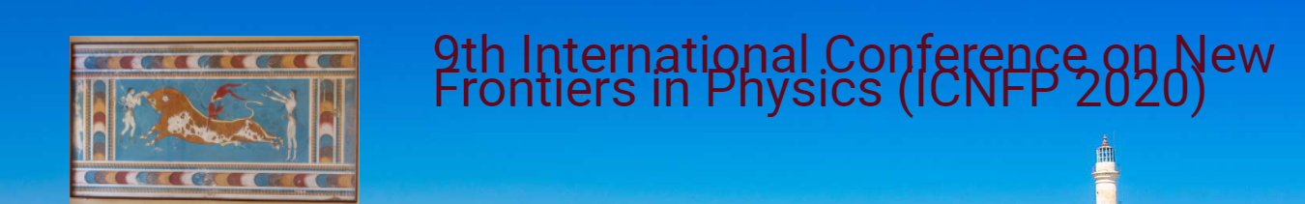
Lorenzo Amati
(INAF – OAS Bologna)
on behalf of the THESEUS international collaboration
http://www.isdc.unige.ch/theseus/
Amati et al. 2018 ( Adv.Sp.Res., arXiv:1710.04638 )
Stratta et al. 2018 (Adv.Sp.Res., arXiv:1712.08153)

Slide 2


Cosmology and multi-messenger astrophysics (and extreme physics) with Gamma-Ray Bursts

Slide 3
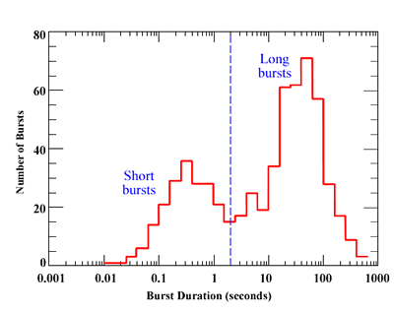
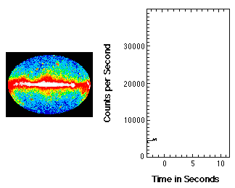
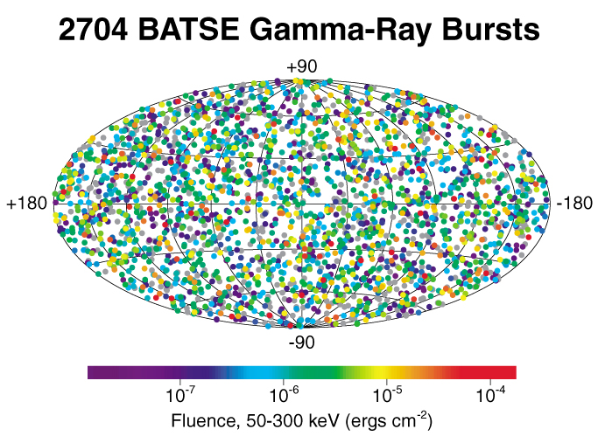
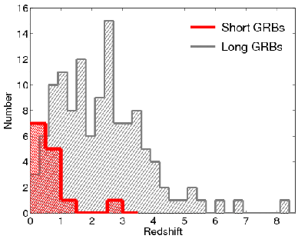
Gamma-Ray Bursts: the most extreme phenomenon in the Universe

Slide 4
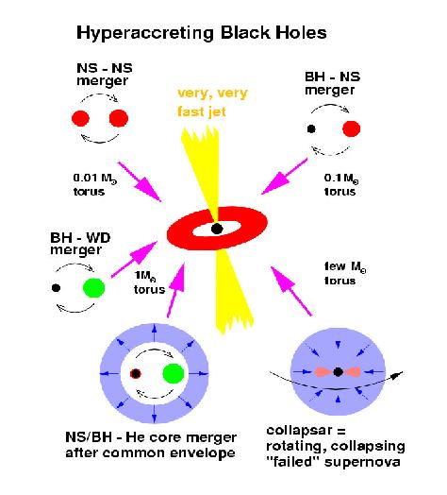
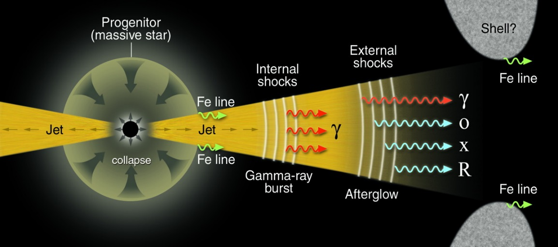
Standard scenarios for GRB progenitors
LONG
SHORT
energy budget up to >10⁵⁴ erg
long duration GRBs
metal rich (Fe, Ni, Co) circum-burst environment
GRBs occur in star forming regions
GRBs are associated with SNe
likely collimated emission
energy budget up to 10⁵¹ - 10⁵² erg
short duration (< 5 s)
clean circum-burst environment
old stellar population

Slide 5
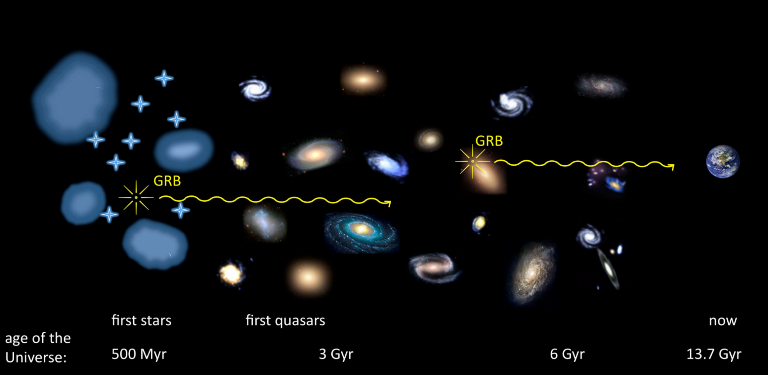
Long GRBs
direct detection and accurate location of exploding stars (and their host galaxies) up to the Cosmic Dawn!!!
cosmological «beacons»
standardizable cosmological candles??

Slide 6
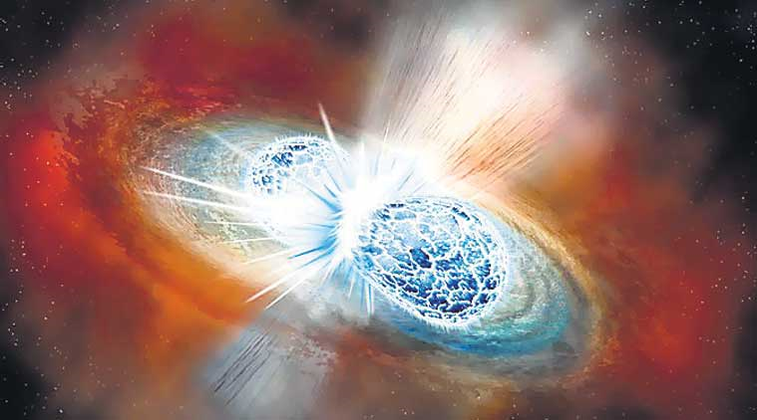
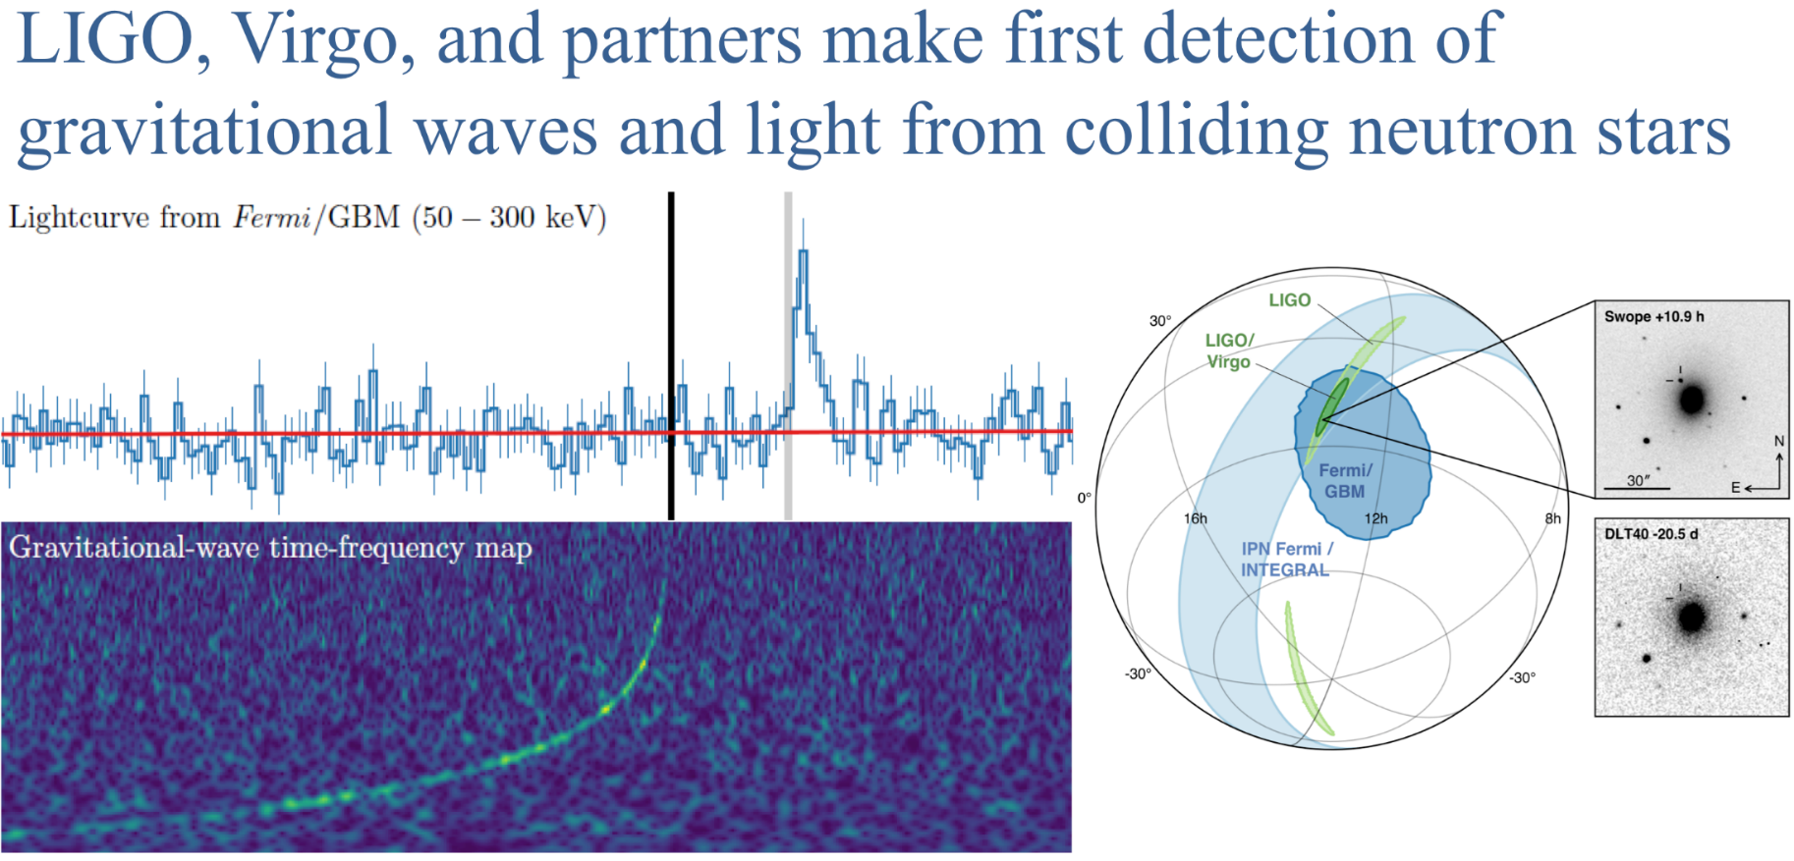
Short GRBs: e.m. counterparts of gravitational-waves sources!!!

Slide 7

The ESA Cosmic Vision Programme
Selected missions
M1: Solar Orbiter (solar astrophysics, 2018)
M2: Euclid (cosmology, 2021)
L1: JUICE (exploration of Jupiter system, 2022)
S1: CHEOPS (exoplanets, 2018)
M3: PLATO (exoplanets, 2026)
L2: ATHENA (X-ray observatory, cosmology, 2032)
L3: LISA (gravitational wave observatory, 2034)
M4: ARIEL (exoplanets, 2028)
S2 (ESA-CAS): SMILE (solar wind <–> magneto/ionosphere)
F1: COMET INTERCEPTOR (solar system origin, 2026)

Slide 8
The ESA Cosmic Vision Programme
Selected missions
M1: Solar Orbiter (solar astrophysics, 2017)
M2: Euclid (cosmology, 2020)
L1: JUICE (exploration of Jupiter system, 2022)
S1: CHEOPS (exoplanets, 2017)
M3: PLATO (exoplanets, 2024)
L2: ATHENA (X-ray observatory, cosmology 2028)
[L3: gravitational wawes observatory (eLISA) 2032 ]
Resonant keywords: cosmology (dark energy, dark matter, re-ionization, structures formation and evolution), fundamental physics (relativity, quantum gravity, QCD, gravitational wave universe), life (exoplanets formation + evolution + census, solar system exploration)

Slide 9
THESEUS Transient High Energy Sky and Early Universe Surveyor Lead Proposer (ESA/M5): Lorenzo Amati (INAF – OAS Bologna, Italy) Coordinators (ESA/M5): Lorenzo Amati, Paul O’Brien (Univ. Leicester, UK), Diego Gotz (CEA-Paris, France), A. Santangelo (Univ. Tuebingen, D), E. Bozzo (Univ. Genève, CH) Payload consortium: Italy, UK, France, Germany, Switzerland, Spain, Poland, Denmark, Belgium, Czech Republic, Slovenia, ESA

Slide 10
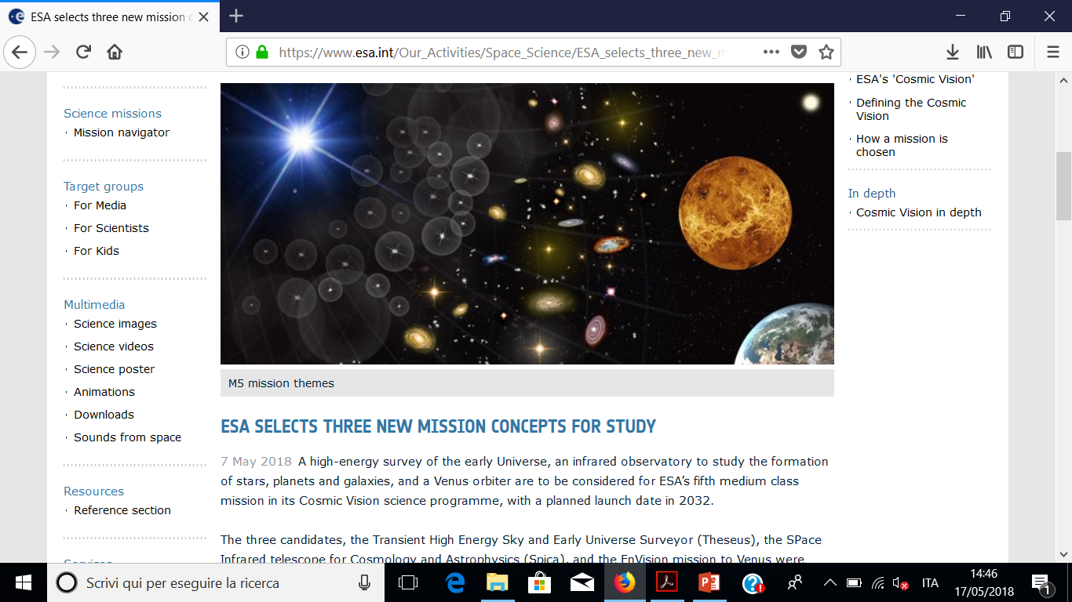
May 2018: THESEUS selected by ESA for Phase 0/A study (with SPICA and ENVISION)

Slide 11
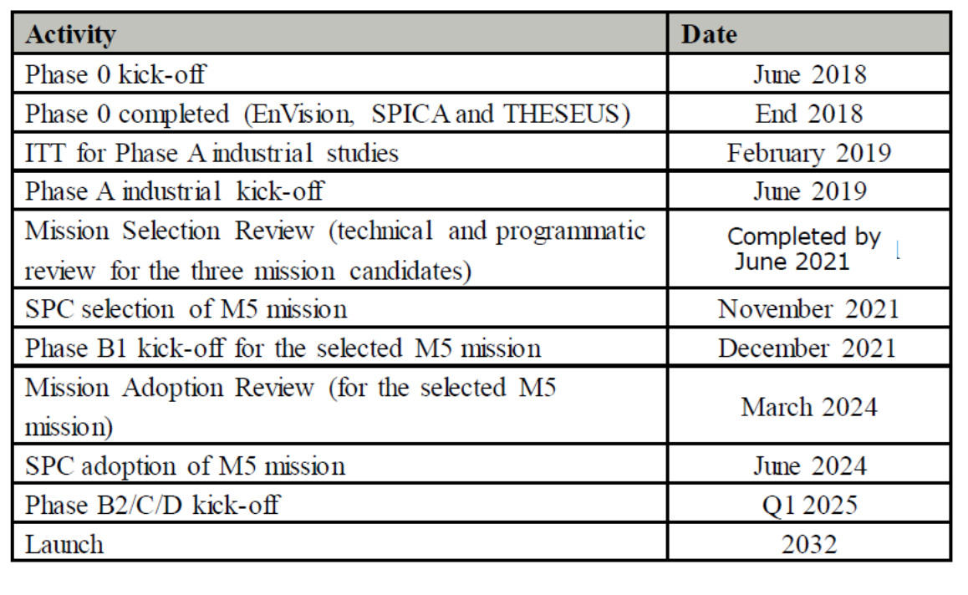
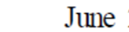
ESA timeline for M5 Phase 0/A study
THESEUS and ATHENA operations may overlap for several years

Slide 12
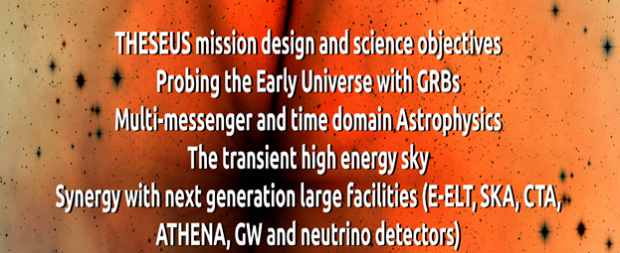
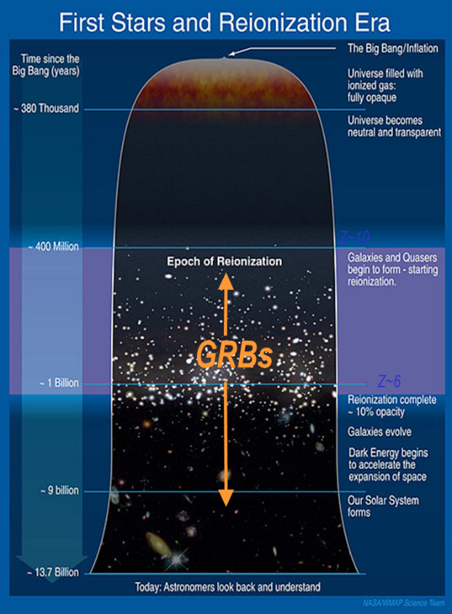


Slide 13
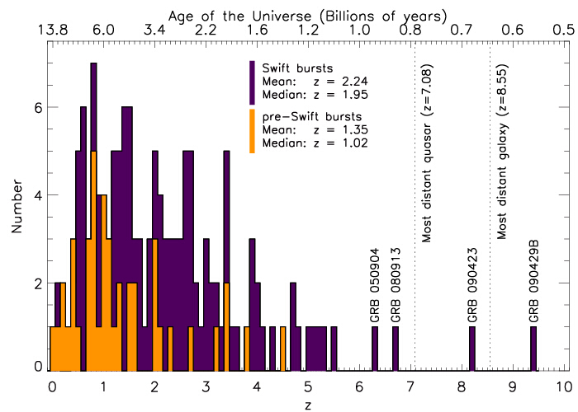
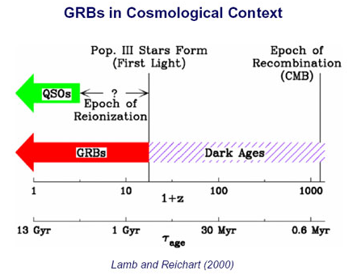
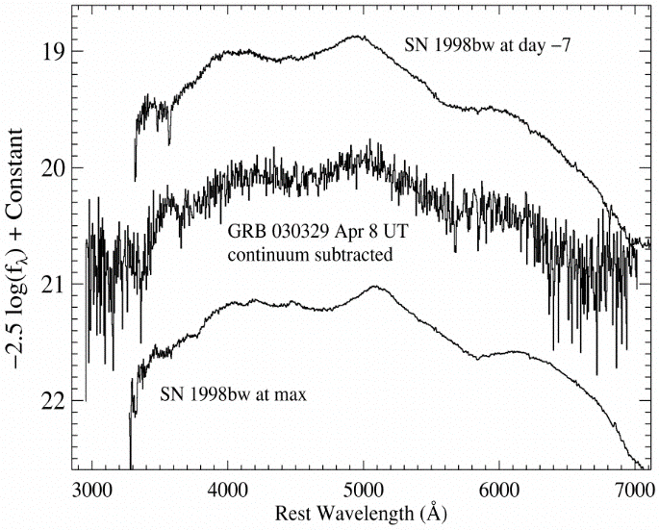
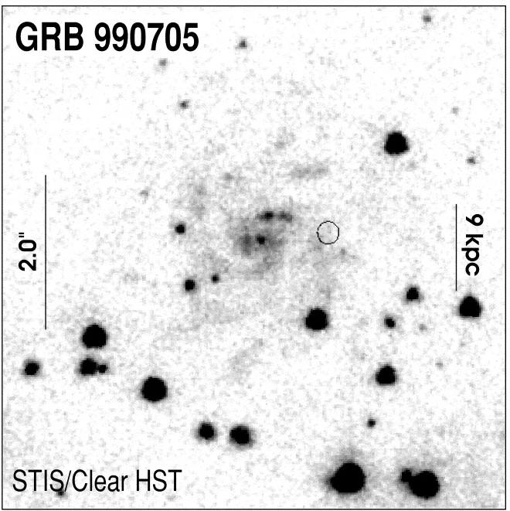
Shedding light on the early Universe with GRBs
Because of their huge luminosities, mostly emitted in the X and gamma-rays, their redshift distribution extending at least to z ~9 and their association with explosive death of massive stars and star forming regions, GRBs are unique and powerful tools for investigating the early Universe: SFR evolution, physics of re-ionization, galaxies metallicity evolution and luminosity function, first generation (pop III) stars

Slide 14
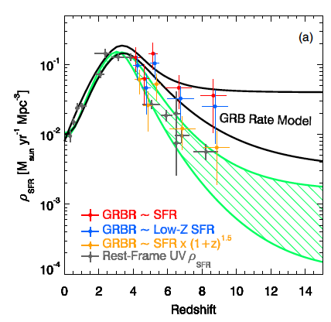
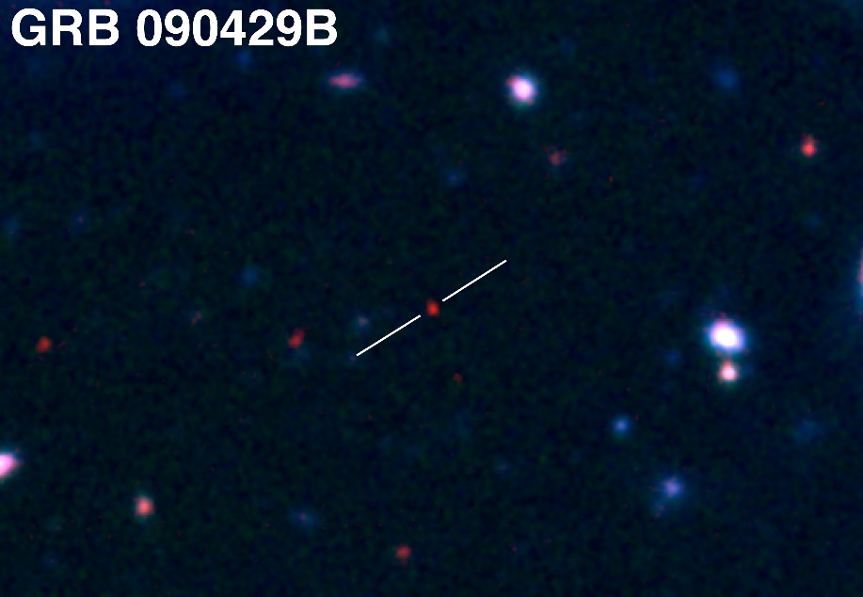
A statistical sample of high–z GRBs can provide fundamental information:
measure independently the cosmic star–formation rate, even beyond the limits of current and future galaxy surveys
directly (or indirectly) detect the first population of stars (pop III)
Z = 9.2
Robertson&Ellis12

Slide 15
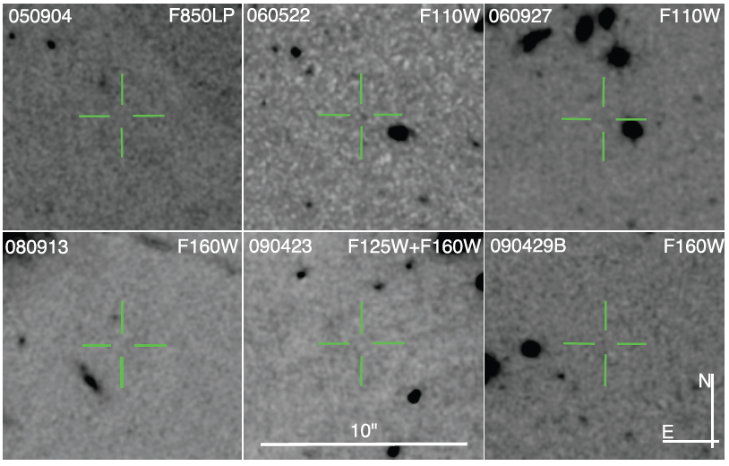
the number density and properties of low-mass galaxies
z=6.29; M_{AB} > 28.86
Z=5.11; M_{AB} > 28.13
Z=5.47; M_{AB} > 28.57
Z=6.73; M_{AB} > 27.92
Z=8.23; M_{AB} > 30.29
Z=9.4; M_{AB} > 28.49
Tanvir+12
Robertson&Ellis12
Even JWST and ELTs surveys will be not able to probe the faint end of the galaxy Luminosity Function at high redshifts (z>6-8)

Slide 16
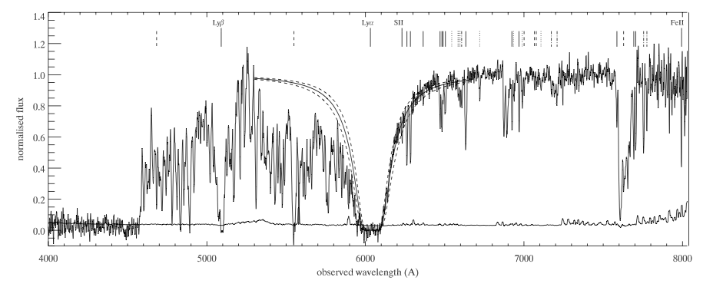
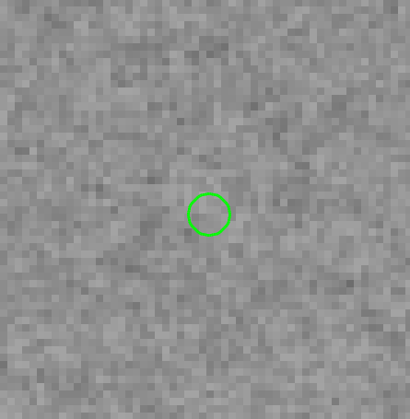
the neutral hydrogen fraction
the escape fraction of UV photons from high-z galaxies
the early metallicity of the ISM and IGM and its evolution
Abundances, HI, dust, dynamics etc. even for very faint hosts. E.g. GRB 050730: faint host (R>28.5), but z=3.97, [Fe/H]=-2 and low dust, from afterglow spectrum (Chen et al. 2005; Starling et al. 2005).
Forest (IGM)
Metals
HST/ACS
Ly-limit
HI(Lya)
Courtesy N. Tanvir

Slide 17
the neutral hydrogen fraction
the escape fraction of UV photons from high-z galaxies
the early metallicity of the ISM and IGM and its evolution
Abundances, HI, dust, dynamics etc. even for very faint hosts. E.g. GRB 050730: faint host (R>28.5), but z=3.97, [Fe/H]=-2 and low dust, from afterglow spectrum (Chen et al. 2005; Starling et al. 2005).
Forest (IGM)
Metals
HST/ACS
Ly-limit
HI(Lya)
Courtesy N. Tanvir

Slide 18
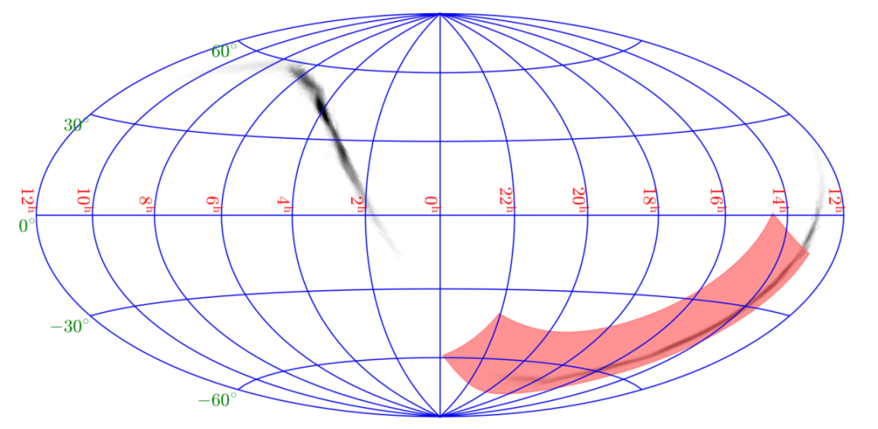
Exploring the multi-messenger transient sky
Locate and identify the electromagnetic counterparts to sources of gravitational radiation and neutrinos, which may be routinely detected in the late ‘20s / early ‘30s by next generation facilities like aLIGO/aVirgo, eLISA, ET, or Km3NET;
Provide real-time triggers and accurate (~1 arcmin within a few seconds; ~1’’ within a few minutes) high-energy transients for follow-up with next-generation optical-NIR (E-ELT, JWST if still operating), radio (SKA), X-rays (ATHENA), TeV (CTA) telescopes; synergy with LSST
Provide a fundamental step forward in the comprehension of the physics of various classes of transients and fill the present gap in the discovery space of new classes of transients events

Slide 19

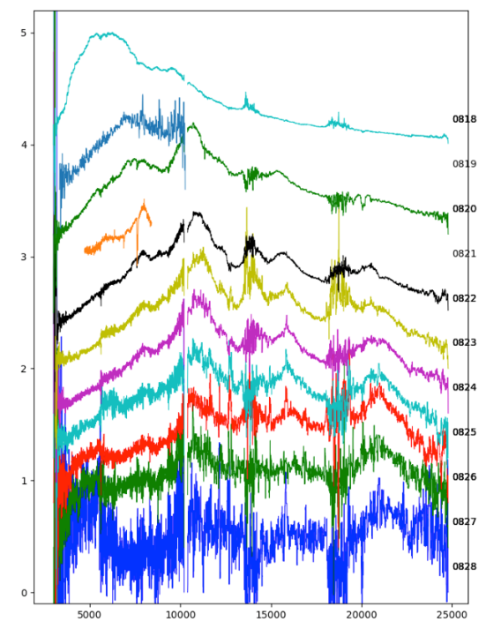

Slide 20
THESEUS:
short GRB detection over large FOV with arcmin localization
Kilonova detection, arcsec localization and characterization
Possible detection of weaker isotropic X-ray emission

Slide 21
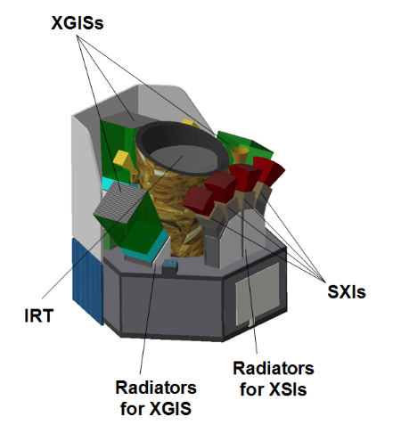
THESEUS mission concept
Soft X-ray Imager (SXI): a set of four sensitive lobster-eye telescopes observing in 0.3 - 5 keV band, total FOV of ~0.5sr with source location accuracy <2’;
X-Gamma rays Imaging Spectrometer (XGIS,): 2 coded-mask X-gamma ray cameras using bars of Silicon diodes coupled with CsI crystal scintillators observing in 2 keV – 10 MeV band, a FOV of >2 sr, overlapping the SXI, with <15’ GRB location accuracy in 2-150 keV
InfraRed Telescope (IRT): a 0.7m class IR telescope observing in the 0.7 – 1.8 μm band, providing a 15’x15’ FOV, with both imaging and moderate resolution spectroscopy capabilities (-> redshift)
LEO (< 5°, ~600 km)
Rapid slewing bus
Prompt downlink

Slide 22
THESEUS will have the ideal combination of instrumentation and mission profile for detecting all types of GRBs (long, short/hard, weak/soft, high-redshift), localizing them from a few arcmin down to arsec and measure the redshift for a large fraction of them
Fermi/GBM
GRB170817A/GW170817
High-redshift

Slide 23
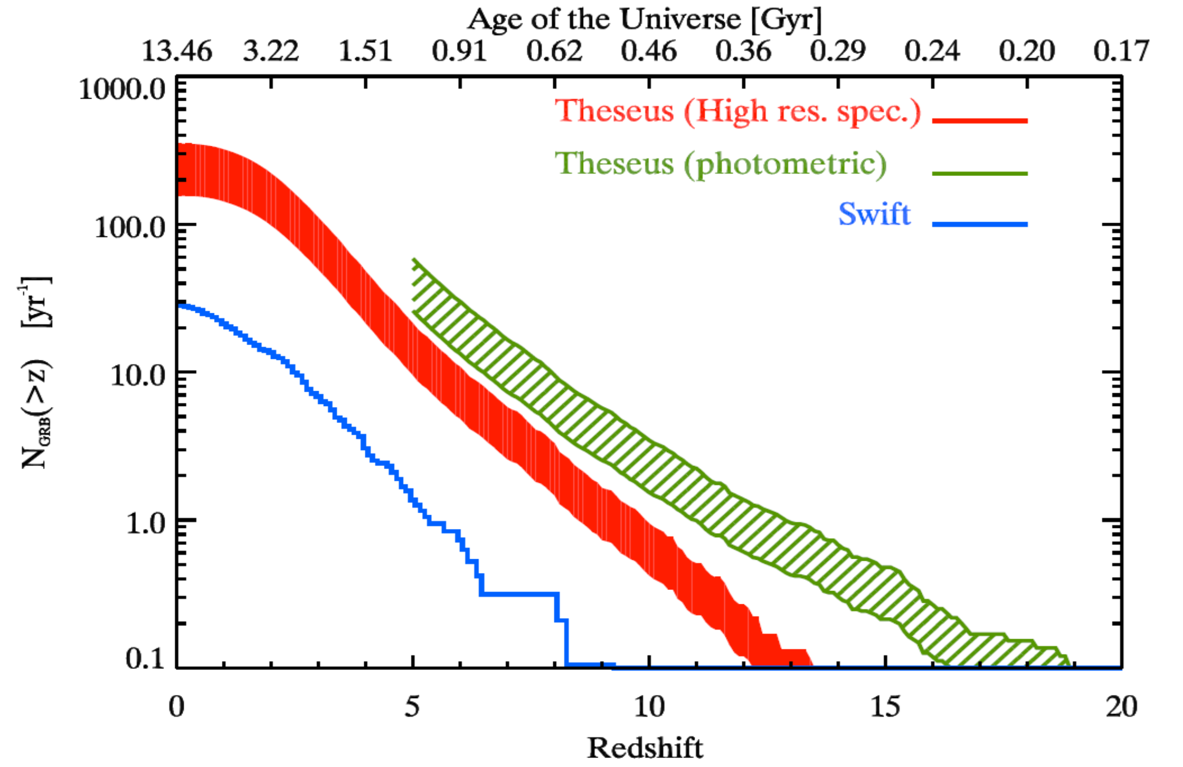
Shedding light on the early Universe with GRBs

Slide 24
THESEUS will also detect and localize down to 0.5-1 arcmin the soft X-ray short/long GRB afterglows, of NS-NS mergers and of many classes of galactic and extra-galactic transients
For several of these sources, THESEUS/IRT may provide detection and study of associated NIR emission, location within 1 arcsec and redshift

Slide 25
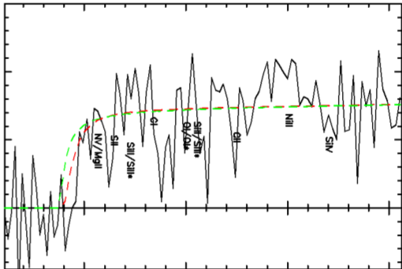
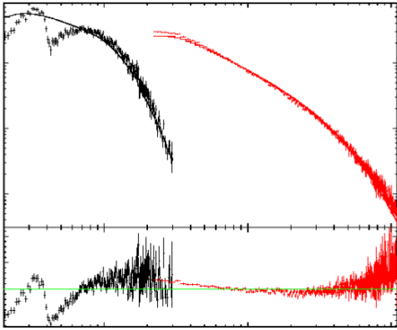
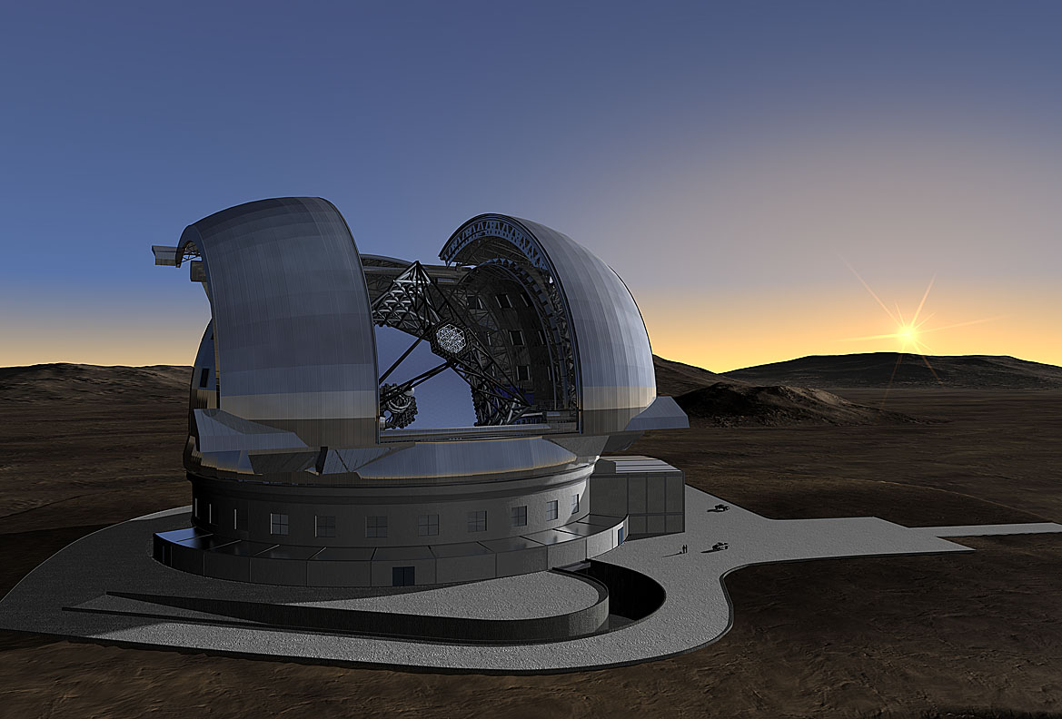
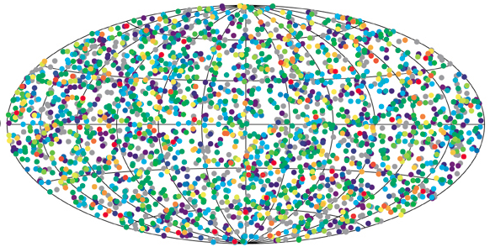
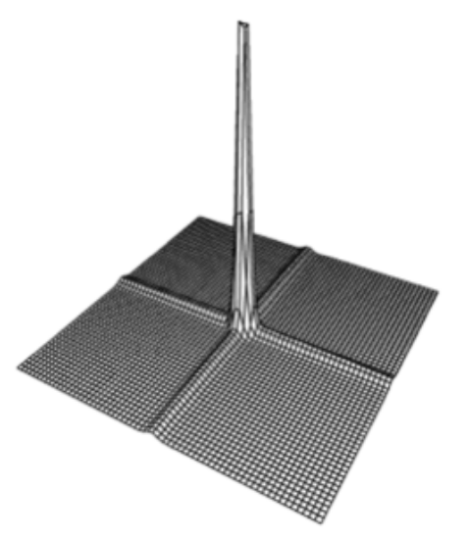
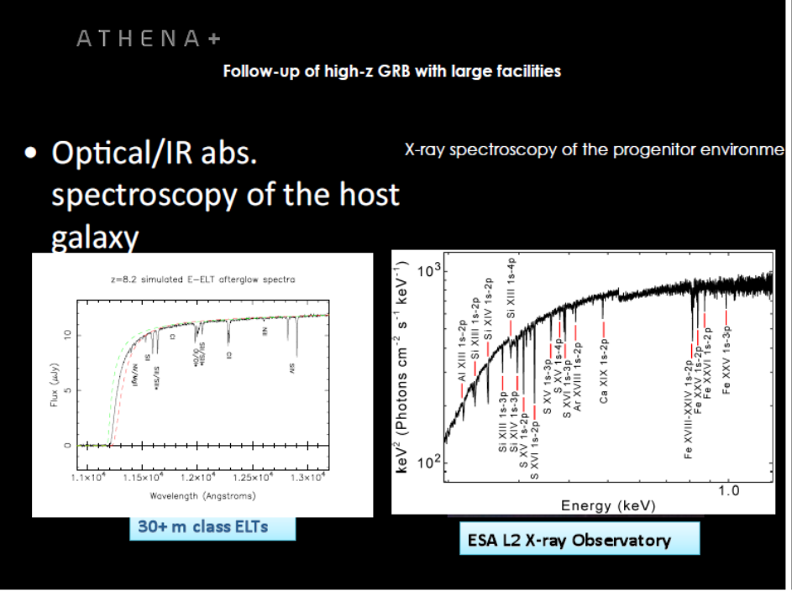
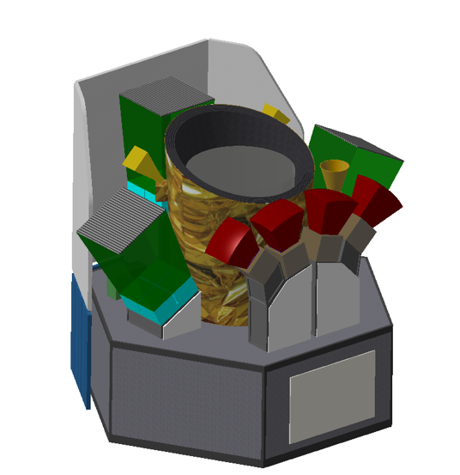
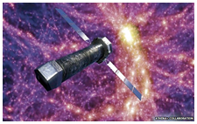
  Star formation history, primordial galaxies
  GRB accurate localization and NIR, X-ray, Gamma-ray characterization, redshift
ELT TMT GMT
Neutral fraction of IGM, ionizing radiation escape fraction
Cosmic chemical evolution, Pop III
ELT TMT GMT
ATHENA
THESEUS SYNERGIES
Notes:
Darach mentions paper on envelope stripping by the general environment in rich OB assocs.

Slide 26
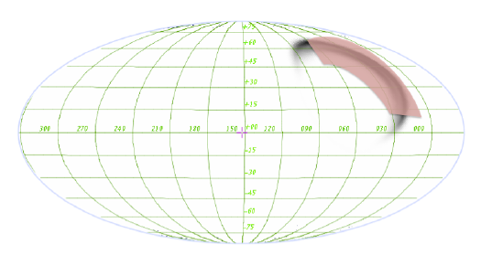
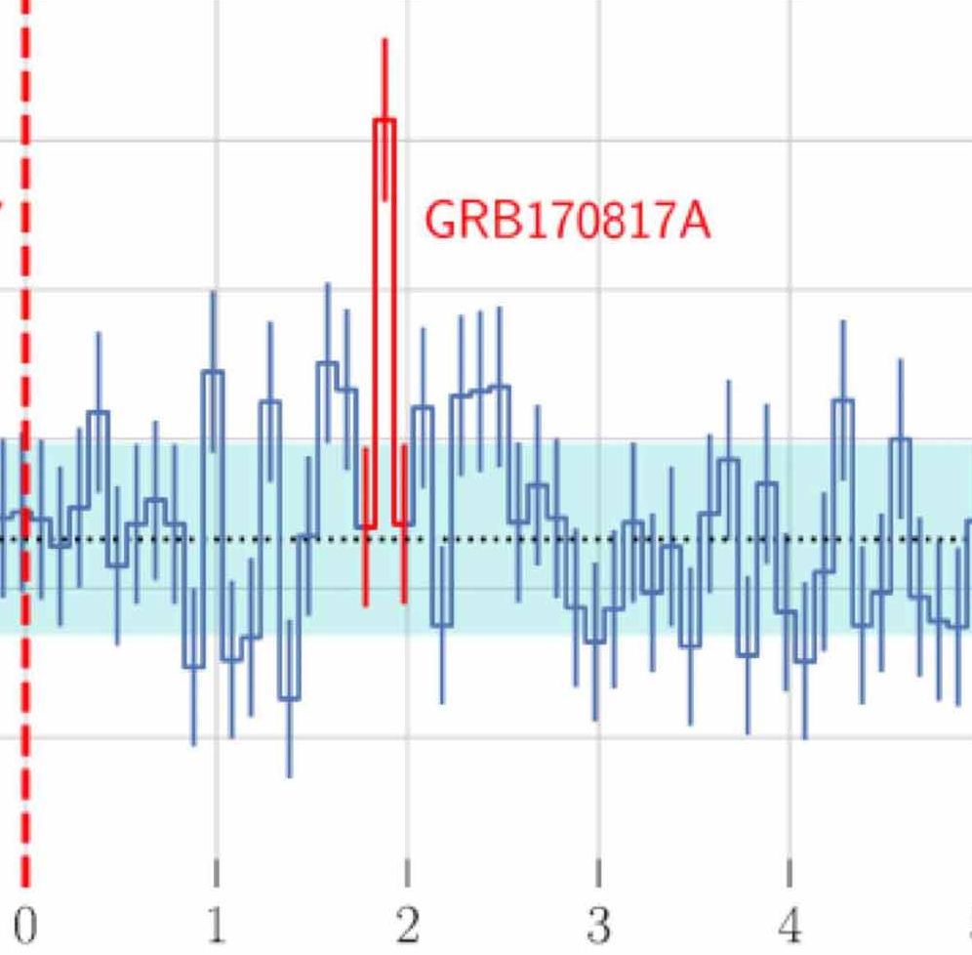
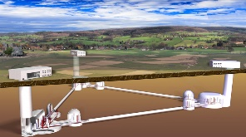
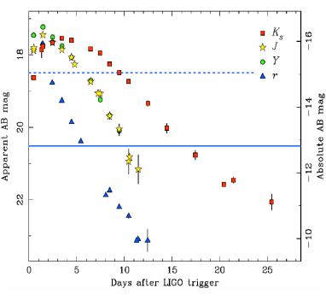
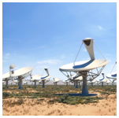
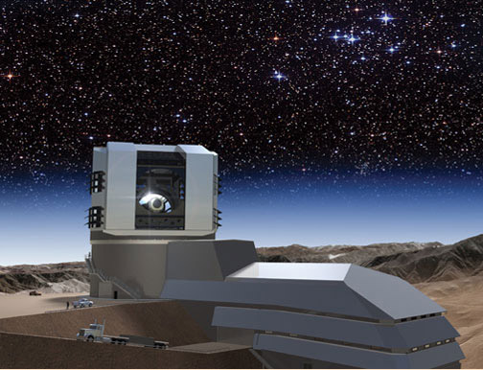
  Localization of GW/neutrino gamma-ray or X-ray transient sources NIR, X-ray, Gamma-ray characterization
  NS-BH/NS-NS merger physics/host galaxy identification/formation history/kilonova identification
Transient sources multi-wavelength campaigns
Einstein Telescope
Accretion physics
ELT TMT GMT
Jet physics
Hubble constant
Star formation
SKA
LSST
r-process element chemical abundances
THESEUS SYNERGIES
ATHENA
Notes:
Darach mentions paper on envelope stripping by the general environment in rich OB assocs.

Slide 27
THESEUS Core Science is based on two pillars:
  probe the physical properties of the early Universe, by discovering and exploiting the population of high redshift GRBs.
  provide an unprecedented deep monitoring of the soft X-ray transient Universe, providing a fundamental contribution to multi-messenger and time domain astrophysics in the early 2030s (synergy with aLIGO/aVirgo, eLISA, ET, Km3NET and EM facilities e.g., LSST, E-ELT, SKA, CTA, ATHENA).
THESEUS Observatory Science includes:
  study of thousands of faint to bright X-ray sources by exploiting the unique simultaneous availability of broad band X-ray and NIR observations
  provide a flexible follow-up observatory for fast transient events with multi-wavelength ToO capabilities and guest-observer programmes.

Slide 28
In summary
THESEUS, submitted to ESA/M5 by a large European collaboration with strong interest by international partners (e.g., US) will fully exploit GRBs as powerful and unique tools to investigate the early Universe and will provide us with unprecedented clues to GRB physics and sub-classes.
THESEUS will also play a fundamental role for GW/multi-messenger and time domain astrophysics at the end of next decade, also by providing a flexible follow-up observatory for fast transient events with multi-wavelength ToO capabilities and guest-observer programmes
THESEUS is a unique occasion for fully exploiting the European leadership in time-domain and multi-messenger astrophysics and in key-enabling technologies
THESEUS observations will impact on several fields of astrophysics, cosmology and fundamental physics and will enhance importantly the scientific return of next generation multi messenger (aLIGO/aVirgo, LISA, ET, or Km3NET;) and e.m. facilities (e.g., LSST, E-ELT, SKA, CTA, ATHENA)
Call for participating THESEUS scientific WGs issued in October 2019; THESEUS International Conference in Malaga on Spring 2020
http://www.isdc.unige.ch/theseus/

Slide 29
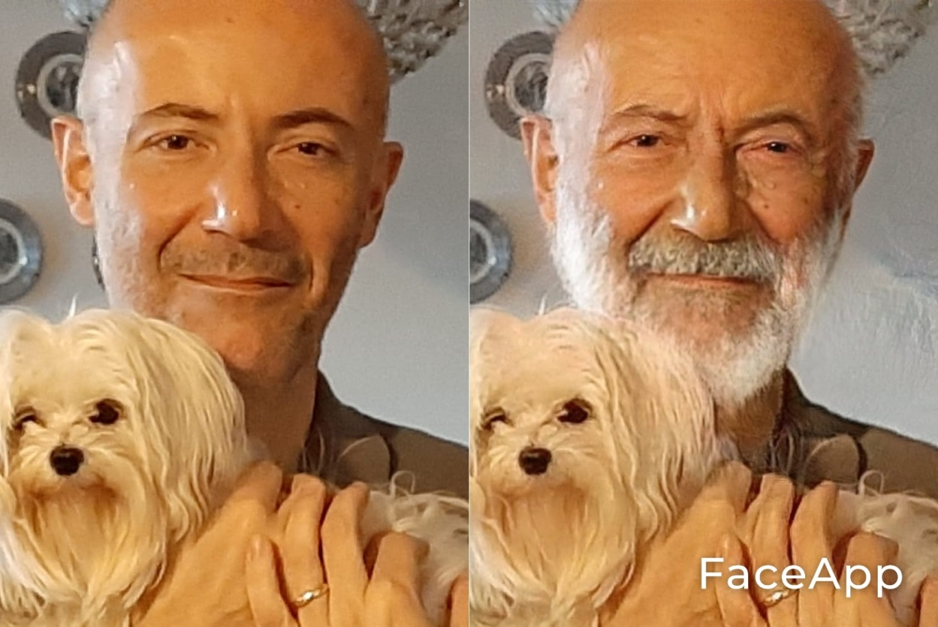
THESEUS, a rather long way from proposal (2016) to launch (2032)…
Phase A
Launch
Baloo
Baloo III
… but a great adventure aiming at great science!!!

Slide 30
Back-up slides

Slide 31
Shedding light on the early Universe with GRBs

Slide 32
GW/multi-messenger and time-domain astrophysics
GW transient sources that will be monitored by THESEUS include:
NS-NS / NS-BH mergers:
  collimated EM emission from short GRBs and their afterglows (rate of ≤ 1/yr for 2G GW detectors but up to 20/yr for 3G GW detectors as Einstein Telescope)
  Optical/NIR and soft X-ray isotropic emissions from macronovae, off-axis afterglows and, for NS-NS, from newly born ms magnetar spindown (rate of GW detectable NS-NS or NS-BH systems, i.e. dozens-hundreds/yr)
Core collapse of massive stars: Long GRBs, LLGRBs, ccSNe (much more uncertain predictions in GW energy output, possible rate of ~1/yr)
Flares from isolated NSs: Soft Gamma Repeaters (although GW energy content is ~0.01%-1% of EM counterpart)

Slide 33
GW/multi-messenger and time-domain astrophysics
GW transient sources that will be monitored by THESEUS include NS-NS / NS-BH mergers:
  collimated on-axis and off-axis prompt gamma-ray emission from short GRBs
  Optical/NIR and soft X-ray isotropic emissions from kilonovae, off-axis afterglows and, for NS-NS, from newly born ms magnetar spindown

Slide 34
Detection, study and arcsecond localization of afterglow and kilonova emission from shortGRB/GW events with THESEUS/IRT
Precise localization is mandatory to activate large ground-based telescopes as VLT or ELT from which detailed spectral analysis will reveal the intrinsic nature of these newly discovered phenomena

Slide 35
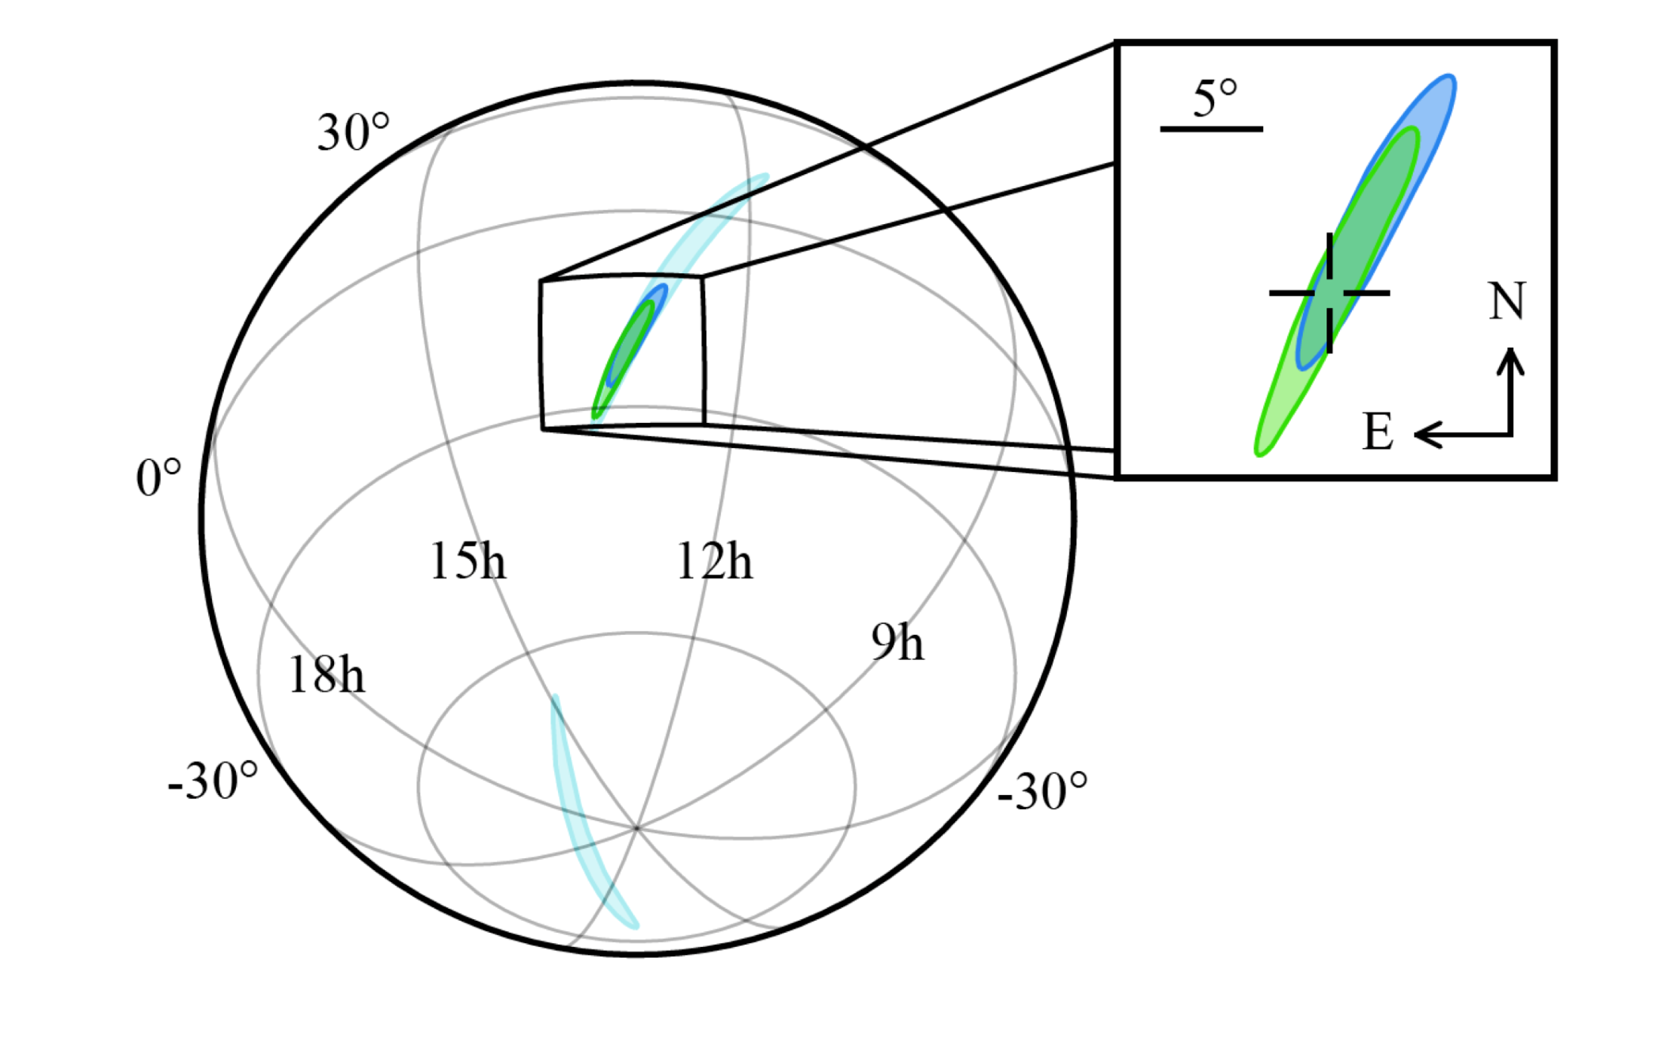
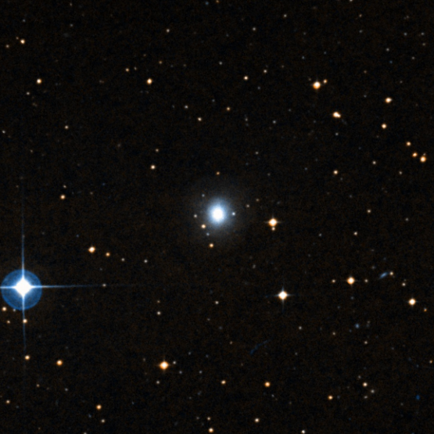
Promptly and accurately localizing e.m. counterparts to GW events with THESEUS
110∘× 30∘
15 ʹ
5 ʹ
1 arcsec !

Slide 36
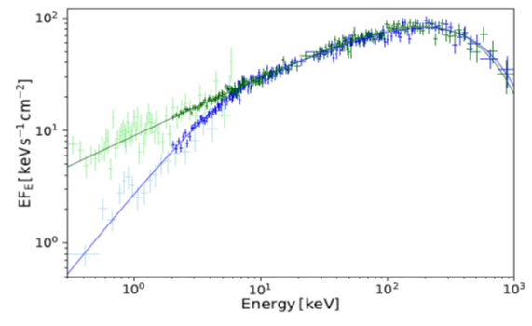
Discriminating GRB prompt emission models through unprecedented SXI+XGIS energy band (0.3 keV – 20 meV)

Slide 37
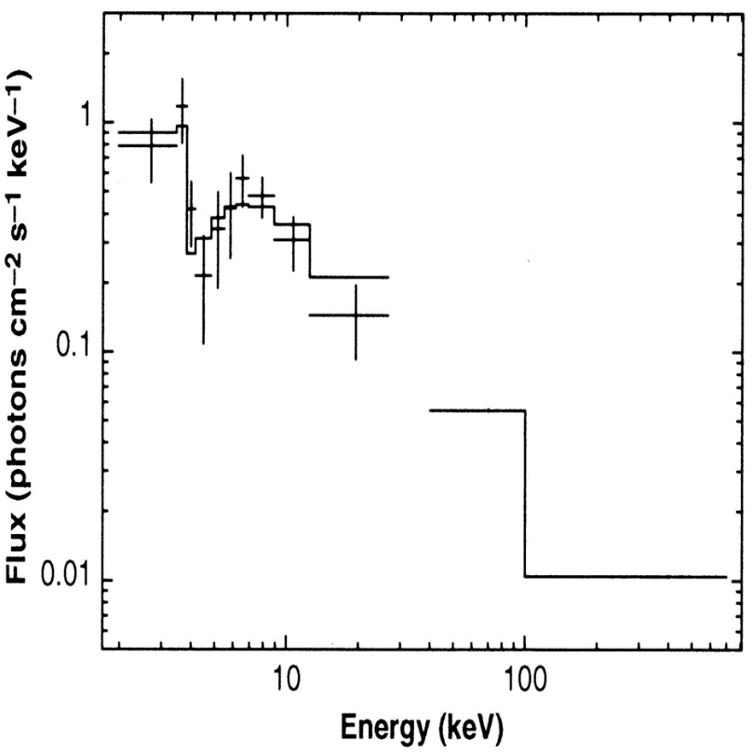
Absorption features: the case of GRB990705 (edge at 3.8 keV -> redshifted neutral iron k-edge -> z = 0.85 -> confirmed by host galaxy spectroscopy: redshift estimate through X-ray spectroscopy (need energy resolution < ~1 keV in X-rays)
BeppoSAX WFC + GRBM
(Amati et al. 2000)
THESEUS SXI + XGIS
(Nava et al. 2018)

Slide 38
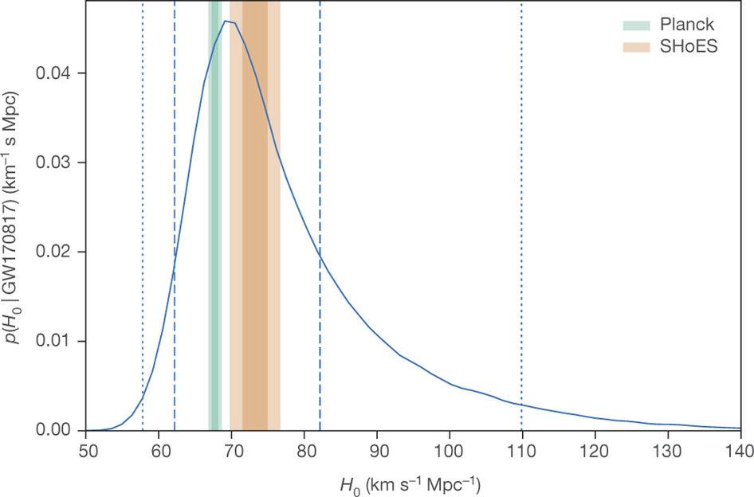
THESEUS measurements + sinergy with large e.m. facilities -> substantial improvment of redshift estimate for e.m. counterparts of GW sources -> cosmology
Estimating H0 with GW170817A
(LVC 2017)
Investigating dark energy with a statistical sample of GW + e.m. (Sathyaprakash et al. 2019)

Slide 39
Time-domain astronomy and GRB physics
survey capabilities of transient phenomena similar to the Large Synoptic Survey Telescope (LSST) in the optical: a remarkable scientific sinergy can be anticipated.
substantially increased detection rate and characterization of sub-energetic GRBs and X-Ray Flashes;
unprecedented insights in the physics and progenitors of GRBs and their connection with peculiar core-collapse Sne;
Soderberg et al.
Nava et al. 2018

Slide 40
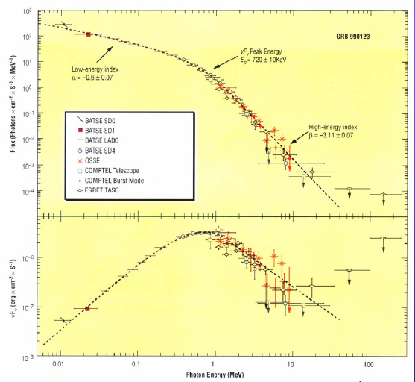
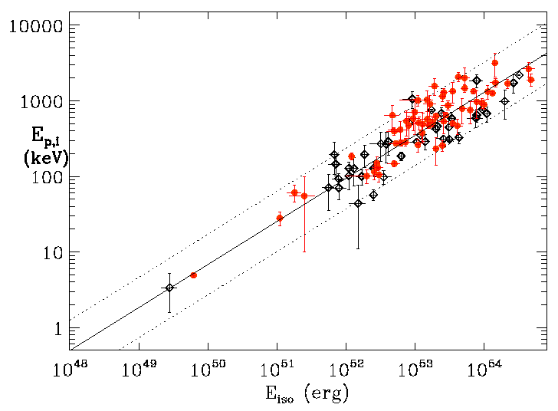

measuring cosmological parameters with GRBs
600 GRB

Slide 41




THESEUS mission concept: ESA study
PROPOSAL
CDF STUDY

Slide 42


Mission profile and budgets: ESA study

Slide 43

Mission Operation Concept (MOC)
IRT Characterization Mode

Slide 44
Mission Operation Concept (MOC)
External trigger (TOO)
3 per month dedicated to core science are granted (SciRD); more / additional science -> GO programme;
reaction times: 12 hr (goal 4hr) during working days (due to mission operation control, despite high level of spacecraft agility and autonomy)
Guest Observer
small deviations ( < few deg) from nominal pointing strategy during survey mode to observe sources of interest selected through a GO programme is in mission baseline;
GO observations (including TOOs) requiring larger deviations / resources are an option subject to achievement of core science objectives.

Slide 45
THESEUS payload contributions
Italy –L.P./coord, responsibility of XGIS, Malindi ground station, Trigger Broadcasting Unit
UK – responsibility of SXI (coord., optics, cal., s/w)
France – responsibility of IRT, Theseus Burst Alert Ground Segment
Germany (with Poland and Denmark) – I-DHUs and Power Supply Units (PSUs)
Switzerland: SDC + IRT filter wheel
Spain: XGIS imaging system (+ SXI focal plane assembly)
Belgium: SXI integration and tests
Czech Rep. (mechanical structures and thermal control of SXI)
ESA P/L contribution: IRT telescope (including cooler), SXI detectors, IRT detectors
Possible minor contributions: Ireland (XGIS detectors, IRT on-board s/w ), Hungary (spacecraft interface simulator, I-DHU, IRT calib.), Slovenia (mobile X-band stations)

Slide 46

The XGIS instrument on board THESEUS
(P.I.: L. Amati, S.E.: C. Labanti @inaf-oas bologna)
2 XGIS Camera
(+ 2 XSU and DHU)

Slide 47


Slide 48


Slide 49


Pointing strategies trade-offs
Minimize Earth in FOV of SXI (and XGIS imaging FOV)
Optimize for follow-up from on-ground large telescopes (e.g., ELT, TMT) -> lower latitudes
Optimize sky exposure of the monitors e.g.,

Slide 50


