Slide 1

Nanoplasmonic Laser Fusion
Laszlo P. Csernai, for the
NAPLIFE Collaboration
Univ. of Bergen, Norway
ICNFP - 2020,
Kolymbari, Crete, Sept. 11, 2020

Slide 2
Nano-Plasmonic Laser Inetial Fusion Experiment (NAPLIFE) Collaboration
Márk Aladi, Attila Bonyár, Alexandra Borok, Larissa Bravina, Maria Csete, Péter Dombi, Miklós Kedves, Péter Lévai, Igor N. Mishustin, Dénes Molnár, Anton Motornenko, István Papp, Péter Petrik, Péter Rácz, Béla Ráczkevi, Leonid M. Satarov, Horst Stöcker Daniel D. Strottman, Melinda Szalóki, András Szenes, Csaba Tóth, Dávid Vass, Miklós Veres, Tamás S. Biró, László P. Csernai , Norbert Kroó
* L.P. Csernai, M. Csete, I.N. Mishustin, A. Motornenko, I. Papp, L.M. Satarov, H. Stöcker & N. Kroo, Radiation Dominated Implosion with Flat Target, Physics of Wave Phenomena, 28 (3) 187-199 (2020), (arXiv:1903.10896v3).
* L.P. Csernai, N. Kroo, & I. Papp, Radiation-Dominated Implosion with Nano-Plasmonics, Laser and Particle Beams 36, 171 (2018), (arXiv:1710.10954)
* I. Papp, L. Bravina, M. Csete, I.N. Mishustin, D. Molnár, A. Motornenko, L.M. Satarov, H. Stöcker, D.D. Strottman, A. Szenes, D. Vass, T.S. Biró, L.P. Csernai, N. Kroó, Laser Wake Field Collider, t.b.p. (arXiv: 2009.00000 )
* L.P. Csernai, N. Kroó, I. Papp, D.D. Strottman, Nano-plasmonic Laser Fusion, Laser and Particle Beams, i.p. (arXiv:2008.09847)

Slide 3
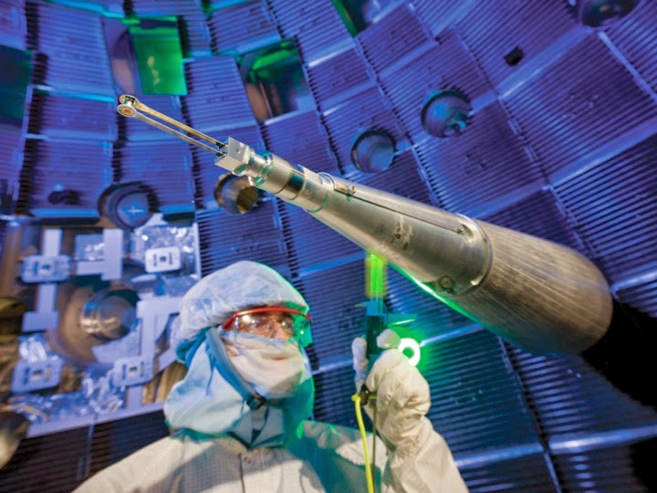
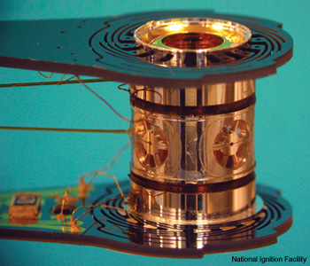
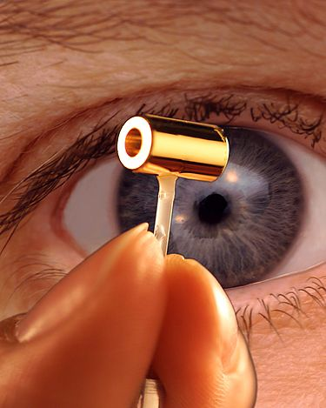
Indirectly Driven,
ICF target for NIF
at LLNL

Slide 4
S. Le Pape et al., (LLNL - NIF)
Depleted
Uranium
Notice: The last energetic part of the pulse is less than 4ns!
(It was ~ 15ns earlier.)
published 14 June 2018

Slide 5
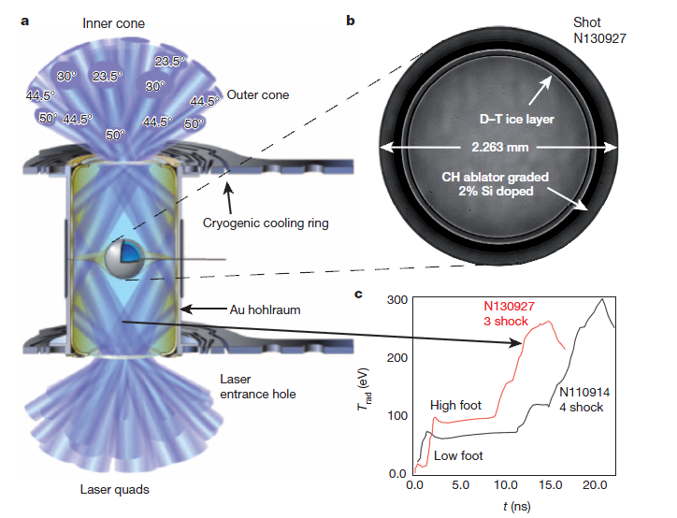
Indirectly Driven, ICF target for NIF
Time profile of the laser beam:
Initial pre- compression of ~ 10 ns,
Stable compression
Then final “shocks” of
~ 15 ns
to ignite
[O.A. Hurricane et al., Nature, 506, 343 (2014), doi:10.1038/nature13008 ]

Slide 6
[Clark et al., Phys. Plasmas,
22, 022703 (2015).]
Snapshots of 3D simulation
22.53ns: peak impl. Velocity
23.83ns: bang, max compr.
22.96ns: jet out, up left
Green surface: Ablator/DT-f.
Peaks: Ablator defects
Colours:
Left: fluid speed
Right: matter density
~adiabatic compression
➔ 80 μm
& heating

Slide 7
[ A.H. Taub (1948) ]
Taub assumed that (physically) only slow
space-like shocks or discontinuities may occur (with space-like normal, λ₄=0).
This was then taken as standard, since then (e.g. LL 1954-)

Slide 8
[ L. P. Csernai, Zh. Eksp. Teor. Fiz. 92, 379-386 (1987) &
Sov. Phys. JETP 65, 216-220 (1987) ]
corrected the work of
[ A. Taub, Phys. Rev. 74, 328 (1948) ]
λ_{α} λ^{α} = ± 1
+1
-1

Slide 9
[ L.P. Csernai:
Introduction to Relativistic Heavy Ion Collisions, (1994, John Wiley & Sons, Cichester, England) ]

Slide 10
Discovery of QGP:
CERN
BNL
[U.W. Heinz and P.F. Kolb, Phys. Lett. B 542, 216 (2002)]

Slide 11
[ R. Chatterjee, et al., Phys. Rev. Lett. 96, 202302 (2006) ]

Slide 12
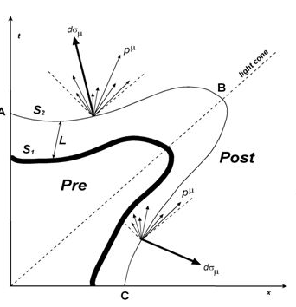
Light cone
[ E. Molnar, et al., J. Phys. G 34 (2007) 1901 ]

Slide 13
[ E. Frodemann, et al., J.Phys. G 34, 2249-2254 (2007) ]

Slide 15
[ Stefan Floerchinger, and Urs Achim Wiedemann,
Phys. Rev. C 89, 034914 (2014) ]
Light cone

Slide 16
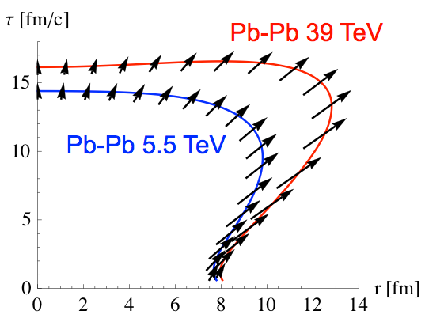
Light cone
Size and time extent of hadronization is measured by two particle correlations,
via Hanbury-Brown & Twiss effect.
[ N. Armesto, et al., Nucl.Phys. A931 (2014) 1163 ]

Slide 17
Applications to Pellet Fusion (I-st)
Relativistic Heavy Ion Physics proves that simultaneous ignition and burning is possible, both theoretically and experimentally (two particle corr.) !
Up to now all theoretical studies of Internal Confinement fusion are based on Classical Fluid Dynamics (CFD)
[HYDRA, LASNEX]
Still the aim is to
achieve Volume Ignition
achieve Rapid Ignition
but within CFD ?! →

Slide 18
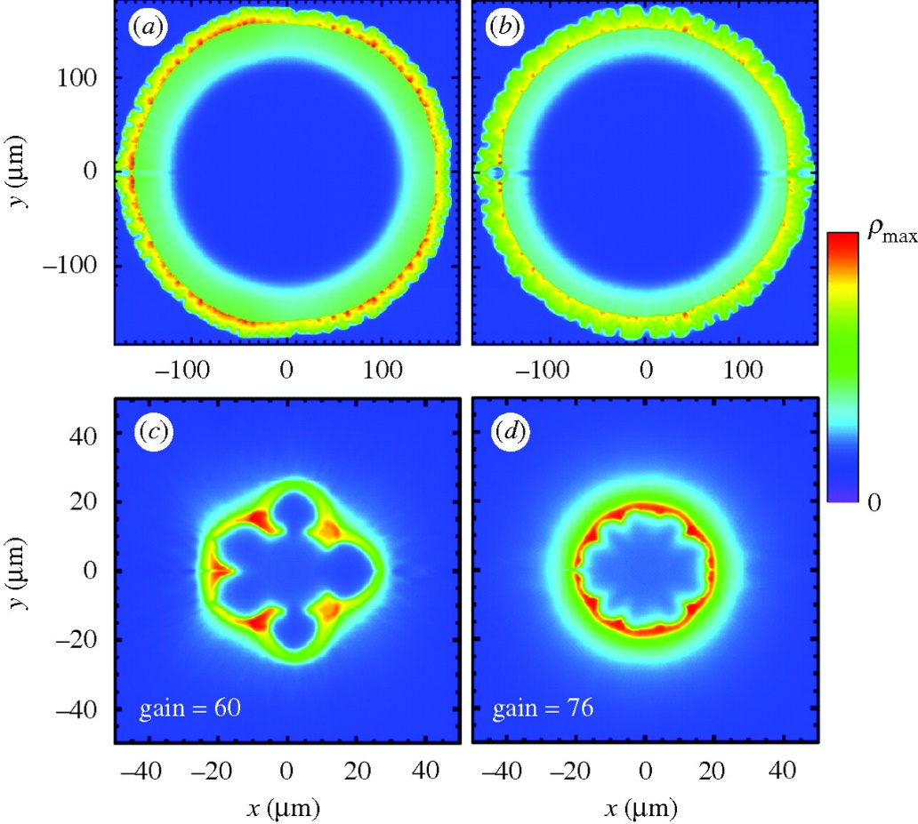
Fusion reaction:
D + T ➔ n(14.1 MeV) + 4He (3.5 MeV)
Constant absorptivity,
Spherical irradiation
Ignition temperature = T1 ➔
Simultaneous, volume ignition up to
0.5 R (i.e. 12% of the volume).
Not too good, but better than:
[ L.P. Csernai & D.D. Strottman,
Laser and Particle Beams 33, 279 (2015).]

Slide 19
Can we achieve larger volume ignition (II-nd)
Two ideas are combined by
L.P. Csernai, N. Kroo, I. Papp [ Patent # P1700278/3 ](*)
(2017)
Heat the system uniformly by radiation with RFD
Achieve uniform heating by Nano-Technology
Uniform, 4π radiation should heat the target to ignition within the light penetration time (i.e. ~ 10-20 ps). This follows from RFD!
[ L.P. Csernai, N. Kroo, I. Papp, Laser and Particle Beams,
LPB, 36(2), (2018) 171-178. . https://doi.org/10.1017/S0263034618000149 ]

Slide 20
LPB, 36(2), (2018) 171-178.
… and 35th Hirschegg Int. Workshop on High Energy Density Physics, Jan. 25‐30, 2015

Slide 21
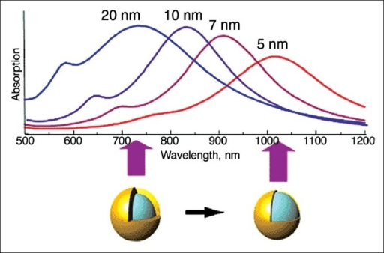
Golden Nano-Shells – Resonant Light Absorption

Slide 22
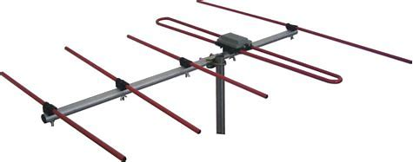
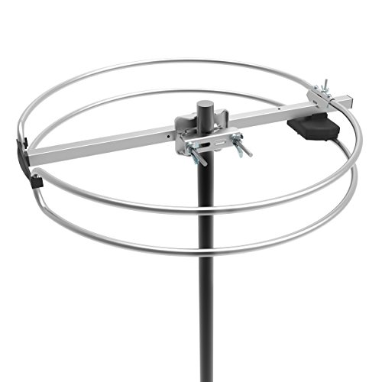
[ Martin Greve, IFT Seminar, Fall (2017) for PV Solar panels]
Omnidirectional TV antenna

Slide 23
L.P. Csernai, N. Kroo, I. Papp [ Patent # P1700278/3 ]
The absorption coefficient is linearly changing with the radius: In the center, r = 0, α_{K} = 30 cm⁻¹ while at the outside edge α_{K} = 8 cm⁻¹.
The temperature is measured in units of T₁ = 272 keV, and T_{n} = n T₁.
Simultaneous, volume ignition is up to 0.9 R, so 73% of the fuel target!
T (MeV)

Slide 24
Thick Coin like target - New Developments
L.P. Csernai, N. Kroo, I. Papp
X
Thickness of the target is: h
h depends on pulse energy, ignition energy, target mass, …

Slide 25
Without nano
antennas
The deposited energy from laser irradiation from one side only. The absorption is constant, this leads to an exponentially decreasing energy deposition, and only a negligibly small energy reaches the opposite end of the target.

Slide 26
Without nano
antennas
Irradiation from both sides.
Exponential decrease of deposited energy. Due to the already deposited energy, less energy reaches the middle ➔
The front and back surface is heated up but the middle is not!
Pulse length is: t_{P} = h/c

Slide 27
With nano
antennas
The absorptivity is increased towards the center, due to the implanted nano antennas.
The deposited energy from laser irradiation from one side only. The absorption is modified by nano antennas so that the absorptivity is increasing towards the middle, so that the deposited energy is constant up to the middle. Then the absorptivity is decreasing, but hardly any energy is left in the irradiation front. Thus again only a negligibly small energy reaches the opposite end of the target.

Slide 28
With nano
antennas
Irradiation from both sides.
Ignition energy is: Q_{i} /m
e.g. for DT target: Q_{i} /m = 27 kJ/g
➔ if we have Q = 100 J , then
we can have a target mass:
m_{DT} = Q / Q_{i} g = 3.703 mg.
Then with m_{DT} and ρ_{DT} given
we get the DT-target’s volume, V_{DT} and h_{DT} = 2.67 mm .

Slide 29
With nano
antennas
Ignition is reached at contour line Q = 1.
[ L. P. Csernai, M. Csete, I. N. Mishustin, A. Motornenko, I. Papp, L. M. Satarov, H. Stöcker, N. Kroo, arXiv:1903.10896, Submitted to MRE]

Slide 30
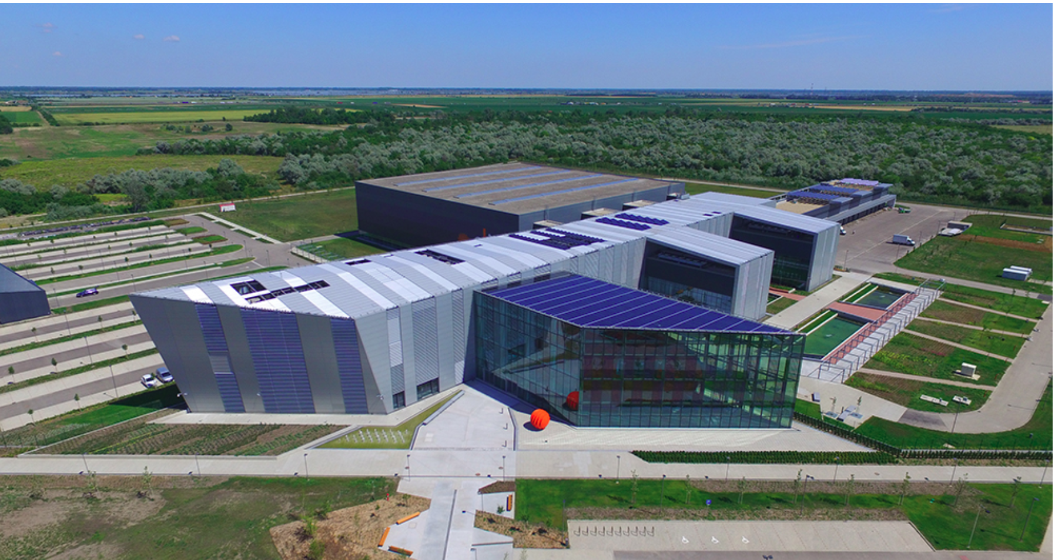
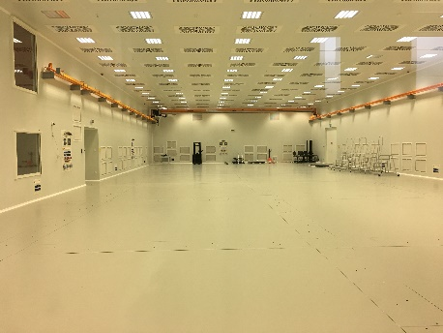
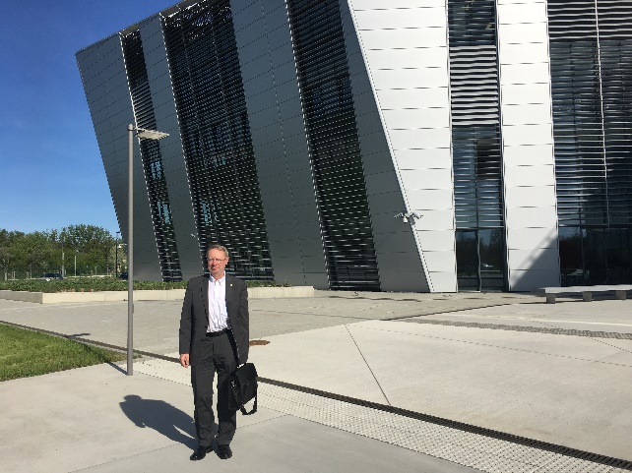
European Laser Infrastructure – Szeged, HU
ELI-ALPS Szeged:
EU Extr. Light Infrastructure
Attosec. Light Pulse Source
2PW High Field laser
10 Hz, <10fs, 20 J

Slide 31
Test of principles with
smaller pulse energy
1 Relativistic time-like (simultaneous) ignition
2 Using nano antennas to reach whole volume uniform ignition
3 Using 1D geometry, with two beams from opposite direction
Let us take
a polilactic acid (PLA) target with T = 150 C melting temperature,
Melting energy: Q_{i} /m = 28 J/g
➔ a P = 30 mJ , 1 ps laser, this leads to m_{i} = 0.32 mg target

Slide 32
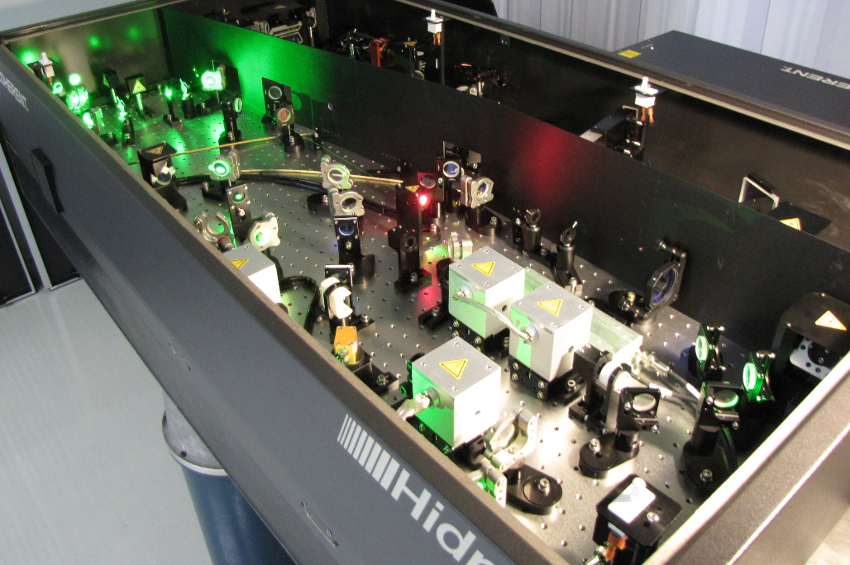
HAS Wigner RCP, Budapest
Márk Aladi, Miklós Kedves, Béla Ráczkevi,
Péter Lévai et al.
Laser wake acceleration of protons for radiation therapy
Fusion plasma diagnostics, ITER, JET etc.
Péter Dombi, Péter Rácz, Norbert Kroo et al.
Laser induced nano-plasmonics
Validation tests:
Ti-Si Hidra L. 30mJ 10Hz 40fs
See Attila Bonyár’s talk

Slide 33
Experimental test of similar configuration @ ShenGuang-II Up, Shanghai :
4 (up) + 4(down) lasers
Target thickness, h (3.6μm-1mm)
& radius, R, (150-400μm) were
varied.
Total pulse energy 1.2kJ (2ns) for 8 beams.
Shortest (250ps) pulses -> 100s MeV ions >
non-thermal distr. = directed ion acceleration
Typical fusion neutron energies were measured & used to extract the target density.

Slide 34
Experimental test of similar configuration @ ShenGuang-II Up, Shanghai :

Slide 35
Deposited momentum
Leads to compression w/o external ablator surface
[Gyulassy, Csernai, NPA 1986]
→ leads to QGP formation
w/o RT instabilities
Implanted nano-antennas increase further the compression !!

Slide 36
Laser Wake Field Collider
E_{y}
B_{z}
The electric field, E_{y} (top) and magnetic field, B_{z} (bottom) in a Laser Wake Field (LWF) wave formed by irradiation from the ±x- direction. The rest number density of the H target is n_{H} = 2.13 10²⁵/m³ = 2.13 10¹⁹/cm³. The laser beam wavelength is λ = 1μm. The LWF wavelength is about 20 λ. Pulse energy is 19.6 J
[Papp, I., et al., NAPLIFE Collaboration, arXiv-2009.03686]

Slide 37
Ionization of the H target
The ionization of the H atoms in a Laser Wake Field (LWF) wave due to the irradiation from both the x- directions, on an initial target density of n_{H} = 2.13 x 10²⁷/m³ = 2.13 10²¹/cm³. The energy of the H atoms in Joule [J] per marker particle is shown. The H atoms disappear as protons and electrons are created. Due to the initial momentum of the colliding H slabs, the target and projectile slabs interpenetrate each other and this leads to double energy density. Several
time-steps are shown at 30 fs time difference.
[Papp, I., et al., NAPLIFE Collaboration, arXiv-2009.0368]

Slide 38
E_{y} in the middle of transverse plane
Electric Field, E_{y} in a Laser Wake Field (LWF) wave formed by irradiation from both the ±x- directions. The field strengths are shown in the middle of the transverse, [y,z], plane along the x-axis. In the other, not shown, directions the fields are weaker by orders of magnitude. The initial target density is n_{H} = 2.13 x 10¹⁹/cm³. Several time-steps are shown at 25, 50, 75, 100, 125 and 150 fs times.
[Papp, I., et al., NAPLIFE Collaboration, arXiv-2009.0368]

Slide 39
E_{y} in the middle of transverse plane
Same as the previous figure, with larger initial target density
n_{H} = 2.13 x 10²¹/cm³. ~ Liquid Hydrogen

Slide 40
Electron density
The density of electrons in 1/m³ units. The electron density reaches
n_{e} = 3 - 5 x 10²⁷/m³, at the initial H atom target density of n_{H} = 2.13 x 10²¹/cm³.
.
[Papp, I., et al., NAPLIFE Collaboration, arXiv-2009.0368]

Slide 41
Thus, ultra-relativistic heavy ion physics lead to discovery Quark Gluon Plasma (QGP), but also
to advances in (i) relativistic fluid dynamics (RFD).
With (ii) nano technology this may revolutionize in a simple, and (iii) affordable 1D geometry the technological development of ➔
Nanoplasmonic Laser Inertialconfinement Fusion Experiment
(NAPLIFE)
*
)*

