Slide 1
Investigation of 2β decay of ¹⁵⁰Nd to the first 0⁺excited level of ¹⁵⁰Sm
O.G. Polischuk¹, A.S. Barabash², P. Belli^{3,4}, R. Bernabei^{3,4}, R.S. Boiko^{1,5}, F. Cappella⁶, V. Caracciolo^{3,4,7}, R. Cerulli^{3,4}, F.A. Danevich¹, A. Di Marco^{3,4}, A. Incicchitti^{6,8}, D.V. Kasperovych¹ , V.V. Kobychev¹, S.I. Konovalov², M. Laubenstein⁷, D.V. Poda^{1,9}, V.I. Tretyak¹, V.I. Umatov²
¹ Institute for Nuclear Research of NASU, 03028 Kyiv, Ukraine
² National Research Centre Kurchatov Institute, Institute of Theoretical and Experimental Physics, 117218, Moscow, Russia
³ INFN, sezione di Roma “Tor Vergata”, I-00133, Rome, Italy
⁴ Dipartimento di Fisica, Università di Roma “Tor Vergata”, I-00133, Rome, Italy
⁵ National University of Life and Environmental Sciences of Ukraine, 03041 Kyiv, Ukraine
⁶ INFN, sezione di Roma, I-00185 Rome, Italy
⁷ INFN, Laboratori Nazionali del Gran Sasso, I-67100 Assergi (AQ), Italy
⁸ Dipartimento di Fisica, Universita di Roma “La Sapienza”, I-00185 Rome, Italy
⁹ Université Paris-Saclay, CNRS/IN2P3, IJCLab, 91405 , Orsay, France

Slide 2
2β processes
2ν2β–: (A,Z) → (A,Z+2) + 2e– + 2ν̃_{e}
0ν2β–: (A,Z) → (A,Z+2) + 2e–
2ε: 2e– + (A,Z) → (A,Z - 2) + (2ν) + (γ)
2ν2β – allowed in standard model (SM) (2β– was observed for 11 isotopes and 2ε for 3 isotopes)
T_{1/2} ≃ 10¹⁸ – 10²⁴ y
0ν2β – forbidden in SM (due to the lepton number violation ΔL=2;
predicted by many SM extensions).
The best current limits: 10²⁴ – 10²⁶ y
Investigation of 0ν2β decay may allow us to test:
the nature of neutrino (Dirac or Majorana?)
the lepton number violation
an absolute scale of neutrino mass and the neutrino mass hierarchy

Slide 3
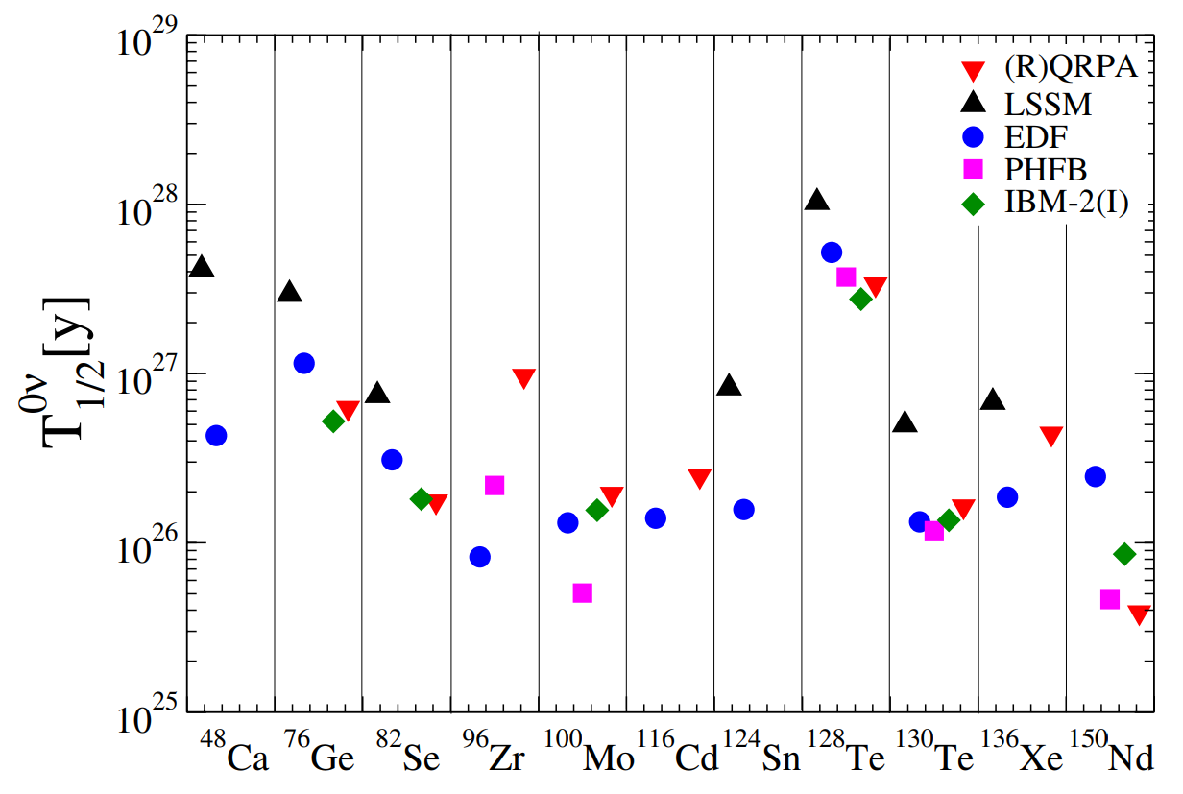
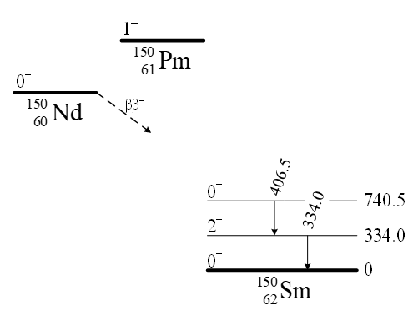
¹⁵⁰Nd: one of the most promising nuclides for 2β experiments
Energy release
Q_{ββ} = 3371.38(20) keV [1]
Optimistic theoretical estimations of T_{1/2}
Comparatively high natural isotopic abundance
δ = 5.638(28)% [2]
Possibility to investigate the decay to excited levels of ¹⁵⁰Sm
¹⁵⁰Nd 2β decay scheme
Q_{2β} = 3371 keV
[1] V.S. Kolhinen et al., Phys. Rev. C 82 (2010) 022501
[2] J. Meija et al., Pure Appl. Chem. 88 (2016) 293

Slide 4
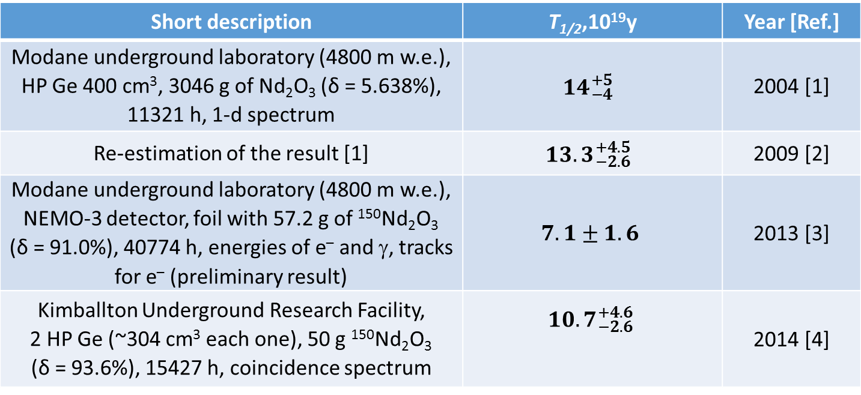
Experimental results for ¹⁵⁰Nd → ¹⁵⁰Sm (0⁺, 740.5 keV)
Short description | T_{1/2}, 10¹⁹y | Year [Ref.]
Modane underground laboratory (4800 m w.e.), HP Ge 400 cm³, 3046 g of Nd₂O₃ (δ = 5.638%), 11321 h, 1-d spectrum |  | 2004 [1]
Re-estimation of the result [1] |  | 2009 [2]
Modane underground laboratory (4800 m w.e.), NEMO-3 detector, foil with 57.2 g of ¹⁵⁰Nd₂O₃ (δ = 91.0%), 40774 h, energies of e– and γ, tracks for e– (preliminary result) |  | 2013 [3]
Kimballton Underground Research Facility (1450 m w.e.), 2 HP Ge (~304 cm³ each one), 50 g ¹⁵⁰Nd₂O₃ (δ = 93.6%), 15427 h, coincidence spectrum |  | 2014 [4]
[1] A.S. Barabash et al., Phys. Atom. Nucl. 67 (2004) 1216.
[2] A.S. Barabash et al., Phys. Rev. C 79 (2009) 045501.
[3] S. Blondel, PhD thesis, LAL, Orsay, France, LAL 13-154 (2013).
[4] M.F. Kidd et al., Phys. Rev. C 90 (2014) 055501.

Slide 5
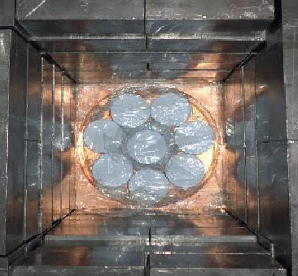
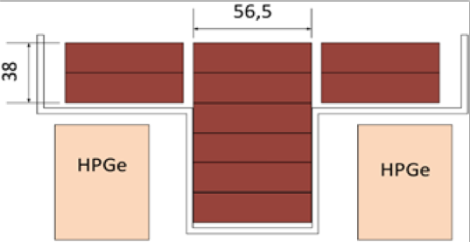
Experimental setup
2381-g Nd₂O₃ sample (average density
~2.84 g/cm³), used in previous experiment [1], additionally purified before the present measurements [2]
4 HP Ge detectors (≃225 cm³ each) in a cryostat with cylindrical well in the center; Gran Sasso National Laboratory (LNGS)
Shield: copper (10 cm), lead (20 cm)
Plexiglas container flushed with high-purity nitrogen gas (to remove radon)
No. of detector | FWHM, keV (1333 keV, ⁶⁰Co calibration source)
1 | 2.36(2)
2 | 2.01(2)
3 | 2.06(2)
4 | 4.01(4)
[1] A.S. Barabash et al., Phys. Atom. Nucl. 67 (2004) 1216. [2] R.S. Boiko, Int. J. Mod. Phys. A 32 (2017) 1743005.

Slide 6
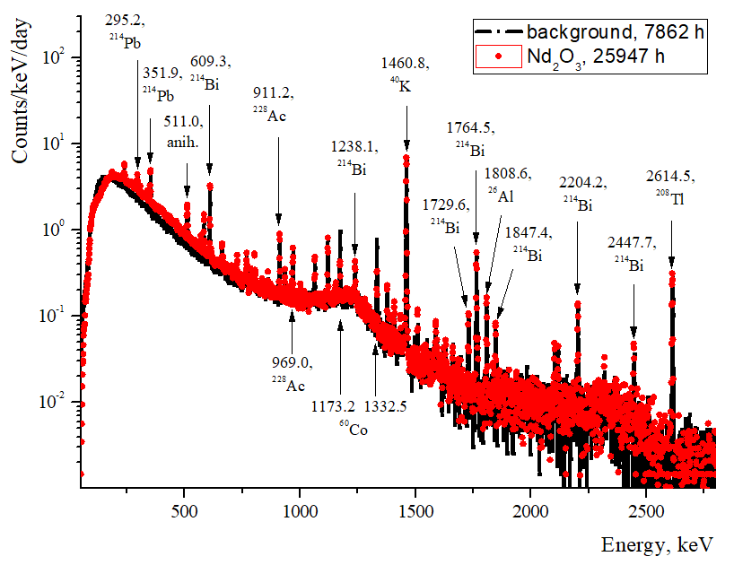
Nd₂O₃ vs background spectra
34174 h

Slide 7
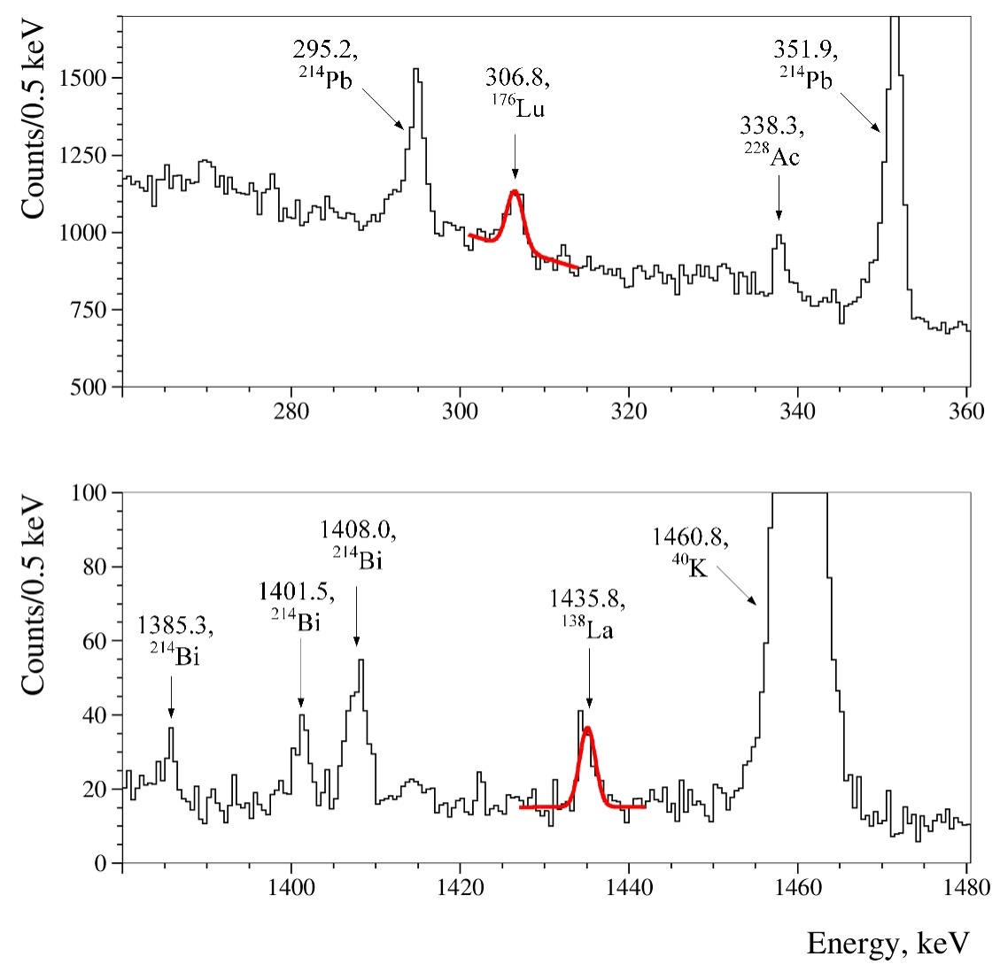
Radioactive contamination of the Nd₂O₃ sample
Radiopurity of samples are important for our experiments.
In addition to usual background contaminations (⁴⁰K, U/Th), γ peaks of lanthanides ¹⁷⁶Lu (306.8 keV) and ¹³⁸La (1435.8 keV) were observed in the spectrum with Nd₂O₃ sample.
While for natural radioactive elements only limits have been set, the radioactive contamination of the sample by the lanthanides have been estimated as:
¹³⁸La: 0.057(9) mBq/kg
¹⁷⁶Lu: 0.29(4) mBq/kg

Slide 8
Radioactive contamination of the sample
Chain | Nuclei | Activity, mBq/kg
 |  | Before purification | After purification
 | ⁴⁰K | 16(8) | ≤ 1.8
 | ¹³⁷Cs | ≤ 0.8 | ≤ 0.04
 | ¹³⁸La | – | 0.057(9)
 | ¹⁷⁶Lu | 1.1(4) | 0.29(4)
²³²Th | ²²⁸Ra | ≤ 2.1 | ≤ 0.3
 | ²²⁸Th | ≤ 1.3 | ≤ 0.4
²³⁵U | ²³⁵U | ≤ 1.7 | ≤ 1.3
²³⁸U | ²³⁴Th | ≤ 28 | ≤ 5.4
 | ²²⁶Ra | 1.5(8) | ≤ 1.9
γ peaks of ⁴⁰K, ¹³⁷Cs, U/Th daughters were observed both in the spectrum with Nd₂O₃ sample and in the background spectrum, which allows to set upper limits on the radioactive contamination of the sample

Slide 9
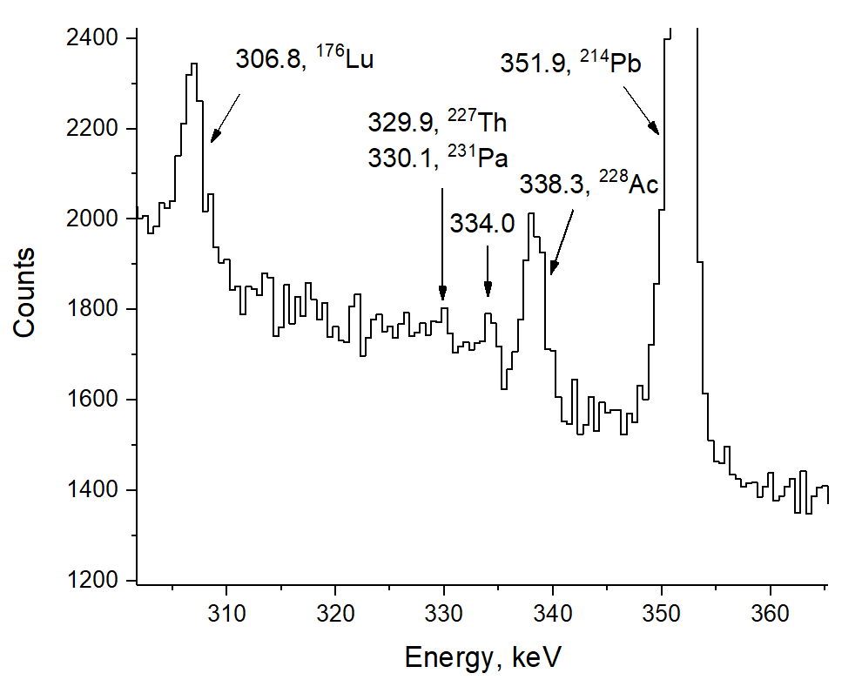
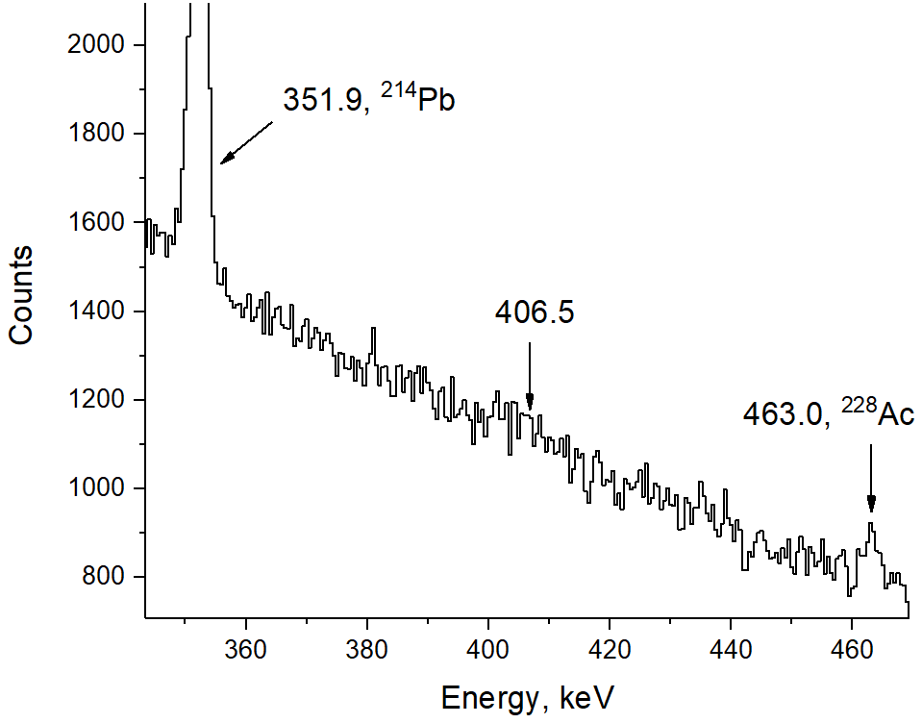
1-dimentional energy spectrum over 34174 h in the regions of interest
334.0
406.5
334.0 keV and 406.5 keV γ quanta in cascade, expected
in the decay ¹⁵⁰Nd → ¹⁵⁰Sm (0₁⁺)

Slide 10
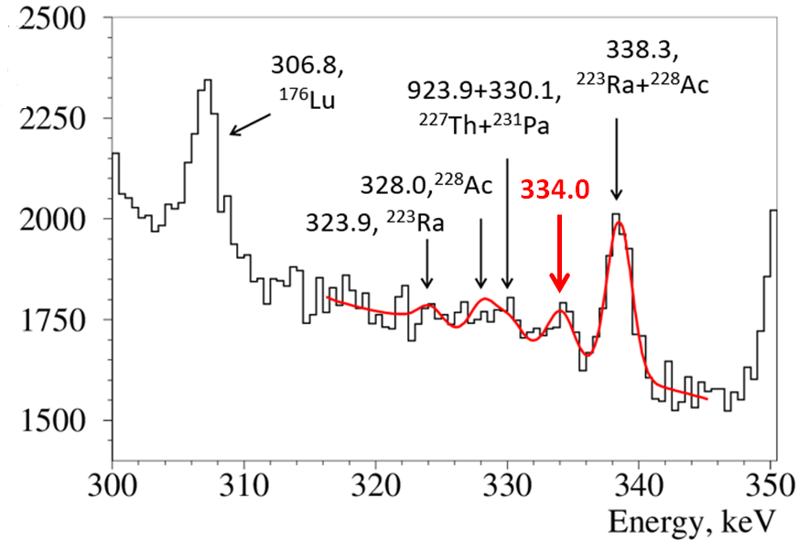
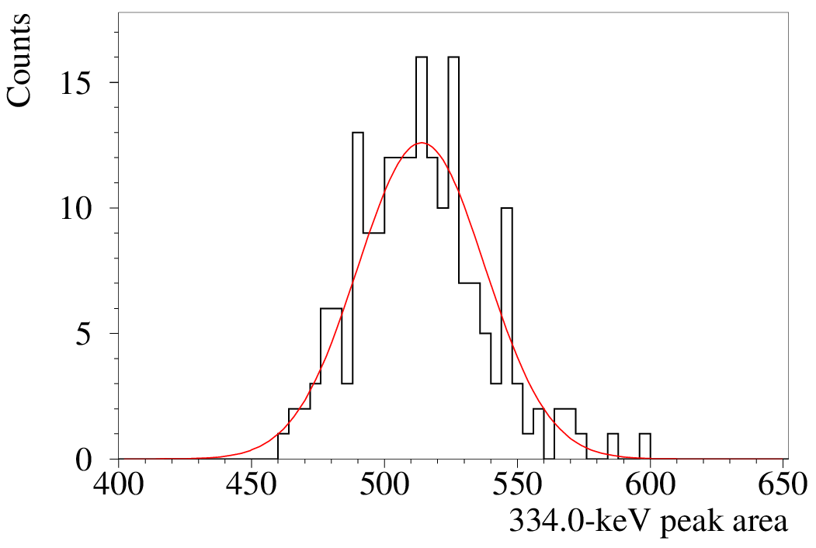

Analysis of the 1-dimensional spectrum (334.0 keV)
Left: [312…322] keV
Right: [342…346] keV
Step: 0.5 keV
Counts/0.5 keV
Number of fits
334.0
FWHM =
58 counts
Frequency distribution of S₃₃₄ with different fit intervals
$S_{334}={492±110(stat)}_{−237}^{+60}(syst)$counts
$T_{1/2}^{334}=\left[{5.7}_{−1.1}^{+1.6}{\left(stat\right)}_{−0.7}^{+5.3}(syst)\right]∙{10}^{19}$y

Slide 11
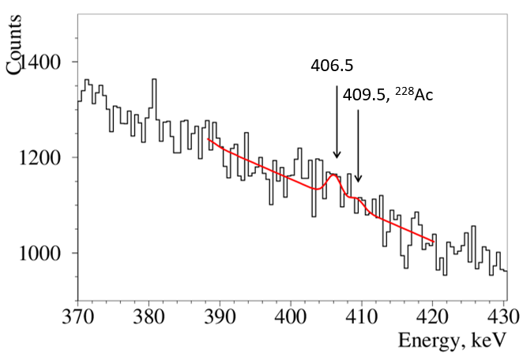
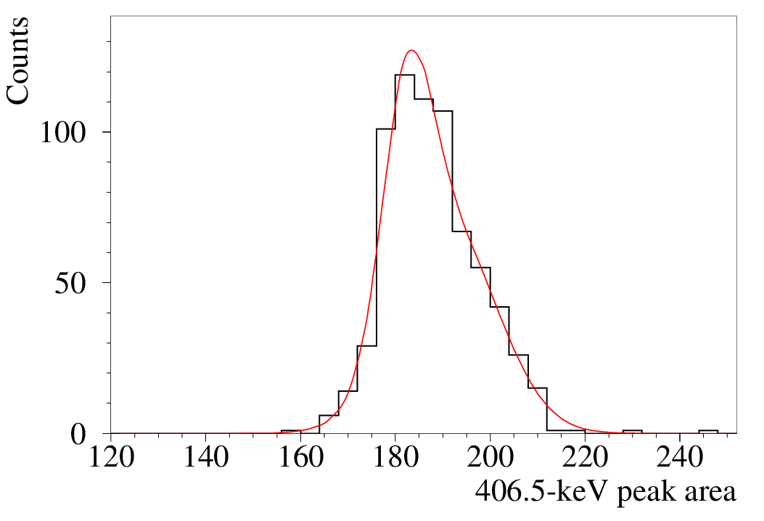

Analysis of the 1-dimensional spectrum (406.5 keV)
Left: [382…390] keV
Right: [420…440] keV
Step: 0.5 keV
Counts/0.5 keV
406.5
Number of fits
FWHM =
28 counts
Frequency distribution of S₄₀₆ with different fit intervals
$S_{406}=203±93(stat)±25(syst)$counts
$T_{1/2}^{406}=\left[{15.1}_{−4.8}^{+12.8}{\left(stat\right)}_{−1.7}^{+2.2}(syst)\right]∙{10}^{19}$y

Slide 12
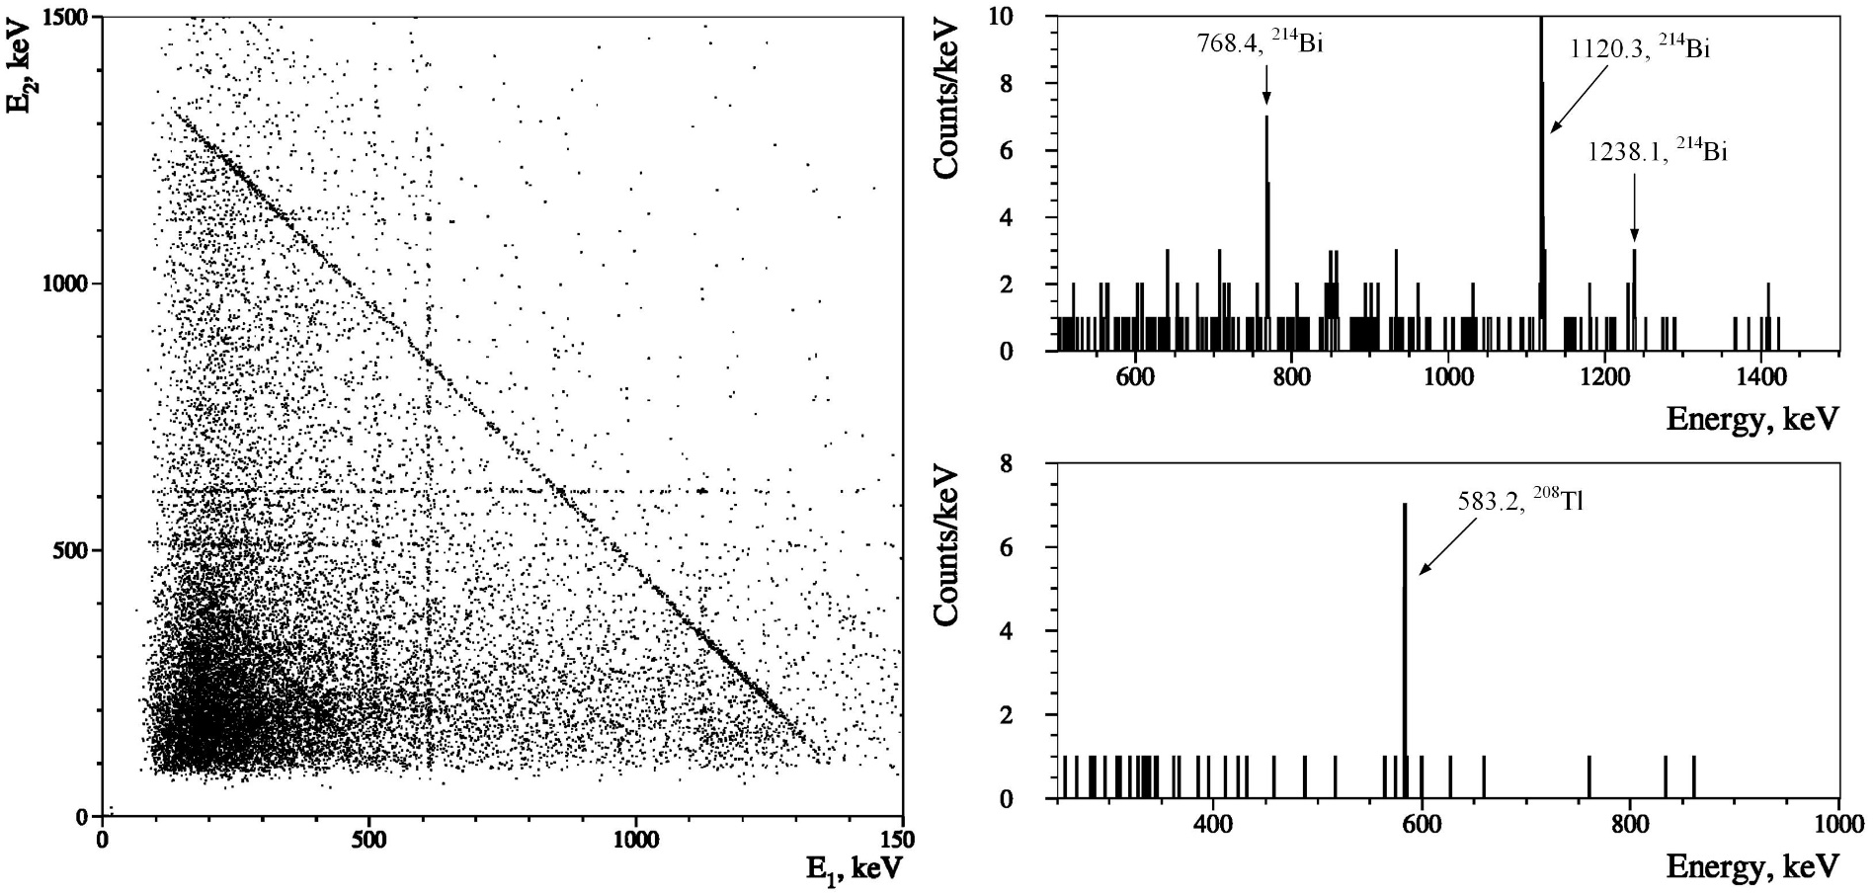
Coincidence spectrum over 34174 h
511 609
⁴⁰K (E1+E2 = 1460.8 keV)
²¹⁴Bi (609 keV)
511 609
The two-dimensional energy spectrum of coincidences allows us to observe
γ quanta emitted in the cascade (left diagram);
The spectrum when the energy in one detector is fixed as (609 ± 5) keV (²¹⁴Bi, top right).
The energy of one detector is fixed as (2615 ± 5) keV (²⁰⁸Tl, bottom right).

Slide 13
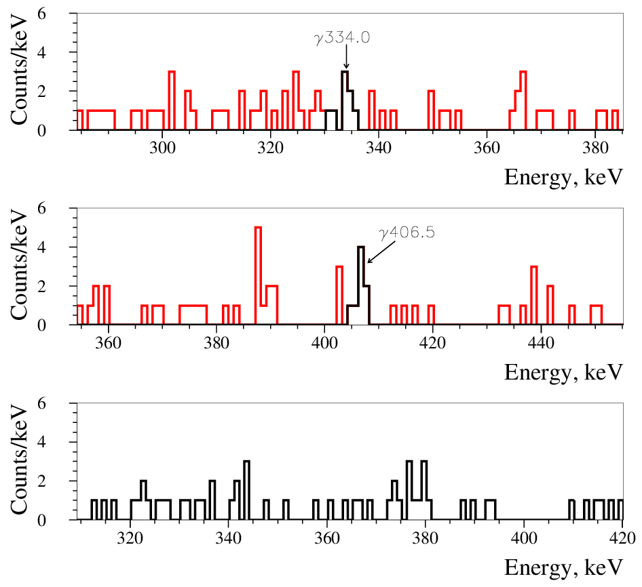
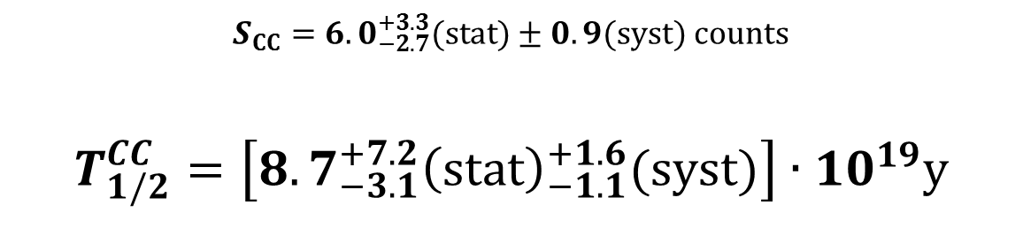
Analysis of coincidence spectra
γ 334.0
The energy in one detector is fixed to the energy interval where γ quanta from the ¹⁵⁰Nd → ¹⁵⁰Sm (0⁺, 740.5 keV) decay are expected:
406.5 keV ± 1.4×FWHM
334.0 keV ± 1.4×FWHM
γ 406.5
A random coincidence background when energy of events in one of the detectors was taken as
375 keV ± 1.4×FWHM
$S_{CC}={6.0}_{−2.7}^{+3.3}(stat)±0.9(syst)$ counts
$T_{1/2}^{CC}=\left[{8.7}_{−3.1}^{+7.2}{\left(stat\right)}_{−1.1}^{+1.6}(syst)\right]∙{10}^{19}$y

Slide 14
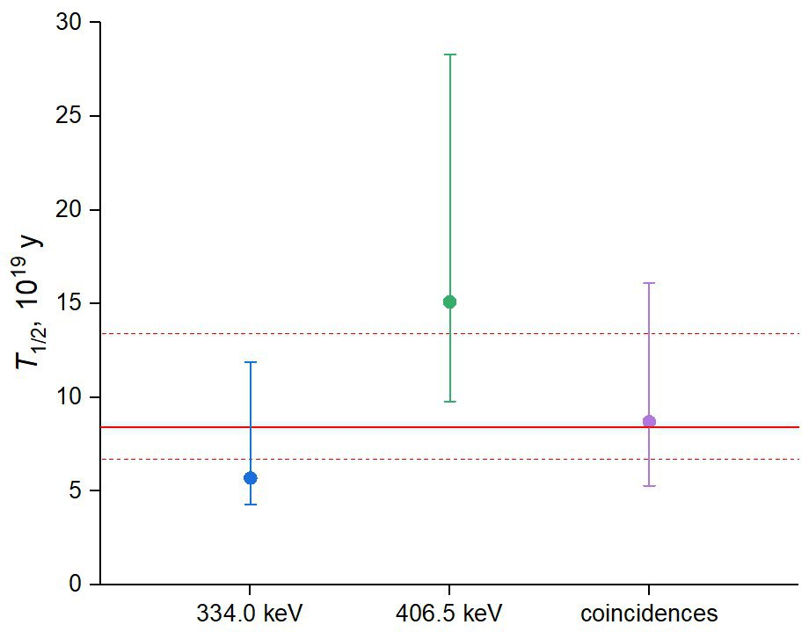





The half-life of ¹⁵⁰Nd relative to the 2ν2β decay to the first excited 0⁺ level of ¹⁵⁰Sm
$$T_{1/2}=\frac{ln2∙N∙t∙\sum{ε_{i}}}{\sum{S_{i}}}$$
$$\sum{S_{i}}=726±150(stat){}_{−249}^{+69}{(syst)}$$
$${[15.1}_{−4.8}^{+12.8}{\left(stat\right)}_{−1.7}^{+2.2}(syst)]$$
S’_{334,406} = S_{334,406}*(1+α_{334,406})
S’_{cc} = S_{cc}*(1+α₃₃₄)*(1+α₄₀₆)
Combined T_{1/2}
(334.0, 406.5 keV and CC)
$$\left[8.4{}_{−1.4}^{+2.2}{\left(stat\right)}{}_{−0.8}^{+4.4}{\left(syst\right)}\right]$$
$$\left[{5.7}_{−1.1}^{+1.6}{\left(stat\right)}_{−0.7}^{+5.3}(syst)\right]$$
$${[8.7}_{−3.1}^{+7.2}{\left(stat\right)}_{−1.1}^{+1.6}(syst)]$$

Slide 15
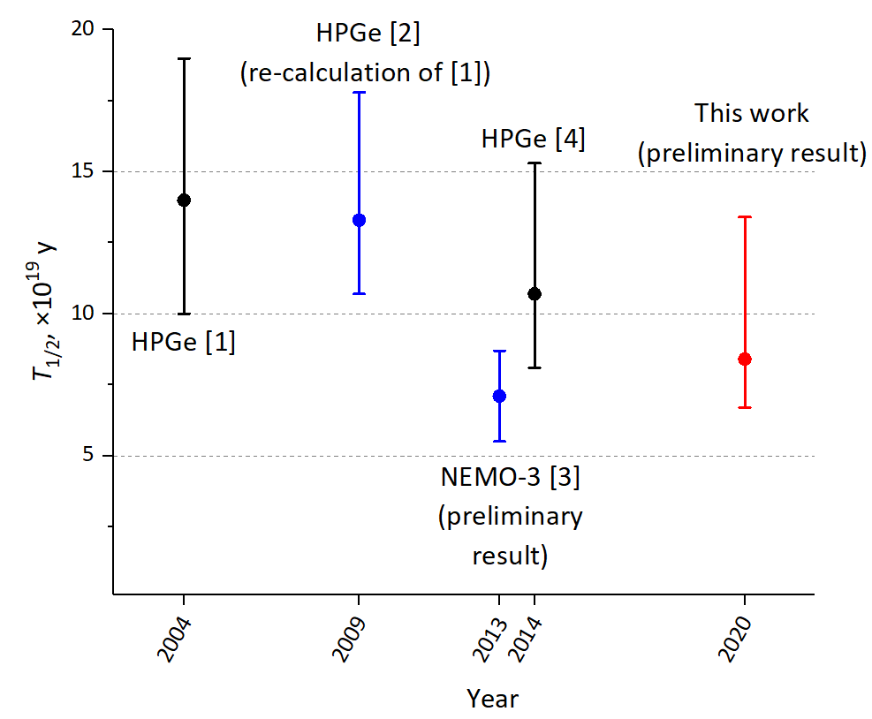
Comparison with other results
[1] A.S. Barabash et al., Phys. Atom. Nucl. 67 (2004) 1216. [2] A.S. Barabash et al., Phys. Rev. C 79 (2009) 045501.
[3] S. Blondel, PhD thesis, LAL, Orsay, France, LAL 13-154 (2013). [4] M.F. Kidd et al., Phys. Rev. C 90 (2014) 055501.

Slide 16
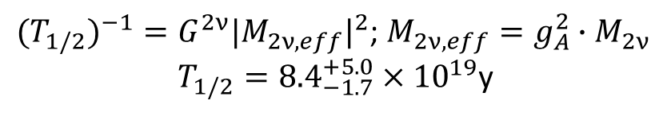
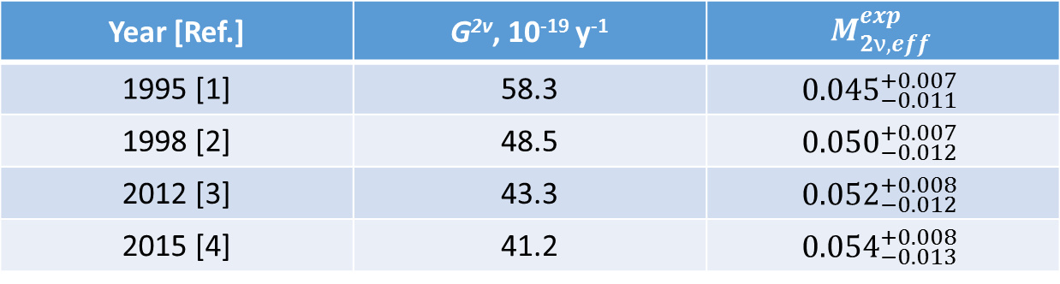

Matrix element of the decay
${{(T}_{1/2})}^{−1}=G^{2ν}{|M_{2ν, eff}|}^{2}$; $M_{2ν, eff}=g_{A}^{2}∙M_{2ν}$
$T_{1/2}={8.4}_{−1.7}^{+5.0}×{10}^{19}$y
Year [Ref.] | G^{2ν}, 10⁻¹⁹ y⁻¹ | $$M_{2ν,eff}^{exp}$$
1995 [1] | 58.3 | $${0.045}_{−0.011}^{+0.007}$$
1998 [2] | 48.5 | $${0.050}_{−0.012}^{+0.007}$$
2012 [3] | 43.3 | $${0.052}_{−0.012}^{+0.008}$$
2015 [4] | 41.2 | $${0.054}_{−0.013}^{+0.008}$$
0.269 [2] – s.p. estimations of double Gamov-Teller NME
0.019 [3,5] – microscopic interacting boson model (IBM-2, HSD)
$M_{2ν,eff}^{th.}$:
G_{A} = 1,27
[1] J.G. Hirsch et al., Nucl. Phys. A 589 (1995) 445.
[2] J. Suhonen, O. Civitarese, Phys. Rep. 300 (1998) 123.
[3] J. Kotila, F. Iachello, Phys. Rev. C 85 (2012) 034316.
[4] M. Mirea, T. Pahomi, S. Stoica, Rom. Rep. Phys. 67 (2015) 872.
[5] J. Barea, J. Kotila, F. Iachello, Phys. Rev. C 91 (2015) 034304.

Slide 17
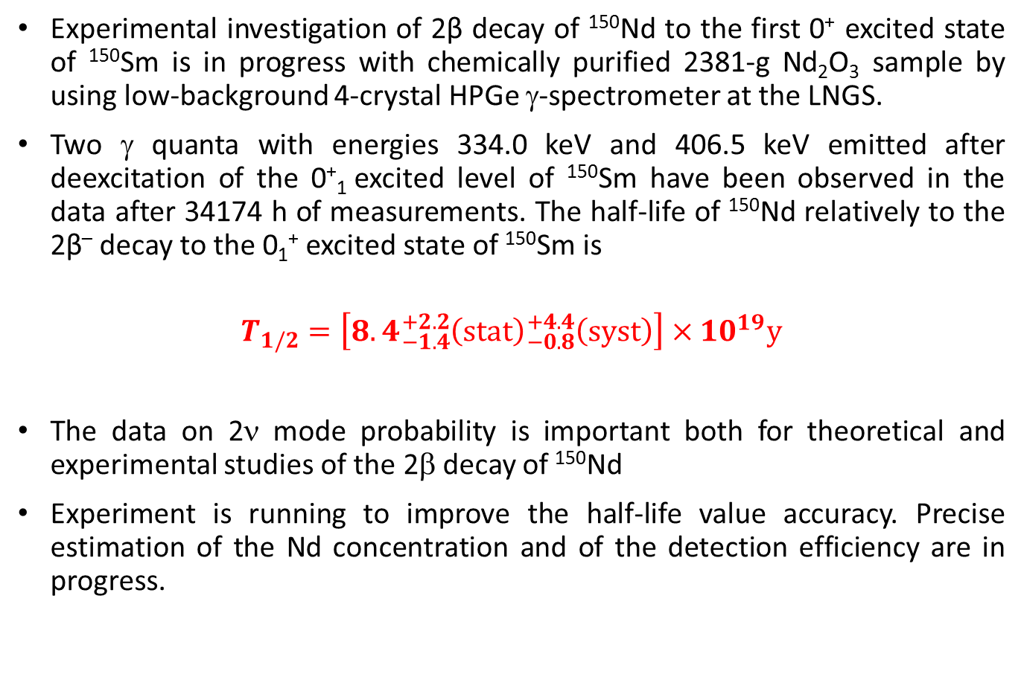
Conclusions
Experimental investigation of 2β decay of ¹⁵⁰Nd to the first 0⁺ excited state of ¹⁵⁰Sm is in progress with chemically purified 2381-g Nd₂O₃ sample by using low-background 4-crystal HPGe γ-spectrometer at the LNGS.
Two γ quanta with energies 334.0 keV and 406.5 keV emitted after deexcitation of the 0⁺₁ excited level of ¹⁵⁰Sm have been observed in the data after 34174 h of measurements. The half-life of ¹⁵⁰Nd relatively to the 2β– decay to the 0₁⁺ excited state of ¹⁵⁰Sm is
$$T_{1/2}=\left[8.4{}_{−1.4}^{+2.2}{\left(stat\right)}{}_{−0.8}^{+4.4}{\left(syst\right)}\right]×{10}^{19}y$$
The data on 2ν mode probability is important both for theoretical and experimental studies of the 2β decay of ¹⁵⁰Nd
Experiment is running to improve the half-life value accuracy. Precise estimation of the Nd concentration and of the detection efficiency are in progress.

