Slide 1




Stefano Profumo
University of California, Santa Cruz
Primordial
Black Hole
ICFNP, September 10, 2020
Notes:
Thanks for the opportunity and greetings from California

Slide 2
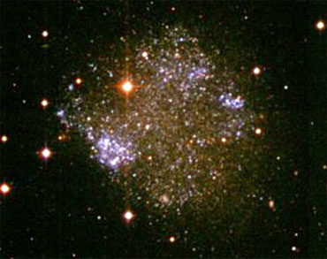
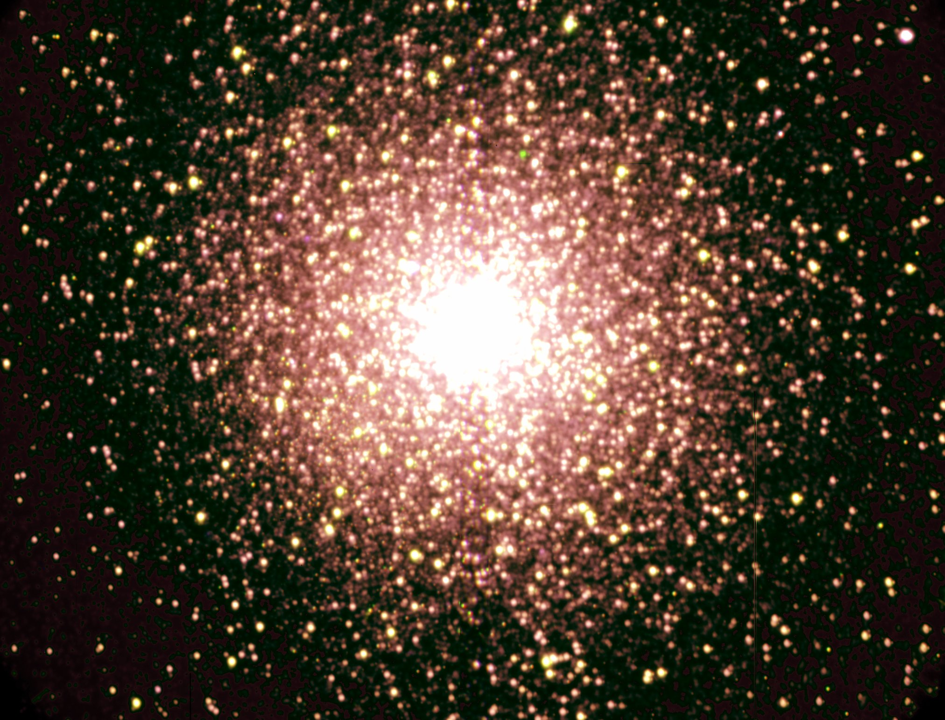
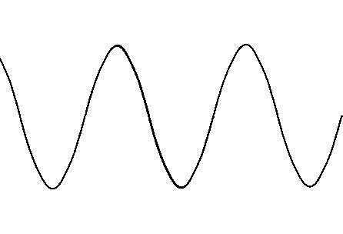
10⁻⁵³ g
10⁻⁴³ g
10⁻³³ g
10⁻²³ g
10⁻¹³ g
10⁻³ g
10⁷ g
10¹⁷ g
10²⁷ g
10³⁷ g
10⁻²⁰ eV
10⁻¹⁰ eV
10⁰ eV
10¹⁰ eV
10²⁰ eV
10³⁰ eV
10⁴⁰ eV
10⁵⁰ eV
10⁶⁰ eV
10⁷⁰ eV
Macroscopic
Quantum
Effects
Macroscopic
Tidal
Effects
Notes:
In a very model-independent way, the phase space of the mass of dark matter particles is bound from below…

Slide 3
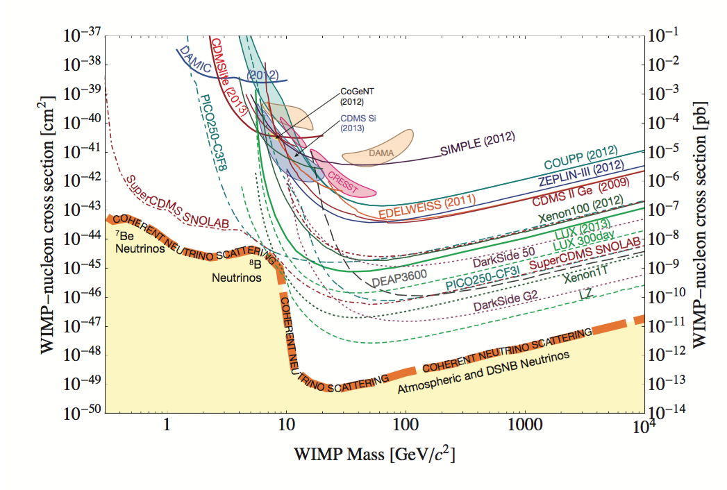
10⁻⁵³ g
10⁻⁴³ g
10⁻³³ g
10⁻²³ g
10⁻¹³ g
10⁻³ g
10⁷ g
10¹⁷ g
10²⁷ g
10³⁷ g
10⁻²⁰ eV
10⁻¹⁰ eV
10⁰ eV
10¹⁰ eV
10²⁰ eV
10³⁰ eV
10⁴⁰ eV
10⁵⁰ eV
10⁶⁰ eV
10⁷⁰ eV

Slide 4
10⁻⁵³ g
10⁻⁴³ g
10⁻³³ g
10⁻²³ g
10⁻¹³ g
10⁻³ g
10⁷ g
10¹⁷ g
10²⁷ g
10³⁷ g
10⁻²⁰ eV
10⁻¹⁰ eV
10⁰ eV
10¹⁰ eV
10²⁰ eV
10³⁰ eV
10⁴⁰ eV
10⁵⁰ eV
10⁶⁰ eV
10⁷⁰ eV

Slide 5
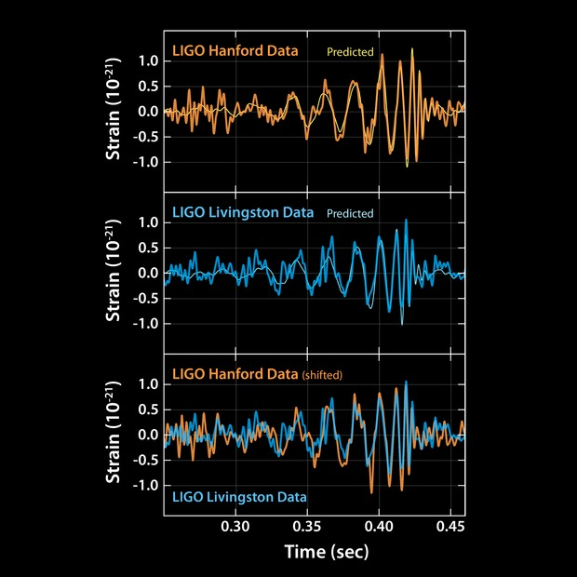
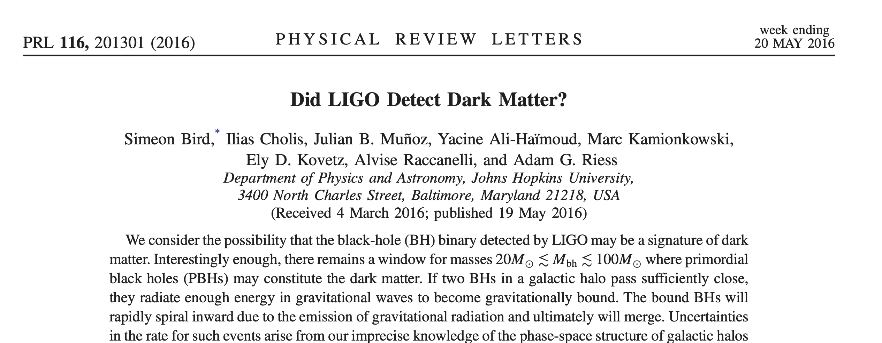

Slide 6
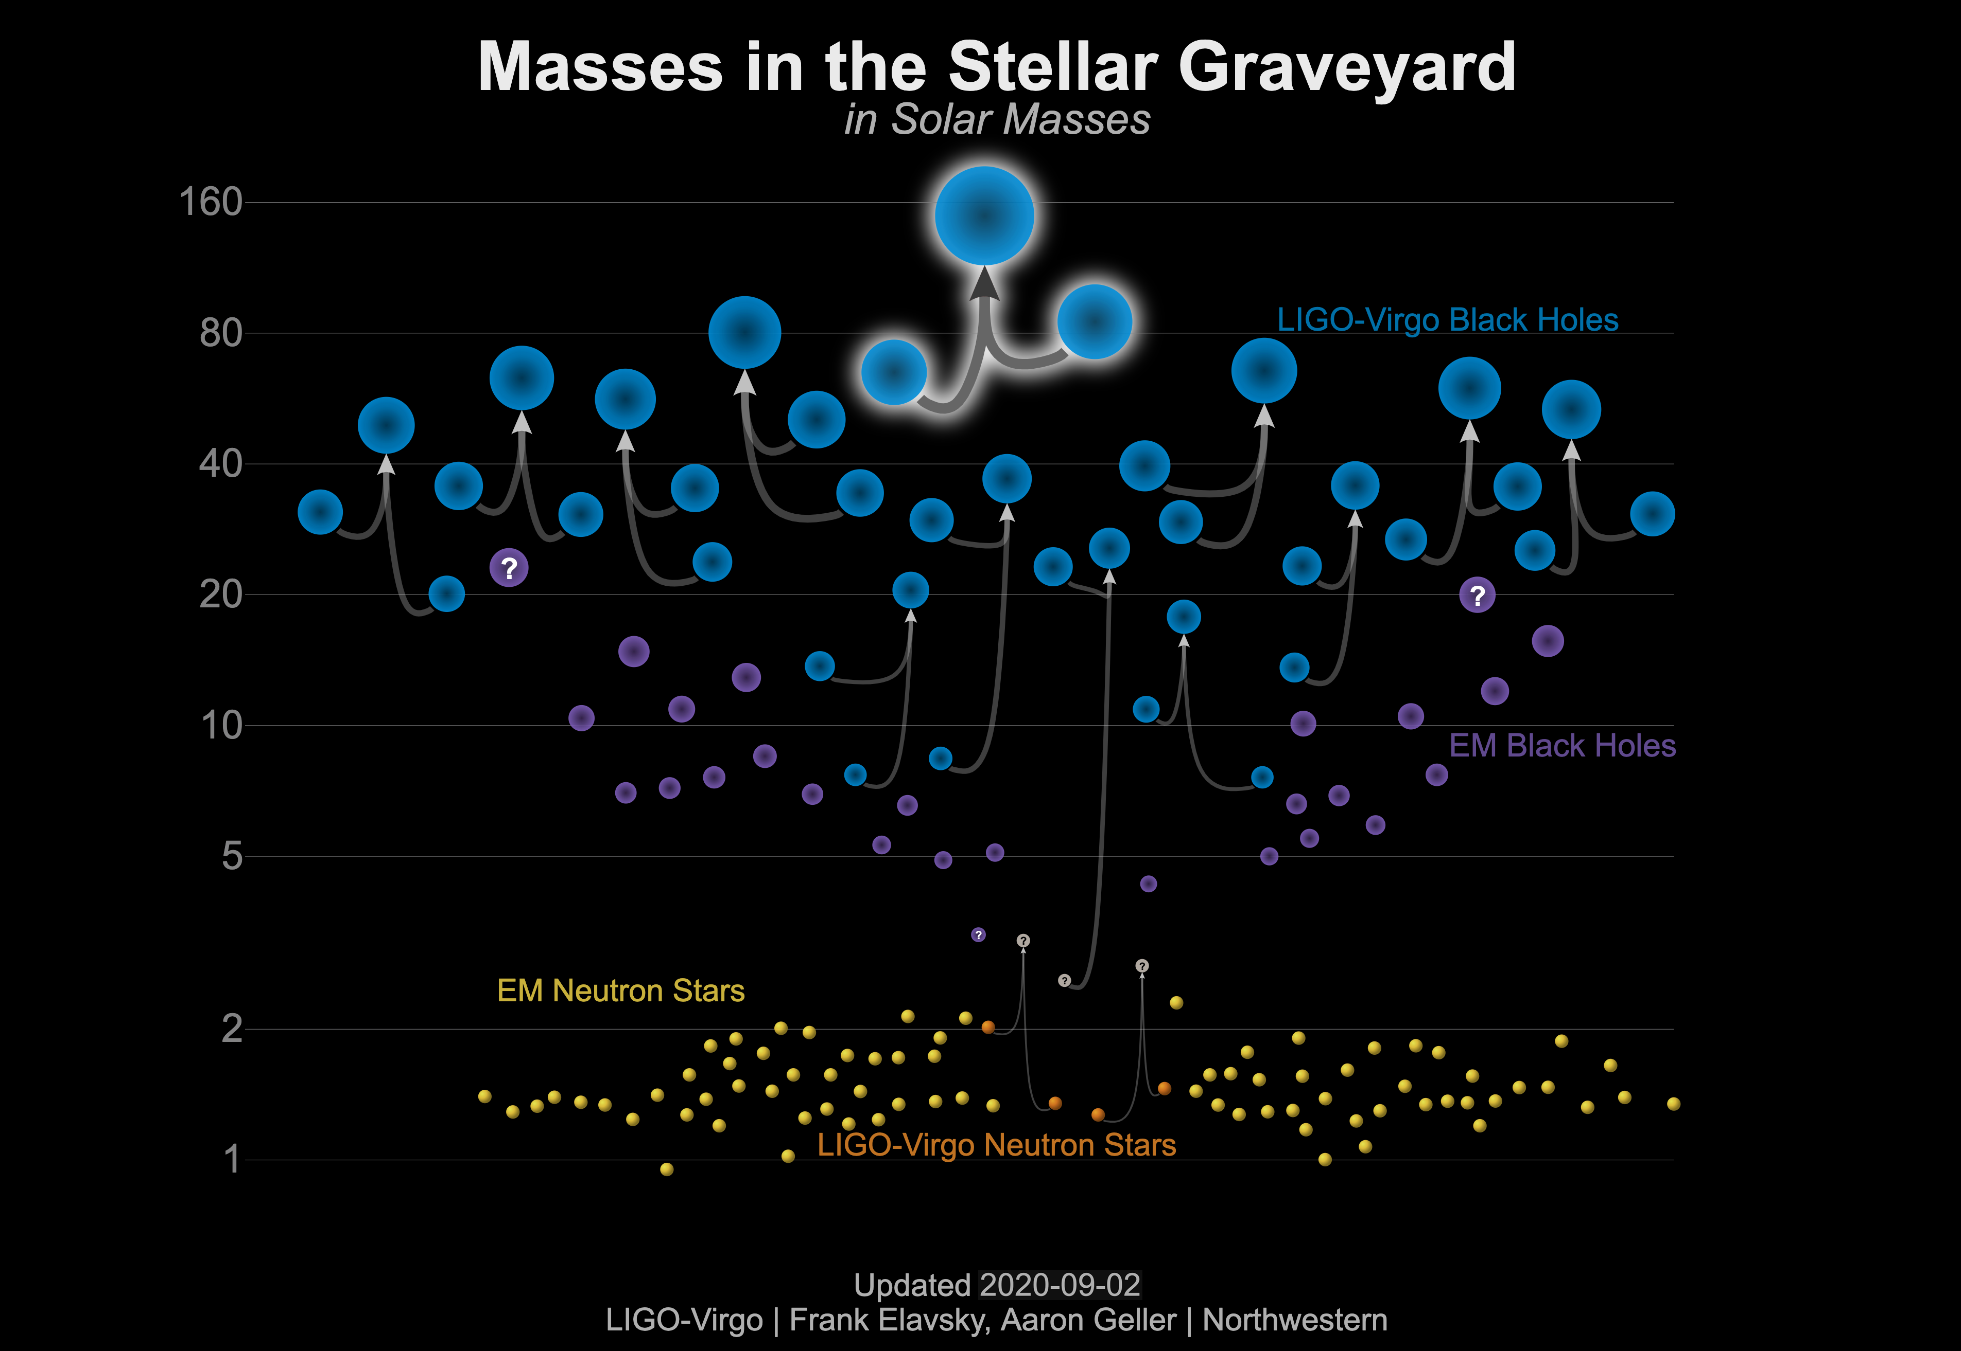

Slide 7
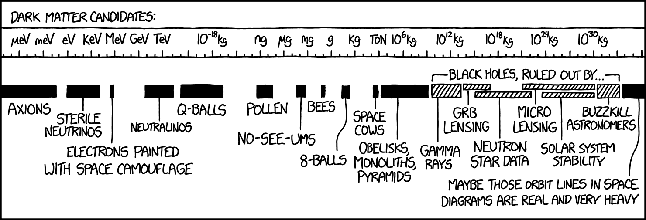
Why it is interesting to consider PBH as Dark Matter
Where it is interesting to look for PBH as Dark Matter
…some “NO-SEE-UMS” AND “SPACE COWS”
source: xkcd
Notes:
In this talk I will, for once, show the authoritative xkcd to be wrong,…

Slide 8
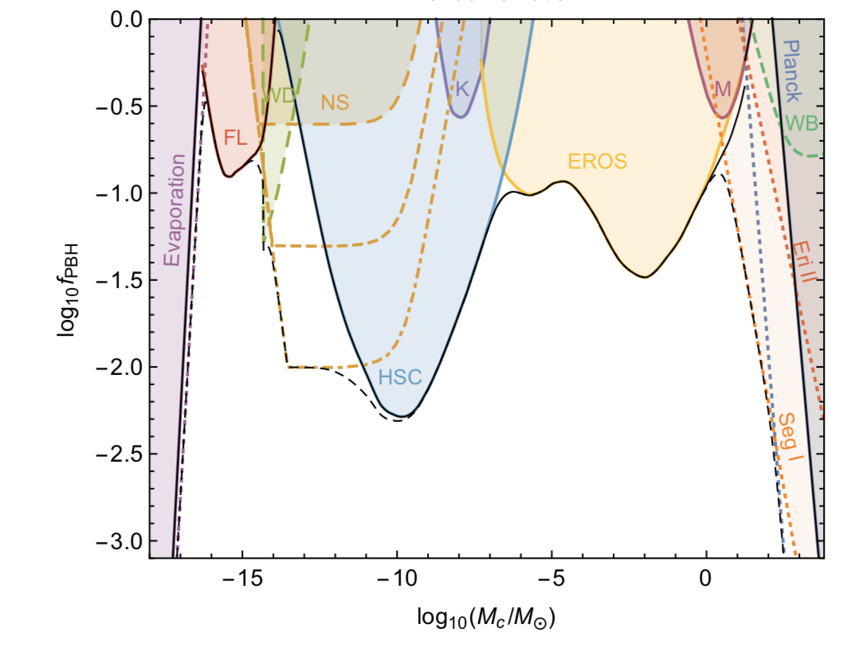
First question: Can there be enough PBH around to be the DM?
What is the maximal fraction of dark matter in PBH?
THIS PLOT
IS WRONG
Carr et al, 2017

Slide 9
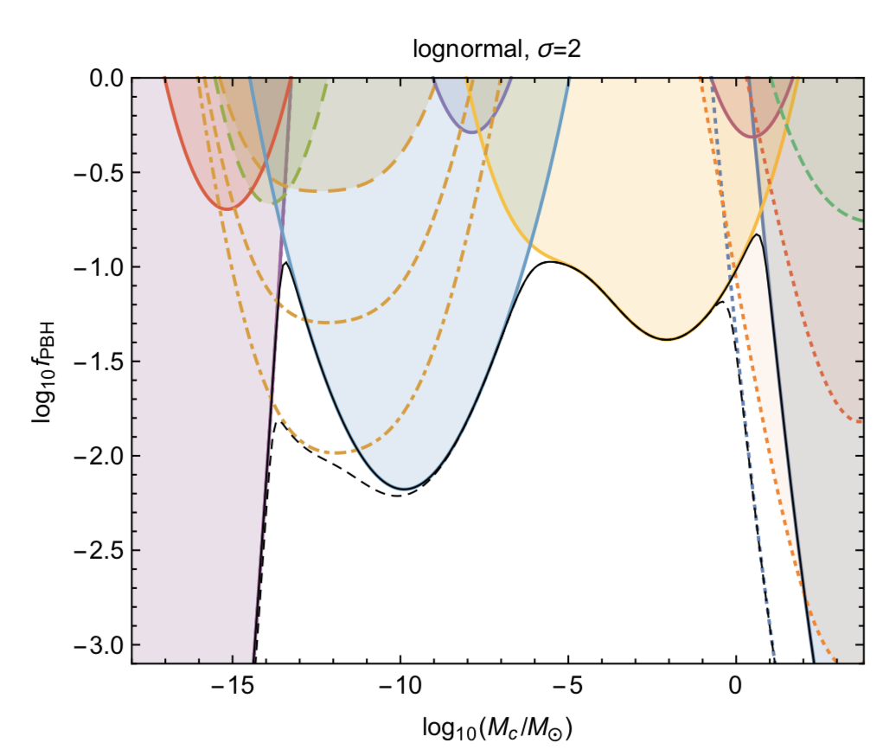
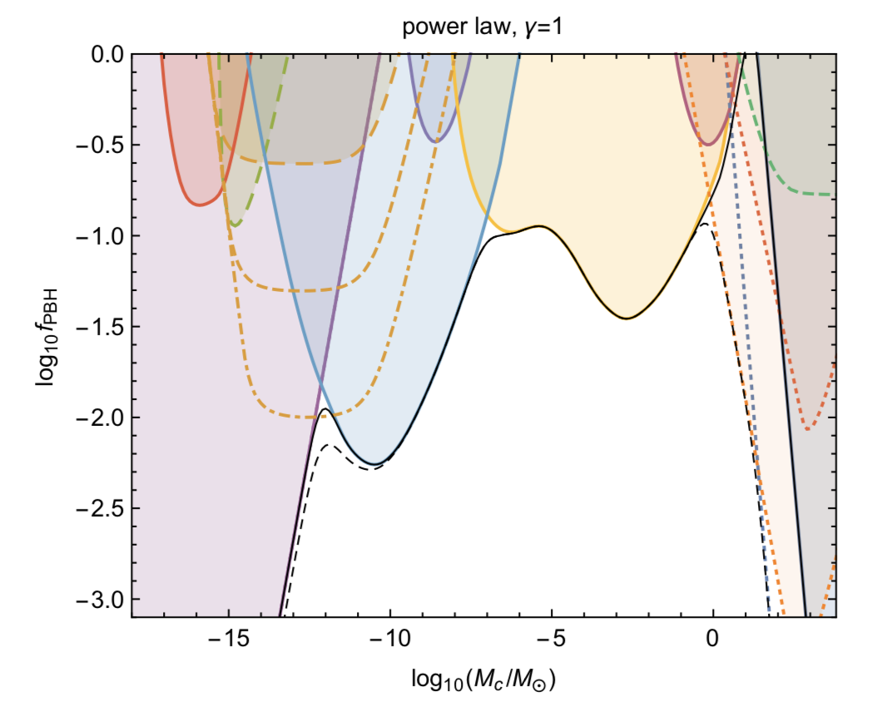
The fraction of PBH that could be the dark matter depends on the mass function!
…what is the mathematical function that maximizes the mass fraction of primordial black holes compatibly with constraints?
Carr et al, 2017

Slide 10
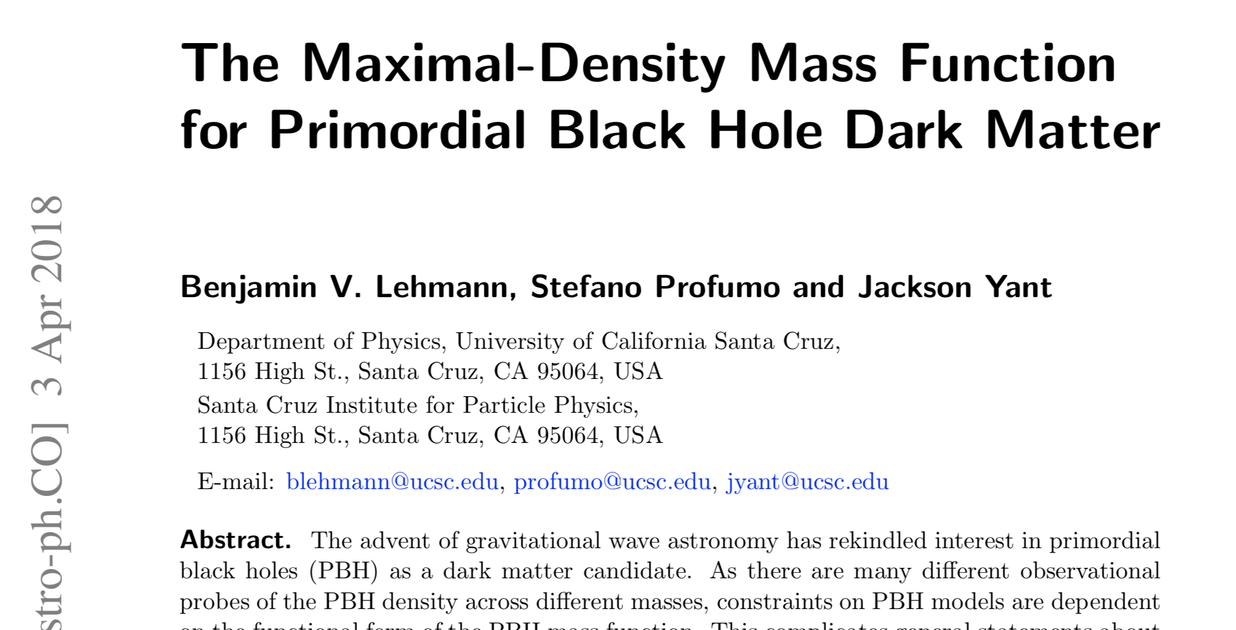

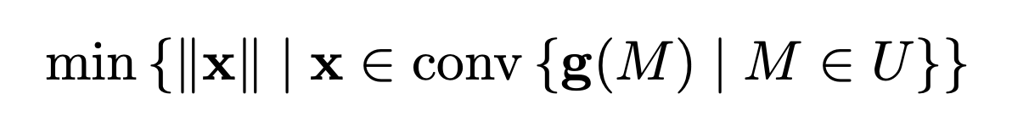
Answer: with N independent constraints, the optimal function is a linear combination of N delta functions
with calculable relative weights
* Lehmann, Profumo and Yant, JCAP 2018

Slide 11
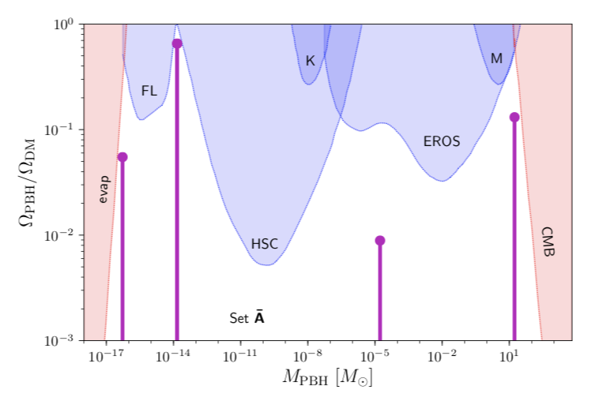
Answer: with N independent constraints, the optimal function is a linear combination of N delta functions
with calculable relative weights
* Lehmann, Profumo and Yant, JCAP 2018

Slide 12
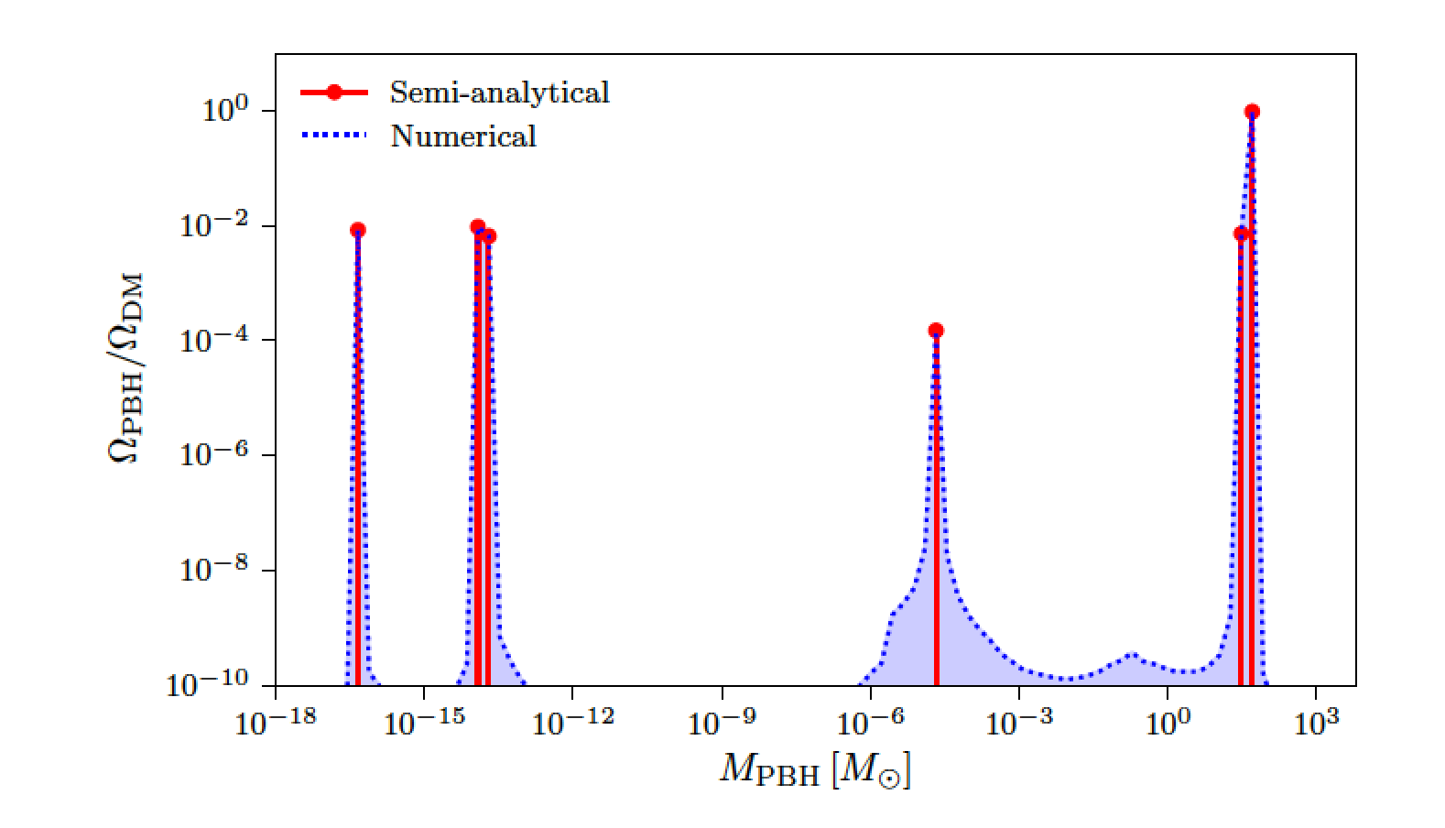

Numerical validation
* Lehmann, Profumo and Yant, JCAP 2018

Slide 13
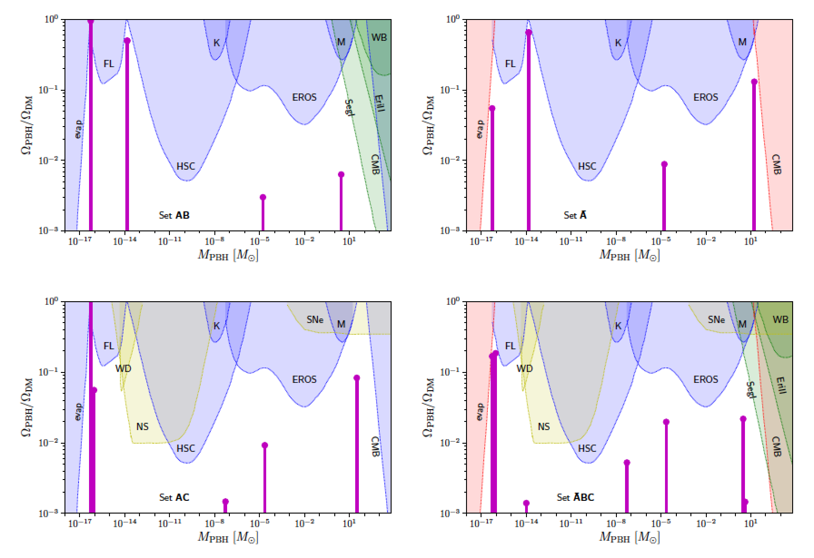
* Lehmann, Profumo and Yant, JCAP 2018

Slide 14
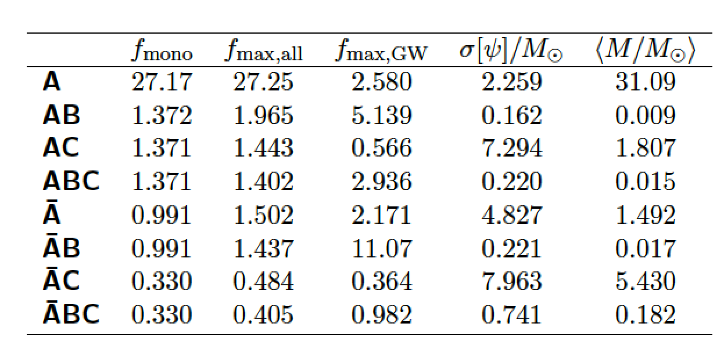
So YES, depending on the constraints choice,
PBH can be 100% of the dark matter!
* Lehmann, Profumo and Yant, JCAP 2018

Slide 15
Is there a goldilocks signature of PBH?
Yes! BH merger with a sub-Chandrasekhar mass (1.4 M_{sun})
LIGO search results are out*

Slide 16
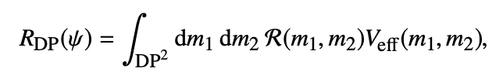
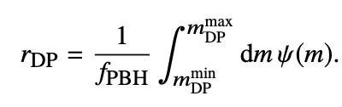
Is there a goldilocks signature of PBH?
Yes! BH merger with a sub-Chandrasekhar mass (1.4 M_{sun})
Given a mass function, one can calculate:
Rate of “goldilocks events”
Mass fraction of light+detectable BHs

Slide 17
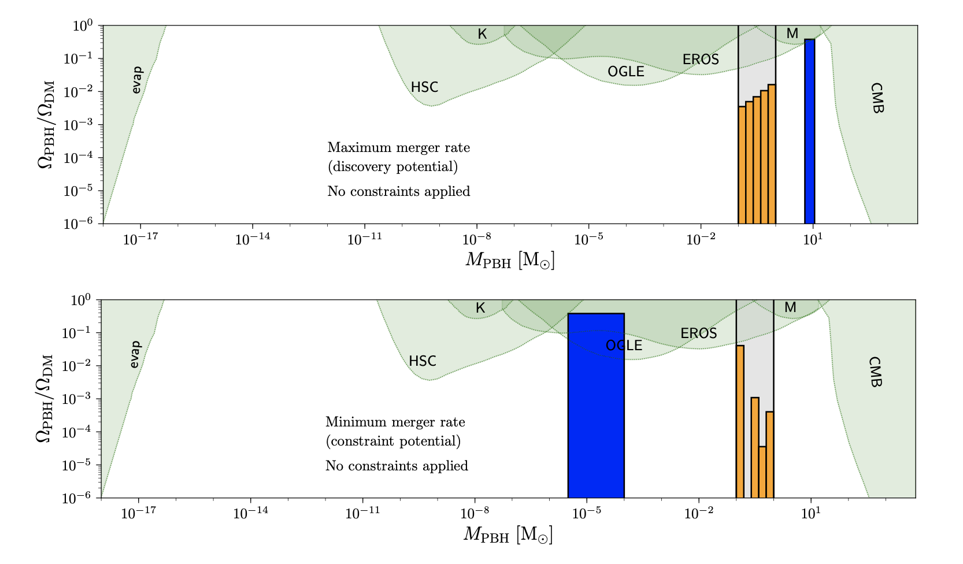
We can numerically compute the maximal and minimal possible “goldilocks event rate”
* Lehmann, Profumo and Yant, MNRAS

Slide 18
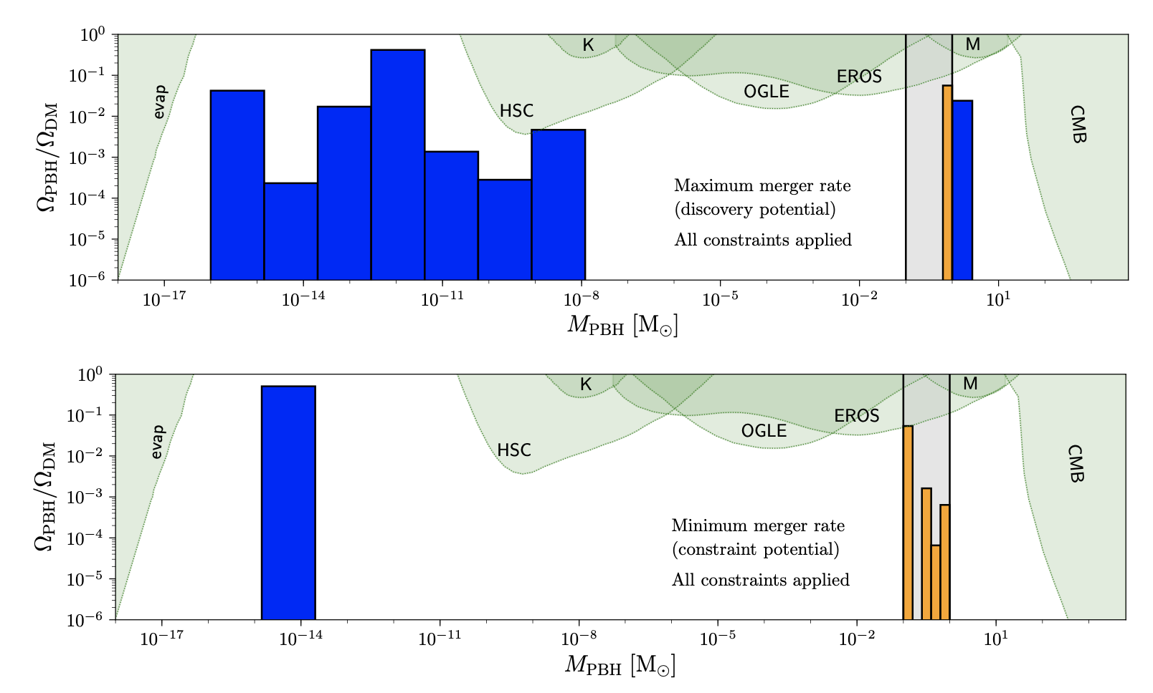
We can numerically compute the maximal and minimal possible “goldilocks event rate”
* Lehmann, Profumo and Yant, MNRAS

Slide 19
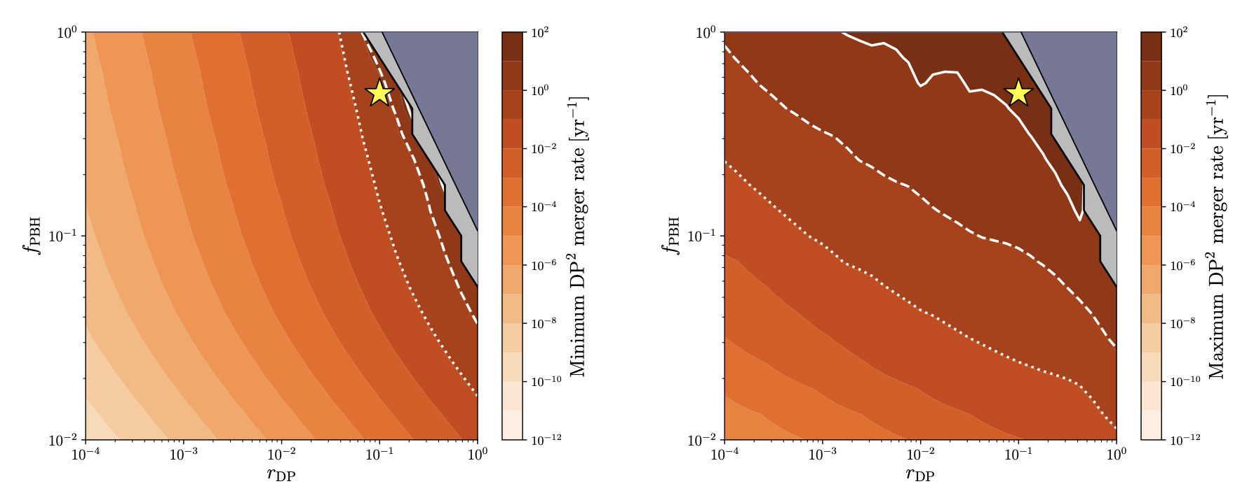
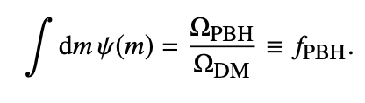
We can numerically compute the maximal and minimal possible “goldilocks event rate”
10 yr⁻¹
1 yr⁻¹
0.1 yr⁻¹
* Lehmann, Profumo and Yant, MNRAS

Slide 20
Besides the mass, LIGO informs us about the spin of BHs…

Slide 21
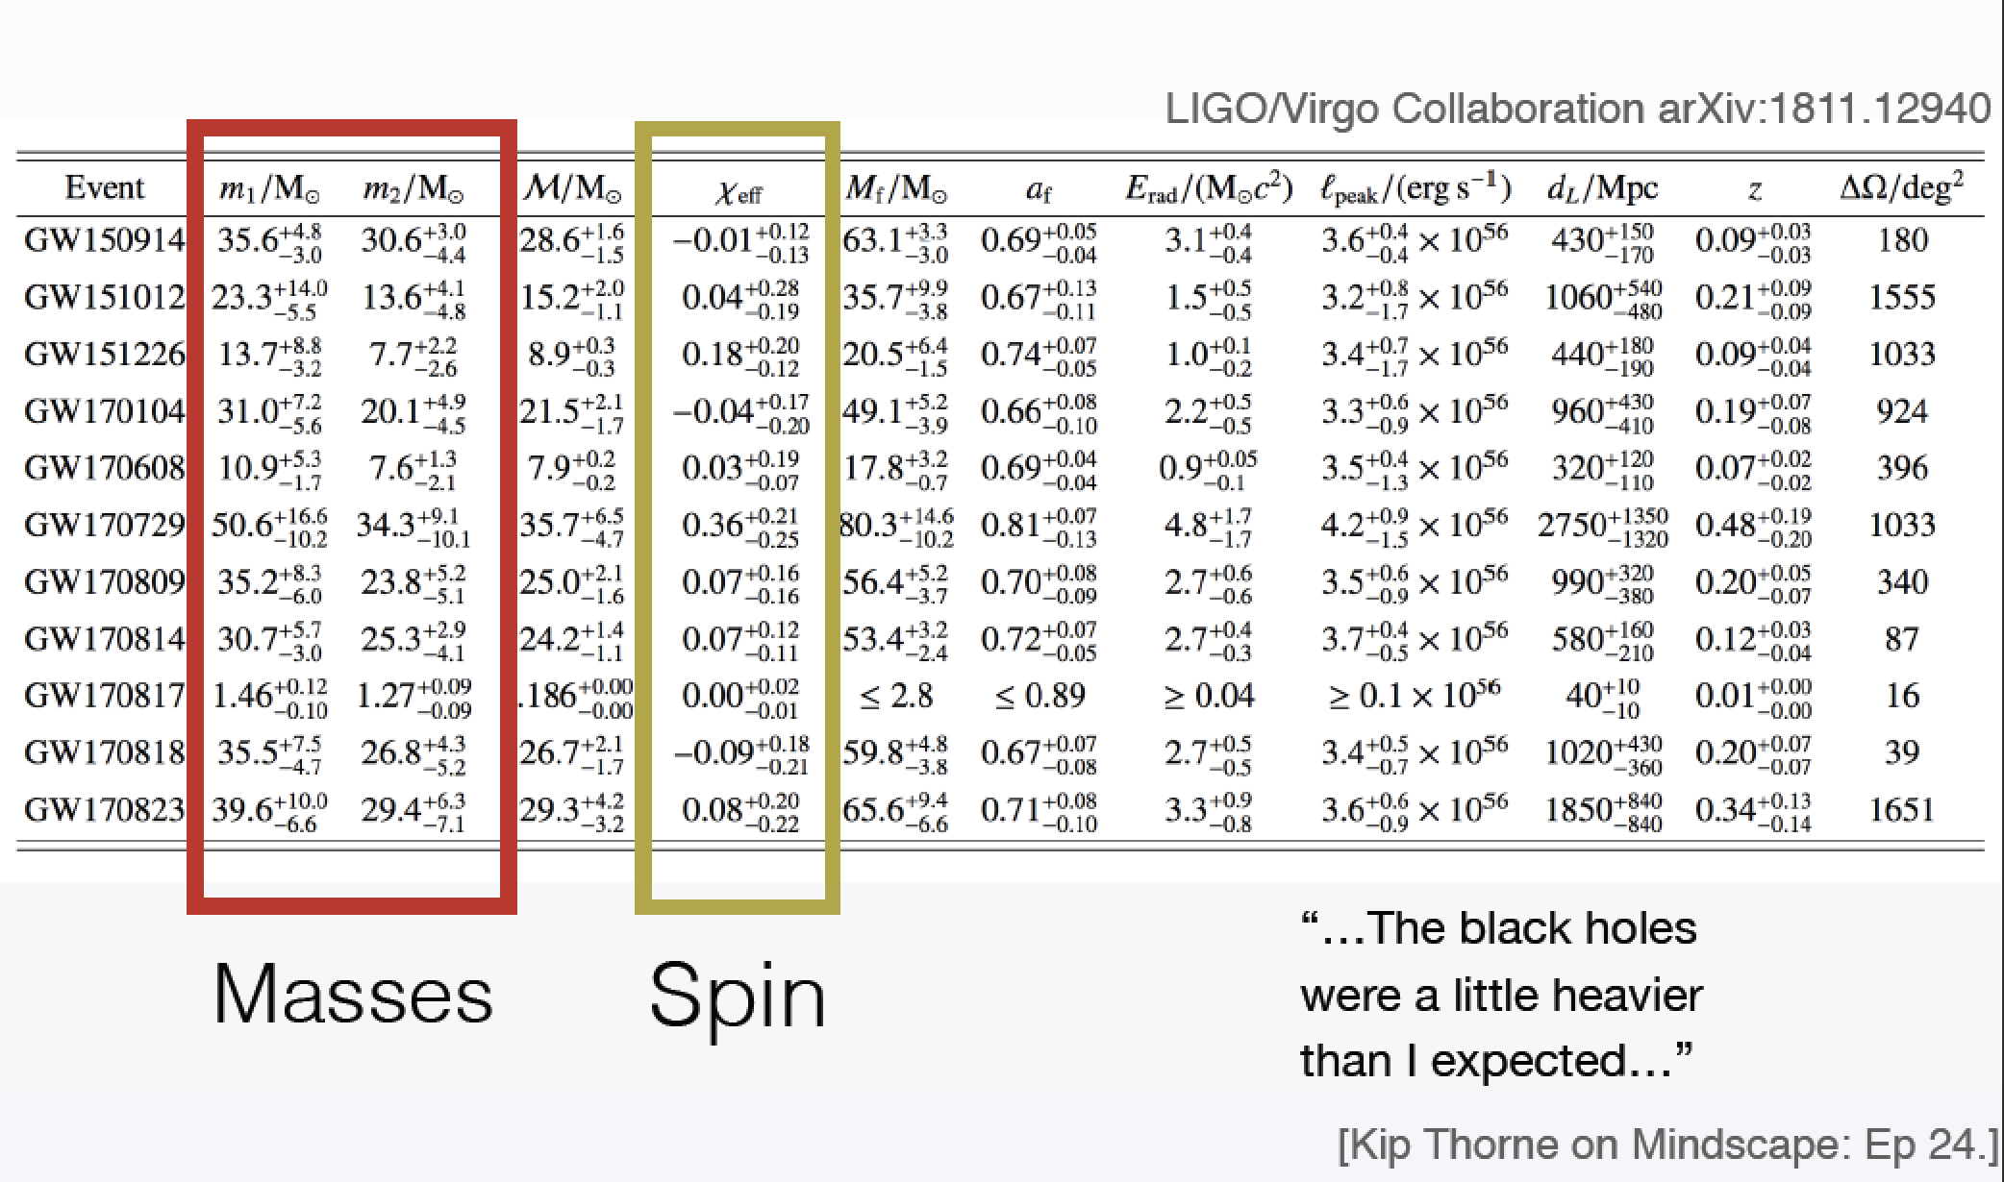

Besides the mass, LIGO informs us about the spin of BHs…
Slide credit: Nico Fernandez (UCSC → UIUC)

Slide 22
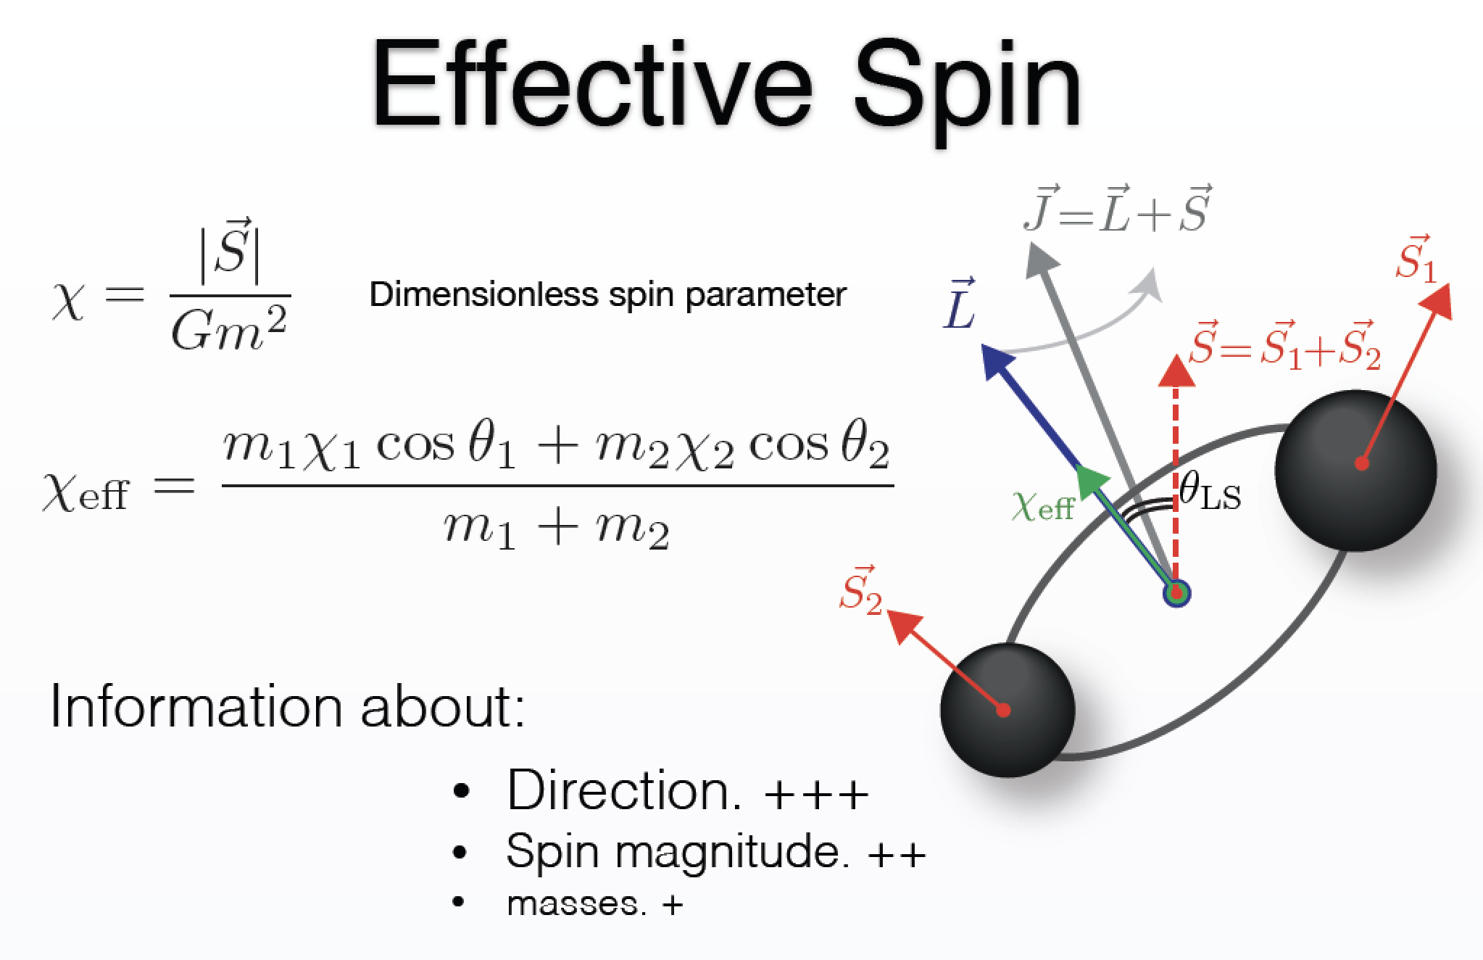
Slide credit: Nico Fernandez (UCSC → UIUC)

Slide 23
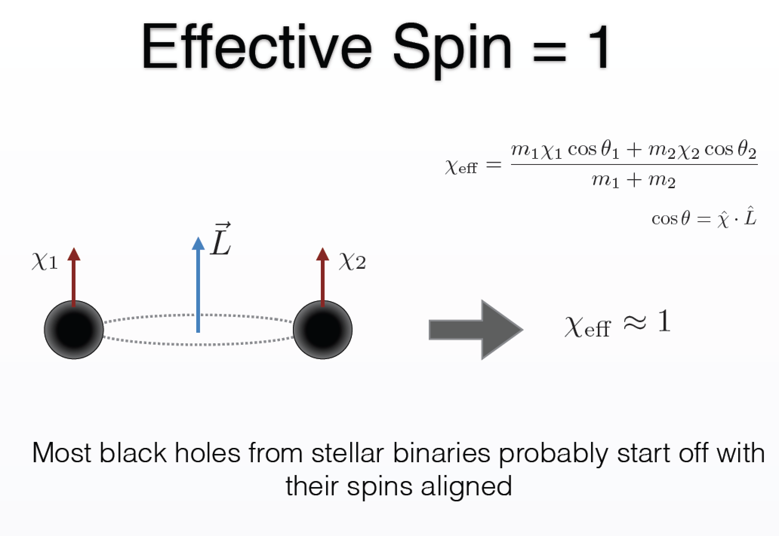
Slide credit: Nico Fernandez (UCSC → UIUC)

Slide 24
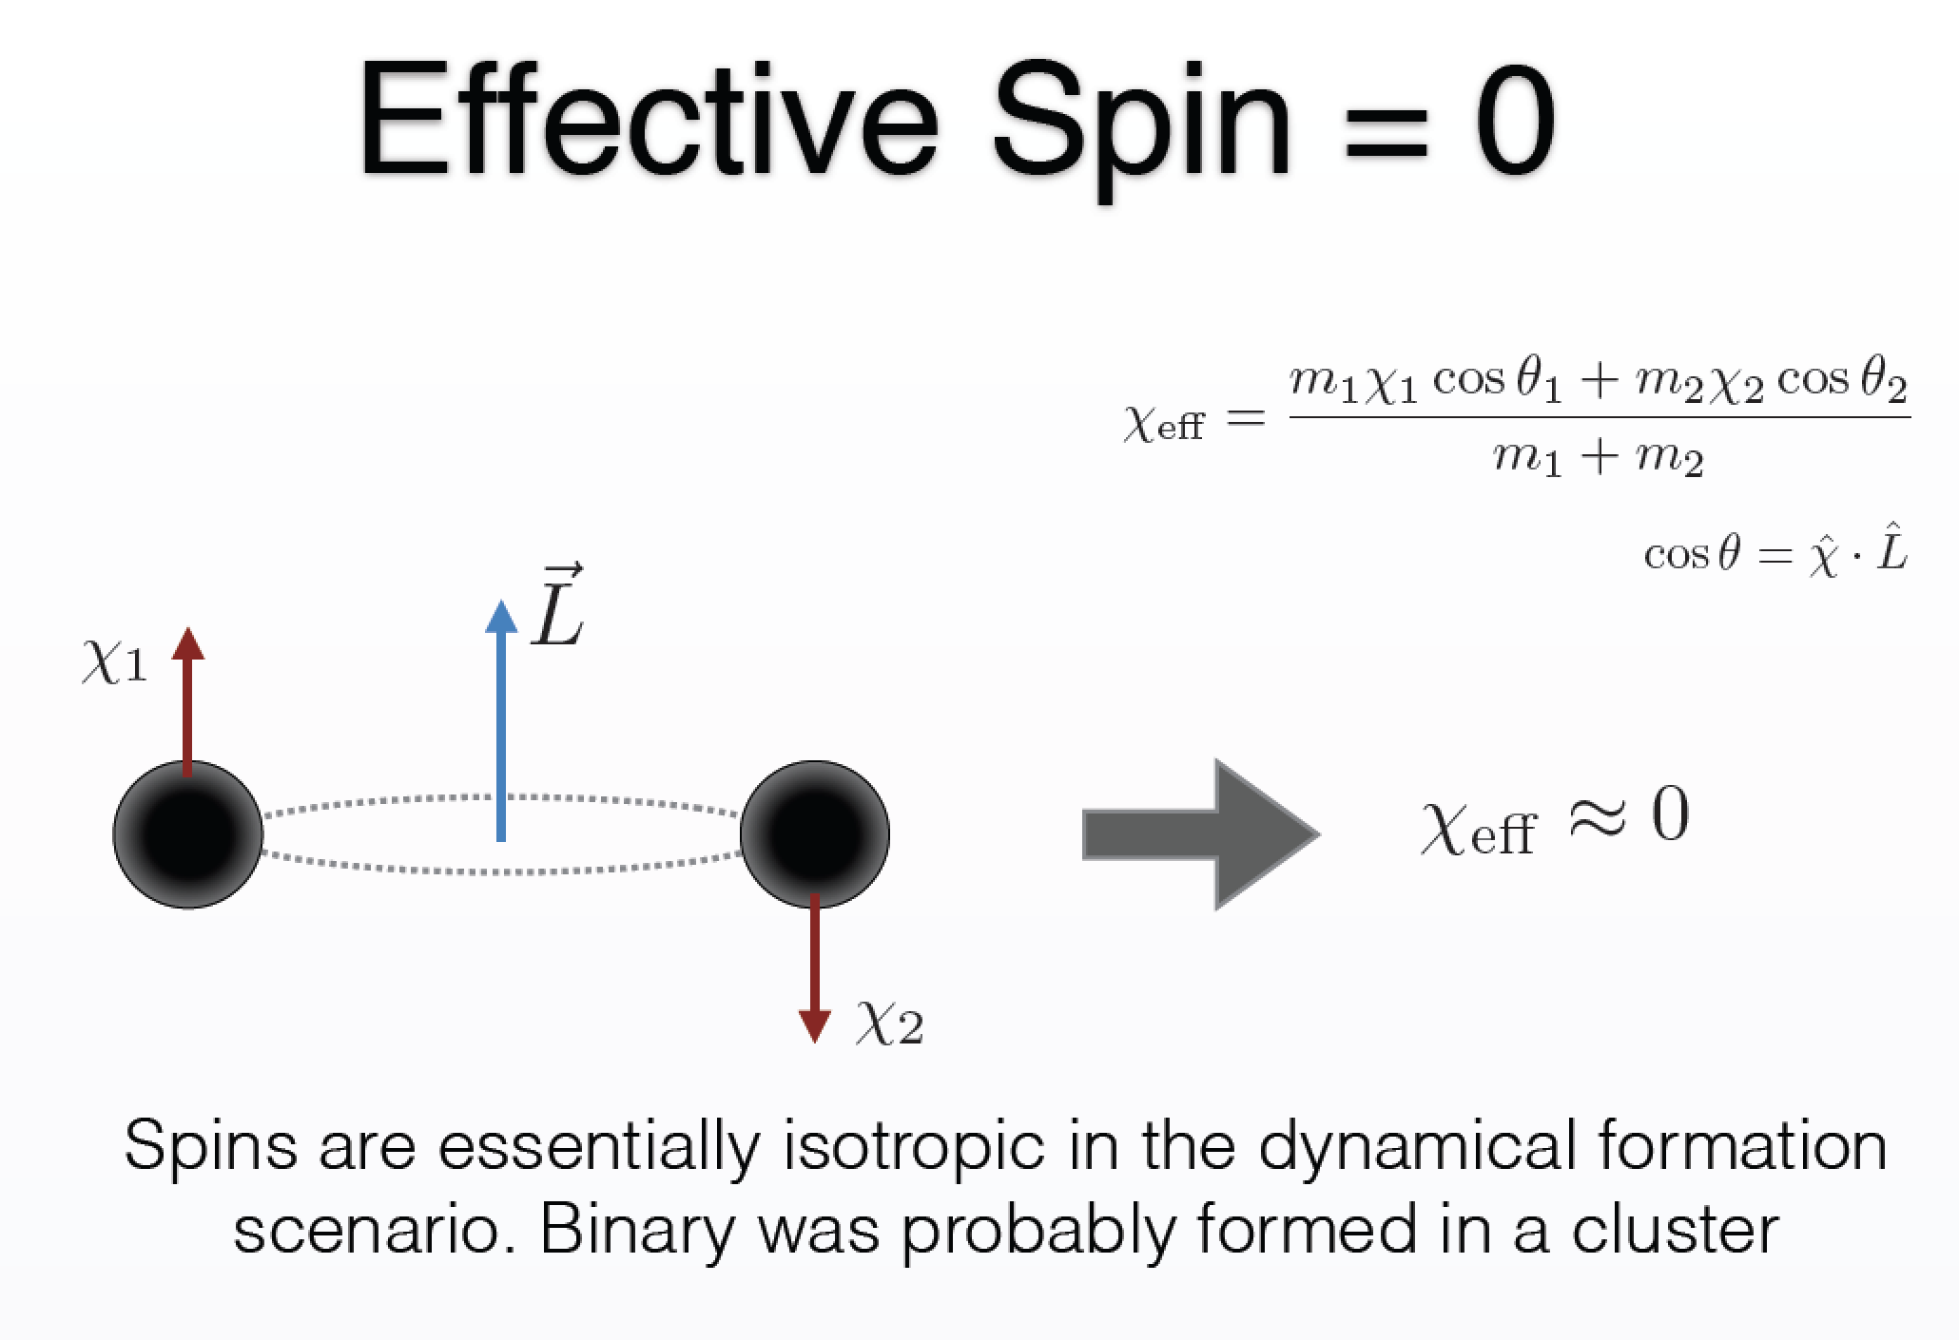
Slide credit: Nico Fernandez (UCSC → UIUC)

Slide 25
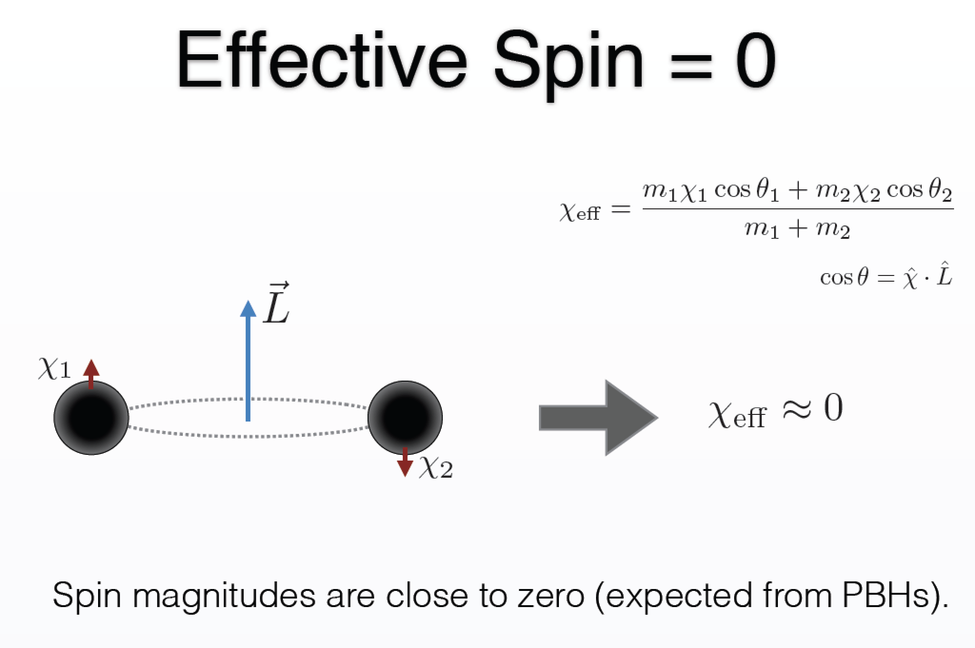
Slide credit: Nico Fernandez (UCSC → UIUC)

Slide 26
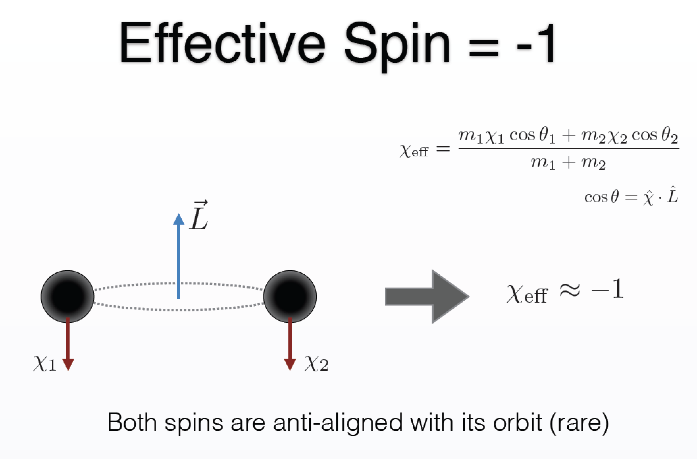
Slide credit: Nico Fernandez (UCSC → UIUC)

Slide 27
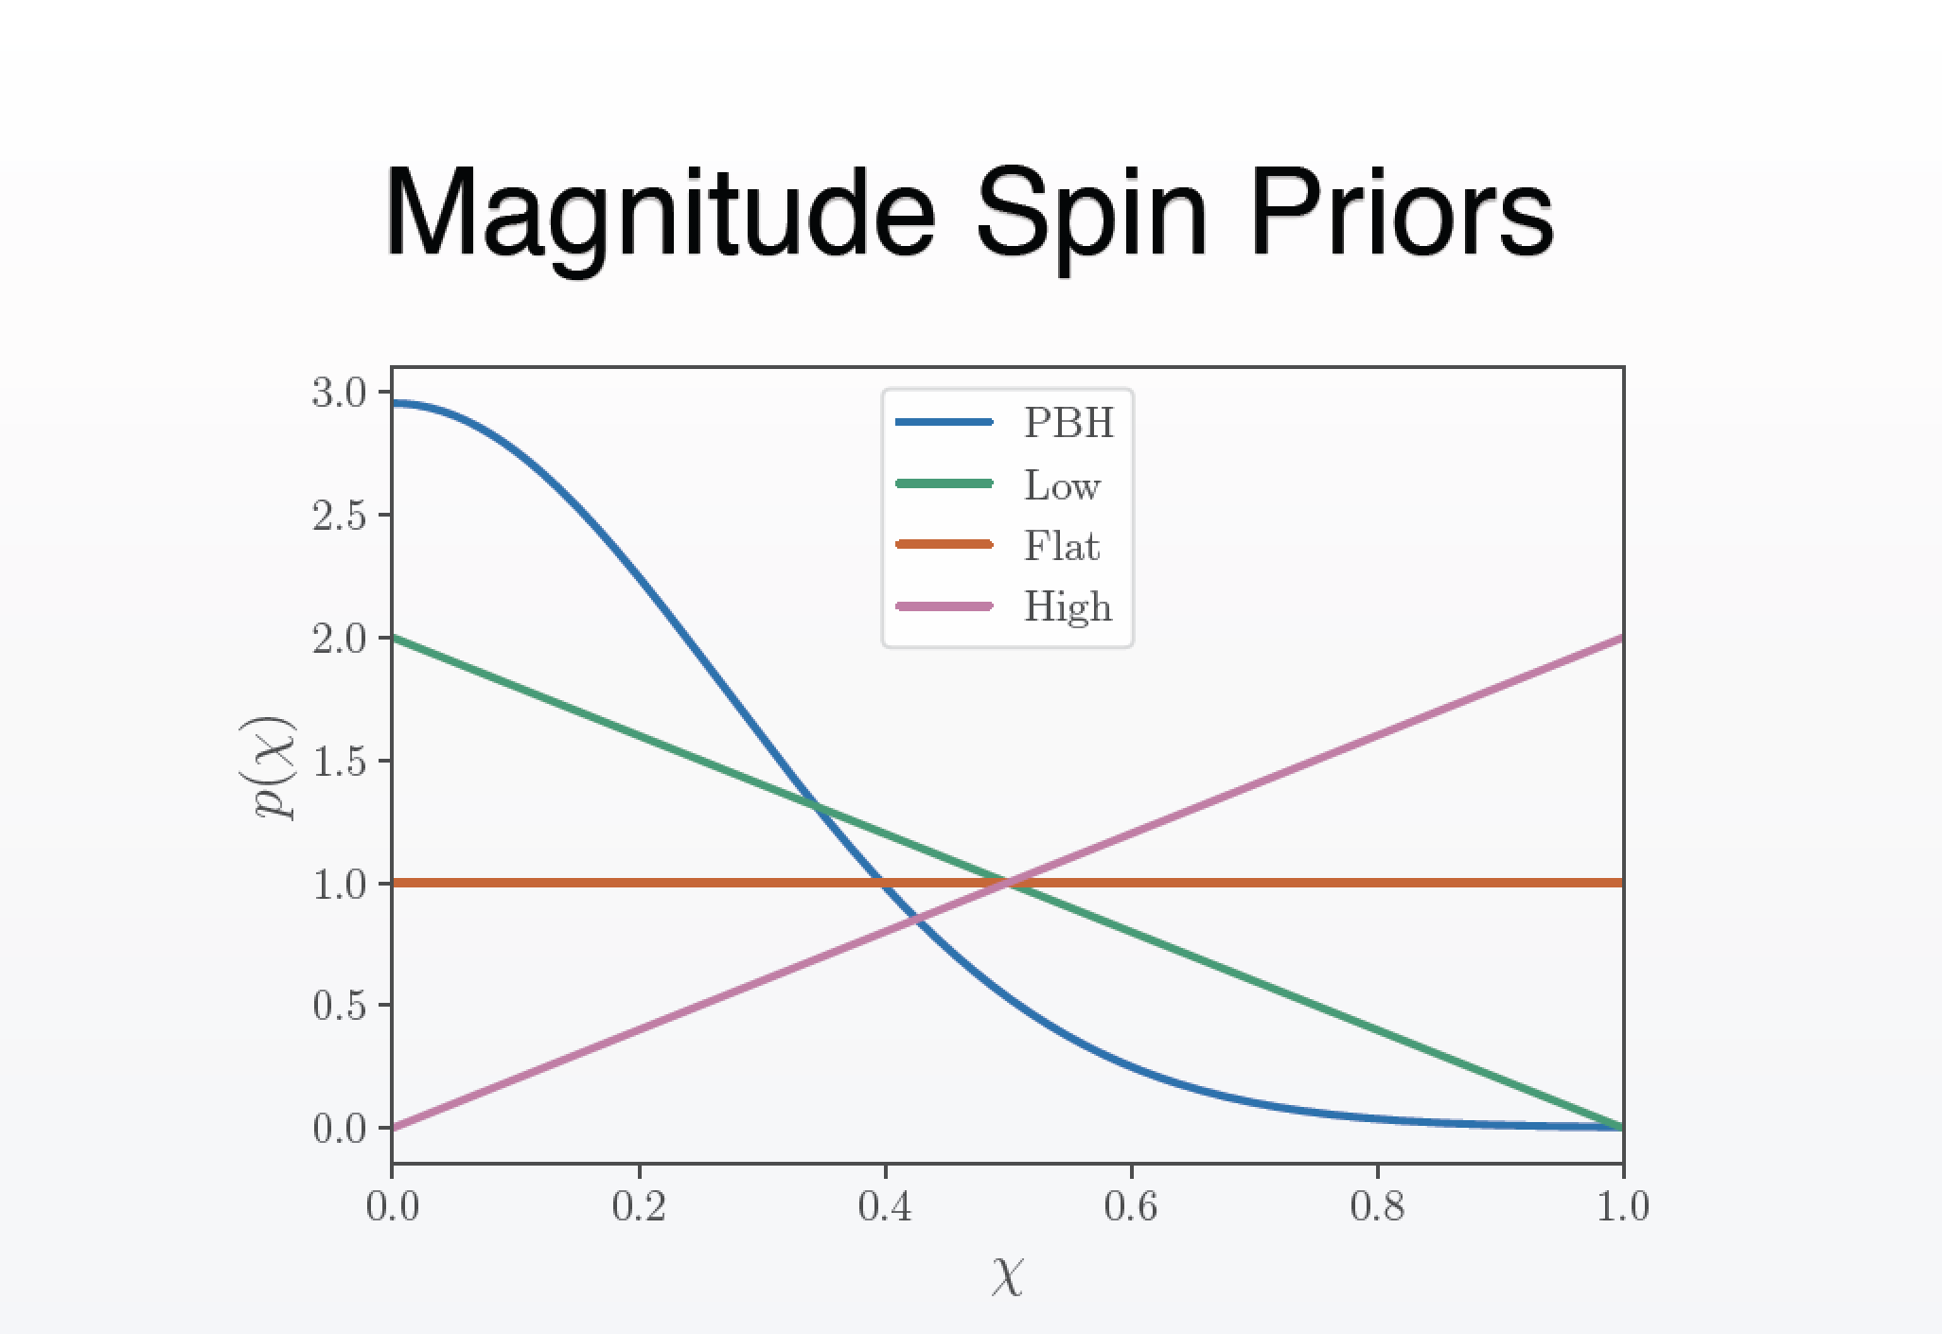
Fernandez and Profumo, 1905.13109 (JCAP); Slide credit: Nico Fernandez (UCSC → UIUC)

Slide 28
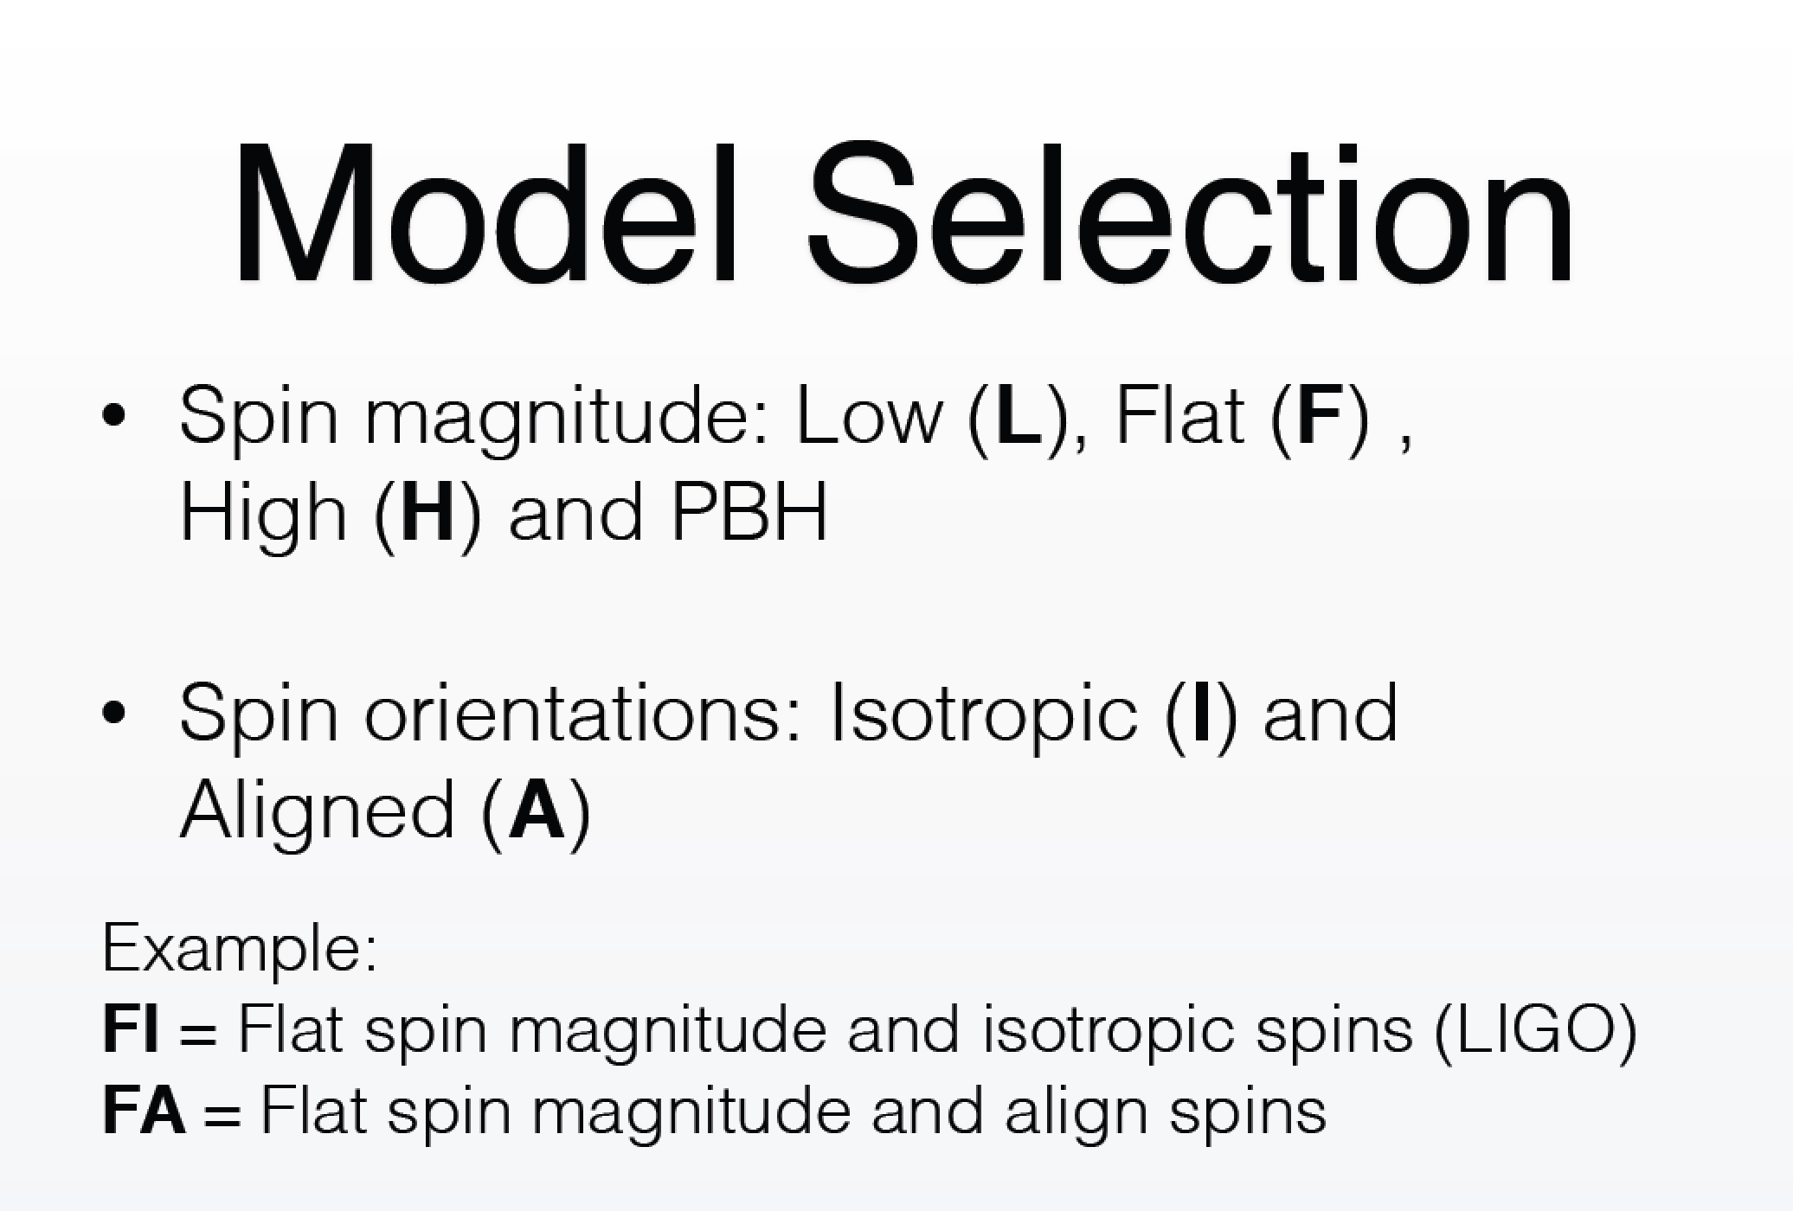
Fernandez and Profumo, 1905.13109 (JCAP); Slide credit: Nico Fernandez (UCSC → UIUC)

Slide 29
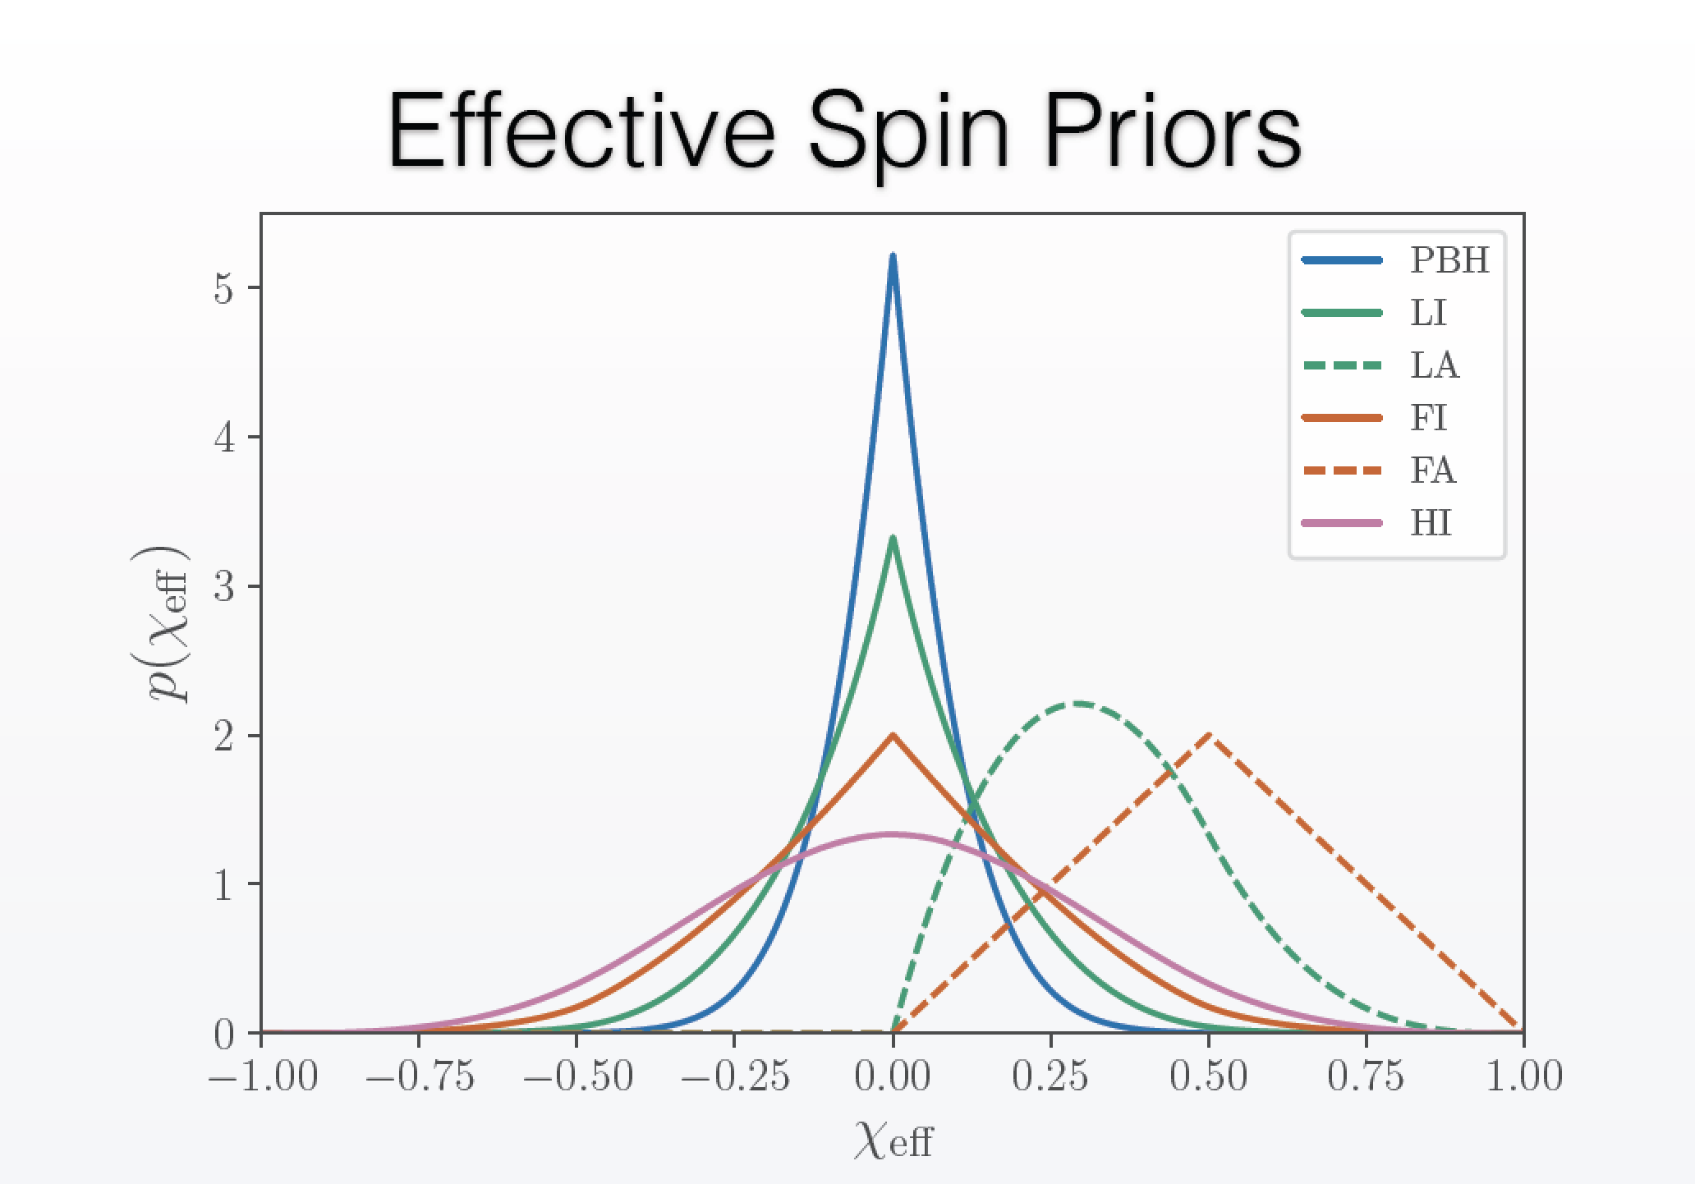
Fernandez and Profumo, 1905.13109 (JCAP); Slide credit: Nico Fernandez (UCSC → UIUC)

Slide 30
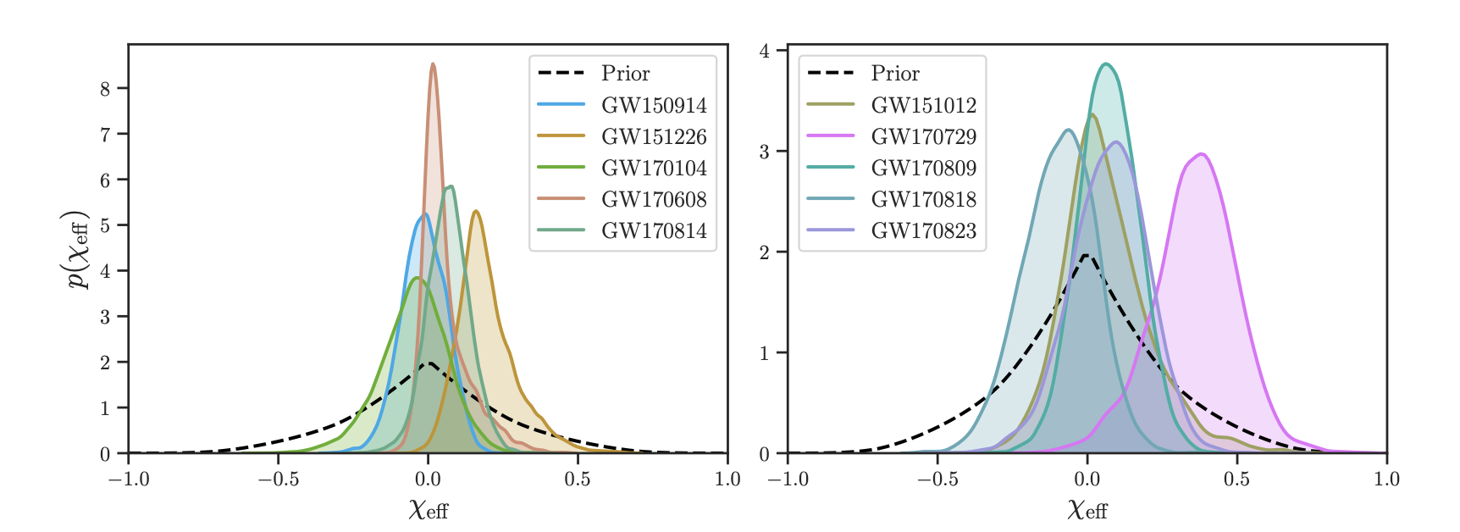
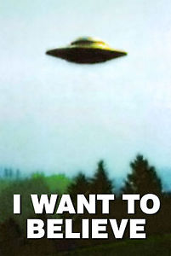
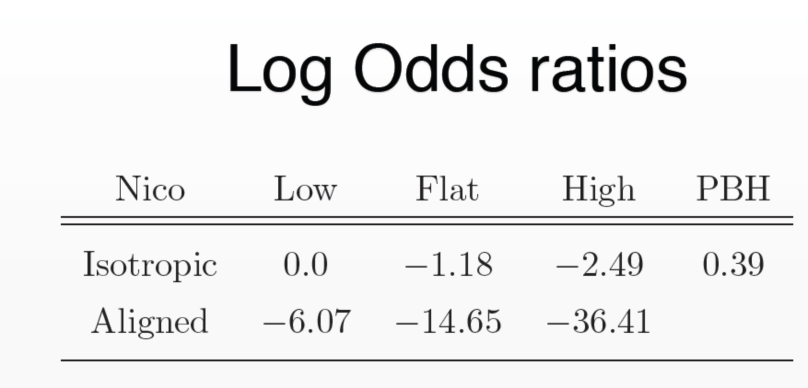

Fernandez and Profumo, 1905.13109 (JCAP); Slide credit: Nico Fernandez (UCSC → UIUC)

Slide 31

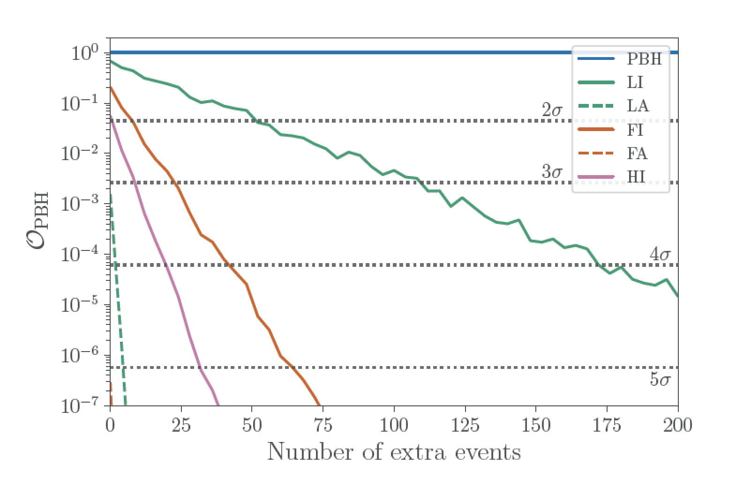
Truth: PBH
Fernandez and Profumo, 1905.13109 (JCAP); Slide credit: Nico Fernandez (UCSC → UIUC)

Slide 32
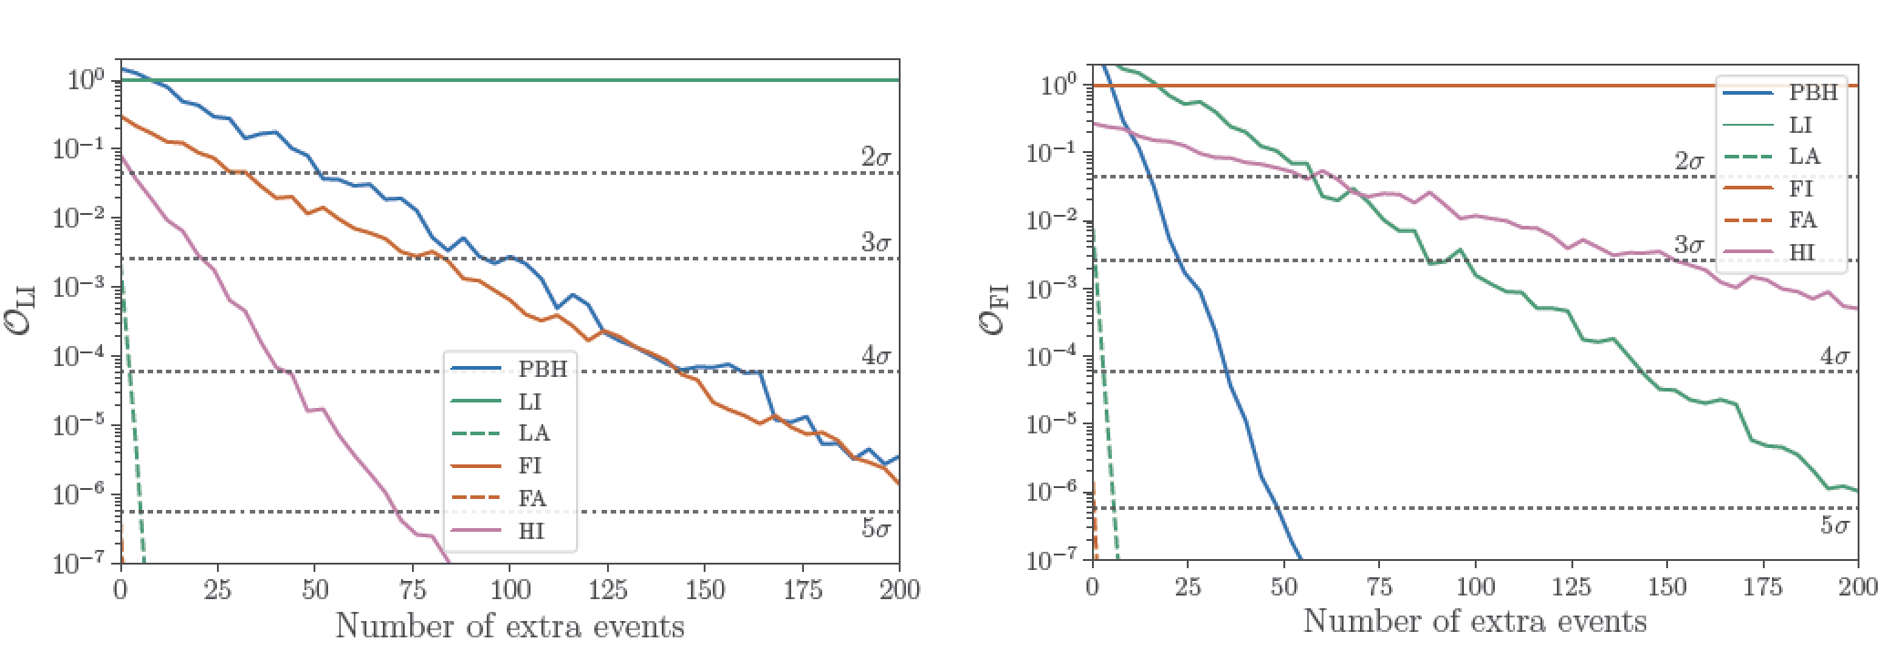
Truth: Low-isotropic
Truth: Flat-isotropic
Fernandez and Profumo, 1905.13109 (JCAP); Slide credit: Nico Fernandez (UCSC → UIUC)

Slide 33
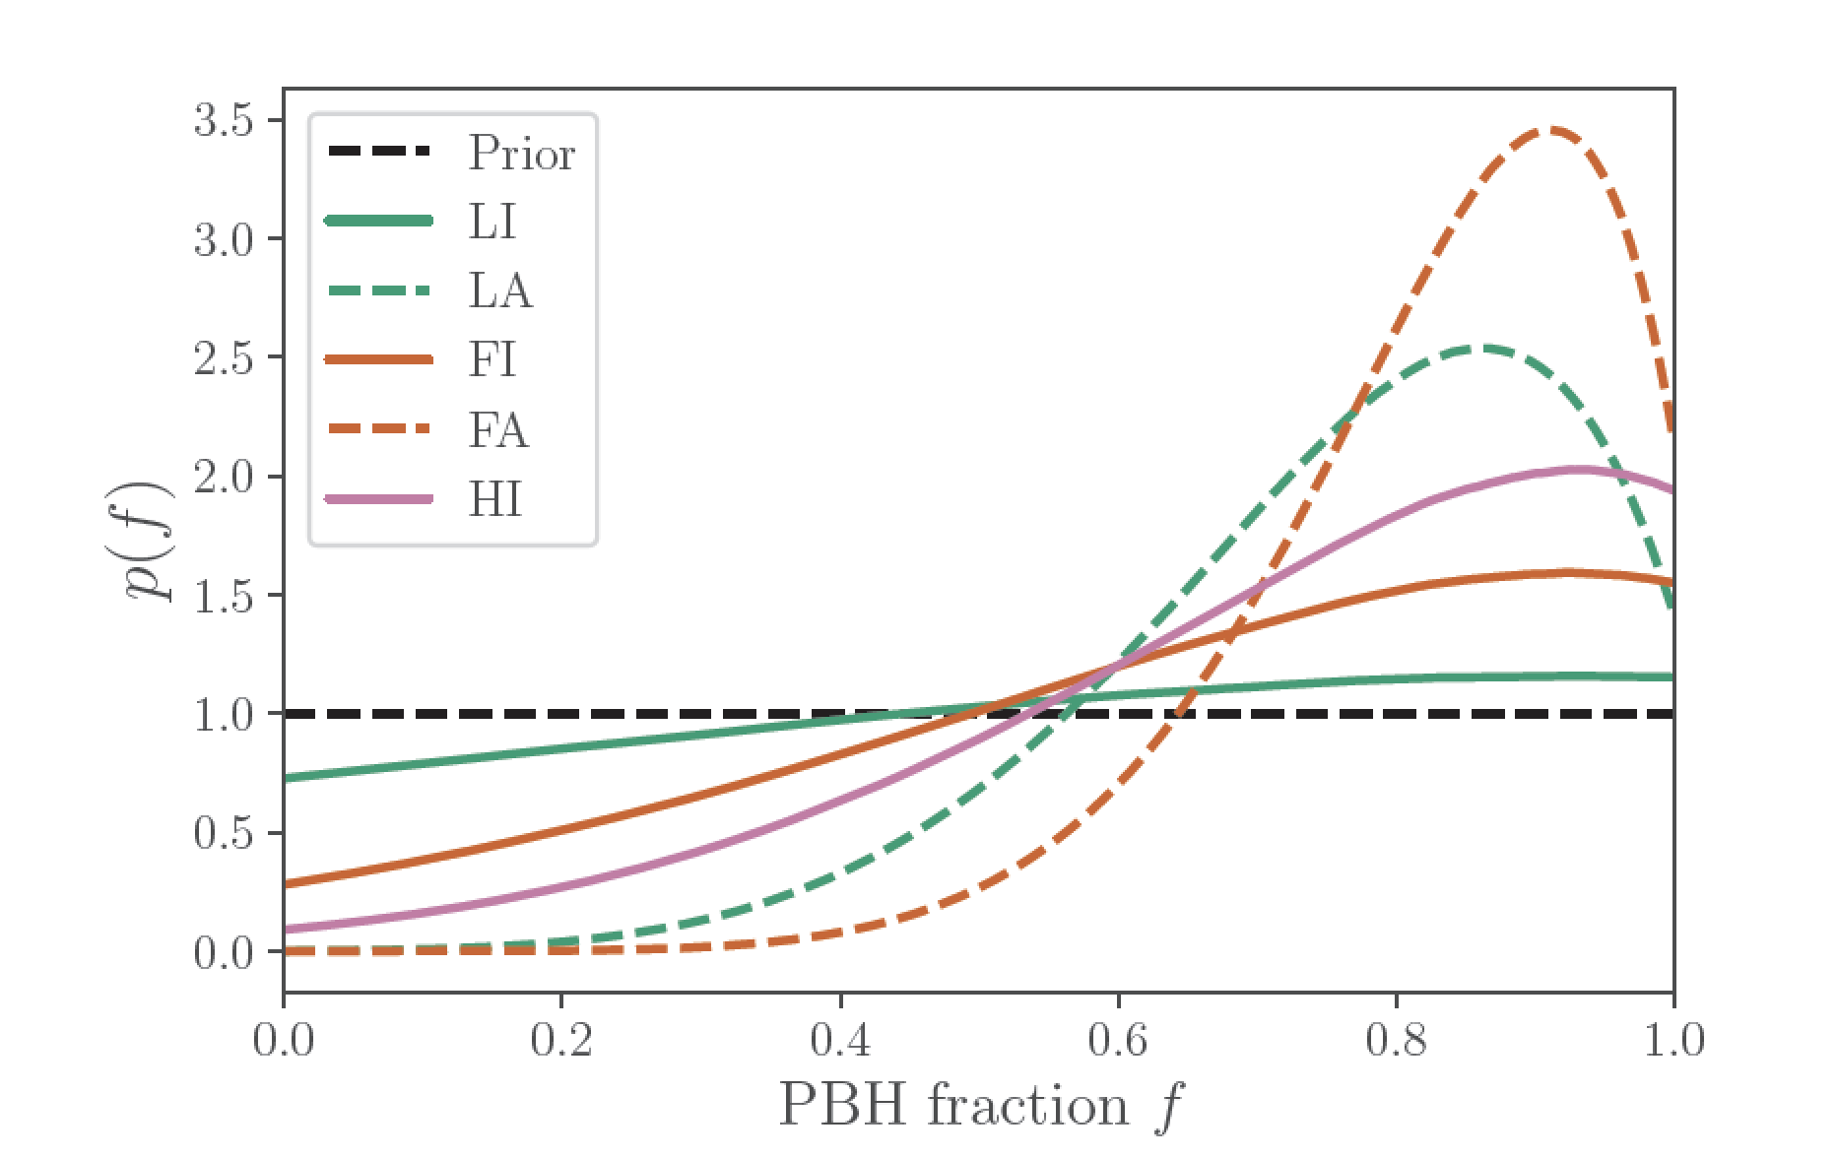
What about mixed models?
current 10
LIGO events
Fernandez and Profumo, 1905.13109 (JCAP); Slide credit: Nico Fernandez (UCSC → UIUC)

Slide 34
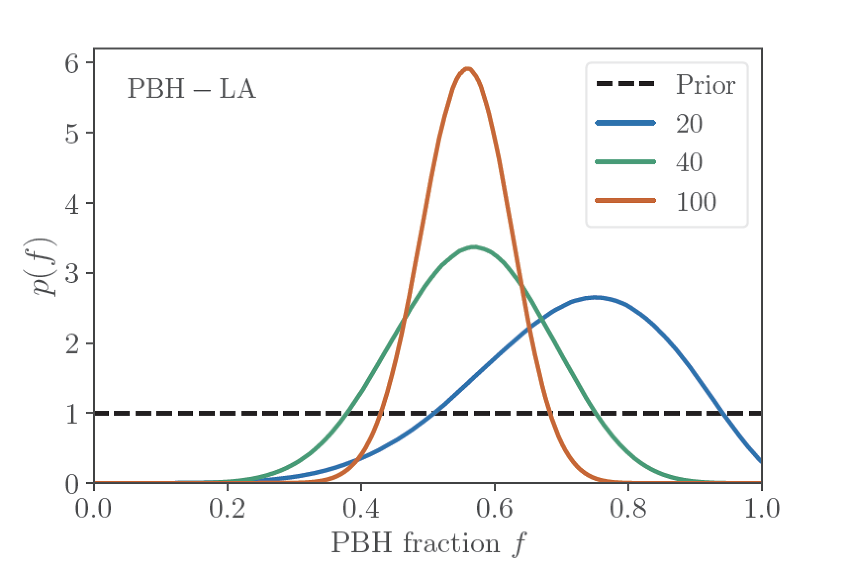
What about mixed models?
projection
truth=0.5
Fernandez and Profumo, 1905.13109 (JCAP); Slide credit: Nico Fernandez (UCSC → UIUC)

Slide 35
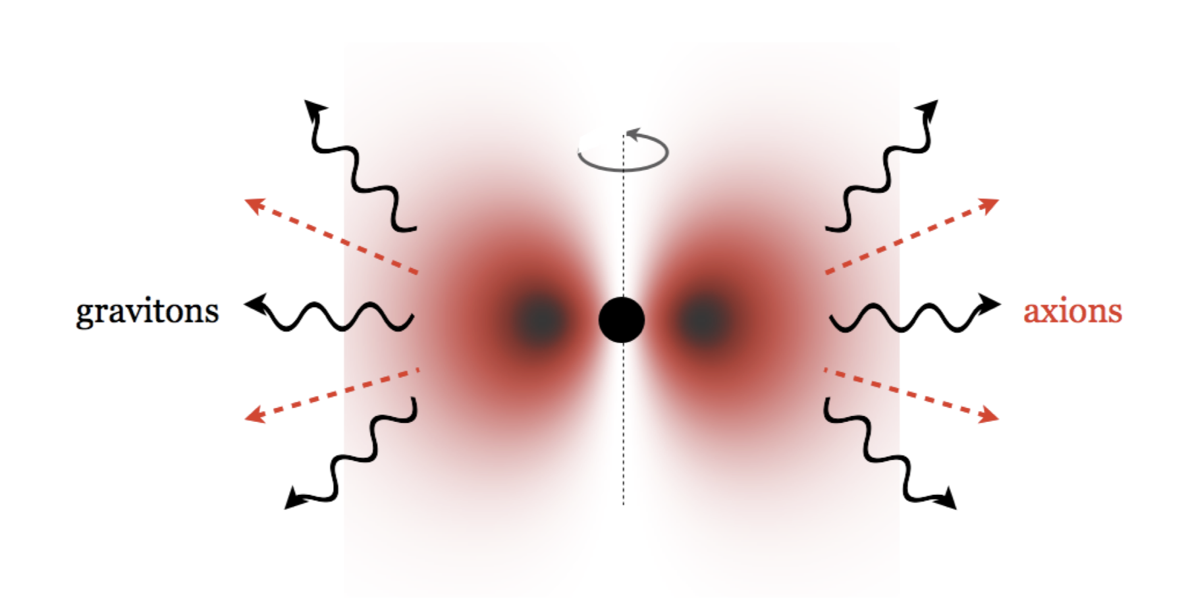
What else could fake a low-spin PBH? Super-radiance!
Assuming an initial spin and alignment distribution, one can compute the “best-fit” axion mass
Similarly, spin measurements can put constraints on axion-like particles

Slide 36
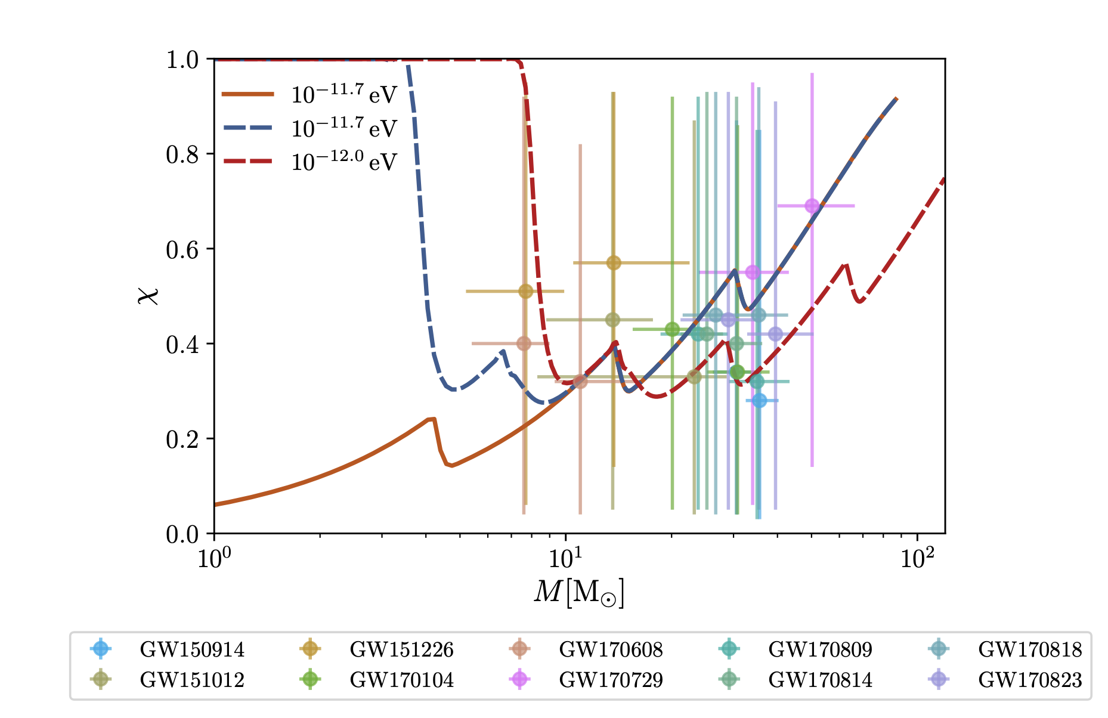

What else could fake a low-spin PBH? Super-radiance!
Regge plot (effective spin vs mass) assuming
Flat priors for both mass and spin*
*Fernandez, Ghalsasy, Profumo, 1911.07862

Slide 37
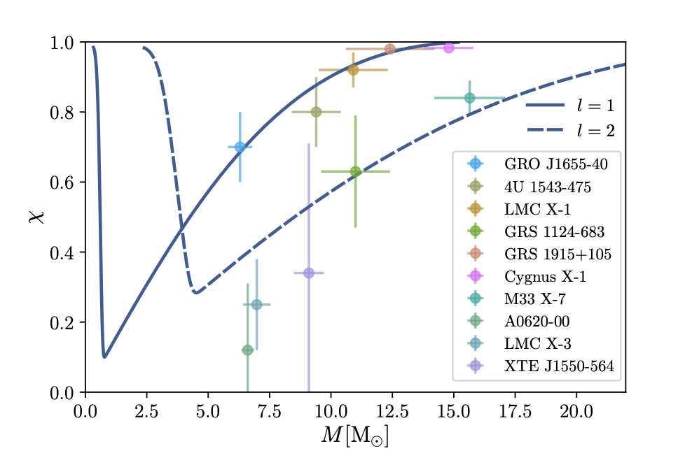
What else could fake a low-spin PBH? Super-radiance!
Regge plot (effective spin vs mass) assuming
Flat priors for both mass and spin*
*Fernandez, Ghalsasy, Profumo, 1911.07862

Slide 38
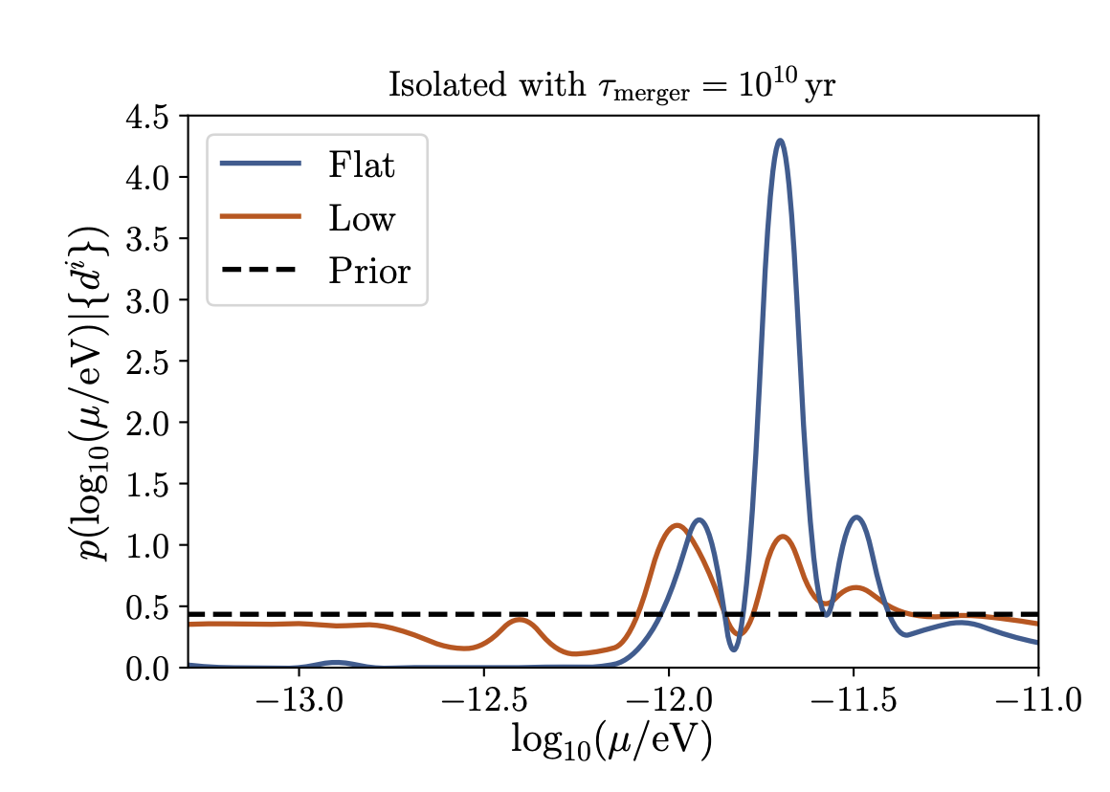
What else could fake a low-spin PBH? Super-radiance!
Posterior Probability for ALP mass
*Fernandez, Ghalsasy, Profumo, 1911.07862

Slide 39
THIS PLOT
IS WRONG

Slide 40
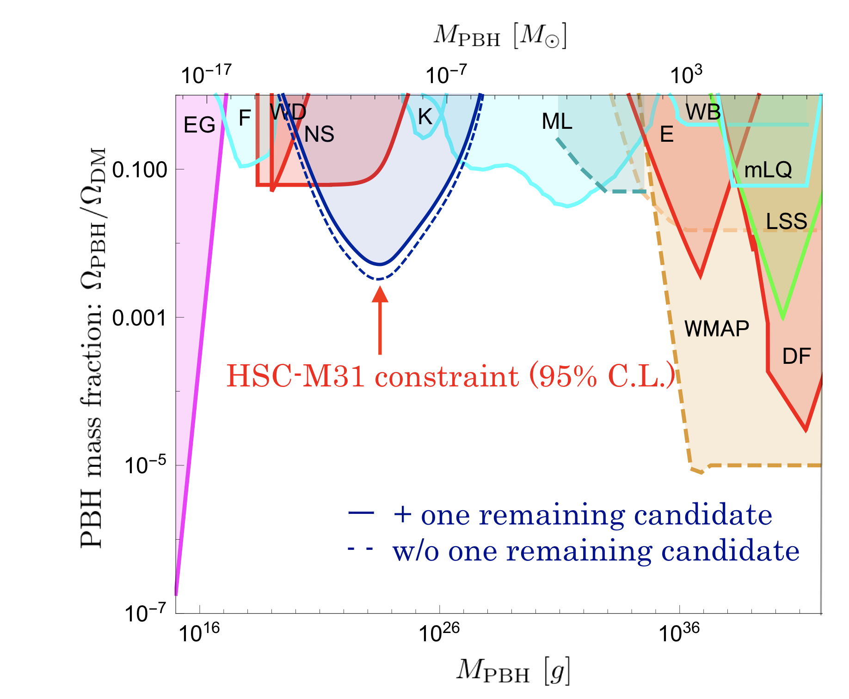
SUBARU HSC microlensing, 1701.02151 VERSION 1

Slide 41
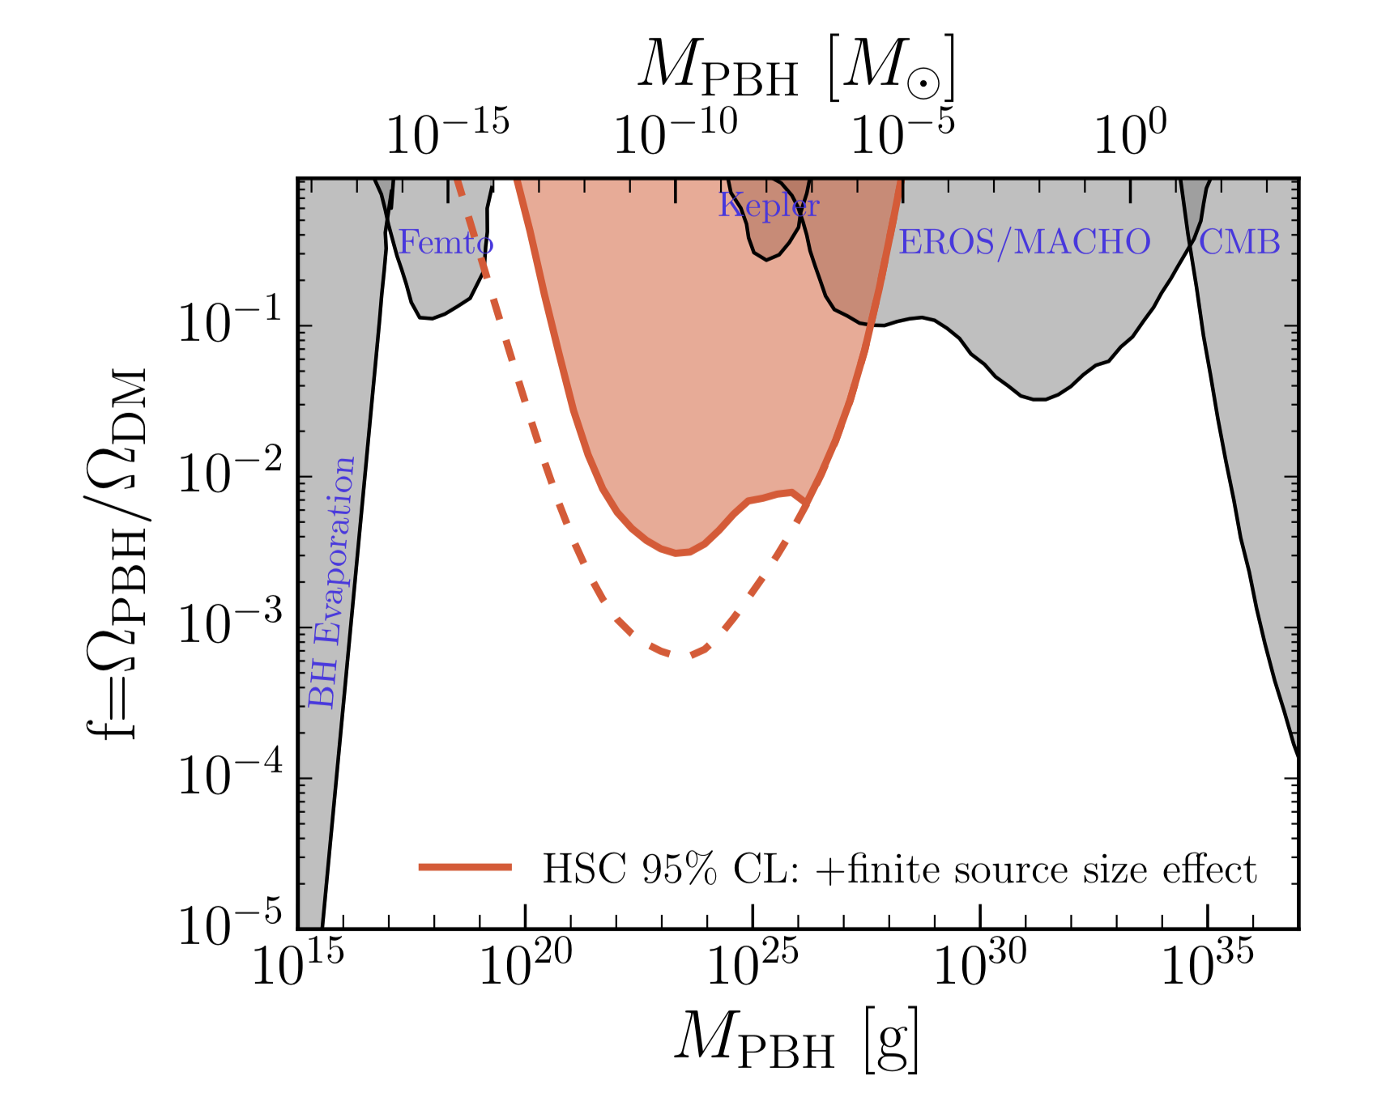
wacky constraints
(WD, NS) have
disappeared
SUBARU HSC microlensing, 1701.02151 VERSION 2: wave effects

Slide 42
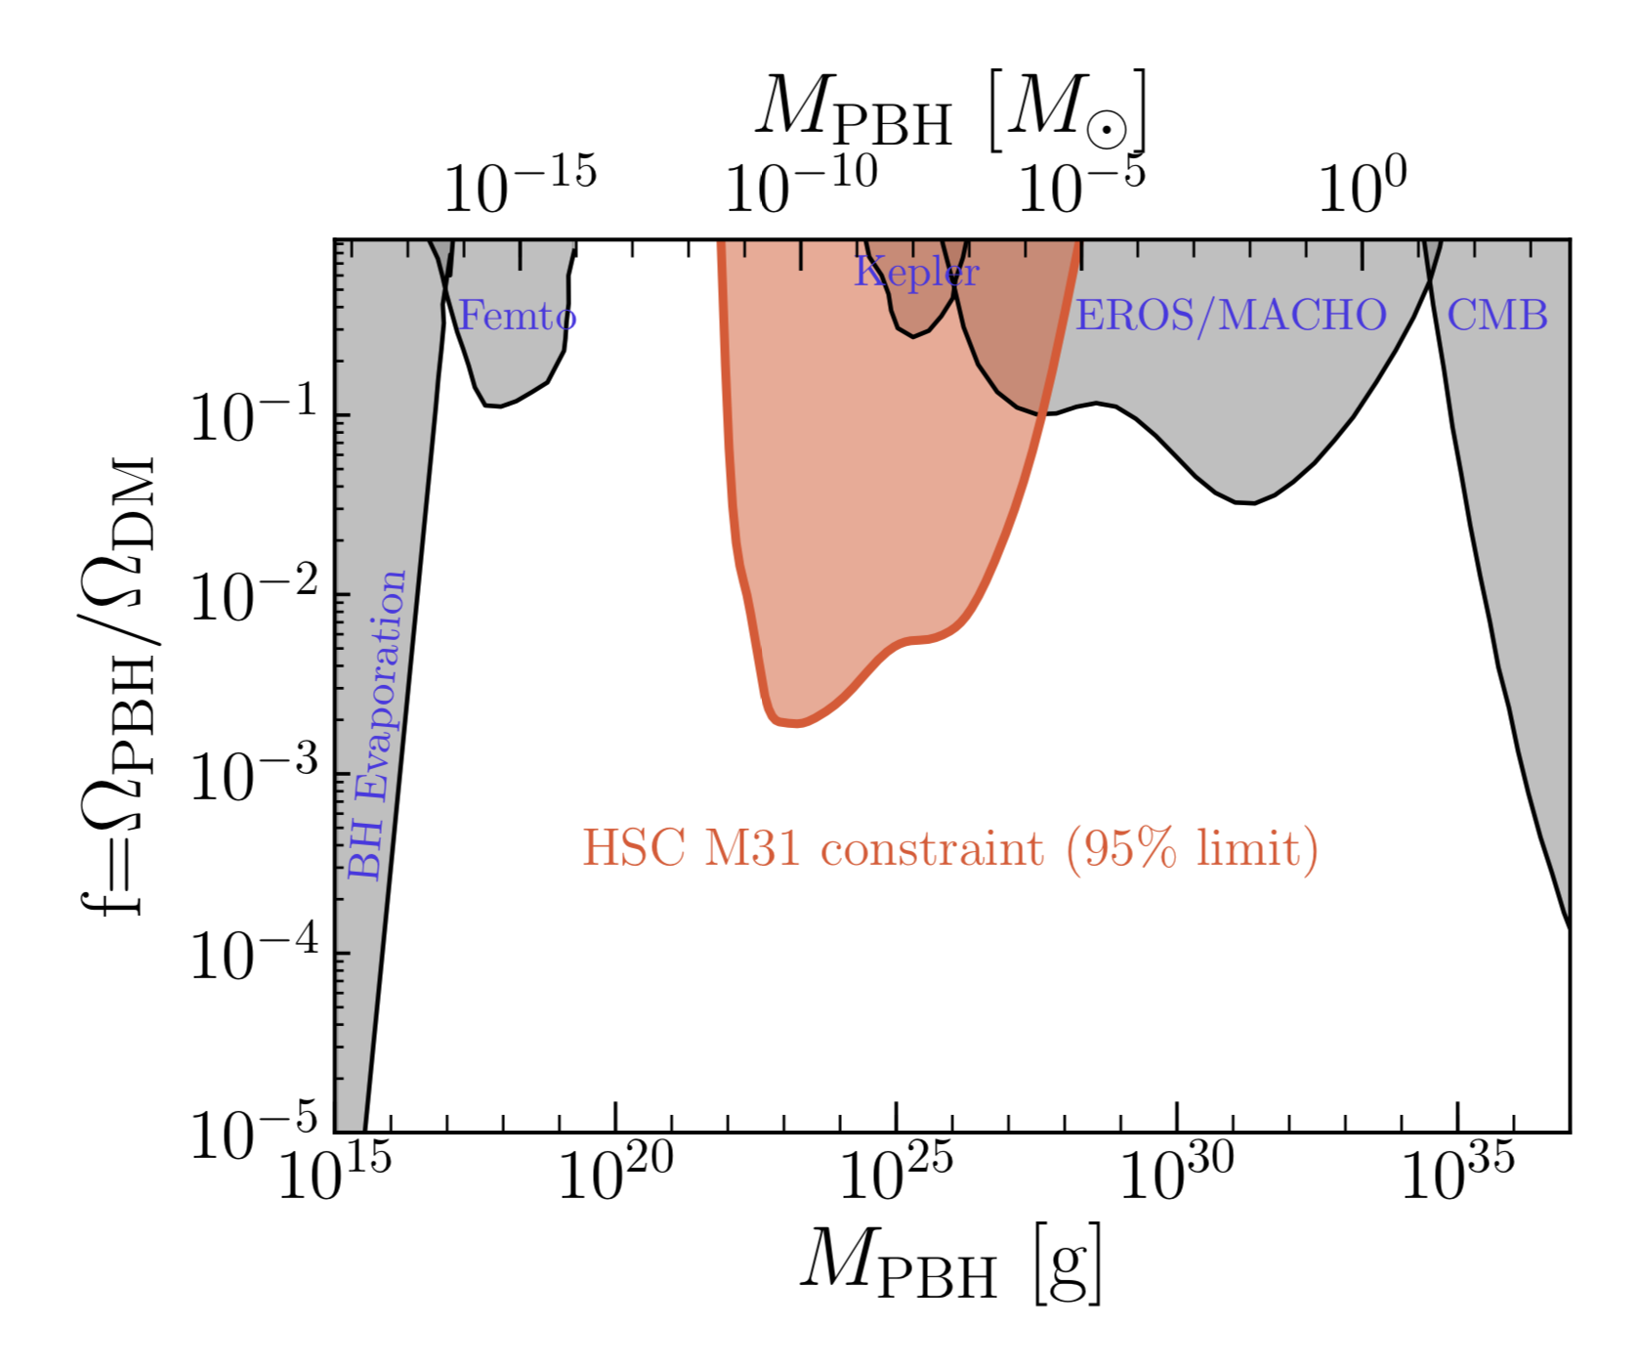
* Katz et al, 1807.11495
This constraint
also non-existent*
SUBARU HSC microlensing, VERSION 3: finite source AND wave effects
…but assuming all stars have R = R_{sun} !

Slide 43

…but are these bounds robust?
A few (worrisome) assumptions:
All stars are at the same distance
All stars have the same size (1 R_{sun})
DM is completely smooth
* Smyth, Profumo et al, 1910.01285, PRD

Slide 44
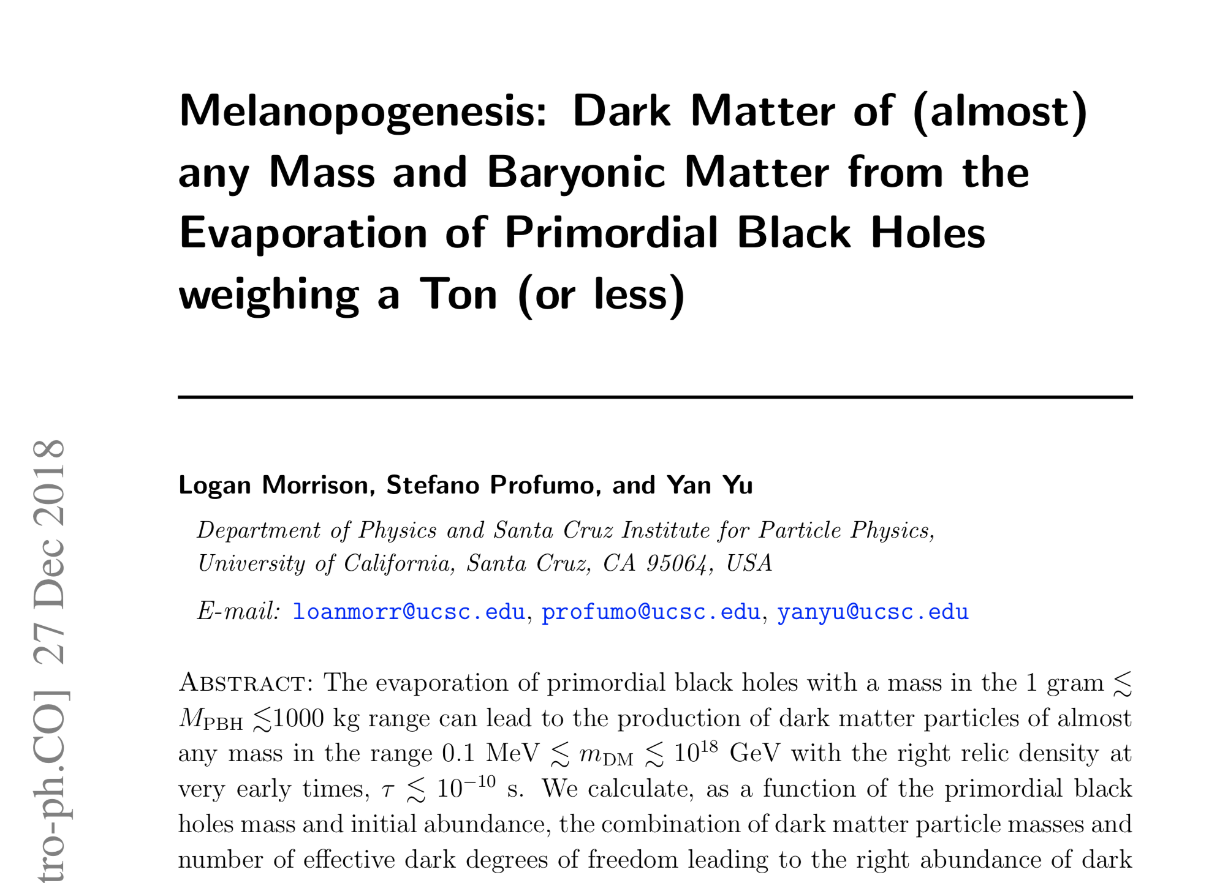
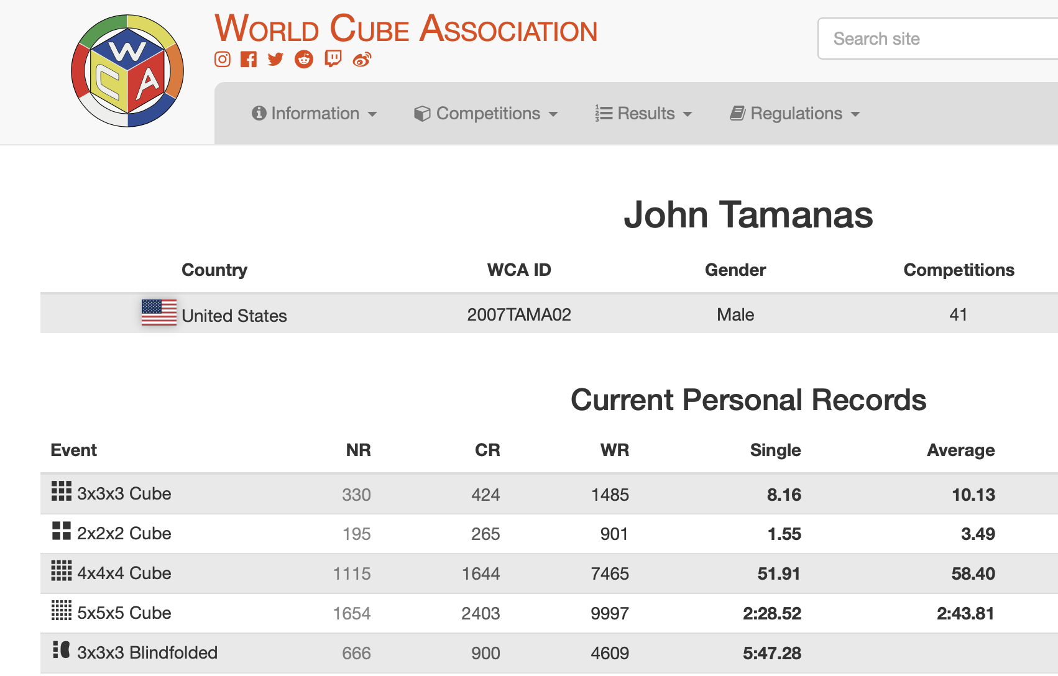

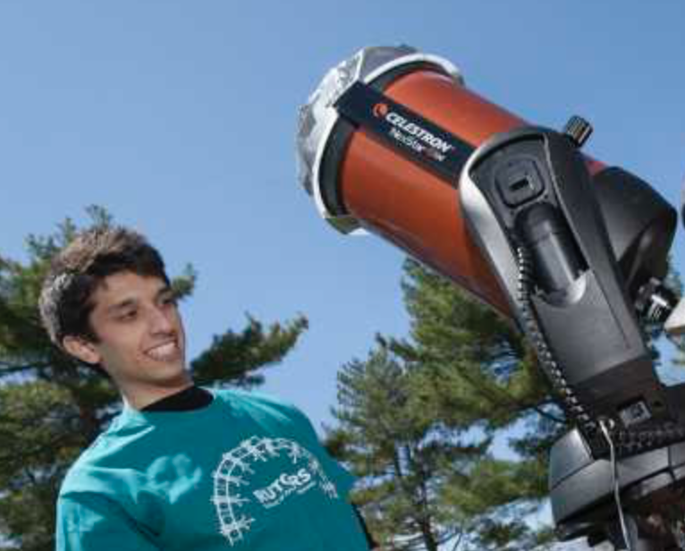
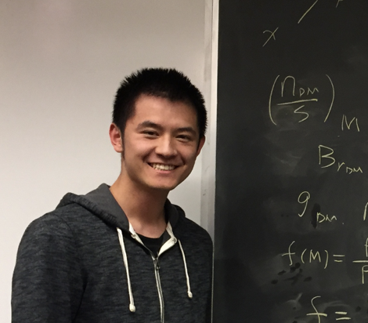
…even if PBH are NOT the dark matter, they can PRODUCE the dark matter via Hawking evaporation!

Slide 45

…even if PBH are NOT the dark matter, they can PRODUCE the dark matter via Hawking evaporation!
* Morrison, Profumo and Yu (JCAP, 2019)

Slide 46


PBH (eventually) dominate universe energy density
Mass of decaying RH neutrino producing baryon asymmetry
RH neutrinos thermalize
Relative initial abundance of PBH to everything else
Ruled out by CMB limits on H_{I}
RH neutrino produced below EWPT
* Morrison, Profumo and Yu (JCAP, 2019)
Dark Matter too fast

Slide 47

Dark Matter can be a mix of Planck-scale relics from PBH evaporation, and stuff the PBH evaporated into!
Too much Dark Matter
* Morrison, Profumo and Yu (JCAP, 2019)

Slide 48


As BH approach the Planck scale, they can acquire a significant relic electric charge
(under simple assumptions) the relic charge is
approximately Gaussian*
If evaporation stops around the Planck scale
(because of extremality, or because of quantum gravity)
we are left with a population of charged, Planck-scale relics!
* Page, 1977
** Lehmann, Johnson, Profumo and Schwemberger, 1906.06348

Slide 49

* Lehmann, Johnson, Profumo and Schwemberger, 1906.06348

Slide 50
“Stellar-Mass”
(10³⁵ g)
Black Holes
10⁻³ g
10⁷ g
10¹⁷ g
10²⁷ g
10³⁷ g
10³⁰ eV
10⁴⁰ eV
10⁵⁰ eV
10⁶⁰ eV
10⁷⁰ eV
Spins look a lot like PBH!
…or maybe they are low because of superradiance?
Do they disrupt CMB*?
* Gaspari, Lehmann, Profumo, in preparation

Slide 51
“Asteroid-Mass”
(10²² g)
Black Holes
10⁻³ g
10⁷ g
10¹⁷ g
10²⁷ g
10³⁷ g
10³⁰ eV
10⁴⁰ eV
10⁵⁰ eV
10⁶⁰ eV
10⁷⁰ eV
Microlensing a lot trickier than previously thought!
Detection strategies? PTA?

Slide 52
Ton-size
“Space-cow”
Black Holes
10⁻³ g
10⁷ g
10¹⁷ g
10²⁷ g
10³⁷ g
10³⁰ eV
10⁴⁰ eV
10⁵⁰ eV
10⁶⁰ eV
10⁷⁰ eV
Decays can produce DM, BAU, Planck relics

Slide 53
Grain-of-Salt
“No-see-ums”
Black Holes
10⁻³ g
10⁷ g
10¹⁷ g
10²⁷ g
10³⁷ g
10³⁰ eV
10⁴⁰ eV
10⁵⁰ eV
10⁶⁰ eV
10⁷⁰ eV
Likely (partly) charged
Detectable!

Slide 54
In the era of gravitational wave astronomy, the physics of macroscopic DM candidates offers many opportunities for the ingenuity of theorists and the craft of observers
10⁻³ g
10⁷ g
10¹⁷ g
10²⁷ g
10³⁷ g
10³⁰ eV
10⁴⁰ eV
10⁵⁰ eV
10⁶⁰ eV
10⁷⁰ eV

Slide 56



Merger rate calculation (Cheng+Huang, 2018; Raidal +, 2017)

Slide 57


