Slide 1
Dry Runs for PS
Denis Cotte, BE-OP-PS
Many thanks to all PS-BCWG participants.

Slide 2
Dry Runs
Dry Run (or a practice run) is a testing process where the effects of a possible failure are intentionally mitigated. -> “Test a Blanc”
  Done in collaboration with equipment groups, BE-CO and OP from CCC.
  In most of our cases, it’s a (sub) system functionality test in operational conditions.
The aim : validate (sub) system and identify problems (or blocking points) as soon as possible in order to generate reports (JIRA issue) and work on fixes.
Planning : Dry Run can be performed anytime (LS2, ISTs, HW tests or cold check-out periods)
  Depends on the availability of the system to be tested
  So far, we can say that 2 dry runs have already been done in PS :
    Validate functionality of LKTIM Trees with virtual LTIMs (September 2019)
    Control validation of the new DFA242 5-steps in TT2 (August 2019)

Slide 3
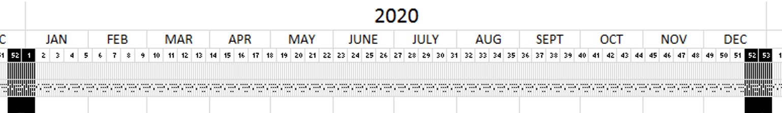

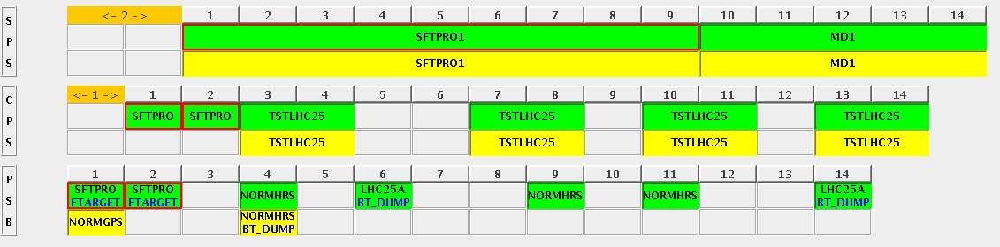
Dry Runs CO + OP
System | Tests | Requirements | Dates
Timing - CO 24 to 32 users | Check machine behavior after migration from 24 -> 32 timing users in CPS complex Check the presence of 8 new timing users in CBCM application & CCM Check PLS number of user ZERO=first position Check the possibility to map/unmap cycle. Check Wset update with 8 new users. Check PPM behavior on operational devices | MTG (Central timing) updated CBCM (application) | Beginning of 2020 end of January
New destination EAST_T9 SEM_PS | Check new destination in CBCM Check inhibit by destination in CCC Check inhibit sequence change | MTG (Central timing) updated CBCM (application) | Beginning of 2020 end of January
Sequence manager with automatic SuperCycle filling | Work with entire complex | CBCM (application) Sandy’s algorithm + integration | To be defined
SIS | Test all tasks | SIS application CO infrastructure | HW test, following device readiness
Vistars | Check vistar displays PS BLM EAST AREA BGI | CO infrastructure Vistar readiness | -

Slide 4
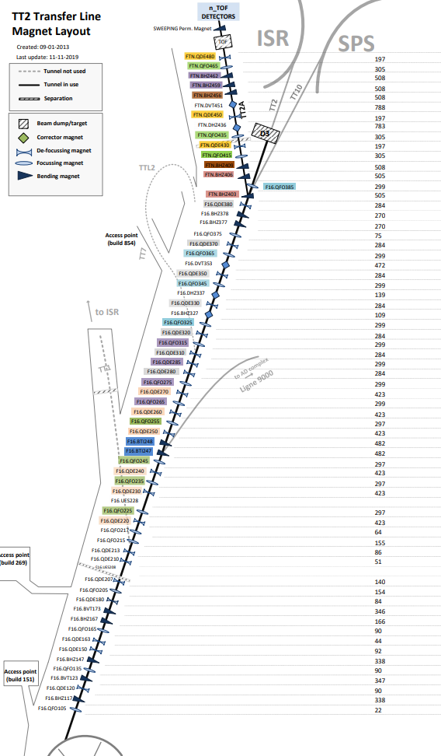
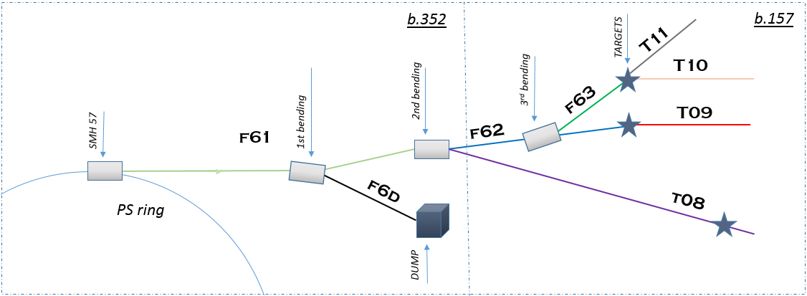
Dry Runs EPC + OP + (support CO)
System | Tests | Requirements | Dates
TT2 Power supply | Validation of Economic mode by Destination on test bench. Find super cycle composition restrictions Validate Configuration, State, Control, Cycling mode(Eco + up-min-max), software External Condition, Acquisition + OASIS (Sampler) | MTG (Central timing) updated CBCM FGC63 OASIS datasource + Sampler | Beginning of 2020 HW test period
F16.BHZ377 F16.BHZ378 (EIS) | Validate Configuration, State, Control, Cycling mode, software External Condition, Acquisition + OASIS + (EIS deconsignation) Validate the fast abort process with SPS BIC. | MTG (Central timing) updated CBCM FGC63 OASIS datasource + Sampler | HW test period August/September 2020
F6x Power supply | Validate Configuration, State, Control, Cycling mode(up-min-max), software External Condition, Acquisition + OASIS (Sampler) Copy MakeRule for device with multiple PC for one magnet. Find super cycle composition restrictions | MTG (Central timing) updated CBCM (application) OASIS datasource + Sampler | PS Cold Check-out November 2020

Slide 5
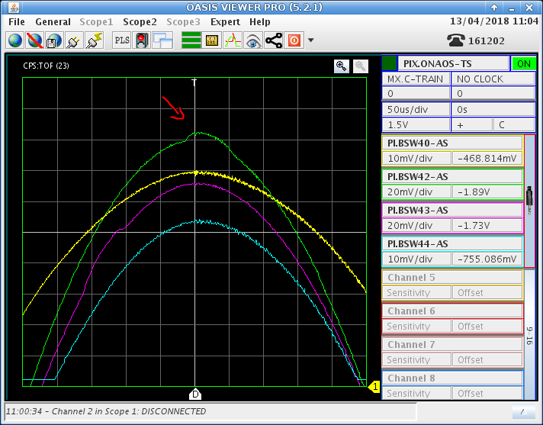
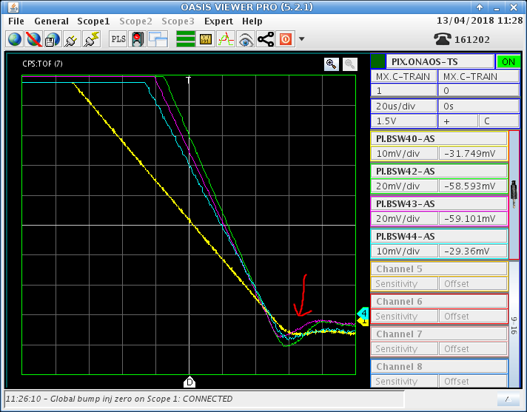
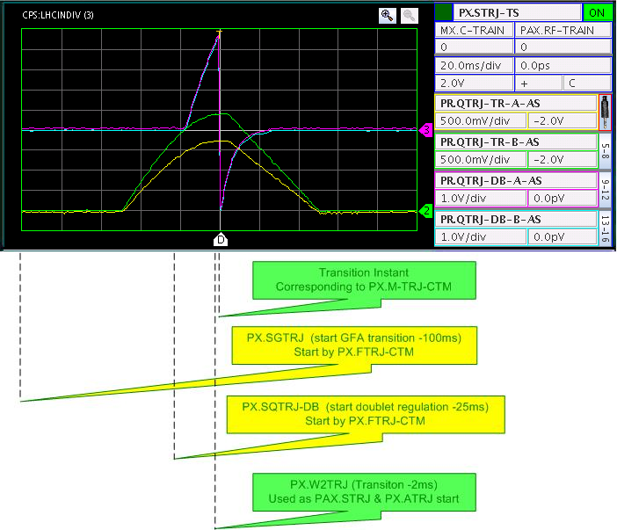
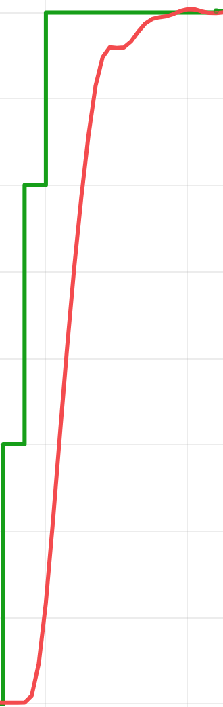
Dry Runs EPC + OP + (support CO)
System | Tests | Requirements | Dates
Injection process Bumper (x5) SMH42 QLB | Specification validation (synchronization, shape, ripple…) Validate Configuration, State, Control, Acquisition + OASIS | MTG (Central timing) Wset/Knobs OASIS datasource FGC62 | HW test period August 2020
Transition process Doublets QTRJ-DB Triplets QTRJ-TR | Specification validation (synchronization, shape, ripple…) Validate Configuration, State, Control, Acquisition + OASIS. Copy MakeRule. | MTG (Central timing) Wset/Knobs OASIS datasource FGC63 | HW test period August/September 2020
Ejection process Bumper (x4) SMH16 QKE16 | Specification validation (synchronization, shape, ripple…) Validate Configuration, State, Control, External Condition, Acquisition + OASIS (Sampler) | MTG (Central timing) Wset/Knobs OASIS (datasource for FGC62) | HW test period September 2020
POPS | Early ramp-up test and validation to save time in order to reach 2 GeV injection B field. | MTG (Central timing) Btrain ready Application update FGC53 | After TE-EPC POPS test

Slide 6
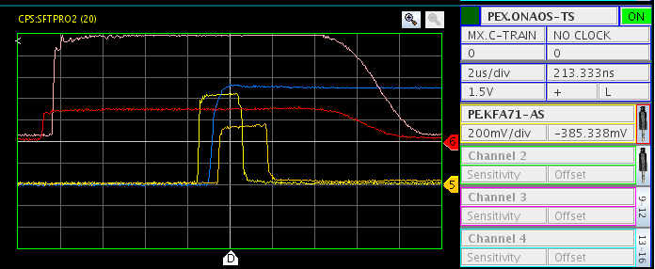
Dry Runs ABT + OP + (support CO)
System | Tests | Requirements | Dates
Injection kicker PI.KFA45 | Specification validation (charge, discharge, operation mode…) Validate Configuration, State, Control, External Condition, Acquisition + OASIS signal per module Simulate operation modes (EDMS : 1967855) | MTG (Central timing) Wset/Knobs OASIS | HW test period August 2020
Ejection kicker PE.KFA71 MTE kickers | Validate Configuration, State, Control, External Condition, Acquisition + OASIS signal per module PPM interlock | MTG (Central timing) Wset/Knobs OASIS | HW test period August 2020
DFA/BFA BFA9P (PS Ring) DFA242 (TT2) DFA254 (TT2) | Validate Configuration, State, Control, software Acquisition + OASIS (Sampler) Test with moulinette | MTG (Central timing) Wset/Knobs OASIS + Sampler | HW test period August 2020
Septa movement + TPS15 | Validate Configuration, State, Control of the new FESA Class | MTG (Central timing) Wset/Knobs FESA class readiness | HW test period or before To be defined

Slide 7
Dry Runs OP + (support ALL)
System | Tests | Requirements | Dates
Christmas Dry-Run | Switch OFF – Switch ON the full machine Identify equipment that requires piquet service to restart. Find or test a sequence to restart the machine. Can be cancelled in case of electrical glitch. ;-) | Machine with all equipment ON. | Start of Cold check-out period End of October 2020
YASP | Check the following configuration : Injection Oscillation (ions, p+) Low energy orbit correction (optics, correctors, BPM) High energy orbit correction (optics, correctors, BPM) Transition ? (optics, correctors, BPM) Validate/Simulate a realignment process of PS magnet(s) (optics, check optics : simulated correctors MU) Simulate a bump creation. | Simulated orbit | HW test period October 2020
Working Point Bumpers | Check high level parameters PFWs function generation MakeRules for change of Qh, QV, Xih, Xiv Check high level parameters MakeRules | LSA LSA tools Calibration curves | As soon as possible

Slide 8
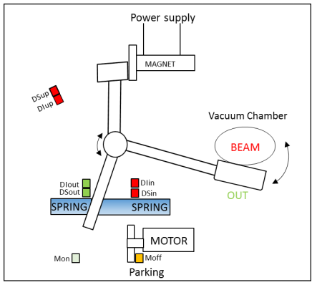
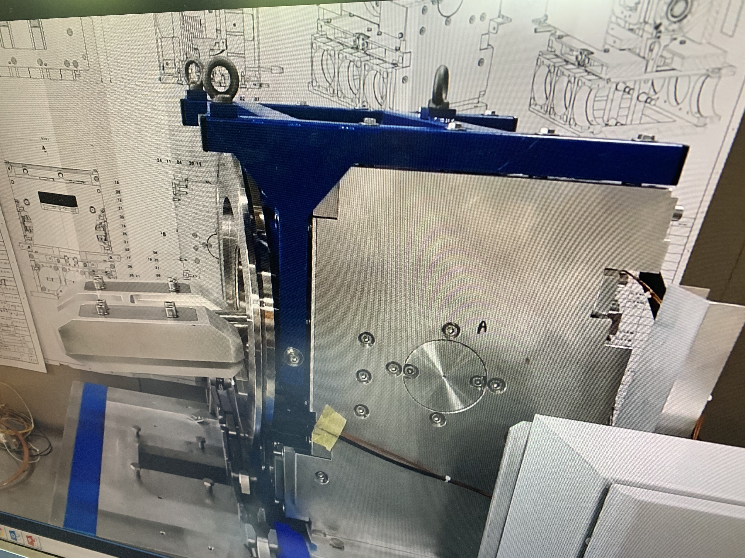
Dry Runs STI + OP + (support BI,CO)
System | Tests | Requirements | Dates
Internal Dump PR.TDI47-48 | Specification validation (Time to dump, interlock with Booster BIC, operation mode…) Simulate operation modes (EDMS : 11582110 and 1977845) Beam dumped event triggering test Communication with TRDC FESA class. | MTG (Central timing) Wset/Knobs BI Trafo | HW test period August 2020

Slide 9
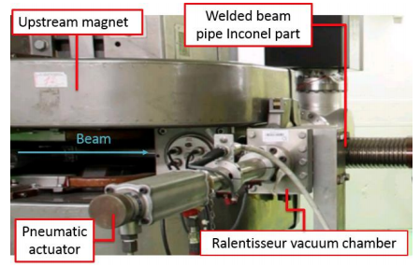
Dry Runs BI + (support CO)
System | Tests | Requirements | Dates
BE-BI | Most of the equipment are already present in check list Basic test to be performed : Beam IN / Beam OUT for BTV and SEMGRID/SEMFIL Test new FWS with SPS new application, find limits, check data transfer with new FESA class, check Harmonics programming. Check optics from LSA. BLM configuration in Wset, application check, interlock test |  | HW test period October 2020
Ralentisseur | Dedicated test to check interlock with injection SemGrid48/52/54 Check that interlock can be masked. | Wset/Knobs | HW test period August 2020

Slide 10
Dry Runs RF + (support CO)
System | Tests | Requirements | Dates
RF (Low Level) | Check Cavity spare selection + C10 Matrix Check C200 Matrix Check C40 selection (1 or 2), including functions for new cavity controllers Check virtualization of CVORB and LTIM + Makerules Check VPROG (main harmonic) and harmonic number sequence + MakeRules Generation of stable phase program Generation of harmonic functions for different loops + MakeRules Check virtualization of function + MakeRules Generation of internal functions + MakeRules Generation and distribution of RF trains (CTUs) Control of 20/40/80 MHz cavity controller Control of digital radial position detection | CO infrastructure LSA Specific applications | Starting in January 2020

Slide 11
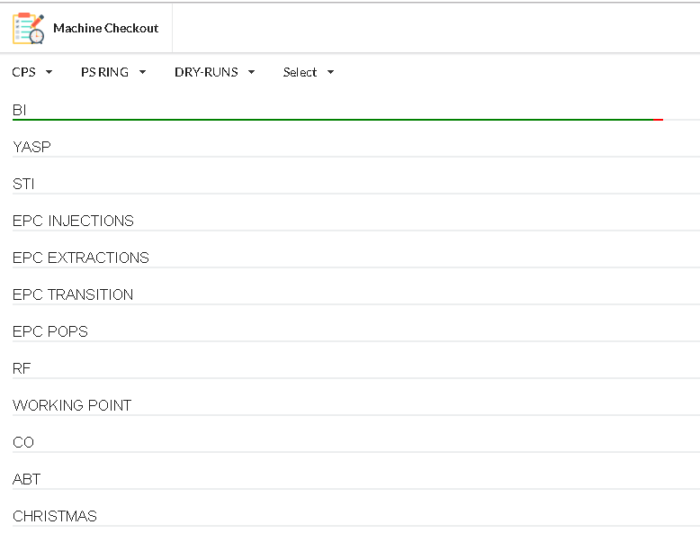
Conclusion
This Dry Run list is focused on different items that will be :
  new,
  renovated,
  or modified during LS2.
  other simple tests are already present in “Check List” and only need a small update.
Dry Run list has been added in check list tool thanks to Marc
Planning:
  For the moment, dates are just a rough idea,
  we need a new iteration when IST & HW test planning
  will be frozen.

