Slide 2
BLM Software Changes during LS2
David Medina Godoy
BE-BI-SW

Slide 3
Outline
Projects I Am Involved With
Agile Approach
BLMINJ System Overview
BLMINJ LS2 Changes
Challenges of Software Development
Initial Results & Future Work
Conclusion

Slide 4
Projects Where I Am Involved
BLM Projects
  LHC
  Injectors (except SPS)
Activities:
  FESA
  Graphical User Interfaces (JavaFX/Swing)
  Ad-hoc assistance to develop and diagnose electronics and installation
Awake

Slide 5

An Agile Approach
Close collaboration BL-SW
Weekly follow-up meetings
Sprints
Pair programming
Code reviews
Mockups
Unit-tests

Slide 6
BLMINJ System Overview
Measures lost particles from the trajectory
Machine protection (HW Thresholds)
Machine optimization (SW Thresholds)
Expert App
OP App
CALS/NXCALS
RT Software (FESA)
Software
Driver (ENCORE/EDGE)
Processing Electronics
Surface
Acquisition Electronics
Hardware
Tunnel
D1
D2
D3
D4
D5
D6
D7
D8

Slide 7
Electronics Synchronisation
With Basic Period (BP) event:
  Received via MTG (Main Timing Generator)
  Broadcasted in backplane by a dedicated timing card
Done at the processing level (i.e. 2 samples jitter between cards).
Each BP:
  Electronics:
    Continuously calculate the integration period values (2 μs, 400 μs, 1 ms)
      Hardware thresholds exceeded -> interlock
      Acquisition frequency is 2 μs
      Implemented with moving sum windows.
  CPU:
    Reads-out and publishes data

Slide 8
System Functionalities per USER
Uses data accumulated over 1..N BP
  3 Running Sums (2 μs, 400 μs, 1 ms)
  Loss Integrals over Beam Presence & Cycle
  Loss Evolution over the cycle
    μs or ms sampling
  Loss Capture function
    On-demand, with adjustable start of recording and sampling

Slide 9
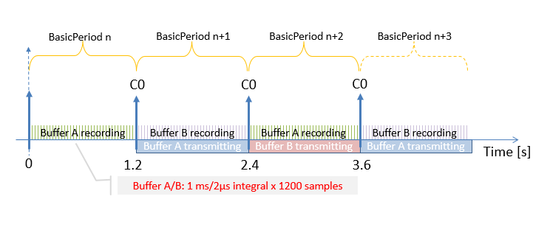
Loss Evolution Function
Evolution of the losses over the entire basic period
  1200 samples
  1ms/sample → PSB, PS
  2 μs/sample → LN4, TT10, TT2

Slide 10
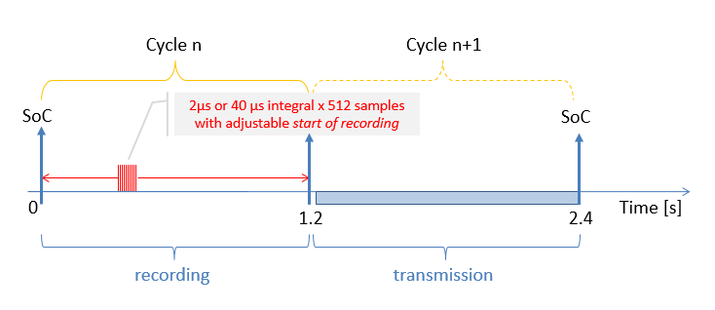
Loss Capture Function
  512 samples
  Settings:
    Start of recording adjustable relative to basic period
    Configurable sampling period (2 μs, 400 μs, 1ms)
  To be used mainly in PSB and PS

Slide 11
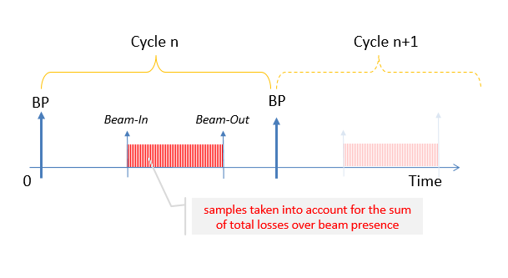
Sum of Losses over Beam Presence
  Timing signal connected via a cable to electronics for Beam In/Out

Slide 12
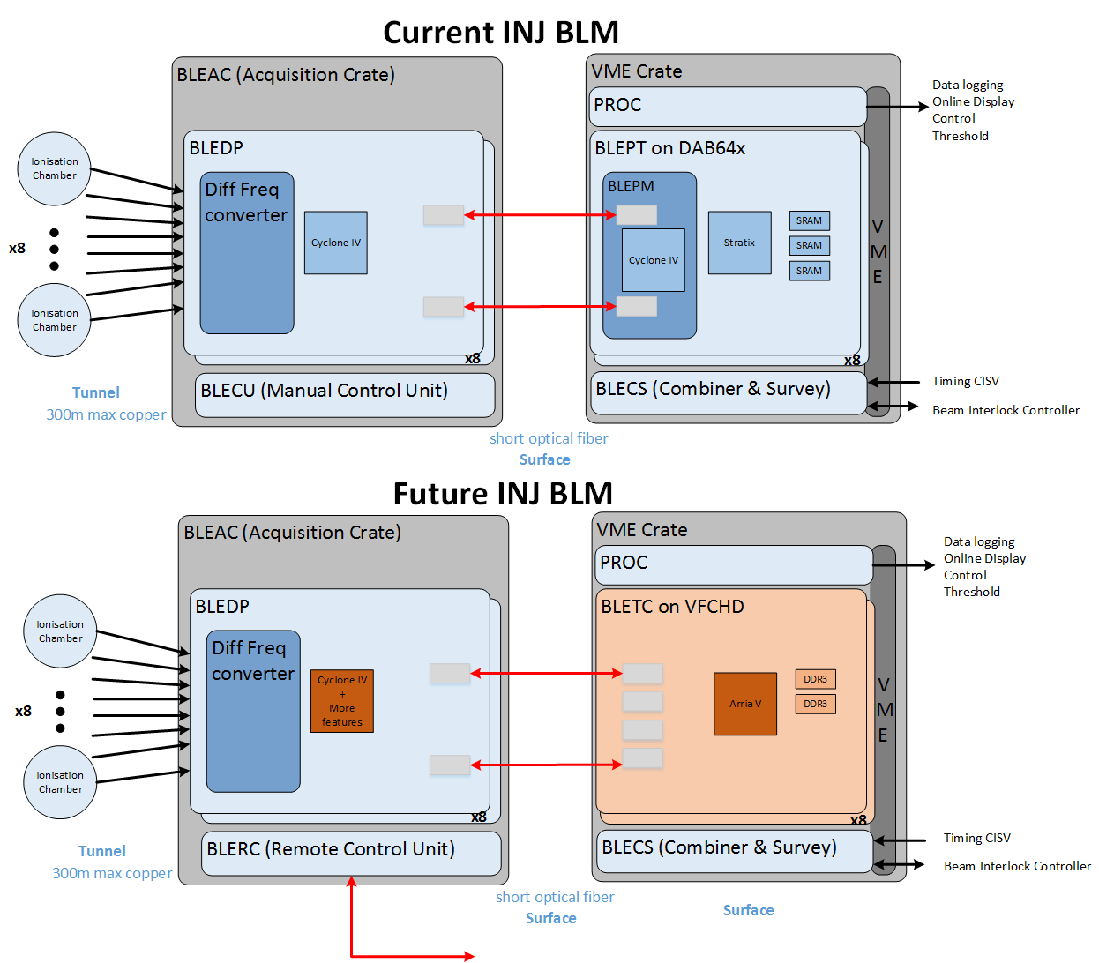
Hardware Changes
Motivation:
  Generic processing board for most BI instruments
  Allow the use of common libraries with the other developments
  Simplify transfer of code to newer electronics
Old System

Slide 13
Hardware Changes
Motivation:
  Generic processing board for most BI instruments
  Allow the use of common libraries with the other developments
  Simplify transfer of code to newer electronics
Replaced by VFC-HD
To be replaced with Remote Control Unit
Old System

Slide 14
Hardware Changes
Motivation:
  Generic processing board for most BI instruments
  Allow the use of common libraries with the other developments
  Simplify transfer of code to newer electronics
New System

Slide 15
Keep BLMINJ Homogeneous
One FESA class to rule them all
BLMINJ
Installation | PSB | PS | TT2 | TT10 | LN4
Type | ring | ring | linear | linear | linear
Cycle | 1 BP | 1..5 BP | 1..20 BP | 1..20 BP | 1 BP
Interlock | BIS | Tail clipper event sent to scraper by BLMSYNC | BIS | BIS | BIS
OP requirements |  | Concatenates all losses from 2 crates |  | Cycle summary acquisition Acquire around injections

Slide 16

LS2 Software Changes
Summary Acquisition (TT10)
BLMSYNC (PS)
Software Interlocks
Changes in register map

Slide 17
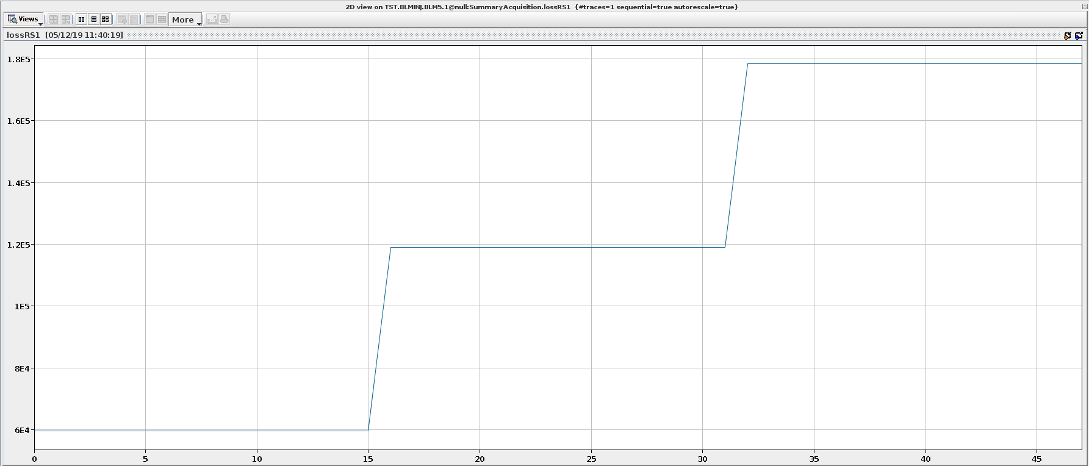
Summary Acquisition for TT10
New feature publishes several injections
Validated with mock-up in the lab
Injection 3
Injection 2
Gy/s
Simulation Data
Injection 1

Slide 18
PS Concentrator (BLMSYNC)
Publish together data acquired from all monitors coming from 2 VME crates
Need to synchronize acquired data
  BLMSYNC: generic solution to concentrate data
Interlocking capabilities
  Protection becomes an issue due to higher brightness after LIU (LHC Injectors Upgrade)
  Calculate total ring losses with sum of all monitors from both crates
  No interlock system in the PS
    Beam inhibit by tail clipper event sent to scraper

Slide 19
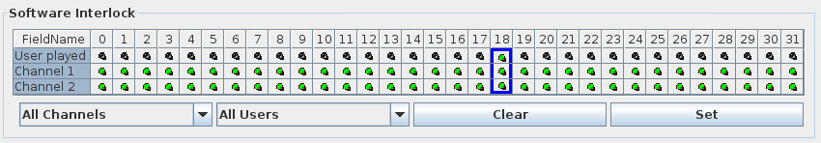
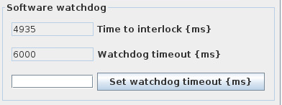
Software Interlocks
Limit radiation levels with software implementation comparisons.
The threshold values are set per user and per monitor
  If losses > threshold → block user’s injections
The blocked beam permit signal will be latched until an operator acknowledges.
Synchronization with current user at the start of cycle.
Possibility to mask software interlock per user and monitor
Added watchdog functionality → Interlock if the software is not active

Slide 20
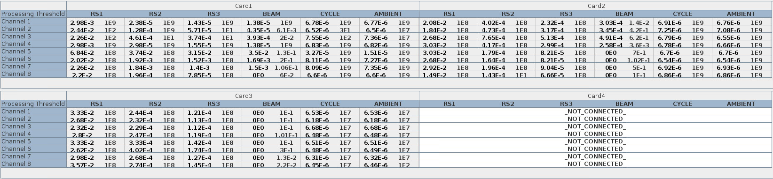
Software Interlocks
Overview of losses vs thresholds displayed in Expert Application
Highlights in red when a threshold is breached
Display in yellow when a mask is active

Slide 21
LS2 Software Changes
Summary Acquisition (TT10)
BLMSYNC (PS)
Software Interlocks
Changes in register map

Slide 22
LS2 Software Changes
Summary Acquisition (TT10)
BLMSYNC (PS)
Software Interlocks
Changes in register map
Assist with firmware validation
Small change at register map level can propagate to many changes in upper levels (encore->FESA->Expert App.)
“Small” on-the-fly requests
Working with legacy code
(re) Commissioning the system

Slide 23
Unit Tests: Improving Quality
Validation of software interlocks
  Systematic setting of thresholds and testing system behavior
Use of simulation data to assert correct data handling
  E.g. New TT10 injection API
  Systematic Unit test
  Visual test in the navigator
Reproducing system anomalies using Python script
  To assist hardware team to diagnose
  And to avoid the anomaly returning in the future!

Slide 24


Initial Results
Revised BLMINJ system deployed during 2019 LINAC4 run
Confident in the system
Software now matches OP requirements
  After last-minute API changes for masking, interlock behavior,…
Workaround in software for data-consistency problem
  BLM Team will continue to work on final fix during Q1 2020
  Some technical debt to catch up on
(re)Commissioned with beam with OP
New system used successfully!!

Slide 25
Future Plans
Finish PS specific concentrator
Finalise strategy for TT10
2 New deployments in TT2, LN4
Many improvements for Expert Tools
Refocus on LHC system during 2020!

Slide 26
Conclusion
New BLMINJ system validated in LN4
One BLMINJ system for all installations
SW experts provide assistance for system validation as well as the FESA class and Expert GUIs
Small changes in the driver level can propagate to many changes in upper layers
Agile methodologies are our allies when working with complex systems

Slide 27
Questions
Thank you

Slide 28
Backup Slides

Slide 29
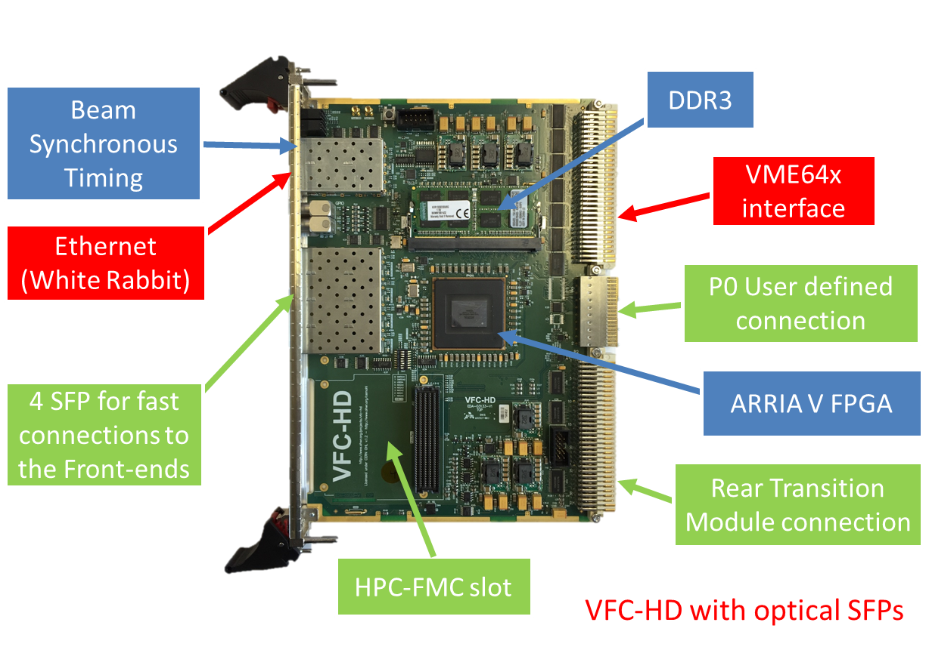
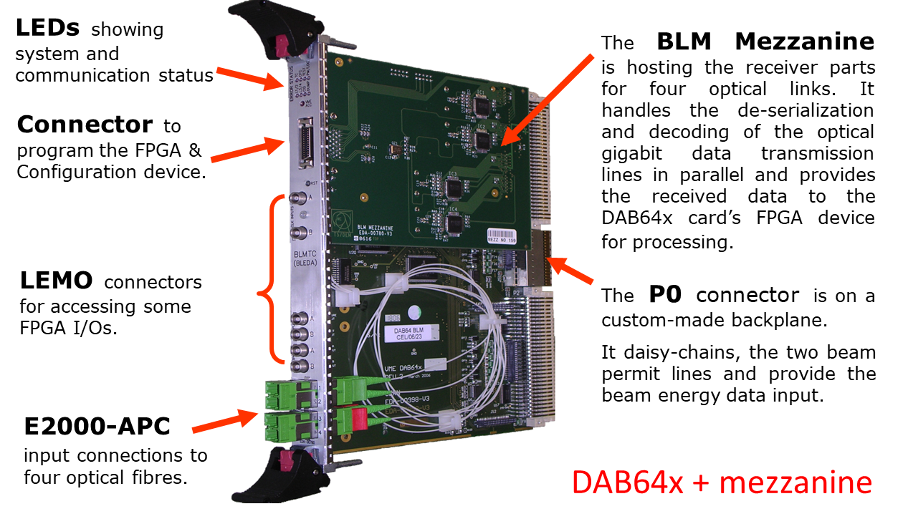
Hardware changes

Slide 30
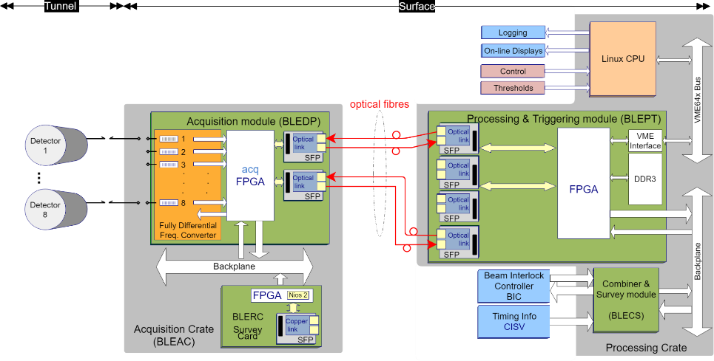
BLMINJ System Overview

Slide 31
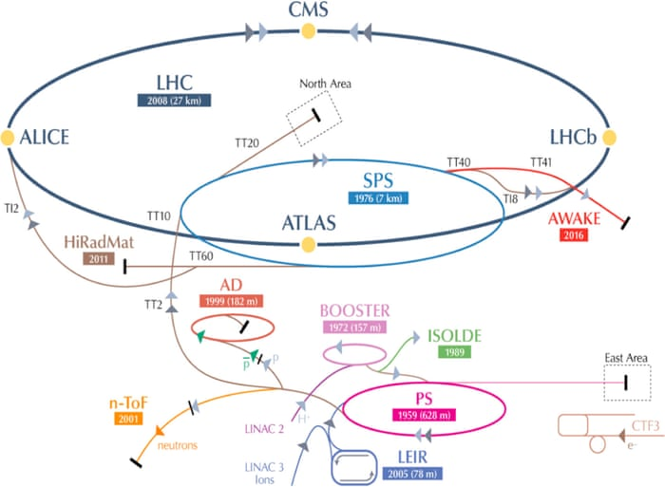
BLM Systems at CERN
LHC
SPS
Injectors*
LINAC 4
*Except SPS

Slide 32
BLM systems in the Injectors (BLMInj)*
LINAC 4
*Except SPS
Notes:
Put where the crates ate

Slide 33
Integration Periods
Continuously the processing electronics will calculate 4 integration period values for each channel:
2 μs, 400 μs, 1 ms and 1.2 s (full cycle)
  implemented as moving sum windows in the hardware
  calculation refreshed at acquisition frequency
Compare with predefined thresholds
  Machine protection with hardware implementation
  comparisons on each refresh
  Limit radiation levels with software implementation
  comparisons at end of cycle
  See also next slide.
Calculate for each channel the maximum values recorded on each integration period during the cycle
  Publish them for the online displays and
  the long-term logging

Slide 34
Software Thresholds
All maximum integration period values recorded on the cycle will be checked against a second set of threshold values. The outputs will be used for repeated over threshold function
  Additional threshold values for the same integration periods will also be required.
  In the case found to be over threshold repeatedly n times it will be required to block that user’s injections.
  The blocked beam permit signal will be latched until an operator acknowledges.
  The repeat value n will be settable per monitor in the range of 1 to 16.
The threshold values will need to be unique per user and per channel:
  Each CPU will process 8 cards x 8 channels
  The information of the current user has to be obtained from the telegram per cycle -> dedicated timing card
  Memory for 32 users will be reserved.

Slide 35
FESA & FPGA Upgrades
Large upgrade program
  BLM INJ: processing module changed to VFC
    New memory map, driver, FESA and firmware
    New diagnostic/status data (consolidation of two firmware)
    New interlocking features (HW interlocks & expert mode for testing)
    Addition of concentrator with interlocking abilities (for PS mainly)
    Addition of persistent data at VFC level (EPROM)
  BLM LHC: FESA3 and new firmware
    New VMEbus core with MBLT mode
    New memory map optimized for block transfers
    Changes for UFO Buster
    Add Injection Interlock Inhibit functionality
Restructure of the FW code to industry standards
  Allow the use of common libraries with the other developments
  Simplify transfer of code to newer electronics

