Slide 1


Directional Dark Matter Search with Nuclear Emulsion
Andrey ALEXANDROV
INFN and University of Naples, Italy
On behalf of the NEWSdm collaboration

Slide 2







NEWSdm COLLABORATION
Nuclear Emulsion WIMP Search directional measurement
75 physicists
14 Institutes
ITALY
University and INFN Bari
LNGS, Gran Sasso
University and INFN Napoli
INFN Roma
JAPAN
Chiba, Nagoya, Toho
SOUTH KOREA
Gyeongsang University
RUSSIA
LPI RAS Moscow
JINR Dubna
SINP MSU Moscow
INR Moscow
Yandex School of Data Analysis
TURKEY
METU Ankara
Website:
news-dm.lngs.infn.it
Letter of intent:
https://arxiv.org/pdf/1604.04199.pdf

Slide 3
WIMP directional information
earth@summer
Nuclear emulsion detector
Direction of solar system
(220km/sec)
Dark matter
wind
WIMP
Target nuclei
earth@winter
Direction of the scattered nuclei has strong correlation with WIMP flux and provide a strong signature and unambiguous proof of the galactic DM origin
Unique possibility to overcome the “neutrino floor”, where coherent neutrino scattering creates an irreducible background
Nuclear Emulsion is a high density solid state media – big mass with a compact detector is possible

Slide 4
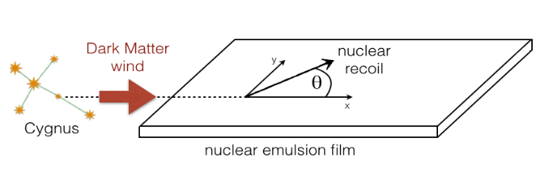
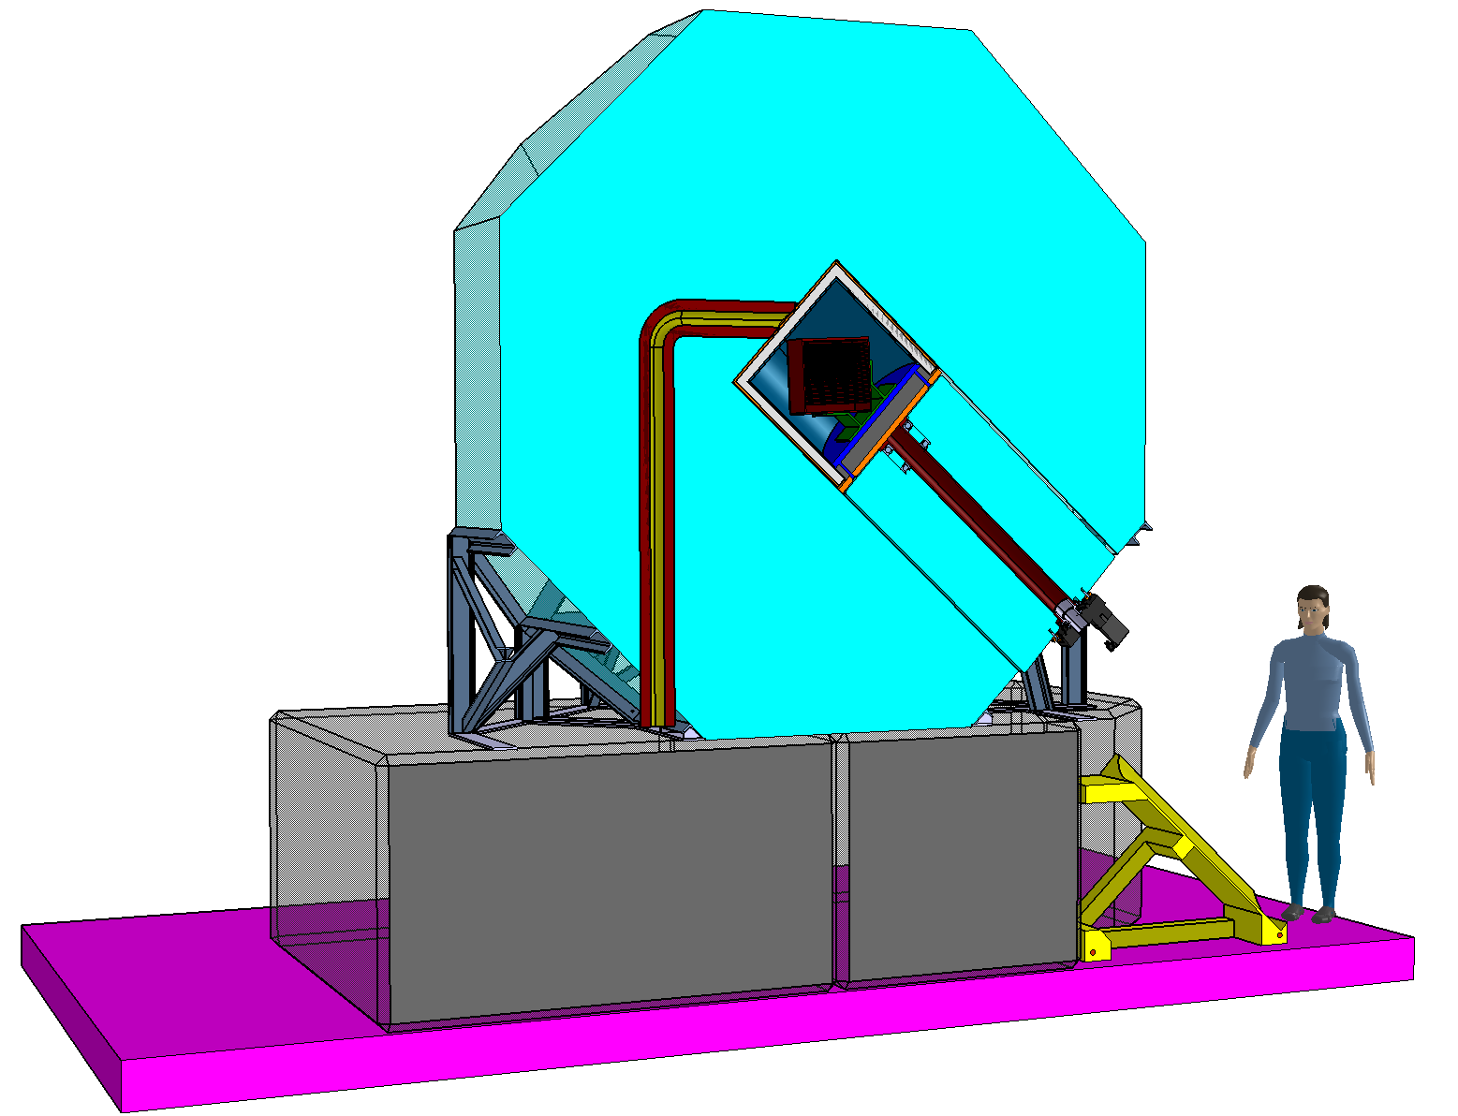
NEWSdm Principle
Goal: detect the direction of nuclear recoils
Target: nanometric emulsion films acting both as target and tracking detector
Background reduction: neutron shield surrounding the target
Fixed pointing: target mounted on equatorial telescope pointing to the Cygnus Constellation
Location: Underground labs
Polar axis
Declination axis
(to Cygnus)

Slide 5
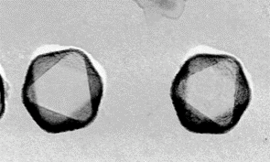
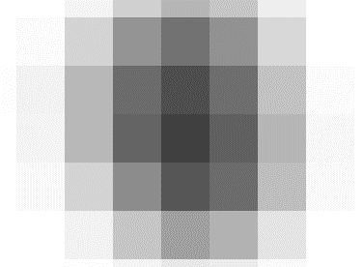
Detection principle
AgBr crystal
Ionization induced by a particle
  2.6 eV band gap
Electrons trapped at a lattice defect on the crystal surface
  Attract interstitial silver ions
  Produce a “latent image” = Ag_{n}
Chemical amplification of signal
  Development → silver filaments
  10⁷ - 10⁸ amplification
Dissolve crystals
Observe it at optical microscopes
+ -
- +
- +
+-
-+
-
-
Silver filament
-
-
~40 nm
-
Ag+
-
Ag+
-
Ag+
-
Ag_{n}
-
Ag+
-
Lattice defect
Latent image
Grain as seen by a sensor of an optical microscope

Slide 6
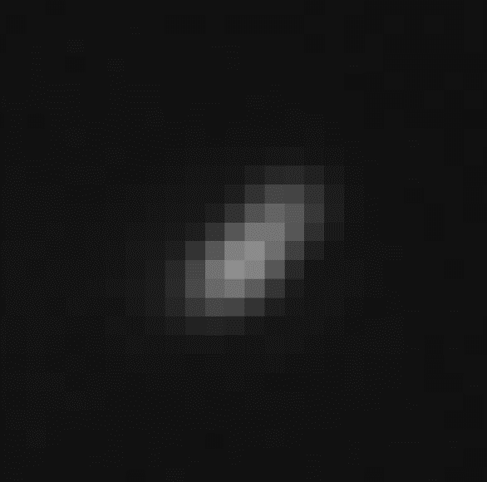
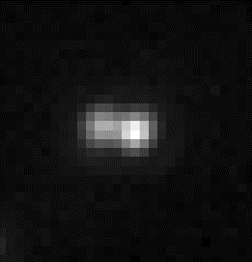
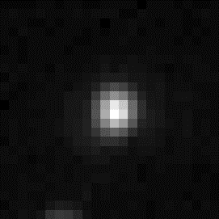
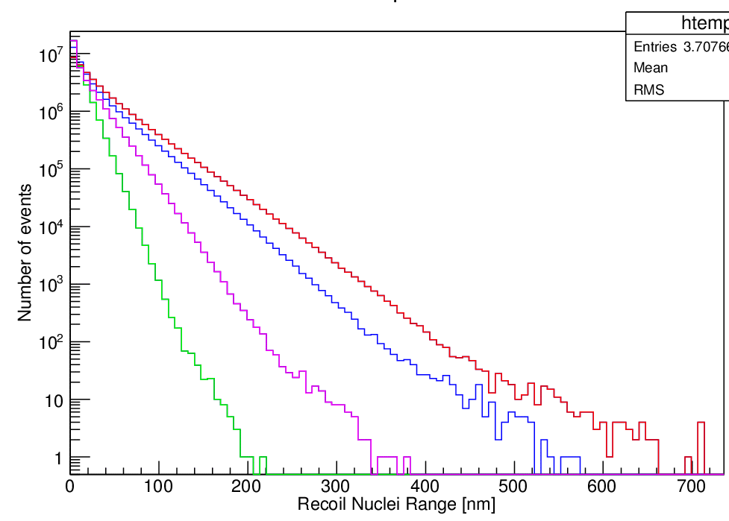
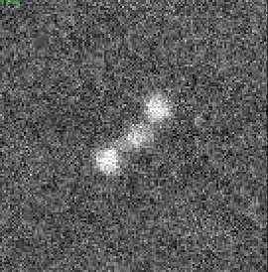
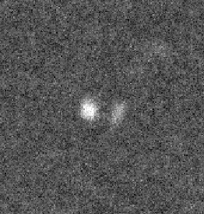
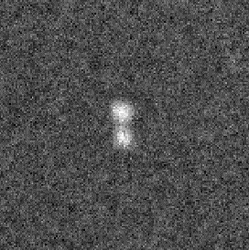
Directional detection challenge
expected recoil length in the nuclear emulsion
Optical
Optical
Optical
WIMP mass
― : 100 GeV/c²
― : 50 GeV/c²
― : 20 GeV/c²
― : 10 GeV/c²
3.2 g/cm³
target : C,N,O, Ag, Br
X-ray
X-ray
X-ray
10 GeV/c²
20 GeV/c²
100 GeV/c²
50 GeV/c²
Track length [nm]
Inaccessible due to diffraction limit
L = 380 nm
L = 265 nm
L = 160 nm
Need super-resolution to measure tracks shorter than 200 nm
Notes:
Directional detection in solids is an extremely challenging task due to low energy of recoils produced in WIMP interactions.
The expected length in emulsions do not exceed 1 micron and the major part of recoils being shorter than 200 nm, which is the resolution limit of optical microscopy.
As it is possible see from the table on the right, the reduction of the detection threshold by the factor of 2 reduces the required exposure by one order of magnitude, the factor of 10.
And, therefore, readout resolution is crucial for the sensitivity.

Slide 7
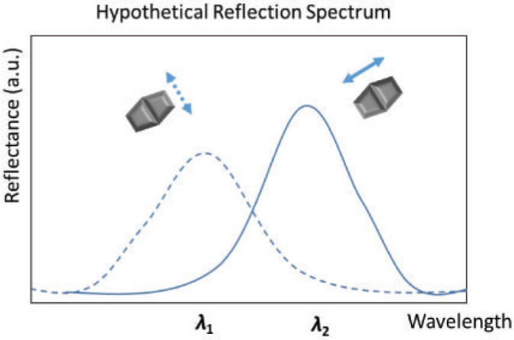
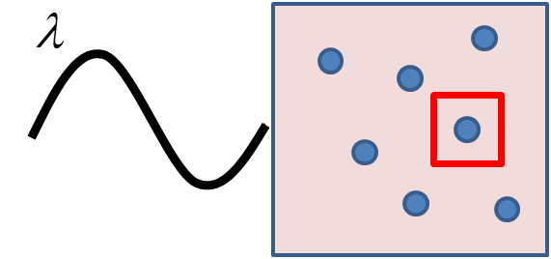

Optical readout beyond the diffraction limit
Super-resolution idea: use the plasmon resonance effect to overcome the diffraction limit:
  generated by a light wave trapped within conductive nanoparticles smaller than the wavelength of light
  resonant frequency strongly depends on the composition, size, geometry, dielectric environment and distance between nanoparticles
  occurs in the visible region for Ag and Au nanoparticles!
  improve resolution by analyzing scattered light polarization and spectrum
λ_{l}
Oscillation of e-cloud
PTEP, Vol. 2019 Issue 62019, 063H02

Slide 8
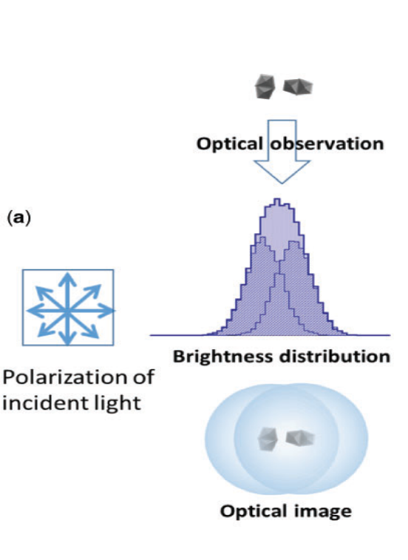
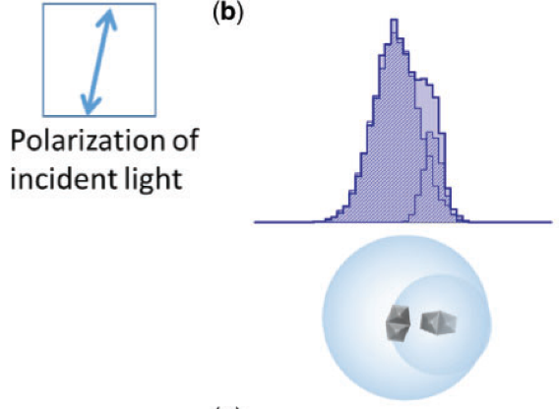
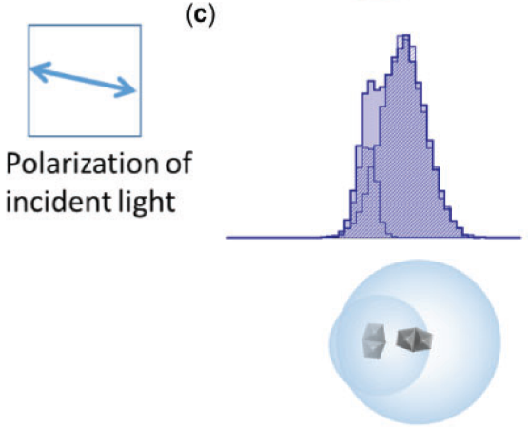
Optical readout beyond the diffraction limit
PTEP, Vol. 2019 Issue 62019, 063H02

Slide 9
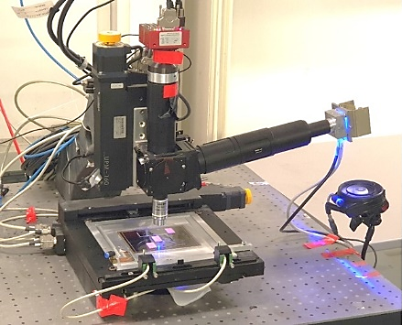
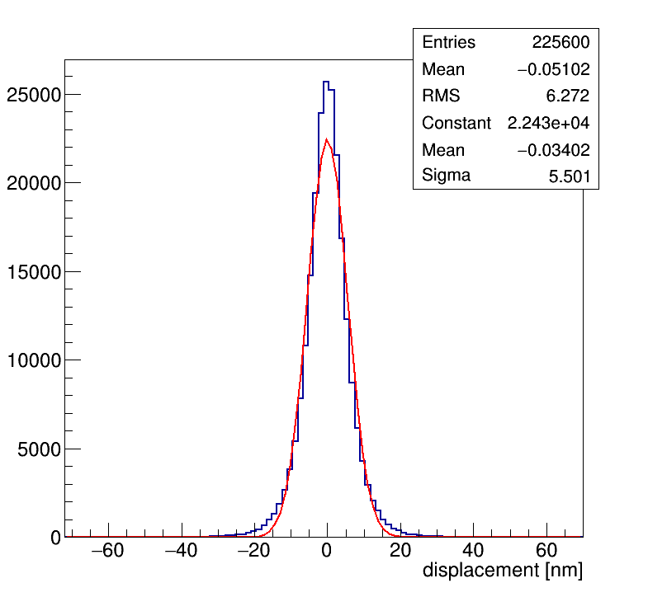
Optical scanning system customized for plasmon
Fast CMOS camera
Exit polarizer plate
Liquid Cristal Polarization Rotator
Blue LED (λ = 460 nm)
Spatial Accuracy = 6 nm
Nikon 100X, 1.45 NA objective
  Field of view = 63 x 47 µm (pixel size = 27 nm)

Slide 10
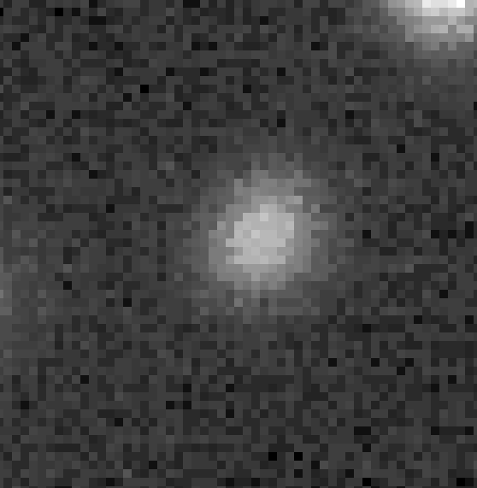
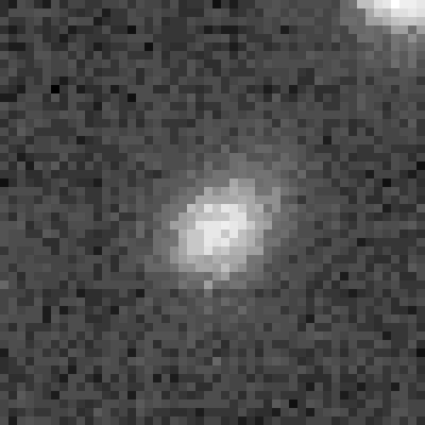
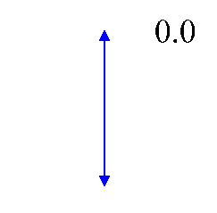
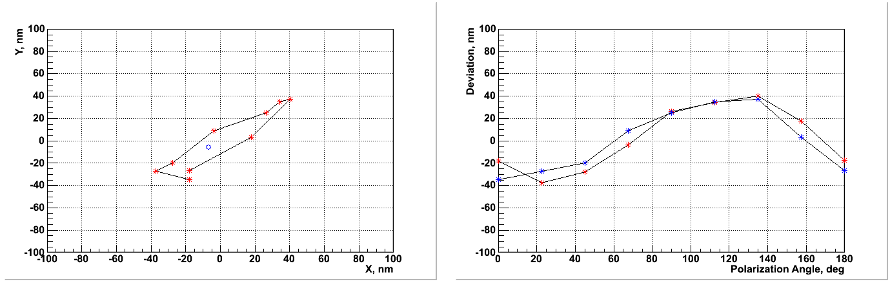
Super resolution: two-dimensions
A track made of two grains
No polarizer
Rotating polarizer
Beam
grain1
Beam
Grains are too close to be resolved (L=100 nm)
A single elliptical cluster is seen without the polarizer
The mass center of the track starts to “oscillate” with the rotation of polarizer
pol angle
grain2
300 nm
200 nm
1150 nm
1150 nm
Center of mass displacement
* - X
* - Y
Barycenter shift
BS=100 nm
Beam

Slide 11
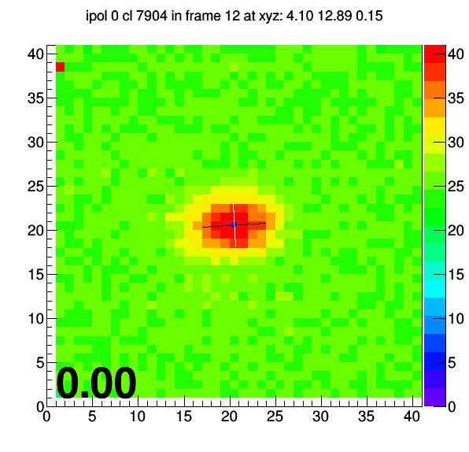
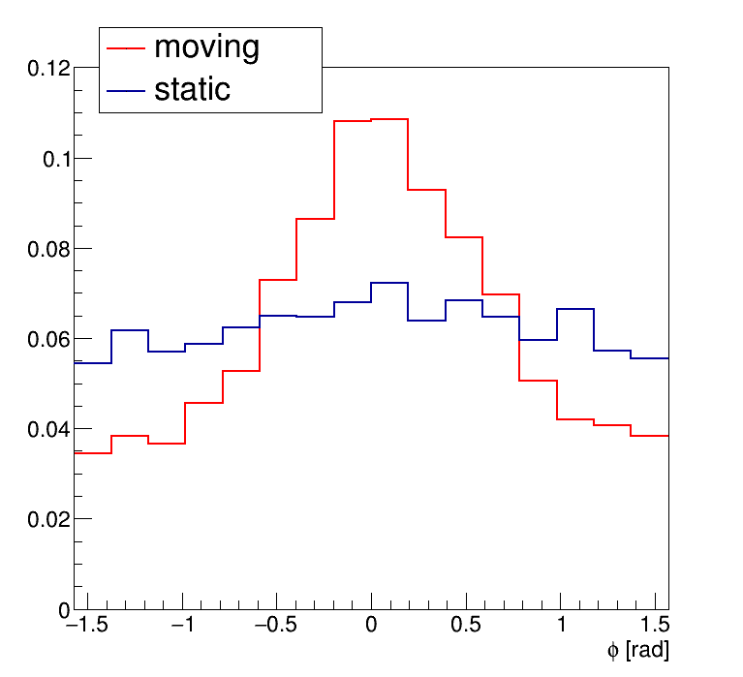
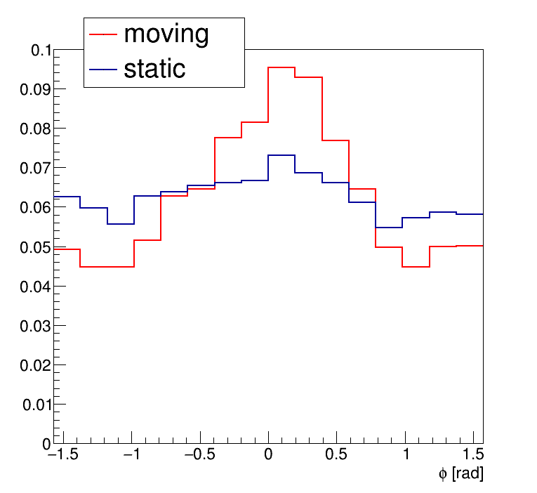
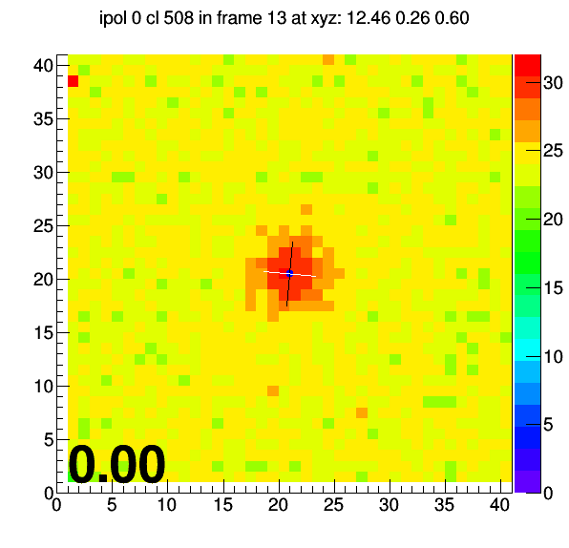
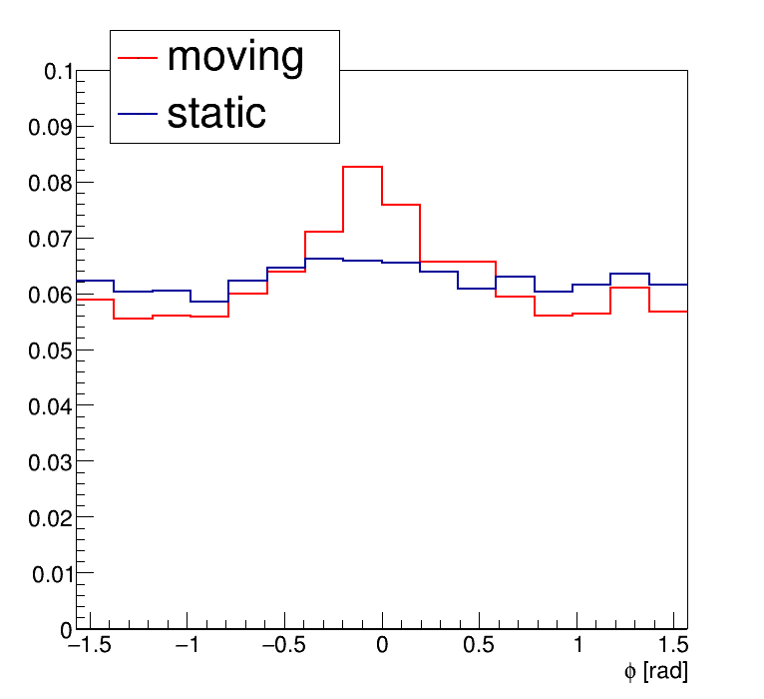
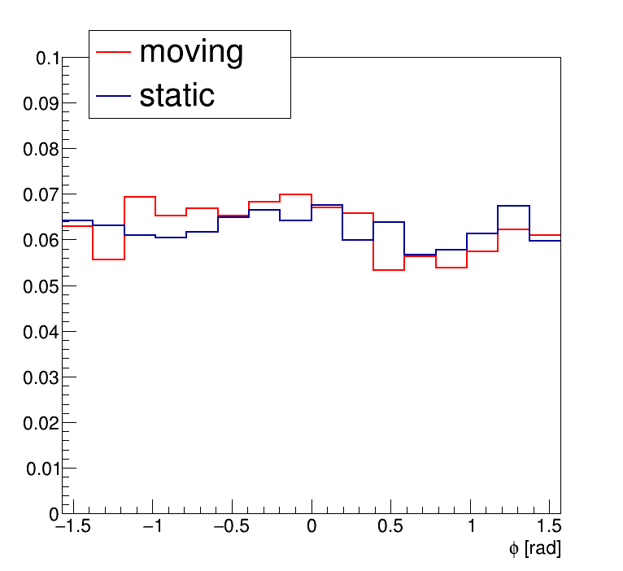
Plasmon analysis of isolated events
MOVING: BS>20 nm
C100keV
C60keV
pol angle
C30keV
C10keV
vertical
STATIC: BS<20 nm
Directionality demonstrated with Carbon ions down to 30 keV

Slide 12
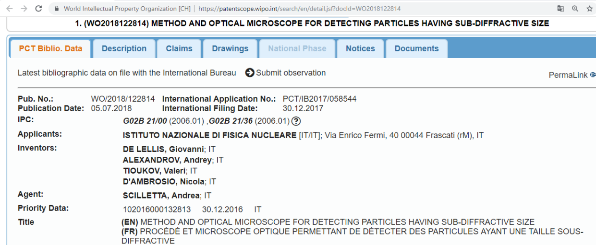
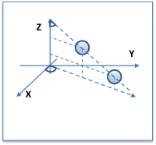
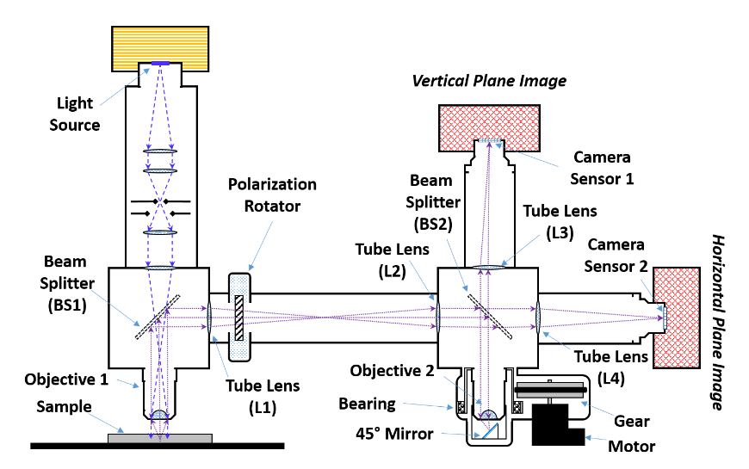
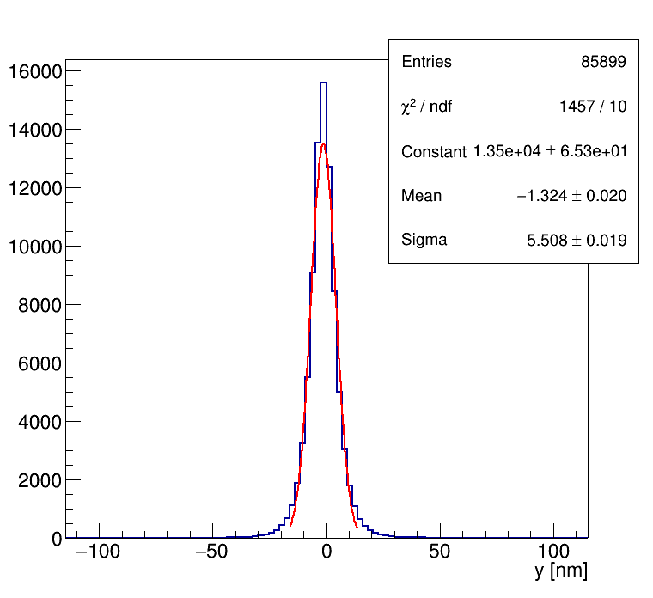
Super resolution:
3-dimensions!
σ ~ 6 nm!

Slide 13
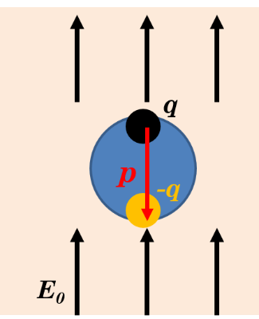
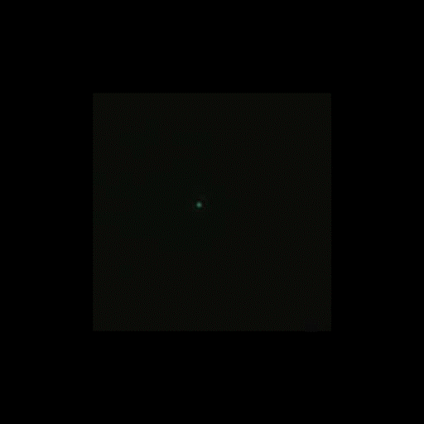
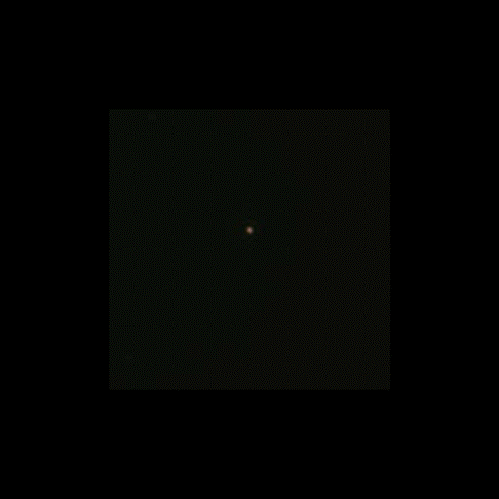
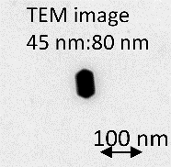
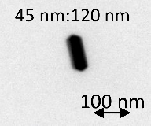
LSP (Localized Surface Plasmon) resonance
Colored optical image of silver rod
Annu. Rev. Phys. Chem. 58 (2007) 267-297
*polarization rotating
dipole in metallic particle
dipole moment
45x80 nm
45x120 nm
resonance
Appl. Phys. Lett. 80, 1826 (2002)
~45 nm : blue
~80 nm : green
~45 nm : blue
~120 nm :orange–red
Ag grain size → resonance wavelength

Slide 14
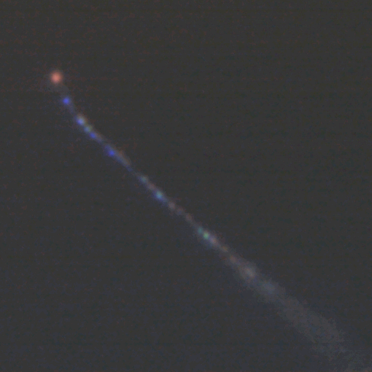
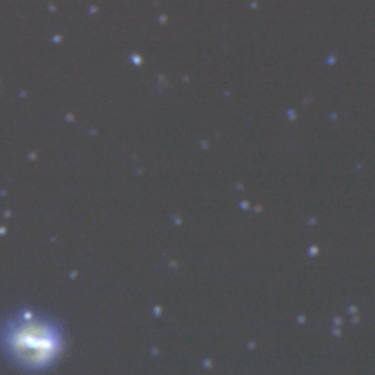
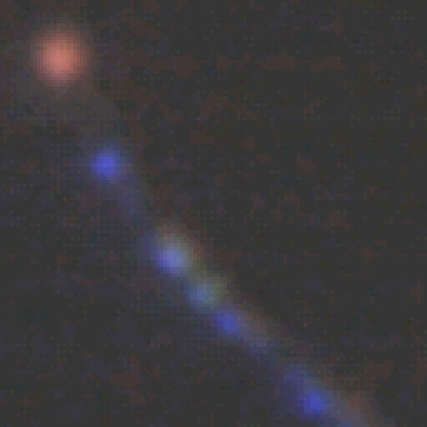
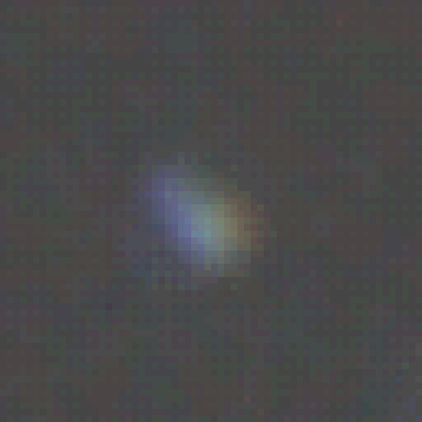
LSP in the NIT emulsion
Alpha track
100keV C-ions
Image size 15 µm x 15 µm
Image size 15 µm x 15 µm
Head-tail discrimination!

Slide 15
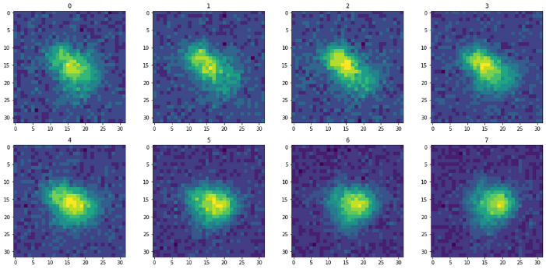
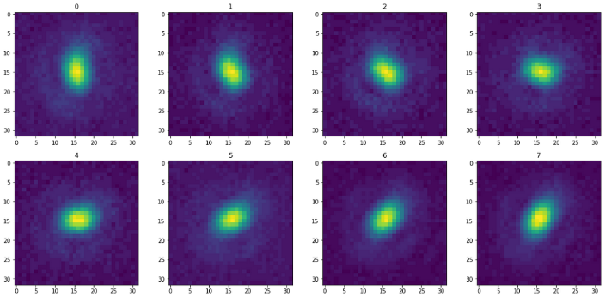
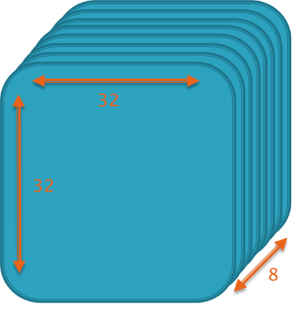
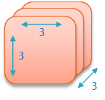
Machine Learning Approach
Experimental data
Signal: samples exposed to C ions at different energies
Background: gamma exposure, random fog
J. Phys.: Conf. Ser. (2020) 1525 012108
C100keV
Fog
  3D CONVOLUTIONAL NN: approach designed to work with images, capable of discovering complex features of images and gaining high performance
  Stacking together images for different light polarizations to obtain a 3D image

Slide 16
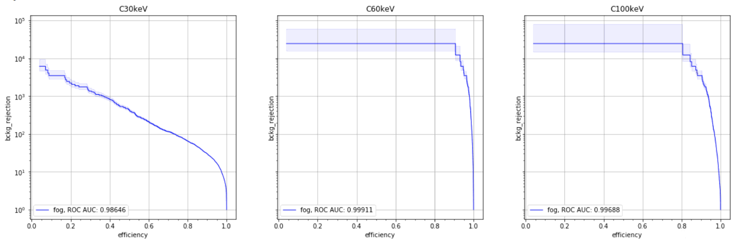
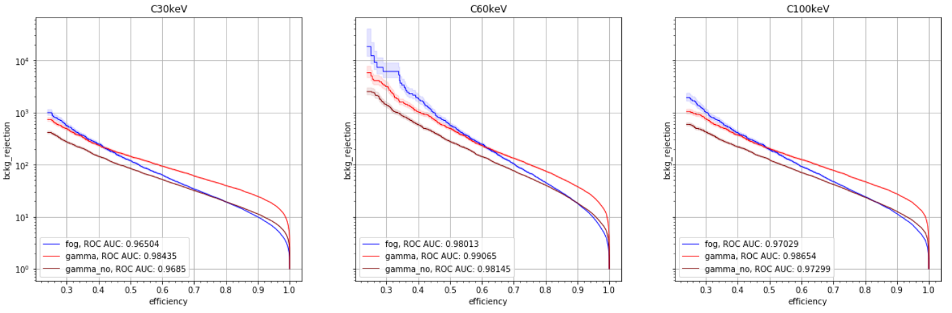
Machine Learning Analysis
Rejection power (against fog and dust)
10⁴
Only color images, no polarization information
10³
10²
Color
(all polarizations)
Preliminary results
10⁴
10³
10²
Only polarization, no color
Polarization
λ=460 nm
Next step: combine polarization and colour

Slide 17
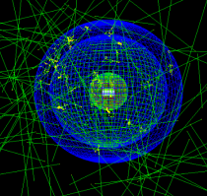
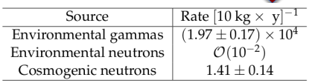
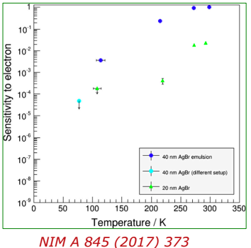
Backgrounds
Intrinsic
Intrinsic Radioactivity | Rate [g × month]⁻¹ | Rate [kg × year]⁻¹
Radiogenic neutrons | (5.0 ± 1.7) × 10⁻⁶ | 0.06 ± 0.02
Intrinsic ß | 33.7 ± 1.8 | (4.04 ± 0.02) × 10⁶
Astropart. Phys.. 80 (2016) 16–21
External (with 1 m HDPE shielding @LNGS)
C14 and gamma;
Strong reduction factor: NIT emulsions insensitive to MIP and largely insensitive to electrons (~10⁻⁴)
Additional level arms being quantified:
• Dedicated chemical treatments
• Reduced sensitivity to electrons at low temperatures (10⁻⁴@77K)
• Electron response to polarized light scattering (10⁻²-10⁻³)
• Colour camera to distinguish nuclear recoils from electrons (10⁻³-10⁻⁴)
• Replace the gelatin with synthetic polymers (final choice)
• Topological veto using MIP sensitive emulsions

Slide 18



Underground emulsion production facility @LNGS
Fully operational since Feb-2019
Production capacity 100-200 g/day
241 Am alpha tracks
- Sensitivity test

Slide 19



Shielding prototype installed at LNGS hall B
(for 10 g demonstrator run)

Slide 20

Equatorial telescope inside shielding
(for 10-kg-scale physics run)
Polar axis
Declination axis
(to Cygnus)

Slide 21

Sensitivity of a pilot experiment 10 kg scale
10kg x year experiment
Zero background assumed
Directionality not exploited

Slide 22


Towards Neutrino Floor
NEWSdm Collaboration
Eur.Phys.J. C78 (2018) no.7, 578
Discrimination based on measurement of recoil direction
Unique possibility to search for WIMP signal beyond “neutrino floor”
Neutrino coherent scattering indistinguishable from WIMP interactions
Phys.Rev.D89 (2014) no.2, 023524 (Xe/Ge target)
REQUIREMENTS
Larger mass scale detector
Reduction of track length threshold
The neutrino bound is reached with:
➡10 ton x year exposure if 30 nm threshold
➡100 ton x year exposure if 50 nm threshold

Slide 23
Conclusion
Nano-grain emulsion based, high resolution detector for a directional Dark Matter search is under development
Technological break-through for optical readout makes possible fast analysis of O(100nm) tracks: 2D and 3D super-resolution, head-tail, color information
Machine learning approach to handle the data complexity
Emulsion production underground is established, experimental tests ongoing to reproduce the full analysis chain
Autumn 2020 run: 10 g detector as the technology demonstrator
Future goal: ~10 kg scale detector for the first physics run
TDR is under preparation

Slide 24
THANK YOU FOR ATTENTION!
Andrey ALEXANDROV (andrey.alexandrov@na.infn.it)
INFN and University of Naples, Italy
For further discussion:
Meeting ID: 960 6793 4407

