Slide 1
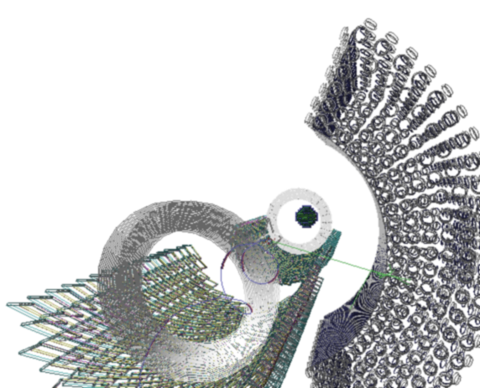


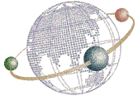

BSM search in rare muon decay: the MEG II experiment
Kei Ieki
on behalf of MEG II collaboration
JSPS
Core-to-Core Program

Slide 2
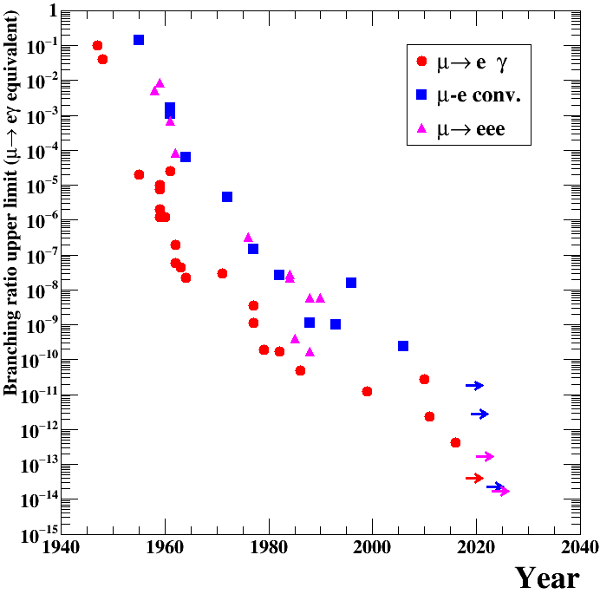

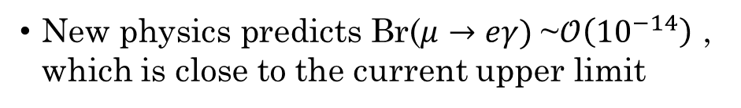

Why $μ→eγ$?
Because it is a good probe of BSM!
μN$→$eN
New physics predicts Br($μ→eγ)$~$𝒪\left({10}^{−14}\right)$ , which is close to the current upper limit
Flavor violation is observed in neutrinos.
There is no fundamental rule which prohibits
flavor violation.
DeeMe
COMET-I
BSM prediction
(SUSY-seesaw etc.)
MEG
Mu3e-I
MEG II
Mu3e-II
COMET-II
Mu2e

Slide 3
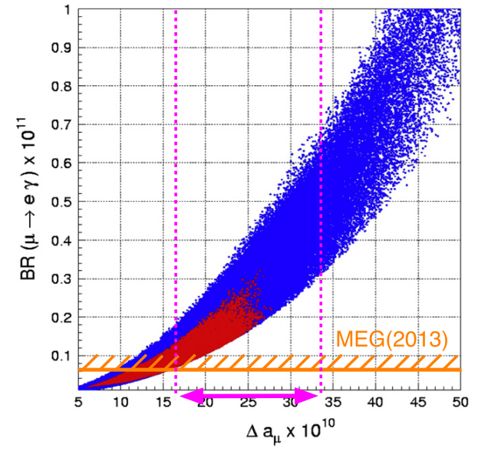






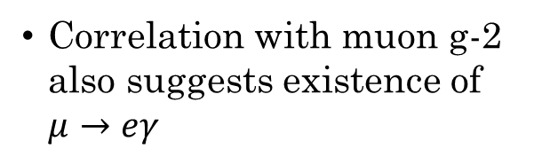






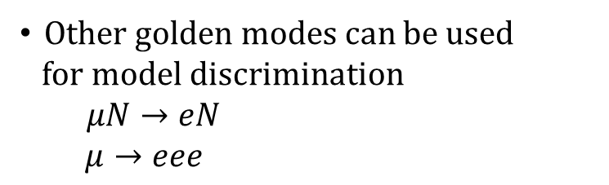













Muon as a probe of BSM
Correlation between $μ→eγ$ and g-2
$$μ→eγ$$
$$g−2$$
$$γ$$
$γ$ (B-field)
Correlation with muon g-2 also suggests existence of $μ→eγ$
$$μ$$
$$e$$
$$μ$$
$$μ$$
G. Isidori, F. Mesia, P. Paradisi, D. Temes, Phys. Rev. D 75 (2007) 115019.
Other golden modes can be used
for model discrimination
$μN→eN$
$μ→eee$
$$μN→eN$$
$$μ→eee$$
$$q$$
$$e$$
$$q$$
$$e$$
$$γ, Z^{′}…$$
$$γ, Z^{′}…$$
$$μ$$
$$e$$
$$μ$$
$$e$$

Slide 4
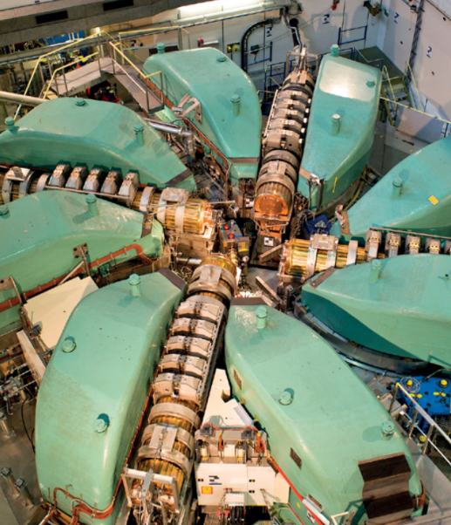
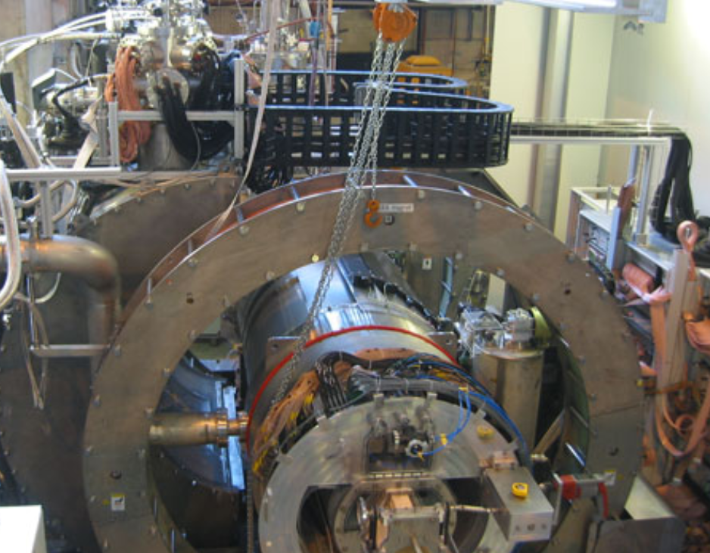
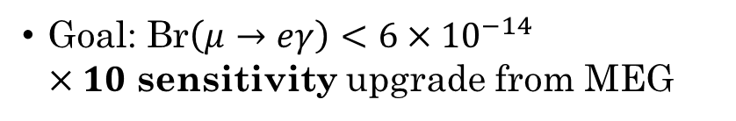
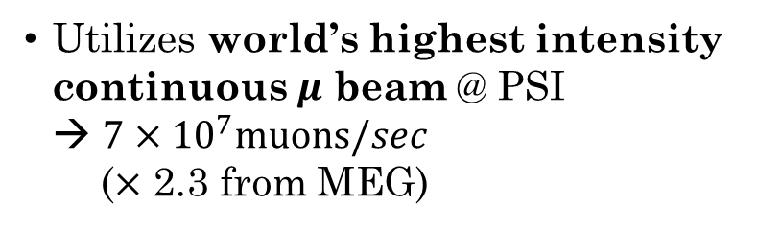


MEG II experiment
PSI proton cyclotron
Goal: Br$\left(μ→eγ\right)<6×{10}^{−14}$
$×10$ sensitivity upgrade from MEG
Utilizes world’s highest intensity
continuous $μ$ beam @ PSI
→ $7×{10}^{7}muons/sec$
($×$ 2.3 from MEG)
MEG detector
Accidental BG (∝beam rate²) limits
the sensitivity
→ Improve detector resolutions
by x2 (energy, timing, direction)
$$γ$$
$$μ$$
e

Slide 5




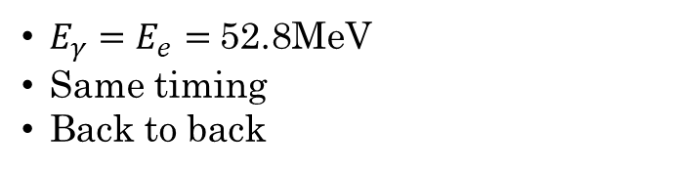
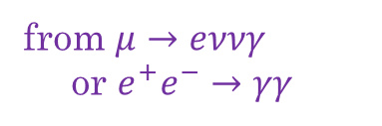

Signal and BG
Signal
Accidental BG
$$∝{\left(beam rate\right)}^{2}$$
$$γ$$
$$γ$$
$$μ$$
from $μ→eννγ$
or $e^{+}e^{−}→γγ$
e
e
from $μ→eνν$
$E_{γ}=E_{e}=$52.8MeV
Same timing
Back to back
Good energy, time and position resolutions are required

Slide 6


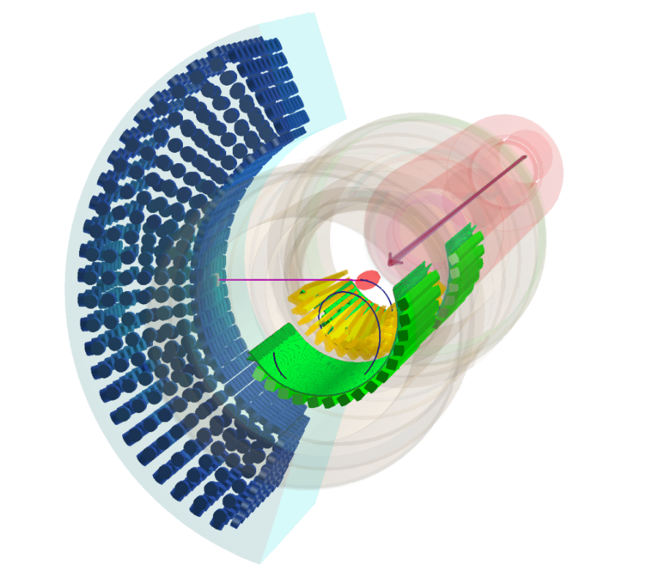
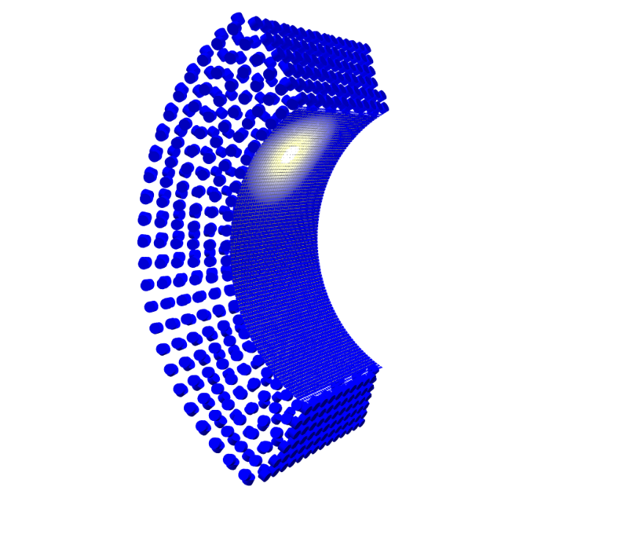
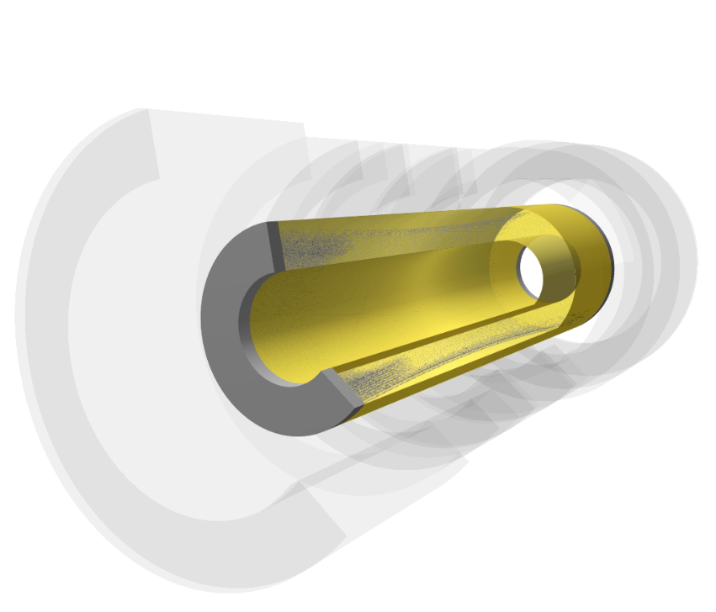


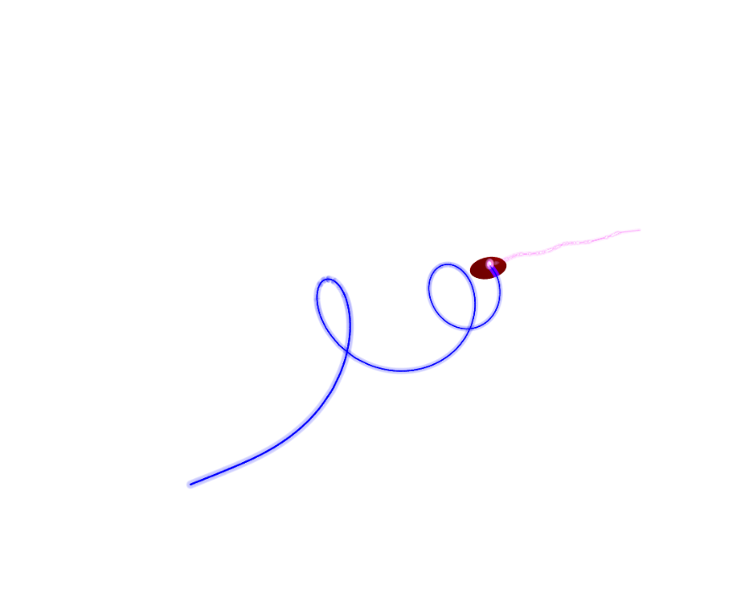






Detector upgrades from MEG
$$μ^{+}$$
$$γ$$
$$γ$$
$$μ^{+}$$
upgrade
$$e^{+}$$
$$e^{+}$$

Slide 7
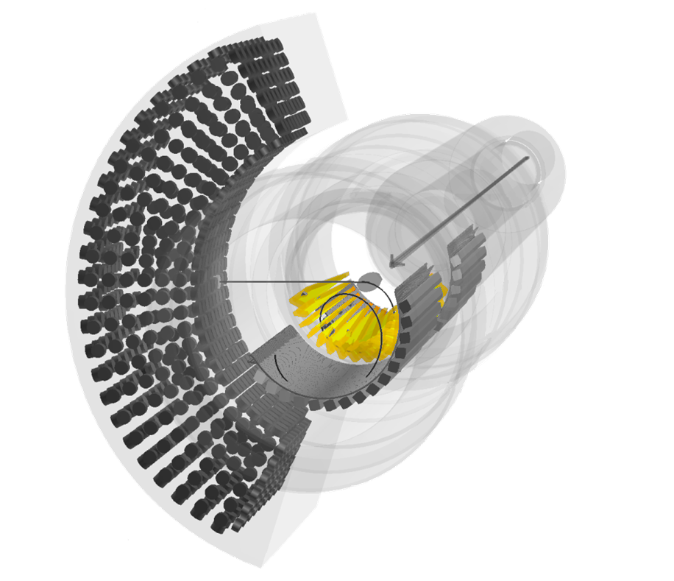
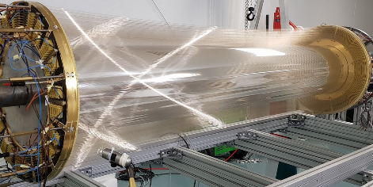
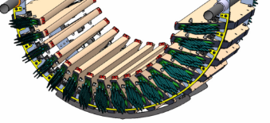
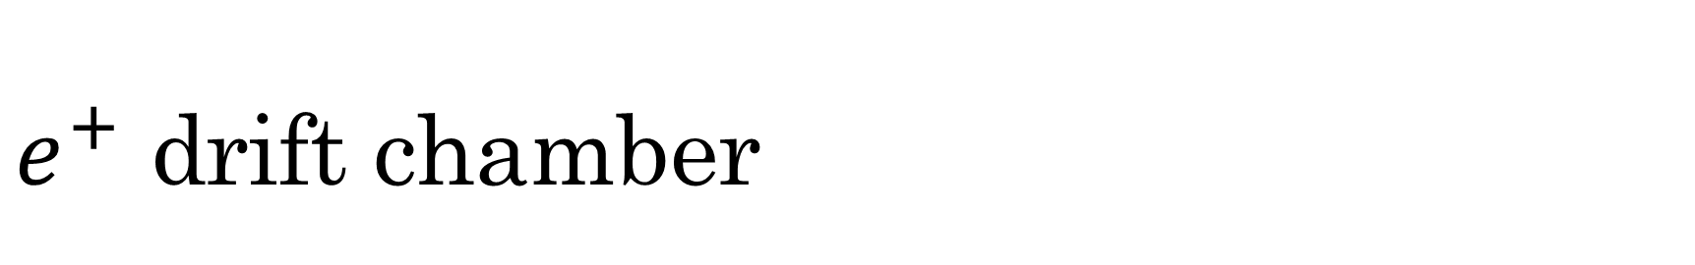
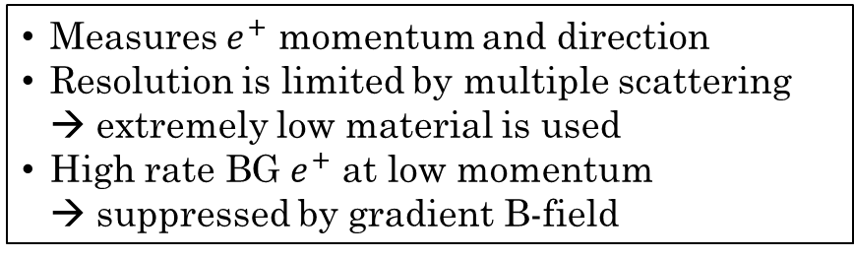
$e^{+}$ drift chamber
upgrade
$$e^{+}$$
16 modules
Measures $e^{+}$ momentum and direction
Resolution is limited by multiple scattering
→ extremely low material is used
High rate BG $e^{+}$ at low momentum
→ suppressed by gradient B-field
single volume
$$e^{+}$$

Slide 8
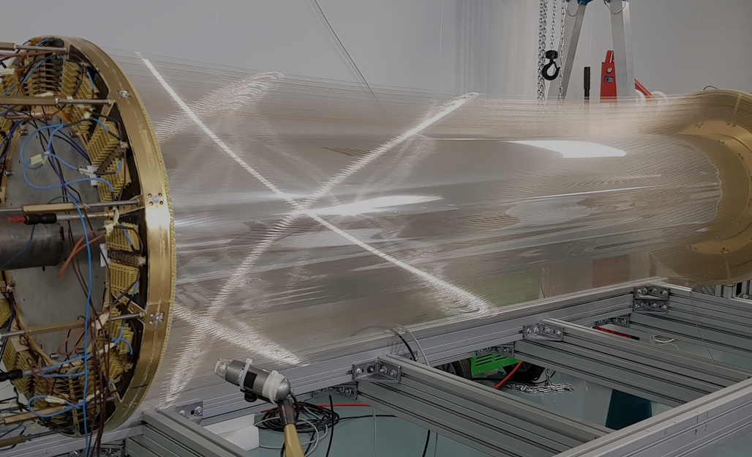
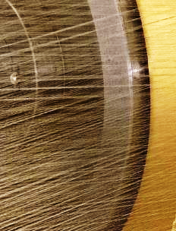
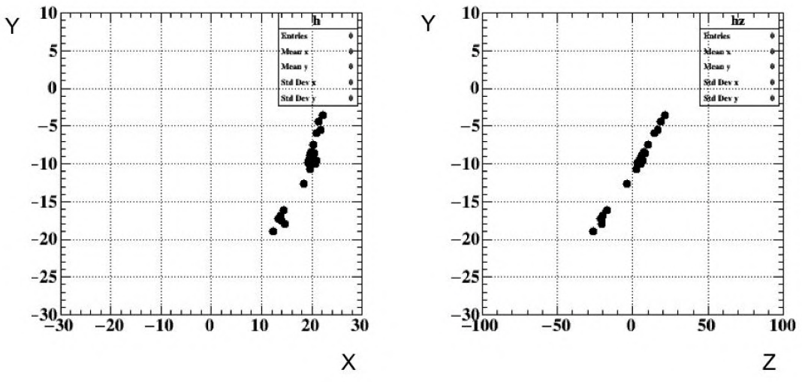
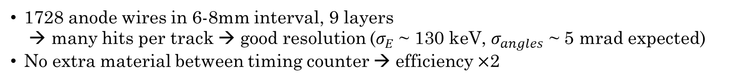

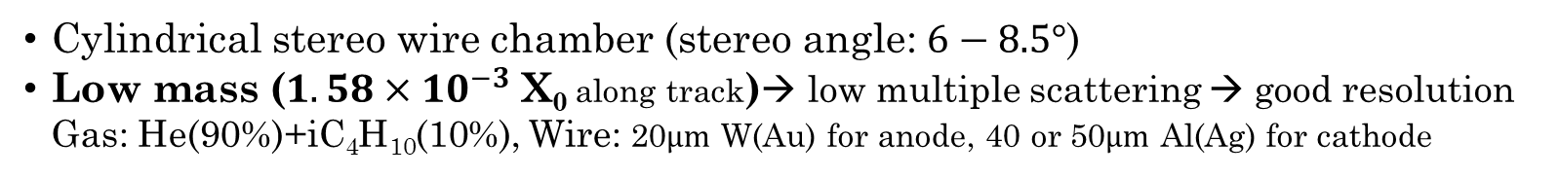
$e^{+}$ drift chamber
Example of signal
Cylindrical stereo wire chamber (stereo angle: $6−8.5°$)
Low mass ($1.58×10^{−3}$ X₀ along track)→ low multiple scattering → good resolution
Gas: He(90%)+iC₄H₁₀(10%), Wire: 20$μm$ W(Au) for anode, 40 or 50$μm$ Al(Ag) for cathode
1728 anode wires in 6-8mm interval, 9 layers
→ many hits per track → good resolution ($σ_{E}$ ~ 130 keV, $σ_{angles}$ ~ 5 mrad expected)
No extra material between timing counter → efficiency $×$2

Slide 9
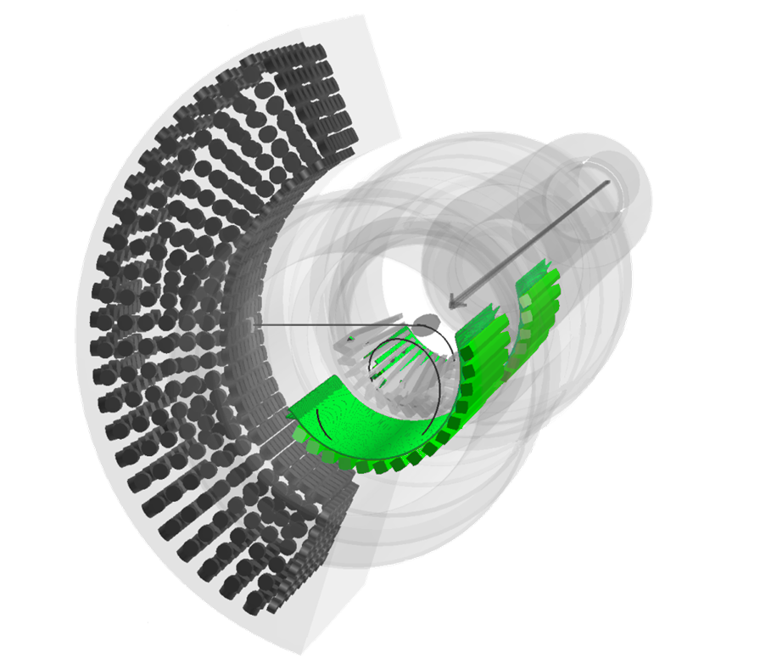
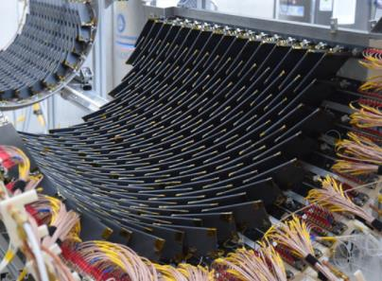
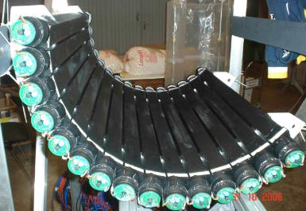
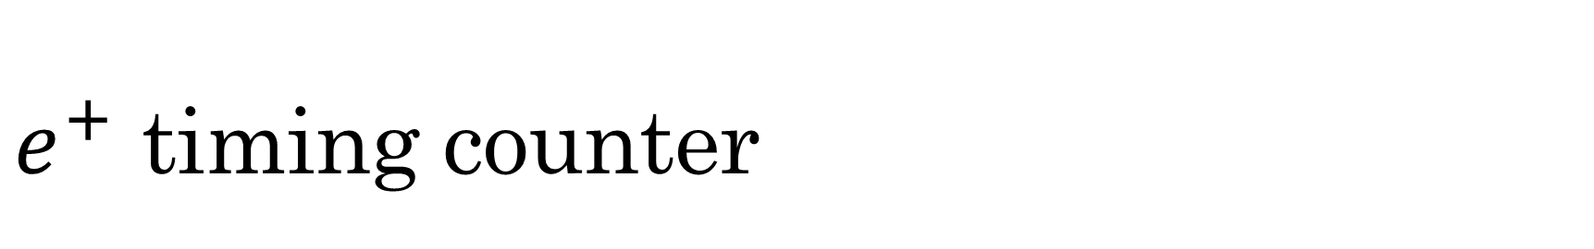
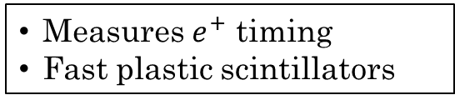
$e^{+}$ timing counter
upgrade
$$e^{+}$$
15 bars x2
256 counters x2
$$e^{+}$$
Measures $e^{+}$ timing
Fast plastic scintillators

Slide 10
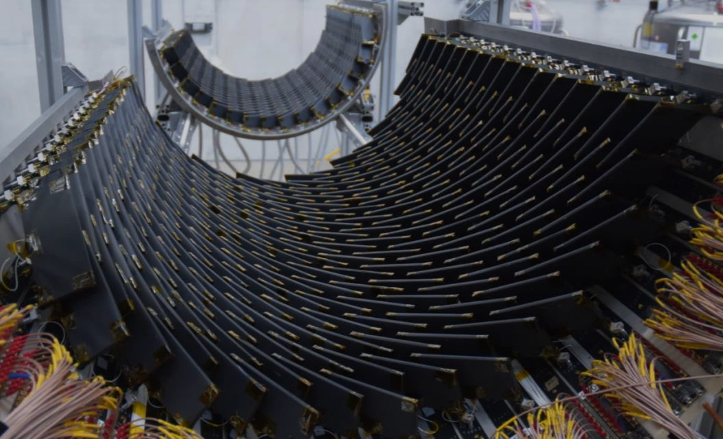
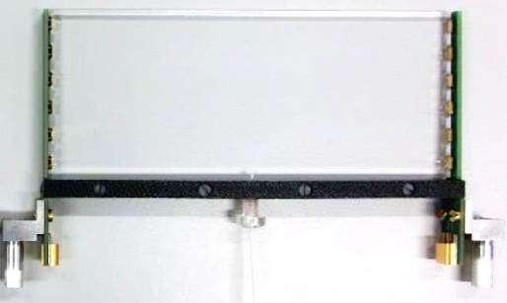

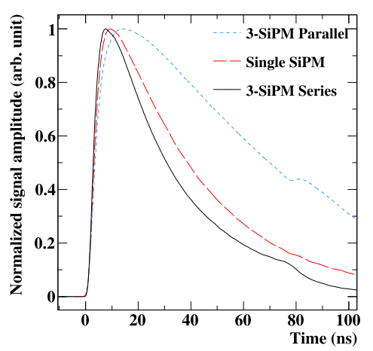
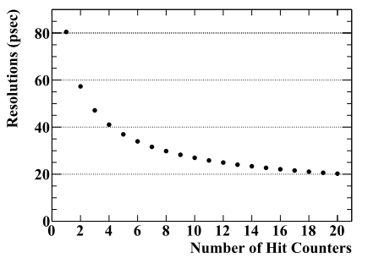
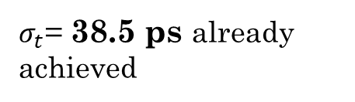


$e^{+}$ timing counter
6 SiPMs
series connection
Fast plastic scintillator + SiPM
Increased segmentation
→ many hits per track
→ good resolution
To improve time resolution:
- Use many SiPMs → high light yield
- Connect them in series
→ less readout ch, short risetime
$σ_{t}$= 38.5 ps already achieved
series connection makes the waveform sharp
$N_{hits}$~8 for signal $e^{+}$

Slide 11
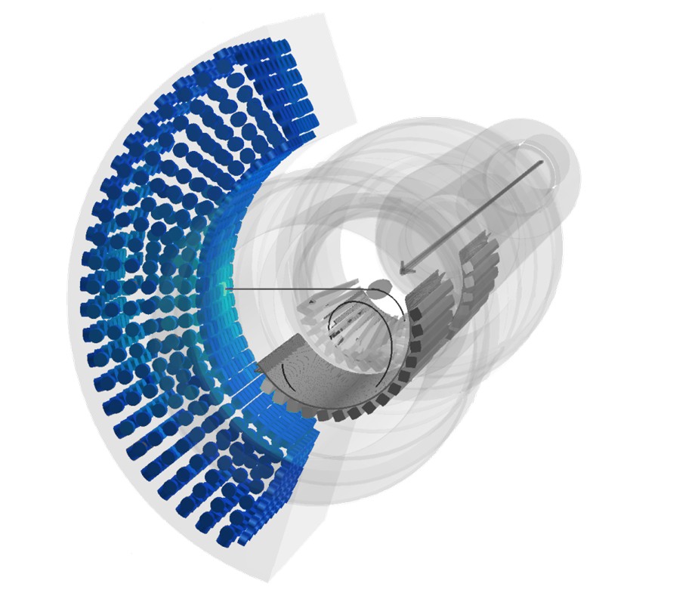
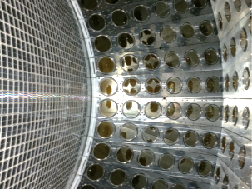
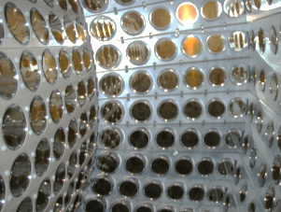
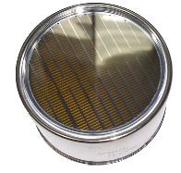

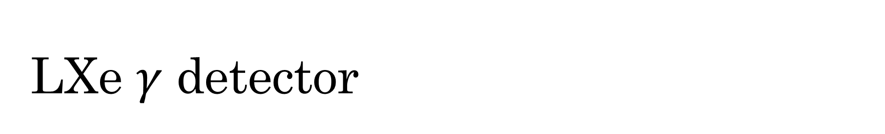
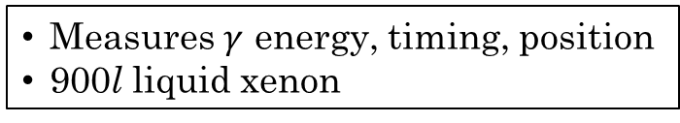
LXe $γ$ detector
$$γ$$
$$γ$$
upgrade
2-inch PMTs
15mm SiPMs
Measures $γ$ energy, timing, position
900l liquid xenon

Slide 12
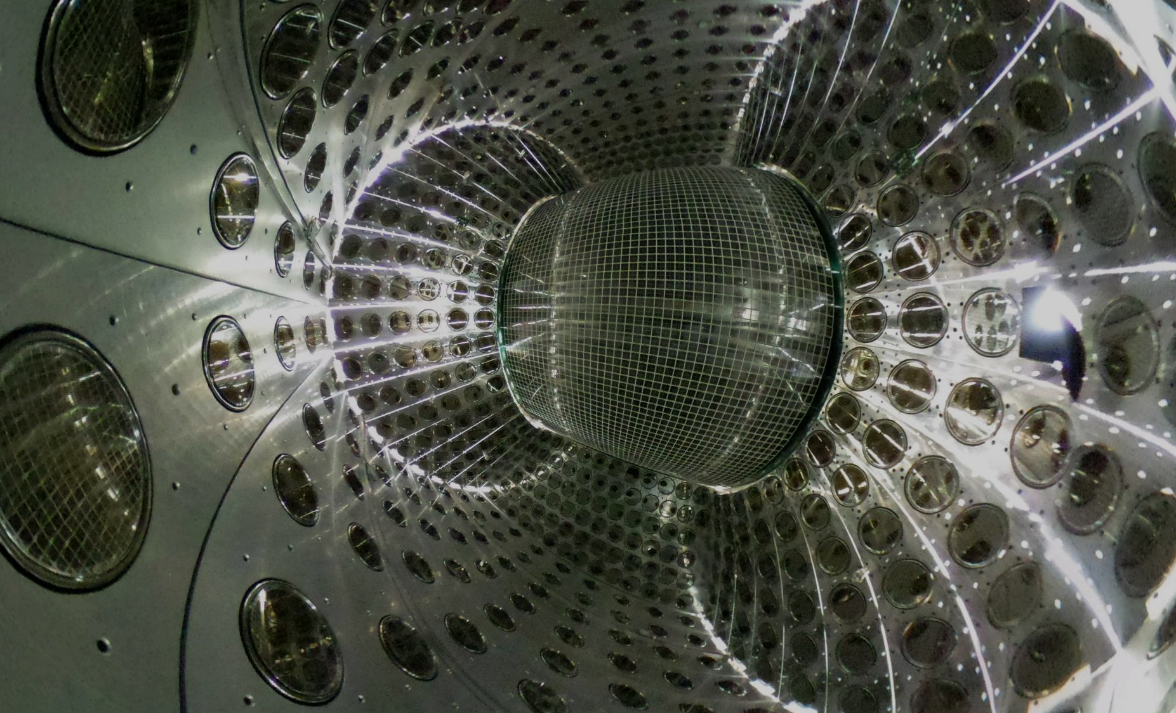
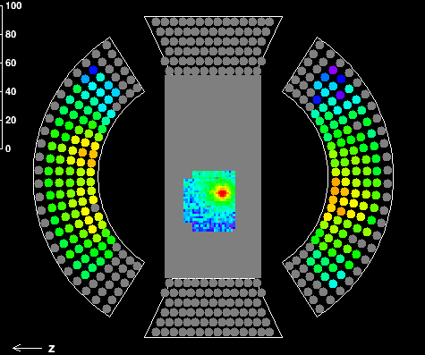
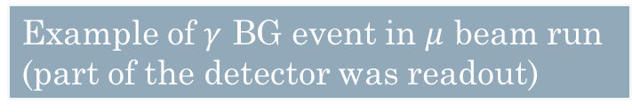

LXe $γ$ detector
Example of $γ$ BG event in $μ$ beam run
(part of the detector was readout)
Energy resolution
2% → 0.7~1.5%
Uniformity of sensor coverage and granularity improved!
→ Energy and position resolution improves by factor of 2 in MC

Slide 13
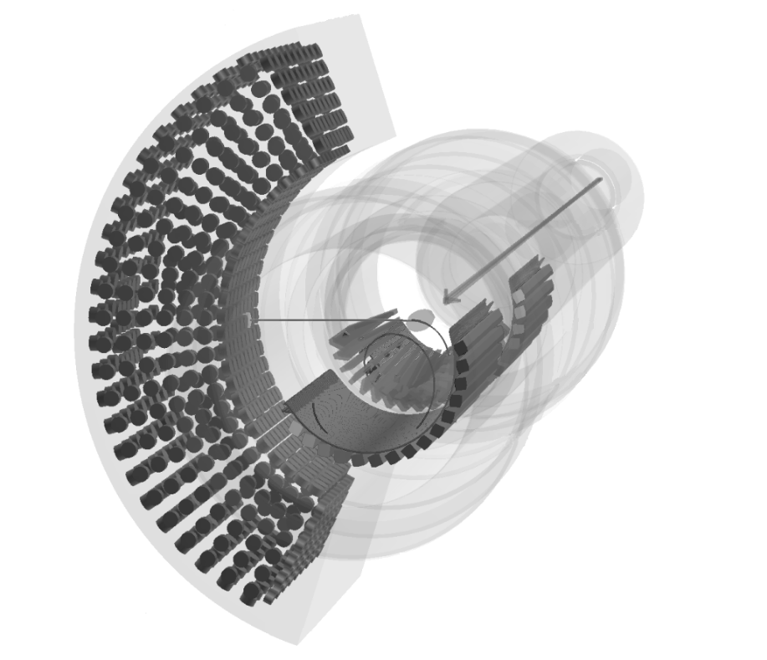
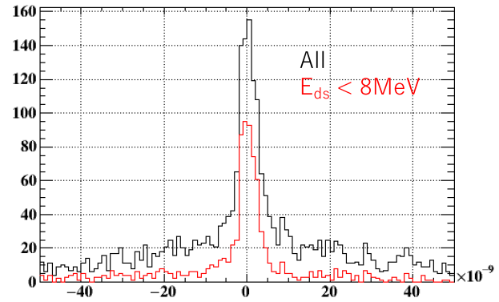
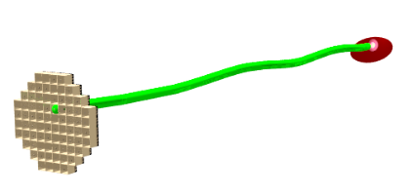
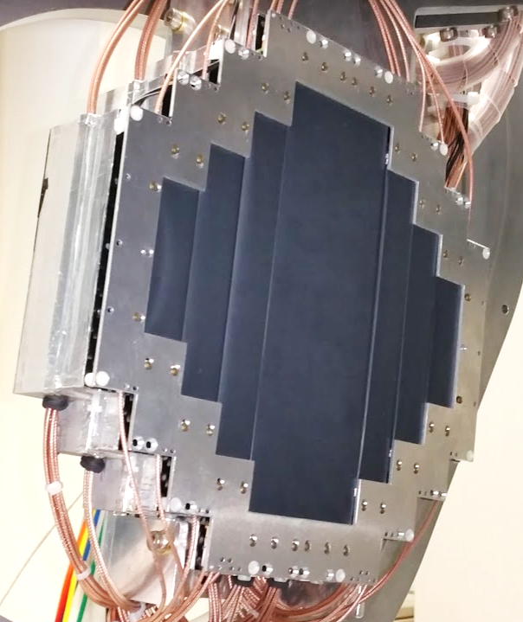







BG tagging detector
$$t_{e}−t_{LXe}$$
$$γ$$
$e \& γ$ time
coincidence
$μ→eννγ$ BG
successfully identified
All events
High energy $e^{+}$ removed
upgrade
$$e^{+}$$
New detector for tagging BG $γ$
Detects low energy $e^{+}$ from $μ→eννγ$
Plastic scintillator (timing) + LYSO crystals (energy) + SiPMs
$$t_{e}−t_{LXe} [sec]$$

Slide 14



Trigger & DAQ
New DAQ + trigger system
developed by PSI+INFN: WaveDAQ
- Waveform (1-2 GHz) readout of
~9000 channels with DRS chip
(Domino Ring Sampler)
- Trigger is integrated
→ Reduced rack space,
Sophisticated trigger
(High energy $γ$, coincidence with
$e^{+}$ back-to-back)
- Amplifier, shaper and HV supply for SiPMs
WaveDREAM board
Mass production in this year

Slide 15



Status in 2020
Corona discharge in drift chamber
Overall status
- Detector construction is finished, commissioning is ongoing.
- Timing counter and BG tag detector are ready for physics run.
Commissioning of drift chamber and LXe detector is ongoing
- For drift chamber, we successfully removed broken/potentially
bad wires (due to corrosion).
Anomalous current was observed → under investigation
- In LXe detector, photon detection efficiency of SiPMs is found
to be reduced (~0.08% per 1-hour beam) likely due to
surface damage by VUV photons. Annealing (heating) was
found to be effective to recover it.
Recovery of SiPM detection efficiency
Pilot run in the end of 2020
- Establish stable operation of drift chamber
- LXe detector resolution measurement with
~55 MeV $γ$ from $π^{0}→2γ$ from $π^{−}$ beam ($π^{−}p→π^{0}n)$

Slide 16

Summary
$μ→eγ$ is a good probe for new physics.
e.g. SUSY-seesaw: Br($μ→eγ)$ ~ O(${10}^{−14})$
MEG II goal: Br($μ→eγ)$ < 6$×{10}^{−14}$
MEG II experiment utilizes world’s most intense
continuous $μ$ beam @ PSI.
Detectors are constructed and commissioning is ongoing.
Commissioning runs with $μ$ beam will continue in 2020.
Physics run will follow soon after.

Slide 17
Backup slides

Slide 18



PDE degradation problem
Decrease of MPPC PDE was observed while commissioning with $γ$ from $μ→eννγ$.
→ surface damage by VUV light from LXe scintillation?
VUV photons
($λ\sim 175nm$)
Mean PDE vs. time
SiO₂
2017
Si
2018
2019
~1.3$×$10¹² photons / day / MPPC
Accumulation of holes near SiO₂-Si interface
→ reduction of carrier collection efficiency
Similar phenomena is known for UV photo diode.

Slide 19


SiPM annealing
Accumulated charges can be removed by annealing (heating).
→ Generate Joule heat by applying reverse bias on MPPC under light
(We need special HV source to apply high current.)
MPPC 100 deg.
PCB 120 deg.
CFRP 45 deg.
Glue 65 deg.
We should not exceed
temperature limits:
Reverse bias, room light
V_{over}~7V, ~11mA
PCB
MPPC
CFRP
2016.7.7

Slide 20


Slide 21


