Slide 1
Prospects on Muon Colliders
Daniel Schulte for the forming international muon collider collaboration

Slide 2
Context
Muon collider has in the past been studied in the US (MAP)
effort largely ceased after last P5 process
some effort mainly in the UK on MICE
some, mainly in Italy, on LEMMA on alternative muon source
For the European Strategy the Laboratory Directors Group (LDG) established a muon collider working group to provide input on the muon collider
LDG represents: CERN, DESY, INFN, STFC, IRFU (CEA), CIEMAT, NIKHEF, LNGS, IJCLab (CNRS), PSI
Working group has been chaired by N. Pastrone
Proposed to the European Strategy Process to form an international collaboration to study the muon collider
The European Strategy Update proposed to include the muon collider in the accelerator R&D roadmap
To start implementing this the Laboratory Directors Group has established an international muon collider collaboration on July 2nd 2020

Slide 3
Physics at High Energy
High energy lepton colliders are precision and discovery machines
Chiesa, Maltoni, Mantani, Mele, Piccinini, Zhao
Muon Collider - Preparatory Meeting
Precision potential
Measure k₄ to some 10%
With 14 TeV, 20 ab⁻¹
A. Wulzer
Discovery reach
14 TeV lepton collisions are comparable to 100 TeV proton collisions for production of heavy particle pairs
Luminosity goal
(Factor O(3) less than CLIC at 3 TeV)
4x10³⁵ cm⁻²s⁻¹ at 14 TeV

Slide 4
Proposed Lepton Colliders (Granada)
Luminosity per facility
Maximum proposed energy CLIC 3 TeV
Cost estimate total of 18 GCHF
  In three stages
  Largely main linac, i.e. energy
Power 590 MW
  Part in luminosity, a part in energy
Similar to FCC-hh (24 GCHF, 580 MW)
Technically possible to go higher in energy
But cost and power are a concern
A muon collider might deliver increasing luminosity per beam power at higher energies
Cost has to be evaluated

Slide 5
Proton-driven Muon Collider Concept
MAP collaboration
Acceleration to collision energy
Collision
Short, intense proton bunches to produce hadronic showers
Pions decay into muons that can be captured
Muon are captured, bunched and then cooled by
ionisation cooling in matter
No CDR exists, no coherent baseline of machine
No cost estimate
Need to extend to higher energies (10+ TeV)
But did not find something that does not work

Slide 6
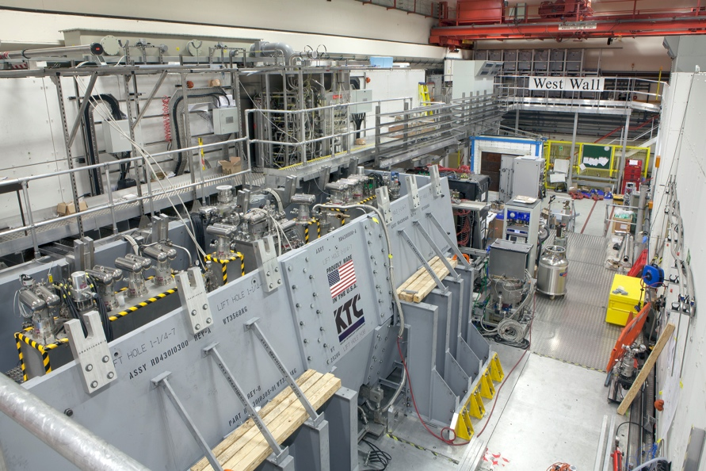
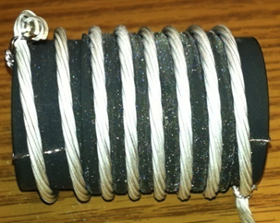
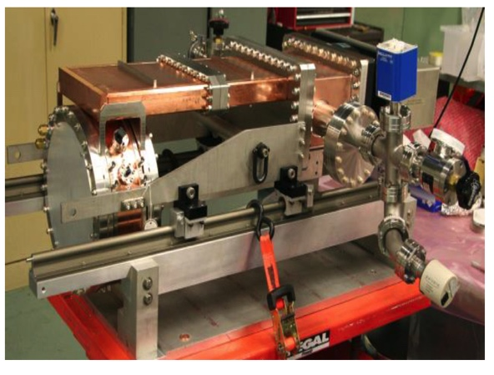
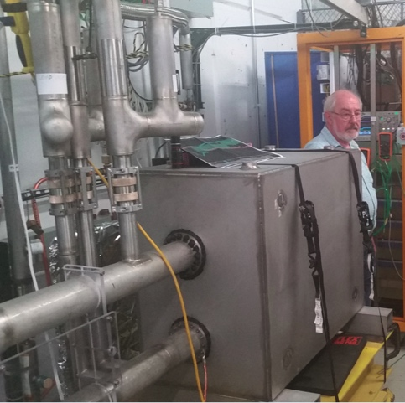
Design Status
See previous presentation by J. Pasternak
Key systems designed for 3 TeV in US
A number of key components has been developed
Cooling test performed according to theory
But no CDR, no integrated design, no reliable cost estimate
More work to be done, e.g. substantial, 6D cooling
MICE
(UK)
MuCool: >50 MV/m in 5 T field
FNAL
Breakthrough in HTS cables
NHFML
32 T solenoid with low-temperature HTS
FNAL
12 T/s HTS
0.6 T max
Mark Palmer

Slide 7
Proposed Tentative Timeline (2019)
PHYSICS DETECTOR
CDRs
TDRs
Technically limited
R&D detectors
Prototypes
Large Proto/Slice test
MDI & detector simulations
1
2
3
4
5
6
7
8
9
10
11
12
13
14
15
16
17
Design
Baseline design
Design optimisation
Project preparation
Approve
Test Facility
Design
Construct
Exploit
Exploit
MACHINE
Technologies
Design / models
Prototypes / t. f. comp.
Prototypes / pre-series
Ready to decide on test facility
Cost scale known
Ready to commit
to collider
Cost known
Ready to construct

Slide 8
Initial Collaboration Goal
Objective:
In time for the next European Strategy for Particle Physics Update, the study aims to establish whether the investment into a full CDR and a demonstrator is justified.
It will provide a baseline concept, well-supported performance expectations and assess the associated key risks as well as cost and power consumption drivers. It will also identify an R&D path to demonstrate the feasibility of the collider.
Scope:
Focus on two energy ranges:
  3 TeV, well above higgs factory, if possible with technology ready for construction in 10-20 years
  10+ TeV, well above normal-conducting linear colliders, with more advanced technology
Explore synergy with other options (neutrino/higgs factory)
Define R&D path and design demonstrator

Slide 9
Initial Collaboration Goal
Objective:
In time for the next European Strategy for Particle Physics Update, the study aims to establish whether the investment into a full CDR and a demonstrator is justified.
It will provide a baseline concept, well-supported performance expectations and assess the associated key risks as well as cost and power consumption drivers. It will also identify an R&D path to demonstrate the feasibility of the collider.
Scope:
Focus on two energy ranges:
  3 TeV, well above higgs factory, if possible with technology ready for construction in 10-20 years
  10+ TeV, well above normal-conducting linear colliders, with more advanced technology
Explore synergy with other options (neutrino/higgs factory)
Define R&D path and design demonstrator
We need to make sure that this timescale is sufficient for other regions
next strategy probably starts in 5 years
An important milestone is set by the current Snowmass process
What do we need to provide and how can we exploit this to the benefit of the muon collider?

Slide 10
Tentative Target Parameters
Parameter | Unit | 3 TeV | 10 TeV | 14 TeV
L | 10³⁴ cm⁻²s⁻¹ | 1.8 | 20 | 40
N | 10¹² | 2.2 | 1.8 | 1.8
f_{r} | Hz | 5 | 5 | 5
P_{beam} | MW | 5.3 | 14.4 | 20
C | km | 4.5 | 10 | 14
<B> | T | 7 | 10.5 | 10.5
ε_{L} | MeV m | 7.5 | 7.5 | 7.5
σ_{E} / E | % | 0.1 | 0.1 | 0.1
σ_{z} | mm | 5 | 1.5 | 1.07
β | mm | 5 | 1.5 | 1.07
ε | μm | 25 | 25 | 25
σ_{x,y} | μm | 3.0 | 0.9 | 0.63
Based on MAP source and concept
The same source for all energies
Achieves physics goal of

Slide 11
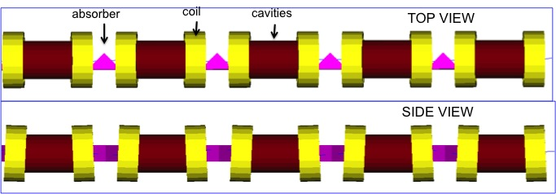
Muon Production and Cooling
Muon source and cooling are the same complex at all energies
key for luminosity
has been important R&D in US
Proton source is ambitious
Target is system is challenging
liquid mercury jet basically demonstrated (MERIT) but solid target better for safety
Cooling system contains high-field solenoids, high-gradient normal conducting RF, targets, compact integration, radiation from proton beam needs to be considered
Do not yet fully reach emittance goal in final cooling stage
improvement by factor 2 required (e.g. highest field HTS solenoids, phase space manipulations, …)
Will review design options,
make choices and optimise

Slide 12
High-energy Accelerator and Collider
The important cost drivers and power consumers
The limit of the energy reach
Several accelerator options approaches considered
Linacs
Recirculating linacs
FFAGs
Rapid cycling synchrotrons
Much larger than collider ring

Slide 13
High-energy Acceleration
Rapid cycling synchrotron (RCS)
Inject beam at low energy and ramp magnets to follow beam energy
Could use combination of static superconducting and ramping normal-conducting magnets
Fast-pulsing magnets (O(ms) ramps))
Field defines size of accelerator ring
normal-conducting
HTS is interesting
Important energy in fast pulsing magnets
O(200 MJ) @ 14 TeV
need very efficient energy recovery
FFAG
Challenging lattice design for large bandwidth and limited cost
High field magnets
RF challenge:
High efficiency for power consumption
High-charge, single-bunch beam (10 x HL-LHC)
Maintain small longitudinal emittance

Slide 14
Collider Ring
High field dipoles to minimise collider ring size and maximise luminosity
Need to protect from O(400 W/m) beam loss
1/3 of beam energy
large aperture and shielding
  150 mm in MAP at 3 TeV, 30-50 mm shielding
open mid-plane magnets
efficient cooling
Need combined function magnets
Combined function magnet design
V.V. Kashikhin et al.
Strong focusing at IP to maximise luminosity
Becomes harder with increasing energy
Divergence independent of energy
Challenging triplet design
Maintaining very short bunch (1 mm) in large ring
Careful control of longitudinal motion
Beam dynamics of frozen beam

Slide 15
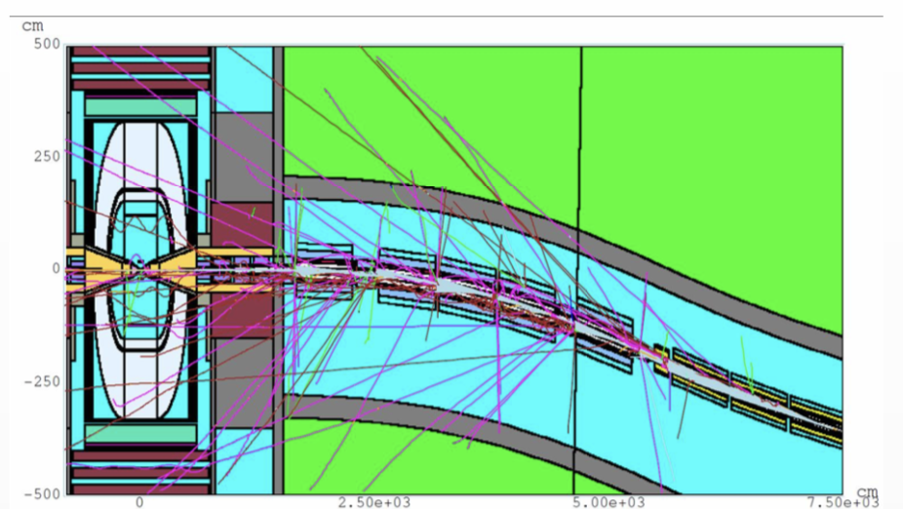
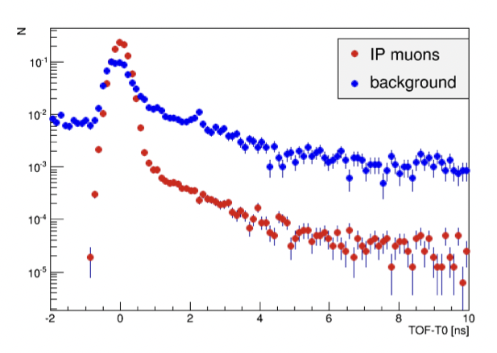
MDI
See next presentation by F. Collamati
At 14 TeV:
40,000 muons decay per m and bunch crossing
At 3 TeV:
200,000 muons per m and bunch crossing
Beamline and detector are shielded
Simulations at 1.5 TeV centre-of-mass show this might be fine
D. Lucchesi et al.
Significant difference in arrival time
Important effort required to study and mitigate impact of muon decays
Detector must be designed for robustness
effective masking
high granularity
fast timing
clever algorithms
Detailed design of machine is required for this

Slide 16
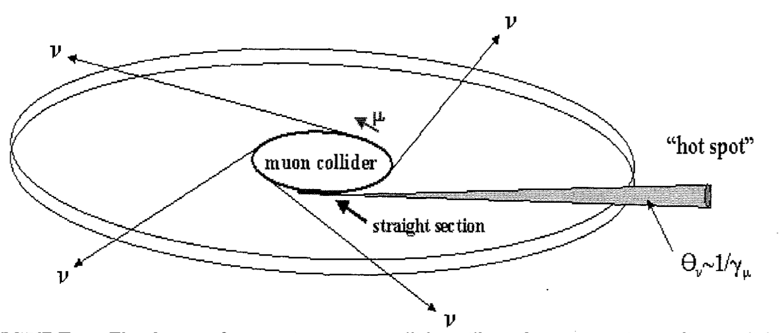
Site Considerations
Could we reuse LHC tunnel?
14 TeV accelerator or combined accelerator/collider ring (V. Shiltsev, D. Neuffer)
3 TeV accelerator using more conventional technology
  with new collider ring of 4.5 km optimised for luminosity
Limit can come from neutrino radiation
Decaying muons produce two neutrinos, which can produce showers just when they exit the earth
Minimise this as much as possible
Potential mitigation by
Owning the land in direction of experimental insertion
Having a dynamic beam orbit so it points in different directions at each turn in the arcs
Some gymnastics with beam in straights to make it point in different directions
Maximise luminosity per beam current
…
Gut feeling based on some calculations, need serious review:
LHC tunnel could work for 3 TeV accelerator
Have to do more work for other options in LHC

Slide 17
Alternative: The LEMMA Scheme
45 GeV positrons to produce muon pairs
Accumulate muons from several passages
Low-emittance muon beam can reduce radiation
Less mature than proton-driven scheme
Large positron current required
Target is challenging
Large positron production rate [O(10¹⁷/s)]
Currently do not reach luminosity goal

Slide 18
Path Forward
We will need you
Highest priority is to form the collaboration
All partners taking ownership
  define the work programme
  find resources
  start to work
Web page: http://muoncollider.web.cern.ch
Will upload information
Mailing lists:
MUONCOLLIDER_DETECTOR_PHYSICS@cern.ch,
MUONCOLLIDER_FACILITY@cern.ch
go to https://e-groups.cern.ch and search for groups with “muoncollider” to subscribe
Many thanks to all that contributed:
M. Palmer, N. Pastrone, D. Lucchesi,
A. Wulzer, K. Long, …
MAP collaboration,
MICE collaboration
LEMMA team
Muon collider working group
European Strategy Update
LDG
…

Slide 19
Reserve

Slide 20
Target Parameter Examples
From the MAP collaboration: Proton source
Even at 6 TeV above target luminosity with reasonable power consumption
But have to confirm power consumption estimates

Slide 21
Comparison MAP vs. CLIC
In linear collider, the luminosity per beam power is about constant
In muon collider, luminosity can increase linearly with energy
A linear collider is single-pass so need full voltage in main linac
Muon collider is multi-pass so have lower voltage
But have to carefully verify this
Overall muon colliders have the potential for high energies
May overcome the energy limitations of linear colliders
The working group concluded that an Interantional collaboraiton should be formed to study the muon collider

Slide 22
European Strategy
From the deliberation document of the European Strategy Update:
  High-priority future initiatives
  [..]In addition to the high field magnets the accelerator R&D roadmap could contain:
  [..] an international design study for a muon collider, as it represents a unique opportunity to achieve a multi-TeV energy domain beyond the reach of e⁺e⁻ - colliders, and potentially within a more compact circular tunnel than for a hadron collider. The biggest challenge remains to produce an intense beam of cooled muons, but novel ideas are being explored;
To start implementing this the Laboratory Directors Group has established an international muon collider collaboration on July 2nd 2020
Covering physics, detector and machine
Now are in the process of getting organised
Had first meeting July 3rd 2020 (270 participants)
International design study
  participation of US and IHEP

Slide 23
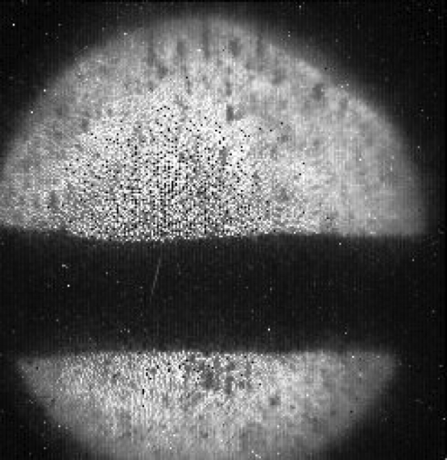
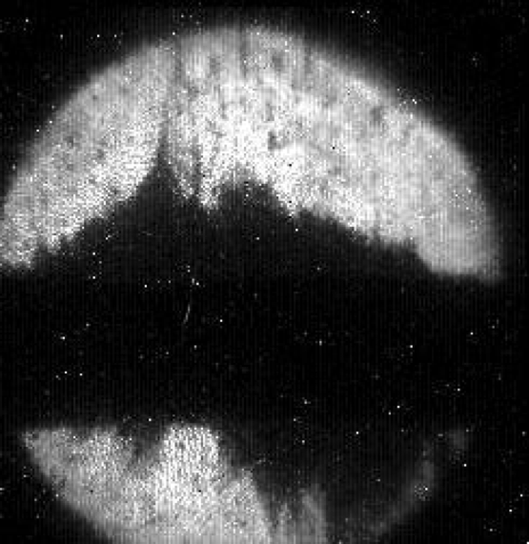
Source
Intense proton beam is challenging
Need to make choices for the target
Ambitious high-field solenoid
MAP design
Target has to withstand strong shock
liquid mercury target successfully tested at CERN (MERIT)
but solid target better for safety
or beads
or …
Important power of proton driver O(MW)
need to take care of debris for downstream systems
need to cool
What could be made available at CERN (or elsewhere) as a proton driver for a potential test facility?

Slide 24
Cooling Concept
See previous presentation by J. Pasternak
MAP collaboration
Superconducting solenoids
High-field normal conducting RF
Liquid hydrogen targets
Compact design

Slide 25
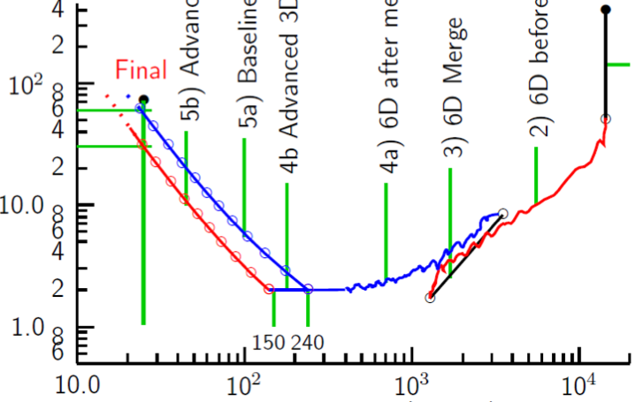
Cooling: The Emittance Path
Target
Y
Specification
•
•
•
For acceleration to
multi-TeV collider
Front End
For acceleration to NuMAX (325MHz injector acceptance 3mm,24mm)
Phase
Rotator
Exit Front End
(15mm,45mm)
Initial Cooling
Longitudinal Emittance (mm)
Final
Cooling
post-merge 6D Cooling
pre-merge
6D Cooling (original design)
For acceleration
to Higgs Factory
Bunch
Merge
Transverse Emittance (microns)
MAP collaboration

Slide 26
Cooling: The Emittance Path
Target
Y
Specification
Achieved (simulations)
•
•
•
For acceleration to
multi-TeV collider
Front End
For acceleration to NuMAX (325MHz injector acceptance 3mm,24mm)
Phase
Rotator
Several ideas to improve final cooling
Need to work out the solution
Highest field HTS helps
Phase space manipulations of beam
Final
Exit Front End
(15mm,45mm)
Initial Cooling
Longitudinal Emittance (mm)
Initial
(X)
Initial
(Y)
Final
Cooling
post-merge 6D Cooling
pre-merge
6D Cooling (original design)
For acceleration
to Higgs Factory
HCC
VCC &
Hybrid
Bunch
Merge
Maybe can improve this
Transverse Emittance (microns)
MAP collaboration

Slide 27
Ongoing LEMMA Effort
Ongoing effort to address identified challenges
Positron production
  Rotating target (like ILC)
  Use of positron beam for production
Positron ring challenge
  larger ring, pulsed ring, lower energy accumulator ring
Large emittance from target
  use sequence of thin targets, H₂ targets, …
  Increased muon bunch charge, e.g. better capturing, …
  muon cooling (crystals, stochastic, …)
Difficulty of combining muon bunches at high energy
  Increasing charge at the source (producing bunches in pulsed fashion)
  increase muons per positron bunch
More detailed studies needed to understand what does work and how well
LEMMA team

