Slide 1
Polarization effects in the search for dark vector boson in e⁺ e⁻ colliders
by Guey-Lin Lin National Chiao-Tung University, Taiwan
Fei-Fan Lee, GLL and Vo Quang Nhat, to be submitted

Slide 2
Introduction and motivations
Growing interests in searching for DM related phenomenon with high statistics and high precision measurements.
Such phenomenon has to do hidden sector*, assumed to interact with the visible sector through a messenger particle.
A popular proposal for such a messenger is the so-called dark photon**, which mixes with U(1)Y in SM.
*B. Holdom, Phys. Lett. 166B, 196 (1986); P. Galison and A. Manohar, Phys. Lett.
136B, 279 (1984)
**J. Alexander et al., arXiv:1608.08632 [hep-ph]

Slide 3
Introduction and motivations
Such a mixing induces EM couplings between dark photon and SM fermions, which generate rich phenomenology.
The search for light boson with the reaction e⁺e⁻ —> A’+gamma has been proposed*.
Many new proposals to search for dark photons with the above process—see the list next page
These proposals are based upon either fixed target or electron-positron collider
*C. Boehm and P. Fayet, Nucl. Phys. B 683, 219 (2004); N. Borodatchenkova, D.
Choudhury and M. Drees, Phys. Rev. Lett. 96, 141802 (2006); P. Fayet, Phys.
Rev. D 75, 115017 (2007).

Slide 4
Introduction and motivations
V. Kozhuharov [PADME Collaboration], Nuovo Cim. C 40, no. 5, 192 (2017)
T. Araki et al., Phys. Rev. D 95, no. 5, 055006 (2017)
B. Wojtsekhowski et al., JINST 13, no. 02, P02021 (2018)
I. Alikhanov and E. A. Paschos, Phys. Rev. D 97, no. 11, 115004 (2018)
L. Marsicano et al., Phys. Rev. D 98, no. 1, 015031 (2018)
J. Jiang et al., Eur. Phys. J. C 78, no. 6, 456 (2018)

Slide 5


Introduction and motivations
The dark photon interaction with EM current is given by
The neutral current interaction is suppressed in the limit MA’ <<MZ
The detection of A’ determines the mixing parameter and the mass of the dark photon.
On the other hand, there could be other mixing between dark boson and SM gauge bosons, such as*
*H. Davoudiasl, H. S. Lee and W. J. Marciano, Phys. Rev. D 85, 115019 (2012)

Slide 6
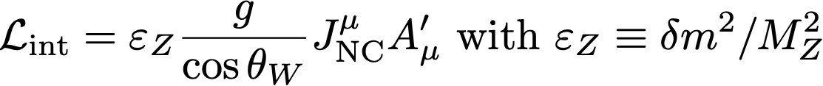
Introduction and motivations
With the above mass mixing, an independent neutral current coupling between dark boson and SM fermions is induced:
Considering both mixings, the interaction between dark boson (renamed as Zd from now on) and SM fermions becomes
In the search for Zd with e⁺e⁻ —> Zd +gamma, can one determine the relative strength of vector and axial-vector couplings?
The key is on the polarization of Zd

Slide 7
Outline
Heuristic derivation of Zd-fermion interactions
Ward-Takahashi identity and the polarization of Zd in e⁺e⁻ —> Zd+gamma
Differential cross section of e⁺e⁻ —> Zd+gamma for each polarization of Zd and the decay distribution of Zd —>l⁺ l⁻
Searching for Zd by e⁺e⁻ —> Zd+gamma and Zd decaying to muon pairs in BaBar and Belle II
Summary

Slide 8

Heuristic derivation of Zd-fermion interactions
The mixing terms give two point functions
The EM interactions of dark boson
The Neutral-Current interactions of dark boson

Slide 9
Heuristic derivation of Zd-fermion interactions

Slide 10

Ward-Takahashi identity and Zd polarization
Zd is expected to be transversely
polarized for dark boson mass
much less than CM energy
+
=0 for me—>0

Slide 11

BaBar search result and Belle II sensitivity to
The Belle II physics book, arXiv:1808.10567
J. P. Lees et al. [BaBar Collaboration], Phys. Rev. Lett. 113, no. 20, 201801 (2014)

Slide 12


Polarized amplitudes
the direction of Zd with respect to e⁻ direction in CM frame
me is neglected except in the denominator

Slide 13
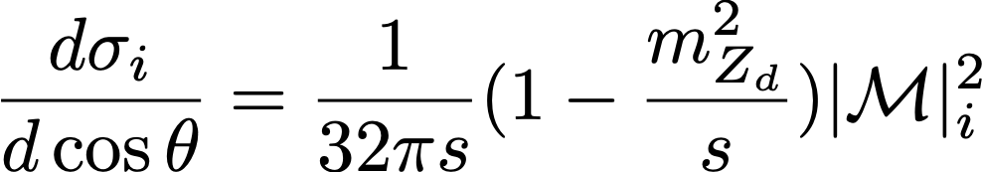

Polarized differential cross sections
Differential cross section for longitudinal state
is clearly suppressed by

Slide 14
Polarized differential cross sections-numerical results
V-A coupling

Slide 15
Polarized differential cross sections-numerical results

Slide 16
Polarized differential cross sections-numerical results
Longitudinal polarization is now equally important
Helicity +1 and -1 states getting closer to each other

Slide 17


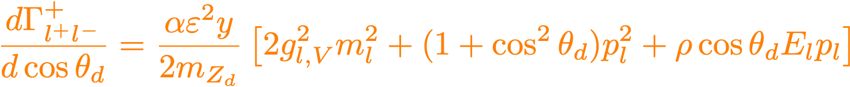
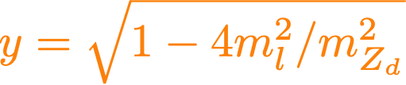
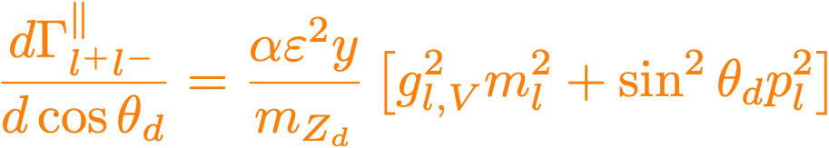
Zd decay distributions and the parity violation parameter
Angular distributions of Zd decays
the angle between l⁻ direction
in the Zd rest frame and the
Zd boost direction
Helicity +1 state
Helicity -1 state
Longitudinal state

Slide 18

Forward-backward asymmetry of leptons from Zd decays; Zd produced in the backward direction

Slide 19
Forward-backward asymmetry of leptons from Zd decays
Zd produced in the backward direction

Slide 20
Forward-backward asymmetry of leptons from Zd decays

Slide 21
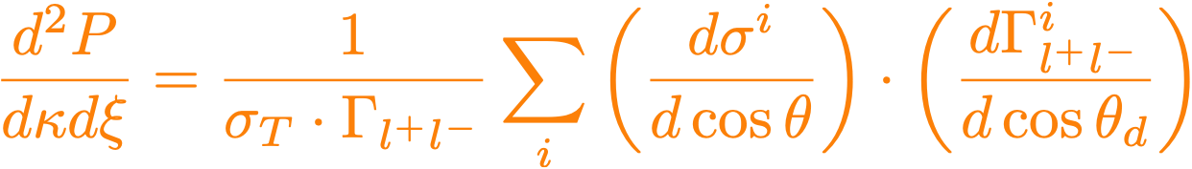





Double angular distributions; correlation between Zd and lepton directions
i: polarization index
Q0: even in both
Q2: odd in both
Changes sign when changes sign;
Reaching to maximum for ultra-relativistic
lepton and the limit

Slide 22
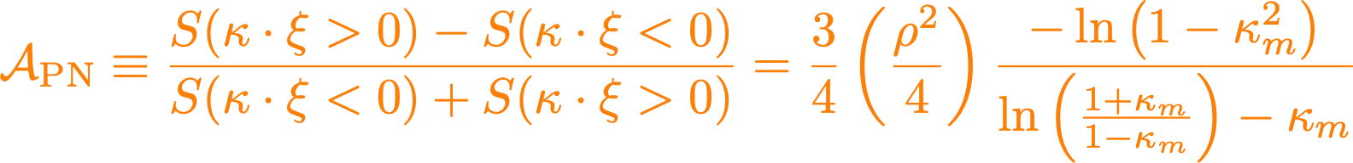



Signal event asymmetry
This parameter has to be calculated with actual detector acceptance
The asymmetry will be diluted by the QED background
How significant is this asymmetry statistically?

Slide 23






Prospect of probing parity violation parameter at Belle II
Belle II calorimeter angular coverage*
Corresponding photon rapidity range
Boost velocity from LAB to CM
7GeV 4GeV
KL-muon detector angular coverage
*I. Adachi et al. [Belle II], Nucl. Instrum. Meth. A 907, 46-59 (2018)

Slide 24
BaBar search result and Belle II sensitivity to
The Belle II physics book, arXiv:1808.10567
J. P. Lees et al. [BaBar Collaboration], Phys. Rev. Lett. 113, no. 20, 201801 (2014)
Belle II sensitivity is comparable to BaBar results for the same integrated luminosity

Slide 25









Calculating in Belle II for two benchmark Zd masses*
V-A
*CalcHEP version 3.7.5, A. Pukhov, A. Belyaev, and N. Christensen, 2019

Slide 26
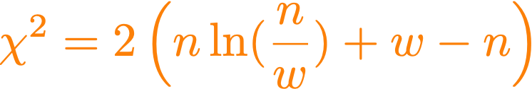
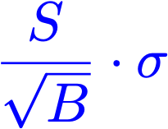

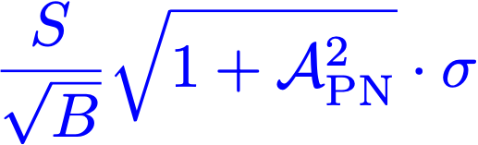
Detection significance and asymmetry parameter
n: observed event number
w: expected event number
n=S+B, w=B Detection significance
Simultaneous fittings to
Detection significance

Slide 27


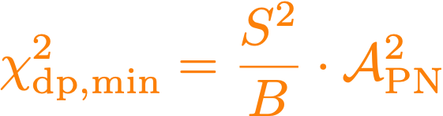
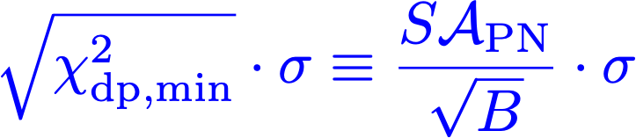
General dark boson scenario versus dark photon case
Fit the observed events by dark photon plus background
The minimum of the happens at
Dark photon less favored by
compared to input true model

Slide 28











Numerical results with Belle II detector angular coverage
Cross section* for QED background
with photon and muon rapidity ranges and ~5 MeV
energy resolution for the invariant mass
Assume a 5 detection of dark boson signature at 50 ab⁻¹
1.5 MeV to 8 MeV
energy resolution taken
in BaBar analysis
*CalcHEP version 3.7.5, A. Pukhov, A. Belyaev, and N. Christensen, 2019

Slide 29
Summary on event numbers and detection significance

Slide 30


Conclusions
We have discussed the search for dark boson with the process e⁺e⁻ —> Zd+gamma in the e⁺e⁻ collider
The dark boson is shown to be transversely polarized when the dark boson mass is much less than the CM energy
We analyze the muon angular distributions from polarized Zd decays and define the asymmetry parameter which is proportional to the square of parity violation parameter
We calculate the asymmetry parameter with Belle II detector angular coverage and discuss its consequences on the dark boson search.

