Slide 1

Explaining the SM flavor structure with grand unified theories
Renato Fonseca
fonseca@ipnp.mff.cuni.cz
Charles University, Prague, Czech Republic
Based on work done in collaboration with
Andreas Ekstedt and Michal Malinský
https://cs.m.wikipedia.org/wiki/Soubor:Prague_charles_bridge_morning.jpg
ICHEP, 28 July 2020

Slide 2
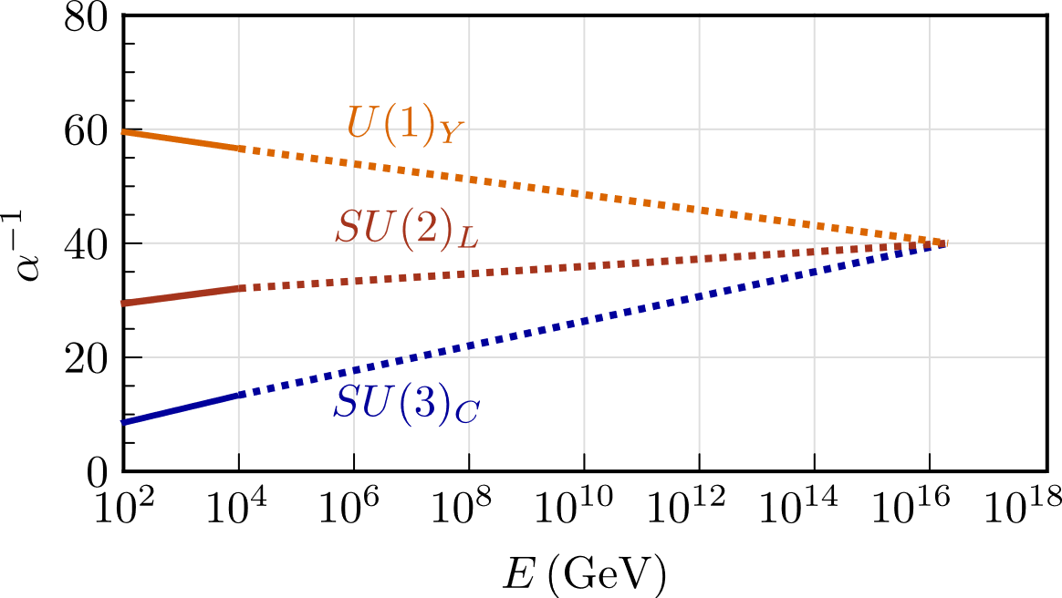

Grand Unification
SM
The Standard Model (SM) is based on the group
Thus … there are 3 gauge couplings to be explained
GUTs
A standard GUT(Grand Unified Theory): values of the gauge couplings can be explained
is a subgroup of some simple Lie group: SU(5), SO(10), E(6), …
Renato Fonseca
Explaining the SM flavor structure with grand unified theories
2

Slide 3



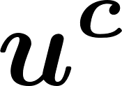
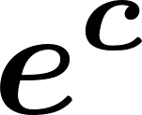

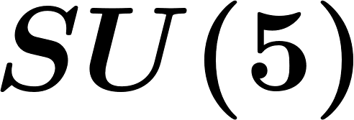



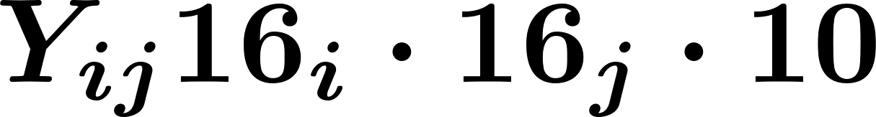
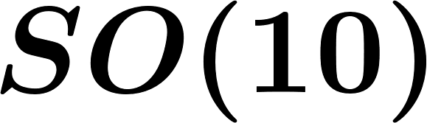


And fermions?
SM fermions are packed together in representations
of the GUT group
Relations between SM Yukawa matrices are expected
E.g.
Renato Fonseca
Explaining the SM flavor structure with grand unified theories
3

Slide 4
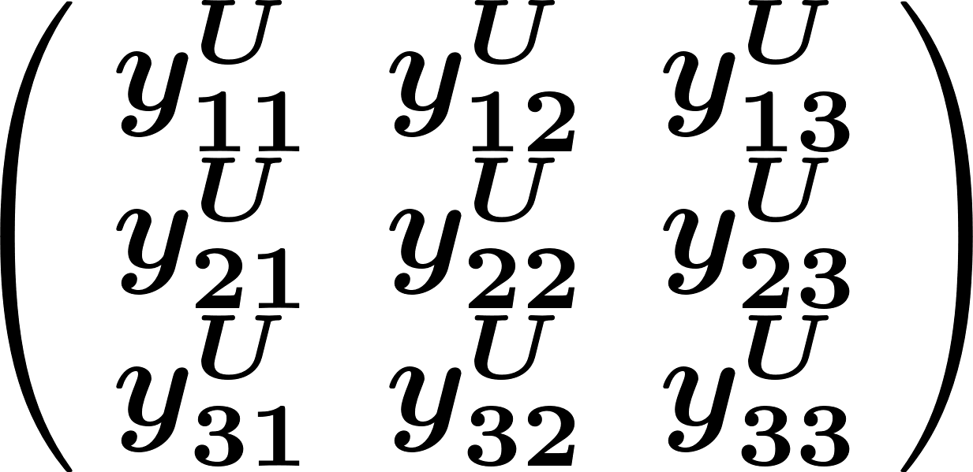
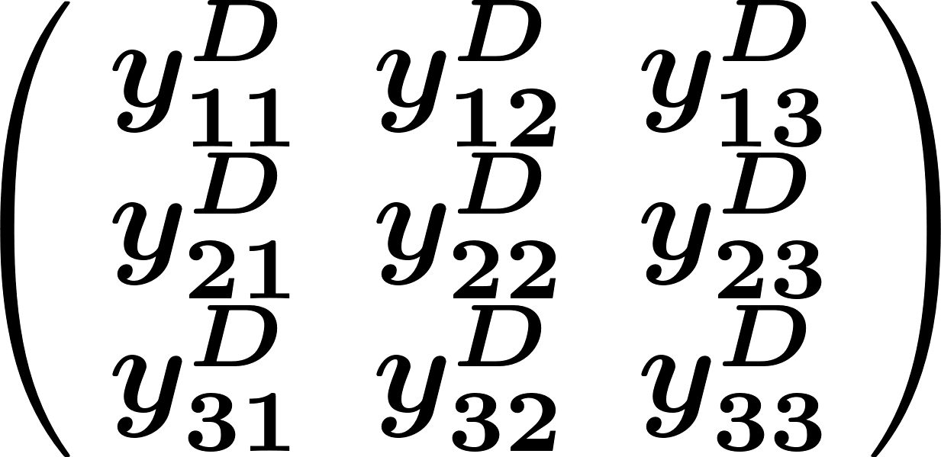
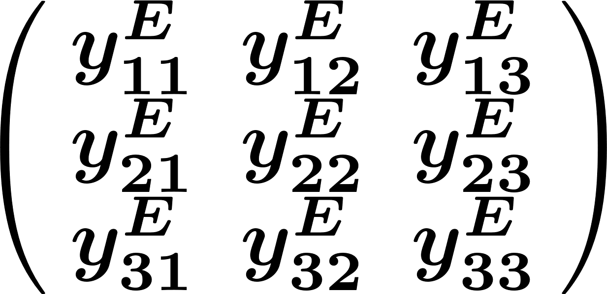
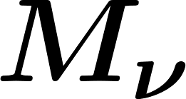
Flavor
There are 3 copies/generations/flavors/families of each fermion representation at low energies (we don’t know why)
Flavor = property of fermions
SM
Yukawa couplings:
3 by 3 matrices
Renato Fonseca
Explaining the SM flavor structure with grand unified theories
4

Slide 5
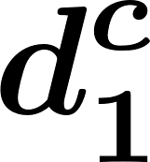
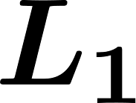

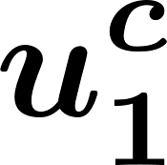
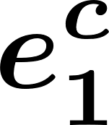

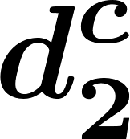
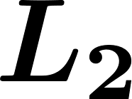

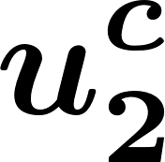
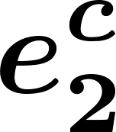
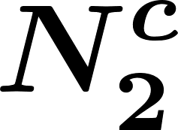
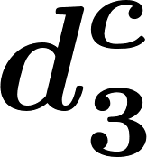
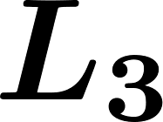

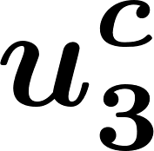
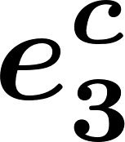
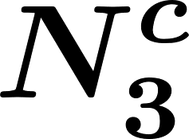
Flavor and GUTs
1st generation
2nd generation
3rd generation
‘Standard’ GUTs:
Perfect family replication
3 by 3 matrix as the SM Yukawas
Cannot explain flavor
Renato Fonseca
Explaining the SM flavor structure with grand unified theories
5

Slide 6
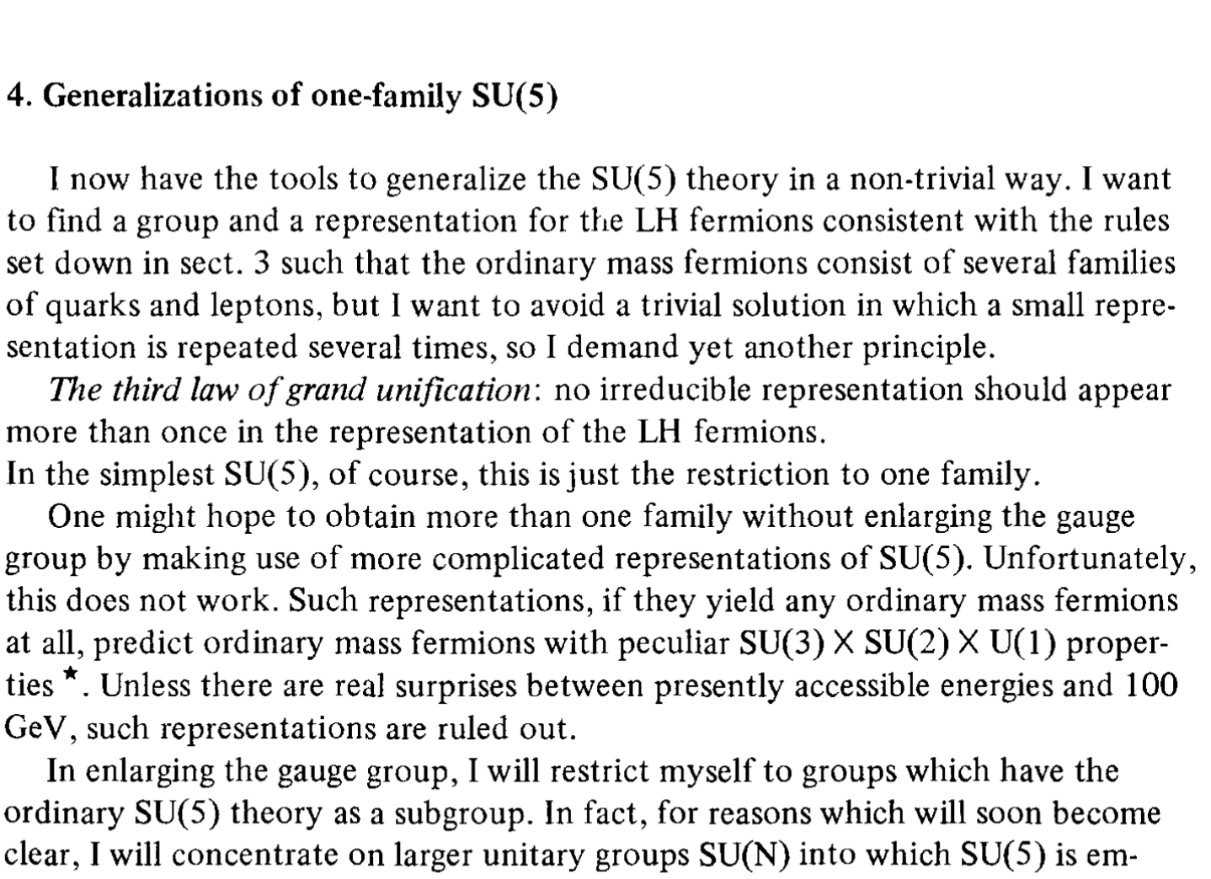

Family unification
All SM in a single representation of a group G
[Georgi, “Towards a Grand Unified Theory of flavor” 1979]
The concept is old
+ … ?
[Gell-Mann, Ramond, Slansky, 1979] [Georgi 1979]
[Wilczek, Zee 1979, 1982] [Frampton 1979] …
But no realistic model until now
Why? Group G and representation R must be such that before EWSB only the SM fermions are be massless
(so must be careful with the ‘…’ in the picture)
Suggestion which might work:
G=SU(19) and R=171
But in the
last few years …
[RF 1504.03695]
[Yamatsu 1807.10855]
It might even be the only setup that works under some assumptions
(4D-spacetime, no extra confining gauge interactions, …)
Renato Fonseca
Explaining the SM flavor structure with grand unified theories
6

Slide 7

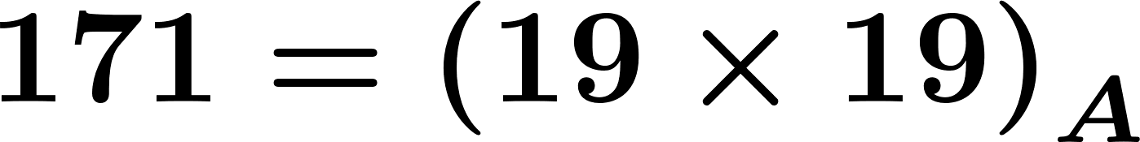

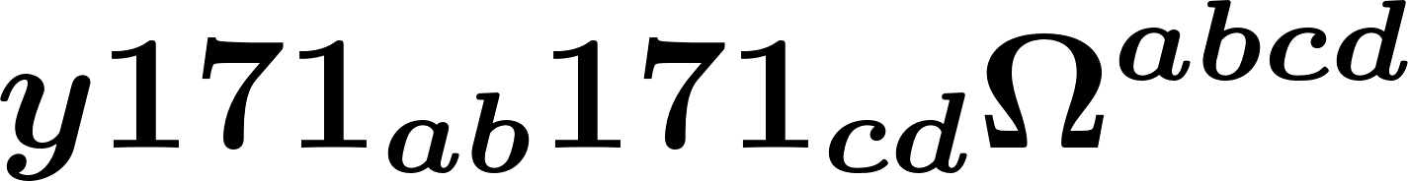

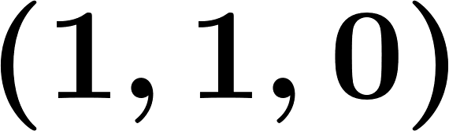
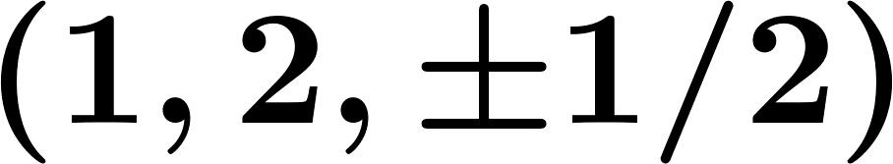
A model
Fermions:
2-index anti-symmetric tensor
We assume one scalar representation only:
4-index fully anti-symmetric tensor
How is this even possible?
!
How do we get all SM flavor
parameters at low energies?
A single number
It alone controls all F-F-S
interactions (normalization factor)
Fundamentally the SM flavor structure
is fully controlled by the scalar potential
Quick description of what is going on
The scalar field ( ) contains several SM group singlets [S] and
doublets [H].
The VEVs of the S’s control which fermions are light (=0 mass before EWSB)
One linear combination of the H’s is the 125 GeV Higgs
Renato Fonseca
Explaining the SM flavor structure with grand unified theories
7

Slide 8

Detail 1
Detail 2
Detail 3
Let’s dive into (some) details
Renato Fonseca
Explaining the SM flavor structure with grand unified theories
8

Slide 9
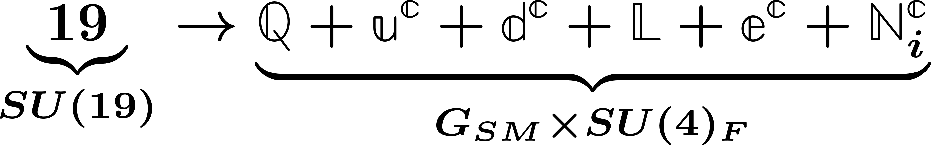
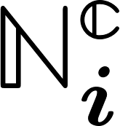
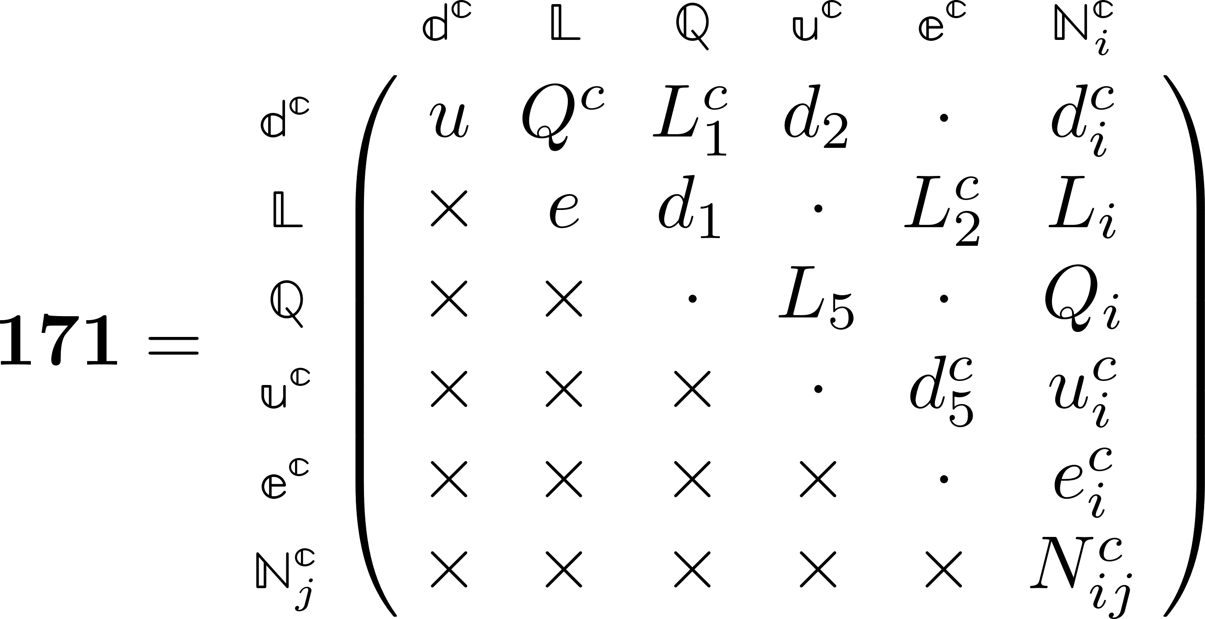
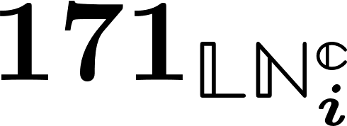
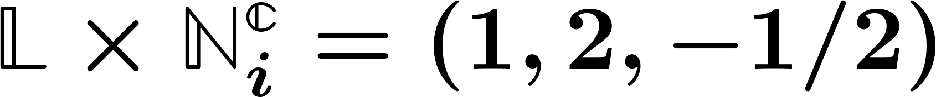
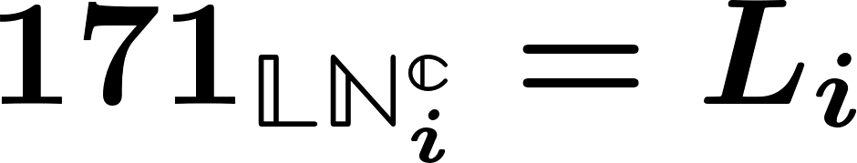
Fermions
There are many G_{SM} subgroups inside SU(19). We want …
Branching
rules
With the usual G_{SM}
quantum numbers
Why SU(4)? It is the largest simple subgroup which commutes with G_{SM} so we can see it as a flavor group
SU(4)
are charged under SU(4) (subindex i: denotes a quadruplet)
19×19 anti-symmetric matrix
Shown here in block form (6x6 blocks)
E.g.: Quantum numbers of block :
Fermions
so
i subscript: quadruplet of SU(4)
!
=
SM fermions only
at low energies
Renato Fonseca
Explaining the SM flavor structure with grand unified theories
9

Slide 10
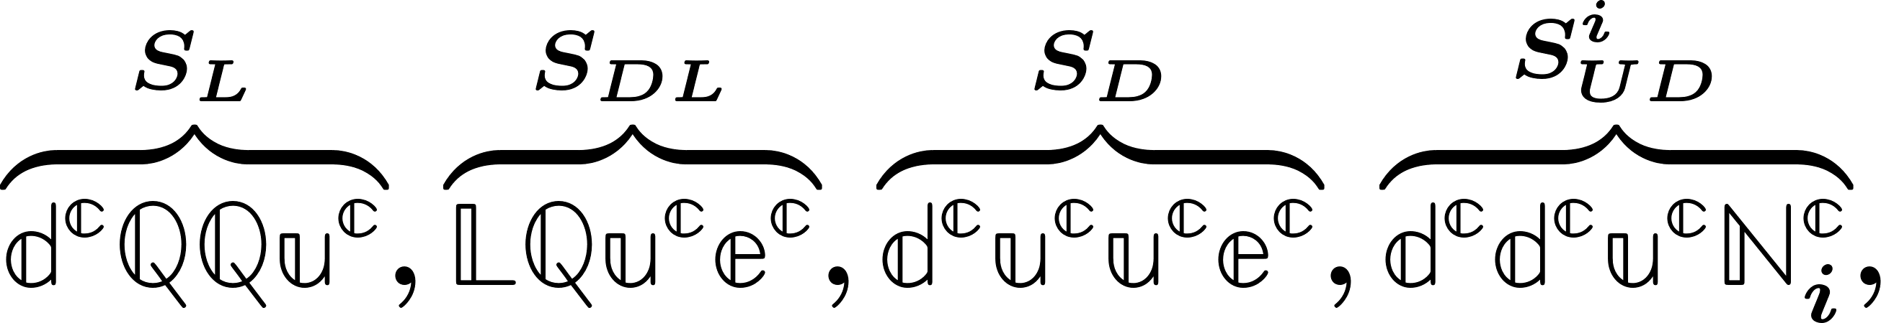

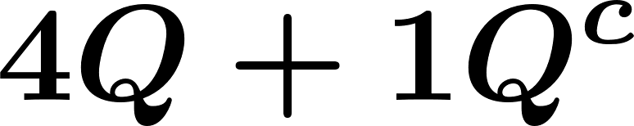

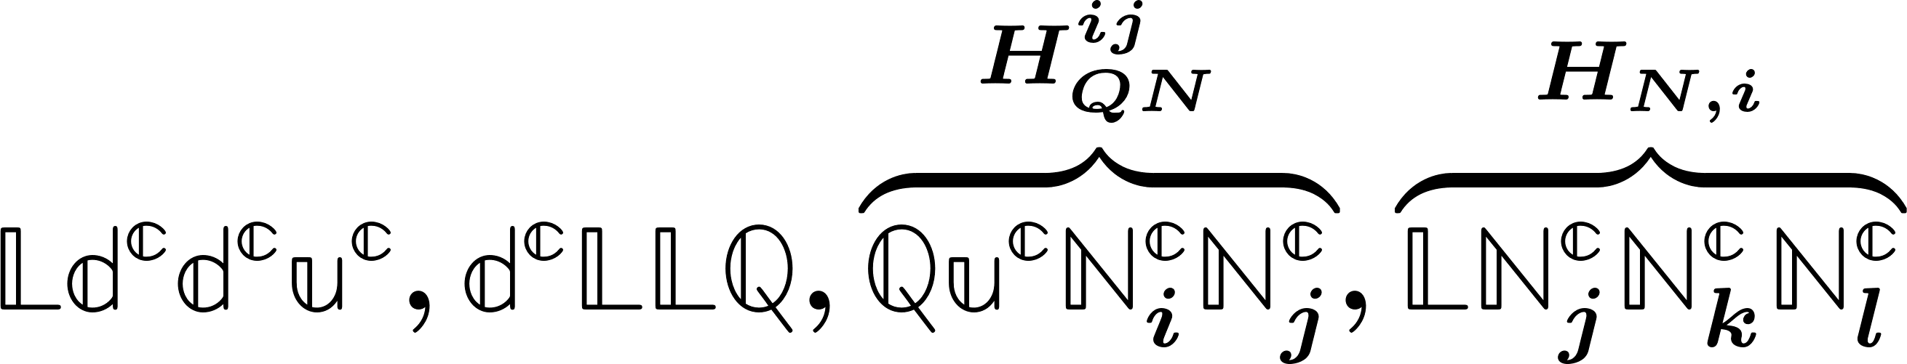
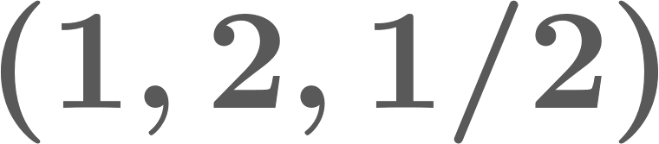
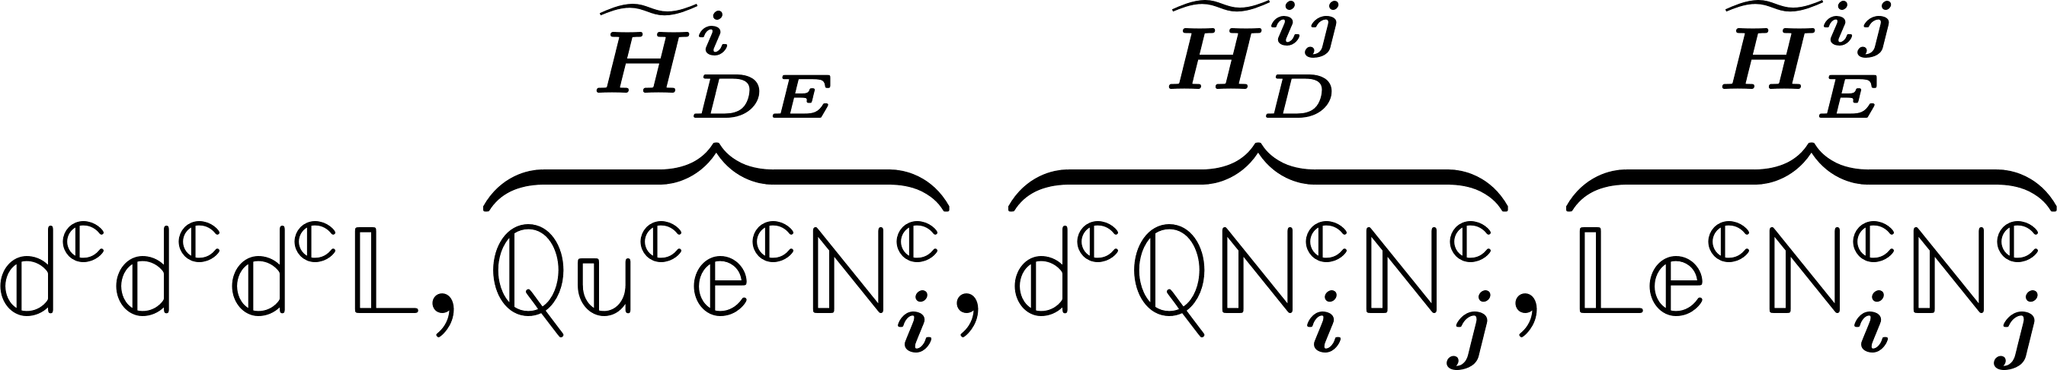

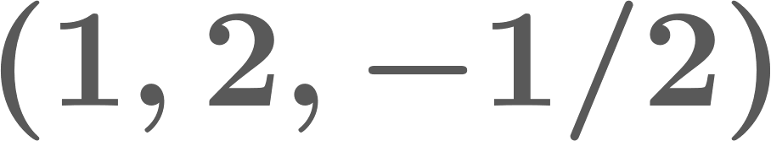
Scalars
Low energy phenomenology is controlled by these scalars only
SM scalar singlets
They control which combinations of fermions are light
S
E.g.:
A combination of the 4 Q’s pairs with Q^{c} and is superheavy. This combination is controlled by S’s.
H
SM Higgs
Linear combinations of all these doublets (requires fine-tunning)
Renato Fonseca
Explaining the SM flavor structure with grand unified theories
10
Low energy phenomenology is controlled by these scalars only

Slide 11

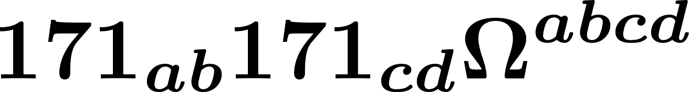
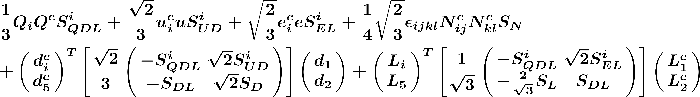
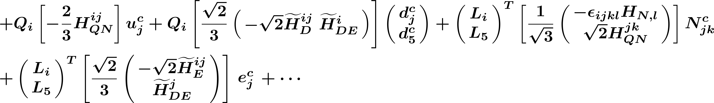
Predicting the SM flavor structure
SM
SU(19)
=
S
Integrates out heavy fermion, leaving
only 3 SM families
H
i,j=1,2,3,4 are SU(4) ‘flavor’ indices
Renato Fonseca
Explaining the SM flavor structure with grand unified theories
11

Slide 12


Predicting the SM flavor structure
S
Integrates out heavy fermion, leaving
only 3 SM families
H
Can the SM masses and angles be reproduced? Yes
Predictions for
SM parameters?
Not without looking at the scalar potential
Renato Fonseca
Explaining the SM flavor structure with grand unified theories
12

Slide 13



Other comments
What about symmetry breaking: ?
Same scalar which interacts with fermions
has a direction which can do it!
I
II
Potential: 1 mass + 3 quartic interactions. SM breaking VEV consistent with tadpole equations …
III
… but some masses are negative (?). Higher order terms and/or other scalars likely needed
IV
Gauge anomaly present. Gauge only part of SU(19) or add more fermions (which decouple)
Renato Fonseca
Explaining the SM flavor structure with grand unified theories
13

Slide 14
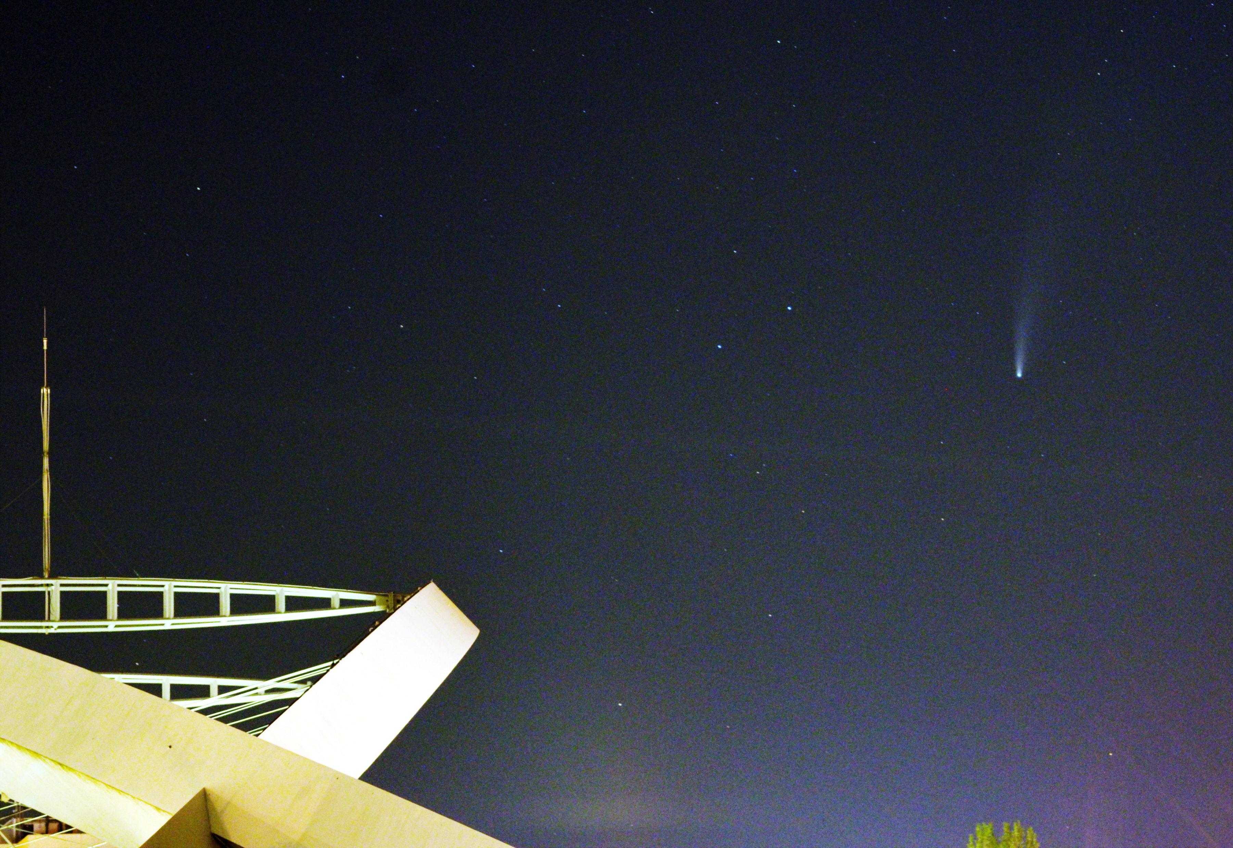
Summary
First realistic model of family unification
All Yukawa interactions depend on 1 number
Flavor = Fermion property? No.
Flavor originates from the scalar sector
The various SM flavor parameters depend
exclusively on ratios of VEVs
Thank you
Prague, 18/July/2020
Renato Fonseca
Automating group theory calculations and the problem of listing EFT operators
14

