Slide 1
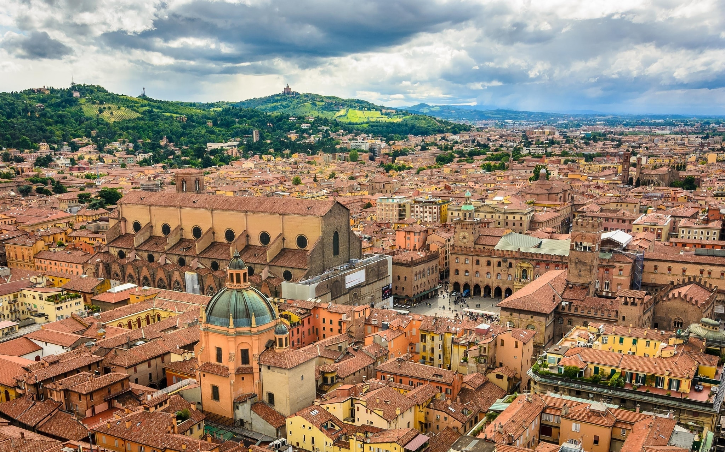


41st International Conference on High Energy Physics, (ICHEP 2022), Bologna
July 6-13 2022

Slide 2
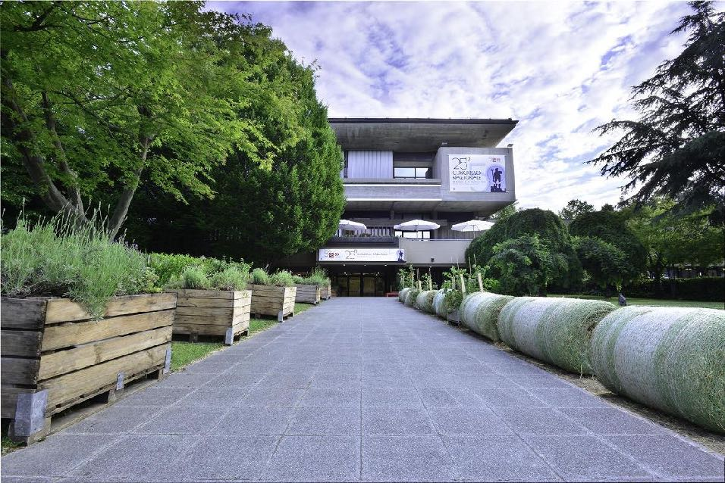
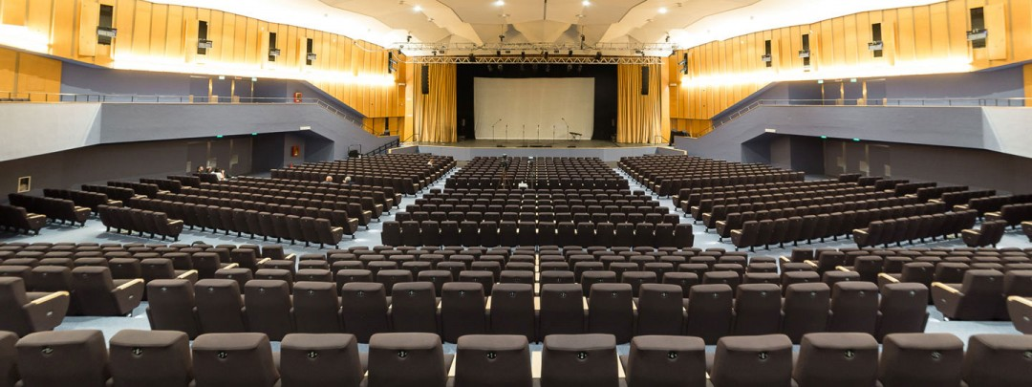
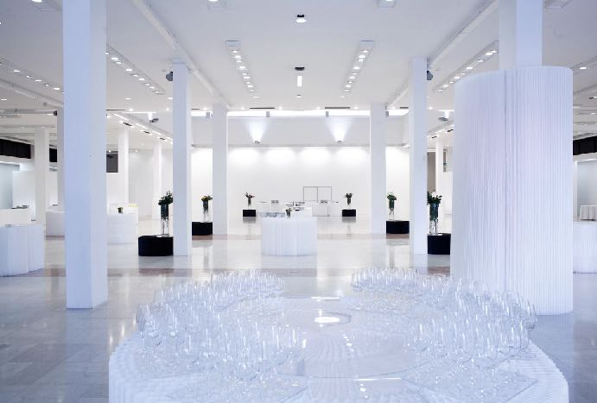
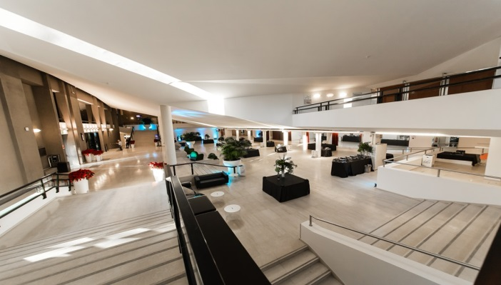
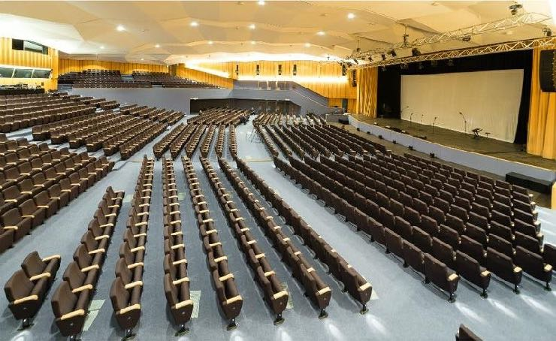
ICHEP 2022
Venue - Bologna Conference Center
Dates of the event
July 6th - July 13th 2022
ICHEP conference will be hosted for the first time in Italy!

Slide 3
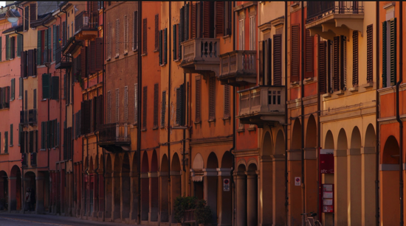

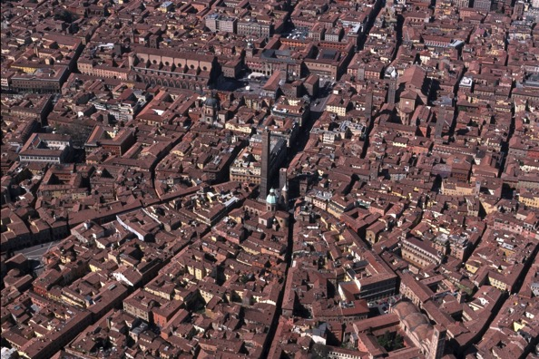
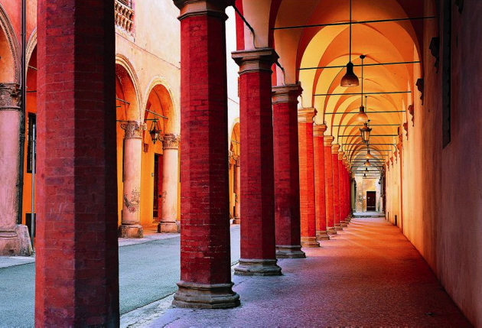
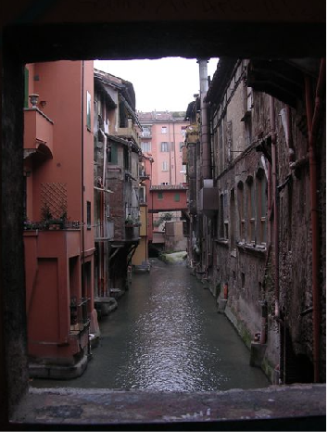
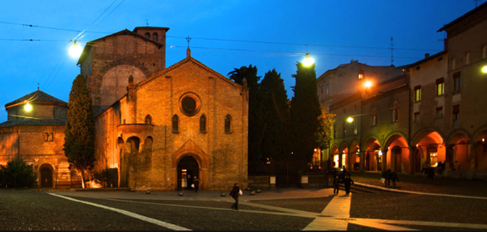

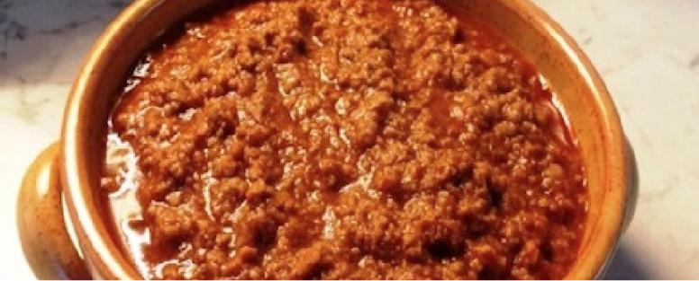
Bologna
University of Bologna “Alma Mater Studiorum” founded in 1088. One of the biggest Italian universities and the oldest of the Western world.
City centre, dating back to Middle-Age with an homogeneous mixture of monuments, churches, museums, antique buildings and other architectural features, such as its famous medieval towers and “portici”
16 June 2016 - LHCP 2016

Slide 4
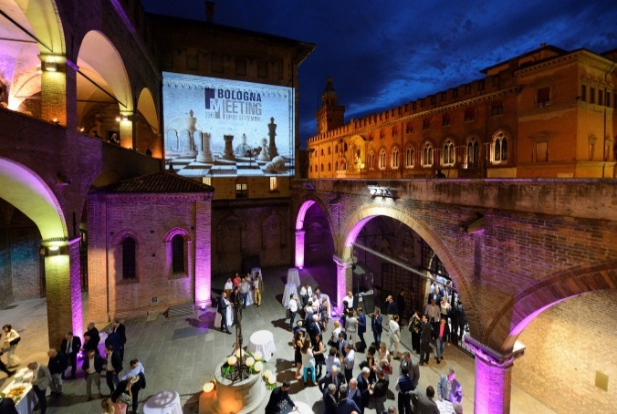
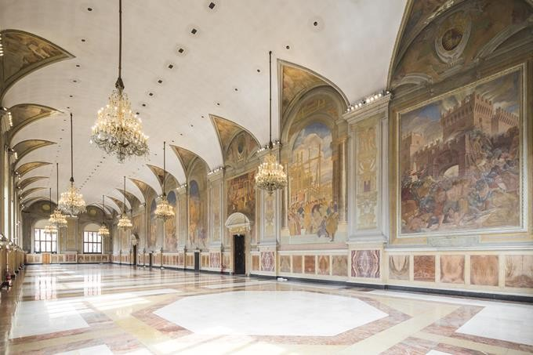
Gala dinner venue
‹#›
Palazzo
Re
Enzo
Surrounded by the magical atmosphere of Piazza Maggiore, in the heart of the city, Palazzo Re Enzo today combines the charm of a building of XIII Century with cutting-edge technology.

Slide 5
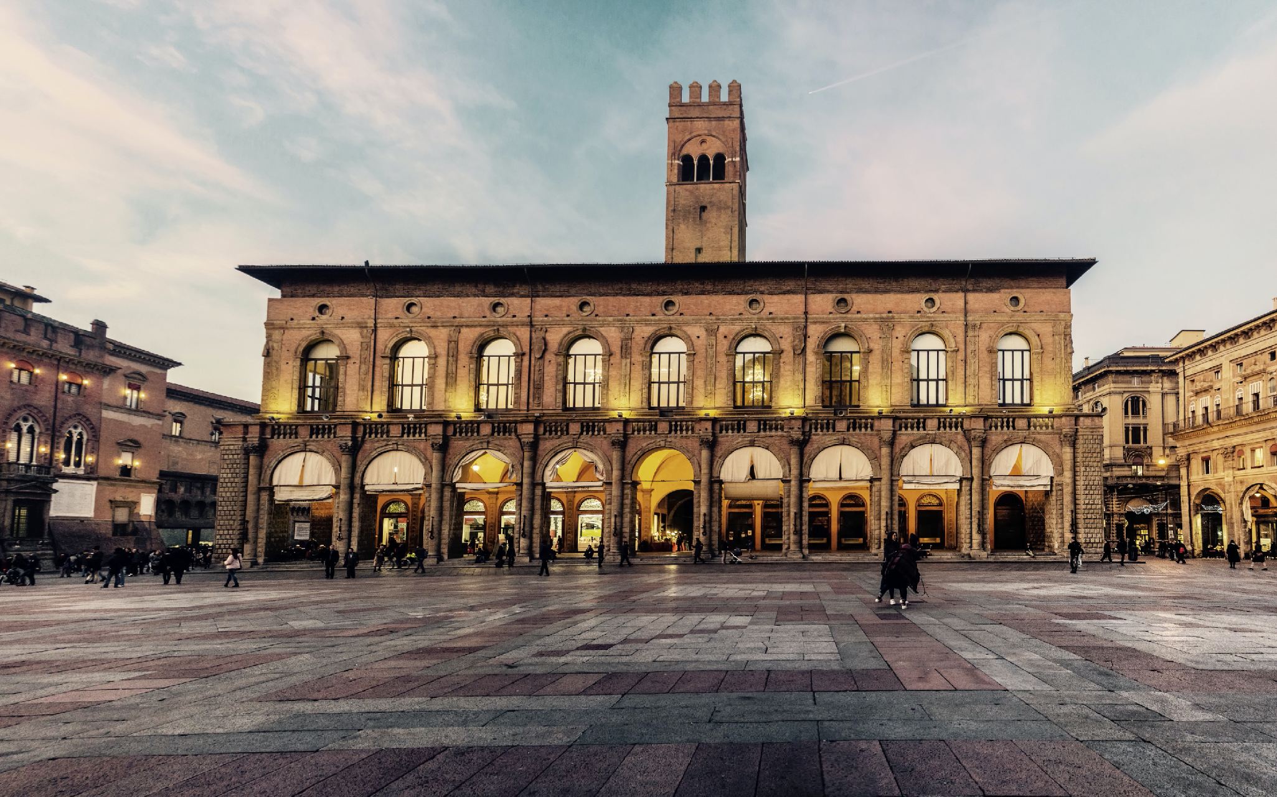
Invitation to Bologna
We look forward to see you all in Bologna on July 6, 2022 !
www.ichep2022.it

