Slide 1
Optimizing Availability Using a Digital-Twin Implementation - a CERN Case Study
Lukas Felsberger, Benjamin Todd

Slide 2
Digital Twins
“A digital twin is an integrated multi-physics, multi-scale, probabilistic simulation of a complex product and uses the best available physical models, sensor updates, etc., to mirror the life of its corresponding twin…
…Once the vehicle is launched, the Digital Twin will increase the reliability of the flying vehicle because of its ability to continuously monitor and mitigate degradation and anomalous event”
Glaessgen, Edward, and David Stargel. "The digital twin paradigm for future NASA and US Air Force vehicles." 53rd AIAA/ASME/ASCE/AHS/ASC Structures, Structural Dynamics and Materials Conference 20th AIAA/ASME/AHS Adaptive Structures Conference 14th AIAA. 2012.

Slide 3
Digital Twins – “Evolutionary steps”
Self learning and adaptive systems
  e.g. anomaly detection, automatic fault prediction systems
Quantitative/Functional models
  e.g. failure behavior models as function of operating conditions, Weibull analysis, Fault trees, Petri Nets…
Life Cycle Data
  e.g. operation logbooks, repair databases, engineering documentation

Slide 4
Digital Twins – Two approaches
Knowledge
Data
Knowledge based approach
Failure Mechanism understood
Small set of (run-to-failure) data required to extract model
Models mostly interpretable and transferable
Mechanisms need to be understood
Data driven approach
Limited failure mechanism understanding
Large set of (run-to-failure) data required to extract model
Models often neither interpretable nor transferable
Models cheap to learn
Hybrid

Slide 5
Digital Reliability Twins
Our experience in electronics: Failures in operation usually rare complex emergent phenomena.
  Complex failure mechanisms, little to no data, little to no models

Slide 6
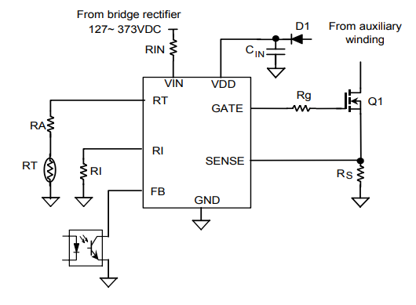
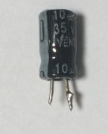
CIBD: Failure Mode-3: Regulation – 5/12
Failure Mode-3 analyse: root cause
    The reason of the fault is the degradation of the C8 electrolytic capacitor of 10uF 35V. The capacitor C8 found dead is a general-purpose grade electrolytic capacitor 10uF 35V
    Two brands has been identified for C8: Pce-TUM & YellowStone, with max T°C of 85°C for Yellowstone, and 105°C for Pce-TUM..
    This capacitor is used to power the PWM, its operating current not highly depending on the DCDC output current (quick eval).
From:
Y. Thurel’s RASWG talk, 13.09.2018

Slide 7
Digital Reliability Twins
Our experience in electronics: Failures in operation usually rare complex emergent phenomena.
  Complex failure mechanisms, little to no data, little to no models
  Possible to predict/prevent/mitigate such behavior?
    → mostly by learning from failure (in tests/existing operations) and generalizing to new operating conditions (in future operations)
    To do so, requires data-efficient flexible framework

Slide 8
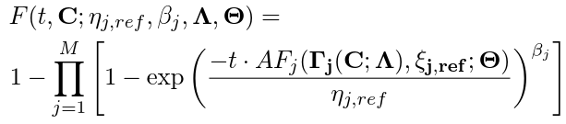




Digital Reliability Twins
Existing systems
Future Systems
Failure and operations data
Usage 1 - 580 Systems
Operating Condition $C_{1}$
Reliability Model
Optimization of operation
Optimization
Usage 2 - 90 Systems
Operating Condition $C_{2}$
Future Usage – 20 Sys.
Operating Condition $C_{f}$
Usage 3 - 116 Sys.
Testing Condition $C_{3}$

Slide 9
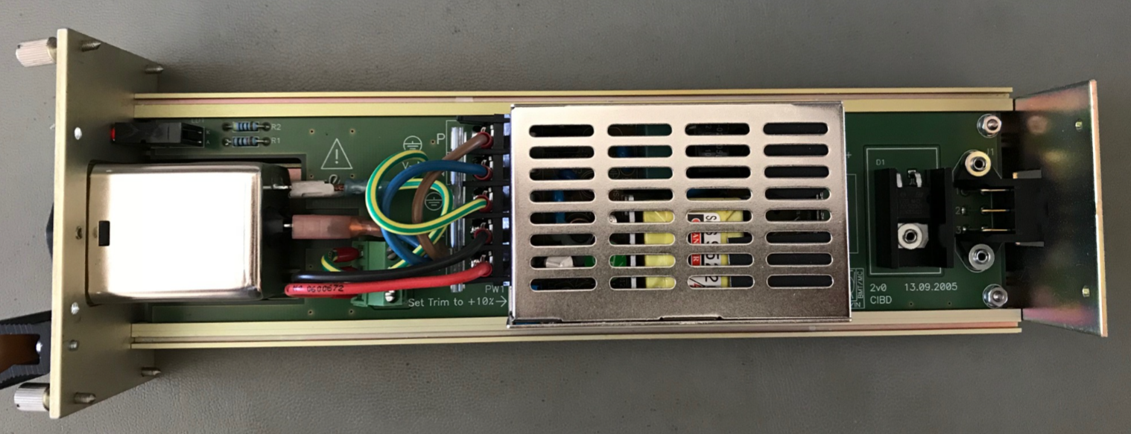
Use-Case: AC/DC power converter
Learn from Existing systems:
  Operated under three different conditions (580,90,116 devices @ 0.4A, 0.9A, 1.2A constant load)
  59 failures in ~10 years
    Three failure modes
Optimize operations of New systems:
  Two conditions: 0.3A and 1.6A
  Lifetime 10000 days
  What is the optimal maintenance strategy in terms of LCC?

Slide 10
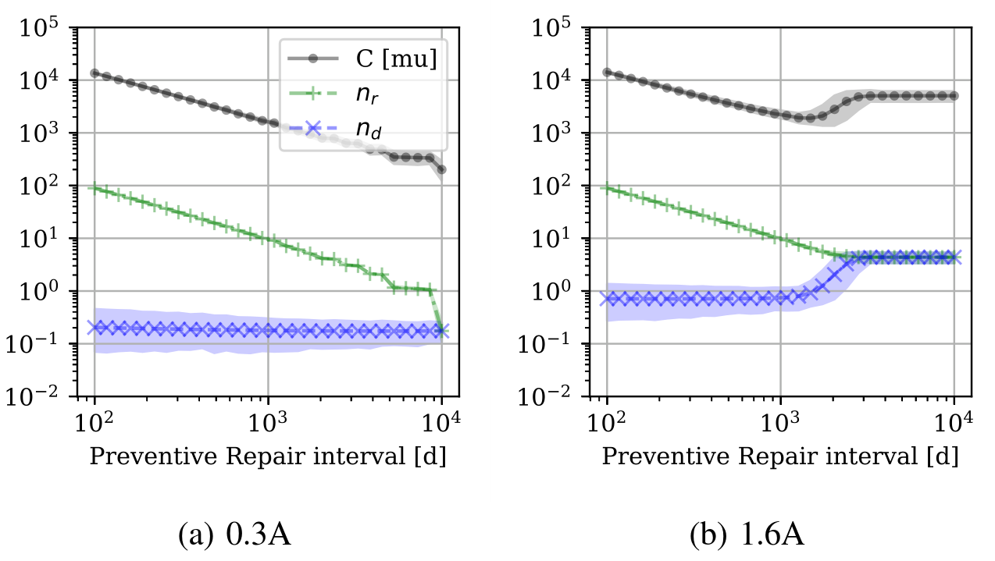
Simulation
Results
Assumed LCC cost parameters not valid for a CERN environment
Reactive maintenance
Main result: maintenance with lowest LCC highly dependent on operating condition
  Possible to identify since Digital Reliability Twin explicitly models dependence on operating condition

Slide 11
Criticism
Generated “Digital Twin” after accumulating knowledge over 10 years of operation
  BUT: should be possible within first years or even earlier
    BUT: Not sufficient accumulated knowledge
      Reliability testing
      Re-use knowledge from older systems (same/similar)

Slide 12
Summary & Conclusions
In electronics:
Digital twin paradigm can be valuable in practice iff compatible with a limited data & knowledge scenario (as typically found in electronics reliability problems)
Should allow to integrate all available knowledge and data from past and current systems
Should be able to function across different operating conditions
Should allow for uncertainty propagation
For technical details of presented method:
Felsberger, Lukas, Benjamin Todd, and Dieter Kranzlmüller. "Power Converter Maintenance Optimization Using a Model-Based Digital Reliability Twin Paradigm" International Conference on System Reliability and Safety 2019

Slide 13
Backup slides

Slide 14
Reliability Model
Operating conditions → Failure Stress: $ξ_{j}=Γ_{j}\left(C;Λ\right)$
Operating conditions → Failure Stress: 𝝃_𝒋=𝚪_𝐣 (𝑪;𝚲)
Failure Stress → Acceleration: $AF_{j}(ξ_{j},ξ_{j,ref};Θ)$
Failure Stress → Acceleration: 𝐴𝐹_𝑗 (𝝃_𝒋,𝝃_(𝒋,𝒓𝒆𝒇);𝚯)
Acceleration → Failures: ${TTF}_{i,j}∝Weibull\left(η_{j}⋅AF_{j},β_{j}\right)$
Acceleration → Failures: TTF_(i,j)∝𝑊𝑒𝑖𝑏𝑢𝑙𝑙(𝜂_𝑗⋅𝐴𝐹_𝑗,𝛽_𝑗 )
Operating conditions: $C$
Operating conditions: 𝐂

Slide 15
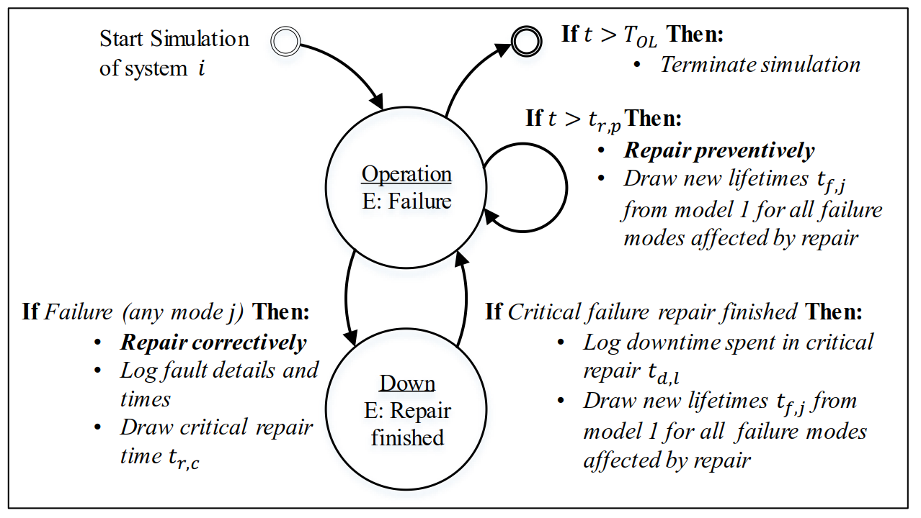
Simulation I

Slide 16
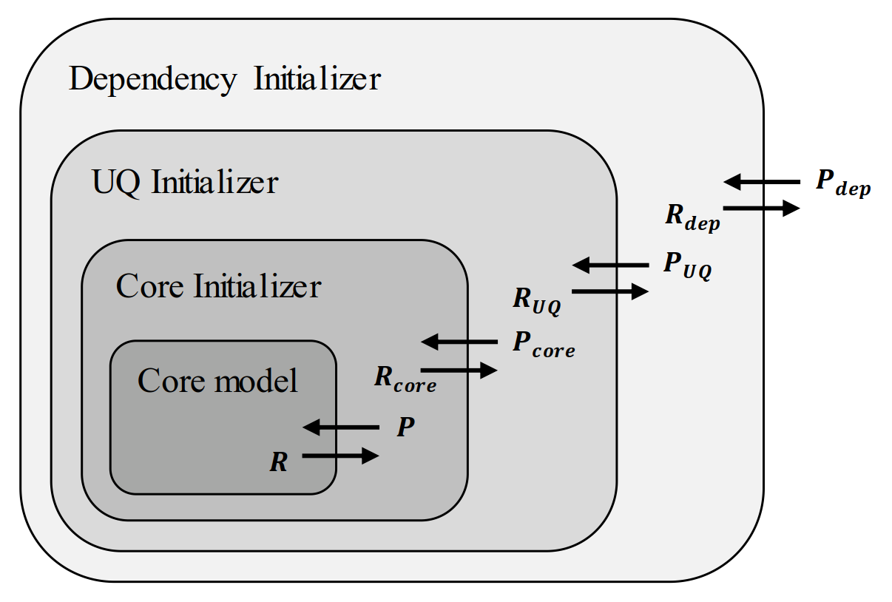
Simulation
Simulates Failure Behavior and Operation (e.g. Maintenance)
Tracks failures and replacements over lifetime to calculate Life Cycle Cost (or other metric)

Slide 17
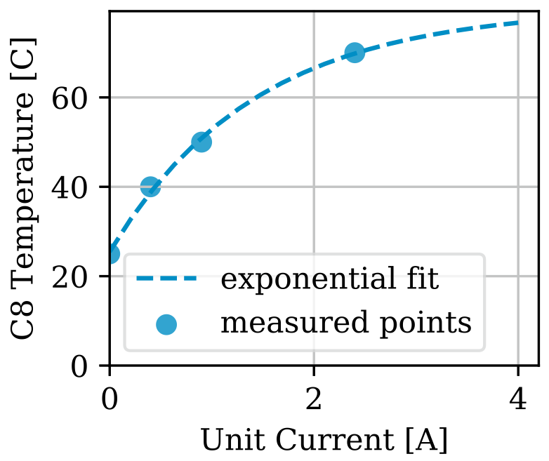
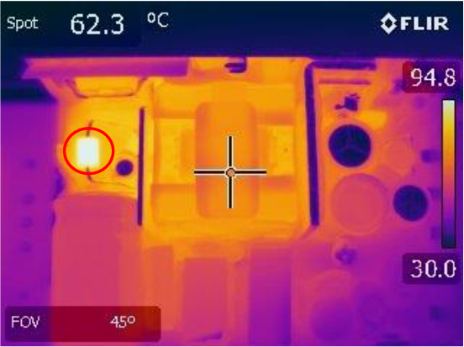
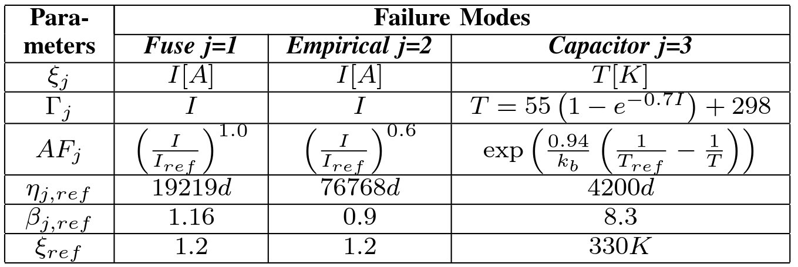
Use-Case: Data Analysis
FM1: Fuse wear-out
Load proportional power law acceleration empirically determined
Weak wear-out behavior
FM2: unknown (rare)
Load proportional power law acceleration empirically determined
No wear-out behavior
FM3: Capacitor degradation
Mechanism: transient voltage suppressor heated electrolytic capacitor
  → leads to evaporation
Operating conditions → Failure Stress: empirically determined
Failure Stress → Acceleration: well studied in literature
Strong wear-out behavior

Slide 18
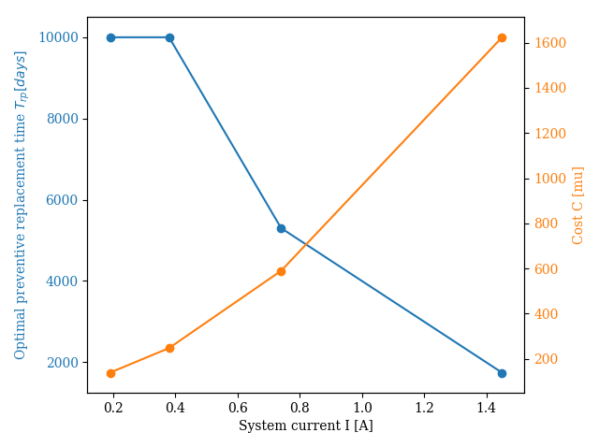
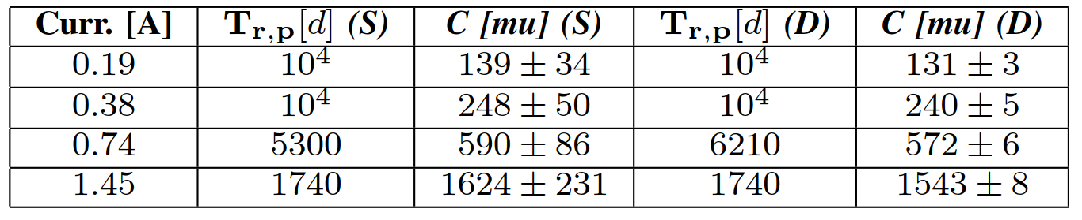
Use-Case: Discussion
Why such different behavior?
FM1 & FM2 are constant in time
FM3 has strong wear-out behavior
For low currents: FM3 inactive
  →system shows no wear-out behavior
  → preventive maintenance useless
For high currents: FM3 active
  → system shows wear-out behavior
  → preventive maintenance useful

Slide 19
Methodology Overview
Data Collection
Digital Twin Synthesis
Simulation
Evaluation and Decision Making

Slide 20

Introduction - Availability
The proportion of time a unit $U$ is in a functional state
$Availability=\frac{E[Uptime]}{E[Uptime]+E[Downtime]}$
E
I
O
U

Slide 21

Methodology – Quantify Failure Mechanism
McPherson, Joe W. Reliability physics and engineering. New York: Springer, 2010.
Material strength -/
Stress - -
$TTF∝Weibull\left(η,β\right)$
Failures
Operational time/cycles

Slide 22

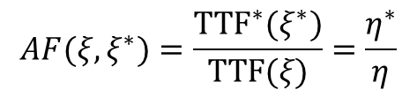


Methodology – Quantify Failure Mechanism
Material strength -/
Stress $ξ$ - -
${TTF}^{∗}∝Weibull\left(η^{∗},β \right)$
$TTF∝Weibull\left(η,β\right)$
$$AF(ξ,ξ^{∗})=\frac{{TTF}^{∗}(ξ^{∗})}{TTF(ξ)}=\frac{η^{∗}}{η}$$
Stress
Operational time/cycles
McPherson, Joe W. Reliability physics and engineering. New York: Springer, 2010.
Notes:
TTF models usually follow power law or exponential model → same for acceleration factor
If acceleration is carried out properly → beta does not change

