Slide 1
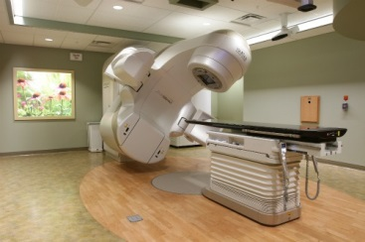
The theoretical background of radiotherapy
Ibrahimović Amra

Slide 2
What is radiotherapy?
Radiotherapy is a type of treatment for cancer and many other diseases
In radiotherapy we use energy from the beam to kill cancerous cells
Therapy can be performed with:
    Electrons
    Photons
    Hadrons (protons and neutrons)
    Heavy ions (e.g. Carbon ions )
Types of radiotherapy:
    External radiotherapy
    Brachytherapy
Application of radiotherapy:
    To cure the patient
    For palliative purposes (to relieave pain, but not cure)

Slide 3
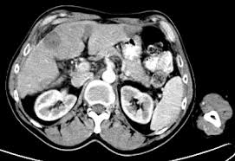
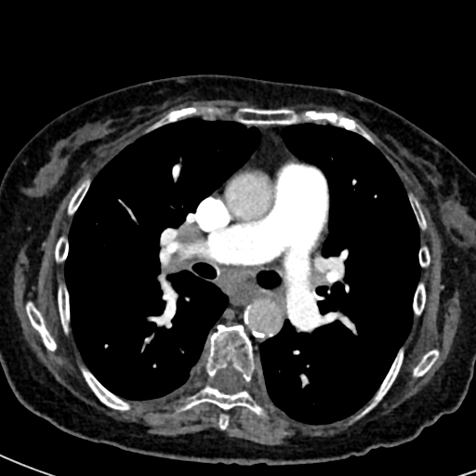
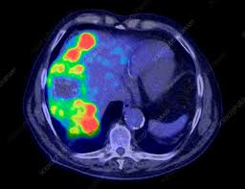
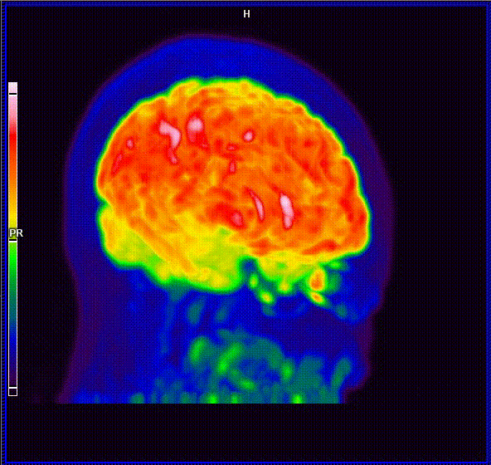
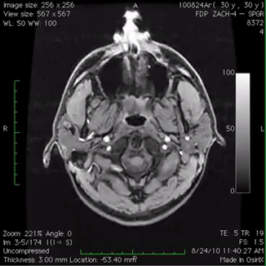
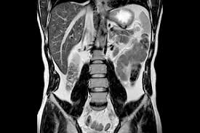
How to detect cancer?
Diagnostic search can be performed on diagnostic machines :
    CT(Computerized Tomography)
    PET(Positron Emission Tomography)
    MRI (Magnetic Resonance Imaging)
CT image (anatomic, obtained by x-rays)
PET image (metabolic, obtained by beta emitter)
MRI image (anatomic, obtained by interaction with a magnetic field)

Slide 4
Sizes and units in radiotherapy
The energy which the particles deposit in tissue cause the dose
Types od doses:
      Absorbed dose
      Equivalent dose
      Effective dose

Slide 5

      Absorbed dose
      The absorbed dose is defined as the energy deposited by ionizing radiation per unit mass of material. Measuring unit is Gray.
1Gy presents 1 J/Kg
1Gy

Slide 6
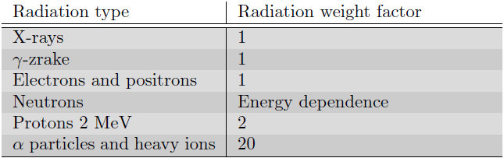

Equivalent dose
The equivalent dose is defined as the absorbed dose multiplied by the radiation weight factor.
The radiation weight factor was estimated based on the damage which is produced in our tissue
Measuring unit is Sivert
H_{T} – Equivalent dose
D – Absorbed dose
W_{R} – Radiation weight factor

Slide 7

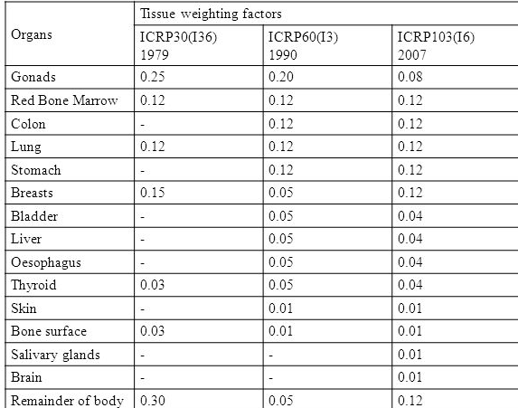
Effective dose
The effective dose is defined as the equivalent dose multiplied by the tissue weight factor which is based on the organ’s sensitivity and summing for whole body.
This is only the one number
The most sensitive organs are the eye lenses, ovaries andtesticles
E – Effective dose
H_{T} – equivalent dose
W_{T} – tissue weight factor

Slide 8
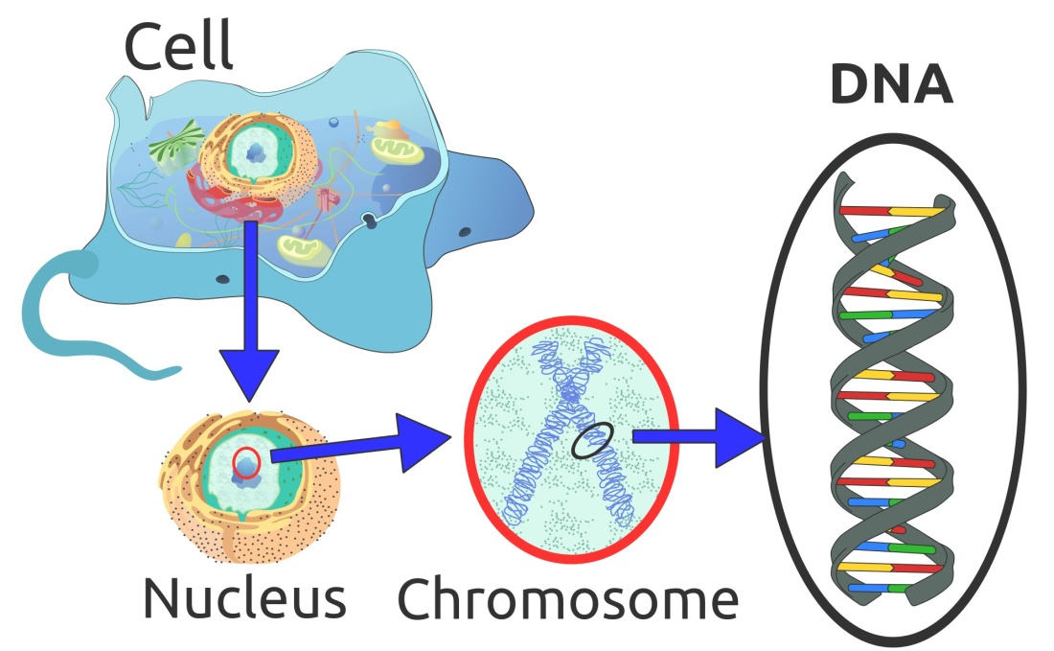
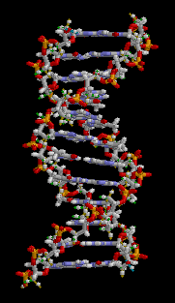
Radiation damage
Radiation damage is manifested through damage to genetic material (DNA) in the cells of the body.
Types of DNA damage
  Single breaks
  Double breaks
There are three possible outcomes
  After damage, the cells are completely repaired and continue to function normally
  Improperly repaired cells continue to live with mutations that may develop secondary cancer in the future
  Cell death
!!! Normal healthy cells have a repair mechanism, while cancerous have also but it is sllower then normal. Therefore, fractionation treatment is used.

Slide 9
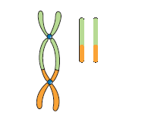
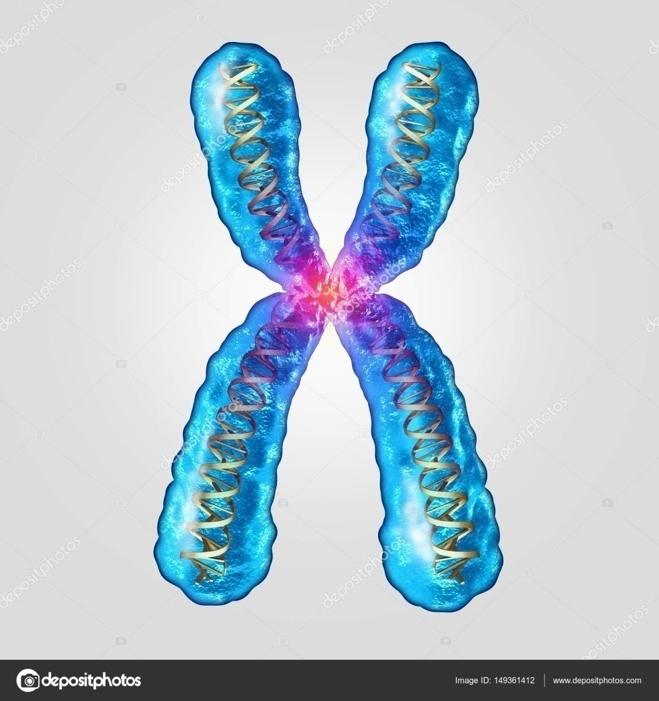
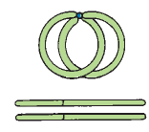

Some types of mutations
Dicentric chromosomes
Normal healthy chromosome
Rings and acentric fragments
Anaphase bridges and acentric fragments

Slide 10
Two reasons for investing in the development of particle radiotherapy:
Hadrons and particles break both strands of DNA, preventing mutations
They have the power to destroy radioresistant tumors

Slide 11
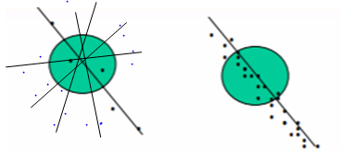
RBE (Relative biological efficency)
Radiation that leaves more energy per unit time produces more ionization in one region, and radiation that leaves less energy per unit time produces less ionization and creates more damage because the ionization will spread beyond the desired region and thus cause more harm to the organ / tissue.
Radiation which has low energy transfer
Radiation which has a high energy transfer
RBE – Relative biological efficiency is a comparison of the amount of damage in the body. This factor shows how much dose does the same damage as some reference radiation (e.g. X-rays ili Co60 gamma radiation)

Slide 12
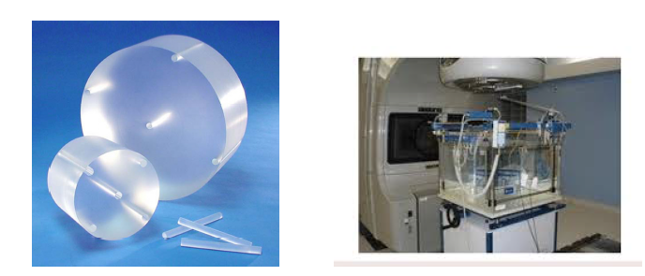
Phantoms
Phantoms are used in radiotherapy and diagnostic purposes to test the machine’s and beam’s parameters, because these phantoms simulate the body.
Phantom for CT made from plaxiglass
Water radiotherapy phantom

Slide 13
Radiotherapy treatment planning

Slide 14
Keywords
SSD-Source to Surface Distance
SAD-Source to Axis Distance
ISOCENTER-the center of the tumor through which the axis of rotation of the machines passes

Slide 15
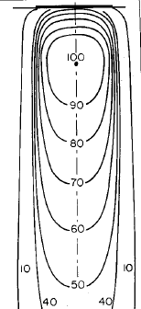
Dose distribution
As radiation enters the patient, it begins to interact with the patient.
The dose distribution over the phantom is measured by radiation detectors.
Dose distribution by depth consists of a family of curves where each curve represents the area of the same dose and is most commonly normalized to the area where 100% of the dose is located or where the maximum dose is.
Interaction depends on several factors and all of these must be taken into account when planning therapeutic treatment:
      Beam energy
      Depth of cancer
      Field size
      SSD
      Beam collimation
      Shape of patient
      Presence of sensitive organs

Slide 16
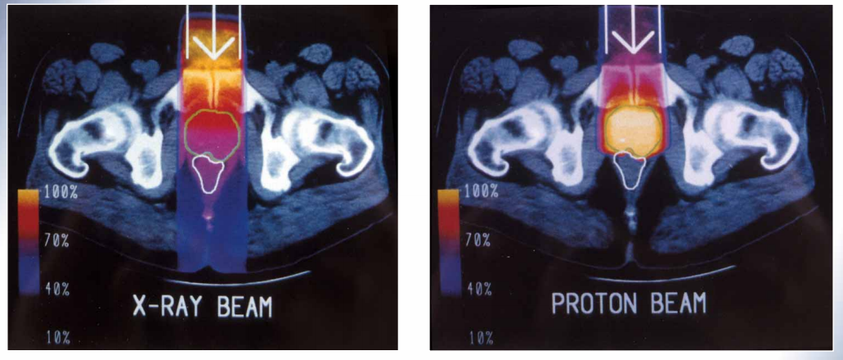
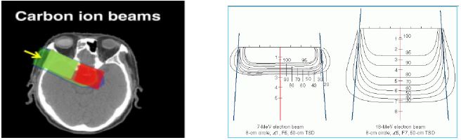

Slide 17
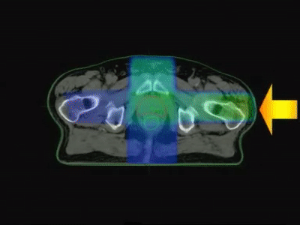
Multiple fields
The most important goal of treatment planning is to deliver the highest dose to the tumor and the least to the surrounding tissue. This is best achieved by using more fields from different angles than from one angle.
Strategy:
(a) using fields of appropriate size
(b) increasing the number of fields
(c) selecting appropriate beam directions
(d) using appropriate beam energy
(f) using beam modifiers such as wedge filters and compensators

Slide 18
Stationary and rotational radiotherapy
The difference between stationary and rotational therapy is that in rotational therapy, the treatment beam is constantly circulating around the patient, and in stationary radiate only in certain positions.
In both species, the center of rotation of the machine is in the tumor within the patient and is called the isocenter.

Slide 19
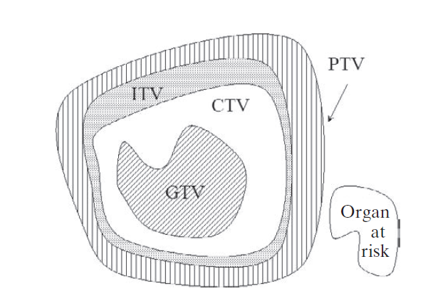
VOI (volume of interest) and margins
CTV- margin whose consists present and any other tissue with presumed tumor
GTV- exactly location
of the tumor
GTV- gross tumor volume
CTV-clinical target volume
ITV-internal target volume
PTV-planing target volume
ITV- margin added to
CTV to compensate for internal physiologic movements and variation in size,
shape, and position
Organ at risk-presence of organs with high sensitivity to radiation
PTV- margin for
patient movement and setup uncertainties

Slide 20
Maximum dose -The highest dose in the target area is called the maximum target dose
Minimum dose in target -The minimum target dose is the lowest absorbed dose in the target area
Mean Target Dose -If the dose is calculated at a large number of discrete points uniformly distributed in the target area, the mean target dose is the mean of the absorbed dose values at these points

Slide 21
Patient positioning and immobilisation
Patient positioning and immobilization depends on the treatment setting and the desired precision.
Immobilization deviceses have two basic roles :
    To immobilize the patient during treatment
    To allow the best keeping of the patient's position from simulations until treatment or between two treatments
Some immobilization devices are masks, pillows, belts, elastic belts, vacuum devices

Slide 22
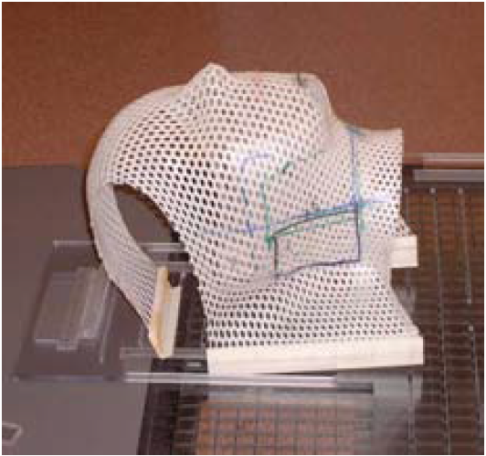
Immobilization head mask

Slide 23
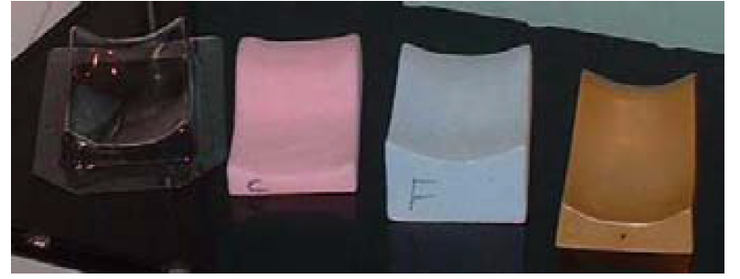
Immobilization pillows

Slide 24
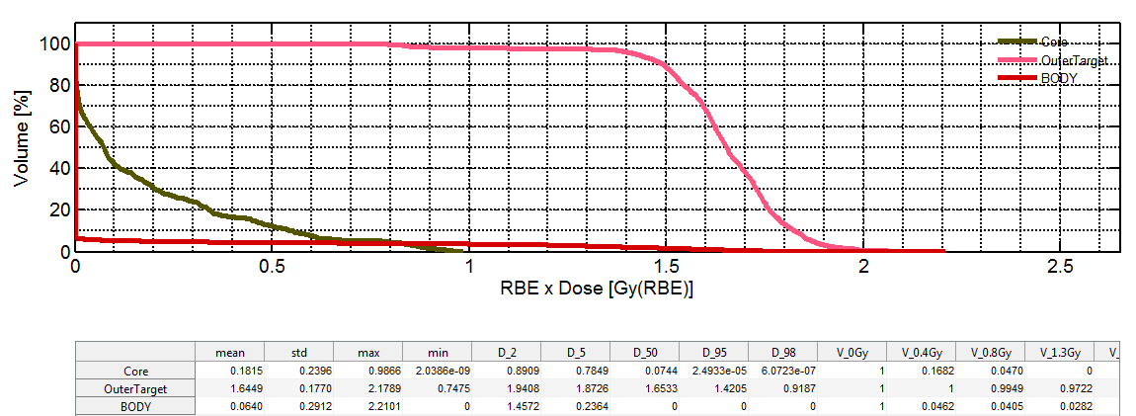
DVH-dose volume histogram
DVH not only provides quantitative data on how much the dose is absorbed in a volume, but also summarizes the entire dose distribution into a single curve for each anatomical structure of interest.

Slide 25
Modern radiotherapy methods
3D Conformal Radiotherapy — Under 3-dimensional conformal radiotherapy (3-D CRT) we mean treatments based on three-dimensional anatomical information and use drugs that match the target volume as closely as possible to give the tumor the appropriate dose and the lowest possible dose to normal tissue.
Intensity Modulated Radiotherapy - The Intensity Modulated Radiotherapy (IMRT) refers to an irradiation technique in which the patient is fed unequal radiation intensity from any treatment position to optimize dose distribution.
Stereotactic radiosurgery - This involves delivering a complete dose with a single fraction in the head region.
Stereotactic Radiotherapy - Assumes delivery of this dose in fractions. Both use very thin beams for extreme precision.
Image guided radiotherapy — It can be defined as a radiotherapy procedure that uses imaging methods at different stages of the process: obtaining patient information, scheduling treatment, simulating treatment, placing the patient, and localizing the patient before and during treatment.

Slide 26
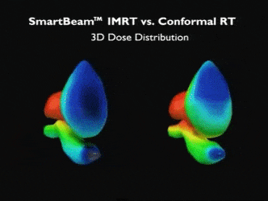
Notes:
A mozeee pa i ja sam ga ovako a nisam na slide show stavlja :D fajaaaaaa

Slide 27
THANK YOU!!!

