Slide 1










SPSC – CERN/Switzerland – 2020 / 01 / 21
BASE
Annual Report 2019
Plans for the 2020 run
Future Proposal
Stefan Ulmer
RIKEN,
Chief Scientist, Fundamental Symmetries Laboratory, RIKEN
Spokesperson BASE collaboration, CERN
2019 / 01 / 21

Slide 2


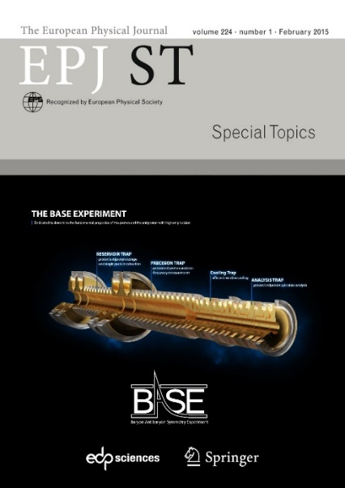
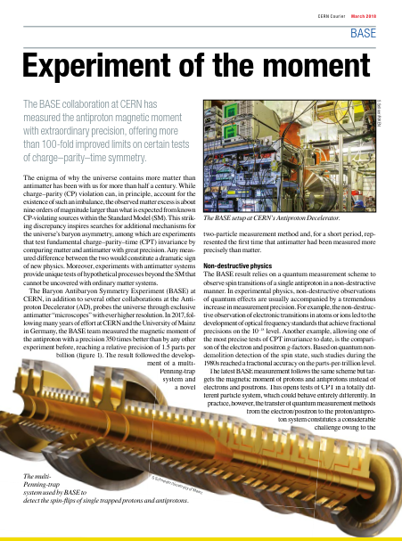






BASE – Collaboration
Mainz: Measurement of the magnetic moment of the proton, implementation of new technologies (laser cooling and BASE-STEP).
CERN-AD: Measurement of the magnetic moment of the antiproton and proton/antiproton q/m ratio
Hannover/PTB: QLEDS-laser cooling project, new technologies
Institutes: RIKEN, MPIK, CERN, University of Mainz, Tokyo University, GSI Darmstadt, University of Hannover, PTB Braunschweig
C. Smorra et al., EPJ-Special Topics, The BASE Experiment, (2015)

Slide 3
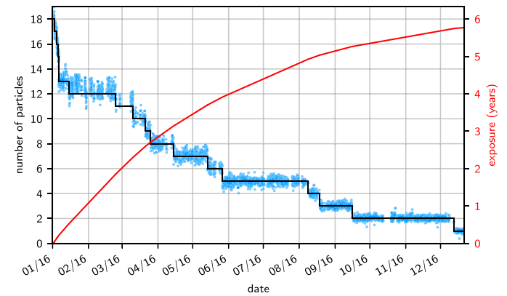
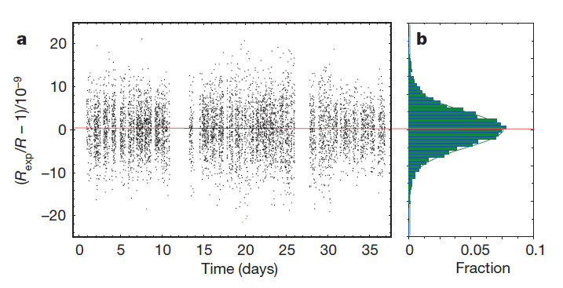
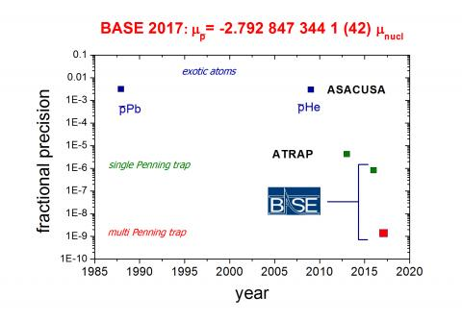
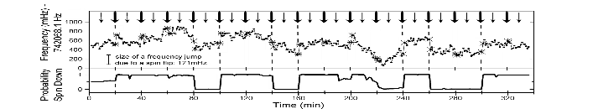
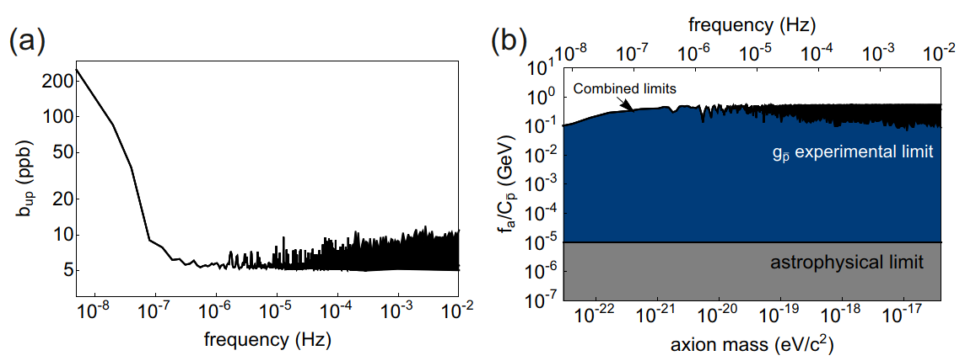

Achievements since 2011
Observation of spin flips with
a single trapped proton
Precise CPT test with baryons
Most precise antiproton/proton
g-factor measurments
Constraining Antiproton Lifetime
S. Ulmer, et al., Nature 524, 196 (2015)
S. Sellner et al., NJPhys. 19, 083023 (2017)
G. Schneider et al., Science 358, 1081 (2017).
C. Smorra et al., Nature 550, 371 (2017)
30-fold improved constraints on directly measured antiproton lifetime
S. Ulmer, et al., PRL 106, 253001 (2011)
A. Mooser, et al., PRL 110, (2013)
$1+\frac{{(q/m)}_{\overline{p}}}{{(q/m)}_{p}}$ $=1\left(69\right)×{10}^{−12}$
Application of the double
Penning-trap technique
Dark Matter / Antimatter Interaction
Rexp,c = 1.001 089 218 755 (64) (26)
Proton:
g/2 = 2.792 847 344 62 (82)
C. Smorra et al., Nature 575, 310 (2019)
To be improved by another factor of 10 to 100
30-fold improvement compared to previous measurement
Reservoir trap for antiprotons
Antiproton:
C. Smorra, et al., Int. Journ. Mass Spec. 389, 10 (2015).
g/2 = 2.792 847 344 1 (42)
First limits on dark matter / antimatter coupling, orders of magnitudes more stringent than astrophysics limits.
Idea: Enable operation with antiprotons independent of accelerator run times.
3000-fold improvement compared to previous measurement
A. Mooser, et al., PLB 723, 78 (2013)
Partly comparable work by J. DiSciacca, G. Gabrielse et al.. (ATRAP/TRAP collaboration)

Slide 4
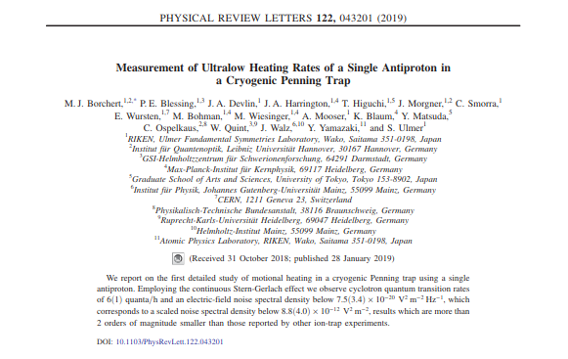
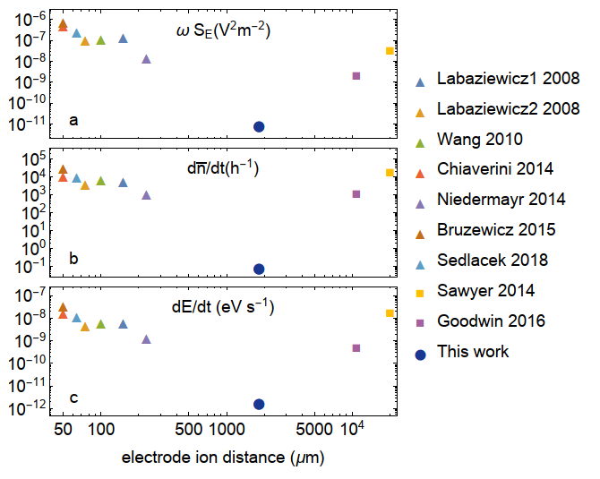
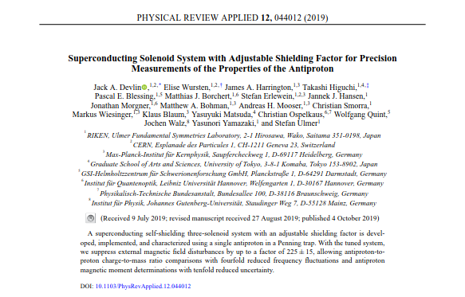
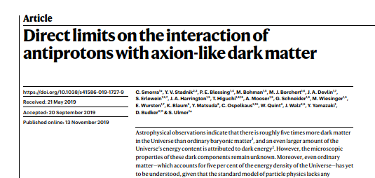
This Talk
M. J. Borchert et al., Measurement of Ultralow Heating Rates of a Single Antiproton in a Cryogenic Penning Trap, Phys Rev. Lett. 122, 043201 (2019).
J. A. Devlin et al., Superconducting Solenoid System with Adjustable Shielding Factor for Precision Measurements of the Properties of the Antiproton, Phys. Rev. Appl. 12, 044012 (2019).
C. Smorra, et al., Direct limits on the interaction of antiprotons with axion-like dark matter, Nature 575, 310 (2019).
Progress and developments during the 2019 run
  Improved charge-to-mass ratio measurement
  Implementation of phase-sensitive frequency measurements
BASE future proposal
  Improved magnetic moment measurement
  Implementation of a transportable trap for antiprotons
  Installation of an offline laboratory

Slide 5
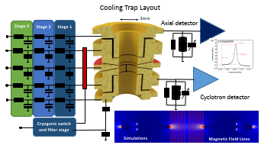
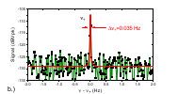
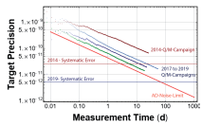

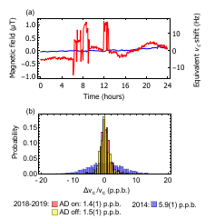
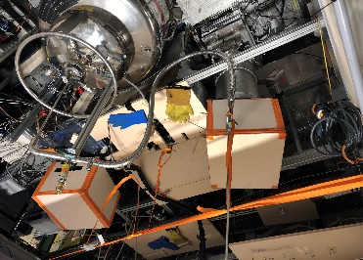
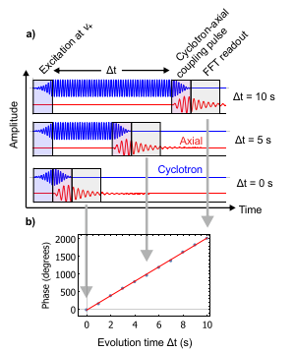
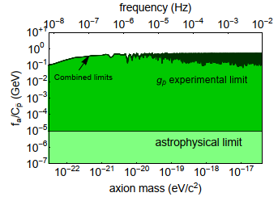
Timeline 2019
Dispersive frequency measurements
Peak ratio measurements and systematic studies
dip ratio measurements
Development of upgrades for R1/LS2
Data analysis of Q/M ratio and lifetime
01
02
03
04
05
06
07
08
09
10
11
12
Installation of new experiment frame
Phase methods with protons
Antiproton lifetime measurements
Characterization of Shielding Coils
Time-base data analysis of g-factor

Slide 6
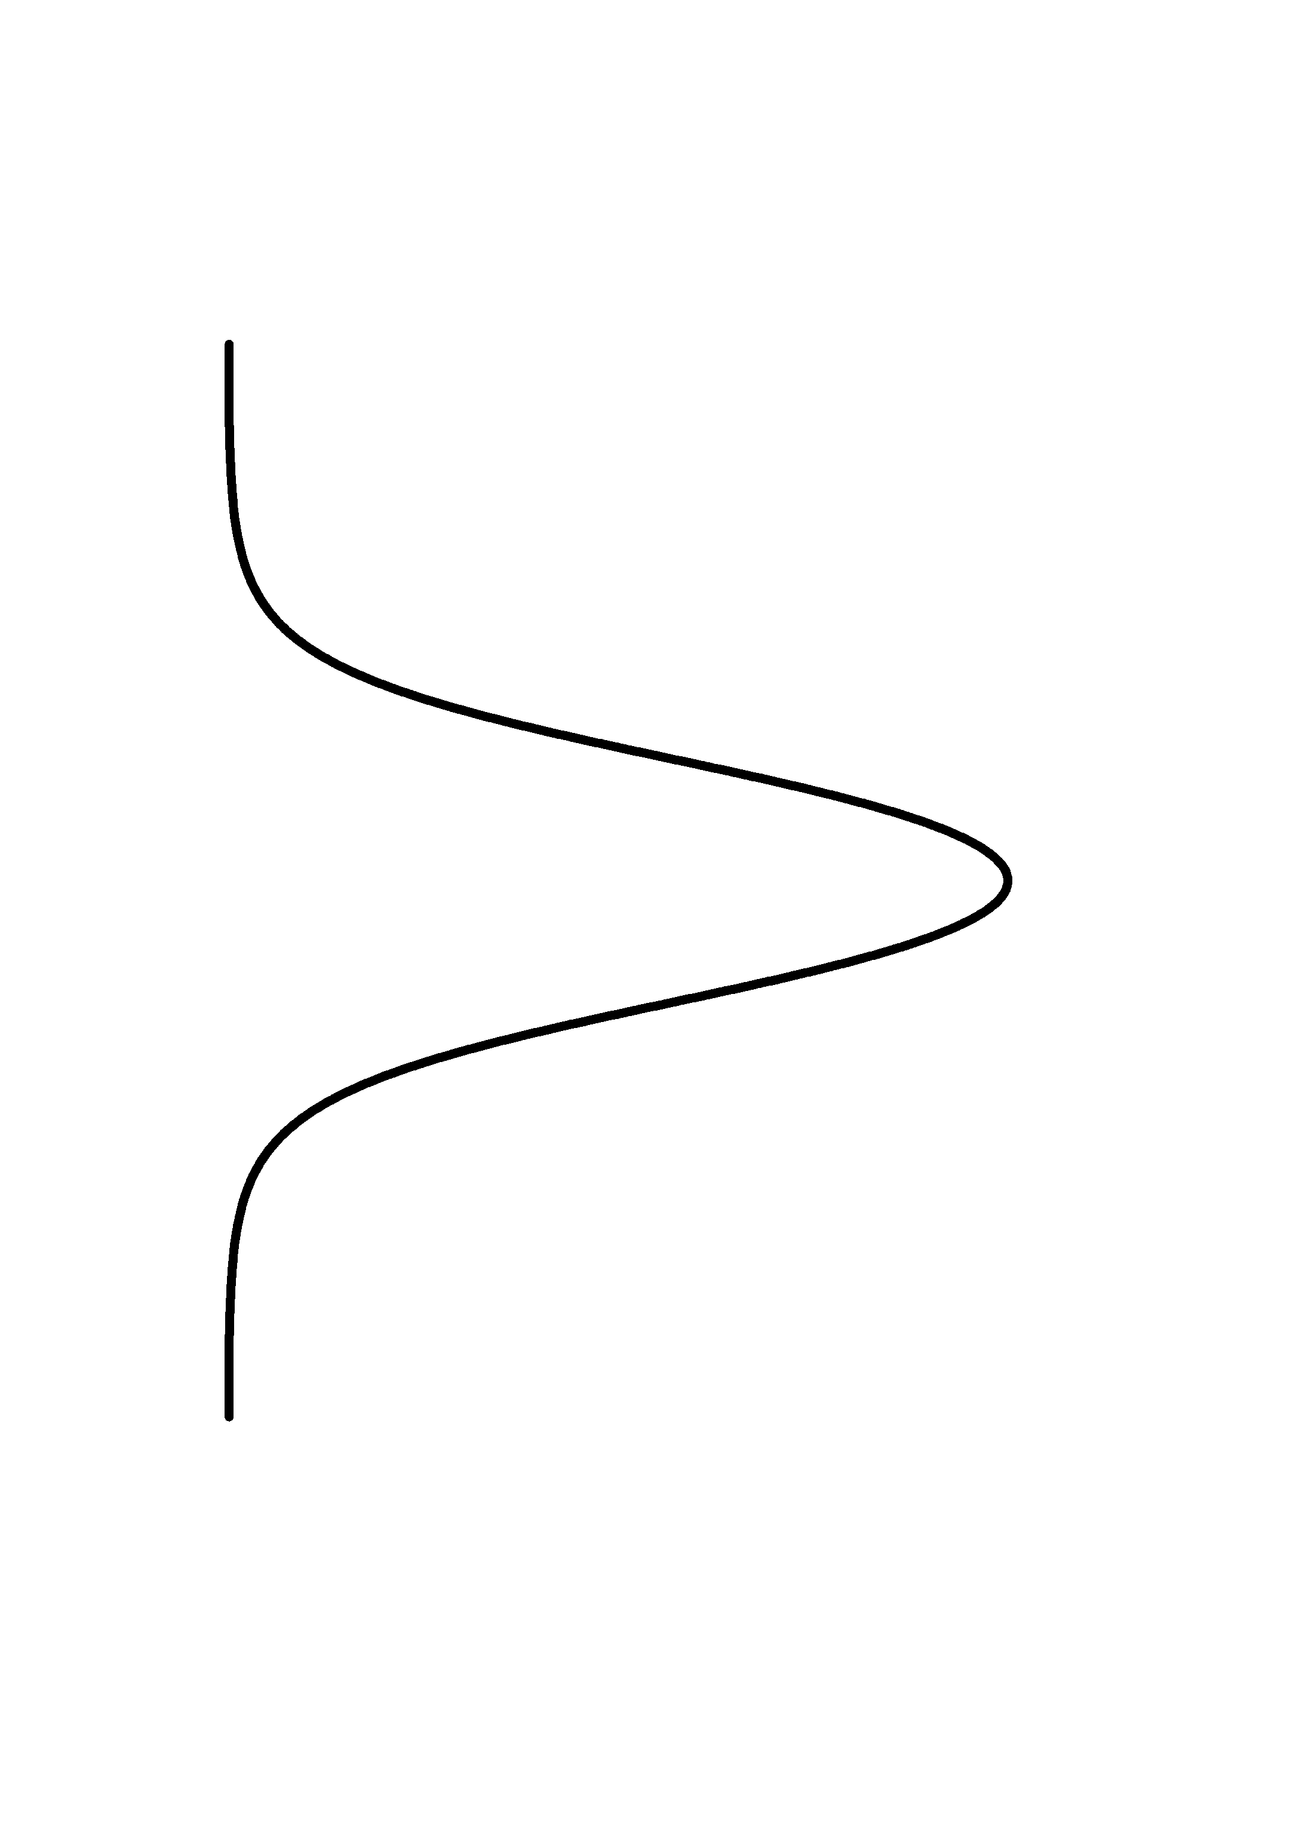
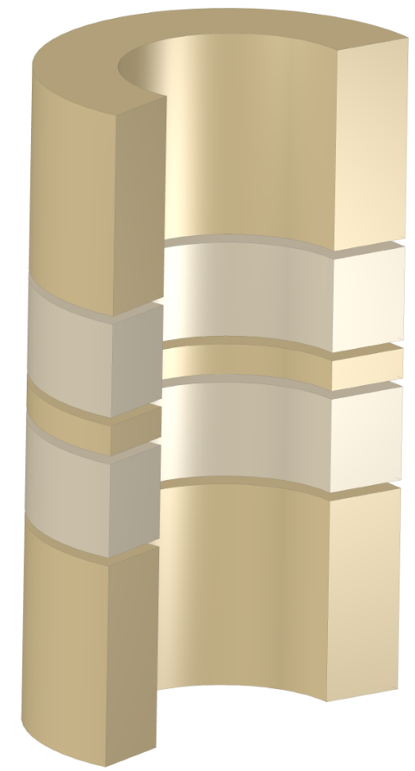
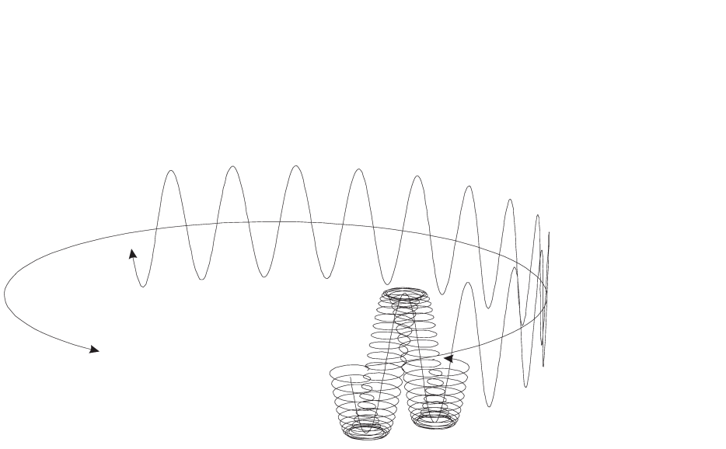

Main Tool: Penning Trap
radial confinement:
Invariance-Relation
axial confinement:
Cyclotron Frequency
Modified Cyclotron Motion
Axial Motion
Magnetron Motion
Cyclotron frequency connects measurable quantity to fundamental properties of trapped charged particle
Axial
Magnetron
Modified Cyclotron

Slide 7
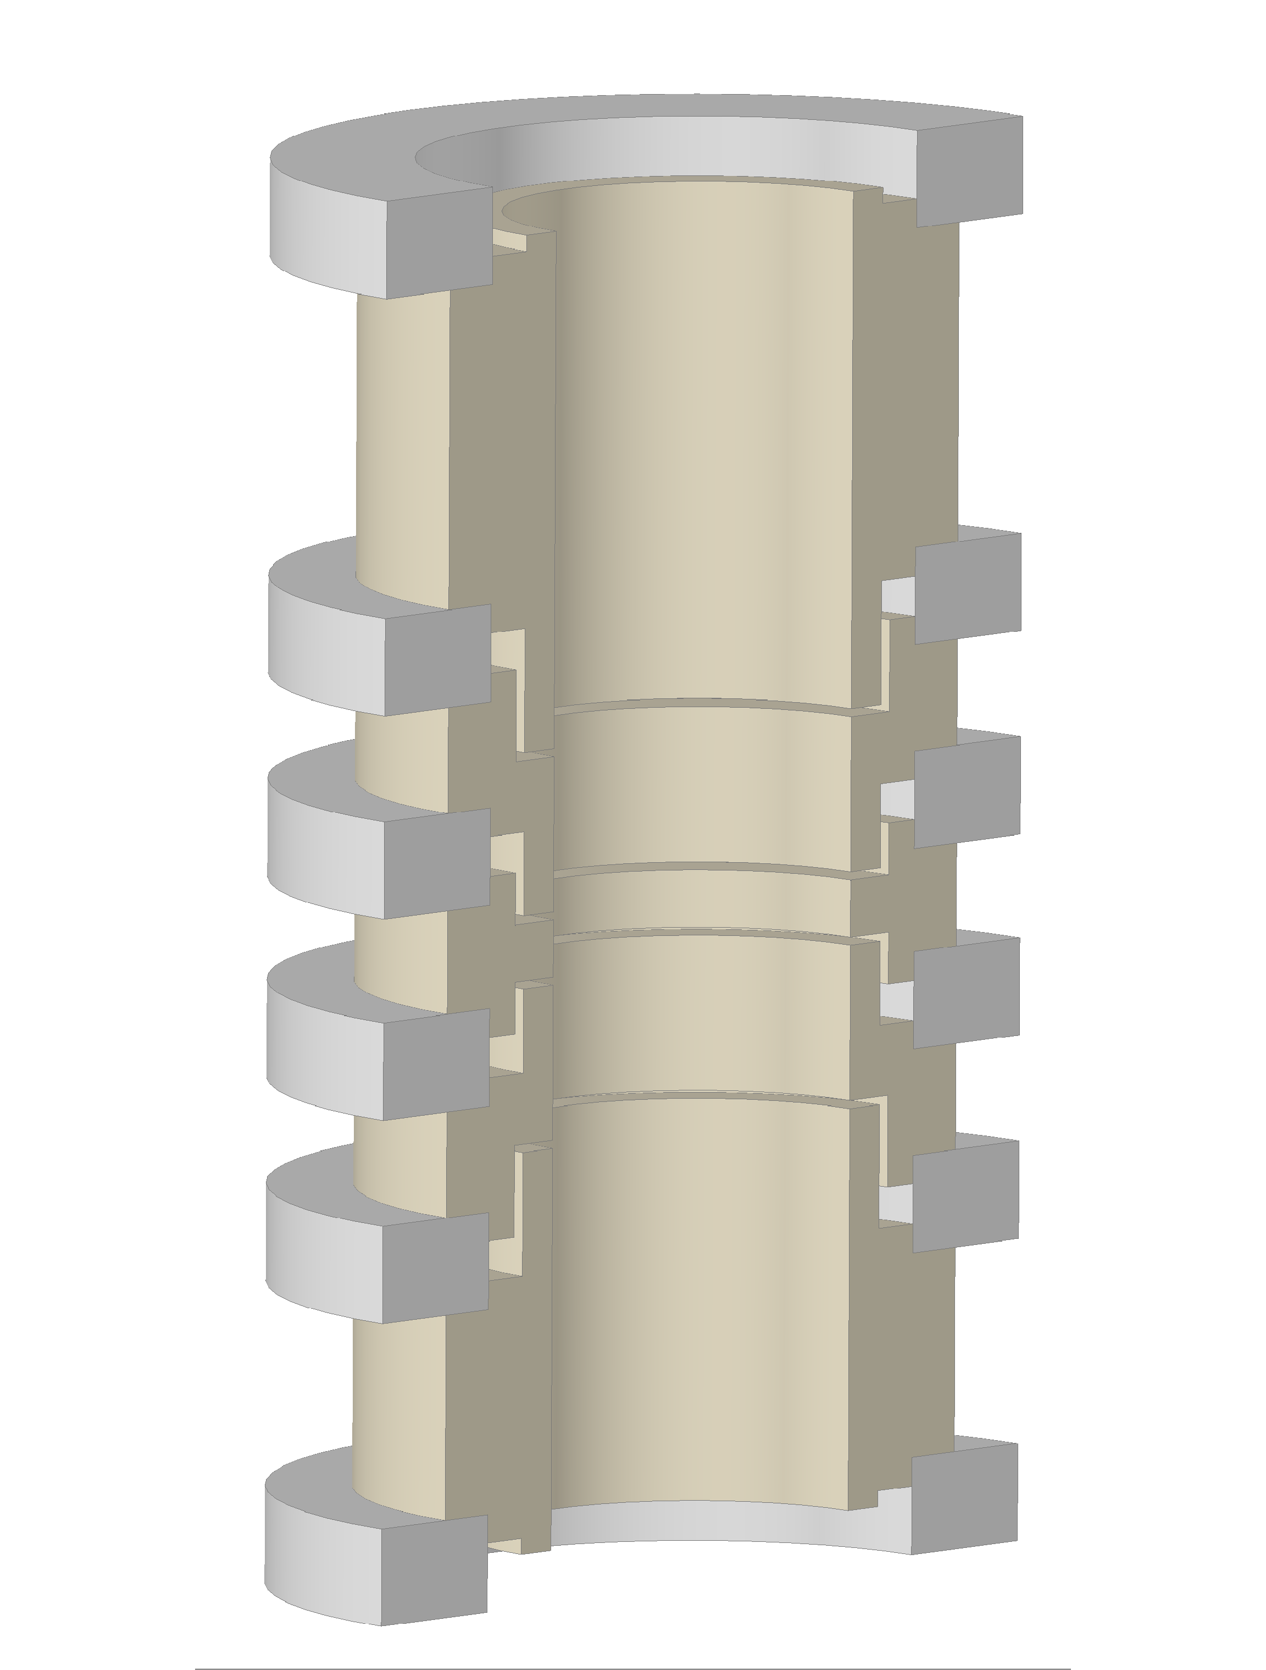
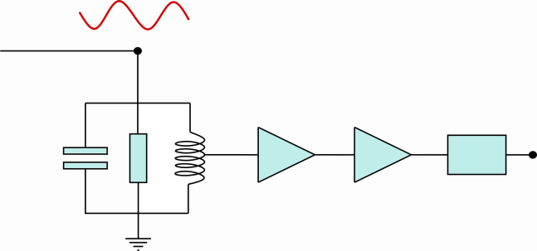
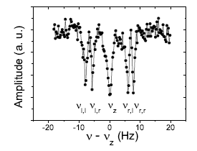
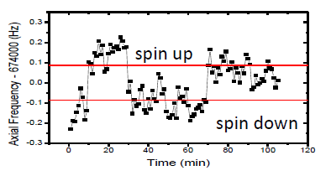
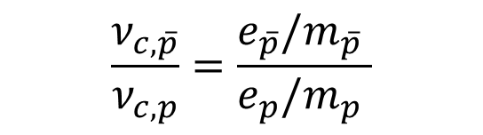
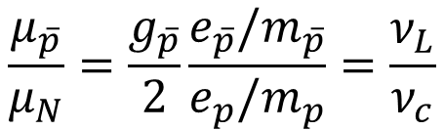
Measurements in Penning traps
Image Current Detection
Cyclotron Motion
Larmor Precession
g: mag. Moment in units of
nuclear magneton
Low Noise Amp
C_{p}
R_{p}
L_{p}
Amp
Amp
FFT
simple
Resonator
FFT
difficult
currents: 1 fA
$$\frac{ν_{c,\overline{p}}}{ν_{c,p}}=\frac{e_{\overline{p}}/m_{\overline{p}} }{e_{p}/m_{p} }$$
Single Antiproton Signal
$$\frac{μ_{\overline{p}}}{μ_{N}}=\frac{g_{\overline{p}}}{2}\frac{e_{\overline{p}}/m_{\overline{p}}}{e_{p}/m_{p}}=\frac{ν_{L}}{ν_{c}}$$
S. Ulmer, A. Mooser et al. PRL 107, 103002 (2011)
S. Ulmer, A. Mooser et al. PRL 106, 253001 (2011)
Determinations of the q/m ratio and g-factor reduce to measurements of frequency ratios -> in principle very simple experiments –> full control, (almost) no theoretical corrections required.

Slide 8
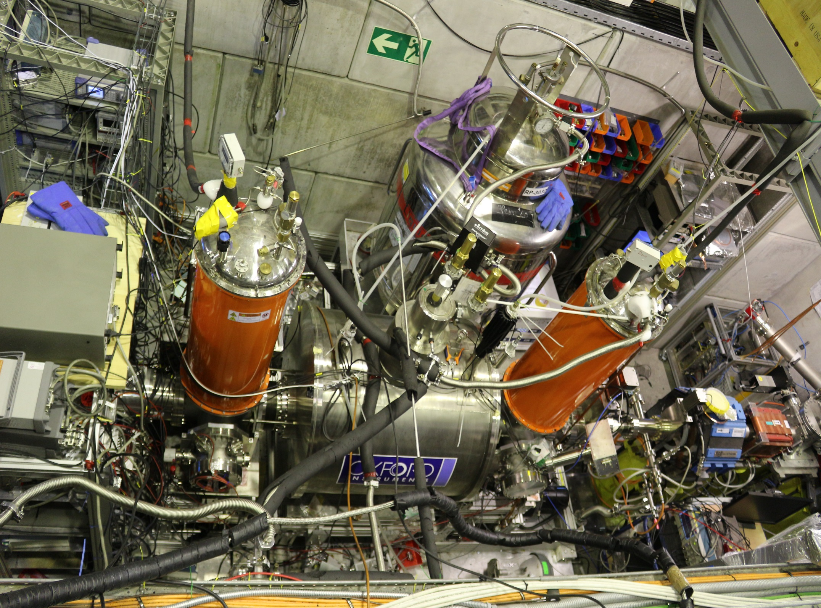
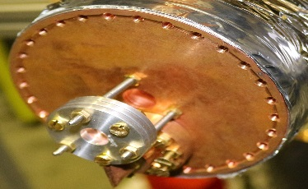
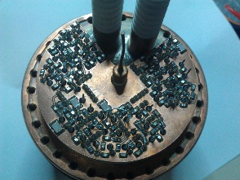
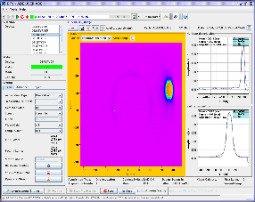
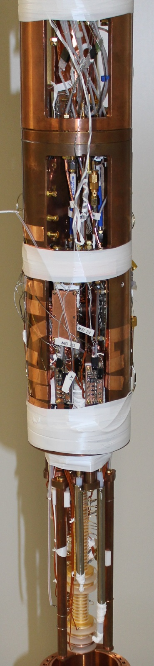
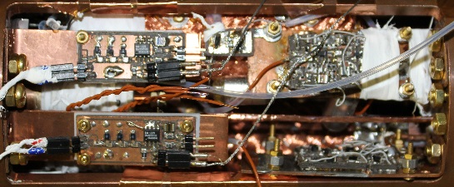
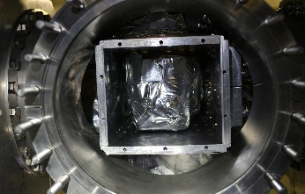
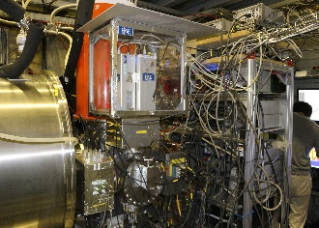
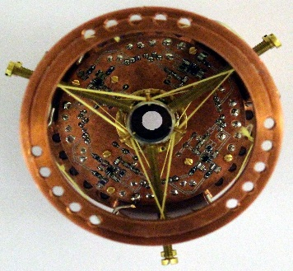
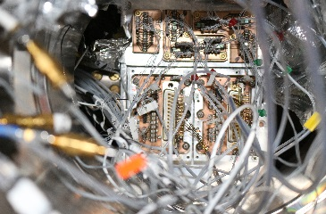
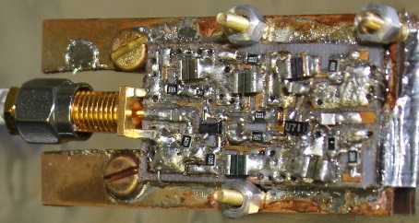
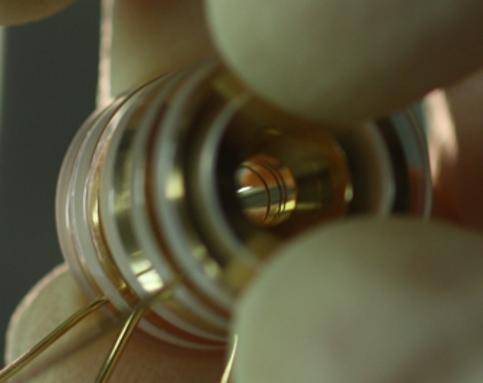
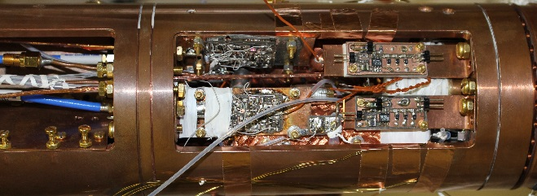
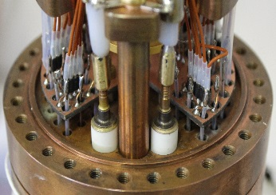
Experiment

Slide 9
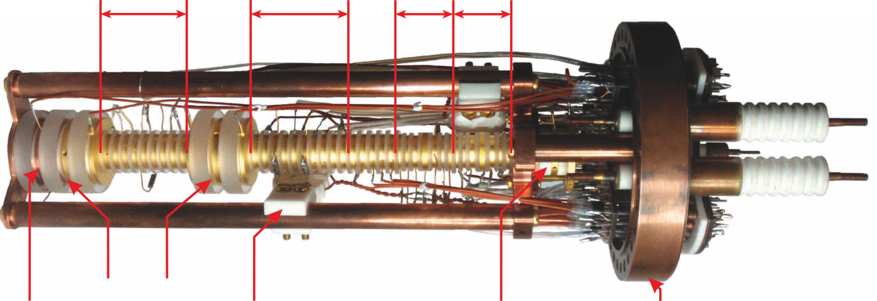
The BASE Trap System
RT
PT
CT
AT
Access to beamline
Particles not continuously available
Trap for efficient cyclotron cooling
S. Ulmer et al., BASE TDR, CDS (2013).
Degrader
HV Electrodes
Spin flip coil
Electron gun
Pinbase
pbar lifetime > 11 a

Slide 10
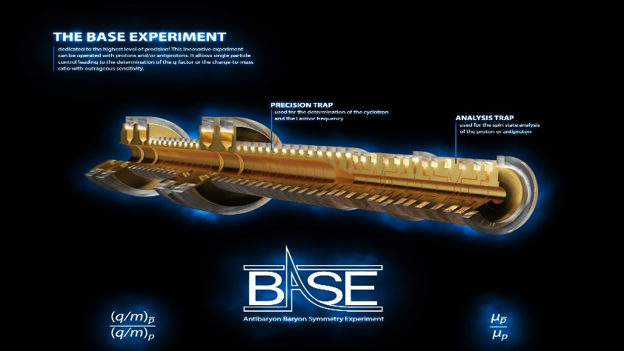
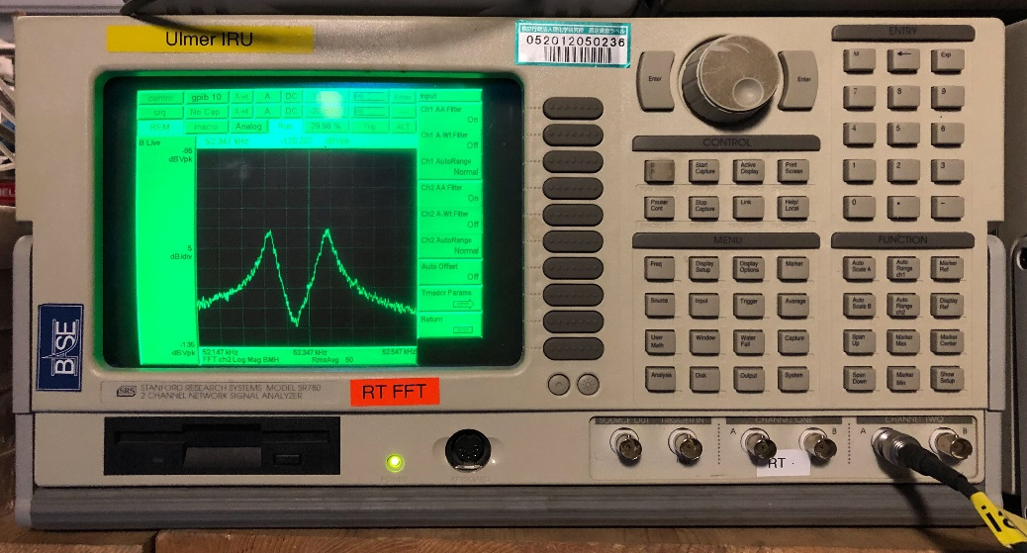
A special place (in the universe?) – the BASE trap
We have
  A vacuum of 5e-19 mbars
    comparable to pressures in the interstellar medium
  Antiproton storage times of several 10 years.
  Not more than 3000 atoms in a vacuum volume of 0.5l
  Order 100 to 1000 trapped antiprotons
  A local inversion of the baryon asymmetry
BASE ANTIMATTER INVERSION
local volume | 0.0001³ m³
Baryons in local trap volume | 1.65*10⁻⁷
Antibaryon in local trap volume | 100
Antibaryon/Baryon Ratio | 5.9*10⁸
Ratio Inversion | 3.8*10¹²
With this instrument: Investigate properties of antimatter very precisely

Slide 11
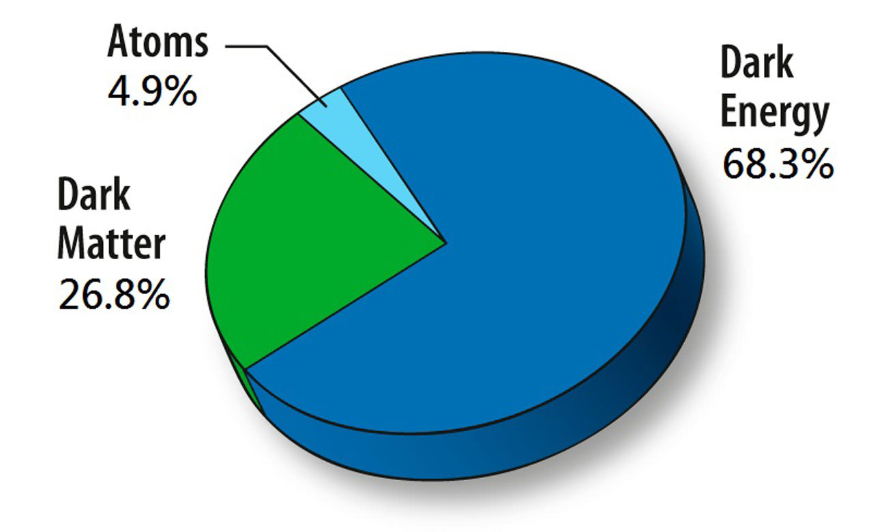
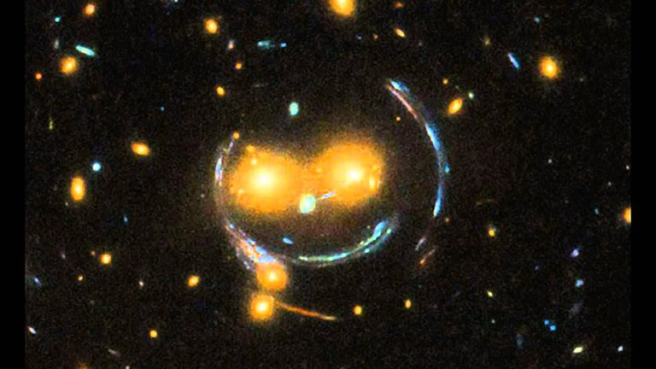
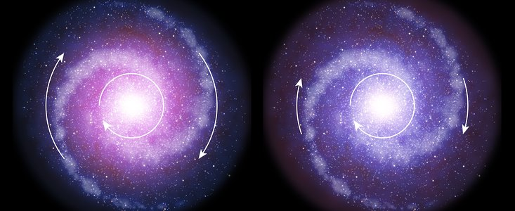
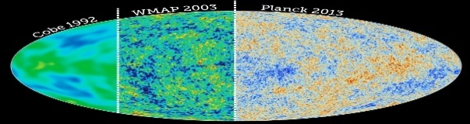

Limits on Antiproton/Dark Matter Coupling
Not understood why they survived
BASE study: Could the appearance of matter/disappearance of antimatter and dark matter be in any sense related?
Know it exists ($ρ_{DM}^{local}=0.4 GeV/{cm}^{3}$), but microscopic properties have yet to be understood.
Need a model which allows us to study this question
Gravitational lensing
the axion
  introduced to solve the strong CP problem (Peccei/Quinn)
  candidate for dark matter (QCD-axion and other hypothetical axion-like particles)
Galactic rotation
Structures in CMWB

Slide 12
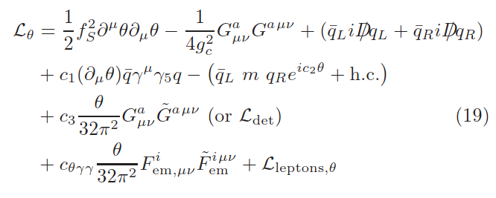




Axion Wind Model
First of all: a quick comment on axion / fermion coupling
J. Kim, G. Carosi, https://arxiv.org/pdf/0807.3125.pdf
A very “simplistic” translation of this “derivative interaction”: the axion dissociates to photons which interact with SM-particles.
Cold dark matter – axion like particles – are gravitationally bound to galaxies.
They produce an “oscillating background”, comparable to diffuse light, which oscillates at a frequency $υ_{a}\sim m_{a}$
This type of interaction would look like a “pseudo”-magnetic field which leads to frequency modulations in the antiproton Larmor frequency at the axion frequency.

Slide 13





Illustration of the concept:
Most important is still that we have a measurement
Antiproton/axion coupling would induce a frequency modulation
$$ν_{a}=\frac{1}{2π}\frac{m_{a}c^{2}}{ℏ}$$
of the measured Larmor frequency.
Analysis: Compare hypotheses H0 – no oscillation / H1 – oscillation at certain g-amplitude
Define test statistic based on Nyman/Pearson Lemma (likelihood ratio test)
Derive constraints based on CLs method ((p-value)/(power of test))

Slide 14





Limits from SN-1987A
SN-1987A
SN-1987A-remnant
Bremsstrahlung type axion emission in SN
  $Γ_{pp→ppa}\sim n_{p}n_{p}{\left({C_{p}}/{f_{a}}\right)}^{2}$
  $Γ_{p\overline{p}→p\overline{p}a}\sim n_{p}n_{\overline{p}}{\left({C_{\overline{p}}}/{f_{a}}\right)}^{2}$
Addition: We derive limits on six previously unconstrained coefficients of the Standard Model Extension (Lorentz Violation for antimatter)
Coefficient | Limit
$${\tilde{b}}_{p}^{∗X}$$ | $9.7∗{10}^{−25}$GeV
$${\tilde{b}}_{p}^{∗Y}$$ | $9.7∗{10}^{−25}$GeV
${\tilde{b}}_{F,p}^{∗XX}$-${\tilde{b}}_{F,p}^{∗YY}$ | $5.4∗{10}^{−9}$/GeV
$${\tilde{b}}_{F,p}^{∗XZ}$$ | $3.7∗{10}^{−9}$/GeV
$${\tilde{b}}_{F,p}^{∗YZ}$$ | $3.7∗{10}^{−9}$/GeV
$${\tilde{b}}_{F,p}^{∗XY}$$ | $2.7∗{10}^{−9}$/GeV

Slide 15








Charge to Mass Ratio Measurement
Extract antiprotons and H⁻ ions, compare cyclotron frequencies
Park
electrode
Precision
trap
Park
electrode
Reservoir
trap
Measure $ν_{z}$ & $ν_{+}⇒ν_{c}$
antiproton
H⁻ ion
Measure $ν_{z}$& $ν_{+}⇒ν_{c}$
$$R=\frac{ν_{c\overline{,p}}}{ν_{c,H^{−}}}=\frac{{(q/m)}_{\overline{p}}}{{(q/m)}_{H^{−}}}x\frac{B/2π}{B/2π}=\frac{{(q/m)}_{\overline{p}}}{{(q/m)}_{H^{−}}}$$
$\frac{{(q/m)}_{\overline{p}}}{{(q/m)}_{p}}$ $+1=1\left(69\right)×{10}^{−12}$
$$m_{H^{−}}=m_{p}(1+2\frac{m_{e}}{m_{p}}−\frac{E_{b}}{m_{p}}−\frac{E_{a}}{m_{p}}+\frac{α_{pol,H^{−} }B_{0}^{2}}{m_{p}})$$
6521 frequency ratios
R_{theo} = 1.001 089 218 754 2(2)
inspired by G. Gabriesle et al., PRL 82, 3199 (1999).
Notes:
Gabrielse idea to use H- ions

Slide 16









Recent Progress
Better stabilisation of cryoliquid pressure, temperature improves magnetic stability
2014 measurement
100mHz
Jan 2018
J. A. B.-Harrington et al.
55mHz
Mechanical upgrade more stable and lower heat load means fewer vibrations
peak measurement technique
M. J. Borchert et al.
Next step:
New magnetic shielding system
25 mHz
2.5 Hz
signal (a. lin. u.)
frequency (Hz)

Slide 17





Implementation of Phase Sensitive Detection
Compared to dip method: Not limited by power supply noise
Compared to peak method: Reduced systematics, reduced noise, faster measurement cycles.
2014 BASE Sideband
2019 BASE Sideband
2019 BASE Phase
Completed campaigns
Phase methods
development
J. Devlin
CERN/RIKEN
M. Borchert
Hannover/RIKEN
Reached in the best cases frequency scatters on the order of 330 p.p.t. per shot

Slide 18


Summary of Achievements / Request
Final resolution: 15 p.p.t. to 20 p.p.t.
Goal of next measurement should be at the level of 1 p.p.t. to 5 p.p.t.
Given the AD noise level of 600 p.p.t. this will require measurement time of years
2014 measurement
2018 measurement
Current status with AD off
current sideband limit
Noise limit with AD on
Strategy to only work during accelerator shutdown is not attractive and not very goal oriented.
We request an offline-laboratory at CERN, which will be supplied with antiprotons from the AD, using a transportable trap.

Slide 19

Laboratory Requirements
Wish list – Magnetically Calm
  Access to a bridge crane with a lifting capability of at least 2 T, better 5 T.
  Access to liguid nitrogen.
  Access to liquid helium and helium recovery line.
  Power supplies comparable to those in the current BASE experiment zone.
  The option to connect to CERN’s uninterruptable power supply.
  A well deﬁned, calm, isolated mains ground.
  The laboratory should have at least the size of the current BASE experiment zone (at least 40 m², wish 80 m²).

Slide 20






Transportable Trap – BASE STEP
All these methods have already been demonstrated by
Magnet cryostat
Portable reservoir trap with 10000 antiprotons
non-destructive extraction
Emergency power connection desired
„Compact“ design, weight below 1000 kg
electronics
1.8 m
Yet open: Extraction mechanism (under development at Mainz)
Differential pumping section
Regarding the implementation of the instrument into the AD hall we need advice by the SPSC.
April 2020:
Project start
April 2022:
Starting at CERN
April 2023:
Online Operation
Christian Smorra
2020
2021
2022
2023
Magnet procurement
18 month
Antiproton
operation
Commissioning in Mainz
6 month
Commissioning at CERN
12 month
BASE magnetic moment measurement
30 month

Slide 21


Possible Locations for BASE-STEP
STEP could be installed in front of BASE
Will interfere with BASE experiments
ATRAP I zone. Offered as an option in a discussion with CERN’s engineering department.
Option 2 – BASE-STEP in independent experiment zone is certainly very attractive.

Slide 22



Flash: IUPAP Prize for AMO Physics 2019
For their outstanding contribution to determine the most precise comparison of the proton-to-antiproton charge-to-mass ratios and the most precise comparison of the proton and antiproton magnetic moments, constituting two different world-record tests of the fundamental charge, parity, and time reversal symmetry in these systems
Christian Smorra
Andreas Mooser

Slide 23







The Magnetic Moment of the Antiproton
A. Mooser et al., Nature 509, 596 (2014)
$$\frac{g_{p}}{2}=2.792 847 344 62 (82)$$
$$\frac{g_{p}}{2}=2.792 847 344 62 (82)$$
first measurement more precise for antimatter than for matter...
updated shortly after antiproton measurement.
$$\frac{g_{\overline{p}}}{2}=2.792 847 344 1 (42)$$
C. Smorra et al., Nature 550, 371 (2017)
G. Schneider et al., Science 358, 1081 (2017)

Slide 24









BASE – «Short Term» Goal – Magnetic Moment
CERN
Mainz
CERN 2016
CERN 2017
$$\frac{Δg}{g}=14 p.p.b.$$
$$\frac{Δg}{g}=1.3(2) p.p.b.$$
TOTAL:
Drive:
$$\frac{Δg}{g}=13 p.p.b.$$
$$\frac{Δg}{g}<0.2 p.p.b.$$
CERN 2017
$$\frac{Δg}{g}=4 p.p.b.$$
$$\frac{Δg}{g}=1.41(2)p.p.b.$$
B-field:
$$\frac{Δg}{g}$$
Indicates a possible width of 650 p.p.t.
Mainz 2017
With the current magnet at CERN and the implemented magnetic shielding system, regardless whether AD is on or off, we could reach Dg/g=0.8 p.p.b. -> Improved measurement 80 p.p.t. to 200 p.p.t.

Slide 25


Error Budgets of previous measurements
better methods
4 p.p.t.
better methods
12 p.p.t.
Estimate on the effect of fitting was too conservative, can be done much better (10 times)
Direct methods (phase) will suppress this by factor of 50
Much better methods available to determine axial temperature

Slide 26












…if we do all the other homework…
Two particle method planned – background B / double trap
Improved Magnet Stabilization
More homogeneous trap center
Reduced noise in AT / better cryo-electronics.
Local shim coils
Cooling trap with improved cyclotron cooler for fast sub-thermal cooling
Improved axial detectors
Working ELENA interface

Slide 27
Cooling trap
cold particle (50mK)
hot particle (1K)
Smaller trap: Improves particle / detector coupling by a factor of 10
Superimposed magnetic bottle with temperature resolution of 8Hz/K makes real-time cooling possible.
Improved cyclotron detector: Higher Q and lower temperature (3K)
Sub-thermal cooling cycles: minutes compared to hours seem possible.
high-fidelity spin state resolution
fidelity at 65%, not useful for measurements

Slide 28

Planned experiment scheme
Cooling trap assisted two particle measurement of the antiproton g-factor
Sub thermal cooling
Cooling trap
g-factor particle
Transport
$$ν_{L},ν_{c}$$
Transport
Key: Larmor and cyclotron frequency measured SIMULTANEOUSLY in a more homogeneous magnetic field. Two particle systematics eliminated.
Confident that we will be able to achieve our target precision.

Slide 29








Planned Developments
Current antiproton magnetic moment measurements are limited by particle preparation time and particle mode temperature
Expect: With traditional methods another 50-fold improvement is possible, afterwards: limit of traditional methods will be reached!
Sympathetic Cooling of Antiprotons
Effort at University of Hannover and PTB
Couple protons/antiprotons sympathetically to laser cooled ⁹Be⁺ ions and imprint Doppler temperatures to the antiproton
Recent dramatic progress: Detection of a single laser cooled ⁹Be⁺ ion, in a Penning trap system which is fully compatible with the BASE trap system at CERN
Publication: K. R. Brown, C. Ospelkaus, Y. Colombe, A. C. Wilson, D. Leibfried, D. J. Wineland, Nature 471, 196 (2011).
Was demonstrated for ⁹Be⁺ ions in Paul traps – implement same in Penning traps
M. Niemann, J. M. Cornejo, C. Ospelkaus et al.
Transportable Antiproton Traps
>100-fold improved antiproton cooling time seems to be in reach
Idea:
Move antiprotons into precision laboratory with magnetically calm environment for experiments with much higher precision
C. Smorra, S. Ulmer, et al.

Slide 30


Possible Timeline
antiproton Q/M

Slide 31
Scenarios…
…without the BASE offline lab…
…with the BASE offline lab…
confident that we will be able to measure the antiproton magnetic moment to order 100 p.p.t. precision.
Proton/Antiproton charge-to-mass ratio measurements with different systematic effects. Maybe slightly more precise…
Currently no perspective to further improve these values in the AD hall.
…no obvious limits regarding fractional precision, sub-p.p.t. measurements will become possible.
Many new technologies involved, transport trap, laser cooling, …additional «classical Penning trap measurements possible»… (proton mass, electron mass, etc…)
Sky is the limit…:-)

Slide 32





Flash – Center for Time, Constants, and Fundamental Symmetries
Combine precision traps, clocks and lasers to challenge the Standard Model at the low energy frontier
Inauguration
PI’s
Blaum
Ulmer
Peik
Katori
Pfeiffer
Crespo
Schmidt
Udem
Hänsch
7 500 000,- over five years

Slide 33


Summary and Outlook
2019 Run: Q/M measurement / Lifetime measurement / Improved experiment stability / implemented phase methods
Publications: Lowest heating rates in traps / better magnetic shielding / direct constraints on antimatter-dark matter coupling.
Future program: 100 p.p.t. measurement of the antiproton magnetic moment, offline laboratory, transportable trap system.
BASE 2016
BASE 2017

Slide 34





















Thanks for your attention!
S. Ulmer RIKEN
J. Devlin
RIKEN
E. Wursten
CERN / RIKEN
J. Harrington
MPIK/RIKEN
M. Borchert
Hannover/RIKEN
S. Erlewein
MPIK/RIKEN
M. Fleck
RIKEN/U. Tokyo
M. Sato
RIKEN/U. Tokyo
K. Blaum, Y. Matsuda,
C. Ospelkaus, W. Quint,
J. Walz, Y. Yamazaki
C. Smorra
RIKEN
M. Bohman
RIKEN/MPIK
M. Wiesinger
RIKEN/MPIK
S. Gavranovic
Mainz
D. Popper
Mainz

Slide 35


THANKS Tommy Eriksson…
…for 7 fantastic years of AD physics
…we wish you a happy retirement!!!

Slide 36



Single Trap – Double Trap – Triple Trap
single-trap method
!!! measured !!!
$$\frac{B_{2,AT}}{B_{2,PT}}>{10}^{6}$$
multi-trap method
!!! measured !!!
two years compared to two months…

Slide 37







Limits on Exotic Physics – ONE example
Test the Standard Model (CPT invariance) by comparing the fundamental properties of protons and antiprotons with high precision
$$\left(iγ^{μ}D_{μ}−m−{a_{μ}γ}^{μ}−b_{μ}γ_{5}γ^{μ}\right)ψ=0$$
$H ψ=\left(H_{0}+ V_{exotic}\right)$ $ψ$
Dirac equation
CPT-odd modifications
$$ΔE_{exotic}=\left\langle \left.ψ\right|V_{exotic}\left|ψ\right.\right\rangle$$
${b_{μ}γ_{5}γ^{μ}→b}_{x}\left(\begin{matrix}{−σ}_{x} & 0 \\ 0 & σ_{x}\end{matrix}\right)$+$b_{y}\left(\begin{matrix}−σ_{y} & 0 \\ 0 & σ_{y}\end{matrix}\right)$+$b_{z}\left(\begin{matrix}−σ_{z} & 0 \\ 0 & σ_{z}\end{matrix}\right)$
Pseudo-magnetic field, with different coupling to matter and antimatter, respectively
$$ΔV_{int}=\tilde{b_{z,D}}\left(\begin{matrix}0 & 0 \\ 0 & ±σ_{z}\end{matrix}\right)$$
V. A. Kostelecky, N. Russell, 0801.0287v10 (2017).
Would correspond to the discovery of a boson field which exclusively couples to antimatter.
sensitive: comparisons of particle/antiparticle magnetic moments in traps

