Slide 1
MQ and MQYY
vertical cold magnetic measurement systems
(KE3586 CEA-CERN collaboration)
D. Akhmedyanov, A. P. Foussat, C. Petrone, S. Russenschuck

Slide 2
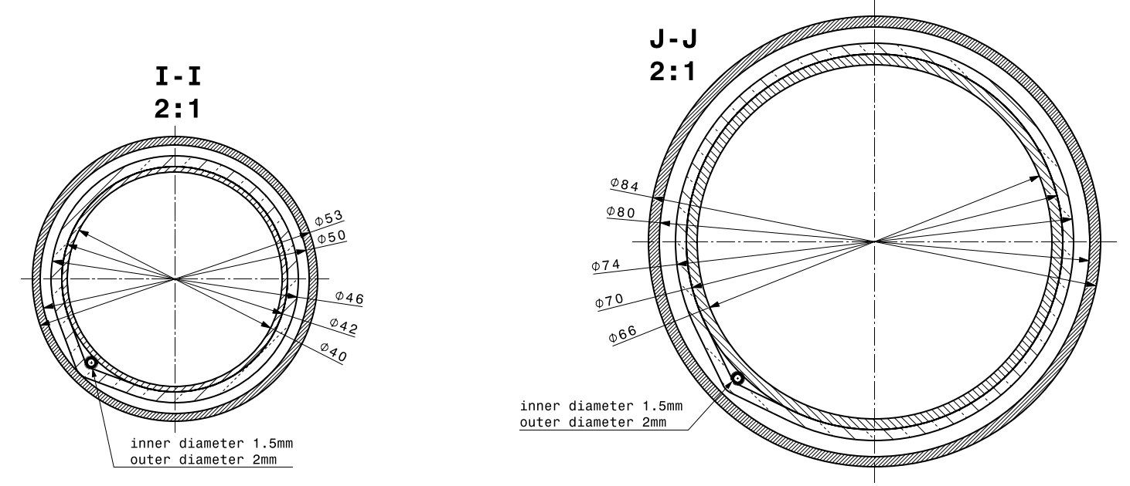
Project objective and reference line
MQ and MQYY
vertical cold magnetic measurements (STAARQ)
6 MQs
aperture 56 mm
magnetic length 3.2 m
anticryostat inner diameter 40 mm
2 MQYYs
aperture 90 mm
MQYY magnetic length 3.7 m
anticryostat inner diameter 66 mm

Slide 3
First method studied: vertical coils scanner
First method proposed and studied: vertical coil scanner
Main rewards associate to this strategy:
Profit from the existing coils used for old MQs measurements (cost saving)
Minimalist and simple coil displacement system (worthy cost/efficiency ratio)

Slide 4
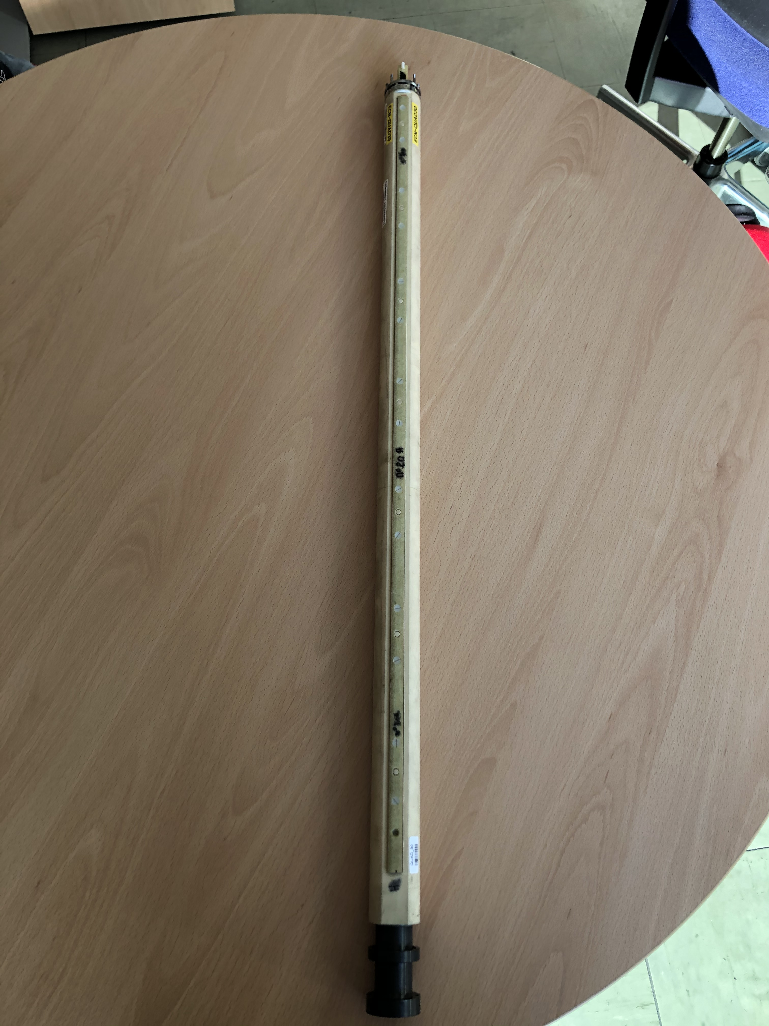
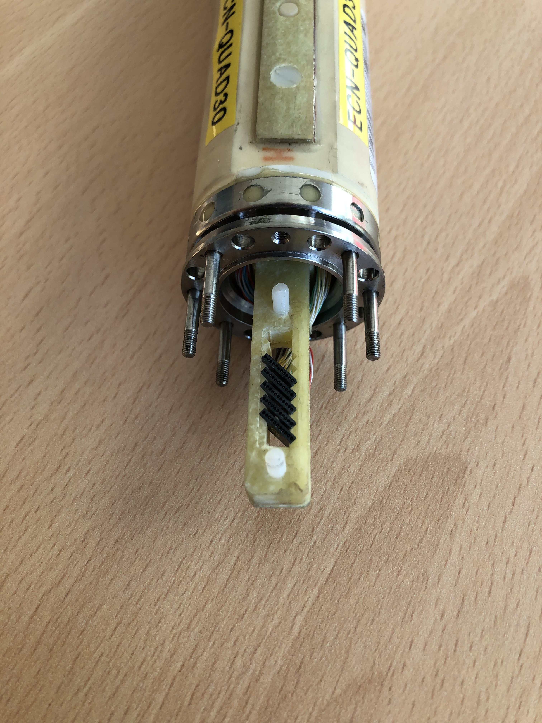
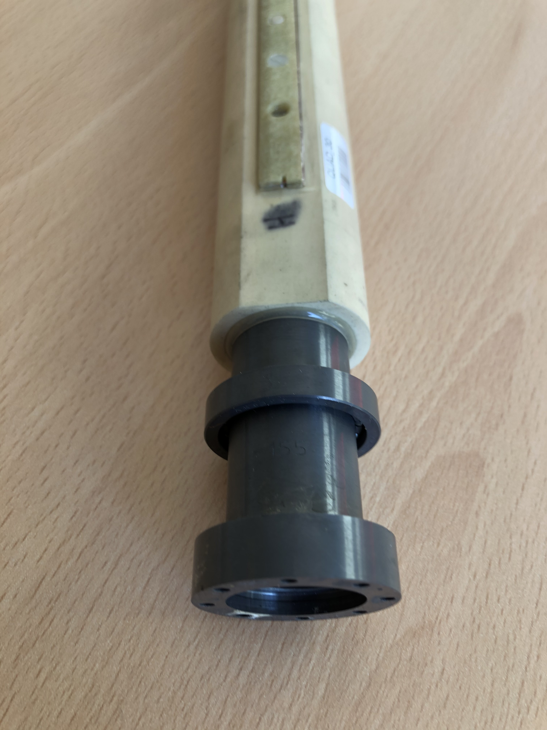
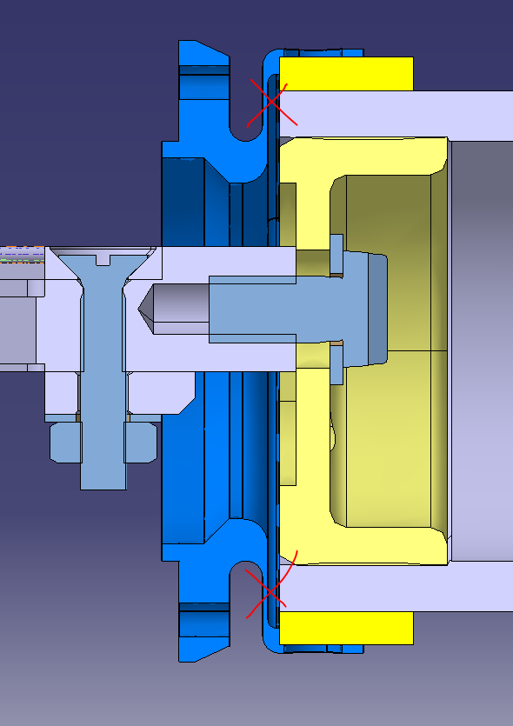
Existing measurement devices for MQs
Existing horizontal induction coil
No possible to use vertically without modifications
Modifications
Shafts need to be unglued and disassembled
Ceramics modifications are difficult and expensive
Not opportune to re-use: costly and risky
New coils need to be designed and developed

Slide 5
First method studied: vertical coils scanner
First method proposed and studied: vertical coil scanner
Main rewards associate to this strategy:
Profit from the existing coils used for old MQs measurements (cost saving)
Minimalist and simple coil displacement system (cost effectiveness)
New coils need to be designed and developed

Slide 6
First method studied: vertical coils scanner
First method proposed and studied: vertical coil scanner
Main rewards associate to this strategy:
Profit from the existing coils used for old MQs measurements (cost saving)
Minimalist and simple coil displacement system (cost effectiveness)
  No manual actions due to safety reasons -> automatic system
  The translation intervention time has an impact -> additional coil segments?
New coils need to be designed and developed

Slide 7
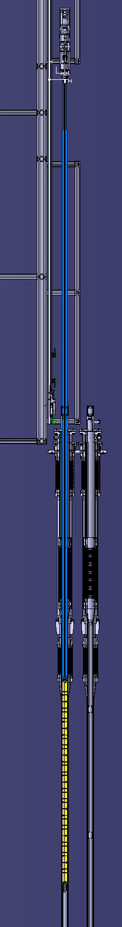
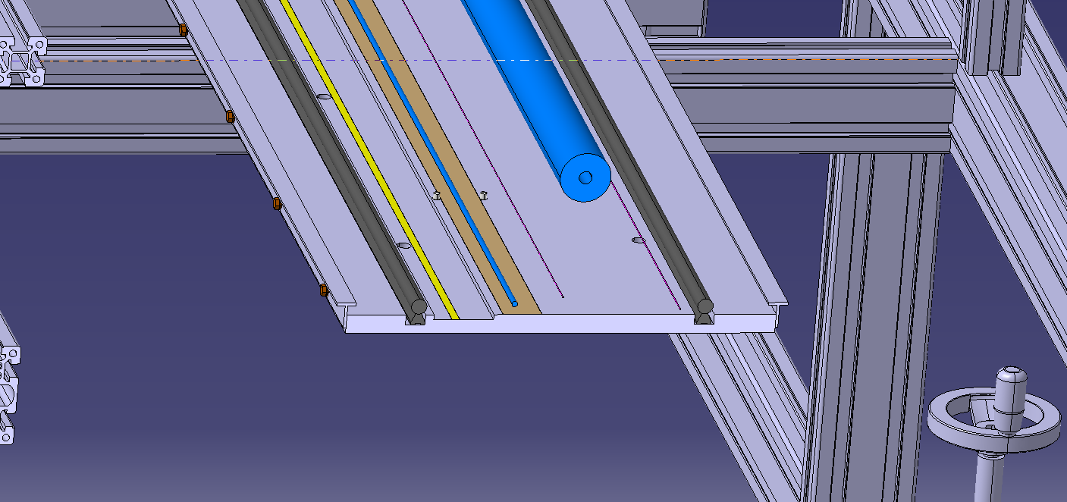
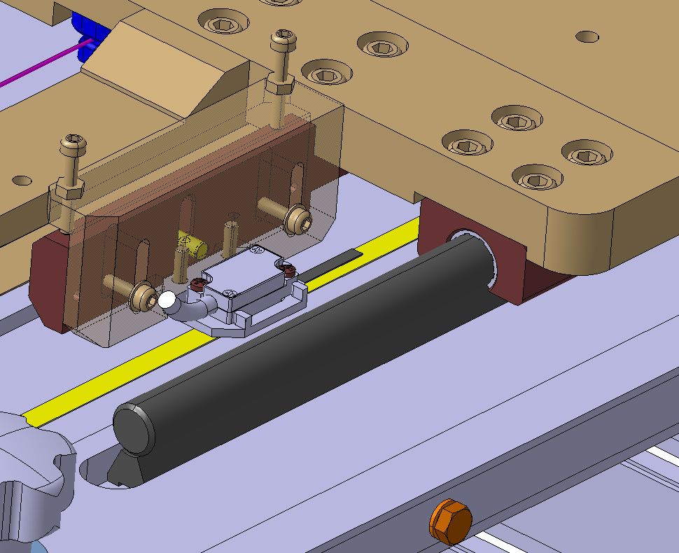
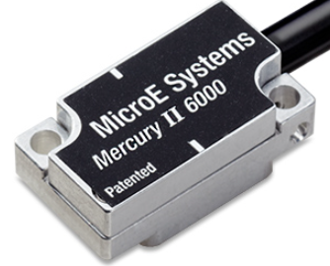
First method studied: vertical coils scanner
Price (CHF) | Description
10000 CHF | Vertical structure
2500 CHF | Precise Rails
10000 CHF | Precise Plate
3500 CHF | Linear encoder
3500 CHF | Motor and mechanics
… | …
Test Facility integration
Software development
Data post processing
…
The initial study and based on previous experience on translating systems
Expensive and time consuming for developing and operating

Slide 8
First method studied: vertical coils scanner
First method proposed and studied: vertical coil scanner
Main rewards associate to this strategy:
Profit from the existing coils used for old MQs measurements (cost saving)
Minimalist and simple coil displacement system (cost effectiveness)
  No manual actions due to safety reasons -> automatic system
  The translation intervention time has an impact -> additional coil segments?
New coils need to be designed and developed

Slide 9
Proposals
Studied proposals
  Vertical coil scanner
    One scanner system -> different measurement positions for each aperture
  Vertical coil array in anticryostat options:
    1 coil array for two apertures -> one aperture at time
    2 coil arrays for two apertures -> two apertures at the same time

Slide 10
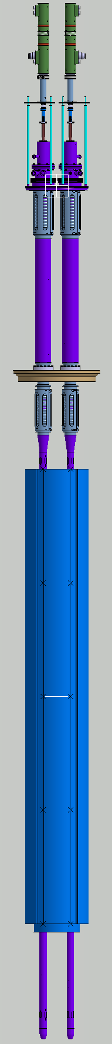
Second method proposed and studied: vertical coils arrays – OPTION #1
1 coil array for MQs (in PCB)
Measurement radius 17 mm
5 sections of 810 mm
anticryostat inner diameter 40 mm
1 coil array for MQYYs (in PCB)
Measurement radius 30 mm
5 sections of 925 mm
anticryostat inner diameter 66 mm
MQ AC
MQYY AC
622.5
Mounting and dismounting
procedure and tool need to be studied and defined
Mounting and dismounting
procedure and tool need to be studied and defined
MQ
MQYY
MQYY
Can be critical and delicate
Can be critical and delicate
807

Slide 11
Second method proposed and studied: vertical coils arrays – OPTION #2
2 coil array for MQs (in PCB)
Measurement radius 17 mm
5 sections of 810 mm
anticryostat inner diameter 40 mm
2 coil array for MQYYs (in PCB)
Measurement radius 30 mm
5 sections of 925 mm
anticryostat inner diameter 66 mm
MQ AC
MQYY AC
622.5
Mounting procedure once only at beginning of the measurement campaign
Mounting procedure once only at beginning of the measurement campaign
MQ
MQYY
MQYY
Coil array safely stored vertically
inside the anticryostat
Coil array safely stored vertically
inside the anticryostat
807

Slide 12
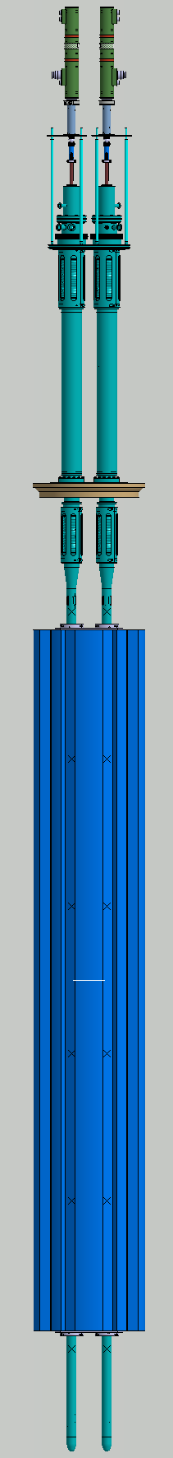
Second method proposed and studied: vertical coils arrays – OPTION #3
2 coil array for MQs measure both magnet types
Measurement radius 17 mm
6 sections of 810 mm (one extra segment MQ type)
anticryostat inner diameter 40 mm BUT LONGER
MQYY AC
MQ AC modified
MQ AC
PRO
622.5
726.5
2 anticryostat instead than 4 (saving 2 anticryostat)
2 coil arrays instead than 4 (saving 2 coil arrays)
MQ
MQYY
MQYY
CONT
Measurement radius smaller for the MQYY
  Less resolution on higher-order multipoles.
MQ anticryostat longer
MQ coil array one segment more
807
665

Slide 13
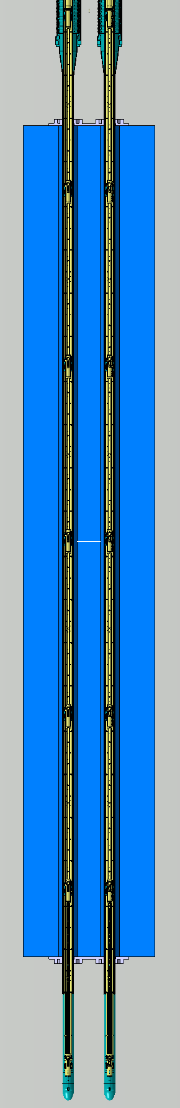
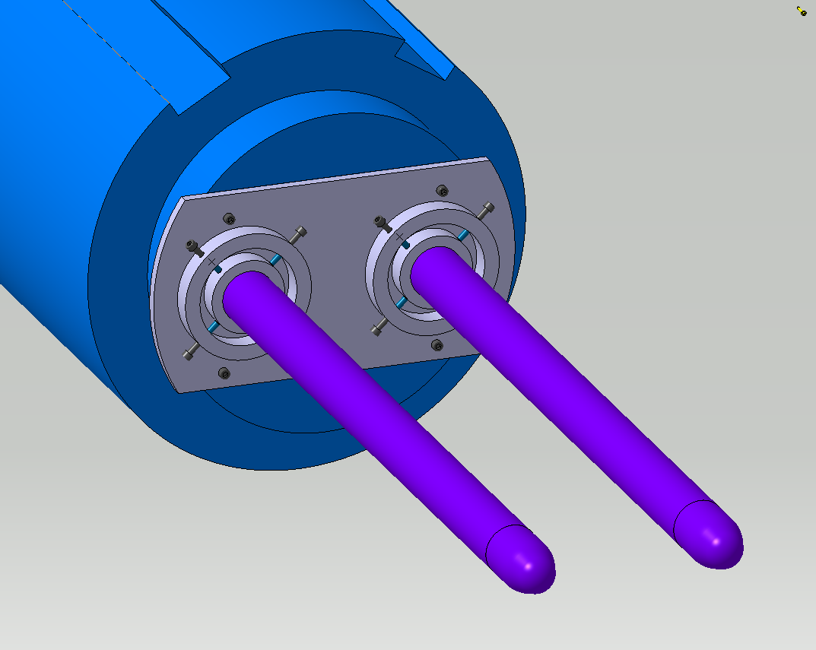
Second method proposed and studied: vertical coils arrays – OPTION #3
MQYY using MQ coil arrays
MQYY
For option #3 alignment supports also along the MQYY magnet are needed to fulfil the gap between magnet bore and anticryostat
Alignment structure on magnets ends for all options (#1,#2 or #3) are need

Slide 14
OPTIONS: cost estimations
MQs coil array
MQYY coil array
Price CHF | Description | Details
32.000 | G11 support structure for shaft + rollers + cabling | 5 x 0.81 m + 1 spare
8.000 | Design + production Printed circuit board | 5 x 0.75 m + 1 spare
5.000 | Extension tube + cabling
Price CHF | Description | Details
35.000 | G11 support structure for shaft + rollers + cabling | 5 x 0.925 m + 1 spare
10.000 | Design + production Printed circuit board | 5 x 0.85* m + 1 spare
5.000 | Extension tube + cabling
#1
*bigger than standard fabrication process at CERN (<750 mm)
~45 000 CHF | 1 Vertical coil array MQ
~50 000 CHF | 1 Vertical coil array MQYY
NOTE option #1 very difficult for the point of view of handling: see next slides for the assembling phase
#2
~90 000 CHF | 2 Vertical coil array MQ
~100.000 CHF | 2 Vertical coil array MQYY
#3
~95 000 CHF | 2 Vertical coil array MQ
- | 2 Vertical coil array MQ

Slide 15
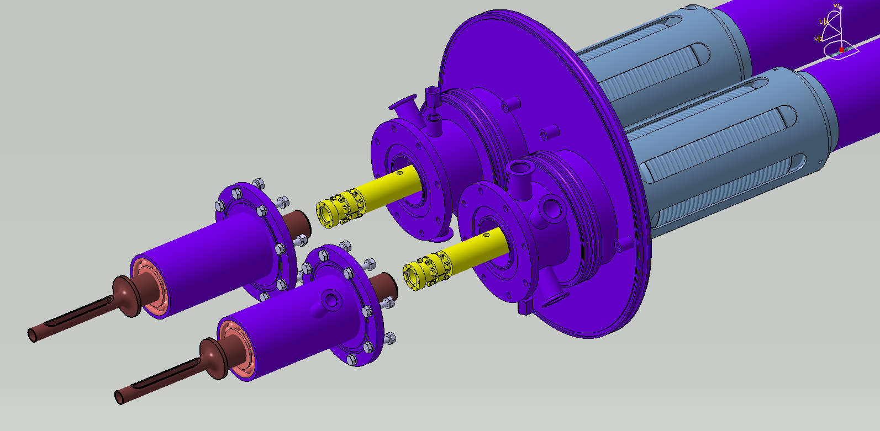
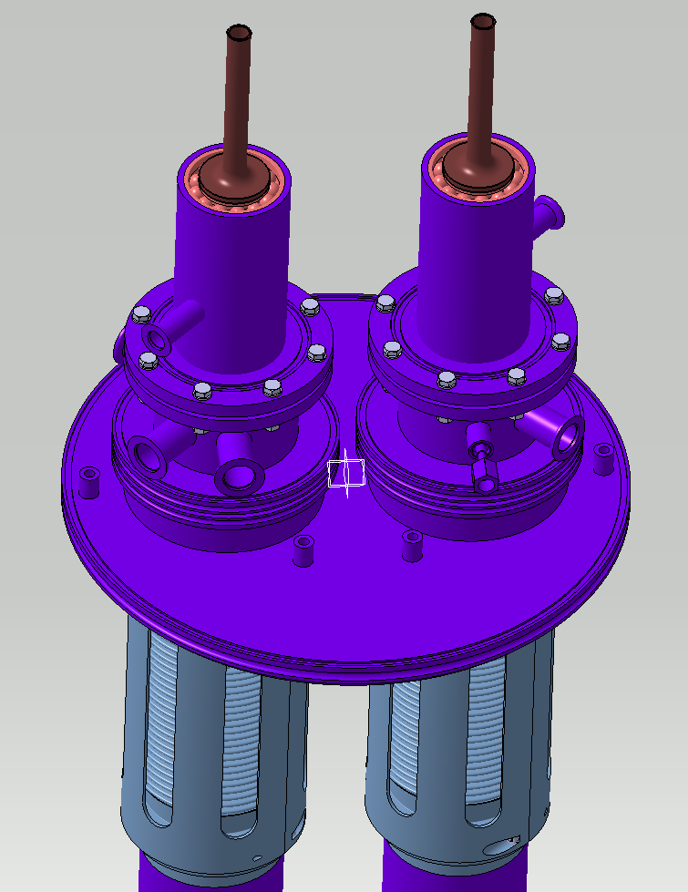
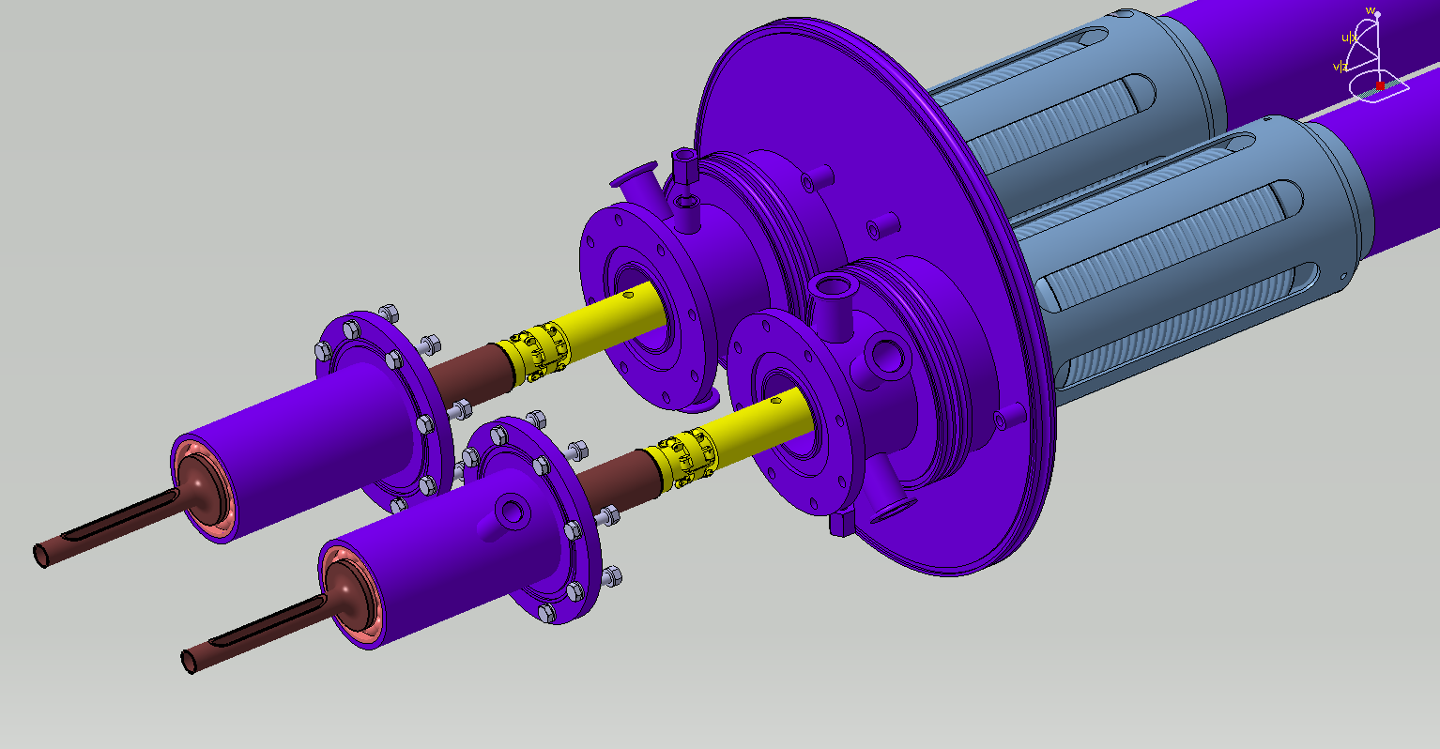
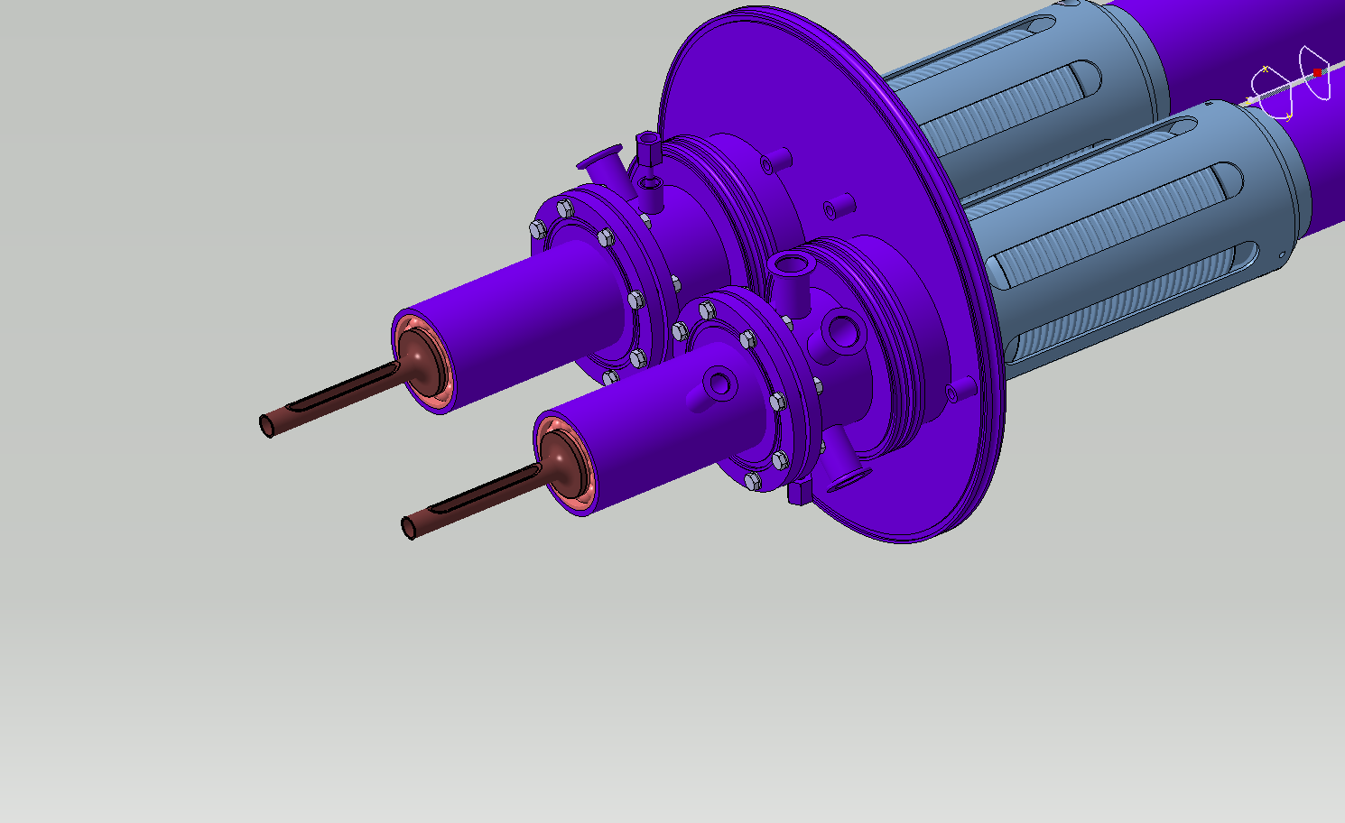
Coil array insertion in the anticryostat
One shaft at the time
Insertion horizontally
Handling tools to put vertical needed
Is it possible to handle one AC at time?
Mounting upper holding parts

Slide 16
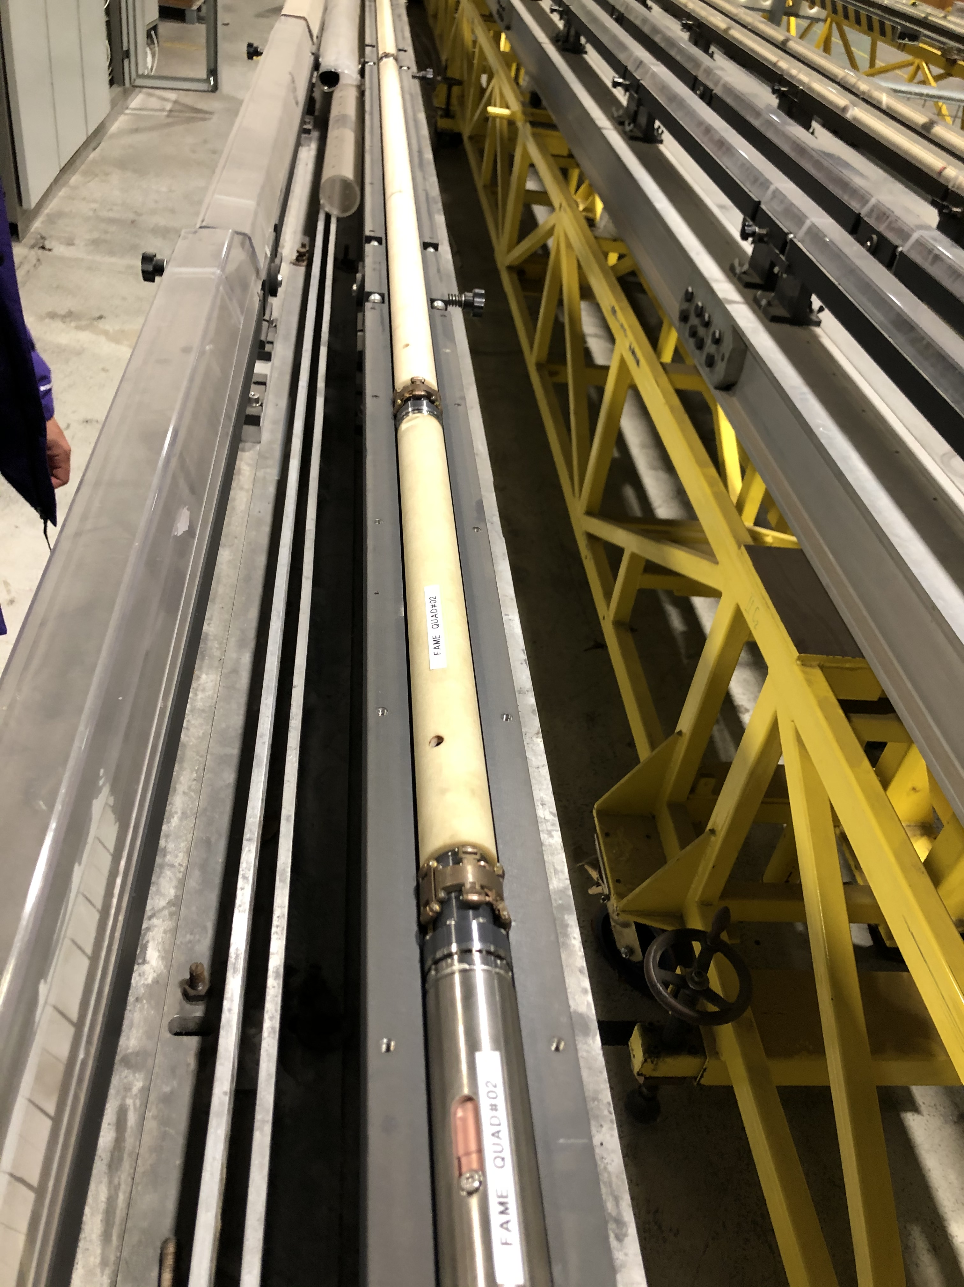
Coil assembling phase
Handling tool for the coil array assembling phase:
The mounting process of the array will be done horizontally
Support is required during the insertion for larger diameter part of the anticryostat

Slide 17
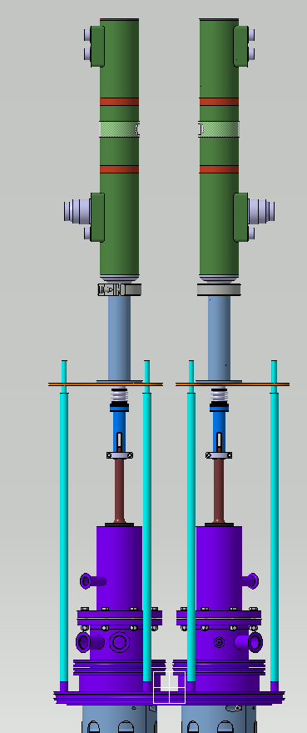
Motor units for vertical coils arrays for all OPTIONs
MQYY AC
MQ AC modified
MQ AC
622.5
726.5
1300
MQ
MQYY
MQYY
MRU support
807
665

Slide 18
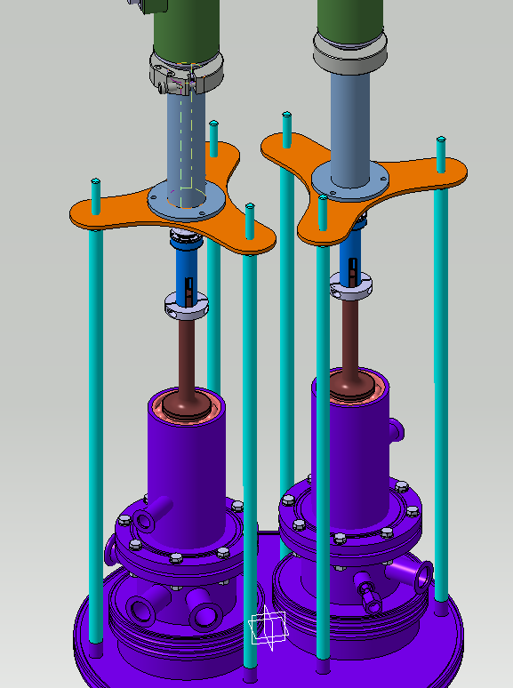
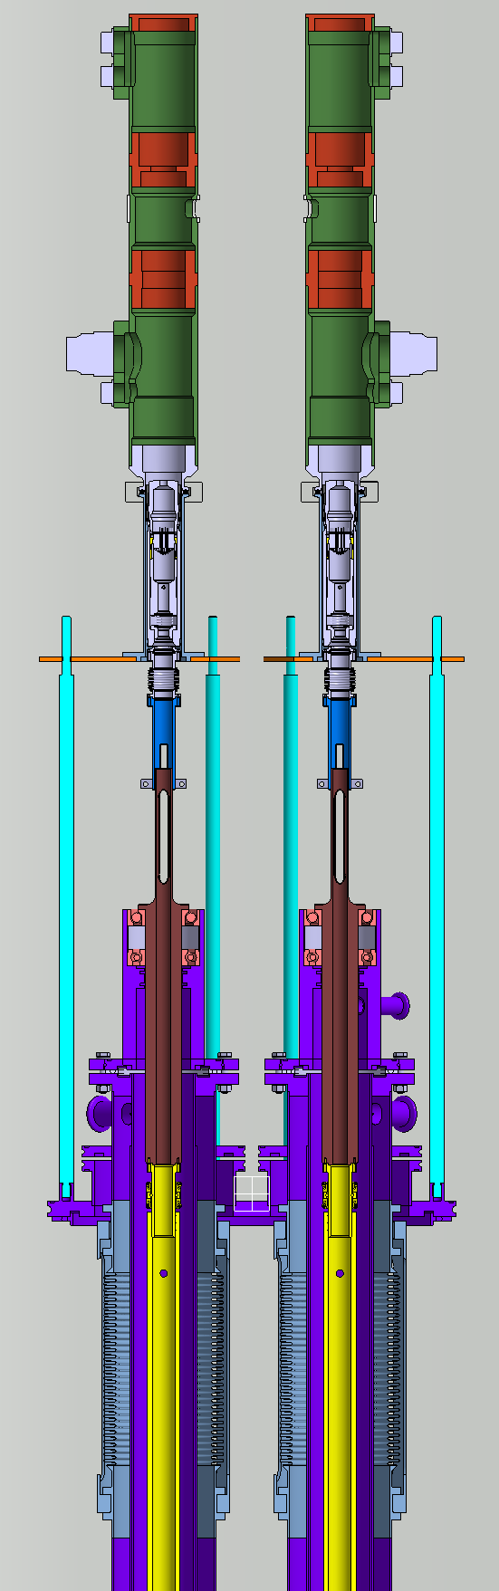
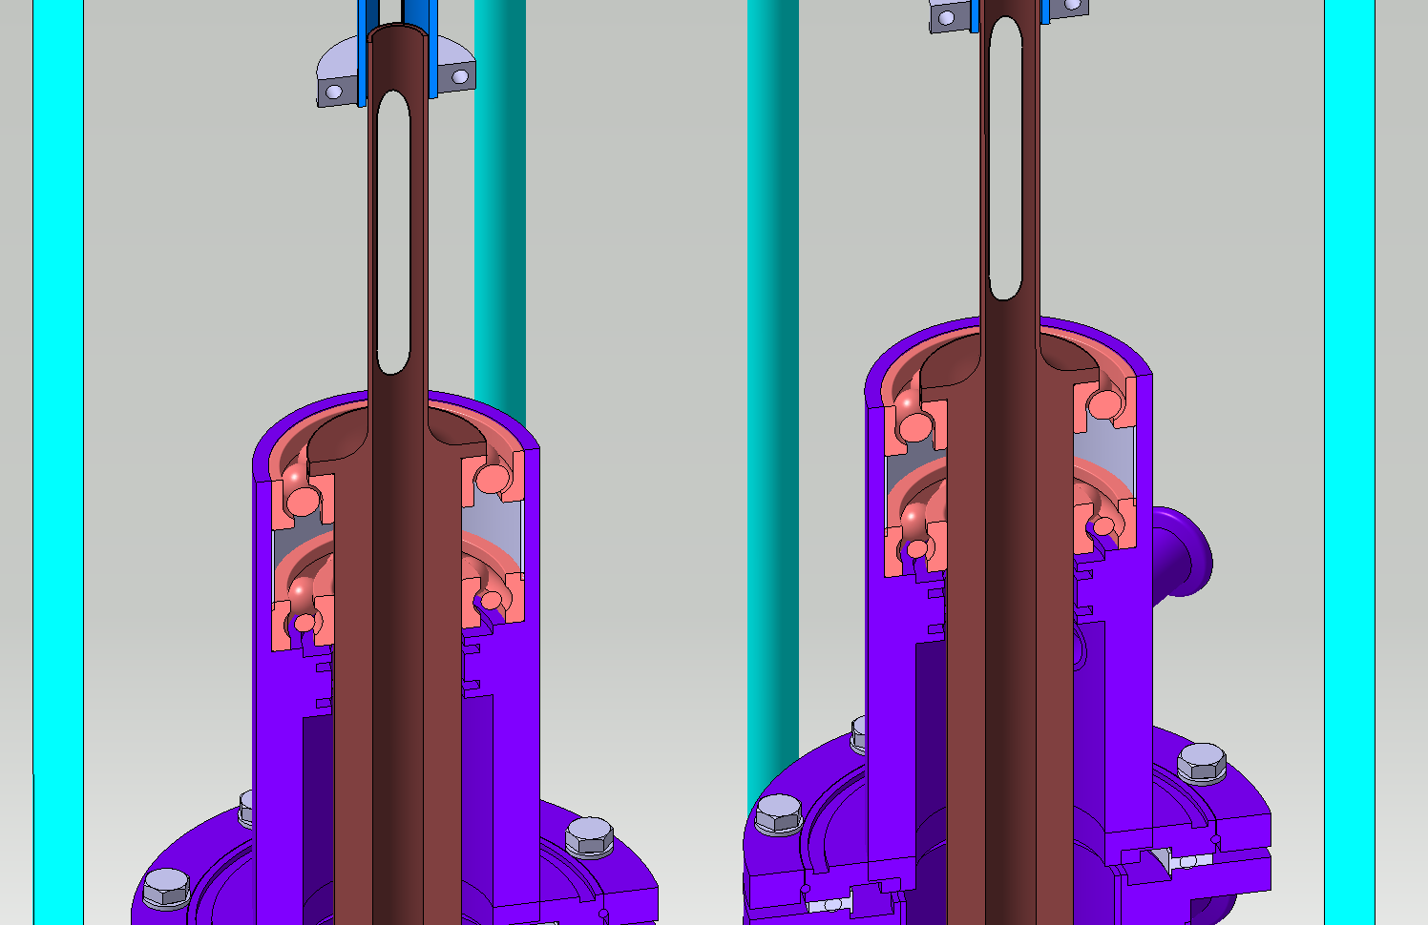
Motor units for vertical coils arrays for all OPTIONs
MRU
MRU connection
Supporting structure
Intermediate connection
Shaft holder
Extension tube

Slide 19
Electronic needed
Description | Option #1 | Option #2 | Option #3
Measurement type | 1 aperture at time 5 sections | 2 apertures at the same time | 2 apertures at the same time
Motor | 1 unit (uRU) | 2 units (uRU) | 2 units (uRU)
Motor controllers | 1 | 2 | 2
Fast Digital Integ. # (scheme) | 10 (5 abs-5 comp) | 12 (coil in series) | 12 (coil in series)
Encoder Card # (channels) | 1 (1) | 1 (2) | 1 (2)
Electronic rack | 1 | 1 | 1
Patch panels | 1 | 2 | 2
Magnet current measurement | needed | needed | needed
NOTE: Space for the electronic rack (~ 8 m²) <8 m away from the vertical measuring station

Slide 20
Conclusions
Vertical scanner study showed certain limits w.r.t. long coil array with stated requirements
Option #2 and #3 are most practicable for long coil array (for MQYY: accuracy vs costs)
Option #3 requests anticryostat design adjusted in length even though it saves two anticryostats and 2 coil arrays for MQYY
Handling tool for the anticryostat with coil inside are required to improve rigidity
Handling tool are needed for the coil array assembling phase (assemble the sections)
Space for the electronic rack next to the vertical measuring station is required
Real time magnet current needs to be provided to the magnetic measurement system

Slide 21
Thank you for your attention

Slide 22
Spare slides

Slide 23
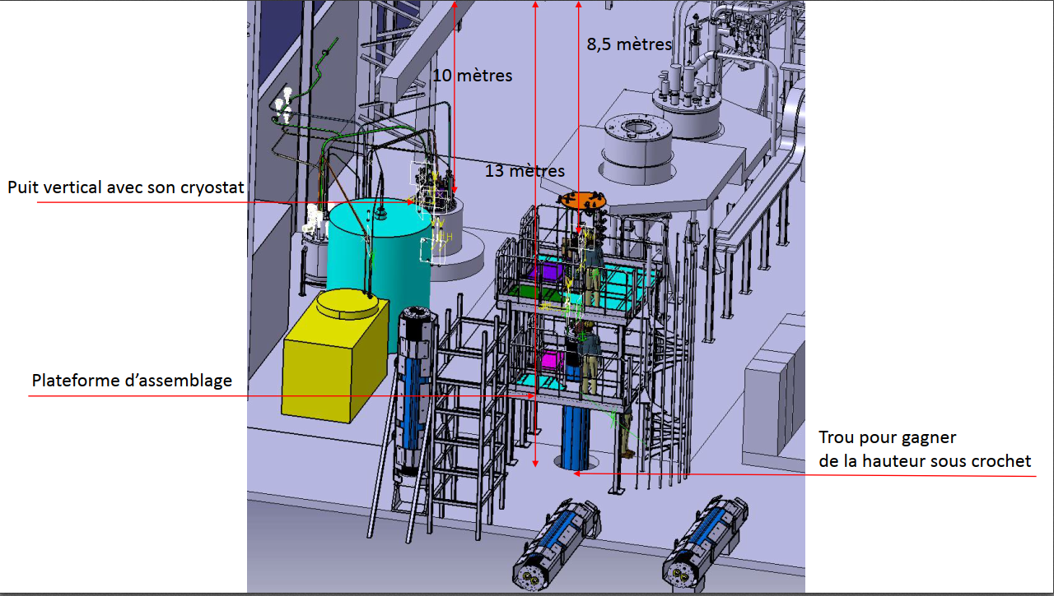
Test facility
est la mise en place des anti cryostats avec le cryostat posé sur la plateforme d’assemblage.
les AC seront toujours stockés à la verticale

Slide 24
