Slide 1
Zero-dispersion optics for horizontal emittance measurements
A. Huschauer, H. Rafique
Acknowledgments:
H. Bartosik, M. Fraser

Slide 2
Motivation
The epic quest of horizontal emittance preservation between PSB and PS
  Multiple effects expected to contribute to discrepancy between PSB and PS horizontal emittance measurements (see e.g. presentation by Matt at LIU-PS BD WG #36)
  Challenge of beam size measurements with resolution in the sub-mm range
  Important dispersive contribution to the beam size in both accelerators
    will become even more important in the future with large longitudinal emittance beams at 2 GeV
Zero-dispersion optics could be a useful tool to evaluate betatronic emittance
  Would remove the necessity of deconvolving the horizontal and longitudinal distributions
  Individually powered LEQ enable us to create a dispersion wave that reaches zero at basically each SEM grid, WS or BGI

Slide 3
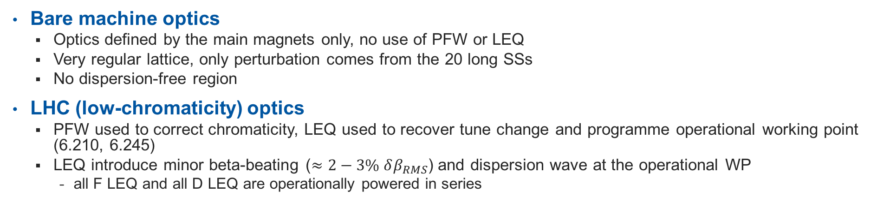
Reminder: standard optics
Bare machine optics
  Optics defined by the main magnets only, no use of PFW or LEQ
  Very regular lattice, only perturbation comes from the 20 long SSs
  No dispersion-free region
LHC (low-chromaticity) optics
  PFW used to correct chromaticity, LEQ used to recover tune change and programme operational working point (6.210, 6.245)
  LEQ introduce minor beta-beating ($≈2−3\% δβ_{RMS}$) and dispersion wave at the operational WP
    all F LEQ and all D LEQ are operationally powered in series

Slide 4
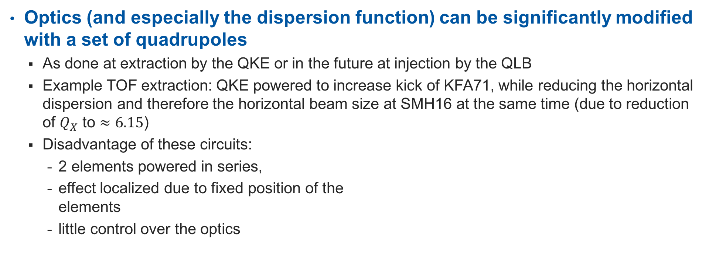
Modification of the dispersion function
Optics (and especially the dispersion function) can be significantly modified with a set of quadrupoles
  As done at extraction by the QKE or in the future at injection by the QLB
  Example TOF extraction: QKE powered to increase kick of KFA71, while reducing the horizontal dispersion and therefore the horizontal beam size at SMH16 at the same time (due to reduction of $Q_{X}$ to $≈6.15$)
  Disadvantage of these circuits:
    2 elements powered in series,
    effect localized due to fixed position of the
    elements
    little control over the optics

Slide 5
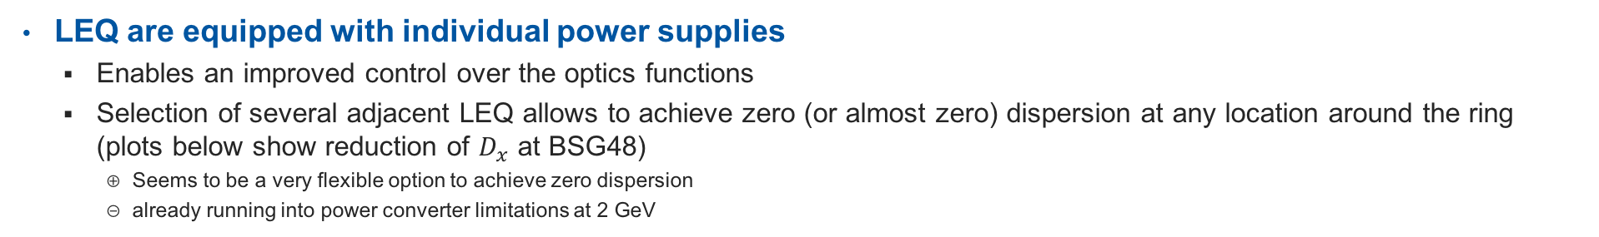
Modification of the dispersion function
LEQ are equipped with individual power supplies
  Enables an improved control over the optics functions
  Selection of several adjacent LEQ allows to achieve zero (or almost zero) dispersion at any location around the ring (plots below show reduction of $D_{x}$ at BSG48)
    Seems to be a very flexible option to achieve zero dispersion
    already running into power converter limitations at 2 GeV

Slide 6
Modification of the dispersion function
LEQ are equipped with individual power supplies
  Enables an improved control over the optics functions
  Selection of several adjacent LEQ allows to achieve zero (or almost zero) dispersion at any location around the ring (plots below show reduction of $D_{x}$ at BSG48)
    Seems to be a very flexible option to achieve zero dispersion
    already running into power converter limitations at 2 GeV

Slide 7
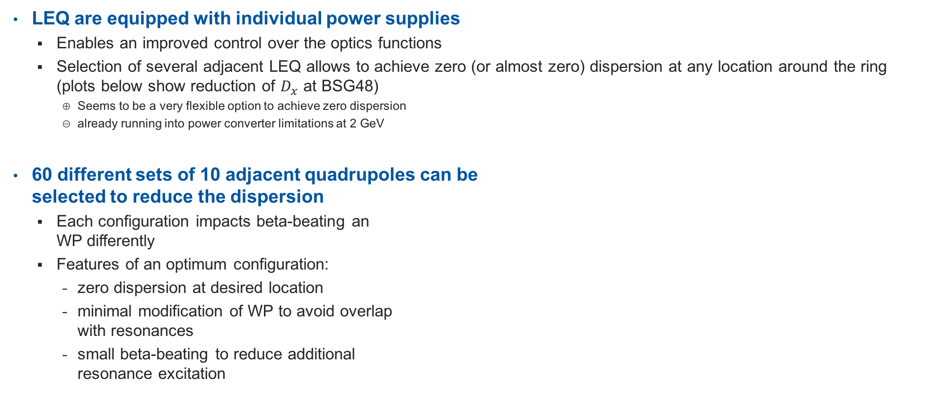
Modification of the dispersion function
LEQ are equipped with individual power supplies
  Enables an improved control over the optics functions
  Selection of several adjacent LEQ allows to achieve zero (or almost zero) dispersion at any location around the ring (plots below show reduction of $D_{x}$ at BSG48)
    Seems to be a very flexible option to achieve zero dispersion
    already running into power converter limitations at 2 GeV
60 different sets of 10 adjacent quadrupoles can be
selected to reduce the dispersion
  Each configuration impacts beta-beating an
  WP differently
  Features of an optimum configuration:
    zero dispersion at desired location
    minimal modification of WP to avoid overlap
    with resonances
    small beta-beating to reduce additional
    resonance excitation

Slide 8
Different solutions to reduce $D_{x}$ at PI.BSG48

Slide 9
Comparison of two different solutions at PI.BSG48
Significant reduction of beta-beating achievable for almost unchanged dispersion
Optimum solution for each device/location shall be carefully studied

Slide 10
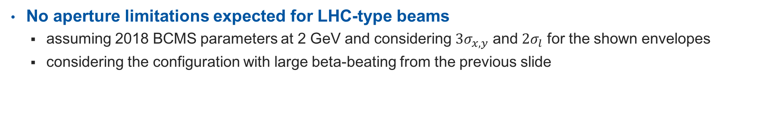
Aperture considerations
No aperture limitations expected for LHC-type beams
  assuming 2018 BCMS parameters at 2 GeV and considering $3σ_{x, y}$ and $2σ_{l}$ for the shown envelopes
  considering the configuration with large beta-beating from the previous slide

Slide 11
Solutions at other locations

Slide 12
Solutions at other locations

Slide 13
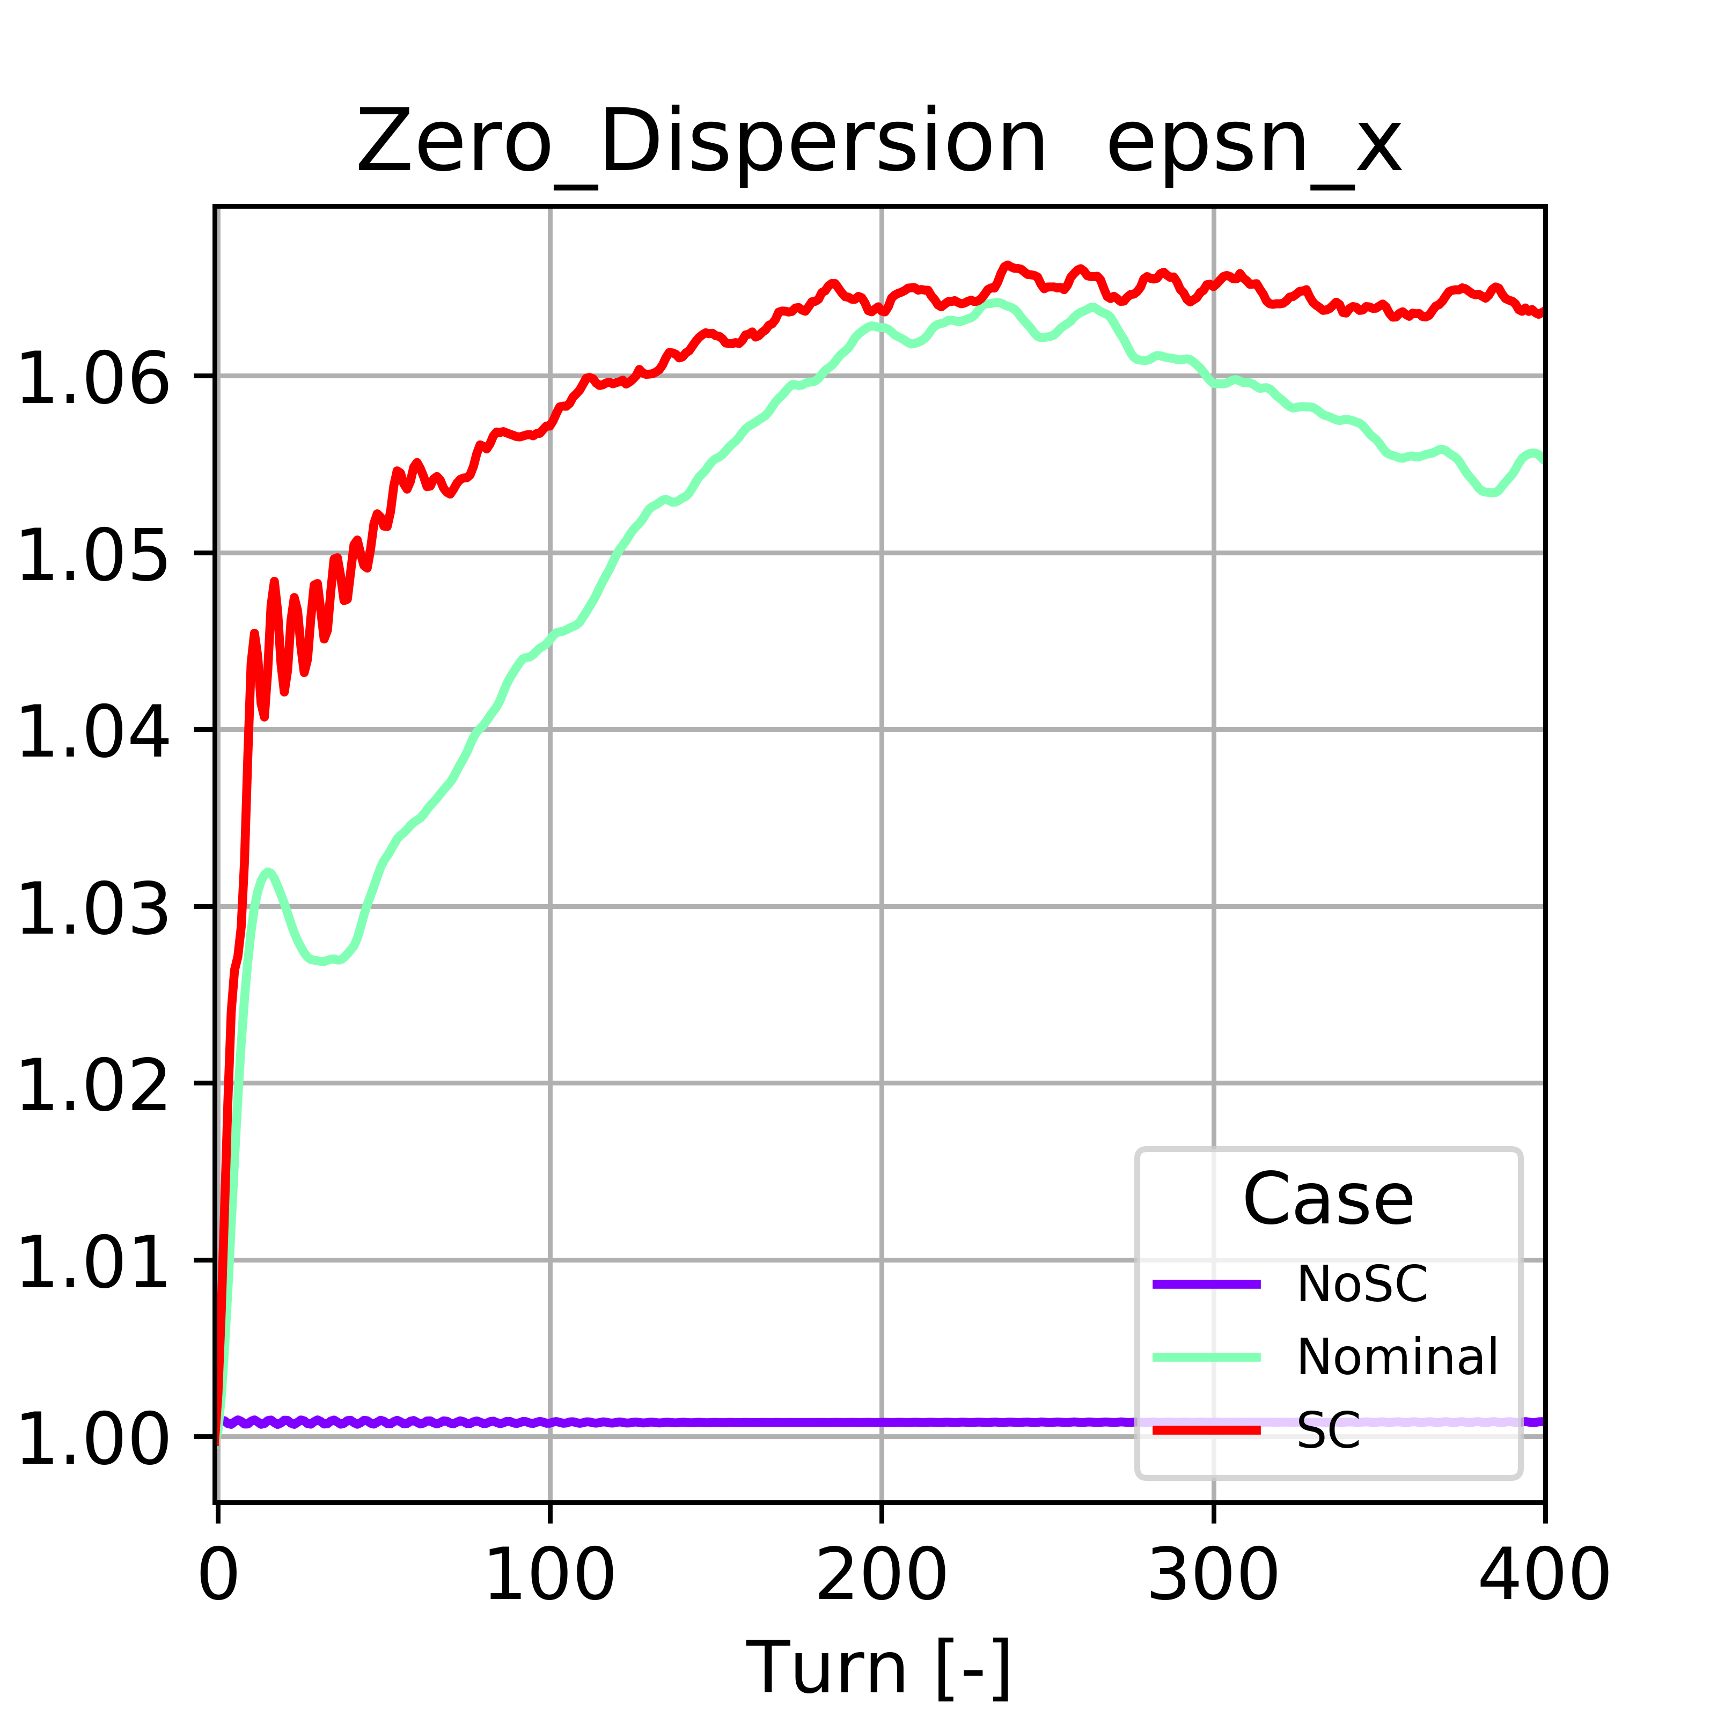
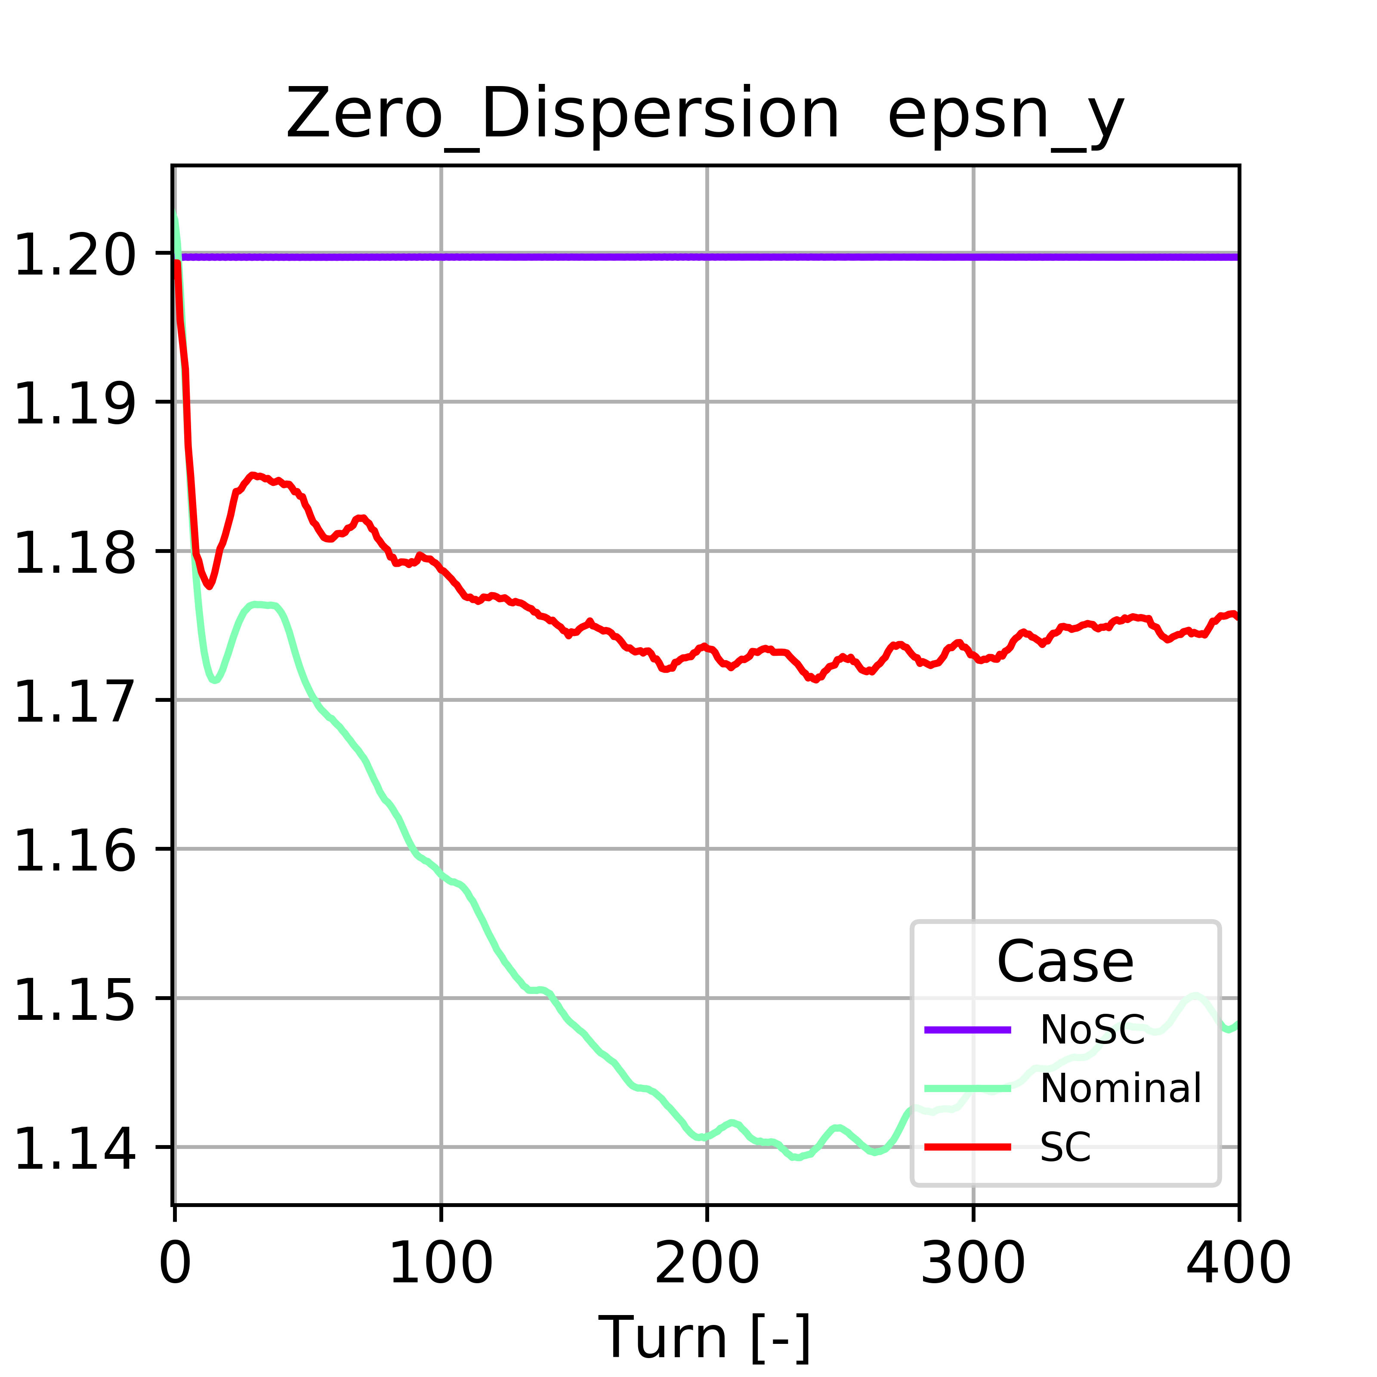
Space charge simulations
PyORBIT space charge simulations to compare performance of the zero-dispersion optics at PI.BSG48 to the nominal (low-chromaticity) optics
  Transverse emittances show emittance exchange due to the Montague resonance
  Effect appears to be smaller in the vertical plane than in the nominal case → reduced space charge tune spread due to new optics?

Slide 14
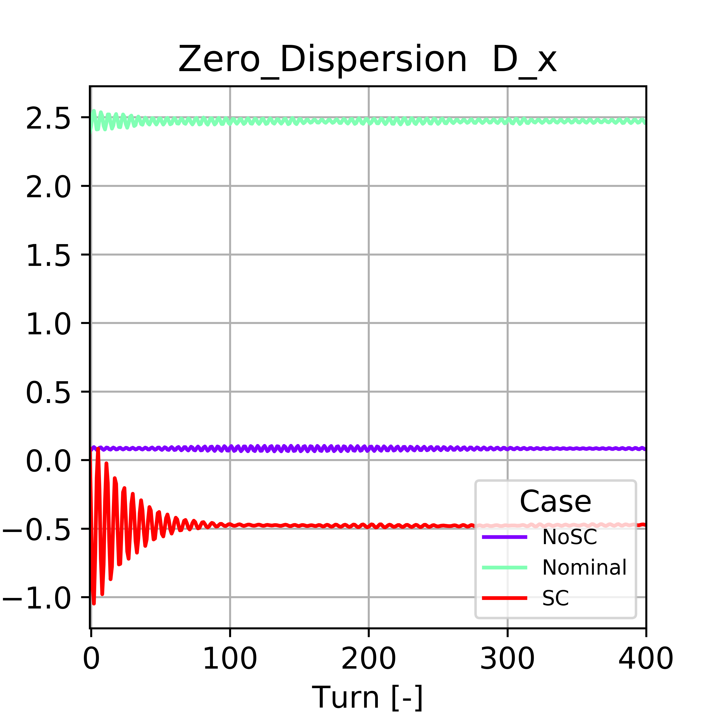
Space charge simulations
PyORBIT space charge simulations to compare performance of the zero-dispersion optics at PI.BSG48 to the nominal (low-chromaticity) optics
  Transverse emittances show emittance exchange due to the Montague resonance
  Effect appears to be smaller in the vertical plane than in the nominal case → reduced space charge forces due to new optics?
Dispersion function reconstructed from the bunch distribution
actually appears even smaller than Twiss indicates
  Optics modification by the additional defocusing of the space charge forces?
  Could be very beneficial in operation:
    Reaching zero dispersion appears limited by the available strengths,
    further reduction would go in the right direction
    During commissioning: scan the dispersion and identify minimum profile
    width using BGI or WS
    Verify that this is true for all locations around the ring
  Mismatch won’t be an issue when adiabatically ramping to the new
  optics configuration

Slide 15
Conclusions and outlook
LEQ provide a lot of flexibility to achieve zero dispersion at any location around the ring
  Potential to gain more insight into the effects hampering the emittance preservation between PSB and PS
  Available power converter strengths at 2 GeV is on the limit
  Space charge simulations indicate that the dispersion seen by the beam is actually different from the zero-intensity dispersion
Several measurements required to validate and commission the optics:
  Beta-beating and dispersion measurements required for validation
  Adiabatic ramp to zero dispersion after beam injection while recording the beam size (ideally with BGI) to identify optimum setting
  Implement dispersion knobs in LSA to simplify the procedure
  Zero-dispersion optics could then be implemented as dedicated measurement optics on the LHC flat bottom
Further optimization of the setup in simulations
  Quadrupole selection for a given instrument/location
  Exploitation of additional available circuits (QKE, QLB, doublets, triplets)
  Check impact of space charge on dispersion at different locations
  Simulate adiabatic ramp to zero dispersion optics with space charge

