Slide 1
Conceptual Design of the DFH
DFH Conceptual Design Review
A. Ballarino
A. Ballarino, R. Betemps, S. Claudet, P. Cruikshank, J. Fleiter, J. Hurte, Y. Leclercq
15 November 2019 - CERN

Slide 2
Table of contents
The DFH in the HL-LHC Cold Powering System
DFH Functionality
The DDFH in Demo 1
DFH: Design evolution
DFH: Concept
SC Link connection to DFH: surface vs underground assembly
Conclusions

Slide 3
Table of contents
The DFH in the HL-LHC Cold Powering System
DFH Functionality
The DDFH in Demo 1
DFH: Design evolution
DFH: Concept
SC Link connection to DFH: surface vs underground assembly
Conclusions

Slide 4
Cold Powering System
WP9
Cryogenics
DFHX → Triplets
DFHM → Matching Sections
WP17 – WP6b
RT Cables
Power Converters
4
Current Leads (DFLH)
He gas
T2≤50 K
Interface to WP3
Nb-Ti to Nb-Ti
HTS
T1≤17 K
MgB₂ to HTS
3
DFH
WP3 - Magnets (λ-plate with Nb-Ti)
1
DF
λ-Plate
2
SC Link (DSL)
LHe
4.2 K
MgB₂
Nb-Ti – 1.9 K
MgB₂ to Nb-Ti
Nb-Ti to Nb-Ti

Slide 5
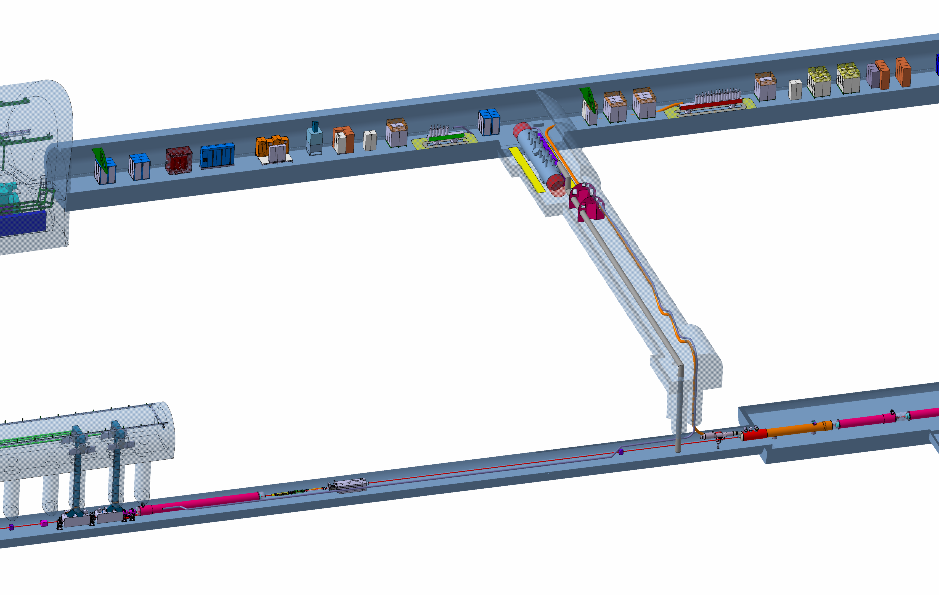
Cold Powering System
Cryostat and leads
Cryostat and leads
DFHX
Power converters
DFHM
Power converters
VALVES BOX
SC Link for Triplets
≈ 100 m
SC Link for
Matching Sections
≈ 130 m
Shaft Φ = 1m
∼ 8 m
DFX
D1
DFM

Slide 6
Table of contents
The DFH in the HL-LHC Cold Powering System
DFH Functionality
The DDFH in Demo 1
DFH: Design evolution
DFH: Concept
SC Link connection to DFH: surface vs underground assembly
Conclusions

Slide 7
DFH Functionality
Receive and shuffle the MgB₂ cables from the SC Link and connect to the HTS cables of the current leads;
Provide appropriate space for making/hosting the electrical splices between the MgB₂ cables and the HTS cables of the current leads. The preference is to have the splices accessible for - highly unlikely - need for repair;
Flow the He gas received at about 17 K from the SC Link and provide appropriate cooling of the electrical connections;
Connect the current leads, distributed near the DFH, to the MgB₂ cables in the SC Link with the most appropriate and compact configuration;
Extract instrumentation signals (Vtaps, Tsensors).

Slide 8
DFH Installation
Present baseline (not based on a detailed design):
  The SC Link is lowered in the LHC underground areas, routed in its final configuration and then connected to the DFH cryostat;
  Routing of MgB₂ and HTS cables and MgB₂ to HTS splices are done in the tunnel (and not tested till final operation in the machine);
  Each SC Link is tested at the surface in a dedicated test station; each current lead is tested at the surface in dedicated test station.

Slide 9
MgB₂ cables in the SC Link
18 kA
18 kA
18 kA
6×3 kA
3×7 kA
6×0.6 kA
6×0.6 kA
18 kA
6×3 kA
18 kA
18 kA
18 kA
Φext ∼ 90 mm
Φext ∼ 60 mm
19 Cables
14 Cables + 1
∼ 120 kA
∼ 60 kA

Slide 10
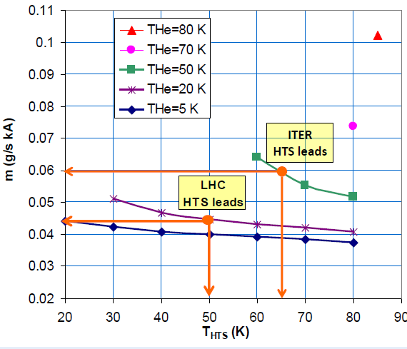
Helium mass flow rate in the DFH
∼ 5.4 g/s for Triplets
∼ 2.5 g/s for Matching Sections
https://arxiv.org/abs/1501.07166

Slide 11
Table of contents
The DFH in the HL-LHC Cold Powering System
DFH Functionality
The DDFH in Demo 1
DFH: Design evolution
DFH: Concept
SC Link connection to DFH: surface vs underground assembly
Conclusions

Slide 12
Demo 1

Slide 13
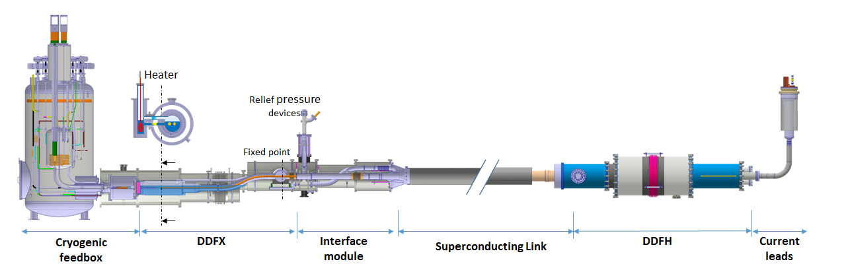
DDFH in Demo 1
System test in SM-18 (completed in March 2019)
Full size SC Link cryostat – 2 × 18 kA

Slide 14
DDFH in Demo 1
Construction of DDFX demonstrator
  Double chamber with thermal shield (thermally floating)
  Acceptable heat load
  Assembly process
Realization of two 18 kA splices
Splices fixed to the cold mass
Optimization of splices’ cooling - GHe
Routing of HTS and MgB₂ cables
Routing out of instrumentation (from cold mass to RT)
Vertical leads

Slide 15
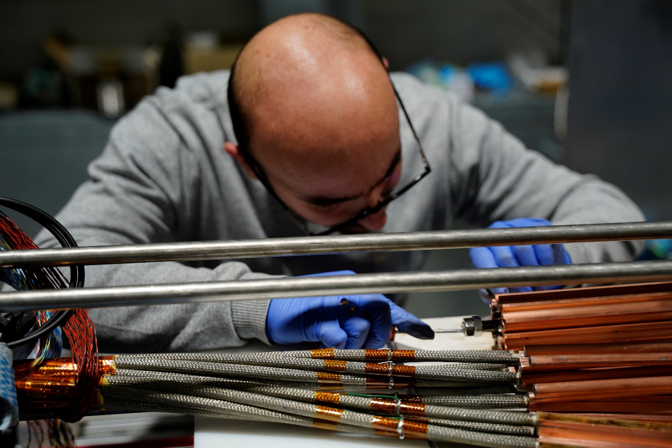
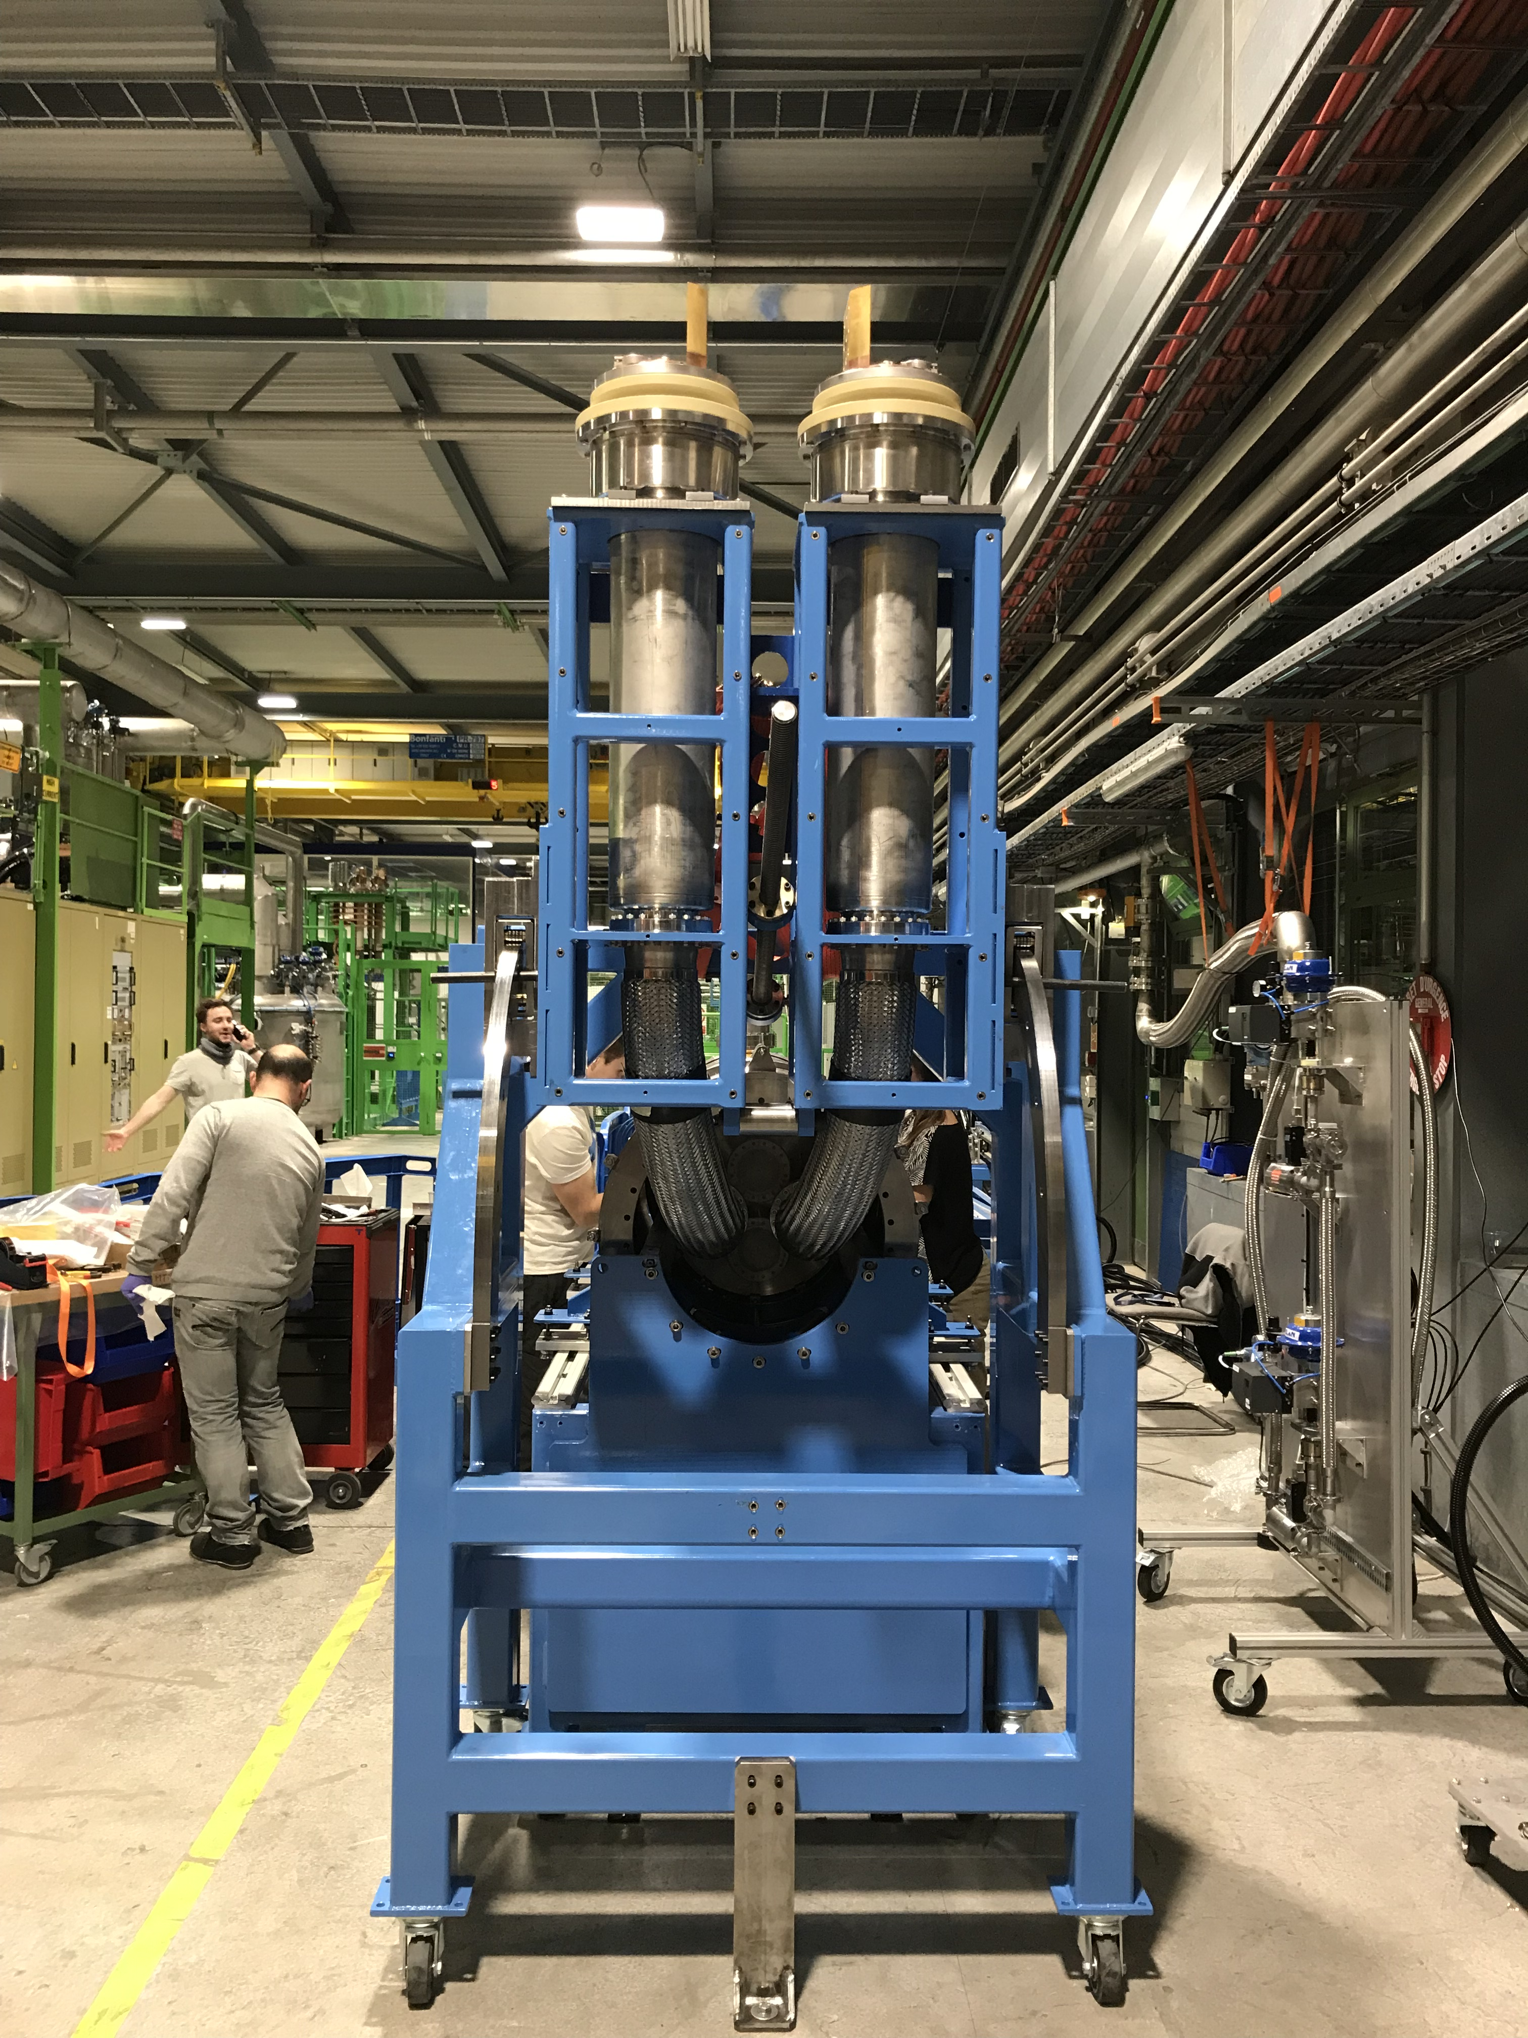
DDFH in Demo 1
  MgB₂/HTS splices:1.9 nΩ
  at 18 kA (measured)
Expected 18 kA splice resistance of 1.7 nΩ (prediction based based on FEM simulation validated via measurements in LHe at 4.5 K)
T ∼ 17 K
GHe

Slide 16
Table of contents
The DFH in the HL-LHC Cold Powering System
DFH Functionality
The DDFH in Demo 1
DFH: Design evolution
DFH: Concept
SC Link connection to DFH: surface vs underground assembly
Conclusions

Slide 17
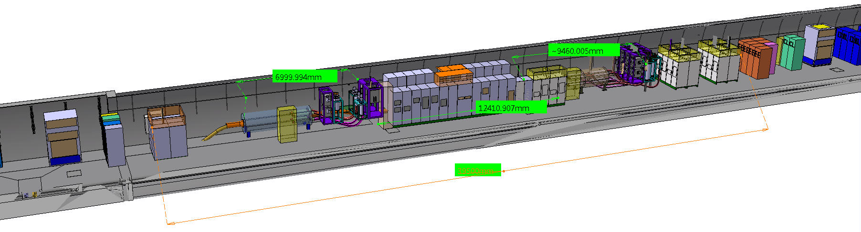
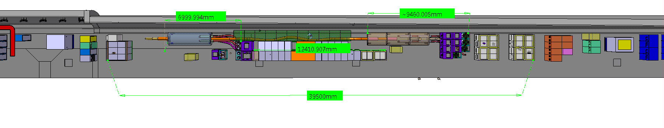
DFH Working Reference
DDFX Design Evolution
Two modules each 4 m long ø - 1,2 m (length without current leads)
Total length with current leads ∼ 15 m (plus SC Link in between)
SC Link in between modules: ∼ 14.7 m
∼ 30 m in the tunnel
A. Ballarino

Slide 18
Table of contents
The DFH in the HL-LHC Cold Powering System
DFH Functionality
The DDFH in Demo 1
DFH: Design evolution
DFH: Concept
SC Link connection to DFH: surface vs underground assembly
Conclusions

Slide 19
DFHX Concept – The cryostat
One single module

Slide 20
DFHX Concept – Cryostat with Current Leads
0.75 deg
1.5

Slide 21
DFHX Concept – Cryostat with Current Leads

Slide 22
DFH Concept
Module 1:
It splays and shuffles all MgB₂ cables coming out from the SC Link.
The 3 kA MgB₂ cables are routed out from the shuffling module (into Module 2) via a single pipe containing the six 3 kA coaxial MgB₂ cables.
It contain the 7 kA and 18 kA joints between MgB2 and HTS. The length of each of the five pipes allocated for the joints (four pipes, one for each of the 18 kA joints, and one pipe for the three 7 kA joints) is ≥ 300 mm.
**
*

Slide 23
DFH Concept
Module 2:
This module routes out the HTS cables of the 7 kA and 18 kA current leads, and contains the box that splays and shuffles the 3 kA MgB₂ cables to Module 3.

Slide 24
DFH Concept
Module 3:
This module contains the 3 kA joints between MgB₂ and HTS, and it routes out the 3 kA HTS cables. The length allocated for the two joints to the coaxial cables is 450 mm. There are three pipes for the MgB₂ to HTS joints, and each pipe contains four joints (two coaxial MgB₂ cables connected to four HTS cables).

Slide 25
DFH Concept
Each DFH module is assembled separately. The modules are then put together for the routing and the splicing of the superconducting cables.
The length of the HTS part of the leads is maintained to less than 2.5 m.

Slide 26
DFH Concept – GHe flow
T_{HTS}
T_{splices}
SC Link

Slide 27
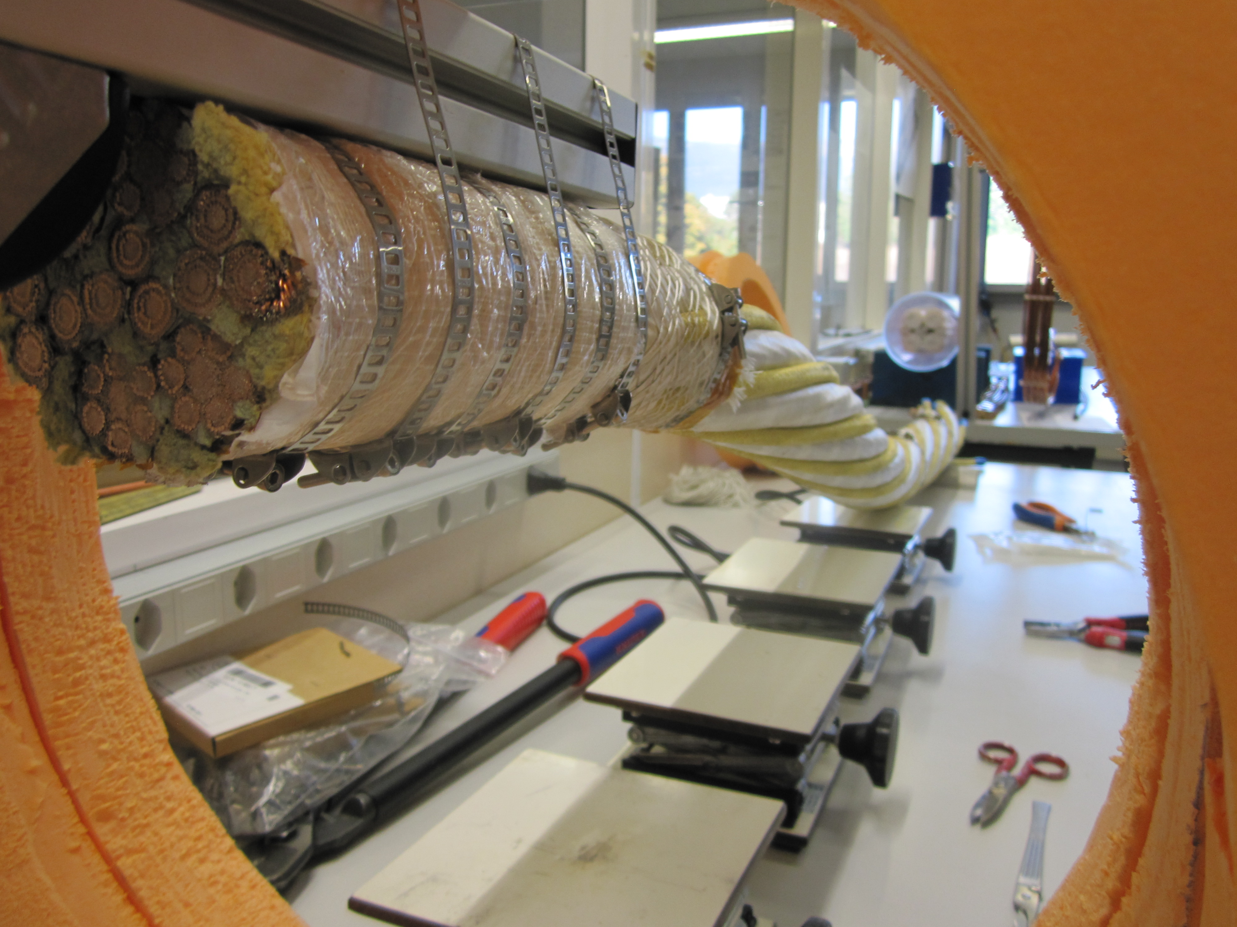
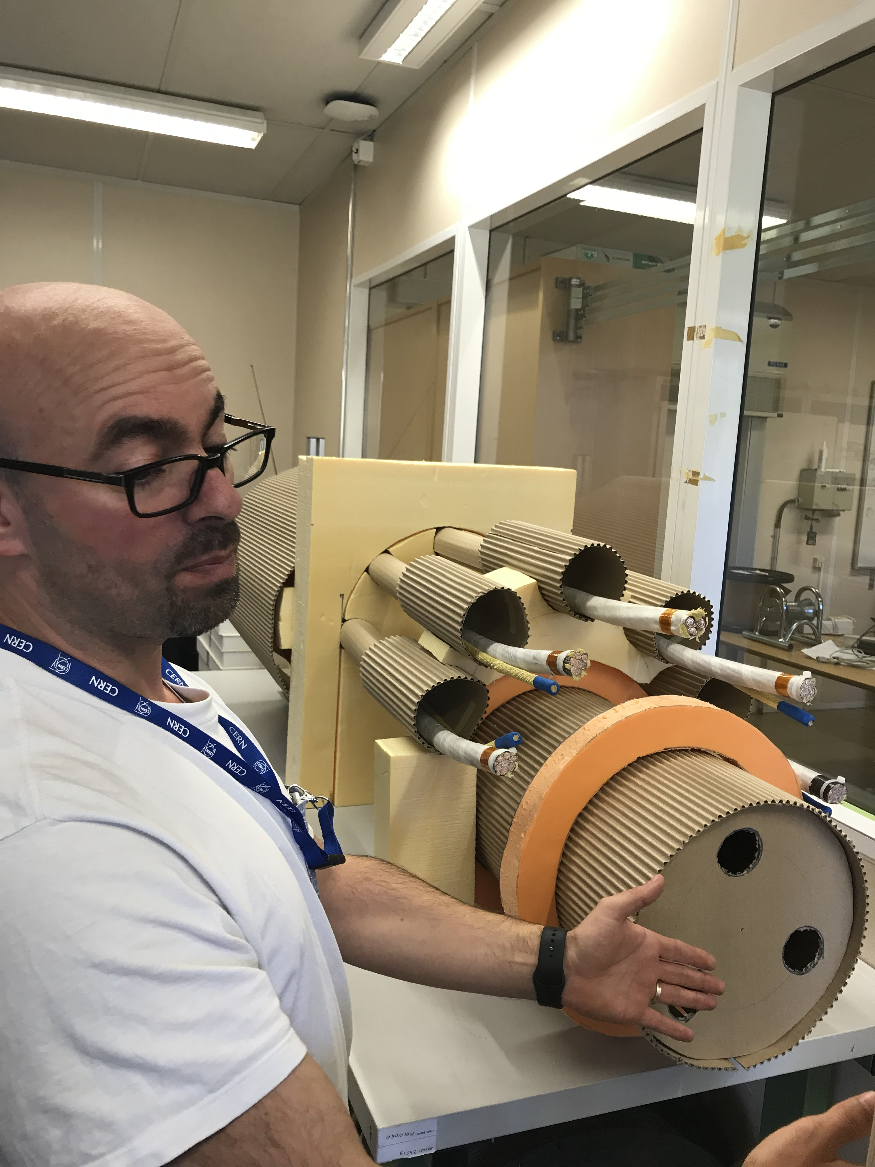
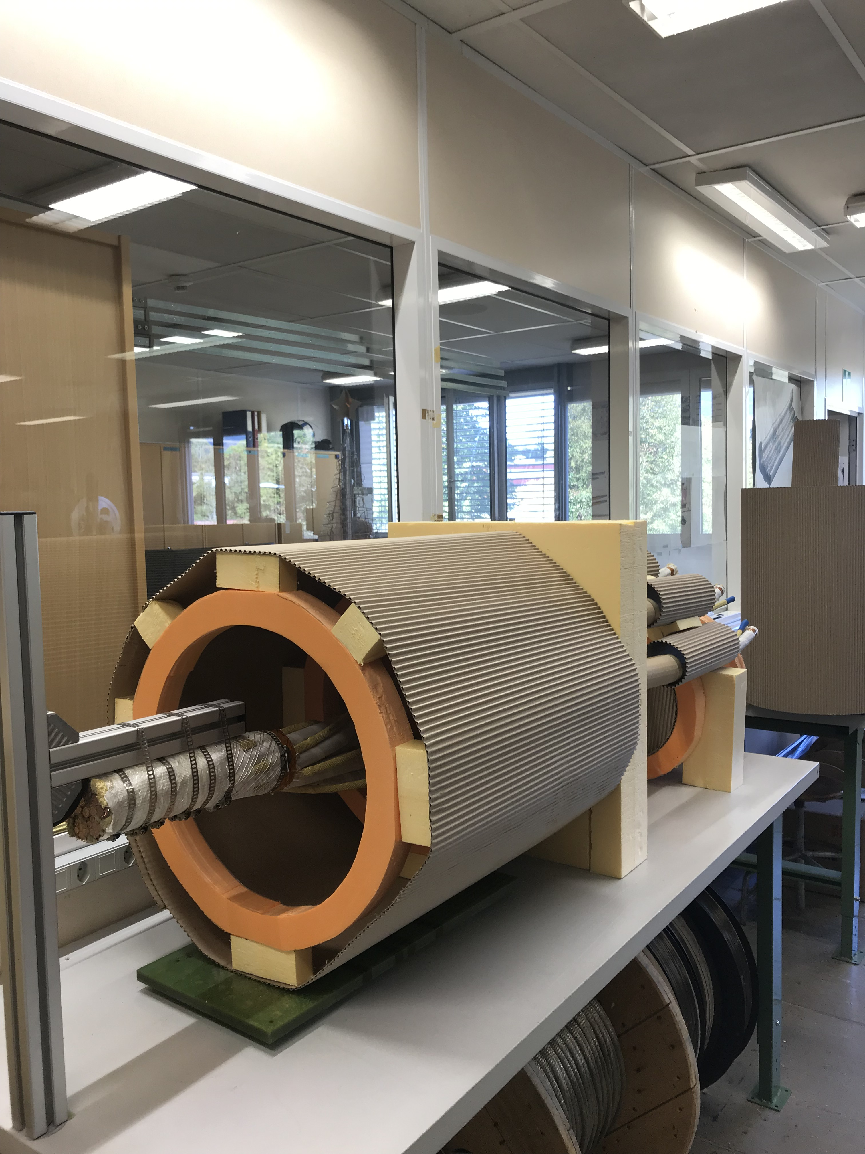
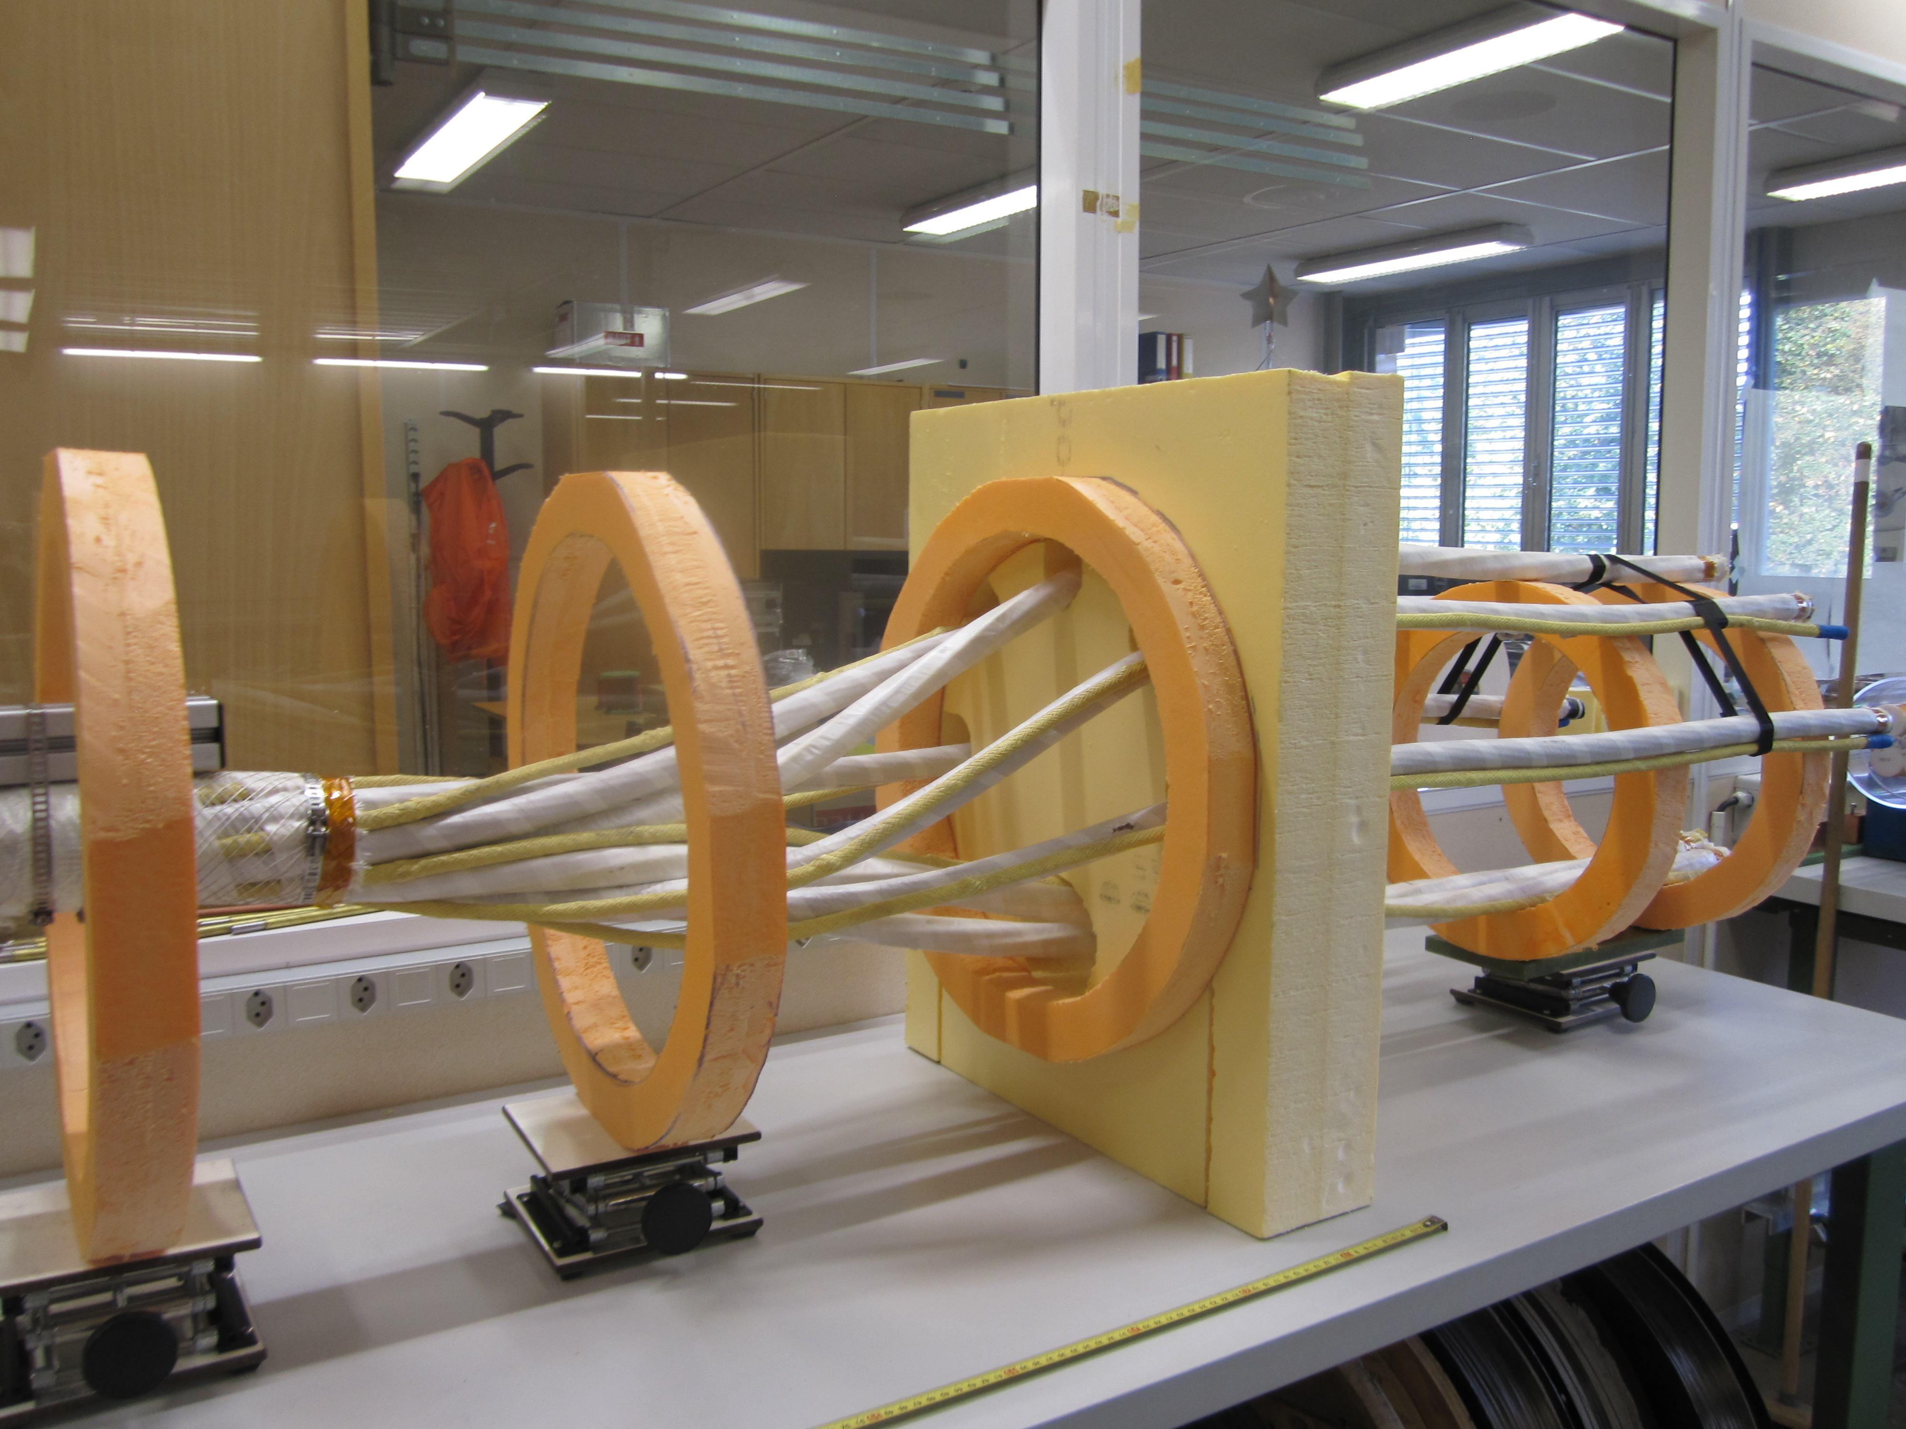
Mock-up
Building 288

Slide 28
From Concept to Design
**
*
** L = 802
Φ 600
* L = 500
Φ 284
3.90 m
500 - 910*** mm
*** Taking into account size of Cutting/Welding machines
Green: 3D design, Black: concept

Slide 29
From Concept to Design
1.4* m
* Iteration with transport

Slide 30
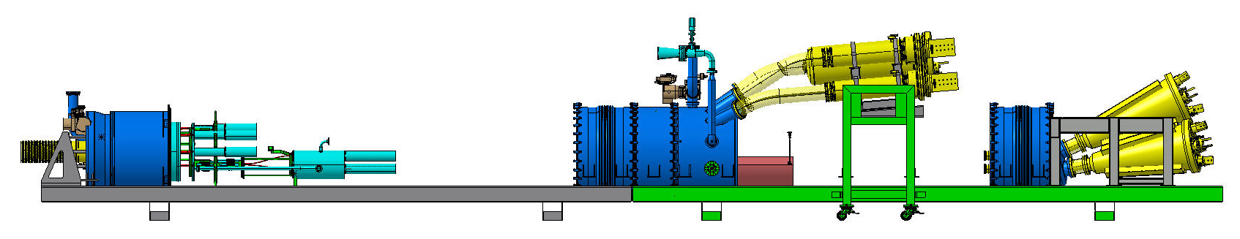
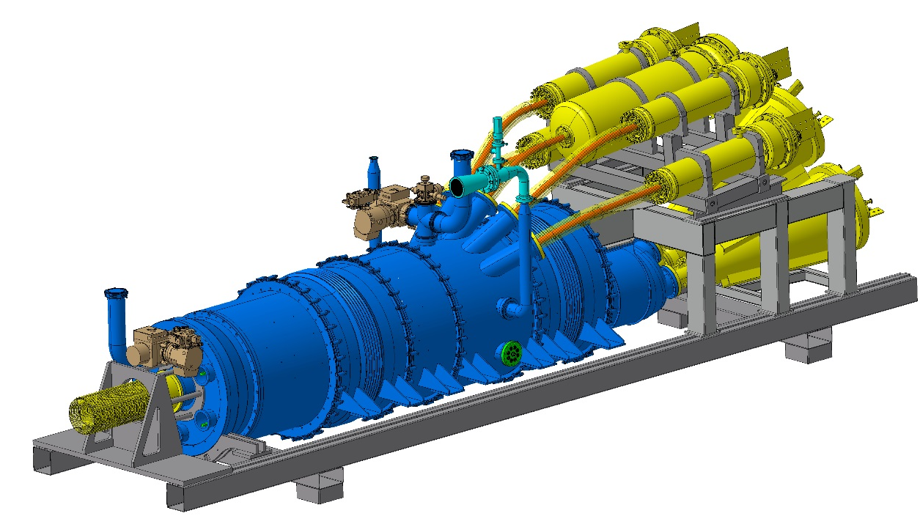
DFH Design
See next presentation

Slide 31
Table of contents
The DFH in the HL-LHC Cold Powering System
DFH Functionality
The DDFH in Demo 1
DFH: Design evolution
DFH: Concept
SC Link connection to DFH: surface vs underground assembly
Conclusions

Slide 32
DFH Concept
Compact concept: possibility of lowering the full system in the tunnel after test at the surface. In addition to system cost reduction because (one module and shorter length of MgB₂ and SC Link), the main advantages are:
Performance of all assembly operations at the surface;
Full qualification of the system at the surface (including splices);
No manipulation of cables (handling/cutting/splicing) after qualification at the surface;
Test station for SC Links largely simplified (use of series DFH and current leads).

Slide 33
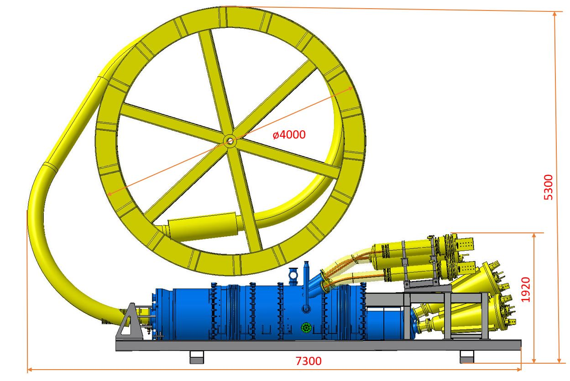
From Concept to Design

Slide 34
Conclusions
A 3D DFH concept has been developed
The compact concept brings in several advantages and guarantee full WP6a functionality
To date, the concept has been validated with a mock-up and engineered in a 3D design
Experience from Demo 1 has been essential for validating several aspects of the proposed concept
Possibility of lowering the system in the tunnel after cryogenic tests brings in a huge advantage for the system

Slide 35
Thanks for your attention

Slide 36
Additional slides

Slide 37

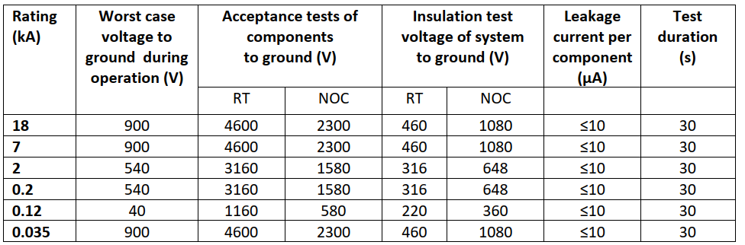
HV Levels - Triplets
RT = Room Temperature (20 ± 5 °C)
NOC = Nominal Operating Conditions. For all WP6s components, it corresponds to
GHe at RT and 1.30 ± 0.05 bar

Slide 38
HV Levels – Matching Sections
D2: treated as for a 18 kA circuit – conservative
18 kA
D2
D2 correctors: 0.6 kA rating, Worst case to ground = 590 V, Components test: 5.7 kV (RT) -
Components test 2.860 kV (NOC)

Slide 39
