Slide 1
FREIA Laboratory
Facility for Research Instrumentation and Accelerator Development
Uppsala University
Organization for the DFH Project
DFH Collaboration Meeting
CERN, 10 December 2019

Slide 2
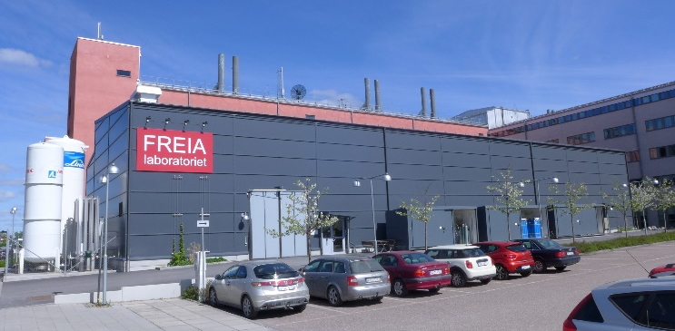
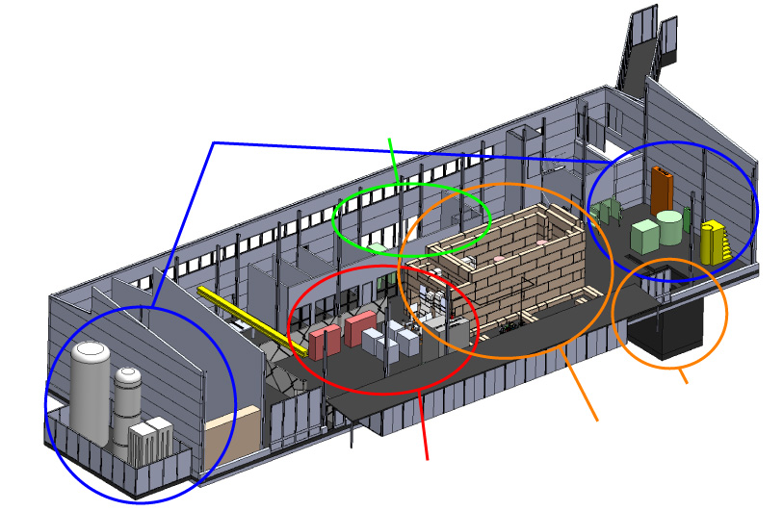
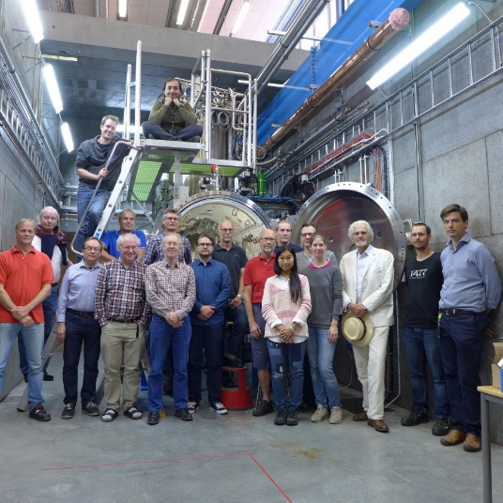
FREIA Laboratory
Facility for Research Instrumentation and Accelerator Development
Funded by
KAWS, Government, Uppsala Univ.
State-of-the-art Equipment
cryogenics
- liquid helium
- liquid nitrogen
control room
- equipment controls
- data acquisition
Competent and motivated staff
collaboration of physics (IFA)
and engineering (Teknikum).
vertical cryostat
3 bunkers
with test stands
horizontal cryostat
radio-frequency (RF) power sources
https://www.youtube.com/watch?v=q6vumxZqW0o

Slide 3

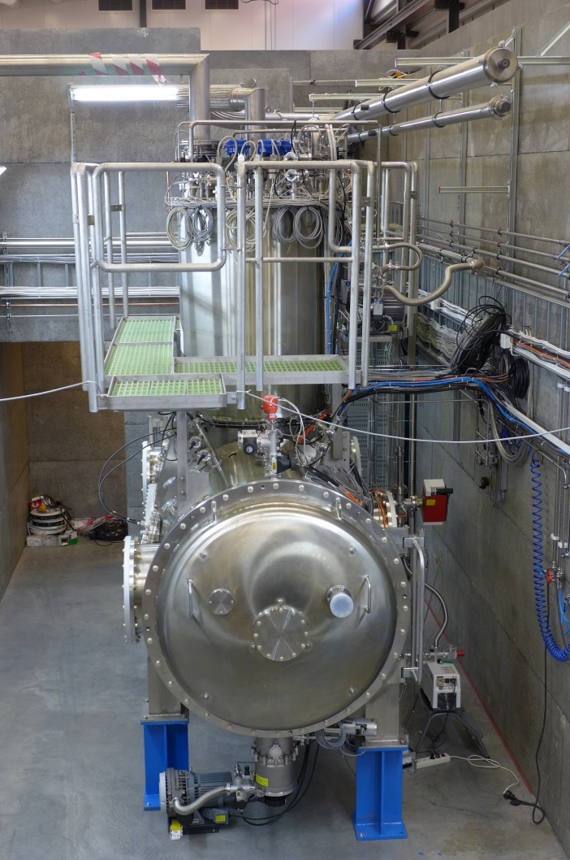
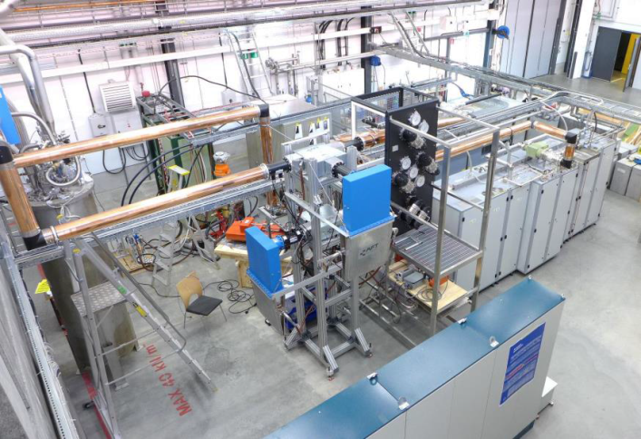
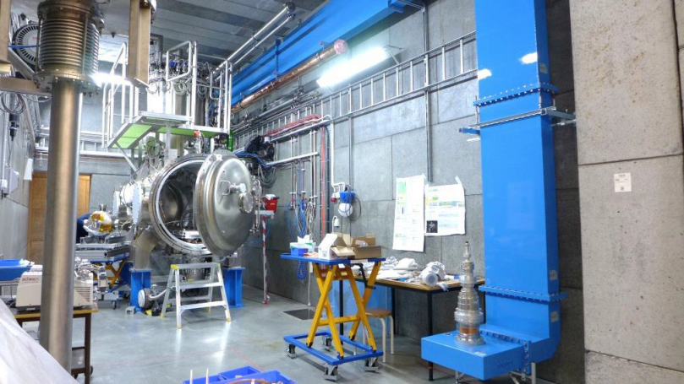
“HNOSS” Horizontal Cryostat
HNOSS = Horizontal Nugget for Operation of Superconducting Systems
Test of superconducting cavities/devices
  3240 x ø1200mm inner volume
  up to two cavities simultaneously,
  each equipped with helium tank,
Low or High power RF testing
  fundamental power coupler (top, bottom, side)
  (cold) tuning system
Operation in the range 1.8 to 4.5K.
Available as ARIES
Trans National Access Facility

Slide 4
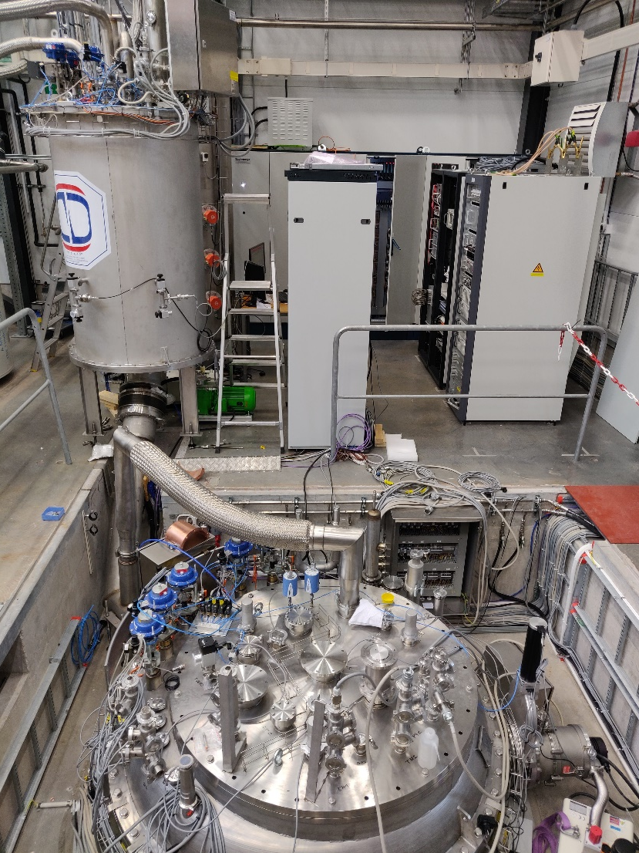
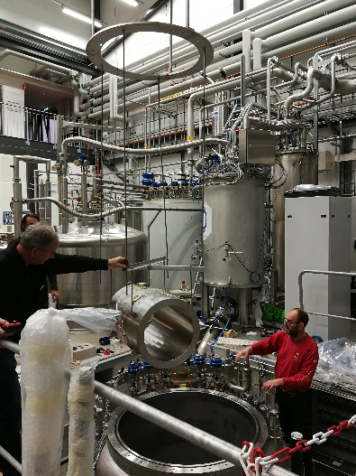
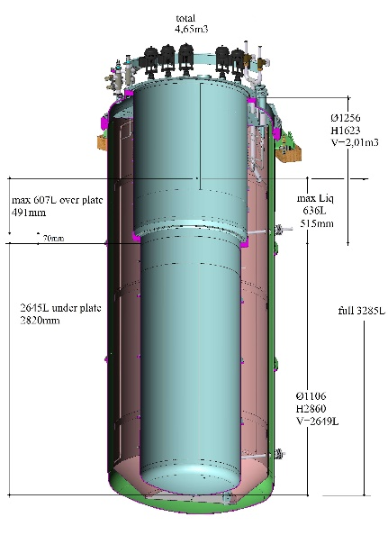
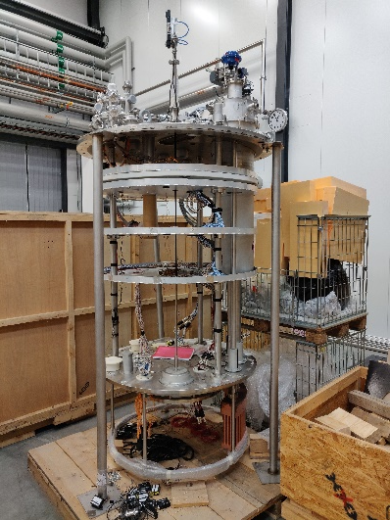
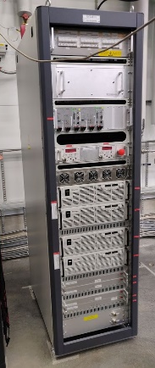
“Gersemi” Vertical Cryostat
Under commissioning
Test of SC cavities & magnets (<350kJ)
  3.2m x ø1.1m total volume
  2.65m x ø1.1m below lambda plate
    design includes joint for lambda plate
Three operation modes
  vacuum; liquid bath; pressurized
  (bath with 2K heat exchanger)
Operation in the range 1.8 to 4.5K
Available as ARIES
Trans National Access Facility
2 x 2000 A

Slide 5
Organization
UU funding
  received from the Swedish Science Council order of 10 MSEK (~ 1 MCHF)
  internal UU discussion to absorb funding shortage
  will be used for work done internally at the university (salary, travel)
K-contract CERN – UU
  order of 1 MCHF (~10 MSEK)
Procurement contract
  UU – RFR
  UU – other subcontractor (if needed)

Slide 6
People Involved
Physics department
  Olof “Charlie” Karis – department head
Physics department – FREIA Laboratory
  Tord Ekelöf – division head
  Roger Ruber – general project management
  Kevin Pepitone – research engineer, accelerator systems
  Rocio Santiago Kern – research engineer, cryogenics and cryostats
  Johan Eriksson – research engineer, mechanics
  other colleagues as needed
Central administration - Procurement department
  Gunilla Petersson – procurement officer
  Johan Asker – legal division

