Slide 1
SPECKLES @ NCD

Slide 2
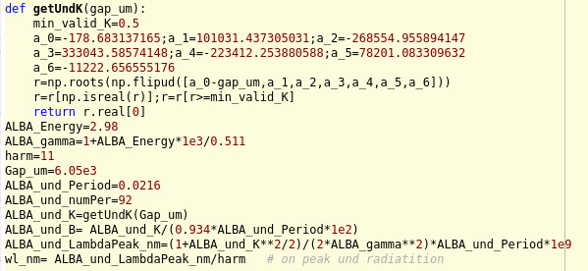
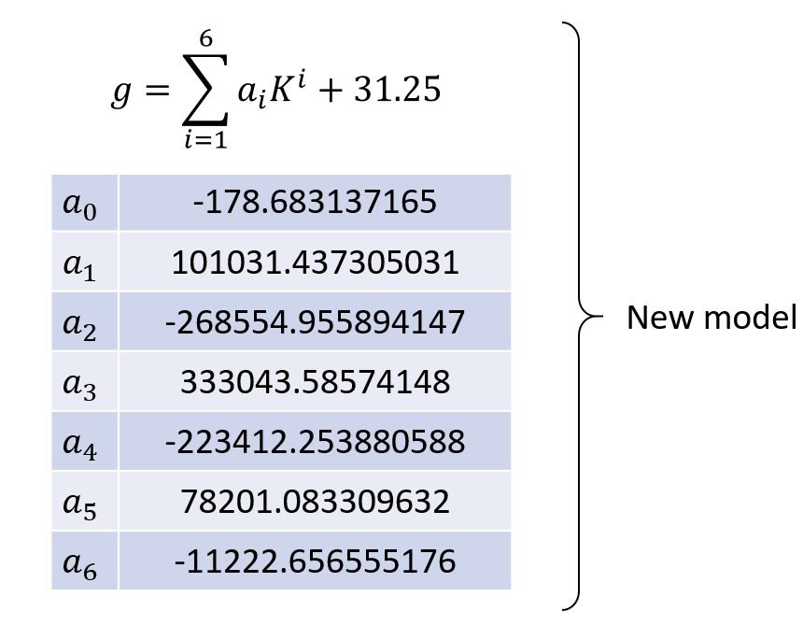
NCD source characterization
Misalignment

Slide 3
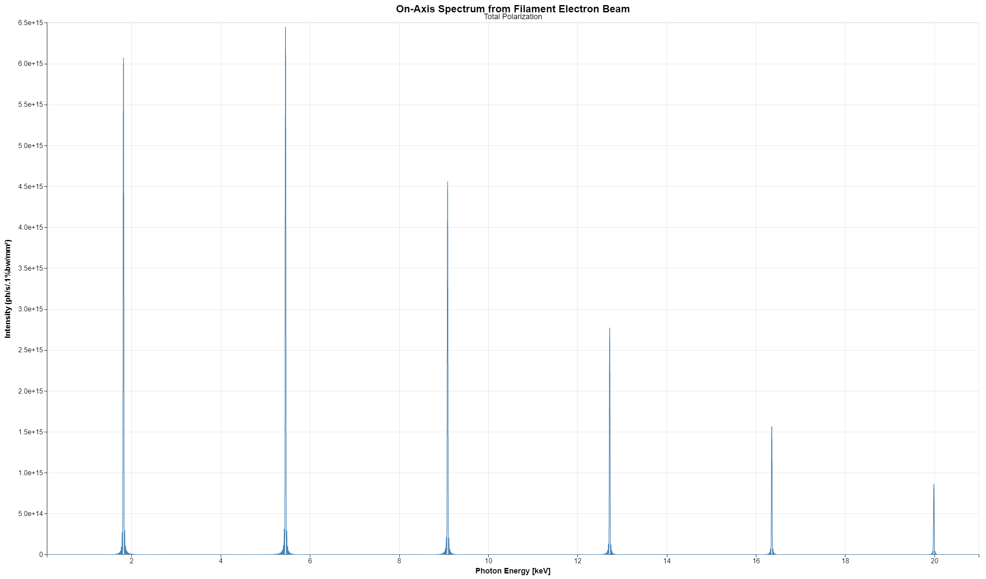
NCD source characterization

Slide 4
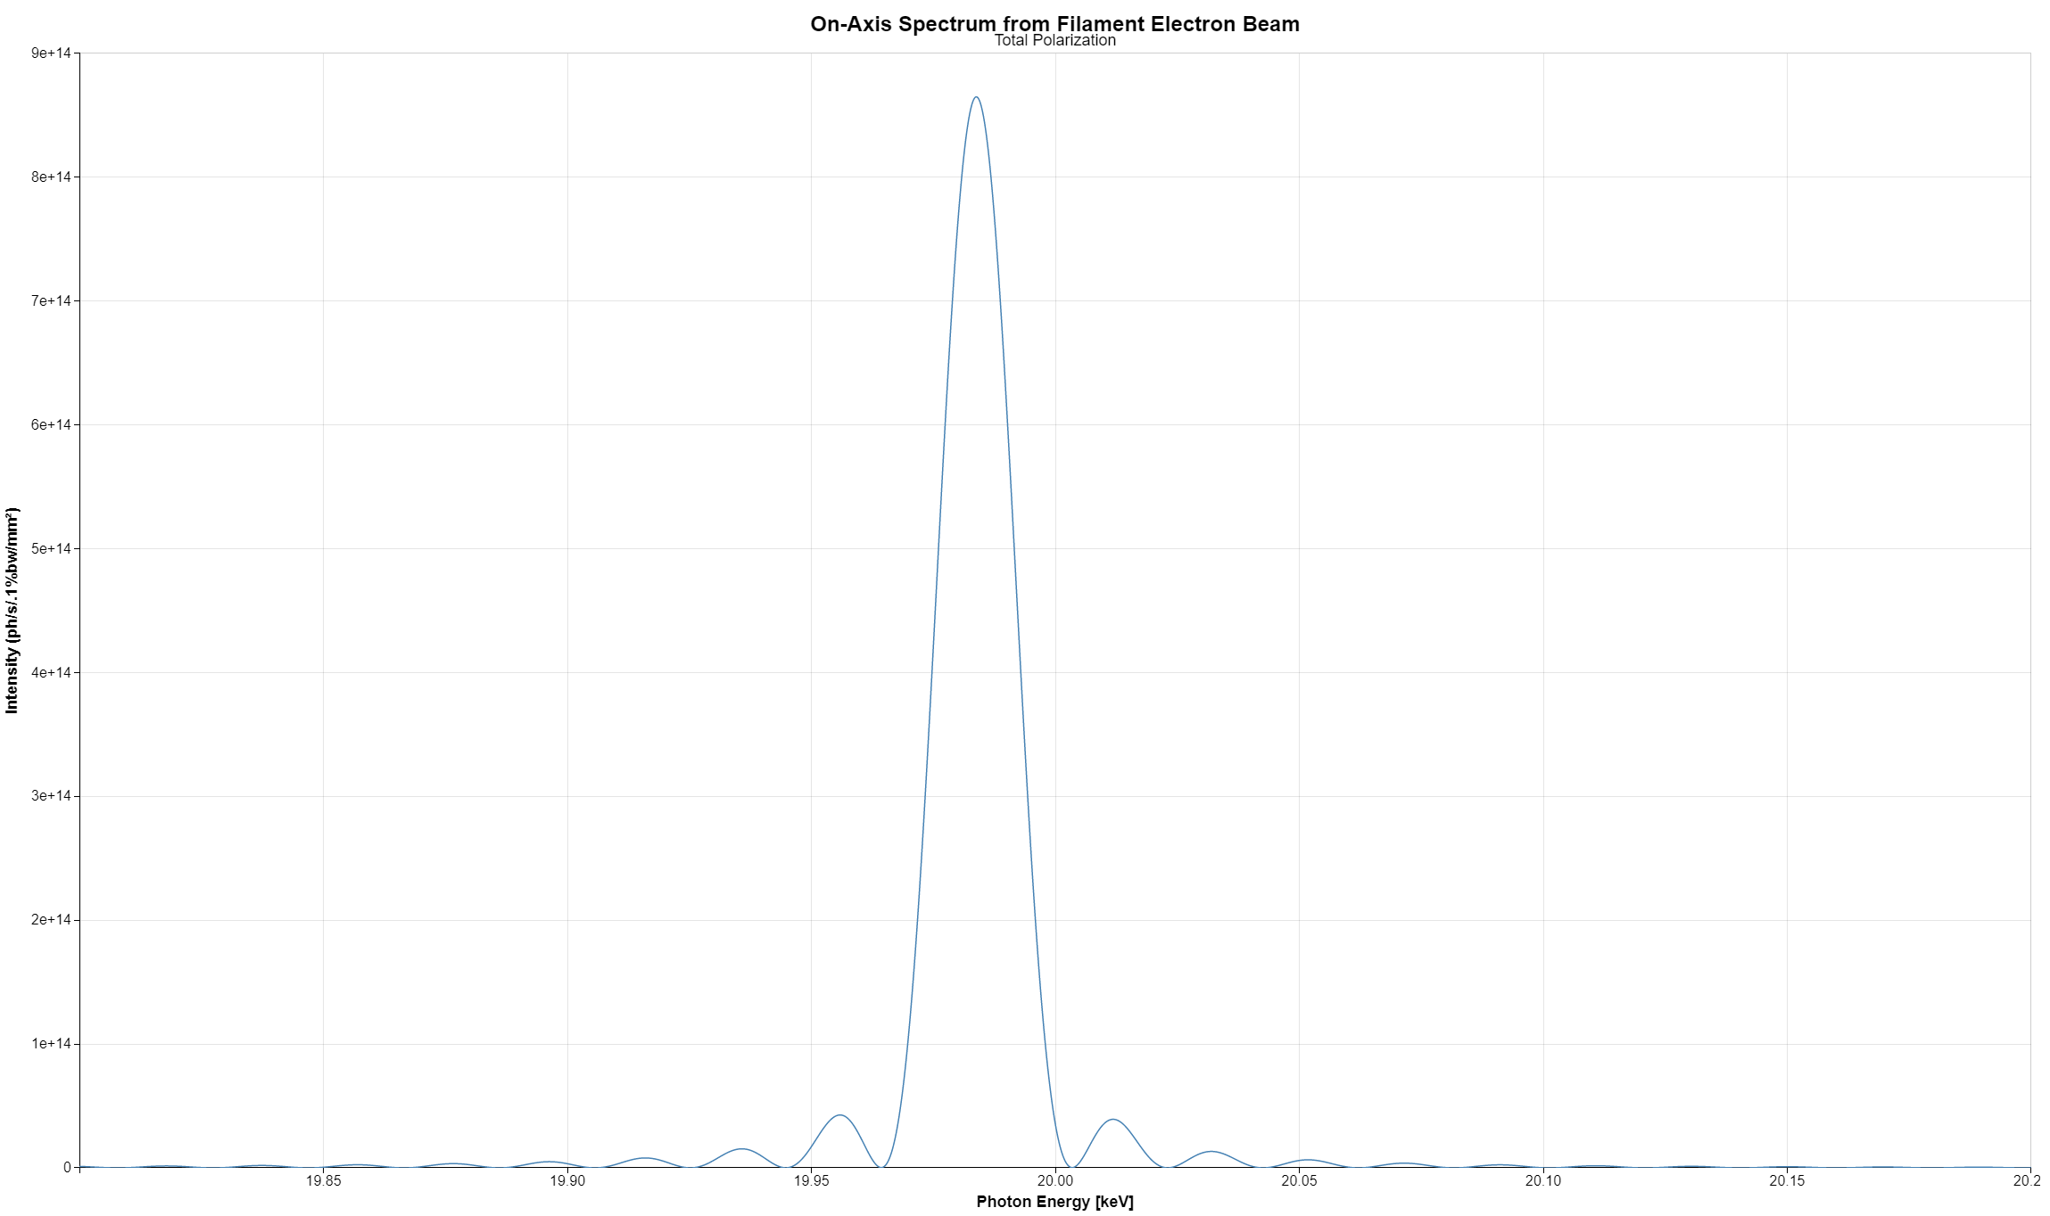
NCD source characterization

Slide 5
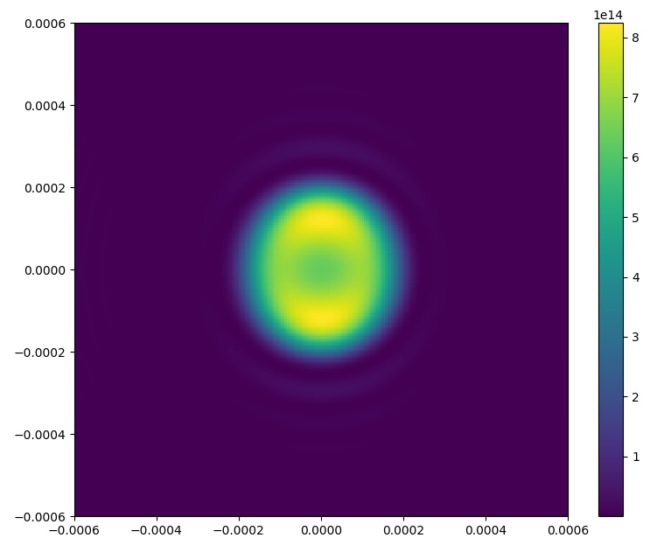
NCD source characterization

Slide 6
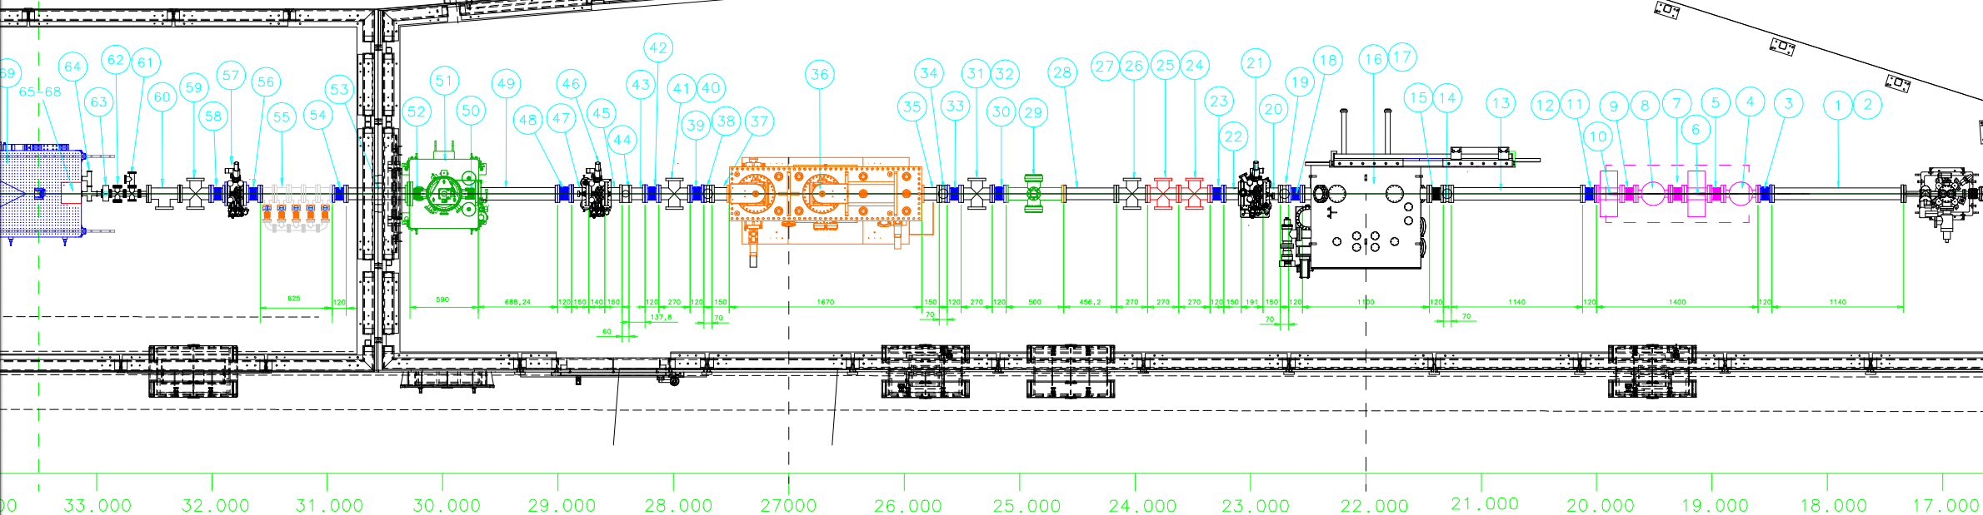
Beam divergence and Slits
JJ X-RAY slit
Closed to 1mm x 1mm ?

Slide 7
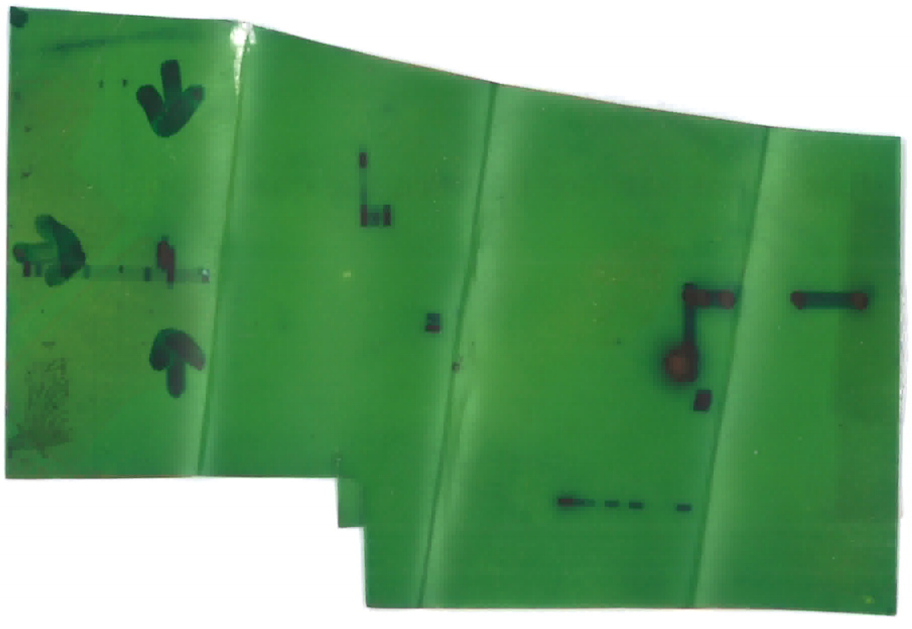
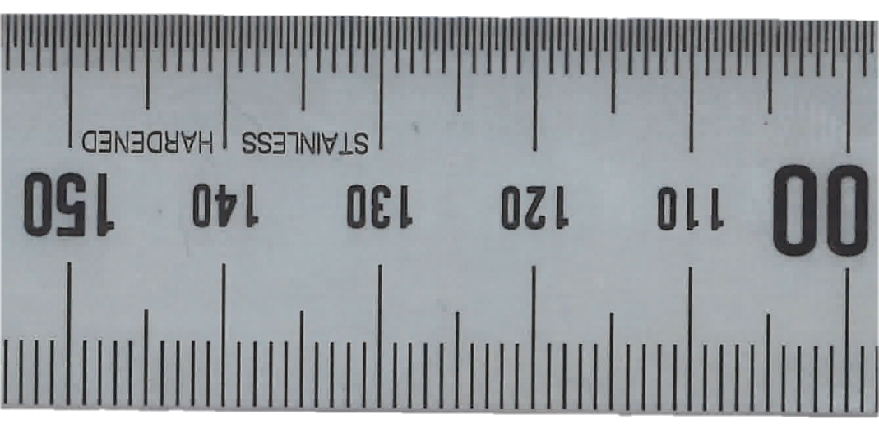
ALBA BEAM (nominal k)
sigX = 130e-6
sigXp = 46e-6
sigY = 5e-6
sigYp = 4e-6
Simulated 800 particles
(estimated output 1 TB)

Slide 8
NCD source characterization
JJ SLIT

Slide 9
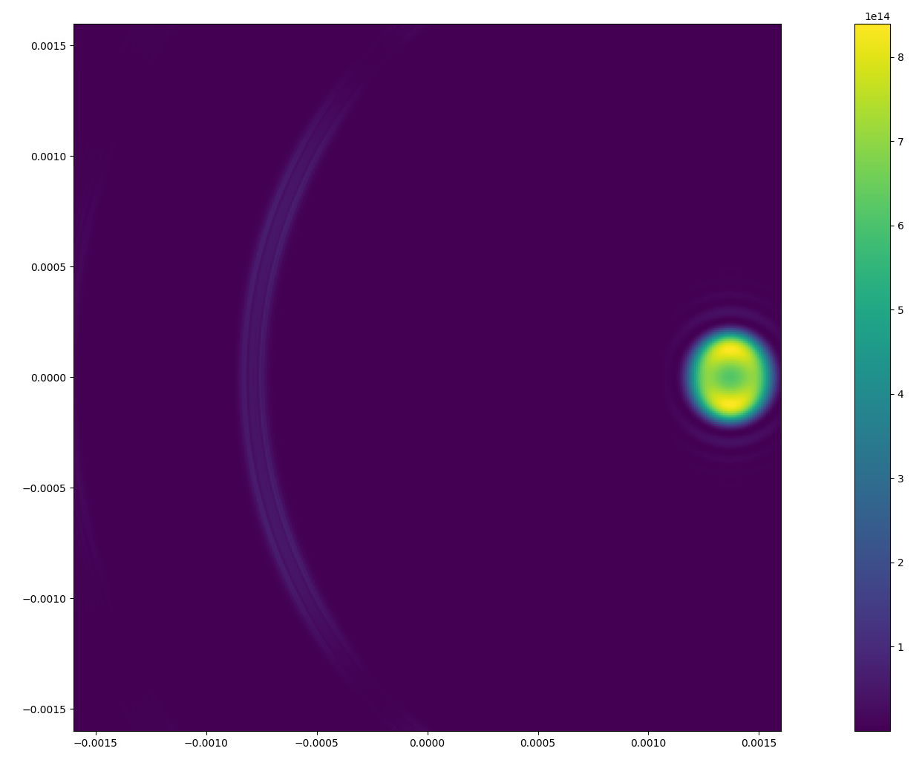
ALBA BEAM (nominal k)
sigX = 130e-6
sigXp = 46e-6
sigY = 5e-6
sigYp = 4e-6
JJ SLIT
Simulated 800 particles
(estimated output 1 TB)
Particle at 1sigma in H divergence!

Slide 10
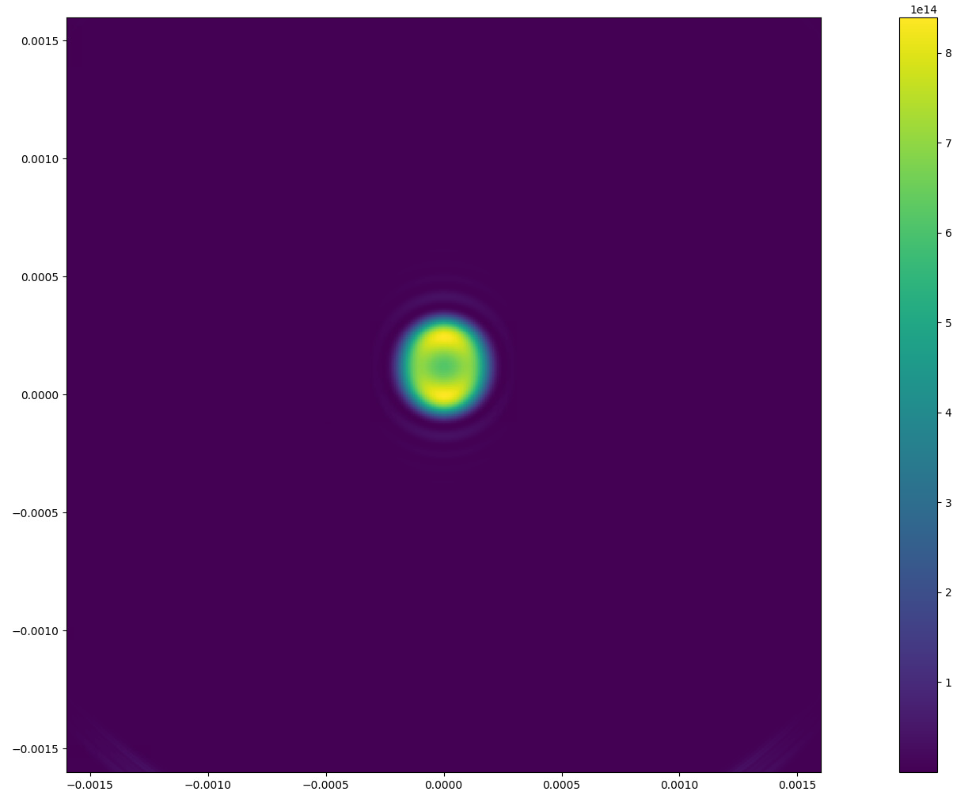
ALBA BEAM (nominal k)
sigX = 130e-6
sigXp = 46e-6
sigY = 5e-6
sigYp = 4e-6
JJ SLIT
Simulated 800 particles
(estimated output 1 TB)
Particle at 1sigma in V divergence!

Slide 11
Simulation
JJ SLIT
UND
Particle
Sampled from
(x,x’,y,y’)
@ Colloids Plane
Propagate without colloids
Propagate with colloids

Slide 12
Colloids
COLLOID
Modifies E field
sensorSize=4e-3 #m
MAG=23
holder_thickness=1e-3 #m
Rcoll=250e-9 #m
Concentration=0.15 #W/W
ro_coll=2650 #kg/m3
ro_water=1000 #kg/m3
E_{in}
E_{out}
E_{out}=k.E_{in}e^{jphi}
N_coll = 25e6
If we slice it longitudinally in slices
Each slice: Ncoll=1e4-1e5 (in 170 um²⁾
Filling ratio of ~2-10%
Amplitude reduction
Phase delay
Both dependent on n @ 20 keV
Could be estimated from the experimental ratio between water and colloids samples.
For the rest of this simulation k=0 (for simplicity)
Both k=0.999 and phi=1º with 1e5 colloids were simulated and speckles were observed

Slide 13
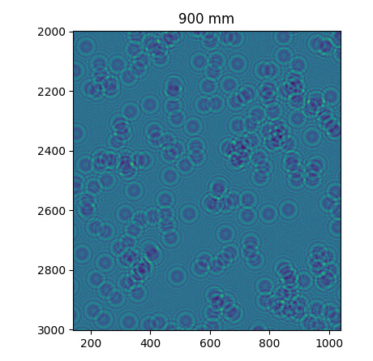
Colloids
Achievement:
Speckles observed
Talbot in FFT observed
S(q) quantified
C(q)=1 by definition
(Single particle)
pixels
pixels

Slide 14
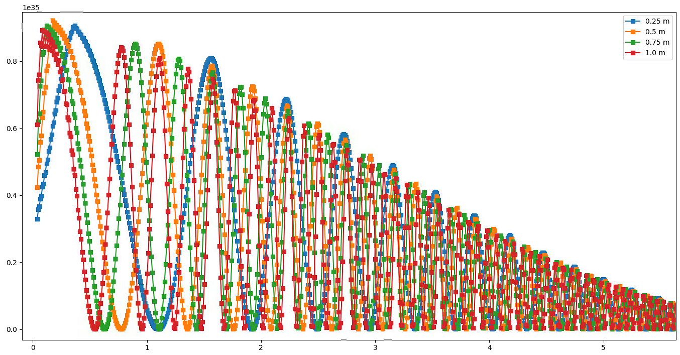
Colloids
Achievement:
Speckles observed
Talbot in FFT observed
S(q) quantified
C(q)=1 by definition
(Single particle)
T(q)*S(q)
q[um]
Simulated T(q)*S(q) at different distances for 20 KeV SR and 1 um colloid diameter

Slide 15
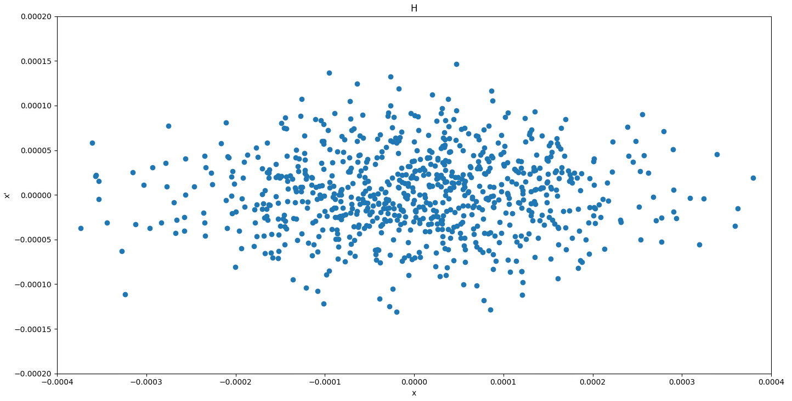
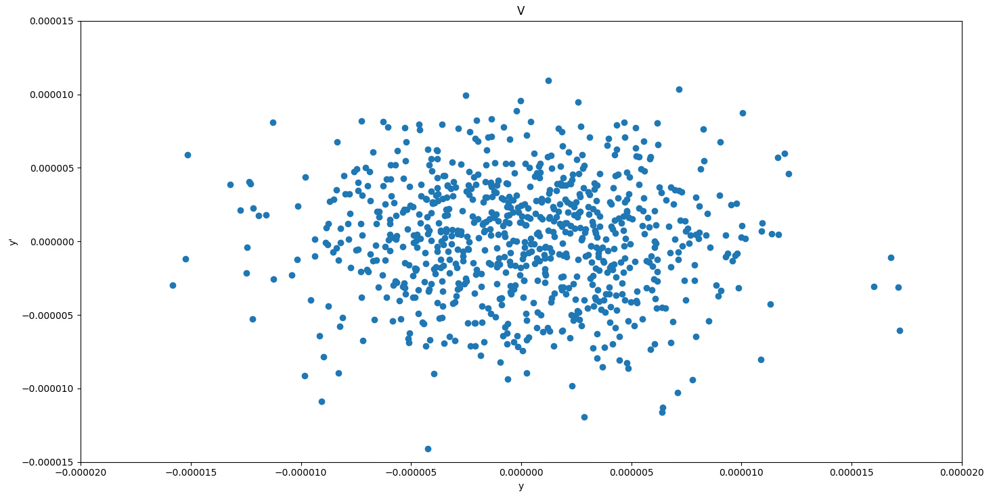
What is ALBA ‘beam size’?
4 D Phase space

Slide 16
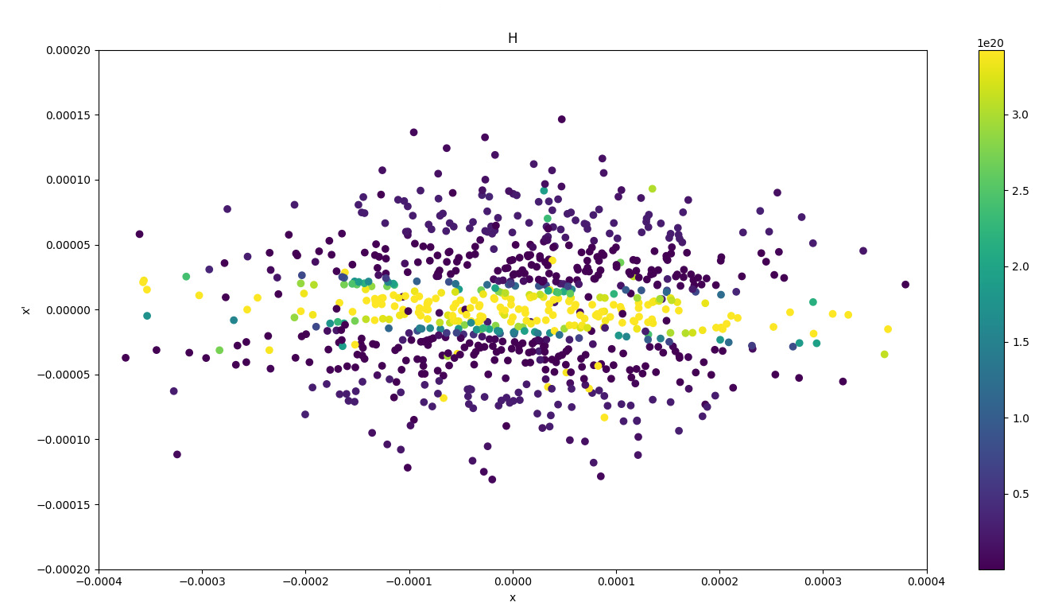
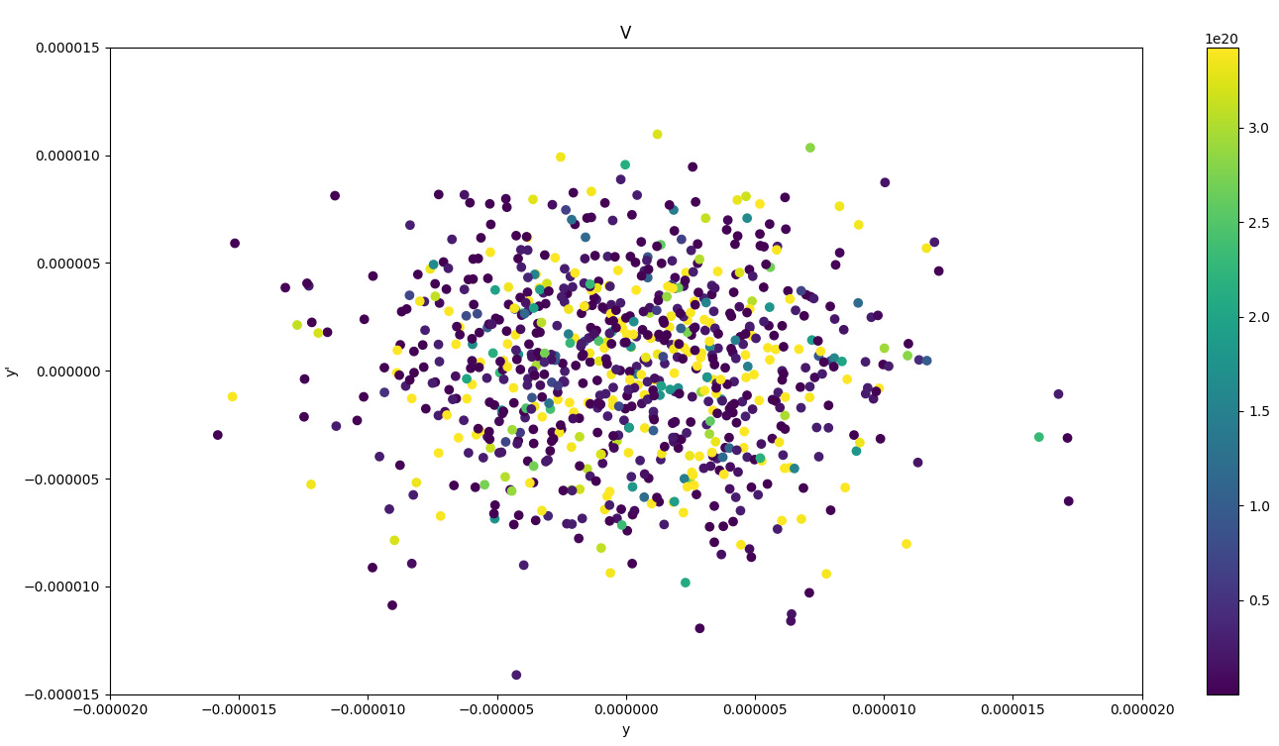
What is ALBA ‘beam size’?
4 D Phase space
Color coded:
SR on the colloids plane after crossing the slit

Slide 17
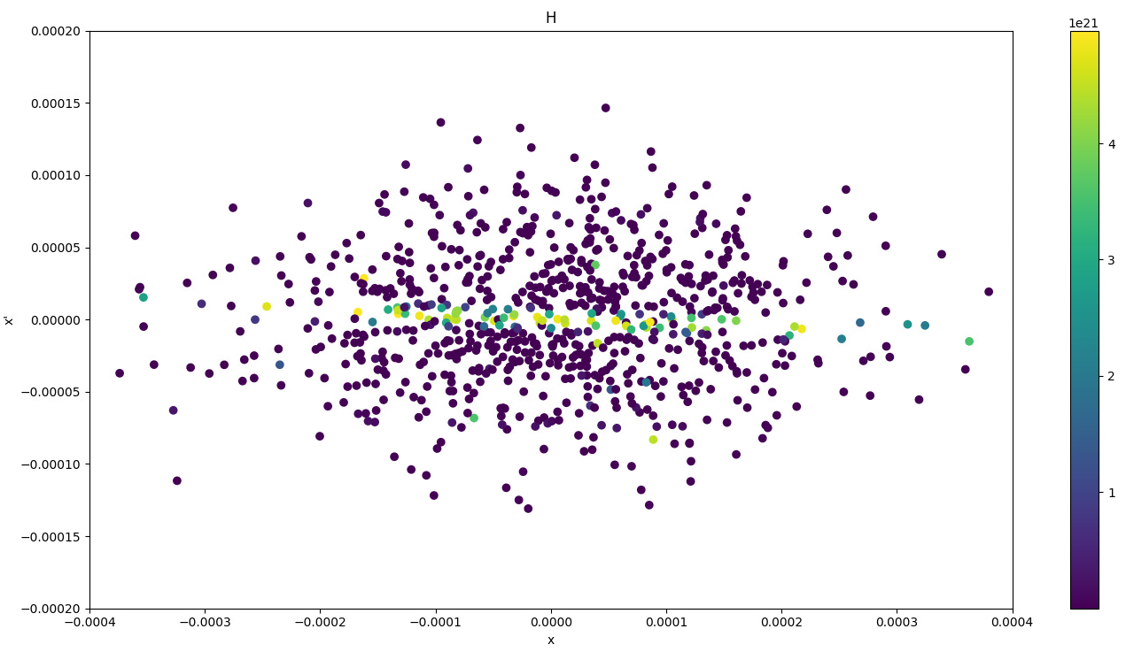
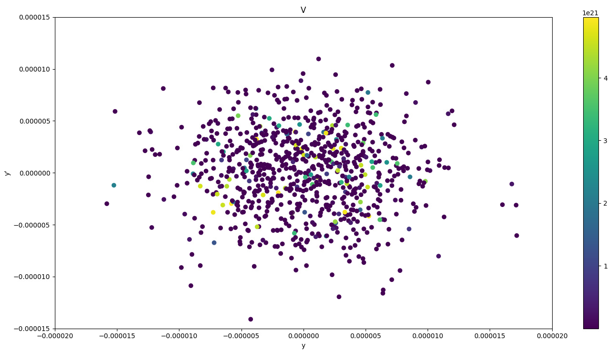
What is ALBA ‘beam size’?
4 D Phase space
Color coded:
SR on the detector plane only inside the FOV

Slide 18
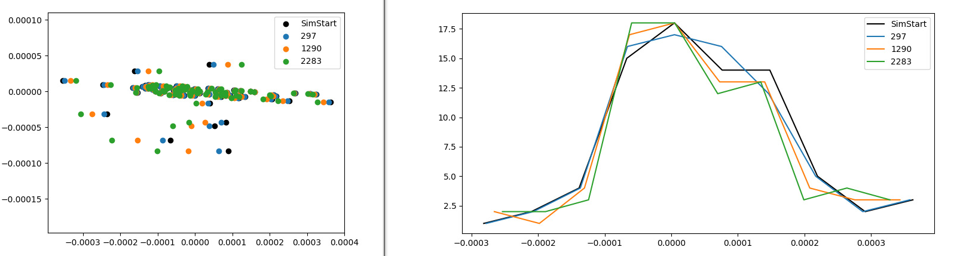
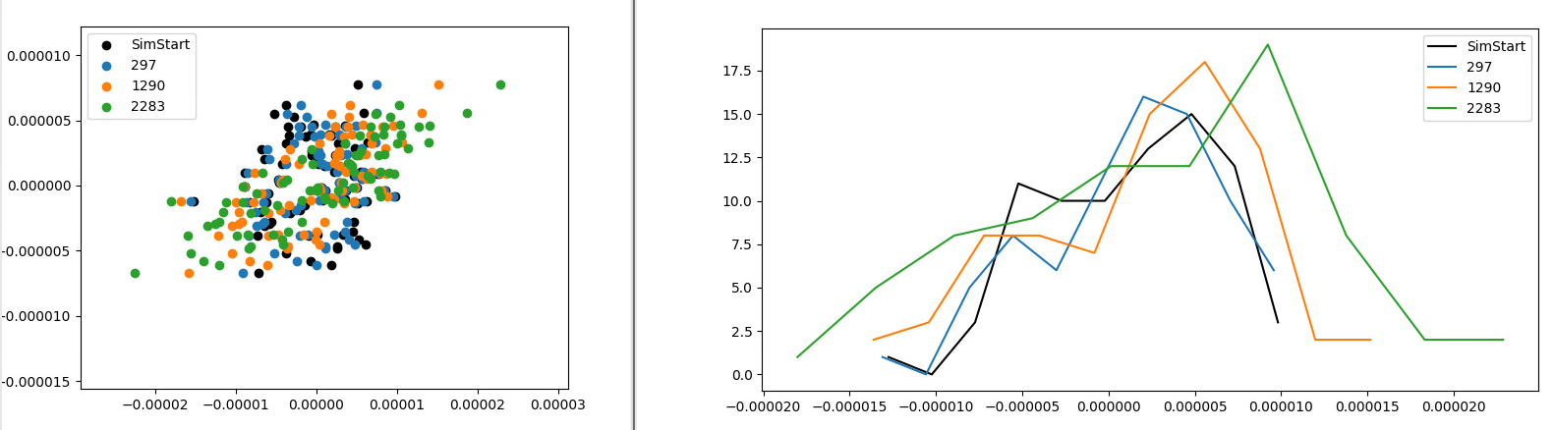
What is ALBA ‘beam size’?

Slide 19
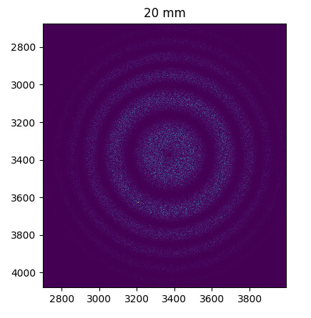
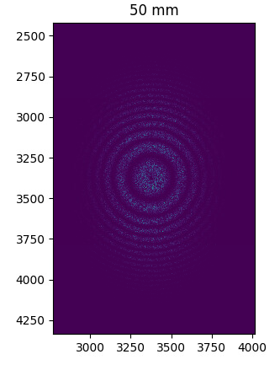
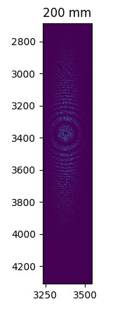
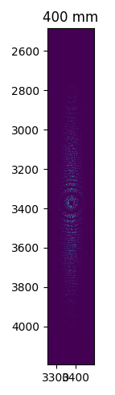
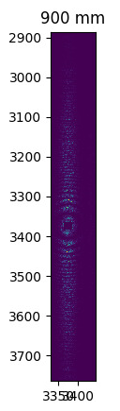
Distance scan
C(q) effect is more appreciated

Slide 20
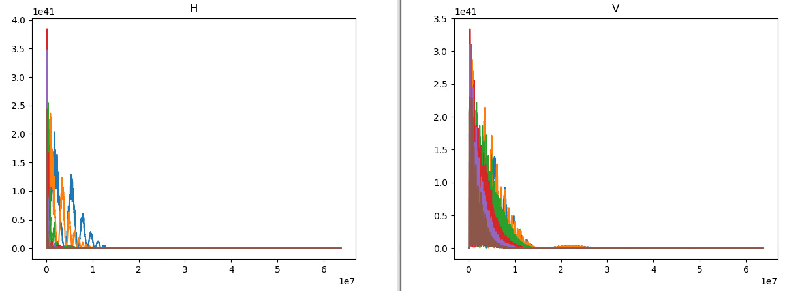
Distance scan
T(q)S(q)C(q)
T(q)S(q)C(q)

Slide 21
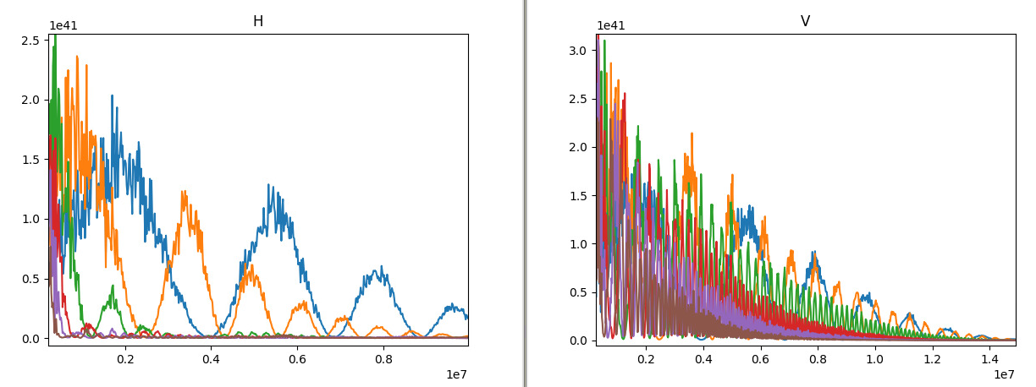
Distance scan
T(q)S(q)C(q)
T(q)S(q)C(q)

Slide 22
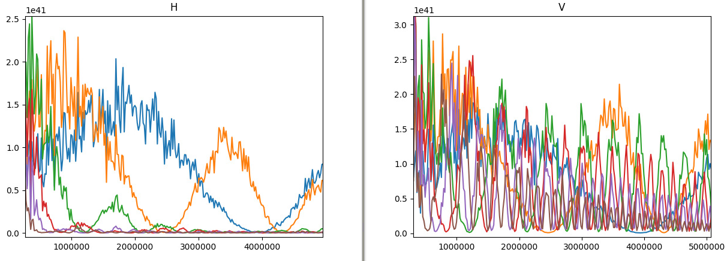
Distance scan
T(q)S(q)C(q)
T(q)S(q)C(q)

Slide 23
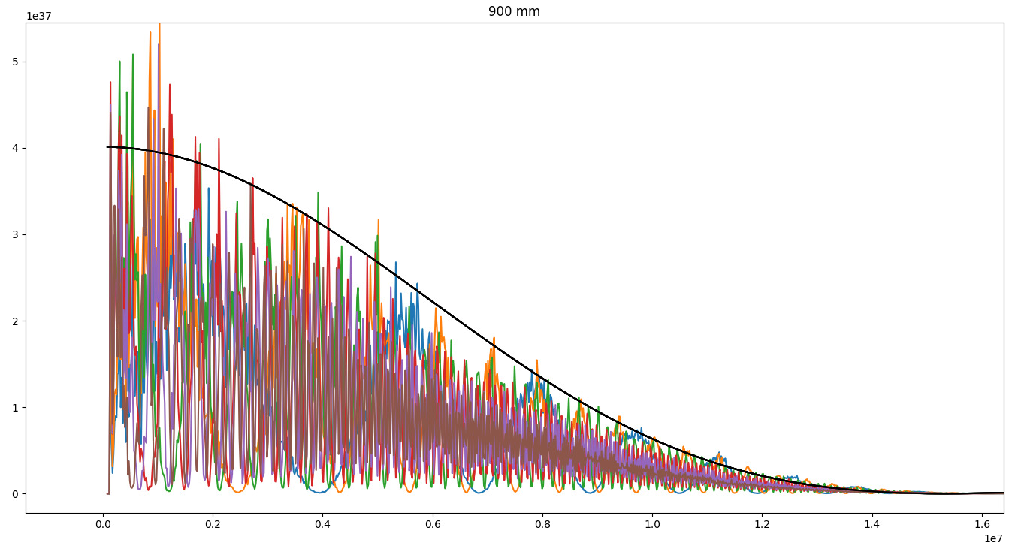
Decay for single particle taken as a reference
Airy disk fairly good in approximating S(q)
To be checked with higher statistics if it is constant (in terms of q) at all distances.
T(q) S(q)
q

Slide 24
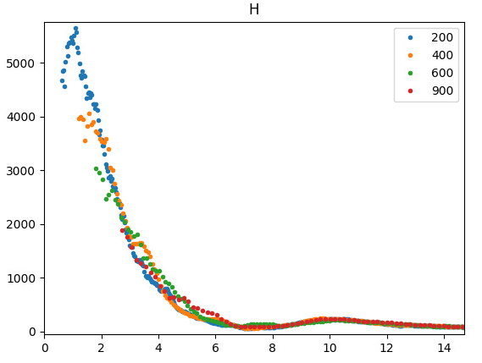
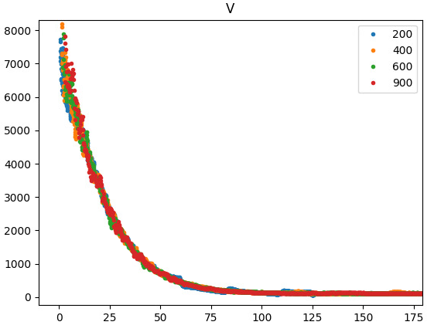
Closing the loop
C(q) = [T(q)*S(q)*c(q)]_{BEAM} / [T(q)*S(q)]_{refParticle}
Δr
Δr
Curves from all distances collapse!

Slide 25
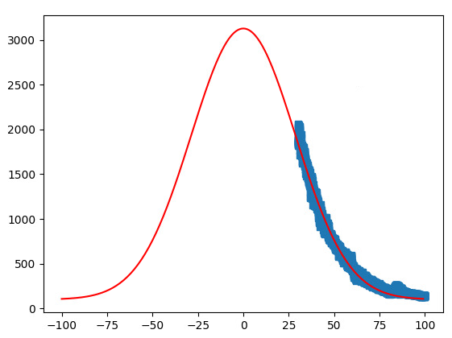
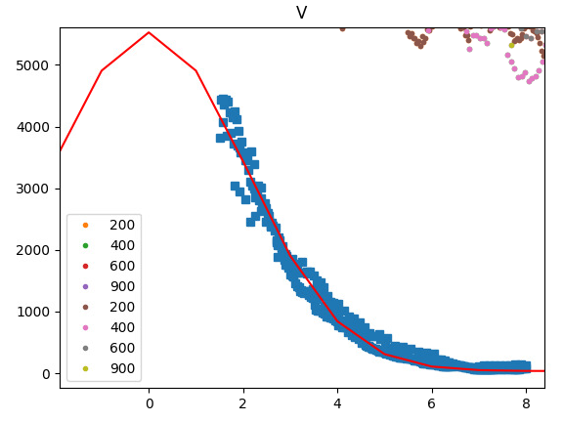
Closing the loop
C(q) = [T(q)*S(q)*c(q)]_{BEAM} / [T(q)*S(q)]_{refParticle}
Δr
Δr
Curves from all distances collapse!

Slide 26
Closing the loop
C(q) = [T(q)*S(q)*c(q)]_{BEAM} / [T(q)*S(q)]_{refParticle}
Δr
Will not enter in beam size reconstruction
(depends on lower cut in q), however:
H: 157 um if q_{min} 2
V: 9.4 um if q_{min} 25
Δr

Slide 27
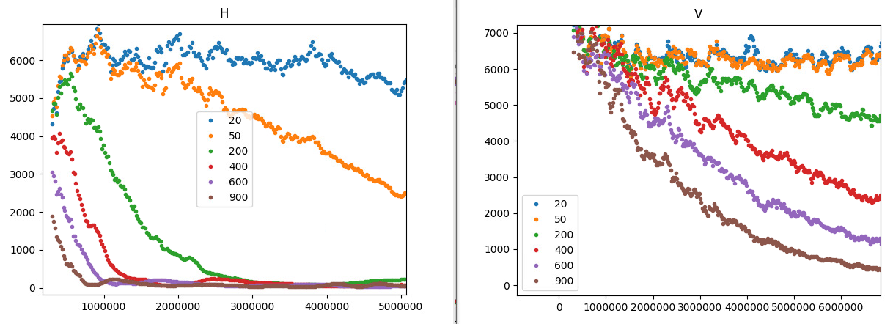
Calibration
C(q) = [T(q)*S(q)*c(q)]_{BEAM} / [T(q)*S(q)]_{refParticle}
Is it really 1, at which distance?

