Slide 1
Geant4 Profiling using CMS Simulation Application
Krzysztof Genser/Fermilab
For the Fermilab Geant4 Performance Team

Slide 2
Fermilab Geant4 Performance Team
Walter Brown, Mark Fischler, Krzysztof Genser, Jim Kowalkowski, Marc Paterno, Ron Rechenmacher, Jason Torola
  a part time involvement for all the members
With thanks to Sunanda Banerjee, Julia Yarba, Liz Sexton-Kennedy for their assistance.

Slide 3
Project Goals/Description
The goal is to routinely profile Geant4 using a realistic application.
  Given Fermilab involvement in CMS using CMS software application was a natural choice.
Over last few months we have undertaken an effort to upgrade and to automate as much as possible the infrastructure/process we used for profiling of Geant4 in the past (e.g. when doing code reviews or optimizing the code).
The application is built/run on set of Fermilab US CMS nodes with CMSSW software installed.

Slide 4
Profiling Infrastructure
The full infrastructure is a set of scripts which take as an input a Geant4 tarball, a version of the CMSSW release, a configuration file specifying simulation parameters and an event generator input file. The Geant4 tarball replaces the Geant4 version used by CMS for a given CMSSW release.
The output is a set of performance related numbers/plots.
The simulation package is build on an interactive US CMS build node and run on a Condor farm. The build and run parameters are recorded in a database for each run.
As of now QGSP_BERT physics list & Z'->dijets Pythia event input file are used.

Slide 5
Profiling Infrastructure, cont'd
The profiling itself is done using SimpleProfiler
  C++ dynamic library collecting detailed call stack
  samples, using "libunwind" plus a set of auxiliary tools
    SimpleProfiler is a part of the FAST package, a collection of tools
    for gathering, managing, and analyzing data about code performance.
    See: https://cdcvs.fnal.gov/redmine/projects/show/fast
The data is uploaded into PerformanceDataBase
  system (written using Ruby on Rails and MySQL) for recording performance run data and handling the assessment of the
  statistical significance of the timing differences.
Timing and function call measurements are a result of a number of
runs on the previously mentioned Condor farm and uploading the information into the database.

Slide 6
Work In Progress
Migrating the system from the old to the new version of the SimpleProfiler
Debugging situations where SimpleProfiler does not
recognize call stack functions or when libunwind incorrectly
processes call stack or crashes.
Modifying the Performance Data Base to make classification of run and build configurations more convenient.
Adding scripts for automatic performance data analysis and
presentation including plots pertaining to comparisons between
different collections of test runs.

Slide 7
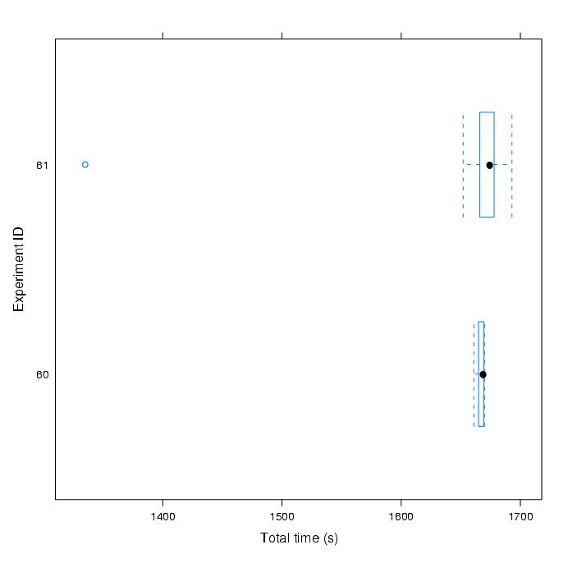
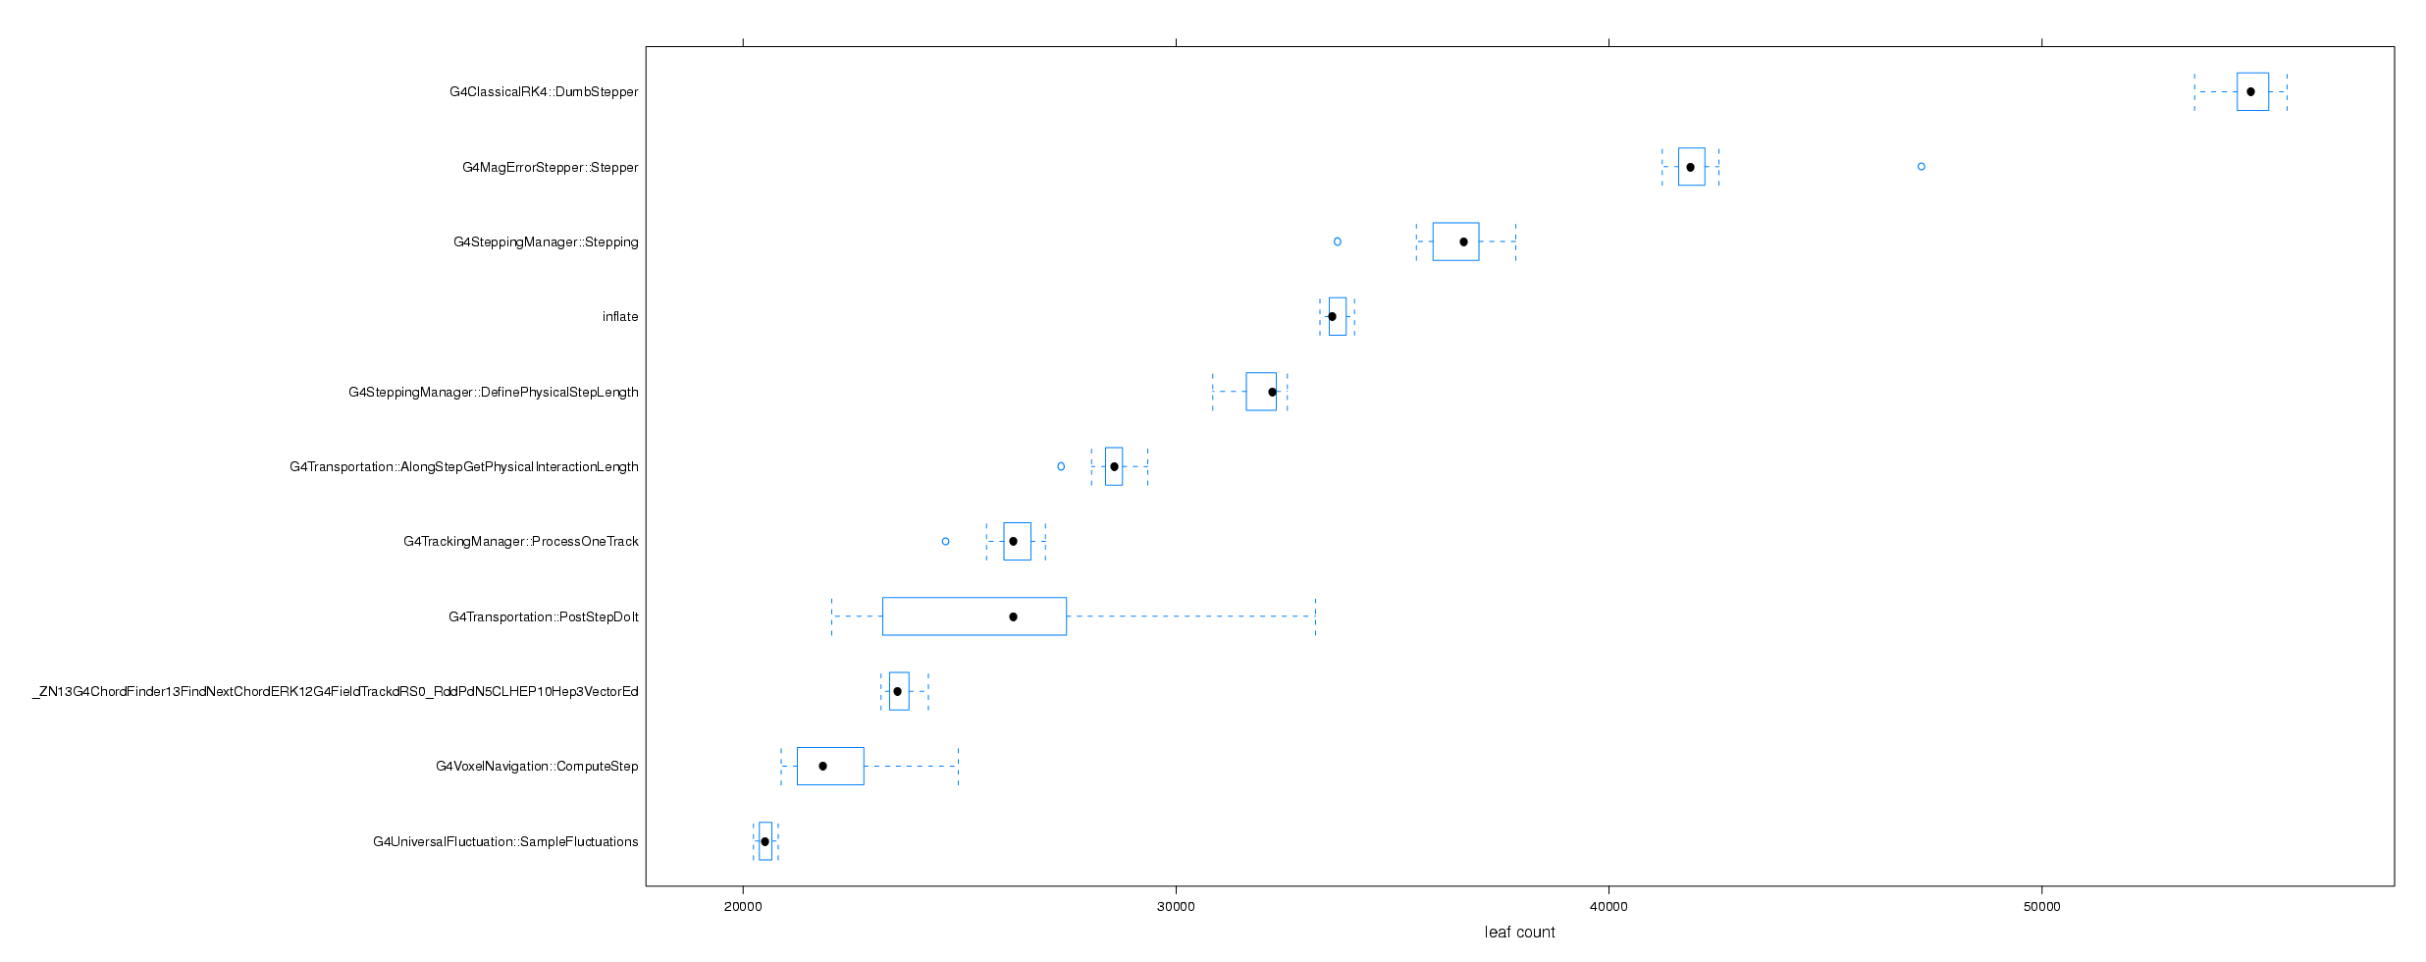
Sample Plots

