Slide 2
HL-LHC instrumentation meeting
CERN TE-CRG-CI

Slide 3
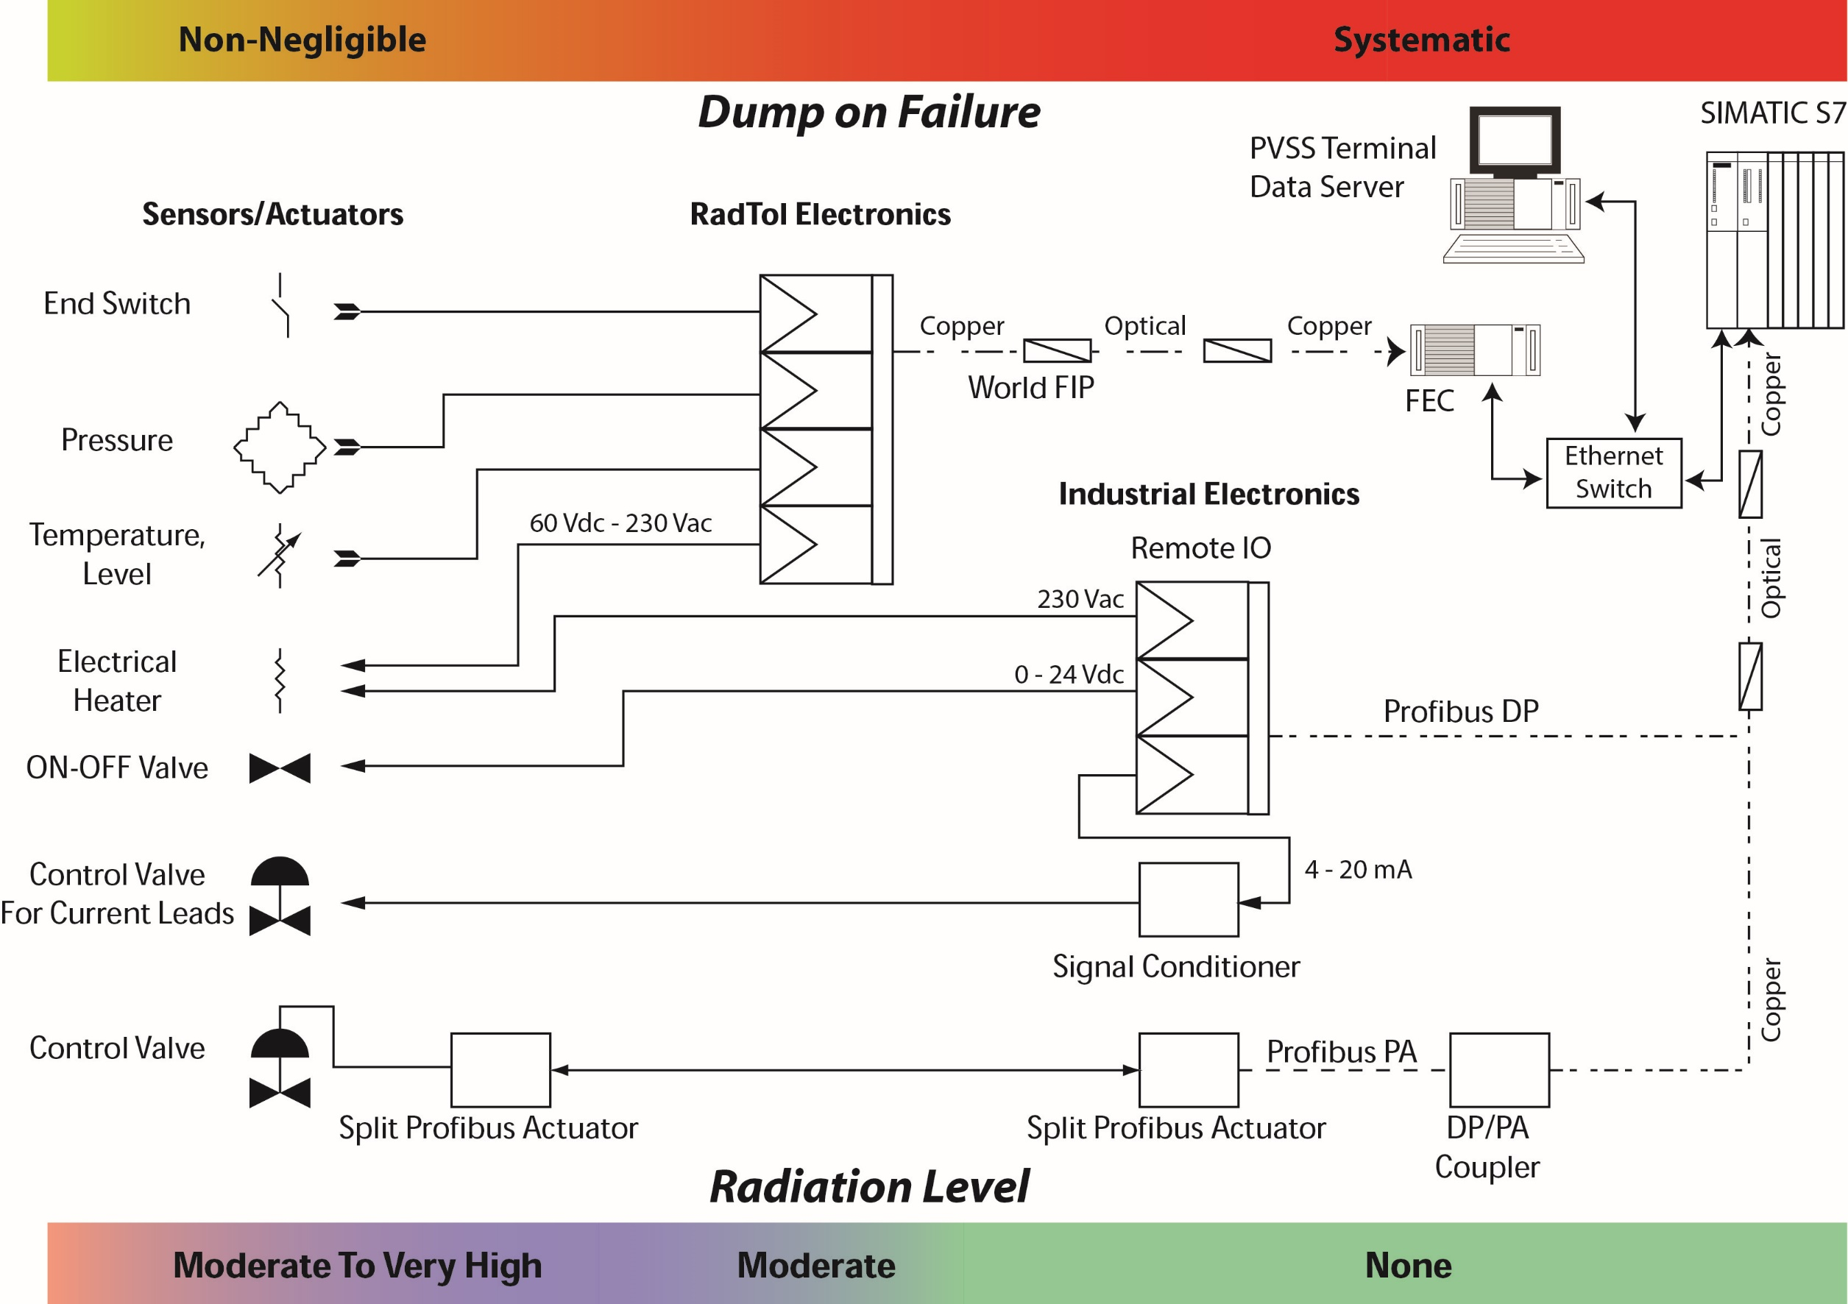
Typical accelerator instrumentation measurement chain
Topic: equipment exposed to non-negligible radiation levels (moderate and above)

Slide 4
LHC case: instrumentation exposed to radiation
Equipment deemed to be critical & non exchangeable was (fully ?) tested for radiation:
Temperature sensors tested in cold conditions to the highest possible reasonable TID
Equipment tested although exchangeable:
Electronic equipment installed in the tunnel
Pressure sensors (absolute > 1bar range, differential & new ABB passive sensors)
Actuating part of the SIPART intelligent valve positioner
Equipment considered rad-hard by design
LHe superconducting gauges (same material as magnets)
Electrical heaters (wire-wound type used, no single failure reported or known yet)
End-switches (only mechanical type)
Coriolis flowmeters (purely mechanical device)
LHC current lead valves (magnetic field provided by coil, purely geometrical)
Air actuated valves (purely mechanical device)

Slide 5
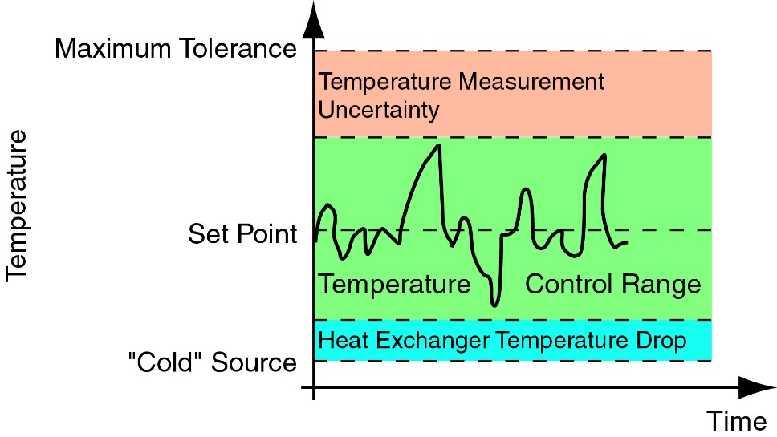
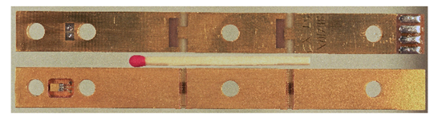
Measurement of temperature
Magnets temperature measurement is critical:
directly linked with the operational margin
reduced with increased error on the measurement
LHC target on uncertainty 0.01 K
Such a target was usual at the lab but never in large scale facilities.
Development required:
Improvement of sensor anchoring: thermometer block with thermal anchoring
Understanding the sources of drift/noise on the sensing element
  Long term drift simulated with thermal cycles => cernox selected
  Radiation effects in cold conditions
    5 x 10¹⁴ n/cm² (10 kGy); 1’000 hour of irradiation below 2.0 K
    Cernox, TVO and allen-bradleys + platinum selected
Potential electromagnetic noise & cost reduction => keep signal cables as short as reasonable
  RadTol electronics required (dealt later)

Slide 6
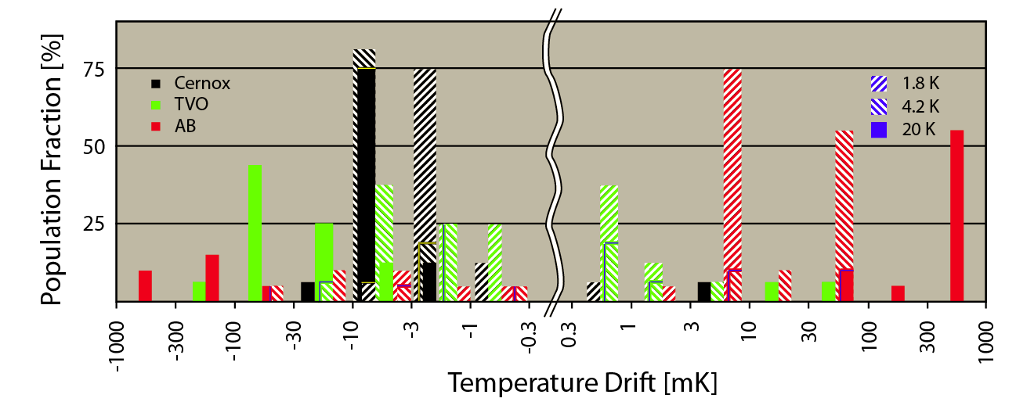
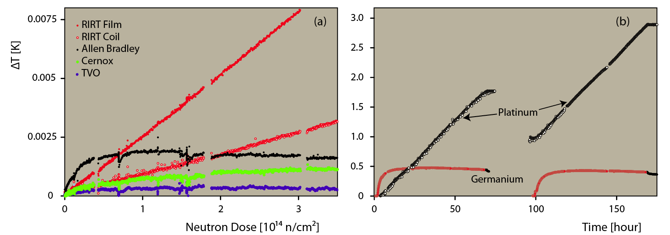
Measurement of temperature: detail on tests
100 thermal cycles
- Cernox excels in particular with increasing temperature
All sensors with increasing resistance when lowering the temperature show similar behavior
Note complete thermal annealing for germanium sensor
  Room temperature irradiation is meaningless for this tek.

Slide 7
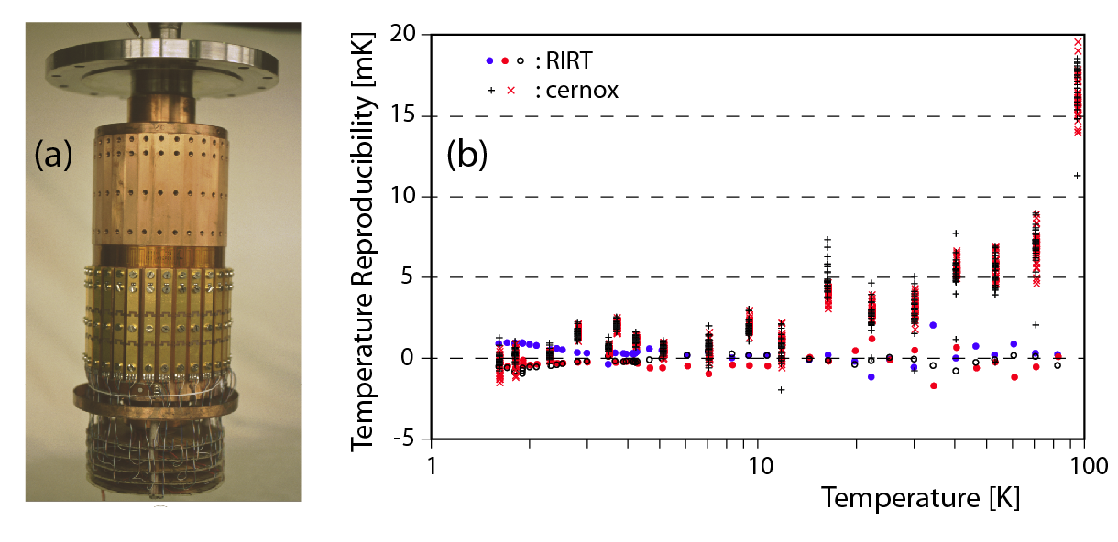
Measurement of temperature: Intrinsic accuracy for cernox
The calibration station uses 1995 state of the art apparatus, anyway the accuracy is still excellent as for today.
The reference temperature is provided by RIRT sensors, reproducibility ± 0.005 K between 1.5 & 300 K
The reproducibility between two runs for the SAME cernox sensors exchanged in position is shown
  The temperature spread increases with increasing temperature
  The WFIP LHC electronics is less accurate than lab type source & volt meters

Slide 8
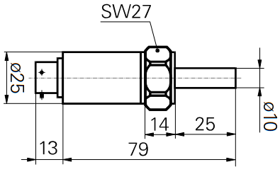
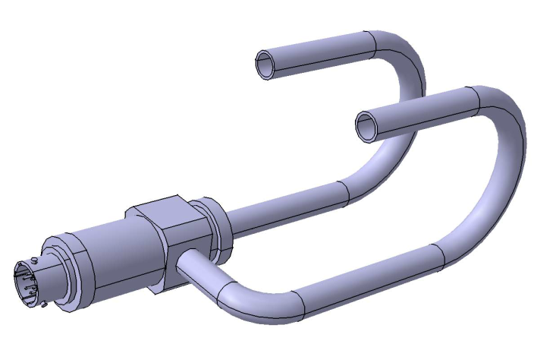

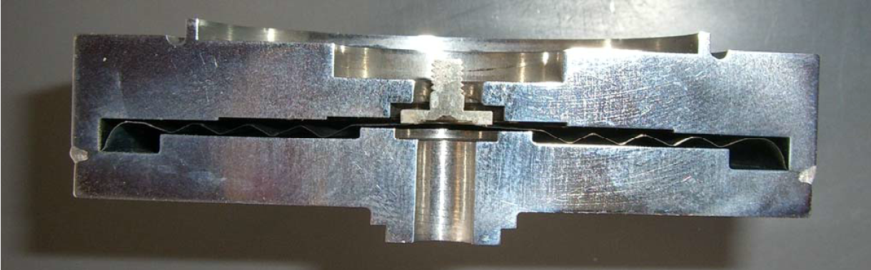
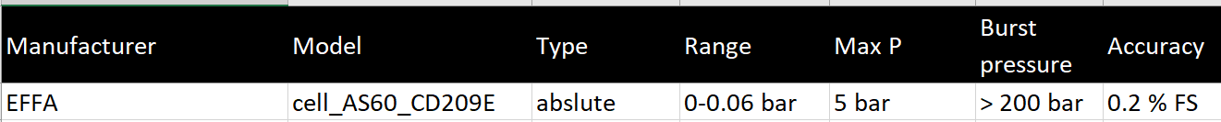
Measurement of pressure
All pressure sensors are accessible and therefore exchangeable.
Absolute LHC pressure sensors provided by Baumer (CH), resistive bridge
Procurement OK but minimum order qty about 50 units
Differential LHC pressure sensors provided by Polaron Schaewiz (?), resistive bridge
Not available for purchase
Absolute LHC low pressure sensors provided by NICHE (FR), inductive bridge
Unfortunately not available for purchase
Mechanical/geometrical device: not qualified for radiation
ABB has delivered passive pressure cells for absolute & differential applications
Radiation tests show some drift
Still looking for other suppliers, in particular for differential & low pressure application

Slide 9
Measurement: level, cold flow, valve actuators
Liquid He level measurement is a mature technology, however:
Accuracy is hardly better than 10 mm
European suppliers (i.e. Cryogenics Ltd – UK) provide relatively wide changes in specs
  Present part uses a steel tube and shorts to case (GND) are observed in our samples
It can be capricious due to changes in pressure, lambda point, etc.
Cold flow will be measured by commercial Coriolis devices made by Micro Motion
Requires very long connecting signals cable because electronics is not qualified for radiation
Valve actuators have been qualified for radiation use up to about 100 kGy
Most sensitive part are the micro valve piezo-actuators
If radiation is too high the piezo actuators can be moved away from valve stem
LHC failures due to potentiometer noise (wear?, corrosion?) or leaks
Electrical heaters
For cryogenic use all the electrical resistances are wire-wound type or PCB type (FR-4 or polyimide)
Beware of film deposited teks as they have already cracked when cooled to 4.2 K
Valves
DFB current leads never qualified for radiation, rad hard by design (mechanical + magnetic)
Pressure actuated valves: diaphragm may be degraded by radiation?

Slide 10
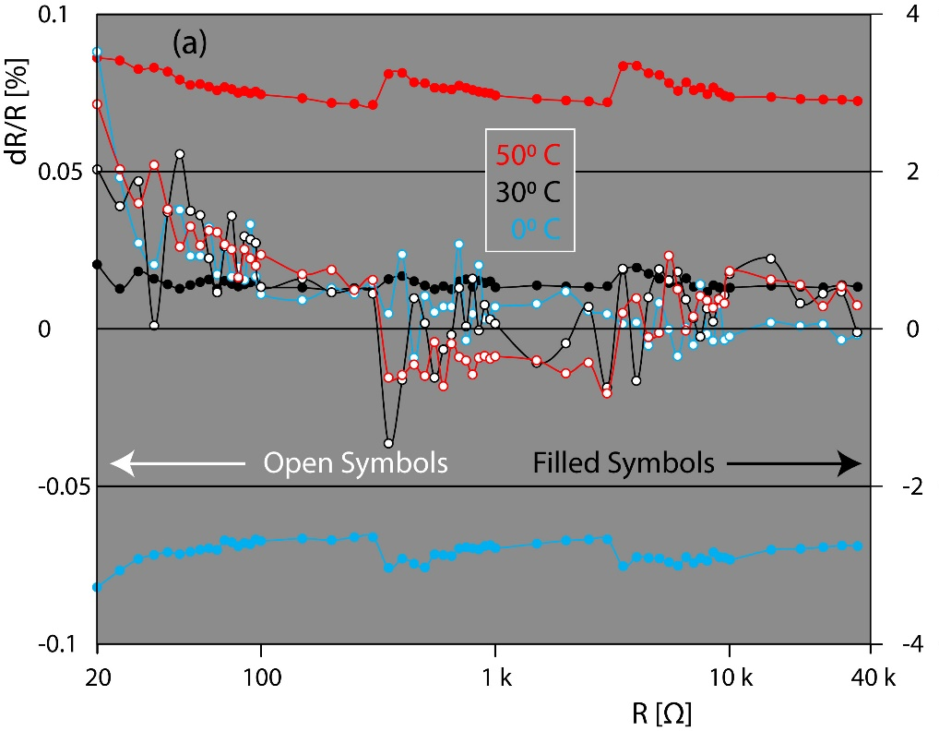
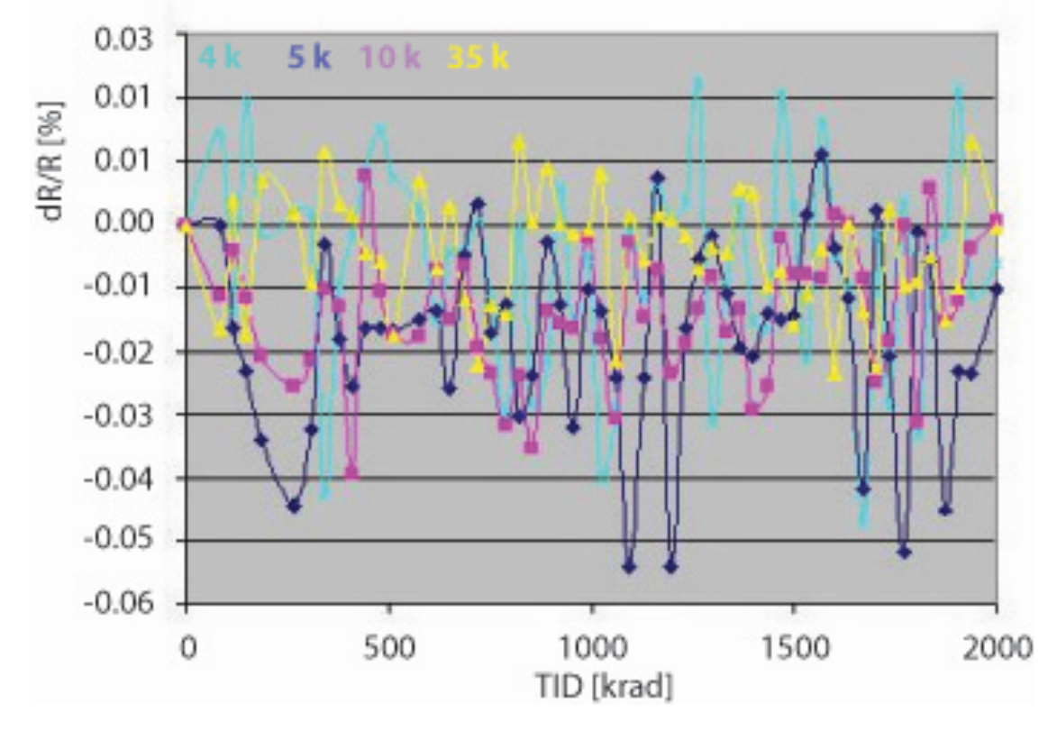
Radiation Tolerant Electronics
The LHC radiation tolerant electronics is compatible with most of the types of channels present in the LHC machine.
Radiation accumulative effects are similar to thermal effects that cause drift in analog values
Most of the measurements rely on comparison bridges to compensate for drift
The reference element (resistor for example) shall be insensitive to radiation
The electronic cards installed in the LHC are not showing signs for end of life.
Most difficult task is dealing with obsolescence
Anti-fuse FPGAs price increased significantly, it may indicate will to end production
WFIP CC-131 present card version is very sensitive to radiation due to change of ICs

Slide 11
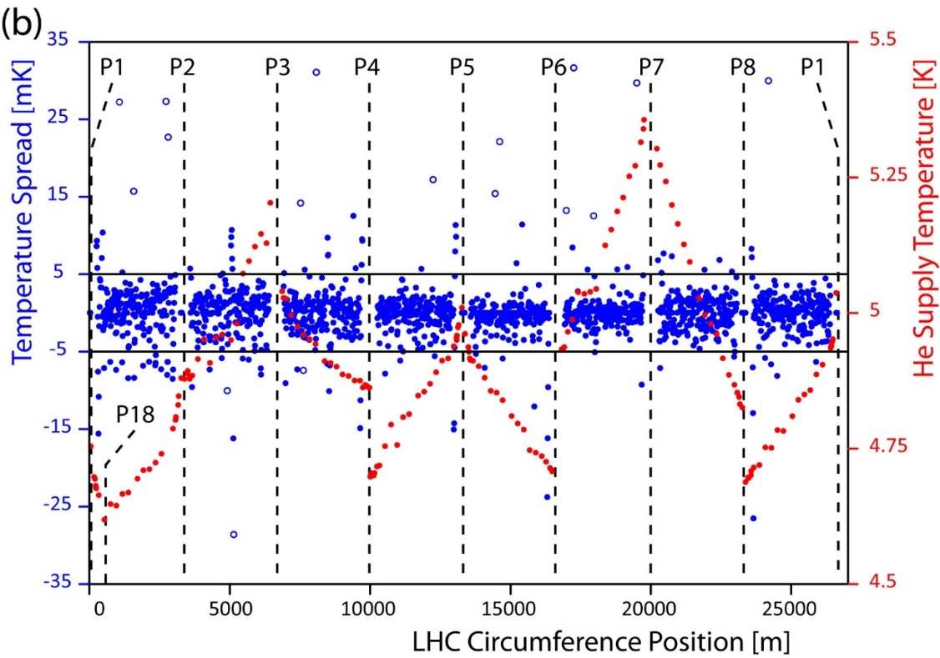
Radiation Tolerant Electronics: Sensor measurement
The WFIP provides inputs for different types of measuring instruments
Temperature sensors based in variable resistance
  Versions with grounded and 2 kV galvanic insulated signals.
  Accuracy depends on digitization/range/value: Typical values: < 0.25% on resistance.
  New card provided better resolution (x5) than original LHC design and accuracy <0.1%.
Pressure: capable of measuring both resistive and inductive bridges
Superconducting level gauge:
  Measuring conditions that cope with the “known” gauge manufacturers
  New version copes better with common mode voltage. Under production will be deployed during next year.
    Range: Up to 2 kOhm, 40 to 500 mA (Resistance x current < 65V/96V for crate/standalone).
    Standalone version to handle faults to ground.
    Standalone to support modes of operation: E.g. different excitation based on magnetic field.

Slide 12
Radiation Tolerant Electronics: Programmable Supplies
The WFIP provides outputs for different types of electrical loads
DC (non-isolated linear) voltage supply with a 0-60 Vdc & 0-0.5/2 A compliance
  Compliance depends on applied load due to the dissipation of the linear regulator.
  Typical values: Max 25W@100R + 100W@25R without ventilation. 100W+100W @ 25R (or less) with ventilation.
AC (isolated PWM) voltage supply with a 0-230 VAC & 0-4 A compliance.
  Card can operate with up to ~400 VAC / 10+ A with some modifications.
DC (non-isolated PWM). Modifications or a revision of the card could make it capable operating in DC (PWM) mode significantly with compliance similar to the one of the AC mode. Configuration might increase noise, feasibility by design, not tested yet in the lab.
Accuracy:
  Reception tests put limits on power at 2% for DC (linear) and 8% on AC (PWM).

Slide 13
Final Comments
Are there alternatives to LHC selected temperature sensors?
For platinum yes, but probably cost would be higher without any gain in accuracy
For cernox there is no alternative, it is a relatively “young” technology first reported by end 1987 (developed in Japanese labs and commercial part since 1993,
In any case the development of a sensor is difficult and may result in early obsolescence
  Example: HERA (DESY) only user of carbon film temperature sensor
  Never validated by metrologists (only cryo engineers) => not produced anymore

