Slide 1
HL-LHC cryo-instrumentation
Status
M. Sisti (TE-CRG)
HL-LHC WP9 Cryogenics
CERN, 17 Dec 2019

Slide 2
Outline
PFD “instrumented”
IT & D2 instrumentation
Thermometer preliminary estimation

Slide 3
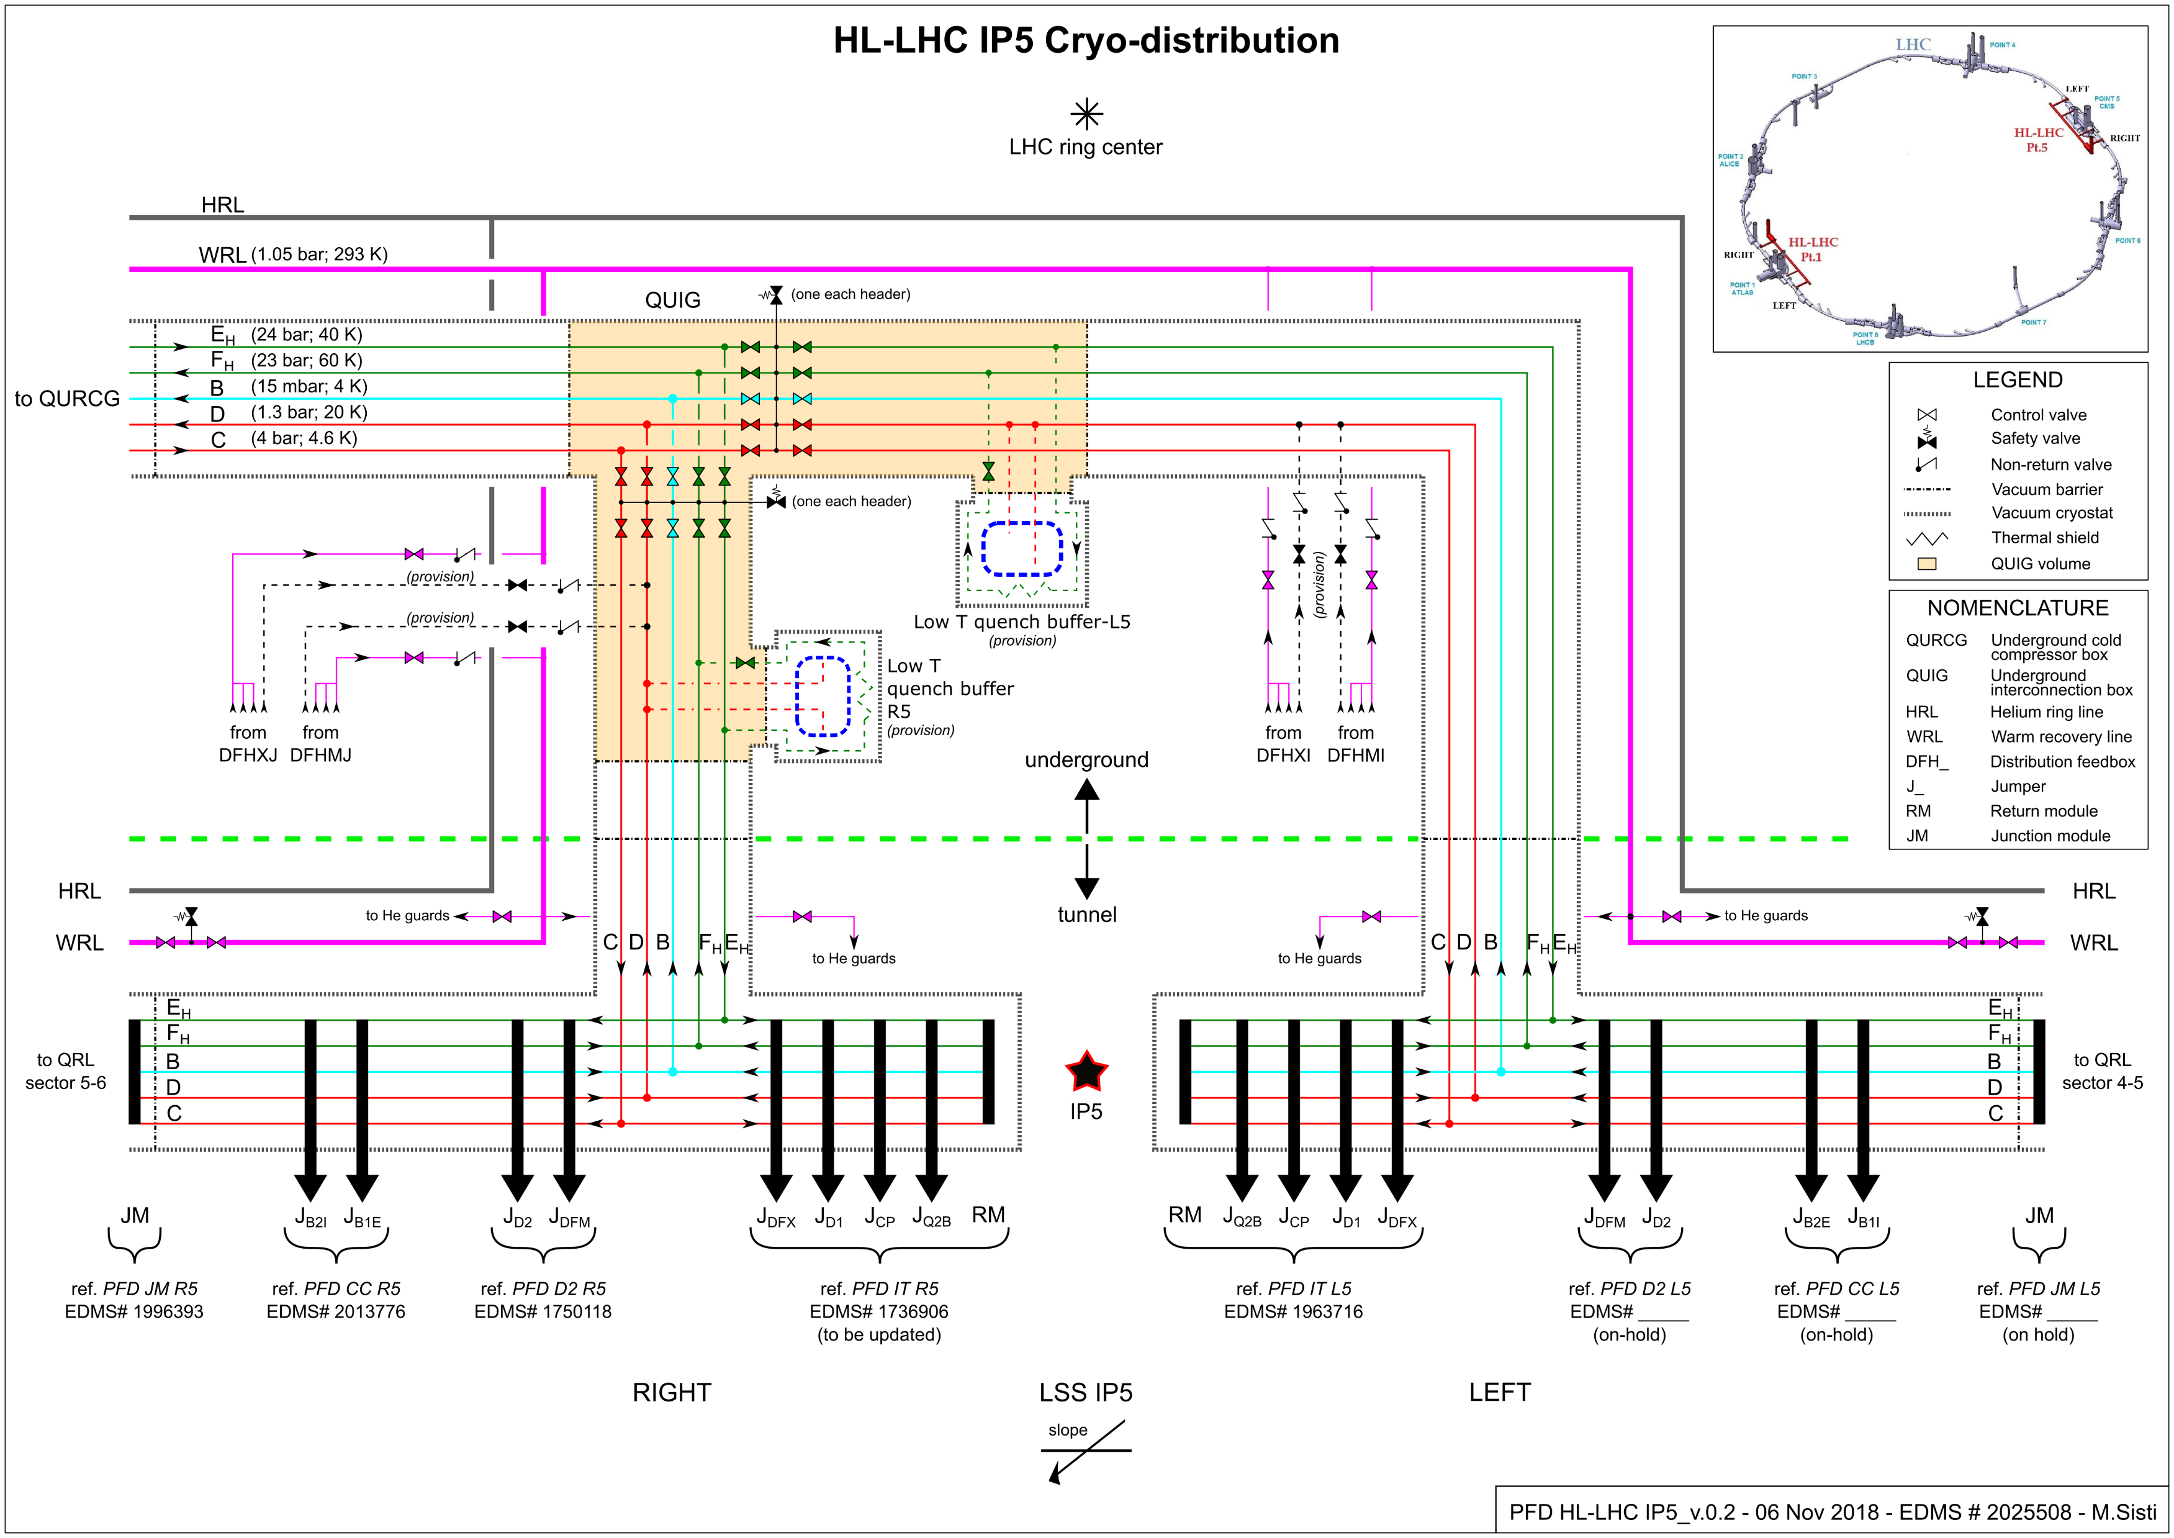
PFD IP5

Slide 4
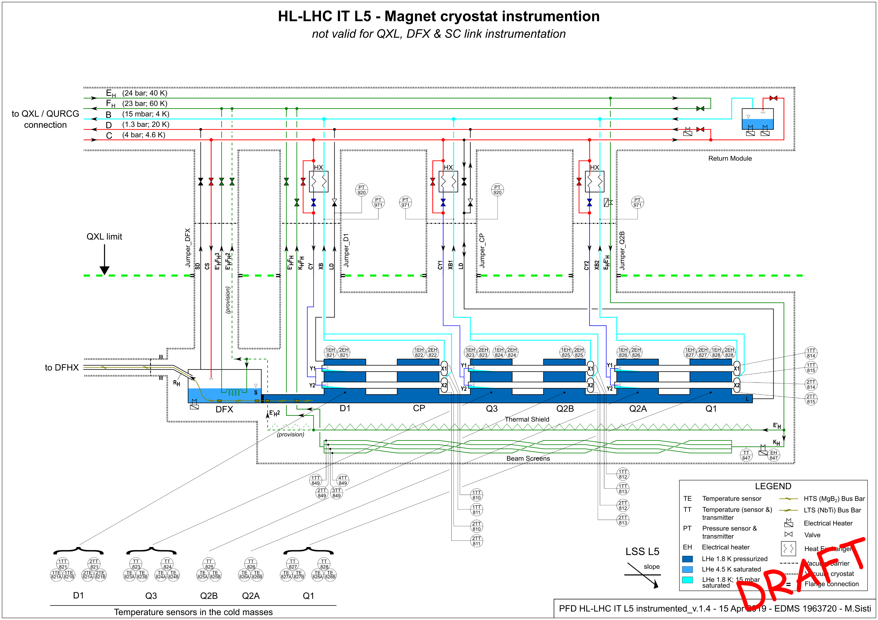
IT reference PFD (left IP5) (EDMS 1963720)

Slide 5
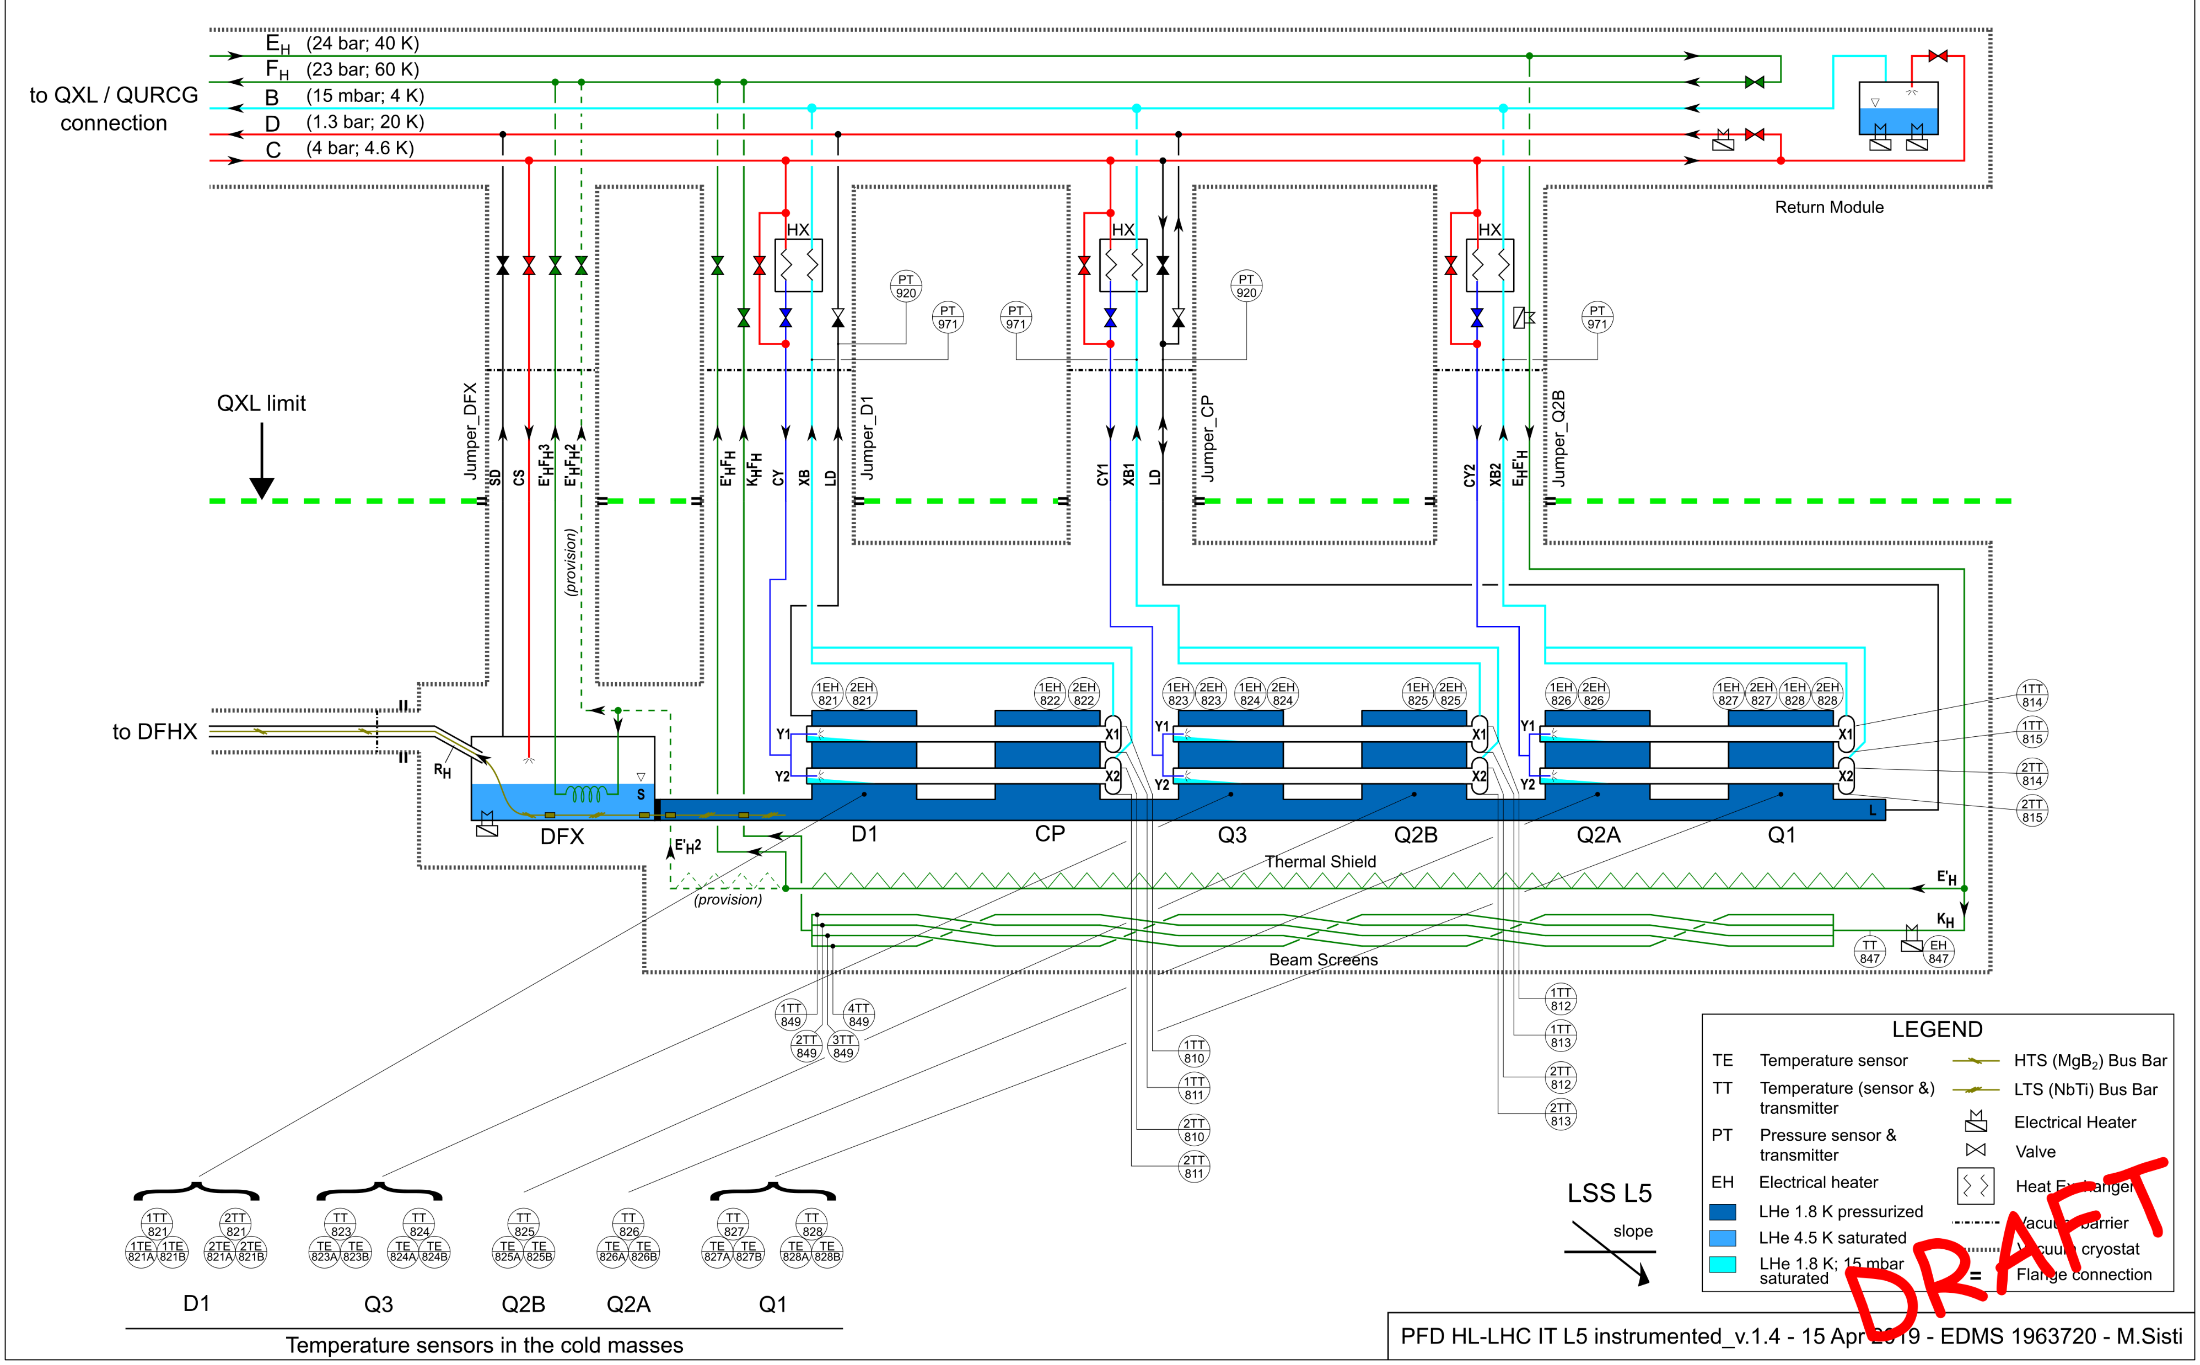
PFD Inner triplet + DFX instrumented L5
Sub-atmospheric circuit:
PT on pumping lines (QXL side)
TT on phase separators
Pressurized LHe bath:
PT on the IFSs
TT into cold masses
Warm-up heaters into cold masses
IFS
IFS
IP5
Beam screen circuit:
TT and heater at the inlet on Q2B Service Module
4 x TT at the outlet

Slide 6
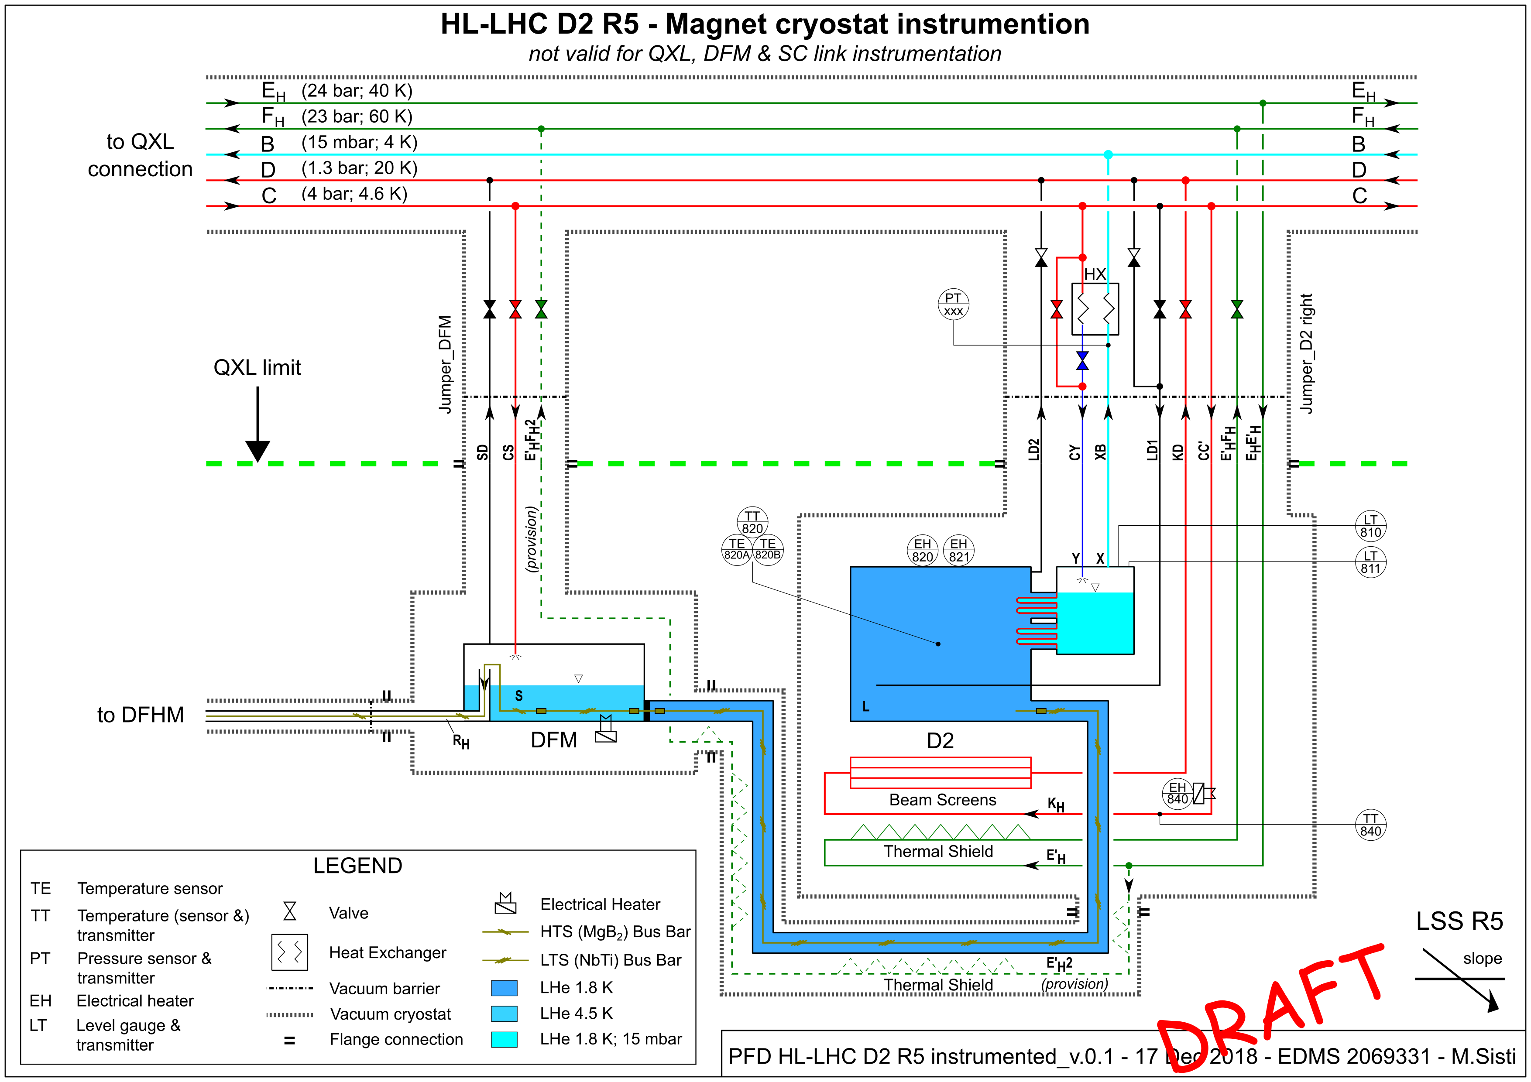
D2 reference PFD (right IP5) (EDMS 2069331)

Slide 7
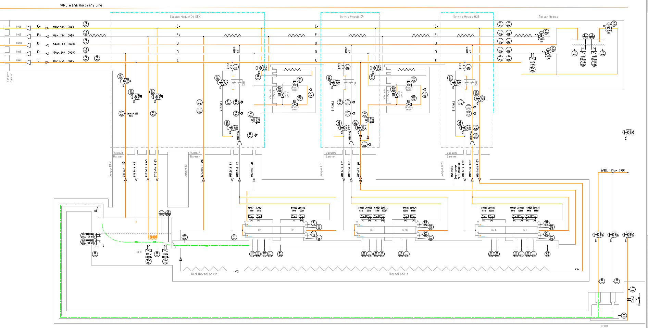
IT String P&ID (CRNLSQLJ0068)

Slide 8






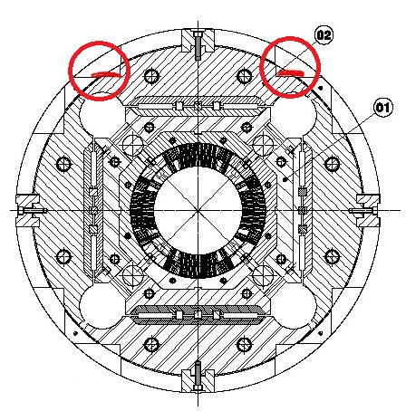
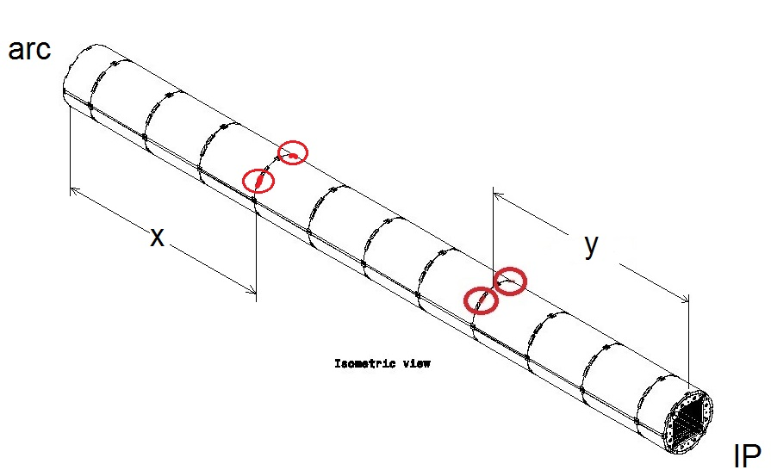
IT cold mass thermometers
LINK to EN-STI ppt for dose estimation
D1
CP
Q3
Q2b
Q2a
Q1
1TE821A
2TE821A
1TE823A
2TE823A
2TE824A
1TE825A
1TE826A
2TE826A
IP
1TE821B
2TE821B
1TE823B
2TE823B
2TE824B
1TE825B
1TE826B
2TE826B
 | y [m] IP side | x [m] arc side
Q1 | 2.4 | 2.4
Q2a | / | 2.4
Q2b | 2.4 | /
Q3 | 2.4 | 2.4
CP | / | /
D1 | 1.8 | 1.8
TOP
from the end-plate
from the end-plate
BOTTOM
Quadrupole typical longitudinal view
Quadrupole typical
cross-section view

Slide 9
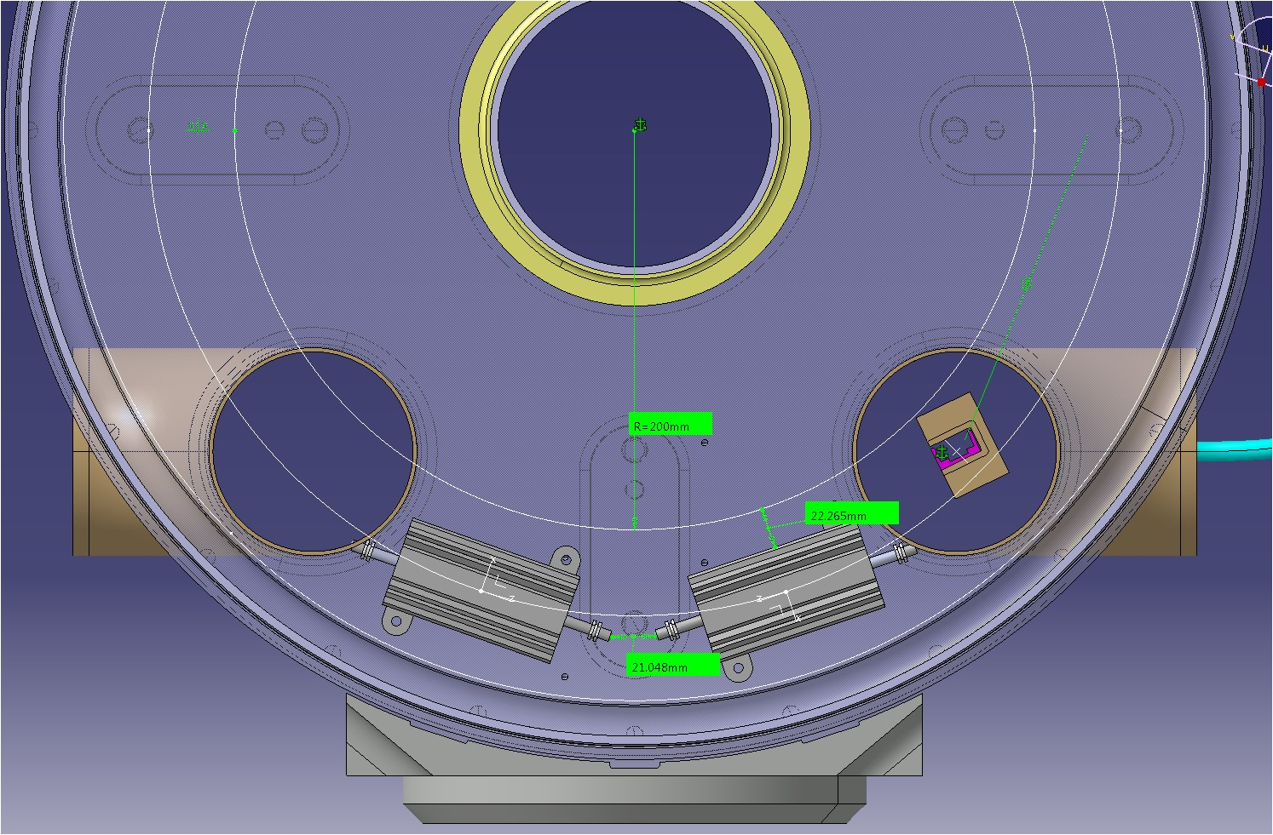
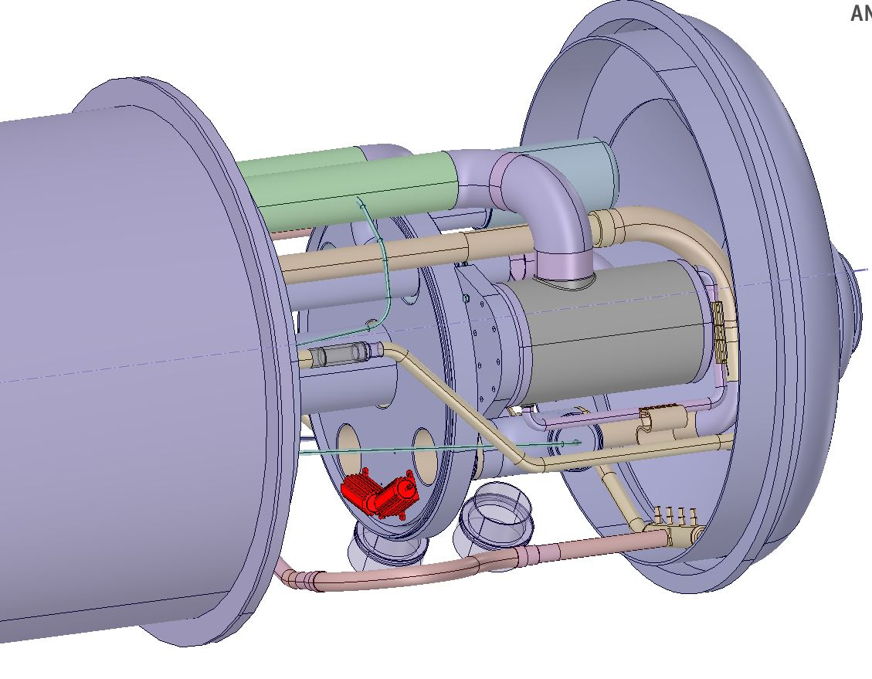
IT warm-up heaters
LINK to EN-STI ppt for dose estimation
D1
CP
Q3
Q2b
Q2a
Q1
EH820
EH822
EH824
EH826
EH828
EH830
EH832
EH834
IP
EH821
EH823
EH825
EH827
EH829
EH831
EH833
EH835
Heaters
Heaters
End cover
Cross-section view
3D view – Q1 IP side
Heaters will be installed always on the end covers, always on the same position.
Pictures above are applicable to all the eight installation locations.

Slide 10
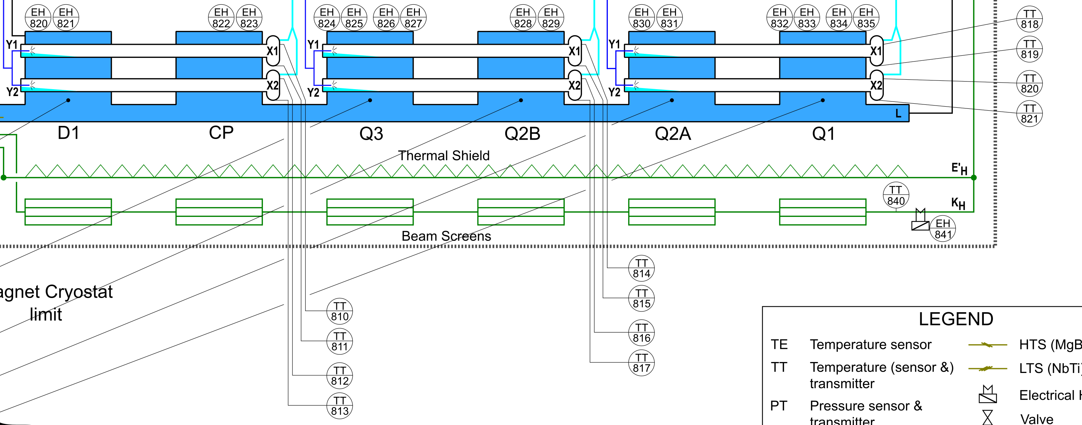
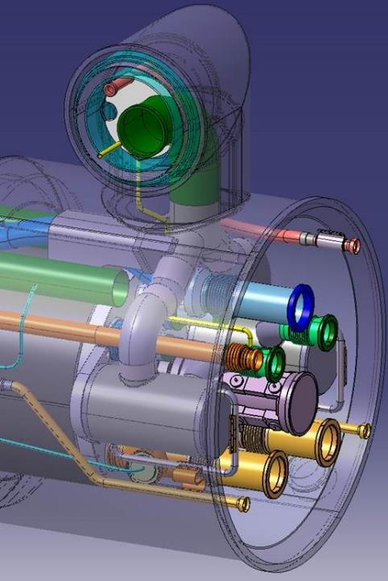
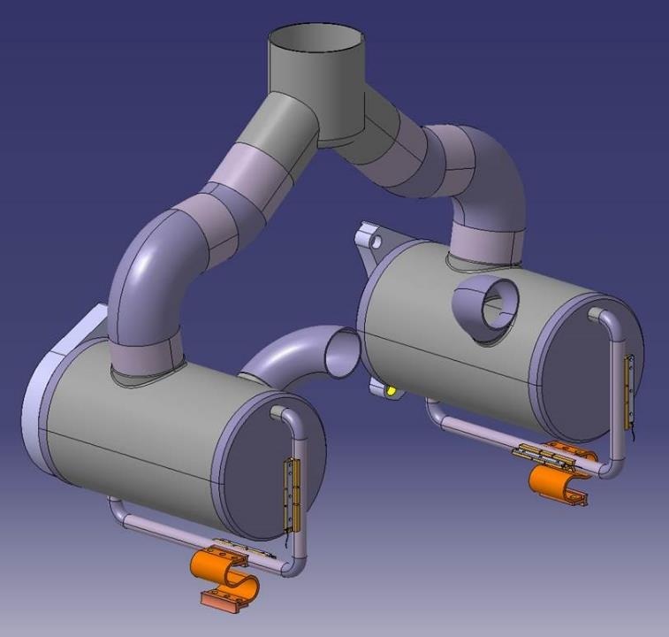
IT phase separator TTs
LINK to EN-STI ppt for dose estimation
Phase separator and thermometer configuration is the same for all the three installation locations
Thermometers
Phase separator

Slide 11
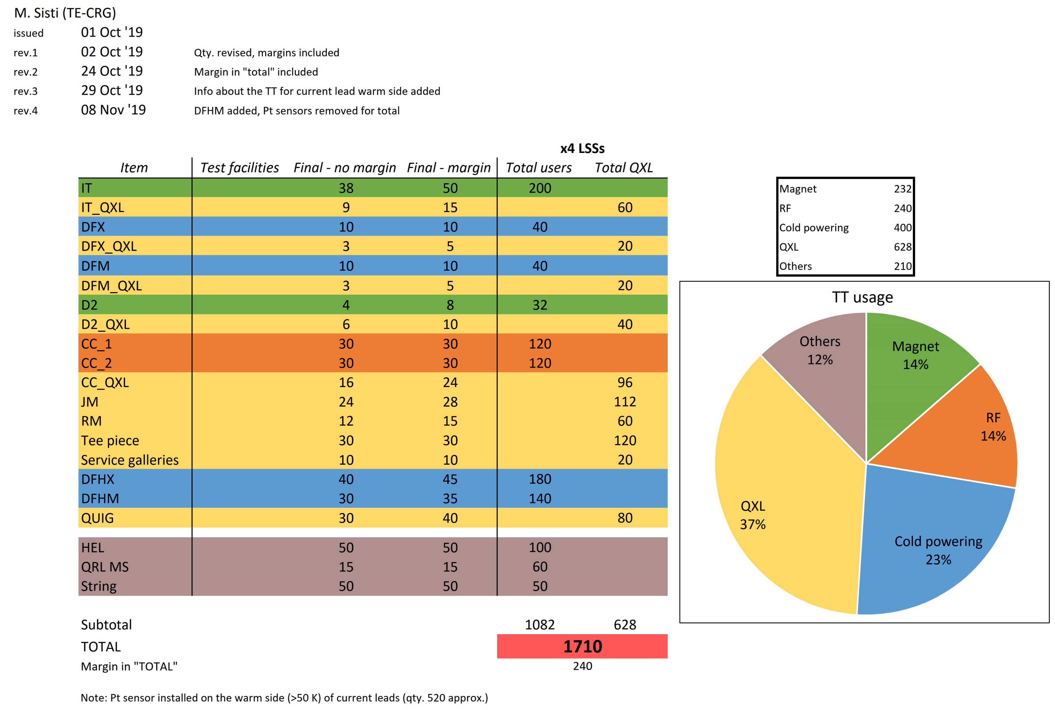
TT quantity estimation

Slide 12
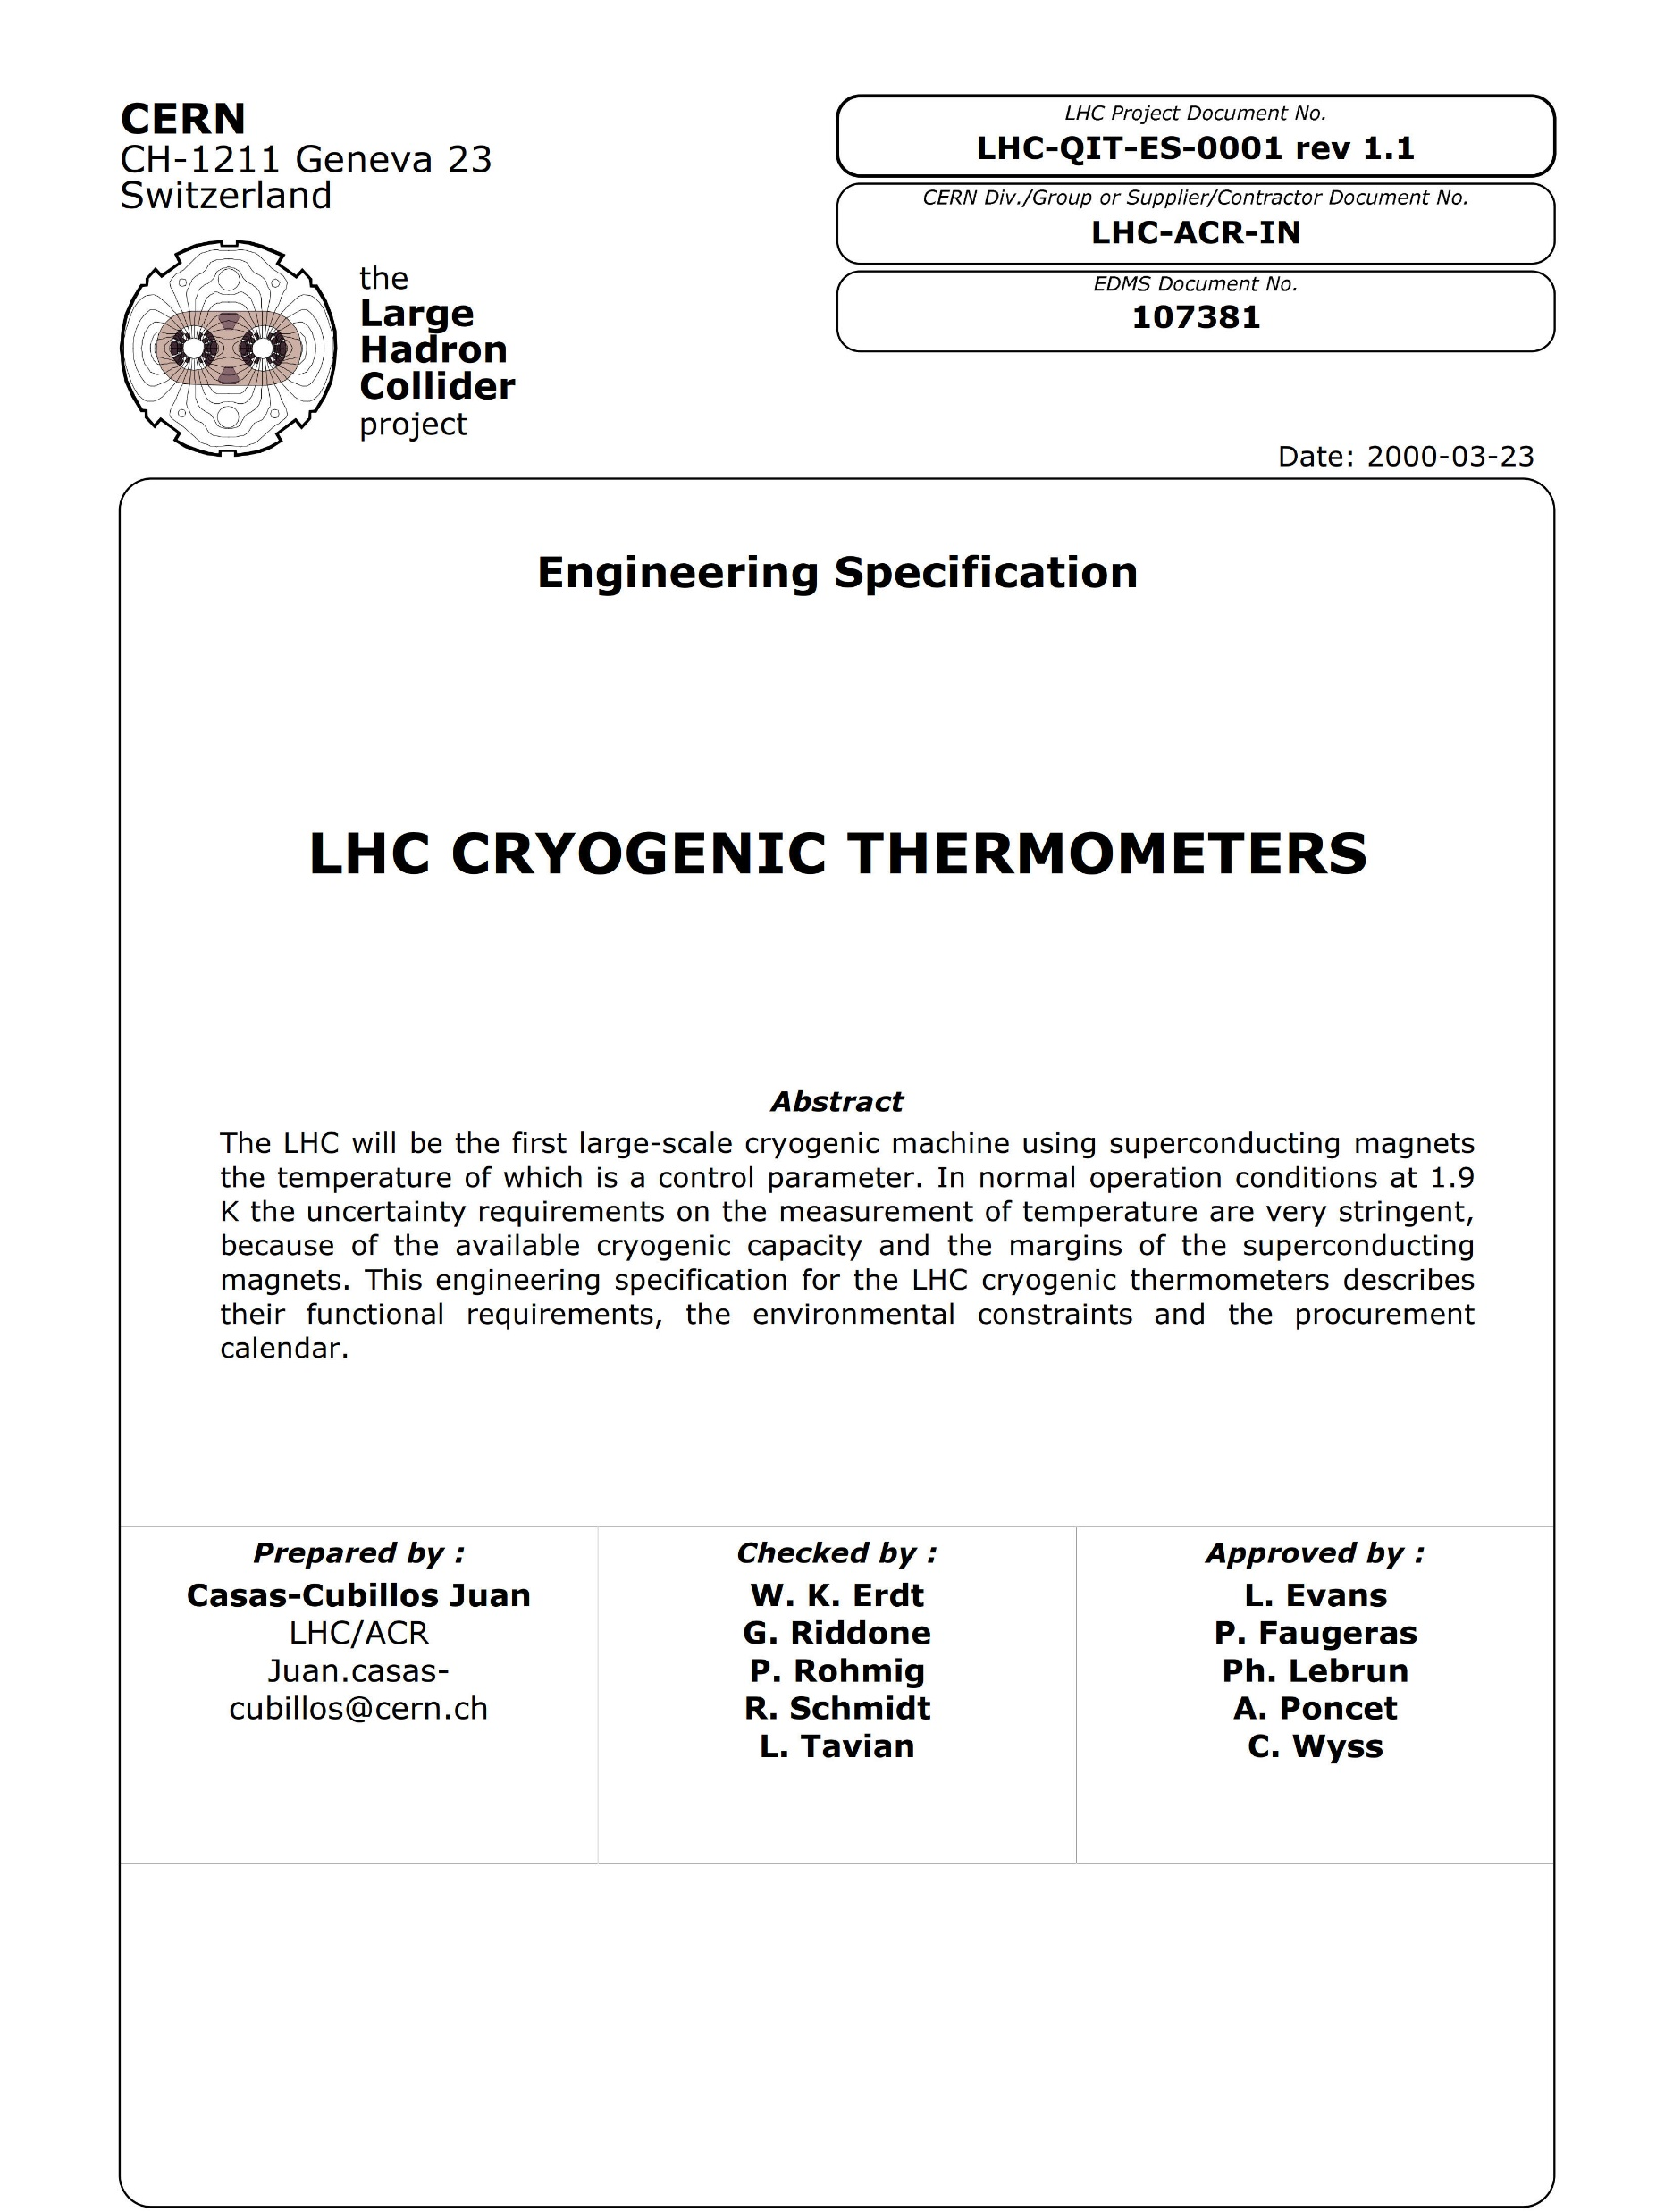
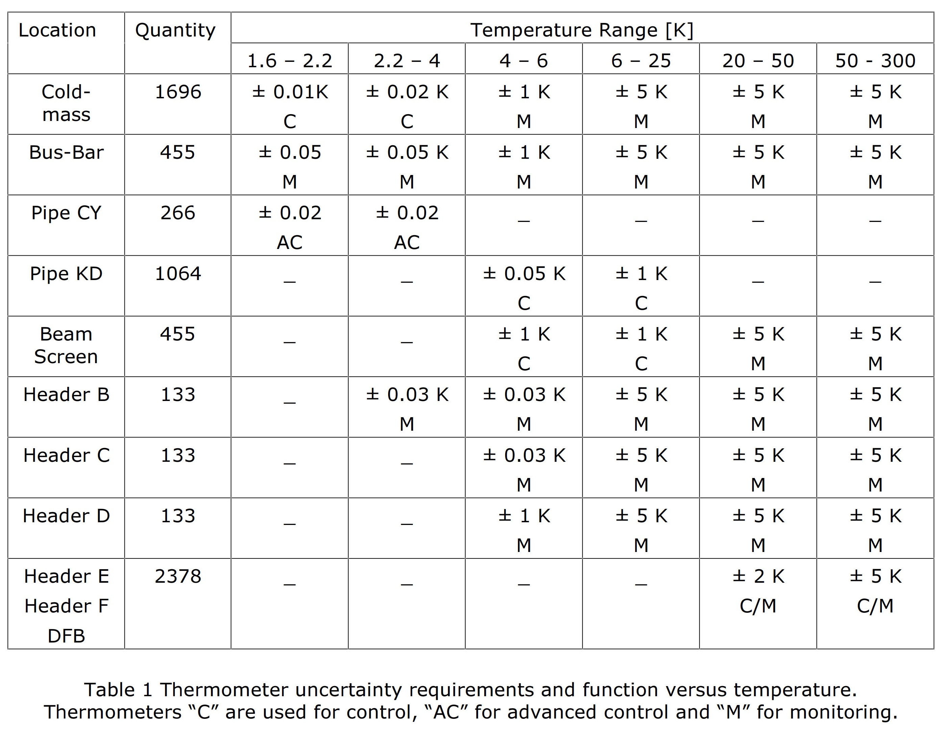
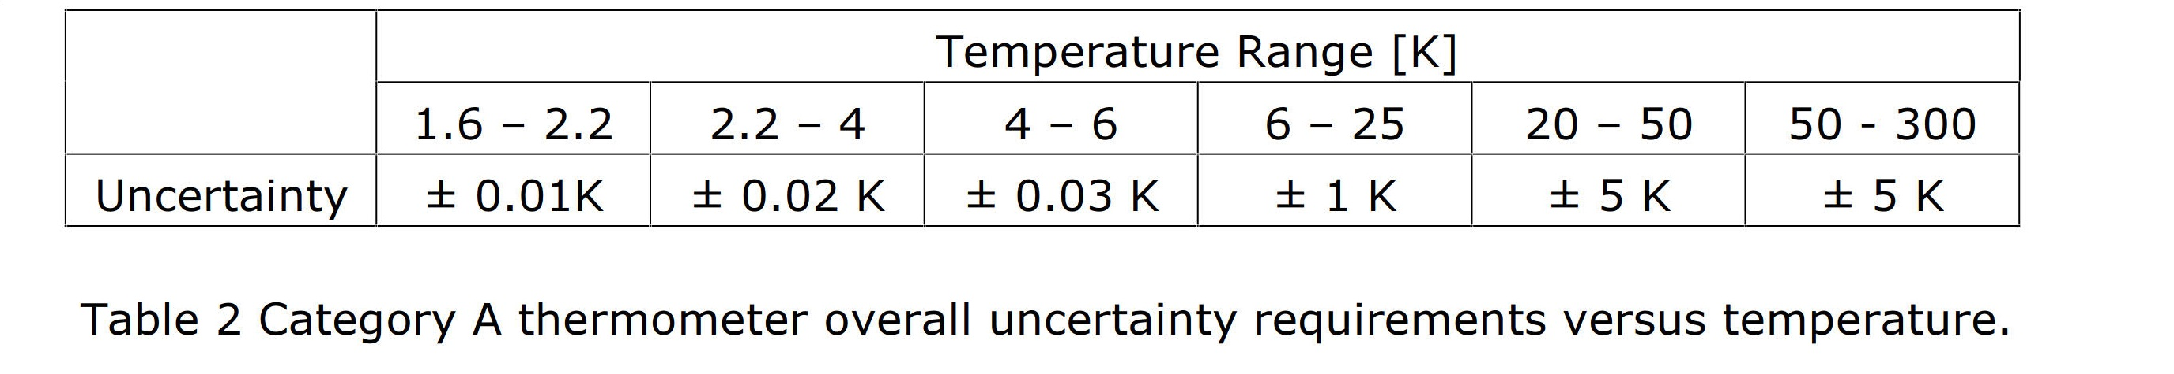
TT uncertainty requirements

