Slide 1

HiLumi Cryogenics,
WHAT-WHEN-WHO for cryogenic instrumentation needs and interfaces
Serge Claudet,
On behalf of the Cryogenic project team
December 17th 2019

Slide 2
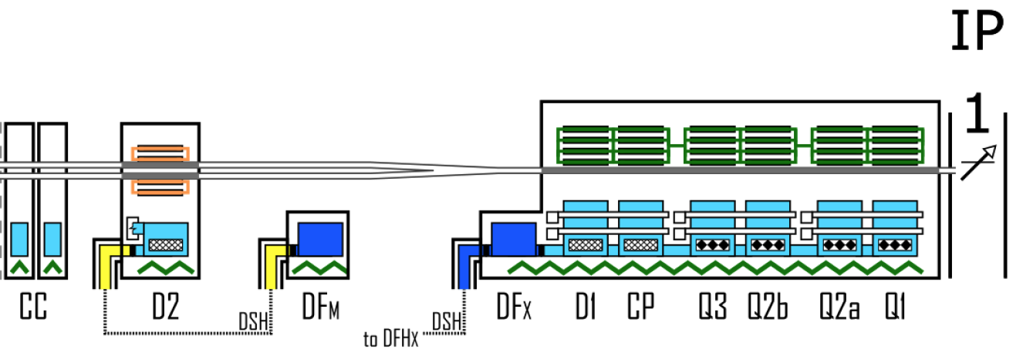
HL-LHC cryogenic upgrade
P1-P5: 2 new cryoplants (~15 kW @ 4.5 K incl. ~3 kW @ 1.8 K ) and 2 x 750m cryo-distribution for high-luminosity insertions
P4: upgrade (+2 kW @ 4.5 K) of an existing LHC 18 kW @ 4.5K cryoplant
SPS-BA6: SRF test facility with beam primarily for Crab-Cavities
+
SPS-BA6
P1/P5: Provide adequate cooling for this
Other test facilities related activities not reported here
16Dec'19

Slide 3
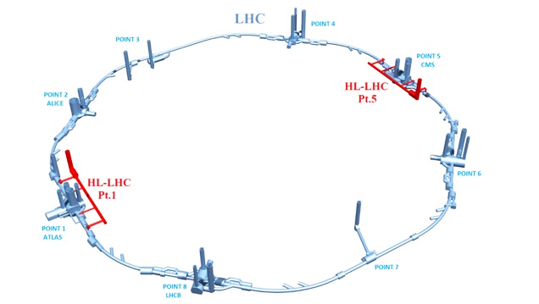
P1/P5 Cryogenic architecture
15 kW equivalent at 4.5 K, including 3 kW at 1.8 K
Warm compressor station
SHE
QSVB
GHe storage tanks
Surface piping
SHM
QSCG
QSAG
Dryer
QSP
Surface cold box
SLN
SD
SLN
Liquid Nitrogen tank(s)
Quench tank
QSDQ
QSRG
QSDN
Surface
QPP
QPLG
Vertical transfer line
Shaft
Underground
US
Cold compressors box
QURCG
DFHX
DFHM
(existing)
DFBL
UR
UL
QUIG
DSHX
DSHM
LHC tunnel
Interconnection box
DFX
DFM
DSL
Q1
Q2a
Q2b
Q3
CP
D1
D2
CC
CC
CC
CC
Q4
Q5
Q6
QRP
QXL
HRL
16Dec'19

Slide 4
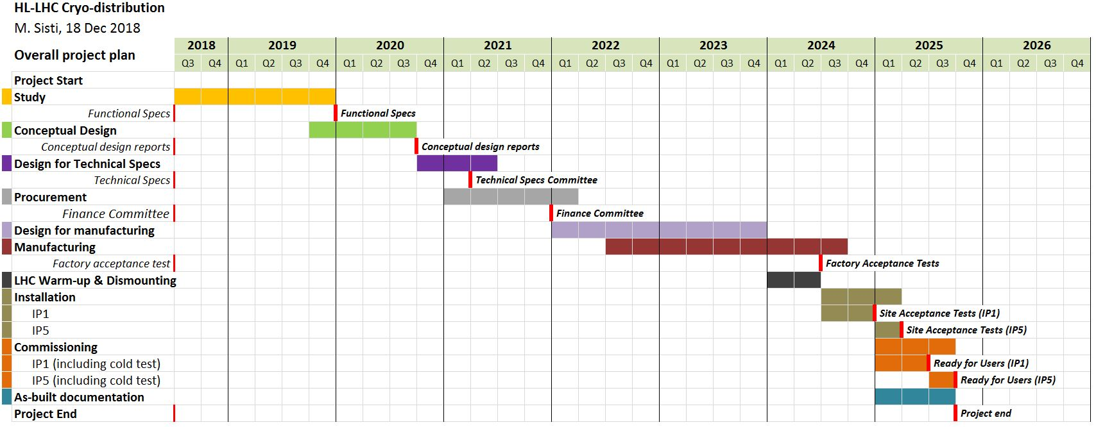
Project plans Refrigeration-Distribution
LS3
UR’s available
+
UL’s available
-
Today
Fine for Cryo deliveries,
Need to catch-up for “users”
Interfaces to be frozen by end 2020
Used now to discuss for LS3 (ready to install, P1 w.r.t P5)
16Dec'19

Slide 5
WP9 organisation and roles
Re-inforced 2019
Coordination: Serge Claudet, Rob Van Weelderen
Quality, documentation, project management: Antonio Perin + Sigrid Knoops*
Magnet cooling requirements: Rob Van Weelderen + K. Puthran
Crab cavities cooling requirements: Krzysztof Brodzinski
Heat Load management: Antonio Perin + M. Spitoni
General process overview: Udo Wagner + Vanessa Gahier + Benjamin Bradu
3D models and integration: Jos Metselaar (+ designers)
Instrumentation & controls: so far CRG/CE-CI experts
P4-RF and P1-P5
  Refrigeration: Emmanuel Monneret (Sep’17)
  Cryodistribution: Michele Sisti (Jun’17)
  Cryogenic infrastructure: Gérard Ferlin (Jul’19)
SPS-BA6:
  Refrigeration: Laurent Delprat
  Cryodistribution: Krzysztof Brodzinski + Hendrie Derking
  Infrastructure: Jos Metselaar + O. Pirotte
Part time contributors during LS2, but valuable help expected from experienced colleagues
Consolidations: S. Claudet + Jos Metselaar
Done!
16Dec'19

Slide 6
Towards new organgram
Coordination:
QA, documentation
Heat loads – Process
3D models
Incl. instrumentation
Cryo sub-systems
Incl Refrigerators, …
- QXL Cryoline: M. Sisti
Interfaces:
- IT+D1 cooling: Rob van Weelderen
- IT+D1 techno: M. Sisti
- 11T-connect-cryostats: R.v.W
- D2: A. Perin + t.b.d
- Crab Cavities: K. Brodzinski (+ t.b.d)
- Cold Powering: V. Gahier

Slide 7
SPARES SLIDES

Slide 8
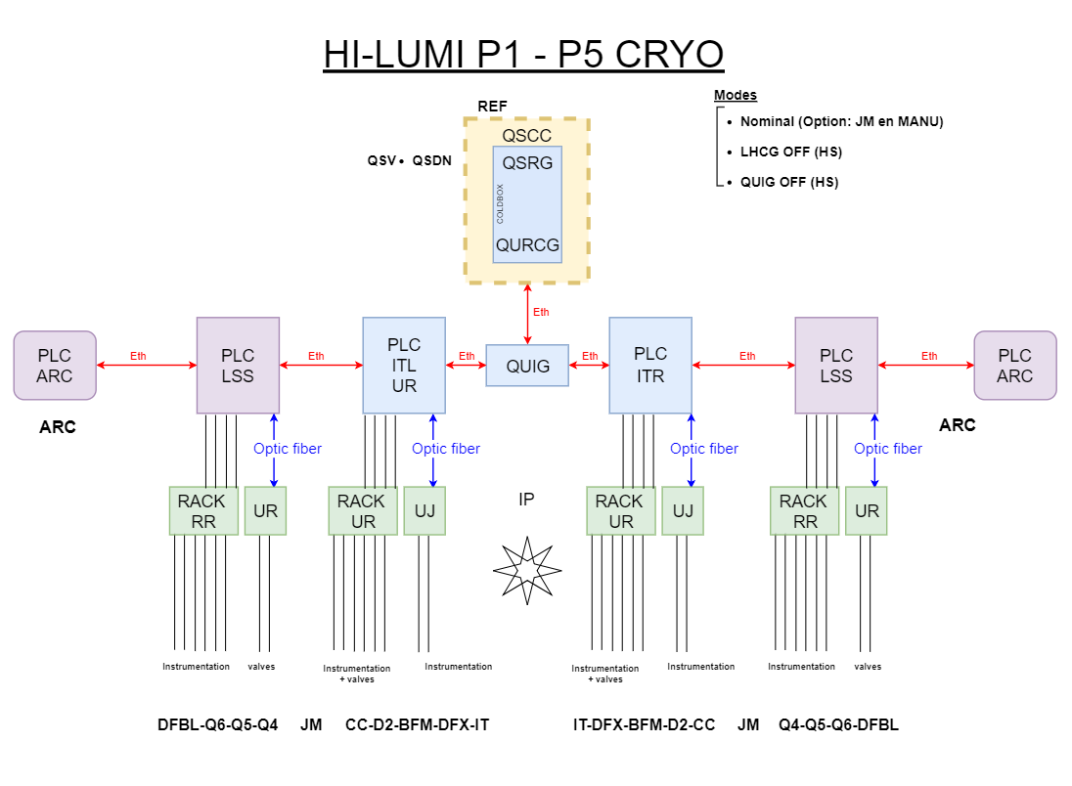
HL-LHC cryogenic “control” principles
Instrumentation
=> Racks-Electronics
=> Controls
16Dec'19

Slide 9
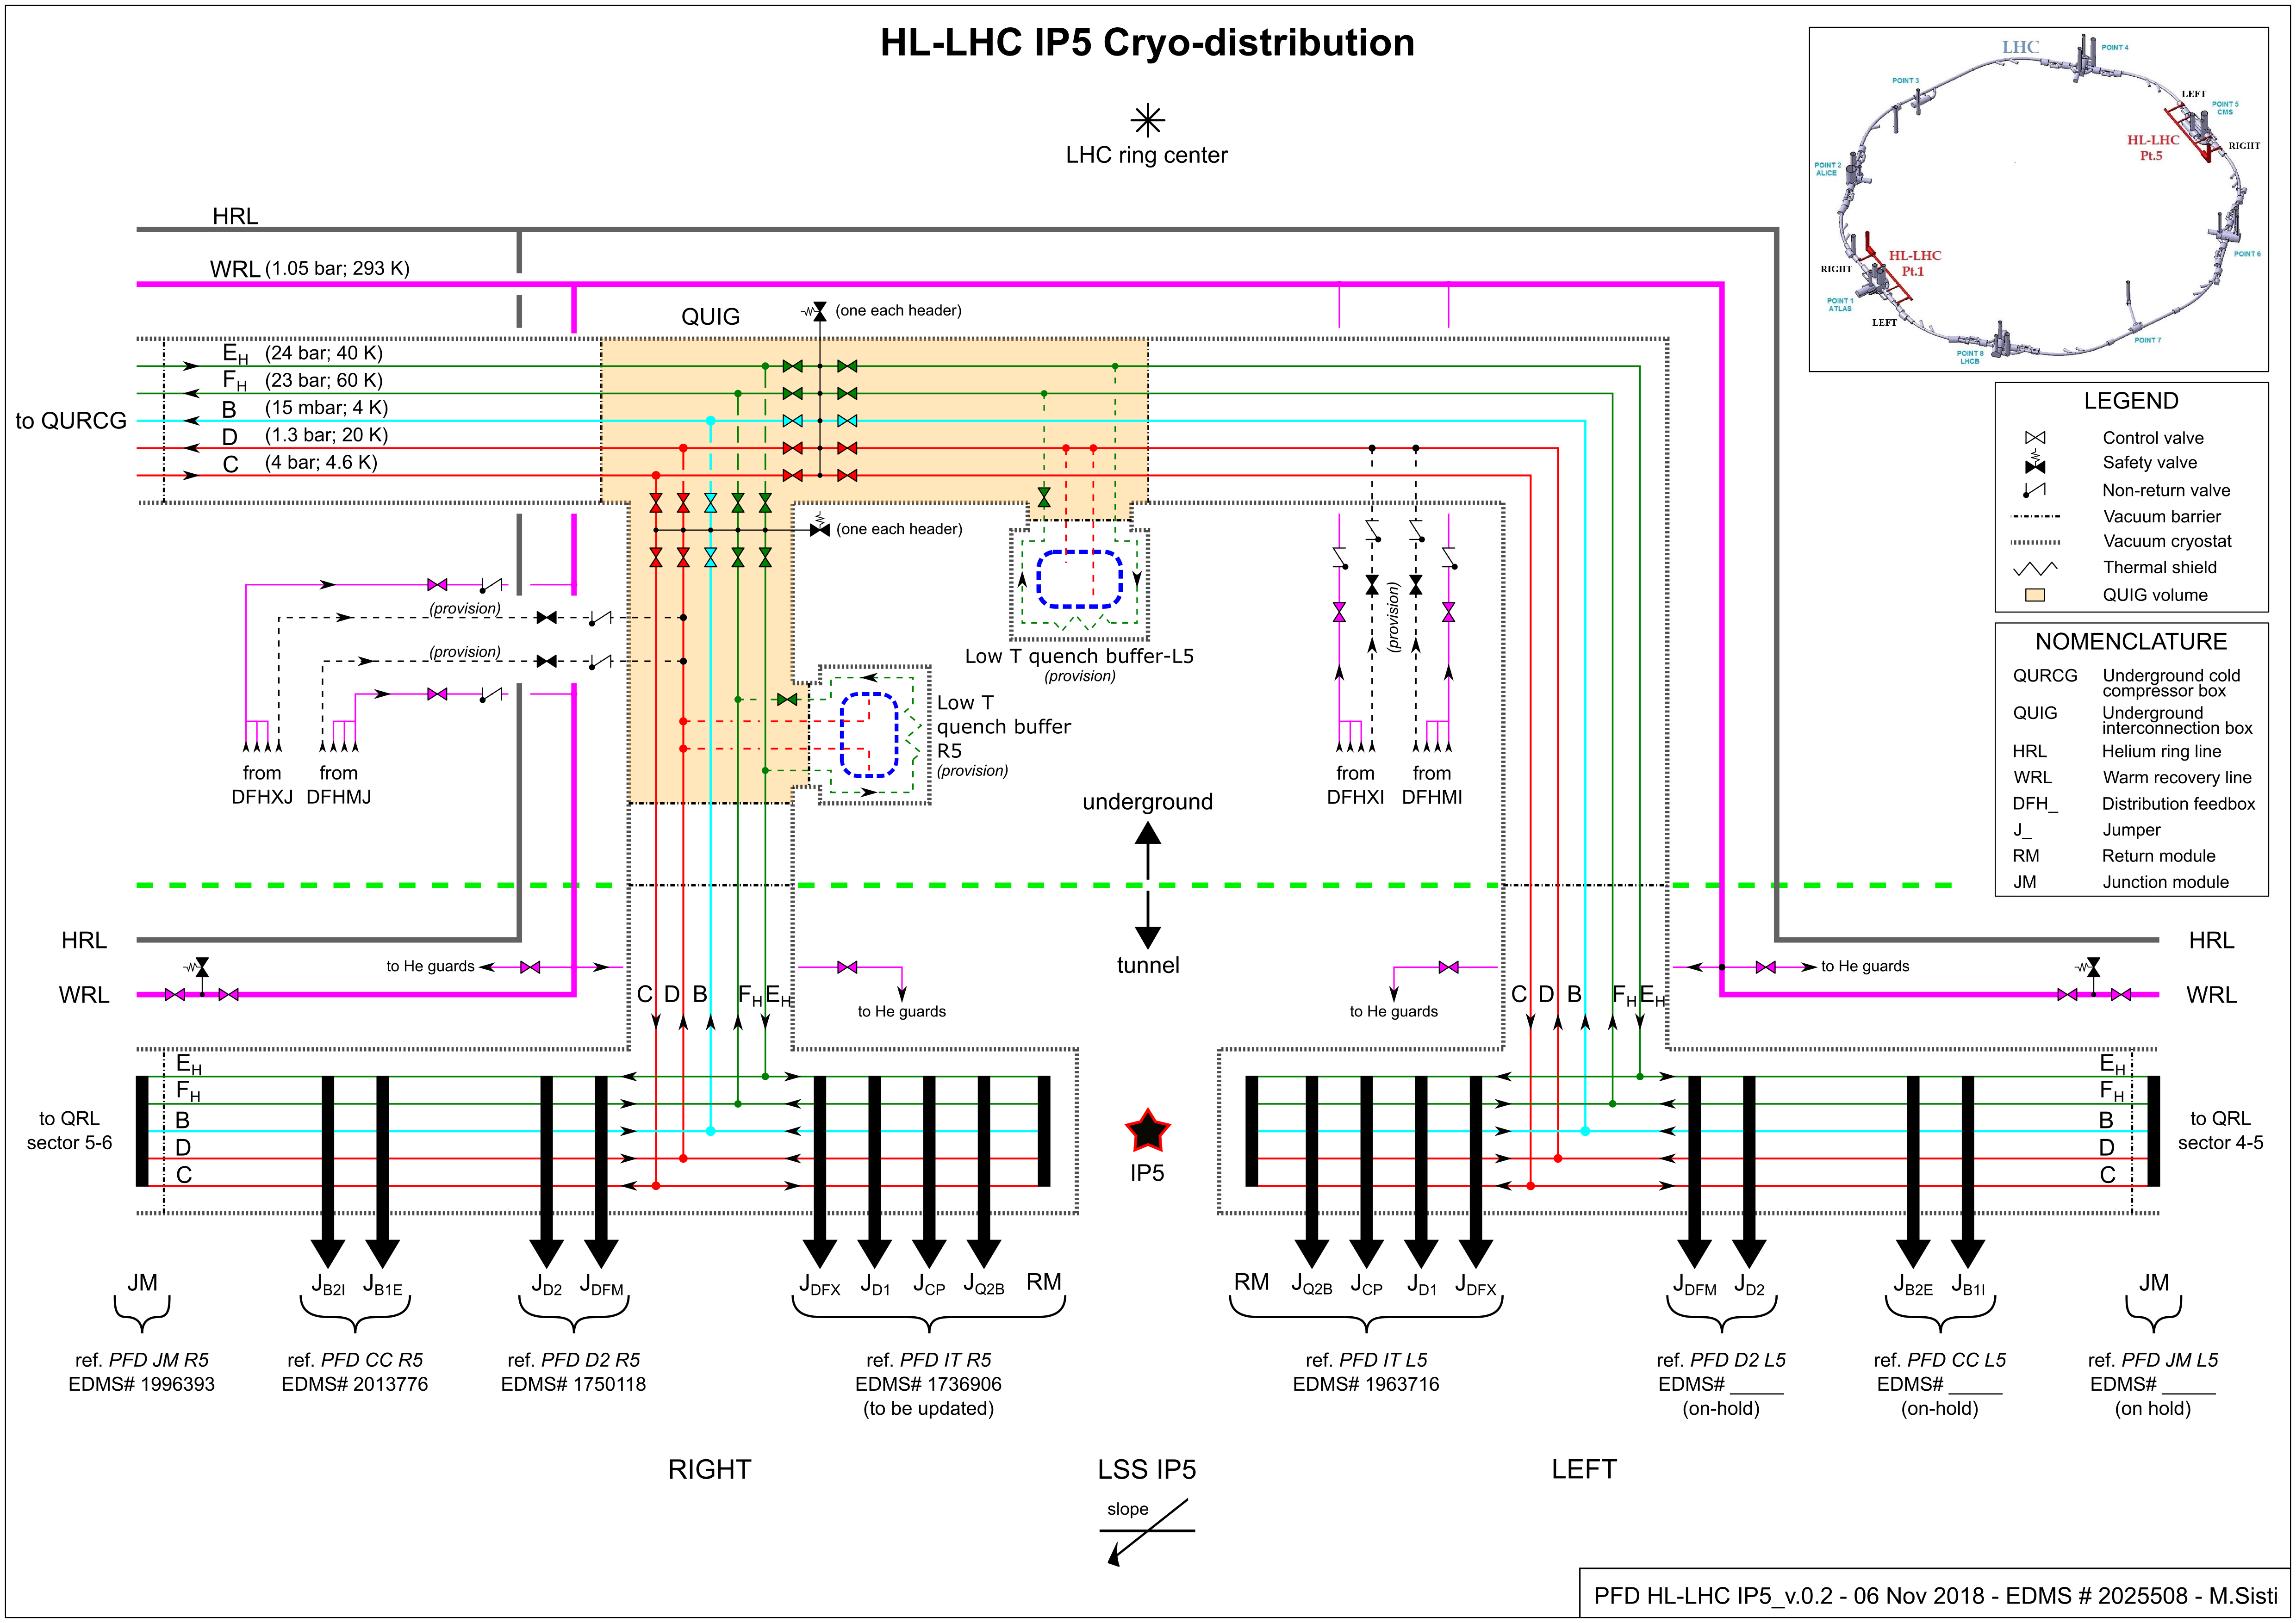
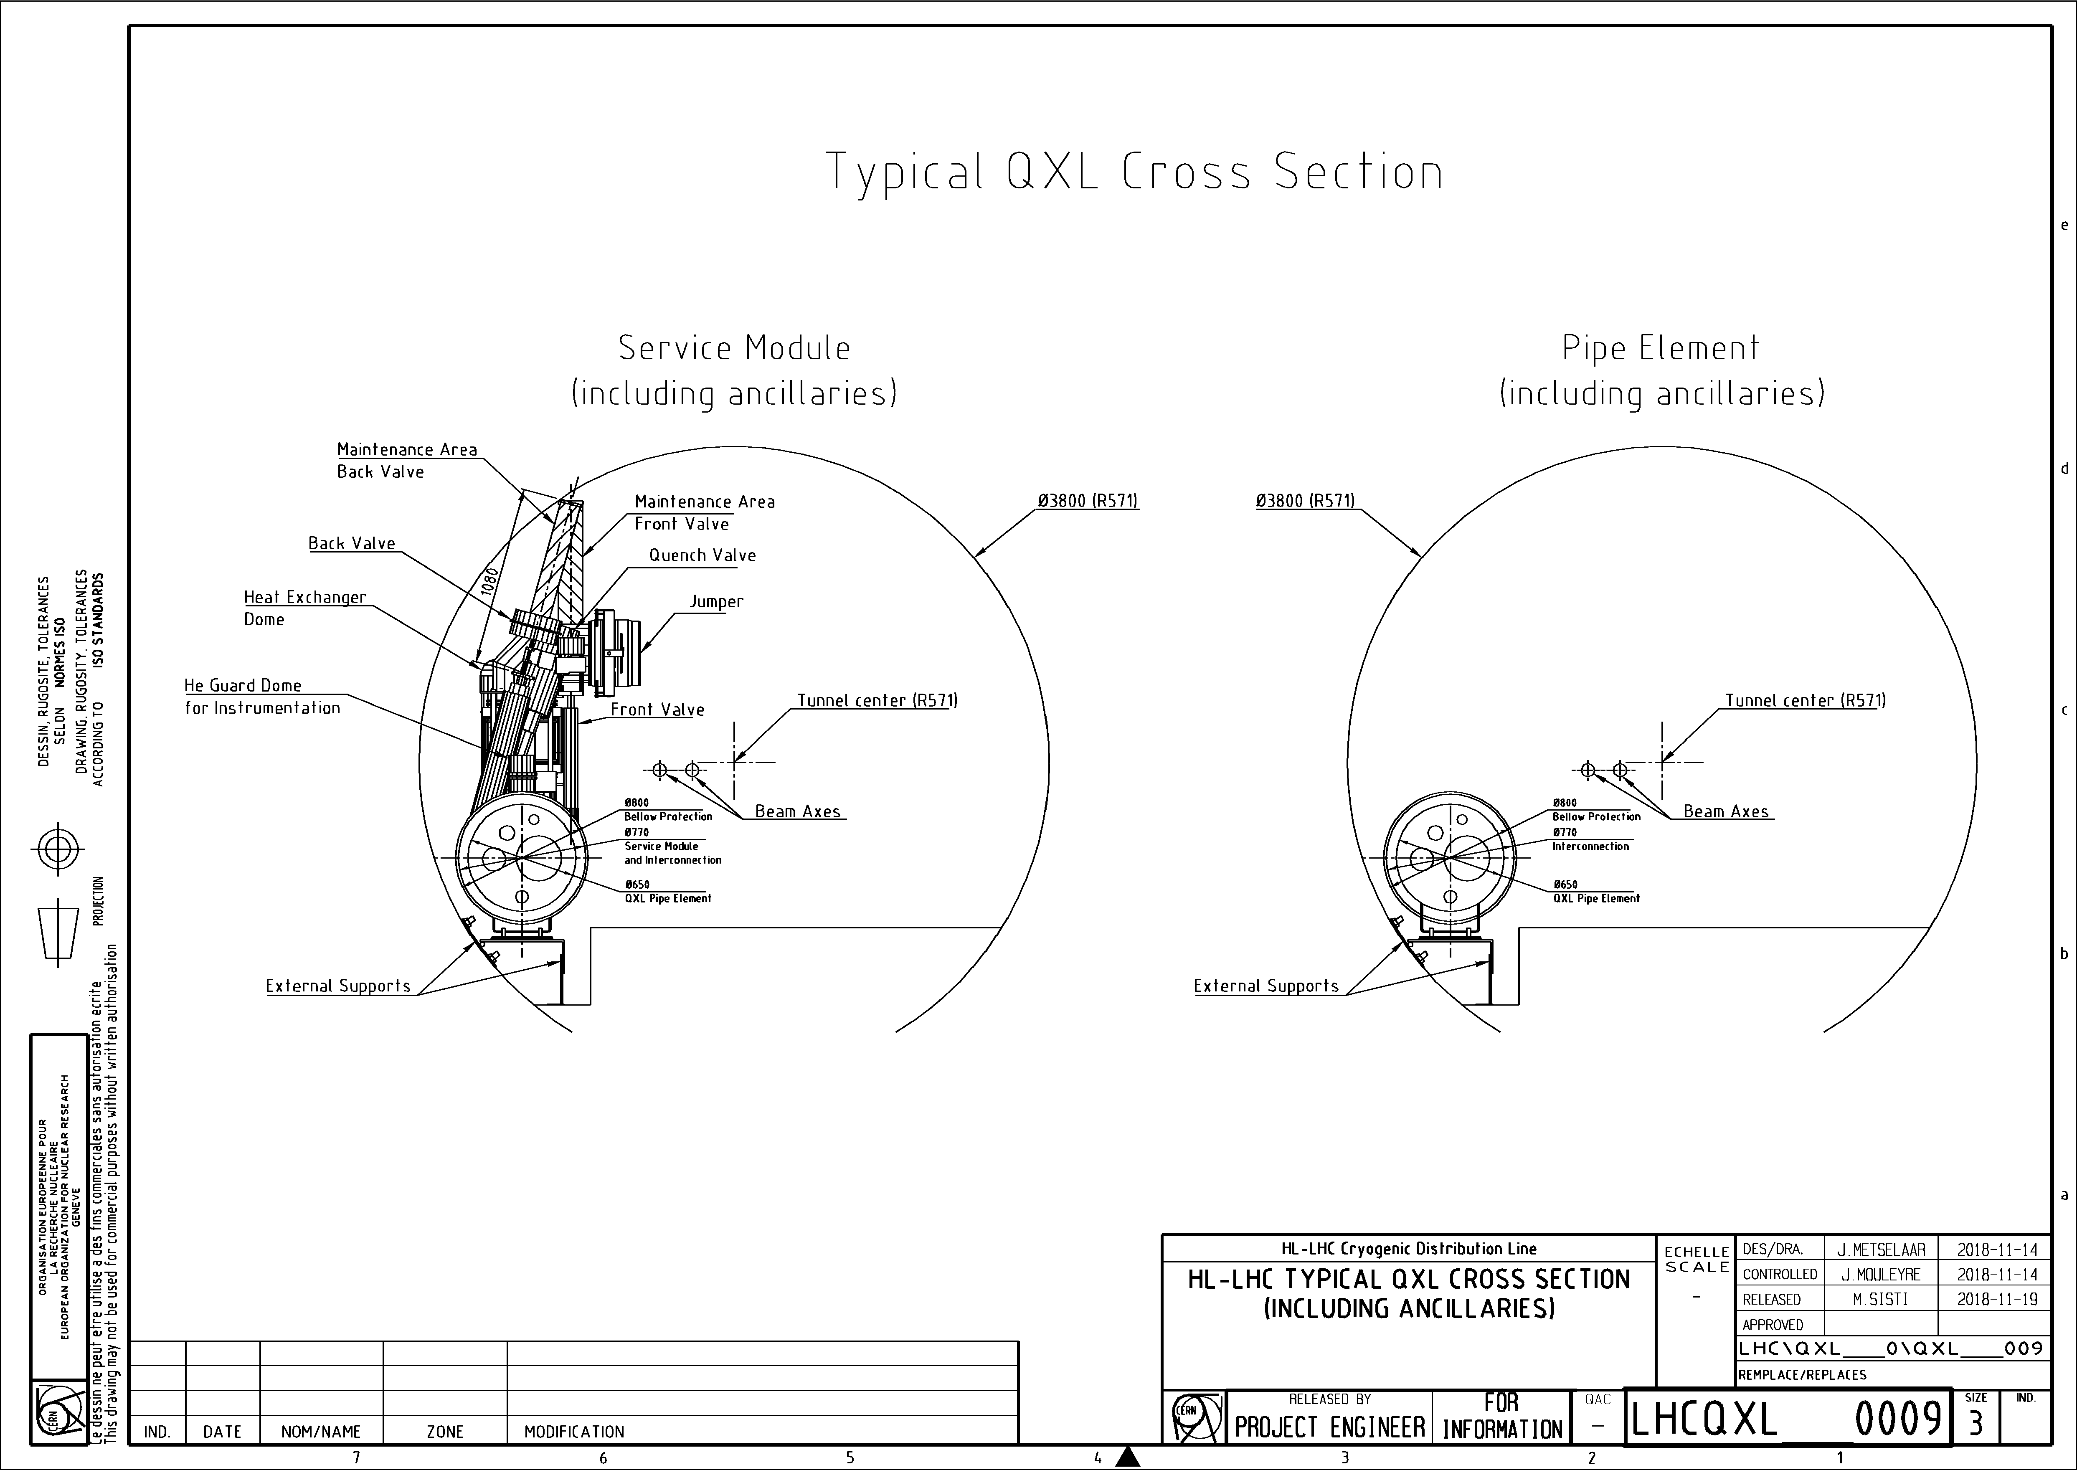
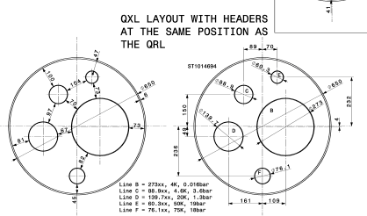
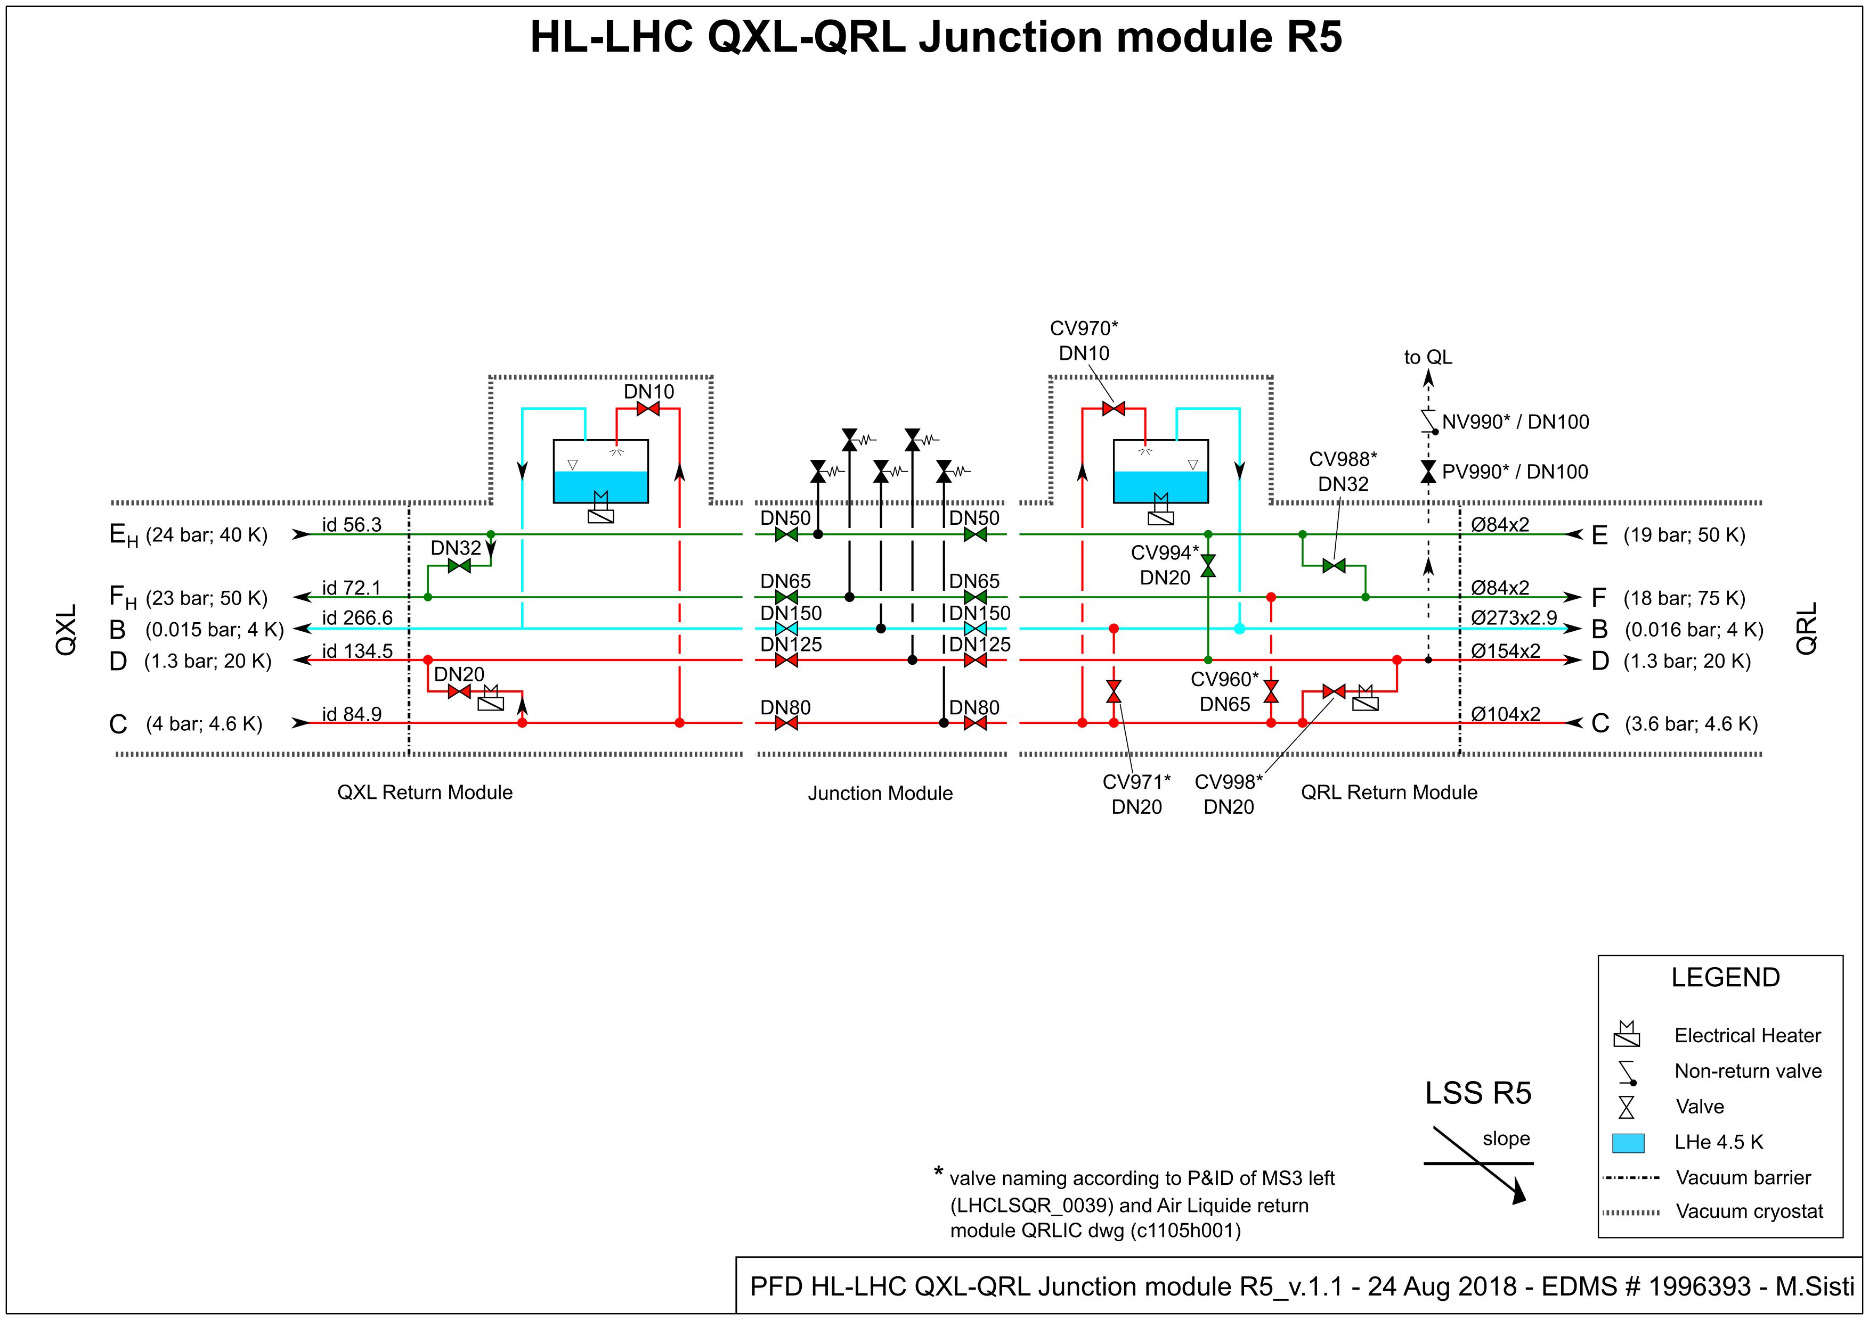
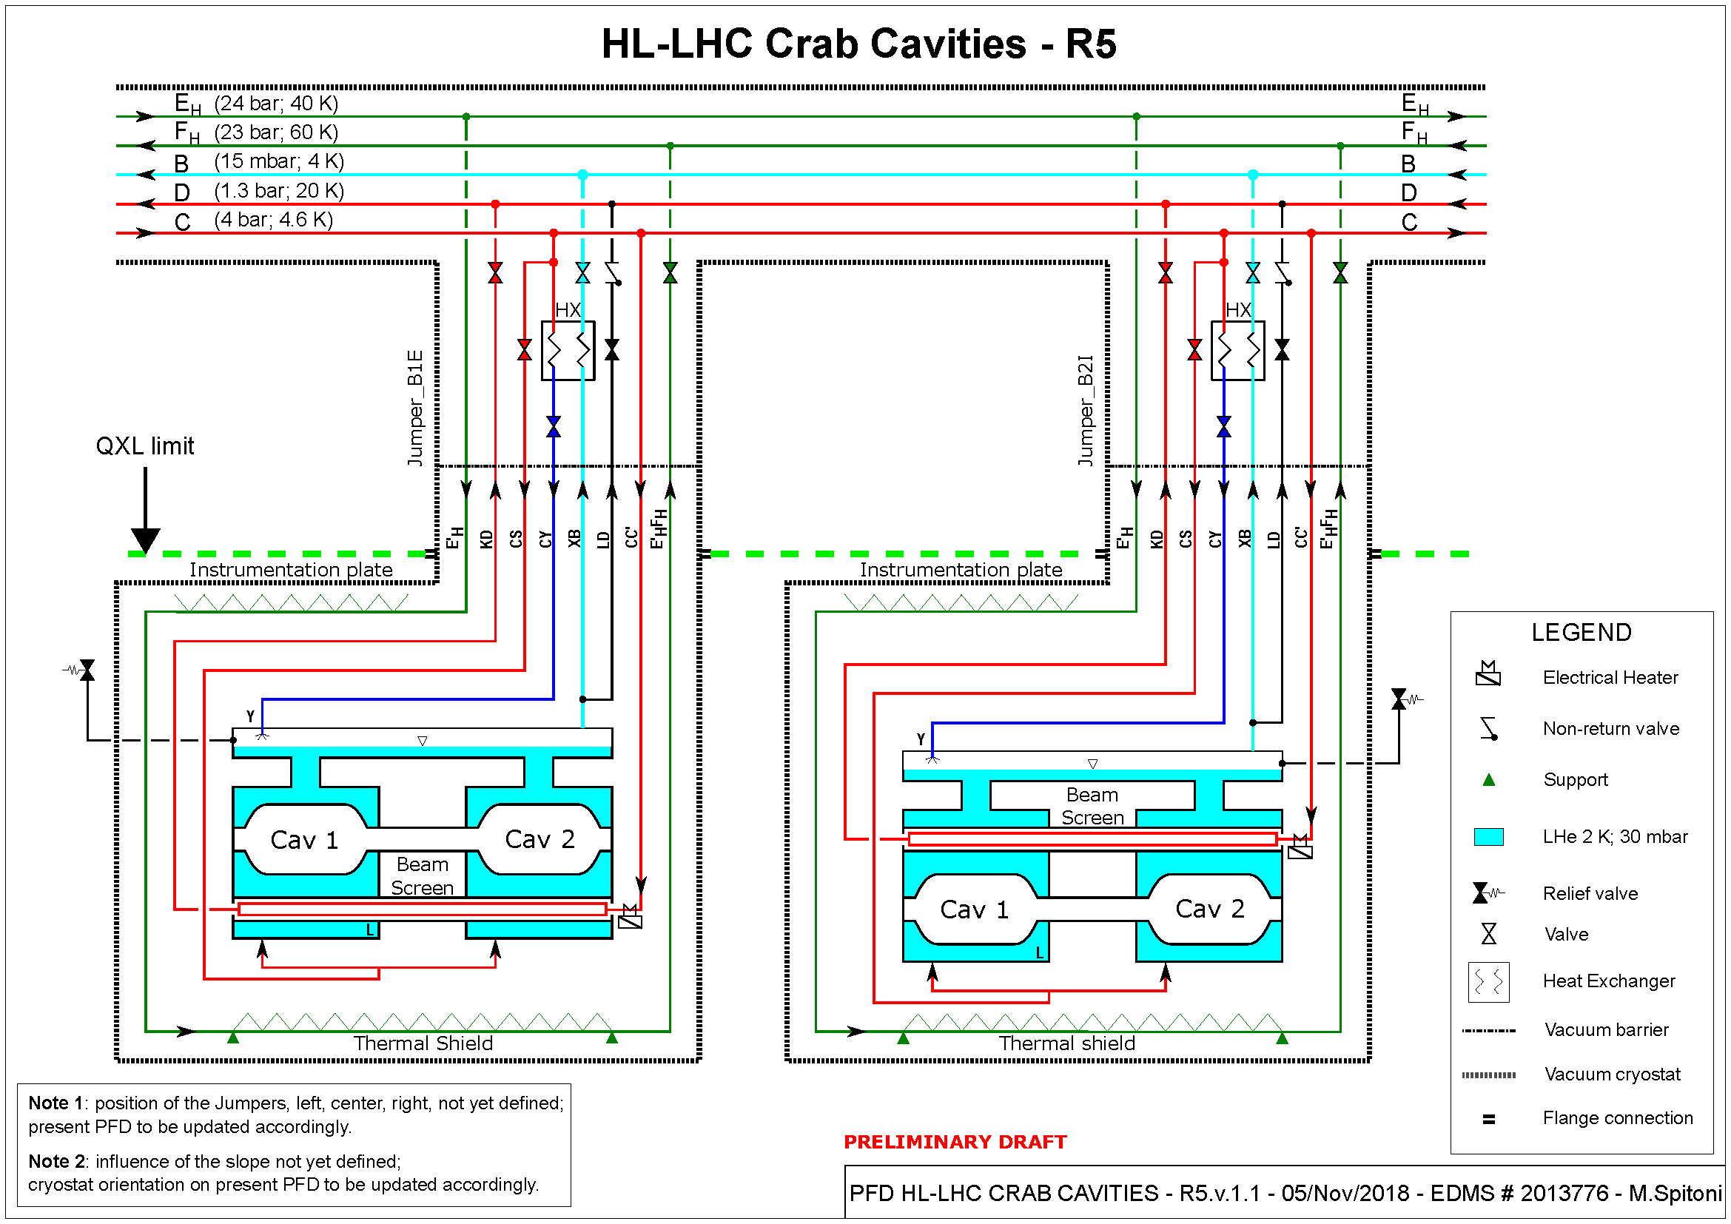
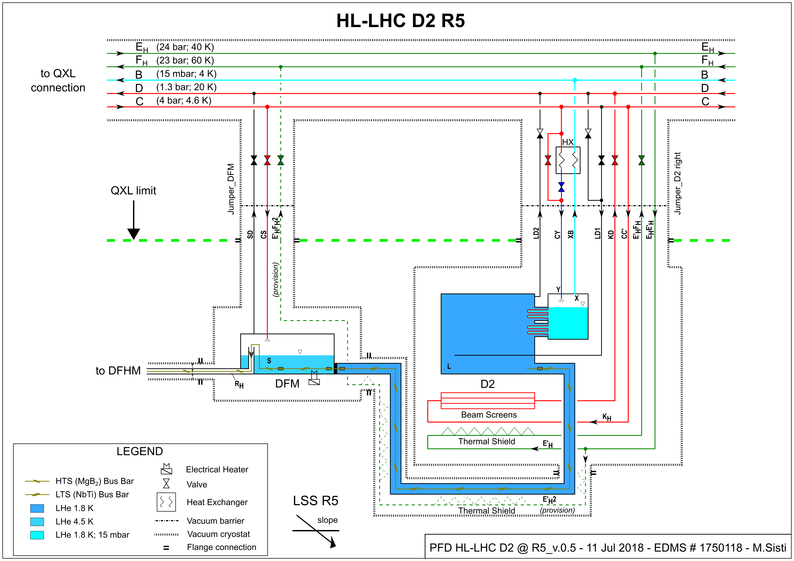
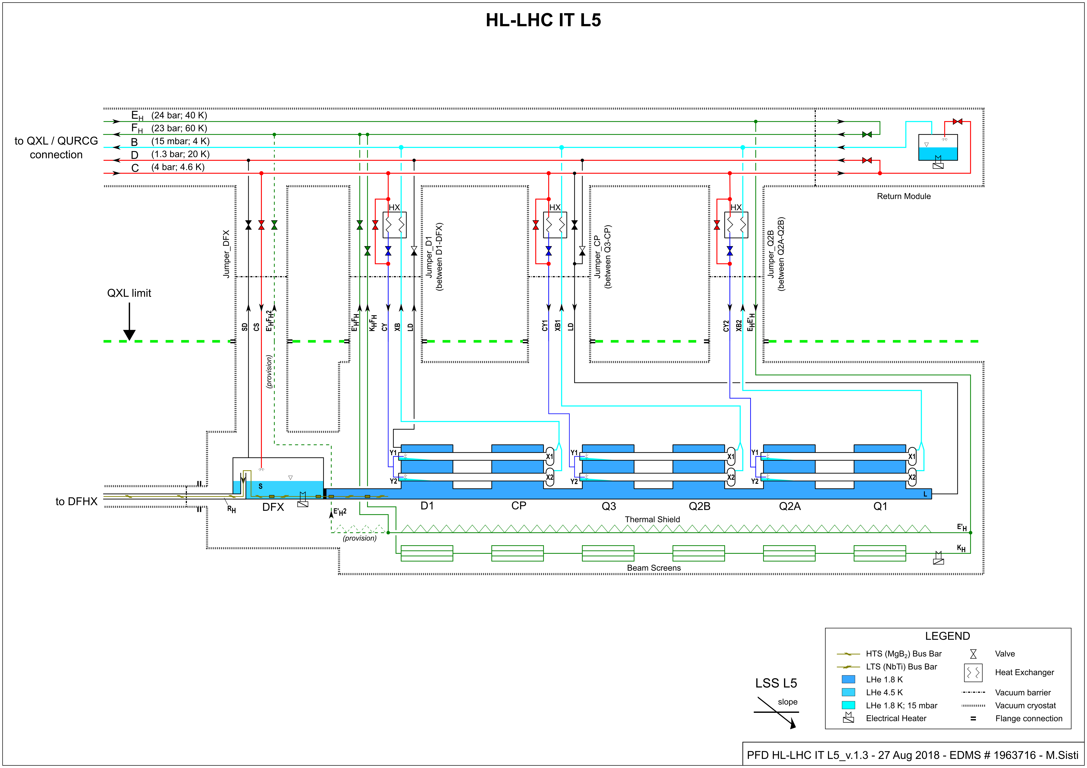
Cryo-distribution reference
All users sharing common resources
CC
D2
QRL-QXL
IT-D1
Reference established, optimised considering project requirements and CRG expertise
16Dec'19

Slide 10
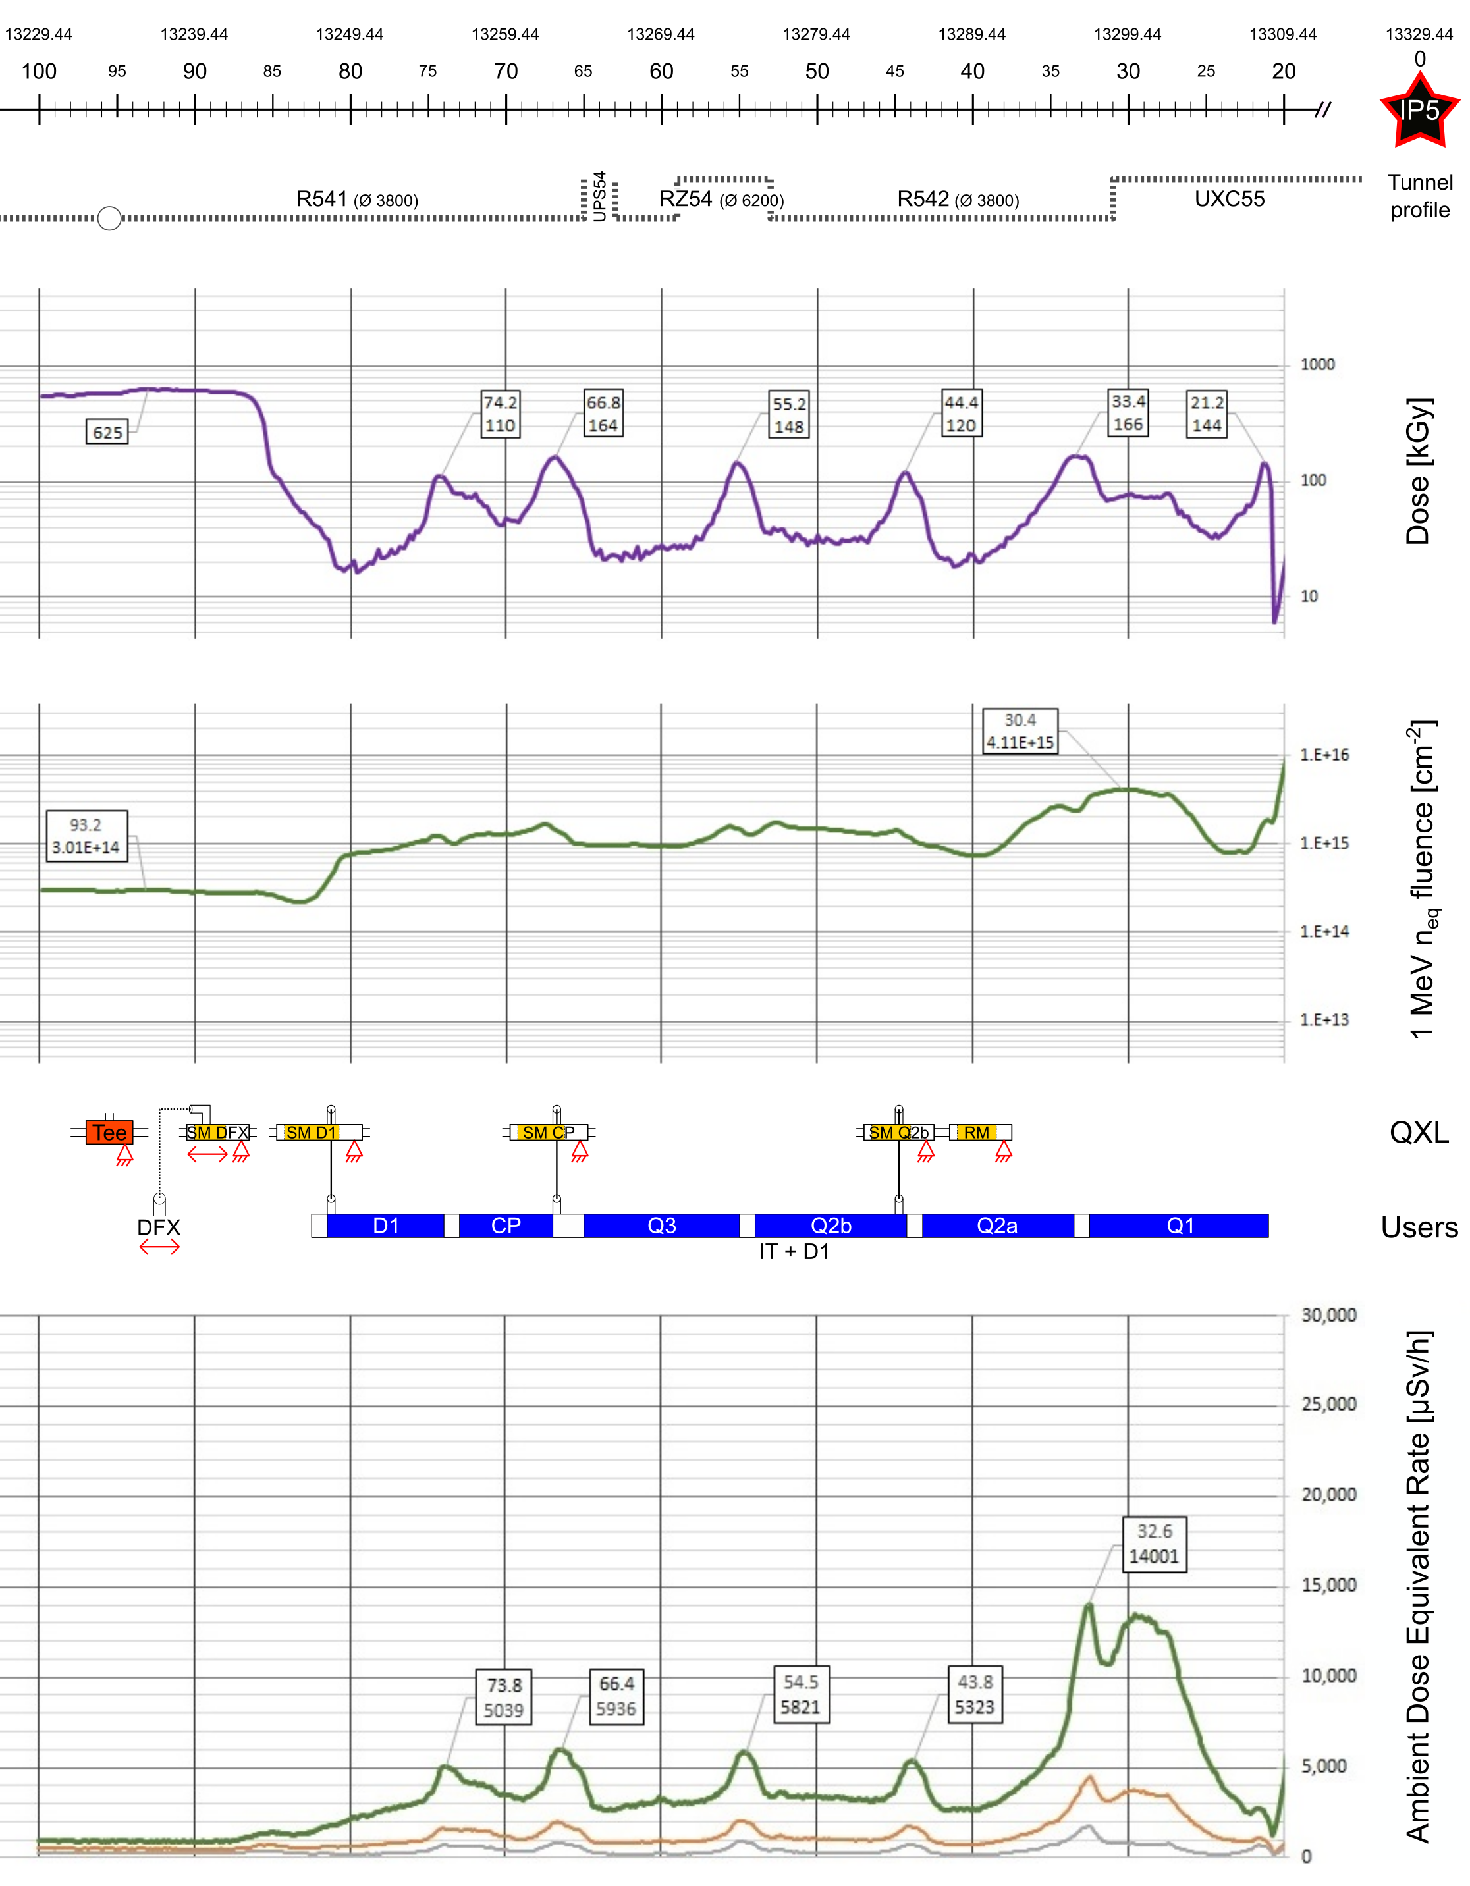
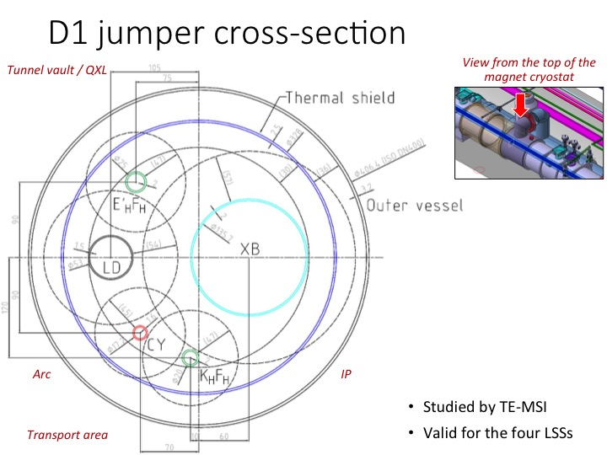
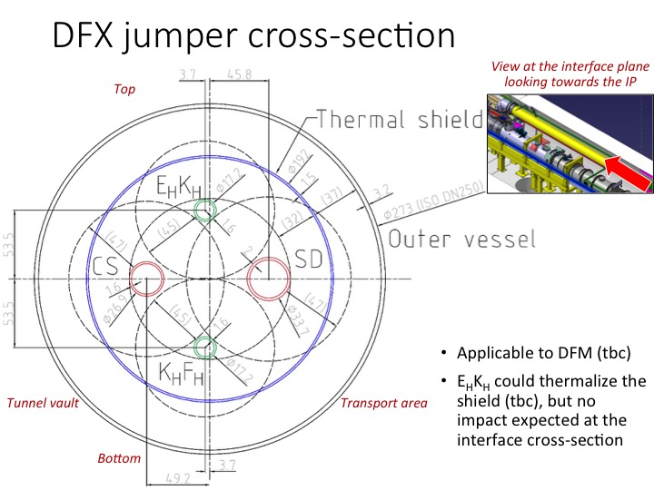
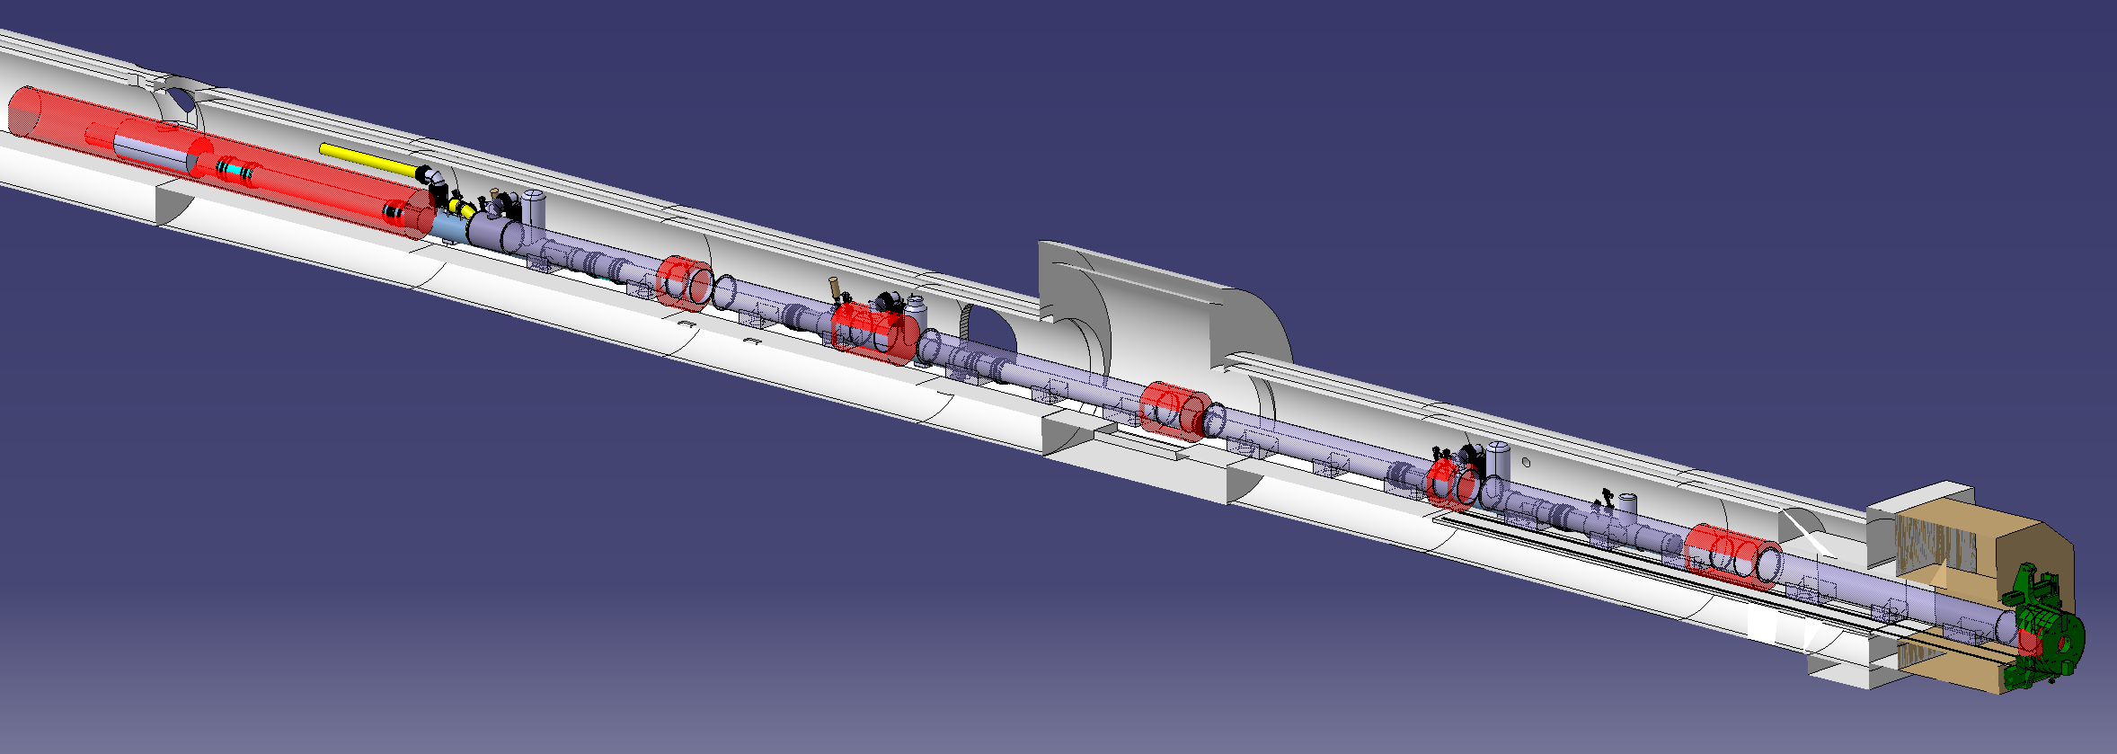
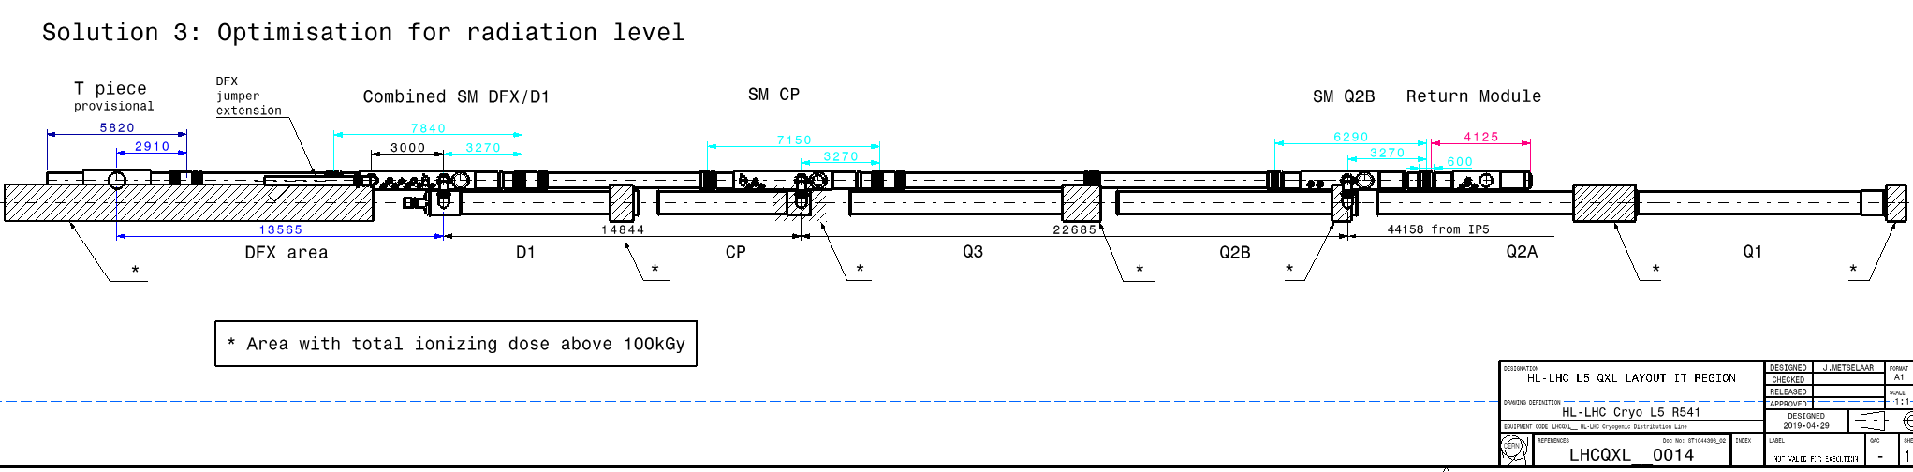
QXL Cryoline integration & interfaces
Radiation level: instrumentation considered OK up to 100kGy
16Dec'19

Slide 11
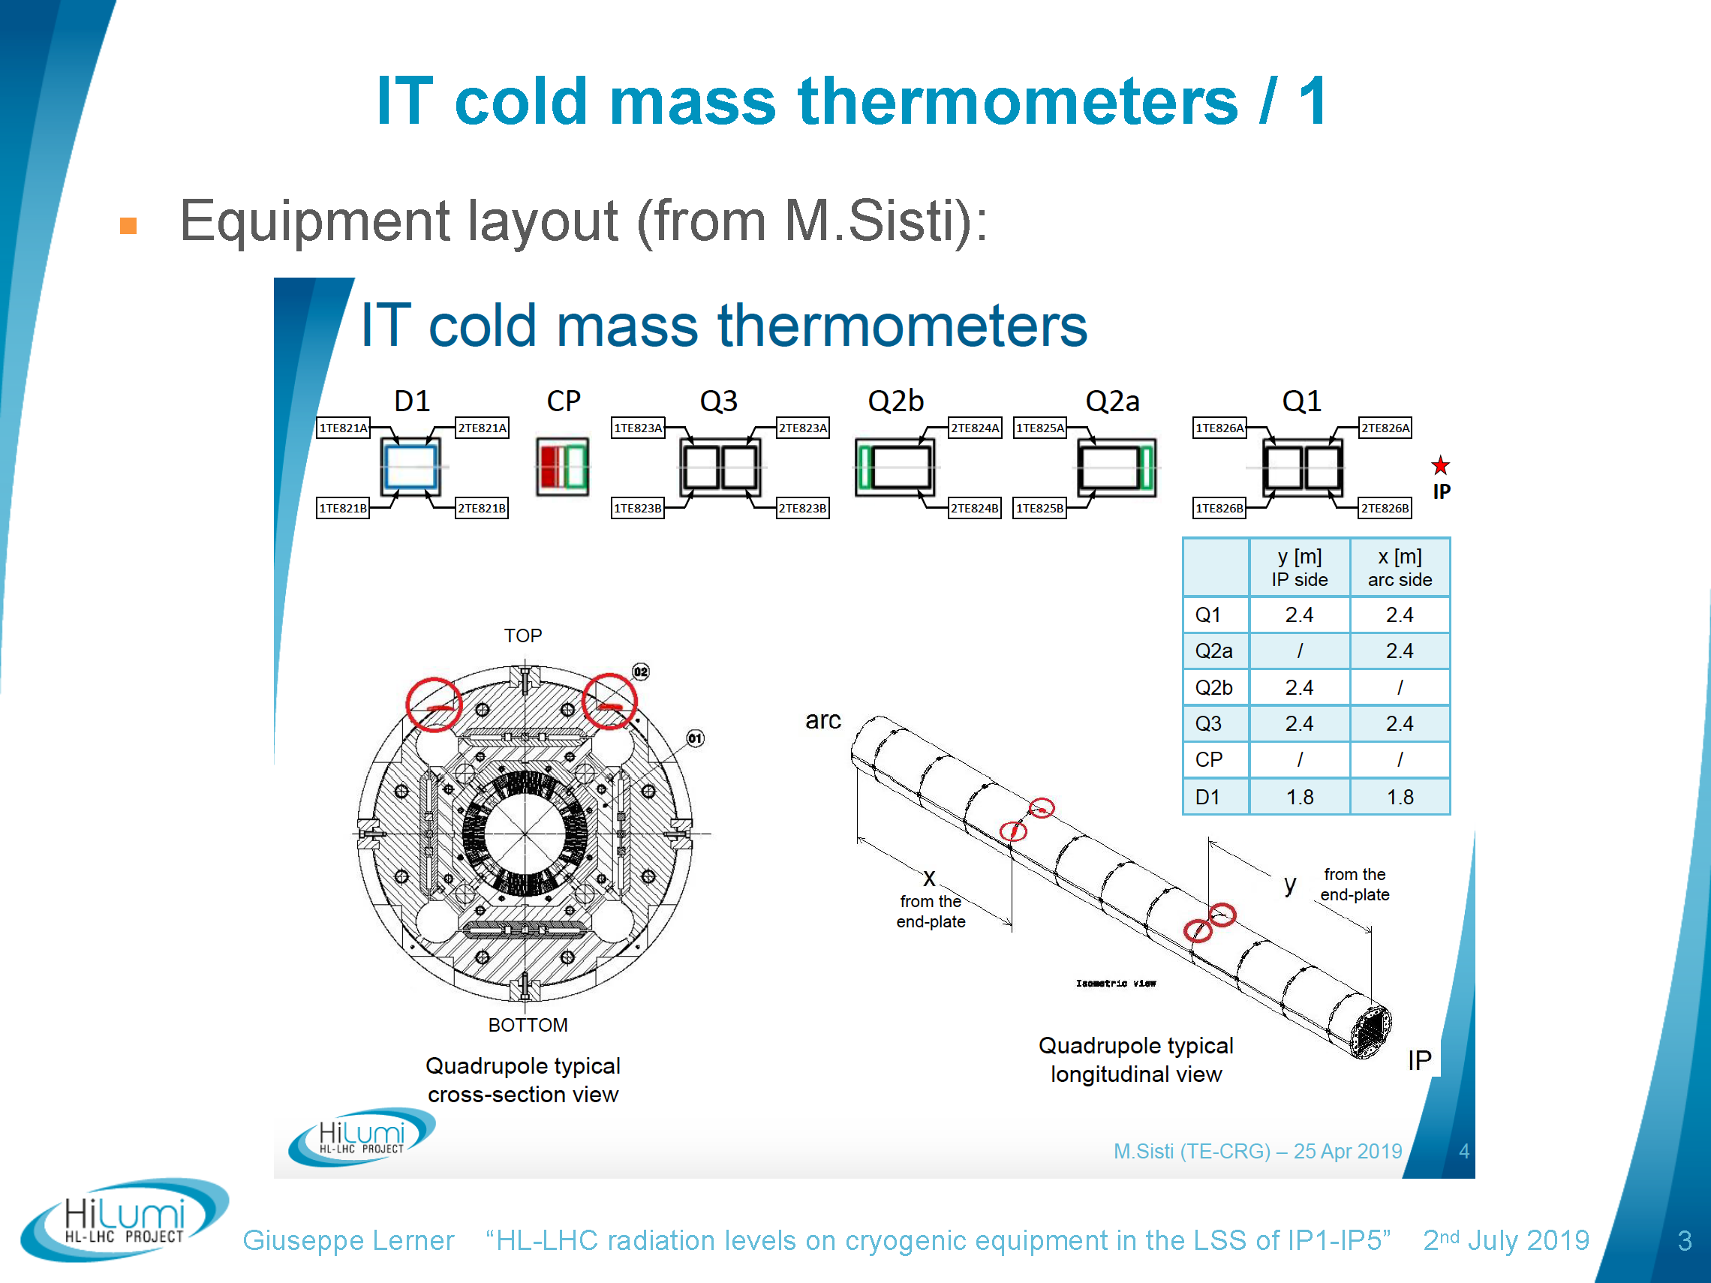
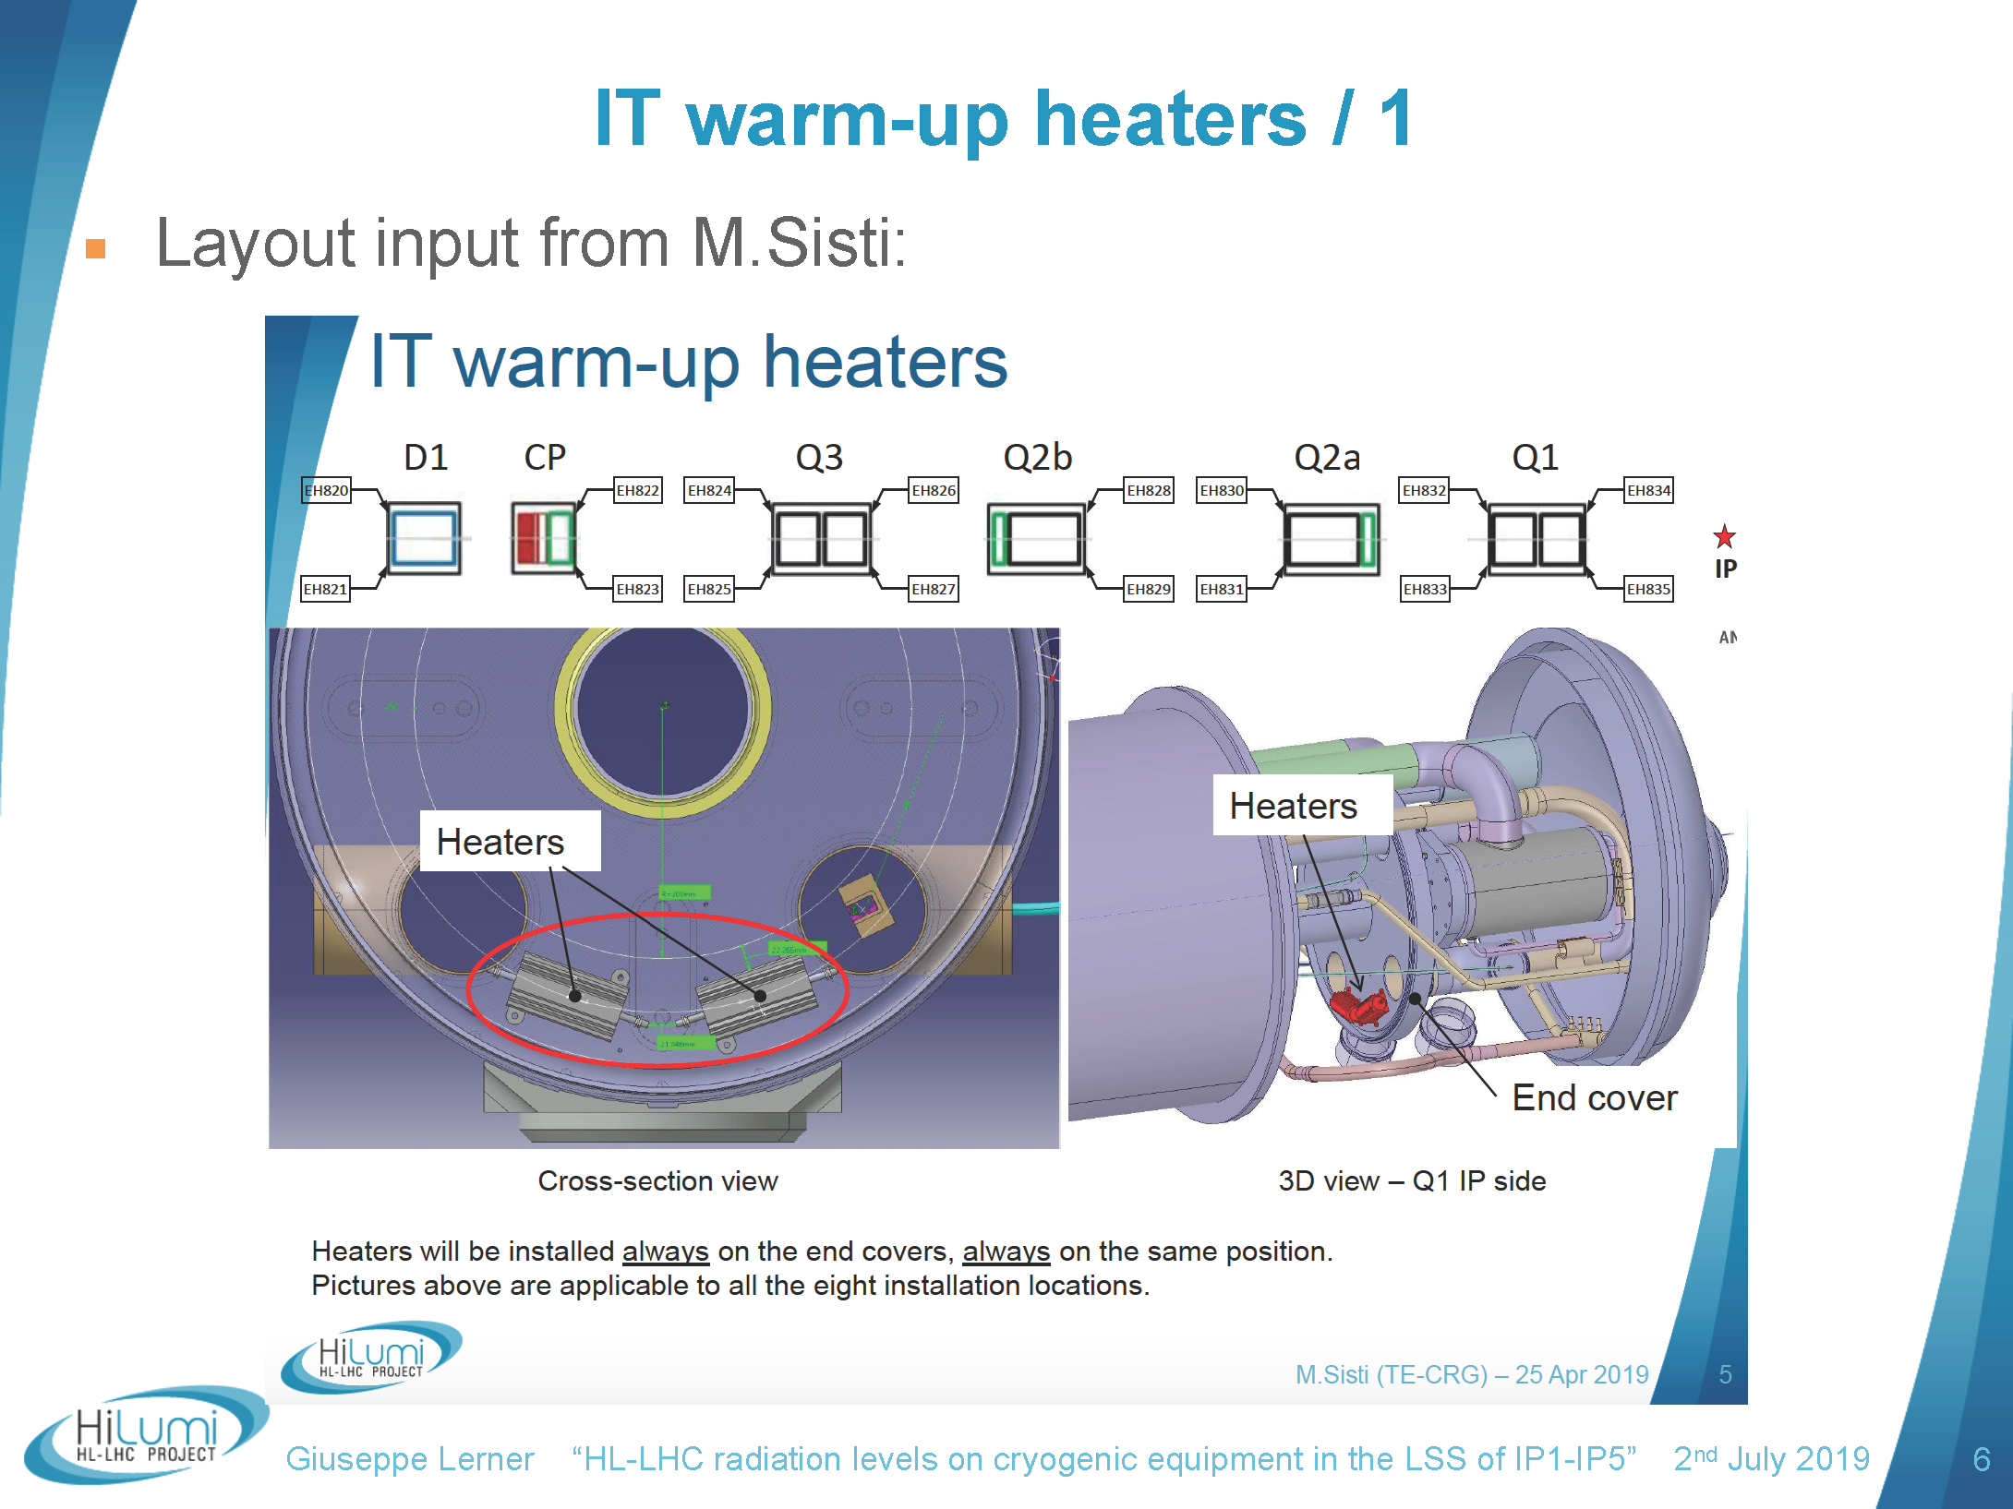
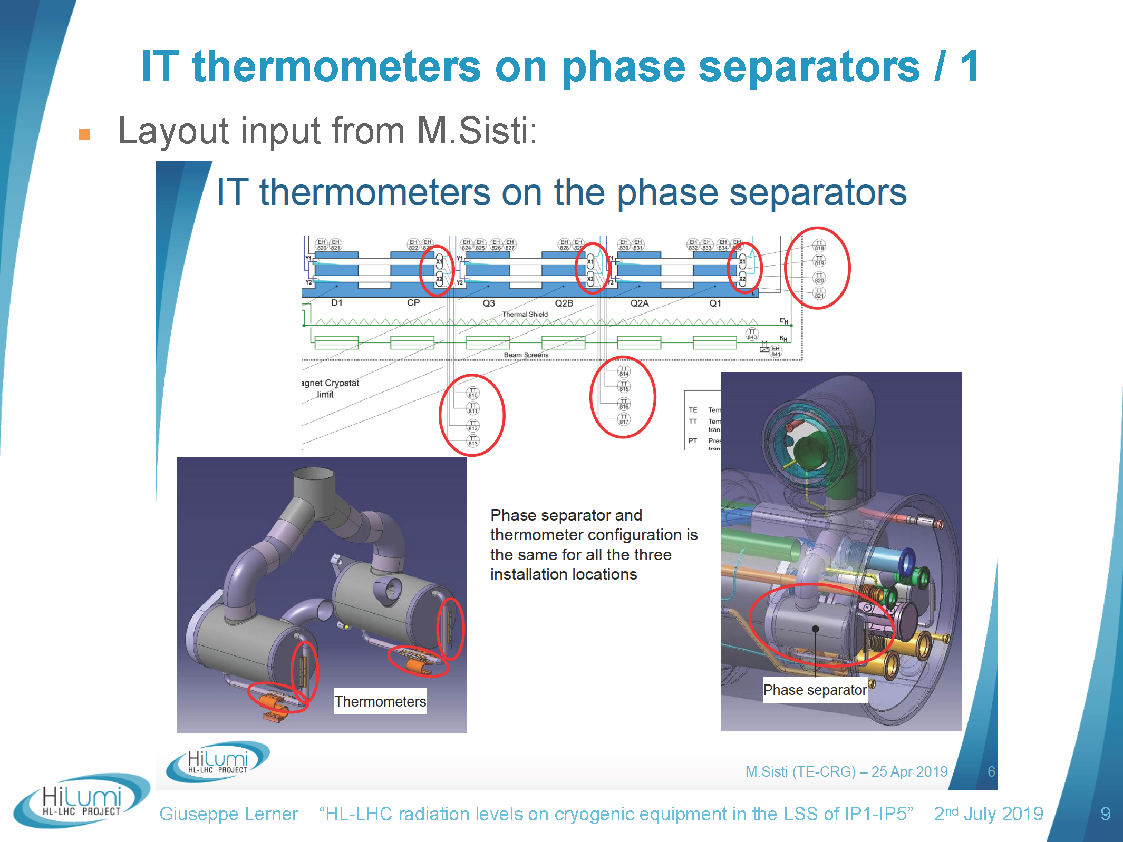
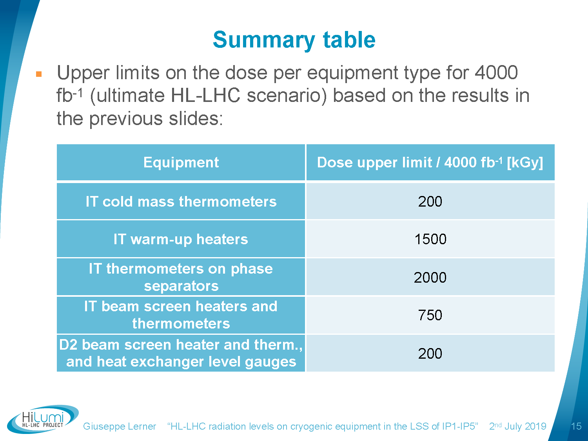
TID on Cryo instrumentation
Thanks to G. Lerner and EN-STI team
OK
NotOK, alternative!
Ok for less accurate technology
16Dec'19

Slide 12
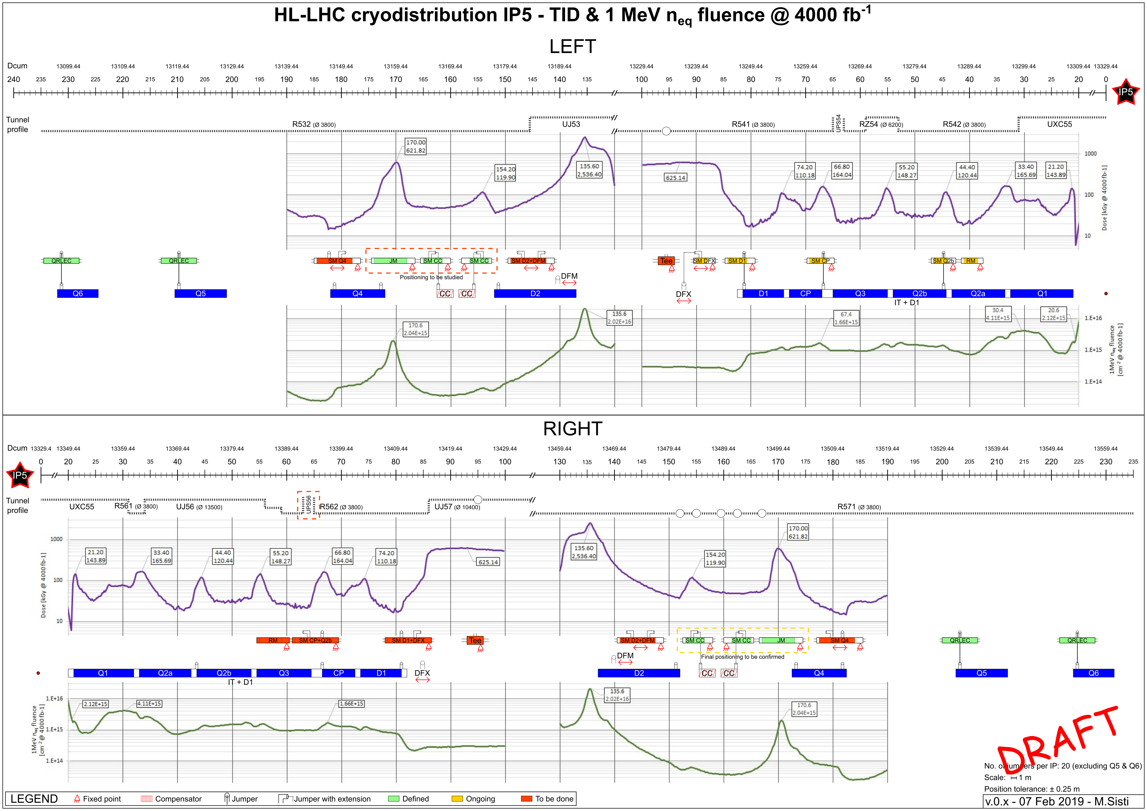
QXL Cryoline integration and radiation constraints
- Strategy defined for instrumentation, (OK up to 100 kGy)
- Cabling to electronic cards in sheltered areas (cryo racks) and control architecture being defined (space reserved for cryo racks)
16Dec'19

Slide 13
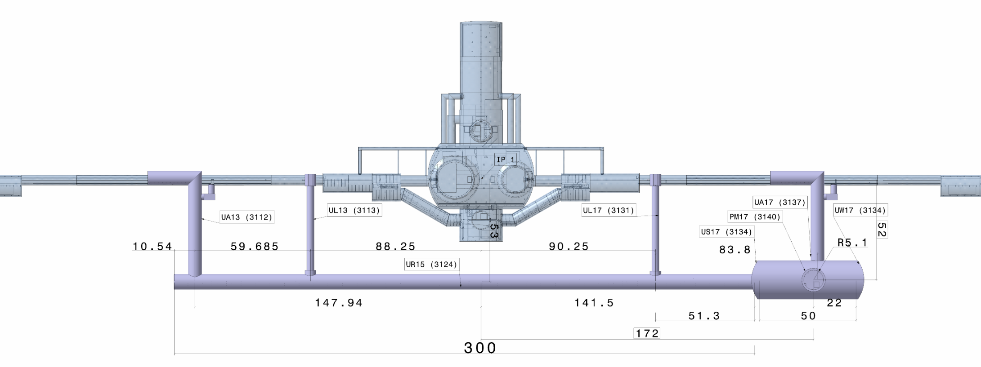
HL-LHC cryogenic “Valve” and “RadTol instrumentation” Racks
IP1
For DS+ARC+QRL_arc ?
For DS+ARC+QRL_arc ?
For IT+D1, DF’s, D2, CC, QXL
For IT+D1, DF’s, D2, CC, QXL
For DFBL, Q6-Q5-Q4, QRL_LSS
UJ14
UJ16
For DFBL, Q6-Q5-Q4, QRL_LSS
Cryo
JM
Junction Module
Cryo
Cryo
Cryo
Cryo
DFM
D1
Q3
Q2a
Cryo
DFBL
Q6
Q5
Q4
2 x CC
D2
DFX
CP
Q2b
Q1
RR13
RR17
Cryo
Cryo
Cryo
Cryo
For QXL valves (2)
Cryo
PLC
Cryo
Spare
Cryo
Cryo
Spare
Cryo
Cryo
PLC
For DFBL + QRL_LSS_RM (1)
For DFH’s + QXL + QRL_LSS, could be placed together in this zone
Cryo
Cryo
For DFH’s, could be moved to gallery extremity
Cryo
Cryo
They will be free after LS3, R2E-LS3 relocation due to the increase of the radiation levels in UJ’s
Cryo
LHC Cryo “RadTol instrumentation” racks, re-work required
Identify RR cryo racks to separate arc from LSS (!all LSS cables dismounted for LS3 => Re-work required!)
Move cryo instrum racks from UJ to UL (R2E-LS3)
Proposal to re-group all non Rad-Tol Cryo racks for LSS (LHC+HL) at gallery extremities
Then cabling + fibers requirements to be made on solid grounds!
Cryo
HL-LHC Cryo “valves” cabinets !New HL!
Cryo
LHC Cryo “valves” racks, R2E-LS3 relocated and re-work required
Spare
HL-LHC rack, Spare to adapt to SC-Link instrumentation
16Dec'19

