Slide 1
BPMs for E-Coolers and E-Lenses at CERN
L. Søby

Slide 2
Outline
Status of Ecooler BPMs
Status of CERN HEL BPM design
  BPM
  Acquisition system
Proposal for Test stand BPM
Summary

Slide 3
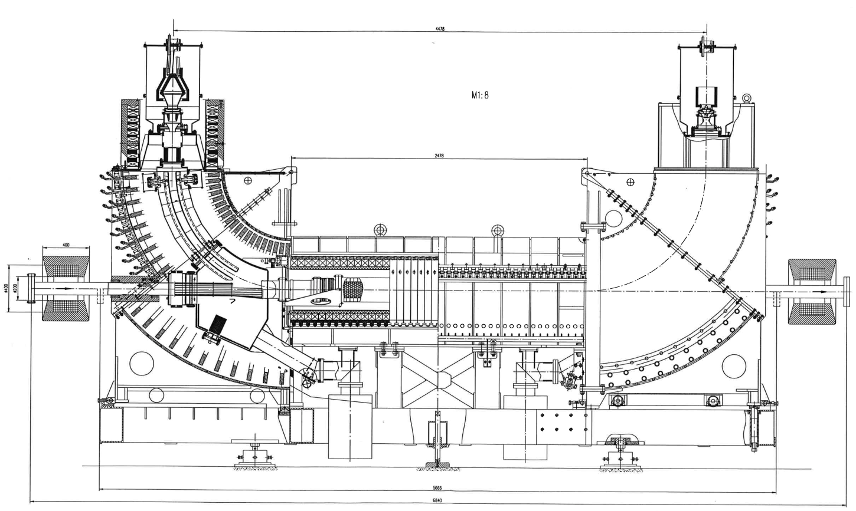
A CERN E-cooler
Typical 2 BPMs per E-cooler
Pbar (Pb) and electron beams in same direction

Slide 4
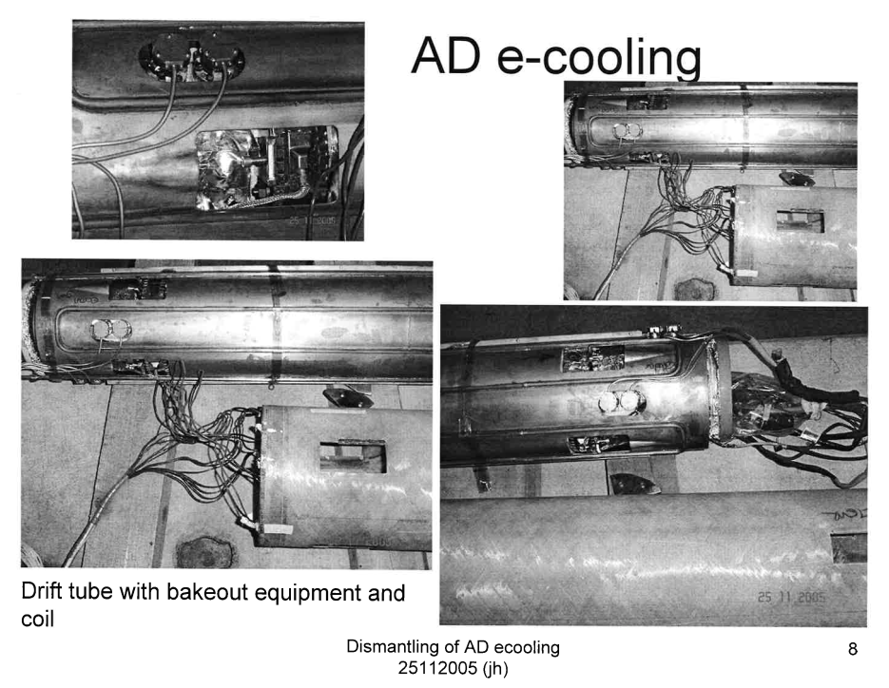
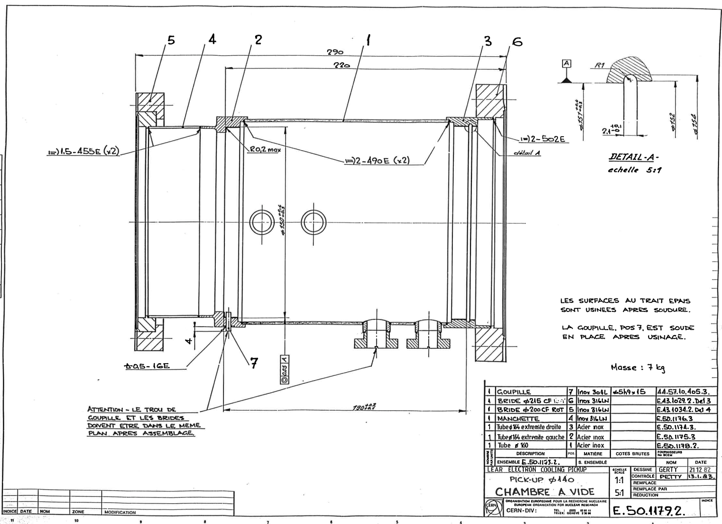
AD E-cooler BPMs
Metalized
Ceramic cylinder

Slide 5
BPMs in CERN E-coolers
 | LEIR |  | AD |  | ELENA
 | E-Beam | Pb beam | E-Beam | Pbar beam | E-Beam | Pbar beam
Current | 1-2.5A | 1E11 Ch | 1-2.5A | 4E7 Ch | 2-5mA | 1E7
Energy | 2.3keV | 4.2-72 MeV | 27keV-3.1keV | 3.5-0.1 GeV/c | 355-55eV | 5.3-0.1 MeV
BPM | Electrostatic; ~500 pF |  | Electrostatic, ~700pF |  | Electrostatic, 20pF
Dimensions | ID=140mm L=190mm |  | ID=140mm | L=190mm | ID= 51mm | L= 100mm
Front-end | High imp. voltage amp. |  | High imp. voltage amp. |  | Charge amplifier
In Orbit acquisition | Yes |  | No, but on the way |  | Yes
Ebeam modul. | (Intensity) and energy |  | Energy modulation only |  | Intensity and energy
E-beam acq. | Yes, oscilloscope/OASIS |  | No, but on the way |  | Yes OASIS+APP
Electrostatic BPMs used everywhere.
E-coolers works with un-bunched beams, but bunching of Pbar (Pb) beams needed to determine position inside the e-cooler.
Modulation of E-beam needed to measure E-beam position.
Measurements of two beams done separately, slow process.
ELENA is at present, only system operational with intensity modulation (100kHz with transformer from LEIR)
If intensity modulation on revolution frequency can be implemented, acquisitions can easily be integrated into acquisition systems of the 3 machines.

Slide 6
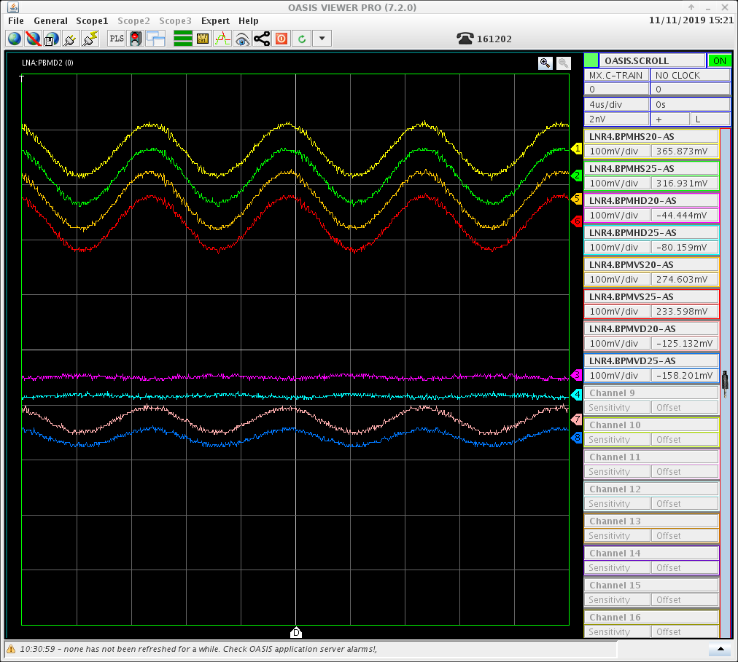
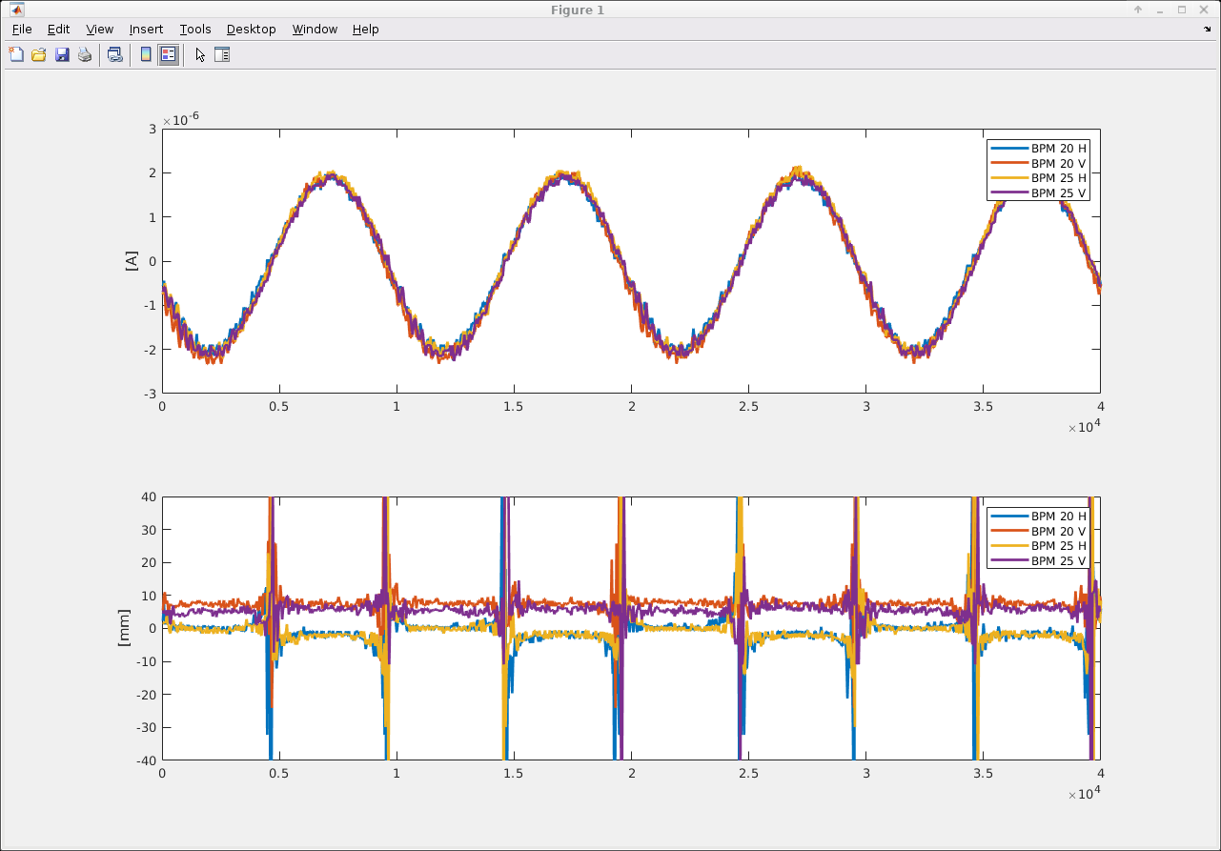
100kHz intensity modulation of E-beam in ELENA
100kHz; ~0.2% modulation
Sum signals
Delta signals
Positions

Slide 7
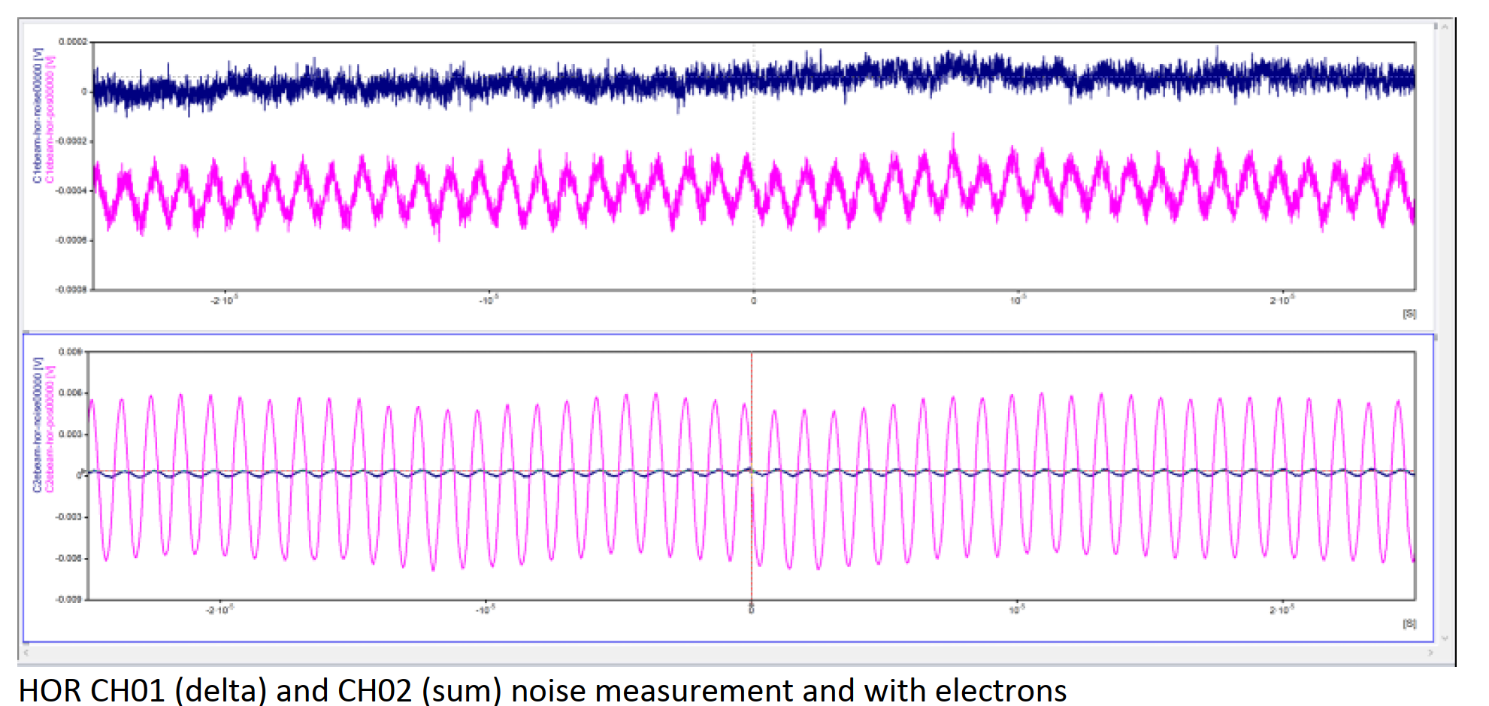
LEIR E-Beam BPM measurements (Intensity mod.)
Different scales

Slide 8
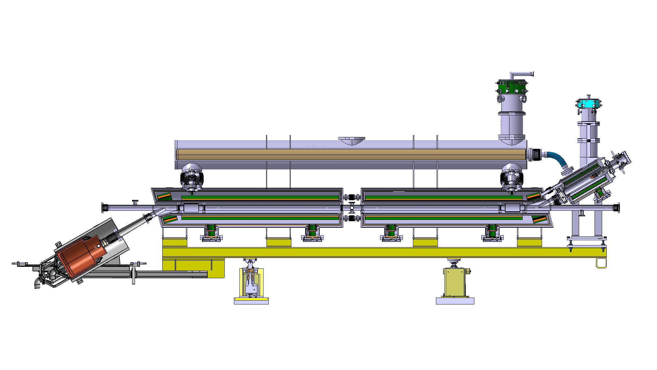
HEL BPM
2 BPMs for Hollow Electron Lens
Proton and electron beams counter rotating

Slide 9
HEL BPM Specifications:
 | Proton beam | Electron beam | Comments
Intensity | 5E9 (2.1A) / 2.5E11 (63A) | 1 / 5A
Bunch / Pulse length | 1ns | 1-86us | P=4σ; E_beam off 3us; tr = 200ns
Relativistic β | 1 | 0.19-0.24 | E_{Beam} Low β ~ 5 * charge density
Resolution | 100um / 20um | 100um / 20um
Relative accuracy | 100um |  | Between beams
Absolute accuracy | 500um | 500um
Max beam displacement | 4mm | 4mm
Time resolution | >1s? | >1s?
Inner diameter | 60mm
Max. outer diameter | 120mm
Functional specifications :
  E_beam on/off, 1 to 3 times per turn
  E-beam on/off either between LHC trains or within their internal structure coming from the SPS.
  Injection and on high energy stable beams
  Single bunch and pilot

Slide 10
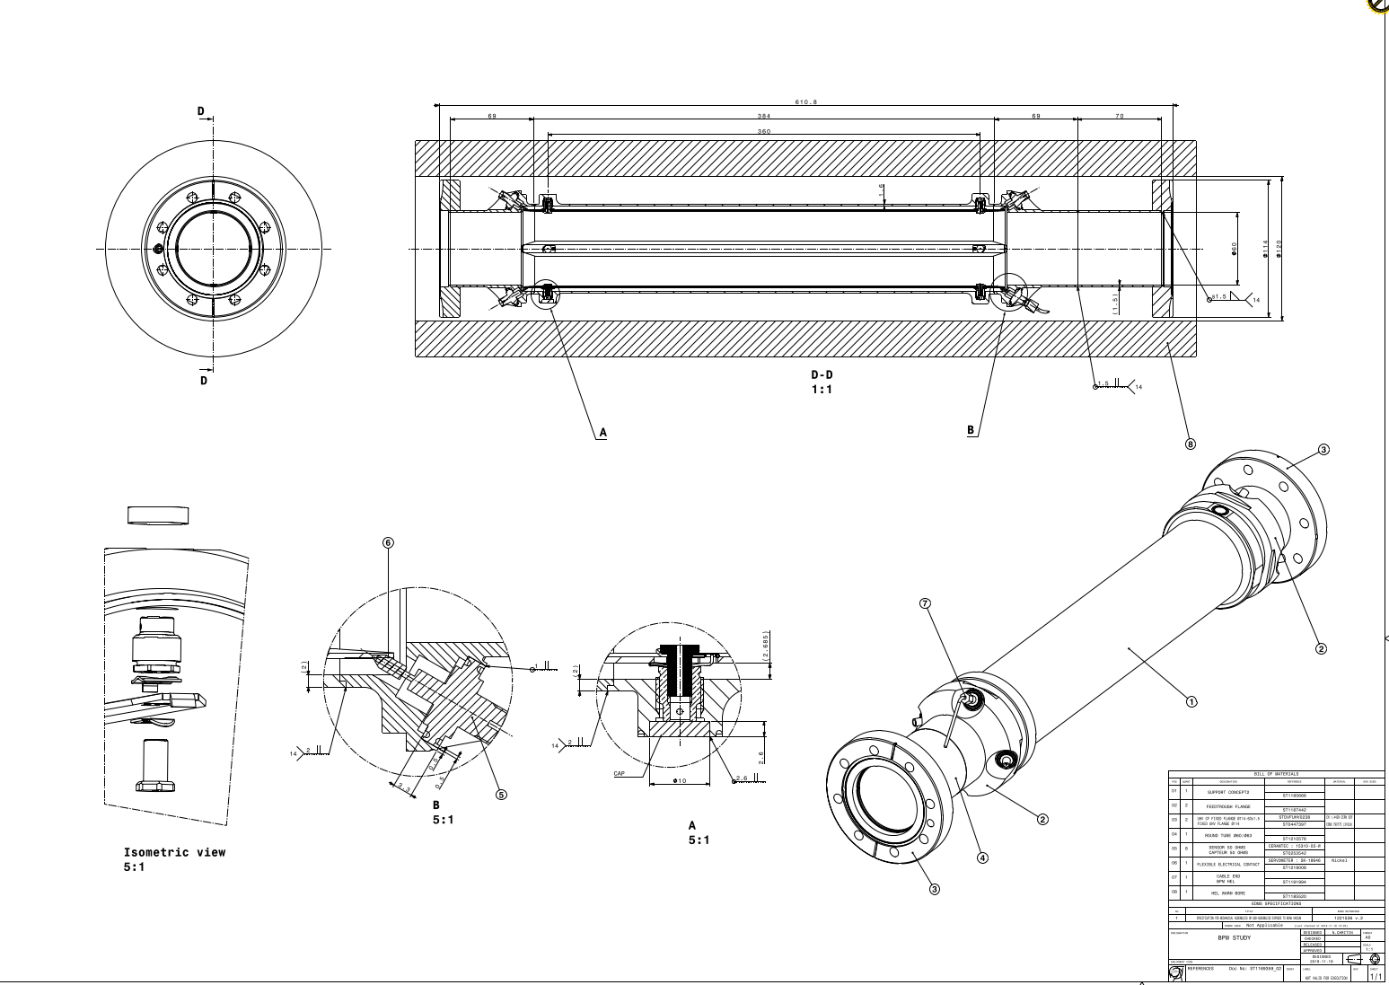
HEL BPM design
50 ohm strip line
Profit from counter rotating beams and directivity.
First simulations on 3D design done by Manfred.
Improvements in RF performance needed.
DN63
610mm
400mm
60mm
120mm
~45° welded feedthrough
Present design details not yet optimized for HF

Slide 11
BPM signal summery
BPM | Electron beam on/off | Gaussian 2.5*10^11, 0.25ns | Gaussian, 2.5*10^11 with ~25MHz LP filter
Button | 0.04vp | 63Vp | ~0.65V
Strip line (0.2m, 45⁰) | 0.22Vp | 200Vp | ~0.45Vp
Strip line (0.4m, 23⁰) | 0.2V | 88Vp | 0.2V
Electrostatic (75⁰) | 0.8Vp | ~200Vp | ~0.4Vp

Slide 12
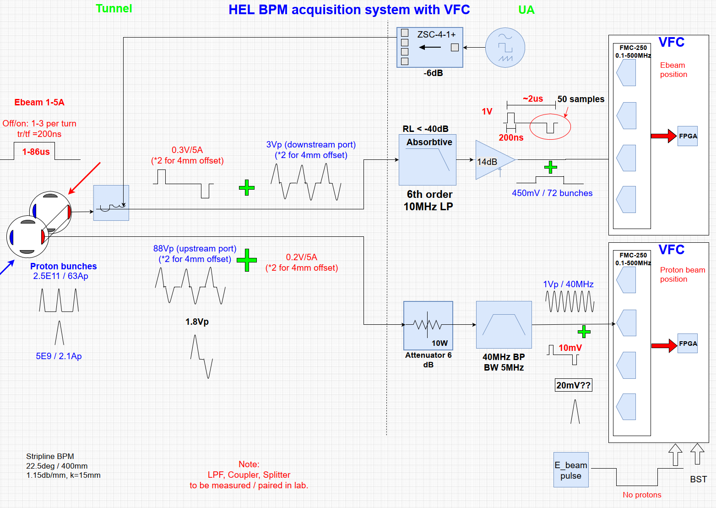
Hel Acquisition system with VFC+FMC
Need to measure two beams simultaneously
Frequency separation not possible
Measure electrons when no Proton's.
Need timing from gun

Slide 13
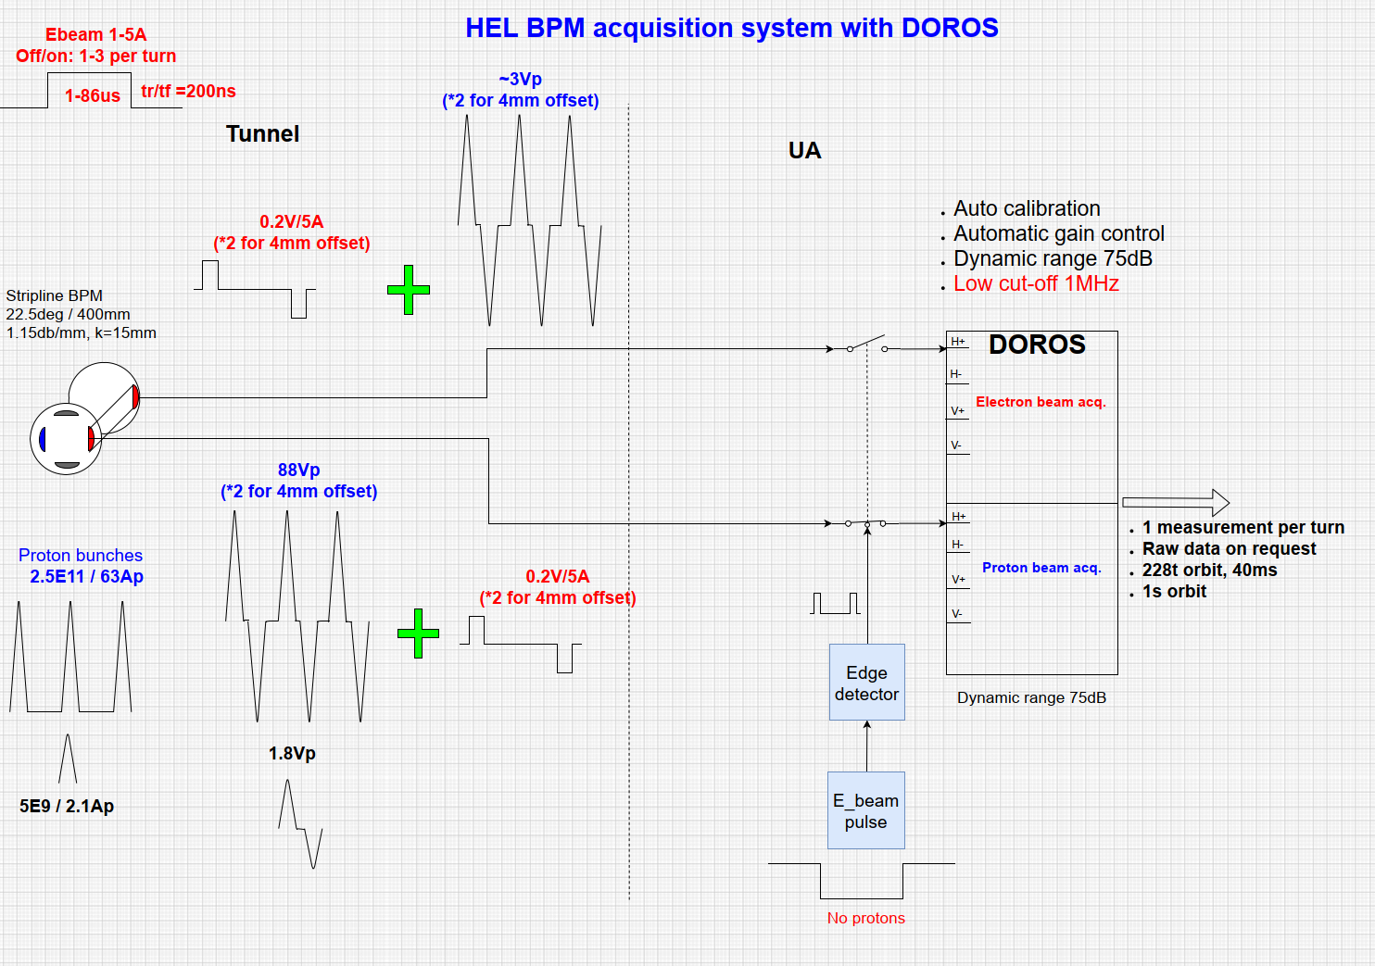
Hel Acquisition system with DOROS
Timing from gun essential

Slide 14
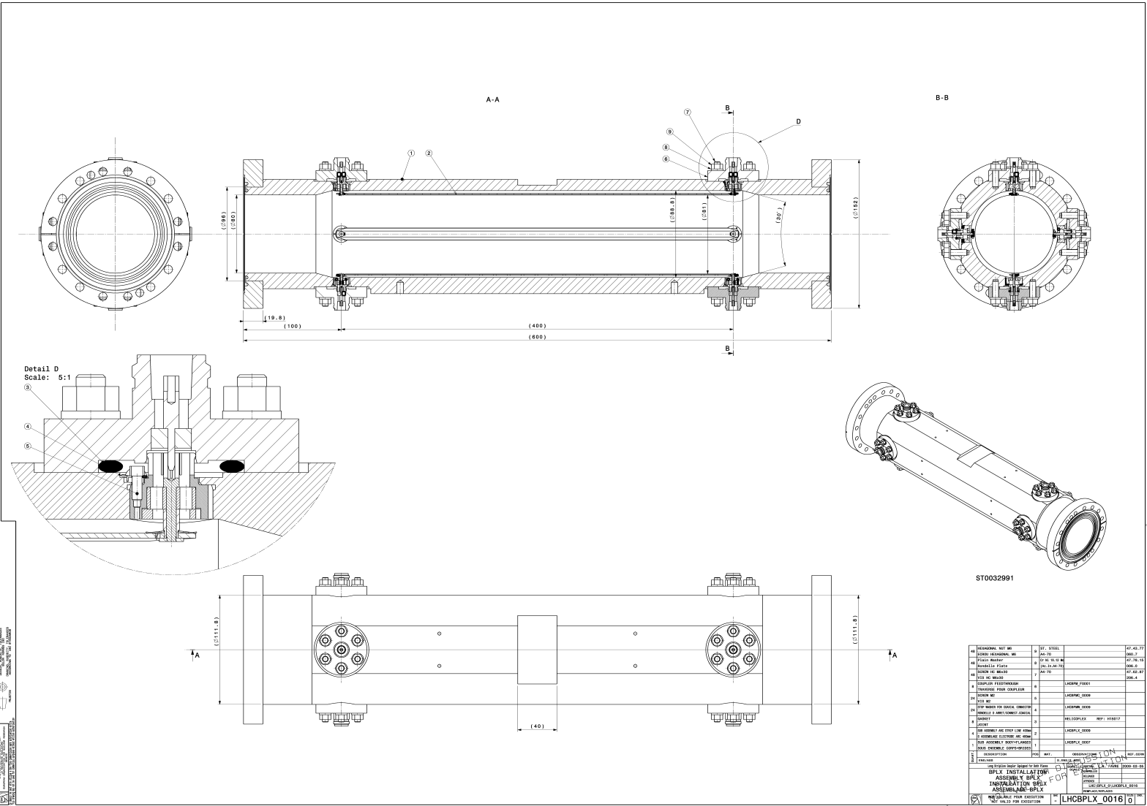
Test stand BPM: LHCBPLX
Two spares on stock
Dimensions close to HEL design
Acquisition with oscilloscope
DN100
80mm
400mm

Slide 15
Summary:
Injector E-coolers:
  Use electrostatic BPMs
  Only ELENA is operational with intensity modulation
  Intensity modulation at revolution frequency would enable E-beam position acquisitions
    Need to buy 2 more transformers
  AD analogue acquisition system being completed
HEL BPM
  3D design exist and has been simulated.
  Needs to be improved
  2 Proposals for acquisition systems
Test stand BPM
  Spare LHCBPLX will be installed in March
  Acquisition with oscilloscope

