Slide 1
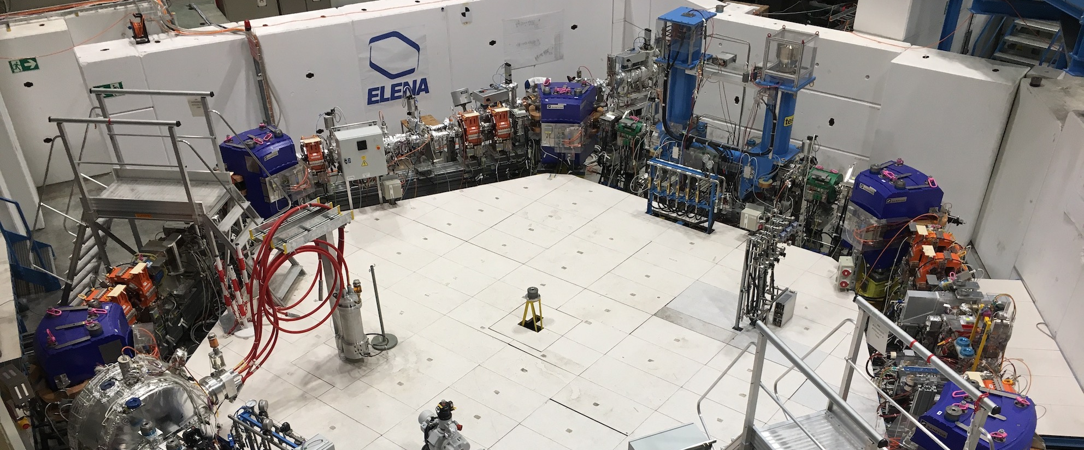
e- beam orbit measurement in
ELENA cooler
A. Frassier, B. Galante, D. Gamba*, L. V. Joergensen, O. Marqversen E-BEAM #8 – 15th Jan 2020
Hardware set-up
First orbit measurement and optimization
Possible issues
Conclusions
* davide.gamba@cern.ch

Slide 2
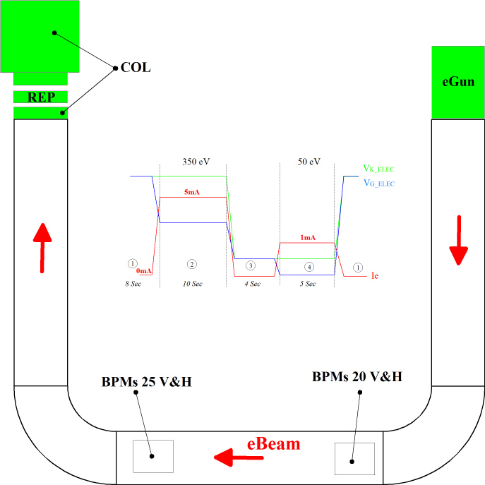
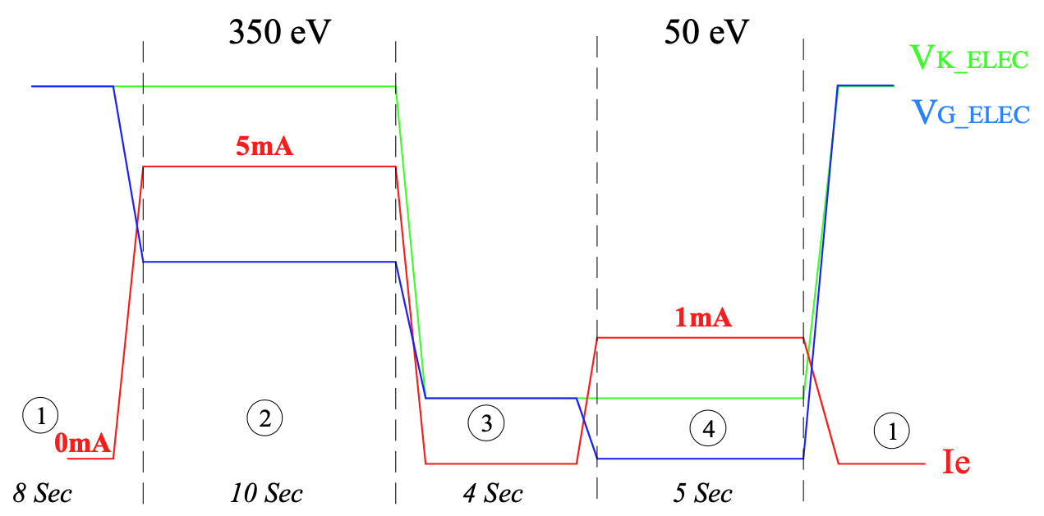
EC ELENA : BPMs & Electron beam
* Electron beam is produced by a thermionic cathode and extracted with the help of 2 electrodes:
Cathode ( K ) is used to set the beam energy
Grid (G): controls the beam intensity
* To get an electron cooling as better as possible this electron beam have to be very stable in intensity and energy …
* … but this is not really compatible with BPMs that need variation
* Two methods have been tested to obtain a variation of beam intensity

Slide 3
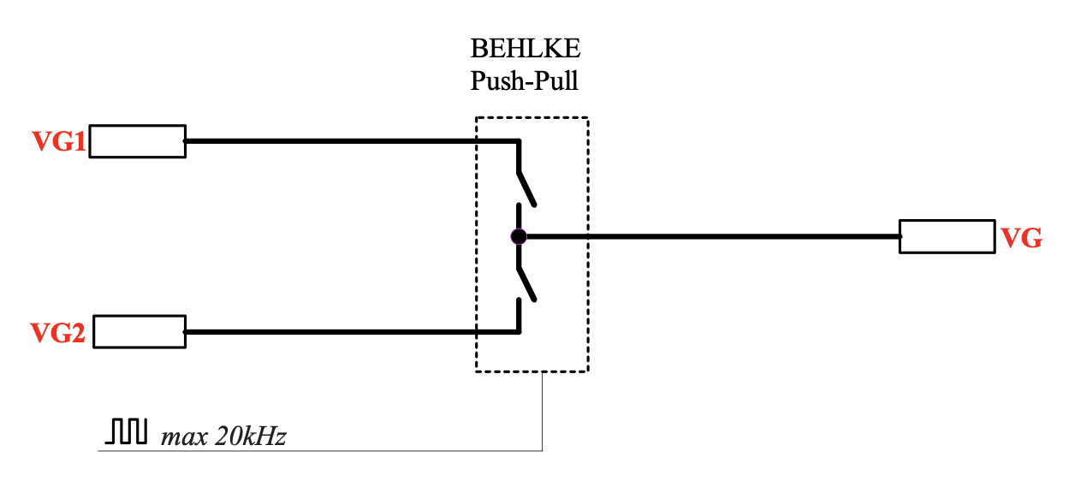
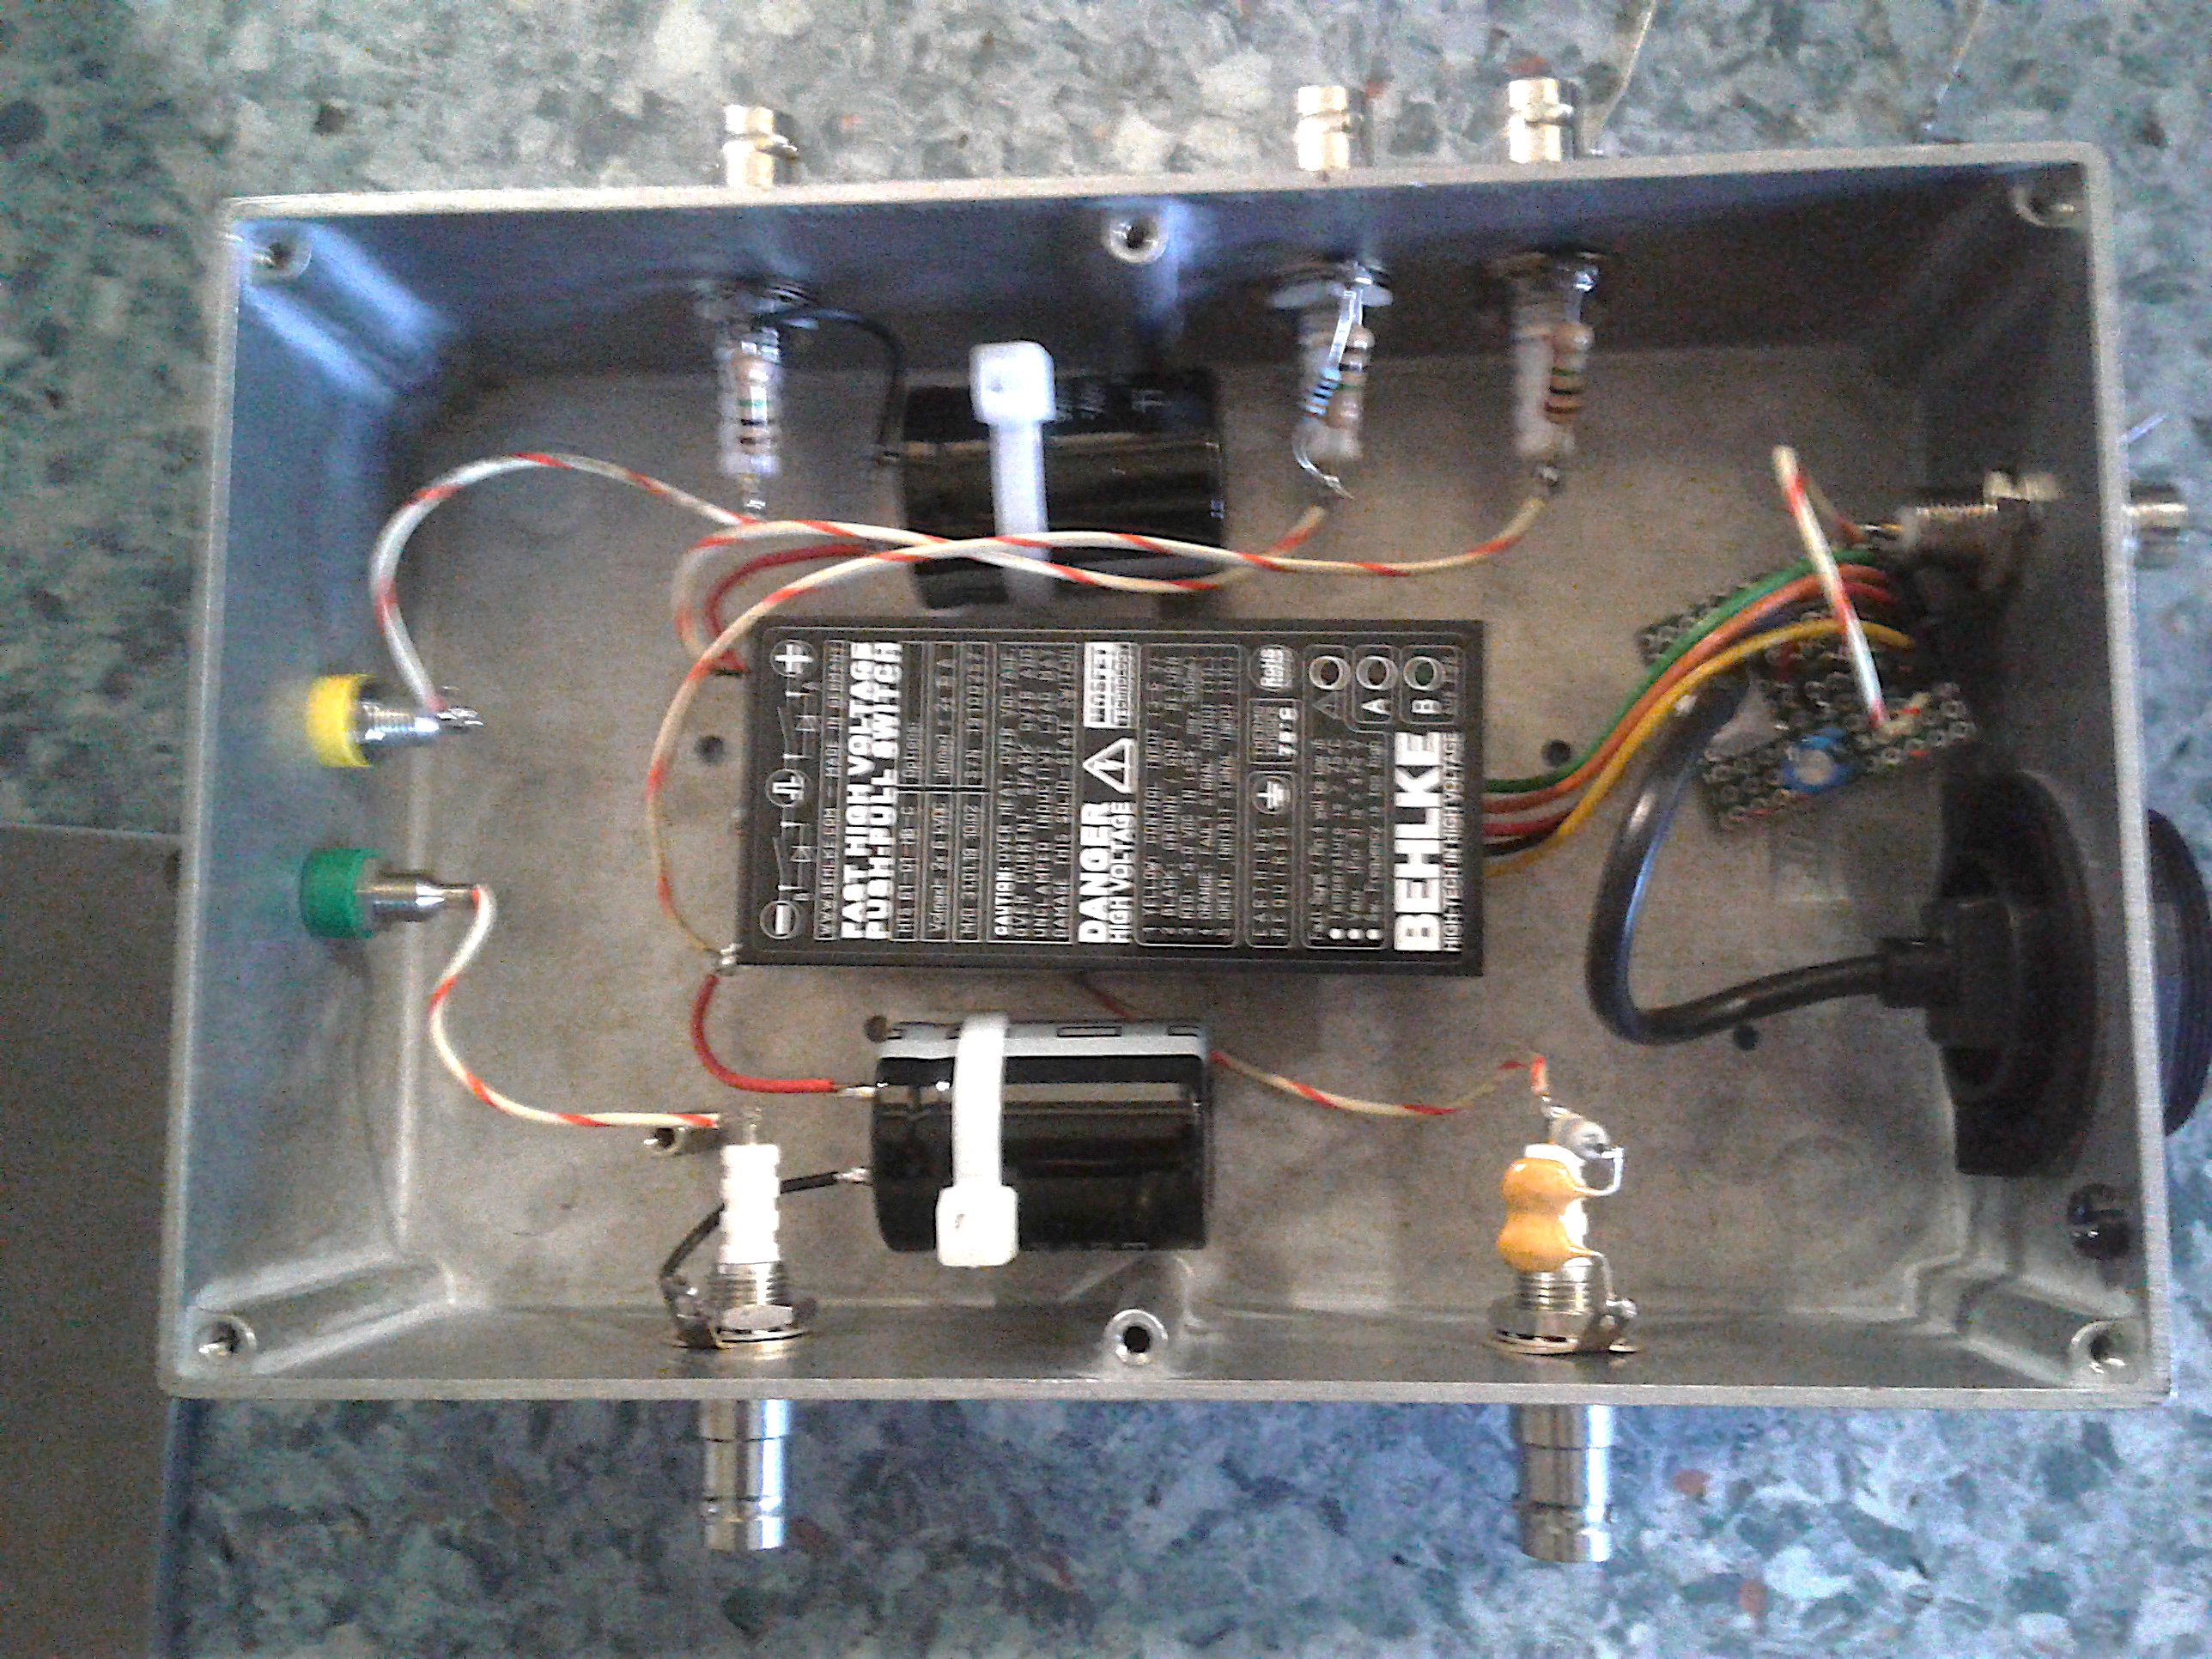
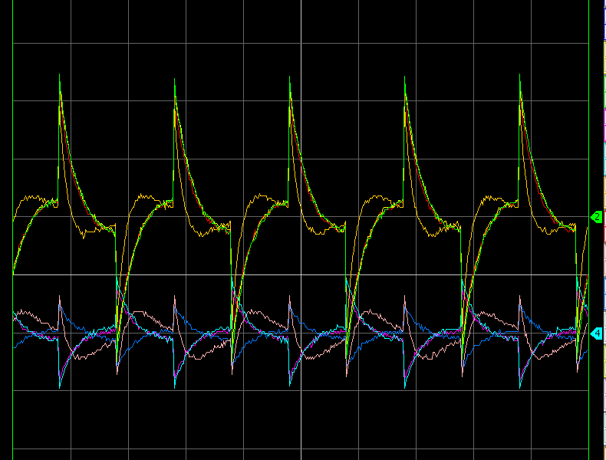
#1: fast switching modulation
* The grid electrode is switched between two different voltage in few ns with a push-pull transistor.
* Expected e-beam intensity variation :
For typical values for 50 eV plateau:
(P = 6e-6 [A V^{-3/2}]; V_{K}=60 [V]; V_{G}=30 [V])
* This can be seen by the BPMs but :
  Signals are saturated and not very exploitable for the position
  Switching frequency is limited @ 20 kHz
From grid PC 1 - 2
Switching control
Step of 0.5 V @0.5kHz -> ~25 uA current step
100 mV/div
To grid
1 ms/div
Notes:
\Delta I_e
&= P \left( (V_K - V_{G1})^{3/2} - (V_K - V_{G2})^{3/2} \right) \\
&= P \left( (V_K - V_{G1})^{3/2} - ((V_K - V_{G1}) + (V_{G1} - V_{G2}))^{3/2} \right) \\
&= P \left( (V_K - V_{G1})^{3/2} - ((V_K - V_{G1}) + \Delta V_G)^{3/2} \right) \\
&\approx \frac{3}{2} P (V_K - V_{G1})^{1/2} \Delta V_G
\Delta I_e &\approx \frac{3}{2} P (V_K - V_{G1})^{1/2} (V_{G1} - V_{G2})
\Delta I_e &\approx 5 \times 10^{-5} (V_{G1} - V_{G2})
P = 8e-6 [A V^{-3/2}]; V_{K}=375 [V]; V_{G}=300 [V]
\Delta I_e &\approx 10^{-4} (V_{G1} - V_{G2})

Slide 4
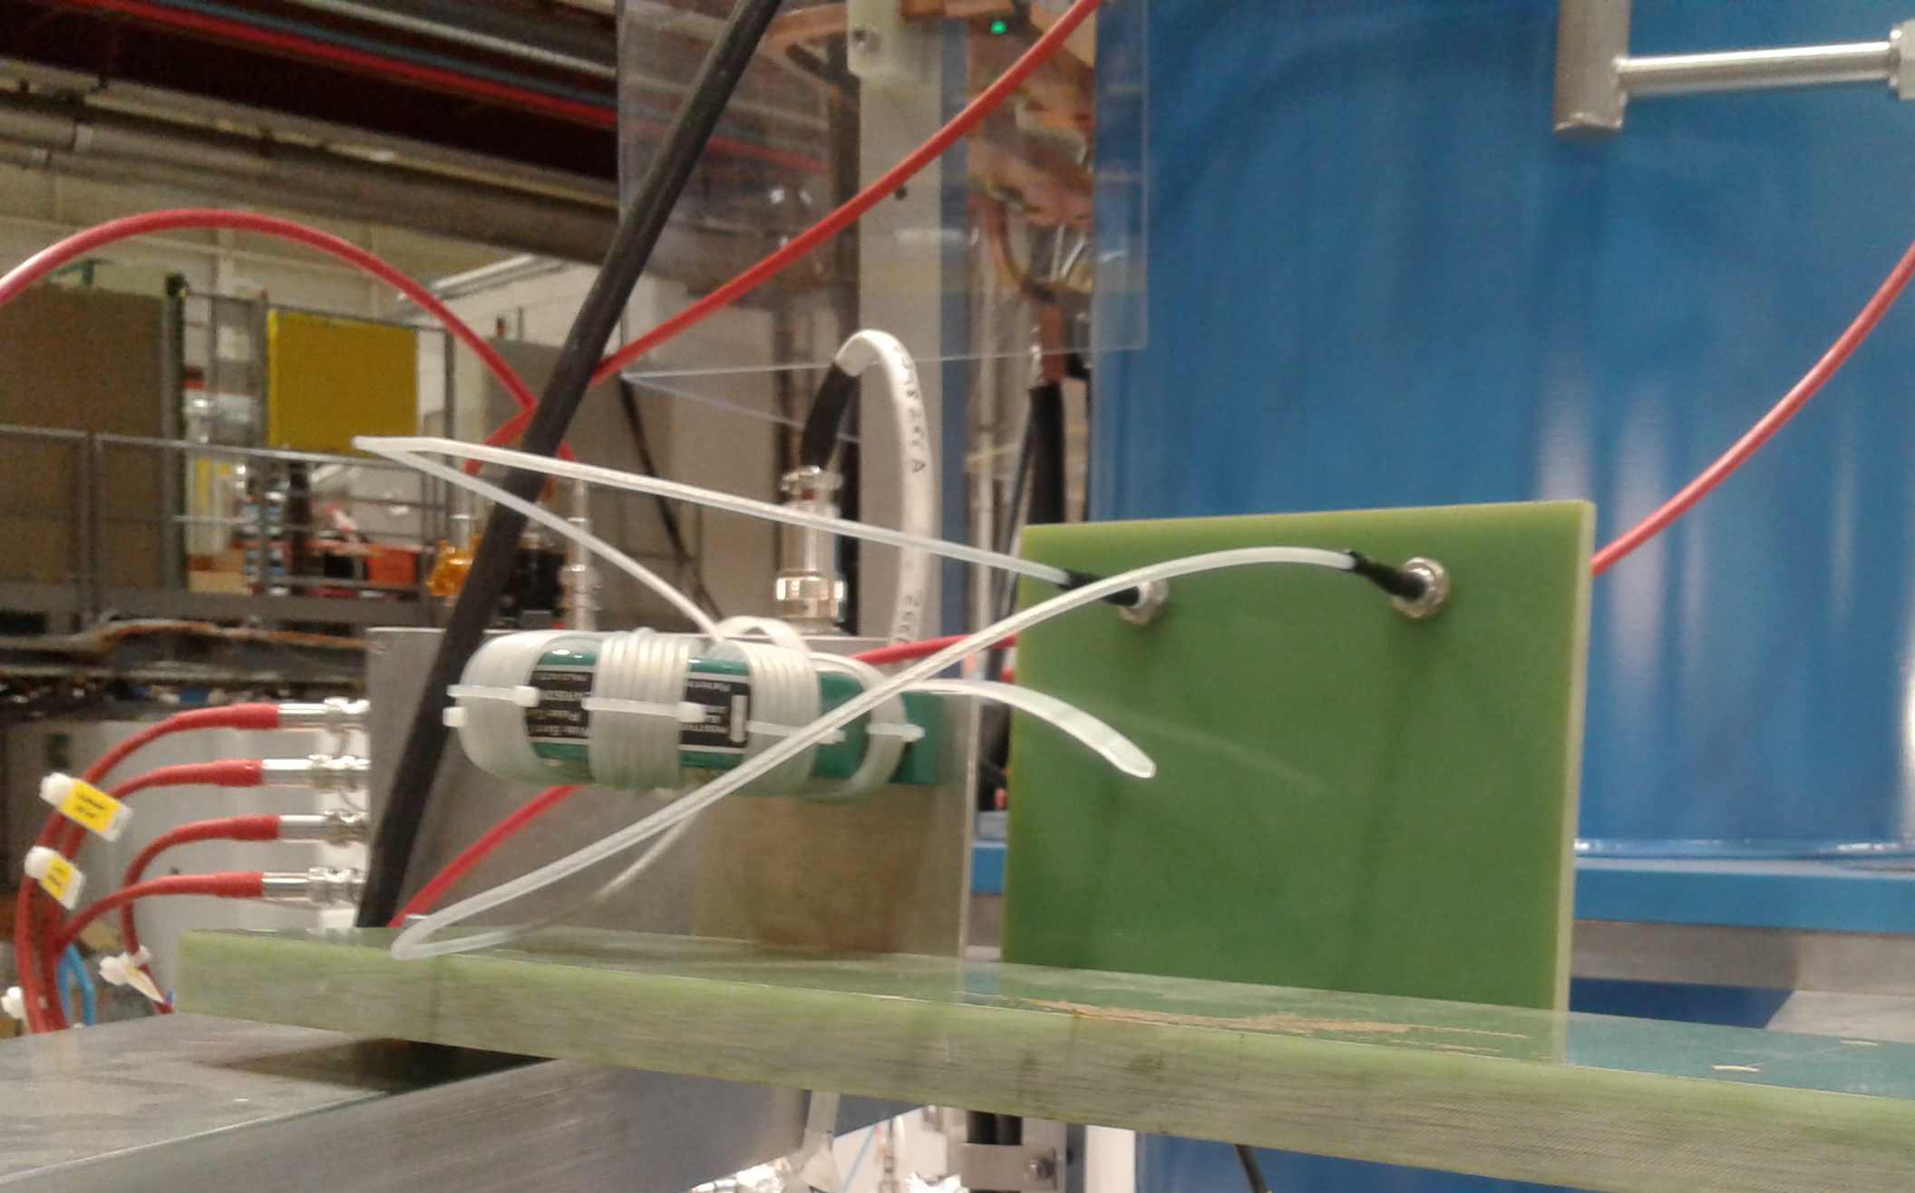
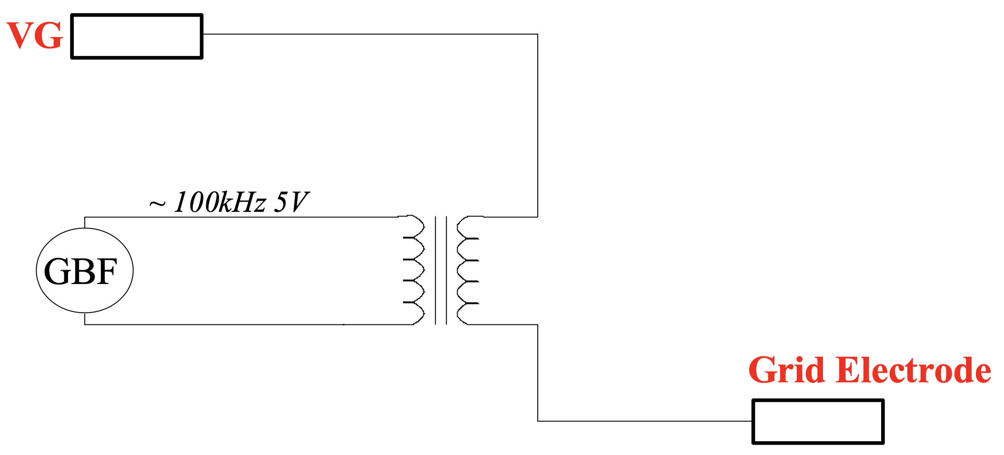
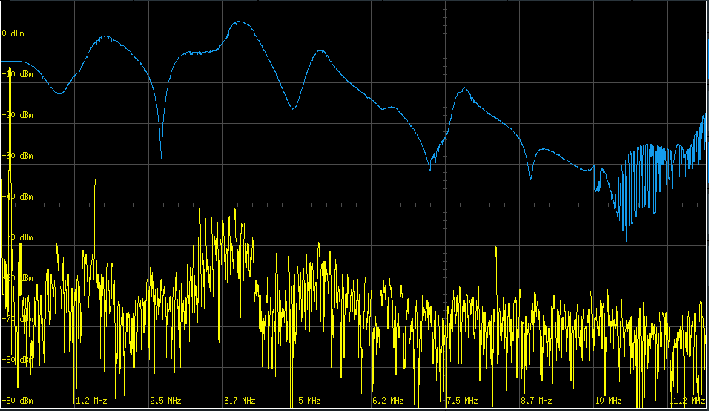
#2: coupling transformer modulation
This method consist in injecting a sinusoidal signal on the grid with the help of a coupling transformer (Pearson)
Response of the BPM signals:
  Clean sinusoidal signal
  Transfer function depends on chosen modulation frequency (e.g. 100 kHz)
Note: probably difficult to actually estimate the induced voltage ripple…
100 mV/div
0 dBm
-20 dBm
~1.1 MHz/div
10 us/div

Slide 5
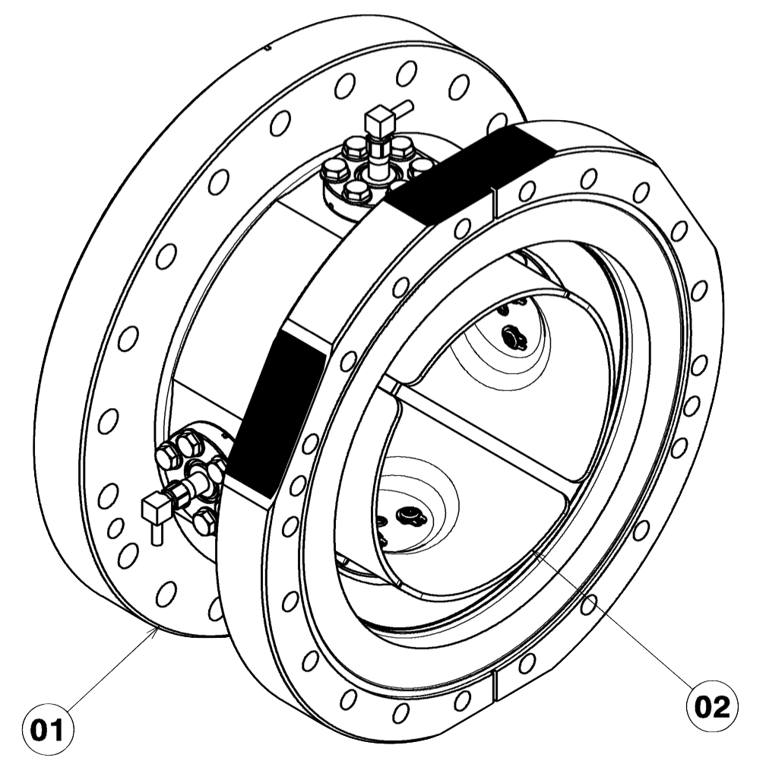
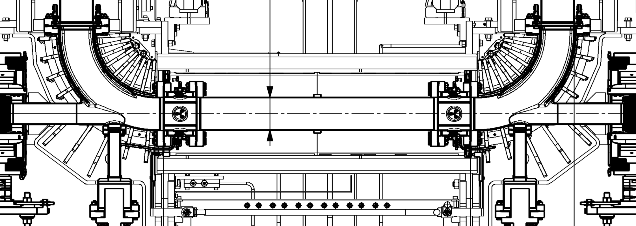
E-Cooler BPMs
Different than normal ring BPMs, but here assumed to behave the same.
  See AD_BPMEC0007, AD_BPMEC0015
Same head amplifier/acquisition chain
Beam position computation according to wikis:
where:
Intensity computed according to
logbook + wikis:
~100 mm
To be checked!!!
~100 mm
100 mm
To be checked!!!
~850 mm
Notes:
Pos [\mathrm{mm}] = \mathrm{k} \frac{1}{(\Delta/\Sigma_{cal})} \left( \frac{\Delta}{\Sigma} - \frac{\Delta}{\Sigma_{zero}}\right) - \mathrm{BPM}_{off}
k = 35 \mathrm{[mm]} &\text{ (default sensitivity)} \\
(\Delta/\Sigma_{cal}) = 2 &\text{ (} \Delta \text{ is x2 more sensitive than } \Sigma \text{)} \\
(\Delta/\Sigma_{zero}) = 0 &\text{ (default cal offset)} \\
\mathrm{BPM}_{off} = 0 &\text{ (default BPM mis)} \\
\Delta &\text{ (Delta signal [V])} \\
\Sigma &\text{ (Sum signal [V])} \\
I \text{[A]} &= k \beta_{rel} c \Sigma \\
\text{where}: \beta_{rel} &\approx 0.0146 \text{ (@100 keV)}\\
k &= 4.4e7 \text{ (C. Carli)} \\
c &\approx 3e8 \\
\Sigma &\text{ (Sum signal [V])} \\

Slide 6
Measuring time of flight
Modulation @0.5MHz at 55eV (β_{rel}=0.0146 )
Observed ~200 ns delay BPM20-BPM25 signals
  ~0.88 m between BPMs (in reality ~0.85 m)
400 ns/div
BPM.HS20
BPM.HS25
From ELENA logbook 22/11/2019

Slide 7
Reasonable EC settings/orbits
Found settings of EC electrodes/steerers to clearly see beam position on both plateaus at the same time (i.e. ~nominal cycle)
Still not optimal (~10 mm-like offsets, changing between plateaus)
  Optimization limited by correctors strength and head amplifier saturation(?) due to partial e- beam losses(?)
55 eV, 1 mA DC
355 eV, 5 mA DC
(intensity calibration might be sizably wrong here)
5 uA
3 uA
-5 uA
-3 uA
40 mm
40 mm
V
-40 mm
H
-40 mm
20 us
20 us
From ELENA logbook 15/11/2019

Slide 8
A few MHz noise: what is this?
12 Nov 2019 – logbook: Ie = 5 mA; ~350 eV;
  Acting on LNR4.ECCV steerer (-0.81 [A] vs -1.5 [A])
  Question: first sign of e- losses on pickups/vacuum chamber?

Slide 9
Saturation of head amplifier(?)
In case of (strong) mis-steering or bad(?) settings of e-cooler gun/collector electrodes, false orbit measurement:
  35 mm level = k calibration: indication that one channel is “blind”(?)
BPM20H Σ signal
≈ half than others
2 uA
Σ signals
-2 uA
40 mm
Δ signals
- 40 mm
From ELENA logbook 29/10/2019

Slide 10
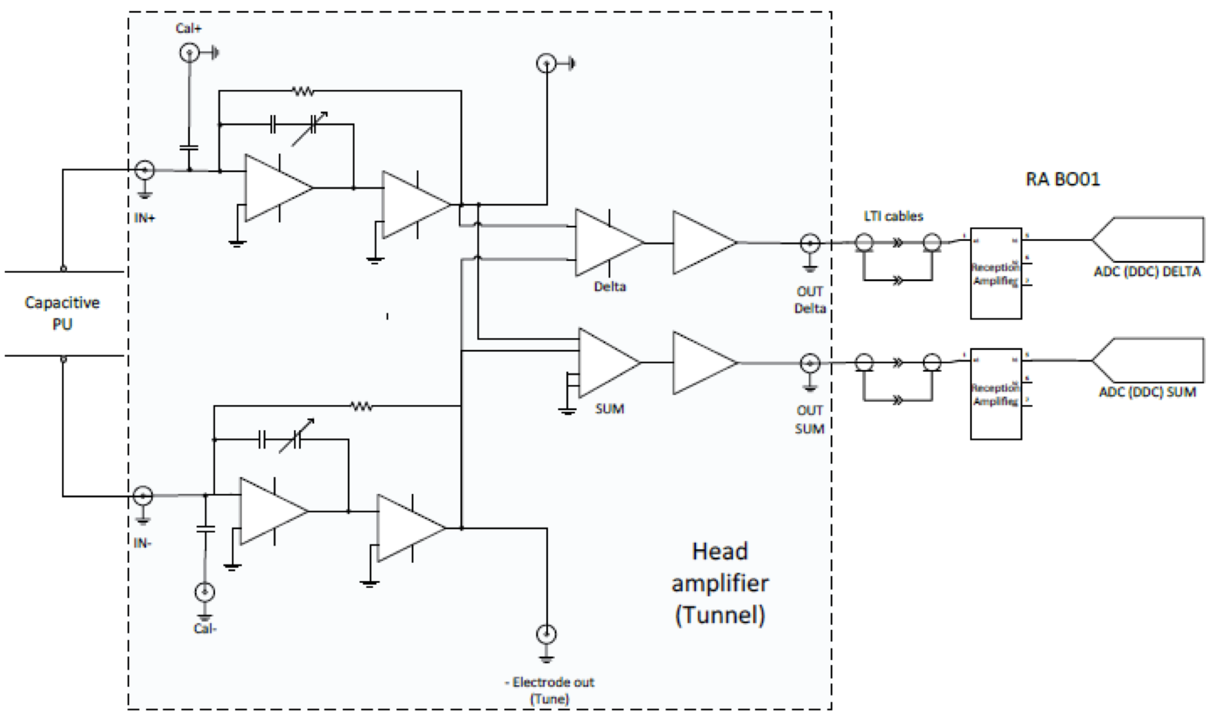
BPMs Head Amplifier
Designed for ~uA pbar bunched beam, while e-cooler DC e- beam ~1-5 mA
Questions:
  What happens when one electrode is hit by a few/many e-?
    Can we think of de-coupling pickup and amplifier with a capacitor?
  The sum signal being used is the sum of only two H (or V) plates:
    given the BPM geometry, shouldn’t one use the sum of all 4 electrodes?
From R.M. Hernandez @BI Day 2016 indico

Slide 11
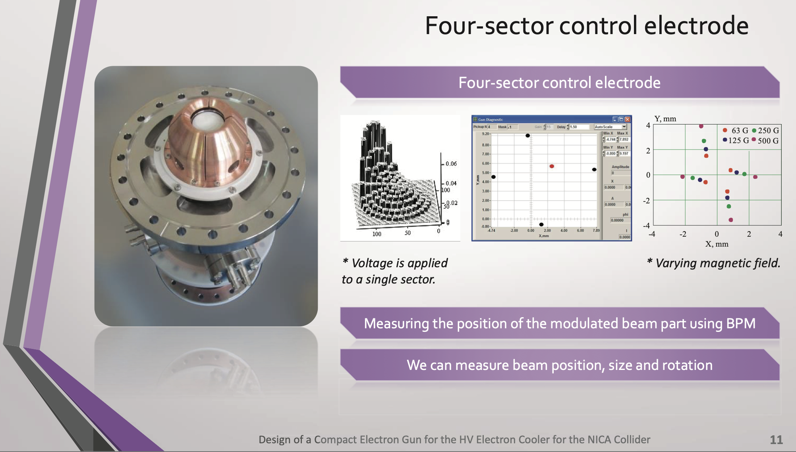
Future GUN(s)?
Could we also profit of such a gun for e-cooler setup-optimization?!
From Andrey Denisov @COOL19 link

Slide 12
Conclusions and discussion
Successfully tested two ways for inducing an e- beam intensity modulation
  For orbit measurement, the sinusoidal excitation seems to be the more appropriate
  Voltage step maybe interesting on V_{K} for cooling force measurement (e.g. see A. Saa Hernandex)
Room for e- beam orbit optimization seems to be limited by saturation of head amplifier due to e- losses on pickup
  Is it possible to overcome this limitation?
Should we proceed for a permanent setup without coupling transformer on (all) E-Coolers?
  Could the e-orbit measurement be treated by standard BI orbit system?
  Should we use TRF signal (amplified) as source for the excitation?
Thank you for your attention and questions!

Slide 13
Backup

Slide 14
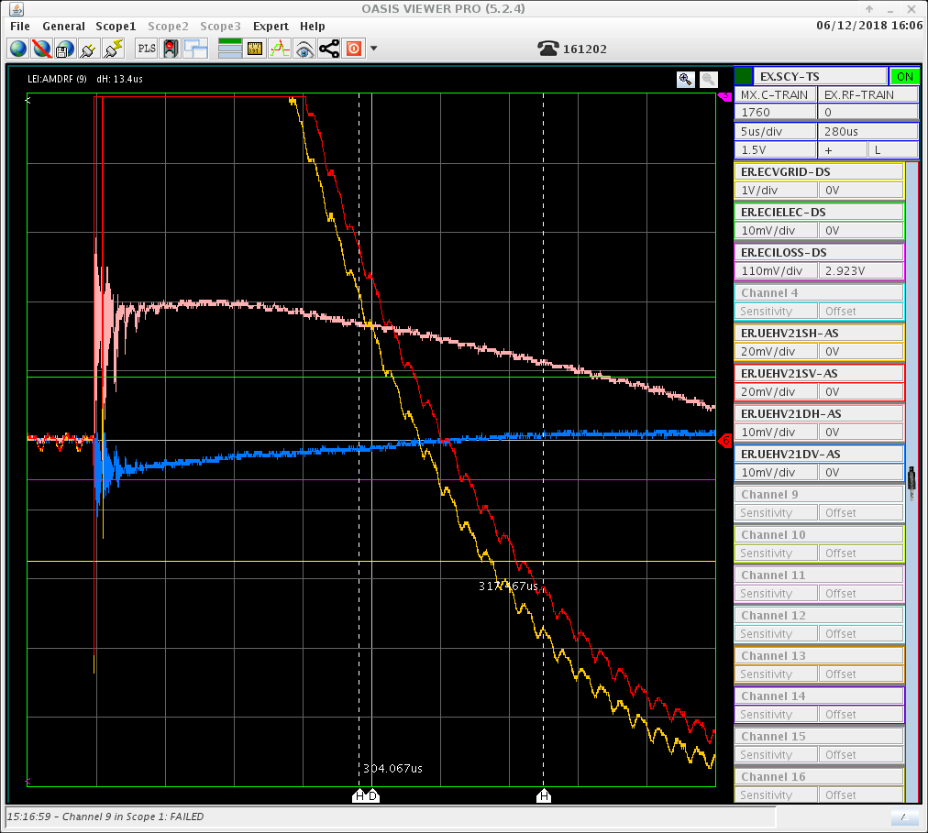
LEIR
Measurements done in 2018 when switching off cooler
Electron signal
(modulated by bunched ion beam)
Switch off E-cooler
Bunched ion beam
See Angela’s presentation: indico

Slide 15
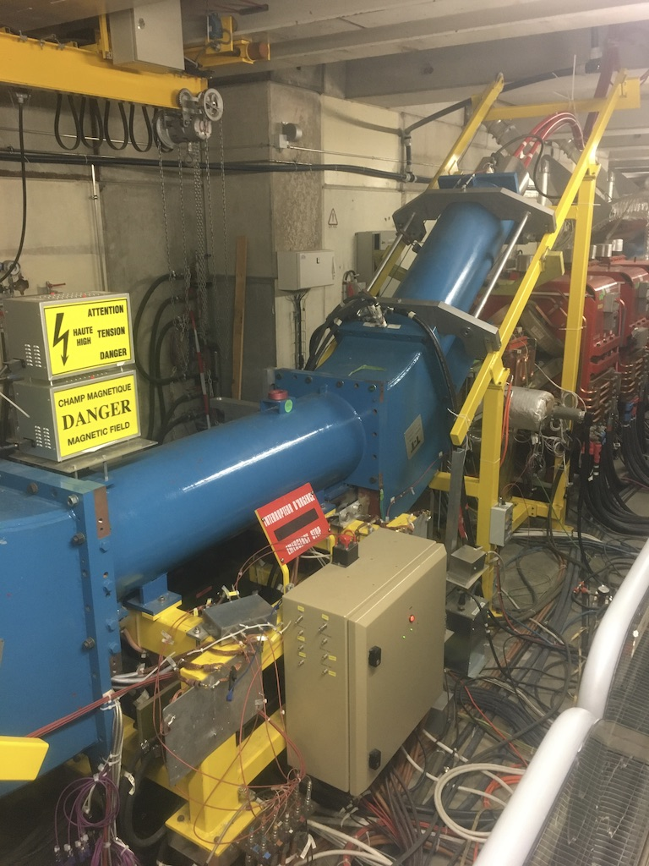
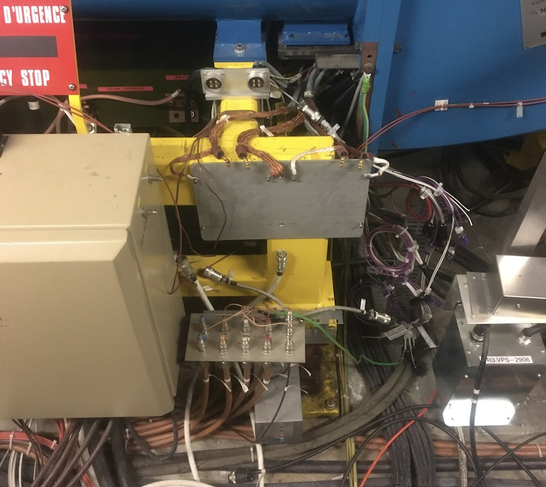
AD
BPMs head amplifier seems to be missing in AD, and all BPMs cables disconnected… To be followed up.
Head amplifier missing here

