Slide 1

Beam-Gas Curtain (BGC) monitor for the Hollow e-lens
Ray VENESS for the BGC collaboration
e-Beam meeting, 15th Jan 2020

Slide 2
Contents
Brief introduction to the principles
BGC collaboration
Key experimental and simulation results
  Experiments with electrons
  Experiments with protons
Instrument design
  Gas jet simulations
  Synchrotron radiation background
Next steps
Summary

Slide 3
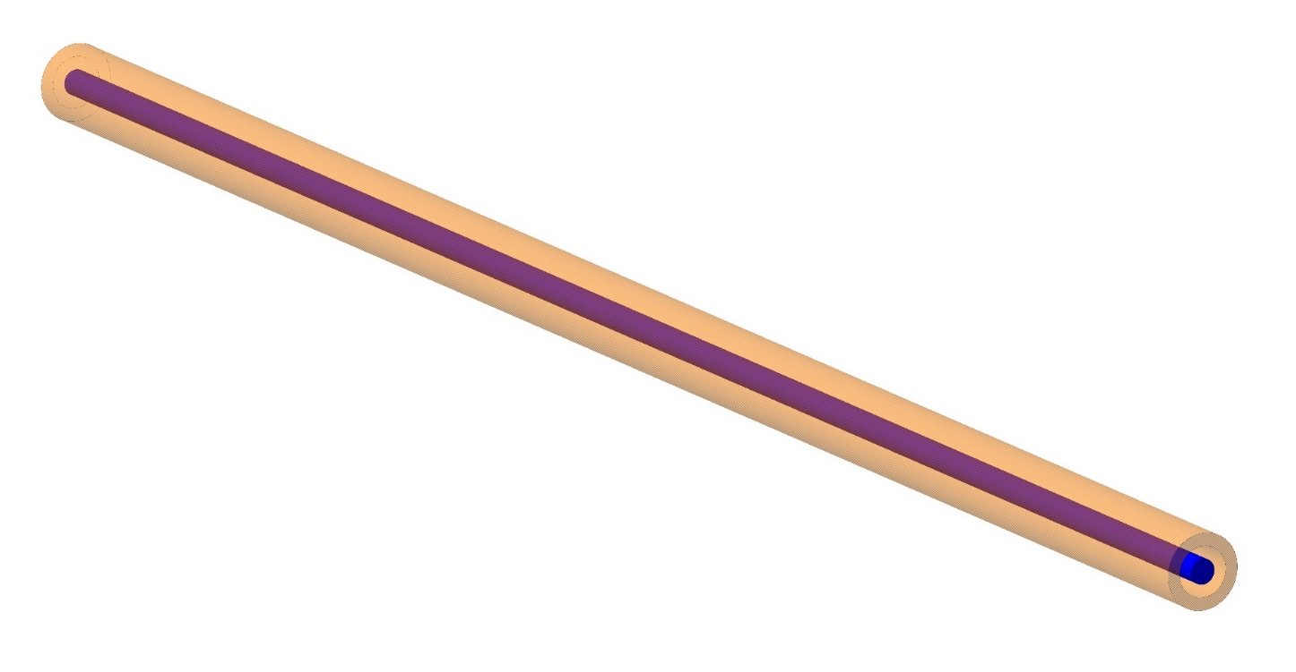
Beam-Gas Curtain: Principles
The challenge:
On-line monitoring of co-axial proton (blue) and electron (orange) beams in a hollow e-lens configuration (ie., in the presence of a strong solenoid magnetic field and with limited available space)

Slide 4
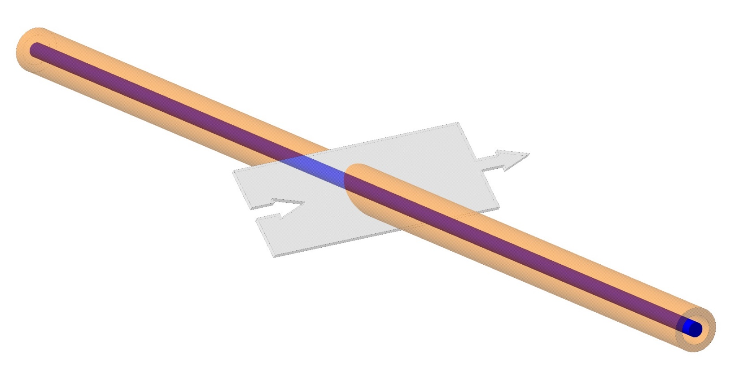
Beam-Gas Curtain: Principles
Laminar, supersonic gas ‘curtain’ traverses the beams
Gas jet atoms or molecules are excited by beam interactions and emit photons (Beam Induced Florescence or ‘BIF’)
Key parameters influencing BIF are beam intensities, gas jet density and thickness, beam-gas cross section. The cross section is a function of gas species, particle type and energy. In addition, a spectral range of different florescence transitions are excited depending on gas species

Slide 5
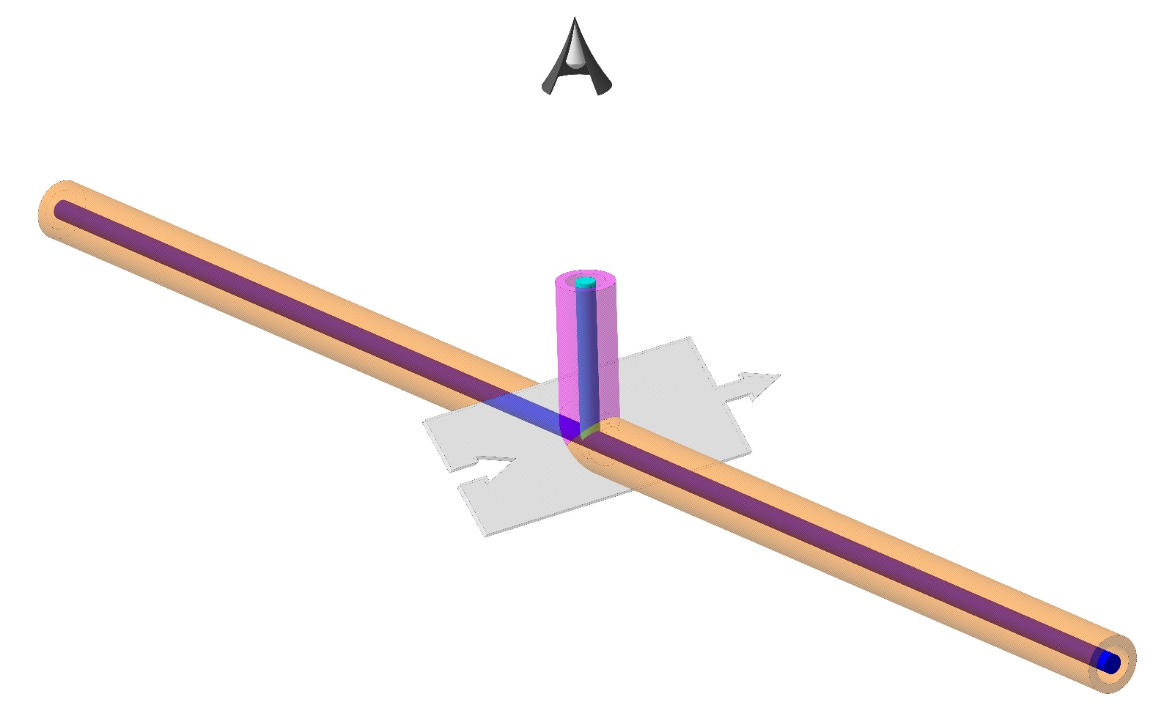
Beam-Gas Curtain: Principles
The light emitted from the BIF is imaged with an ex-vaccua optical system consisting of lens, image intensifier and CCD camera.

Slide 6
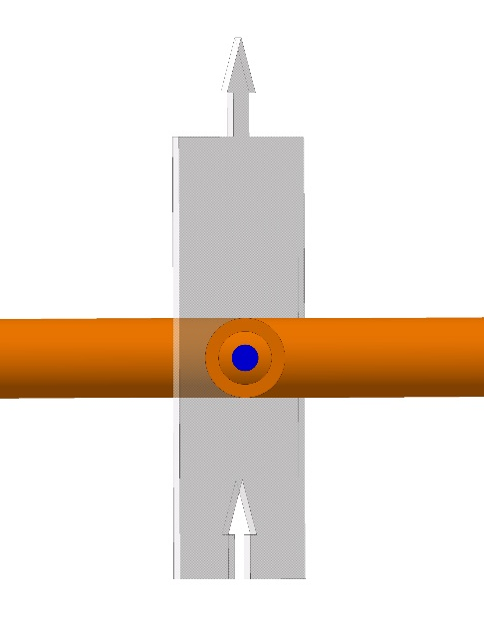
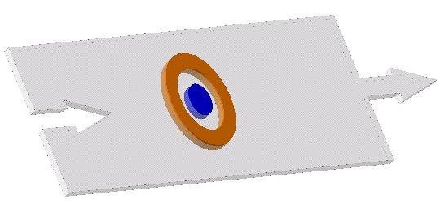
Beam-Gas Curtain: Principles
Eliptical image of two beams on the ‘virtual screen’
True 2D beam image seen by the camera when viewed at 90° to the beam axis

Slide 7
The BGC collaboration
Cockcroft institute/Liverpool Uni. (C.Welsch et al.)
  Expertise in gas jet diagnostics, experiment and theory
    Full instrument set-ups with 5 keV/650 uA electron gun and diagnostics
  BGC instrument developer and supplier
    HL-UK funding for gas jet 2016-2020
    HL-UK phase 2 funding just approved for 100% in-kind supply of the final instruments for HL
GSI, Darmstadt (P.Forck et al.)
  Expertise in optics and fluorescence simulations and experiment for diagnostics
    Fluorescence measurements with 13.8 MeV protons at TU Munchen
CERN
  Project management, engineering design, integration
  Expertise in Monte-Carlo simulations for gas and SR
  Expertise and experiments at close to nominal conditions
    LHC background gas fluorescence measurements at 450 GeV and 7 TeV for p+ and ions
    HEL test stand with high-intensity 10 keV electrons (Summer 2020)
BGC on INDICO at https://indico.cern.ch/category/9896/

Slide 8
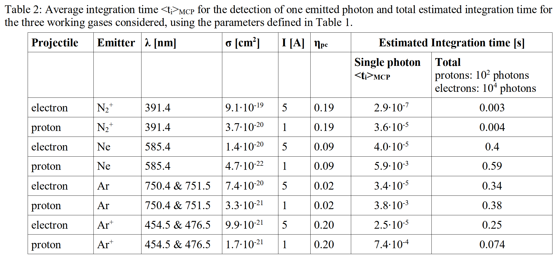
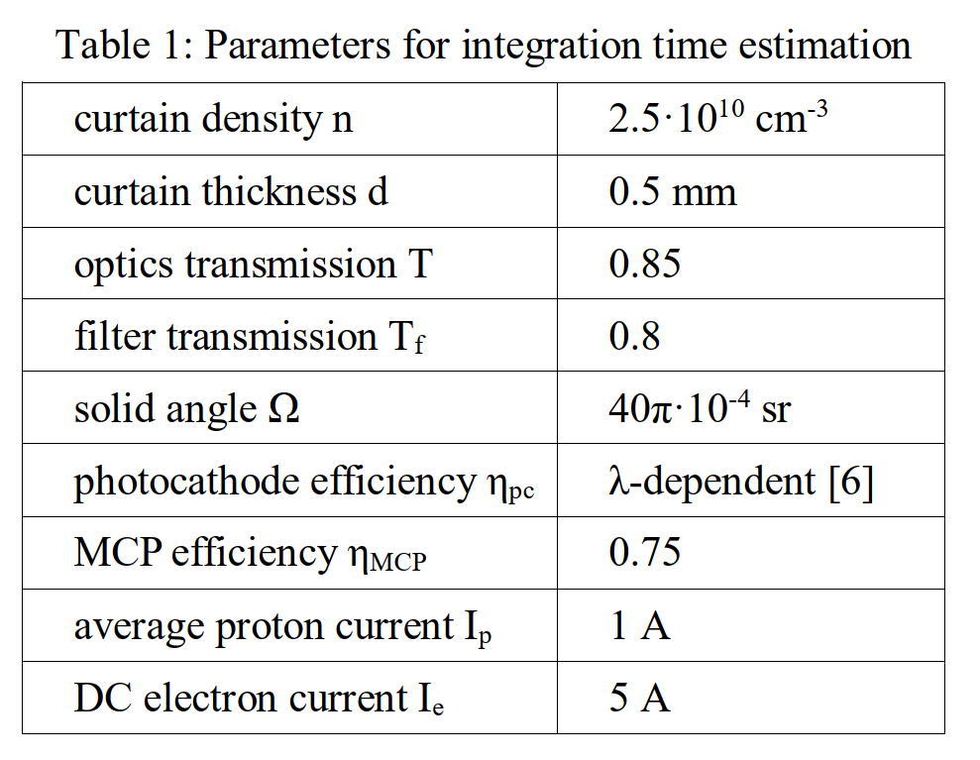
Expected signal integration times for electron and proton beam profiles
From: Development of a beam-gas curtain profile monitor for the high luminosity upgrade of the LHC. R.Veness et al. IBIC 2018

Slide 9
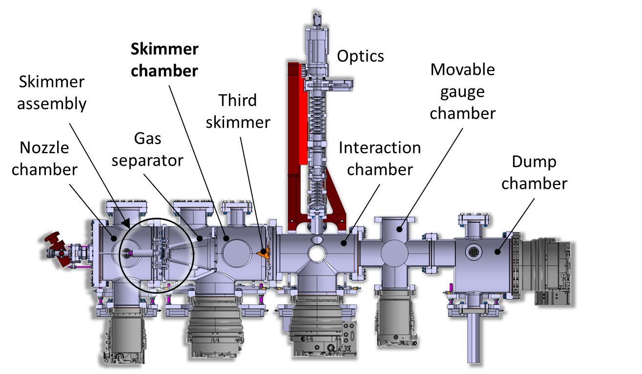
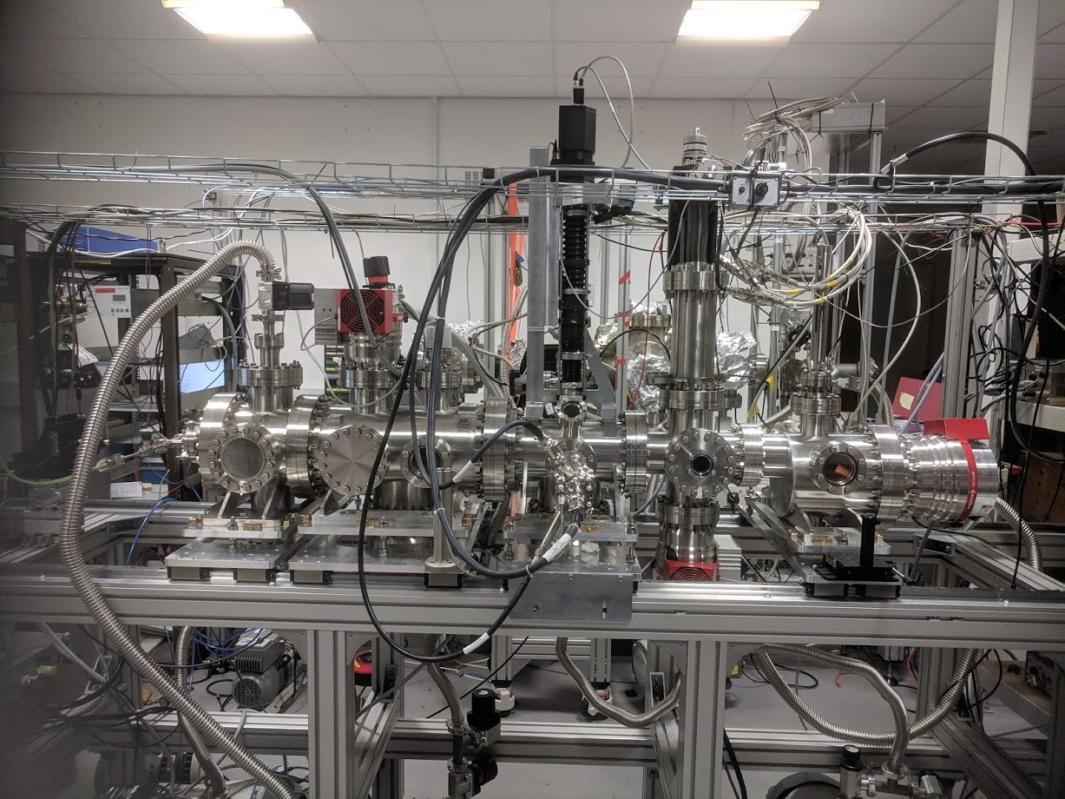
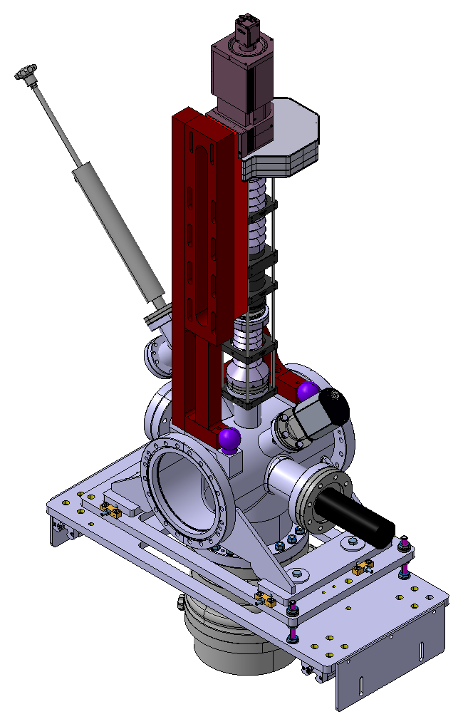
Experiments with a 650 uA electron beam using the prototype at the Cockcroft Institute
Imaging System
Skimmer Chamber
Skimmer Assembly
Moveable Gauge Chamber
Third Skimmer
Gas Separator
Interaction Chamber
Nozzle Chamber
Dump Chamber
HIPACE 300L/S
Turbo-molecular pump
HIPACE 700L/S
Turbo-molecular pump
Courtesy A. Salehilashkajani, H.Zhang, C.Welsch

Slide 10
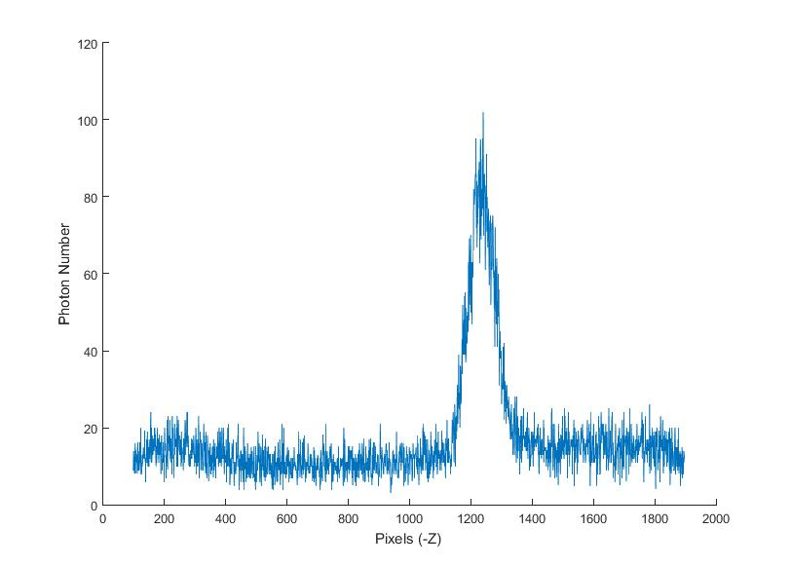
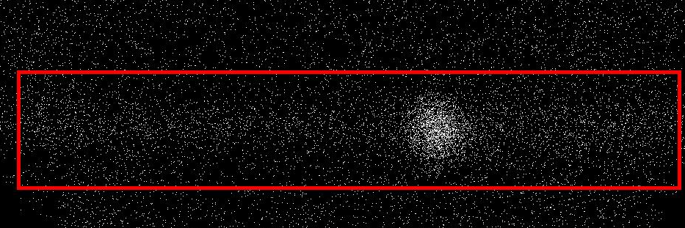
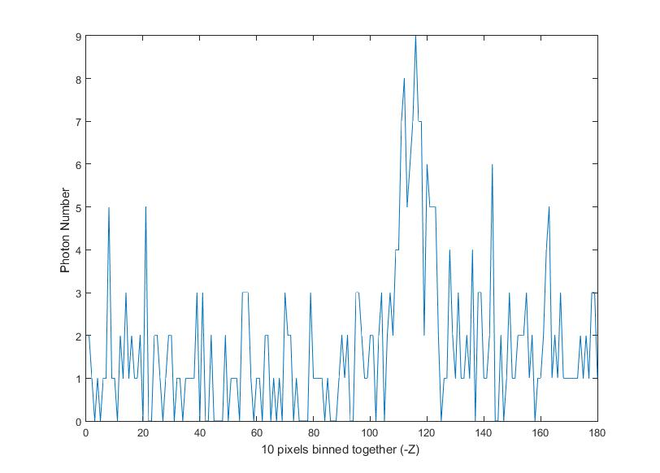
Typical BIF image from a nitrogen jet
Integration time for the picture below : 400 S
Integration time : 400 S
Calibration = 0.0147mm/pixel
Gas jet
Electron beam
z
FWHM = 1.2mm
Integration time : 4 S
Calibration = 0.147mm/pixel
FWHM = 1.2mm
Filter used for Nitrogen : 391 +/- 3nm, HW : 10 +/- 2nm
Number of photons per second from the jet: ~ 17
Electron beam signal is visible in just 4seconds via binning.
Courtesy A. Salehilashkajani, H.Zhang, C.Welsch
Notes:
Check fitlers

Slide 11
Theoretical Photon Numbers vs Experimental
Emitter | Photon Number/s (LHC conditions) | Expected Photon Number/s (Lab conditions) | Experimental Photon Number per second
N2+ | 3.4E6 | 2.4E1 | 17
Ne | 2.5E4 | 1.76 | 1.6
Ar (750 & 751.5) | 2.9E4 | 1.17 | -
Ar+ ( 476) | 2.3E4 | 1 | 1.3
Ar+ (Broadband) | N/A | N/A | 4
LHC Conditions :
Cross sections calculated at 10KeV
Gas jet density assumed to be 2.5E16
Current assumed to be 5A
Lab Conditions :
Cross sections calculated at 5KeV (Assuming Linearity)
Gas jet density :
  Nitrogen: 7E14/m^3
  Argon: 4E15/m^3
  Neon: 6.5e15/m^3
Current assumed to be 0.65mA
Courtesy A. Salehilashkajani, H.Zhang, C.Welsch

Slide 12
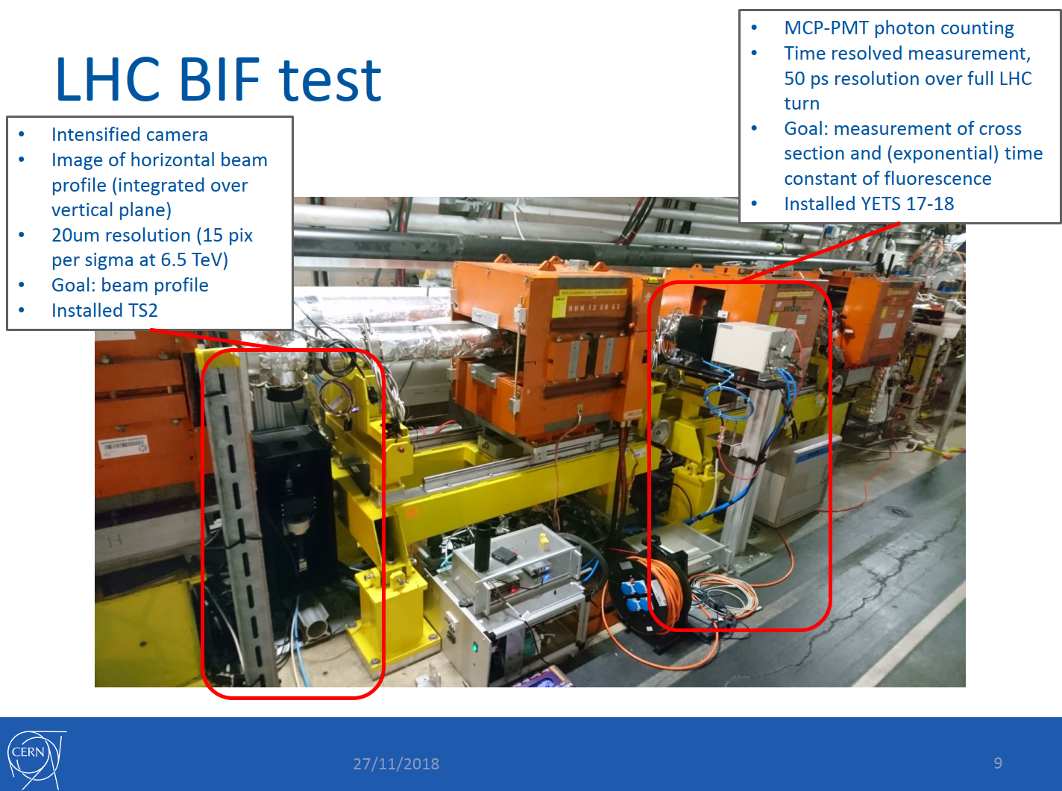
Courtesy S.Mazzoni, LHC Beam size review, Oct. 2019

Slide 13
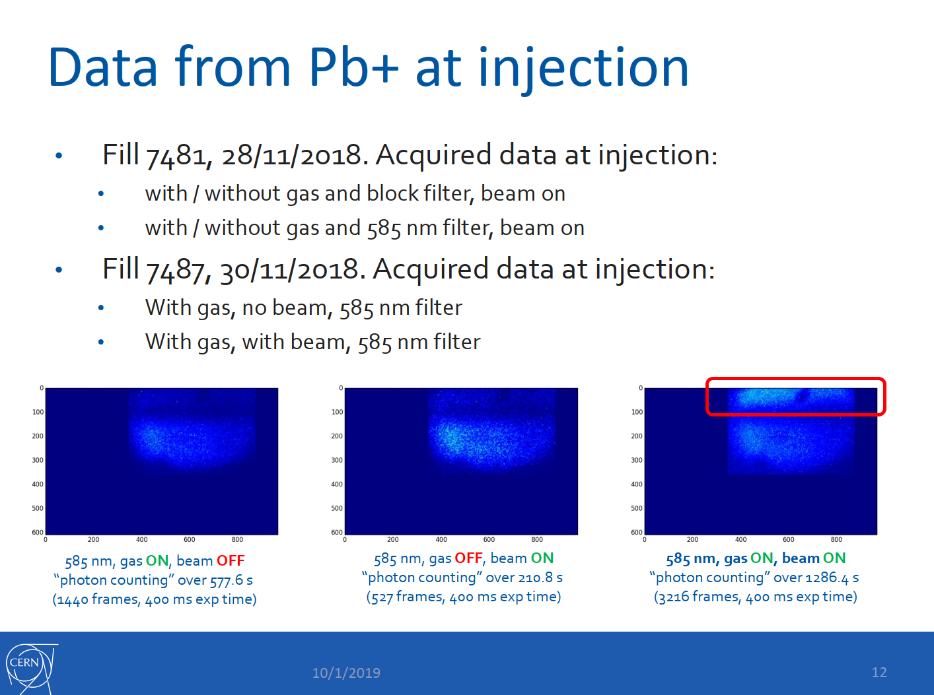
Courtesy S.Mazzoni, LHC Beam size review, Oct. 2019

Slide 14
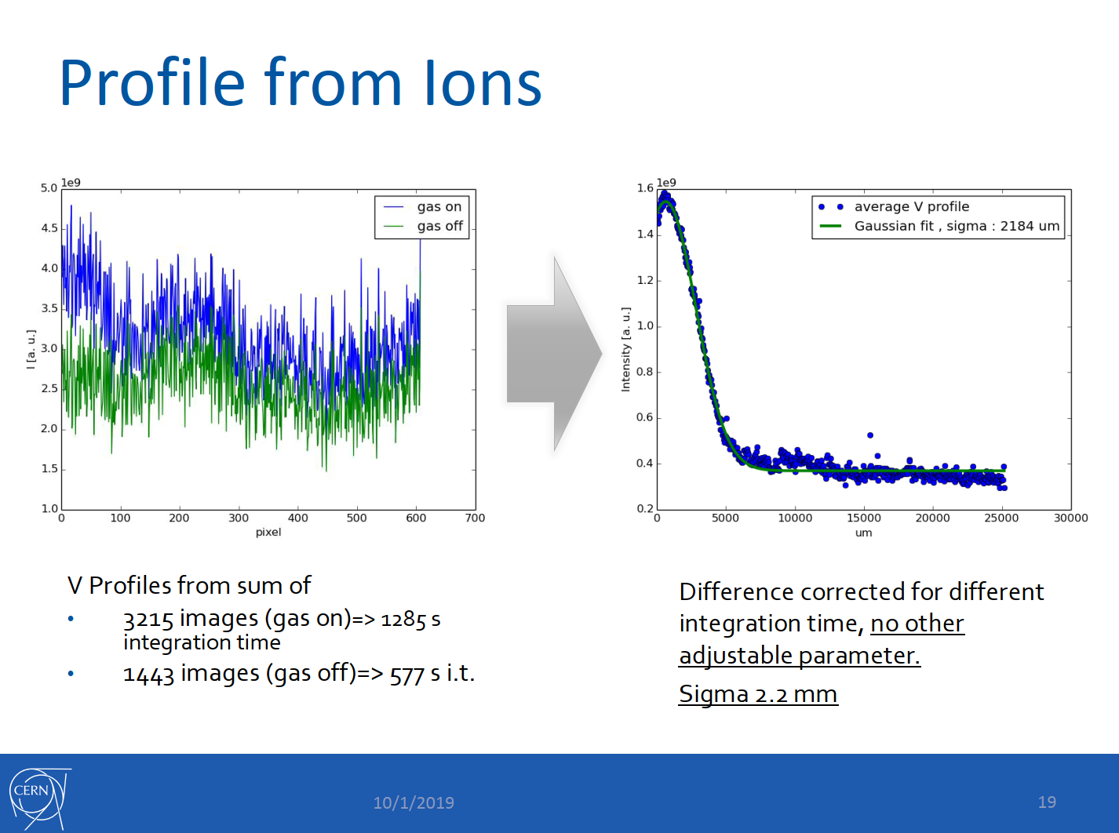
Courtesy S.Mazzoni, LHC Beam size review, Oct. 2019

Slide 15
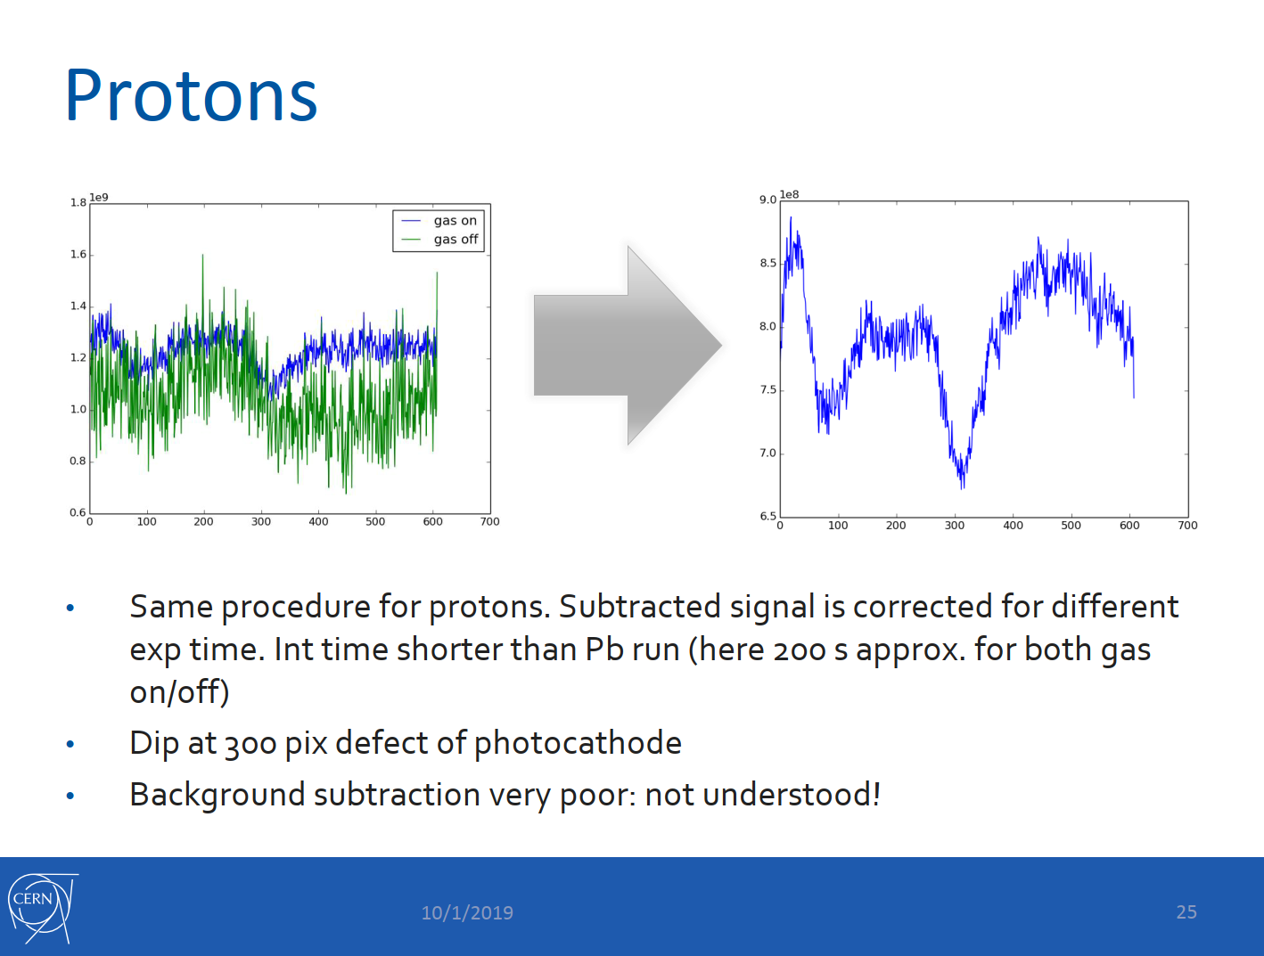
Courtesy S.Mazzoni, LHC Beam size review, Oct. 2019

Slide 16
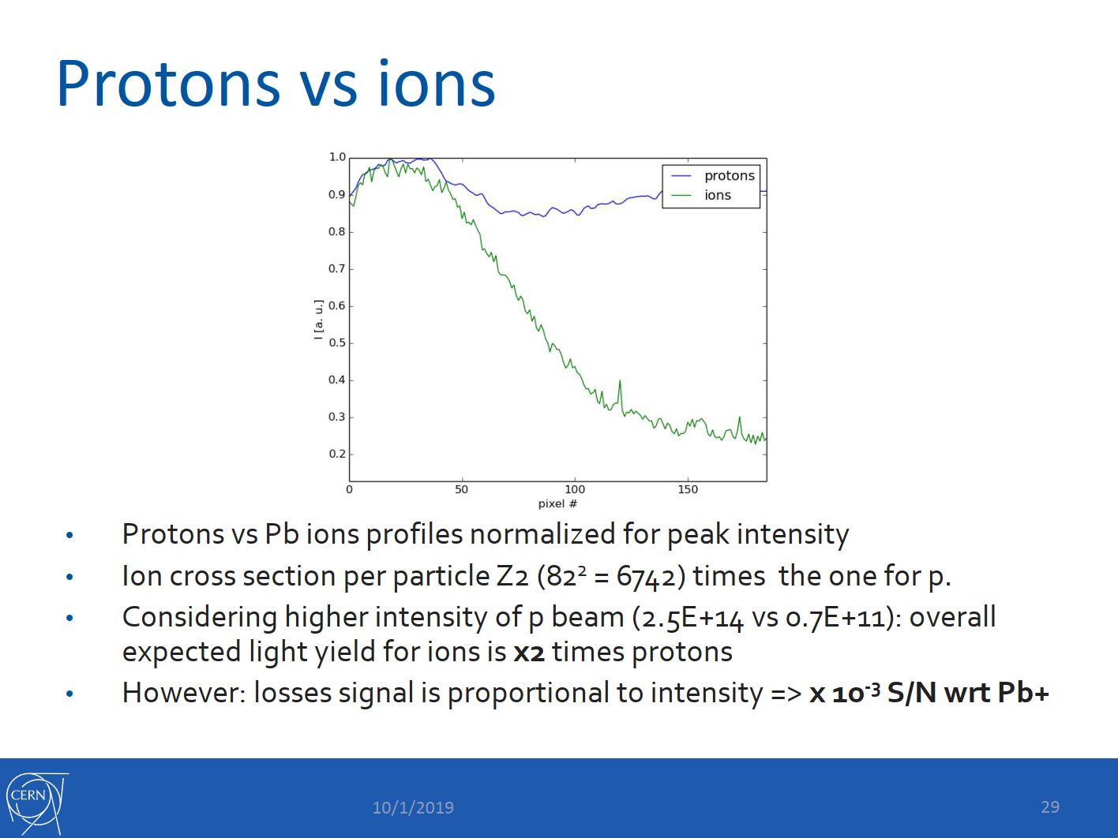
Alignment of optics vs. beam
SR background in LHC
Beam-gas background in LHC
Data analysis and background subtraction
Courtesy S.Mazzoni, LHC Beam size review, Oct. 2019

Slide 17
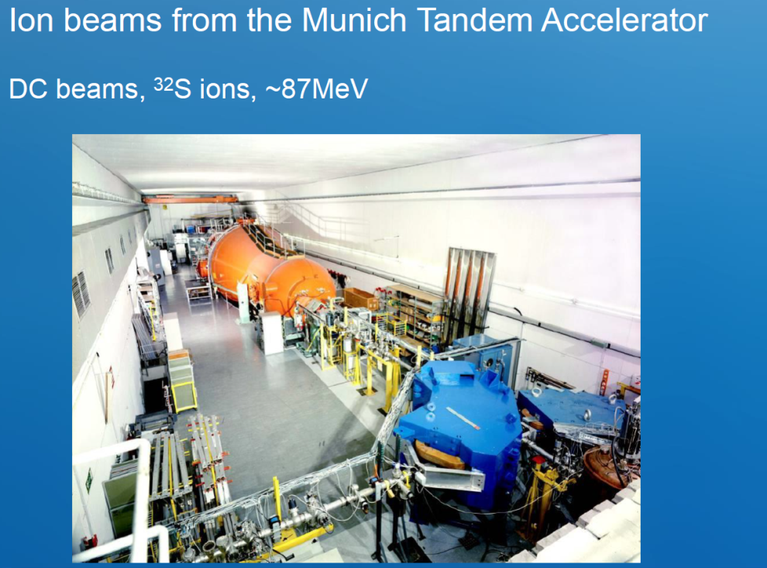
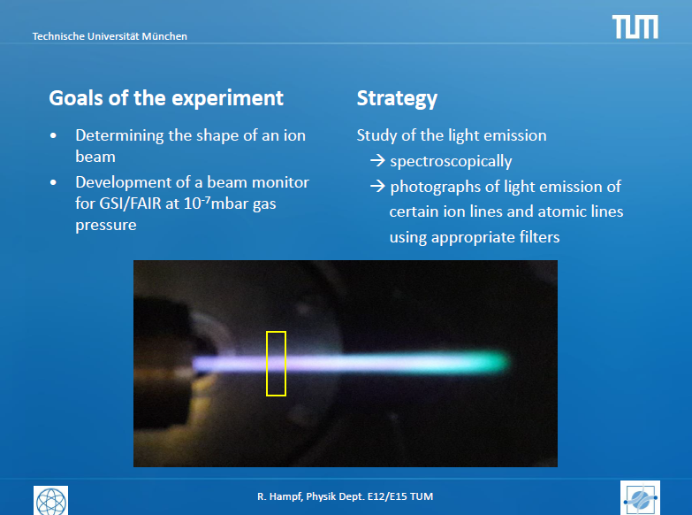
Setup at TANDEM TU München
Blue underlay:
Measurement and statements from TU München
& protons 13.8 MeV
Advantage: Some 100 nA dc beam,
some days exclusive beam time

Slide 18
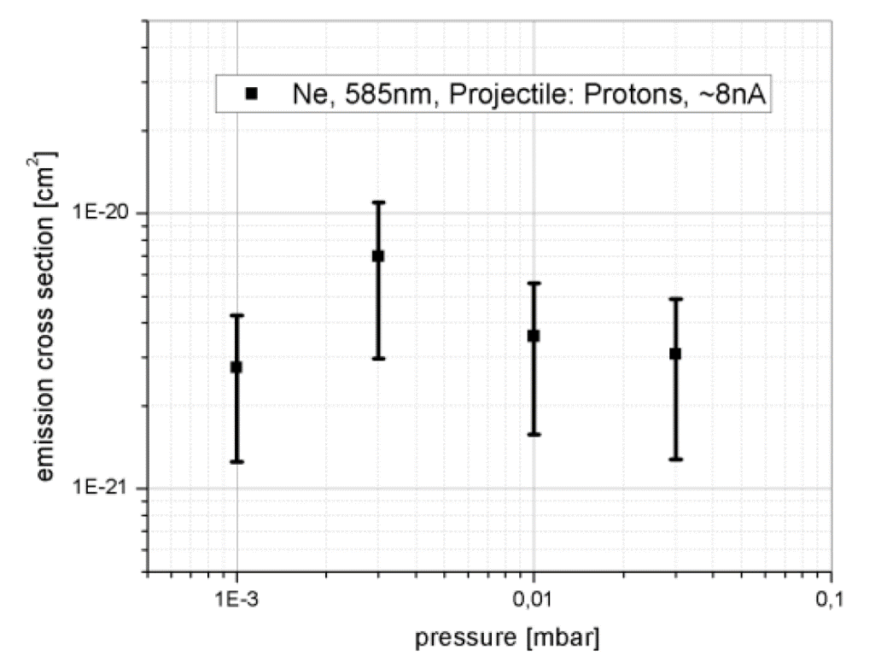
Neon Spectra with Proton Impact at 14 MeV
Result for cross section:
Ne & low pressure p < 10⁻³ mbar:
σ is constant
i.e. reflects beam profile
Absolute systematic error Δσ _{sys} = 50 %
Estimation of cross section for neutral Ne:
Proton σ_{p}(14MeV) = 4 ⋅ 10⁻²¹ cm²
Energy loss from 14 MeV to 7 TeV by factor 0.1
⇒ Bethe-Bloch scaling σ_{p}(7TeV) = 0.1 ⋅ σ_{p}(14MeV) = 4.0 ⋅ 10⁻²² cm²
⇒ Bethe-Born scaling σ_{p}(7TeV) = 0.06 ⋅ σ_{p}(14MeV) = 2.3 ⋅ 10⁻²² cm²
Serban’s estimation σ_{p}(7TeV) = 4.7⋅10⁻²² cm² ⇒ factor 2 too small (1.1 for B-Bloch)
(scaling from S⁸⁺ factor 6 too large)
Absolute value of fluorescence cross-section at LHC energies

Slide 19
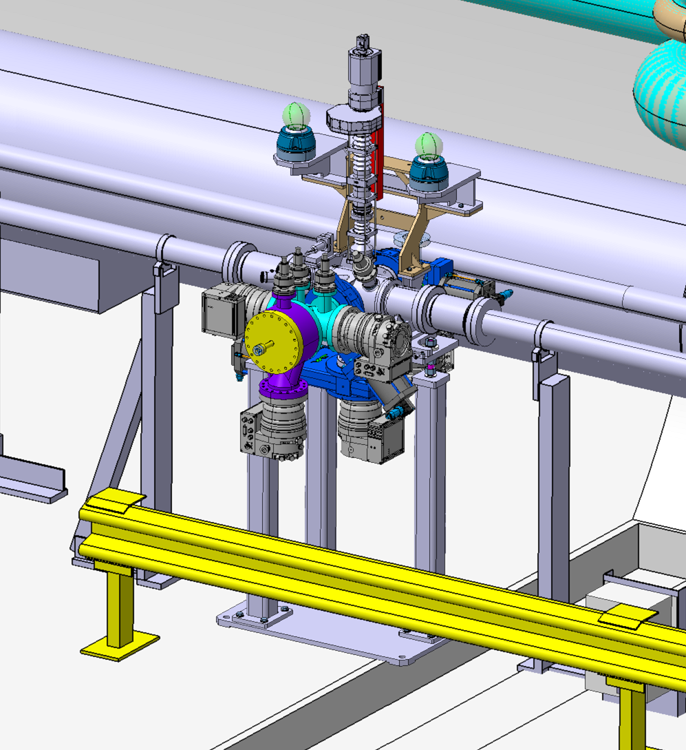
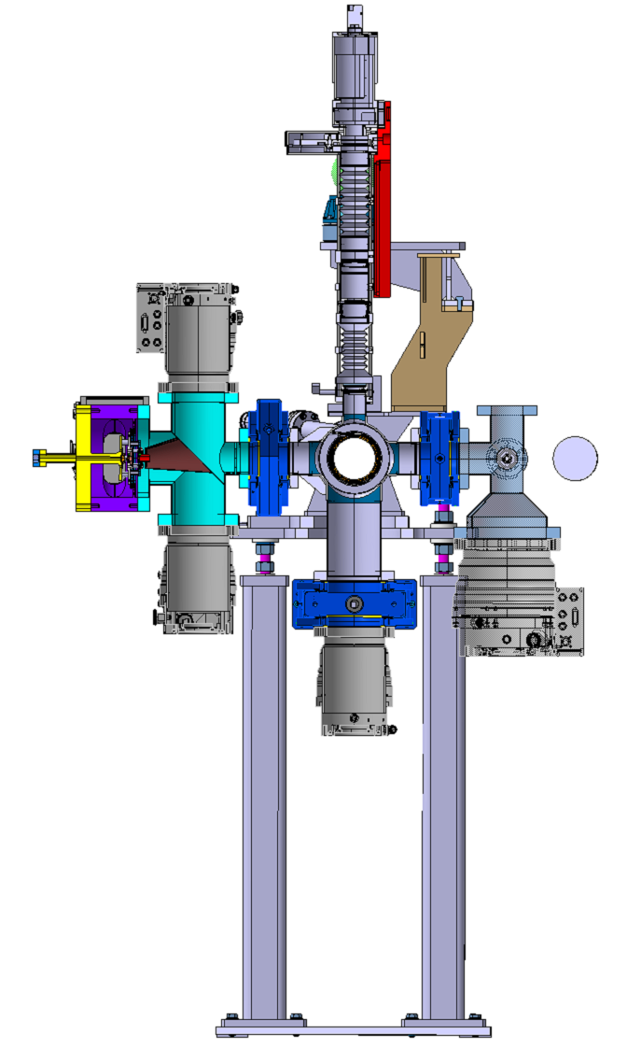
Full prototype Instrument LHC integration
Ex-vacua optics
Gas jet generation
Interaction chamber
Gas exhaust

Slide 20
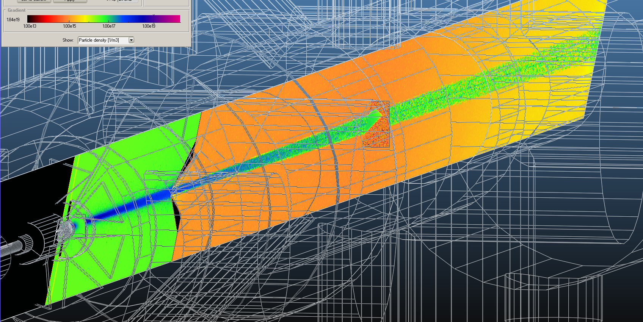
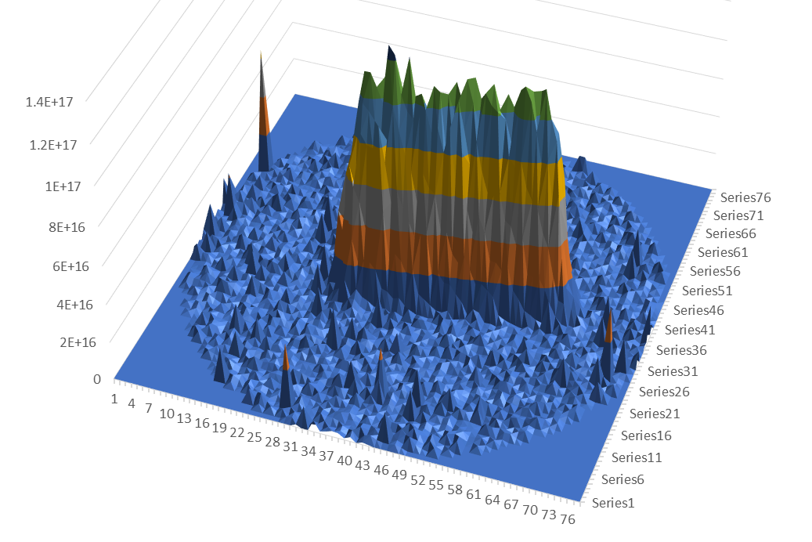
Gas jet simulations using MolFlow Code
Images courtesy of M.Ady/TE-VSC

Slide 21
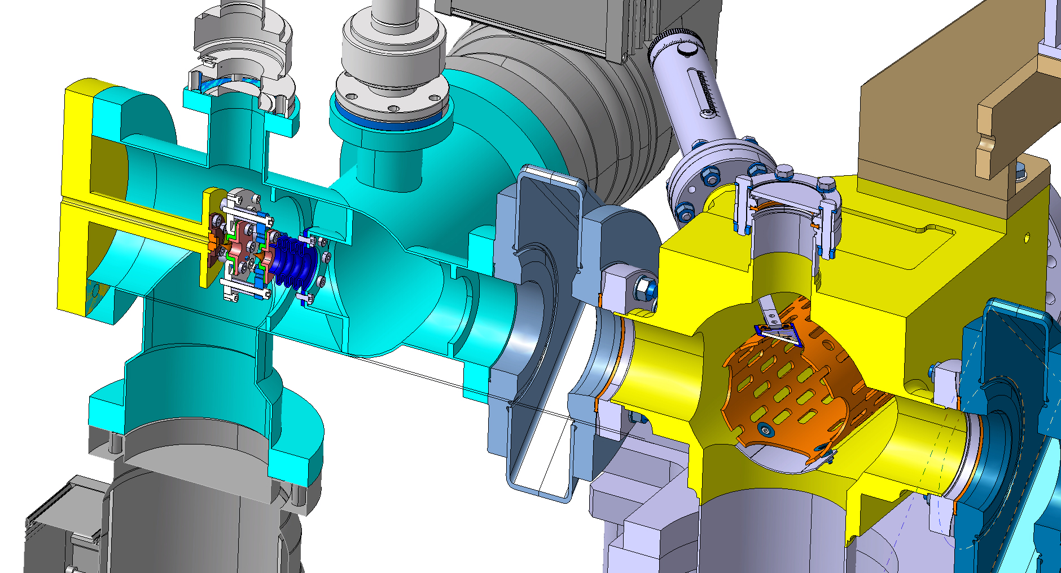
Gas injection design
Retractable target for optics

Slide 22
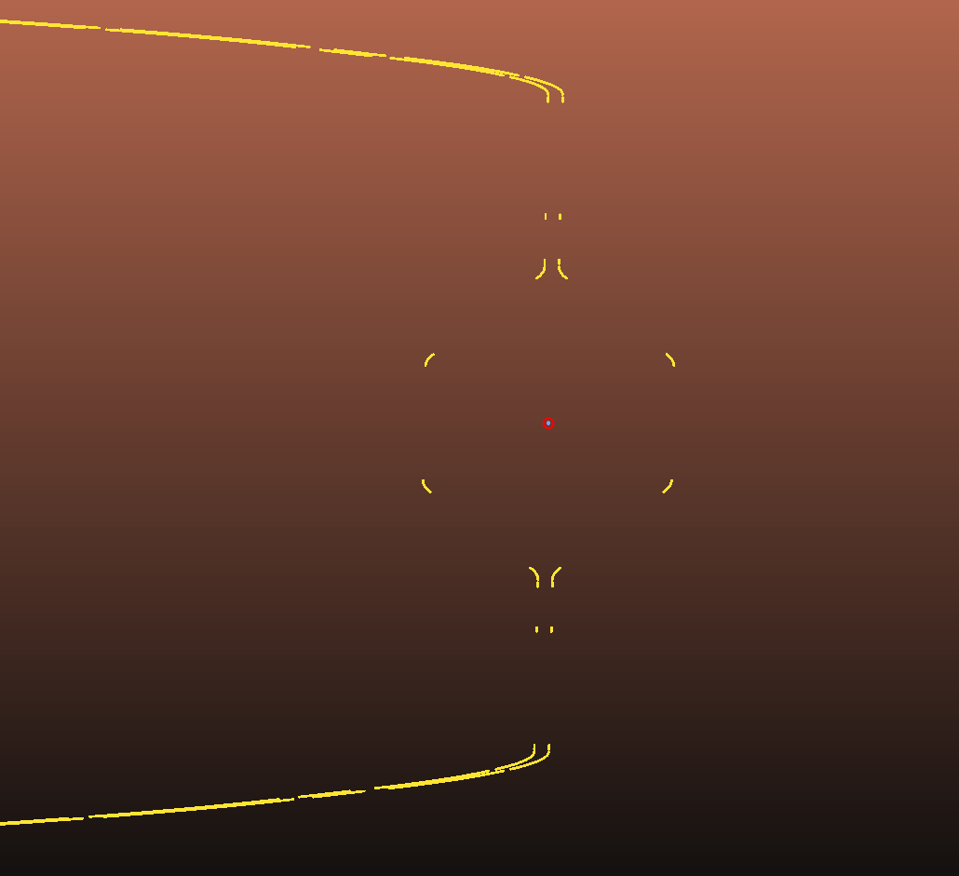
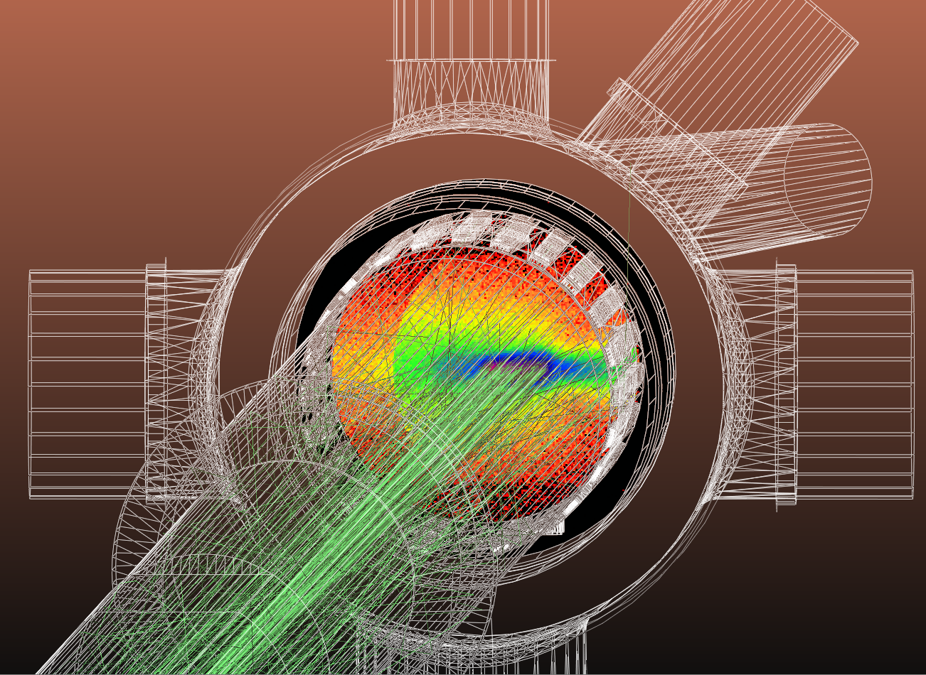
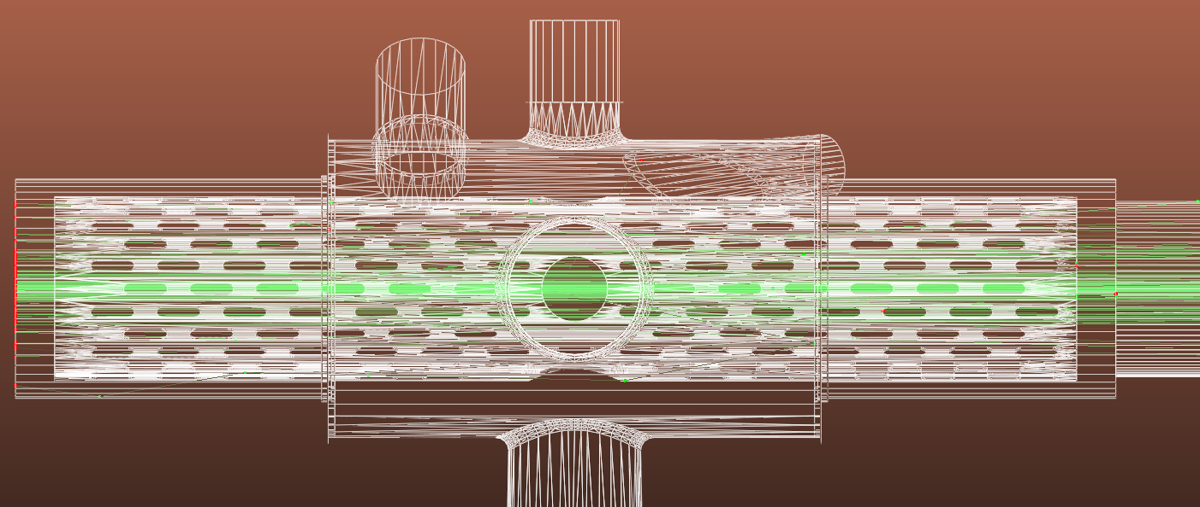
Simulations for synchrotron radiation background used to design the interaction chamber
Arcs
S
X
IP4
BGC
D4/D3 aperture separator magnets
Arcs
Simulation courtesy of M.Ady/TE-VSC

Slide 23
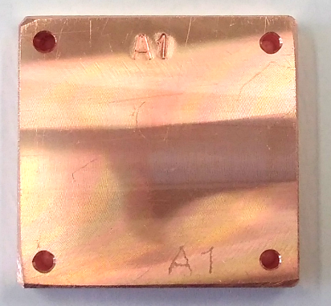
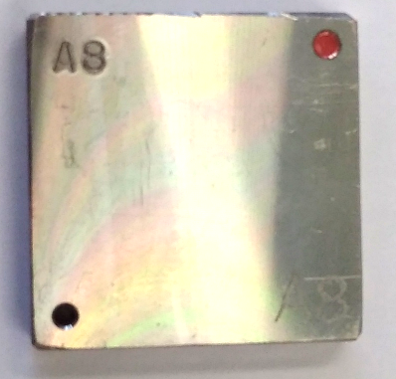
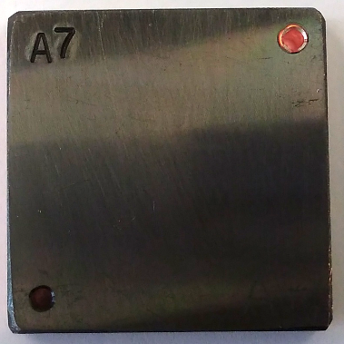
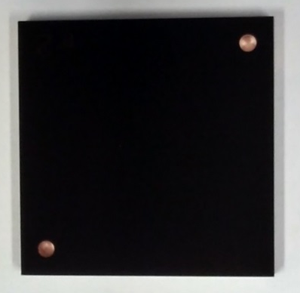
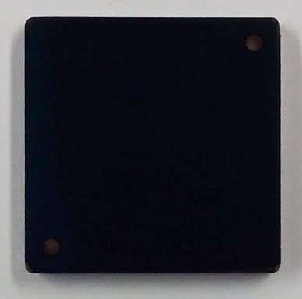
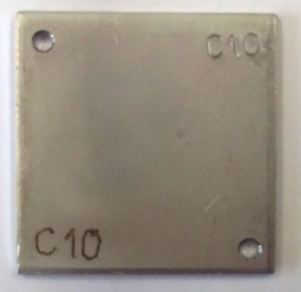
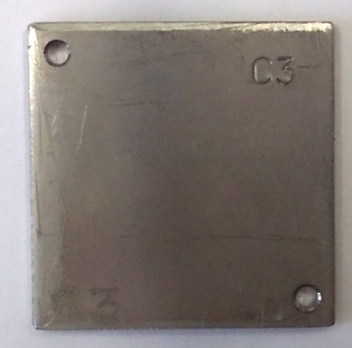
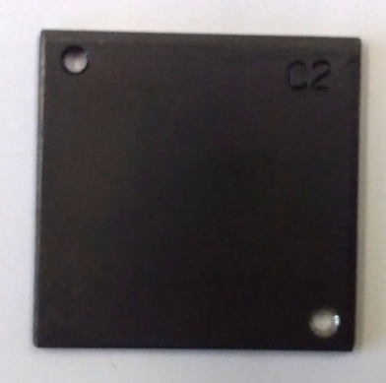
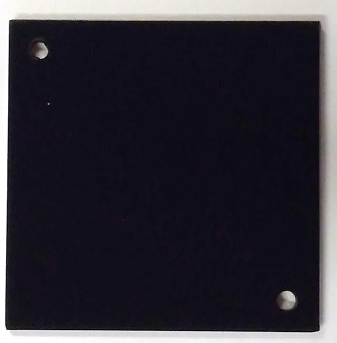
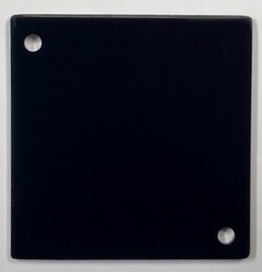
Reflectivity at neon wavelength 584nm
 | Degreased no coating | NEG | Amorphous carbon | LESS (Dundee) | Multilayer sputtering (Polyteknik)
 | ≈ 85% | ≈ 45% | ≈ 13% | ≈ 2% | ≈ 0.2%
 | ≈ 56% | ≈ 45% | ≈ 14% | ≈ 2% | ≈ 0.2%
Copper
Steel
Images: Johanna Glutting/BE-BI

Slide 24
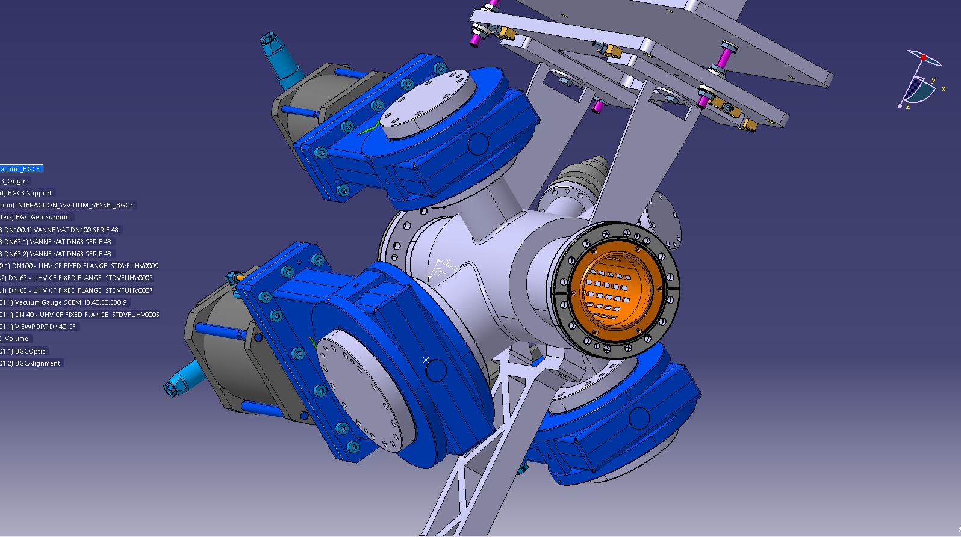
Prototype Interaction Chamber for LHC installation in LS2
This is the first stage of the LHC installation, planned for March 2020
It can be used in the first year of run 3 to continue to background gas fluorescence measurements
These measurements will benefit from the improved, blackened chambers and new optics design
Instrument can be completely isolated from the LHC with valves to allow for staged installation and operation

Slide 25
LHC-BGC experimental roadmap
Transport prototype instrument from HEL stand to LHC
Install the prototype interaction chamber in the LHC
Prototype instrument testing on HEL e- stand
2019
2020
2021
2022
2023
Long shutdown 2
Background gas tests in LHC
YETS
YETS
LS3
prototype commissioning & experimental programme in the LHC
Install prototype optics on LHC interaction chamber

Slide 26
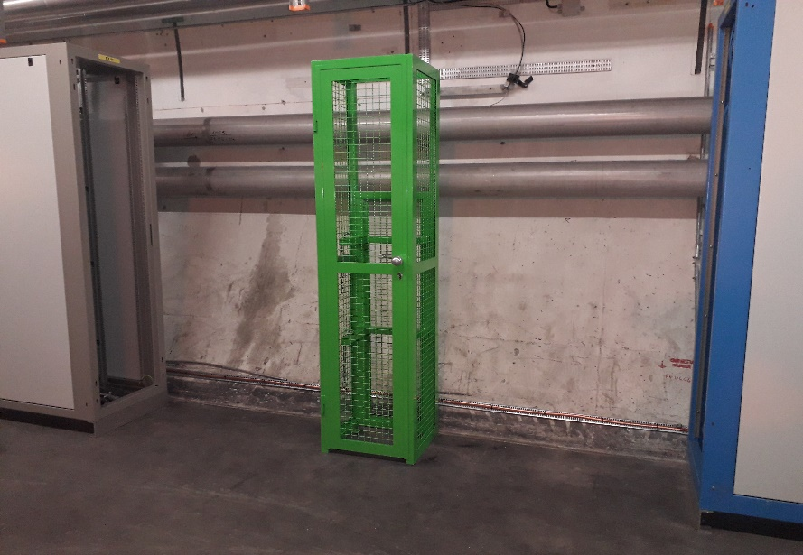
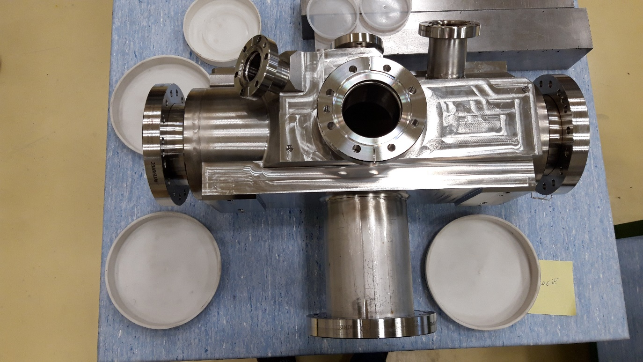
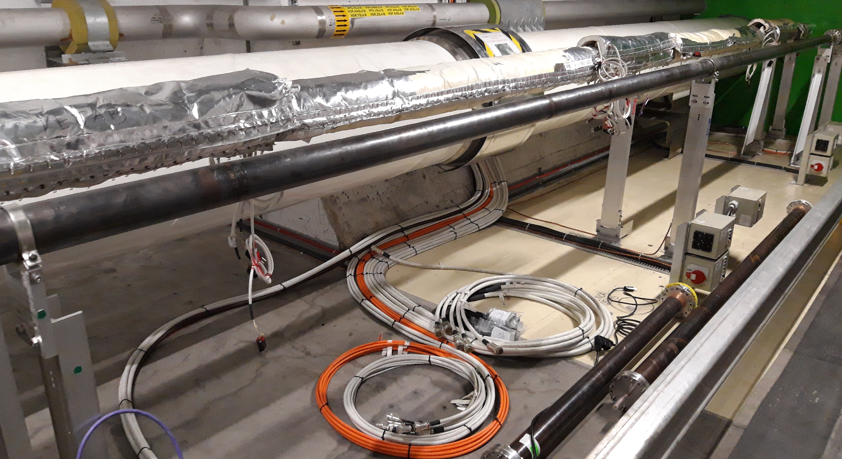
LHC status
Gas rack installed and piping installation planned
Interaction chamber under final preparation for installation from March 2020
Cables installed for the full prototype instrument and vacuum system in LSS4L

Slide 27
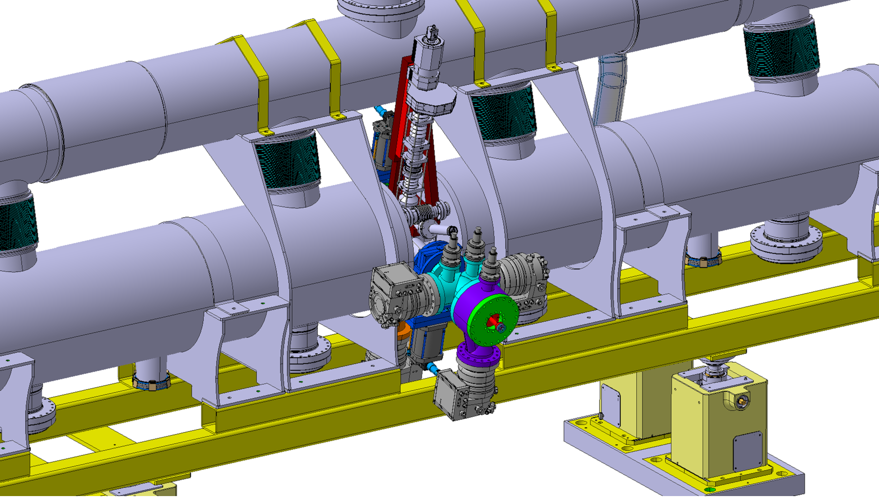
Current version of BGC integration in the HEL, LHC4L

Slide 28
Summary
A beam-gas curtain instrument is being designed as the baseline monitor for overlap and beam(s) profile for the HEL
  Recently confirmed as a fully in-kind contribution as part of HL-UK2
A collaborative experimental programme is well developed to validate the design
  Parameters for integration times for electrons and protons
  Optimisation of the gas curtain density and gas selection
Further experiments are being prepared to test instrument performance for nominal beam conditions
  HEL test stand for electron profiles
  LHC prototype in background gas fluorescence mode
  Full LHC prototype for 7 TeV proton profiles

Slide 29
Thanks for your attention

Slide 30
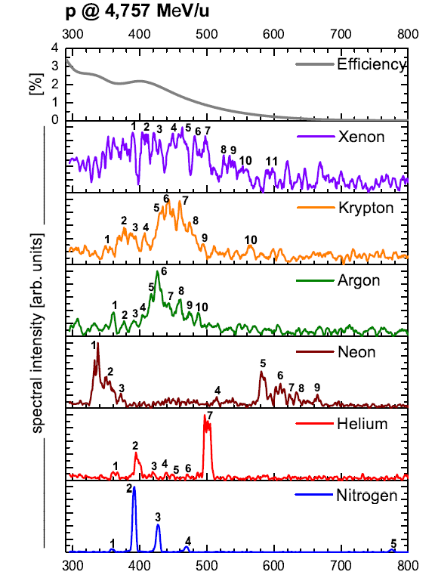
Fluorescence of different gases
Fluorescence cross-section
Emission from ion or neutral?
Emission lifetime?
Photocathode efficiency?
Pumped by NEG surfaces or not?
Strongest emission from Ar⁺ blue/green lines mainly corresponding to different [3s²3p⁴(³P)]4p → 4s transitions with life times of 10-20 ns.
Several Ne⁺ UV lines mainly corresponding to different [2s²2p⁴(³P)]3p → 3s transitions with life times below 10 ns.
Several Ne yellow/red lines mainly corresponding to different [2s²2p⁵(²P)]3p → 3s transitions with life times of about 20 ns.
The strong UV/blue lines correspond to the B²Σ_{u}⁺ → X²Σ_{g}⁺ electronic transition band of N₂⁺, life times are of about 60 ns.
λ [nm]
F. Becker, Ph.D. thesis, T.U. Darmstadt, Germany, 2009
Courtesy P.Forck/GSI

Slide 31
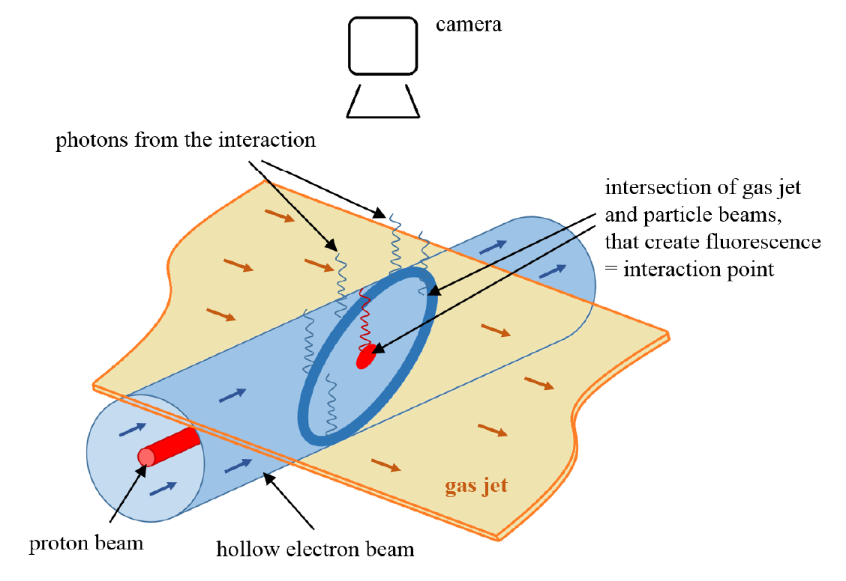
BGC principle
HEL schematic representation, courtesy of Johanna Glutting

