Slide 1

Flavor Physics
(heavy) quark sector
Focus on French activities on Belle 2 and LHCb
Francesco Polci
(LPNHE, CNRS/IN2P3)
rECFA – Paris, 10/09/2021

Slide 2


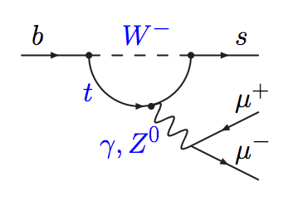
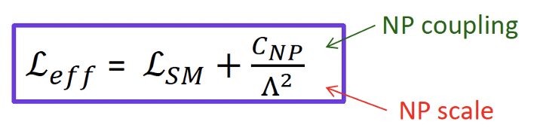
Flavor Physics’ strategy
          precision measurements for taming new physics
          search for forbidden or highly suppressed processes
          study dynamics of quarks interactions
  Sensitivity to much higher scales and/or smaller couplings than searches at the energy frontier.
  Pattern of deviations in a large set of complementary observables (CP violation, rare decays, beauty, charm, kaon... ) could point to new physics and reveal its nature.
Introduction
2

Slide 3

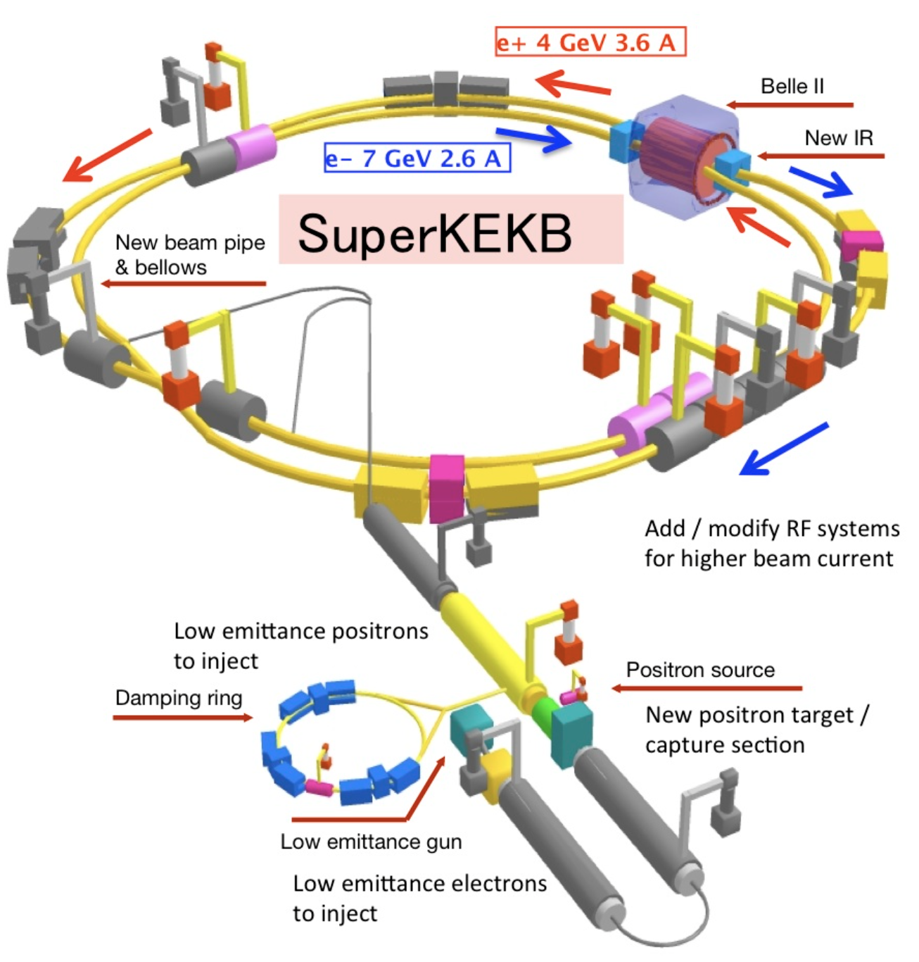
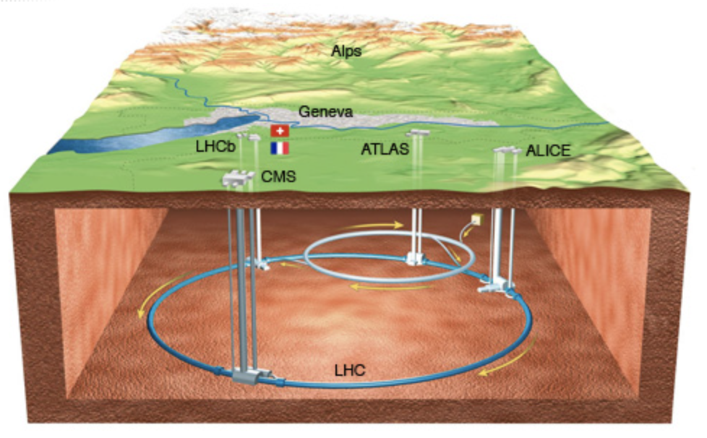

France in Flavor Physics at colliders
France (IN2P3) is member of two main flavor physics experiments at colliders today: LHCb and Belle II
Past and present French responsibilities within the collaborations include physics coordination, run coordination, leadership of subdetectors projects and projects.
CPPM Marseille
IJCLab Orsay
LAPP Annecy
LLR Palaiseau
LPC Clermont-Ferrand
LPNHE Paris
Introduction
CPPM Marseille
IJCLab Orsay
IPHC Strasbourg
France joined in 1998.
As of 2021, 59 researchers from 6 IN2P3 laboratories
France joined in 2017.
As of 2021, 20 researchers from 3 IN2P3 laboratories
Intense exchanges among experimentalists (including other collaborations)
and theorists working in the field.
(See talks by Sebastien, Guillaume, Michael)
3

Slide 4
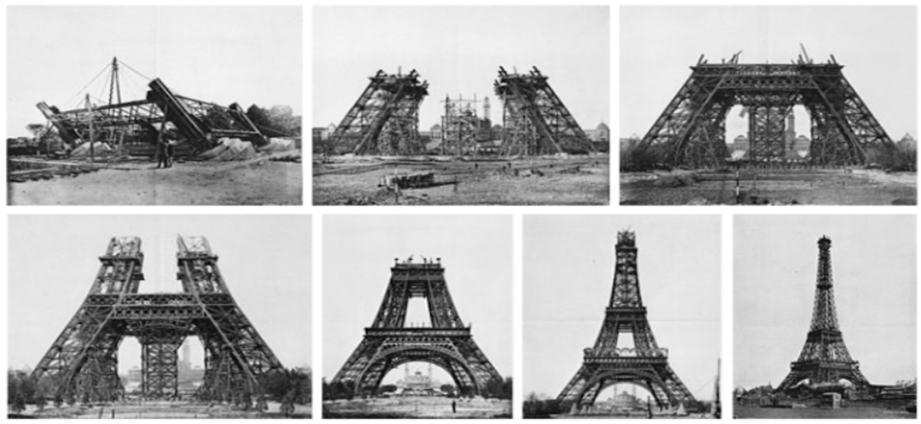
Detector activities

Slide 5
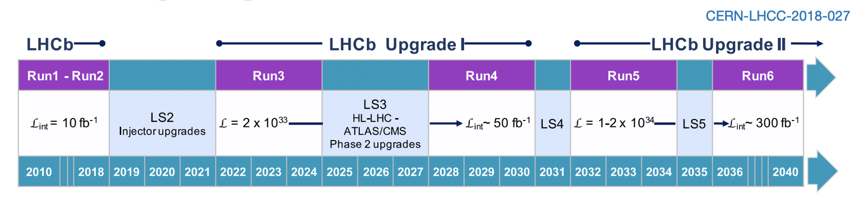
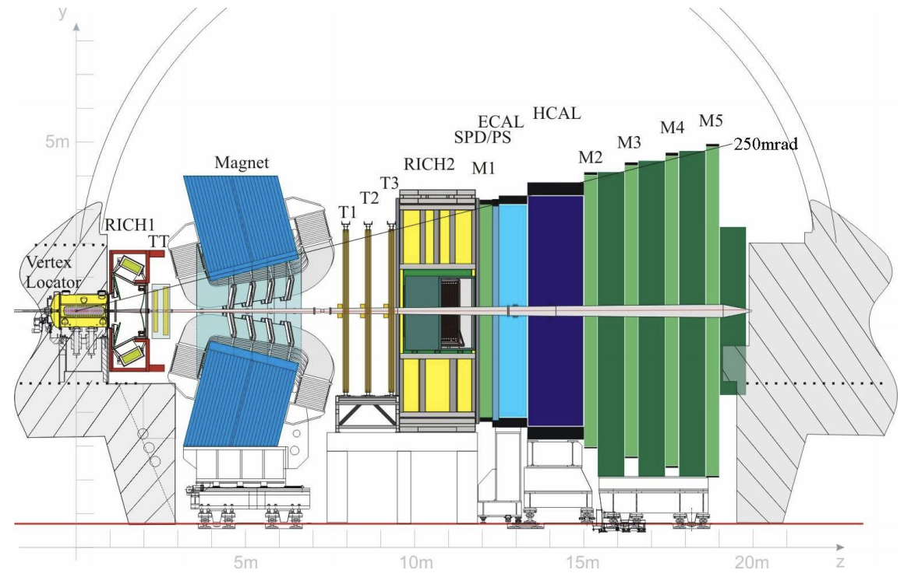
French contributions
Calorimeters (IJCLab, LAPP, LPC)
PS/SPD, ECAL, HCAL readout PS/SPD, ECAL, HCAL mechanics
Detector activities
Hardware trigger (CPPM, IJCLab, LAPP, LPC)
L0 electron L0 muon L0 decision unit
Also an intense activity in operations, computing and evaluation of performances
5

Slide 6
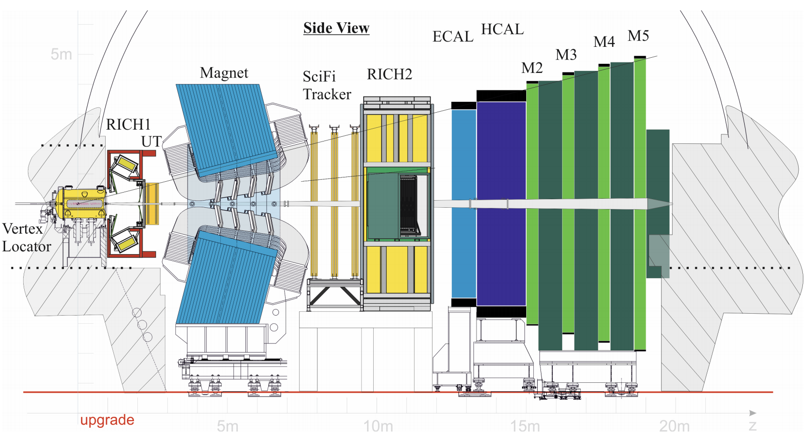
Upgrade
French contributions
Calorimeter (IJCLab, LAPP)
Front-End Electronics Back-end specific firmware
DAQ (CPPM, LAPP)
PCIe40 board hardware and generic firmware
New optics and
photon detectors
New electronics
New silicon
pixel detector
Detector activities
Scintillating Fiber Tracker (LPC, LPNHE)
Front-end electronics Back-end specific firmware
Real Time Analysis (CPPM, IJCLab, LPNHE)
Real time reconstruction with offline quality and selections
PLUME (IJCLab/LLR)
Luminometer
New silicon
strip detector
New scintillating
fiber detector
+ Real Time Analysis:
No hardware trigger!
6

Slide 7
Upgrade II
(Not yet approved)
Magnet stations
TORCH
(TOF quarz)
No HCAL
(iron shielding)
silicon pixel
detector + timing
French interest (FTDR) Not yet arbitrated by IN2P3
VeLoPix
Upper Tracker
Calorimeter
PCIe400
Real Time Analysis
Detector activities
+RTA hybrid architectures
SpaCal
Pixel and
scintillating fibers
RICH
Reduced pixel size
Improved
muon chambers
UT pixel
7

Slide 8
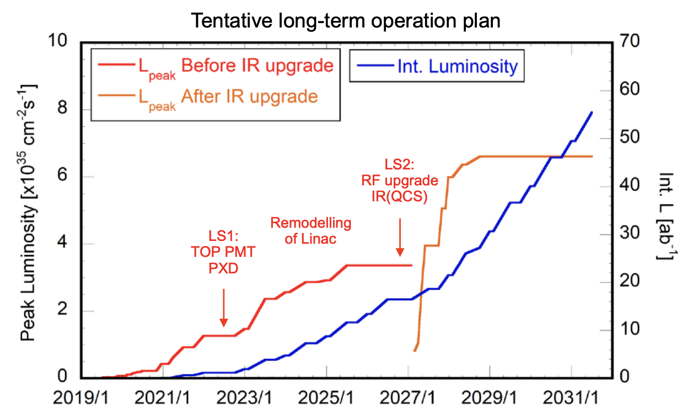
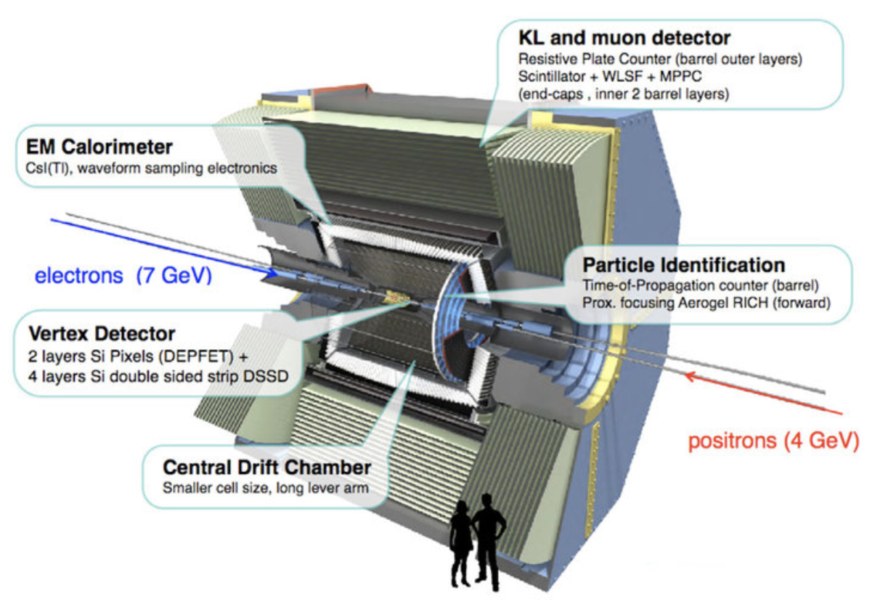
French contributions
BEAST (2018) (IPHC)
silicium counters for machine background study
SVD (CPPM, IPHC) | ARICH (IJCLab)
Operations and performances | Cooling and mechanics
PXD (IJCLab) | DAQ (CPPM, IJCLab) | HLT (IJCLab)
cooling for beam pipe/PXD (for 2nd layer in 2022) | PCIe40 (since 2021) | reconstruction software optimization, trigger and data quality monitoring
Detector activities
For a possible upgrade (not yet approved):
VTX (CPPM, IJCLab, IPHC) | HLT (IJCLab)
Mechanics and chip design for CMOS pixel detector | Software
8

Slide 9

b-anomalies

Slide 10
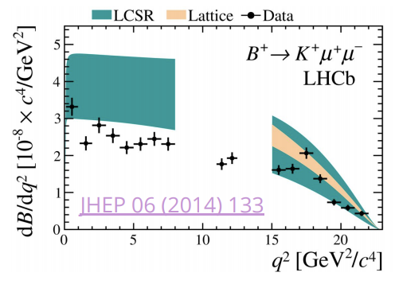
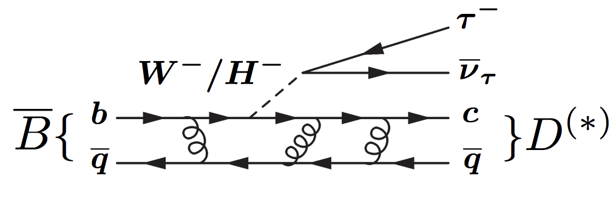
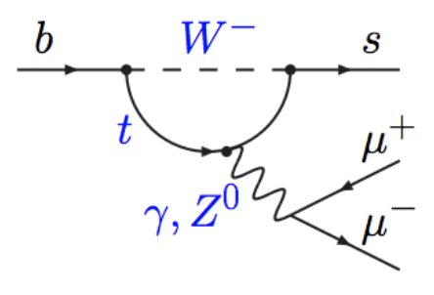
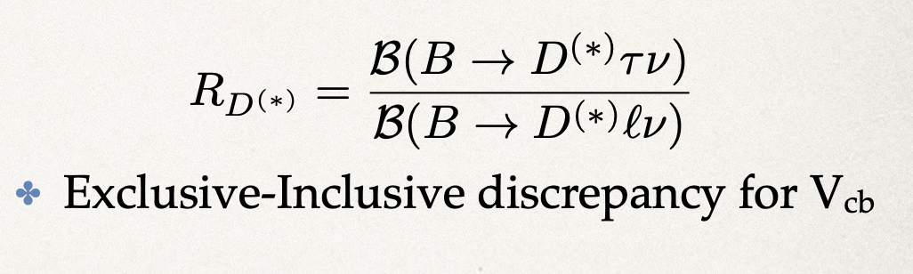
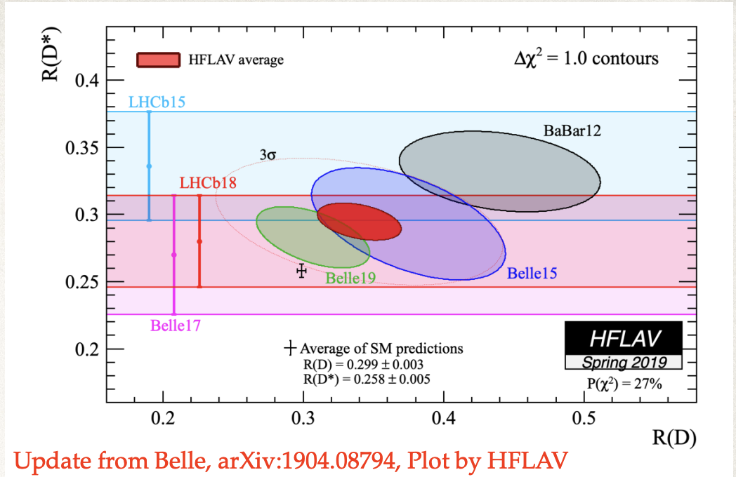
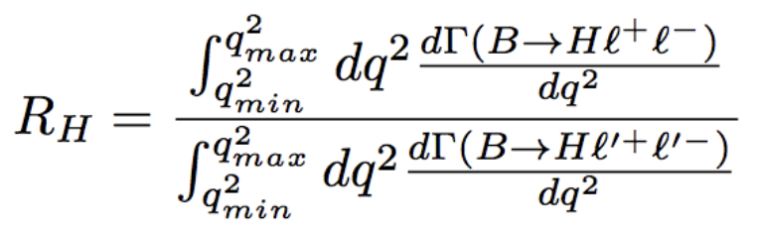
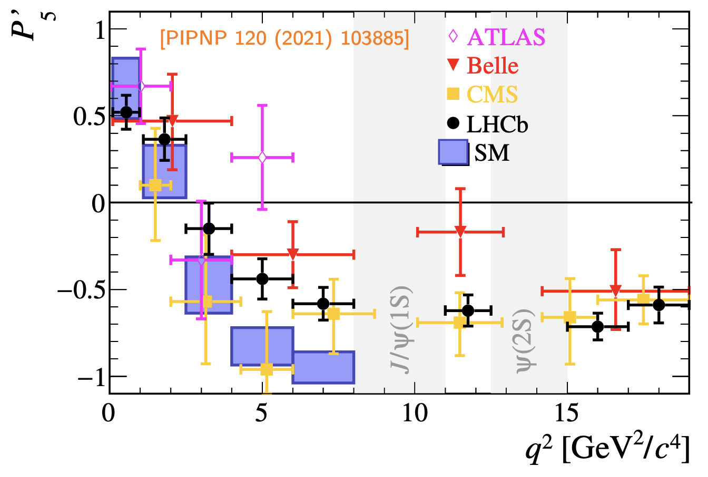
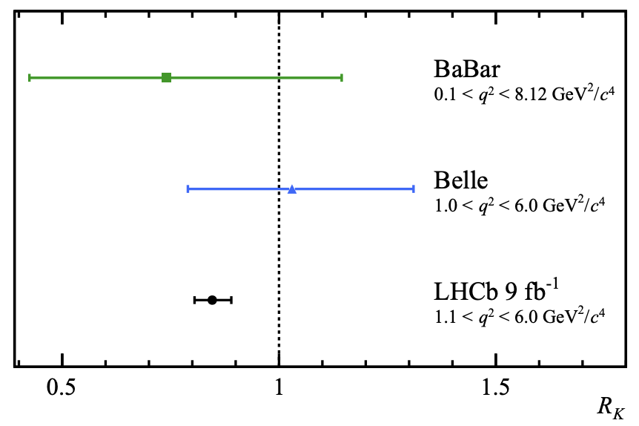
b-anomalies: the general context
b⟶ s l l transitions
BRs
b⟶ c l v transitions
LFU tests
LFU tests
b-anomalies
Angular observables
+ Exclusive/inclusive discrepancy for V_{cb}
Coherent pattern of deviations
Possibly pointing to new physics
10

Slide 11
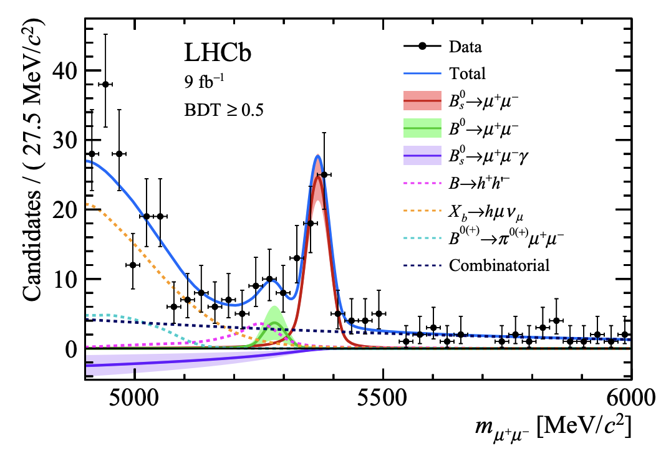
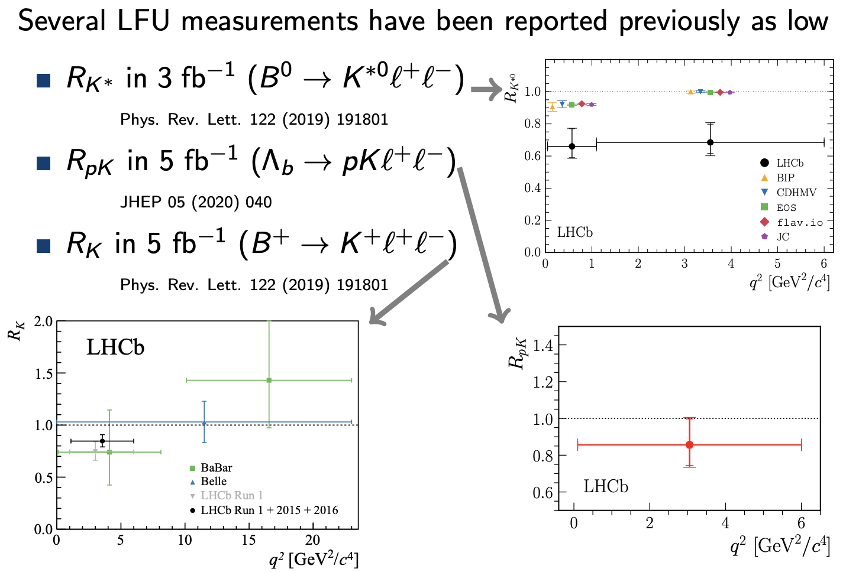
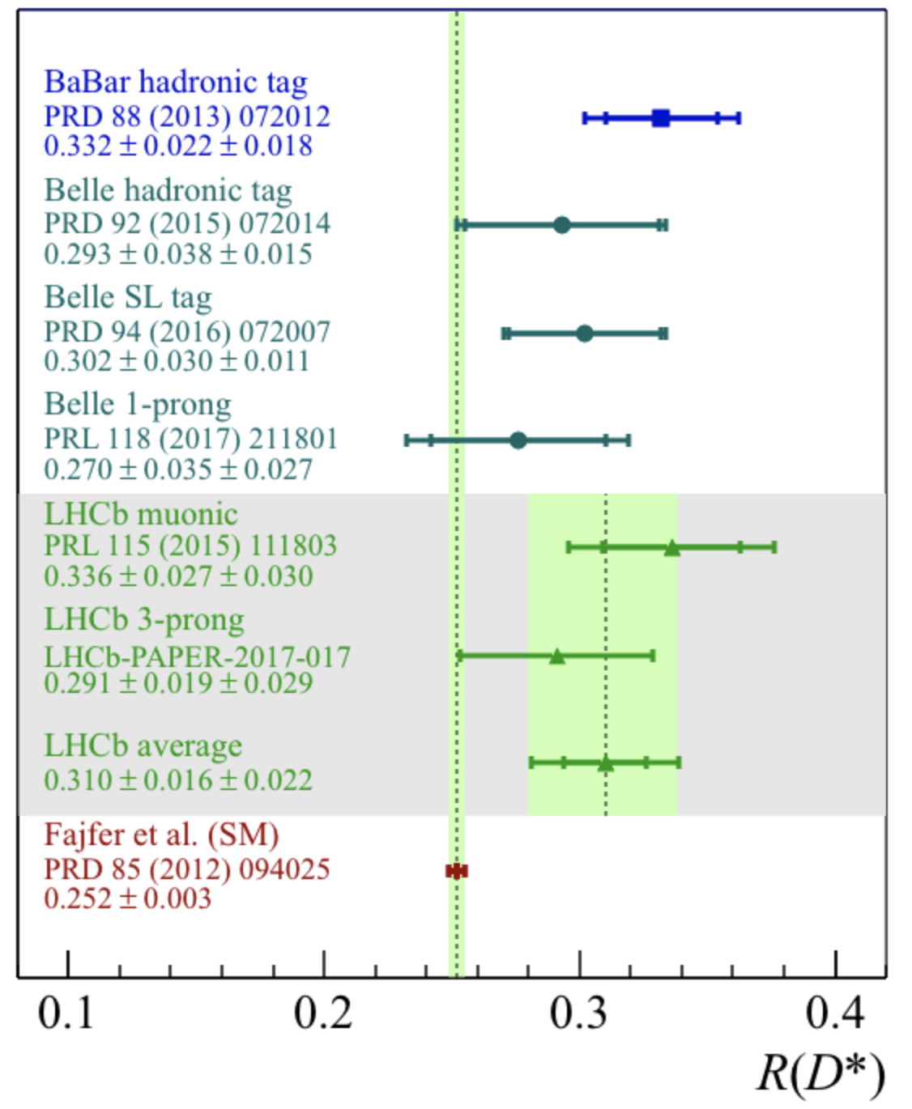
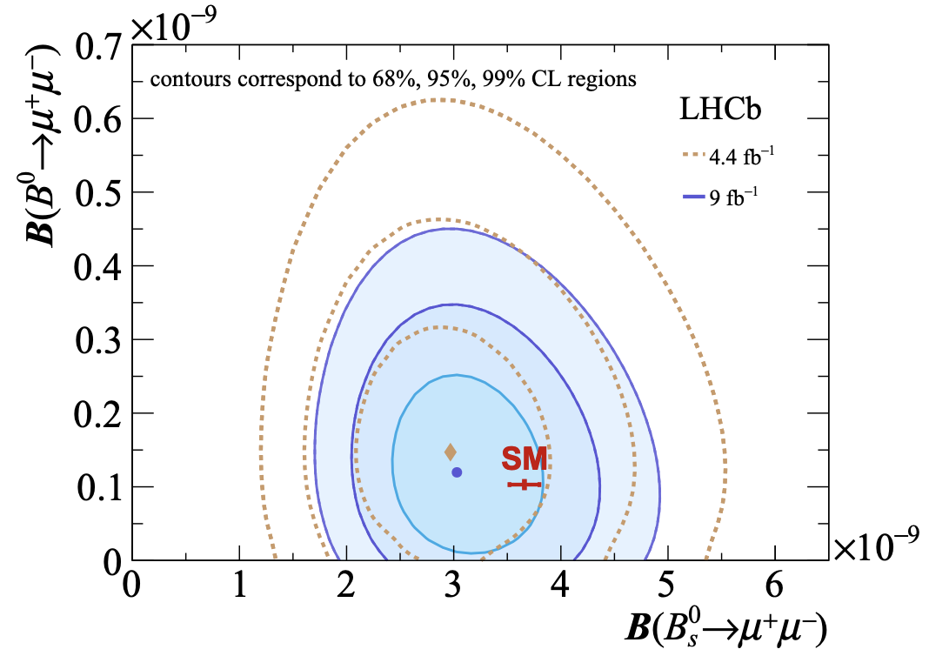
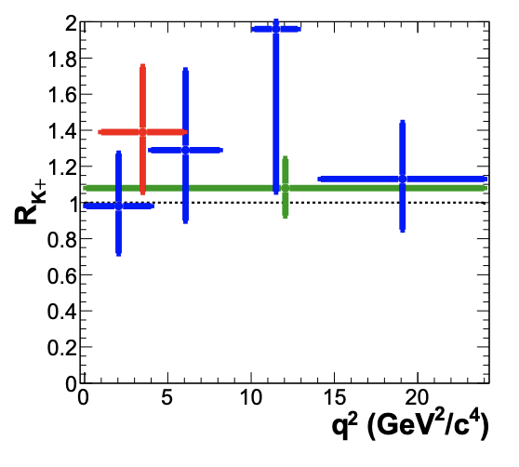
French contributions : B_{d(s)} ⟶ μμ(γ) and LFU tests
B_{d(s)} ⟶ μμ(γ)
Lepton Flavor Universality tests
b-anomalies
Ongoing: R_{D*} update, R_{X} (simultaneous R_{K*} and R_{K} )
Also: LFV in B->K^{(*)}emu
11

Slide 12
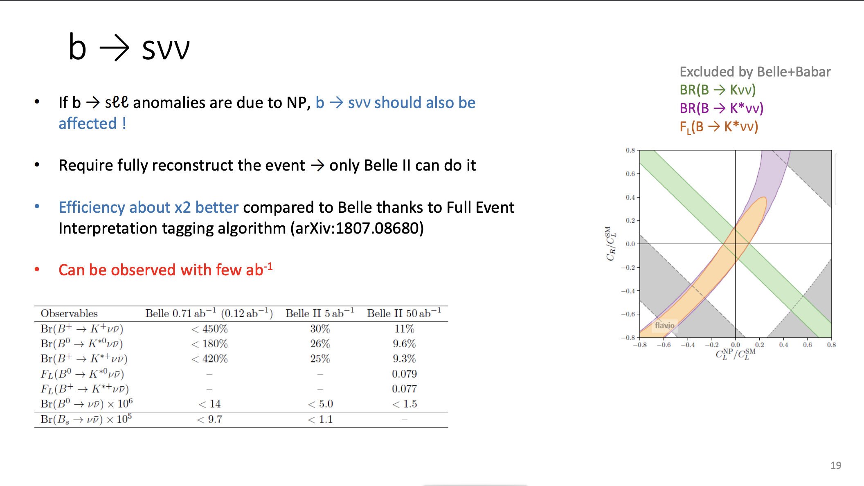
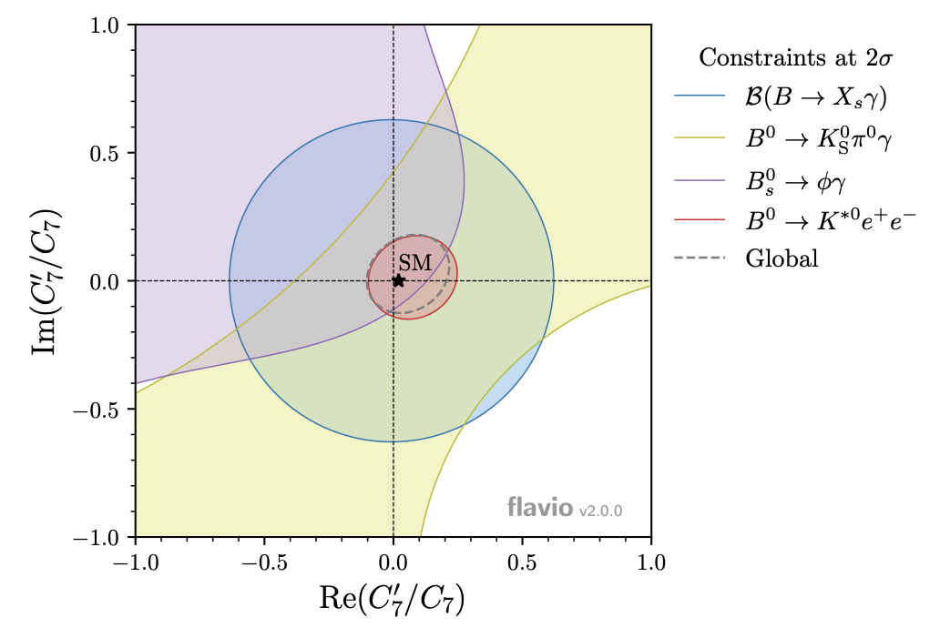
French contributions: b ⟶ sν ν and b ⟶ s γ
B ⟶ K v v
Photon polarization
(C₇ Wilson coefficient)
b-anomalies
studying:
continuing effort in:
B_{d} ⟶ K * e e
B_{d}⟶ K_{s} π ⁺π –γ
B_{s}⟶ φ γ
B_{d}⟶ K* γ
B_{u} ⟶ K ⁺π ⁺π –γ
B_{d}⟶ K⁺π ⁻π⁰ γ
B_{d}⟶ K_{s} π ⁺π –γ
B_{d}⟶ K_{s} π ⁰γ
12

Slide 13
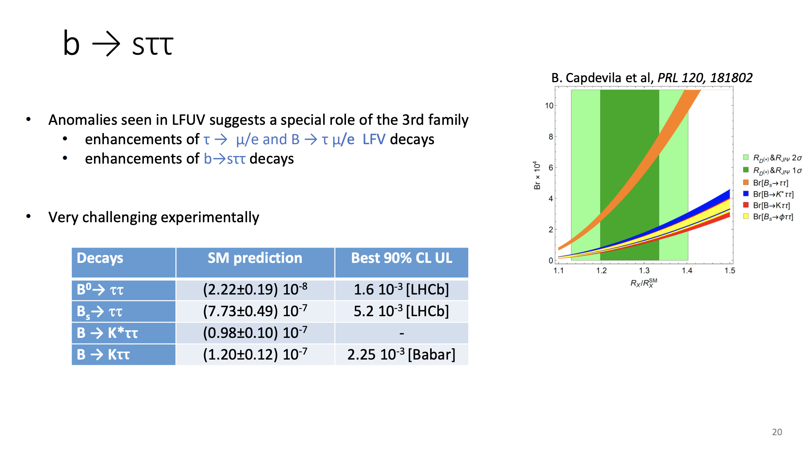
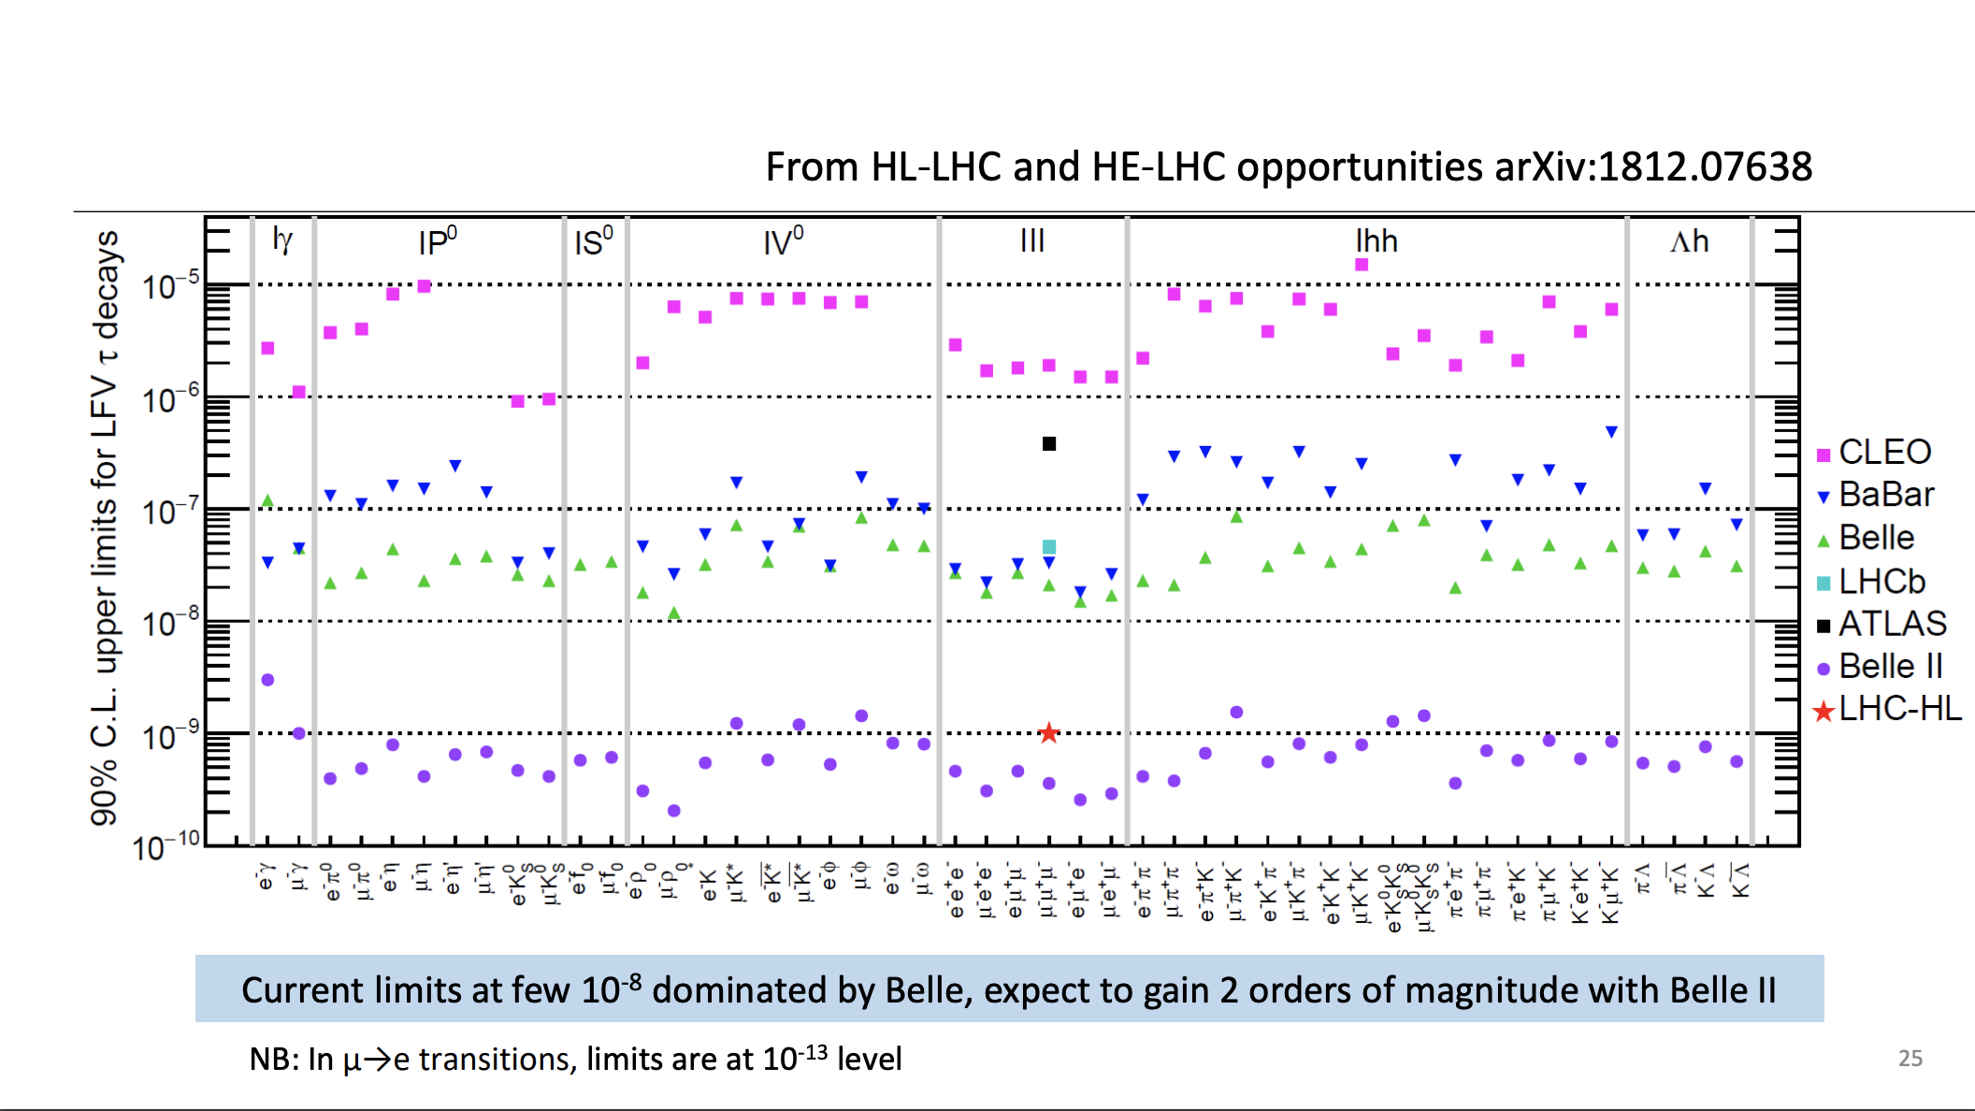
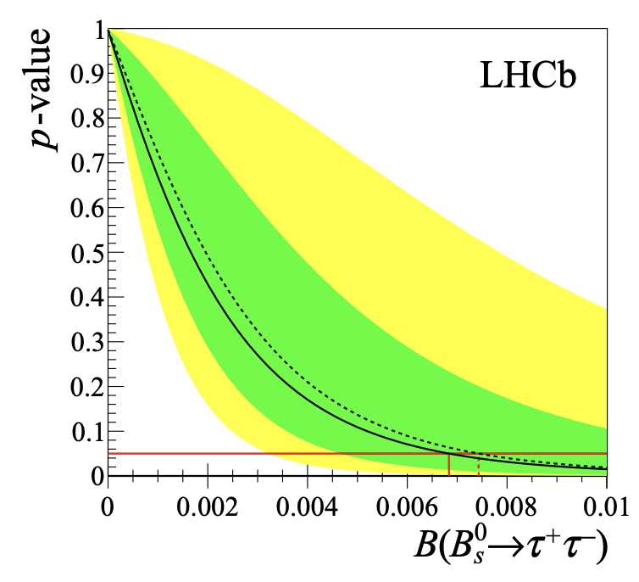
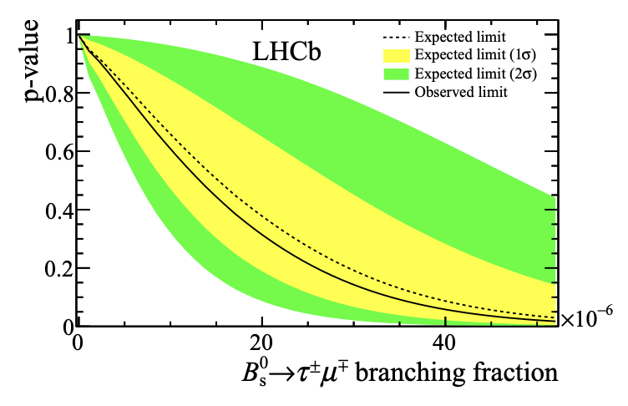
French contributions: decays with τ
Anomalies could imply enhancement of B decays involving τ , including Lepton Flavor Violating
τ LFV searches ongoing:
τ ⟶ μμμ
τ ⟶ μππ and τ ⟶ eππ
τ ⟶ μφ and τ ⟶ eφ
b-anomalies
Explored or ongoing in LHCb and :
B_{d(s)} ⟶ ττ and B_{d(s)} ⟶ τμ
B_{d} ⟶ K^{(*)}τ τ and B_{d} ⟶ K ^{(*)} τ μ
Any observation would be clear sign of new physics!
13

Slide 14
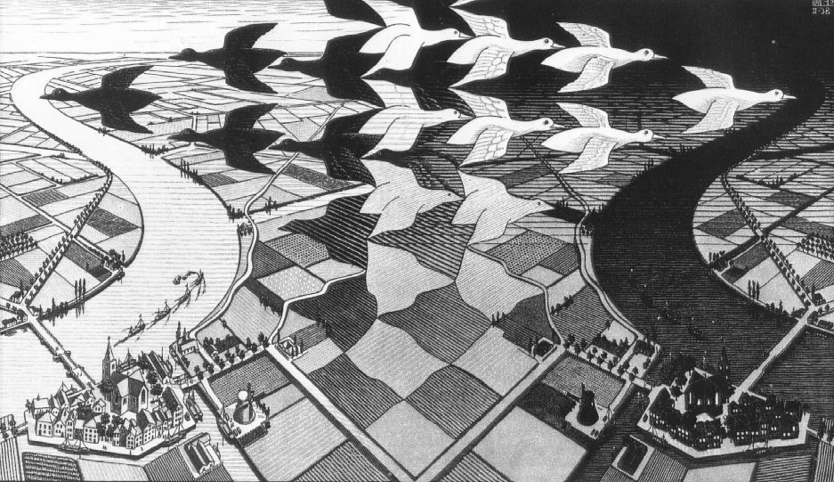
CP violation

Slide 15
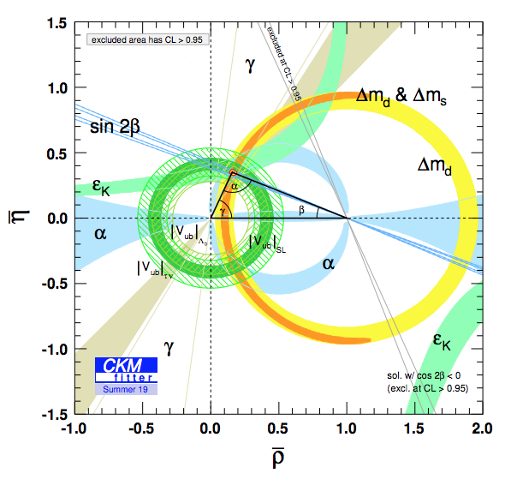
CP violation: the CKM paradigm
Remarkable consistency with the SM: CKM is at work in charged EW currents.
Legacy measurements from
B-factories
LHCb improved γ precision to 4° and stepped in significantly in Vub and Vcb measurements
Belle 2 is expected to improve the precisions on many parameters
CKMFitter: phenomenological collaboration with roots in France
CP violation
15

Slide 16
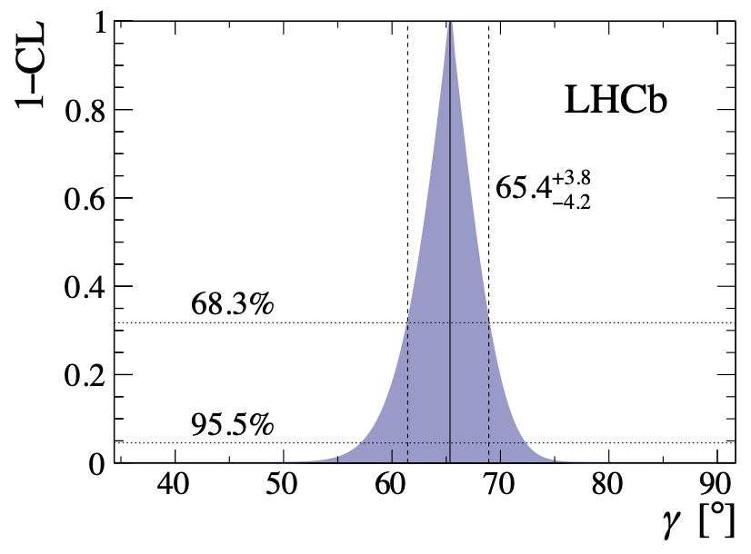
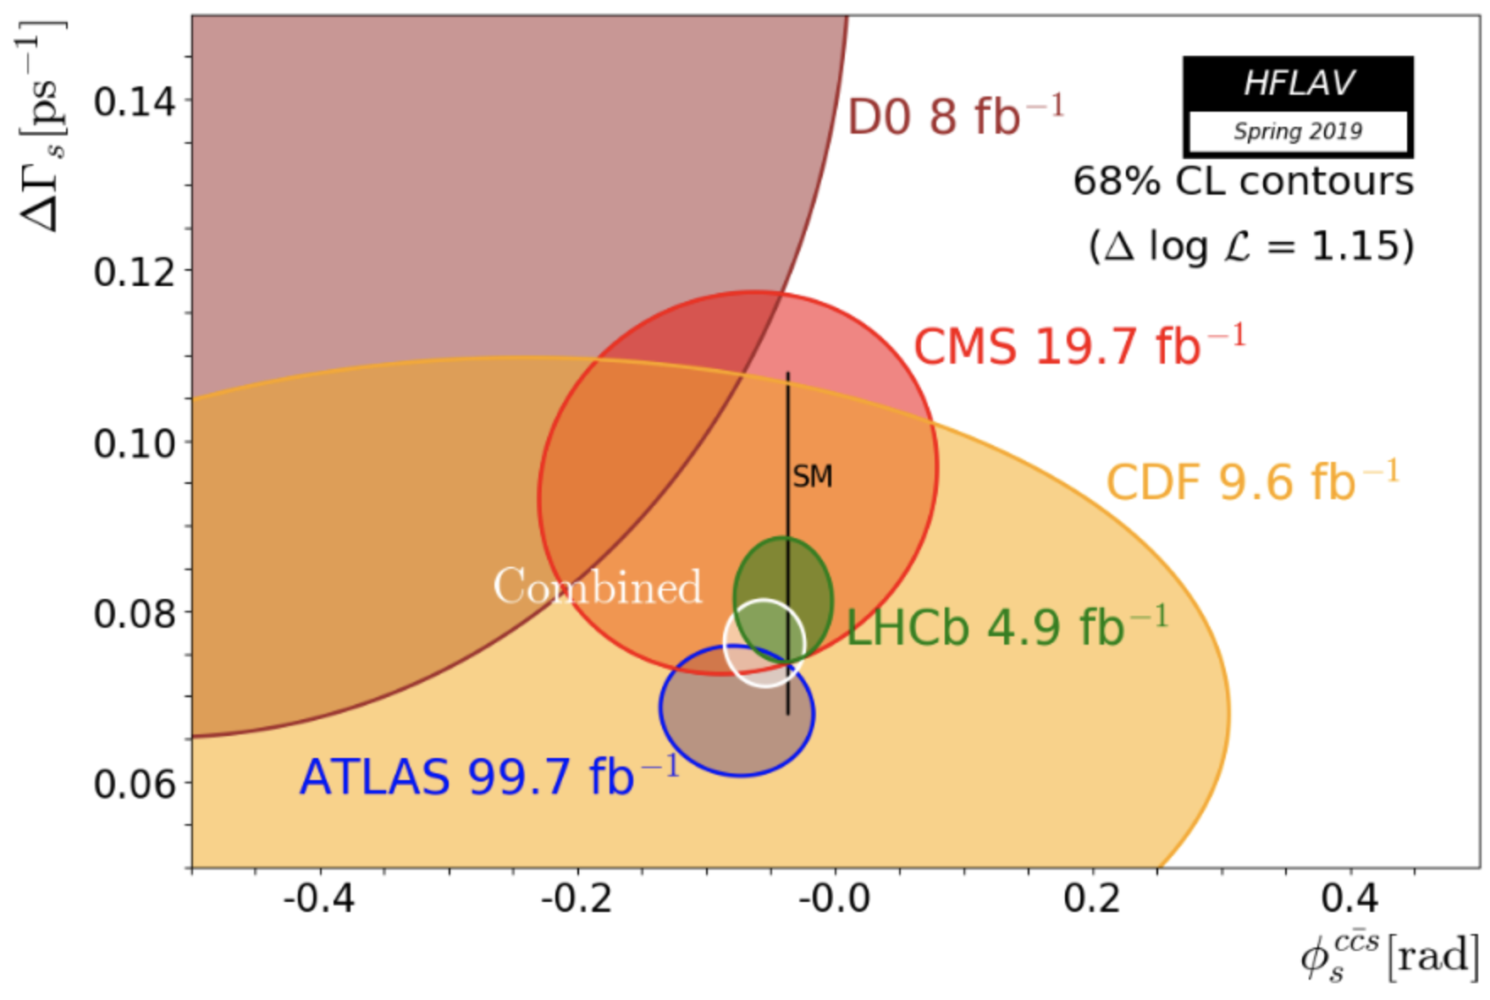
French contributions: angles γ and φ_{s}
CP violation
LHCb France contributed in the recent past to the measurements of γ and φ_{s}
Belle II France contributing to ongoing γ measurement.
16

Slide 17
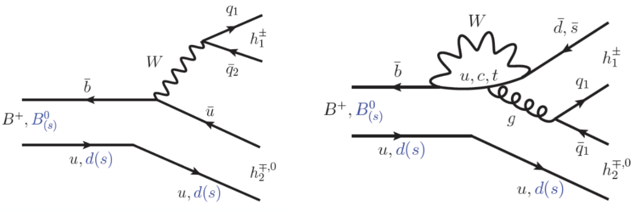
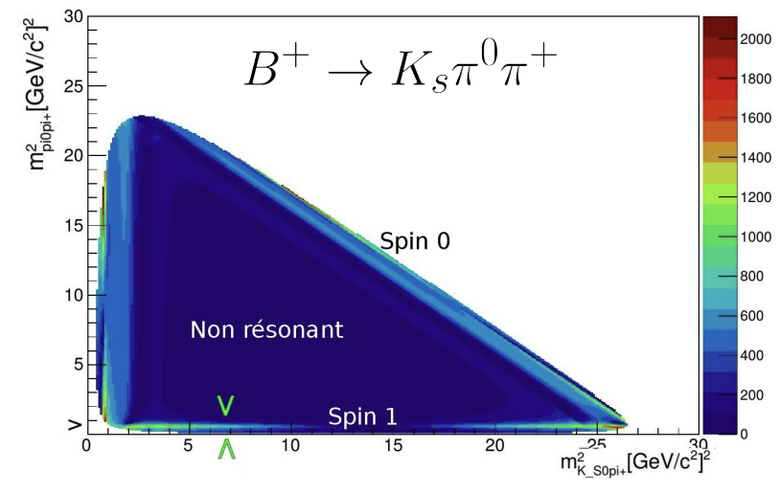
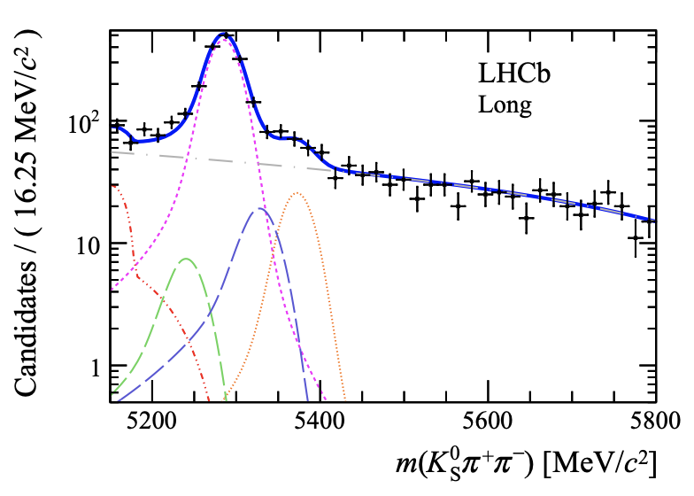
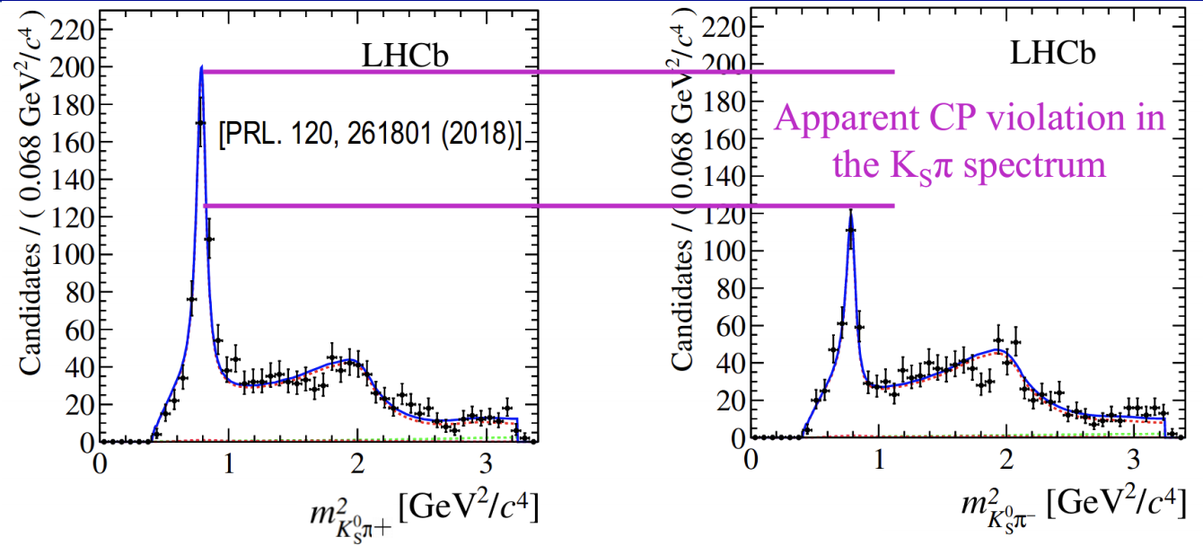
French contributions: charmless 3-body B decays
French effort in
on (time-dependent) Dalitz analyses
of charmless 3-body decays.
Rich phenomenology, many CP observables, sensitive to new physics.
CP violation
First observation of CP violation in B⁰ ⟶ K*(892)π
17

Slide 18

Heavy flavour production and spectroscopy

Slide 19
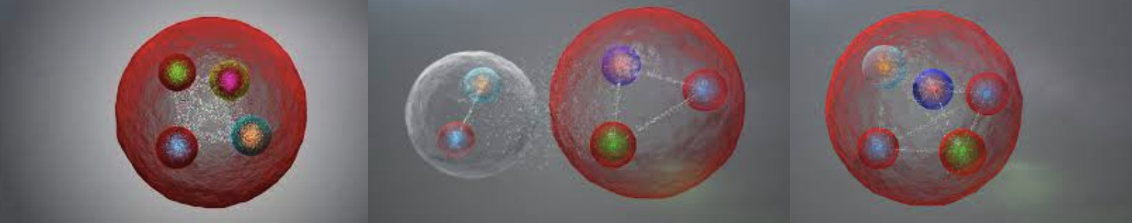
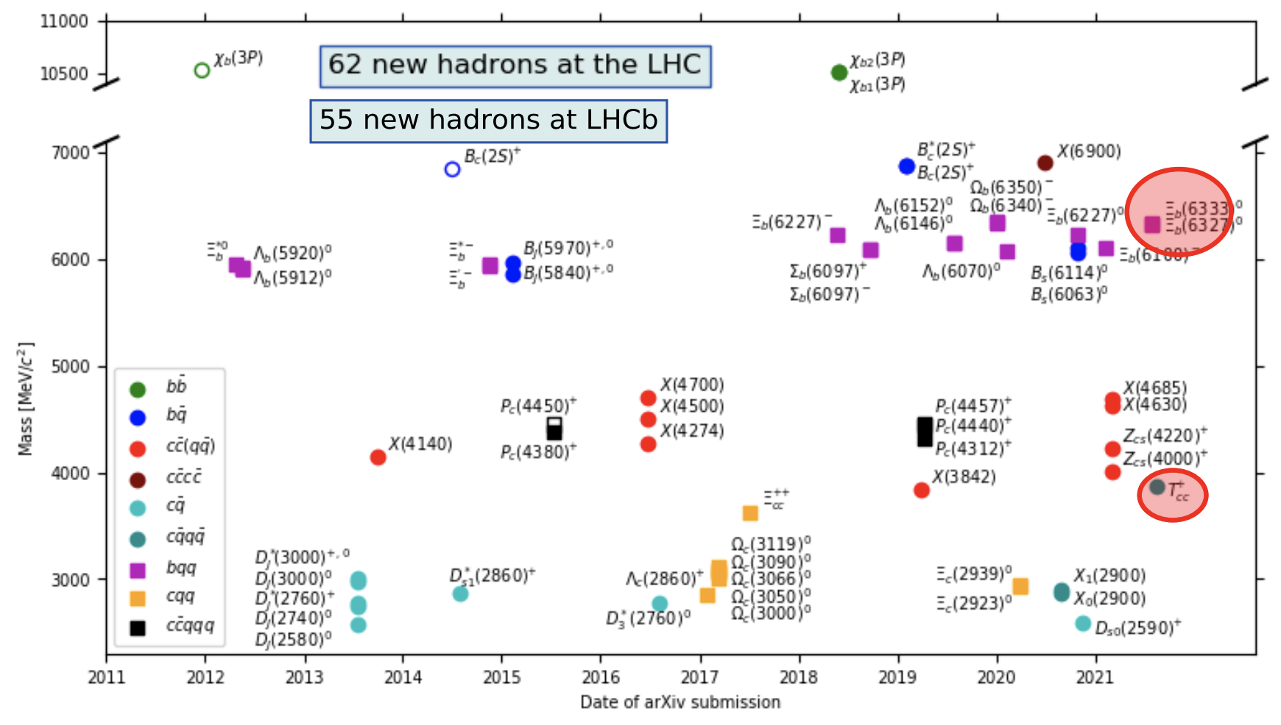
Many new hadrons discovered at LHC
Spectroscopy and heavy-flavor production studies are powerful test of LQCD calculations.
Crucial for tuning simulations, and as inputs of other measurements.
Spectroscopy
https://www.nikhef.nl/~pkoppenb/particles.html

Slide 20
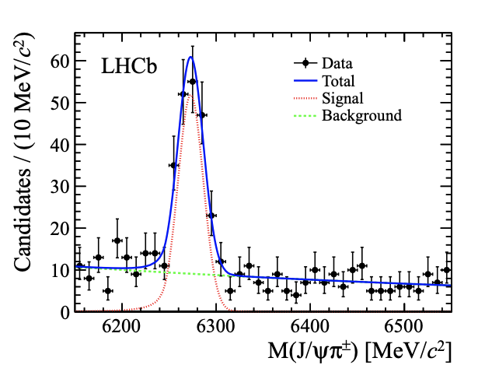
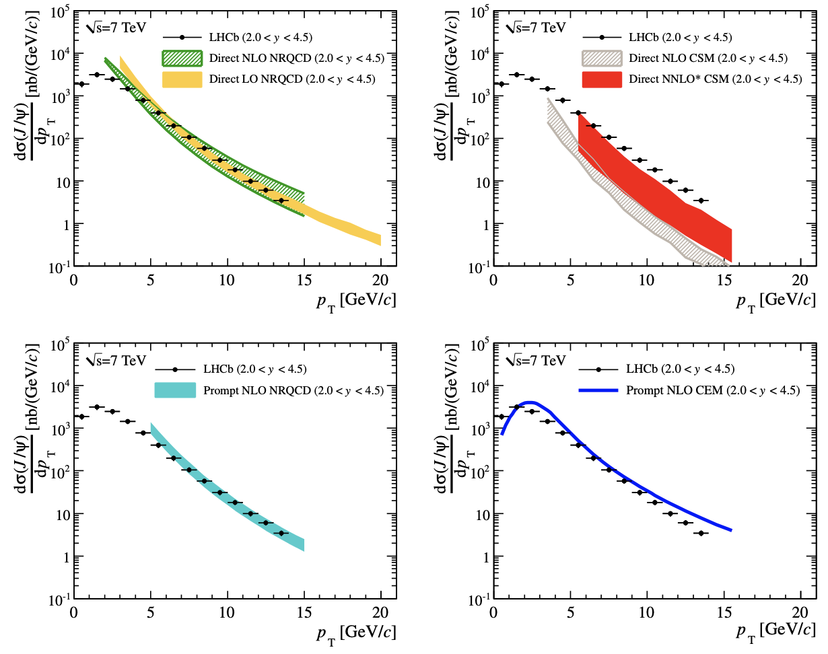
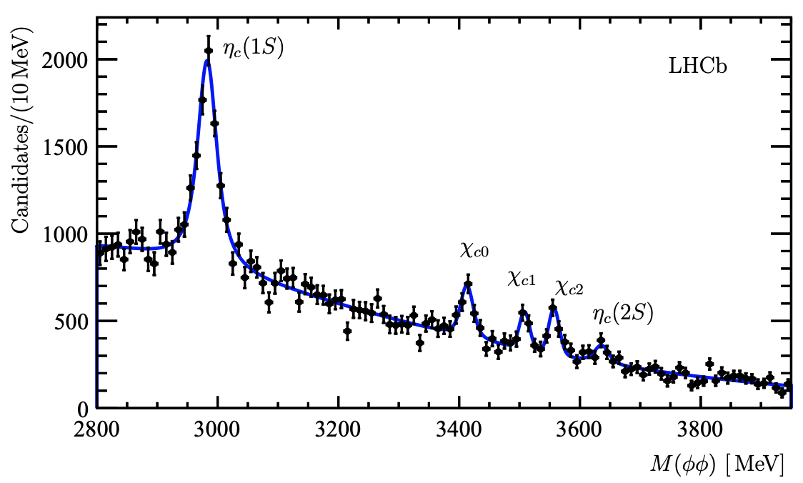
Examples of French contributions in heavy flavor production
B⁺_{c} production and
mass with the B⁺_{c} → J/ψ π⁺
https://arxiv.org/abs/1209.5634
J/ψ production at 7 TeV
https://arxiv.org/abs/1103.0423
Initiated charmonium measurement
program at LHCb
First observation of the Bc at CERN
Charmonium production in b-hadron decays
Eur.Phys.J.C 77 (2017) 9, 609
Heavy flavor production and spectroscopy
First or most precise measurements of inclusive decays
b → η_{c}(1S), η_{c}(2S), χ_{c0} , χ_{c1} , χ_{c2}
First evidence of B_{s} → φφφ.
20

Slide 21
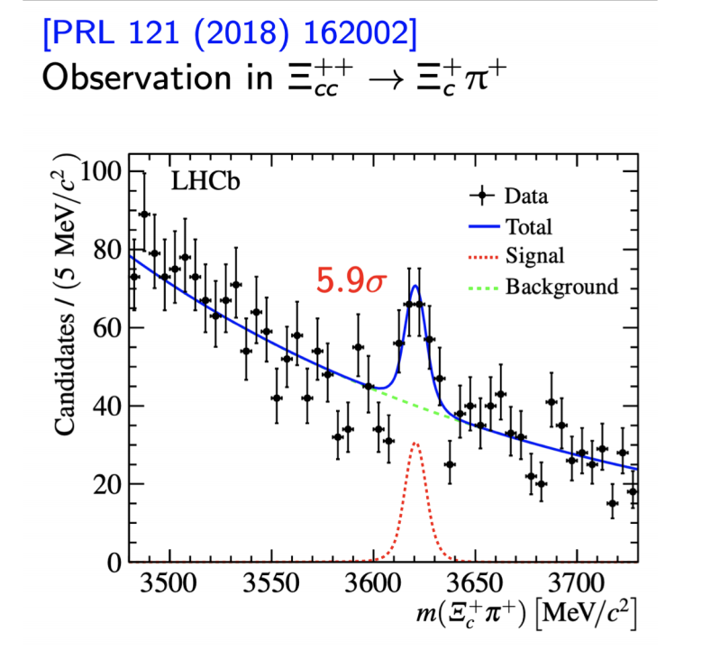
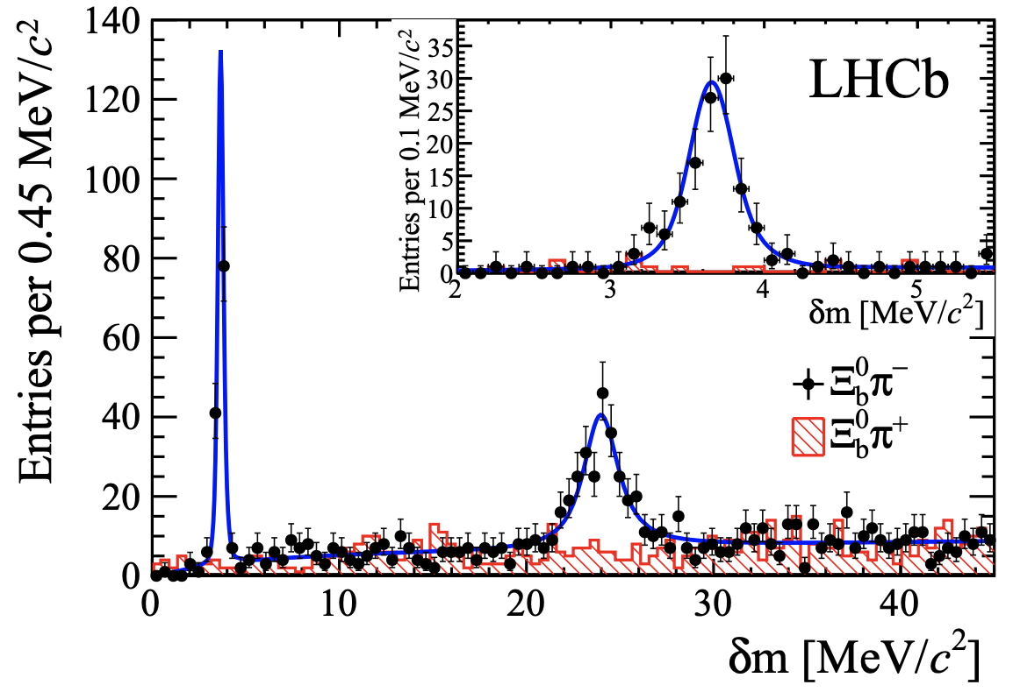
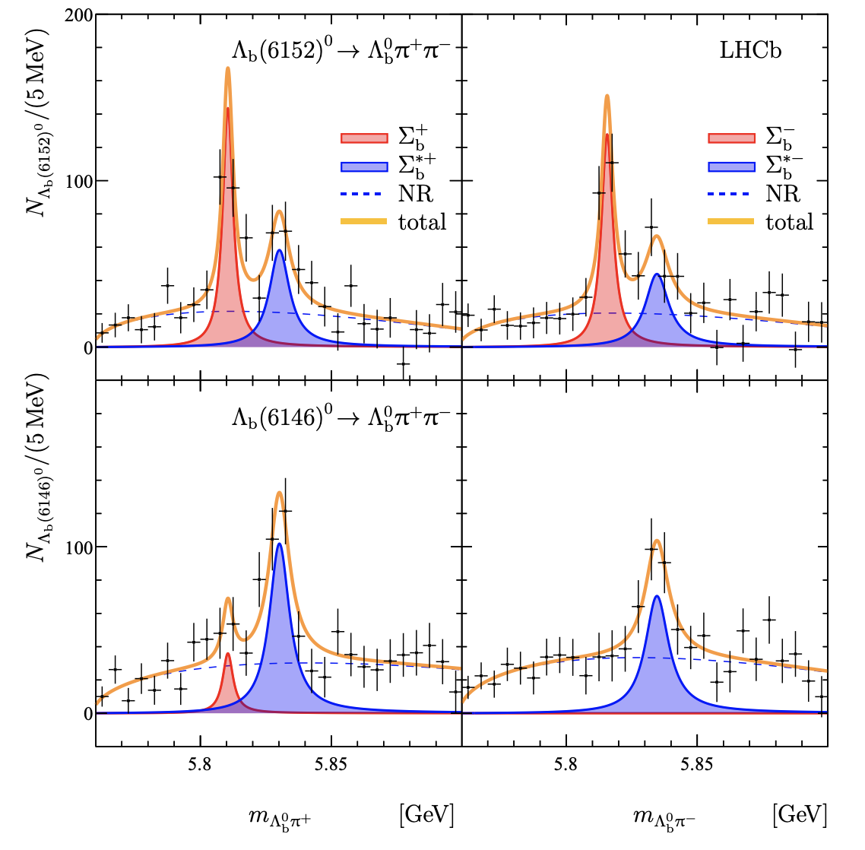
Examples of French contributions in spectroscopy
First baryon with two heavy quarks.
Observation of two new Ξ_{b} baryons
arXiv:1411.4849
New states in Λ_{b}ππ spectrum.
PhysRevLett.123.152001
Heavy flavor production and spectroscopy
21

Slide 22

CONCLUSION
France plays an active role in LHCb and Belle 2:
- conception, construction and operation of sub-detectors in
current experiments and future upgrades
- data analysis in topics at the core of particle physics today:
b-anomalies, CP violation, spectroscopy
French flavor community has interest in developing the flavor physics program at current and future facilities.
Exciting times in flavor physics:
possible path towards new physics emerging!

Slide 23
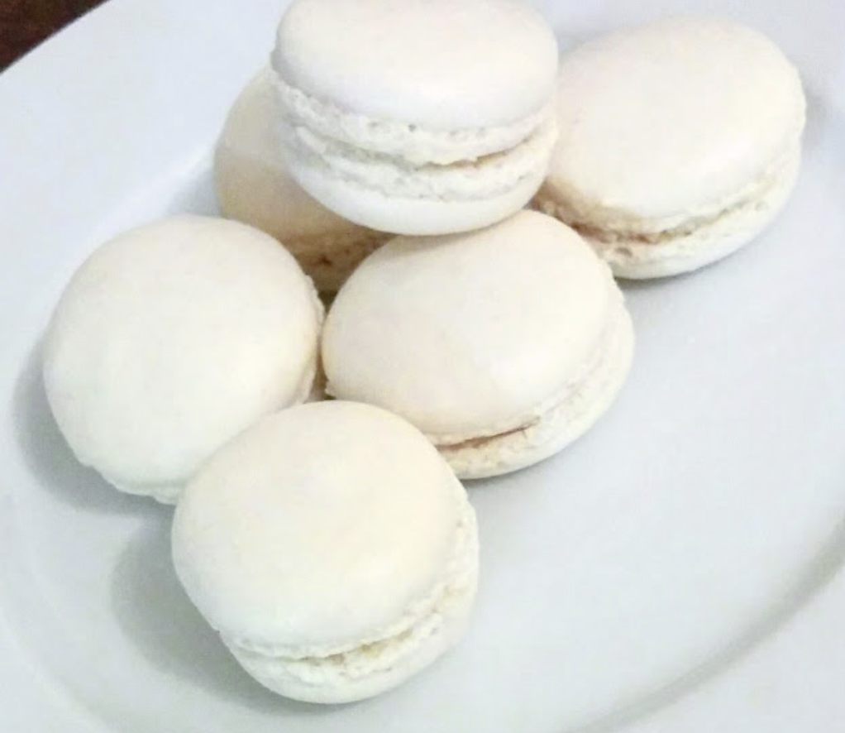
BACKUP
23

Slide 24
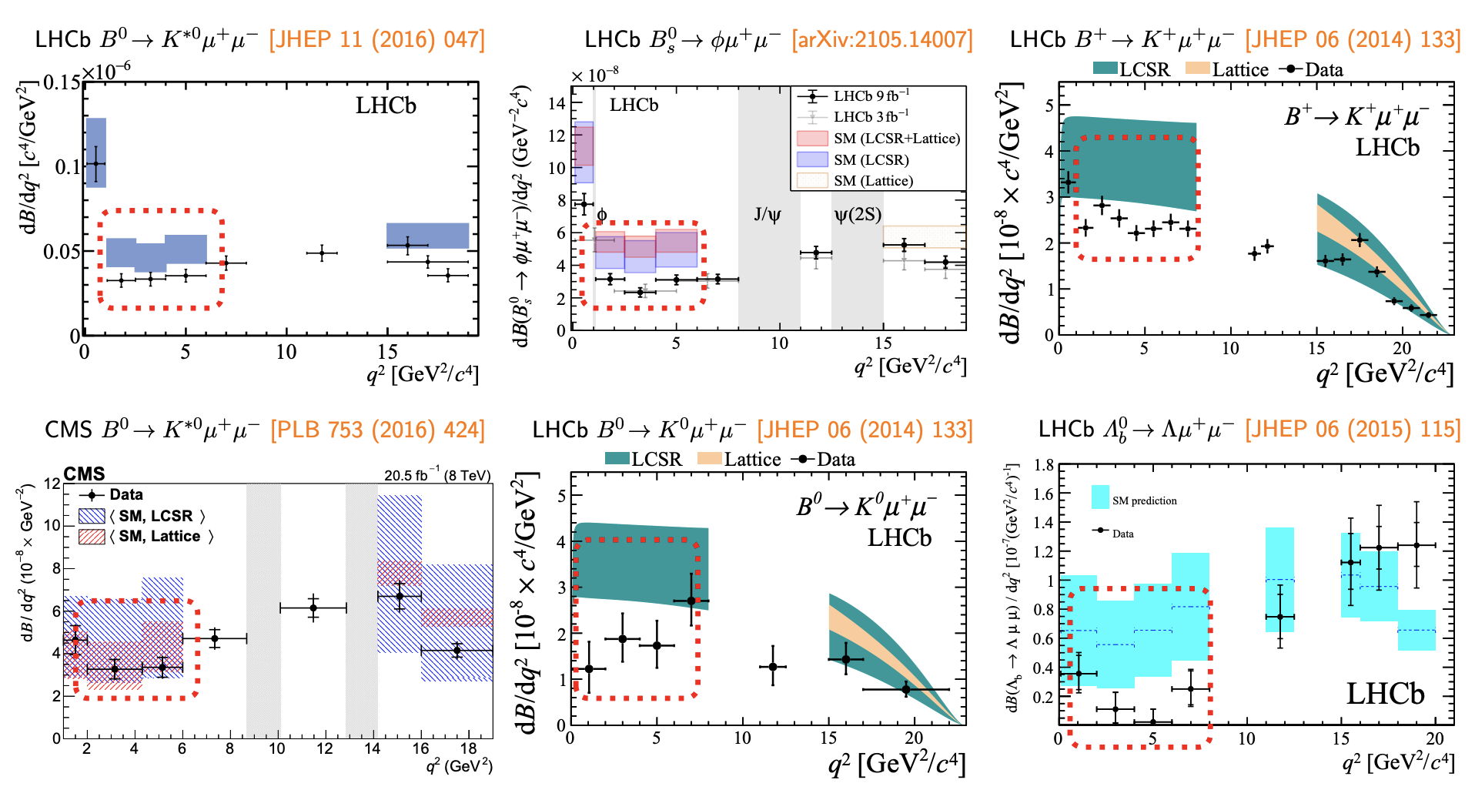
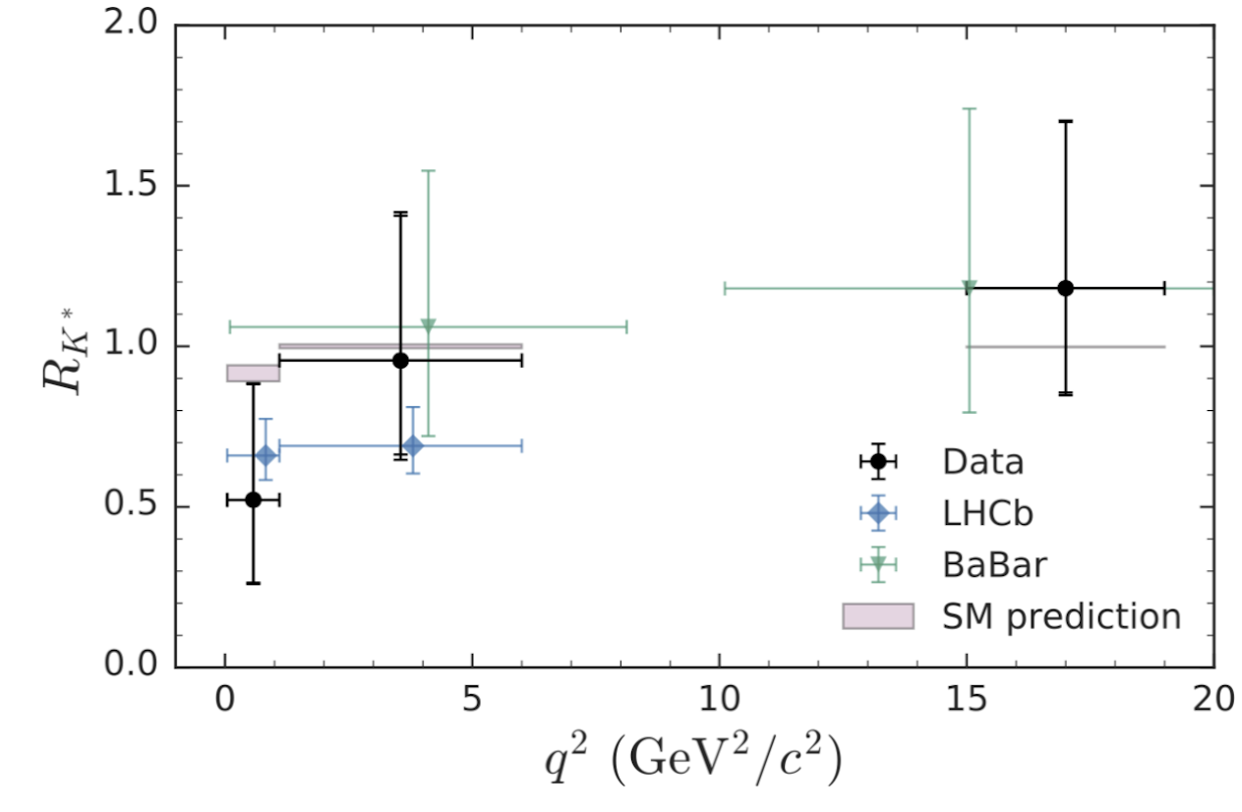
B-anomalies: branching ratios
b->sll transitions
b->clv transitions
24

Slide 25
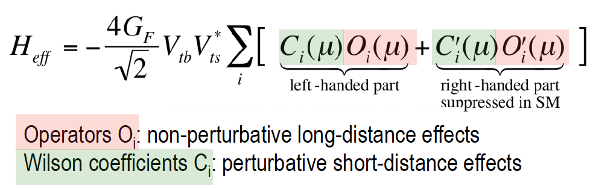
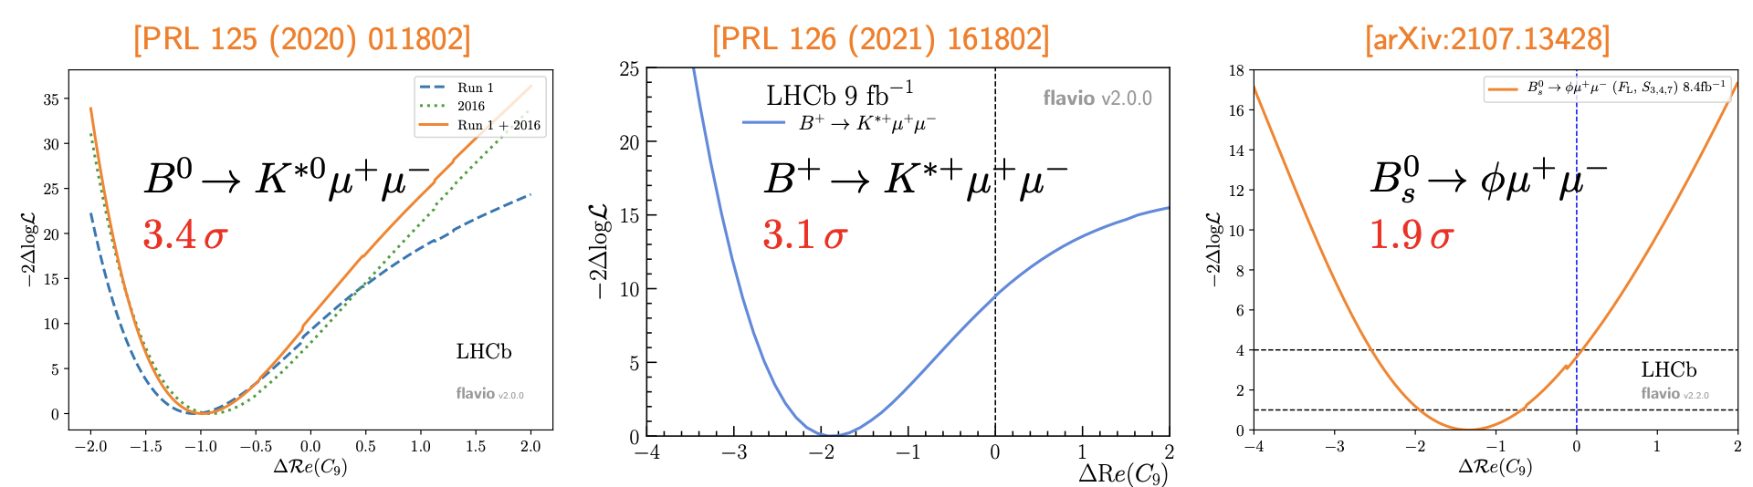

Interpretation of the anomalies
Coherent pattern of deviations
Possibly pointing to nature of new physics
25

Slide 26

Improving measurements
26

Slide 27


b-anomalies prospects
LFU
Angular analysis: upgrades to distinguish NP scenarios
Angular LFU tests, measurements with baryons and b->dll also foreseen.
27

